Slide 1
On the Use of β-NMR in Studying van der Waals Materials*
John O. Ticknor
TRIUMF Science Week CMMS Seminar (July 2024)
* Terms and conditions apply – mostly graphite

Slide 2
Outline
Brief personal background and biography
Motivation for studying van der Waals materials
How ionic diffusion is measured and studied using NMR
Condensed Overview of β-NMR Technique
Results in key case study – graphite
Discussion of similar and upcoming work
Summary and “take-home messages”

Slide 3
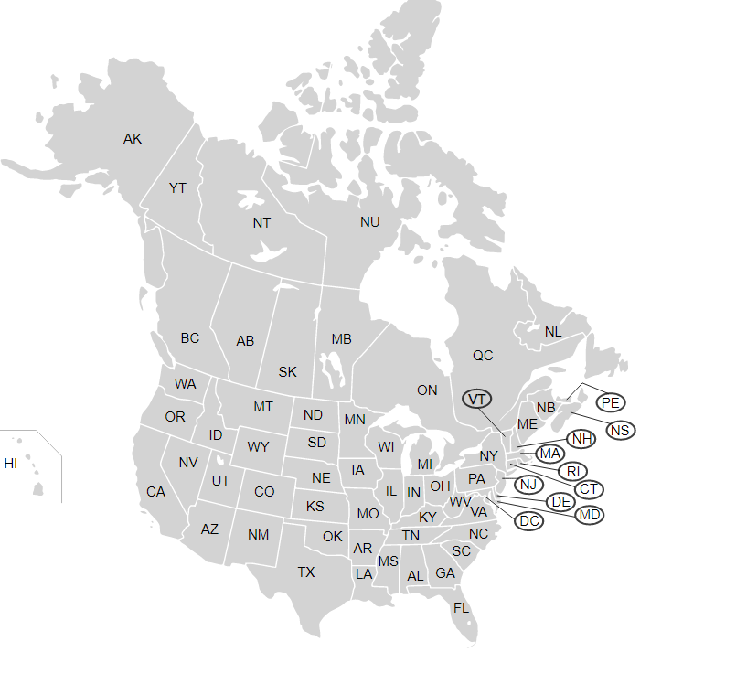
Venturing Down “Memory Lane”
Georgia Institute of Technology
Atlanta, GA, USA

Slide 4
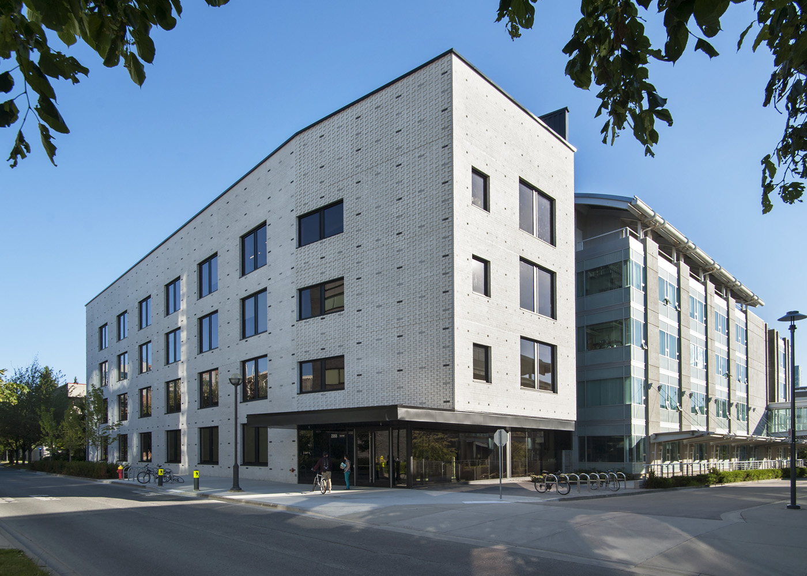
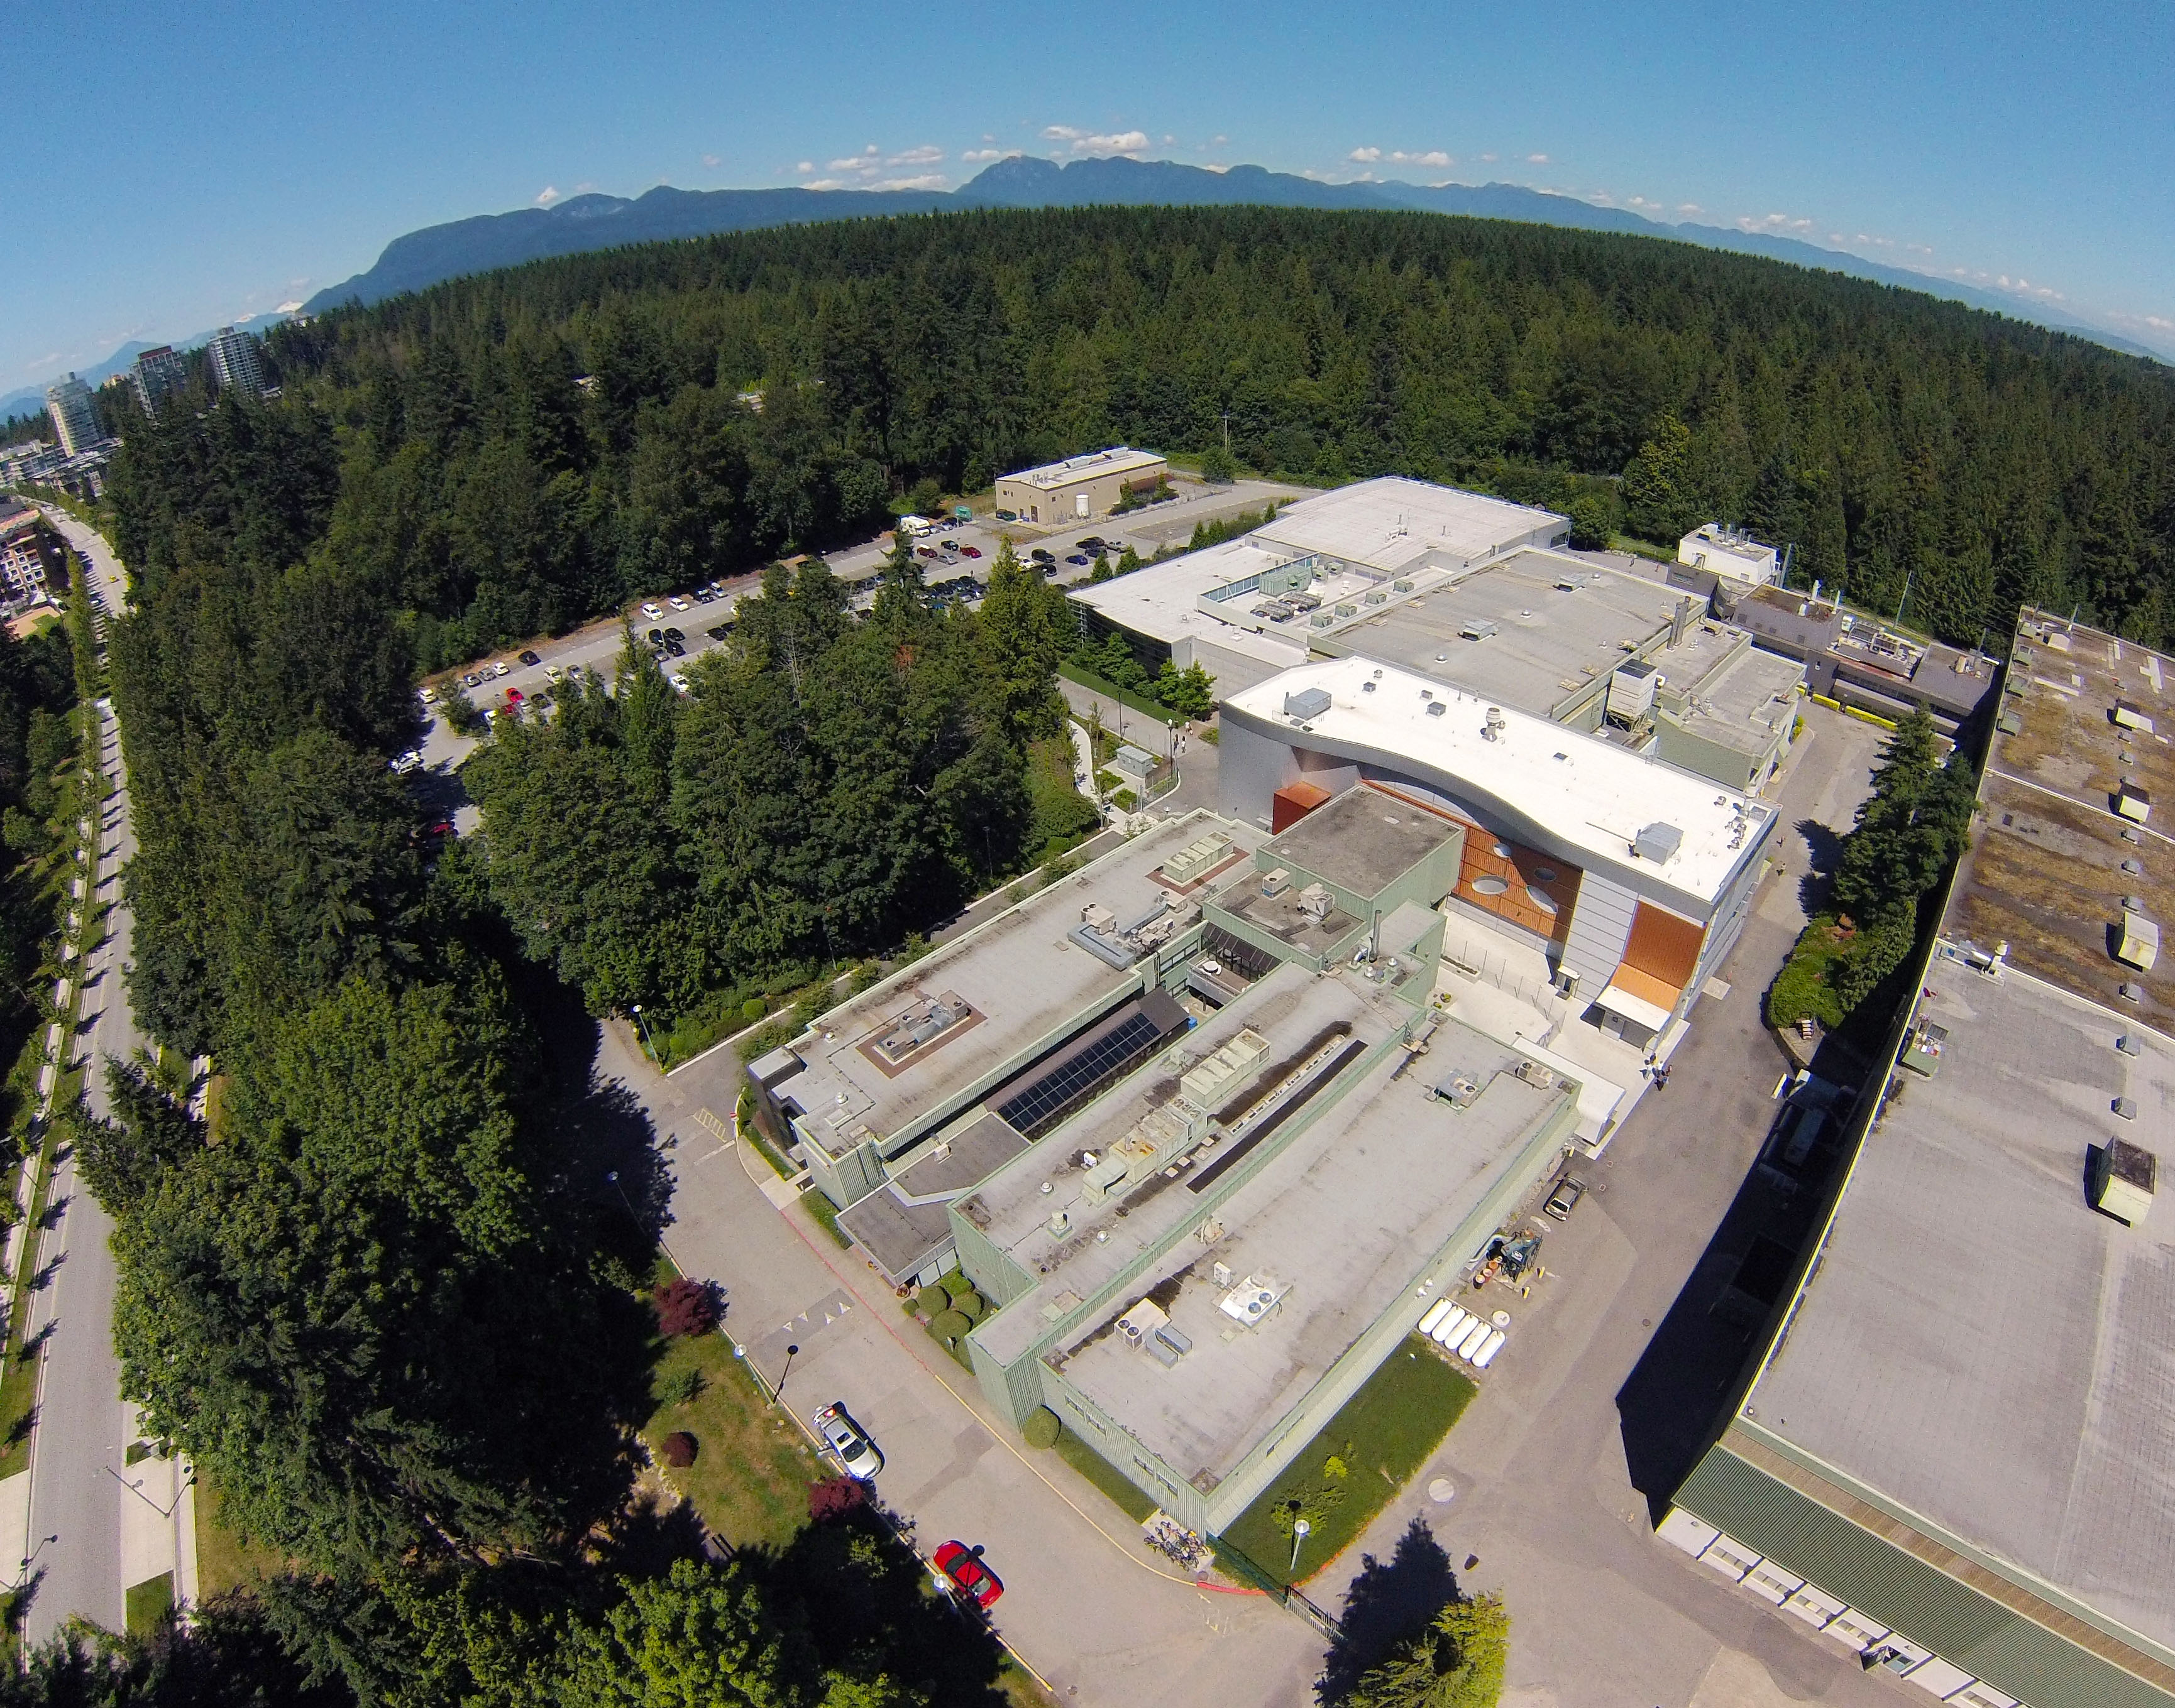

Slide 5
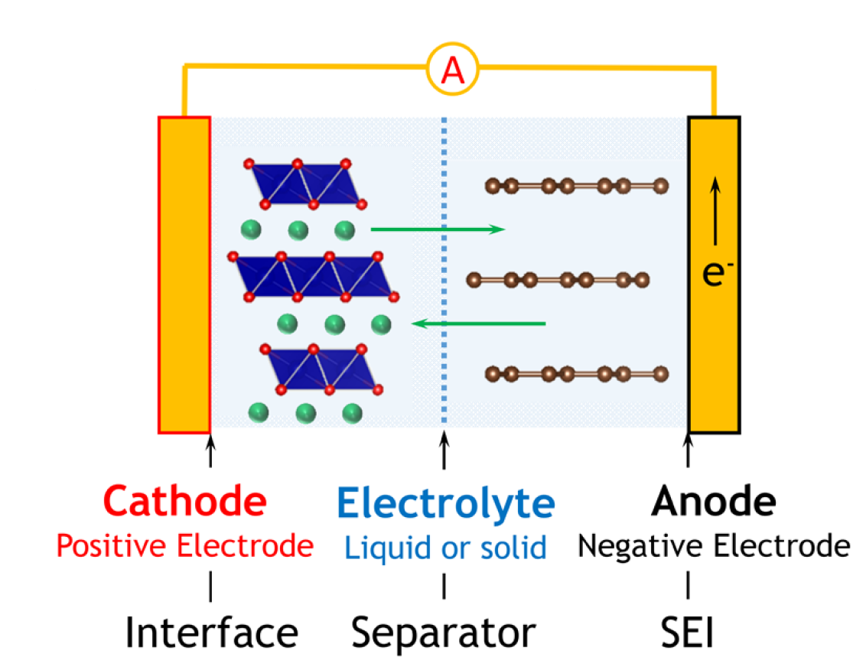
A Broader Background and Motivation
Intercalation – the basis for the charging and discharging of any rechargeable battery
Note the layered structures!
Pecher, et. al. Chem. Mater., 29: 213-242, 2017.

Slide 6
van der Waals (vdW) Materials
Vadlamani, et. al. J. Electrochem. Soc., 161: A1731, 2014.
Van Noorden, et. al. Nature., 438: S32-S33, 2012.
Weak vdW interaction holding the layers together (a) allows these materials to be easily exfoliated (b)

Slide 7
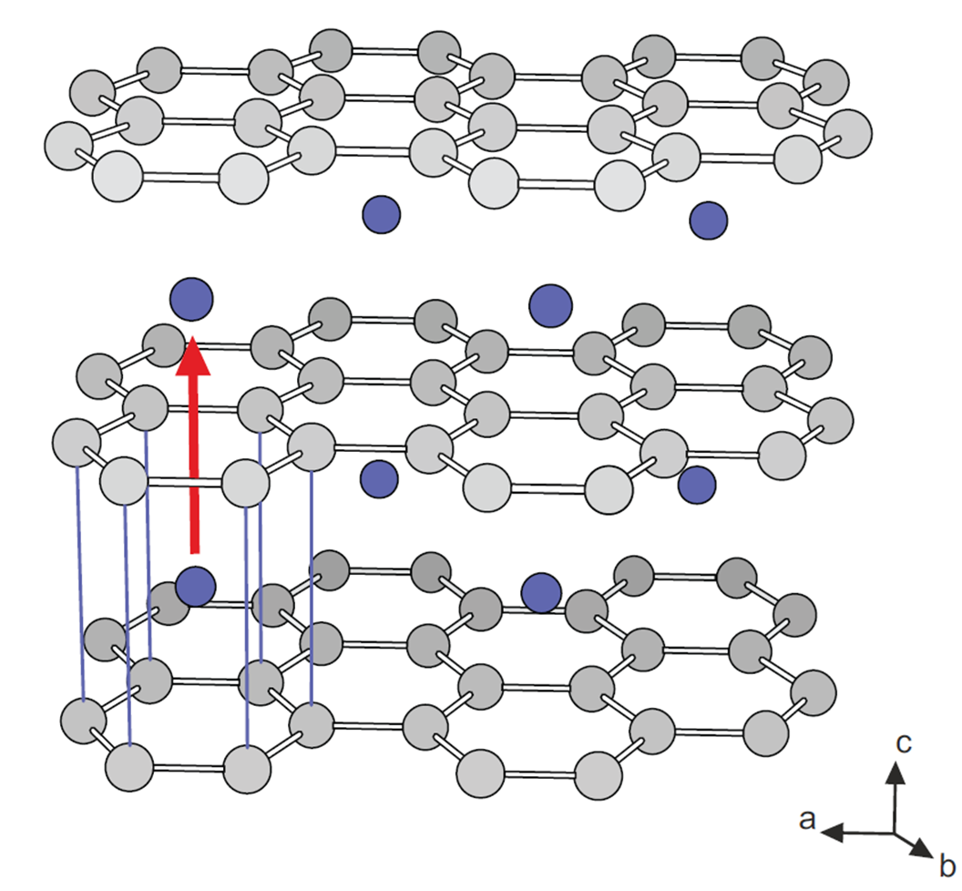
An Overarching Cause (Part I) …
Graphite is a commonly used electrode in modern rechargeable lithium-ion batteries
If we want to optimize the rate of charge/discharge – we need to understand the underlying process of ionic diffusion
Langer et. al, Phys. Rev. B, 88: 1-9, 2013.

Slide 8
… An Overarching Cause (Part II)
What if we want to simulate this process?
Most simulations are best suited for the “dilute-limit”
But most experiments operate in the opposite “concentrated” regime

Slide 9
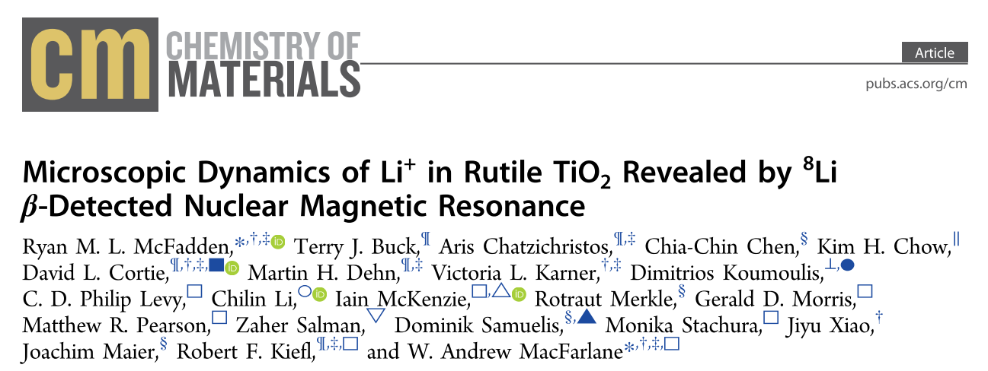
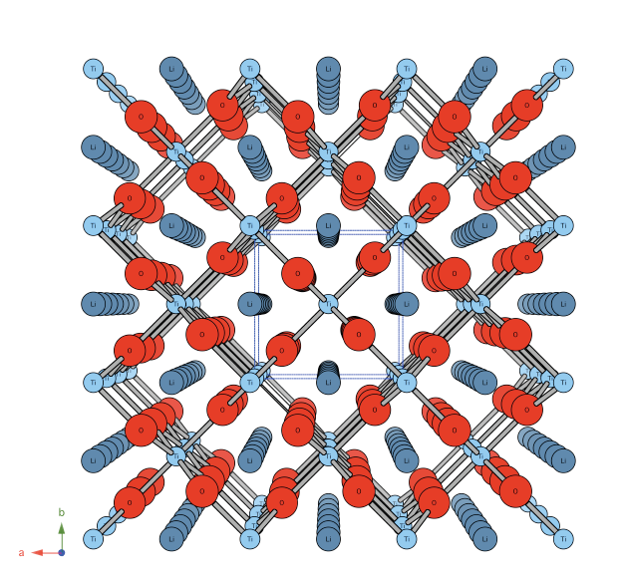
β-NMR Sets the Foundation
Fortunately, β-NMR is ideally positioned to help to bridge this gap

Slide 10
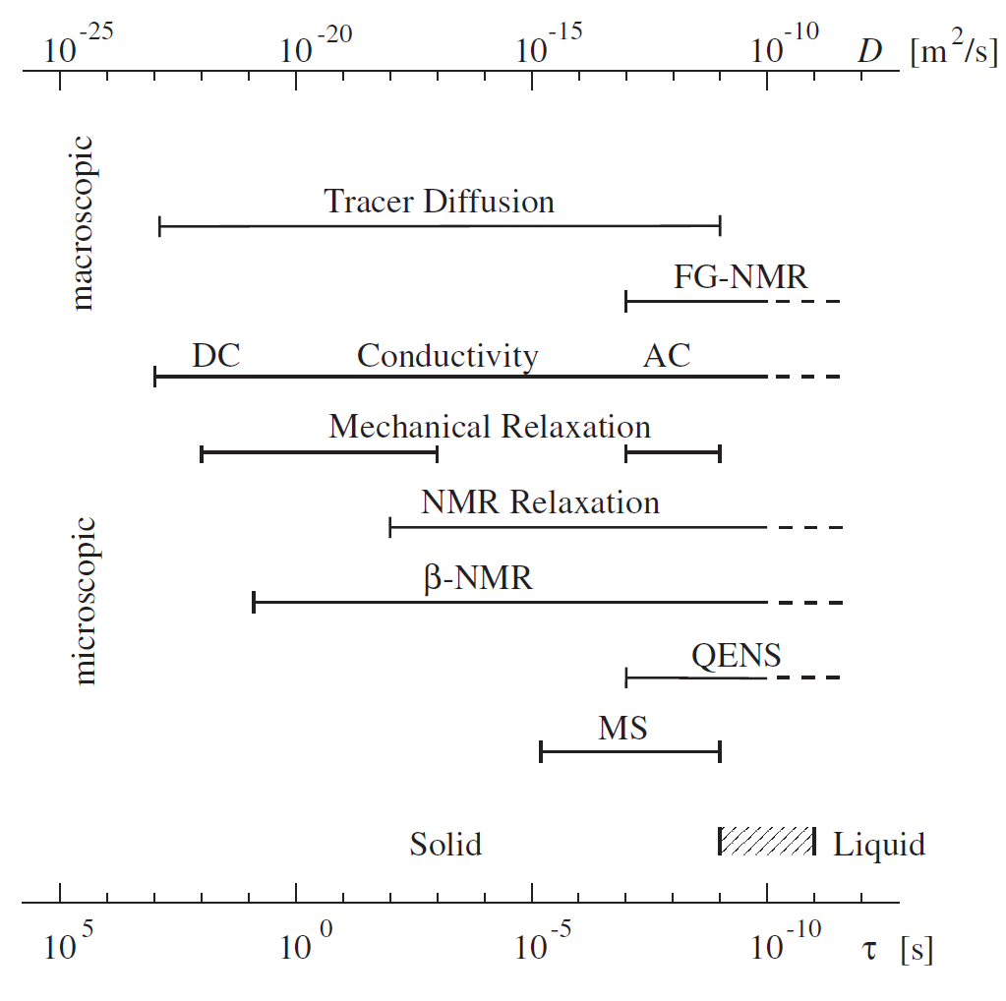
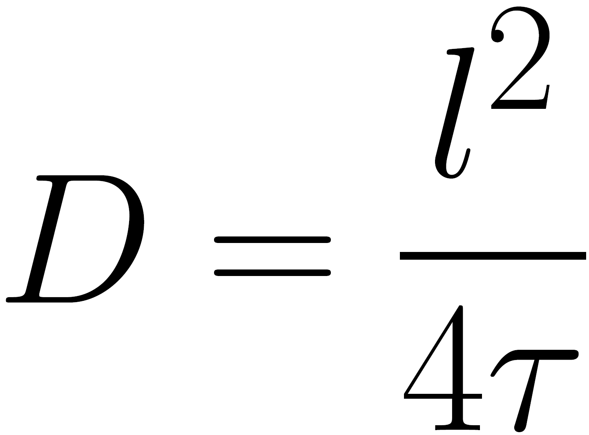
How to Measure Ionic Diffusion …
If we can determine the hop rate of the ion – we can estimate a diffusion coefficient
Heitjans et. al, J. Phys.: Condens. Matter, 15: R1257, 2003.

Slide 11
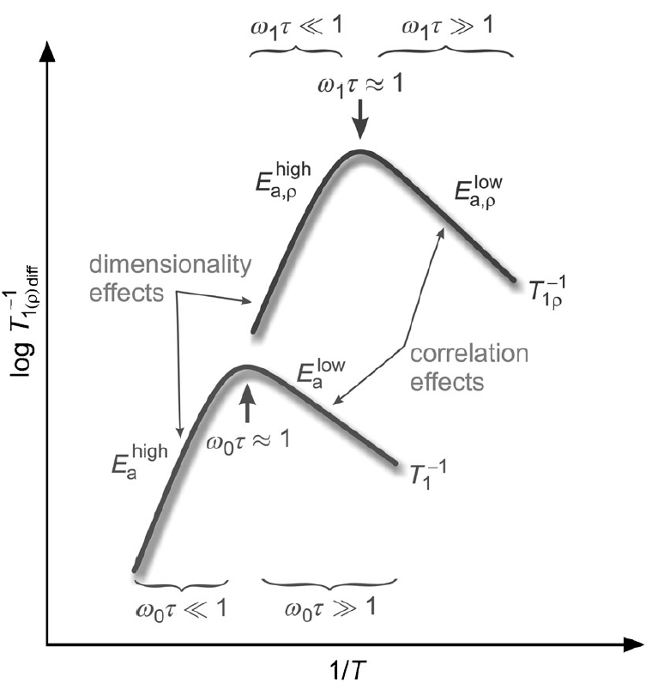
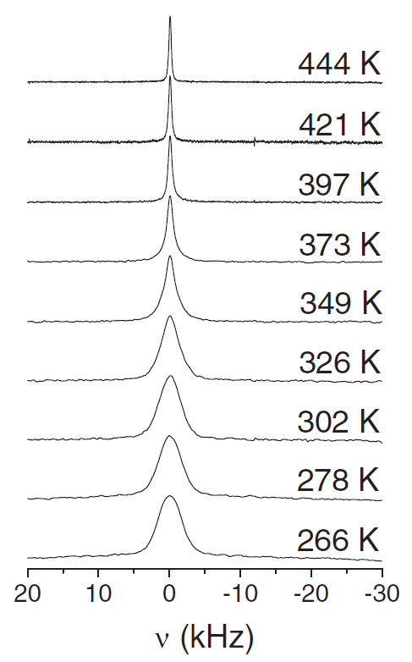
Using NMR, What Are We Looking For?
Wilkening et. al, ChemPhysChem, 13: 53-65, 2012.
Faske et. al, Phys. Rev. B, 77: 104301, 2008.

Slide 12
Key Observables
So, we search for:
SLR rate maxima, where the hop rate ≈ the Larmor frequency (ω₀ = γB₀)
AND
(2) A narrowed resonance line on warming

Slide 13
The Closest Precedent(s)

Slide 14
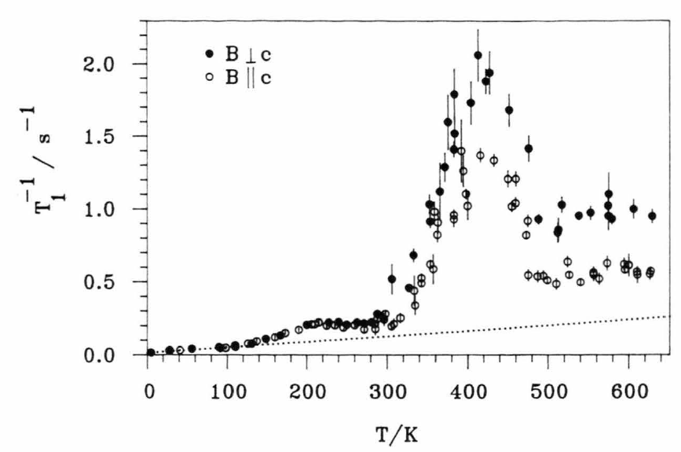
LiC₁₂
Schirmer et. al, Z. Naturforsch. A, 50: 643-652, 1995.

Slide 15
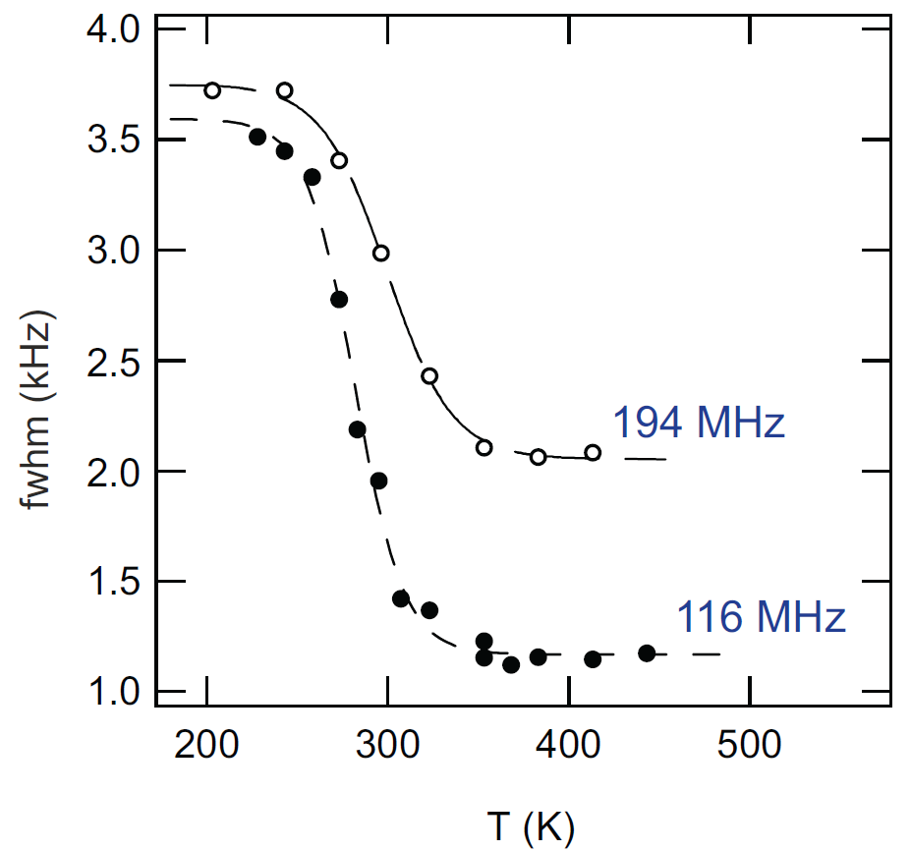
… or LiC₆
Langer et. al, Phys. Rev. B, 88: 1-9, 2013.

Slide 16
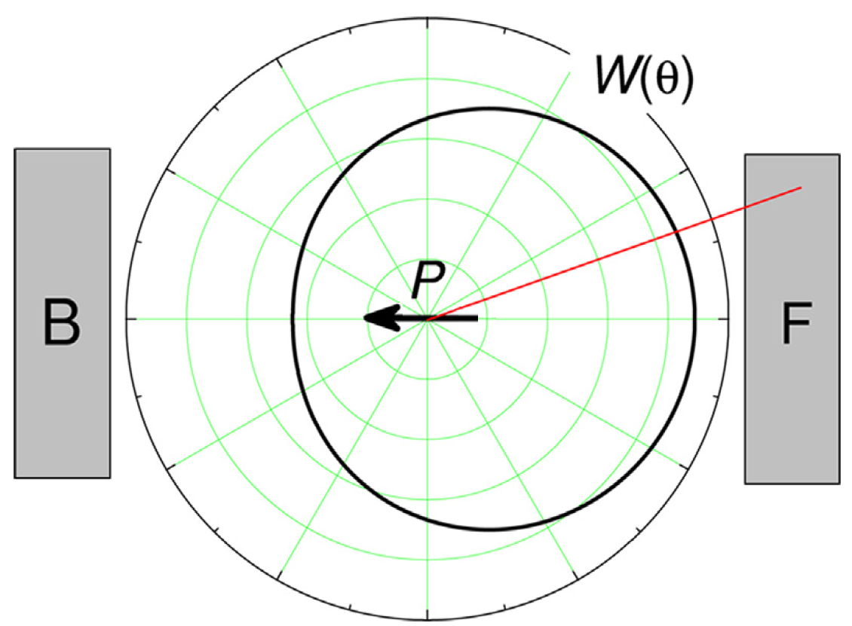
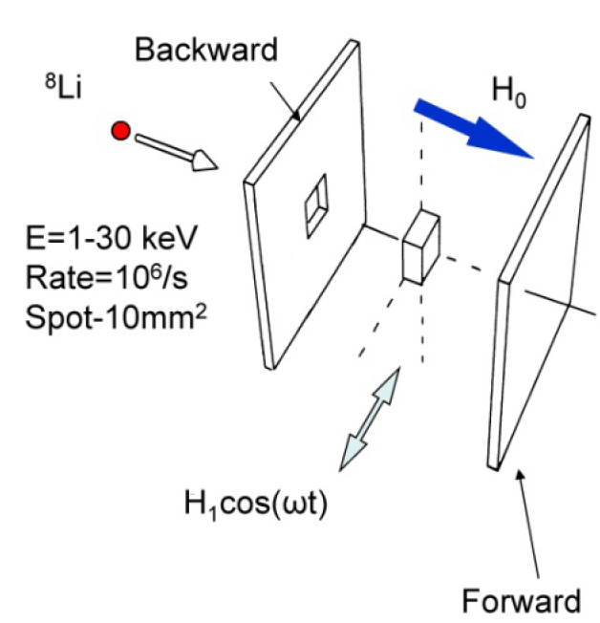
(Very Condensed) Overview of β-NMR
MacFarlane, Solid State Nucl. Mag. Reson., 68: 1-12, 2015.
Kiefl et. al, Nucl. Phys. News, 23: 29-32, 2013.
The μ and ⁸Li are viewed as complementary probes

Slide 17
And now for what we’ve all been waiting for …
Ticknor et. al, Phys. Rev. B, 108: 108195, 2023.

Slide 18
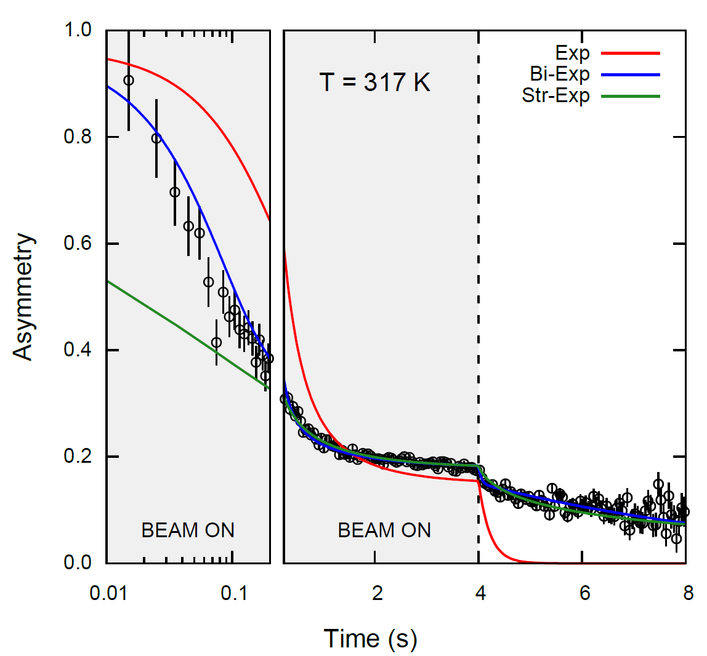
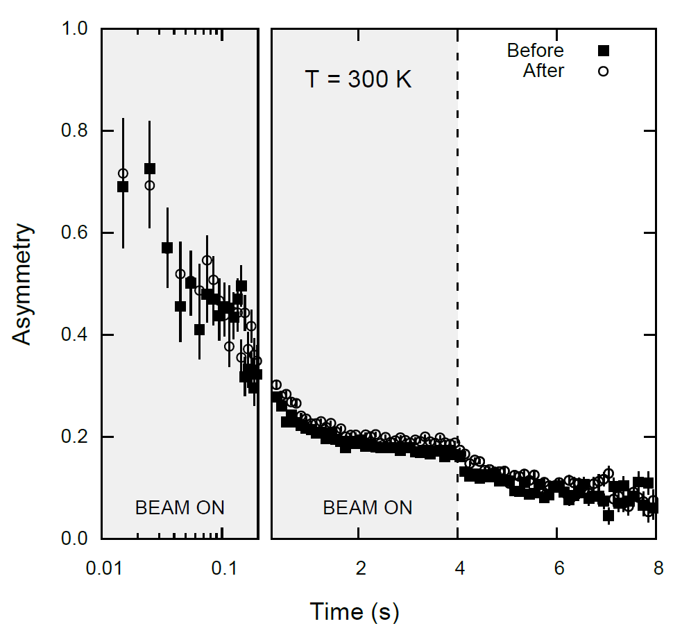
What Do We See in Graphite?

Slide 19
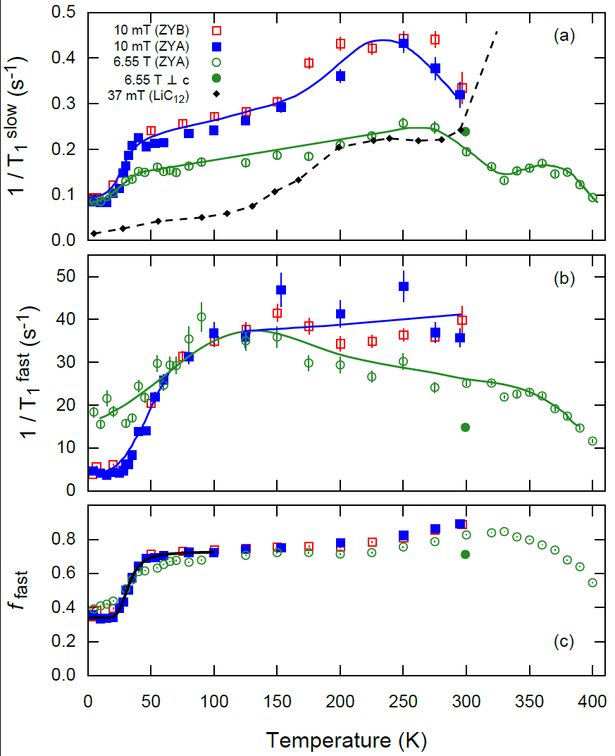
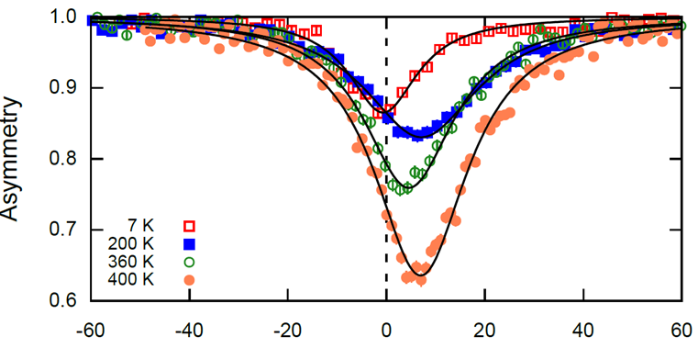
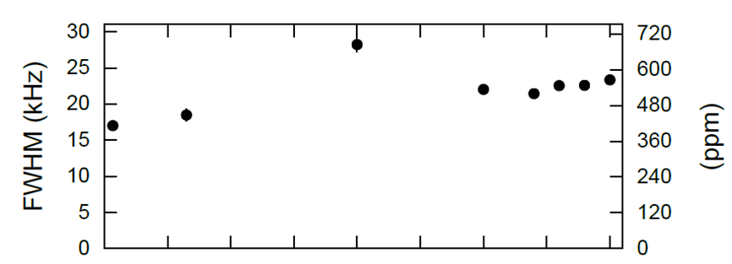

Slide 20
What Are Some Possible Explanations?
Although the absence of diffusion is somewhat surprising, this is consistent with other measurements
This marks a clear departure from the more concentrated graphite compounds (e.g., LiC₆ and LiC₁₂)
It is possible that the Li is getting trapped near the surface … and/or … a narrowed interlayer gap inhibits its mobility in this regime

Slide 21
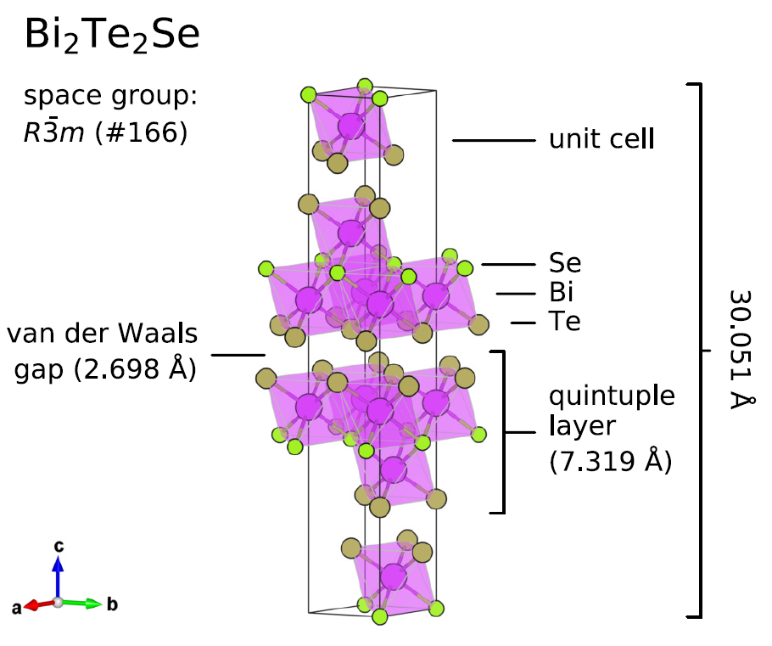
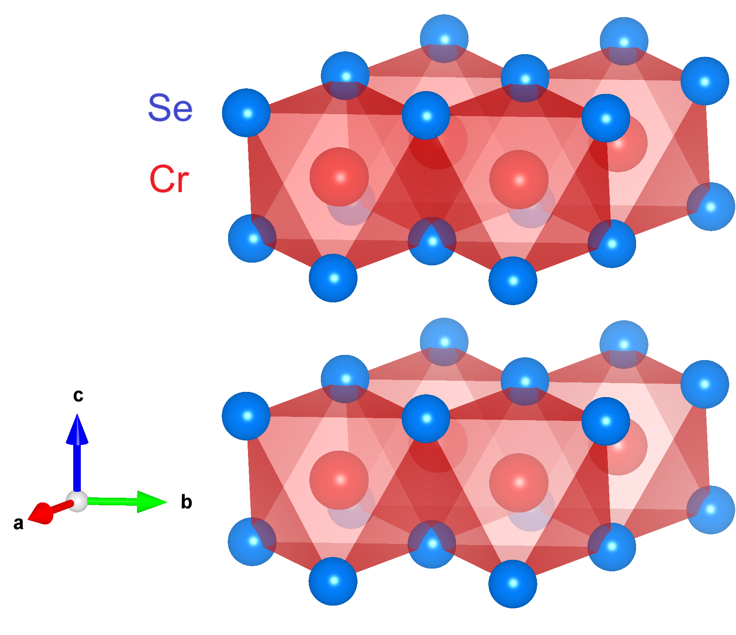
What About Other vdW Materials?
CrSe₂
McFadden et. al, Phys. Rev. B, 99: 125201, 2019.
Ticknor et. al, RSC Adv., 10: 8190-8197, 2020.

Slide 22
Summary and “Take-Home” Messages
β-NMR is uniquely suited to study dilute-limit diffusion of Li in a variety of crystalline solids
Although the absence of appreciable mobility in graphite is somewhat surprising, it is not without precedent
We’ve barely scratched the surface of vdW materials … many more remain to be explored!

Slide 23
Acknowledgments
UBC
Jonah Adelman
Aris Chatzichristos
Martin Dehn
Derek Fujimoto
Victoria Karner
Robert Kiefl
Andrew MacFarlane
Ryan McFadden
Mohamed Oudah
TRIUMF
Sarah Dunsiger
Luca Egoriti
Alex Gottberg
Phil Levy
Ruohong Li
Iain McKenzie
Gerald Morris
Monika Stachura
Edward Thoeng

Slide 24
THANK YOU – QUESTIONS?

