Slide 1
On the Use of β-NMR in Studying van der Waals Materials*
John O. Ticknor
TRIUMF Science Week CMMS Seminar (July 2024)
* Terms and conditions apply – mostly graphite
Notes:
Thank you to the CMMS group and the organizers for TRIUMF’s Science Week for extending an invitation my way to tell you all about van der Waals materials and bNMR
The technique of bNMR is very closely related to that of muSR, so this serves as a nice “segway” from the work of my colleagues

Slide 2
Outline
Brief personal background and biography
Motivation for studying van der Waals materials
How ionic diffusion is measured and studied using NMR
Condensed Overview of β-NMR Technique
Results in key case study – graphite
Discussion of similar and upcoming work
Summary and “take-home messages”
Notes:
Here is a quick road map of what I’ll be covering …
NOTE that I’ll be keeping the focus of this talk to be fairly narrow and centered around this topic of ionic diffusion
Although it’s worth noting that NMR is also sensitive to a broad range of other phenomena (i.e., magnetic and electronic behavior)

Slide 3
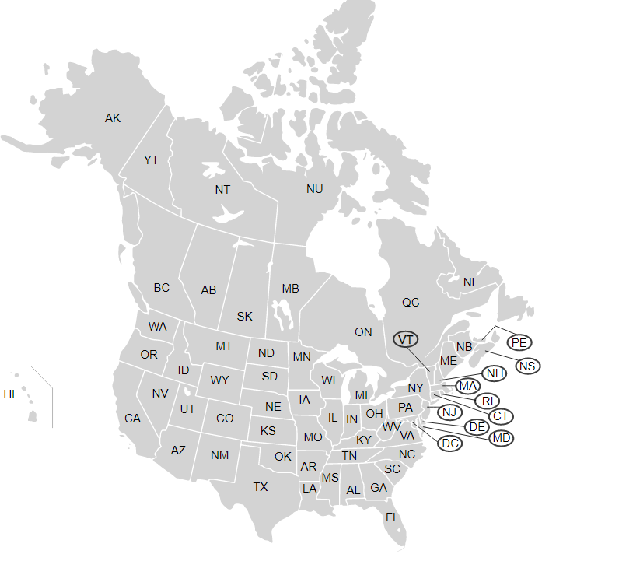
Venturing Down “Memory Lane”
Georgia Institute of Technology
Atlanta, GA, USA
Notes:
When I describe to others as to where I’m from, I often give this very convoluted response …
… GT where I learned about solid state chemistry and really gained an immense appreciation for the subdiscipline

Slide 4
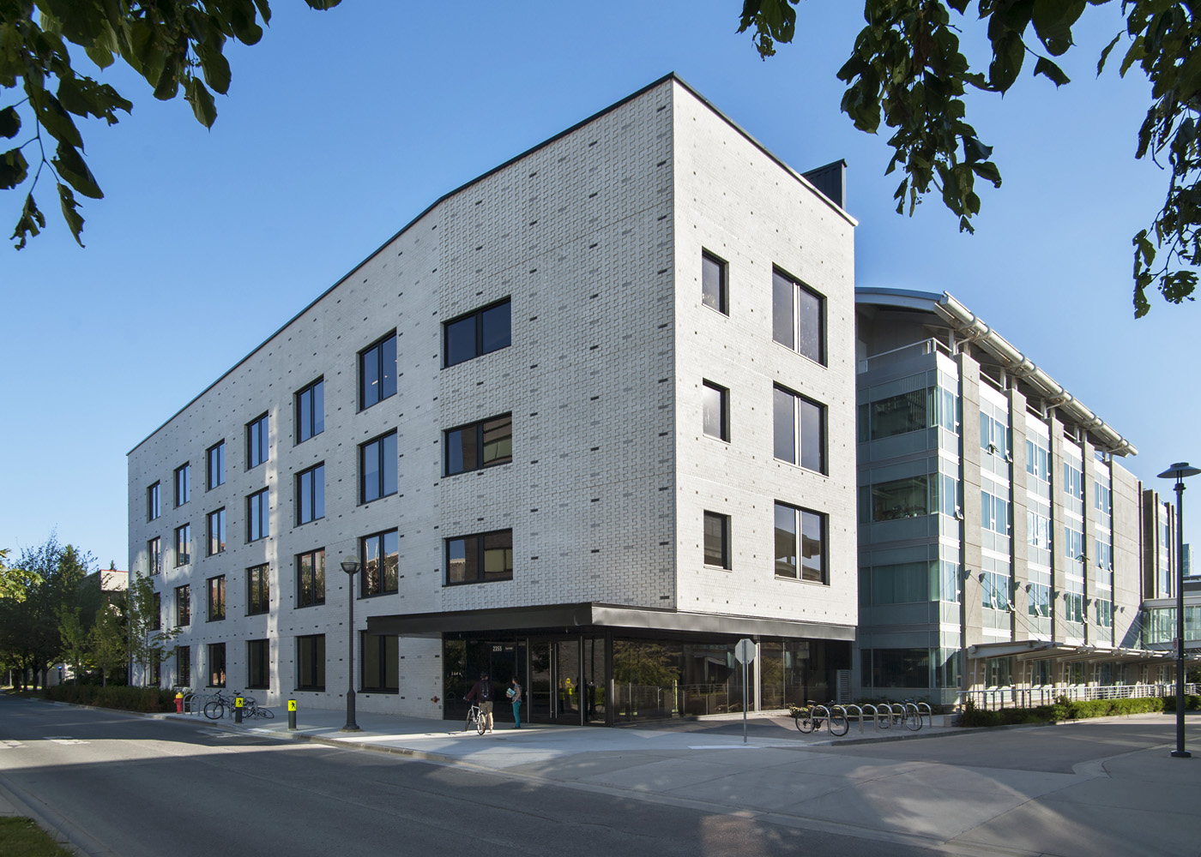
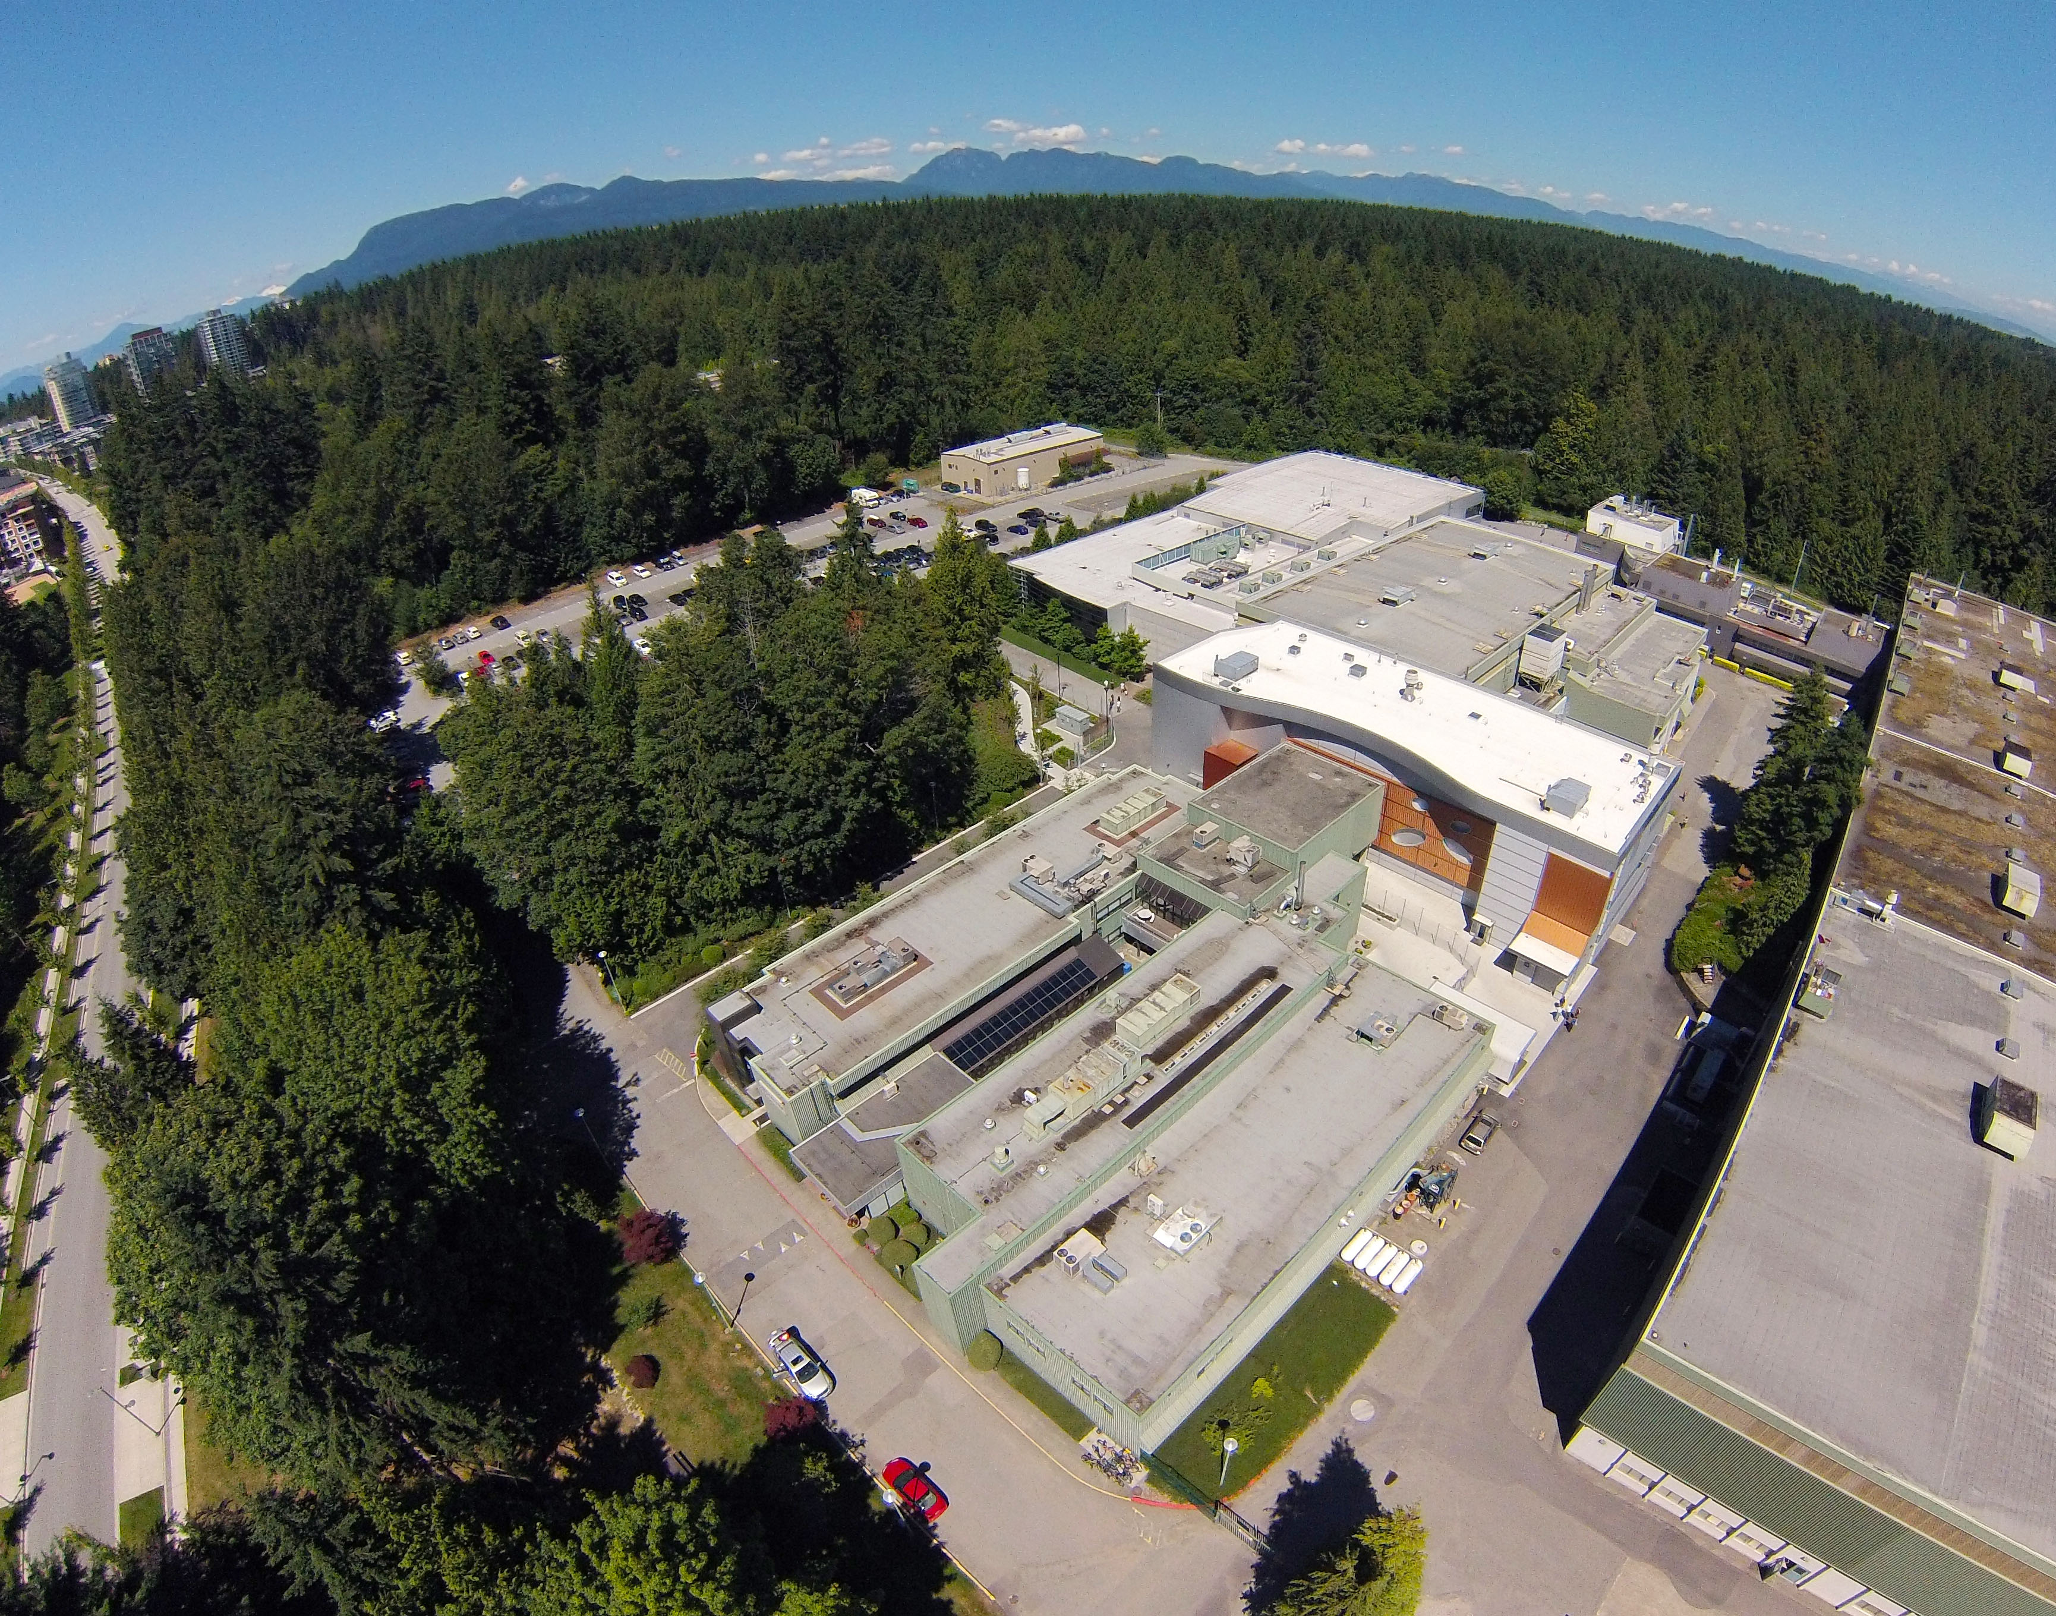
Notes:
It was through my work at GT/APS that attracted me to yet another particle accelerator facility for my graduate work
Here, I have joint affiliations with the QMI at UBC
And you see here this beautiful aerial photo of TRIUMF … (point out ISAC/MOB/meson halls)

Slide 5
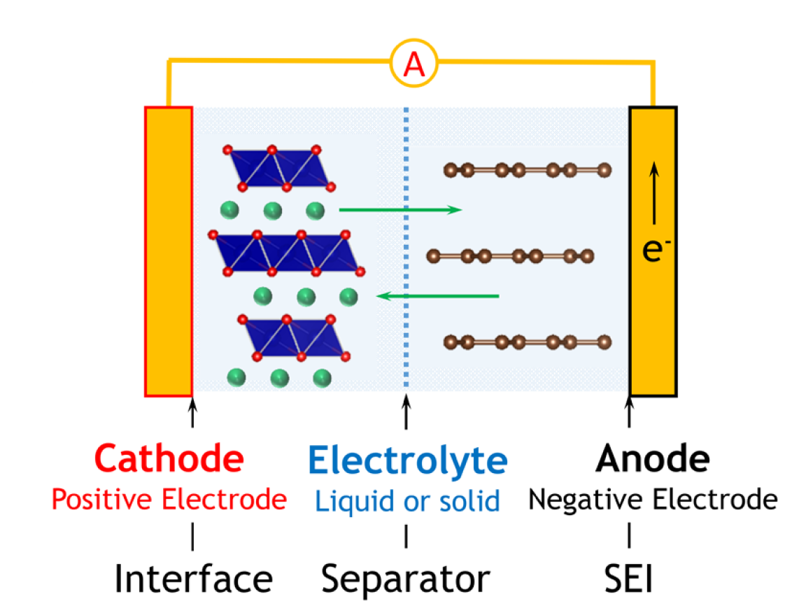
A Broader Background and Motivation
Intercalation – the basis for the charging and discharging of any rechargeable battery
Note the layered structures!
Pecher, et. al. Chem. Mater., 29: 213-242, 2017.
Notes:
In any rechargeable battery, such as what I’ve shown here … you’re interested in the process of intercalation
This denotes the reversible de-insertion and insertion of the charged guest species (Li in the case of a LIB)
On discharging, these species must traverse between the anode and cathode, passing through an electrolyte
On charging, this process must be reversed … you see here also the interfaces that spontaneously form between the electrodes and electrolyte on charge/discharge
So therefore, the rate of charge and discharge is directly affected by how quickly the guest species move throughout this process
Notice that the layered structure of these materials enable them to serve as ideal intercalation hosts

Slide 6
van der Waals (vdW) Materials
Vadlamani, et. al. J. Electrochem. Soc., 161: A1731, 2014.
Van Noorden, et. al. Nature., 438: S32-S33, 2012.
Weak vdW interaction holding the layers together (a) allows these materials to be easily exfoliated (b)
Notes:
One major category of such layered structures are broadly referred to as van der Waals materials
Graphite is easily the best known example!
Thinking back to your first year chemistry course … here you are reminded of a classic example of covalently bound C atoms that form a hexagonal array in a 2D plane … and each of the layers are held together by weak non-bonding interactions that result from their transient dipole interaction … here I’ve shown its unit cell … (A-B-A) stacking
It is also the weak van der Waals interaction that allows for each of the layers to be cleaved using something surprisingly simple: Scotch tape … this is how you’d isolate graphene (single layer)

Slide 7
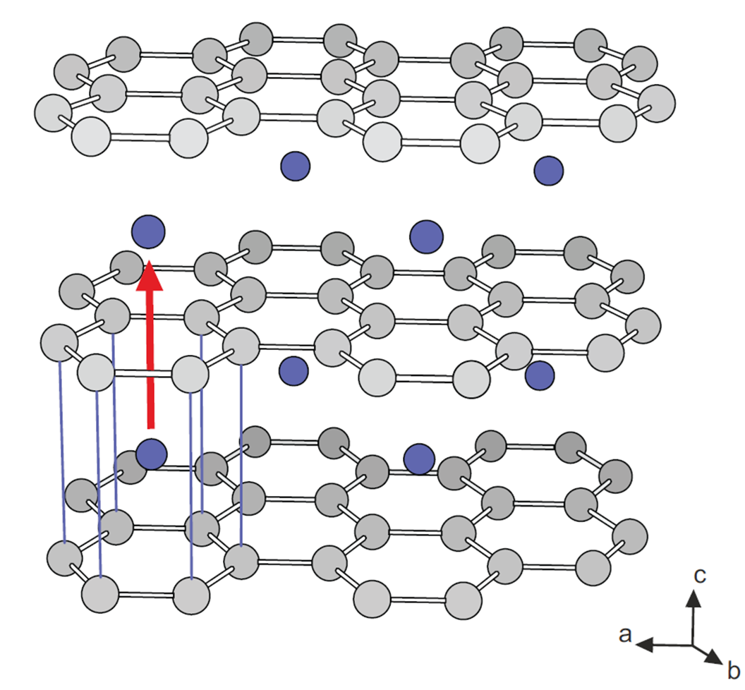
An Overarching Cause (Part I) …
Graphite is a commonly used electrode in modern rechargeable lithium-ion batteries
If we want to optimize the rate of charge/discharge – we need to understand the underlying process of ionic diffusion
Langer et. al, Phys. Rev. B, 88: 1-9, 2013.
Notes:
Even today, the cost and reliability of graphite makes it a very useful anode in lithium-ion batteries
So, if we want to improve how a LIB charges and discharges … if we want to maximize the efficiency of this process … then we will need to understand the underlying mechanisms and processes that govern how the guest ions diffuse within the material
What I’ve shown here what the fully lithiated graphite structure looks like … and here you see that the Li resides directly on top of another … and that the stacking sequence has shifted from A-B-A stacking to A-A-A stacking

Slide 8
… An Overarching Cause (Part II)
What if we want to simulate this process?
Most simulations are best suited for the “dilute-limit”
But most experiments operate in the opposite “concentrated” regime
Notes:
Now there’s also a tremendous amount of interest in developing computational simulations to predict which materials will serve as good intercalation hosts … and how to perhaps modify their structure to improve this
But there’s a real issue here and that is that most of these simulations are best suited for what’s called the dilute limit … due the comparative simplicity of modeling an isolated Li …
And most experiments operate in the polar opposite of this regime where the material is fully lithiated (concentrated) … especially when using conventional techniques
So this presents an apparent dilemma – how do we bridge this gap between experiment and theory

Slide 9
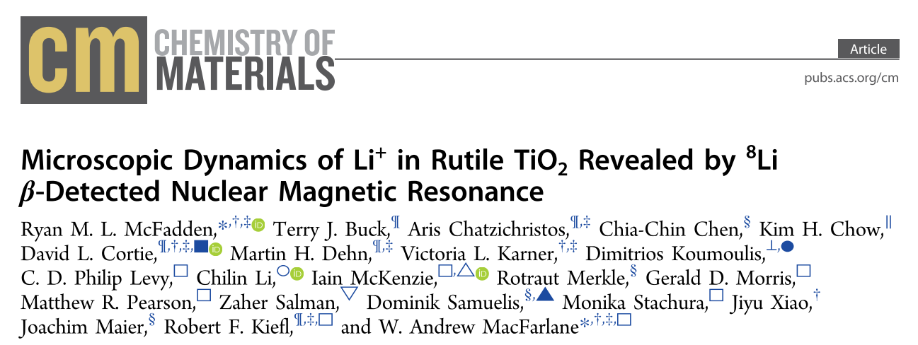
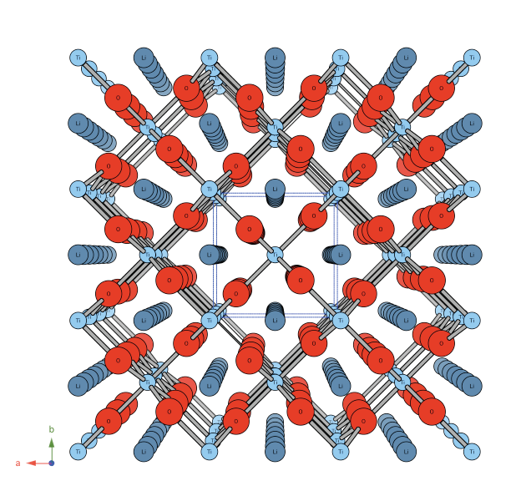
β-NMR Sets the Foundation
Fortunately, β-NMR is ideally positioned to help to bridge this gap
Notes:
This was pioneered by Ryan McFadden who made use of a 1D ionic conductor … rutile TiO2
Here you see that its structure has open channels oriented along the c-axis which acts as a convenient pathway for the Li ions to diffuse

Slide 10
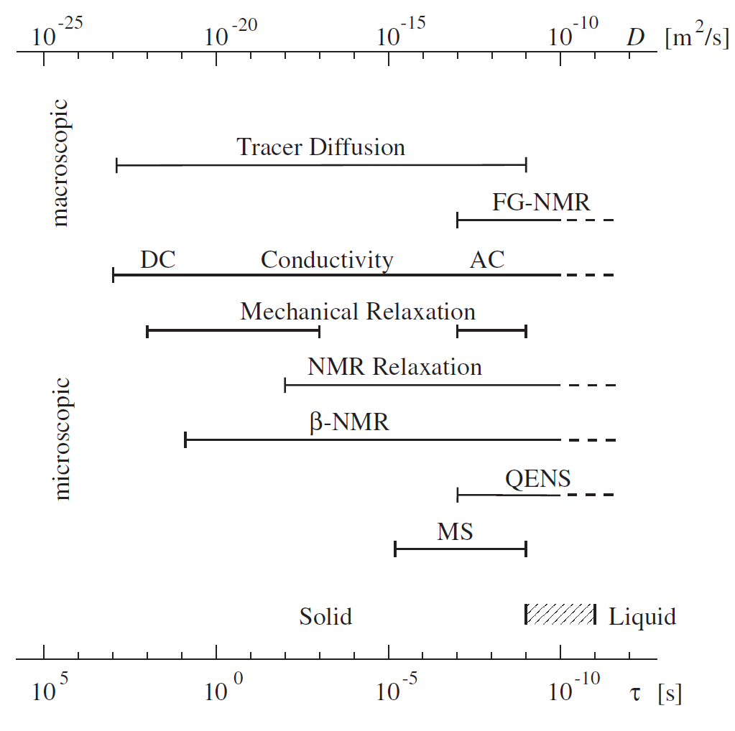
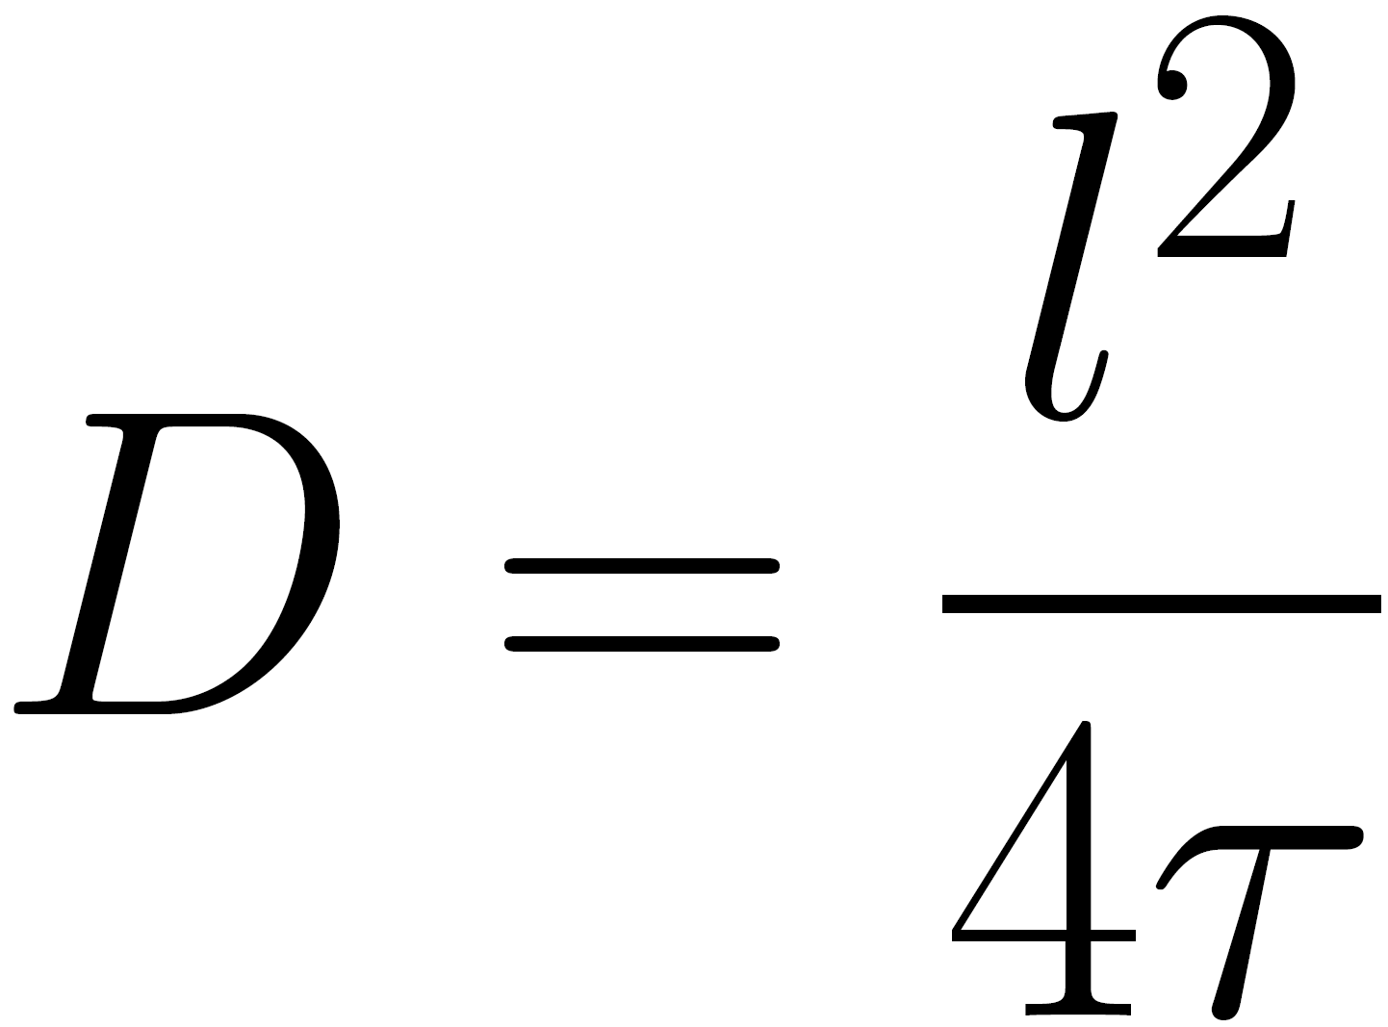
How to Measure Ionic Diffusion …
If we can determine the hop rate of the ion – we can estimate a diffusion coefficient
Heitjans et. al, J. Phys.: Condens. Matter, 15: R1257, 2003.
Notes:
How is it that you actually measure diffusion (experimentally)
Here you can turn to a variety of different techniques
These are distinguished between whether they probe macroscopic (long range) versus short range ionic transport
If you know the approximate jump distance of an ion that hops from an interstitial site to a nearby adjacent interstitial site (you could estimate this from XRD, for example) …. you can then determine the diffusion coefficient through an estimate of the hop rate
Okay, so then … how do we determine the hop rate? For this, we can now turn to how NMR does this

Slide 11
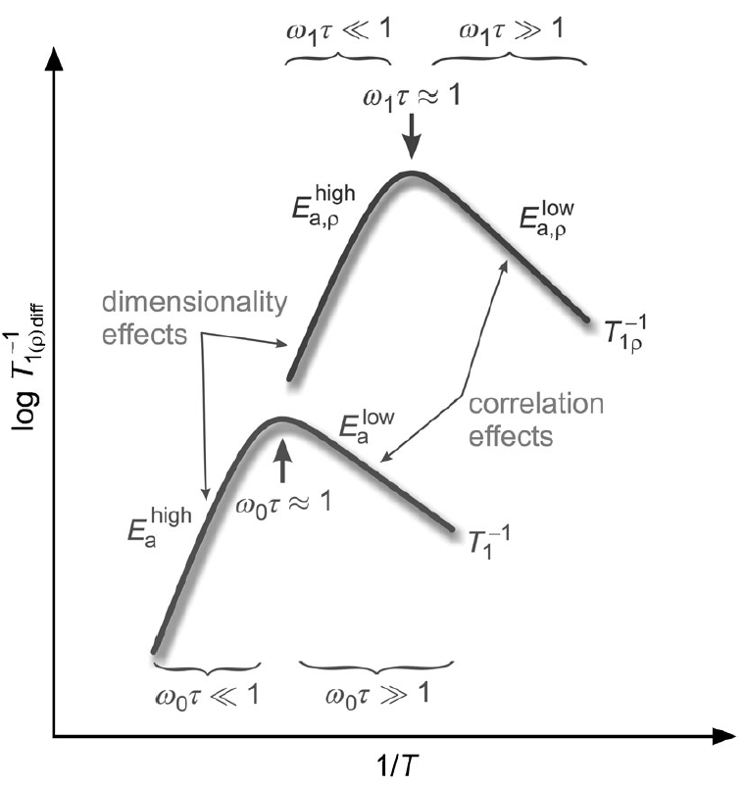
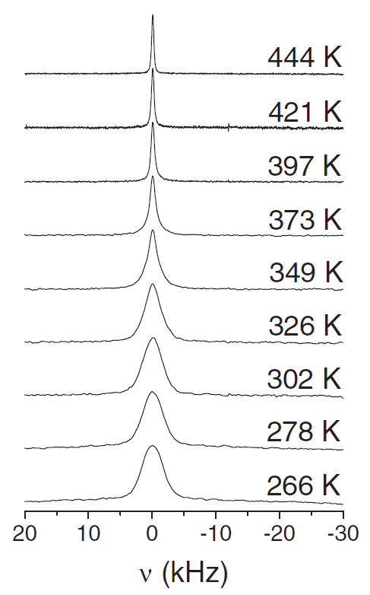
Using NMR, What Are We Looking For?
Wilkening et. al, ChemPhysChem, 13: 53-65, 2012.
Faske et. al, Phys. Rev. B, 77: 104301, 2008.
Notes:
In any NMR experiment, what you’re doing is you prepare the nuclear spins in a state of polarization far from equilibrium, and then allow them to relax
It turns out that as you monitor how quickly these nuclear spins relax, you can connect this to rate of how quickly those nuclei are diffusing
This was developed through pioneering work of BPP in the late 1940s
The net result is that the relaxation rate … 1/T1 … passes through a maximum at some temperature … and here, the hop rate exactly matches the resonance frequency of the nuclei
But this isn’t all … because you might see relaxation rate maxima that correspond to other effects … so you have to corroborate this through resonance measurements (right)
Here, you’re instead stepping through frequency space and the peak that you see here corresponds to transitions of the spin energy eigenstates
When the your nuclei are not mobile … they sense a distribution of nearby local fields … but as they begin to move, their sense of the local field distribution becomes averaged … and this gives rise to a narrowing of the resonance line

Slide 12
Key Observables
So, we search for:
SLR rate maxima, where the hop rate ≈ the Larmor frequency (ω₀ = γB₀)
AND
(2) A narrowed resonance line on warming
Notes:
So, in summary … what we look for is the combination of SLR rate (1/T1) maxima where we know the hop rate of the diffusing ion (in our case, Li) matches the Larmor frequency (this is unique to the nucleus and the applied field) … this occurs in the MHz range
And … in combination with this … an onset of motional narrowing which corresponds to the hop rate exceeding that of the linewidth (kHz) range

Slide 13
The Closest Precedent(s)
Notes:
Here what we see are the closest comparisons in graphite … where Heitjans and colleagues investigated the concentrated Li “stage” compounds of graphite using both bNMR and conventional NMR

Slide 14
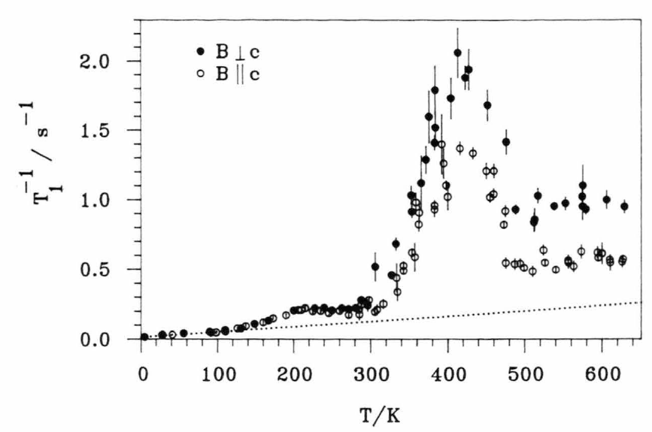
LiC₁₂
Schirmer et. al, Z. Naturforsch. A, 50: 643-652, 1995.
Notes:
Here is an example of the 1/T1 maxima that we see … this occurs well above room temperature in LiC12

Slide 15
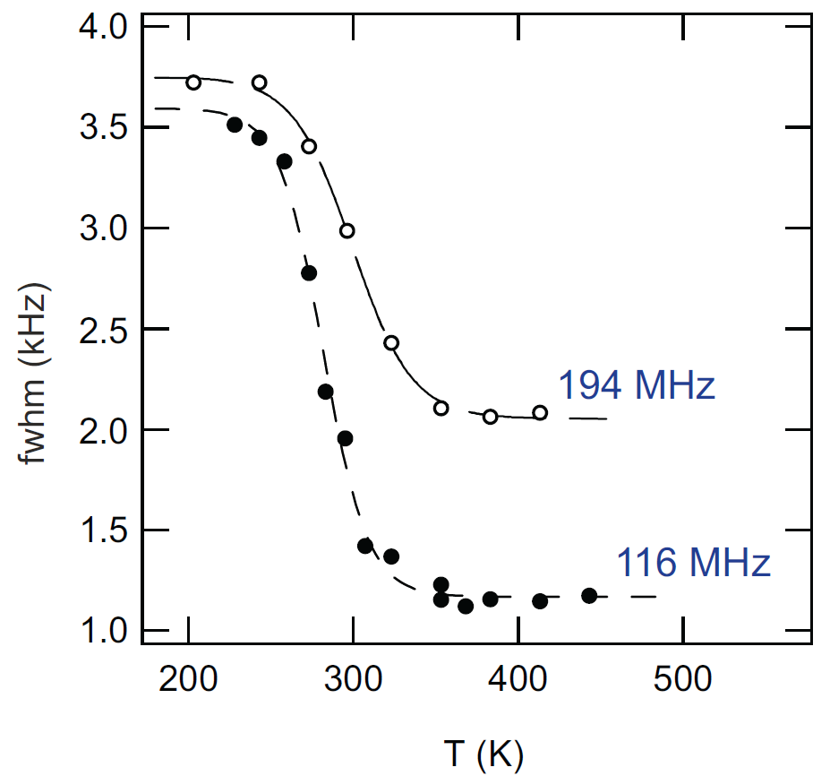
… or LiC₆
Langer et. al, Phys. Rev. B, 88: 1-9, 2013.
Notes:
And here is an example of the motional narrowing that we see for two different applied fields … here the linewidth falls precipitously by a factor of 2-3 above room temperature

Slide 16
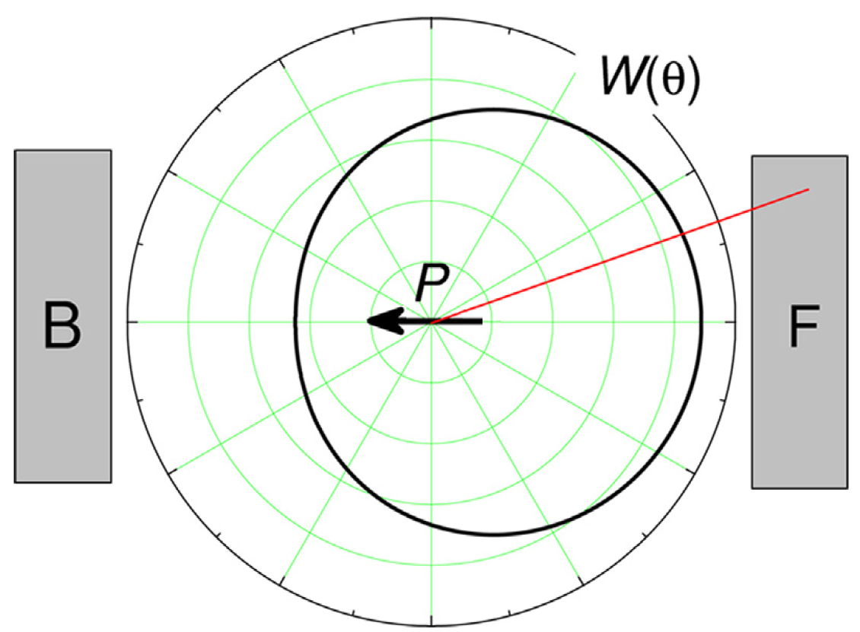
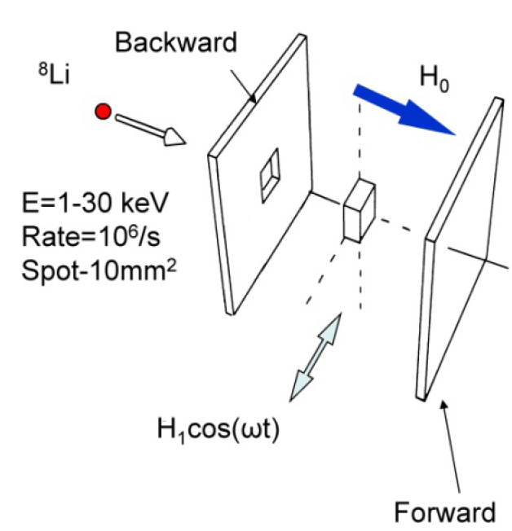
(Very Condensed) Overview of β-NMR
MacFarlane, Solid State Nucl. Mag. Reson., 68: 1-12, 2015.
Kiefl et. al, Nucl. Phys. News, 23: 29-32, 2013.
The μ and ⁸Li are viewed as complementary probes
Notes:
Okay … so how exactly do we investigate this using bNMR
Well it’s fortunate that we have the background of muSR to rely on
Here, the spin polarization of the 8Li nuclei (the probe that we use) is generated externally using an optical pumping technique
What you’ll notice is that the direction of the spin polarization is oriented preferentially opposite to the direction of your emitted beta particle at the moment the 8Li beta decays
So on the right here you’ve got a schematic of how this is arranged
You’ve got two detectors opposite the sample … and when you perform a resonance measurement, you continuously apply RF perpendicular to the direction of the spin polarization (and the static applied field)

Slide 17
And now for what we’ve all been waiting for …
Ticknor et. al, Phys. Rev. B, 108: 108195, 2023.
Notes:
And now, at long last, we finally have the background needed to discuss our results in graphite

Slide 18
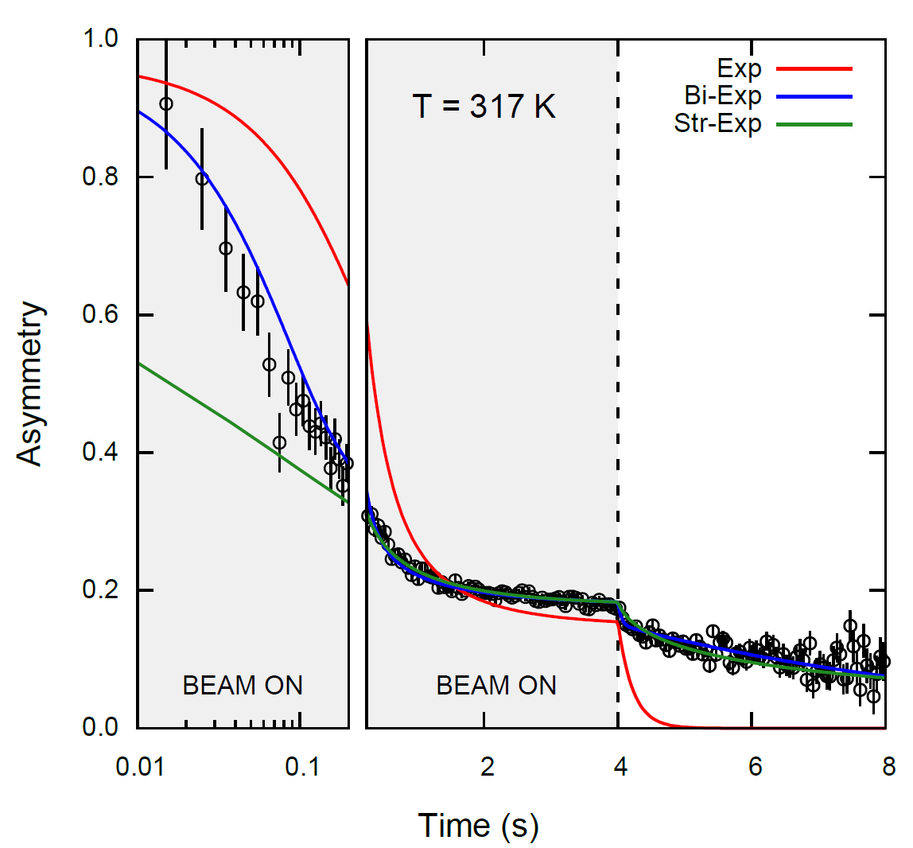
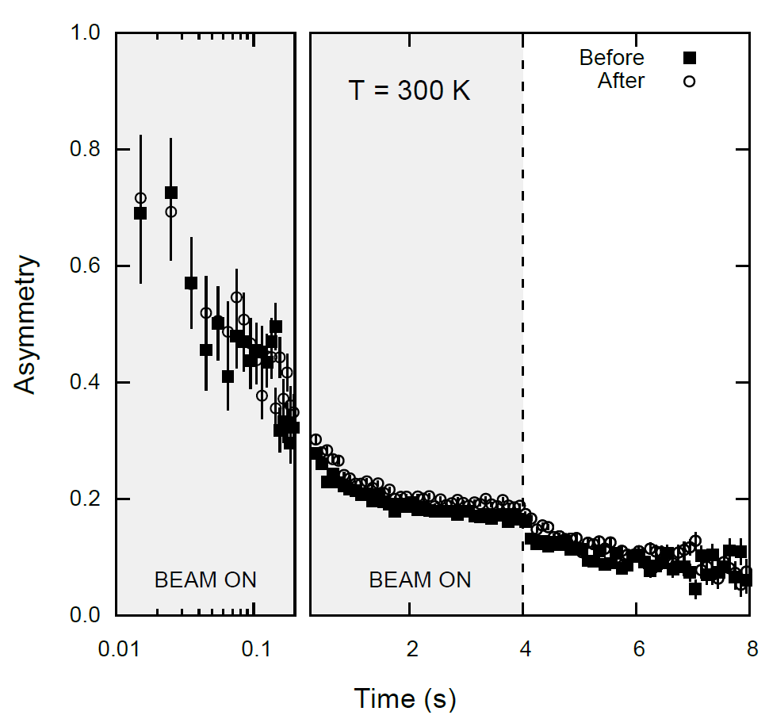
What Do We See in Graphite?
Notes:
So what do we see … well the way our spin lattice relaxation measurements work is we apply a beam pulse (here 4 s) and monitor the decay of the spin polarization both before and after the pulse … notice the error bars are inhomogeneous with respect to time (EXPLAIN)
Explain the different exponential fits … and the annealing procedure we adapted to help to eliminate any possible presence of ferromagnetism

Slide 19
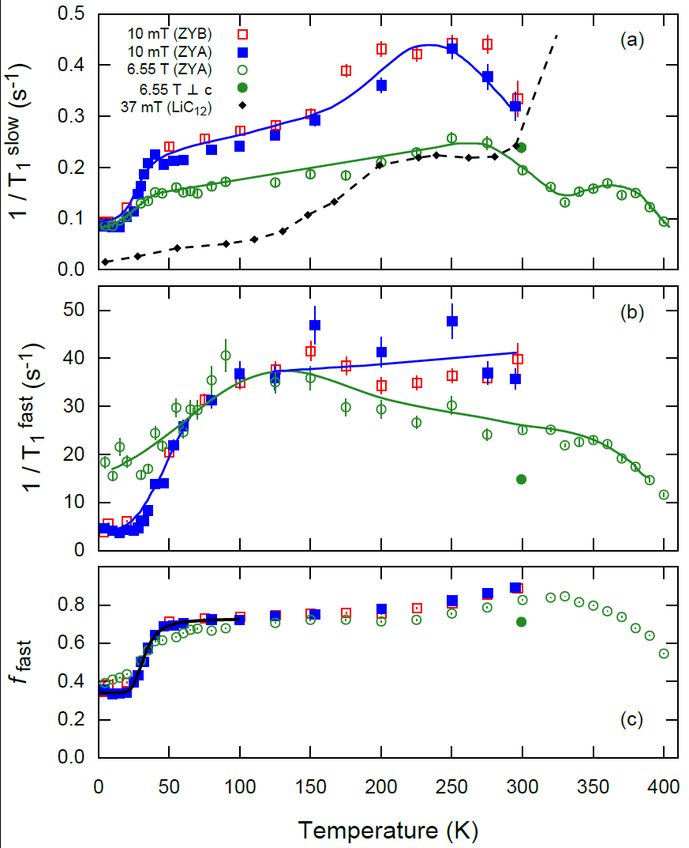
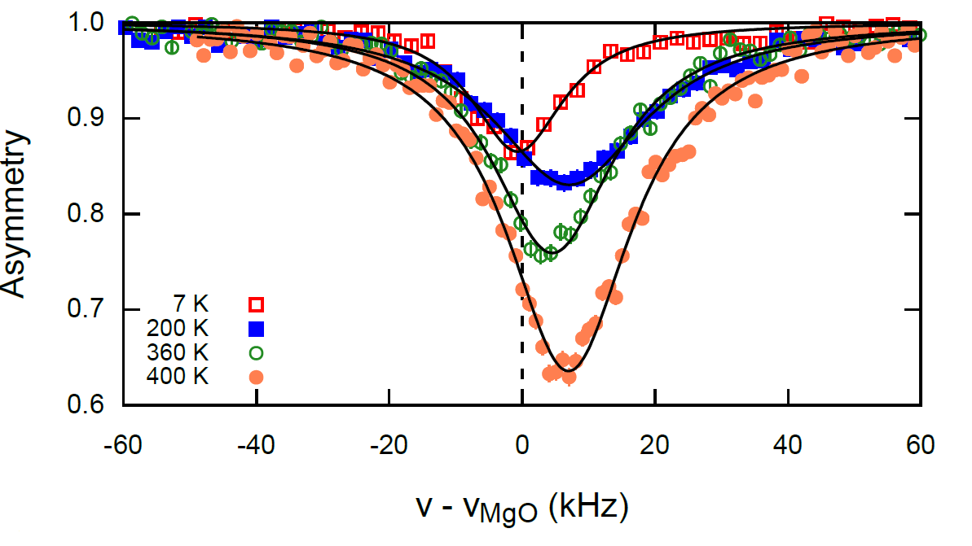
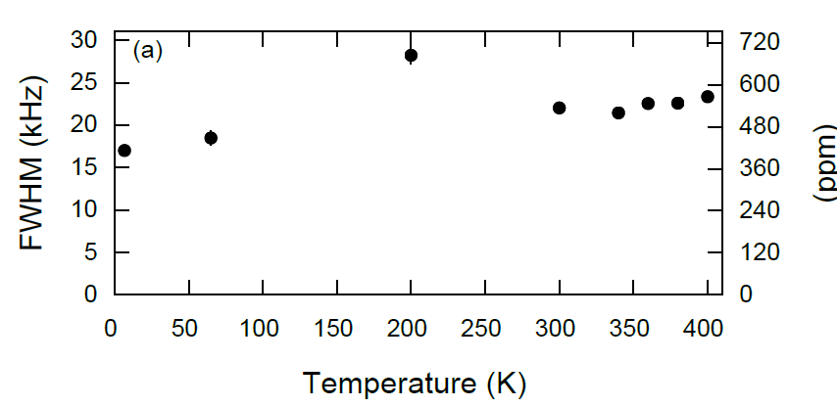
Notes:
Explain these figures in a fairly ad-lib manner
The key things to point out is that while it initially might appear that you see a 1/T1 maxima for the graphite in our data
This is not consistent with the higher stage compound LiC12
Nor is it consistent with the picture of the resonance linewidth …. As you can see that the linewidth actually broadens on warming!

Slide 20
What Are Some Possible Explanations?
Although the absence of diffusion is somewhat surprising, this is consistent with other measurements
This marks a clear departure from the more concentrated graphite compounds (e.g., LiC₆ and LiC₁₂)
It is possible that the Li is getting trapped near the surface … and/or … a narrowed interlayer gap inhibits its mobility in this regime
Notes:
So although the absence of diffusion is somewhat surprising, it’s also important to remember that we’re in a very distinct regime here in the dilute limit … and this is consistent with other macroscopic release measurements which made use of mass spectroscopy for also dilute limit Li in graphite to measure a diffusion coefficient … our findings concur with their work (1989, Jungblut in Berlin)
So this demonstrates a clear difference from the more lithiated stage compounds and hopefully this work will motivate theorists to investigate why this discrepancy emerges at lower concentrations of Li
As to why the diffusion of Li might be impeded … this may relate to Li being trapped near the surface … or that the interlayer gap is reduced to the extent where it increase the activation energy barrier that the Li must overcome in order to hop to the next nearest interstitial site within the vdW gap

Slide 21
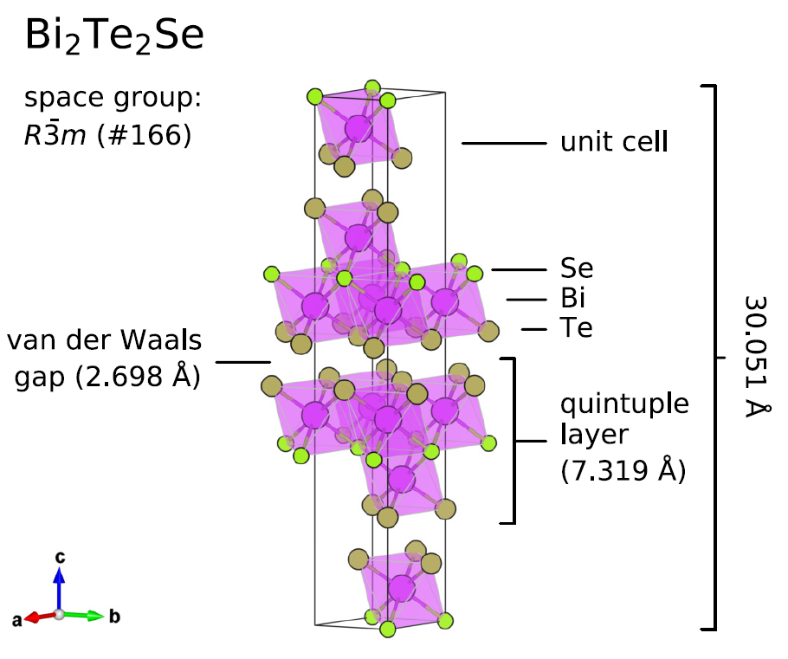
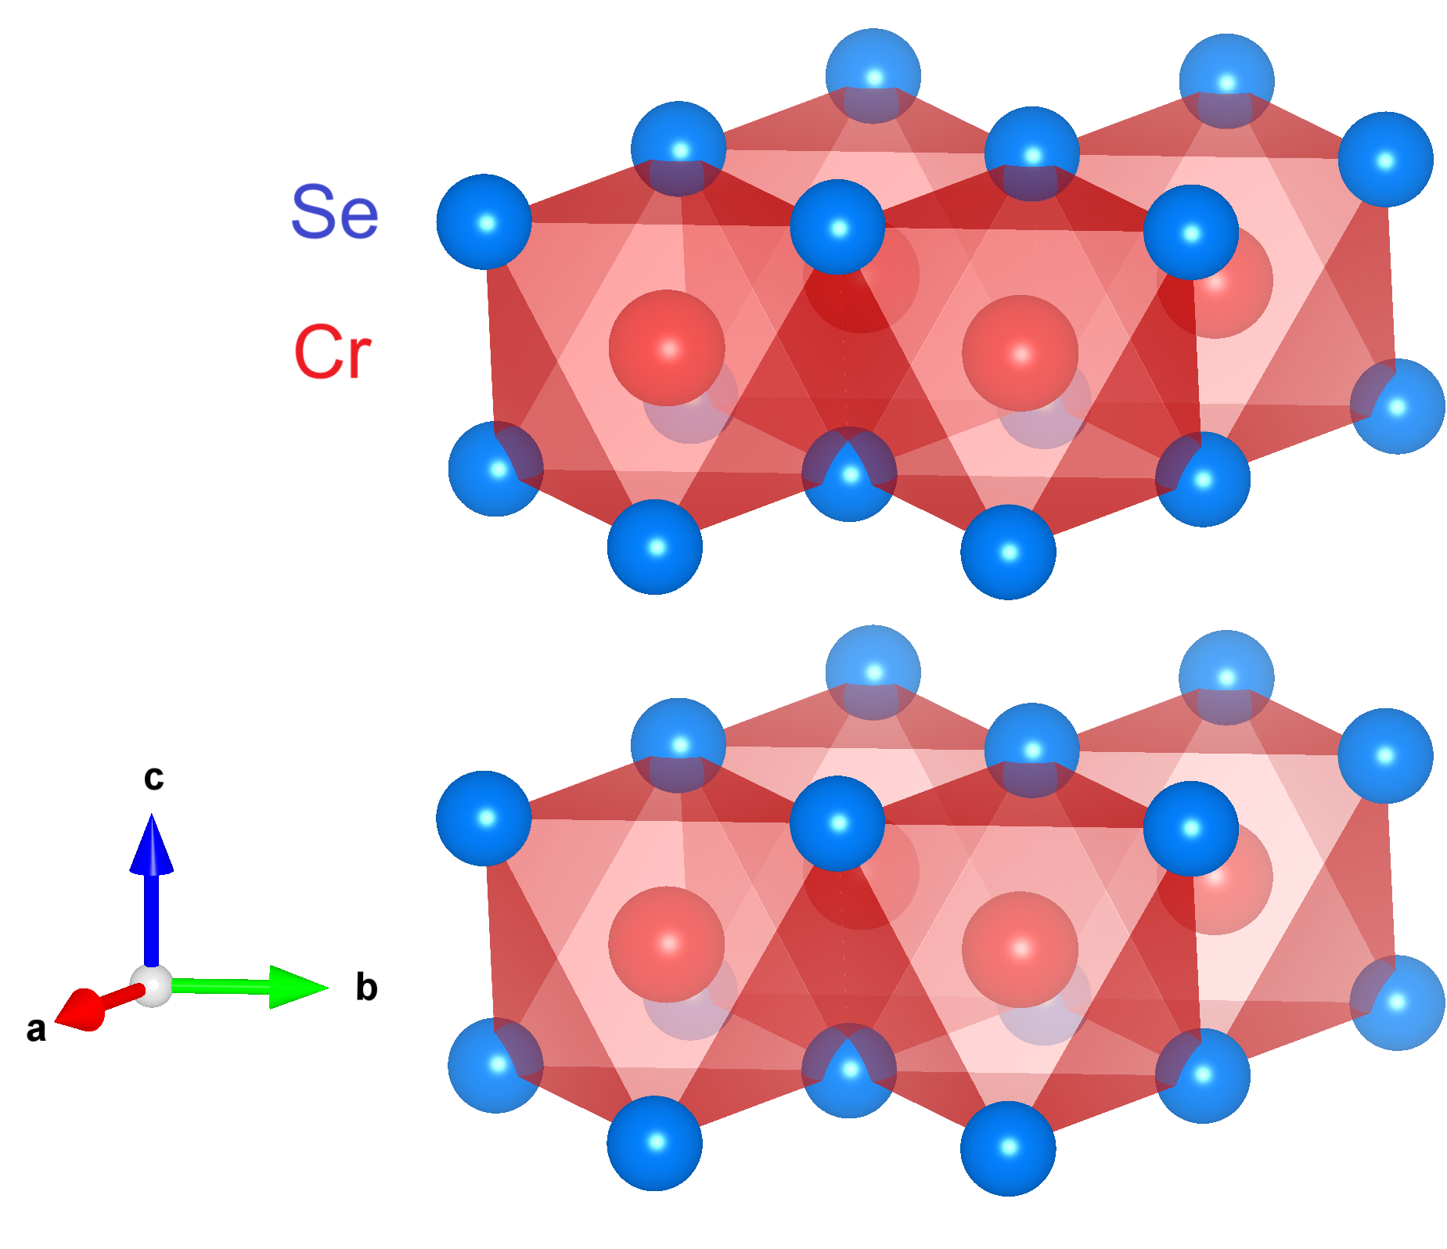
What About Other vdW Materials?
CrSe₂
McFadden et. al, Phys. Rev. B, 99: 125201, 2019.
Ticknor et. al, RSC Adv., 10: 8190-8197, 2020.
Notes:
Let’s say that graphite is not so interesting a case … what about other vdW materials?
We’ve so far published on a handful of other cases studies
This includes BTS (topological insulator)
And CrSe2 (a rather anomalous magnetic and metallic TMD)
Here, we found convincing evidence of Li diffusion through the bNMR in both of these materials … you see the onset of it emerge in the case of CrSe2 and its occurrence at even lower temperatures in BTS

Slide 22
Summary and “Take-Home” Messages
β-NMR is uniquely suited to study dilute-limit diffusion of Li in a variety of crystalline solids
Although the absence of appreciable mobility in graphite is somewhat surprising, it is not without precedent
We’ve barely scratched the surface of vdW materials … many more remain to be explored!
Notes:
Mostly self-explanatory

Slide 23
Acknowledgments
UBC
Jonah Adelman
Aris Chatzichristos
Martin Dehn
Derek Fujimoto
Victoria Karner
Robert Kiefl
Andrew MacFarlane
Ryan McFadden
Mohamed Oudah
TRIUMF
Sarah Dunsiger
Luca Egoriti
Alex Gottberg
Phil Levy
Ruohong Li
Iain McKenzie
Gerald Morris
Monika Stachura
Edward Thoeng
Notes:
In particular,
My advisor Andrew MacFarlane
Ryan McFadden who laid the groundwork for what this work is based on … where I’ve really picked up where his thesis left off
Sarah Dunsiger for introducing me and helping to organize this CMMS seminar
Luca and Alex for their efforts in the annealing procedure that we adapted for the graphite
Phil and Ruohong for their indispensable work on the laser polarizer that we rely on for the bNMR experiment
And Gerald for his vast technical expertise for all things bNMR

Slide 24
THANK YOU – QUESTIONS?
Notes:
If you have any questions, I’ll be glad to answer them to the best of my abilities

