Slide 1
TRIUMF 5YP community feedback: LSD
Hua Yang
Research Scientist, Life Sciences Division, TRIUMF
Adjunct Professor, Department of Chemistry, Simon Fraser University

Slide 2
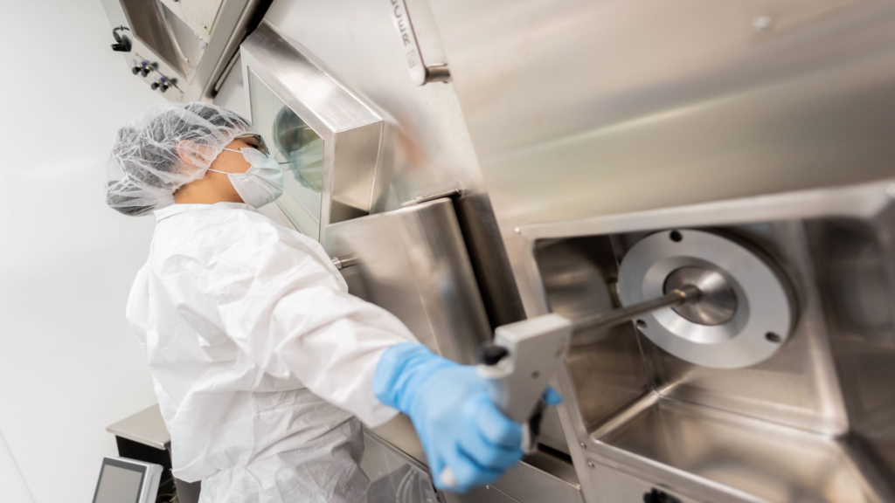
Life Sciences Division – Production
Esther Schirrmacher
Qing Miao
Manage and maintain a GMP radiopharmaceutical production program
Supply C-11 brain tracers to UBC for patient use
Supply F-18 to BC Cancer for [¹⁸F]FDG patient dose synthesis during their cyclotron maintenance time
Supply Ac-225, Bi-213, Ac-227, Pb-212, and Hg-197 for research partners
R&D on radiometal production

Slide 3
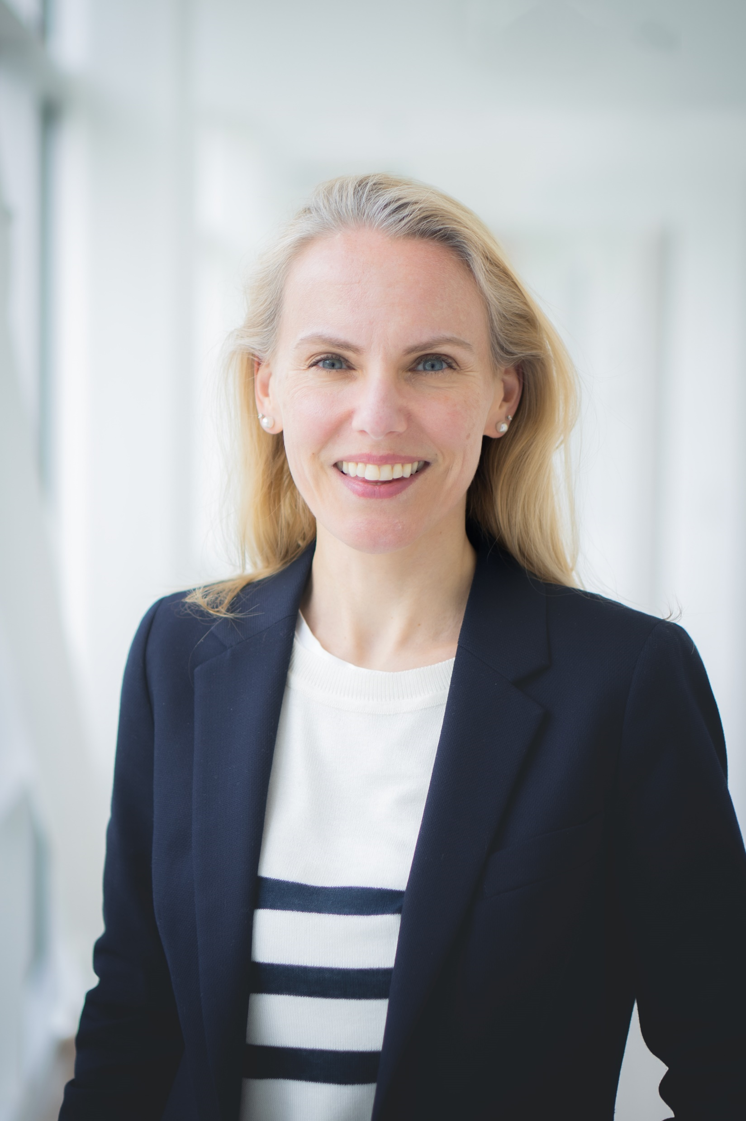
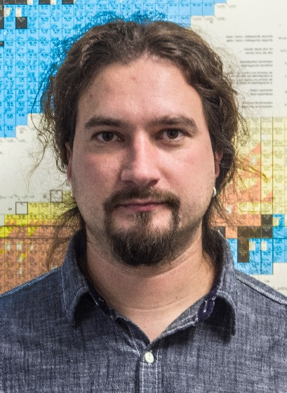
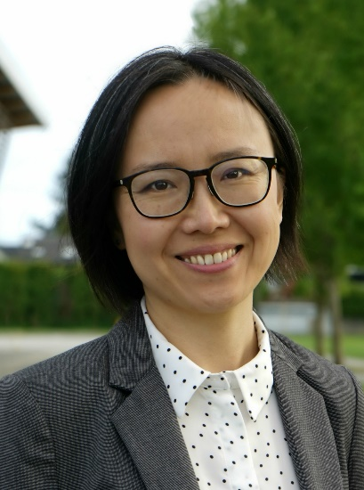
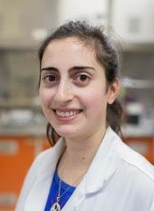
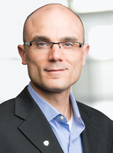
Life Sciences Division – Research
Applied Ion Beams
Nuclear Chemistry
Applied Isotopes
Cornelia
Hoehr
Valery
Radchenko
Paul
Schaffer
Hua
Yang
Caterina
Ramogida
Science: Proton therapy, Target development, Production of unconventional radionuclides, New chemistry, New radiopharmaceuticals
Deliver grant mandates
HQP training: 34 trainees (end of 2023)
We discover and innovate, inspire and educate, creating knowledge and opportunity for all

Slide 4
Life Sciences Division – 5Y goals (2025-2030):
Build, commission and operate IAMI: cold lab, hot labs, cyclotron.
Delivery on our commitments: grant mandates (NFRF-T, CIHR, NSERC), UBC brain tracer, BC Cancer isotope supply
Enhance R&D capacity and HQP training: grants, thesis projects, publications, collaborations, and other research output

Slide 5
Life Sciences Division – 5Y goals: IAMI
 | Phase I | Phase II | BC Cancer
Goals | Building, 2 production labs, TR24 | 2 Research hot labs, 1 cold lab | 2 Hot labs, cyclotron
Status | Building done, target stations ~70% built, TR24 needs more work | Planning | ~20% complete
To-do | Finish TR24 O-ring replacement, solid target stations and commissioning | Construction of the labs Ventilation and hotcell installation
Who | TR13 crew (Acc. Div.) and contractors | Majority of the work on contractors | All work done by contractors
TRIUMF support | Admin support Need operation budget. | Admin support Need operation budget starting 2026/2027 | Admin support (paid by BC Cancer)
Timeline | Likely in 2025 | Before mid 2026 | Construction complete end 2025, commission mid 2026

Slide 6
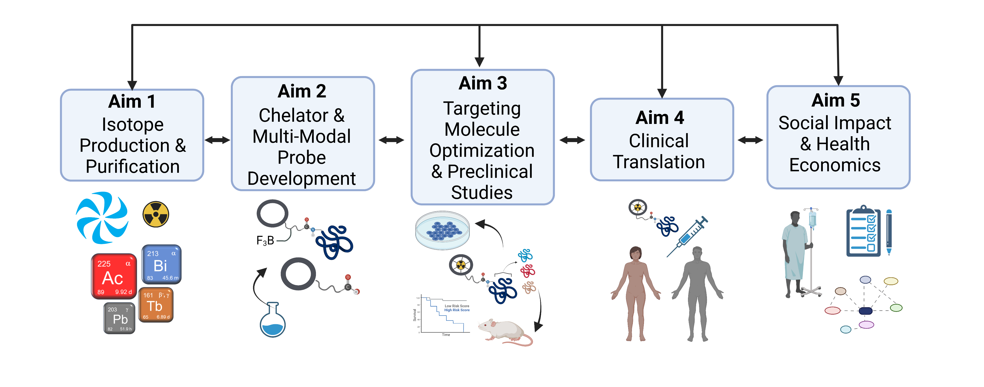
Life Sciences Division – 5Y goals: NFRF-T (2023 – 2029)
BC Cancer, TRIUMF, SFU, UBC, BC Children’s Hospital, U of Alberta, U of Toronto, Western Ontario, U of Laval, U of Sherbrooke
Notes:
Our research covers the key areas necessary to transform radiopharmaceutical therapy in Canada. We capitalize on the world’s largest cyclotron at TRIUMF, radioisotope production infrastructure in BC, Alberta, Ontario and Quebec and at international collaborator facilities. We build on world class research in radiometal chelator design and radiopharmaceutical development, and a proven ability to conduct investigator initiated clinical trials from phase 1 to phase 3 using radiopharmaceuticals, in partnership with our oncologist colleagues. Key decision points highlighted by the arrows in this figure are informed by Social Impact and Health Economics analyses, to select which novel radio-isotopes to prioritize, guide the design of clinical trials and facilitate adoption by patients and health care funders.

Slide 7
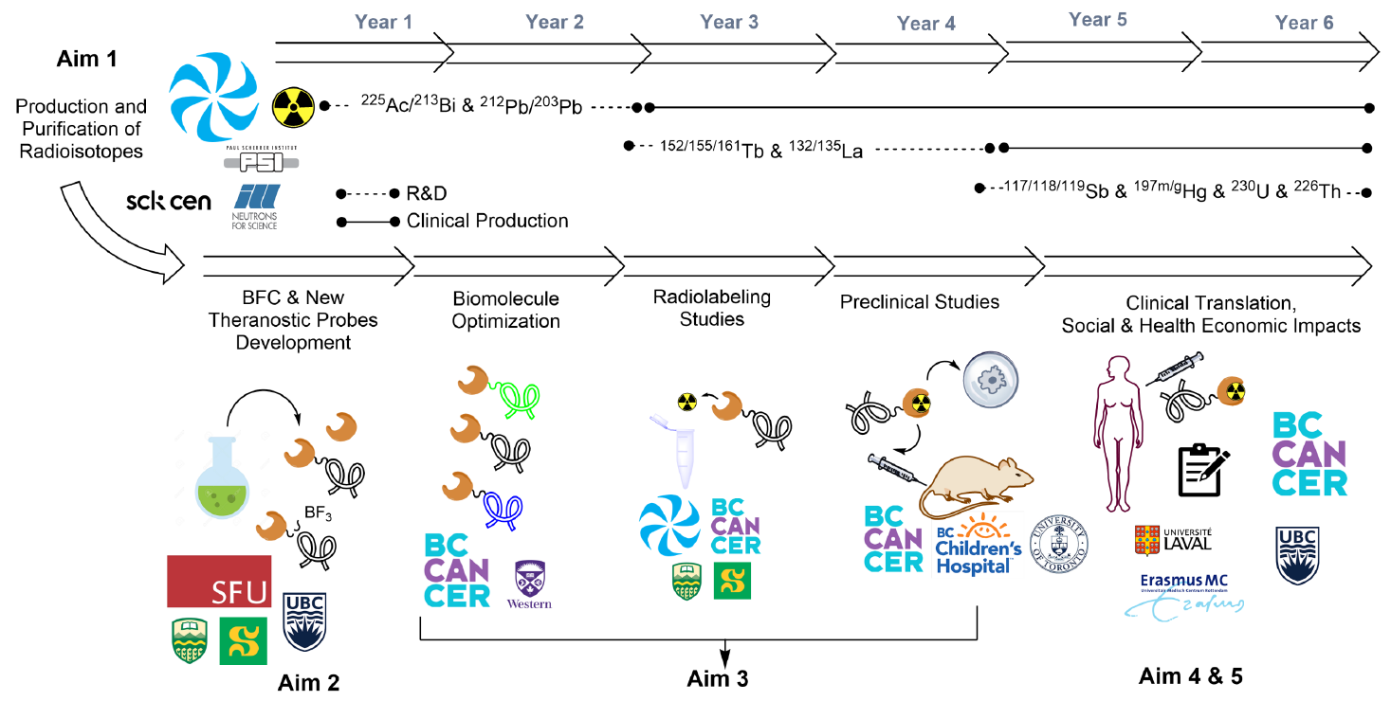
Our Commitment to NFRF-T
2026 (mid review)
2027

Slide 8
Impact of various scenarios for LSD
 | Affected areas
 | Defer ARIEL, IAMI | Finish ARIEL, IAMI | Delay ARIEL, IAMI
Considerations | 1 (8-month cycle) | 2 (extended shutdown) | 3 (6-month cycle)
Position LSD for next 5YP
Maintain international scientific user base / excellence |  | Reduced publications
Talent development |  | No thesis projects with Ac-225 or ISAC produced isotopes
Complete and operate IAMI | May not have $$ to operate |  | May not have $$ to operate
Medical isotope production |  | Ac-225/Bi-213/U-230/Tb-155/Ac-226/At-209/At-211
Manage reputation with users |  | 1.5 year no Ac-225 for users | Shorter delivery period
Maintain reputation with international collaborators |  | Interrupt IAEA CRP
Manage reputation with government |  | Grant mandates delayed
Manage reputation with business partners

Slide 9
Key considerations:
Ac-225 for NFRF-T team
Can we purchase? Cost? Enough for early phase clinical trial?
ISAC beamtime: student thesis projects, grants, and publications
Interruption on grant cycles and collaboration opportunities.
Retention of talent
Reputation / trust / uncertainty: would TRIUMF have extensive shutdown of main cyclotron again? What if BL1A requires a separate shutdown. What if ARIEL still not done.

Slide 10
Mitigation strategies
Isotope availability | Plan for alternative Ac-225 supply (source?, fund?)
 | Ask for help from other producers (CNL, CERN)
 | Plan ahead: Fresh generators for Pb-212 and Th-227 at end of 2025
 | Ensure TR13 operational
Thesis projects | Remove projects rely on main cyclotron produced isotopes
 | Ensure TR13 operational
NFRF-T | Communicate with the team
 | Seek alternative supplies
Grants | Accelerate or delay deliverables
 | Do not submit any grants require Main Cyclotron

Slide 11
Summary
Scenario 2 has negative impact on isotope supplies.
Mitigation strategies (ordering medical isotopes in, creating generators) are necessary. Ensuring TR13 operational is important
Some experiments, student projects and collaboration and grant deliverables will need to be adjusted.
Clear communication with collaborators and partners

Slide 12
Acknowledgement
TRIUMF
Life Sciences Division
Accelerator Division
Engineer Division
RPG
ATG
BC Cancer
Department of Molecular Oncology
UBC
CCM
Department of Chemistry
Department of Physics
Department of Radiology
UBC Hospital
SFU
Department of Chemistry
SCK CEN
$$: TRIUMF, NSERC, CIHR, NFRF, CCSRI, NETRF, CRS, CFI
Hua Yang
Email: hyang@triumf.ca

Slide 13
Thank you Merci
www.triumf.ca
Follow us @TRIUMFLab

