Slide 1
5YP
Centre for Molecular & Materials Science (CMMS)
Perspective

Slide 2

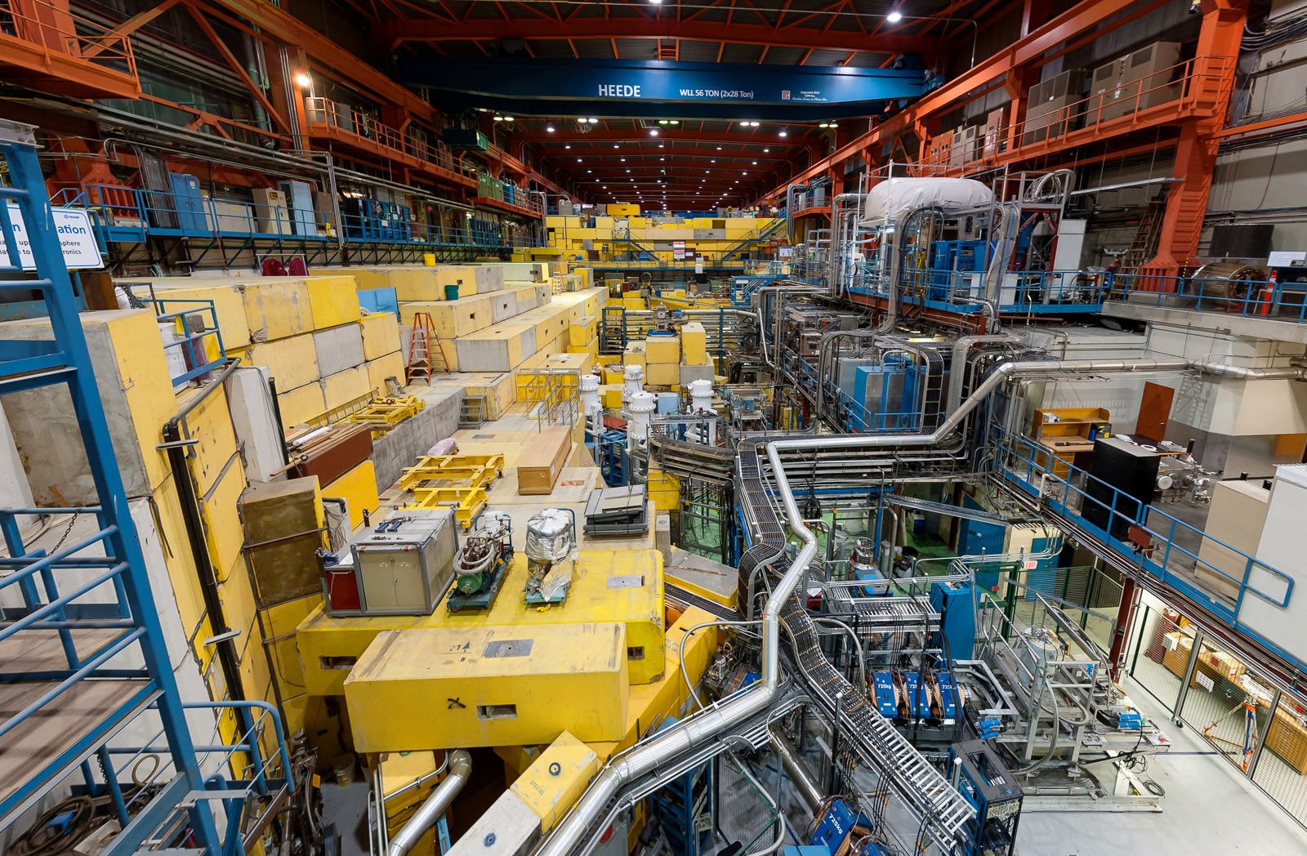
μSR facilities
500 MeV cyclotron
← M15
M9A
M9H
M20D
Meson Hall
M20C

Slide 3


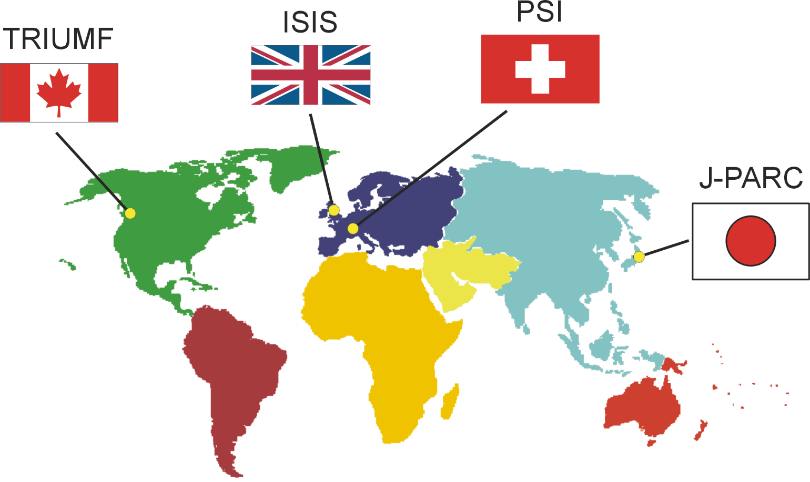





World’s μSR Facilities
Pulsed
Planned
The available beamtime for muon experiments around the world is fairly limited as there are currently only five operational muon facilities

Slide 4
Continuous vs Pulsed Muon Beams
Continuous
Pulsed
Canada
Switzerland
Japan
South Korea
United Kingdom
Japan
China
High time resolution (< 1 ns)
Limited time resolution (> 10 ns)
Detection of high magnetic fields (frequencies up to ~ 5 GHz)
Detection of fast relaxing signals
Detection of high magnetic fields not possible (frequencies ≤ 10 MHz)
Detection of fast relaxing signals not possible
Non-negligible background
Very low background
- Limited time window (~ 10 μs)
- Long time window (up to ~ 26 μs) enables detection of slower relaxation rates
Limited intensity
High intensity

Slide 5
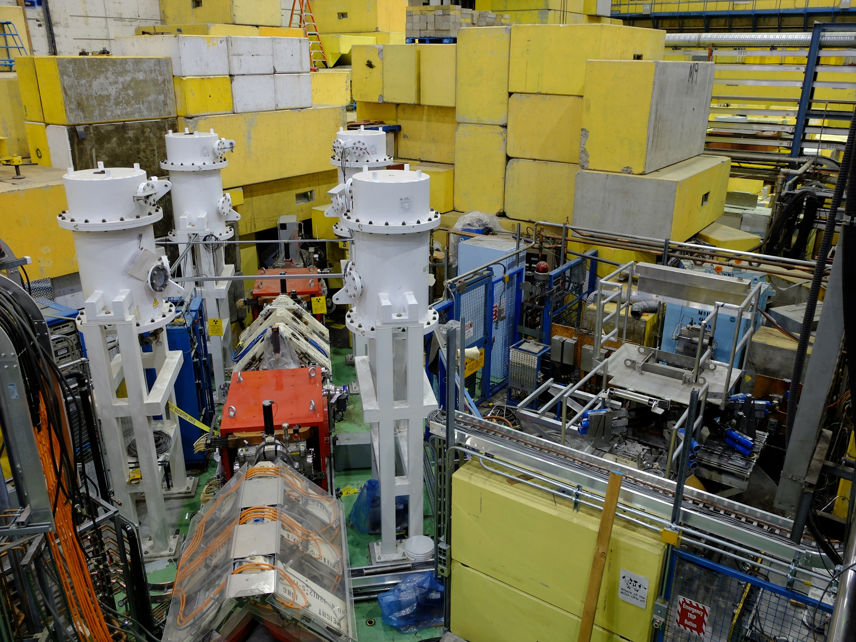
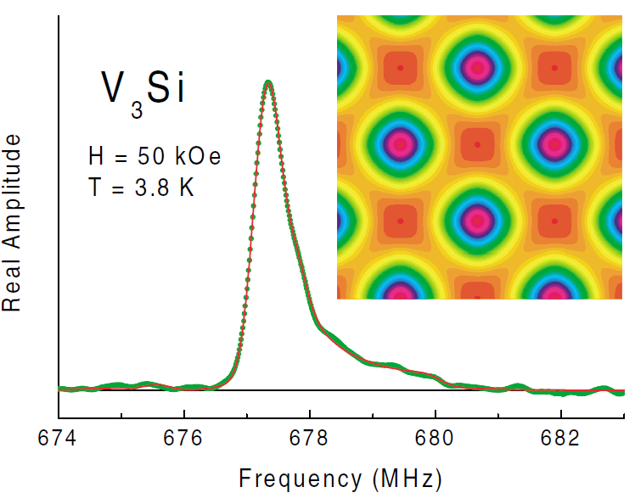
“A global leader in the development of μSR techniques & facilities”
TRIUMF has played a central role in the development of modern muon beams, advanced μSR techniques and effective user facilities. Technical advances pioneered
at TRIUMF that are now considered essential at every μSR facility in the world include:
Surface muon beams
Spin rotators
High-momentum muon beams
Low-background spectrometers
Ultra-low energy muons
Many new μSR experimental techniques were first introduced and/or developed at
TRIUMF. Noteworthy examples are:
Zero-field (ZF) μSR
High-transverse field (HTF) μSR
Avoided level-crossing resonance (ALCR)
Radio frequency (RF) μSR
Muon spin echo (μSE)

Slide 6
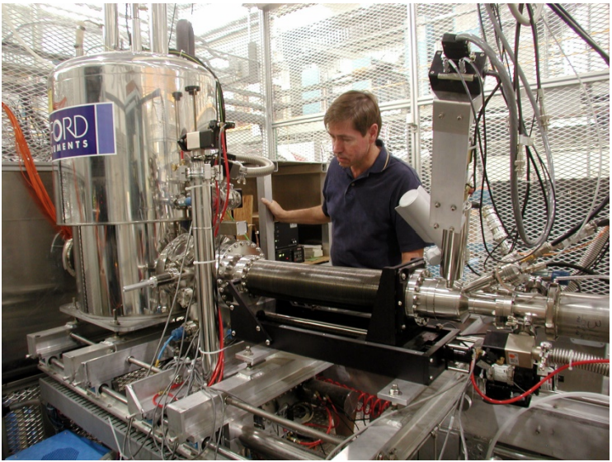
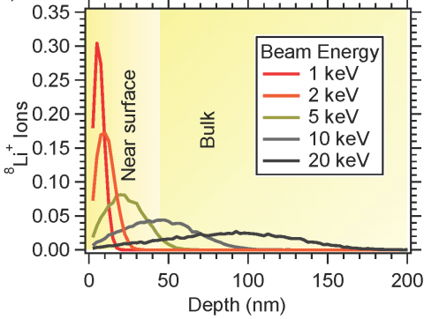
βNMR (ISAC) – since 2003
Low-energy βNMR, which allows one to probe the internal magnetic and electronic properties in very thin films with radioactive ⁸Li nuclei, has been developed at TRIUMF
“One of a kind” in the world
User facility but limited by available beam time

Slide 7
CMMS Users
The CMMS has a diverse international user base, ranging from visiting university scientists and engineers, to industry researchers, to students (both undergraduate and graduate levels) and postdoctoral researchers.
73 Canadian + 141 International = 214 users
Users come for the unique μSR and βNMR capabilities at the CMMS
Quantum
Materials
Superconductivity
Semiconductors
Magnetism
Energy
Materials
Chemical
Reactions
μSR
Molecular
Systems
βNMR
Organic
Radicals
Quantum
Technologies
Surface/Interface Science
Electronics
Green Chemistry
Batteries
Power Generation

Slide 8

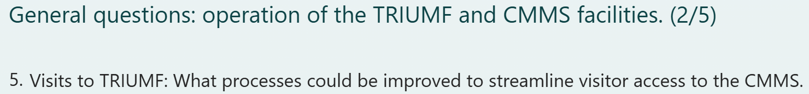
33 respondents
“TRIUMF is in desperate need of a professional user office and user support team. Compared to other facilities I have used (x-ray, neutron, muon), the user experience at TRIUMF is very challenging from proposal submission (e.g. why do we need to send an email to request an experiment number 2 weeks ahead of the proposal deadline?) to the system for arranging new user visits (e.g. subordinate system is confusing).”
“A User Office that handles visitors, as in any other international facility.”
“TRIUMF needs a users office, as other major accelerator facilities have.”
Also, lots of complaints about the TRIDENT system, the complexity of the visitor access requirements, and the visa process

Slide 9
“It kills my students and postdoc activity for the year. This kind of announcements has to come three years in advance, because the competition for fellowship is already started.”
“During the year-long shutdown of TRIUMF, it is not easy to seek alternatives to conduct similar CW muon experiments. Possibly, the graduation of PhD students will be delayed.”
“Of course this would make it more difficult to plan e.g. PhD projects, but it is good (vital) that information about exact shutdown dates are sent out to all previous users + e.g. user organizations as soon as possible. In this way we can plan accordingly.”
“Having advance notice would be helpful. I have been planning to put in for additional experiments at TRIUMF (my work has been recently completed at PSI and RAL/ISIS but have a few projects that need TRIUMF/CMMS). Obviously the shorter the downtime the better; however, I recognize the importance of appropriate time to do a good job of getting stuff taken care of without cutting corners.”
“It will greatly reduce my research output (due to the cost of doing muSR experiments elsewhere) and potentially delay graduation for my students. However, I am willing to endure this if upgrades/repairs to BL1A take place at the same time.”

Slide 10
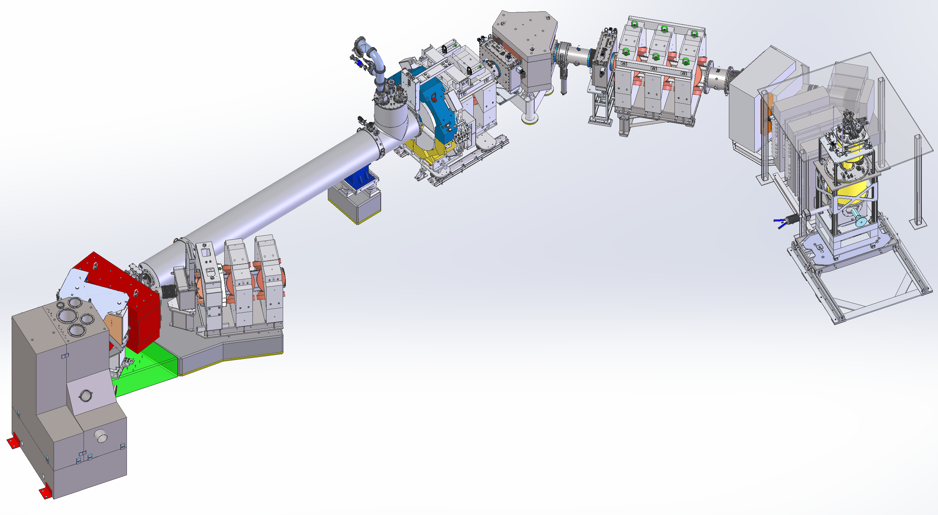
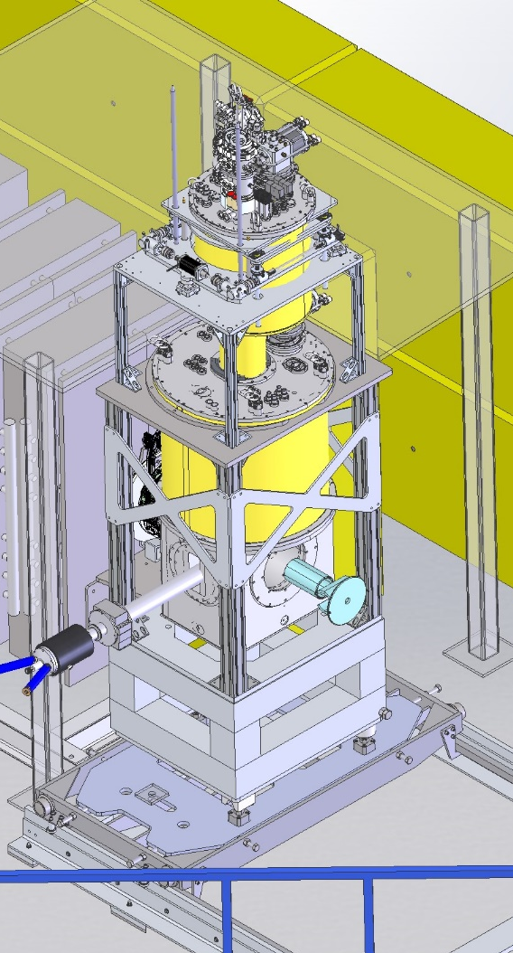
M9H Muon Beam Line^{*new}
Major infrastructure of $10.7 M 2017 CFI IOF grant
- commissioning later this year and potentially operational in 2025
5 T Solenoid
DQ345
Compact slits /w
beam profile detector
SC 4T 6-port magnet
In bore SiPM spectrometer
70uW DR with large sample space
Retractable/ rotating slit
(design by MK, JL)
The M9H Muon Spectrometer End Station: 4 T / 50 mK / 2.5 GPa pressure cells
Quantum materials under pressure
Chemistry under extreme conditions
Elemental analysis with muonic X-rays
μ⁻ applications

Slide 11
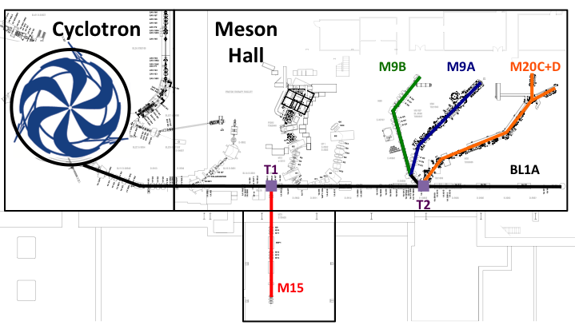
Dependence of μSR on BL1A
M9H

Slide 12
CMMS – 2026 Shutdown
Silver lining
The μSR component of the CMMS needs the BL1A upgrade to ensure long-term continued operation.
PSI is planning a shutdown for June 2027 – June 2028. There is an opportunity to coordinate accommodation for μSR users at the world’s only two CW facilities, but advance notice is essential.
Concerns
Concerns that work on ARIEL and BL1A will not be completed on time, impacting available muon beam time in 2027.
i.e., Are there sufficient resources to do all of the work in the proposed time schedule? What about unforeseen delays?
To take advantage of the shutdown the CMMS needs to tackle deferred maintenance, build and develop spectrometers, improve automation etc. But this can only happen with some access to the machine shop, electronics shop etc. and by retaining sufficient personnel for these tasks.
Other promises made in the 5YP proposal will be difficult to deliver on with this shutdown.

Slide 13
“Given the level of staffing very satisfied. I run experiments at PSI as well where there is more support but with more staff. In my opinion CMMS needs more beamline scientists to become a true user facility. I wonder if some experiments could be further automatized. This could be a project for a year long shutdown.”
“Overall, I am very satisfied with the support provided by the CMMS facility personnel for our experiments. The staff are knowledgeable, responsive, and always willing to assist with any technical issues. However, it would be beneficial to hire additional scientists to upgrade the existing instrumentation.”
“Staff are excellent, however, it is woefully understaffed to give the support a modern muon facility needs. In addition, extra support for advanced data analysis would be greatly appreciated.”
There are upcoming retirements of CMMS personnel that will result in a loss of significant expertise. Replacing them will be difficult, but this must be an immediate priority.

Slide 14


International Conference on Muon Spin Rotation, Relaxation and Resonance (μSR)
St. John’s, Canada (2025)
Parma, Italy (2022)
Sapporo, Haikkado, Japan (2017)
Grindelwald, Switzerland (2014)
Cancun, Mexico (2011)
Tsukuba, Japan (2008)
Oxford, UK (2005)
Williamsburg, USA (2002)
Les Diablerets, Switzerland (1999)
Nikko, Japan (1996)
Maui, USA (1993)
Oxford, UK (1990)
Uppsala, Sweden (1986)
Shimoda, Japan (1983)
Vancouver, Canada (1980)
Rorschach, Switzerland (1978)
16th International Conference on μSR
St. John’s, July 20-25, 2025

