Slide 1
GAPS Perspective on 5 year plan
Louis Croquette
GAPS Vice Chair HR

Slide 2
GAPS Demographics
Grads And Postdocs Society
Advocate for graduate students and postdocs at TRIUMF

Slide 3
GAPS 5YP feedback
Initial in-person session to discuss 5YP and impact of extended shutdown
Survey – 35 responses / 127 students and postdocs ≈ 30%
Note: 5 anonymous submissions

Slide 4
Leave date from TRIUMF
“Impacts for students include delayed graduation (so lost opportunity) and tuition fees.”

Slide 5
Extended shutdown impact on GAPS
“It would possibly delay graduation by at least a year or drastically change the course of my research plans and material for my dissertation.”

Slide 6
Extended shutdown GAPS sentiment
“I would not come to TRIUMF if I knew that an extended shutdown is happening.”

Slide 7
GAPS sentiment summary
Over 36% of GAPS members here in 2026 will be impacted by extended shutdown
Increases to over 63% if included “Maybe” response
Wide range of impact on GAPS members – some positive and but mostly negative
Some divisions affected more
Extended shutdown to impact number of graduate students and postdocs in 2026/2027 and beyond
Overall – GAPS acknowledges that extended shutdown is likely the best plan for TRIUMF, want support from the lab to mitigate impact

Slide 8
Highest priority initiatives
Supervisors need to talk with their students
Critical for student-supervisor alignment to ensure thesis/project progress
Necessary to develop a new plan, and multiple contingency plans for prior to and during extended shutdown
Facilitate students acquiring data in other labs
GAPS consultation for major resource allocation decisions
Have GAPS representation involved in high- and medium-level discussions
Consulted if further extension of shutdown is necessary
Continued transparency
Plans and project updates should be easily available
Clear definitions and goals

Slide 9
Support from TRIUMF
Prioritizing students when scheduling beamtime
Include question on beam schedule request
Regular schedule for 2025 and 2027 – 8 full months of beamtime
Support to conduct research in other labs
Financial
Make use of existing connections
Support for offline experiments
RPG, machine shop, electronics shop, medical radionuclide production, target hall for long-lived radionuclides

Slide 10
Contingency plans
Note: 14 students non-impacted

Slide 11
Ideas for contingency plans
Presents an opportunity for engagement
Build into timeline work that can be done offline during 2026 – simulations, data analysis, paper writing, thesis writing, conferences
Datasets from previous beamtimes
Offline studies
Find alternate projects
Experiment upgrades
Detector development – requires facilities support
Radioisotope production independent of main cyclotron
Find collaboration partners at other facilities

Slide 12
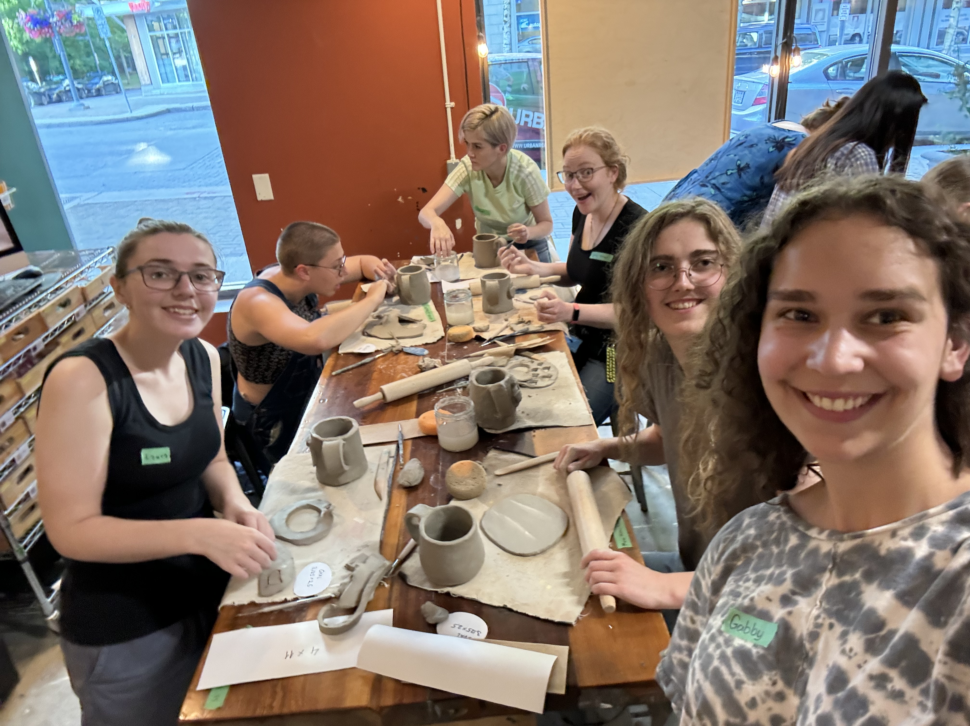
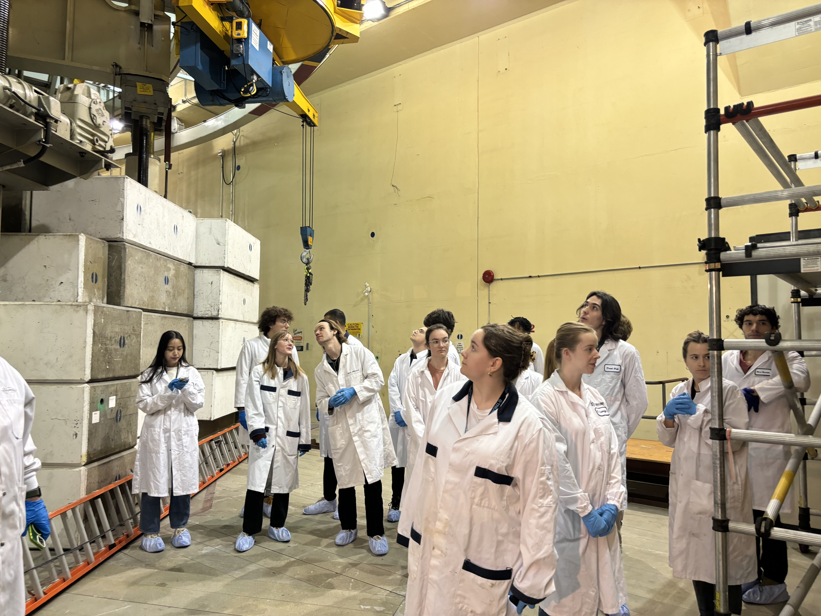
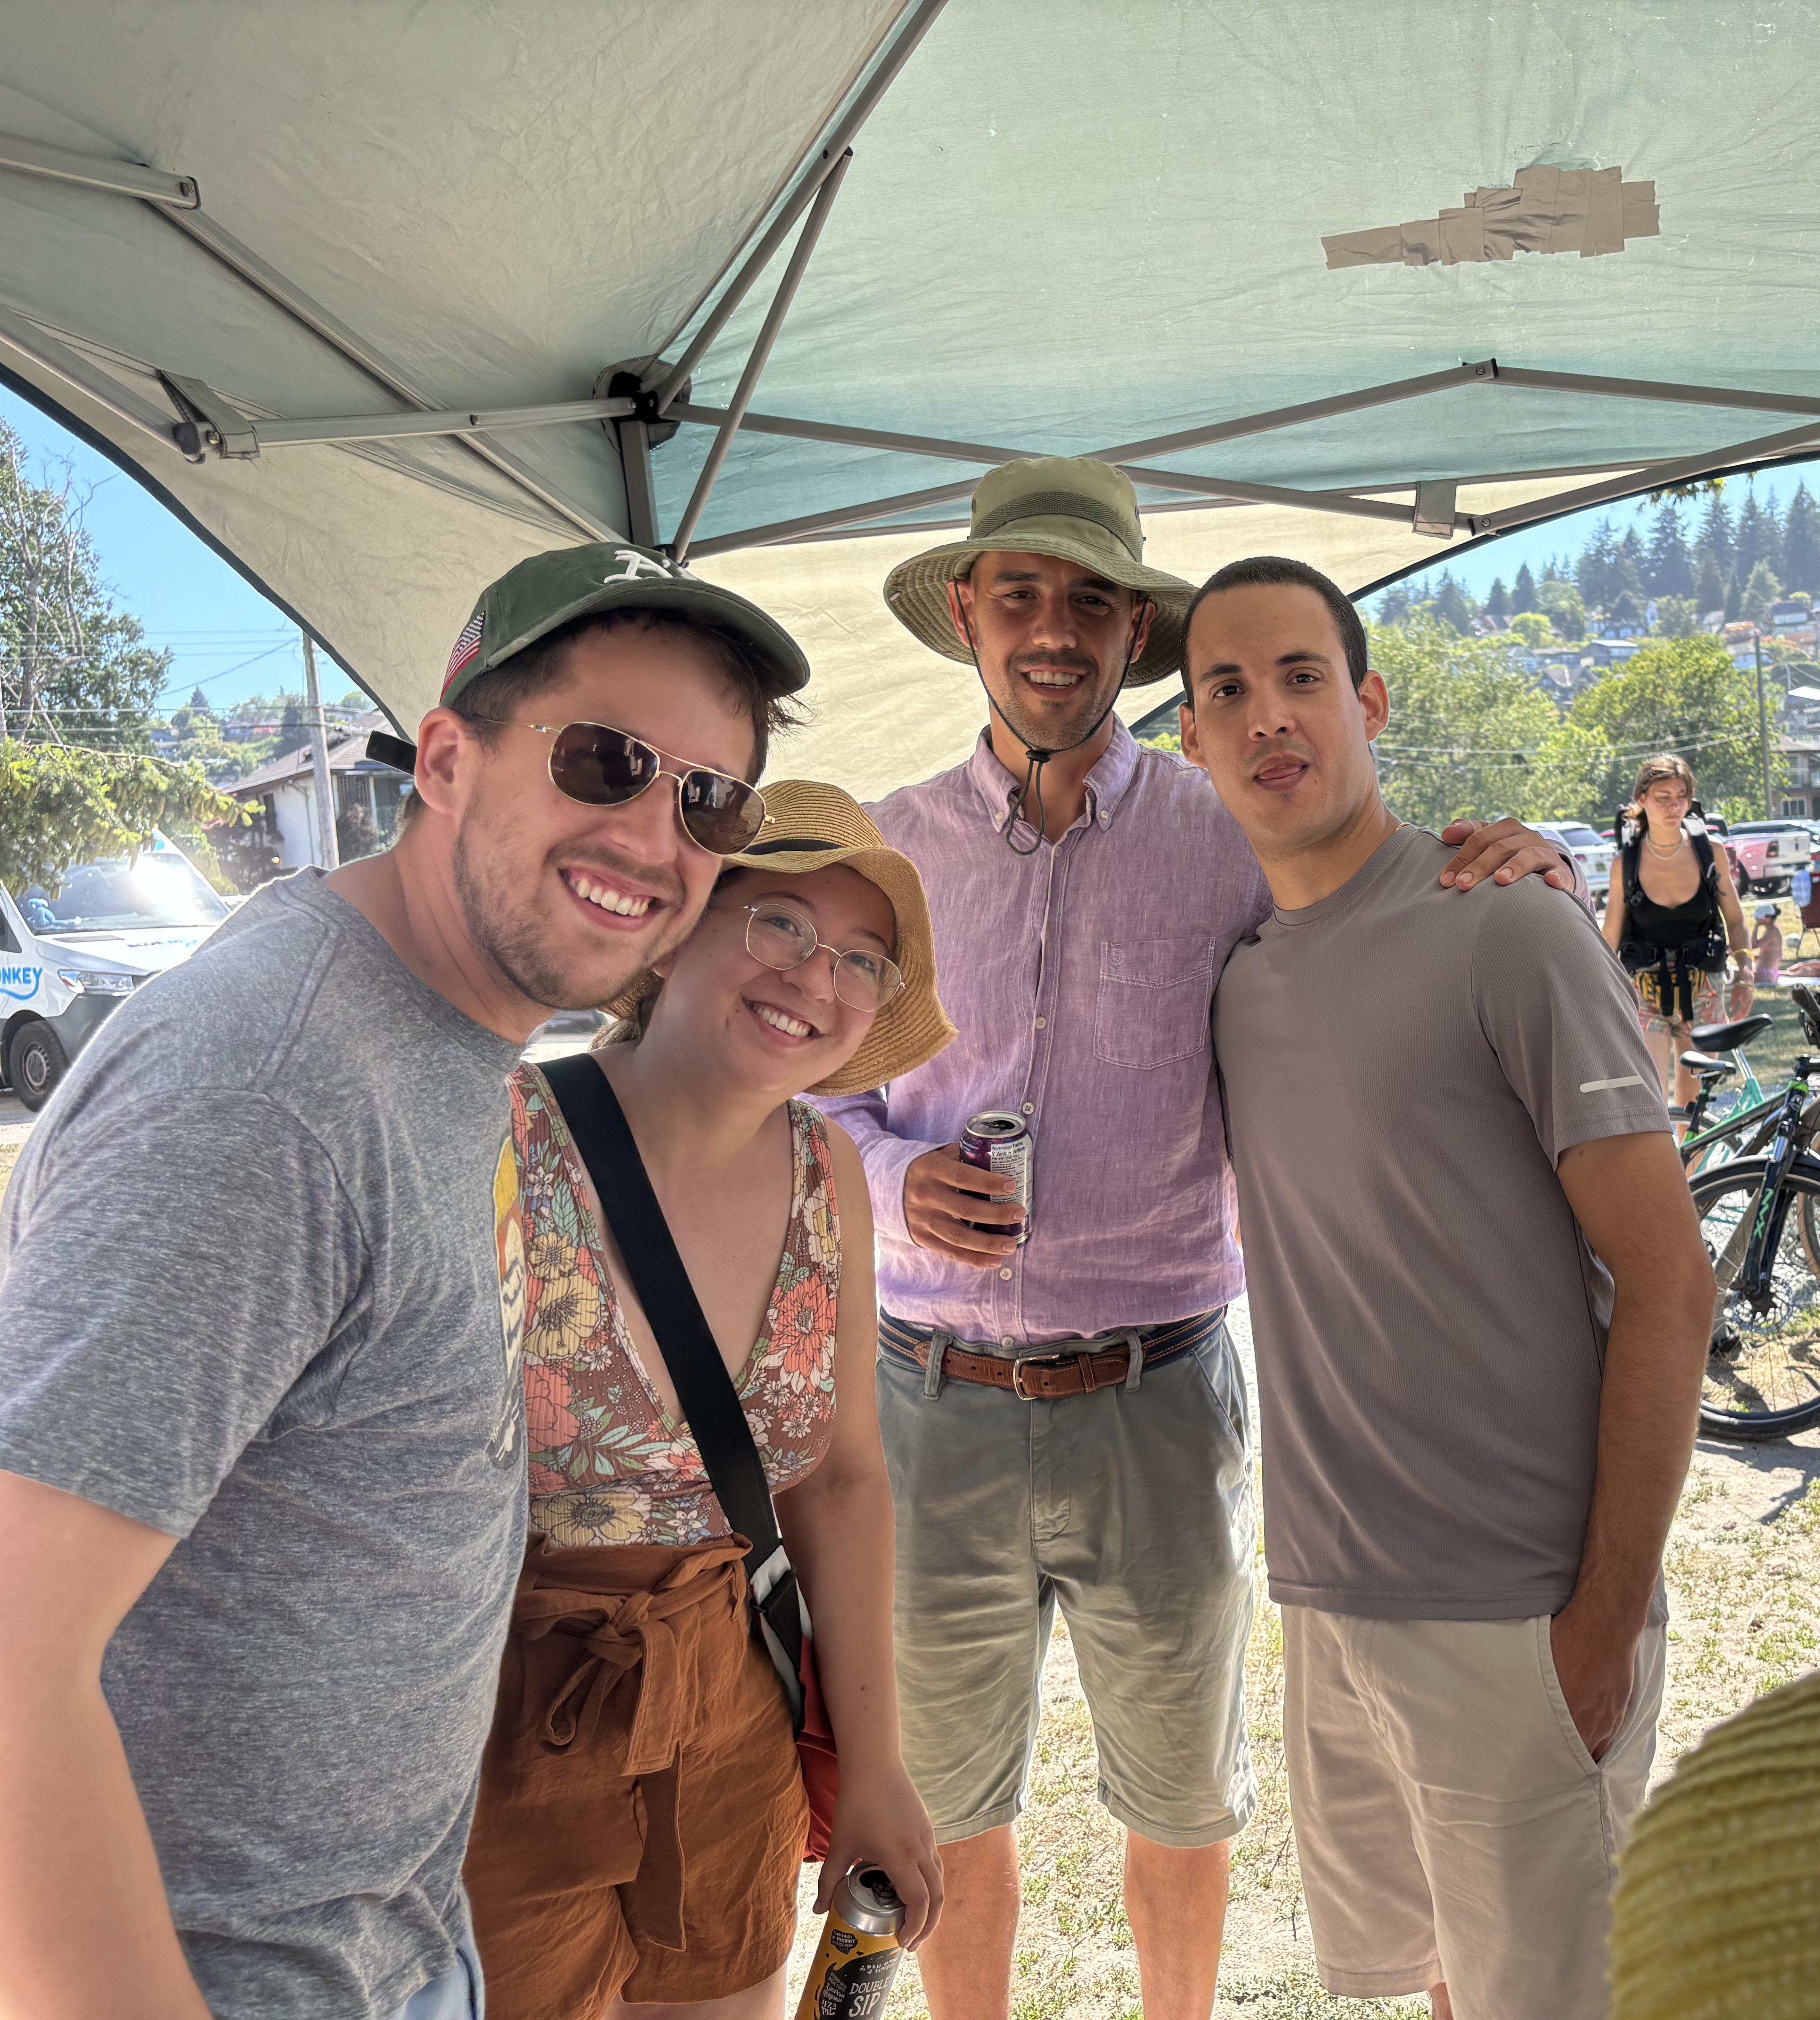
Thank you
Questions?

