Slide 1
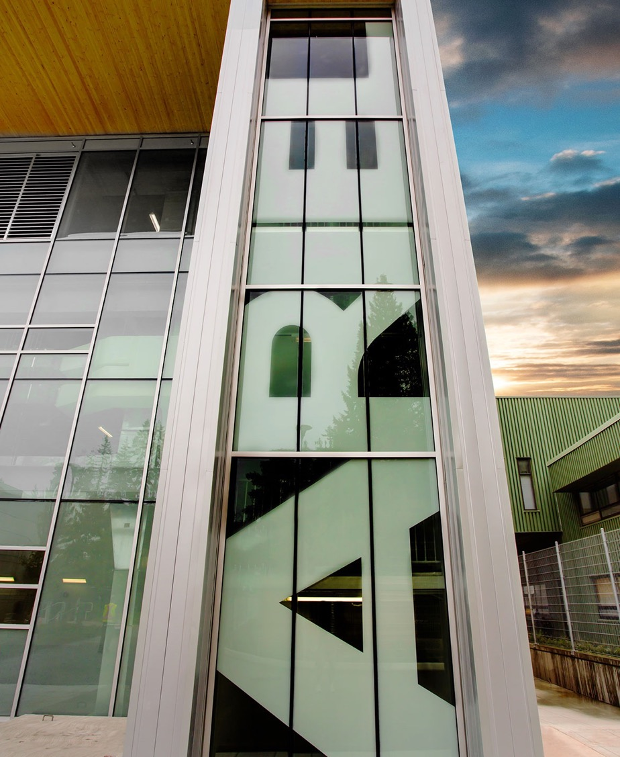
Alignment of the 5YP with the 20-year vision
Oliver Stelzer-Chilton
Science Week
July 22-26, 2024

Slide 2
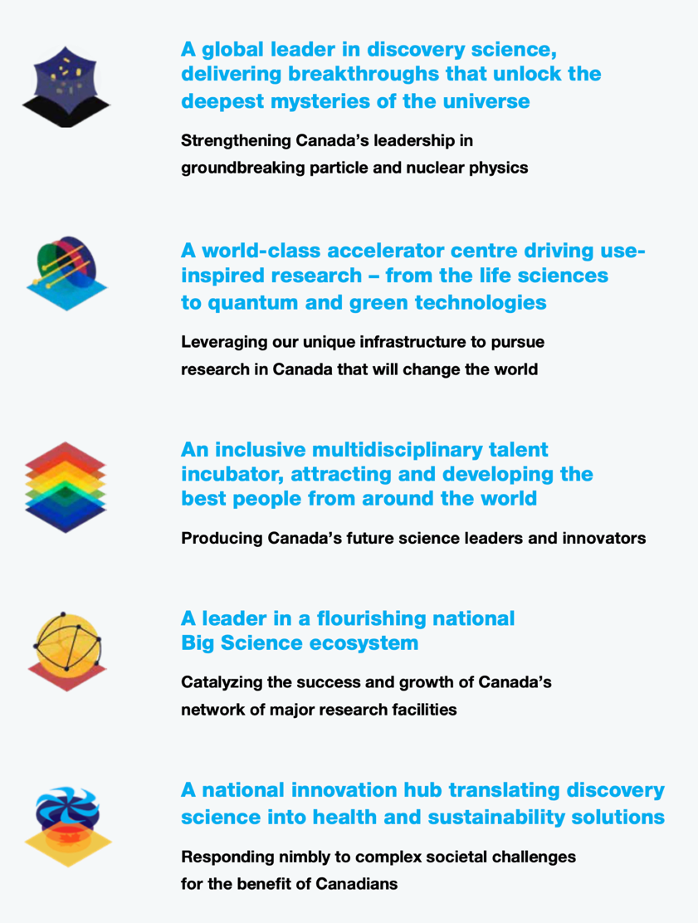
TRIUMF completed the 20-year vision in an 18-month process engaging a broad research and stakeholder community, leading to five core themes
All work leading to the Vision is available on the TRIUMF web site
20-year vision for TRIUMF

Slide 3
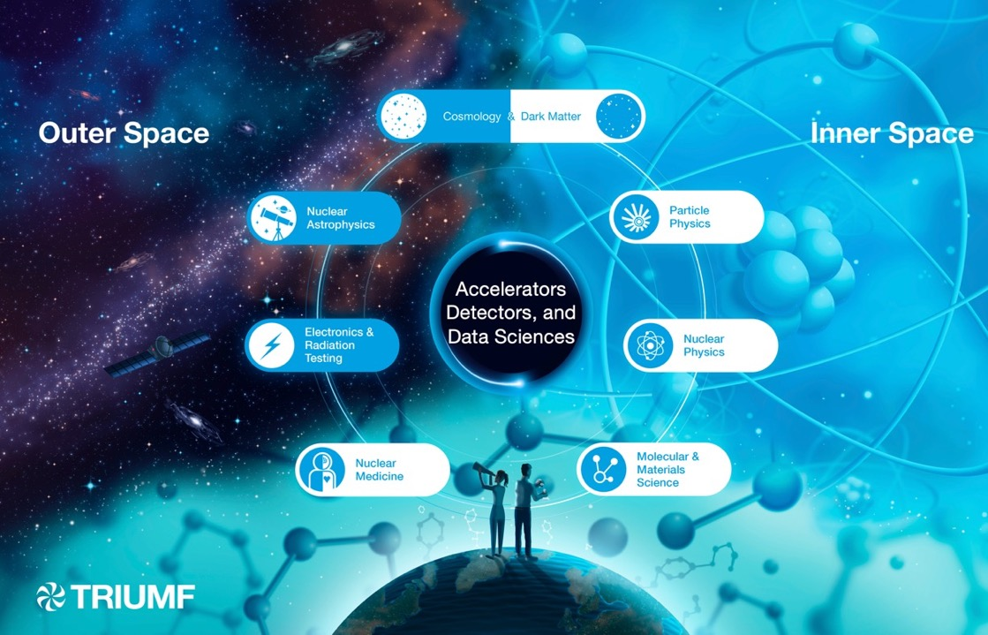
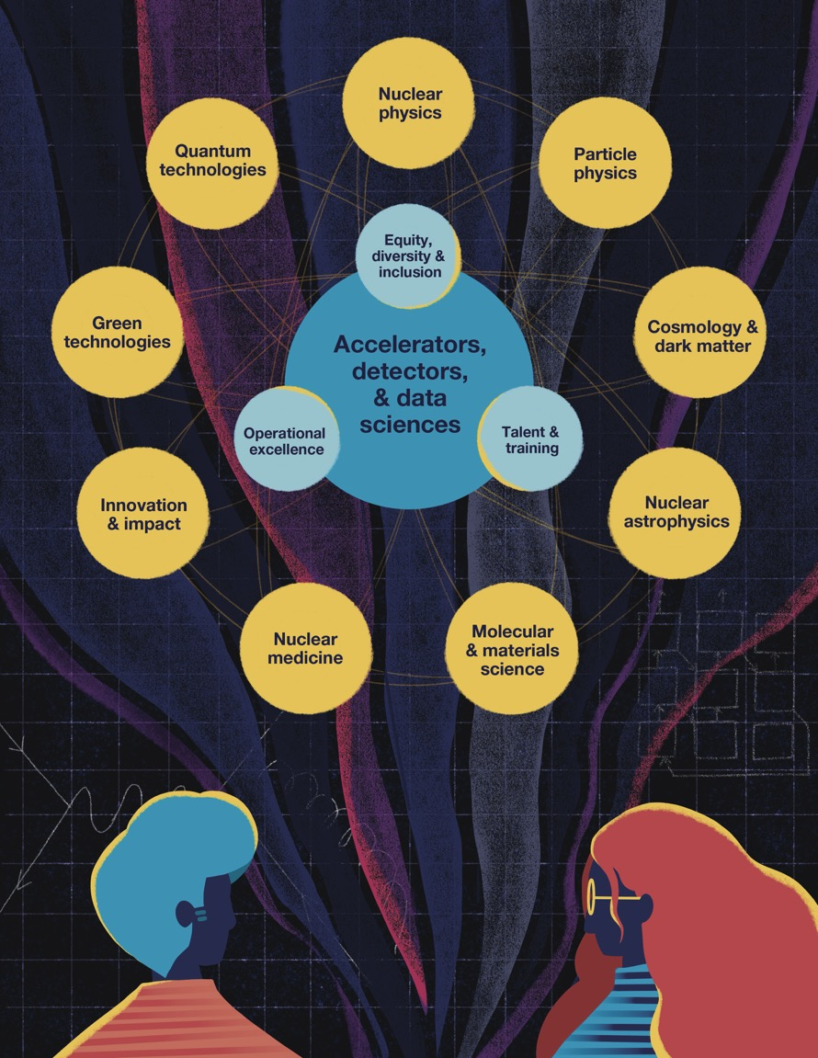
20 – year vision
Core themes remain on nuclear / particle physics and life / material science
Additional themes around green and quantum technologies (to be developed)
Innovation and societal benefit called out directly
Strengthened focus on EDI, people, talent and training and operational excellence as enablers

Slide 4
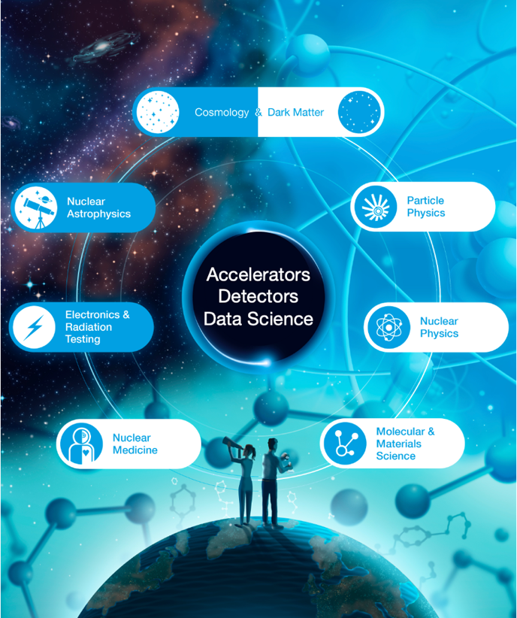
Five-Year Planning – Physical Sciences
Bottom-up approach
Start at departmental level
Scientists retreat in June 2022, 2023, 2024
Discussion on infrastructure and staffing needs led to focus on enablers, including for future initiatives
First Five-Year Plan in decades without new major accelerator component
Task forces formed across departments and divisions to complete ~2-pager summaries of the New Initiatives
Detector Development
Quantum
Data Science / AI Center
Summary
IPP-AGM presentation in June 22, 2023 at CAP

Slide 5
Five-Year Plan
Engagement with broader community
Science Week 2022 & 2023
Release of Five-Year Request for Support 2025-2030 in October 2023 with subsequent Lobby Days in Ottawa
Centers for
Detector Development
Quantum Technologies
Data Science / AI

Slide 6
Detector Center
Facilitate novel detector development that is accessible to all departments and divisions and the TRIUMF community + with Admin support could connect to MRS programs
Leverage on existing infrastructure ITK, nEXO, SiPM, ..
Builds resilience for mission critical assignments,
both internally for TRIUMF and Canada
Ties into ECFA / CERN Detector R&D Roadmap (DRD)
New chip and sensor design capabilities would allow full development cycle A-Z
Design custom chips in-house for e.g. CMOS, SiPM, BeEST, Qbits… -> possible tech-transfer

Slide 7
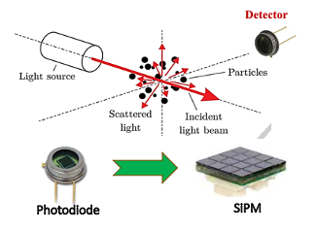
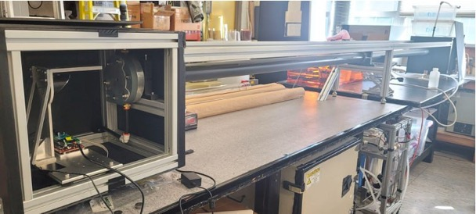
Sustainability Spin-Offs
Air Quality detectors (SiPM)
In demand for early forest fire detection, health risk assessment
Drinking water monitoring (Water Cherenkov detectors)
Interest from:
First Nations communities to identify contamination
Municipal water treatment plants

Slide 8
Staffing
R&D for world class center would require expertise currently not existing in SciTech
Difficult to hire and retain on a temp basis and needs long term perspective (Five Year Plan)
Complementary to core expertise
Funding multipliers for dedicated hardware and personnel through (CFI, NFRF) grants
Training
TRIUMF has an excellent track record on graduate student training and has a first class undergraduate & coop program
Building on GRIDS, opportunity for a CREATE program
On-the-job training in cutting-edge research environment
Work integrated learning, in collaboration with e.g. BCIT

Slide 9
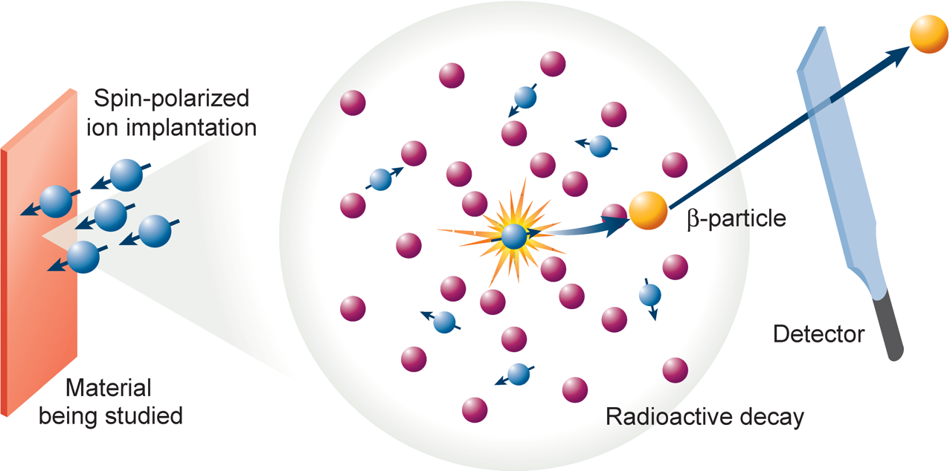
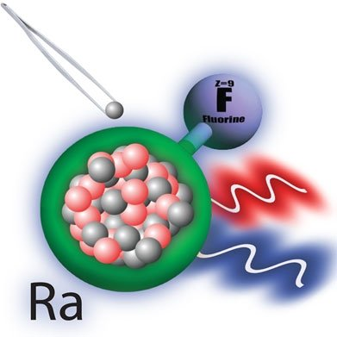
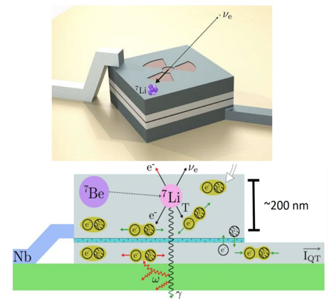
Quantum Center
Existing quantum efforts spans across the laboratory (currently not recognized as such)
Spin polarized beams μSR and βNMR, TUCAN, ALPHA/HAICU, RadMol, etc
Require common expertise and infrastructure which will allow new R&D and cross-fertilization
Examine existing quantum efforts and overlap with National Quantum Strategy
Two recent workshops (Iain McKenzie et.al.)
Quantum Science has become an integral part at laboratories across the globe
Fermilab, CERN, DESY (Helmholtz), Oak Ridge, KEK, Riken, PSI, …
RadMol
Radioactive Molecules
Beryllium Electron-capture with Superconducting Tunnel junctions

Slide 10
QUANTUM-ENABLED FUNDAMENTAL SCIENCE
NEW OPPORTUNITIES
Quantum Center
Quantum Center
ALPHA BeEST HAICU
RadMol TITAN TUCAN
ACCELERATOR-CONNECTED QUANTUM SCIENCE RILIS Polarized beams OLIS etc
etc
CRYOGENICS R&D
LASER & METROLOGY
POOLED RESOURCES
QUANTUM MATERIAL SCIENCE
QUANTUM MATERIAL CHARACTERIZATION
MAGNET DESIGN & PRECISION MAGNETOMETRY
PRECISION FUNDAMENTAL SCIENCE
$μ$SR $β$NMR etc
Diagram from Chloe Malbrunot

Slide 11
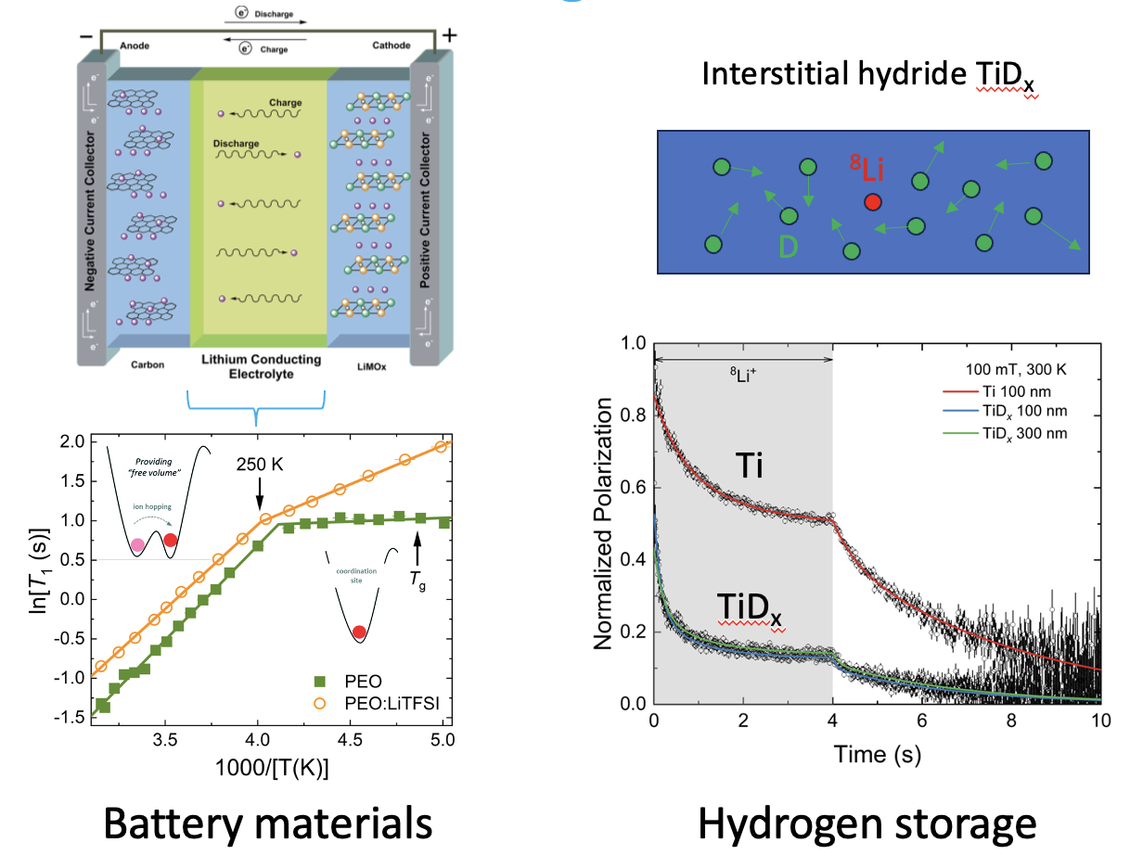
Green Technologies
Quantum Sensing with spin polarized beams enable green technology solutions
New enhanced beamlines capabilities

Slide 12
Quantum Center

Slide 13
Data Science /
AI Center
ML engagement recent since 2018 – highly successful
Collaboration across departments and divisions
Particle physics applications driven by science outcomes Water Ch., ATLAS, ALPHA, NA62
Bleeding edge:
Quantum Assisted ML (calorimetry simulation / ATLAS) (NRC, MITACS)
Trigger/ Real Time on FPGA (ATLAS)
Accelerator; AI-based beam tuning ➠ Efficiency of operations
Drives collaboration national and international (Helmholtz, WatChMal Collaboration)
Intense HQP training, MITACS, TSI’s
Person-power limited

Slide 14
Reflections and Considerations
Centers would connect across TRIUMF divisions, ensure efficient delivery of the research threads, creating multidisciplinary teams
Alignment with 20-Year Vision on new pillars around Quantum Tech and Sustainability
Start now to position ourselves (wedge into) the next Five-Year Plan
Put TRIUMF on the Quantum Map
Aligns with the Vision of the IDSSD that foresees multidisciplinary hubs
Allow for new training capabilities (e.g. new CREATE)
Strengthen R&D capabilities for TRIUMF and the Community
Funding multipliers
Given that the government funding for the Five-Year Plan was at the ~400M level, start with reduced scope: Two options to realize the centers in a “constant effort” scenario
Each division supplies FTE’s to the centers
Give talented short-term hires longer term perspective into the next Five-Year Plan, where broader scope can be realized

Slide 15
Summary
Proposed centers were result of a bottoms up approach across TRIUMF
Objective is to strengthen core competencies around Detectors and Data Science
Alignment with 20 Year Vision on new pillars around Quantum and Sustainability
Strengthen world class R&D capabilities for TRIUMF and the Community
Slides were result of consultations, discussion and brainstorming of the task force leaders
Fabrice Retiere, Makoto Fujiwara, Chloe Malbrunot, Stephan Malbrunot-Ettenauer, Akira Konaka, Wojtek Fedorko, Reda Tafirout, Iain McKenzie, Bernd Stelzer,… and many more

Slide 16
Thank you Merci
www.triumf.ca
Follow us @TRIUMFLab

