Slide 1







Barium Tagging and Geant4
Tag, you’re it!
Iroise Casandjian
On behalf of
T. Brunner, M. Cvitan, A. Kwiatkowski, A. Lennarz, D. Ray

Slide 2
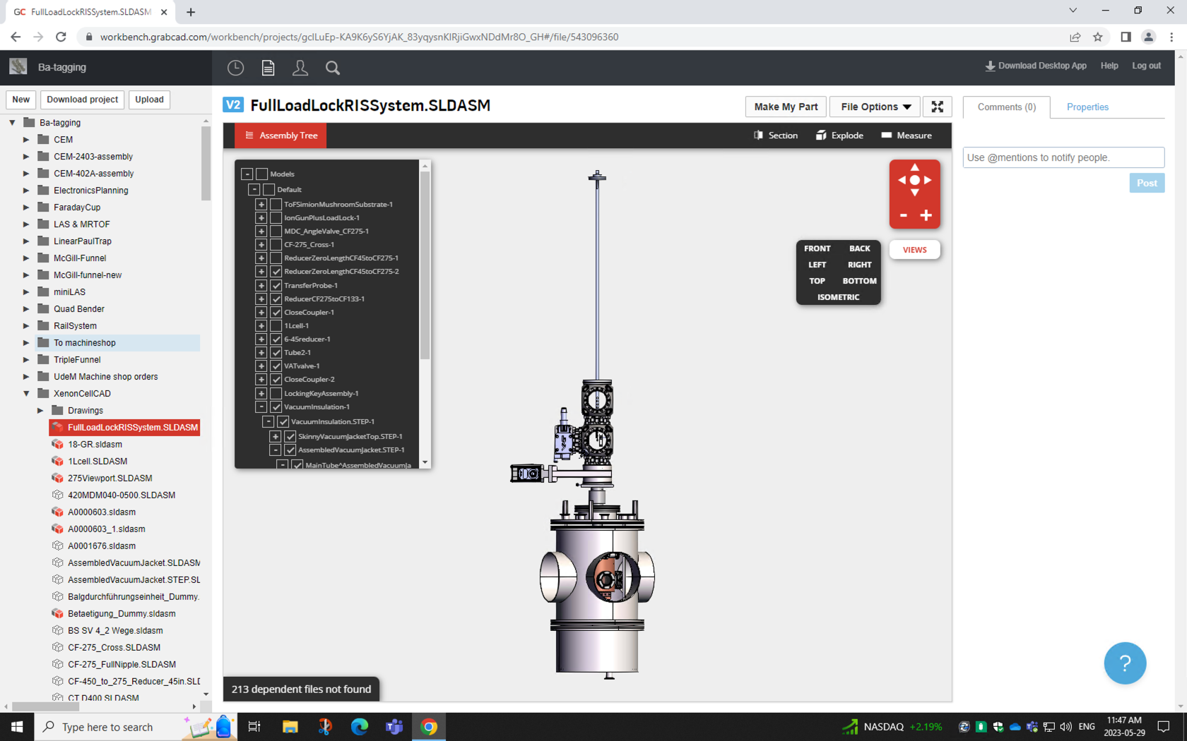
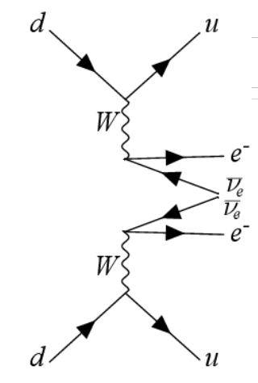
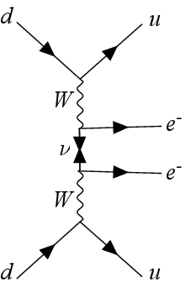
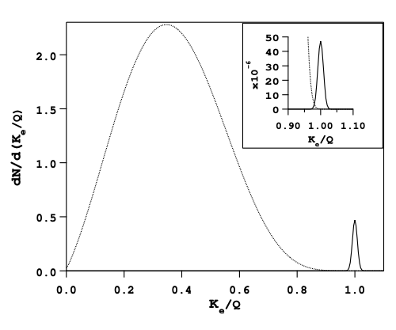
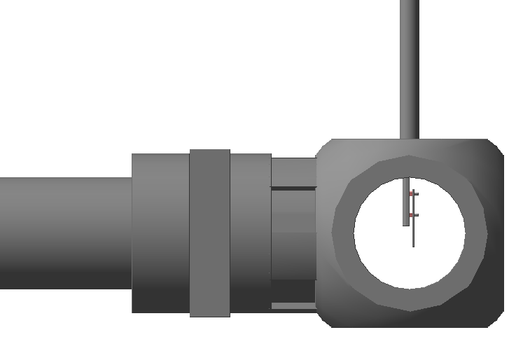
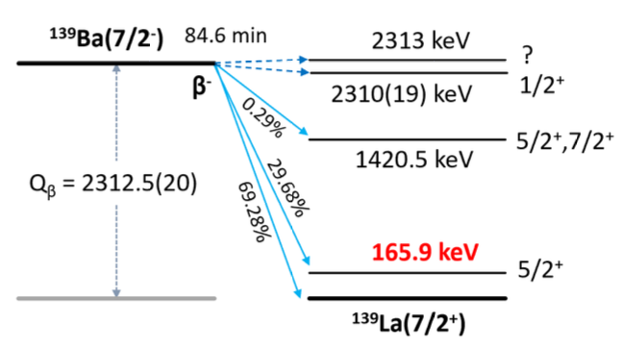

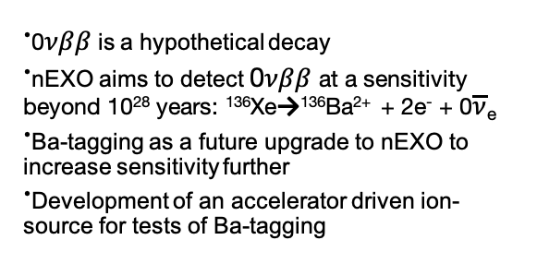

(A,Z) → (A,Z+2) +2e⁻ + 0$\overline{\text{ν}}$_{e}
ᐧ0𝜈𝛽𝛽 is a hypothetical decay
ᐧnEXO aims to detect 0𝜈𝛽𝛽 at a sensitivity beyond 10²⁸ years: ¹³⁶Xe→¹³⁶Ba²⁺ + 2e⁻ + 0$\overline{\text{ν}}$_{e}
ᐧBa-tagging as a future upgrade to nEXO to increase sensitivity further
ᐧDevelopment of an accelerator driven ion-source for tests of Ba-tagging
arXiv:hep-ph/0611243
arXiv:1910.04688v2
Extraction probe
Ge chamber
166 keV
ᐧInjection of ¹³⁹Ba and ¹³⁹Cs ions
ᐧElectrostatic extraction using probe
ᐧIdentification with 𝜸-spectroscopy:
Geant4 as a simulation tool
10⁷ ions in a 1:1 mix of ¹³⁹Cs and ¹³⁹Ba after 90 minutes of data acquisition

