Slide 1
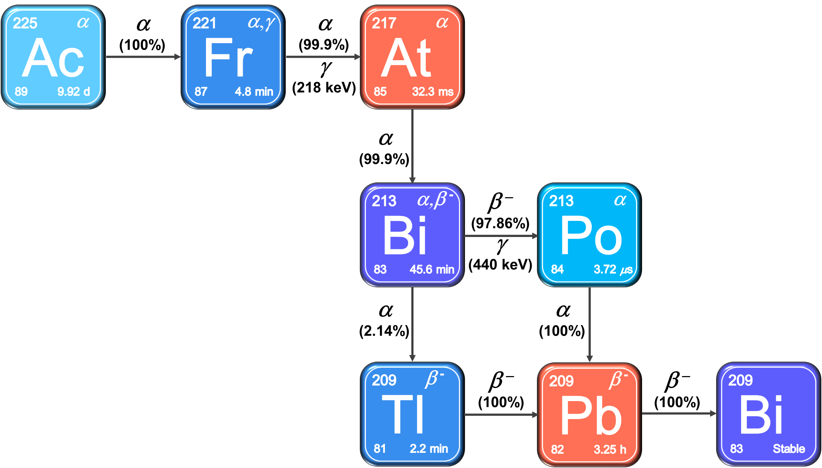
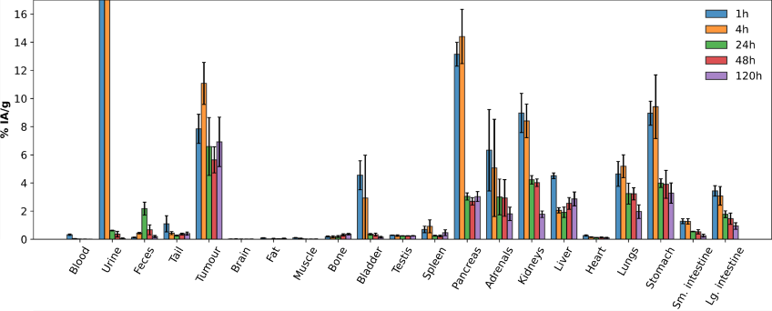
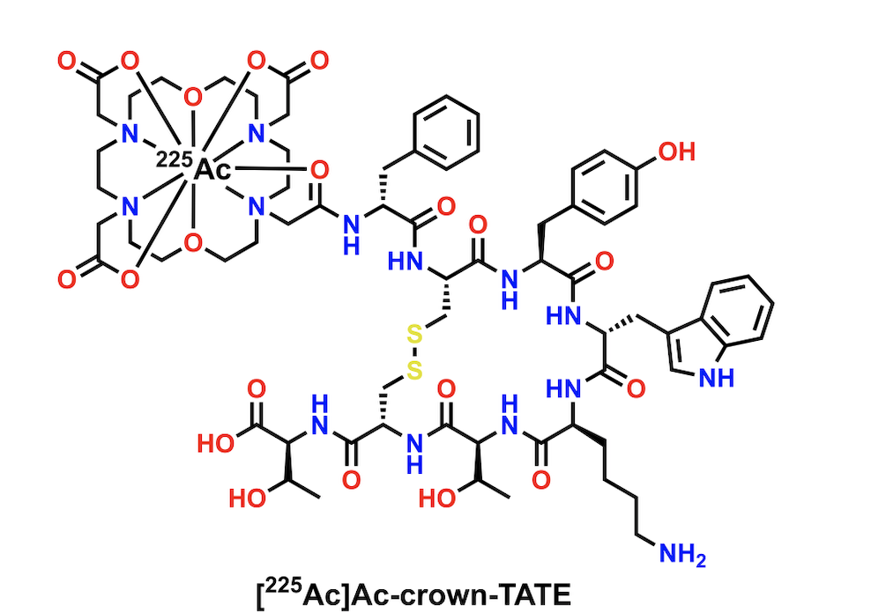
Lending a "Hand," or Rather an Arm. The Synthetic Development of a Four- armed, Bifunctional Version of Crown for Optimized Actinium-225 Chelation in Cancer Therapies
Adlih Britton
Bifunctional Chelator Diagram
crown
²²⁵Ac Decay Chain
Targeted Cell
Linker
Chelator
Targeting Vector
[²²⁵Ac]Ac-crown-TATE Animal Study¹
p-NCS-Ph-crown
12 Step Synthesis of Novel
Macrocycle
¹Ingham, A.; Wharton, L.; Konair, H.; Merkens, H.; Osooly, M.; Rodríguez-Rodríguez, C. (2024), “[225Ac]Ac-crown-TATE”. Manuscript Submitted
Notes:
SCIENCE WEEK PITCH TALK
- hello and welcome to my talk ____
-
TATE – metastatic neundorcrine system – rapidly multiplying cells in the neudocrine system – glands and nerve cells
start set the stage – ac 225 is a promising radionuclide in medicinal chemistry because of its 4 alpha decay to stable bismuth 209. for comparison, on eof the more common medicinal isotopes 177 Lu (beta emission) approved for neudocrine tumors in 2018 and prostate in 2022, has a lower LET due to beta emission.
to be able to deposit the power in the decay chain of 225 Ac would be of benefit but you have to be able to direct the radionuclide to the tumor cell.

