Slide 1
Five-year plan 2025-2030
Life Sciences Division
Cornelia Hoehr
Acting Director, Life Sciences Division
TRIUMF Science week
July 24, 2024

Slide 2
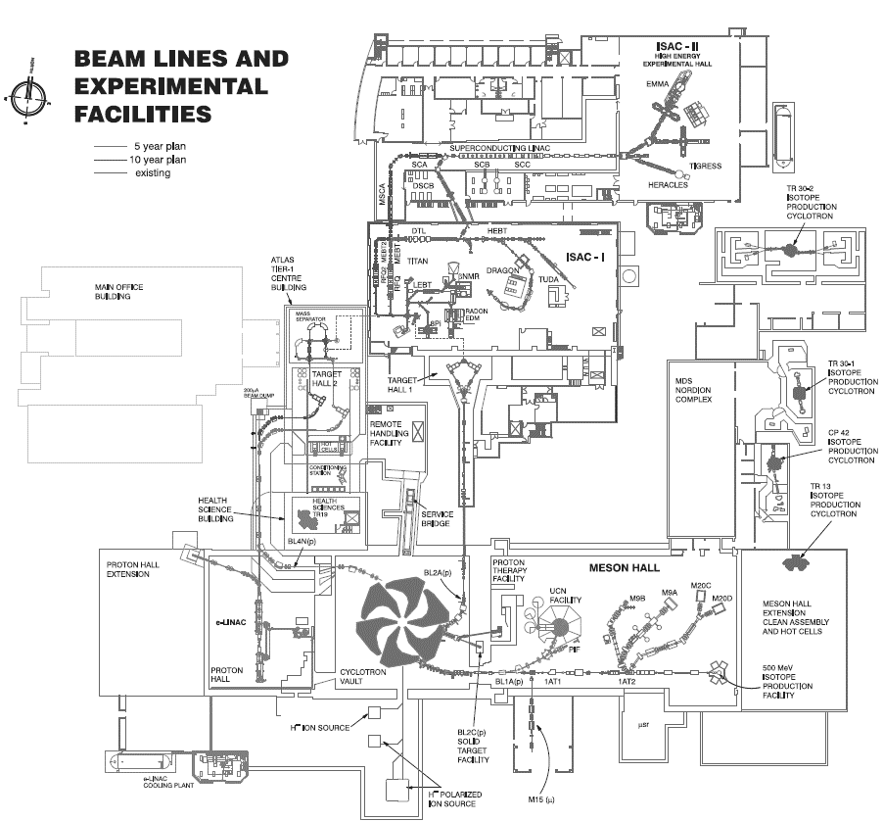
Life Sciences Division
Mission: To improve and save lives through the production of medical radioisotopes and the research and development of novel radiopharmaceuticals, as well as the novel application of particle beams for health sciences.
IAMI

Slide 3
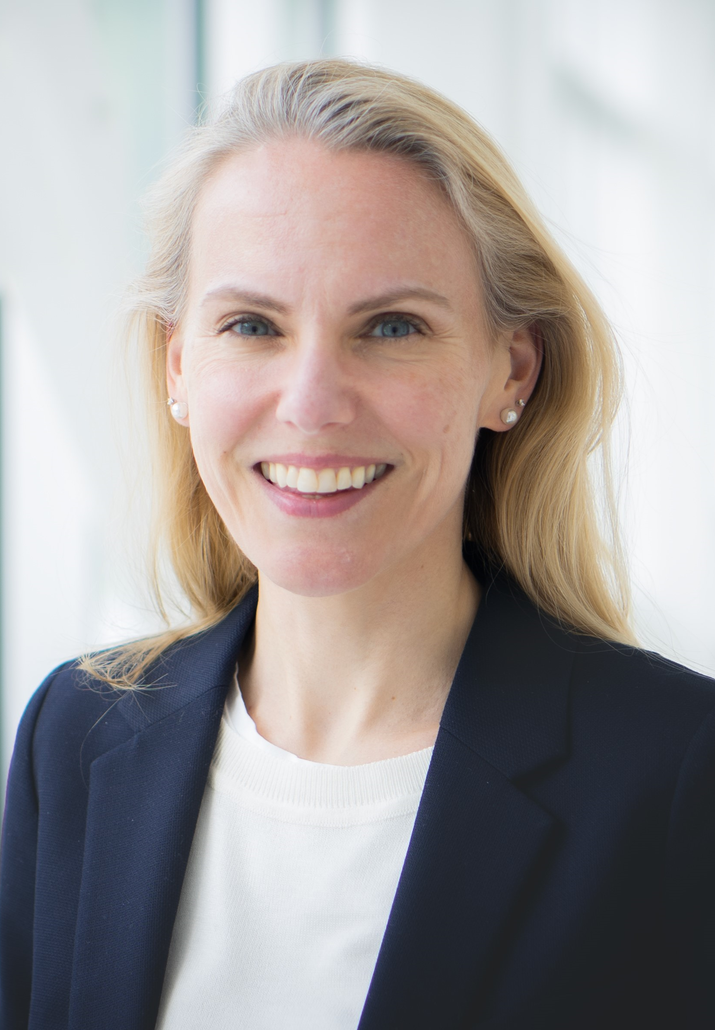
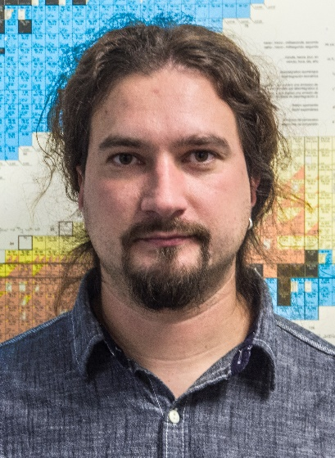
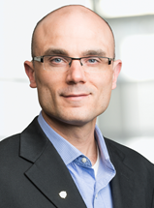
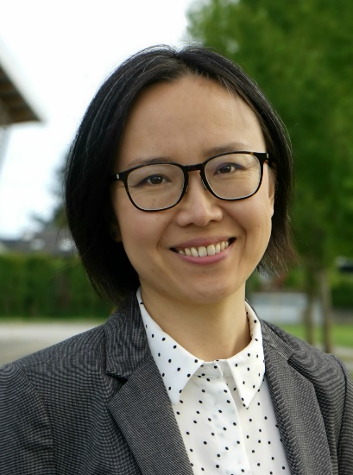
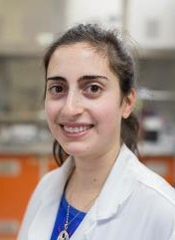
Life Sciences at TRIUMF
Applied Ion Beams
Nuclear Chemistry
Applied Isotopes
Cornelia
Hoehr
Valery
Radchenko
Paul
Schaffer
Hua
Yang
Caterina
Ramogida
(joint SFU)
Research within TRIUMF Life Sciences focuses on advancing accelerator-based technology for the development of ion beams and isotopes that can improve life.

Slide 4
Life Sciences Priorities
Build, commission and operate Institute for Advanced Medical Isotopes (IAMI)
Deliver on our commitments (UBC, BCCA, grants – NFRF-T)
Enhance R&D capacity in Life Sciences, HQP training

Slide 5
Scenario 2 impact on LSD
No medical isotopes from ISAC in 2026
No medical isotopes from IPF in 2026
No experiments at PIF, TNF in 2026
No experiments at e-linac in 2026
Medical isotopes and experiments from TR13 in 2026
Medical isotopes from IAMI starting in 2026 instead of end of next 5-year plan (2029)
Medical isotopes from ARIEL in 2028 instead of in the next 5-year plan (2030-2035)
IAMI

Slide 6
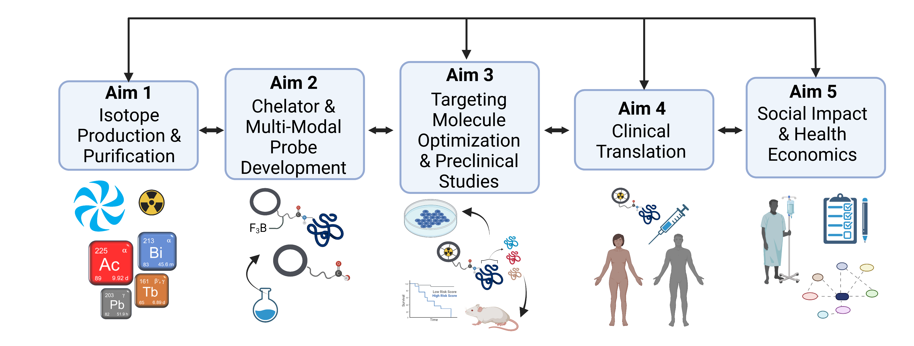












Life Sciences Division – NFRF-T
Notes:
Our research covers the key areas necessary to transform radiopharmaceutical therapy in Canada. We capitalize on the world’s largest cyclotron at TRIUMF, radioisotope production infrastructure in BC, Alberta, Ontario and Quebec and at international collaborator facilities. We build on world class research in radiometal chelator design and radiopharmaceutical development, and a proven ability to conduct investigator initiated clinical trials from phase 1 to phase 3 using radiopharmaceuticals, in partnership with our oncologist colleagues. Key decision points highlighted by the arrows in this figure are informed by Social Impact and Health Economics analyses, to select which novel radio-isotopes to prioritize, guide the design of clinical trials and facilitate adoption by patients and health care funders.

Slide 7
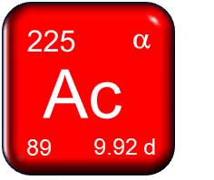
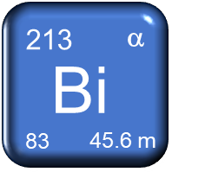
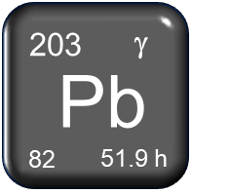
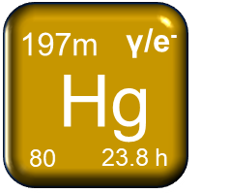
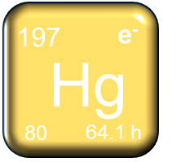
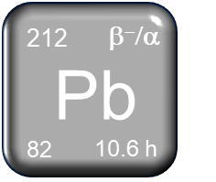
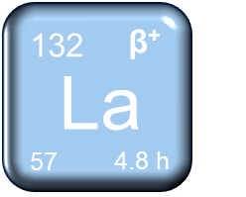
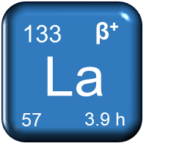
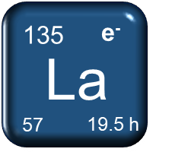
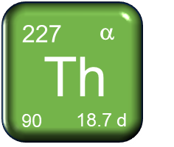
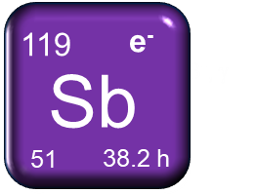
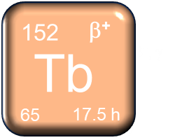
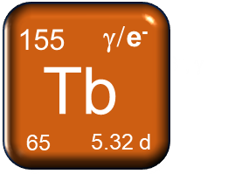
Life Sciences Division – NFRF-T
Availability in 2026
IPF: Alpha therapy
TR13, 24: SPECT, PET, Auger therapy
ISAC: PET imaging
Notes:
Our research covers the key areas necessary to transform radiopharmaceutical therapy in Canada. We capitalize on the world’s largest cyclotron at TRIUMF, radioisotope production infrastructure in BC, Alberta, Ontario and Quebec and at international collaborator facilities. We build on world class research in radiometal chelator design and radiopharmaceutical development, and a proven ability to conduct investigator initiated clinical trials from phase 1 to phase 3 using radiopharmaceuticals, in partnership with our oncologist colleagues. Key decision points highlighted by the arrows in this figure are informed by Social Impact and Health Economics analyses, to select which novel radio-isotopes to prioritize, guide the design of clinical trials and facilitate adoption by patients and health care funders.

Slide 8
R&D
Life Sciences Division – NFRF-T
Clinical production
Y1
Y2
Y3
Y4
Y5
Y6
Alpha emitters will need to be either paused, produced on generators in advance, or sourced elsewhere
Imaging isotopes and Auger emitters will continue to be available
Clear communication with the wider NFRF-T team (change of schedule)

Slide 9
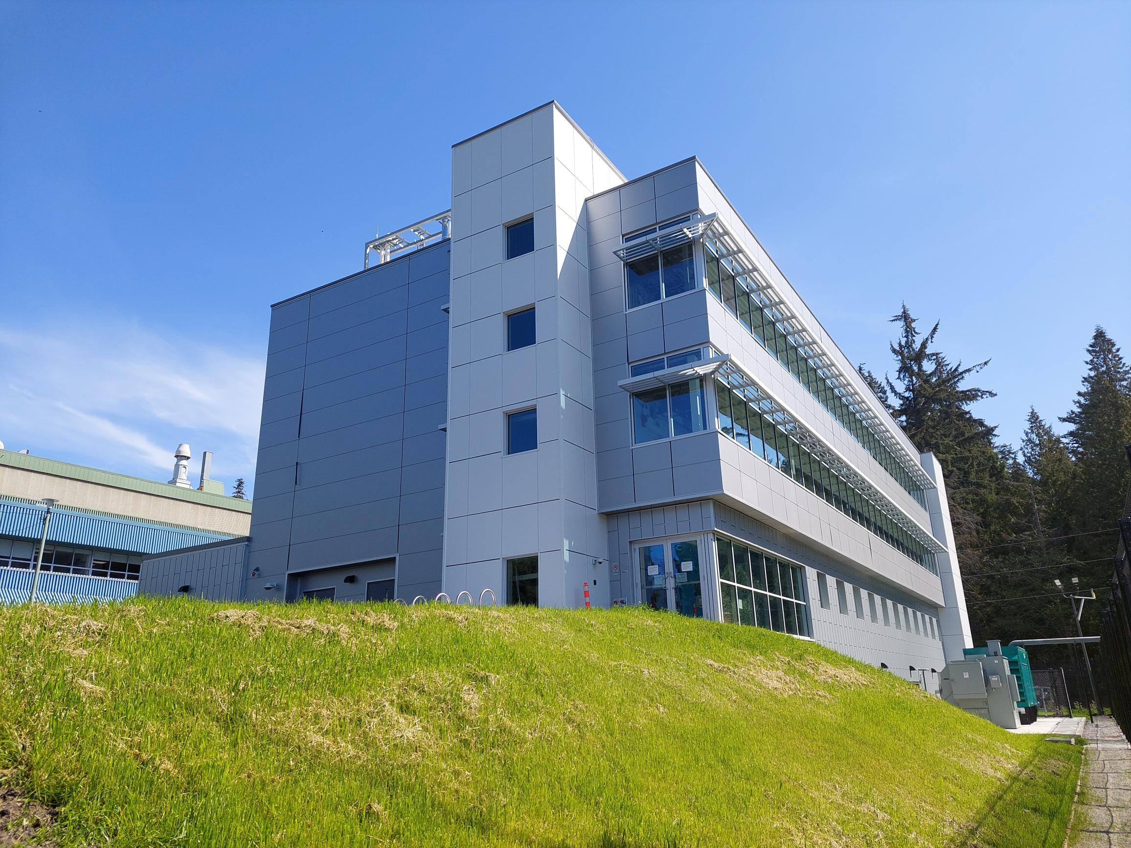
Life Sciences Division – IAMI
Scenario 2 will accelerate the operation of IAMI
More isotope production
More radiochemistry lab space

Slide 10
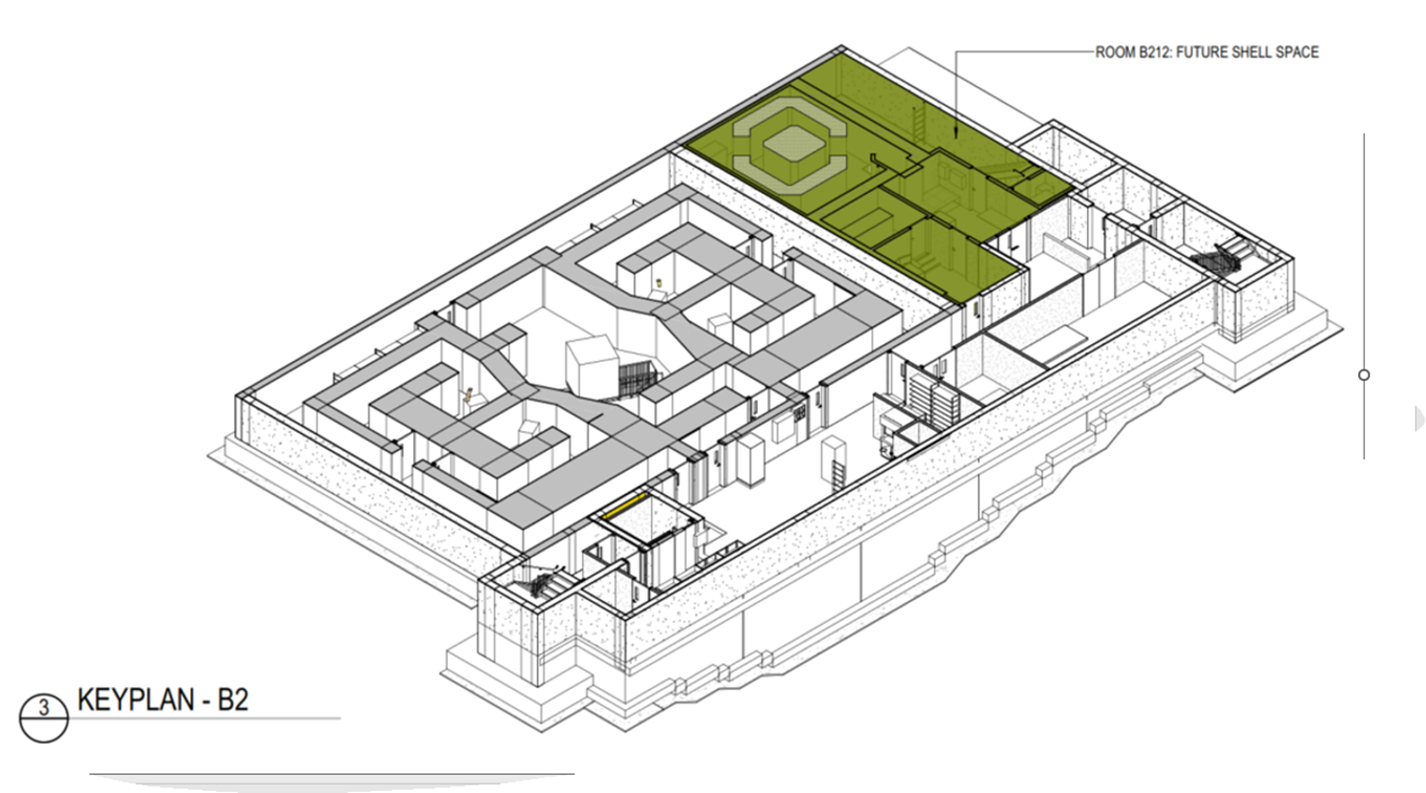
Life Sciences Division – IAMI
B2 level
TR24 cyclotron
4 target caves
Hot workshop
In green: cyclotron and support spaces for BCC

Slide 11
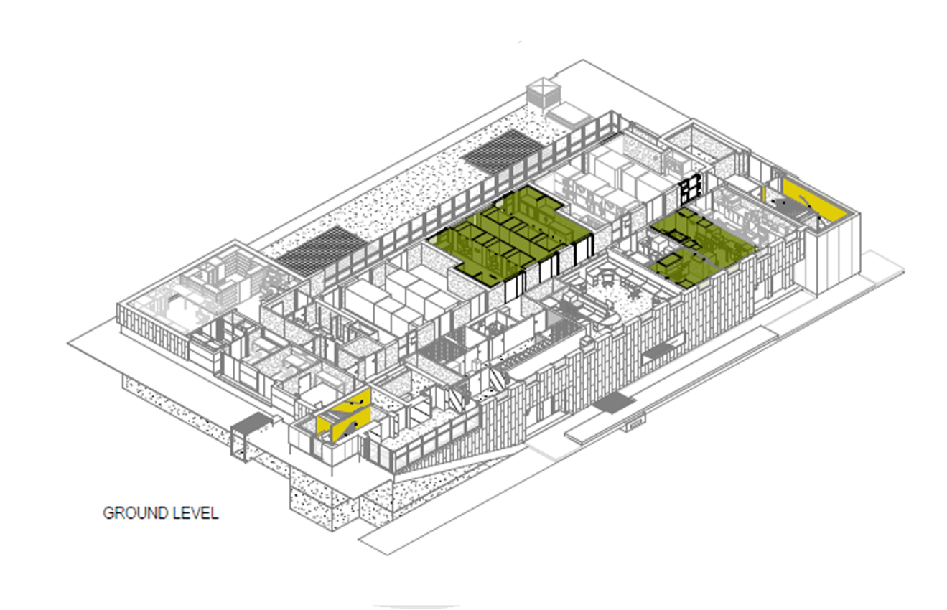
Life Sciences Division – IAMI
G level
4 hotlabs for TRIUMF (2 for BCC)
Control room
Material receiving, quarantine and storage areas
Suite for GMP compliance
QC lab space
In green: areas competed in phase 2

Slide 12
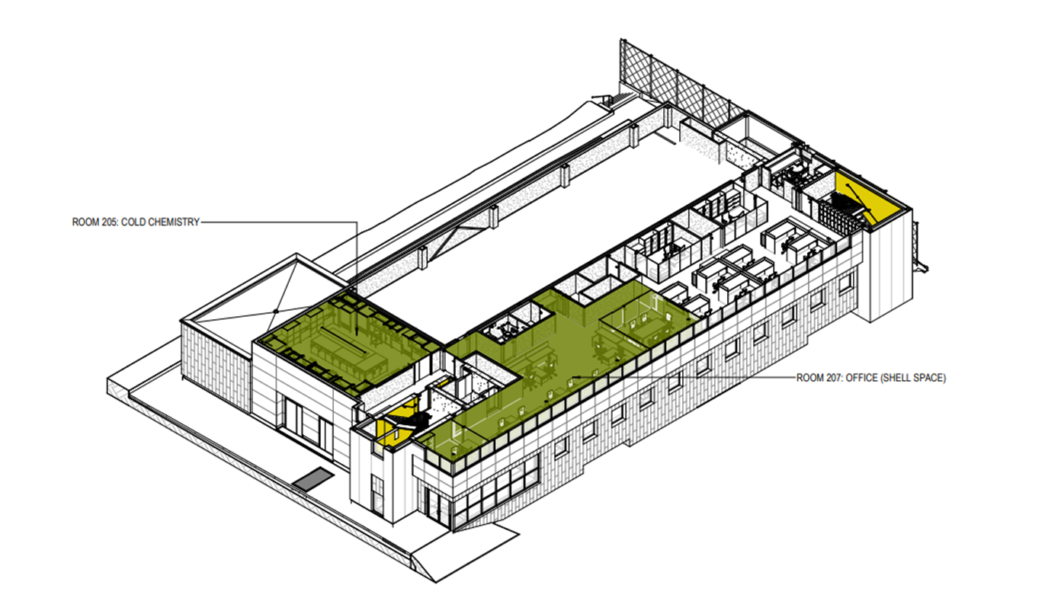
Life Sciences Division – IAMI
L1 level
Office space
Cold chemistry labs
In green: areas completed in phase 2 and occupied by TRIUMF

Slide 13
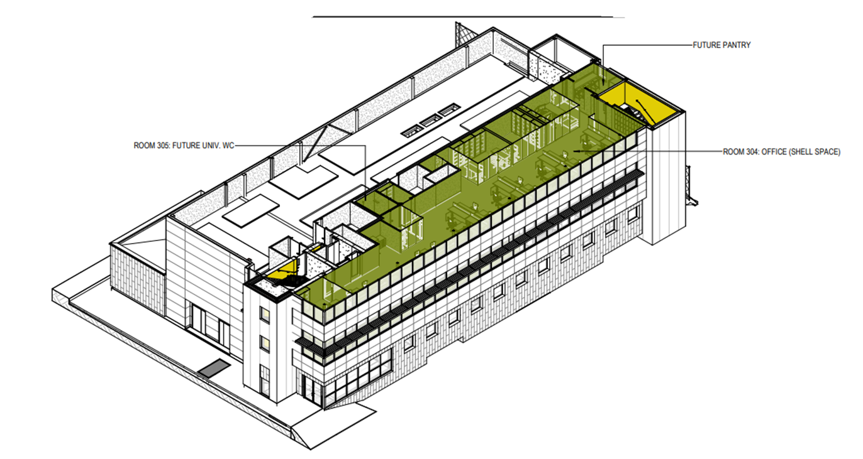
Life Sciences Division – IAMI
L2 level
Office space
In green: areas completed in phase 2 and occupied by TRIUMF

Slide 14
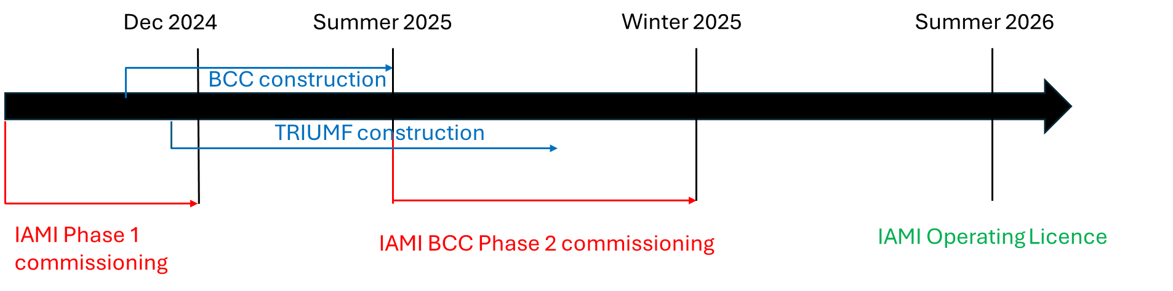
Life Sciences Division – IAMI timeline in scenario 2

Slide 15
Summary
Scenario 2 has negative impact (limited alpha emitters, no PIF/NIF or e-linac in 2026) and positive impact (operating of IAMI/ARIEL sooner).
Mitigation strategies (pausing experiments or switching to TR13/24, ordering medical isotopes in, creating generators, changing schedule) will alleviate the impact.
Some experiments, student projects and collaboration and grant deliverables will need to be adjusted.
Clear and timely communication with BAEs, collaborators and partners!

Slide 16
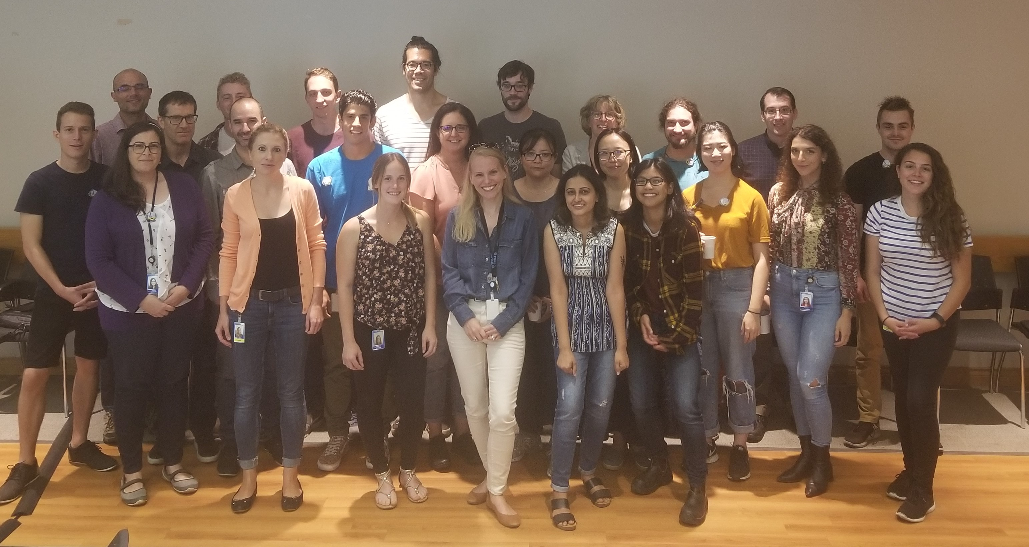




Acknowledgement
Thank you!
Merci!
2019

