Slide 1
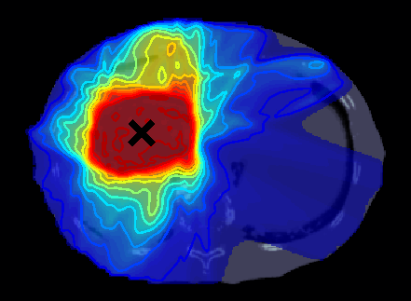
Comparing the
Dose to Circulating Lymphocytes
in Conventional and State-of-the-Art
Radiation Therapy
Alasdair Holmes
Supervisors: Sebastian Tattenberg, Cornelia Hoehr
TRIUMF, Life Sciences, Medical Physics
Notes:
Abstract title: Comparing the Dose to Circulating Lymphocytes in Conventional and State-of-the-Art Radiation Therapy

Slide 2
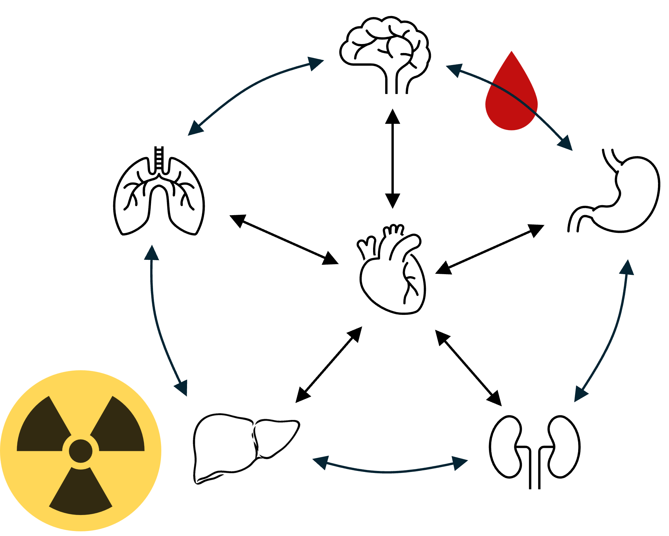
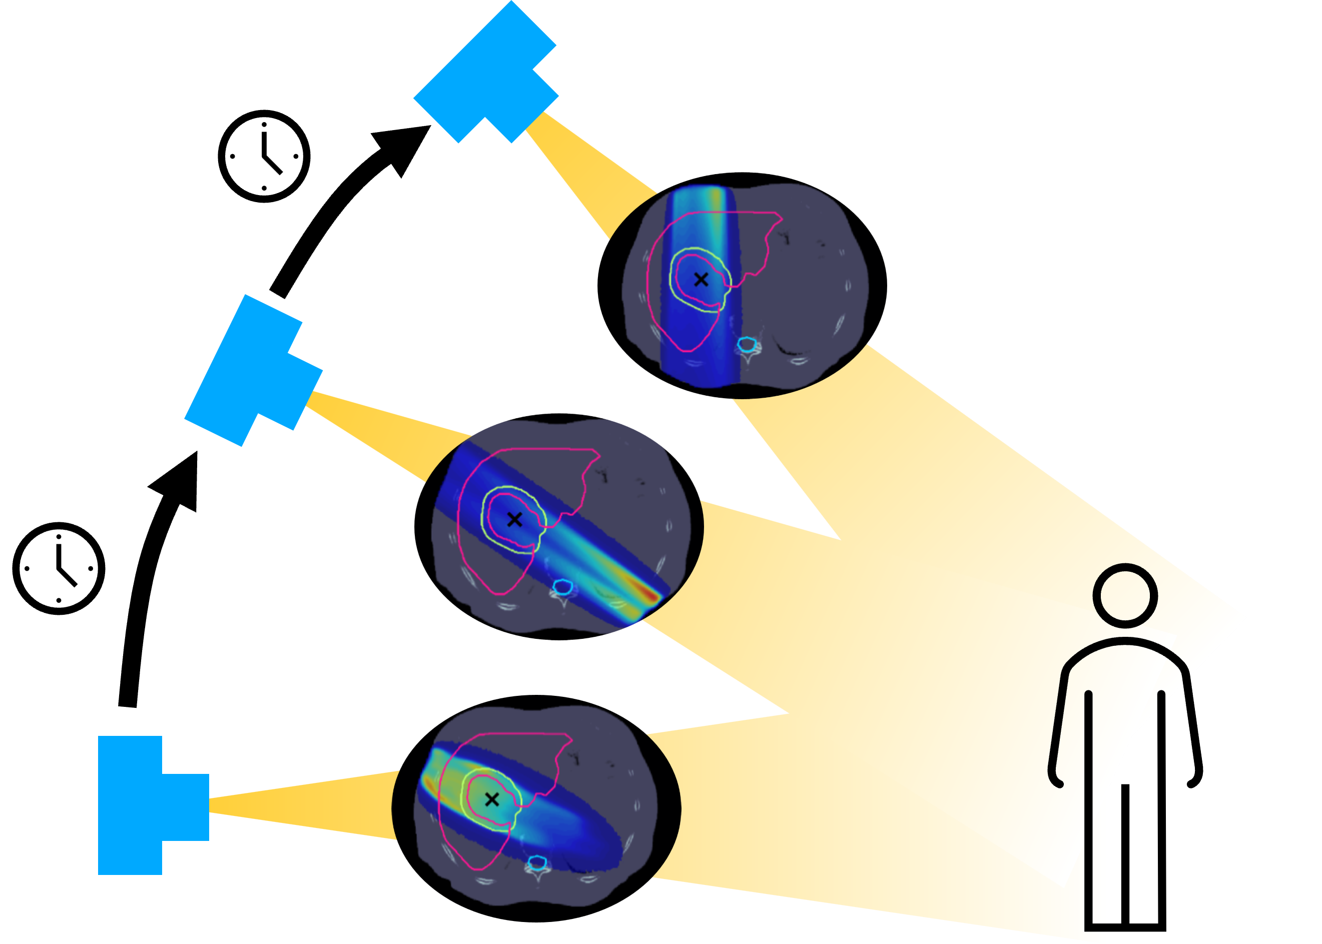
Motivation: Radiotherapy → Lymphopenia → Worse Outcomes
Photon
Therapy
Proton
Therapy
Blood Dose Model
Delivery Modelling
Up to Δ15% in
blood dose
# BPs
Decrease of up to 53%
in blood dose
Dose

