Slide 1
Fix #1: using ground truth hit mask
Fix #2: energy-weighted BCE hit loss

Slide 2
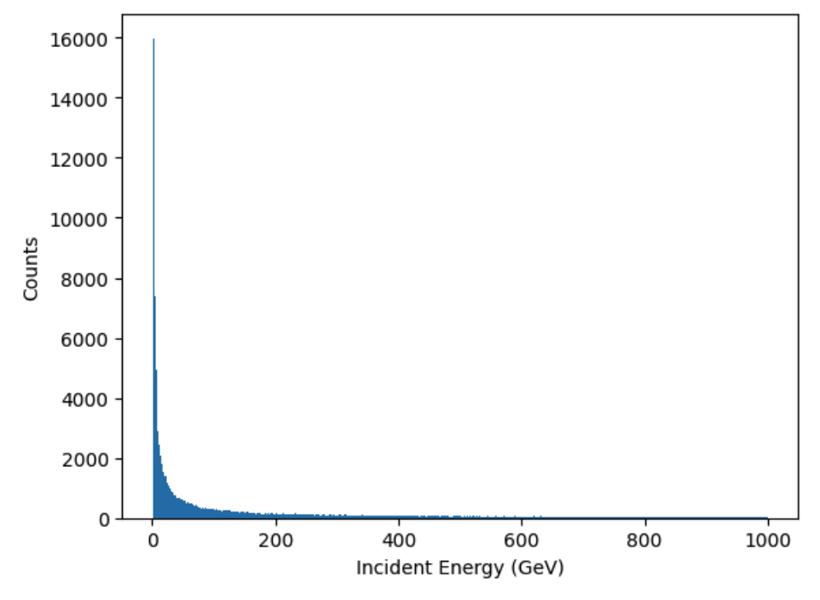
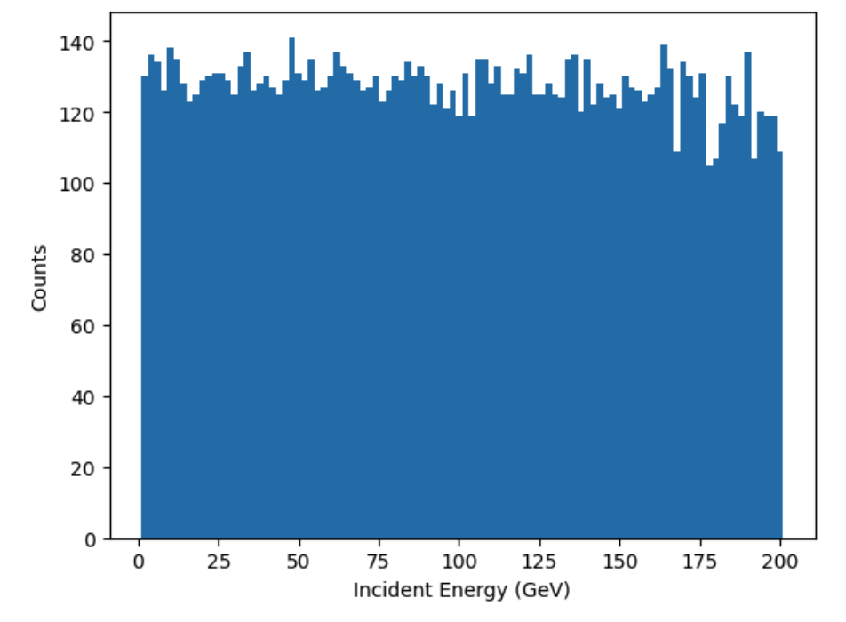
Original Dataset
Filtered Dataset

Slide 3
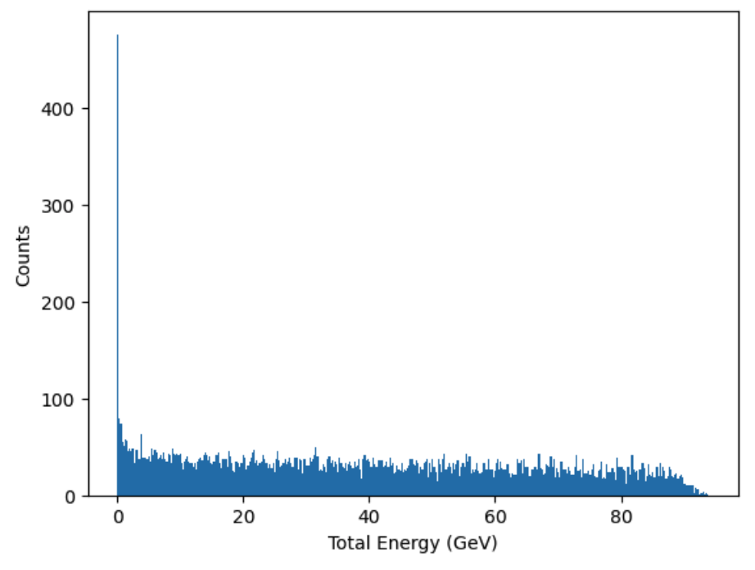
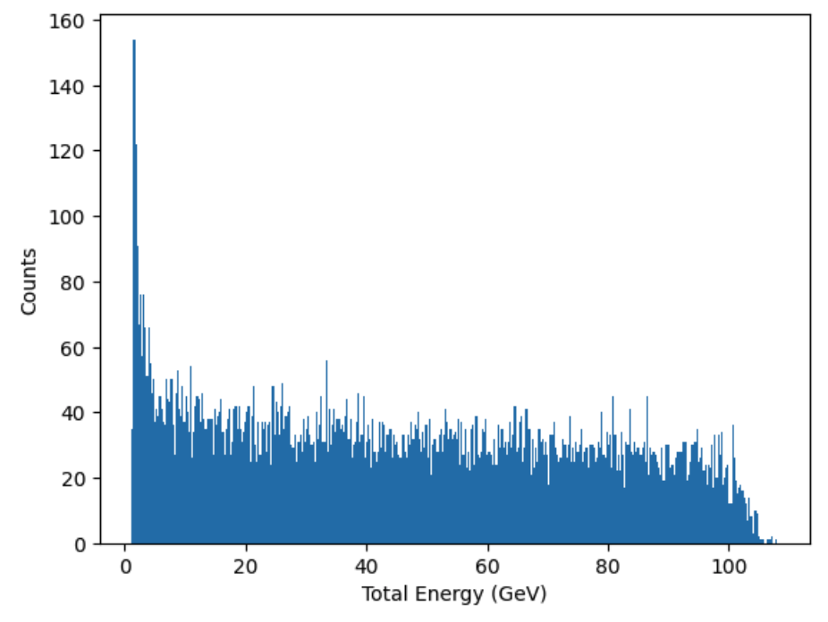
No fix
Bit mask fix
Bit mask and BCE fixes

Slide 4
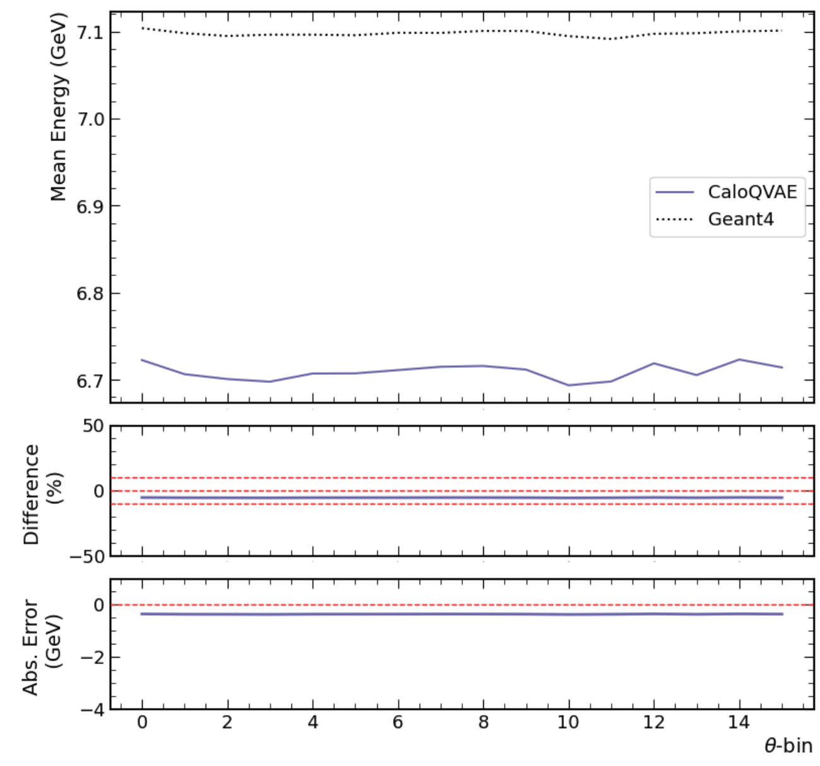
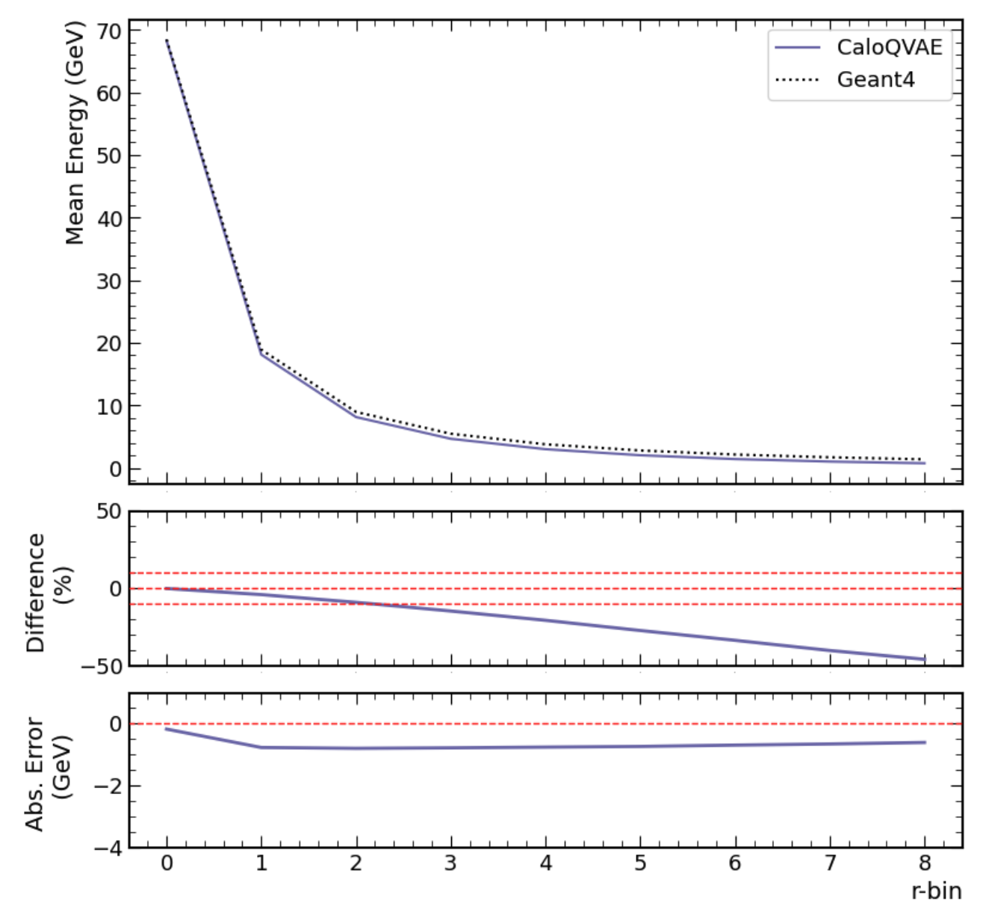
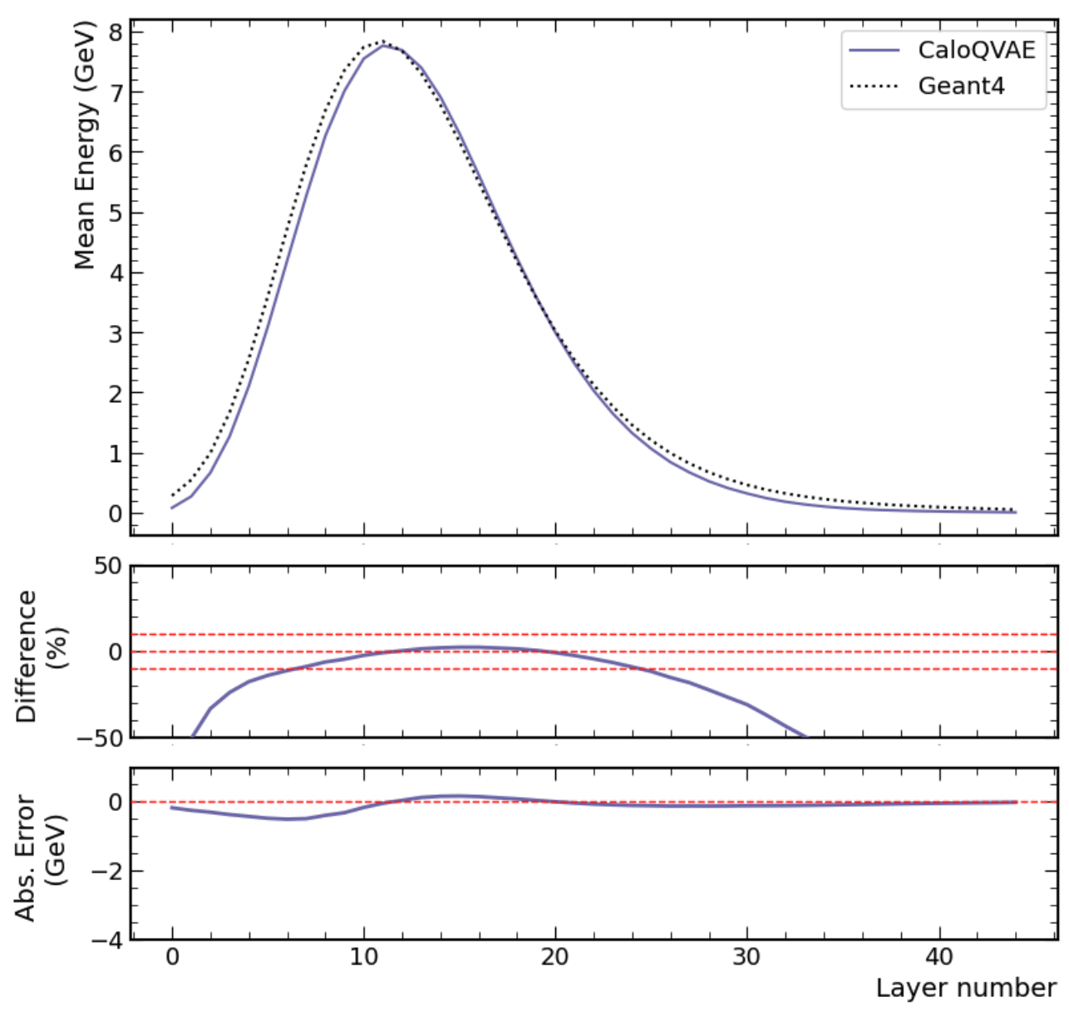
Mean Energy Distributions before fixes (Non-Chi MSE Loss)

Slide 5
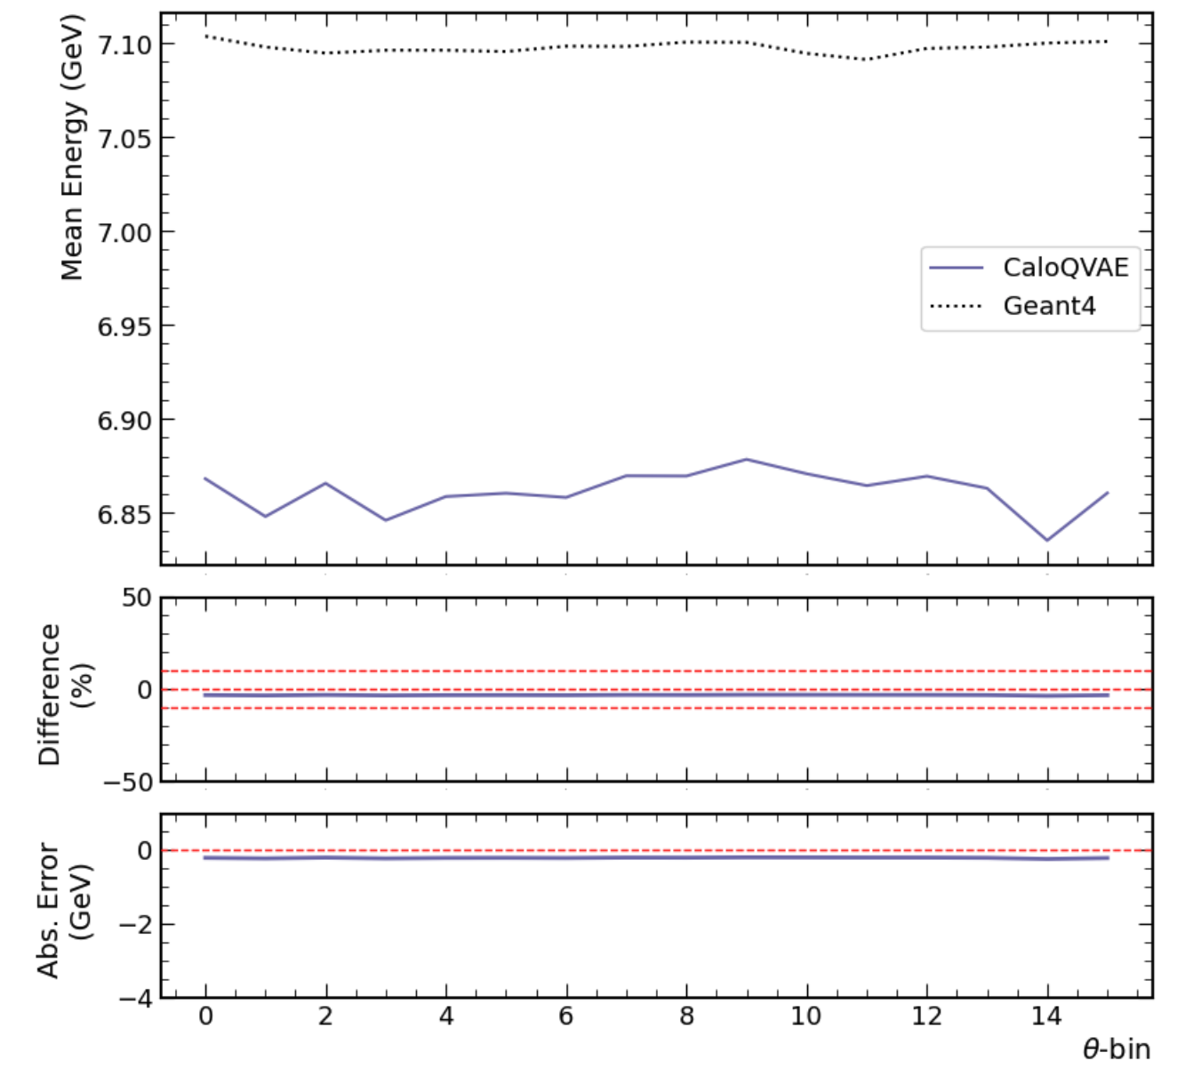
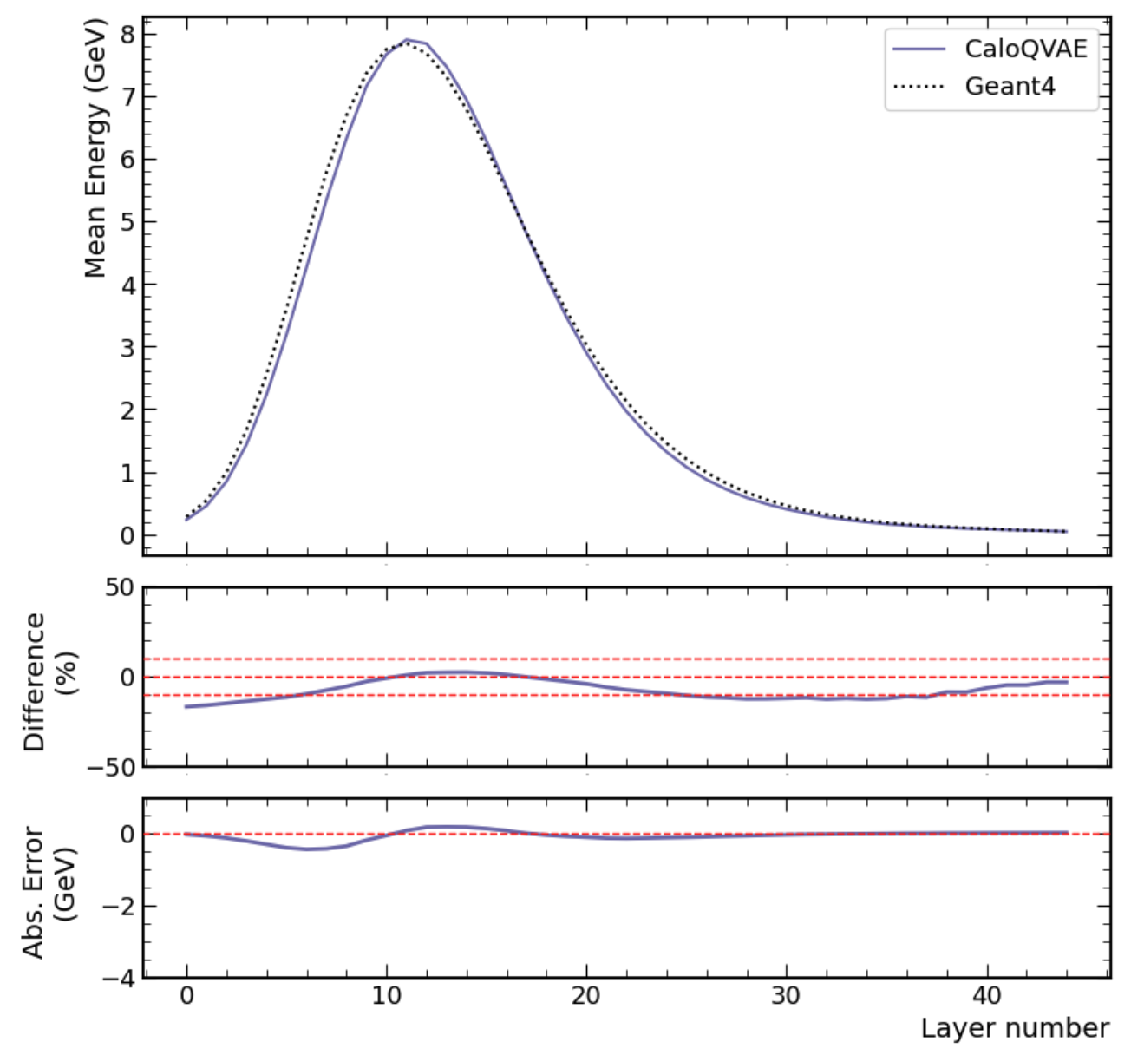
Mean Energy Distributions after fixes (Non-Chi MSE Loss)

