Slide 1
Replacing MSE by utilizing the covariance matrix in the loss function

Slide 2
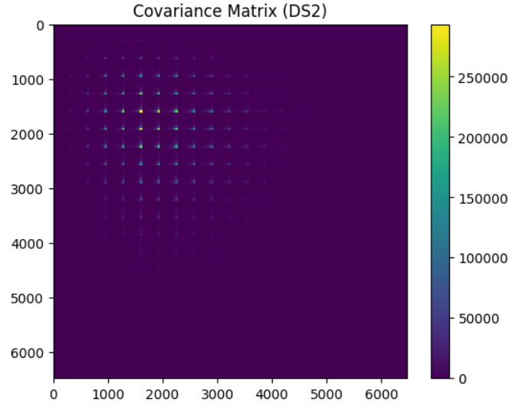



Slide 3
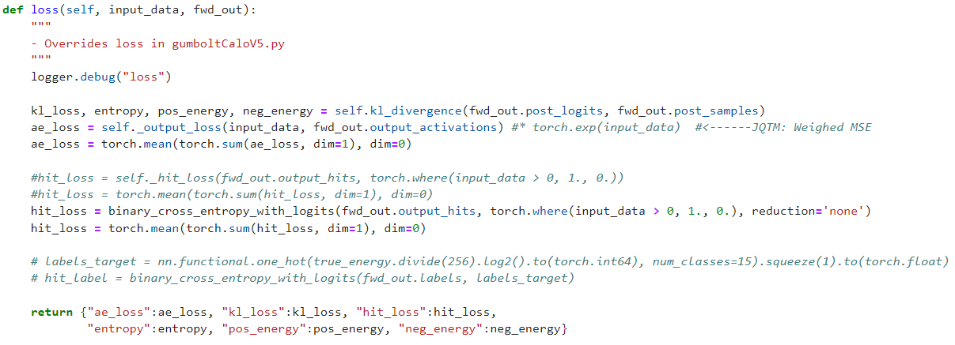
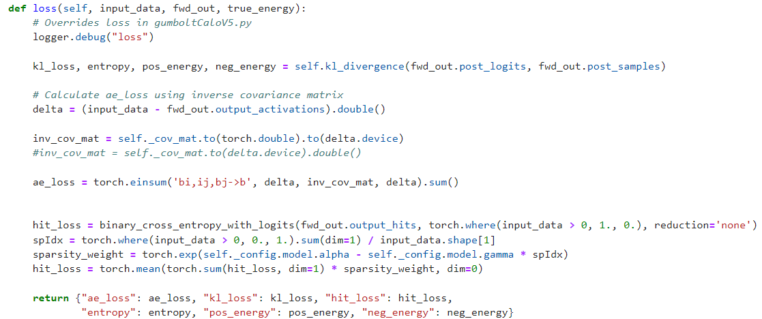

Slide 4
