Slide 1
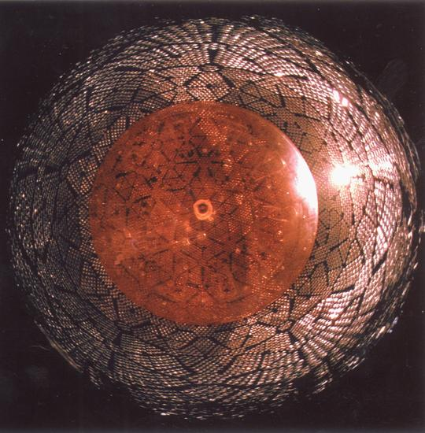
TRIUMF detector center
Link with the Quantum world

Slide 2
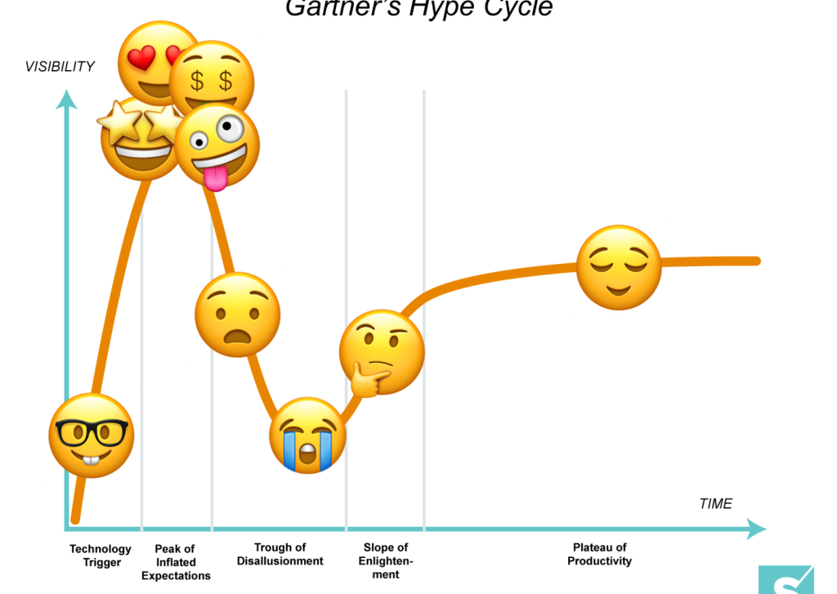
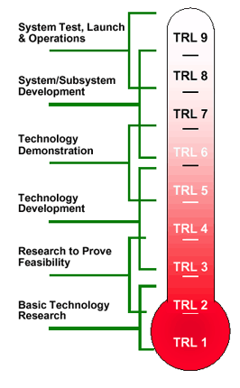
Detector center scope
Sci. Tech. Dept.
Detector center

Slide 3
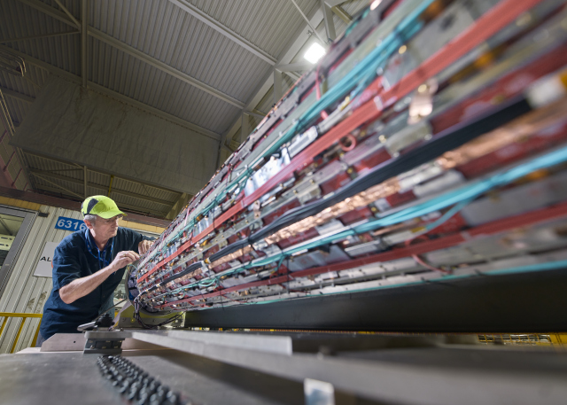
Detector project evolution
Excellence in gas detector …
  First working Time Projection Chamber
  T2K near detector, early adopter of Silicon photo-multipliers
  Alpha-g Time Projection chamber
… May be becoming less relevant …
  All silicon solutions in HEP
  (ultra) low energy physics growing field
Requiring evolution expertise
  May become more about instrumentation than only detectors

Slide 4
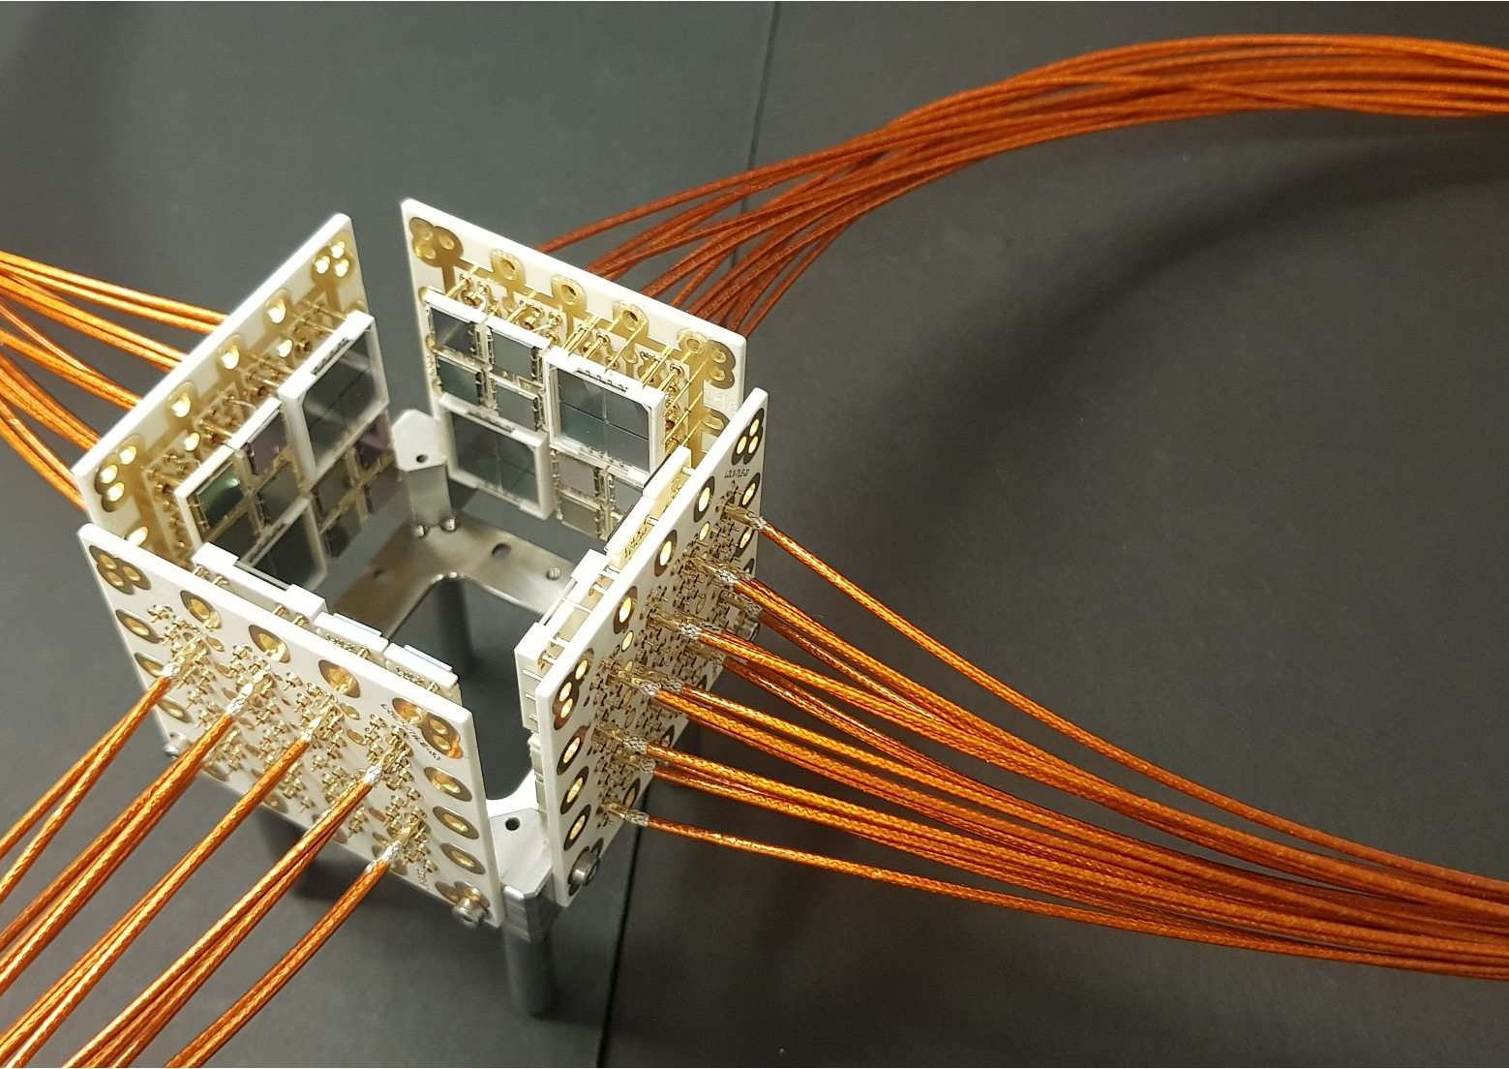
Current evolution
”integrated” silicon detector development
  For charged particle detection (collider)
  For single photon detection
  Leverage ATLAS ITK and nEXO infrastructures
Expand technology transfer projects
Other technology, being looked into:
  Noble liquid detectors (Chloe + FR)
  mK detectors (Pietro, Wolfgang, Annika)
  GHz sensors (FR + … Conny?)
  ASIC in general (Leonid + many others)

Slide 5
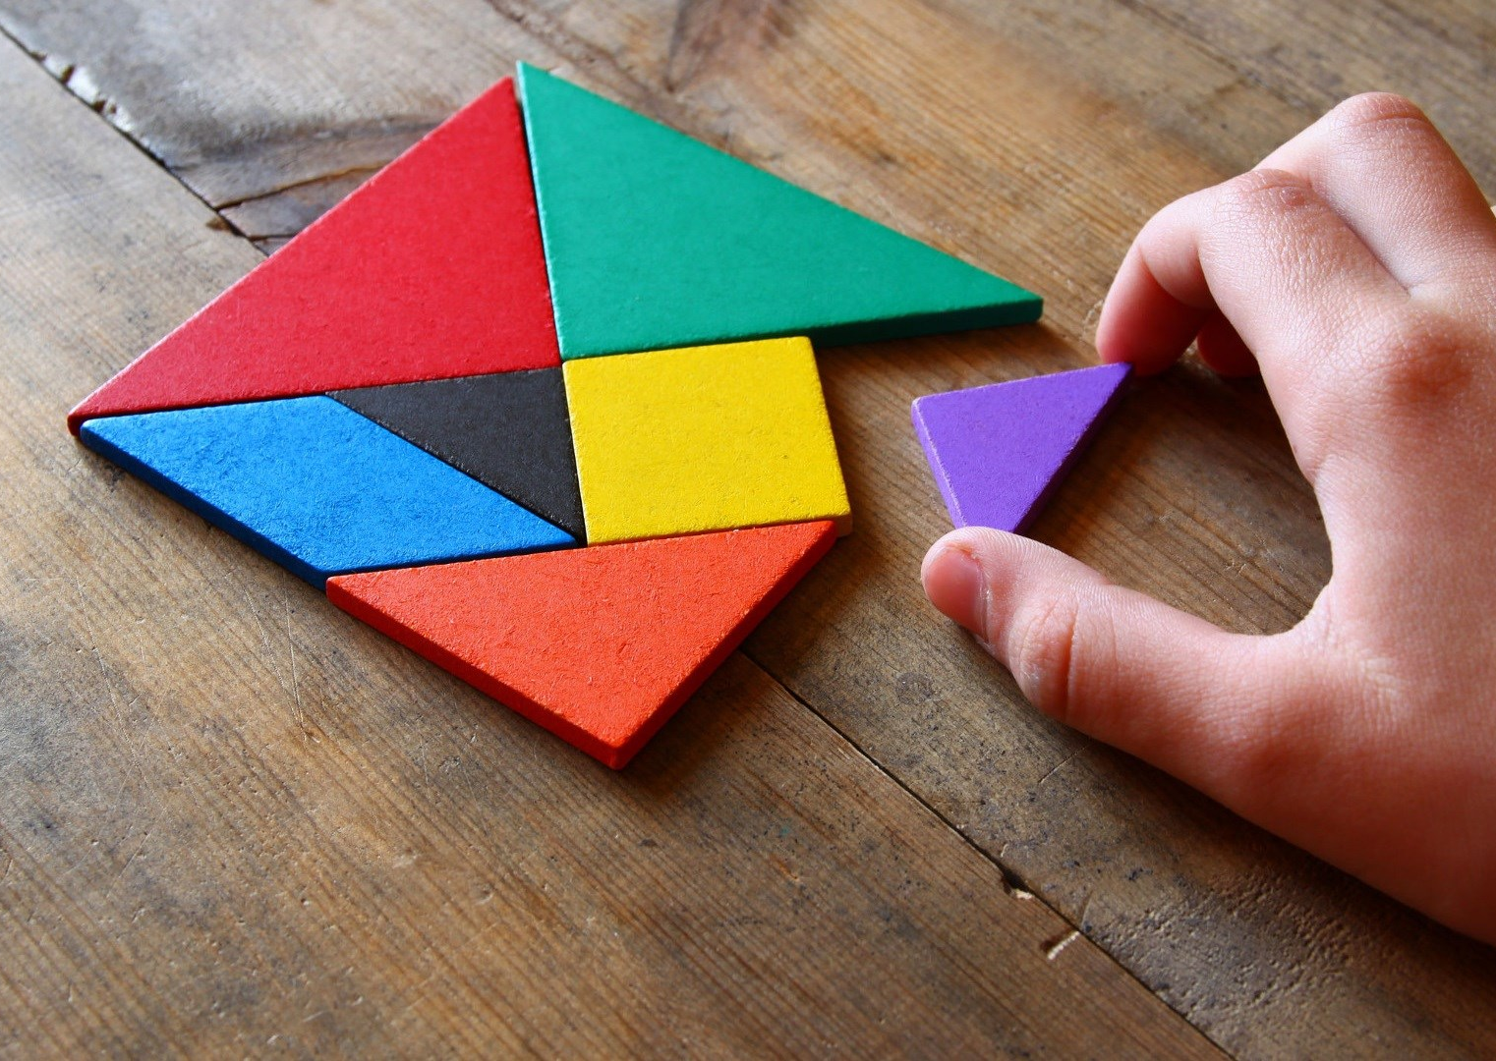



Funding scheme: Multi-sources
SAPES, ALLIANCE, CERC

Slide 6
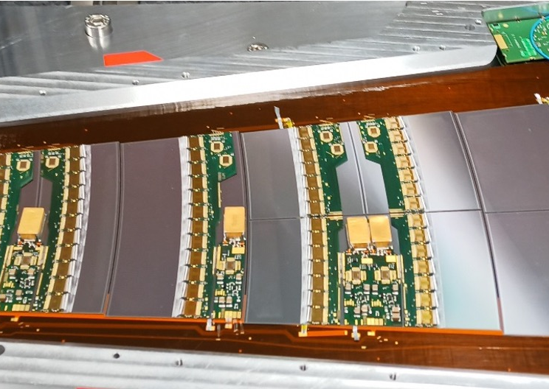
All proposals are now known. Was a lot of back and forth
  Innovation Driven Integrated Detector, ID^2 with SFU. Infrastructure for detector development
  Project specific: Liquid Argon for DM search, nEXO, PIONEER, UCN EDM, ALPHA

Slide 7
Technology Readiness level
Design and modeling facility
Die Integration facility
System integration facility
Characterization labs
4D detector
Application labs
Physics experiments
Collider, Dark matter, neutrinos
Charge collection process
Digital LGAD
Tracking
Det. system
Can Silicon avalanche diode solve all problems?
Avalanche process
BSI SPAD
Digital Hybrid photodetector
Scint. Det. systems
Radiation monitoring in health care, space and Fusion
2D SPAD
Is Short Wave IR detection of interest?
In field detector systems
MAPD SPAD
Digital SPAD array
Light emission in avalanche
Single Photon Air Analyzer
Forest fire mitigation
Quantum superposition for air analysis?
Optical material
Air analysis sensor array
Scattering + fluorescence co-detection
Light prod. & transport models
Scint. material
Quantum coherence

Slide 8

Blue sky R&D including quantum?
Clear need for instrumentation expertise
  Sci Tech and detector center could help
Some clear overlap
  Next generation muSR spectrometer without scintillator, i.e. using high speed silicon
  Helping with development of HAICU
  Building expertise in photon detection and transport, including on-chip
    Collaboration with ANSYS/LUMERICAL to be revisited

Slide 9
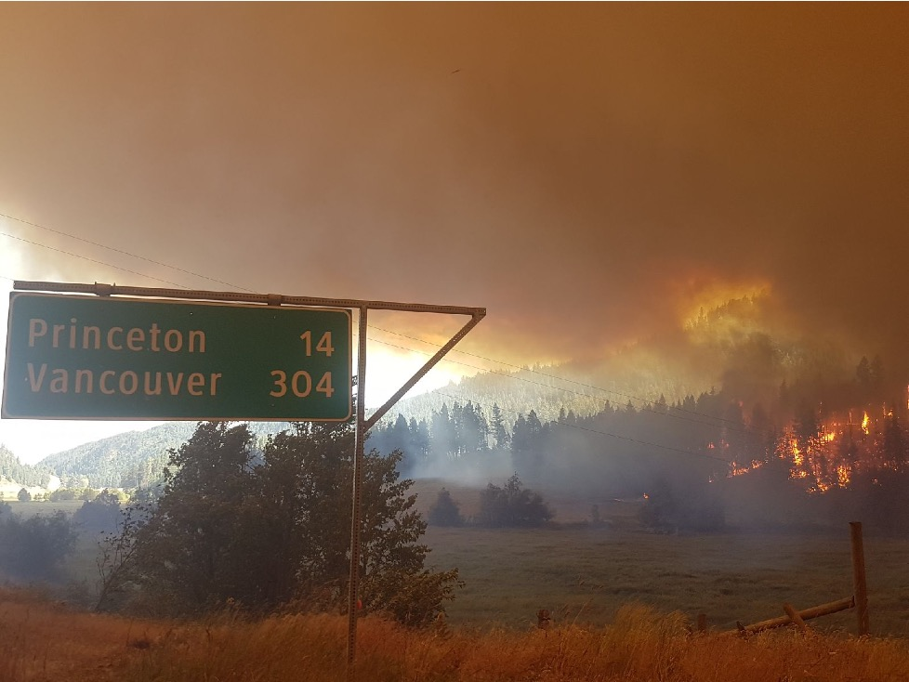
Innovation
The land of opportunity and little time
Lots of opportunities tied to climate change
  Many many grants
Assessing competitive niche is tough
  For example CO may be a much better early forest fire signal than smoke…
Companies are interested in us
  General Fusion, SenseNet,… need more
Not-for-profit strategy also compelling
fff
HQPs are more and more drawn to this

Slide 10
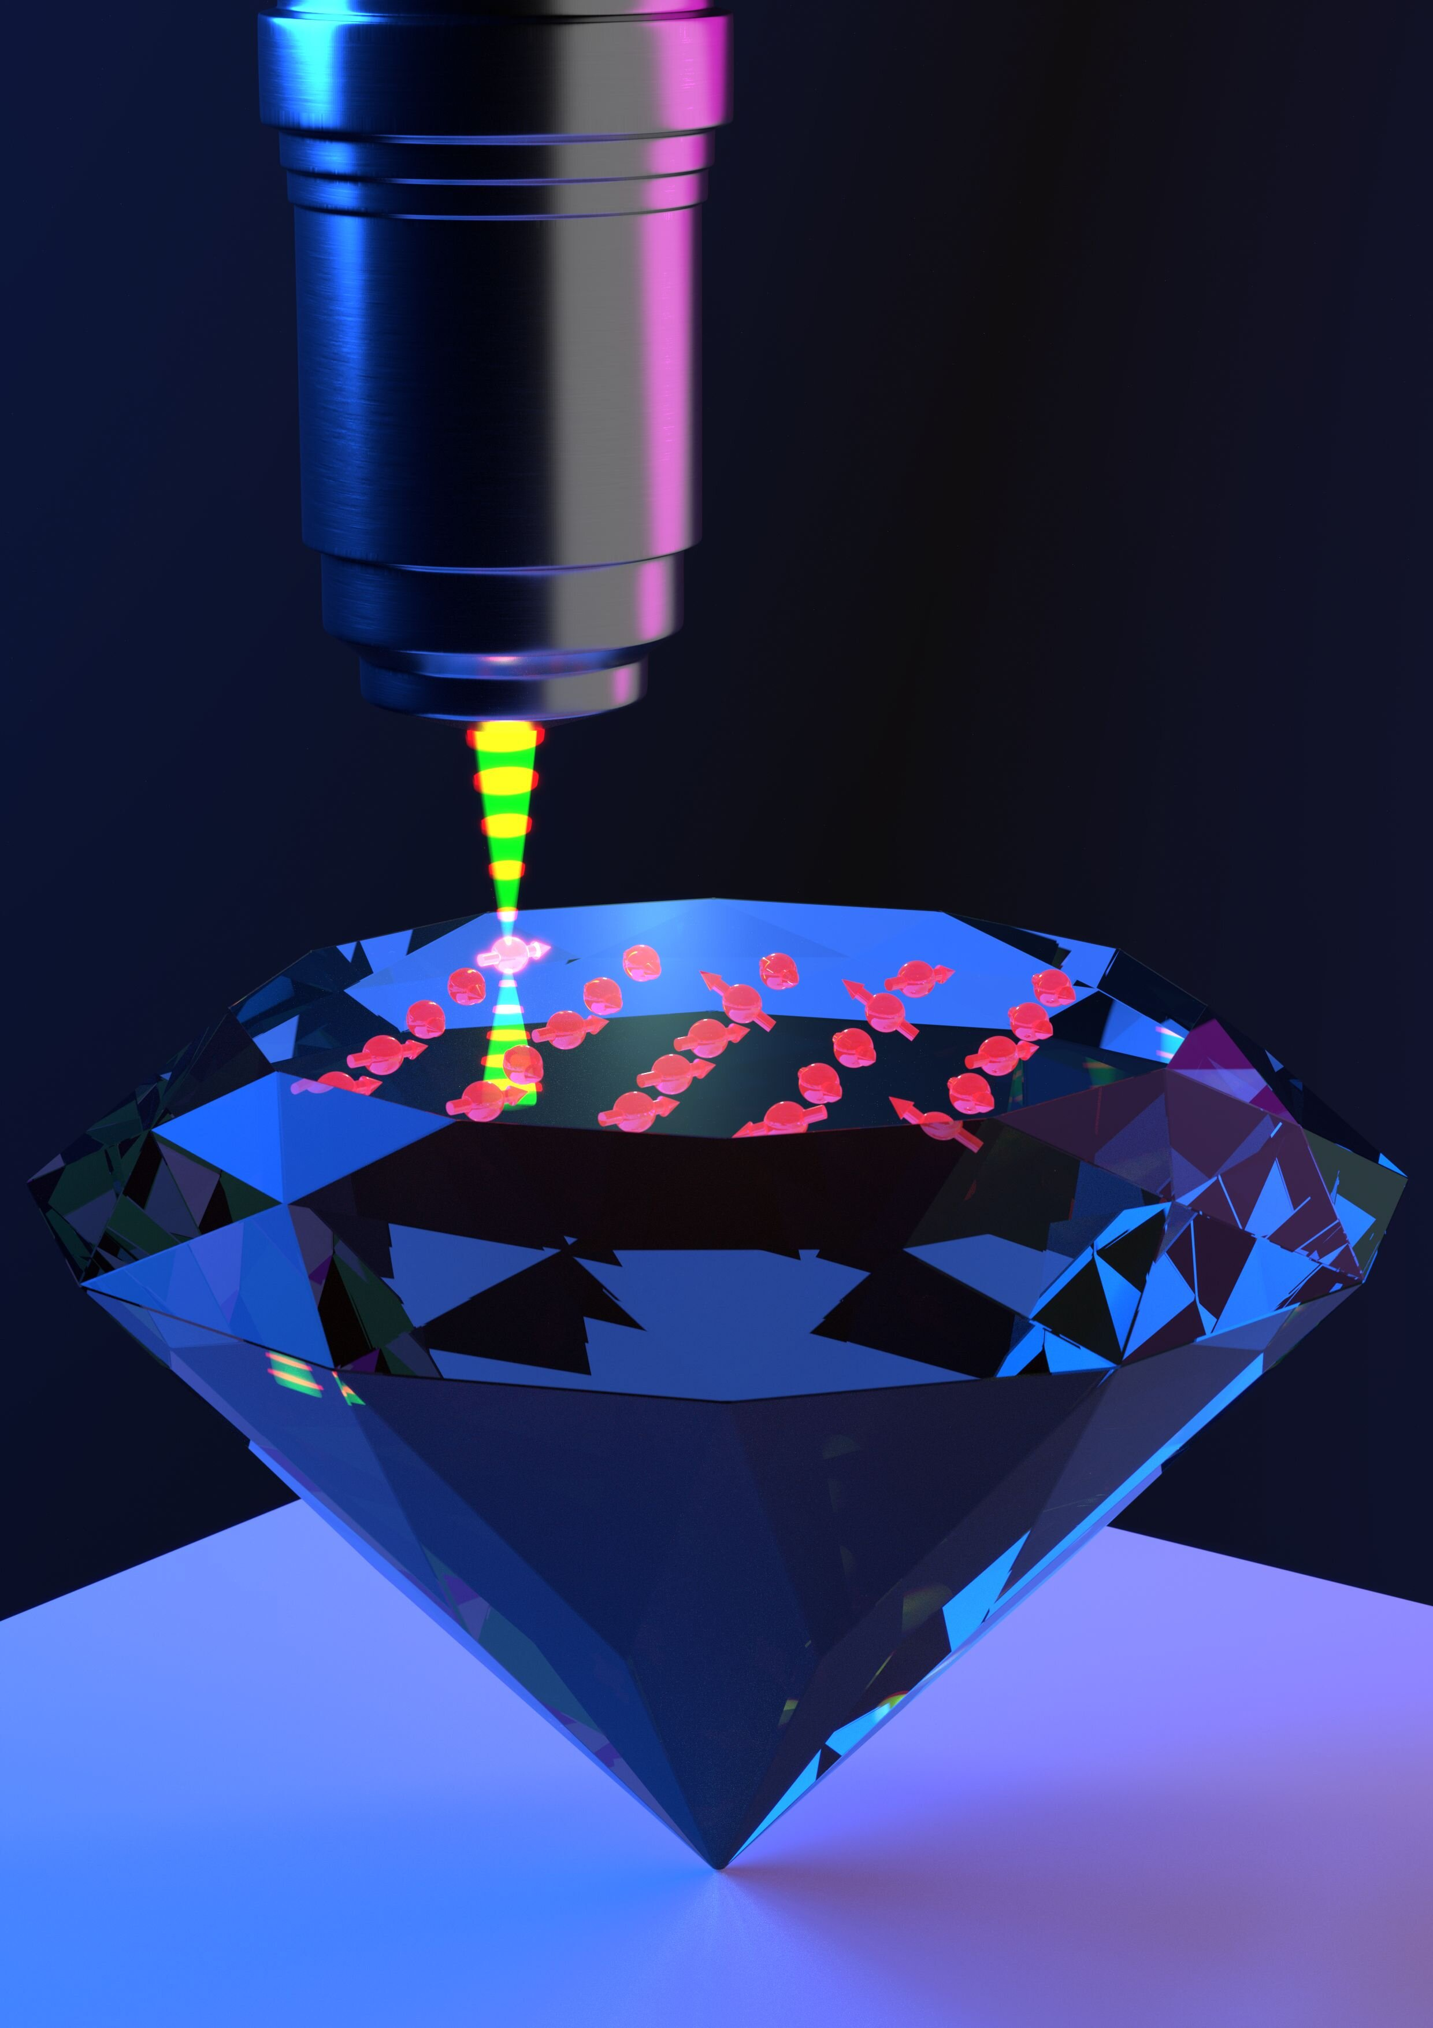
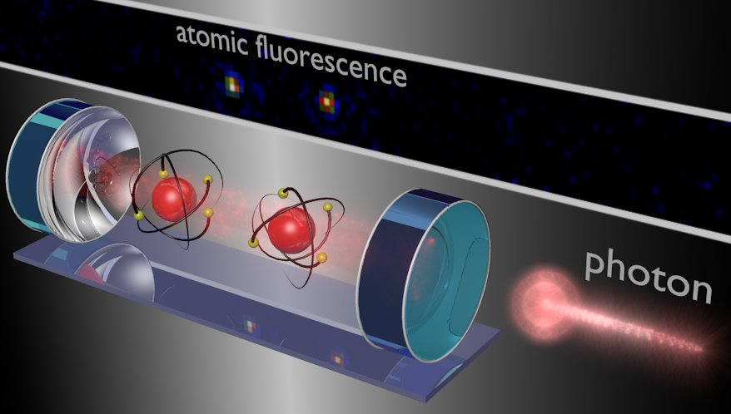
Innovation: quantum sensors
Oportunities… But can we be competitive?

Slide 11
Innovation
Pull: responding to needs
  Forest fire mitigation (Sensenet)
  Fusion reaction monitoring (General Fusion)
  Mining industry (IDEON)
  … Health care, need for more imaging and dosimetry capabilities
Detector center trying to attune to needs
Push: quantum
  New technology opens up new application
  Detector center could help quantum push

Slide 12
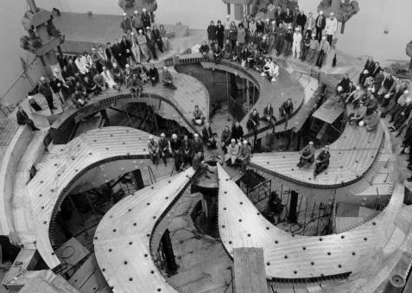
TRIUMF 5 year plan
The detector center
Focus on emerging technologies
  Different level of emerging
Fosters collaborations
  Internal across dept. and div.
Seeds new projects
  Enable fleshing out ideas
Foster technical capabilities
  ”Talent” management
  Teamwork
  Operation of key equipment
  … My wish, admin support for collaboration, grants, networking

Slide 13
Detector center & quantum
Detector center is an opportunity for TRIUMF
  5 year plan funding is important for long term stability
  Funding opportunity aplenty
  Key is working together and being strategic
My proposal for “Pushing the envelope” workshop in September did not happen
  Too much time spent on figuring out what to do for CFI
Happy to help make Quantum effort a success even though I am not always quite sure what it means

Slide 14
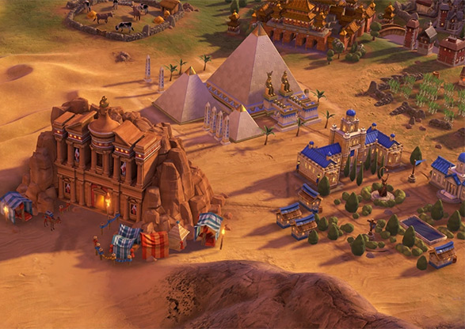
Ultimate goal is making wonders
Detector Center and Sci Tech together
From early technology to building complete system
The end goals are systems with world leading capabilities
  Deliver world leading science
  Inspire our staff
  Challenge ourselves
  Establish an outstanding reputation
Build upon earlier successes

Slide 15
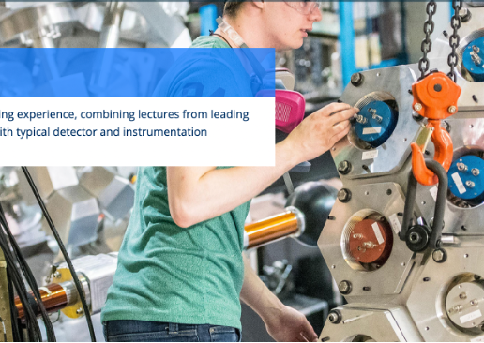

NSERC CREATE
ISOSIM was very effective
  And a lot of work
TRIUMF has a strong track record of student teaching at graduate level
Need to coalesce around a compelling program
Need a champion!

Slide 16
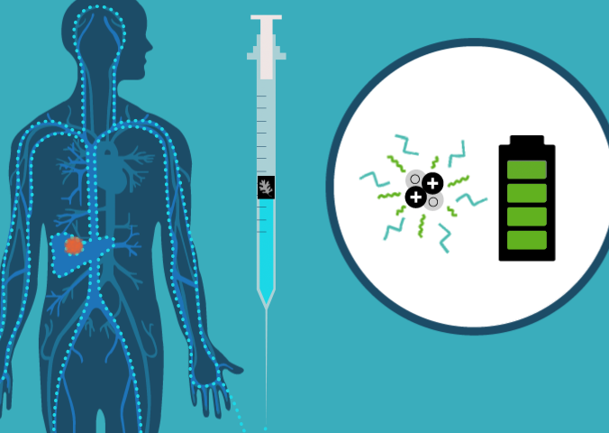
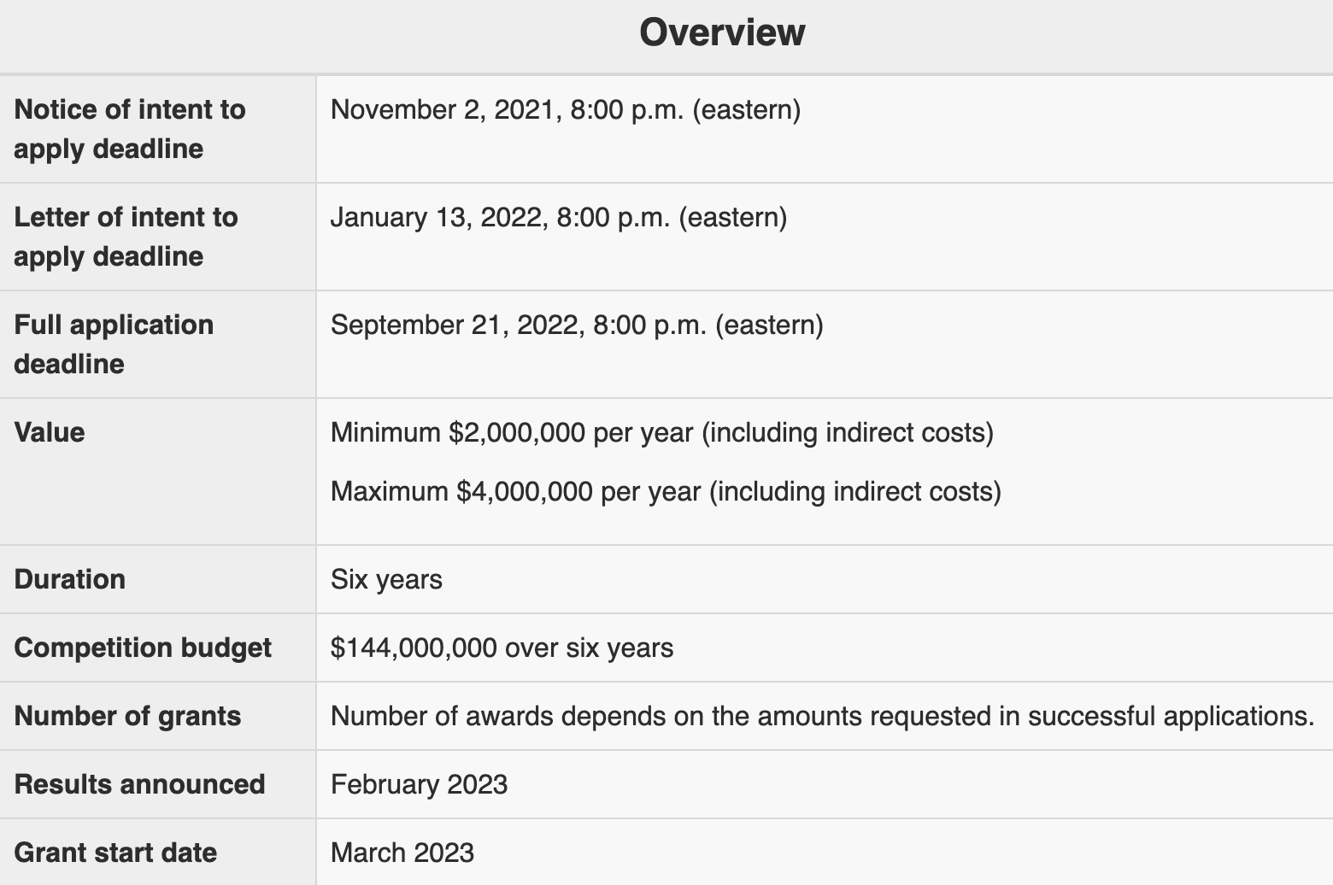
Transformation in 2024?
  Major multi-disciplinary program
  Ideas?
    Therapeuthic isotope imaging
    Detectors for Science and climate change
Exploration in 2023 (sept?)
  Stepping stone
Need partners as multi-disciplinary is key

