Slide 1
Quantum Science Centres Across Canada and Around the World
Iain McKenzie

Slide 2
Typical University Organization Schemes
Faculty of Engineering
Faculty of Science
Mechanical Engineering
Electrical Engineering
Physics
Chemistry
Biology
Civil Engineering
Computer Engineering

Slide 3
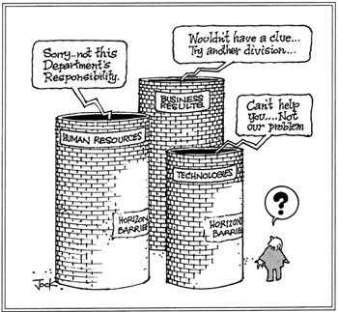
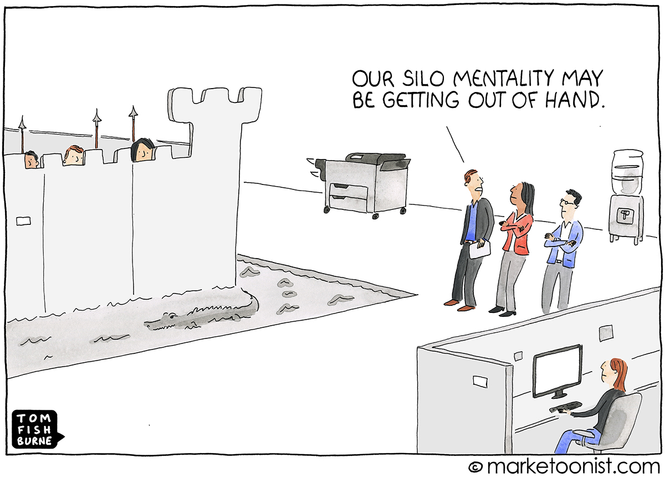
Organizational Silos in Business and Academia
Problems arise when individual departments become so focused on their own priorities that they lose track of the organization’s wider needs.
Inefficiencies and missed opportunities

Slide 4
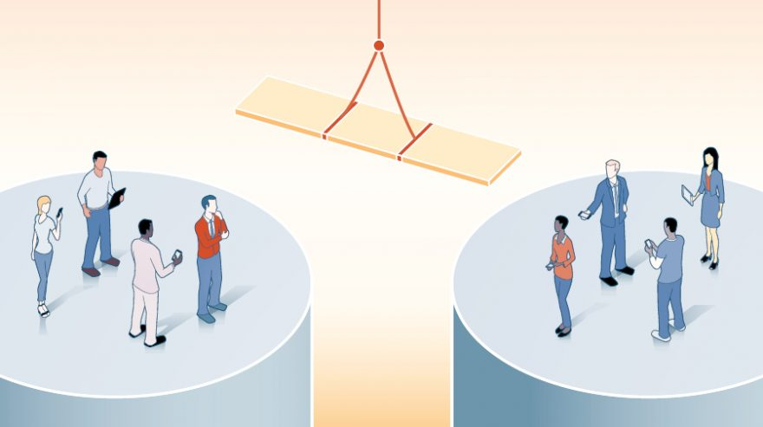
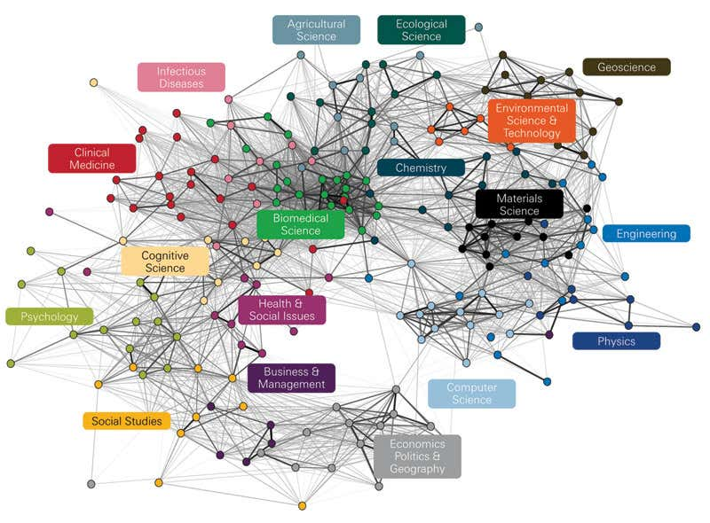
Breaking Down Silos – Encouraging Interdisciplinary Science
Map of journal cross-citations
Node = subdiscipline
Get executive buy-in
Bring teams together
Create a unified vision
Develop shared goals
Incentivize collaboration
https://www.newscientist.com/article/mg20928002-100-open-your-mind-to-interdisciplinary-research/

Slide 5
Quantum Science Centres Vs. Typical University Organization Schemes
Faculty of Engineering
Faculty of Science
Mechanical Engineering
Electrical Engineering
Physics
Chemistry
Biology
Civil Engineering
Computer Engineering
Quantum Science Centres

Slide 6
Electrical Engineering
Physics
Quantum Science Centres
Computer Engineering
Chemistry

Slide 7
Canada
Worldwide
UBC Stewart Blussom Quantum Matter Institute https://qmi.ubc.ca/
U. Calgary Institute for Quantum Science and Technology https://iqst.ucalgary.ca/
U. Saskatchewan quanTA: Centre for Quantum Topology and Its Applications https://artsandscience.usask.ca/quanta/index.php
U. Waterloo Institute for Quantum Computing https://uwaterloo.ca/institute-for-quantum-computing/
U. Toronto Centre for Quantum Information and Quantum Control https://cqiqc.physics.utoronto.ca/
U. Sherbrooke Institut Quantique https://www.usherbrooke.ca/iq/en/
ORNL Quantum Science Center https://qscience.org/about/
Fermilab Superconducting Quantum Materials and Systems Center https://sqmscenter.fnal.gov/
LBNL Quantum Information Science and Technology https://cs.lbl.gov/what-we-do/quantum-computing/
LLNL Quantum Science and Technology https://quantum.llnl.gov/
Munich Center for Quantum Science and Technology https://www.mcqst.de/research/overview/
DESY Center for Quantum Technology and Applications (CQTA) https://quantum-zeuthen.desy.de/
CERN Quantum technology initiative https://quantum.cern/
And more……

Slide 8
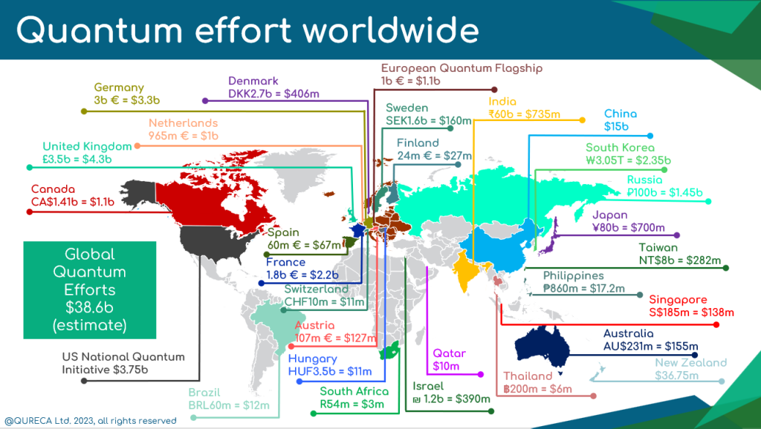
https://qureca.com/overview-of-quantum-initiatives-worldwide-2023/

Slide 9
What can TRIUMF learn from Quantum Science Centres in Canada and around the world?
Similar visions – quantum science as a unifying
Similar organizational structures (cross departmental)
Varying emphasis on five principal quantum technologies reflecting the underlying strengths of the organization.
Rely on the nebulous definition of ‘quantum’ to include a wide range of science.
How effective are they in practice?

Slide 10
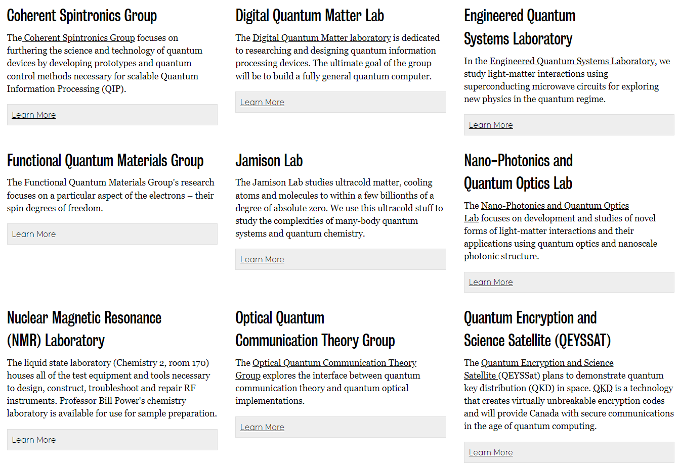



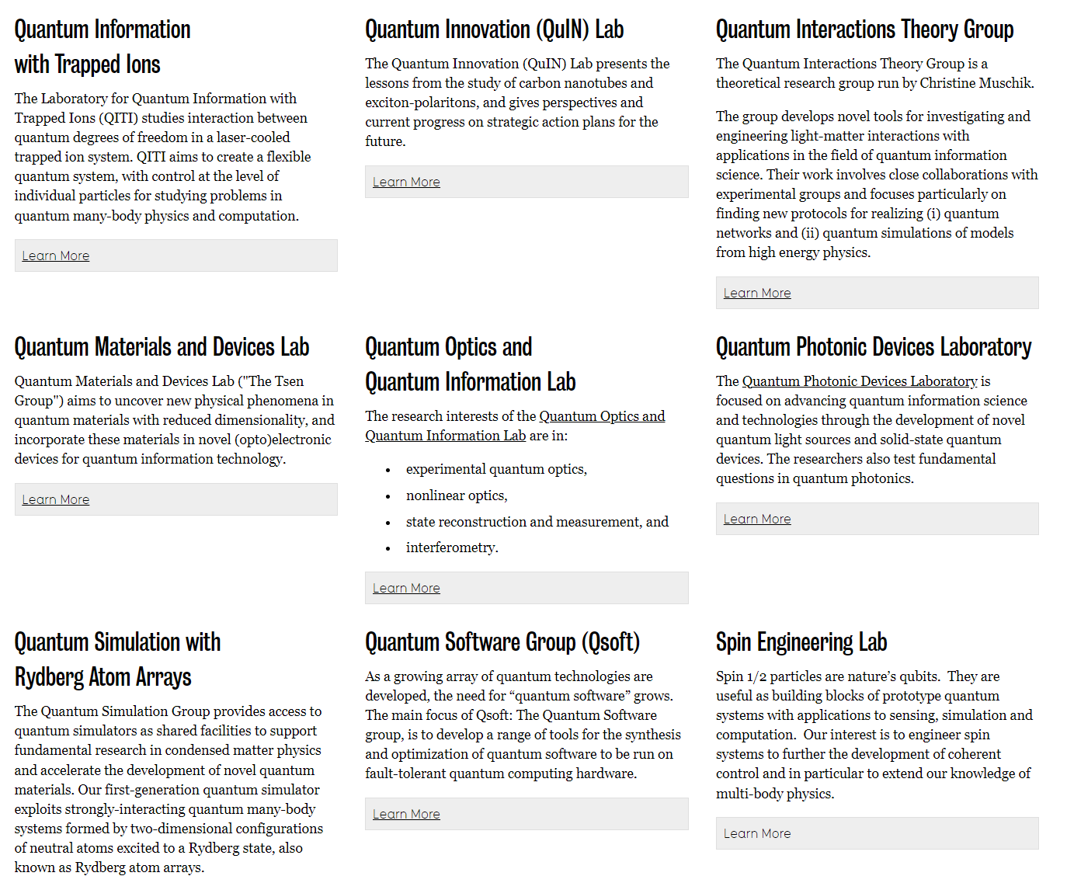

Slide 11

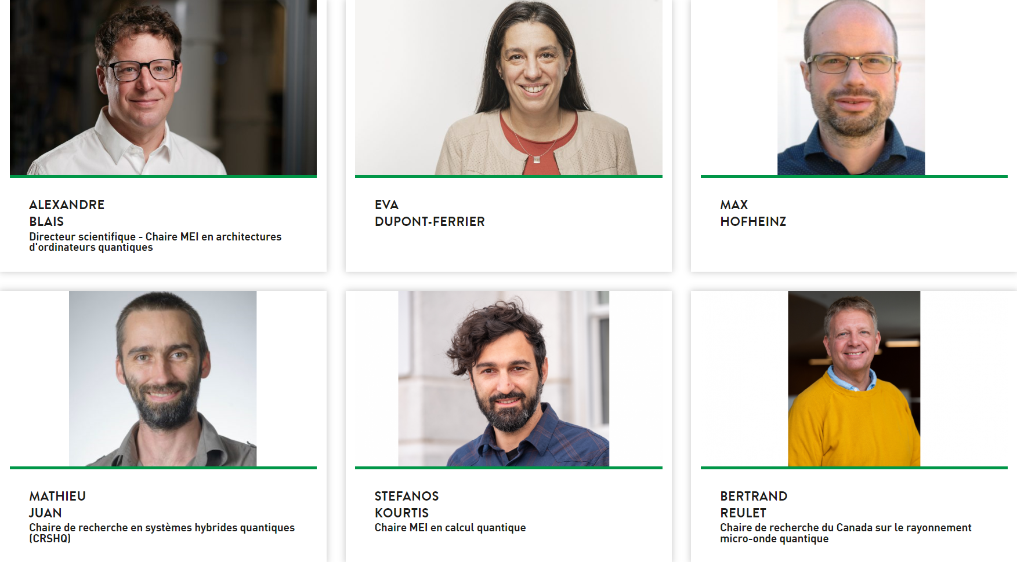
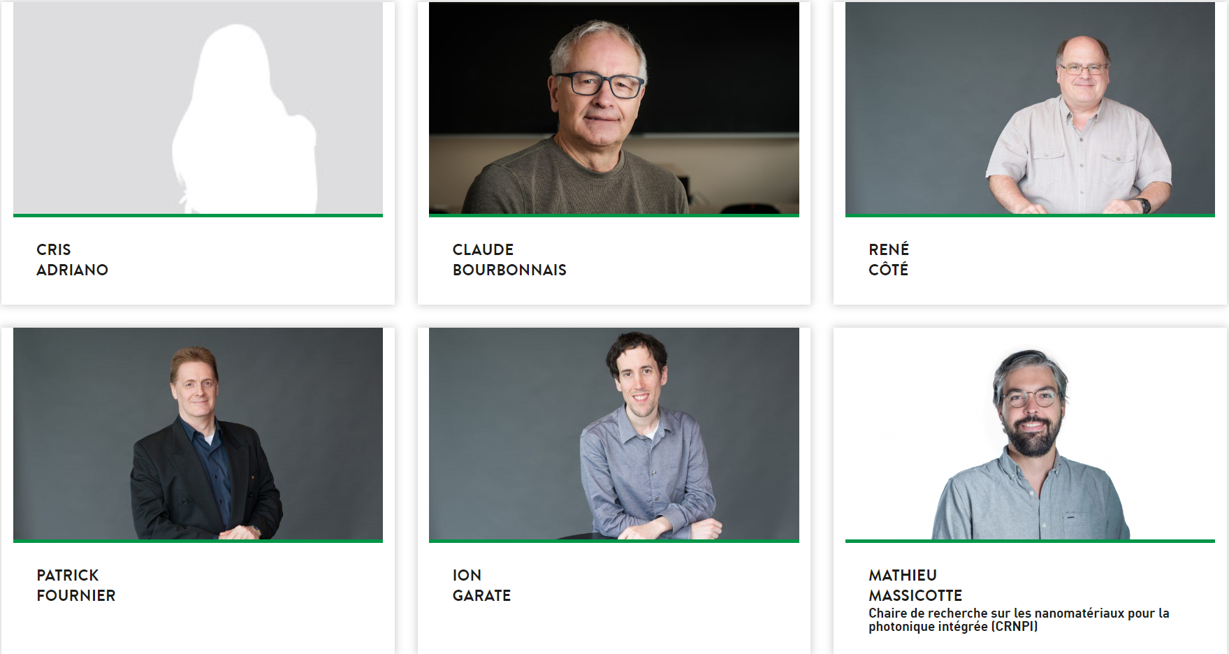
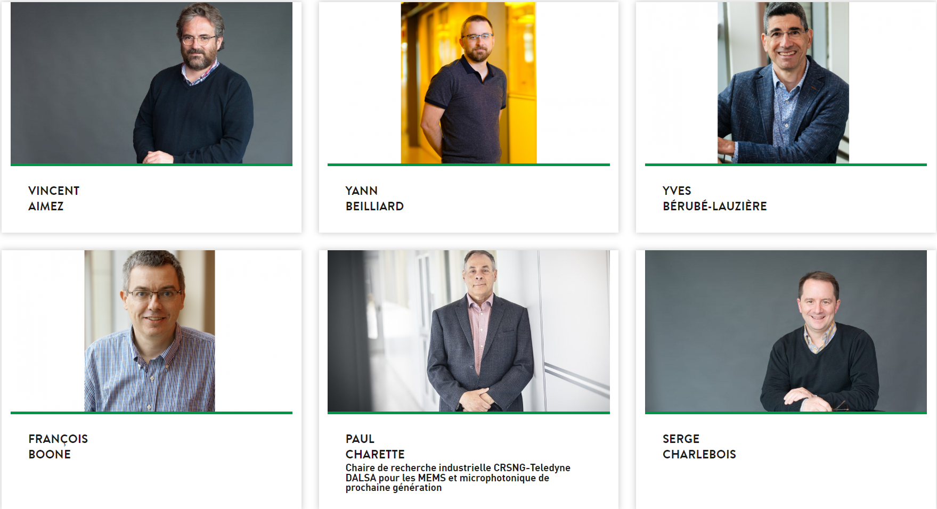
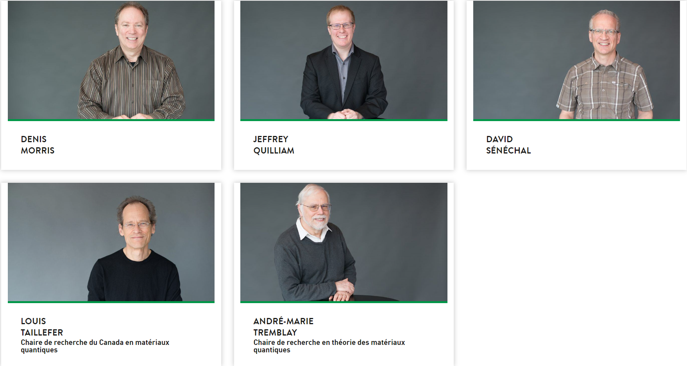
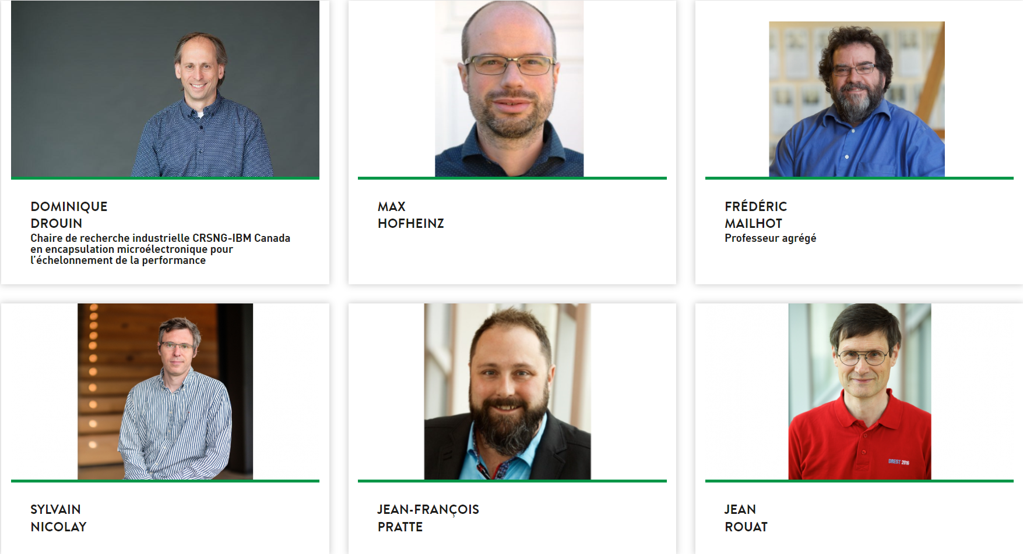
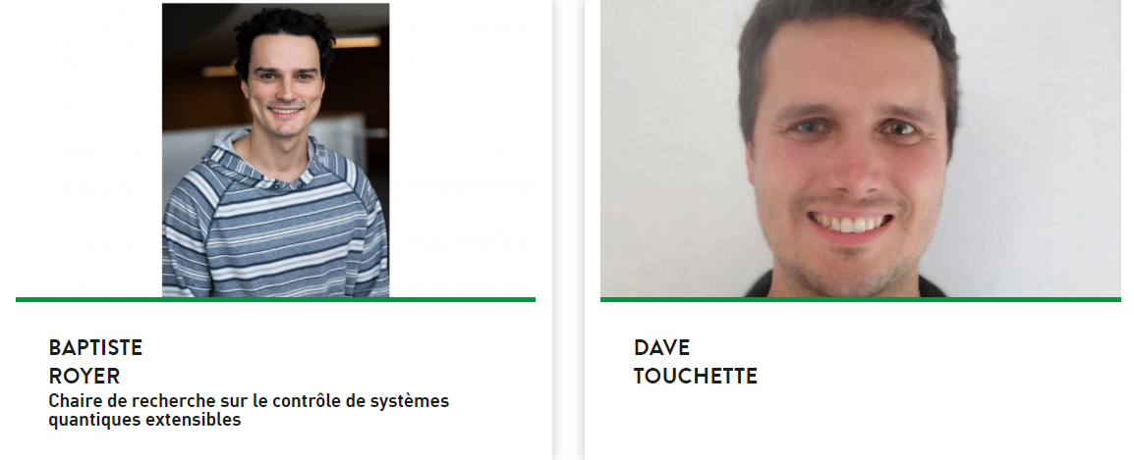
Quantum Information
Quantum Materials
Quantum Engineering

Slide 12

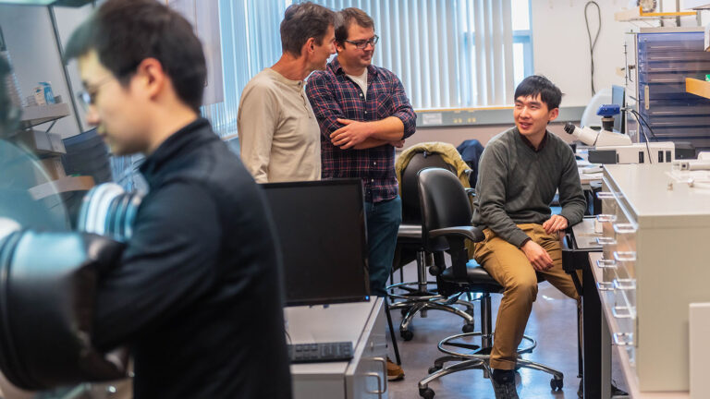
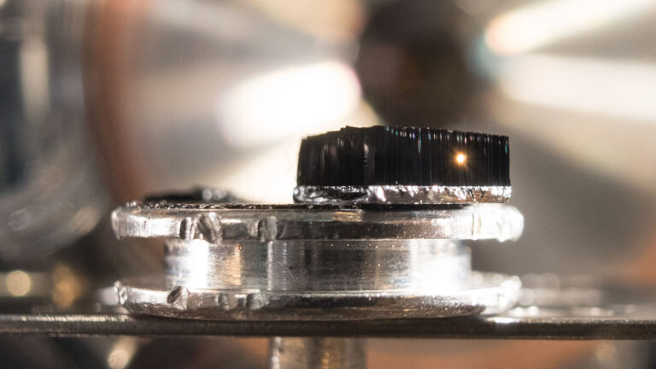
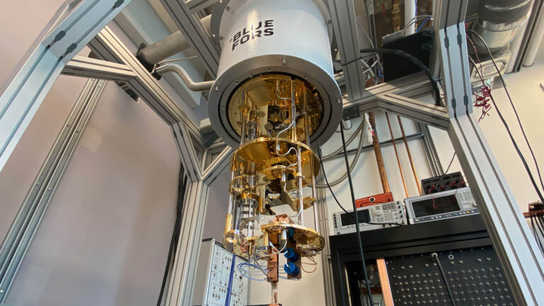
Grand Challenges
Research Themes
Atomic Level Design of Quantum Materials
Emergent Electronic Phenomena at Interfaces
Topologically Protected Quantum States
Photonic Manipulation of Quantum States
Engineering exotic phases in 2D materials
Atomistic approach to emergent properties of disordered materials
Pushing the boundaries of Noisy Intermediate Scale Quantum (NISQ) computing by Focusing on Quantum Materials

Slide 13
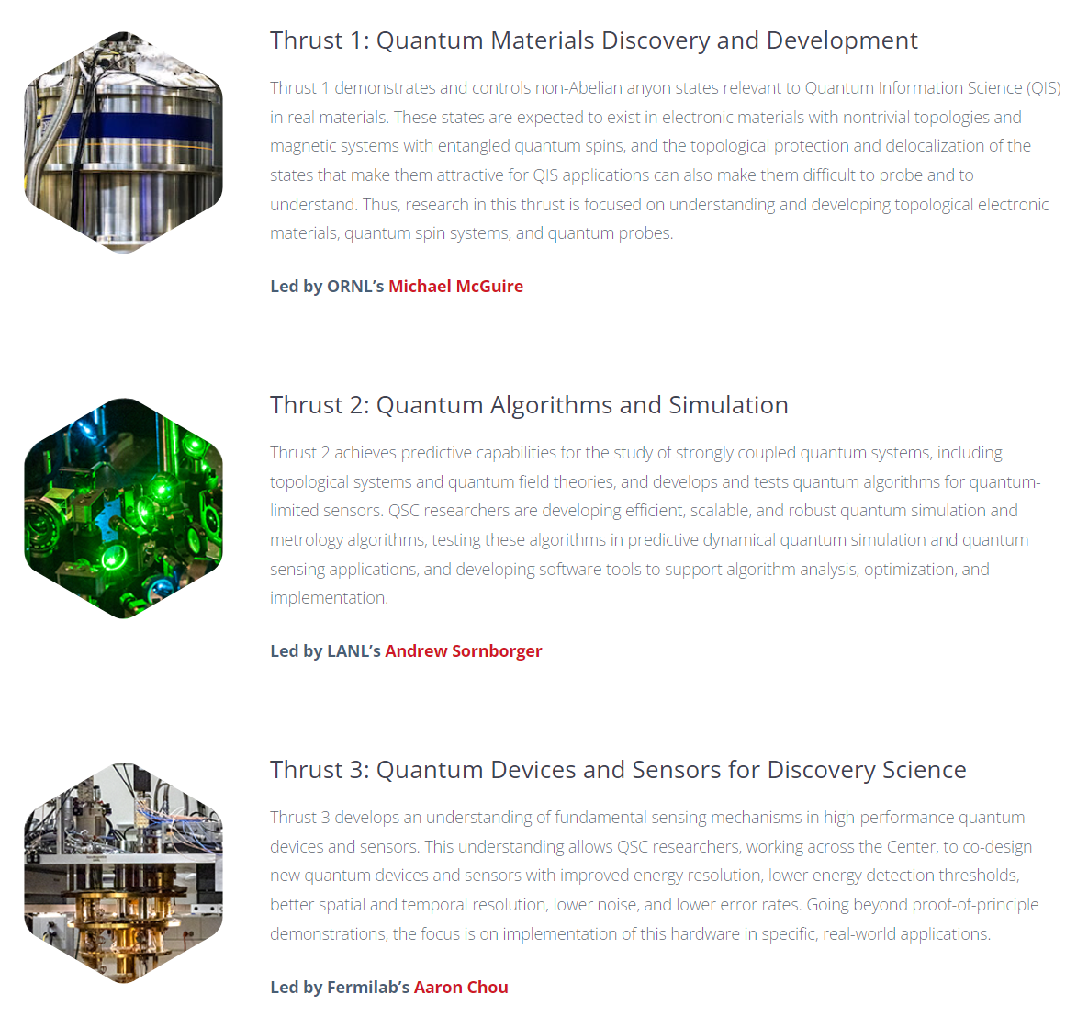



Slide 14
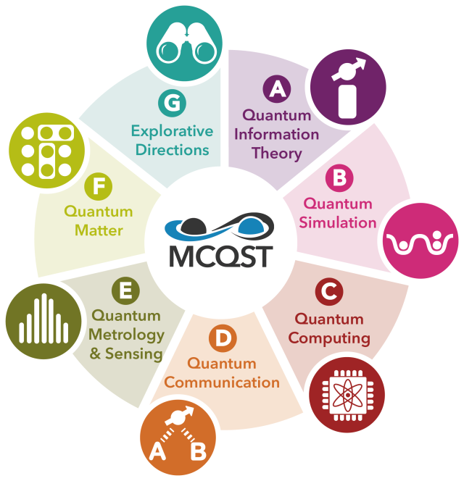
Explore and identify novel research directions for QST in other fields of science, including fundamental physics, cosmology, high-energy physics, and quantum chemistry.
Munich Center for Quantum Science and Technology

Slide 15
