Slide 1
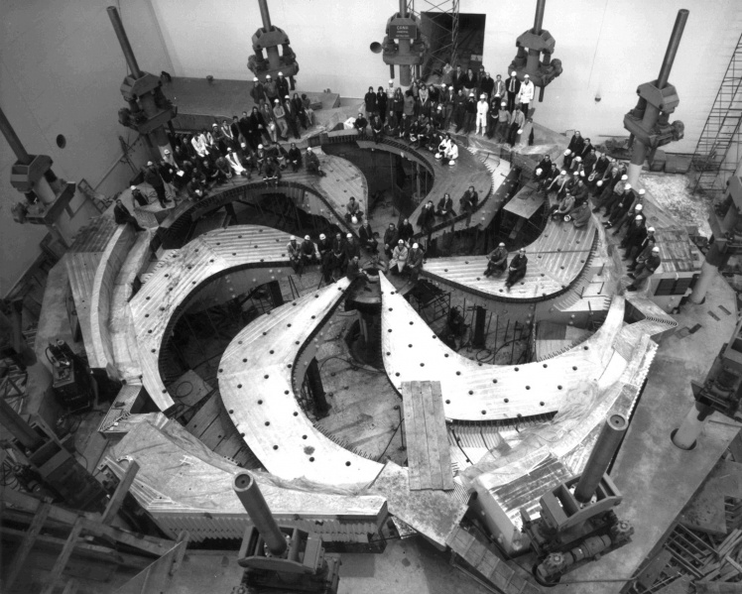
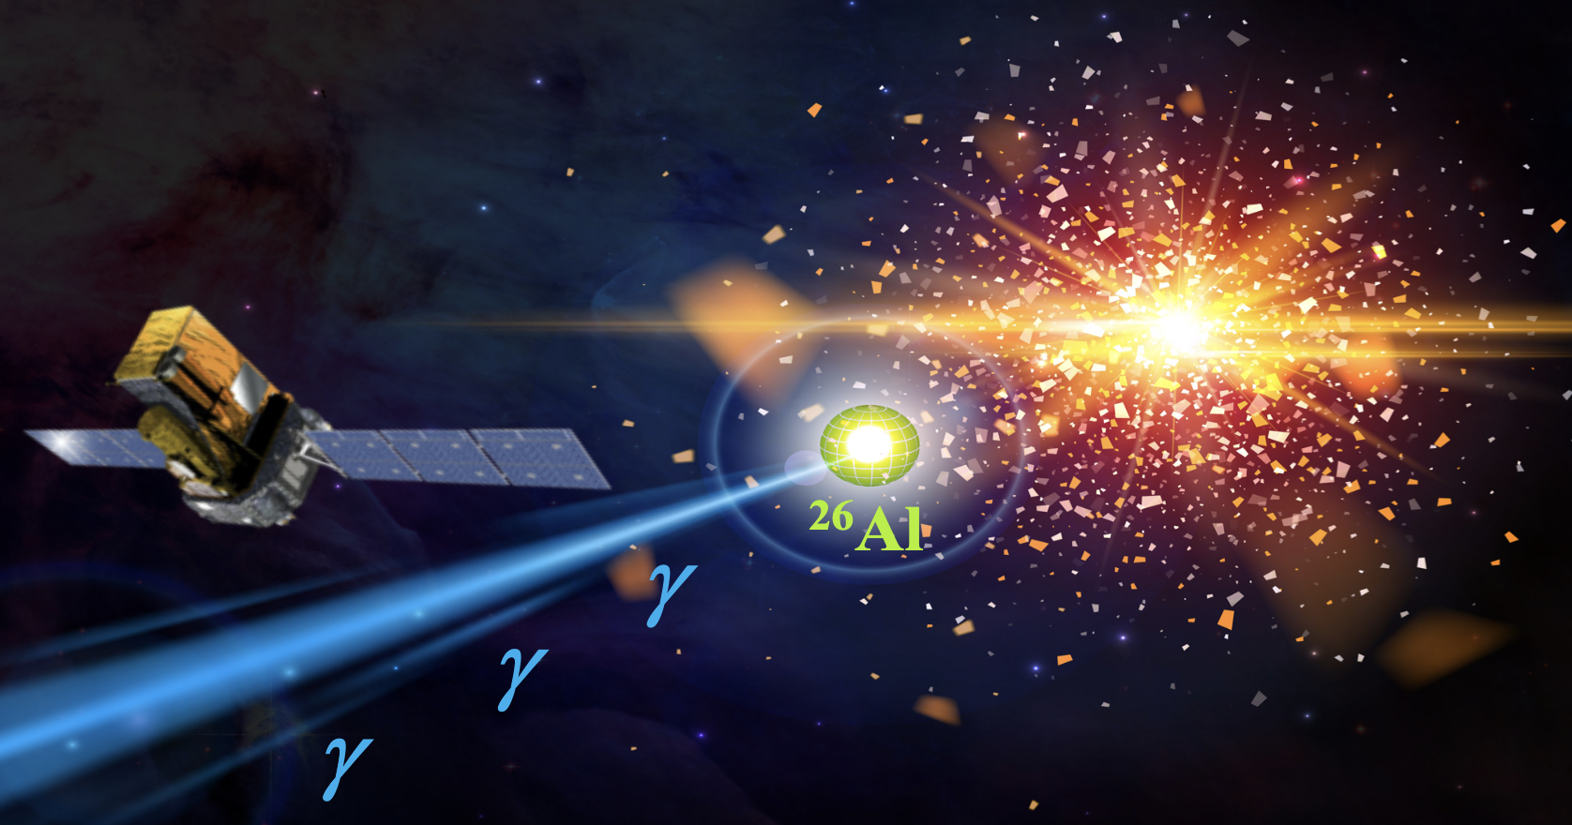
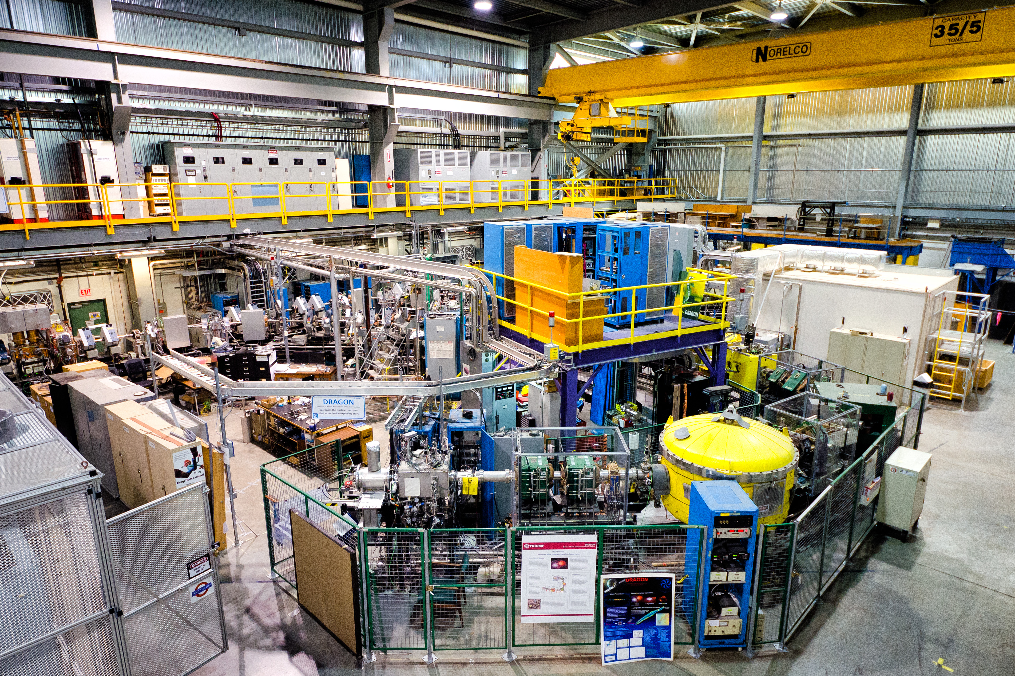
Radiative capture on a nuclear isomer
– Direct measurement of the ^{26m}Al(p,γ)²⁷Si reaction at DRAGON
Annika Lennarz
Division of Physical Sciences | TRIUMF
CaNPAN meeting - May 1-3, 2024

Slide 2
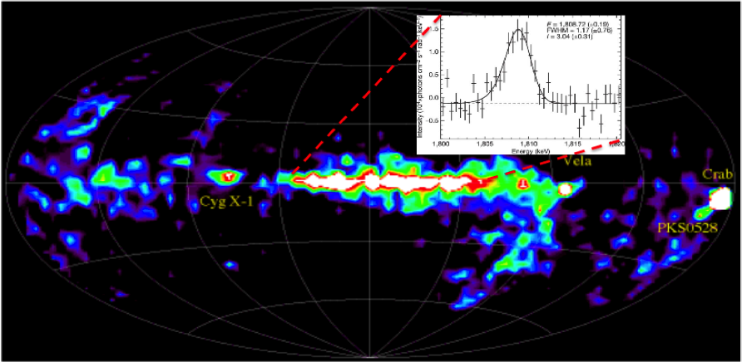
Cosmic γ-ray emitter ²⁶Al
Relatively short half-life (0.72 Myr) provided first direct evidence of active nucleosynthesis in our Galaxy (1.809 MeV γ-ray)
➔ Tracer for star formation!
²⁶Mg isotopic excesses in meteorites
➔ Early Solar System
Image credit: Erin O’Donnell
The radioisotope ²⁶Al provides insight into the nature of nuclear processes in stars in the Milky Way.
Identifying the main sources of ²⁶Al would have far-reaching implications:
Circumstances & conditions of the solar system birth
Strong constraints on the chemical evolution of the Galaxy
However, it’s astrophysical origin is still under debate!
Annika Lennarz – CaNPAN meeting 2024

Slide 3
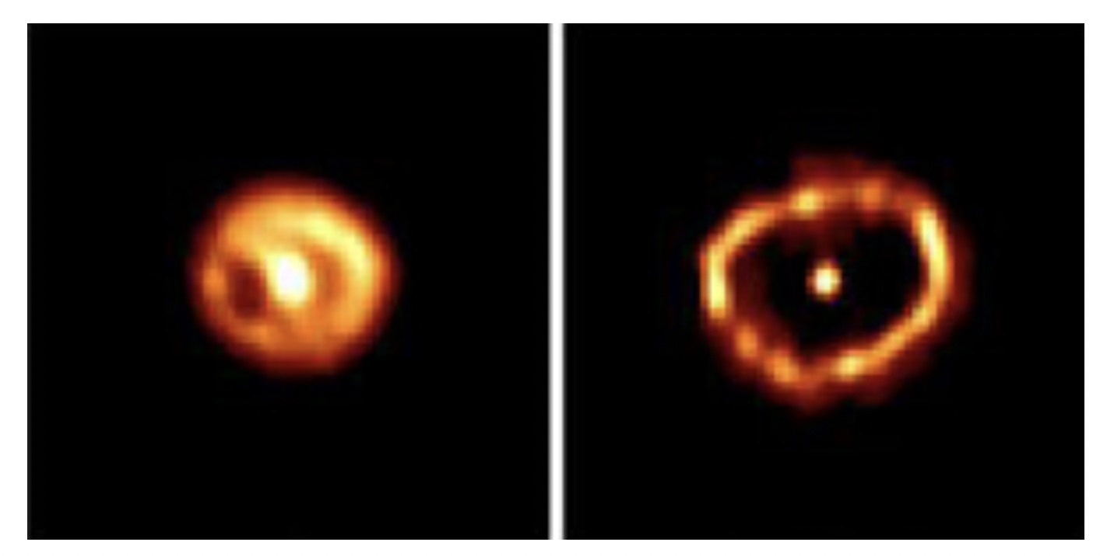
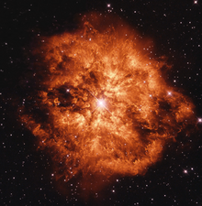
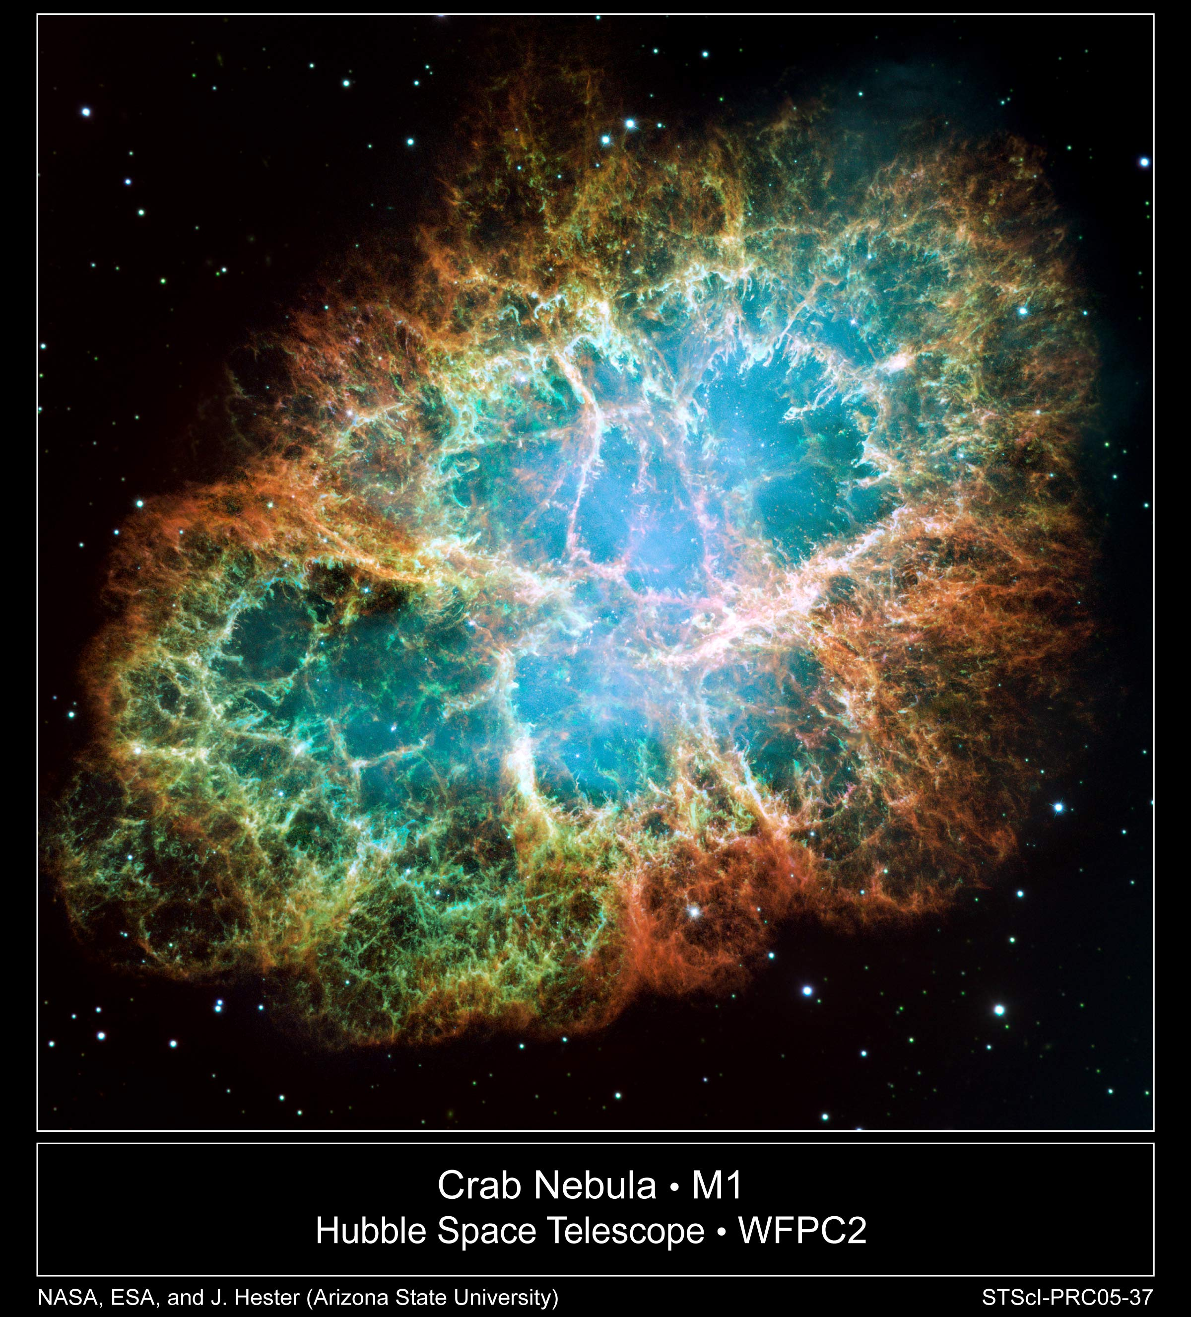
Sensitivity studies:
show that this uncertainty leads to
variations of up to two orders-of-magnitude in AGB calculations [89].
The astrophysical origin of ²⁶Al
Several stellar sites discussed:
Massive & very massive stars
  Wolf-Rayet winds
  & their final Core-Collapse Supernovae (CCSN)
Winds of low- & intermediate-mass AGB stars
Novae ejecta
Several stellar sites:
Classical novae
Convective core hydrogen burning in massive stars
Hydrogen burning in intermediate-mass AGB stars
Evolution of the shell of material around Nova Cygni 1992
  ²⁶Al/²⁷Al ratios in presolar grains suggest nova or AGB star origin [Bose & Starrfield, APJ. 873, 14 (2019)]
  Satellite missions ➔ massive stars and CCS [R. Diehl et al., Nature (London) 439, 45 (2006)]
“To properly interpret the large variety of astronomical and meteoritic data, it is crucial to understand both the nuclear reactions involved in the production of ²⁶Al in the relevant stellar sites and the physics of such sites!”
Annika Lennarz – CaNPAN meeting 2024

Slide 4
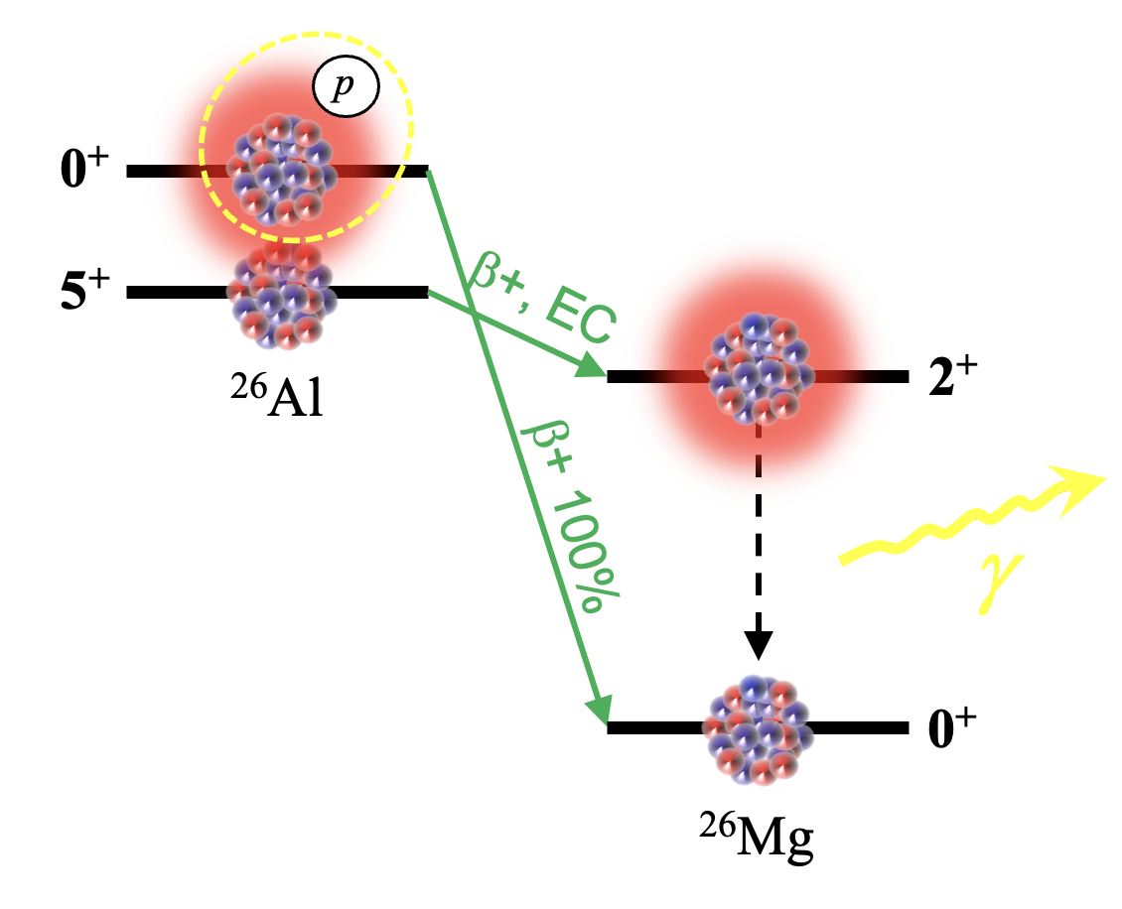
^{26m}Al(p,γ)²⁷Si – Destruction of ²⁶Al
Need to understand production & destruction of ²⁶Al in stellar scenarios!
Experimental physics has focused on reactions on nuclear ground states
²⁶Si
²⁷Si
²⁸Si
Nucleosynthesis of ²⁶Al is complicated by the presence of an isomer (E_{x} = 228.31(3) keV)
²⁵Al
²⁶Al
²⁷Al
Can act as entirely separate nuclei!
6.3s
²⁴Mg
²⁵Mg
²⁶Mg
E_{x} = 228.31(3) keV
Need to measure proton capture on excited quantum state of ²⁶Al
EXPERIMENTAL CHALLENGE
Proton capture reactions on ^{26m}Al impact all observational signatures of ²⁶Al in our universe (directly or indirectly)
bypasses emission of the 1.809 MeV γ ray
WOLF-RAYET STARS
Figure from G. Lotay
Annika Lennarz – CaNPAN meeting 2024

Slide 5
Previous work
States of relevance for the ^{26g}Al(p,γ)²⁷Si reaction have been studied extensively
BUT: Little experimental information is available on the rate of the ^{26m}Al(p,γ)²⁷Si reaction
Difficulty in producing pure, isomeric ²⁶Al beams to probe low-spin excited states in ²⁷Si.
Recent study by Hallam, Lotay et al. used concept of isospin symmetry to mimic proton capture on isomer via a ²⁶Si(d,p)²⁷Si transfer reaction study
➔ Stringent upper limits were placed on the spectroscopic factors of all resonant levels with E_{r} < 500 keV
➔ Estimated ωγ(447-keV) ~ 385meV ➔ resonance is likely to dominate the entire ^{26m}Al(p,γ) rate for T > 0.3 GK
2009: Deibel et al. used ²⁷Al(³He,t)²⁷Si*(p)²⁶Al & ²⁸Si(³He,α)²⁷Si*(p)²⁶Al to observe p-decays from excited states and found E_{r} = 445(4) keV
[Deibel et al., Phys. Rev. C80, 035806 (2009)]
2009/10: Lotay et al. performed spectroscopy study (Argonne) identifying low-energy ^{26m}Al + p states
E_{r} = 447.7(6) keV, J = ½, + 4 more lower energy resonances.
However, exact strengths unknown!
[S. Hallam et al., Phys. Rev. Lett. 126, 042701 (2021)]
[G. Lotay et al., Phys. Rev. C80, 055802 (2009)]
Annika Lennarz – CaNPAN meeting 2024

Slide 6
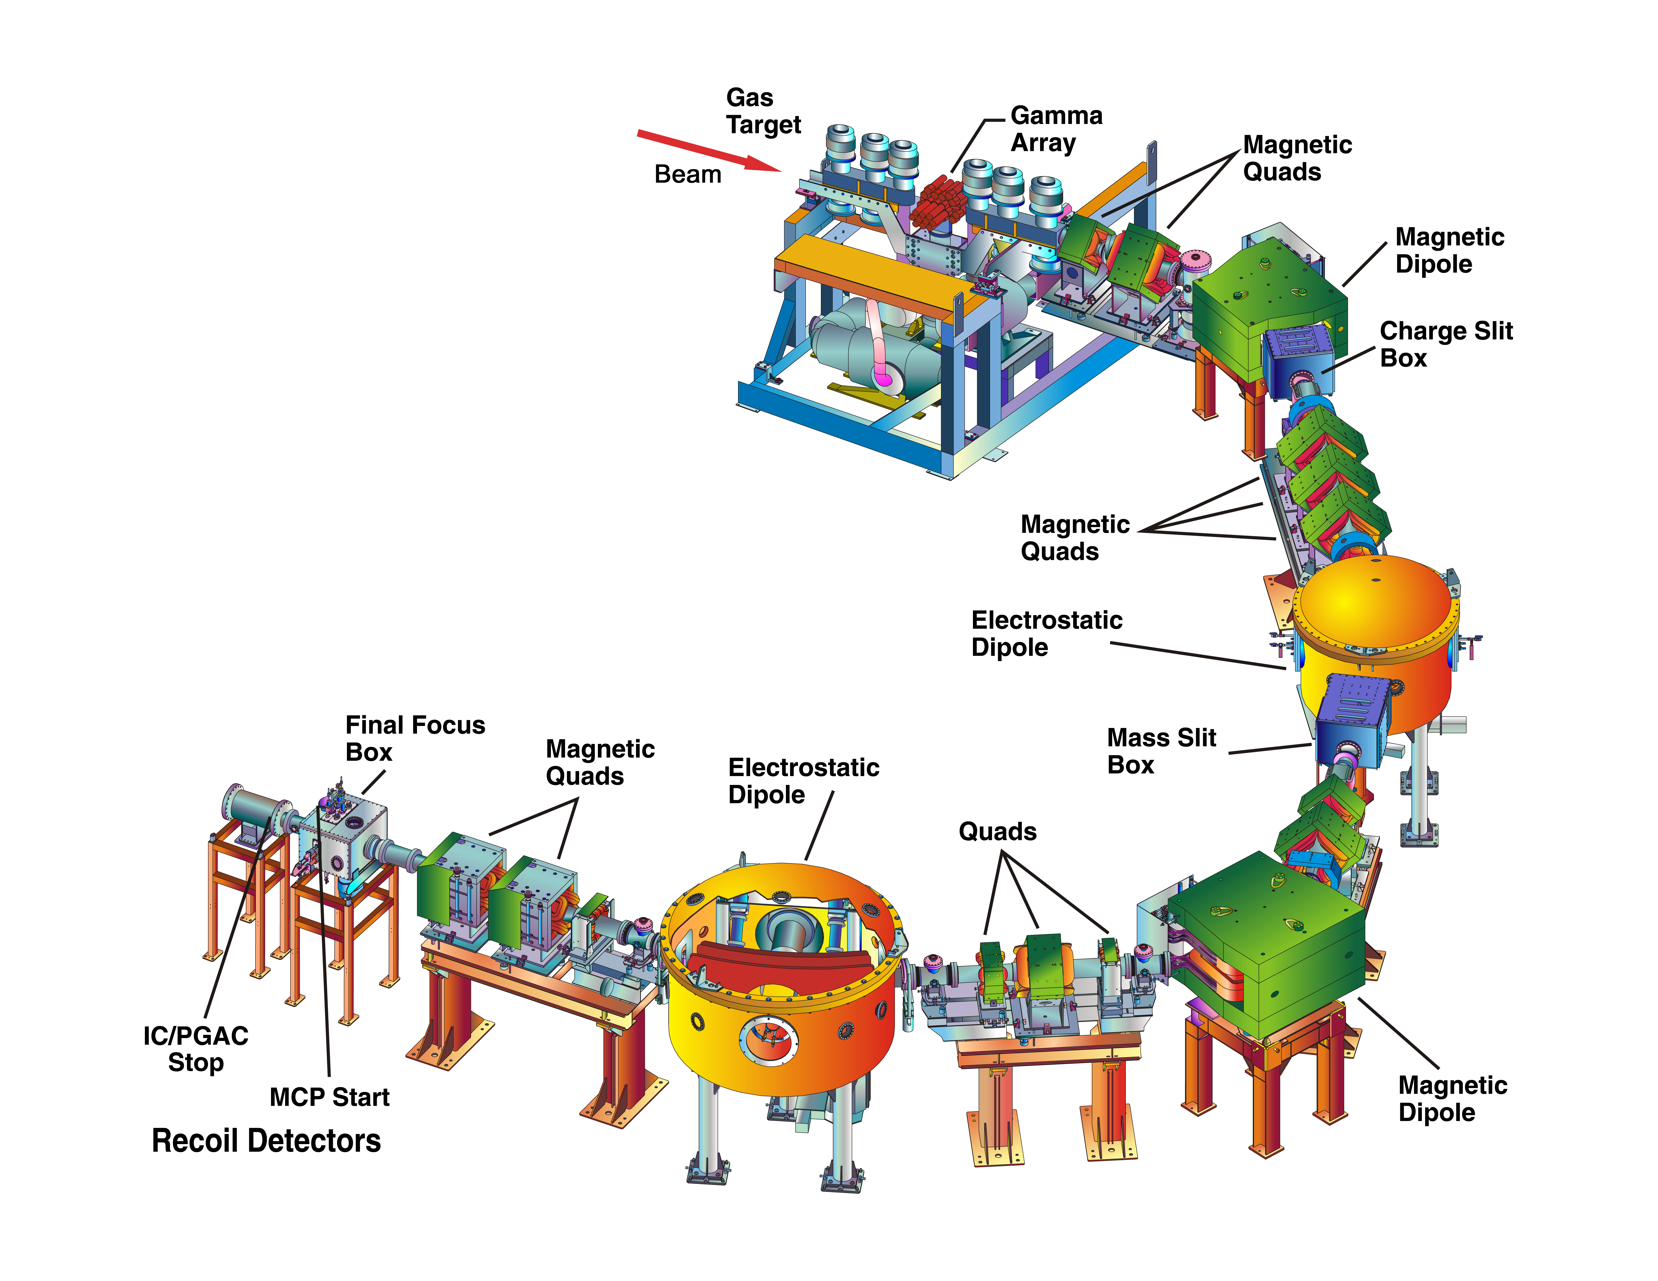
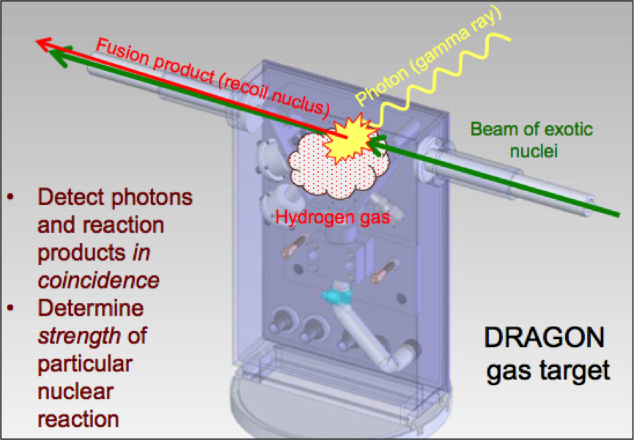

DRAGON – Detector of Recoils and Gammas of Nuclear Reactions
Windowless gas target
BGO γ-detection array
MEME mass separator
Recoil detection system
#reactions per incident ion
  Coincidence measurement: Prompt γ-rays, PID cuts & TOF
  suppression factor of ~10¹⁵ for p-capture & ~5x10¹⁷ for α-capture
Annika Lennarz – CaNPAN meeting 2024

Slide 7
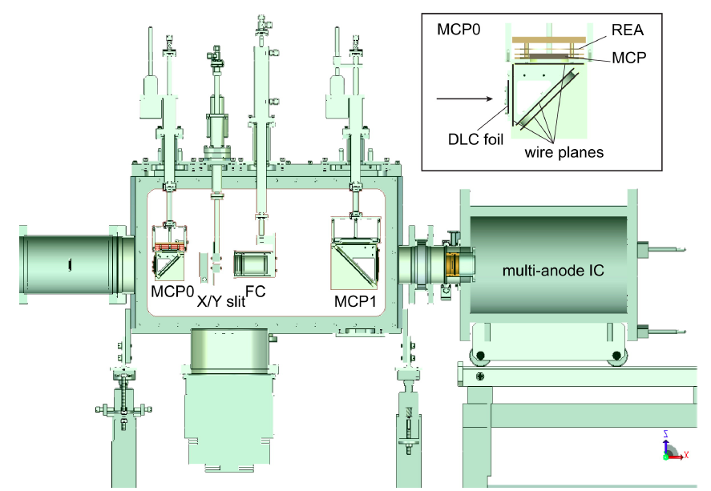
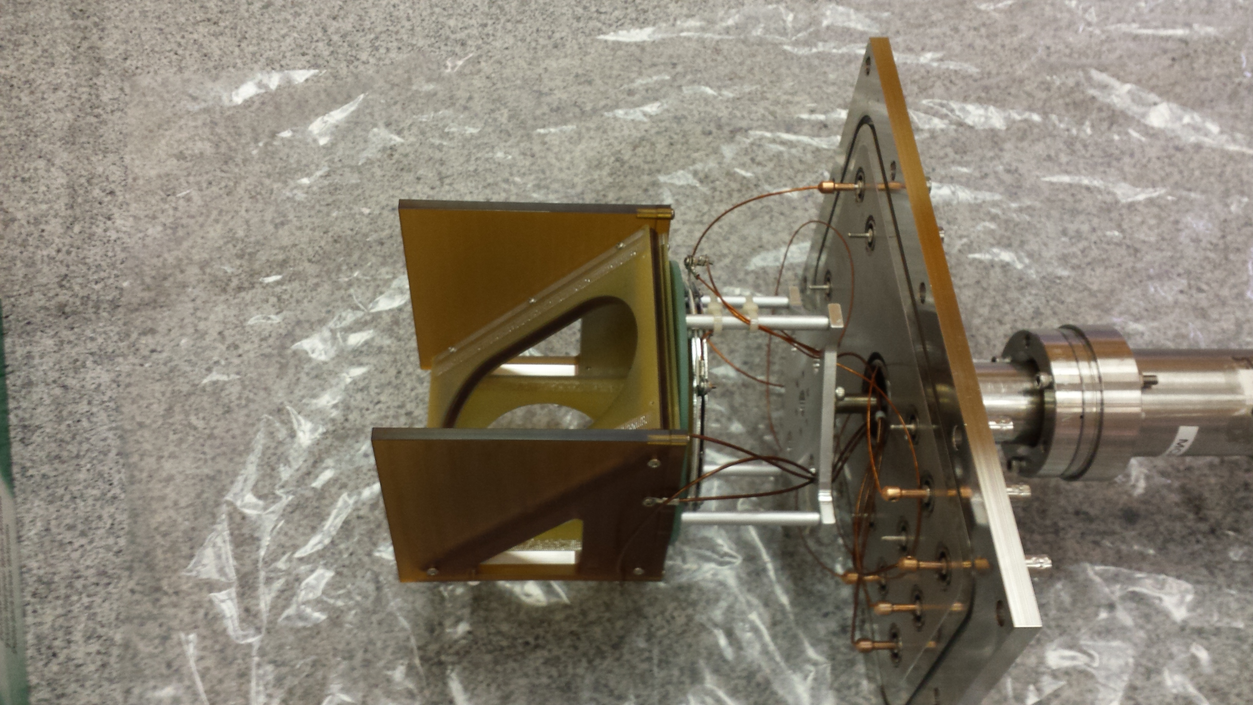
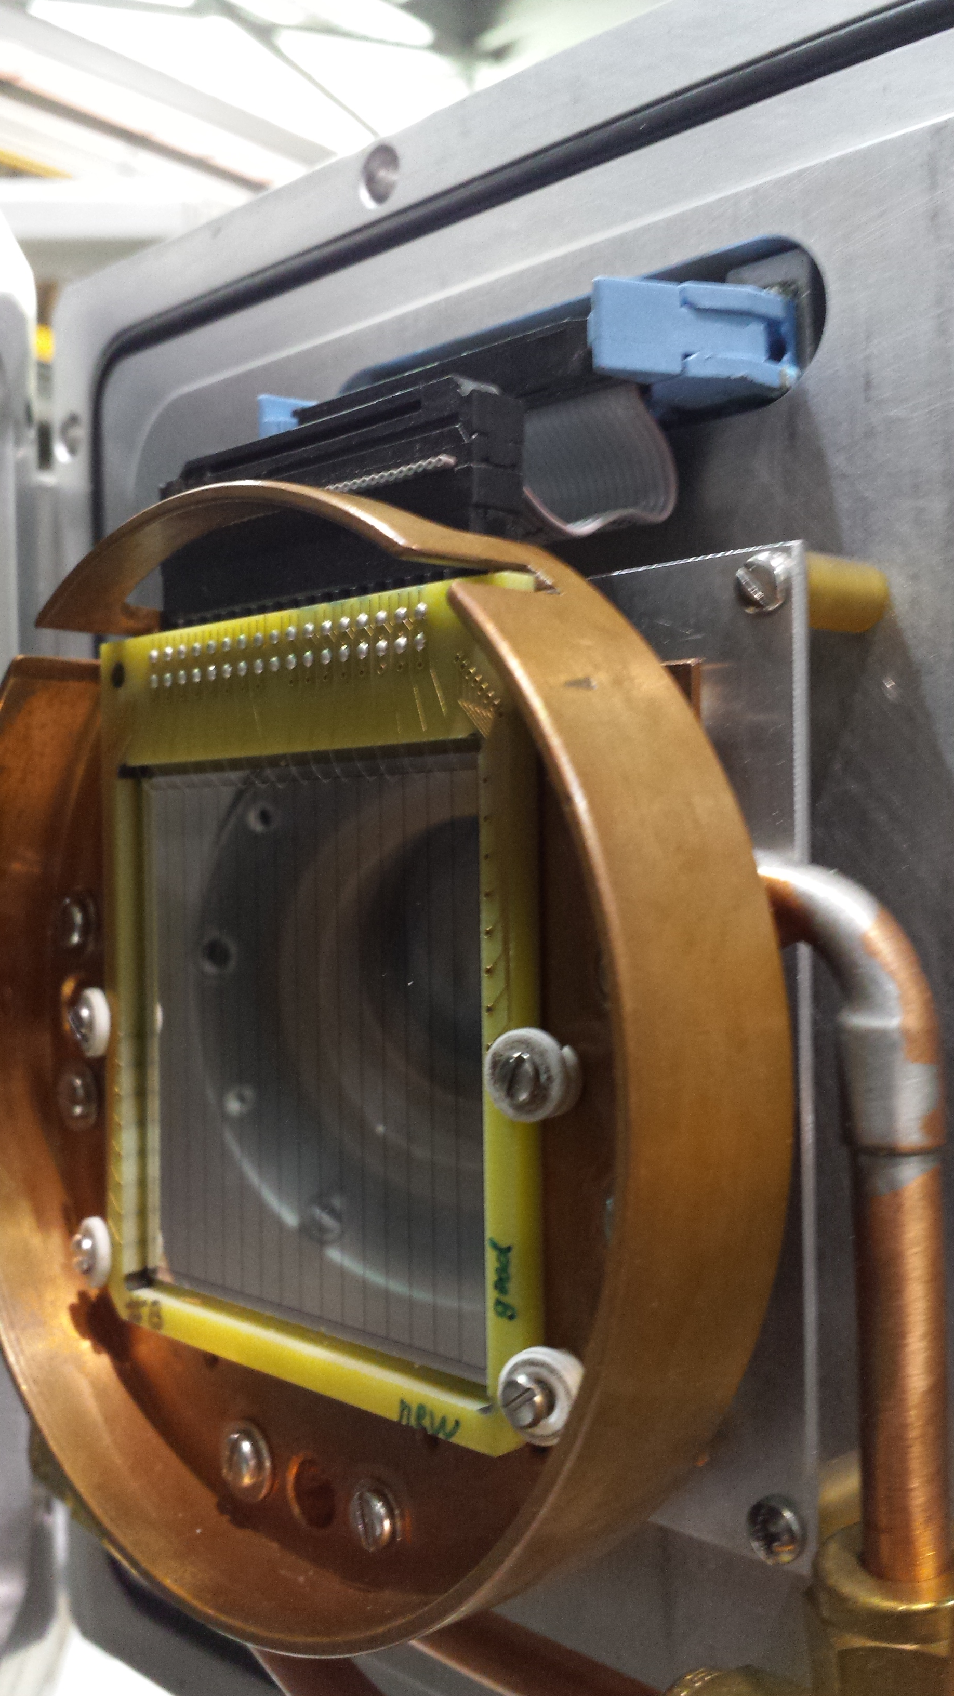
Particle Detection – End Detector Station
Interchangeable end detectors
IC, DSSSD or Hybrid
(Depending on reaction)
MCP based timing detector for local TOF
  Particle ID
  Local TOF
  ΔE/E, Total E
Beam/Recoils
ΔE-E in ionization chamber for
Z-identification
Absolute energy & position via double-sided silicon strip detector
(DSSSD)
Annika Lennarz – CaNPAN meeting 2024

Slide 8
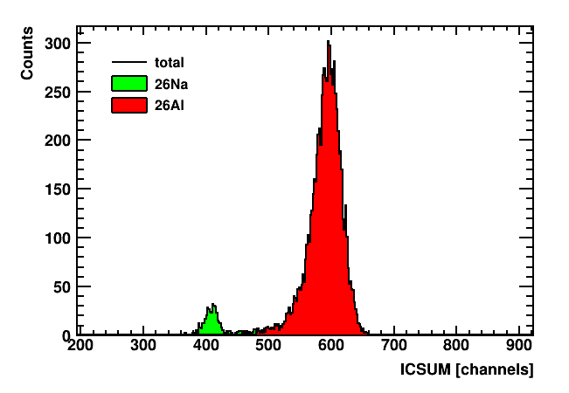
Experimental details
Beam composition
Data collection
p+ beam (70 μA) impinged on HP SiC target
Incoming beam composed of ^{26m}Al, ^{26g}Al, ²⁶Na
²⁶Na easily separated
Collected 50 hrs of data at E_{c.m.} = 447 keV at 5 T, q = 7+
Covered energy range from E_{c.m.} = 439 keV to 456 keV in target (E_{center} = 447 keV)
Measured ωγ of g.s. resonance at E_{c.m.} = 369 keV, q = 6+ as reference
Charge state distributions were measured for ²⁶Al and ²⁸Si in hydrogen
IC + MCPs for recoil detection
Total beam on target for 447 keV measurement:
6.21(2)E+14 incident ²⁶Al g.s. beam ions
7.5(2)E+10 incident ^{26m}Al beam ions
Annika Lennarz – CaNPAN meeting 2024

Slide 9
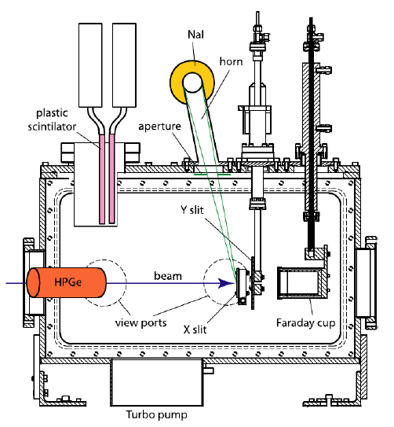
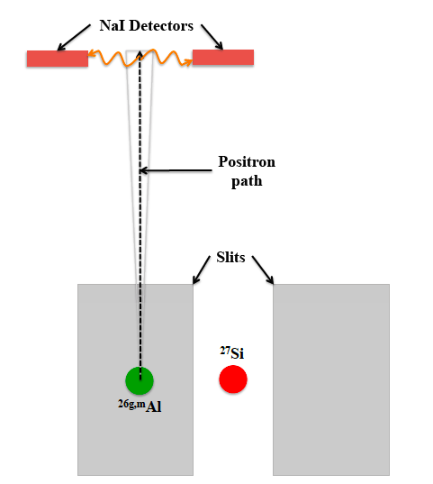
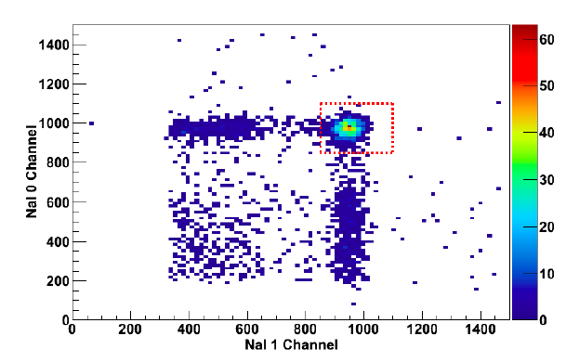
Normalization
All measurements of cross sections/resonance strength require knowledge of the number of particles incident on the target
Faraday Cup readings cannot distinguish between beam components
➔Isomeric component was identified by its associated β+ decay to the ²⁶Mg g.s.
Beam deposited on left mass slit downstream of ED1
Emitted positrons are “guided” up a horn at the center of two NaI scintillators positioned 180 degrees to each other.
Allows for β+ detection via annihilation in the horn and subsequent detection of 511 keV coincidence photons.
Figure from C. Vockenhuber et al. – NIMB 266, 4167 (2008)
Annika Lennarz – CaNPAN meeting 2024

Slide 10
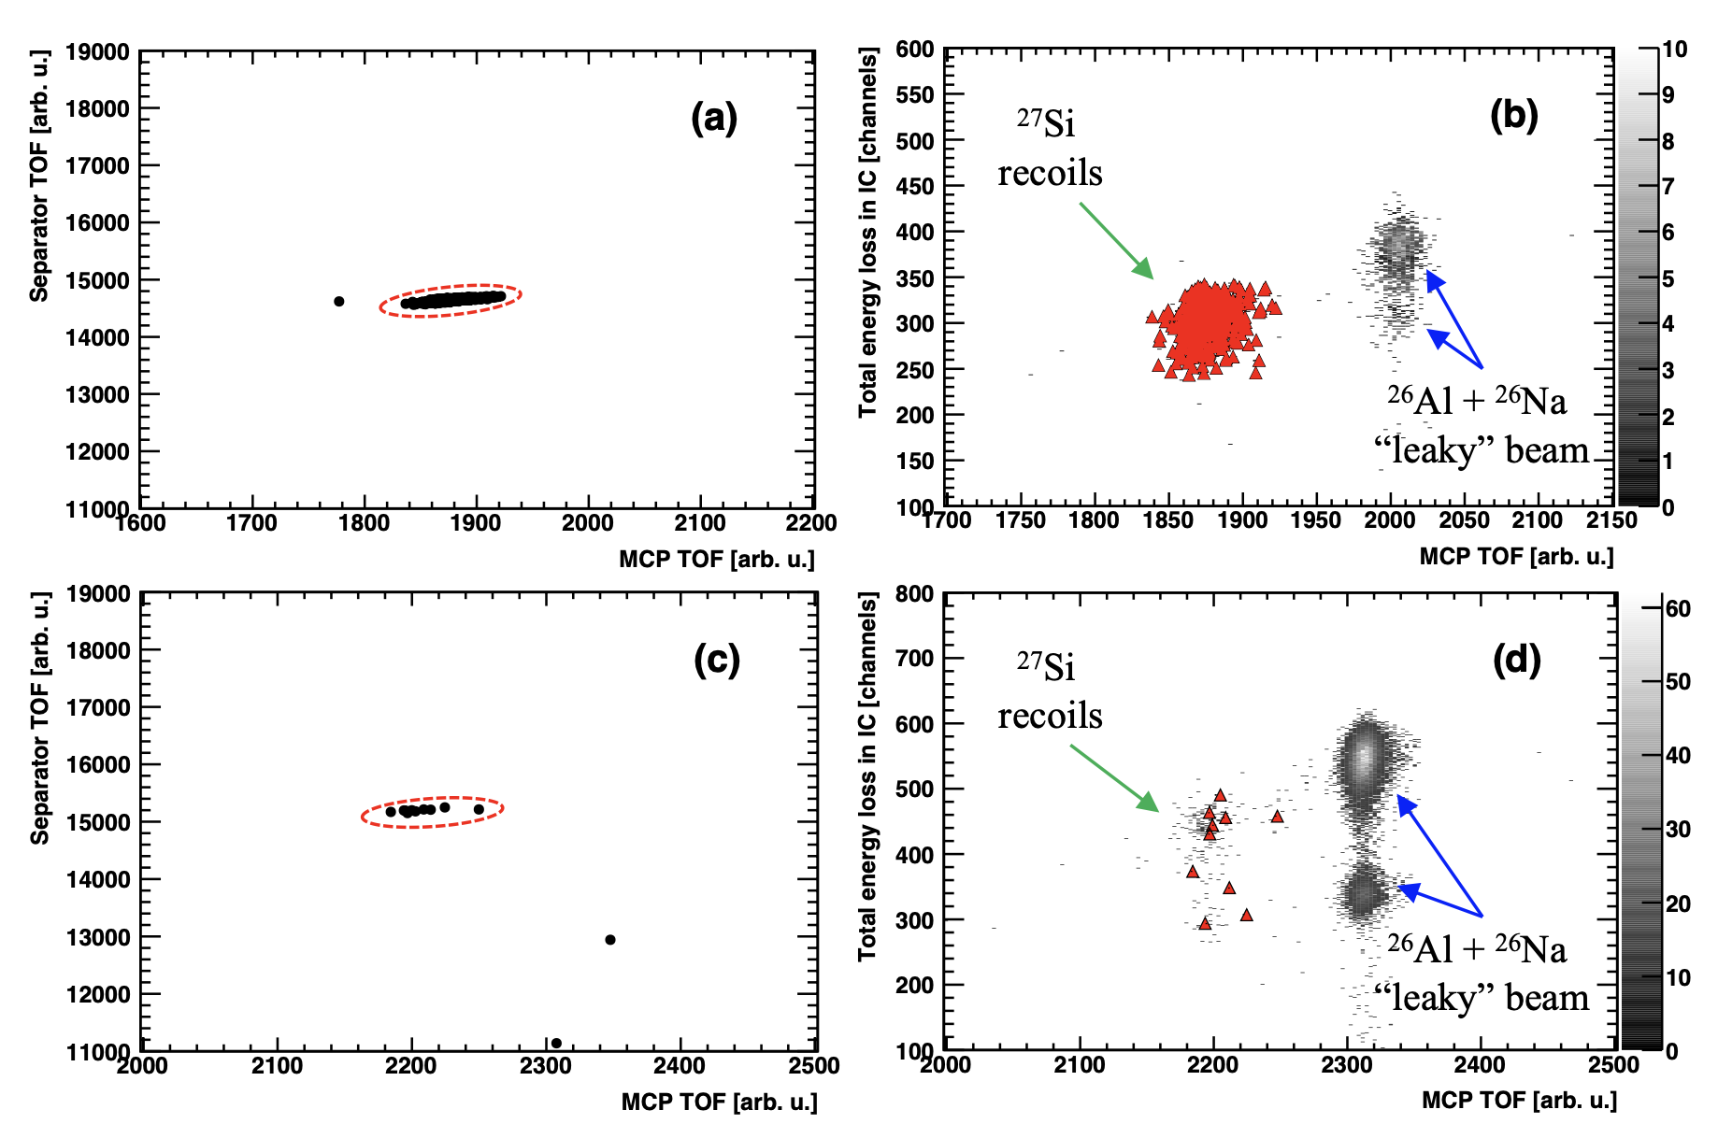
Particle Identification
Incoming beam composed of ^{26m}Al, ^{26g}Al, ²⁶Na
E_{c.m.} = 369 keV
DRAGON end detector system
10 golden recoils!
Beam/Recoils
E_{c.m.} = 447 keV
G. Lotay, A. Lennarz, C. Ruiz et. al., Phys. Rev. Lett. 128, 042701 (2022)
Used Ionization chamber & MCPs for recoil detection
Annika Lennarz – CaNPAN meeting 2024

Slide 11
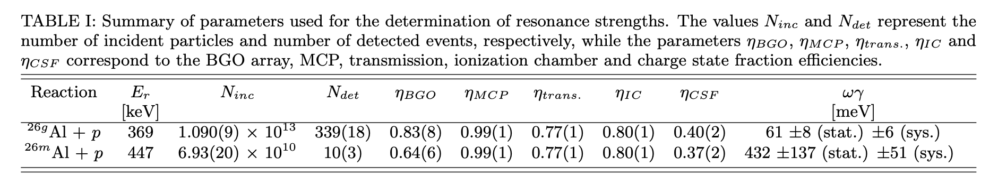
Results
Reference resonance: ωγ(369keV) = 61 +/- 8(stat.) +/- 6(sys.) meV (singles & coincidence analysis in good agreement). Good agreement with previous measurements ➔ Verifies exp. methodology.
Off-resonance measurements were taken at a beam energy of 484 A keV
  ➔ No coincident events were observed in those data runs, confirming zero background counts in the region of interest.
Strength for 447 keV resonance is high! Consistent with constraints given in Hallam, Lotay et al. (PRL126, 2021)
G. Lotay, A. Lennarz, C. Ruiz et. al., Phys. Rev. Lett. 128, 042701 (2022)
Annika Lennarz – CaNPAN meeting 2024

Slide 12
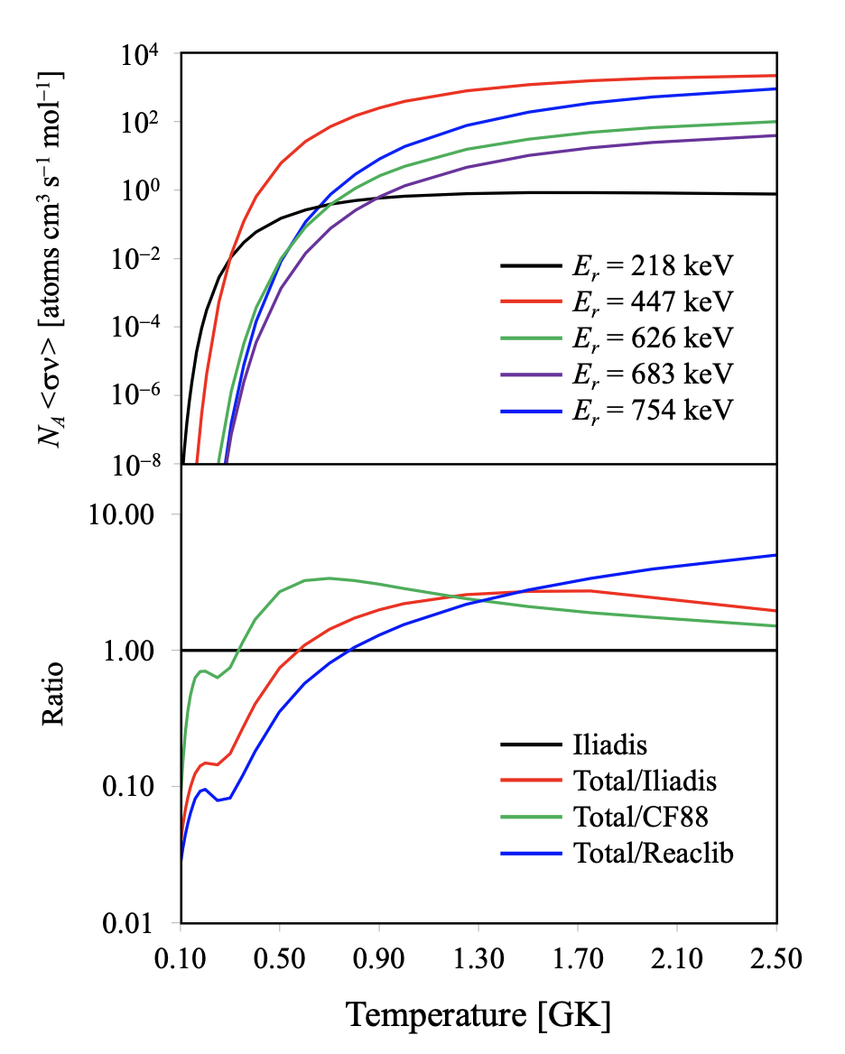
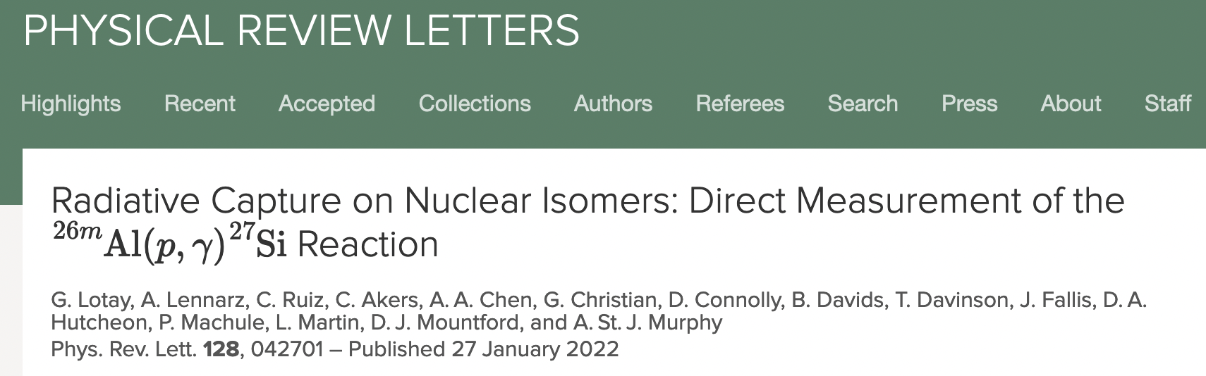
Conclusions – contribution to reaction rate
➔ With present result for ωγ, E_{c.m.} = 447 keV resonance governs entire ^{26m}Al(p,γ) stellar reaction rate over the peak temperature range (0.3-2.5GK) of classical novae & supernovae
But, keep in mind, strengths of resonances in ^{26m}Al + p with E_{r} > 447 keV remain uncertain
➔ could still increase the overall ^{26m}Al(p,γ) rate considerably at high temperatures!
G. Lotay, A. Lennarz, C. Ruiz et. al., Phys. Rev. Lett. 128, 042701 (2022)
Annika Lennarz – CaNPAN meeting 2024

Slide 13

Summary
Nuclei often exist in excited quantum states
➔ Isomers can act as entirely separate nuclei and strongly influence the formation of chemical elements
Studying these reactions on earth represents a significant experimental challenge
This needs to be overcome to fully understand many astronomical observations
Astrophysical observations and their wide implications can only be addressed by understanding how stars and explosive scenarios produce ²⁶Al
At DRAGON we have performed the first ever direct study of excited state proton capture at TRIUMF
Measured ^{26m}Al + p to investigate origin of ²⁶Al
Work will continue

Slide 14




Thank you
Merci
www.triumf.ca
Follow us @TRIUMFLab

Slide 15






Acknowledgements
C. Ruiz, M. Alcorta, C. Akers, C. Brune, A.A. Chen, G. Christian, D. Connolly, B. Davids, T. Davinson, J. Fallis, U. Greife, U. Hager, D. Hutcheon, A. M. Laird, A. Lennarz, G. Lotay, P. Machule, L. Martin, D. Mountford, A. Murphy, S. Upadhyayula, L. Wagner, M. Williams

