Slide 1
NICA heavy ion collider @ JINR Grigory Trubnikov, JINR DG
IUPAP WG9 and C12 Annual General Meeting 2024
June 21 – 22, 2024, TRIUMF

Slide 2
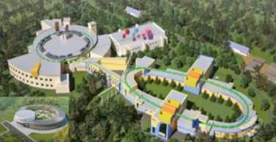
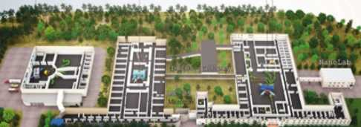
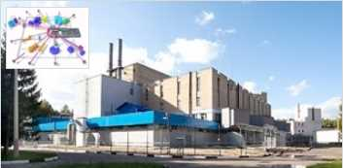
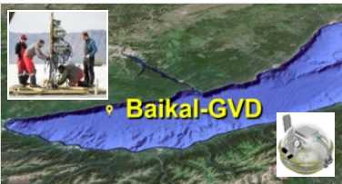
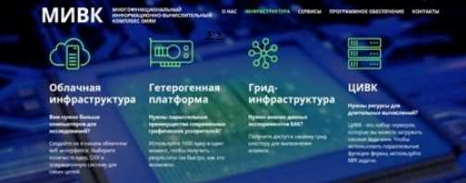
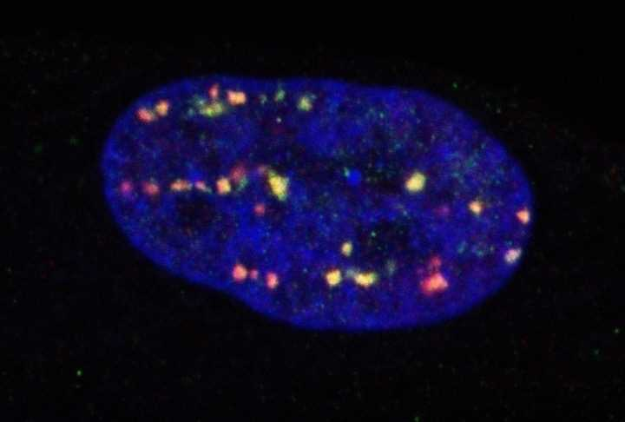
7-year Plan for the Development of
Joint Institute for Nuclear Research (JINR, Dubna)
Relativistic Heavy Ion & Spin Physics
NICA complex
Low Energy Nuclear Physics
SHEF& DRIBS-III project
Condensed matter and Neutron physics (IBR-2М+spectrometers)
Particle physics, Neutrino &
Astroparticle. Baikal-GVD
IT and High Power Computing. MICC
Life Sciences
RB, AB, BM
Notes:
2

Slide 3
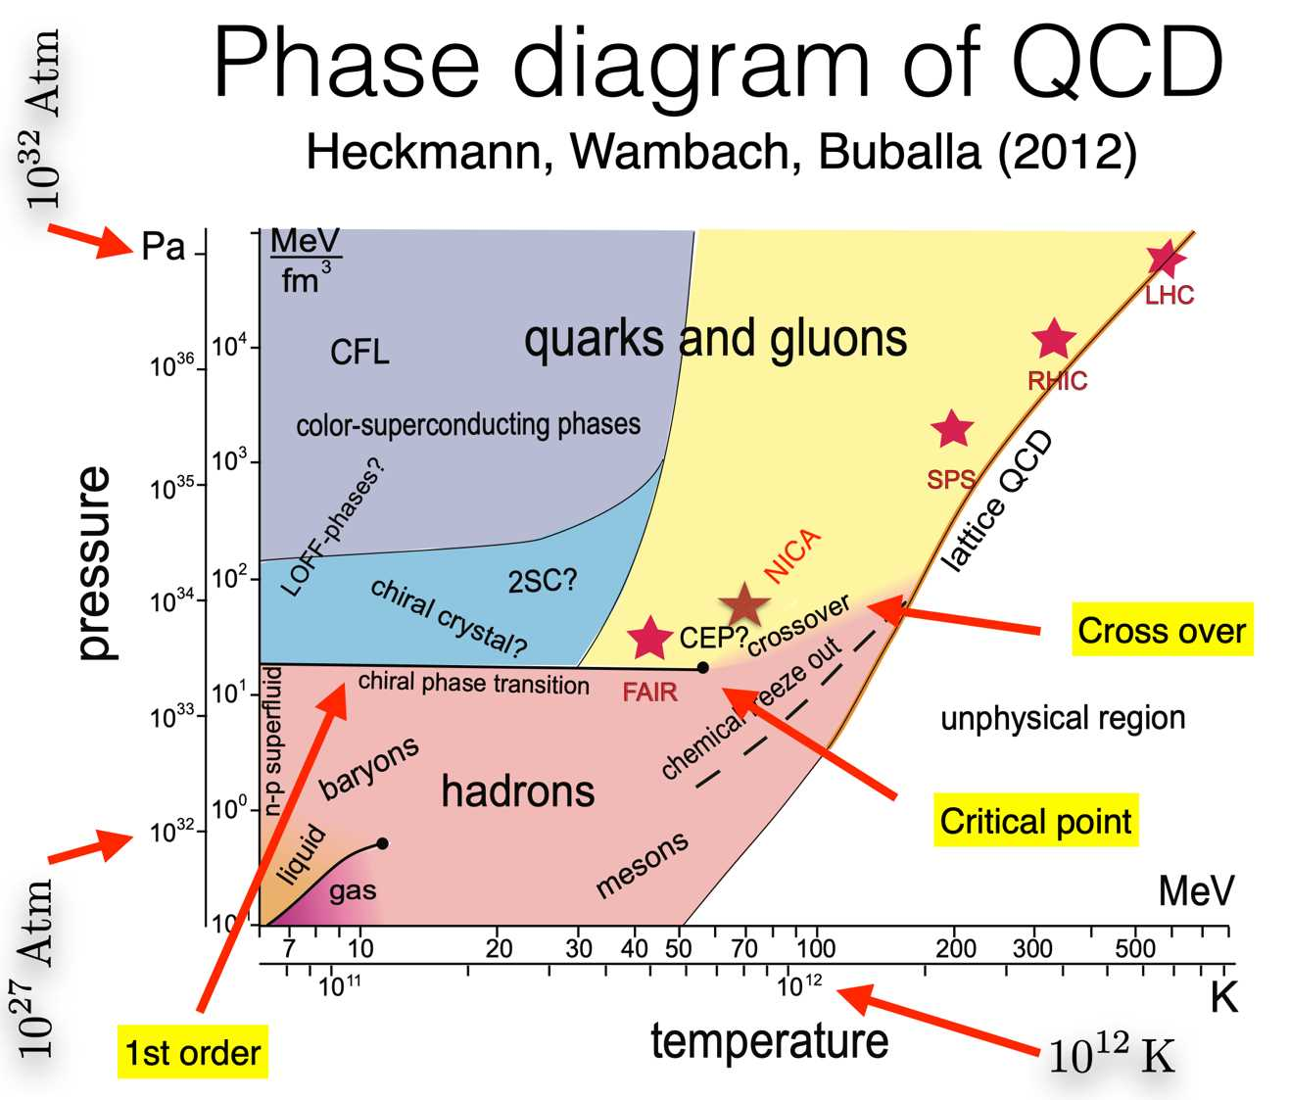
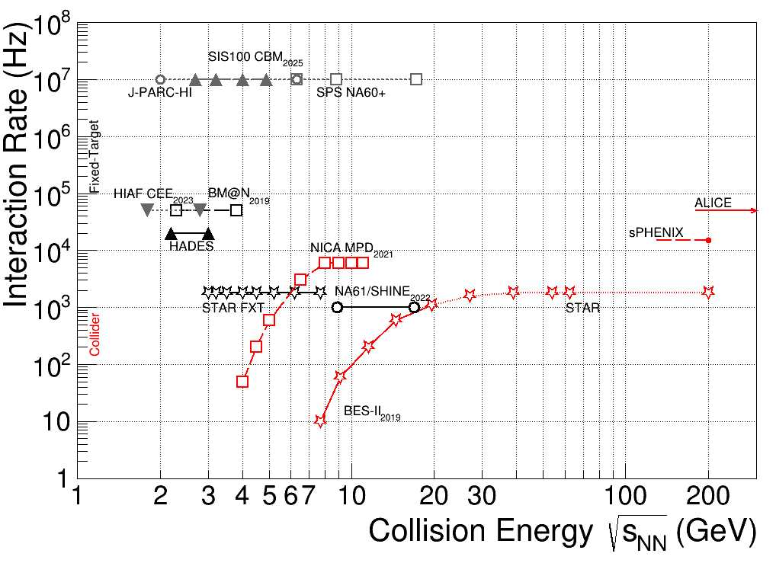
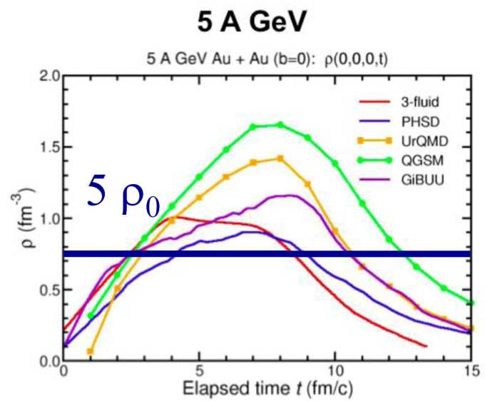
Heavy Ion Collision Experiments
BM@N/NICA: √s_{NN}= 2.3 - 3.8 GeV MPD/NICA: √s_{NN}= 4 - 11 GeV
The energy region of the NICA collider is of particular interest because it corresponds to the maximum possible density of baryons at the moment of their “freezing out.” In this energy range, the system occupies the maximum volume of space-time in the state of a mixed phase of quark-gluon matter (coexistence of hadrons with free quarks and gluons).
In perturbative and non-perturbative QCD, the main tasks is to study properties of strong interactions by measuring the proton and deuteron spin structures at NICA-SPD project, as well as within the framework of JINR’s participation in the most important international collaborations (COMPASS/AMBER, BESIII, PANDA).

Slide 4
NICA Collider parameters (circumference 503 m):
√s_{NN} = 4-11 GeV heavy ion beams @ luminosity L~10²⁷ cm⁻² c⁻¹ (Au), and
polarized p↑ (d↑) of √s_{NN} up to 26 (13) GeV at L ~ 10³² cm⁻² c⁻¹
NICA is aimed at generation of intense heavy ion and polarized nuclear beams for searching the baryonic
matter of a high density at high (comparatively) temperature and investigation of polarization phenomena.

Slide 5
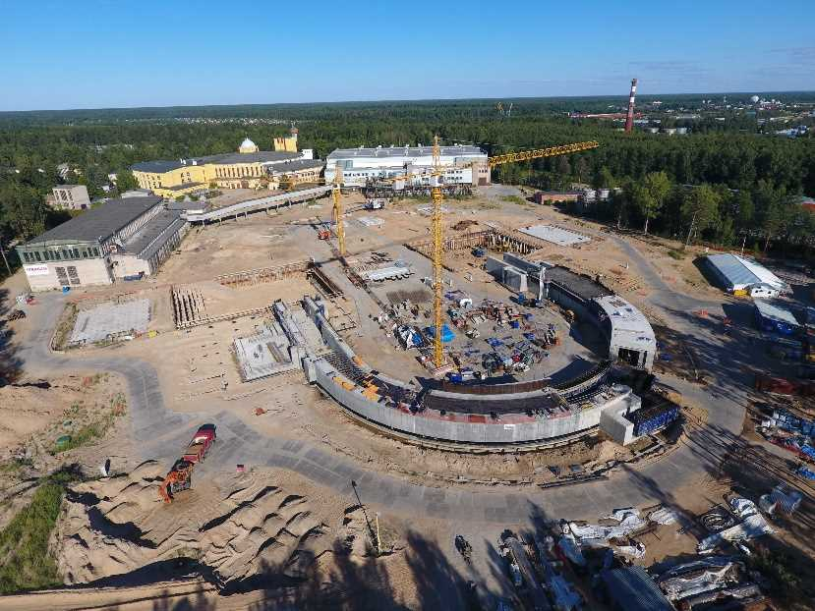
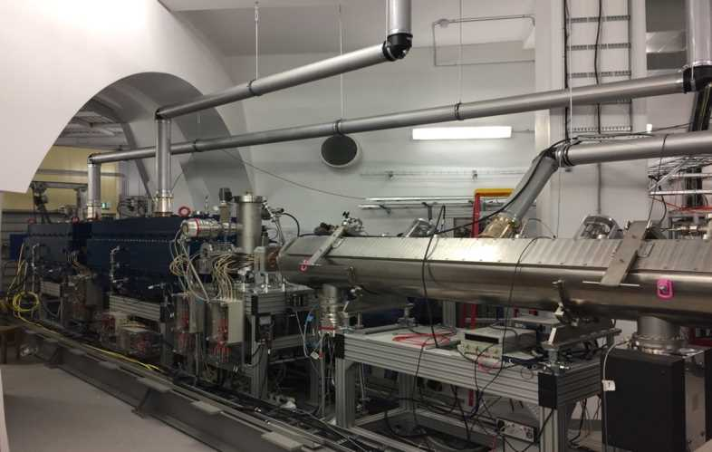
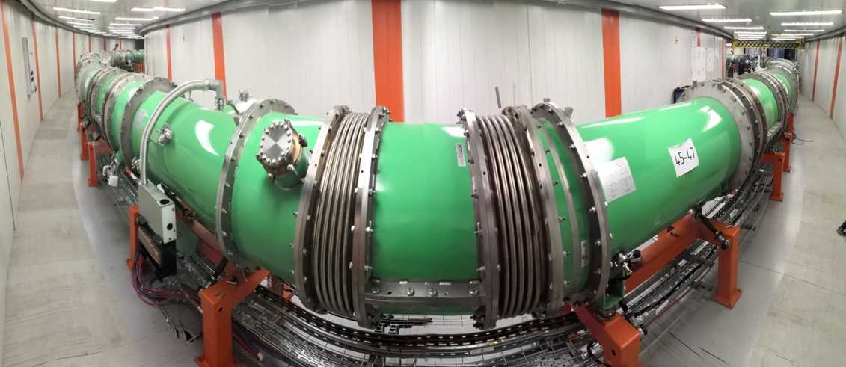
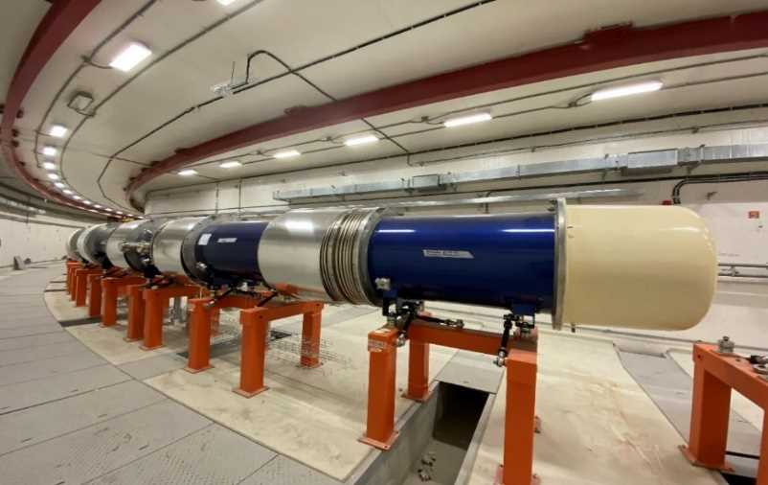
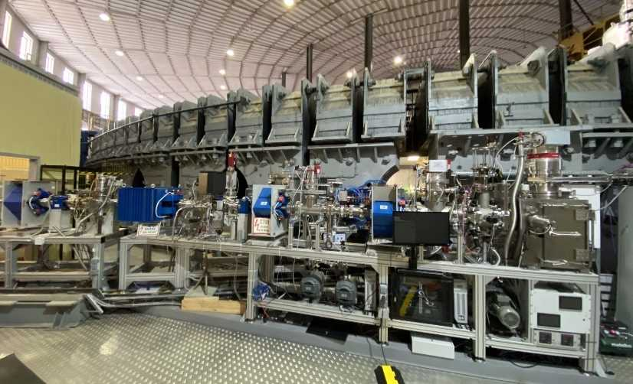
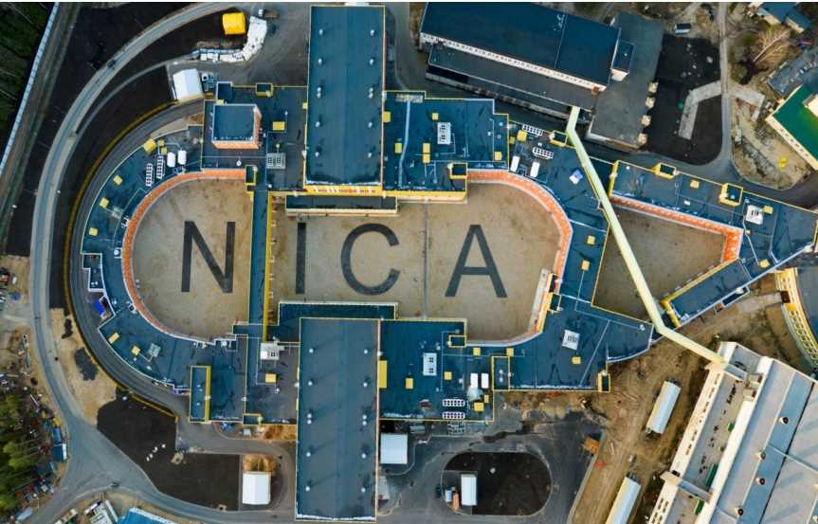
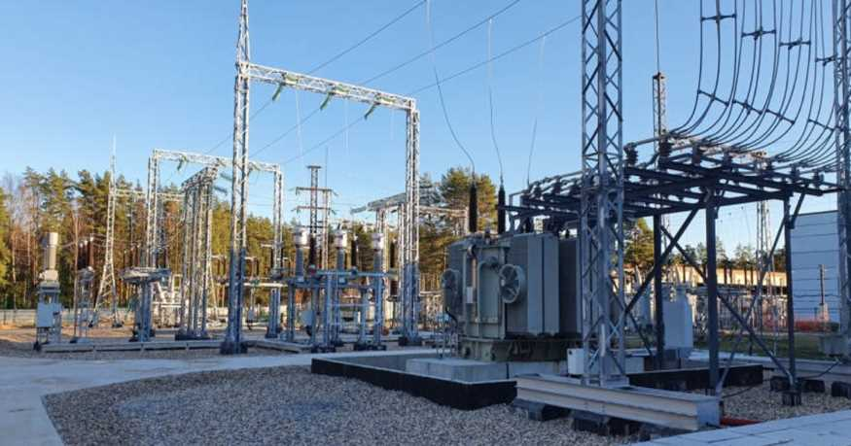
2017
NICA Project Development in 2017-2023
HILac commissioning
2018
Booster commissioning with beam
2020
2021-2022
4th Technical Run (2022-2023):
HILac + Booster + Nuclotron
Commissioning of the
NICA injector complex!
2023
SOCHI ‒ applied researches
NICA collider tunnel
2023
In this period Accelerator Division have published 490 Scientific papers and presented 240 reports at various conferences + students practice (online/in-person).
Approaching 5th commissioning run at NICA
40MW ‒ now available
Notes:
NICA project implementation in 2017-2023:
2018 – HILac commissioning
2020 – Booster commissioning with the ion beam
2021 – completion of the beam transportation line from Booster to Nuclotron;
installation of the e-cooling system in Booster
2022- technological run (4th run) of the injector complex (HILac+Booster+Nuclotron) with e-cooling
magnets installation in the NICA tunnel
start of applied research program within ARIADNA collaboration, continued in 4th run
2023 – increase of electric power to 40 MW;
assembly of RF station in the NICA tunnel;
installation of cryogenic equipment in building 1B;
installation of satellite refrigerators in building 17

Slide 6
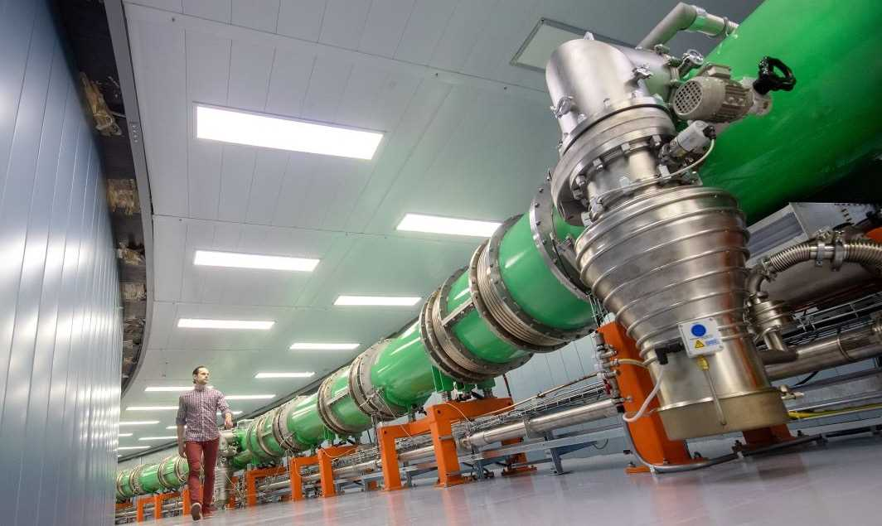

Slide 7
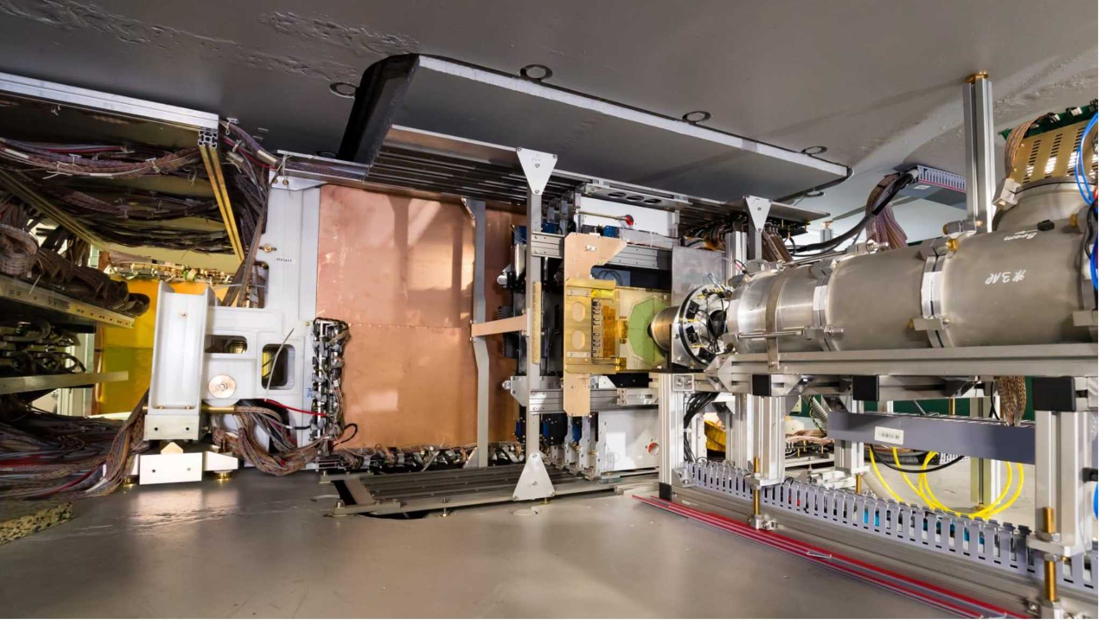
BM@N 2023 4th Run:
3.8 AGeV Xe + CsI collisions; beam intensity 2.5∙10⁵/s; DAQ rate 2.5∙10³/s;
accelerator duty factor 0.25; 1.8∙10⁹ interactions; 1.8∙10¹¹ beam ions
Program with heavy ions:
EOS for symmetrical nuclear matter at high baryonic densities
hypernuclei
Phase transition from hadron matter to partonic
Courtesy M.Kapishin (BM@N)

Slide 8
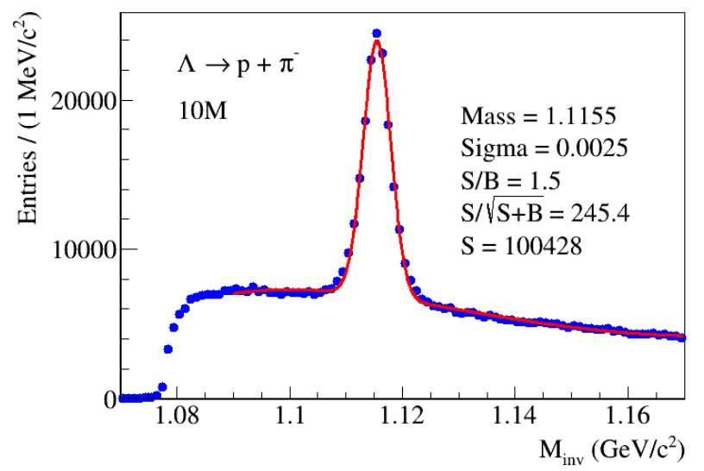
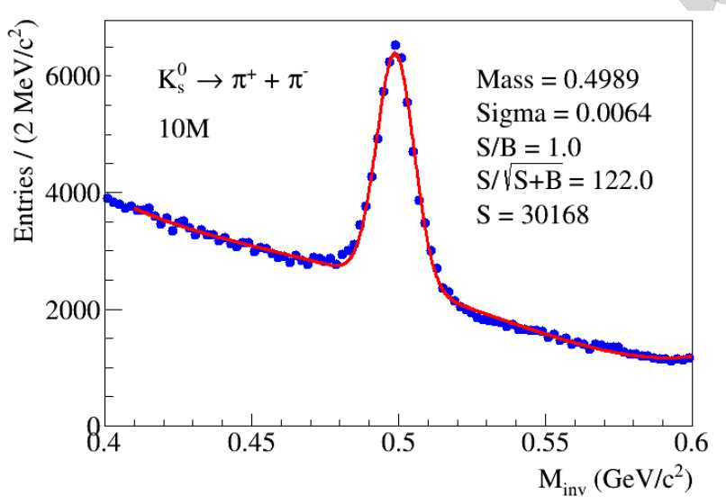
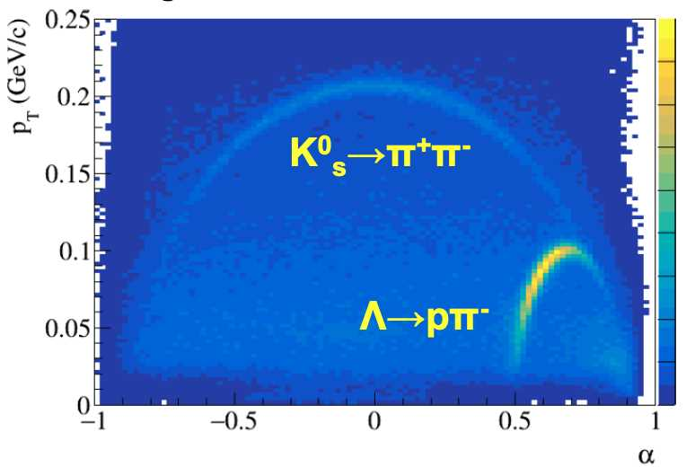
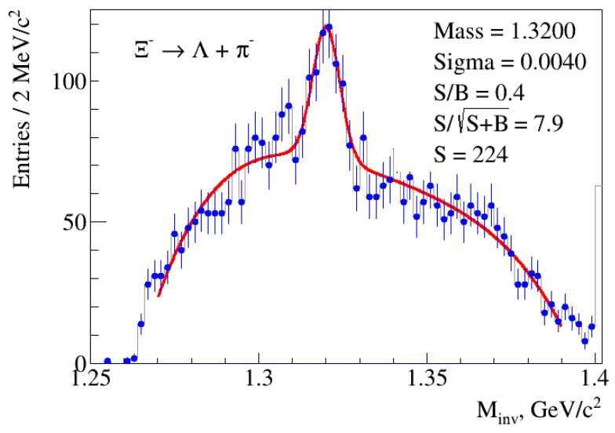
BM@N: Preparations for a physics run with the Bi beam
Further development of the central tracker is foreseen:
installation of additional stations of silicon detectors;
It is planned to put into operation a 2-coordinate (X/Y) neutron detector of high granularity to measure neutron yield and collective flow.
Courtesy M.Kapishin (BM@N)

Slide 9
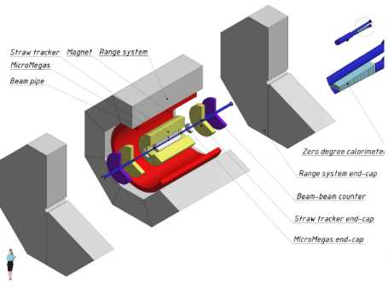
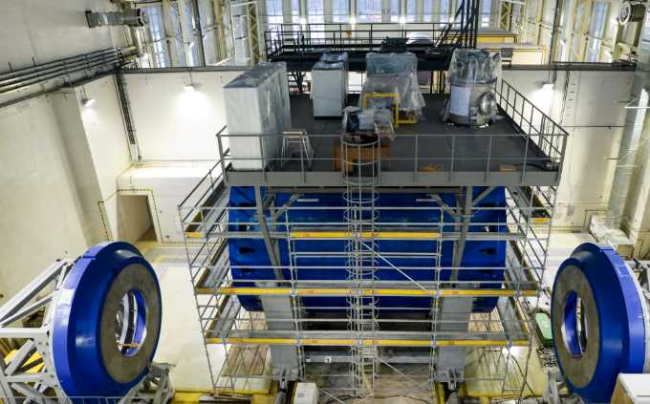
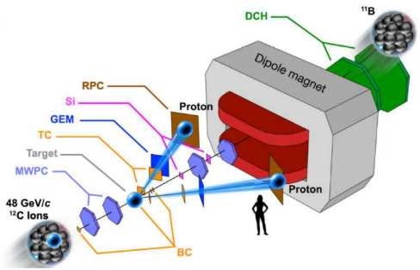
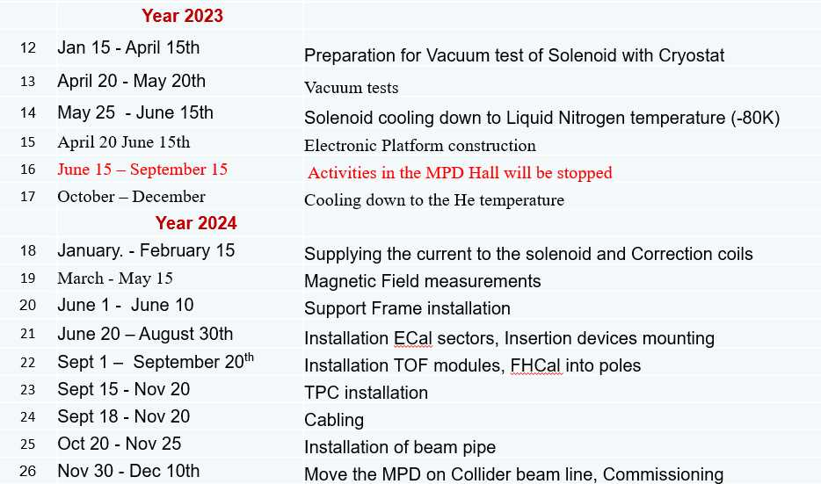
4 international collaborations have been formed and effectively functioning around NICA
MPD: 12 countries, 44 institutes, >500 participants
SPD: 14 countries, 32 institutes,
~300 participants
SPD CDR was approved in Jan’2022;
detectors prototyping/tests are ongoing;
new version of TDR – Jan’2024;
start of operation (Stage-I) – 2028;
50 papers and 70 conference reports.
SPD Stage-I
BM@N: 10 countries, 19 institutes, >250 participants
4th NICA run (2022-2023):
550M events Xe+CsI at 3.0A, 3.8A GeV;
analysis is ongoing;
80 publications and 80 reports,
including “Quark Matter”,
“Strangeness in Quark Matter”,
ARIADNA – Applied Research Infrastructure for Advanced Developments at NICA fAcility:
6 countries, 21 institutes, > 120 participants
116 conference papers
65 publications

Slide 10
Courtesy V.Ryabov (MPD)

Slide 11
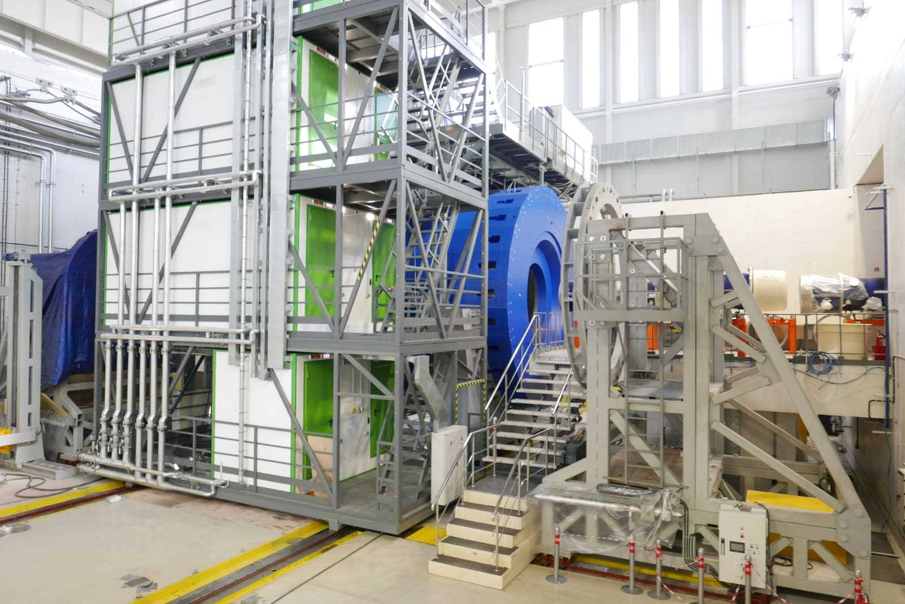
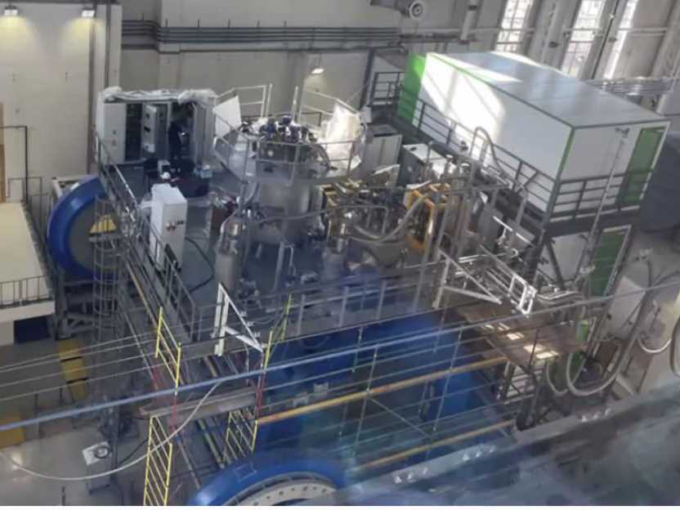
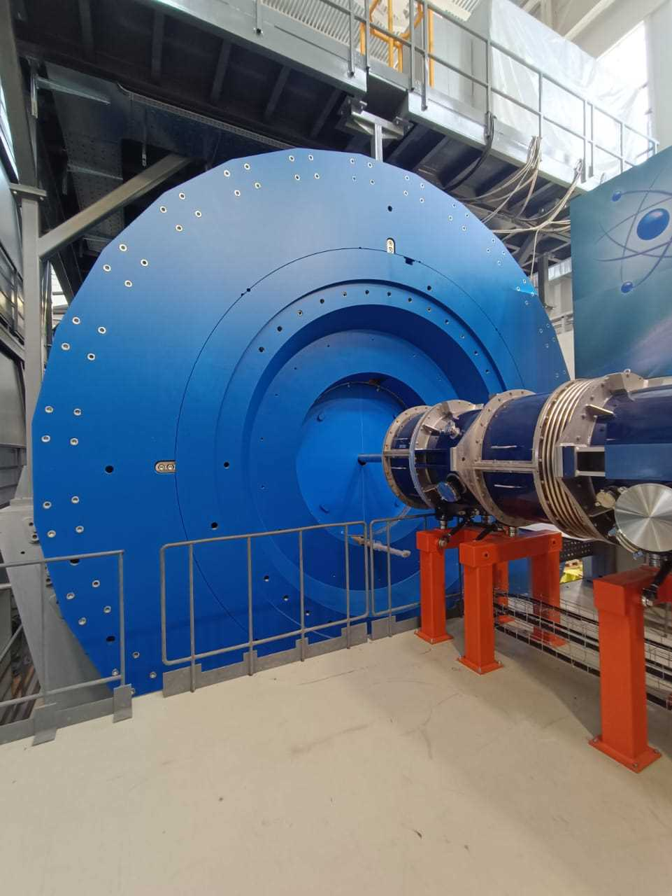
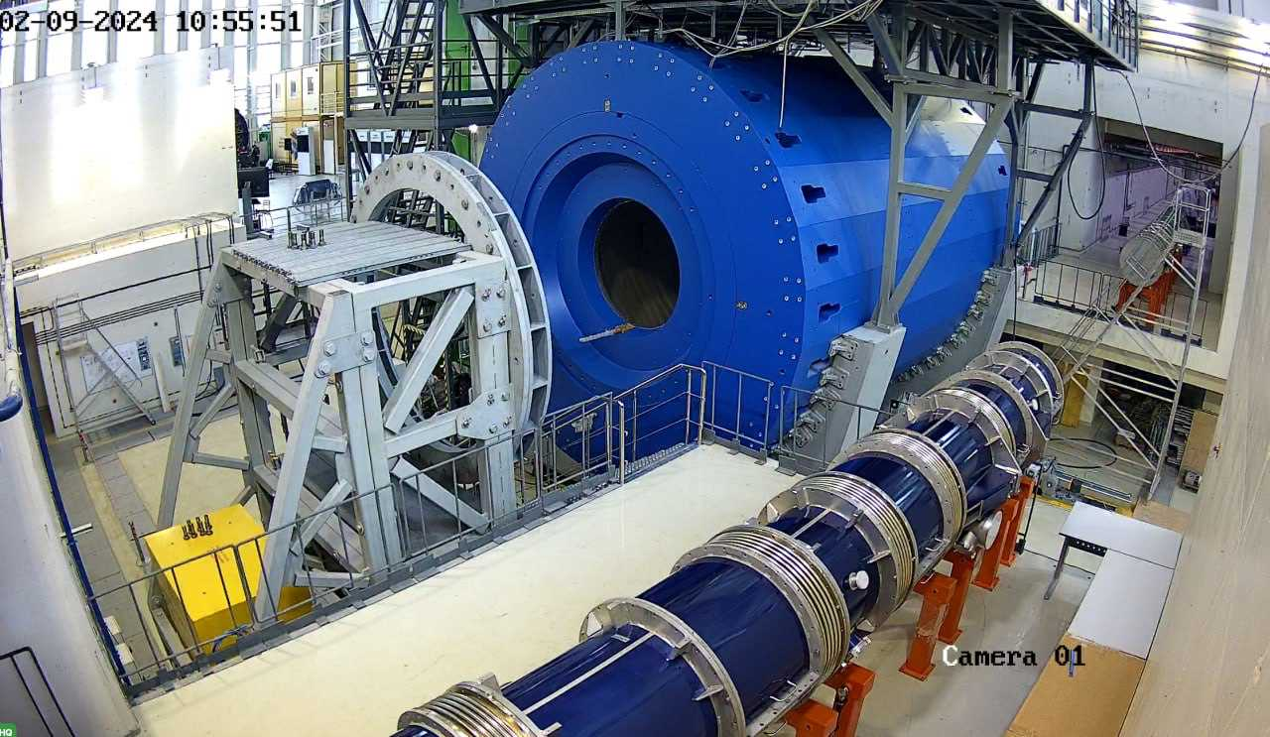
Status assembly and montage of SC solenoid and magnet yoke of the MPD
The SC magnet is installed in the MPD hall. Cryogenic tests were carried out;
preparations are underway for:
final cooling down;
magnetic field measurements.
Notes:
у

Slide 12
Courtesy V.Ryabov (MPD)

Slide 13
Courtesy V.Ryabov (MPD)

Slide 14
Courtesy V.Ryabov (MPD)

Slide 15
Courtesy V.Ryabov (MPD)

Slide 16
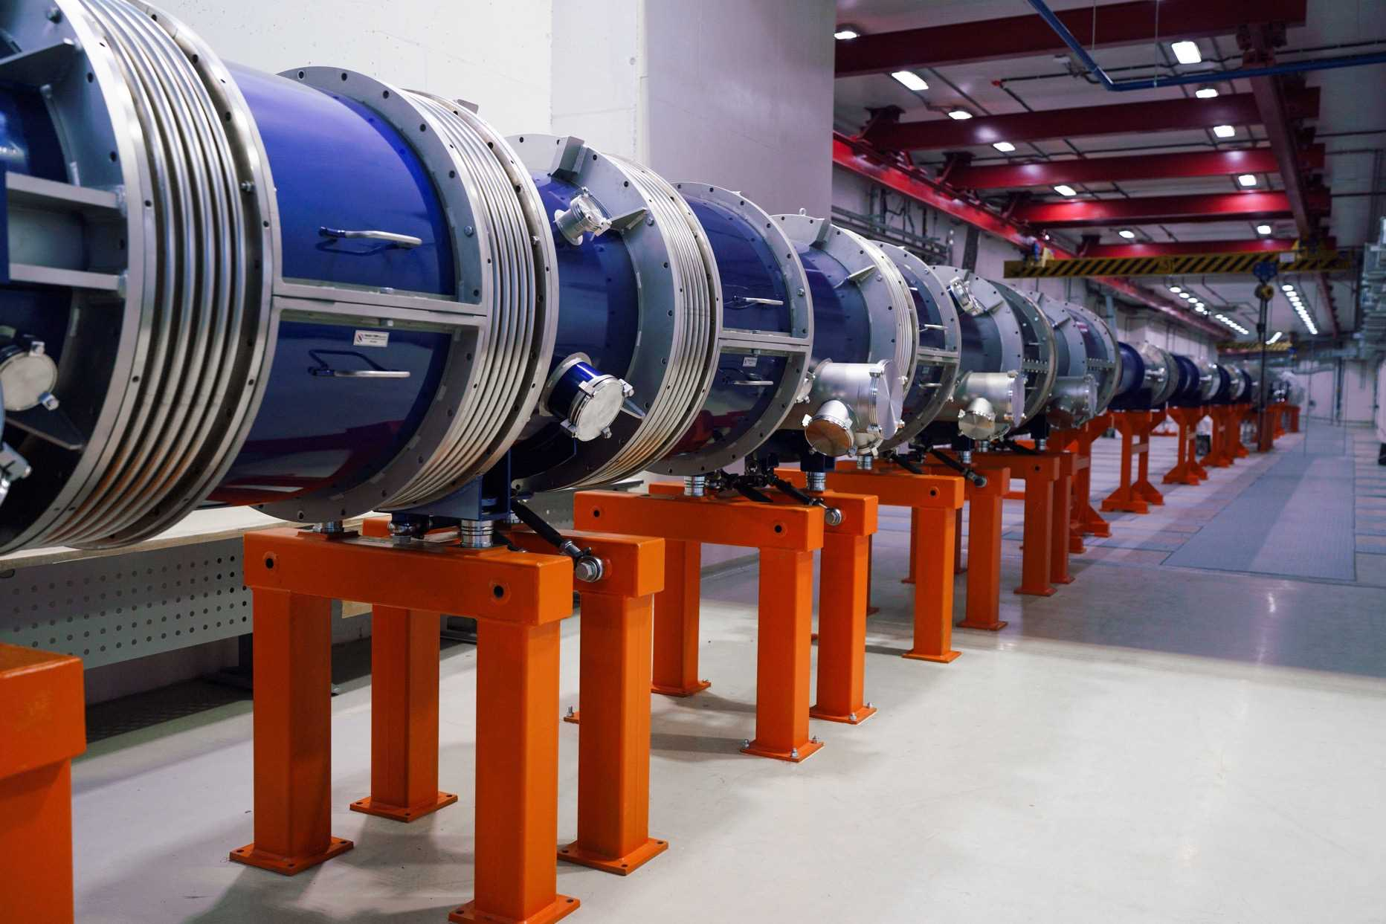
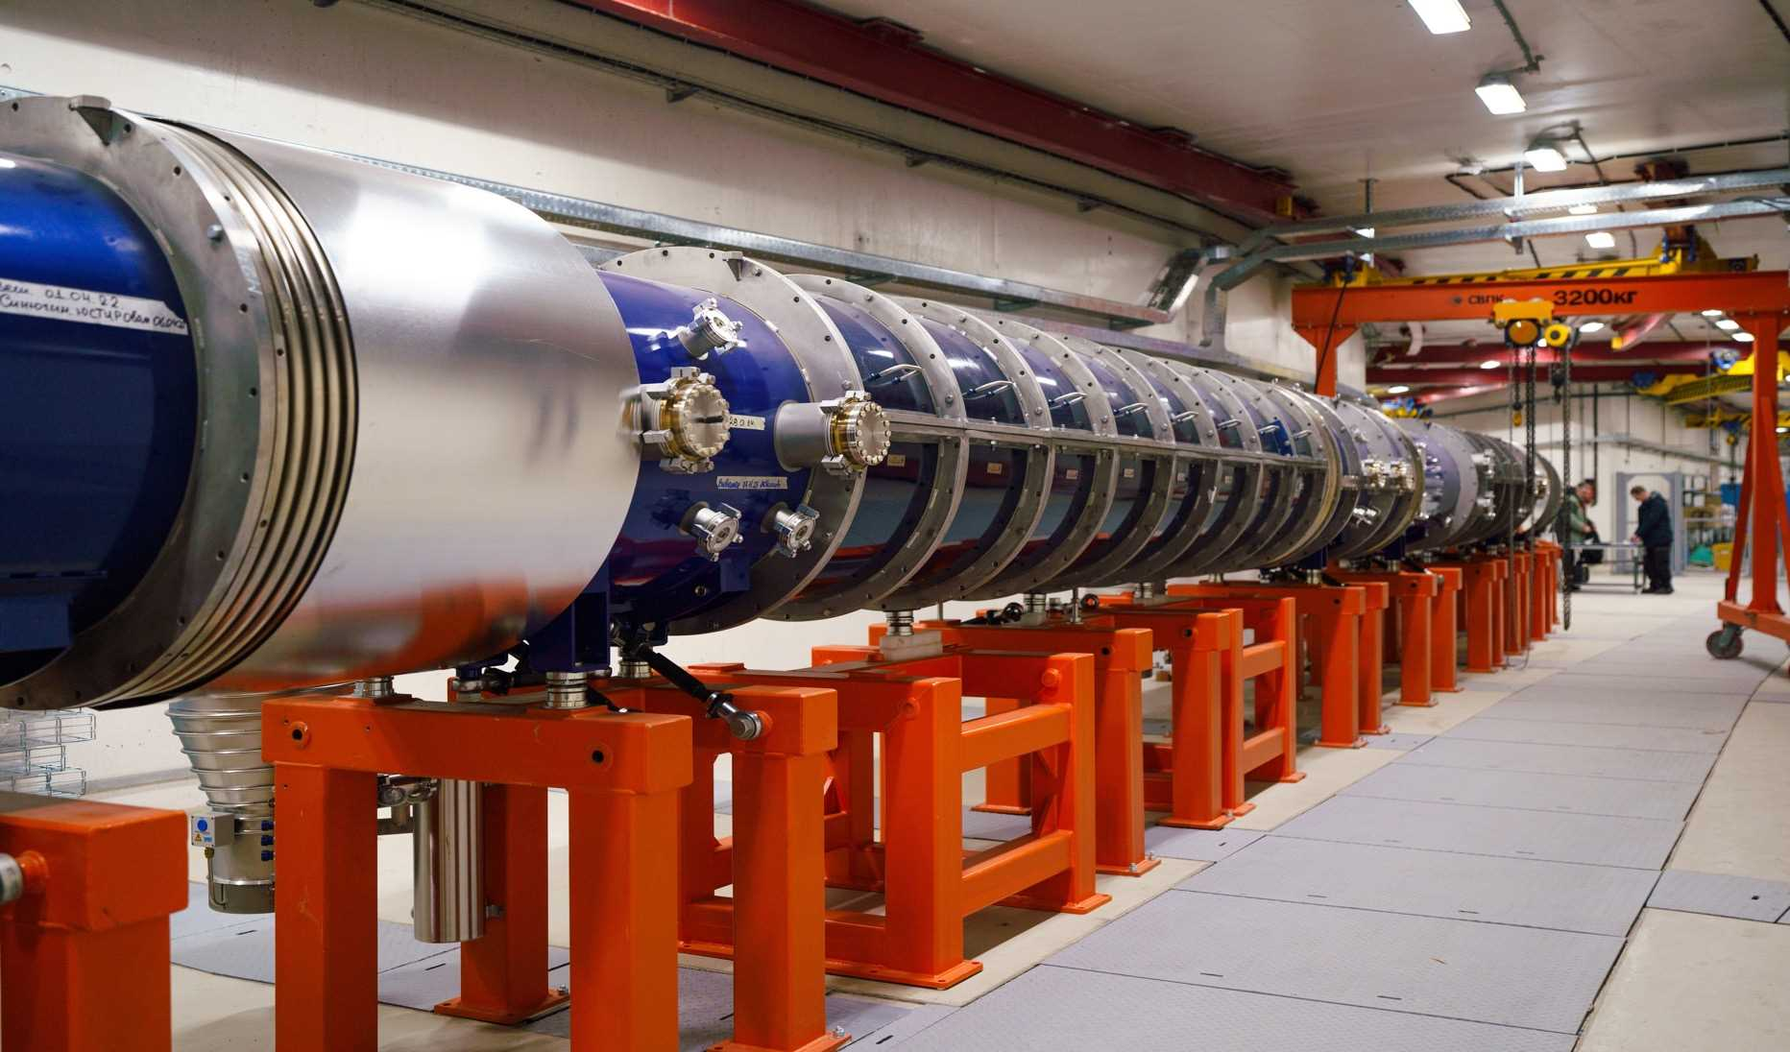
Commissioning of the collider ring had started in June 2024 (Ring assembled):
Test of RF systems
Vacuum system
Cryogenics
Ring magnets
Power supply and control
others

Slide 17
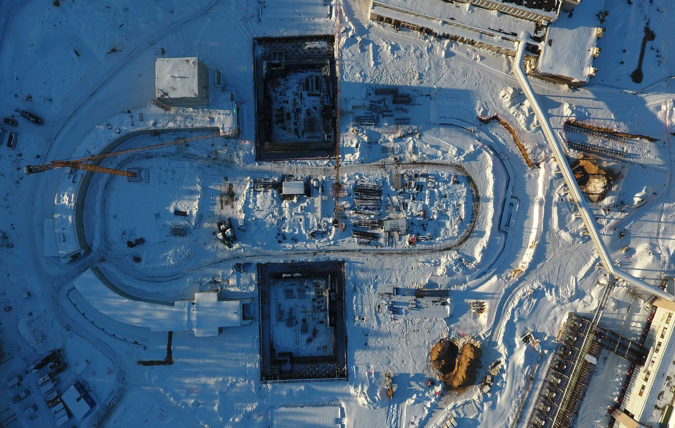
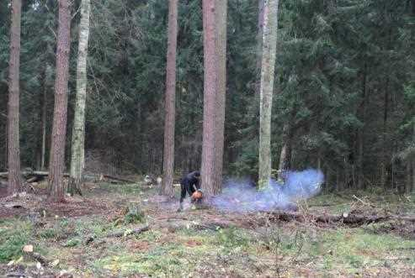
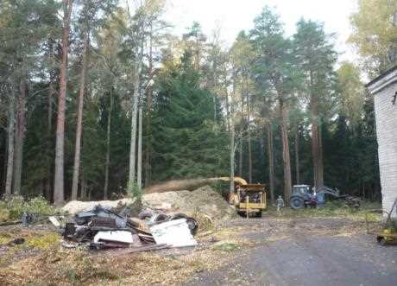
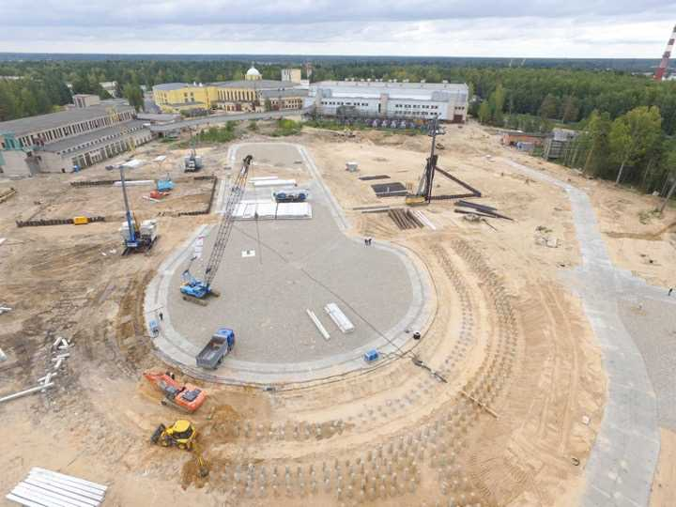
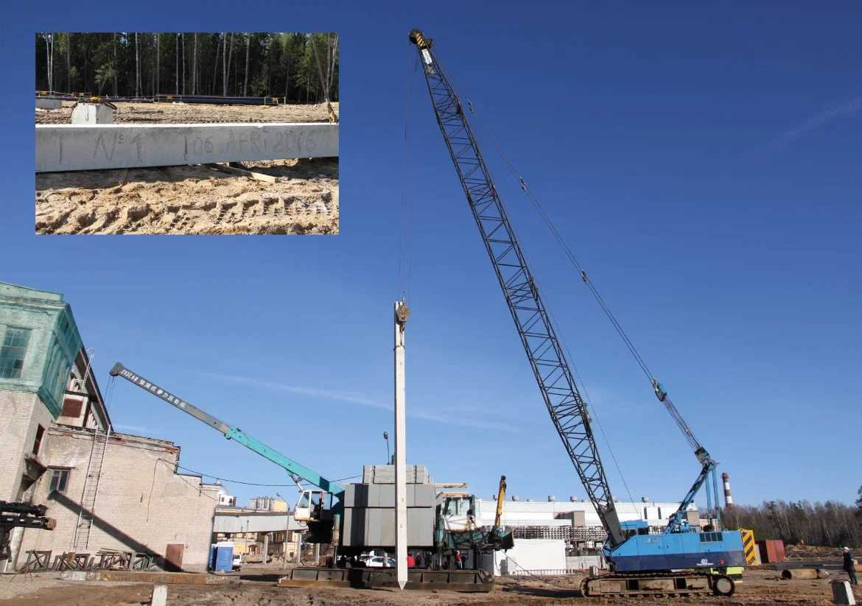
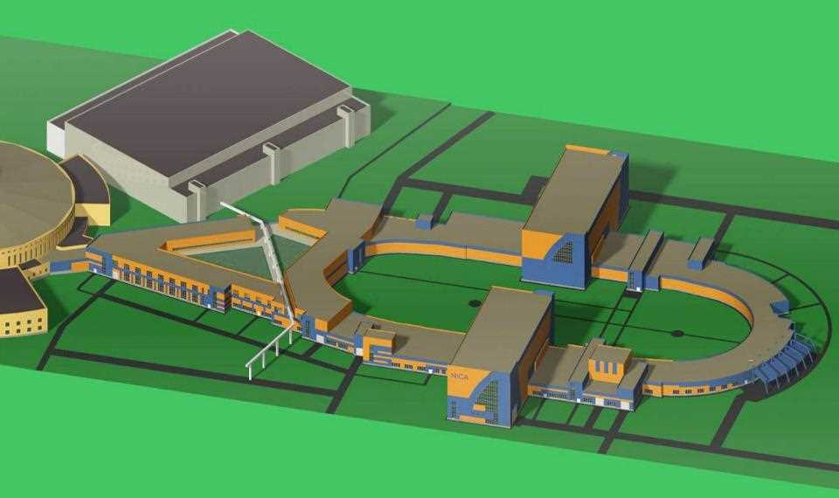
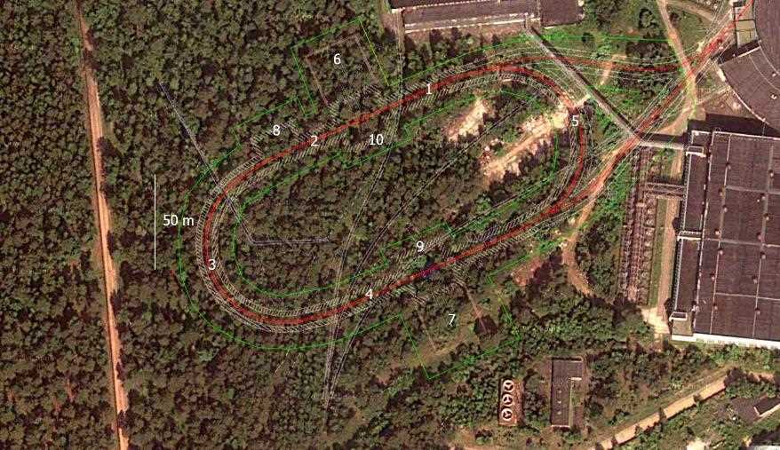
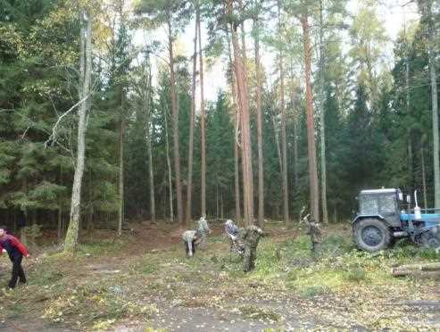
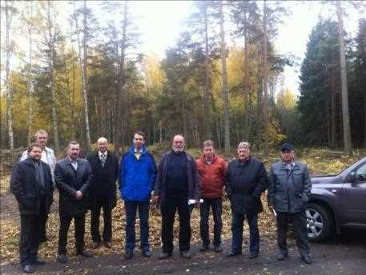
17

Slide 18
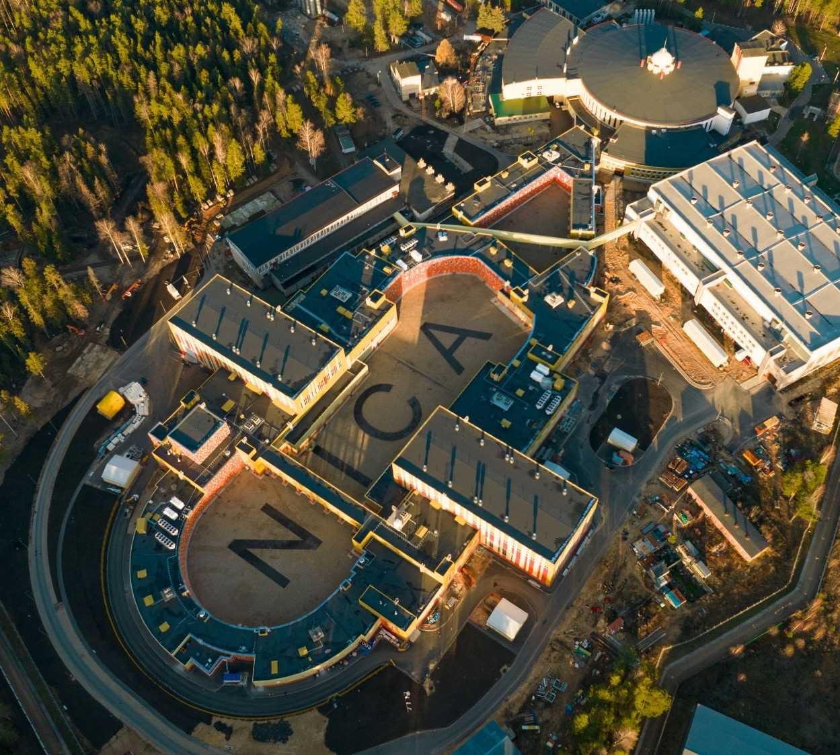
The first run with colliding beam – III-IVth quarter of 2025
Injector chain:
KRION => Booster => Nuclotron
2. BTL Nuclotron => Collider
3. Collider equipped with
RF-1 - (barrier voltage system) for ion storage
RF-2 - 4 cavities per ring (100 kV RF amplitude)
22 bunches (length σ ∼ 2 m) per collider ring that gives 5e25 cm⁻²⋅s⁻¹.
Maximum kinetic energy 2.5 GeV/n
 | Booster |  | Nuclotron |  | Collider
 | Injection | Extract. | Inj. | Extract.
E, Gev/u | 0.0032 | 0.53 | 0.53 | 1,5-2,5 | 1,5-2,5
I | 10⁹ | 8*10⁸ | 5,6*10⁸ | 5*10⁸ | 5*10⁸ ^{22 bunches RF-2}
В_{field}, T | 0,1 | 1,6 | 0,4 | 1,2 | 1.2
18
Notes:
Магнитно-криостатный объем Коллайдера разделен на два полукольца и состоит из двух регулярных периодов и четырех прямолинейных участков.

Slide 19
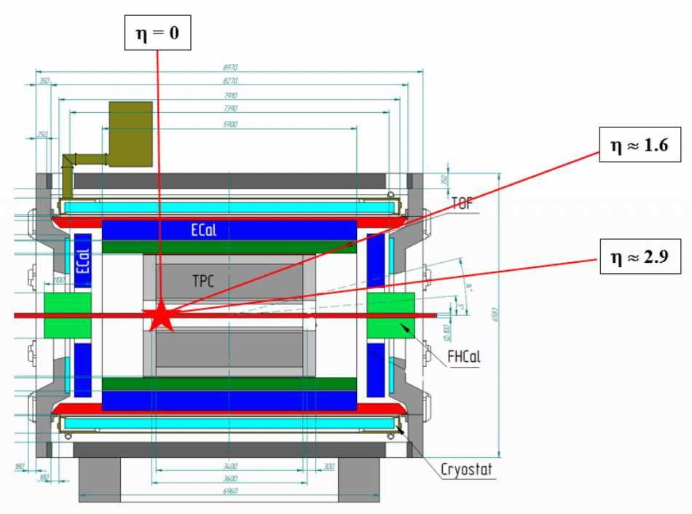
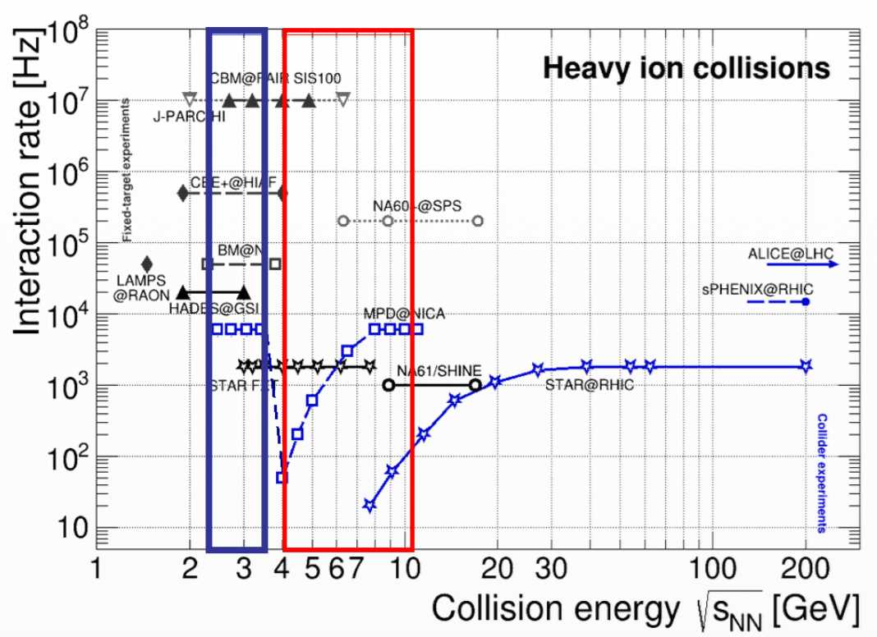
Preparation for the fist run in 2025: possible fixed-target mode
Fixed-target mode: one beam + thin wire (~ 100 μm) close to the edge of the MPD central barrel:
extends energy range of MPD to √ S_{NN} = 2.4-3.5 GeV (overlap with HADES, BM@N and CBM)
solves problem of low event rate at lower collision energies (only ~ 50 Hz at √ S_{NN} = 4 GeV at design luminosity)
backup start-up solution (too low luminosity, only one beam, etc.)
Courtesy V.Ryabov (MPD)

Slide 20
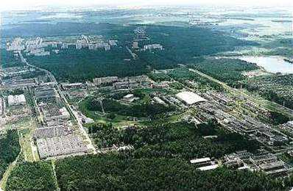
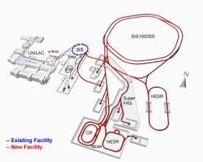
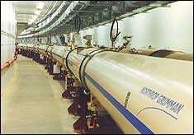
Thank you !
Budker INP
Booster RF system, e-cooler
Collider RF system
HV e-cooler for collider
Electronics
IHEP NRC KI (Protvino)
RFQ,beam dynamics, RF,
Feed-back systems
NRC Kurchatov Institute
Current leads, HTSC technologies, etc
MSU, MEPhI, Baumanka, MEI, MFTI,
SPbSU, Kazan’, ...
INR RAS (Troitsk): polarised source,
Linacs, beam diagnostics
FZ Juelich (IKP)
HV Electron cooler
Stoch. cooling
FNAL
HV Electron cooler
Beam dynamics, Stoch.cooling
ITEP NRC KI
Beam dynamics in the collider,
RFQ linac, SC linac
CERN
SC technologies, Rad.safety, energetics,
beam cooling and dynamics, metrology,
GSI/FAIR
SC magnets for Booster/Collider/SIS-100
RF, UHV, beam cooling, diagnostics
BNL (RHIC)
Beam dynamics,
Stoch. Cooling

Slide 21
Courtesy V.Ryabov (MPD)

Slide 22
Courtesy V.Ryabov (MPD)

Slide 23
Strong interactions play a key role in the physics of the fundamental forces of nature and are well described by QCD, but questions remain:
phenomena at large distances, such as quark confinement;
collective behavior in extreme conditions of high temperatures and high densities;
reliable forecasts in non-perturbative mode;
How do fast moving quarks and gluons group into color singlet hadrons?
How does the spin of a nucleon work and what is the contribution of gluons?
Lattice QCD calculations predict the transition of matter into a quark-gluon plasma, in which the quarks are not bound and chiral symmetry is restored
- confirmed experimentally!
Future progress in this area will rely on a diverse research program with close interaction between theoretical advances and new experimental measurements.
These questions are being intensively studied in heavy ion collisions;
- and this does not require extremely high energies

Slide 24
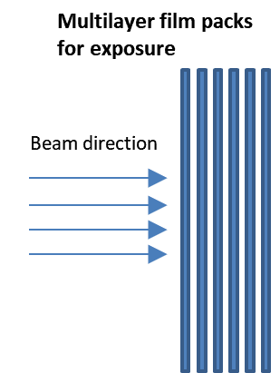
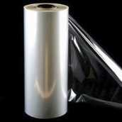
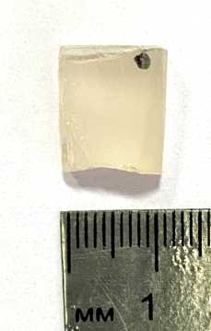
Status of the ARIADNA Research Programme @ NICA
ARIADNA – Applied Research Infrastructure for Advanced Developments at NICA fAcility
First High-energy Beam for Applied Research @ NICA
The Research Programme is STARTED
Radiation Materials Science
Sapphire sapmles
¹²⁴Xe⁵⁴⁺
3.8 GeV/nucleon
Beam profile
A = 34.2 mm
B = 29.3 mm
The most uniform area: a = 12.0 mm b = 9.0 mm
B
First run: 11 December 2022
– 30 January 2023
A
a
b
Beam trace at the EBT3 radiochromic film
Composite Materials
Development of ARIADNA Collaborations
Composition of collaboration: 21 institution;
Total number of participants (as of 6 September 2023): 157.
Beam dump
Beam direction
ISS
ROSS
Composite material at ISS
New composite material for ROSS
FHCal
Radiation Modifications
In High-temperature Superconductors
Installation of dosimetry equipment and samples to ARIADNA target station in BM@N zone
Notes:
This year, the ARAIDNA applied research program was launched at the NICA complex. Within the NICA run, ended at the beginning of this year, the first high-energy beam for applied research was obtained. The research programme of seven organizations was carried out. The organizations submitted their proposals are the members of ARIADNA collaboration. The research directions proposed at the first stage dealt mainly with radiation materials science, radiation testing of composite materials and modification of properties of high-temperature superconductors. Many of the proposed works were carried out for the first because of the use of high energy ion beams being of order of several GeV/nucleon. Based on the results of the experiment, a series of publications are being prepared. At the same time, the development of ARIADNA collaborations continued. Recement months, the collaboration has included a number of new organizations, in particular, most recently, the Institute of General Inorganic Chemistry of the Russian Academy of Sciences and North Ossetian State University. It is agreed to start of joint work with organizations of Armenia and Mexico within the ARIADNA collaboration.
В текущем году стартовала программа прикладных исследований ARAIDNA на комплексе NICA. В сеансе, завершившемся в начале года, получен первый пучок высоких энергий на комплексе NICA для прикладных исследований. Была выполнена программа облучения, предложенная семью организациями, входящими в состав коллаборации ARIADNA. Предложенные на первом этапе работы касались , главным образом, вопросов радиационного материаловедения, радиационных испытаний композитных материалов и модификации свойств высокотемпературных сверхпроводников. Многие из предложенных работ выполнялись впервые с использованием ускоренных ионов с энергиями порядка нескольких ГэВ/нуклон. По результатам состоявшегося эксперимента готовится ряд публикаций.
Вместе с этим, продолжалось развитие коллабораций ARIADNA. В последние месяцы в состав коллаборации вошли ряд новых организаций, в частности, совсем недавно – Институт общей неорганической химии РАН и Северо-Осетинский государственный университет. Достигнуты договоренности о начале совместных работ с организациями Армении и Мексики в рамках коллаборации ARIADNA.

Slide 25
HV E-cooler: location in the collider
E-cool’s parts
The first parts was delivered at November of 2022;
Start of mounting – November of 2023;
First beam tests – Spring of 2025
25

Slide 26
Stochastic cooling system for the Collider
the design was finalized. Prototype in production
we have to start procedure for the 30 units in parallel to save time.
s-Cooling system locations
RF cables path location
Supports for the ceramic tubes
currently the longitudinal and transverse PickUps for the collider are under development
Cables path
Standard 19’’ electronics racks
Notes:
Stochastic cooling system is not necessary for the first collider Run, however, the vacuum still MUST be closed. In essence, closing the vacuum is the only mandatory part for the 2024.

Slide 27
Courtesy V.Ryabov (MPD)

Slide 28
…What next ?...
Electron-ion collider E-NICA
The Facility will allow you to explore/discover:
Parton density distribution function
DVCS, Compton-Bethe-Heitler process
Bjorken sum rule, Ji's sum rule
Dirac and Pauli formfactors, axial and pseudo-scalar formfactors
Spin and charge asymmetry of beams
Electric dipole moment
The Inner Strangeness of Nucleons
Right currents
 | p | e | e
 | 13.6 | 7.5* | 7.5*
Bunch intensity |  | *
 | - | 20 | 20
 |  | 6*
 | 0.6 | 5.0 | 5.0
 | 20*
Circumference, m | 503.04 | ∼503
POSSIBLE PARTNERS: BINP (“SKIF”), NRC KI (“SILA”), NIIEFA
E-NICA
EIC (BNL)
E.Syresin

