Slide 1
UPDATE ON WG16: PHYSICS AND INDUSTRY
Report WG16 (Since the WG9+C12 meeting in June 2023@ARIS)
A. Navin
Grand Accélérateur National d'Ions Lourds, Caen, France
Objectives
Provide recommendations to IUPAP General Assembly and Executive Council on
how to foster international cooperation in physics between industry and academia
Acquire new Corporate Associate Members (CAMs)
Provide resources of interest to industrial physicists and students interested in industrial careers
https://iupap-corporate-associate-members.web.cern.ch/

Slide 2
WG16 members as of today
1. Christophe Rossel (IBM Research-Europe, Zurich, Switzerland) (Chair)
2. Cyrus Walther (International Association of Physics Students (IAPS), Tech. University Dortmund, Germany) (Vice Chair)
3. Navin Alahari (GANIL, France) liaison officer to WG9
4. Tariq Ali (University of Liverpool, UK)
5. Barbora Bruant Gulejova (Uni. Bern, EPFL, CERN, Geneva, Switzerland)
6. Cinzia Da Vià (University of Manchester, UK, Stony Brook University, USA )
7. James Kneller (International Association of Physics Students (IAPS), UK)
8. K.S. Narayan (Jawaharlal Nehru Centre for Advanced Scientific Research, India)
9. Michel Spiro (IUPAP President, France) (ex-officio)
10. Jens Vigen (CERN, IUPAP Secretary-General, Switzerland) (ex-officio)
11. Lawrence Woolf (General Atomics Aeronautical Systems, Inc., San Diego, USA)
Need to replace some members who left and get members from non-represented continents, in particular India, China, and Japan.

Slide 3
News - update
WG16 Meetings
WG16 has been meeting monthly via Zoom since March 2020, except for a summer break.
Minutes of each meeting are recorded and approved by the members.
Actual list of CAMs
ALLS: Advanced Laser Light Source (Varenne, Canada 2022)
CERN: European Organization for Nuclear Research (Geneva, Switzerland, 2022)
JINR: Joint Institute for Nuclear Research (Dubna, Russia, 2023) via Grigory V. Trubnikov, WG9 & B. Sharkov
SESAME: Synchrotron-Light for Experimental Science and Applications in the Middle East (Jordan, 2022)
PARK SYSTEMS Corp.: (Suwon, South Korea, 2023) via Young Dong Kim, chair of the C8 commission
CAEN Group: Electronic product and service (Italy, 2024)
Presentations and interactions of WG16
C. Rossel gave a presentation on WG16 to IUPAP General Assembly, CERN, 9 October 2023
L. Woolf wrote an article about WG16 for the December 2023 APS FIAP newsletter
New column on WG16 is planned for the IUPAP newsletter
WG16 initiated IUPAP joining the LinkedIn industrial social media site; IUPAP has now over 1500 follower
https://www.linkedin.com/company/iupap/
WG16 members participated in the EPS Forum 2024, Berlin (24-25 March 2024), by inviting plenary speakers and moderating
round table discussions in sessions related to physics and industry https://www.epsforum.org/
A satellite event at the BSBF2024 conference is planned on 1 October in Trieste, organzed by Barbora Bruant Gulejova

Slide 4
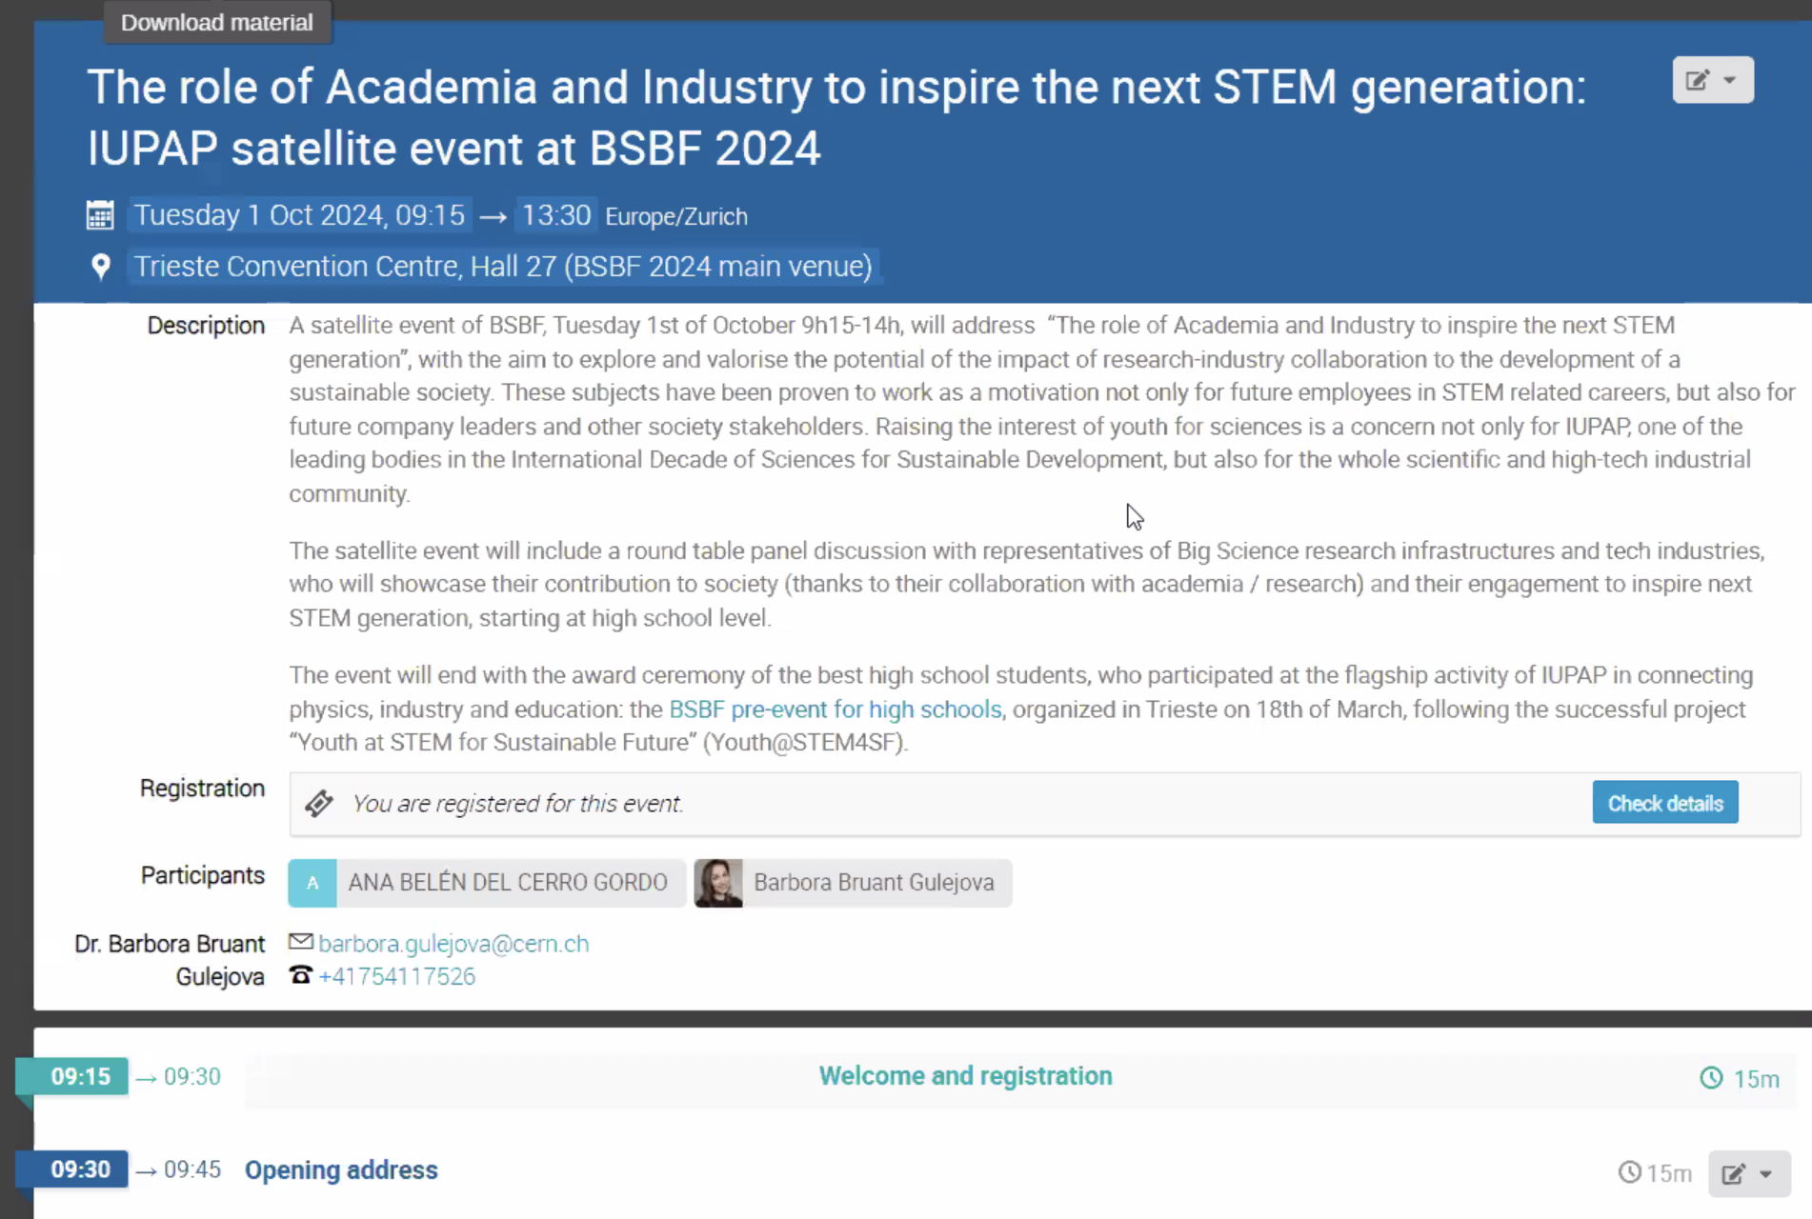
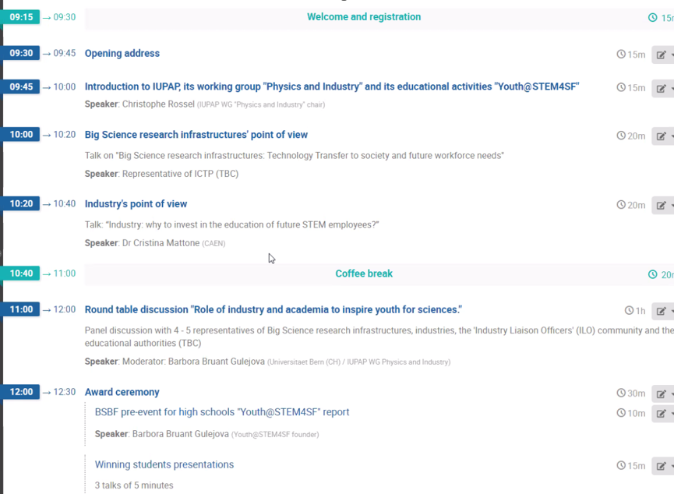
Stake holder to make them CAM
Satellite event of BSBF 2024
with the aim to explore and valorize the
potential of research-industry collaboration
to the development of a sustainable society.
https://ep3guide.org/

Slide 5
Future of WG16
What’s next with the WG?
It was discussed at the last GA in October 2023 and with the Executive Council officers whether the WG16 should be upgraded to a Commission:
The outcome was:
The WG16 will remain as such until next GA in 2024 in Hainan, China
Conversion into a Commission is premature: not field centred, no specific community, more action flexibility as a WG
Restructuring plan will open for new types of entities where WG16 will better fit
Possible to combine industry with physics for development, sustainability, education, etc.
A concrete proposal will be submitted to the next GA after an external evaluation being done on the IUPAP structure
At the next GA the Executive council will have new elected members and aim for a better worldwide distribution (Asia, Africa, South America) and higher women representation (50%). The event will be part of the Chinese Physical Society meeting, in addition to joint sessions with dedicated lectures, a forum on Women in Physics and Physics for Development will take place.
The policy of IUPAP exclude discrimination in any way. No country will be excluded from participation in IUPAP organized conferences or events for political reasons.

Slide 6
More CAMs
Part of the WG16’s mandates is to recruit industrial companies or/and research organizations as new CAMs.
This appears more difficult than expected to advocate for the proposed benefits to join IUPAP as CAM
Often potential candidates don’t answer our invitation letters or don’t follow up on the initial discussions
Best results are achieved with personal and direct contacts
Several companies are in the pipeline, but it is the responsibility of the WG16 members to establish such contacts
(ongoing: Riken, Sumitomo, Toshiba, Mitsubishi, Nature Springer, Swatch Co. etc.)
…
One concrete project is to organize in 2025 an online event, inviting actual CAM’s representatives, chairs of IUPAP commissions and other scientists to address some of the grand challenges of our time where physics and industry could play a role in finding solutions. The idea is discussing two important recent publications:
EPS Grand Challenges - Physics for Society in the Horizon 2050 (IOPP for EPS)
Globalizing Physics – One Hundred Years of the International Union of Pure and Applied Physics (IUPAP)

Slide 7
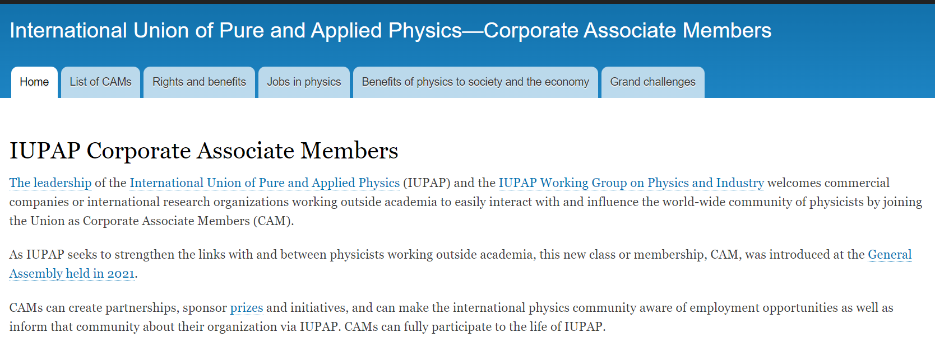
WG16: CAMs webpage

Slide 8
Corporate Associate Members – rights and benefits
CAMs are international or national research organizations and commercial companies
CAMs can make nominations and hold positions in IUPAP but have no voting rights
CAMs could contribute and participate in IUPAP conferences, workshops or commercial exhibits
CAMs will benefit from reduced participation fees at IUPAP conferences
CAMs can submit proposals to other CAMs to collaborate on R&D projects
CAMs can sponsor prizes, awards, or focused initiatives in their field of interest that will be publicized within IUPAP
CAMs can get more visibility within IUPAP and physics community platforms
CAMs have access via IUPAP’s website to other key stakeholders, industry insiders, and decision makers (partnerships)
CAMs have access to information and job posting sites, career guidance for students and young physicists.
Examples of benefits of physics to society and the economy, and to grand challenges are available on dedicated WG16 webpage together with specific resources of interest for new CAMs.

Slide 9
Thank you for your attention

