Slide 1



Report from RAON
Seung-Woo HONG
Institute for Rare Isotope Science (IRIS)
IBS
WG9
June 21, 2024

Slide 2
Status of RAON
I. Introduction to the RAON
II. Current Status of the Project
(Accelerator systems and Experimental systems)
III. Summary

Slide 3

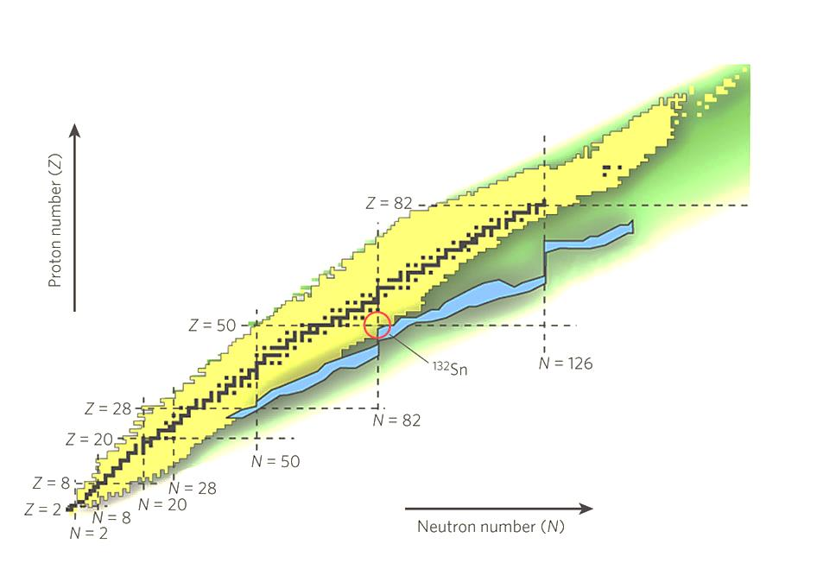
RAON :
“라온” > RAON > Rare isotope Accelerator complex for ON-line experiments
Rare Isotope accelerator complex:
1. Cyclotron for ISOL
2. Superconducting Linac for In-Flight Fragmentation
What is it?
Accelerator complex
ISOL + In-Flight Fragmentation
Origin of Matter
Applied Sciences
Properties of Exotic Nuclei
Nuclear Astrophysics
Nuclear Matter
Super Heavy Element Search
High-precision Mass Measurement
Bio-Medical Sciences
Material Sciences
Neutron Science
Nuclear Structure
Electric Dipole Moment and Symmetry
Hyperfine Structure Study
Rare Isotope Science Project (RISP) : Dec. 2011 – Dec. 2022
RISP is changed to “IRIS” as of July 1, 2023. (From project to operation)
R&D for the 2nd Phase for high energy linac : 2022.12 - 2025.12
Status
Budget
~$ 1.4 B (Facilities ~ $ 0.5 B, Land, Bldgs & Utilities ~ $ 0.9 B)
Facilities include experimental apparatus

Slide 4
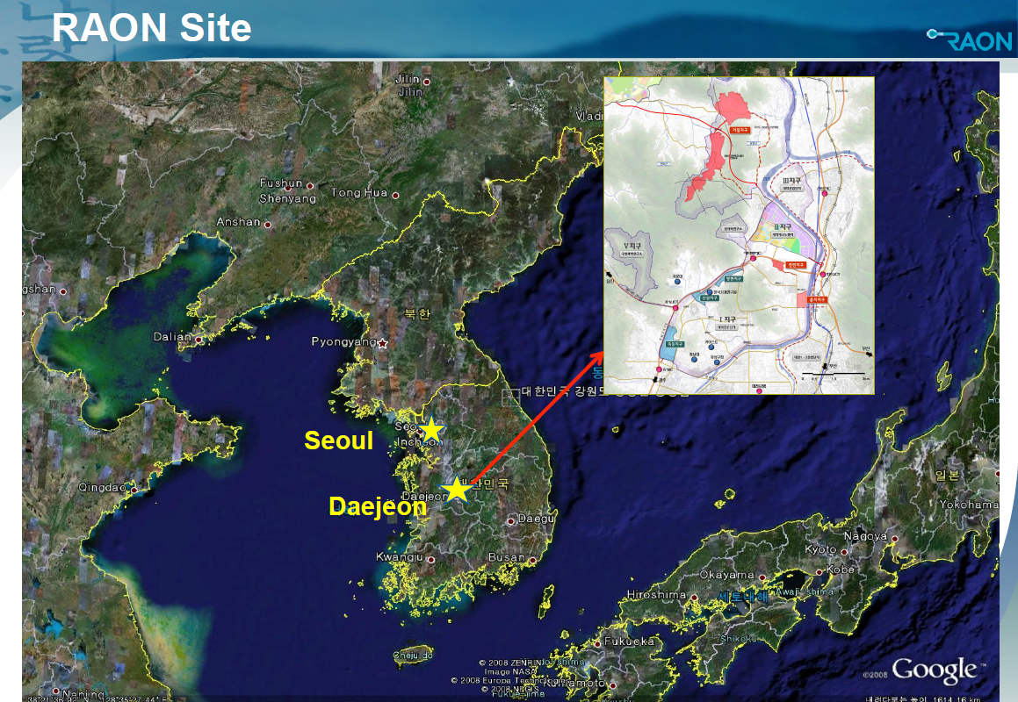

Slide 5
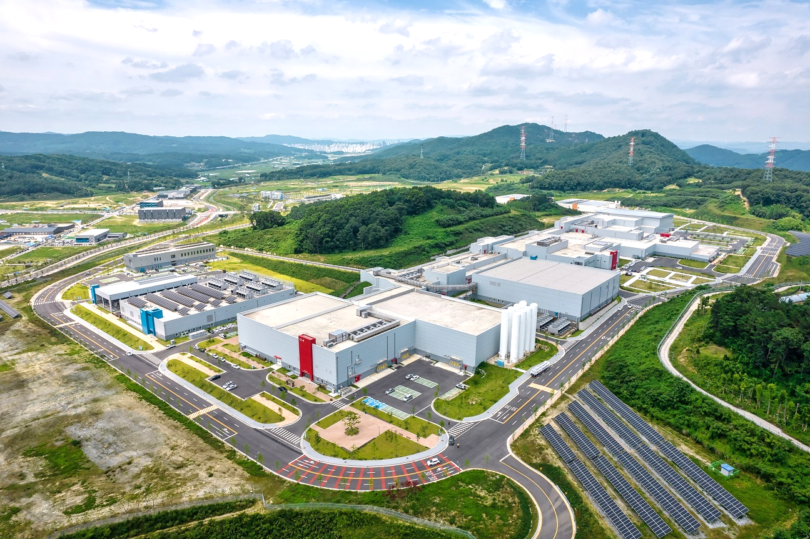
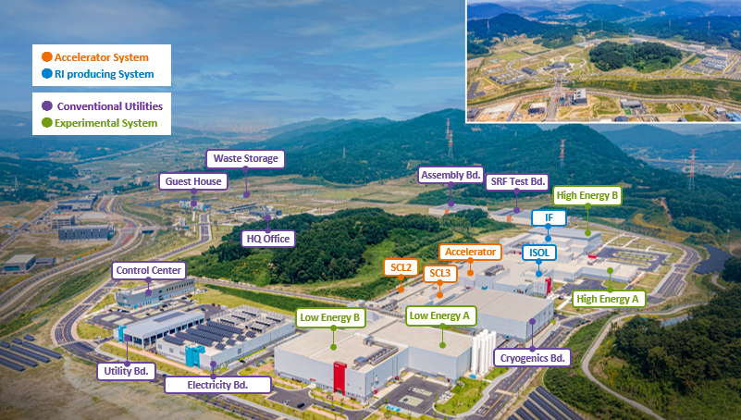
Bird’s-eye-view of RAON
● Accelerator System
● RI production System
● Conventional Utilities
● Experimental System
Waste Storage
Assembly Bd.
Guest House
SRF Test Bd.
IF
High Energy B
HQ Office
Accelerator
Control Center
ISOL
SCL2
High Energy
SCL3
Low Energy A
Utility Bd.
Low Energy B
Cryogenics Bd.
Electricity Bd.
Area of the land ~ 1 M m²

Slide 6
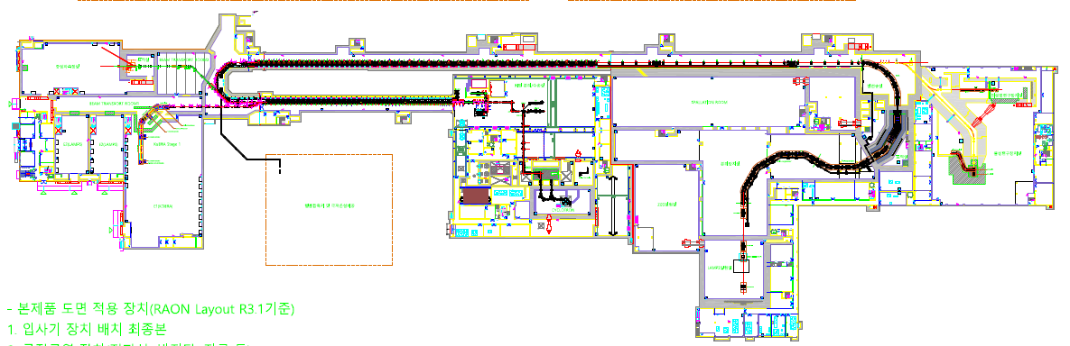




Accelerator System
Injector
SC Linac
IF
SCL3
SCL2
0.5 MeV/u
18 MeV/u
200MeV/u
ISOL/ECR
LEBT
RFQ
MEBT
SCL3-1
SCL3-2
CSS
SCL2-1
SCL2-2
HEBT
IF
$β$=0.047
$β$=0.12
$β$=0.3
$β$=0.51
2nd phase
NDPS
SCL2
Injector
MMS, CLS System
IF System
BIS
SCL3
ISOL System
μSR System
KoBRA System
Cryogenic Facility
LAMPS System
※ SCL1 is postponed and is not shown here.

Slide 7
Accelerator System
Injector
SC Linac
IF
SCL3
SCL2
0.5 MeV/u
18 MeV/u
200MeV/u
ISOL/ECR
LEBT
RFQ
MEBT
SCL3-1
SCL3-2
CSS
SCL2-1
SCL2-2
HEBT
IF
$β$=0.047
$β$=0.12
$β$=0.3
$β$=0.51
※ SCL1 is postponed and is not shown here.
2nd phase
NDPS
SCL2
Injector
MMS, CLS System
IF System
BIS
SCL3
ISOL System
μSR System
KoBRA System
Cryogenic Facility
LAMPS System
※ SCL1 is postponed and is not shown here.

Slide 8
Accelerator System
Injector
SC Linac
IF
SCL3
SCL2
0.5 MeV/u
18 MeV/u
200MeV/u
ISOL/ECR
LEBT
RFQ
MEBT
SCL3-1
SCL3-2
CSS
SCL2-1
SCL2-2
HEBT
IF
$β$=0.047
$β$=0.12
$β$=0.3
$β$=0.51
2nd phase
NDPS
SCL2
Injector
MMS, CLS System
IF System
BIS
SCL3
ISOL System
μSR System
KoBRA System
Cyclotron
Cryogenic Facility
LAMPS System
※ SCL1 is postponed and is not shown here.

Slide 9
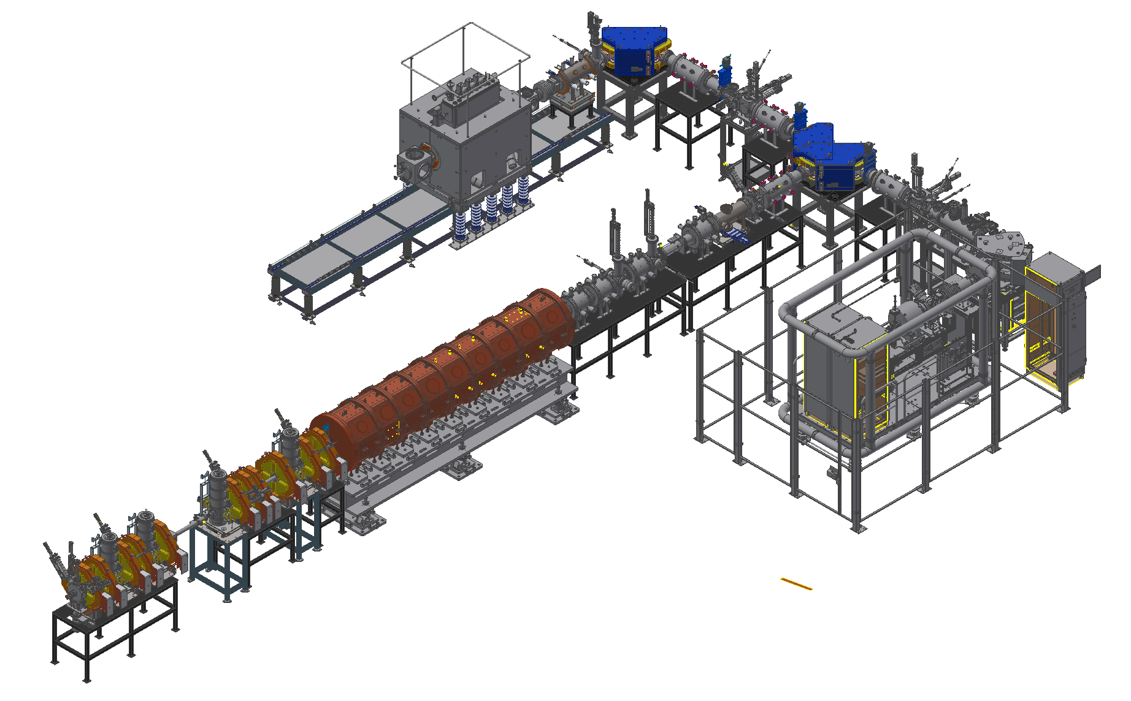
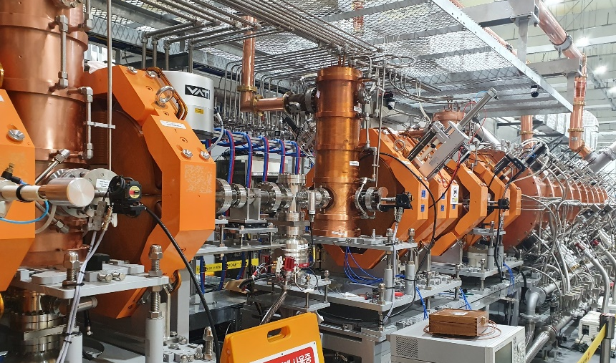
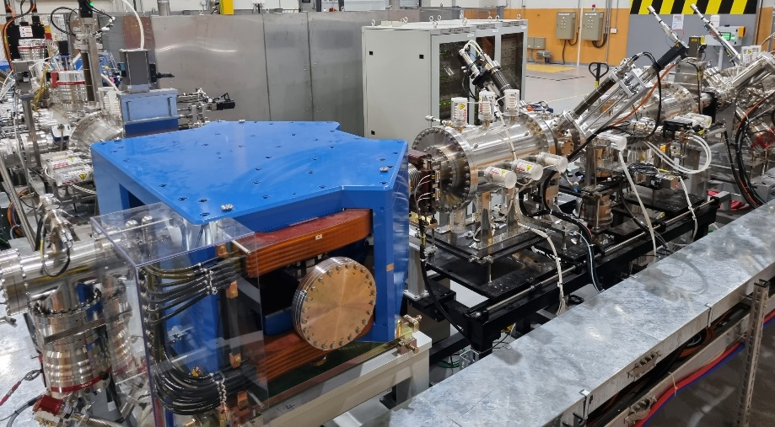
Injector System
Two ECR-IS on high voltage platforms
14.5 GHz ECR ion source
28 GHz superconducting ECR ion source
LEBT (E = 10 keV/u)
10 keV/u, Dual bending magnet
Chopper & Electrostatic quads, Instrumentation
RFQ (E = 500 keV/u)
81.25 MHz, Transmission Eff. ~98%
CW RF Power 94 kW (SSPA: 150 kW)
MEBT (E = 500 keV/u)
Four RF bunchers (SSPA: 20, 15, 2×4 kW)
Simple quadrupole magnets, Instrumentation
SC
ECRIS
LEBT
ECRIS
MEBT
RFQ

Slide 10
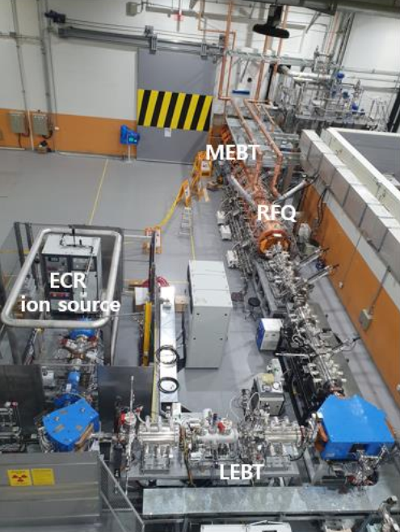
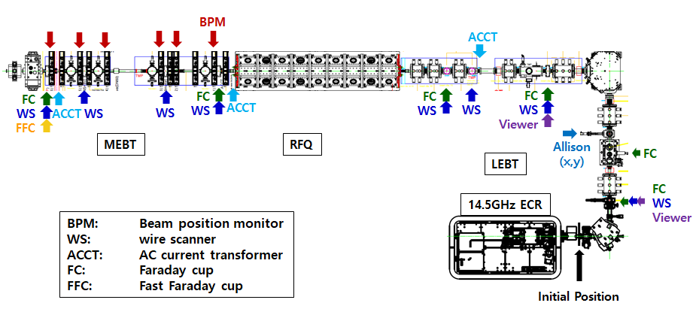
Injector Commissioning
Injector: 14.5 GHz ECR (10keV/u),
LEBT (charge selection, matching),
RFQ (507 keV/u, 98% transmission),
MEBT (matching)
Injector beam commissioning:
Ion | Argon | Neon | Oxygen | Helium | Proton
A (Q) | 40 (8, 9, 11) | 20 (4) | 16 (6) | 4 (2) | 1(1)
Current [μA] | 50, 30, 50 | 40 | 40 | 50 | 50 ~ 160
Layout of RAON injector
[ Beam Diagnostics in injector ]

Slide 11
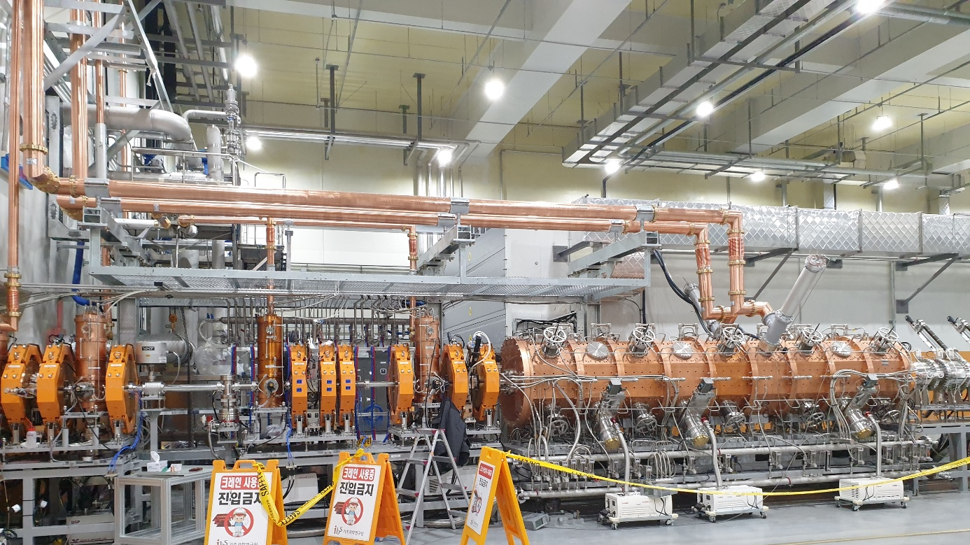
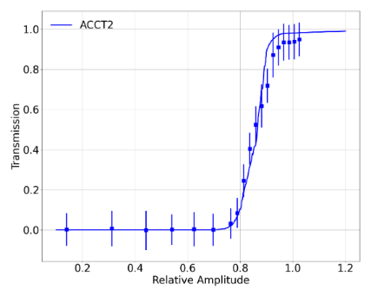
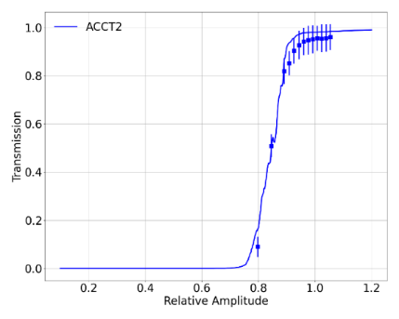
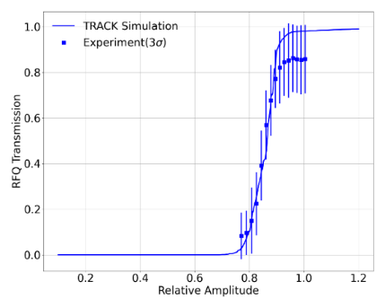
RFQ set point and transmission
RFQ set point: beam transmission measured by ACCT in LEBT and MEBT.
- Low RFQ transmission for Ne beams ⇒ main issue in injector beam commissioning with Ne beams
- Different set values for the same A/Q (Ar8+, Ne4+): Need more study
 | Ar(Q=9) | Ar(Q=8) | Ne(Q=4)
Transmission | 93.4% | 95.4% | 85.7%
RF set value | 51.5 kW | 62.9 kW | 67.4 kW
[ Installed RFQ and MEBT ]
[ RFQ set-point for Ar (9+)]
[ RFQ set-point for Ar (8+)]
[ RFQ set-point for Ne (4+)]

Slide 12
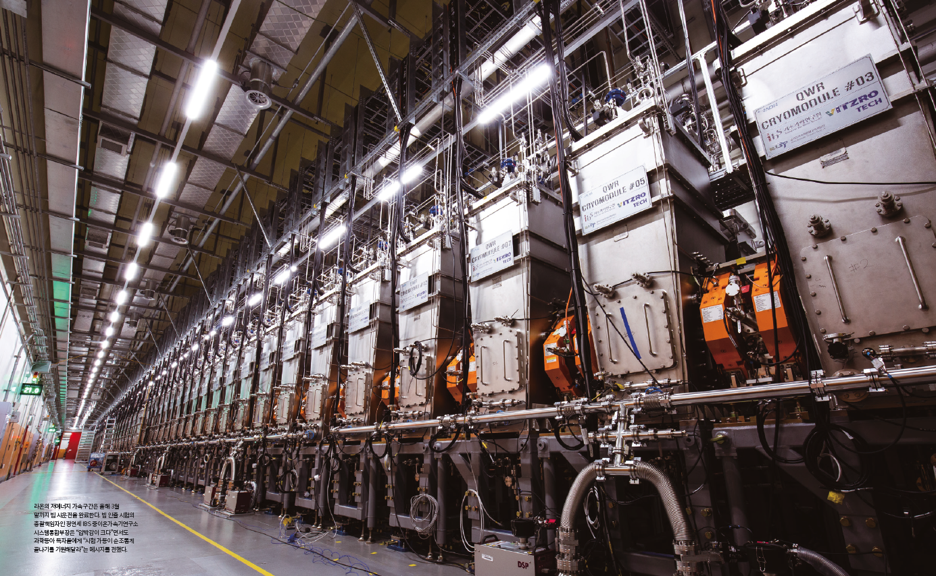
SCL3 linac assembly completed - Dec. 7, 2021

Slide 13
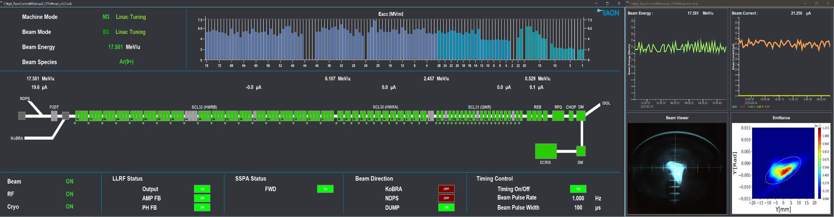
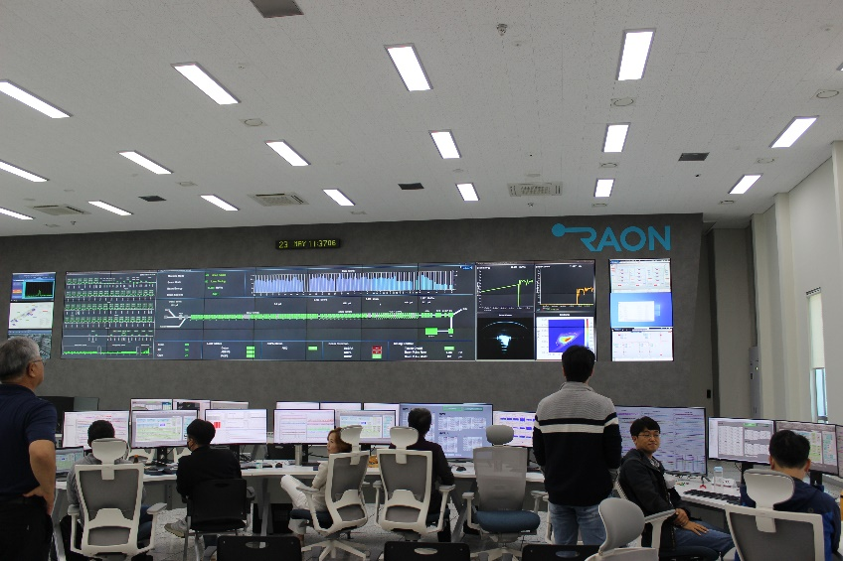
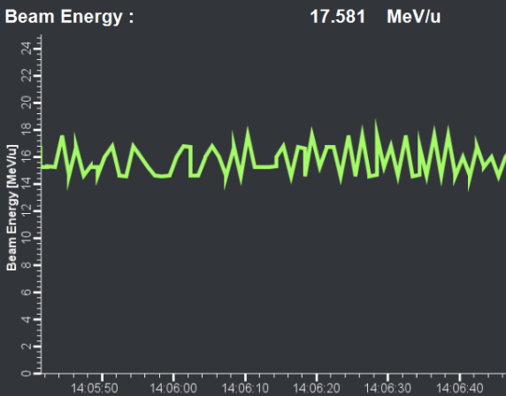
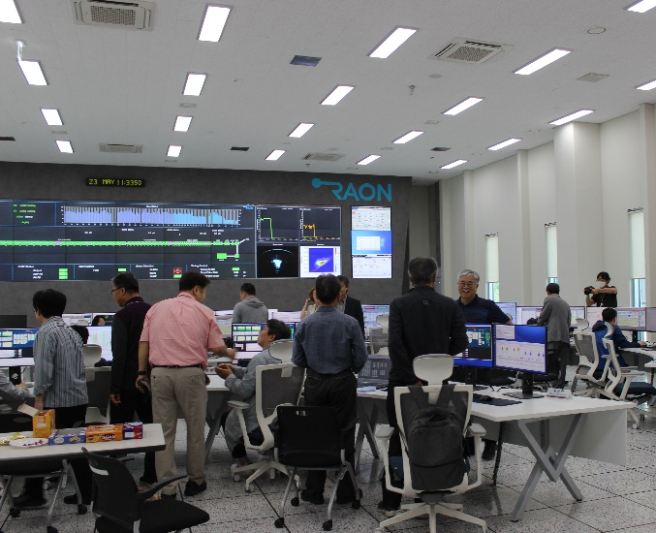
May 23, 2023: The 1st commissioning of SCL3 with ⁴⁰Ar⁹⁺ beam
Beam Energy ~17 MeV/u
  Ar⁹⁺ beams accelerated by entire SCL3(QWR/HWR) on May 23, 2023
  Shutdown on June 3, 2023 for maintenaince.

Slide 14
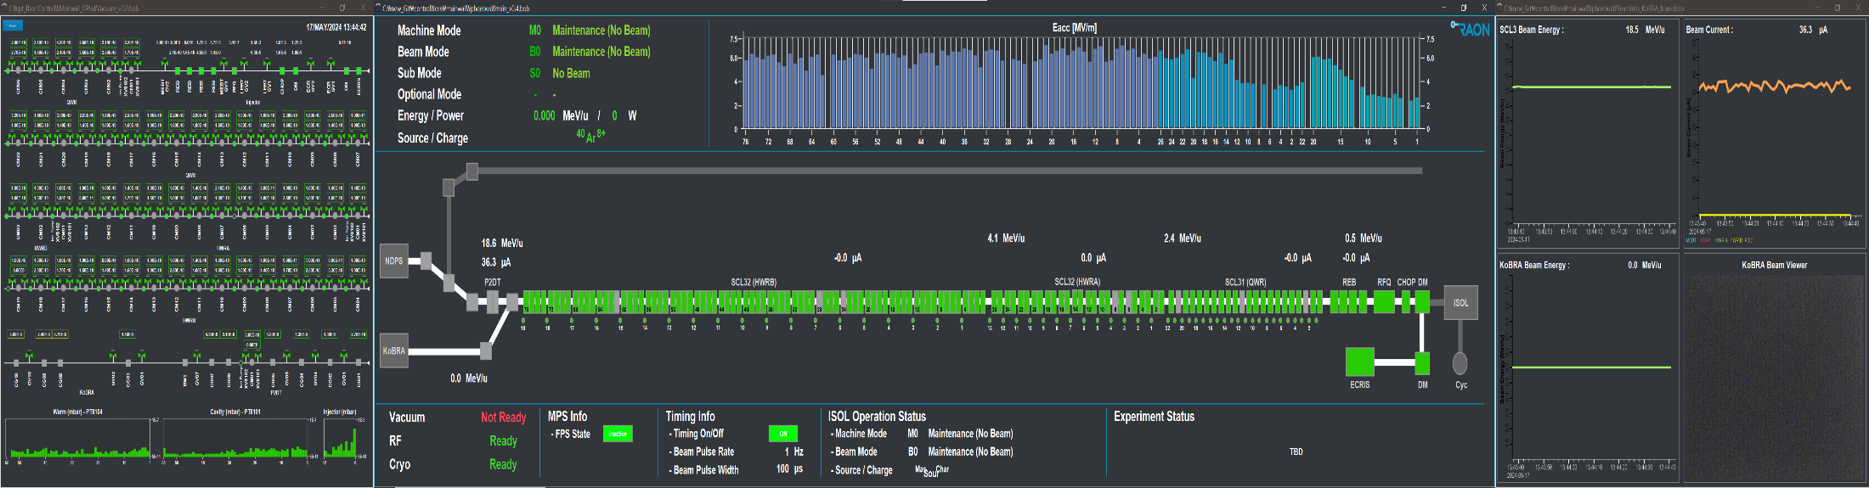
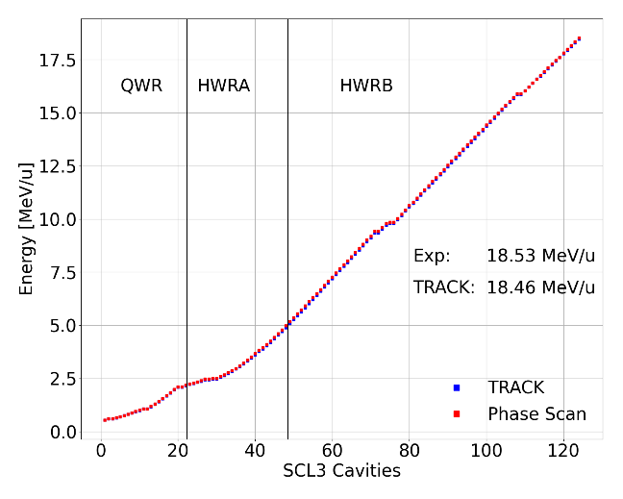
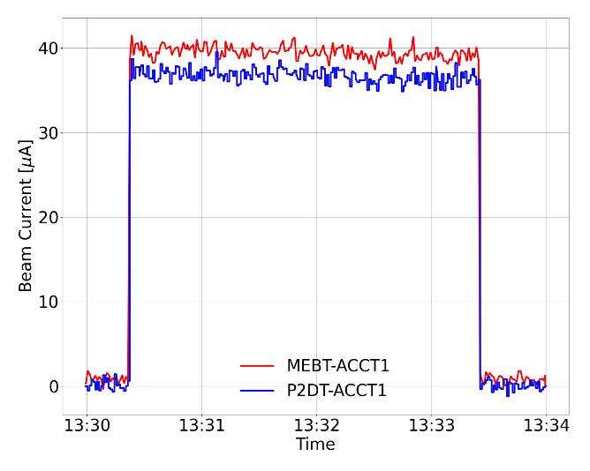
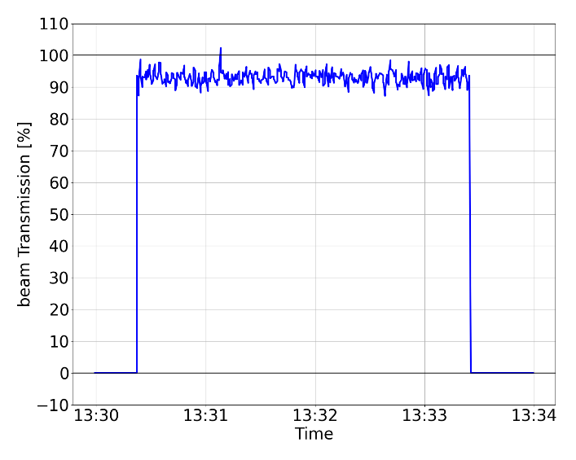
May 17, 2024 : The 2nd commissioning completed with ⁴⁰Ar⁸⁺
Beam Energy 18.5 MeV/u
  ⁴⁰Ar⁸⁺ beam accelerated by the entire SCL3(QWR/HWR) on May 17, 2024
[ Energy in SCL cavities ]
[ Beam current measured by ACCT in MEBT and P2DT ]
[ Beam transmission through SCL3 ]

Slide 15
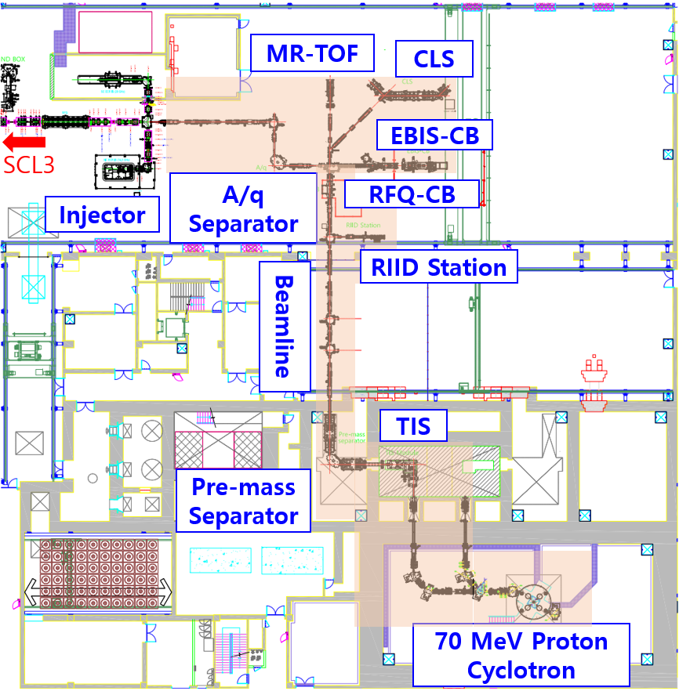
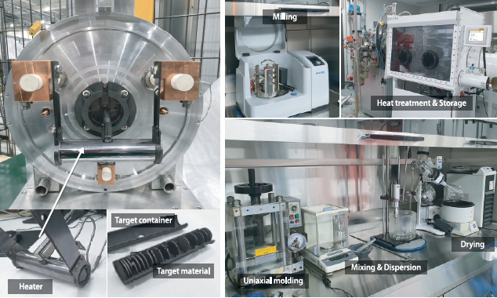
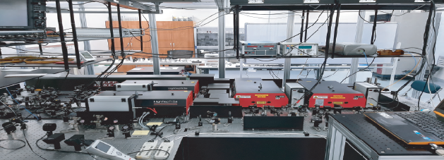
ISOL System
ISOL Experimental Hall
• Driver beam : proton 30~70 MeV, up to 70 kW
• Target : SiC, BN, MgO, LaC₂, UCx, CaO, TiC, BeO, etc
• Ion Source : Surface, RILIS, Plasma
• Pre-mass separator (R_{m} ~ 400), A/q separator (R_{A/q} ~ 250)
• RIB : 6< A < 160, 10<K< 80 keV, 10⁸ pps(Sn), >90% purity @Exp.
- incident to RFQ at 10 keV/u for post acceleration
- fully remote maintenance system with TIS modularization
Target
RILIS
• 2022. 10: SAT Cyclotron
• 2022. 12: System integration & commissioning with a Cs ion source
• 2023. 03: First production of RI (Na isotopes) with SiC target
• Present : Na, Al isotopes to RIID - RFQ-CB – EBIS - MR-TOF

Slide 16
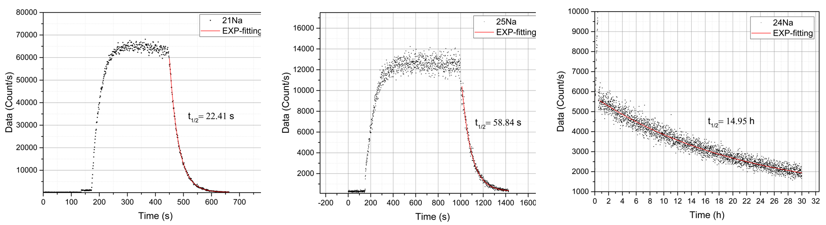
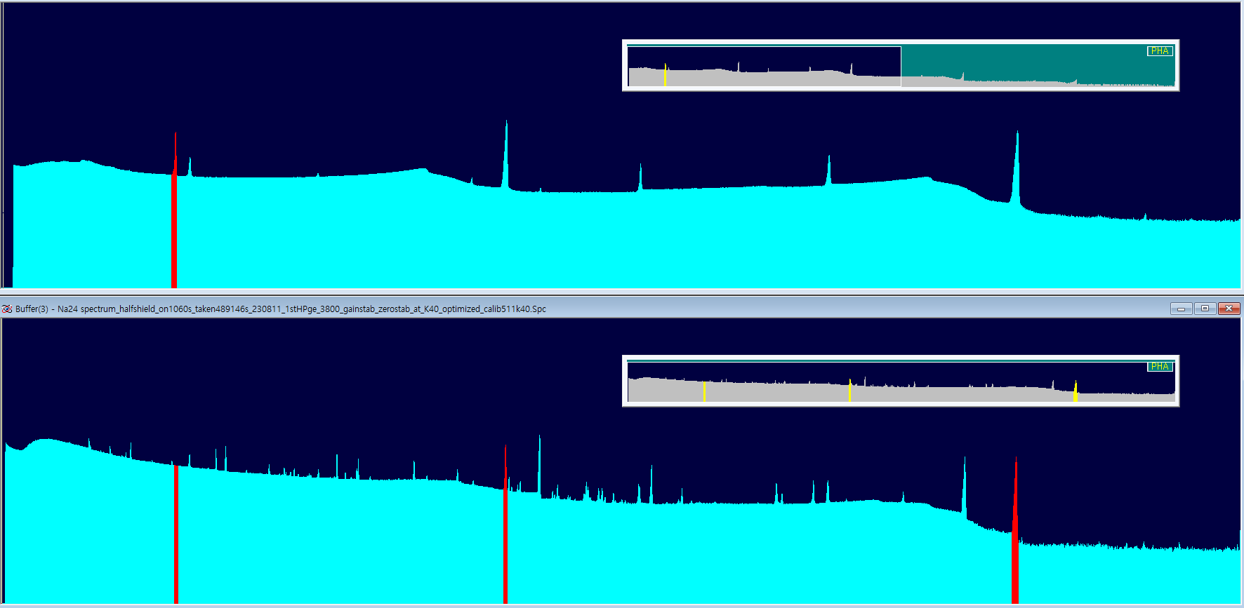
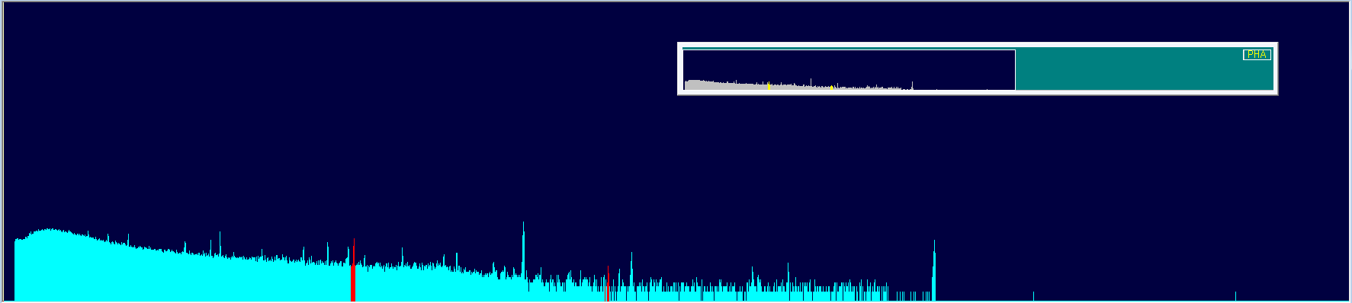
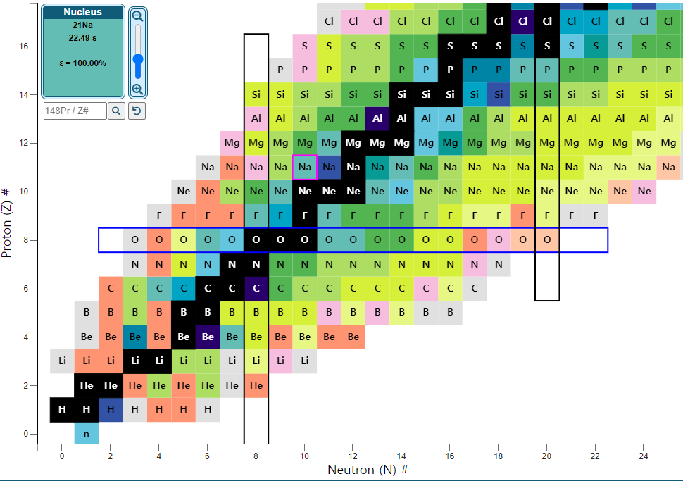
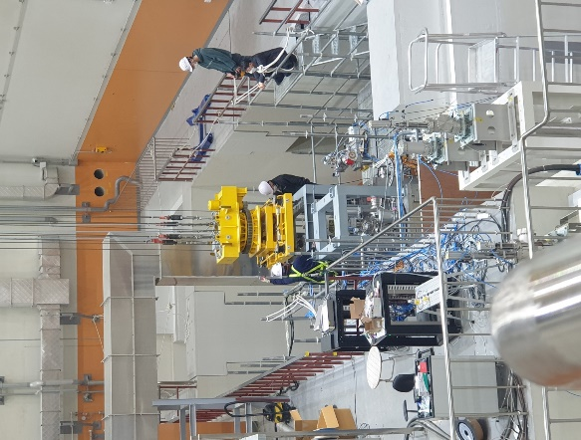
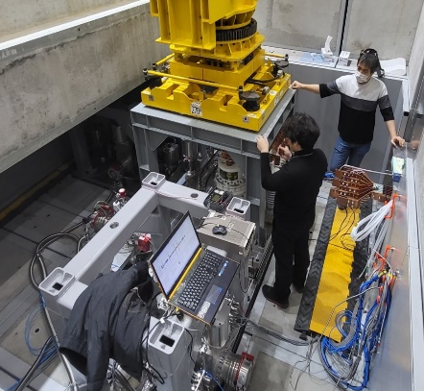
First ISOL Beam Commissioning with RIB (^{21, 22, 24, 25}Na)
The first RI production with SiC target and transport on March 3, 2023
Na-24m (T1/2 20 ms)
◀ Gamma spectrum
of Na-24 measured
by HPGe
Proton 7 uA (upper)
& 1.5 uA (lower)
472 keV, 100%
Proton 70 MeV, 7 uA
²¹Na(22.49(4)s)
²⁵Na(59.1(6)s)
²⁴Na(14.99h)
Proton 70 MeV, 1.5 uA
Na-27 (T1/2 301 ms)
◀ Gamma spectrum
of Na-27 measured
by HPGe
Half-lives of Na isotopes measured by using scintillators & PMT
985 keV, 87%
1,698 keV, 12%
Measurement of short-lived Na beams
- Proton beam : 70 MeV, 7 μ A
Na-24m (T_{1/2} 20 ms) & Na-27 (T_{1/2} 301 ms) detected at RIID
Al-25, 26m, 27, 28 detected
Z=13
Z=11

Slide 17

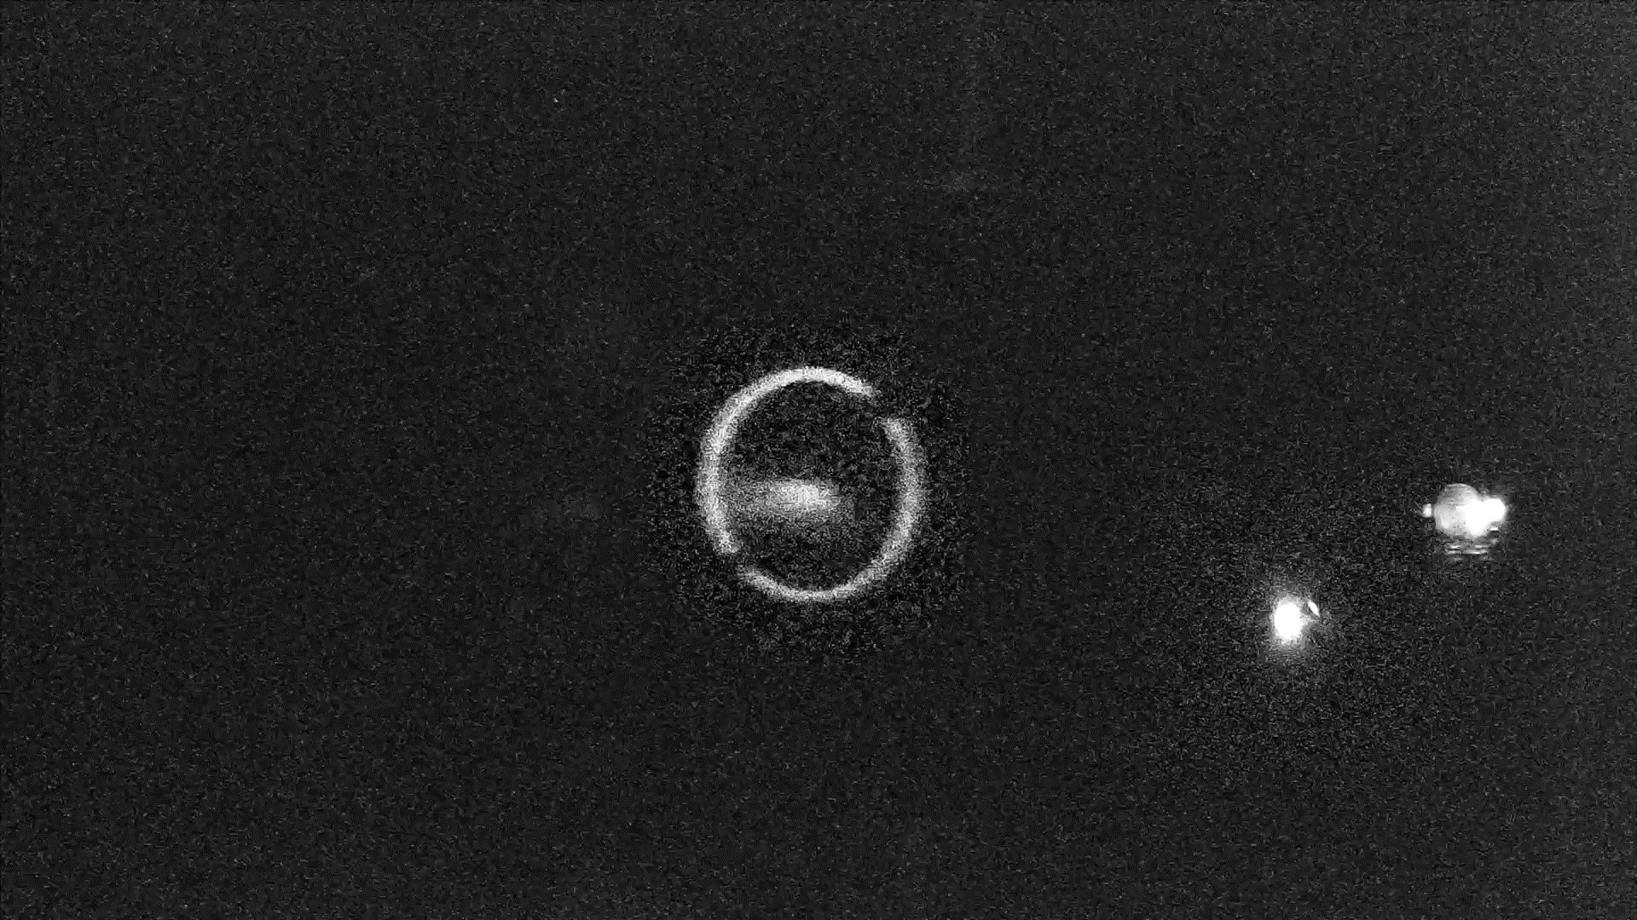
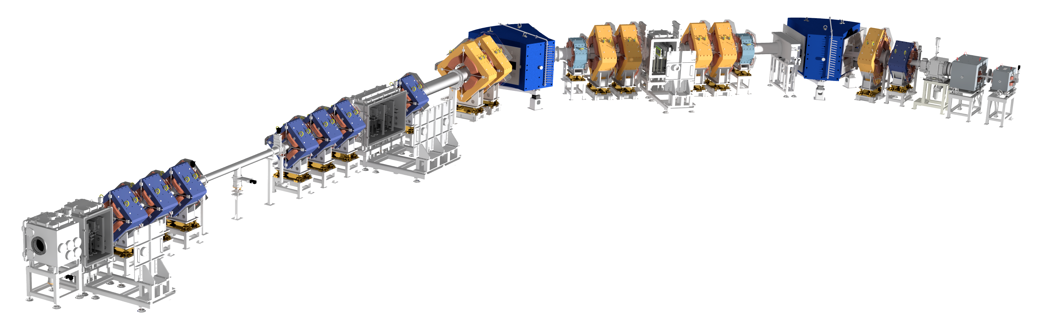
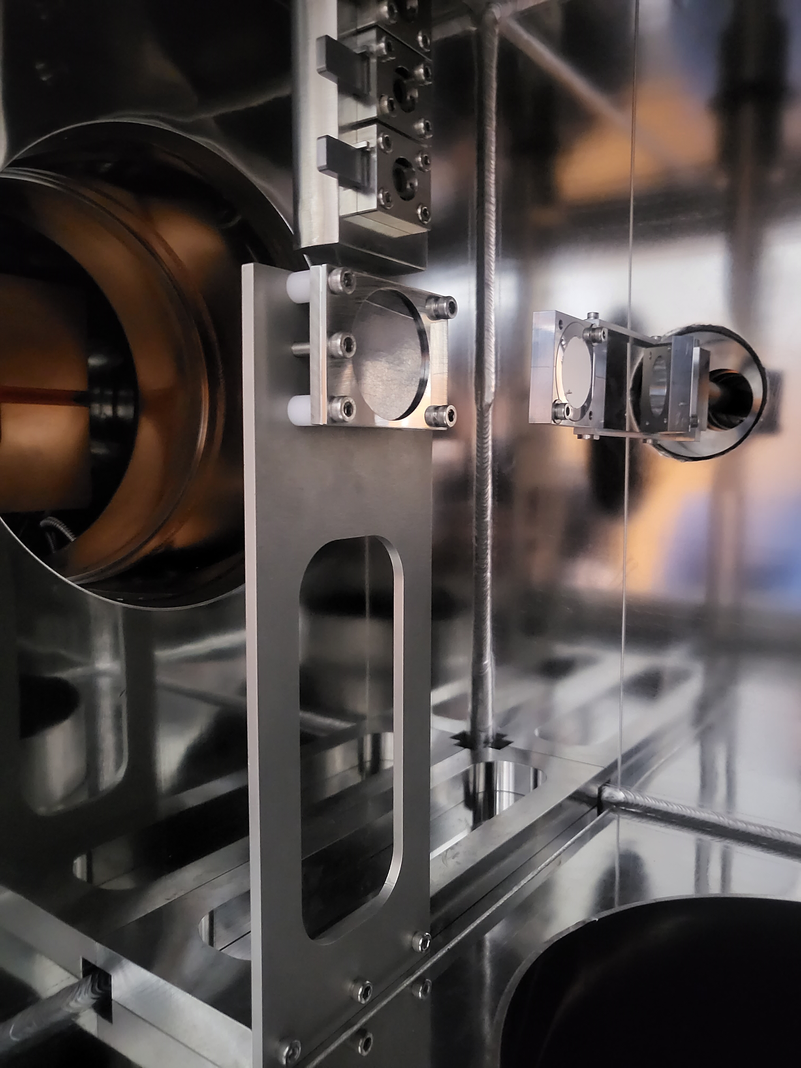
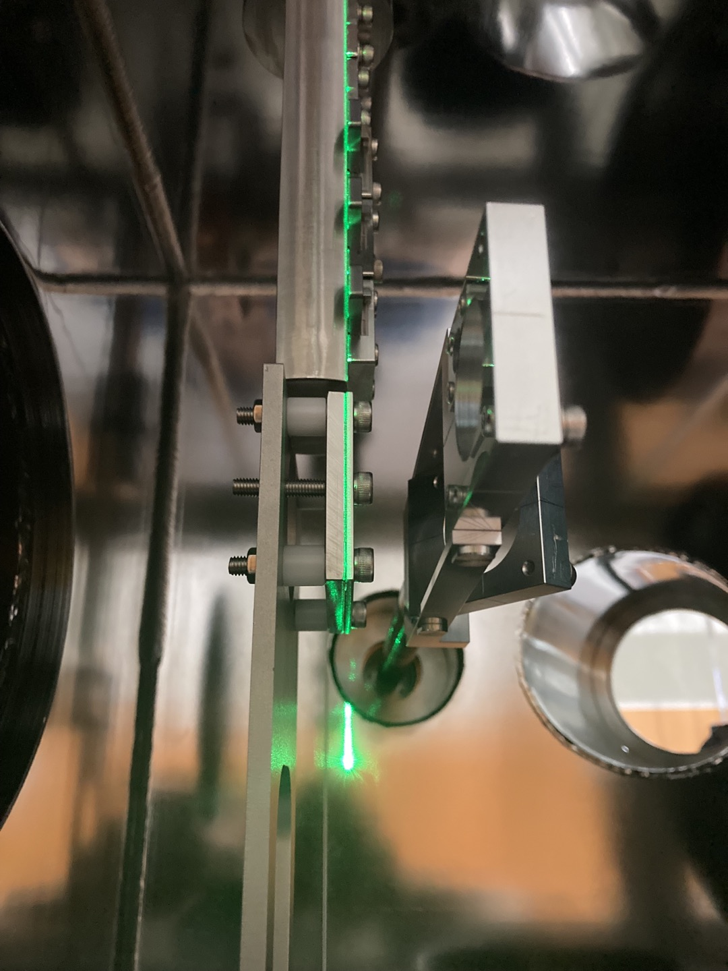
KoBRA spectrometer
First Beam Commissioning of KoBRA (May 31 ~ June 2, 2023)
F0 Phosphor at KoBRA
⁴⁰Ar⁹⁺ Primary Beam
Beam Energy
Beam Current
⁴⁰Ar⁹⁺ 16.1 MeV/u, 0.22 pnA
Beam Shape
at F0 Position
Beam time: 23.05.31 to 23.06.01. (10:00 AM to 18:00 PM)
1. RI Production Experiment (23.05.31 ~ 23.06.01, total 16 hours)
2. Nuclear Physics Experiment (23.06.02, 4 hours)
16.1 MeV/u
⁴⁰Ar⁹⁺ beam
F1
F0
Plastic (Degrader)
Beam phosphor
Production Target
F2
Position & Time measurement
(2 x PPAC)
Inside of target chamber
F3
Position & Time measurement (2 x PPAC)
Energy loss measurement (SSD)
No use of attenuator
Production target: 0.1 mm graphite
Swing angle on production target : 0 mrad
Target
Phosphor
View Port

Slide 18
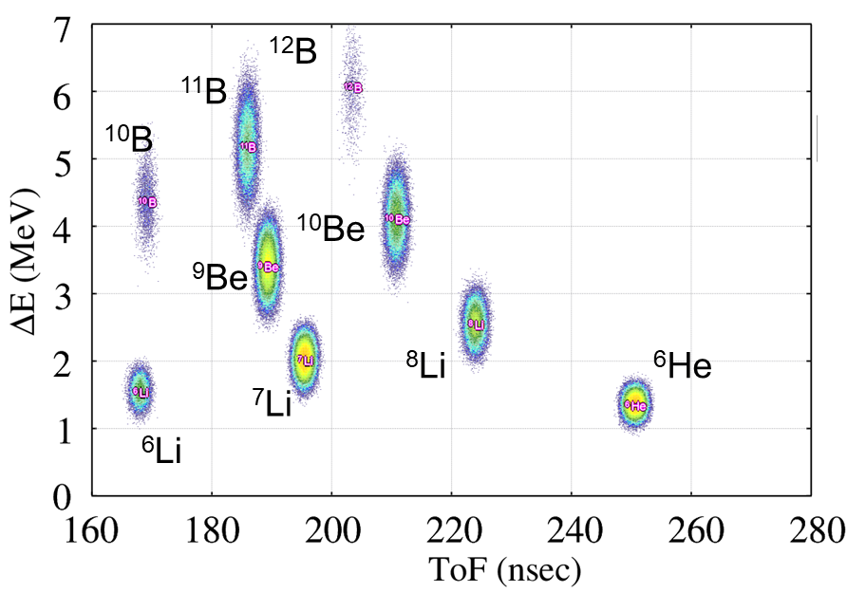
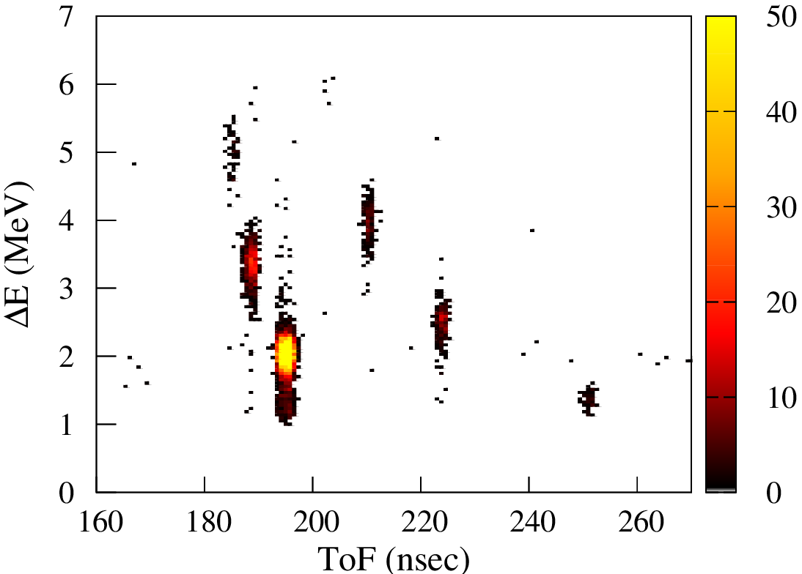
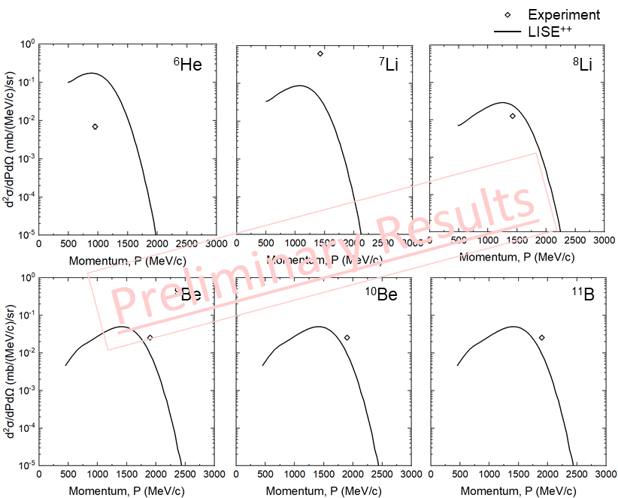
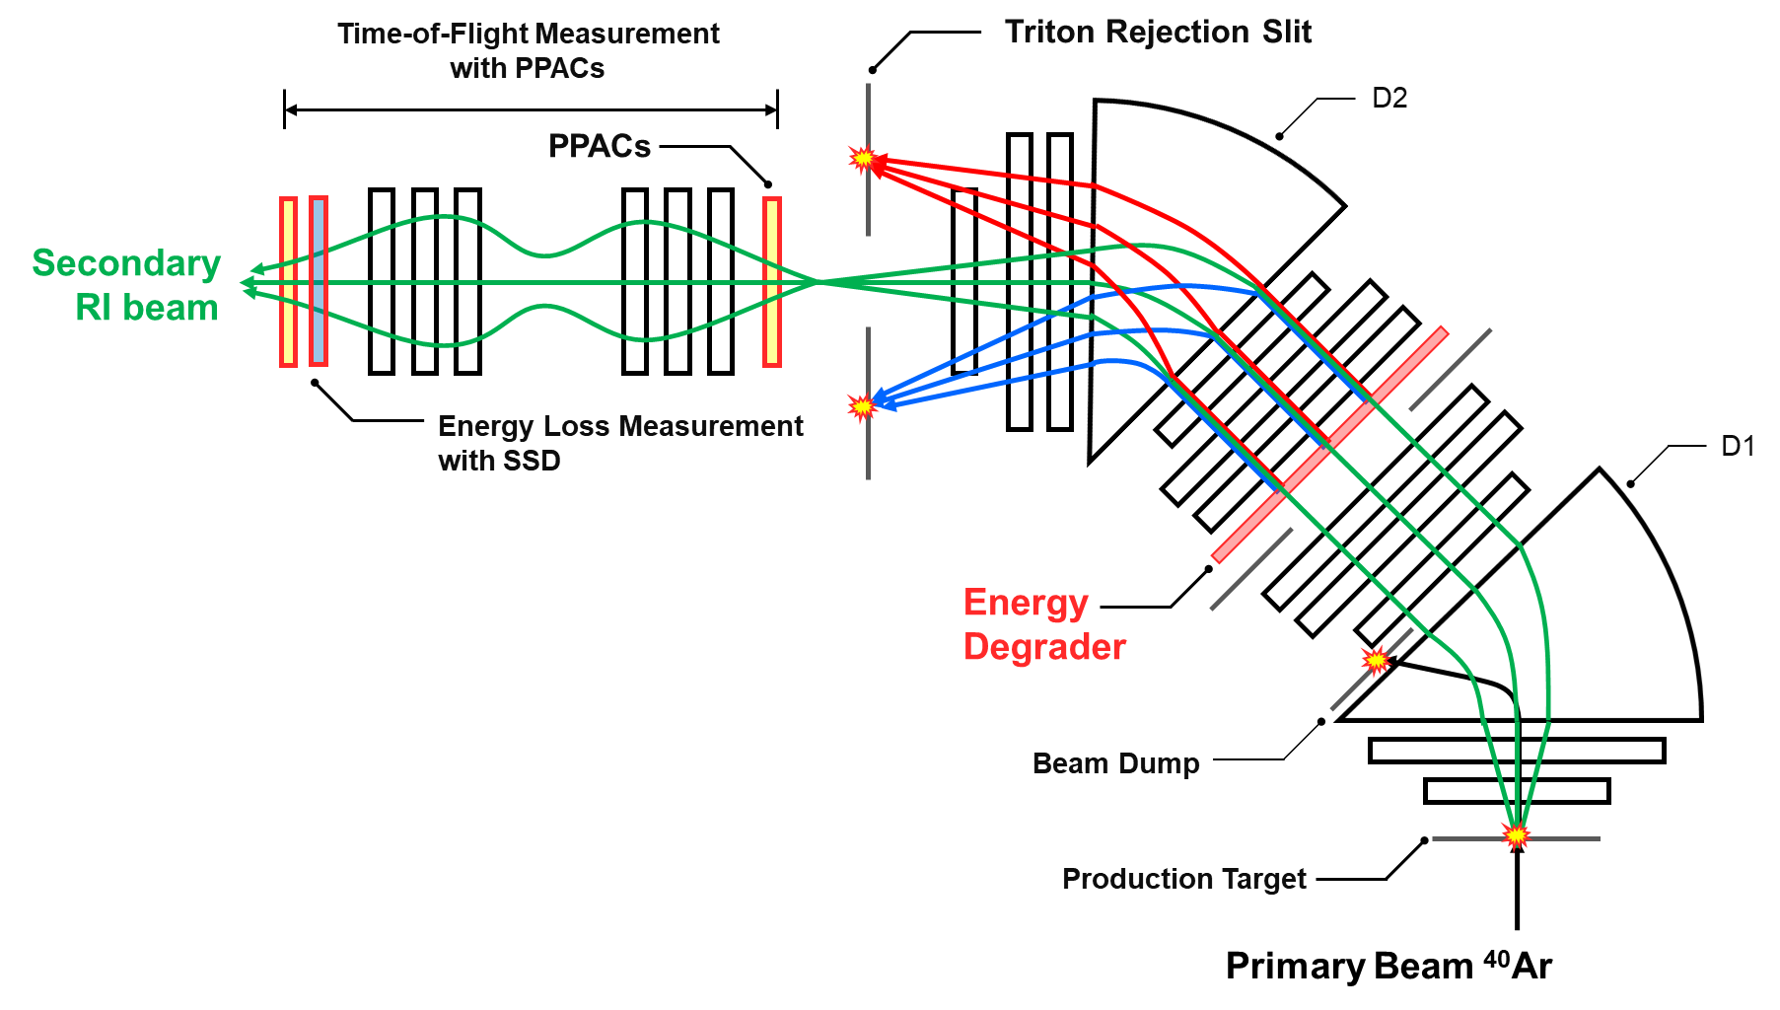


KoBRA spectrometer
Particle Identification
Double Differential Cross Section (DDXS)
$$\frac{d^{2}σ}{dPdΩ}=Y\left(A,Z\right)\frac{A_{t}}{I_{p}A_{v}d_{t}}\frac{1}{ΔPΔΩ}\frac{1}{ε_{trans}} [mb/(MeV/c)/sr]$$
Particle identification with ΔE-ToF method
SSD: Energy loss measurement
PPACs: Time-of-flight measurement
Y(A,Z) : Fragment rate [pps]
I_{p} : Primary beam intensity [pps]
A_{v} : Avogadro number [particles/mol]
A_{t} : Atomic number of ¹²C target [g/mol]
d_{t} : target area density [g/cm²]
ΔP : Momentum acceptance [MeV/c]
ΔΩ : Angular acceptance [sr]
ε_{trans} : Transmission efficiency of fragments
$$Y\left(A,Z\right)=\frac{N(A,Z)}{t_{live}}\frac{S_{DAQ}}{ε_{ToF }} [pps]$$
LISE⁺⁺
Experiment
N(A,Z) : Count of events for fragment in DAQ [#]
t_{live} : Live time of DAQ [sec]
S_{DAQ} : Scaling factor for counts in DAQ
ε_{ToF} : Efficiency of Time-of-flight Measurement
¹¹B
¹⁰Be
⁹Be
⁸Li
⁷Li
⁶He
F1
F3
F2

Slide 19
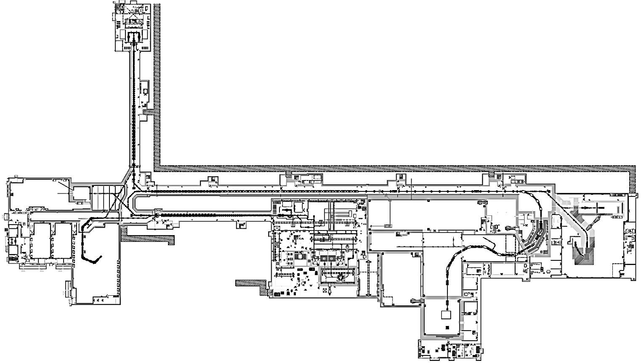

NDPS (Nuclear Data Production System)
Neutron beam production system with proton and deuteron beams
- Nuclear data measurement
- Applications such as neutron irradiation test for semiconductors
White neutrons produced by 50 MeV/u deuteron beams from SCL3
Monoenergetic neutrons, by using proton beams of 20-80 MeV/u from SCL3
Low energy experimental hall B
SCL2
SCL3
IF
Deuteron (E_{d} ≤ 49 MeV/u)
Proton ( E_{p} ≤ 83 MeV/u)
ISOL
Low energy experimental hall A

Slide 20
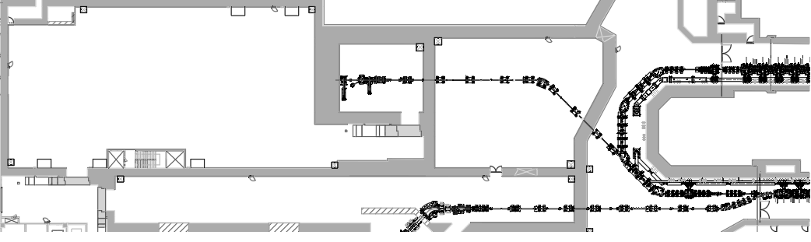

NDPS (Nuclear Data Production System)
target room
Beam Transport Room 2
SCL2
ToF room
Deuteron or proton
Beam Transport Room 1
SCL3
SCL3-KoBRA beamline
Beam ion | Proton, deuteron
Maximum Beam energy | 49 MeV/u for deuteron 83 MeV for proton
Maximum Beam current | ~10 μA
Target | C for white neutron Li for monoenergetic neutron
Bunch length | ~ 1 ns
Repetition rate | (1 – 200) kHz
Flight length | 5 – 40 m
Neutron flux | ~ 10⁸ cm^{–2} sec^{–1} at 5 m

Slide 21

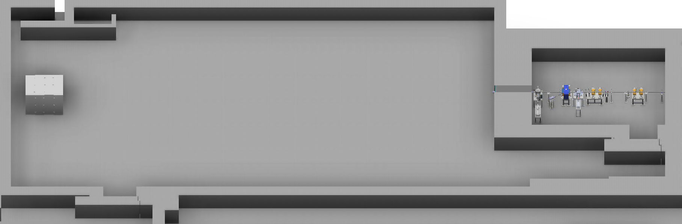
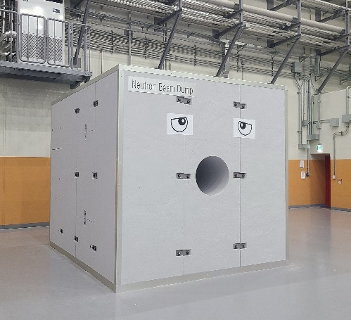
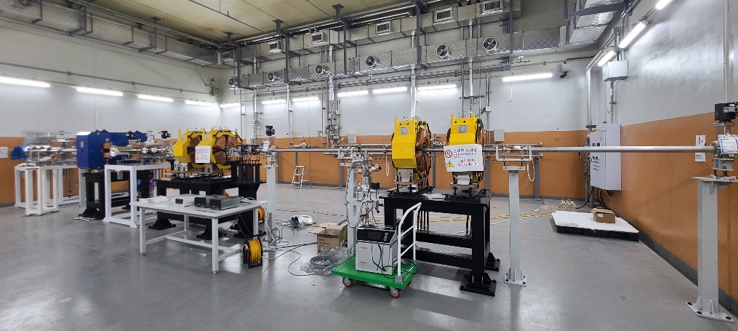
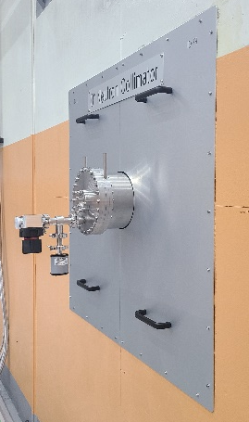
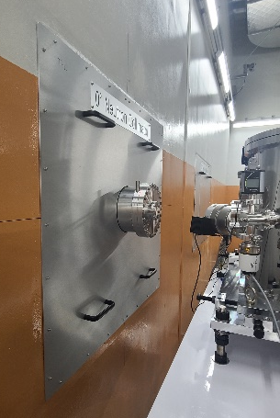
NDPS (Nuclear Data Production System)
ToF room
Target room
Ion beam
Neutron beam
Neutron Beam Dump
(50 m away from C target)
Neutron
Collimator
C target
Li target
Neutron Beam Dump
Neutron Collimator
Target room
ToF room
Target room

Slide 22
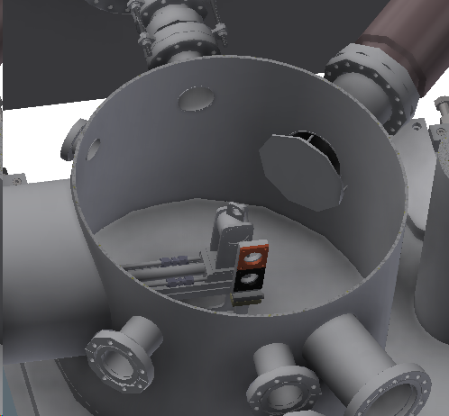
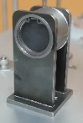
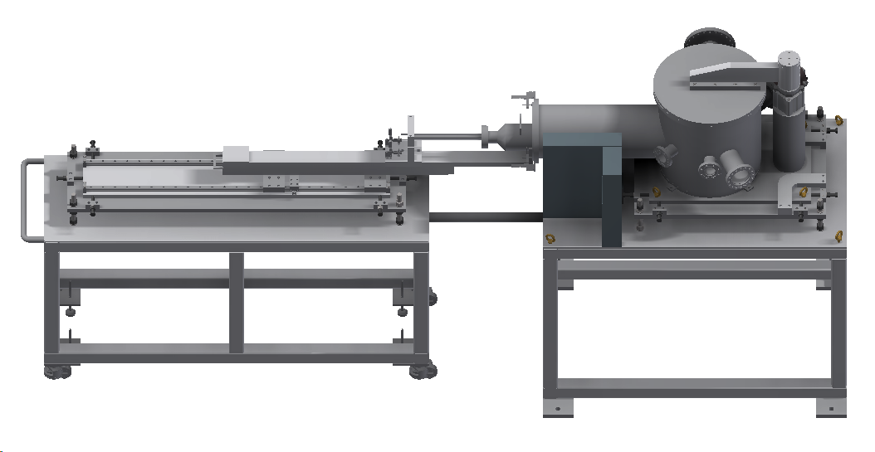



Carbon target
NDPS (Nuclear Data Production System)
Now, under radiation safety inspection together with KoBRA
3D modeling
Target actuator
Graphite target
Phosphor monitor
view port
^{nat}Fe (n, x) ⁵⁶Mn
Phosphor
actuator
Lead block
Fe foil
~ 156,000 neutrons/s at the Fe foil
Ar beam
Measured activity at EOB = 37.7 ±1.3 Bq
~ 70 % of estimated activity (PHITS) at EOB = 53.9 Bq

Slide 23







Other Experimental Systems
IF Separator
Cyclotron
NDPS
muSR
MMS
LAMPS
BIS
All exp. systems are installed and machine-commissioned by 2022

Slide 24

















International Cooperation
MOUs with 17 International Institutes

Slide 25
Summary
The first commissioning of the SC Linac (SCL3), ISOL & KoBRA is done.
The ISOL beam power (currently 1 kW) will be ramped up to 5 kW in 2026.
In 2026, actinide targets and laser/plasma ion sources will be used.
The first call for proposals was done in Dec. 2023 for domestic users.
(The Science Advisory Committee’ recommendation)
30 proposals were submitted for beam times (~ 1,600 hrs) in 2024.
The first PAC was held in March 6~7, 2024.
Beams will be provided to users from June to August, 2024.
The first ISOL beam will be provided to users for CLS in Oct. 2024.
International collaboration has been essential in the construction of RAON.
Beams will be provided to the international users near future.

Slide 26





INPC 2025
In DAEJEON, Korea
May 25 ~ 30, 2025
Daejeon Convention Center, Korea

