Slide 1



Engineering of small grain size and porous Th-based targets for ISOL@MYRRHA
Lisa Gubbels – 22/10/2025

Slide 2
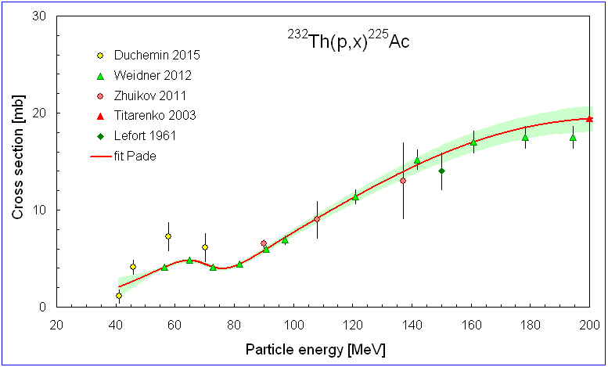
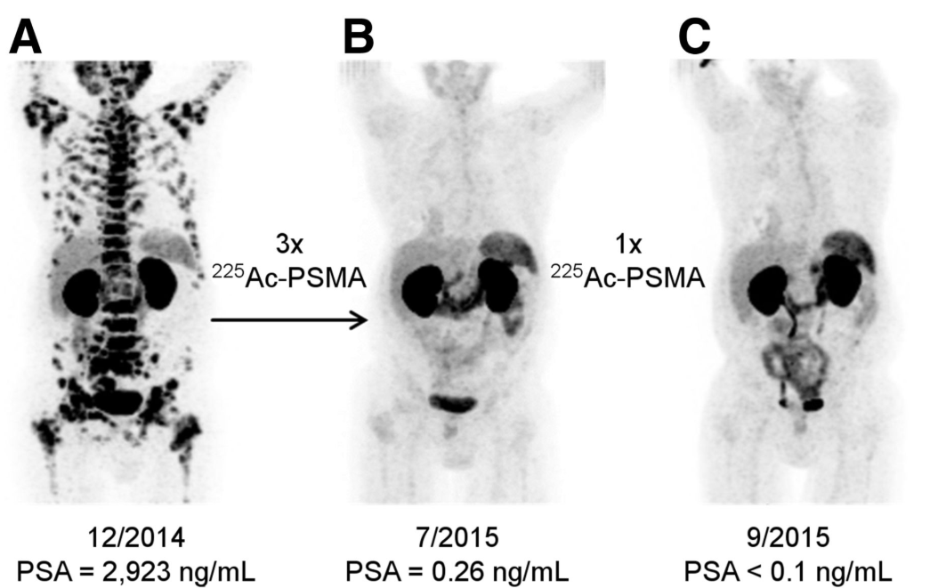
Why are we interested in a Th-based target ?
Introduction
Medical isotopes of interest for ISOL@MYRRHA:
²²⁵Ac for TAT
Kratochwil, JNM 2016, 57 (12) 1941-1944
Recommended cross sections with estimated uncertainties for the ²³²Th(p,x)²²⁵Ac reaction
ISC: Public

Slide 3
Design of a ThO₂ and a ThC_{x} target material
Introduction
Properties | ThO₂ | ThC_{x}
Handling Safety | 🤲 Safe to handle | 💣 Pyrophoric (requires careful handling)¹
Chemical Reactivity | 😇 Chemically stable | 🧪 May react with ²²⁵Ac
Thermal Conductivity | ⛰️ Low (~2–5 W/m·K at 2000 °C) | 🌋 High (~15–30 W/m·K depending on carbon content)^{2, 3, 4}
Impact on Target Design | 🫖 Poor heat dissipation can lead to hot spots and sintering | 🧽 Better heat management, helps preserve porosity^{2, 3, 4}
Temperature Uniformity | 🧊 Less uniform, risk of localized overheating | 🌡️ More uniform, supports stable operation^{2, 3, 4}
Sintering Behavior | 🪨Rapid densification above 1700 °C | 🧽 Sintering hindered by excess carbon^{2, 3, 4}
Porosity Retention at High T | 😔 Loses porosity due to sintering | 🏆 Retains porosity at >2000 °C^{2, 3, 4}
ThO₂ remains highly attractive because of its higher release efficiency both from a bulk target and from a coating of actinium on the surface of a material⁵
¹ Corradetti, S., et al. (2021)Sc. Re. 11(1): 9058.
² Hagebø, E., et al. (1992). Nuc. Ins. and Me.70(1-4): 165–174.
³ Ravn, H., et al. (1975). Nuc. Ins. and Me. 123(1): 131–144.
⁴ Ravn, H. L., et al. (1987). Nuc. Ins. and Me.26(1): 183–189.
⁵Johnson, PhD Thesis: KU Leuven; 2024.
ISC: Public

Slide 4

Target material development is a balancing act
Introduction
Hypothetical requirements put forwards from literature research
For refractory isotope release:
Stable > 2000°C for 1 – 4 weeks
Open porosity of >50 %²
Small grain size
< 10 µm²
Tailored pore size: No closed pores
Mechanical stability of the pellet to high power
General ISOL target
Optimized target material for isotope release which is mechanically stable for handling
Main goal
²Guillot, J., et al. (2019). Nuc Inst and Me, 440: 1–10.
ISC: Public

Slide 5
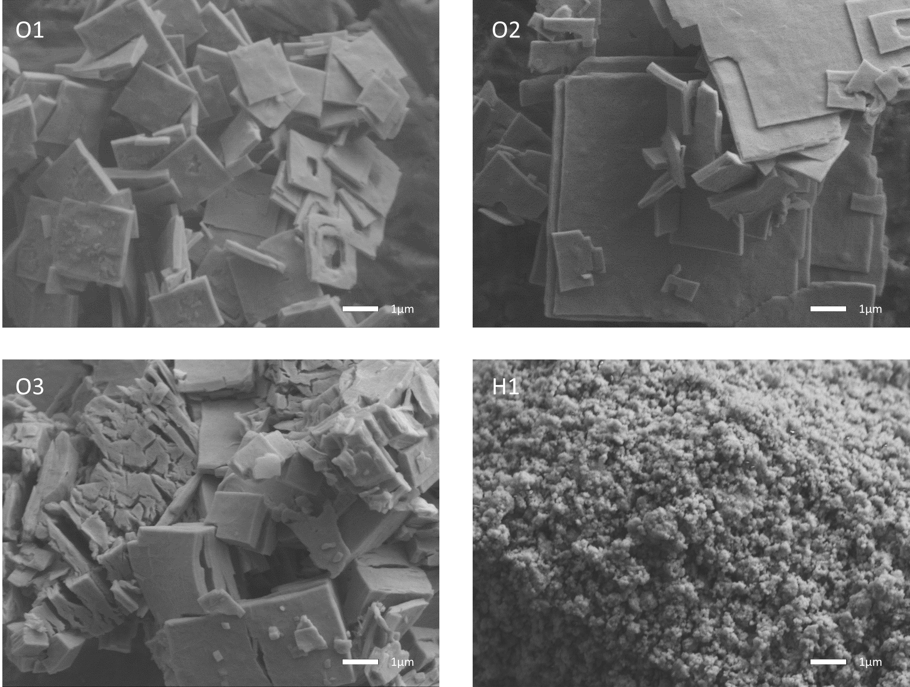
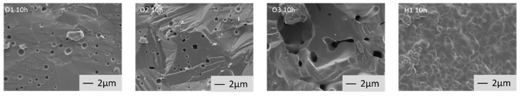
ThO₂
Tailoring ThO2 target material through morphology changes
ThO₂ material with different morphologies
Results from 76-93 % TD after 1h at 1750°C in reductive atmosphere for all of the powder morphologies:
1
2
Material | 1 | 2 | 3 | 4
Bulk density (%TD) | 76.0±1.0 | 87.0±2.0 | 89.0±1.4 | 93.0±1.0
% Closed porosity | 3.0±1.1 | 4.0±2.0 | 3.0±1.5 | 4.0±1.0
% Open porosity | 21.0±1.1 | 9.0±2.0 | 7.0±1.5 | 3.0±1.0
1 µm
1 µm
After 10 h at 1750°C in -420 kJ/mol reductive atmosphere:
3
4
1
2
3
4
1 µm
1 µm
93-98 % TD after 10h for all of the powder morphologies
1 and 2 are platelets of different dimensions, 3 cubic particle and 4 nanoparticles
L.Gubbels (2025), J. Nucl. Mater. submitted
ISC: Public

Slide 6
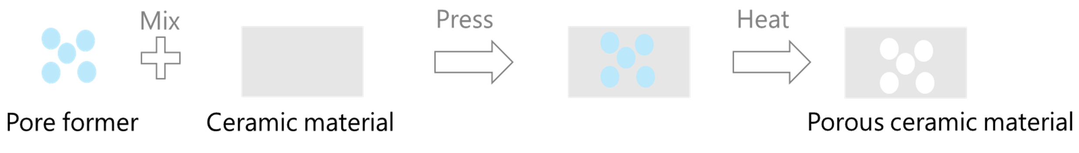
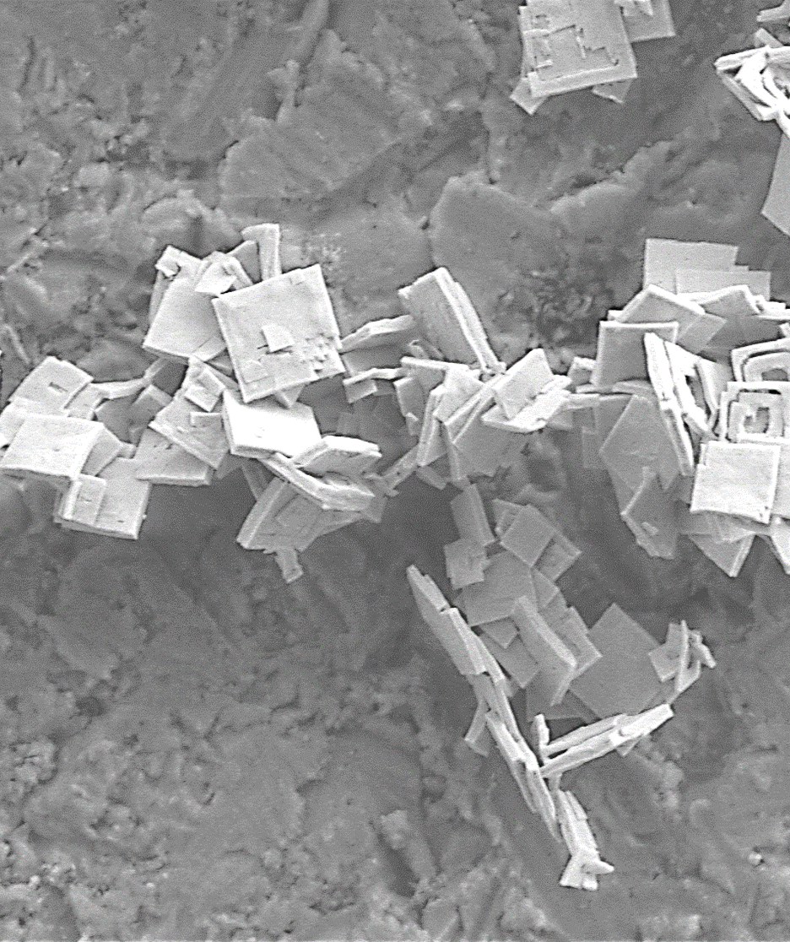
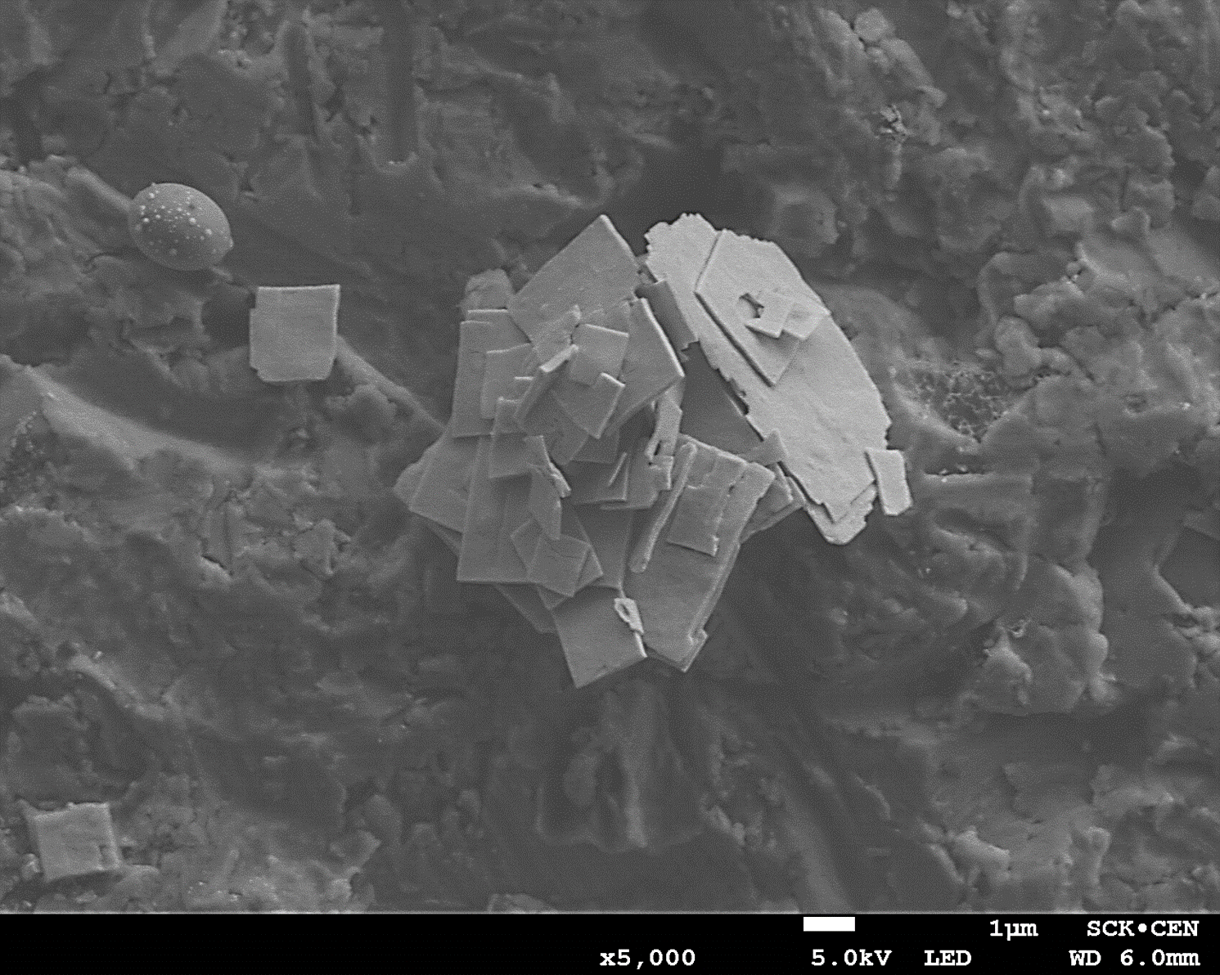
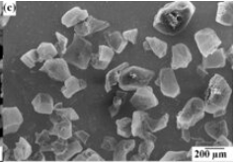
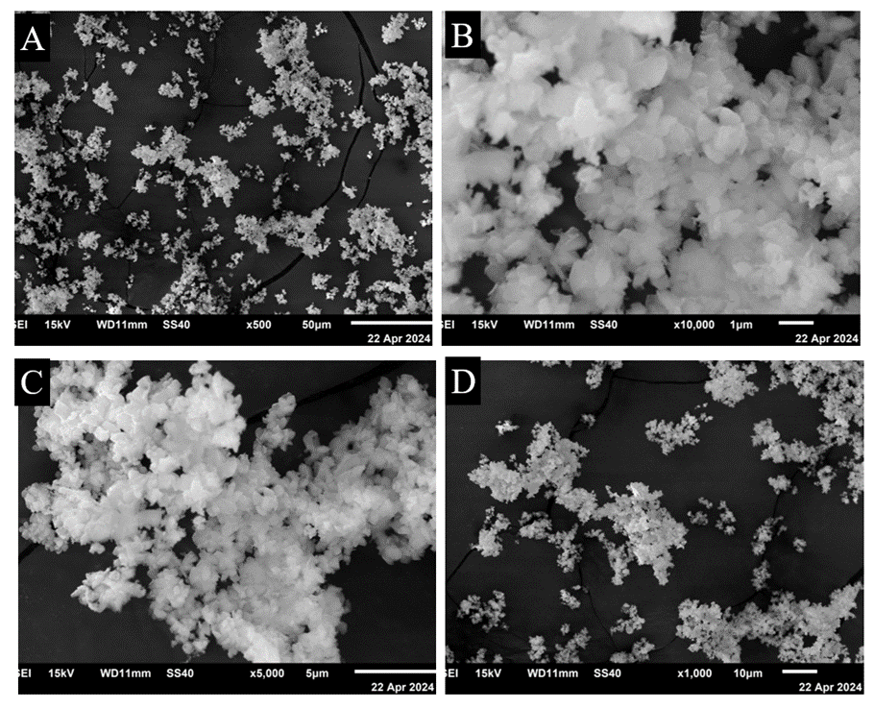
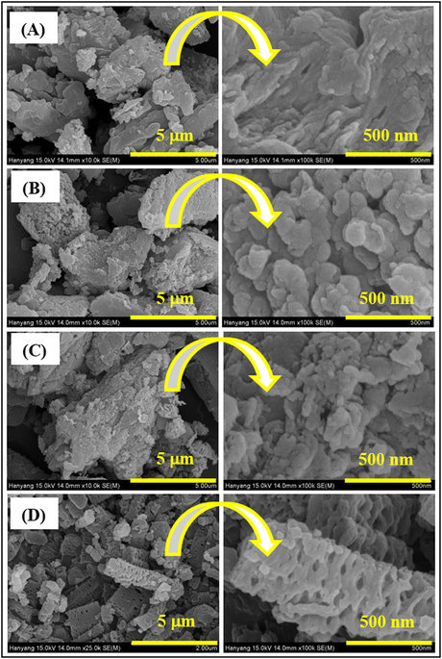
Mixing ThO₂ with pore formers
ThO₂
Volume ratio of the mixture
ThO₂ | AB | NY | GCN
25% |  | 75%
50% |  |  | 50%
33% | 33% |  | 33%
25% | 25% | 50%
50% | 20% | 10% | 20%
Surrogate material study presented in poster ID 71
1
2
Tested on surrogate material³
Pore formers used:
2 µm
2 µm
10 µm
ThO₂ starting powders of different morphologies precipitated from heterogeneous oxalate precipitation (RT and 70°C)
400 µm
2 µm
2 µm
Ammonium bicarbonate (AB)¹
Nylon (NY)³
Graphitic carbon nitride (GCN)²
Garnica, Macias et al. 2020
Pawar, Kang et al. 2016
(3) A.Cordero, L.Gubbels, F.Jutier, et al., Tuning of ThO2 target materials towards highly porous structure to produce medical radioisotopes, Master Thesis, 2024
ISC: Public

Slide 7
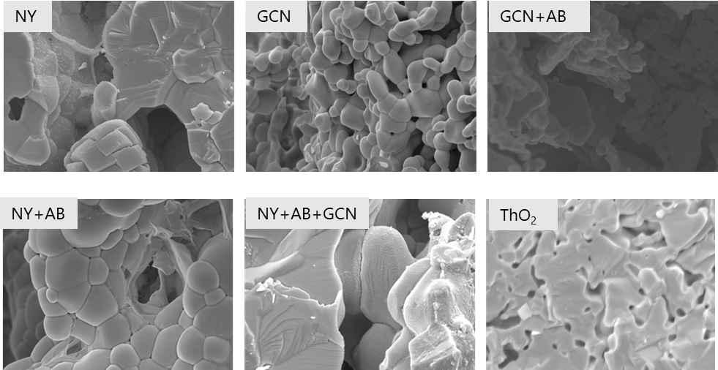
Results after heat treatment 1750°C for 1h
ThO₂
2
Oxalate precipitation based ThO₂ pellets with O2 after 1h at 1750°C
Pore former used in ThO₂ | Open porosity (%)
NY | 17
GCN | 39
GCN + AB | 35
NY +AB | 15
NY+GCN+AB | 20
2 µm
2 µm
2 µm
2
2
2
No pore former
Pore formers ratio
ThO₂ | AB | NY | GCN
25% |  | 100%
50% |  |  | 50%
33% | 33% |  | 33%
25% | 25% | 50%
50% | 20% | 10% | 20%
2
2 µm
2
2 µm
2
2 µm
ISC: Public

Slide 8
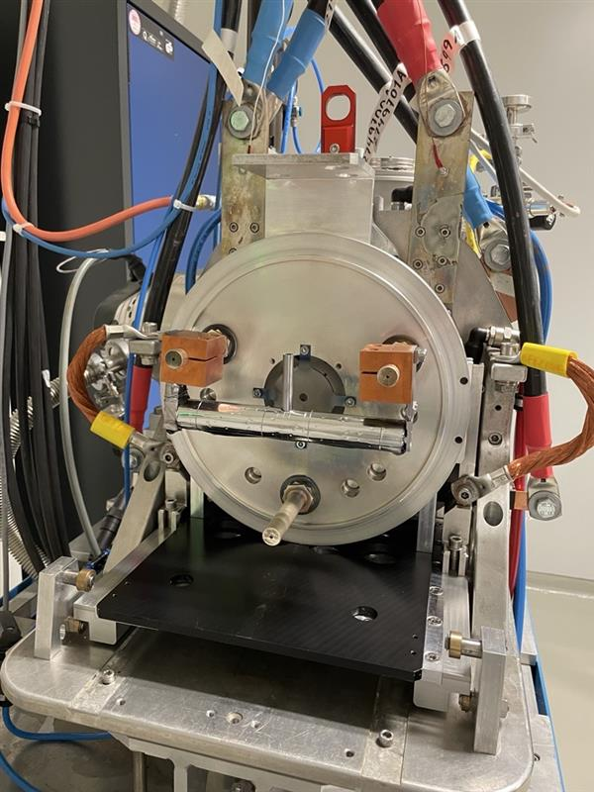
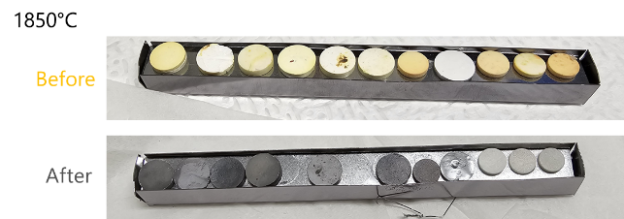
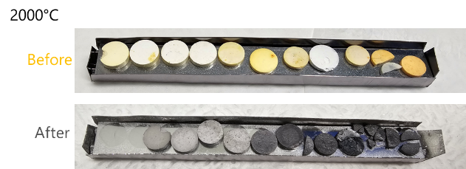

ThO₂
Heat treatment at CERN
Transport of material to CERN for testing at higher temperature
High temperature stability
Test conditions: 1850°C for 24h and 2000°C for 24h in vacuum
ISC: Public

Slide 9
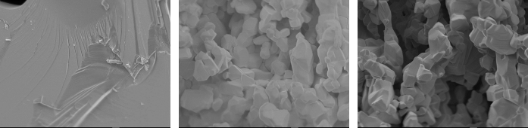
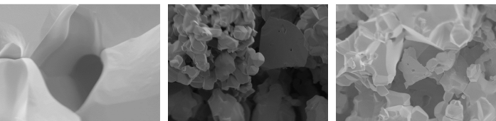
Results after higher temperature heat treatment
ThO₂
ThO₂
GCN
GCN + AB
1850°C
2 µm
2 µm
2 µm
1
1
1
2 % open porosity
29 % open porosity
25 % open porosity
ThO₂
GCN
GCN + AB
2000°C
2 µm
2 µm
2 µm
1
1
1
3 % open porosity
33 % open porosity
25 % open porosity
ThO₂ target material remains porous after treatment 2000°C 24h in vacuum!
ISC: Public

Slide 10
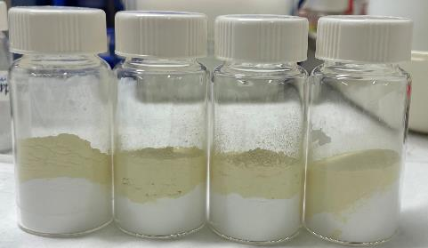


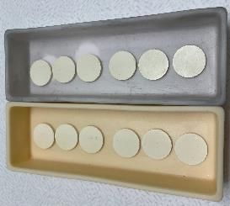
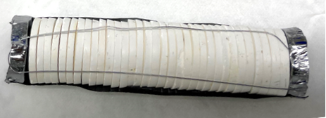
Irradiation of ThO₂ at CERN
ThO₂
Objective : 50 g of ThO₂ from the pore former study
ThO₂ powder 1 made of small platelet
Dry mixed for 30 min at 50 RPM
Pellets of 20 mm of diameter and 1.5 mm thick
Mechanically stable (sintered 1750°C for 1h)
Irradiation test in early November at CERN
Extraction of radioisotopes in the MEDICIS facility
Unmixed powder of ThO₂ + graphitic carbon nitride the pore former
ThO₂ target material that will be irradiated on the 3rd of November
ISC: Public

Slide 11


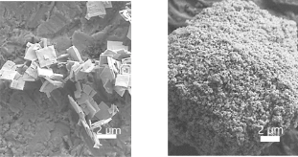
ThC_{x}
Development of porous ThC₂
Synthetized
Mixed
Pressed
$${ThO}_{2}+5C → → → { ThC}_{2}+1C+2CO (g)$$
Heating to 1700°C in inert atmosphere
at JRC Karlsruhe
Surrogate materials ZrC_{x}, NbC_{x} and TiC_{x} presented in poster ID 71
Carbon sources
ThO₂ precursors
Graphite
Expanded graphite
Carbon black
1
4
100 µm
100 µm
100 µm
2 µm
2 µm
(reference ISOL carbon source)
(Novel material)
(novel for ThO₂)
18 pellets of ThO₂ made of platelets and nanoparticles and mixed with carbon sources
ISC: Public
In Karlsruhe
Notes:
Also the work of Lisa

Slide 12
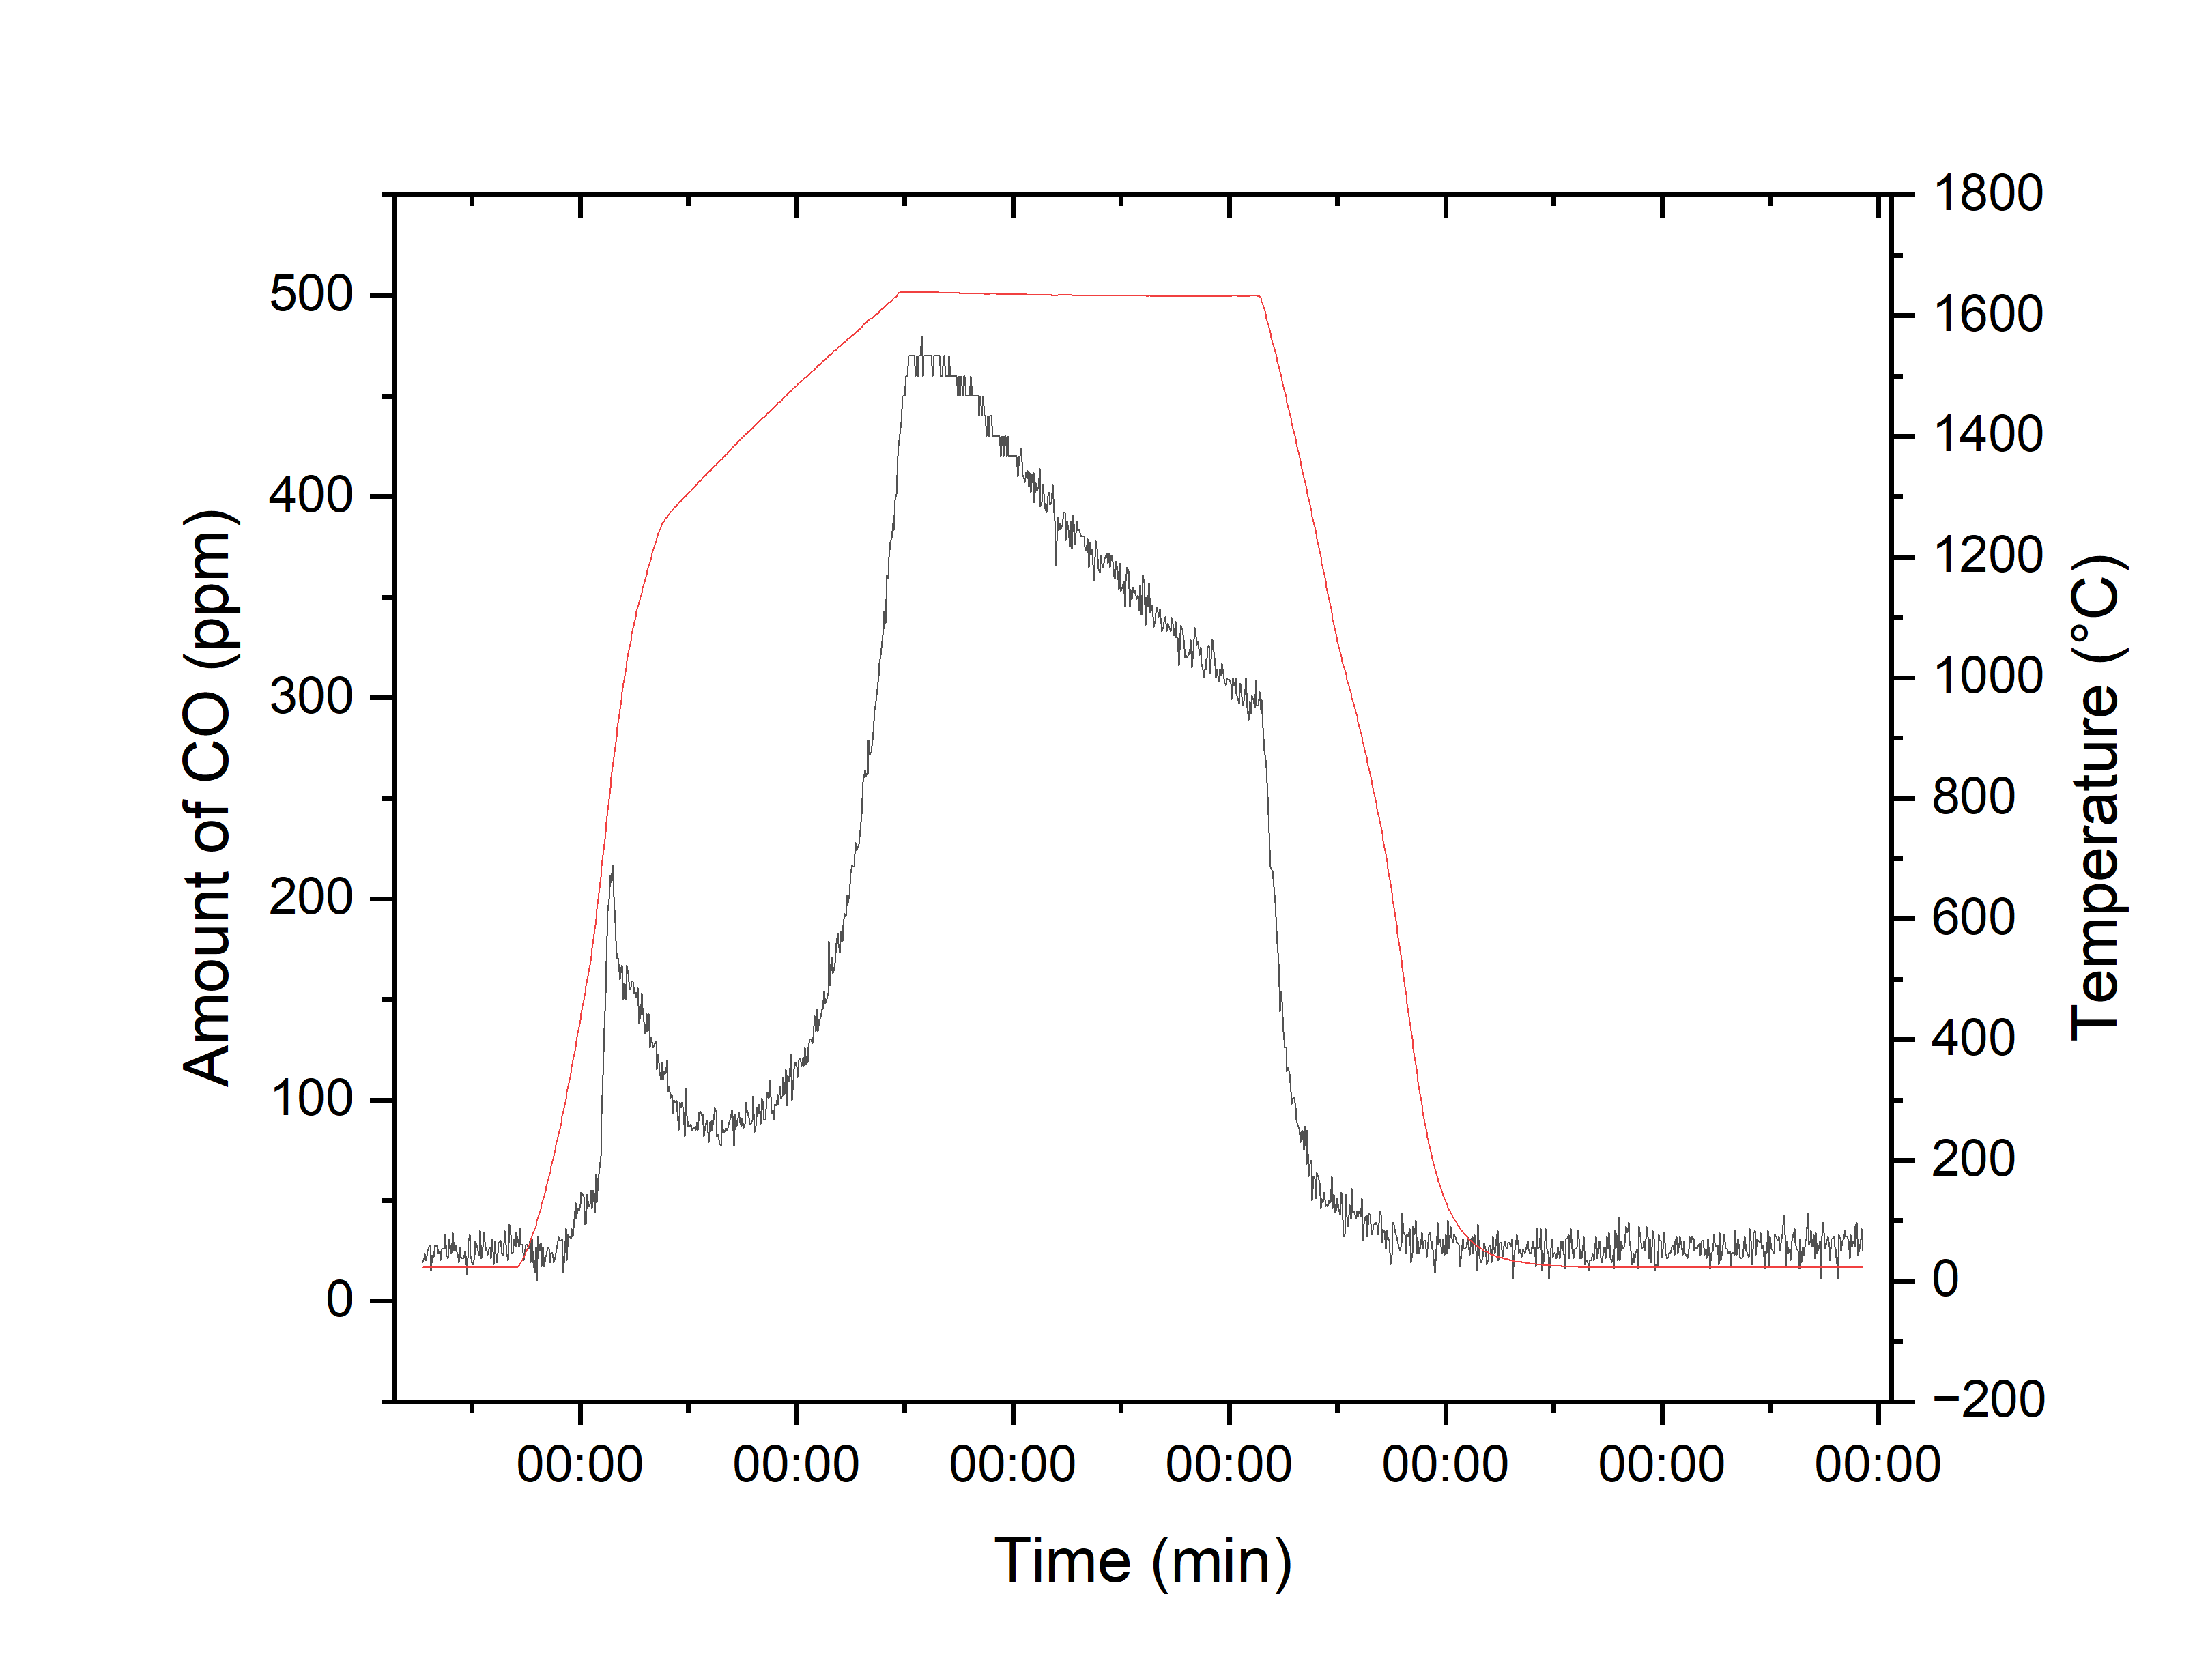
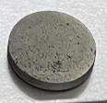
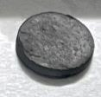
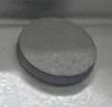
Development of porous ThC₂
ThC_{x}
Carbothermal reduction of ThO2 with CO exhaust monitored
Based on the mass loss the reaction was completed
The characterization of the material is done by SEM, XRD, BET and TGA in air
ThC_{x} pellets after CTR
11 mm
11 mm
11 mm
100
200
300
400
600
Pellet | #1 | #2 | #3
Mass loss | 52,6 | 59 | 55,6
Theoretical mass loss | 48,3 | 59,3 | 55,9
CO measured by IR detectors
ISC: Public

Slide 13
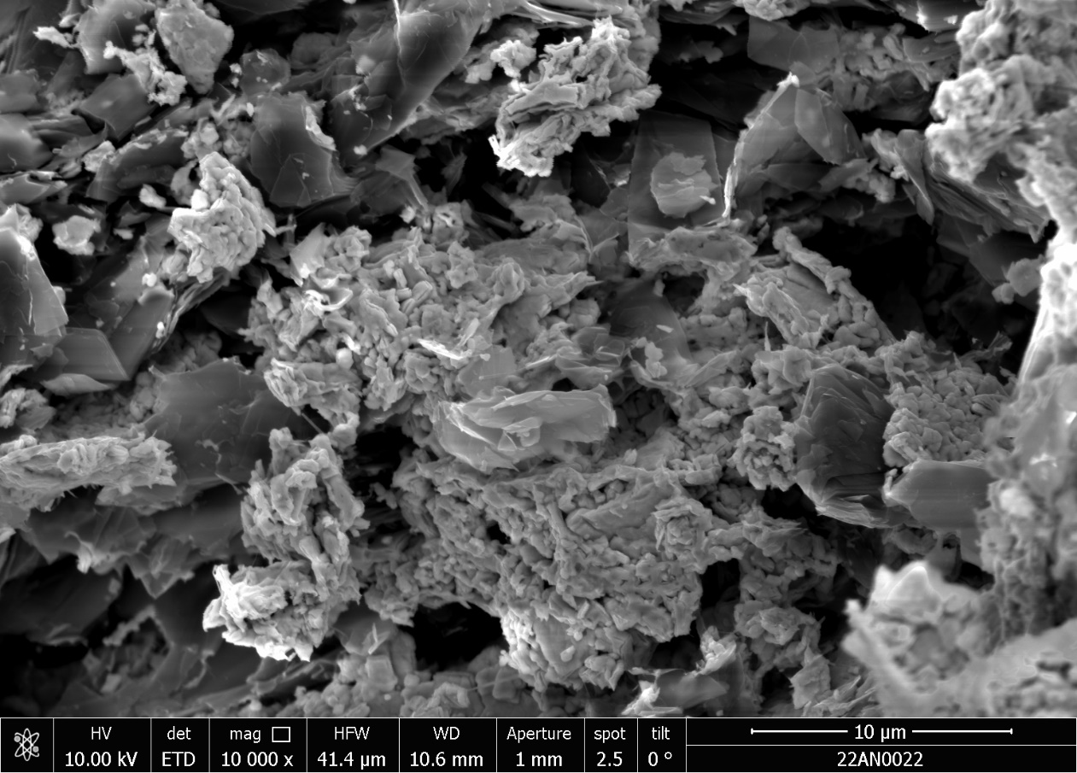
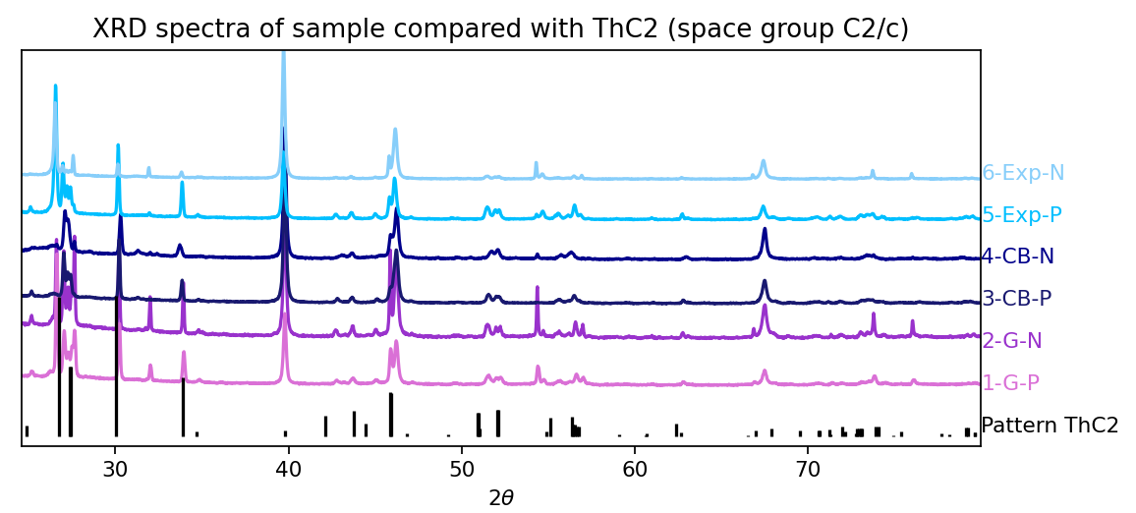
ThC₂ material characterization ongoing
ThC_{x}
First results of graphite mixed with 1 (platelets)
ThC₂ C2/c seems to correspond with the all the pellets synthetized by carbothermal reduction of ThO₂
2 µm
ISC: Public

Slide 14
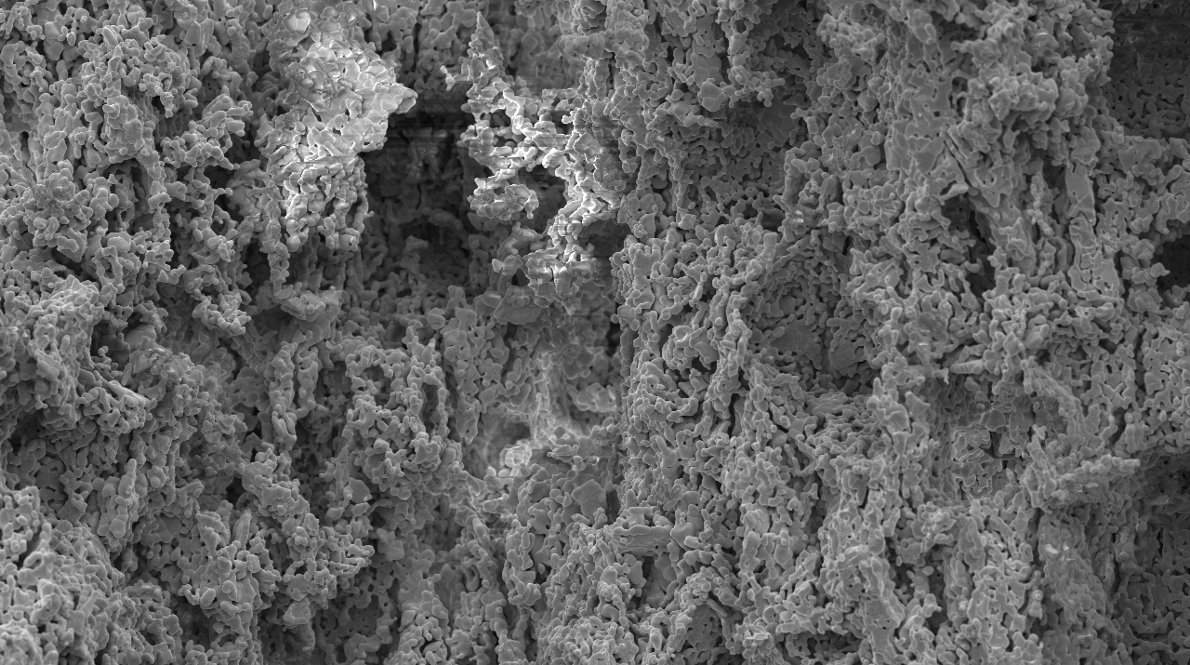
Conclusion and outlook
Conclusion
Development of porous ThO₂
0 % of open porosity from ThO₂ morphology tests after 10h at 1750°C
42 % of open porosity reached after pore former addition and heat treatment of 1h at 1750°C in reductive atmosphere
33% of open porosity after 24h at 2000°C in vacuum
Isotope release at CERN with a 1.4GeV proton beam in November 2025
Development of porous ThC_{x}
Carbothermal reduction at JRC Karlsruhe was successful
Characterization is ongoing
ISC: Public

Slide 15

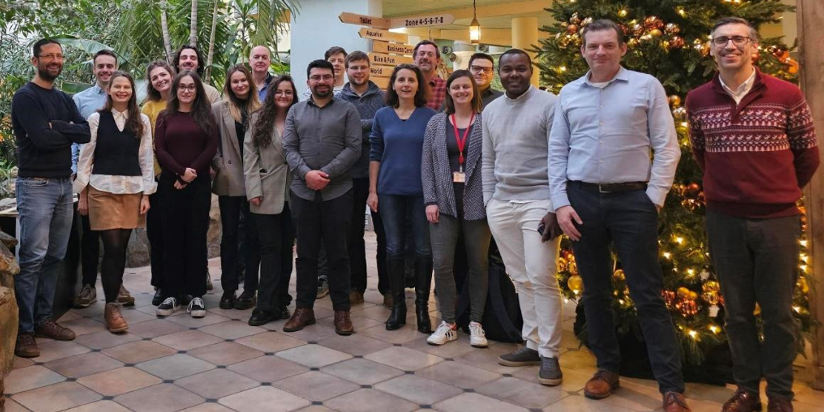
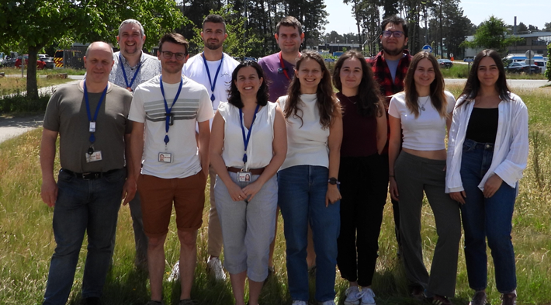
Thank you for your attention!
I would like to thank my colleagues from KULeuven, FMA and PTR group, and all of CERN and JRC people that helped me!
Funded by MYRRHA and SCK CEN academy
ISC: Public

Slide 16
Copyright © SCK CEN
PLEASE NOTE!
This presentation contains data, information and formats for dedicated use only and may not be communicated, copied, reproduced, distributed or cited without the explicit written permission of SCK CEN. If this explicit written permission has been obtained, please reference the author, followed by ‘by courtesy of SCK CEN’.
Any infringement to this rule is illegal and entitles to claim damages from the infringer, without prejudice to any other right in case of granting a patent or registration in the field of intellectual property.
SCK CEN
Belgian Nuclear Research Centre
Foundation of Public Utility
Registered Office: Avenue Herrmann-Debrouxlaan 40 – BE-1160 BRUSSELS
Operational Office: Boeretang 200 – BE-2400 MOL
32
confidential
ISC: Public

