Slide 1
ISOL@MYRRHA recent advancements Aknowledgements Dinko Atanasov, Marc Dierckx, João Pedro Ramos, Kim Rijpstra, Lucia Popescu
Donald Houngbo for the ISOL@MYRRHA team - 20/10/2025

Slide 2
ISOL@MYRRHA within MYRRHA phase1

Slide 3
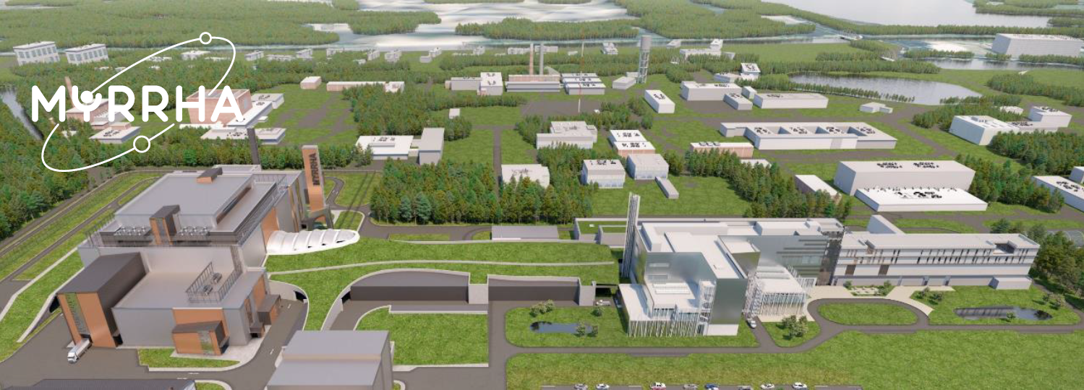
The MYRRHA program
PHASE 3:
MYRRHA Reactor
PHASE 2:
LINAC up to 600 MeV
PHASE 1:
LINAC (100 MeV, 4 mA)
& two target facilities
3

Slide 4
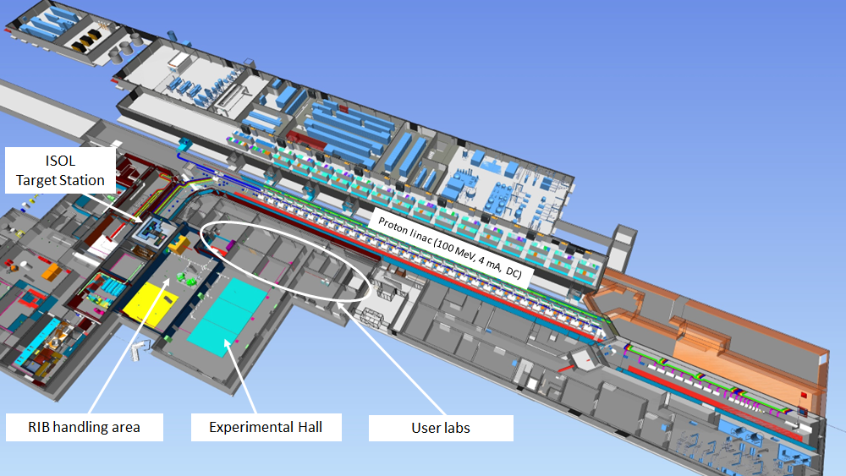
MYRRHA phase 1
ISOL
Target Station (up to 0,5 mA)
FPF
Target Station (up to 4 mA)
4

Slide 5
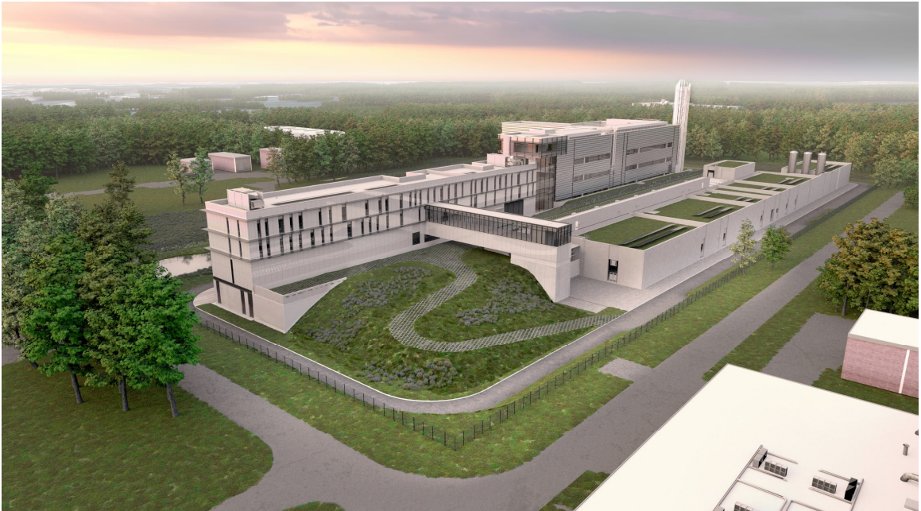
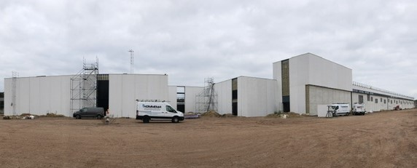
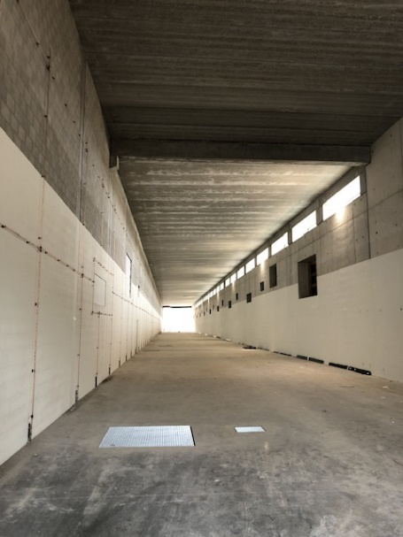
MYRRHA phase1 buildings under construction

Slide 6
MYRRHA phase 1
ISOL
Target Station (up to 0,5 mA)
FPF
Target Station (up to 4 mA)
6

Slide 7
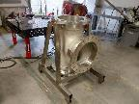
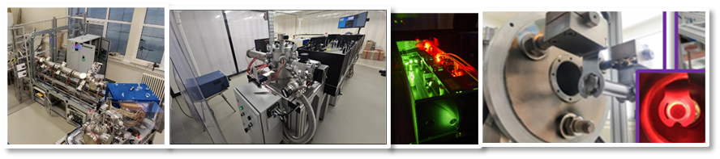
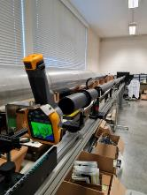
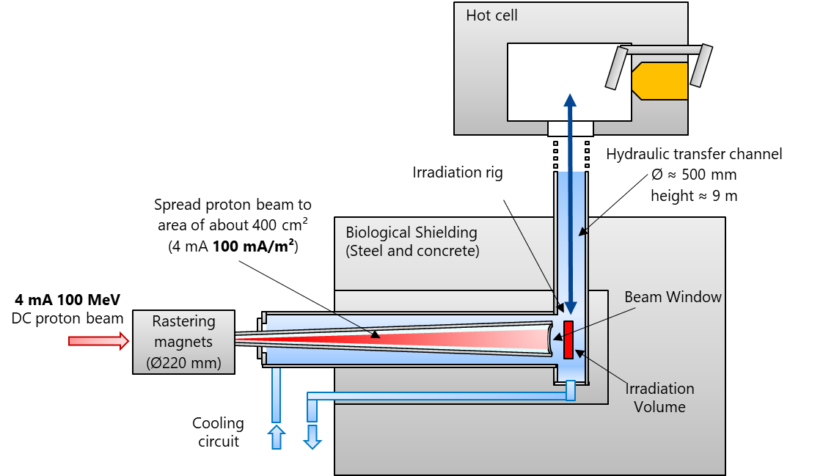
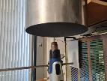
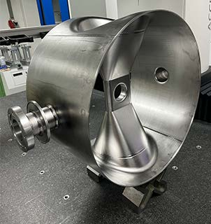
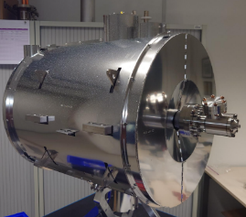
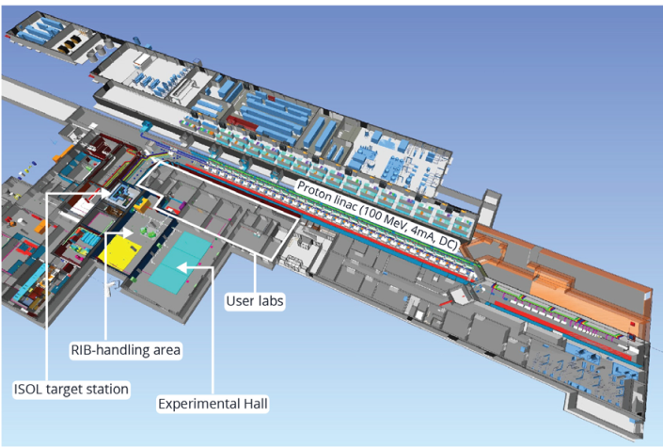
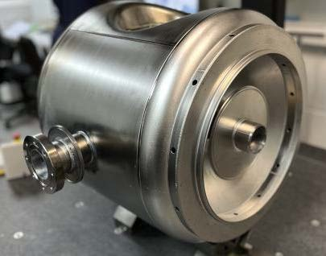
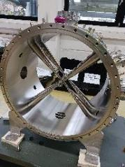
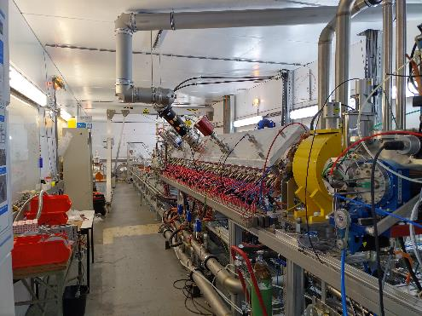
ISOL@MYRRHA systems
under advanced prototyping
Full Power facility Beam dump for testing LINAC reliability, Fusion-material irradiation with p & n
LINAC components Under manufacturing
Injector ITS Constructed & tested in LLN,
Transfer for reassembly in Mol
7

Slide 8

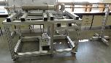


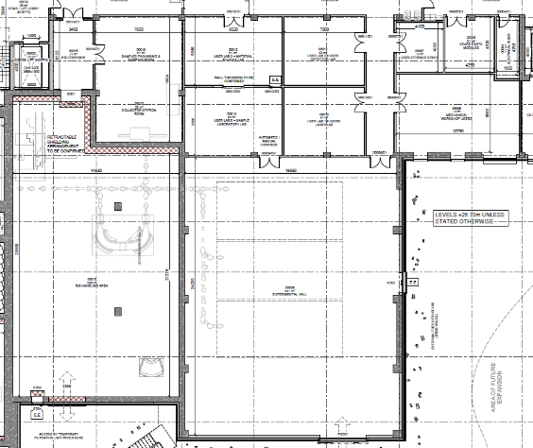
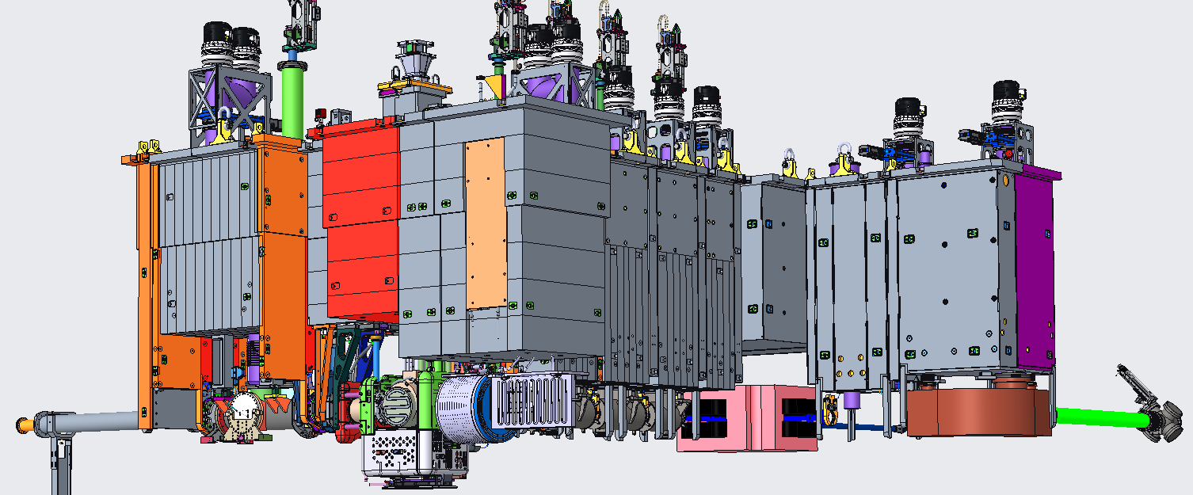
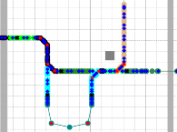
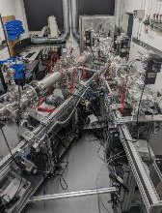
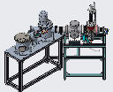


ISOL@MYRRHA systems
Isotope Collector Station
(medical isotopes)
User Labs
(Solid-state physics, laser spectroscopy, etc)
100 MeV 500 µA
Laser spectroscopy beamline
Inspired by TRIUMF-ARIEL
Modular design
2 Project Agreements
IKS, KU Leuven October ’24
Courtesy of Agota Koszorus (KU Leuven, SCK CEN)
Level 0
Talk #138 Tuesday
Floor-space and services available for installing experimental setups

Slide 9
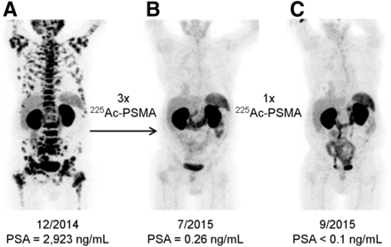
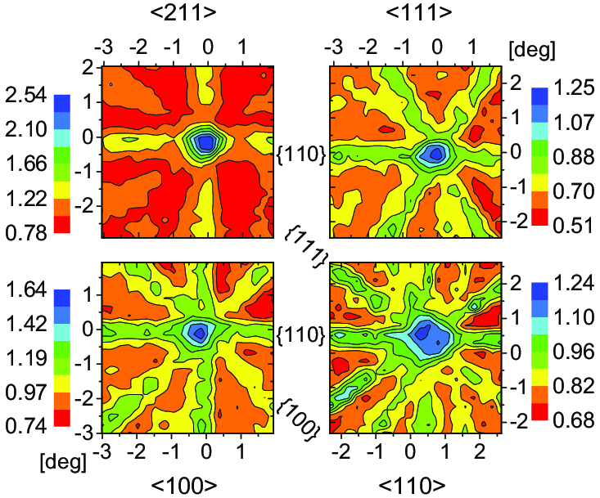
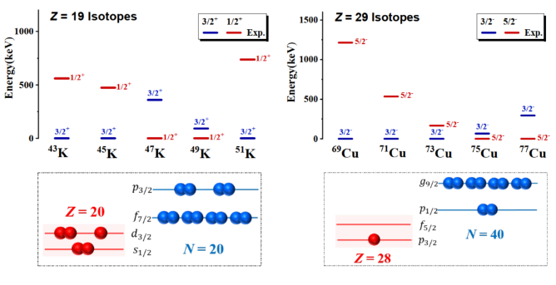
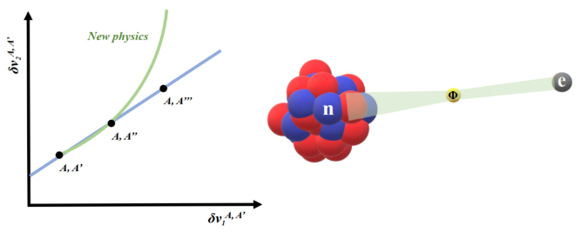
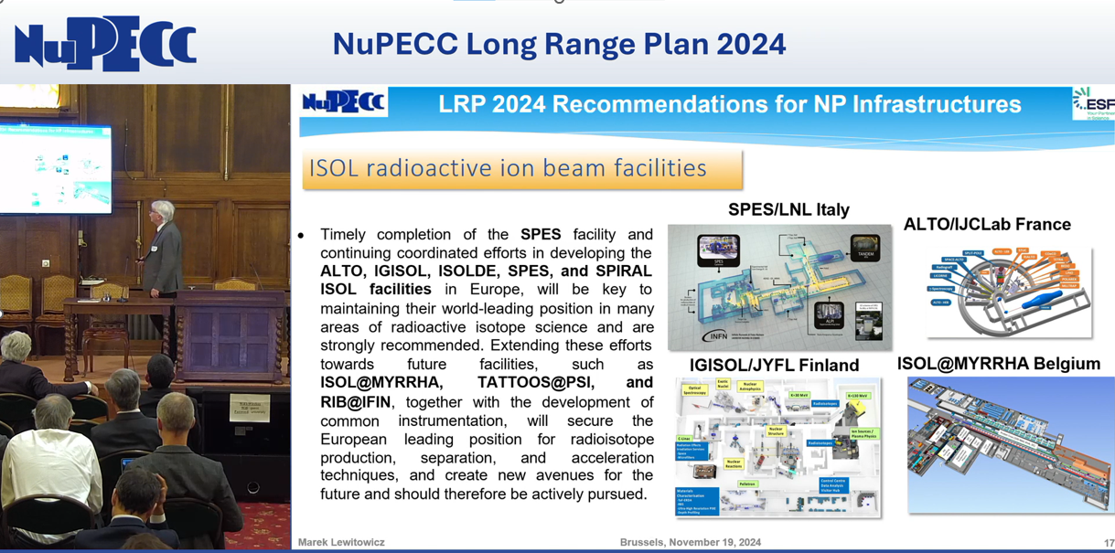
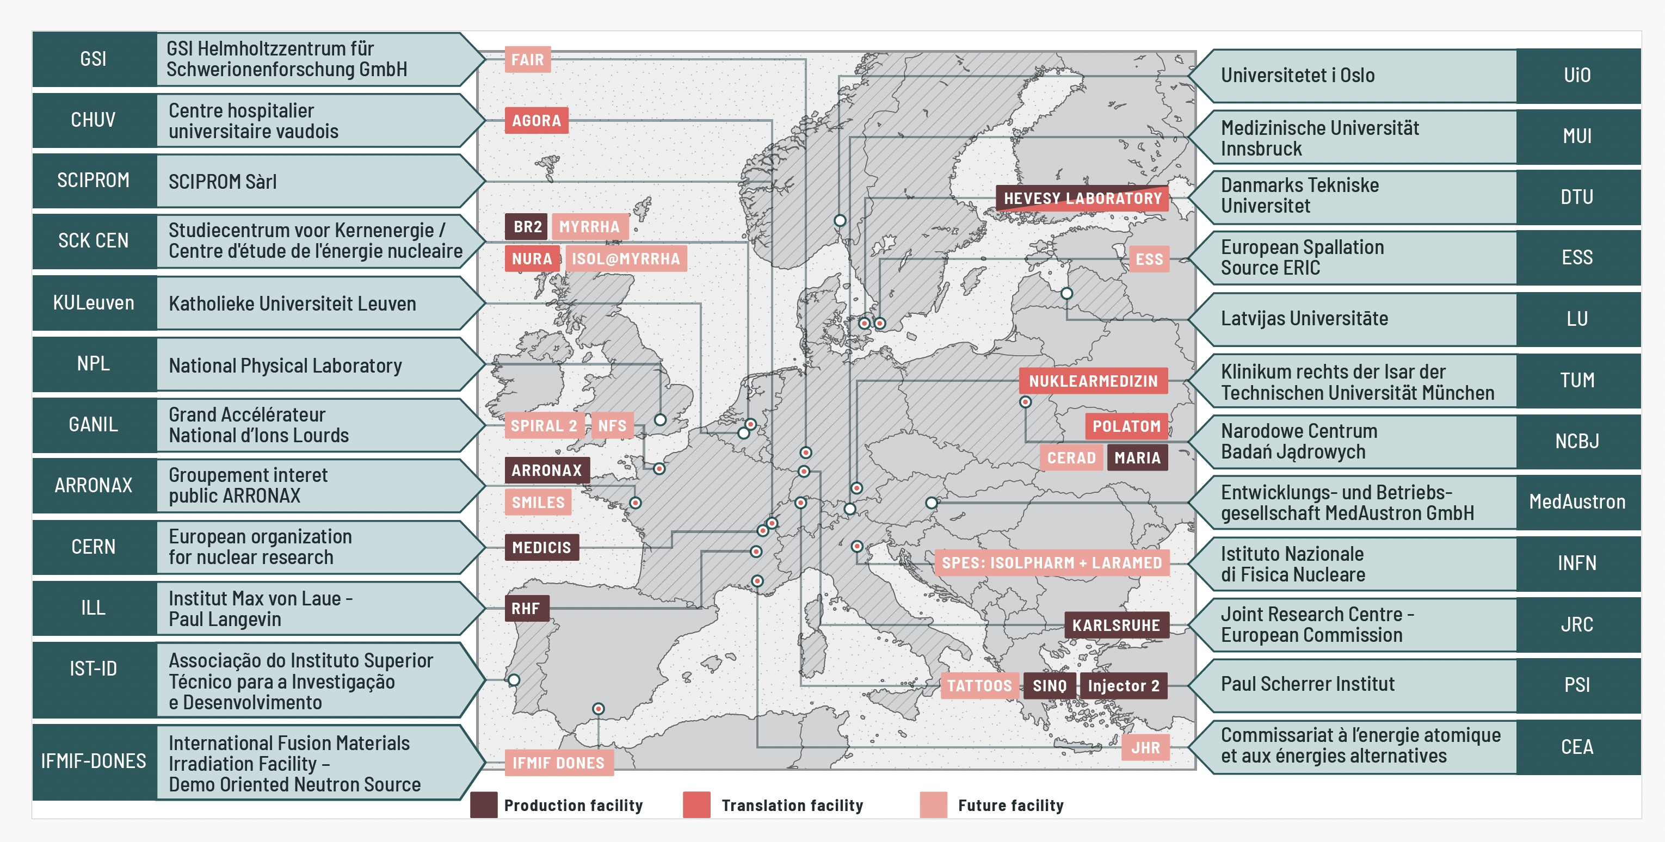
ISOL@MYRRHA – Applications & users
Fundamental nuclear physics
Innovative Medical Isotopes
Solid-state physics
Emerging infrastructure recommended in NuPECC Long Range Plan
Emerging infrastructure in PRISMAP (access platform with leading institutes in the supply chain for European biomedical researchers)
Image credits: DOI:10.1016/j.ppnp.2022.104005, DOI:10.1007/s00259-023-06165-9, DOI:10.1103/PhysRevC.100.024315, https://www.nupecc.org/lrp2024/Documents/nupecc_lrp2024__video_kurz.mp4, https://www.prismap.eu/

Slide 10
ISOL@MYRRHA technical progress

Slide 11
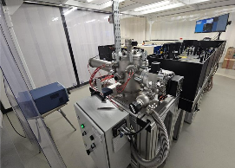
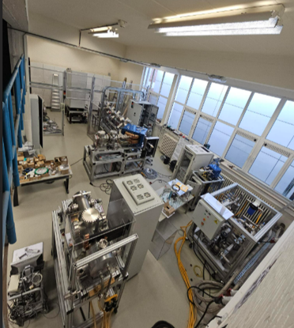
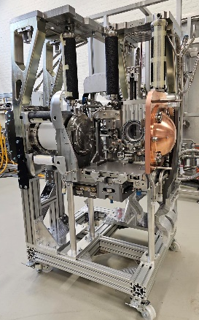
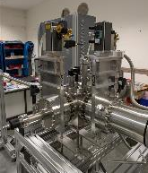
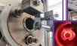
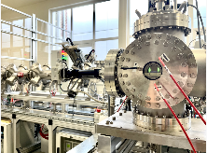
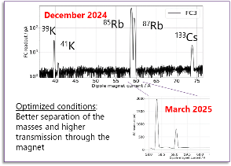
Status ISOL systems
Advancing the technical design
Basic design of ISOL@MYRRHA systems either completed/advancing
Prototyping
ISOL system offline – constructed, operational
Isotope-Collector station – under tests
TISA & RDS - under manufacturing
Target Module - constructed -> ARIEL front-end (collab. TRIUMF)
1st separated ion beam
R&D program @ SCK CEN & external labs
R&D infrastructure at SCK CEN
ISOL@MYRRHA labs
ISOFF
Material & Thermal test systems
IMRILS lab
Materials-research laboratories

Slide 12
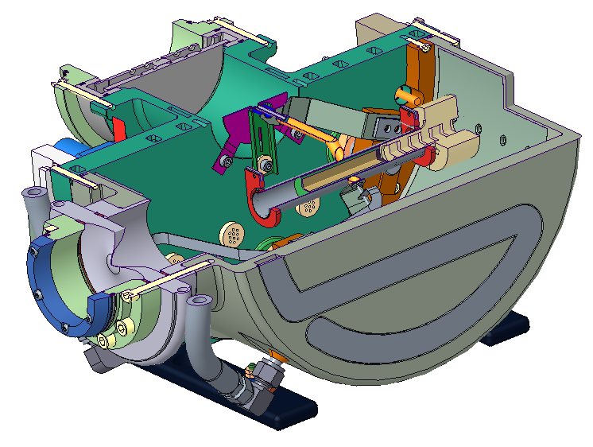
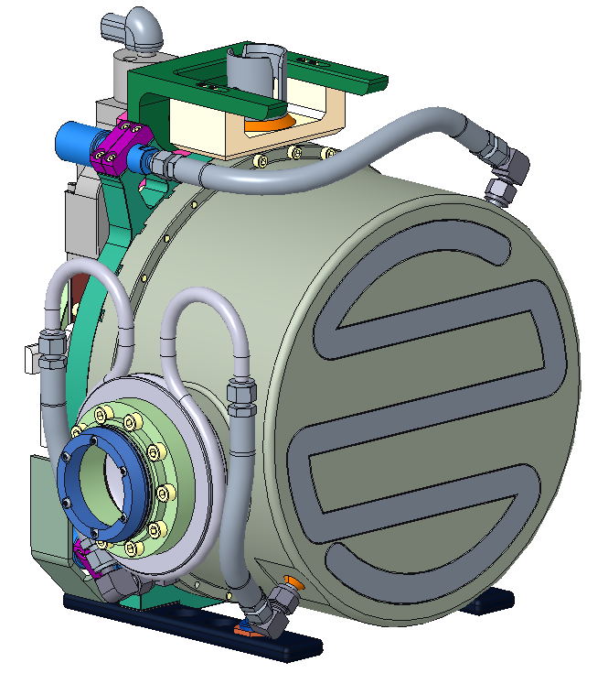
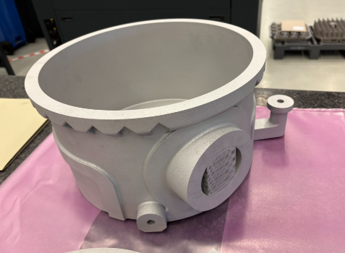
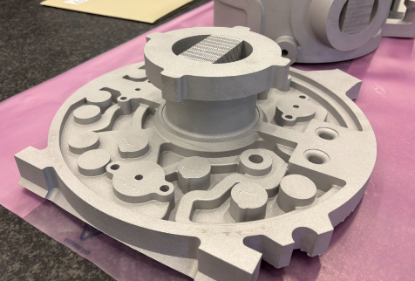
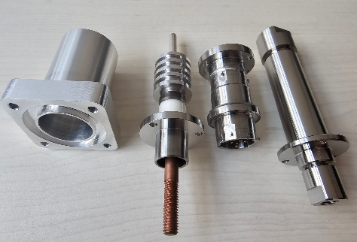
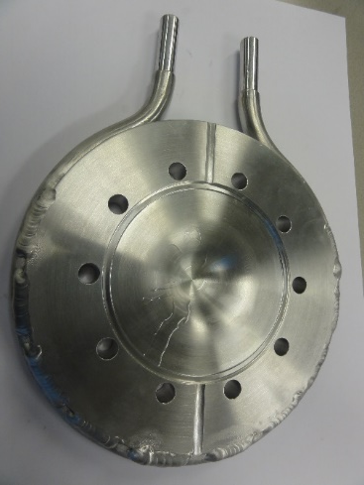
Target assembly
Target vessel based on the ARIEL (which is an evolution from ISOLDE)
Can theoretically operate any ion source, transfer line, mass markers, etc. from ISOLDE or TRIUMF
Vessel prototype under manufacturing (3D printing)
Window prototype under test

Slide 13
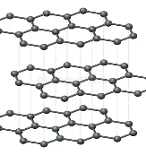
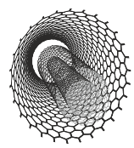
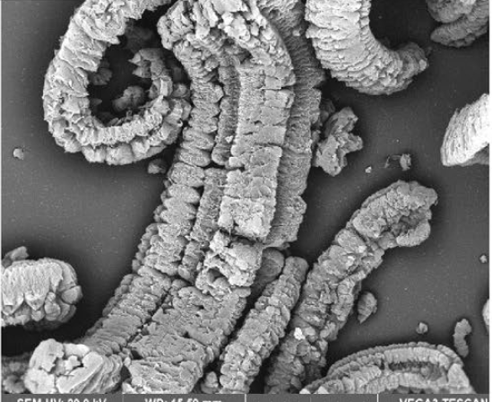
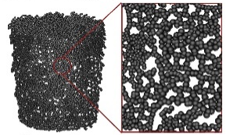
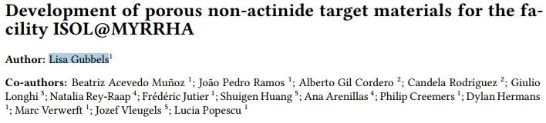
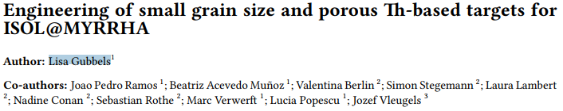
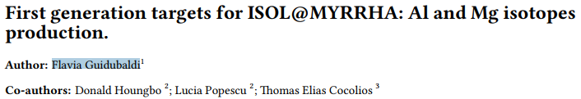

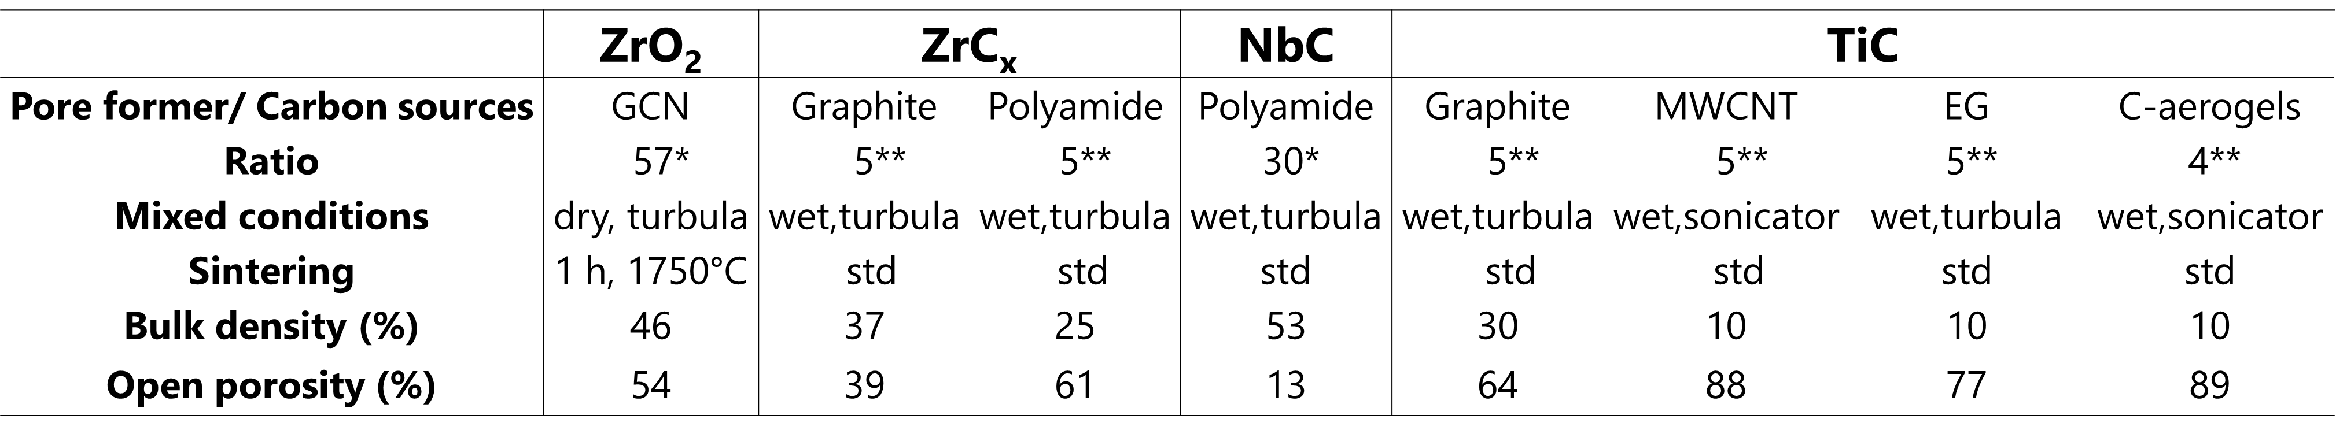



Target-material R&D
Goal – high porosity & stability vs temperature
Strategy
Various carbon sources for carbides
Pore formers for oxides
Developments
Surrogate/ day-1 - Titanium carbide
Surrogate/ day-1 - Zirconium oxide
Surrogate/ day-1 - Zirconium and Niobium Carbides
Day-1 – Thorium oxide
High power: Thorium carbide
Day-1 - Silicon Carbide
Graphite
MWCNT
Expanded Graphite
Carbon Aerogel
Poster #71
Talk #41 Wednesday
Poster #28

Slide 14
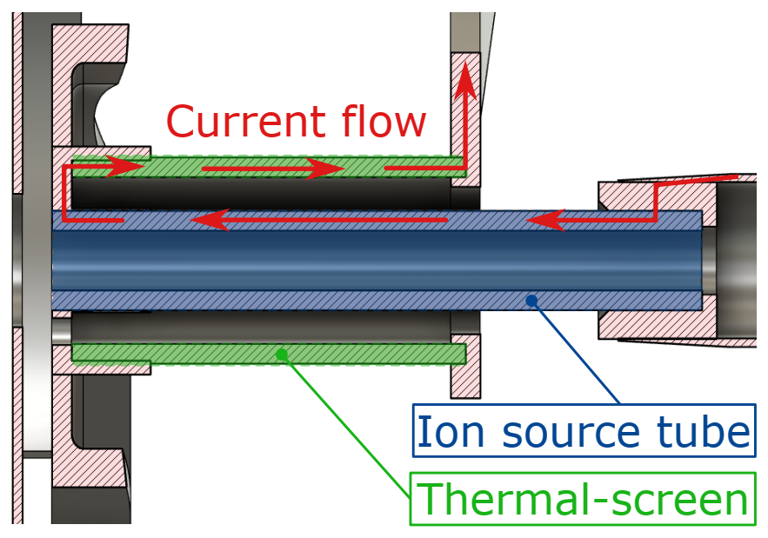




Ion-source R&D
Goal – high throughput & prolonged operation
Design
Active thermal screen
Press-fit construction
Tests at ISOLDE - Pumpstand and Offline 2
Validation of thermal-electric simulations
Successful thermal-electric characterization
Impact of volatile ionizable impurity
Mechanical resilience vs thermal cycling
Identified contribution of transfer line
Ongoing
Refined thermal-electric modeling of linker
Multiphysics modeling
S. Hurier et al 2022 J. Phys.: Conf. Ser. 2244 012065
L. Quanjel, K. Rijpstra, et al – article in preparation

Slide 15
ISOL@MYRRHA yield estimates

Slide 16
Expected yields – Methodology
Goals
Gather, in one access point, information on which nuclides can be produced
Provide access to production rates from different targets including contaminants
Enable determination of most suitable target for each nuclide
$Y_{ield}$ $=$ $P_{rod. }$ $∗ ε_{ff.}$

Slide 17

Expected yields – In-target production database
Query panel
Adjustable width
Display panel
Adjustable subpanel dimensions
Nuclide chart display
Query result display in special query tab
Other tabs, display Max value for each nuclide over the full database
Flexible queries
e.g.: All nuclides produced from Ti
All targets producing ²⁸Al
Display only uncertainty column
Predefined queries
For which nuclides are the Max Prod. Rate (#/s or #/µC), or the Max. Purity reached in e.g. SiC
Toggle chart display
Summary Numbers
Scroll table display for the rest
Tabular display of query results
17

Slide 18











Expected yields – Yield database
Measured yield
$$εff.=\frac{Yield}{P_{rod.}}$$
In-target production
Fitting
ISOL@MYRRHA estimated efficiencies
ISOL@MYRRHA estimated Yield
$$ε=\frac{ε_{0}}{1+{\left[\frac{t_{1/2}}{t_{0}}\right]}^{−α}}$$
$P_{rod}∙εff.$ = 𝑌_{𝑖𝑒𝑙𝑑}

Slide 19
Summary
Facility buildings under construction
Facility systems’ in advanced design or manufacturing
ISOL system off-line and laser lab under operation at SCK CEN
Intensive RIB-production R&D program ongoing in-house and at international collaborating labs; First user systems under construction
Yield-estimate database available
Thank you

Slide 20
Copyright © SCK CEN
PLEASE NOTE!
This presentation contains data, information and formats for dedicated use only and may not be communicated, copied, reproduced, distributed or cited without the explicit written permission of SCK CEN. If this explicit written permission has been obtained, please reference the author, followed by ‘by courtesy of SCK CEN’.
Any infringement to this rule is illegal and entitles to claim damages from the infringer, without prejudice to any other right in case of granting a patent or registration in the field of intellectual property.
SCK CEN
Belgian Nuclear Research Centre
Foundation of Public Utility
Registered Office: Avenue Herrmann-Debrouxlaan 40 – BE-1160 BRUSSELS
Operational Office: Industriezone Boeretang Zuid – Boeretang 190 – BE-2400 MOL

