Slide 1
Expanding User Capabilities and Increasing Reliability at TRIUMF-ISAC
Carla Babcock
October 2025
EMIS XX

Slide 2
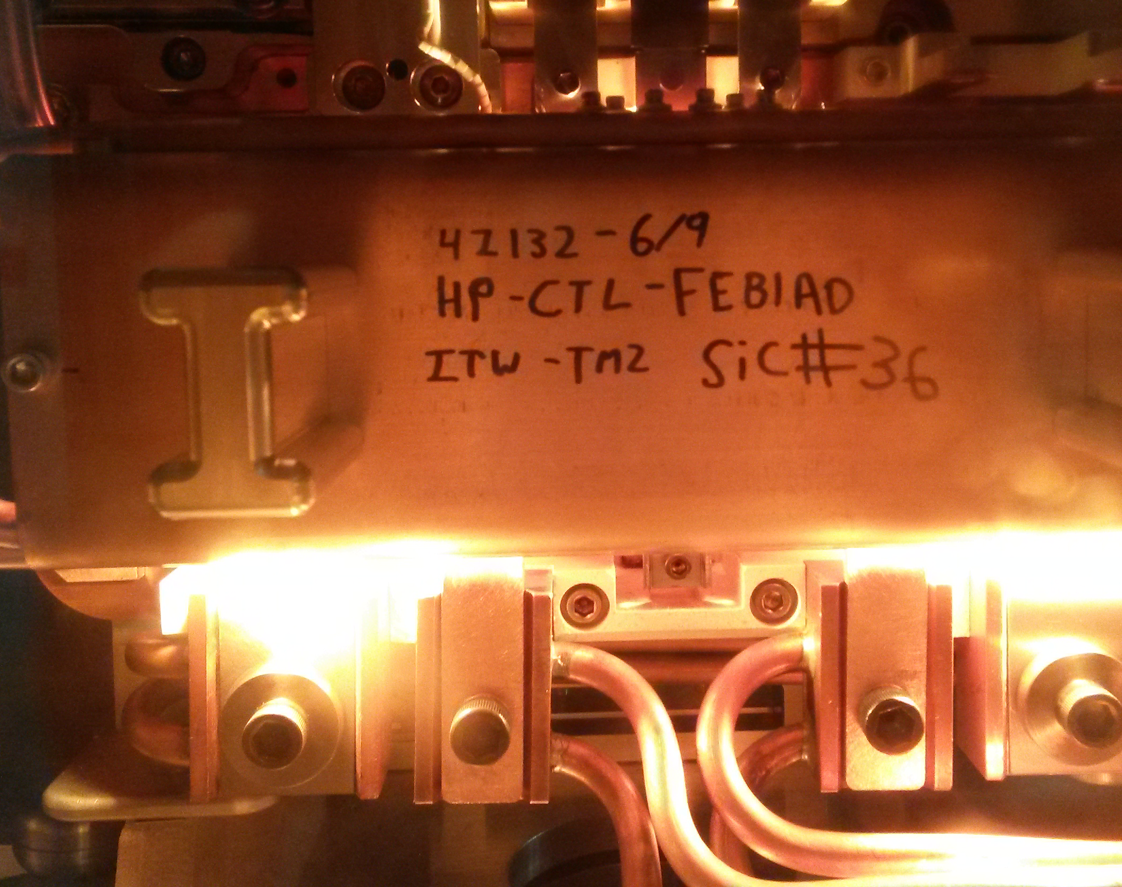
Reliability at TRIUMF-ISAC
Reliably operating ISAC and providing a maximum number of beam hours to experiments is a core principle for TRIUMF
Maintaining the trust between TRIUMF and scientists, students, funding agencies and the broader scientific community is paramount
As systems age, focusing on reliability becomes more important

Slide 3
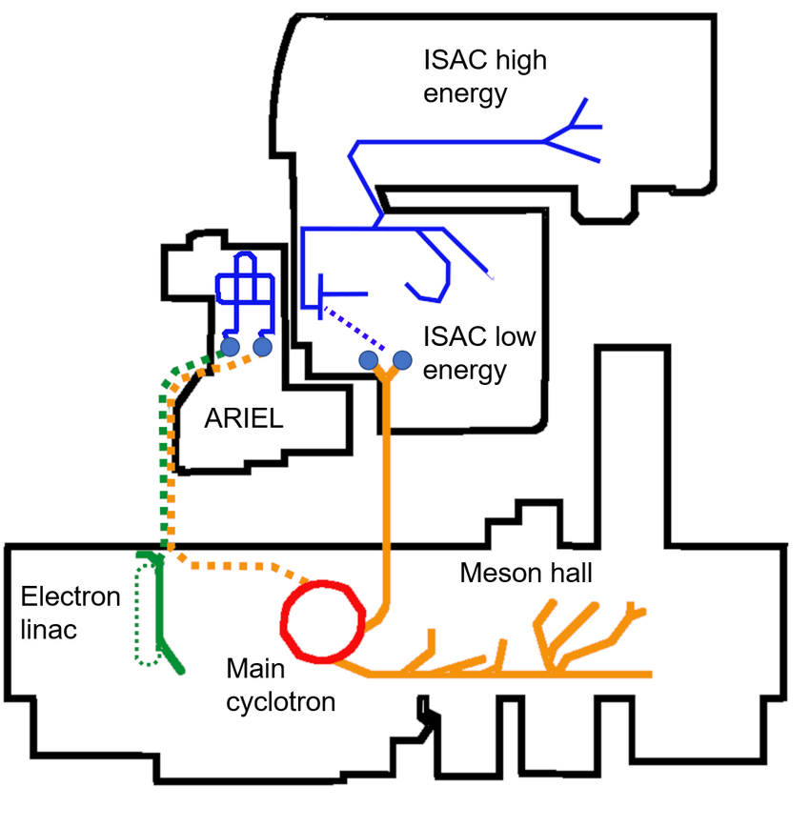
TRIUMF-ISAC basics
The TRIUMF cyclotron creates a beam of up to 100uA of protons at 480MeV to send to the ISAC target stations.
ISAC (Isotope Separator and ACcelerator) delivers beams of radioactive ions to a variety of fundamental physics, life sciences, material sciences and astrophysics experiments.
700 isotopes extracted
~3000 h of high intensity RIB beam per year
State-of-the art experimental setups
TRIUMF schematic
(B.E. Schultz et. al. J. Phys : Conf. Ser. 2022)

Slide 4
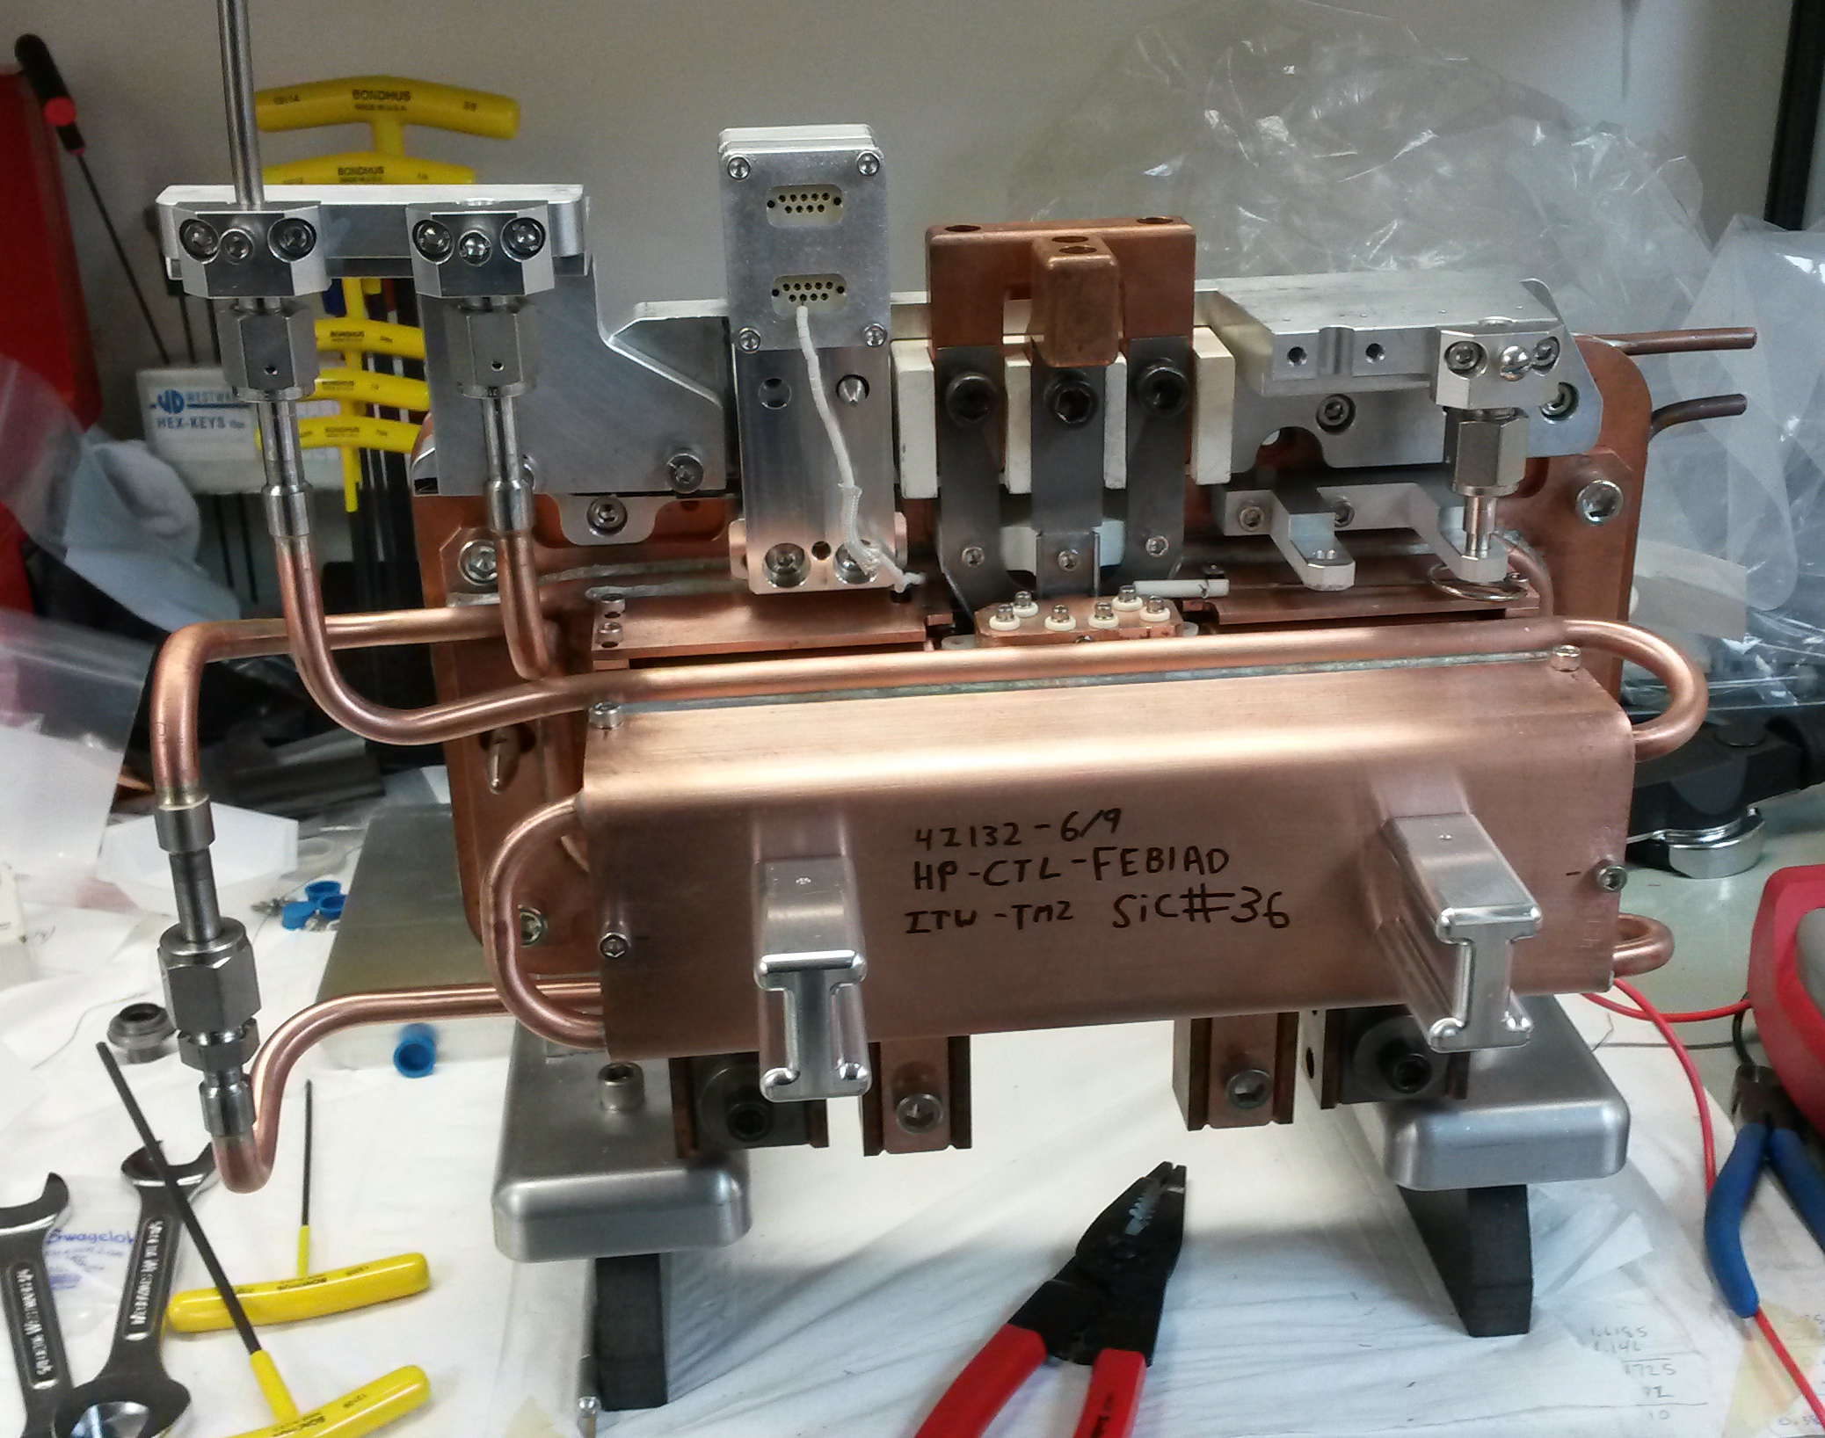
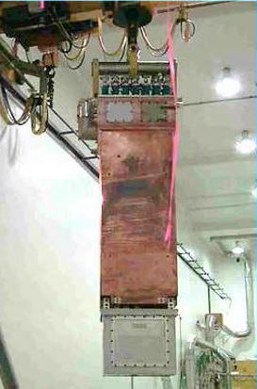
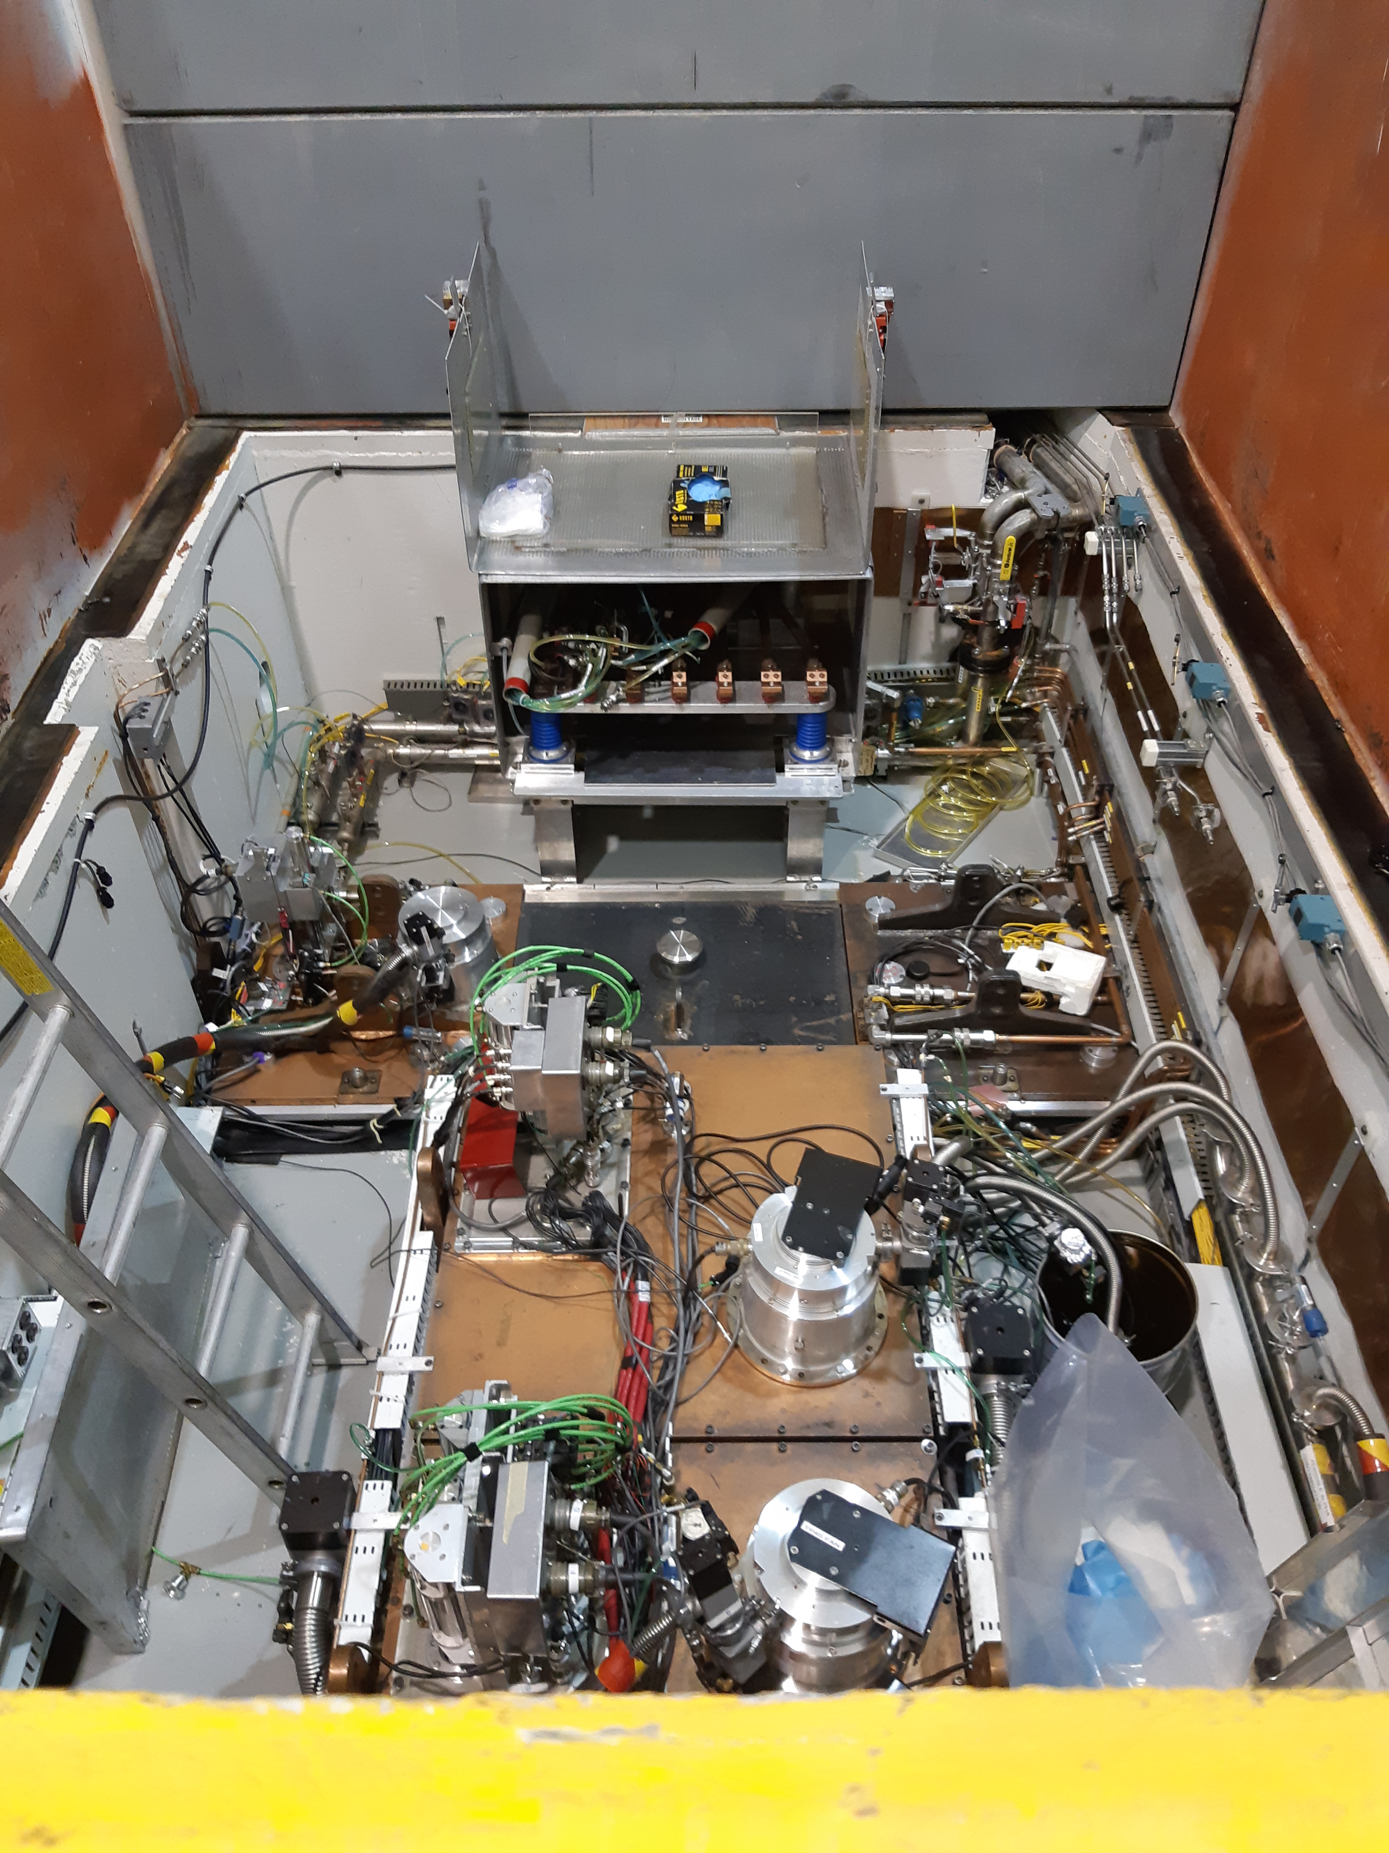
ISAC radioactive ion beam target basics
ISAC target infrastructure is composed of the target stations, the target modules and the target assembly.
Target assembly
Target module
Target station
~35cm
~3m
~3.5m
Notes:
Downstream of the target, the beam is mass separated, steered and focused, among other things.
It can then be sent directly to experiments, or can be charge bred and accelerated, then sent to experiments.

Slide 5
Some caveats
We measure reliability in hours of downtime (DT).
Downtime categorization is subject to interpretation and can be messy – numbers are guidelines and not exact.
Notes:
If the cyclotron doesn’t run, ISAC cannot have downtime
For instance discretionary time

Slide 6
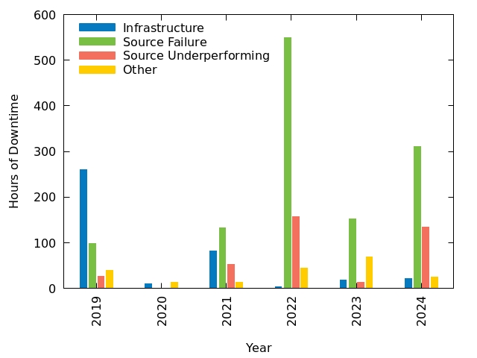
ISAC target and ion sources reliability in numbers 2019-2024
Some relevant categories of downtime:
Infrastructure failures
Target/ion source failures
Underperforming target/ion source
Controls issues
Power supply issues
Tuning difficulties
Human factors
Source issues
Other

Slide 7
Reliability Category : Infrastructure
In 2019 and the prior years, most downtime was related to infrastructure.
ISAC began a campaign in 2019 to solve infrastructure issues.
Water conductivity too high to start operations
Vacuum pump failure
Water leak inside one of the target modules
High voltage instabilities
COVID...

Slide 8
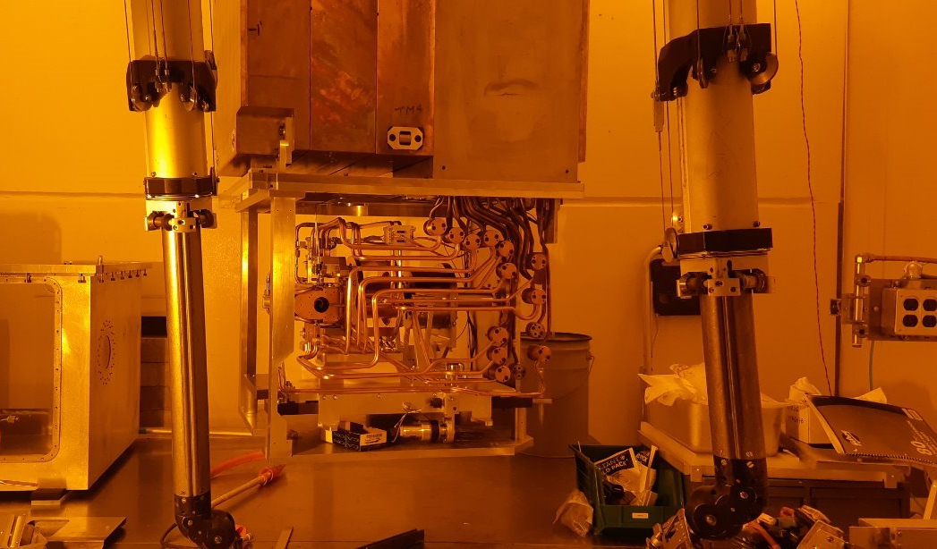
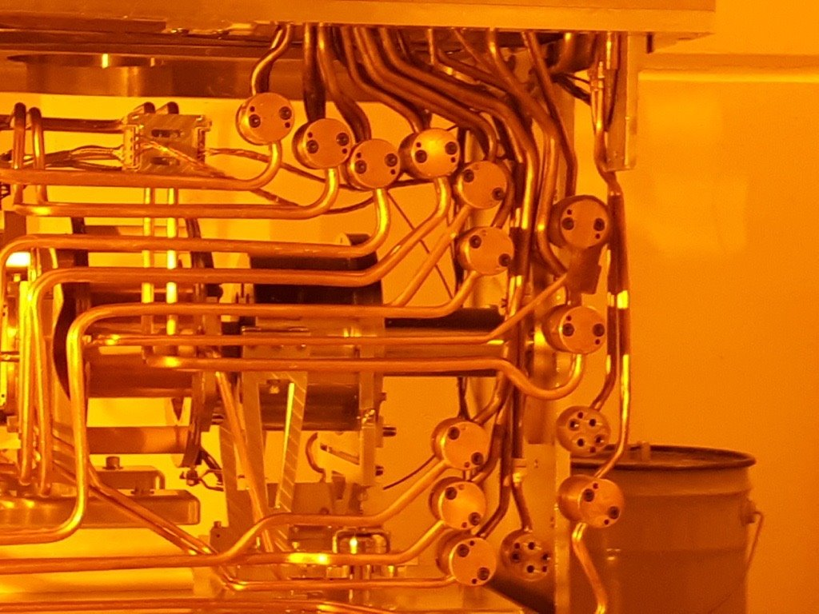
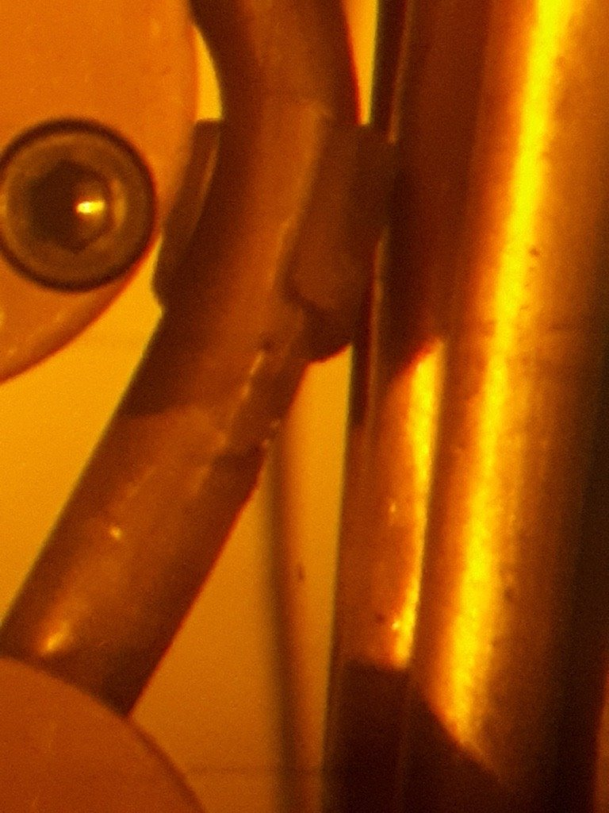
Infrastructure Reliability : Electrical Shorts
Modules are complicated, they get moved and worked on frequently and they exist in an extreme environment
Electrical shorts on the copper tubing carrying current/voltage/cooling water are common – fixed on-the-fly
Program of module retro-fitting begun in 2019 and currently ongoing

Slide 9
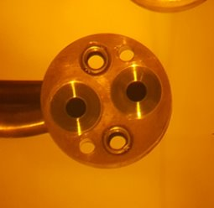
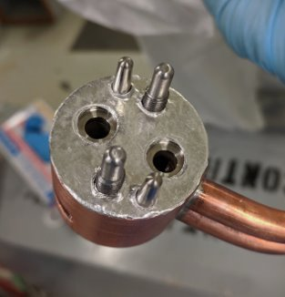
Infrastructure Reliability : Water Leaks
Water leaks were also common in the modules and in the stations
Main source of 2019 downtime was several water leaks on a module caused by radiation induced degradation of solder joints
Tubes carrying cooling water
Specialized connector with soldered in stainless inserts
Full face indium gasket solution (installed in hot cell with tweezers!)

Slide 10
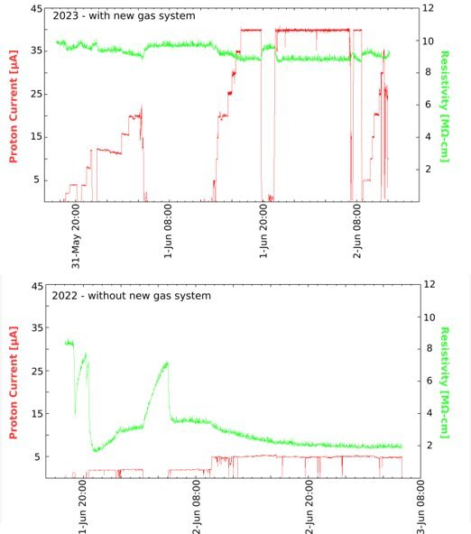
Infrastructure Reliability : Water Conductivity
In 2021, the main source of downtime was due to high water conductivity – ISAC uses low conductivity water for and proton irradiation causes chemistry changes that can put the conductivity above our threshold for operation.
Understanding and fixing these chemistry issues now saves us days worth of time when we start the protons up after a shutdown.

Slide 11
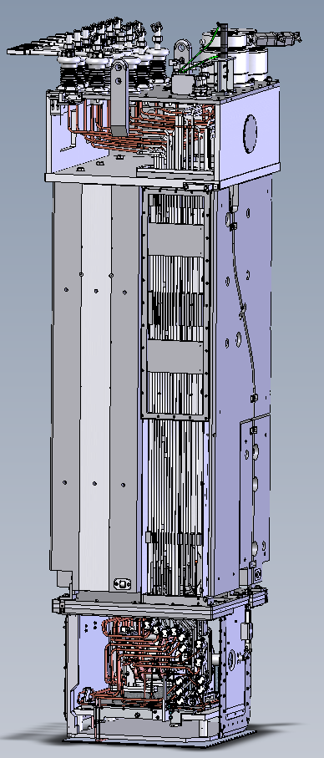
Infrastructure Reliability : High Voltage (HV)
Target module
ISAC accelerates beam by floating the source up to 60kV but this has rarely been done and now that HV infrastructure has degraded over time, cannot be done (see poster #151).
HV can contribute to downtime in many ways – can cause pinhole water leaks by sparking through lines, can make stable operations impossible, sparks can cause failures in sensitive equipment…
But also, some experiments require higher voltages to run – better infrastructure = more science possibilities.
HV

Slide 12
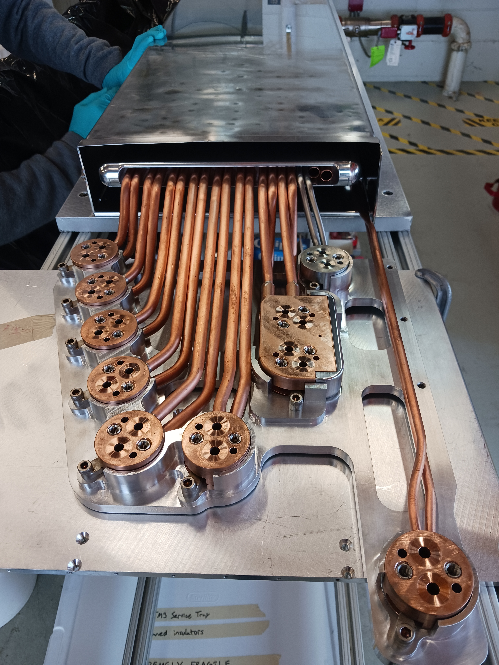
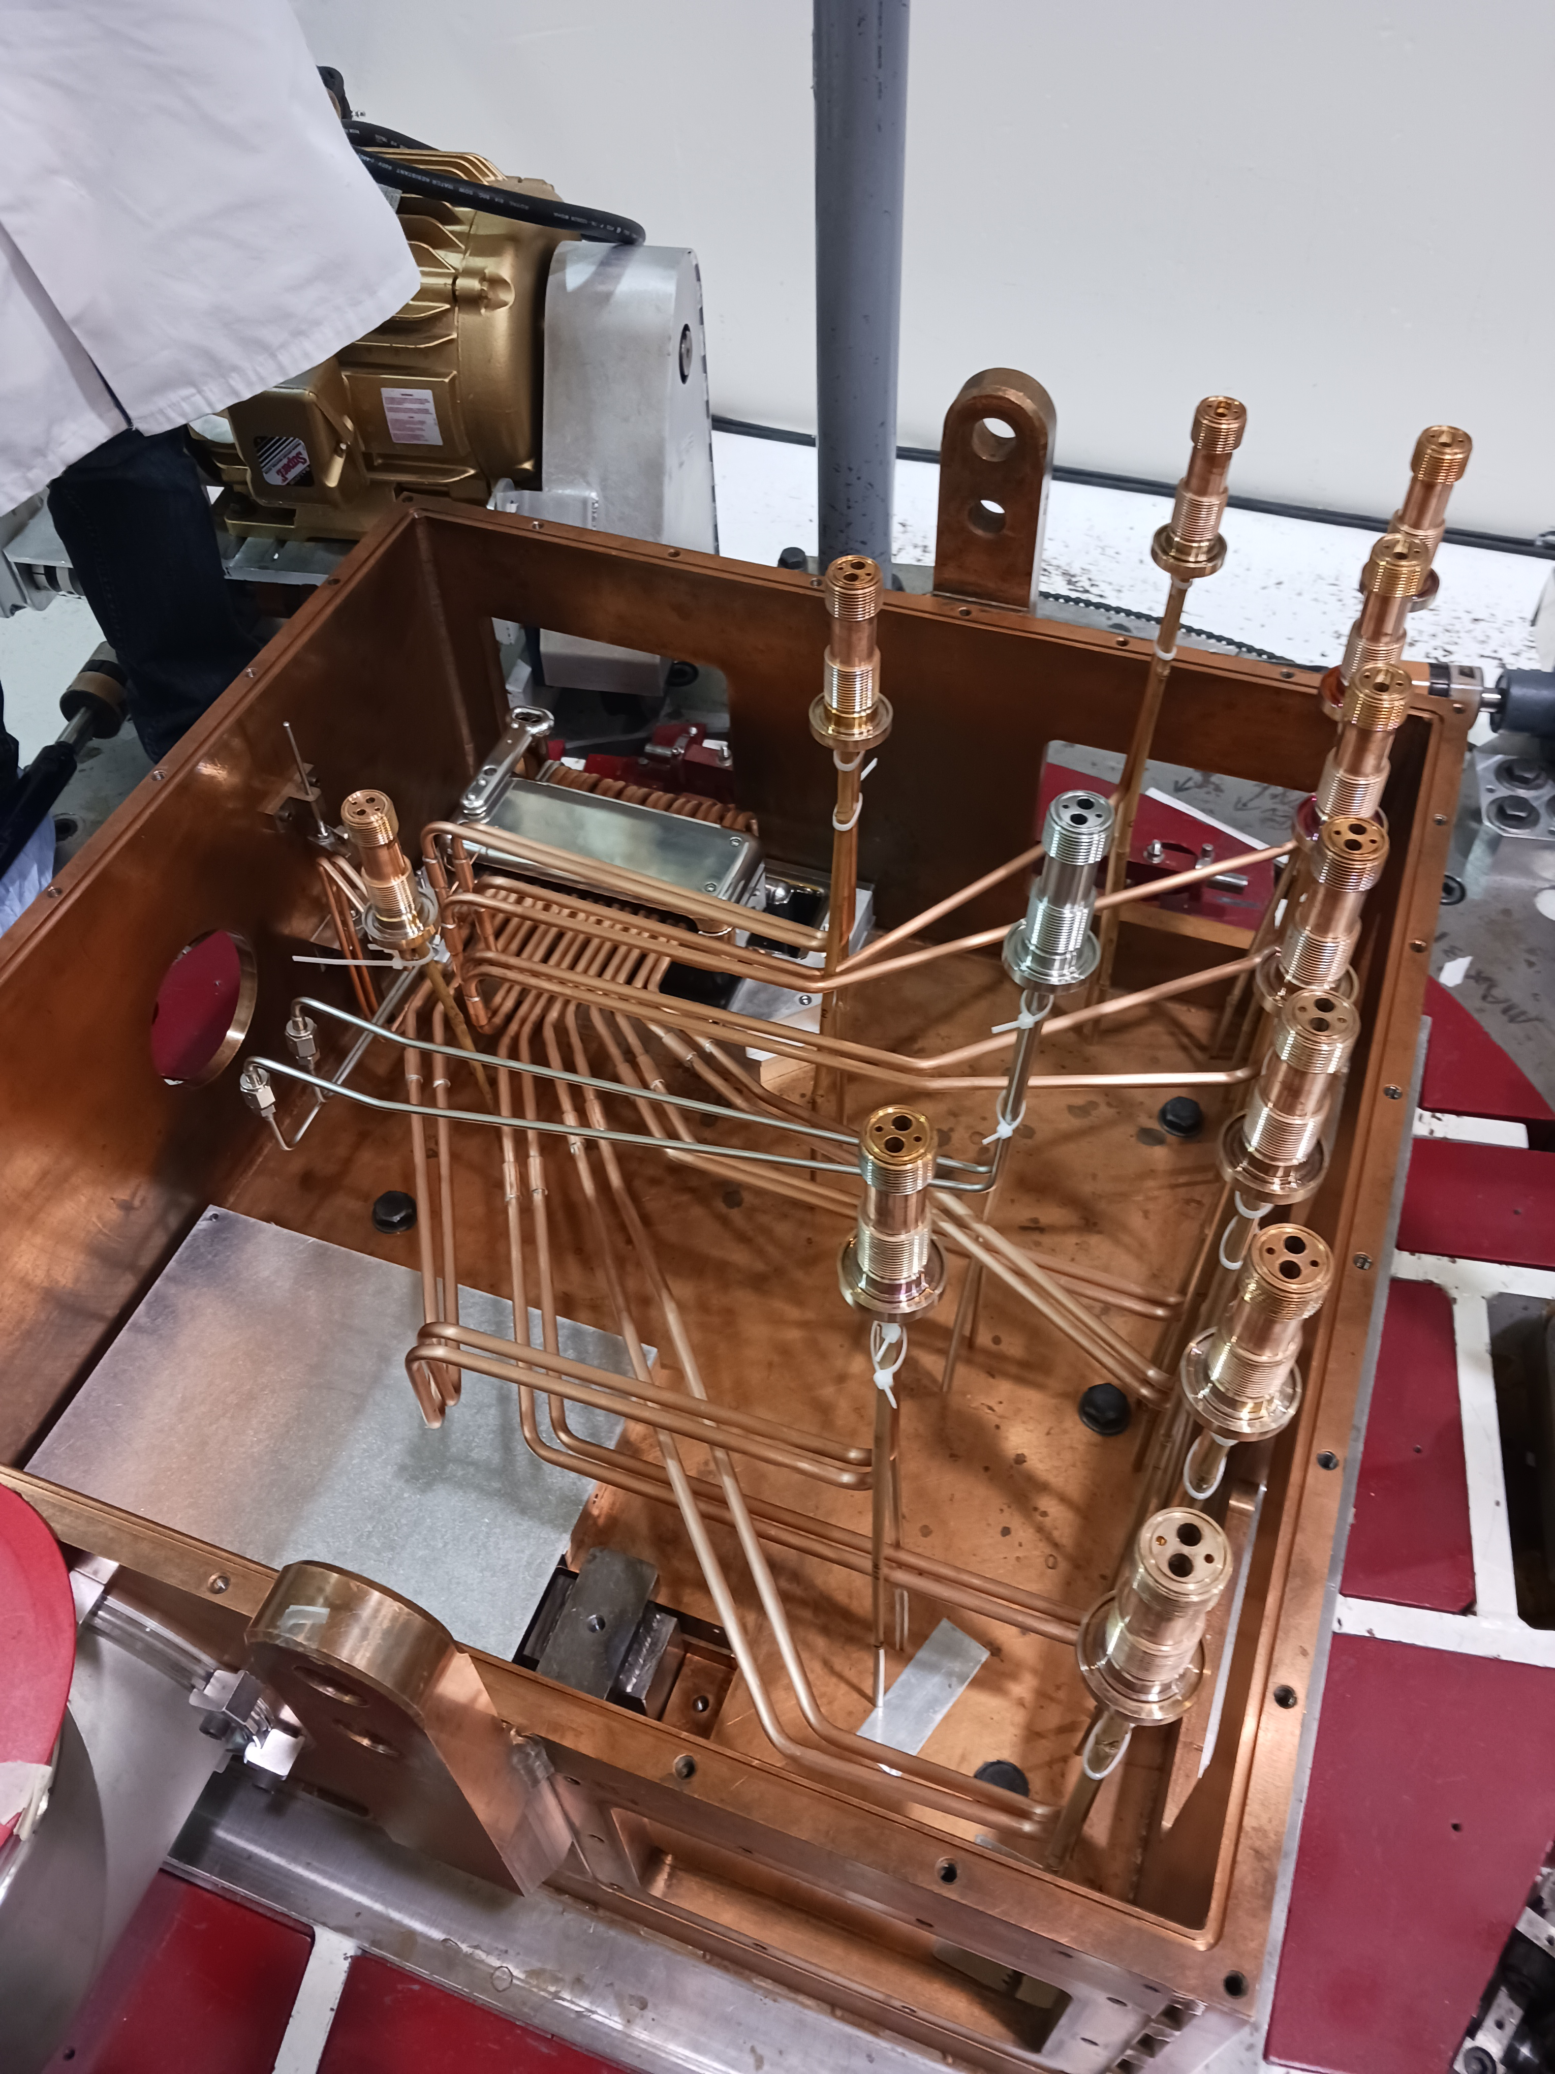
Infrastructure Reliability : High Voltage (HV)
Interface with part of module that holds the target
In 2024 we successfully ran a fully refurbished module (TM3) with newly HV-engineered systems up to 60kV.
First experiment put on hold due to HV limitations was run successfully at 53kV.
All HV to ground interfaces designed with HV engineering/analysis
Above module shielding

Slide 13
Final Thoughts : Infrastructure
Significant focus was put on solving common infrastructure failures - downtime hours related to infrastructure fall off after 2019.
Water conductivity too high to start operations
Vacuum pump failure
Water leak inside one of the target modules
High voltage instabilities
COVID...

Slide 14
Reliability Category : Target/Ion Source Problems
Single target failure is very expensive in DT hours (4-10 days).
One failure often produces another in the rush to get a backup target installed and online (as in 2022 & 2024).
Development comes with the risk of failure.
FEBIAD target failures
FEBIAD target failures
High power target failure due to human factors
Broken ion source, cause unclear
IGLIS target failure
COVID...

Slide 15
Source Reliability : How to Interpret
Some things to note:
One target failure is extremely expensive in terms of downtime, a minimum of 4 days, up to 10 days, is needed to turn around a new target.
One failure often produces another – in order to recover as many hours as possible during an emergency target swap, we often have to cut out steps we would otherwise have taken and this can increase the probability that the new target fails – a lesson learned the hard way in 2022 and 2024.

Slide 16
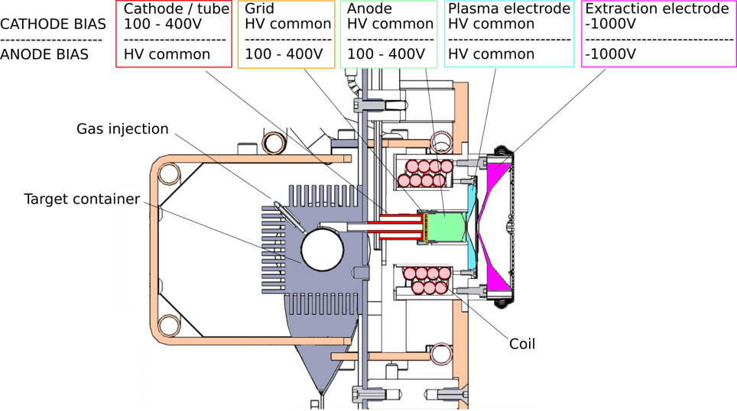
Source Reliability : FEBIAD targets
Most source failures in the past 5 years have been FEBIAD targets
The design is complex as the result of many patch-type fixes over the years.
Since high power targets require the proton beam to heat them to full temperature, we don’t have good ways to test them offline so troubleshooting is difficult and design changes are riskier.
Cross section of the ISAC FEBIAD target showing the bias voltages for all components in each of the 2 running modes.

Slide 17
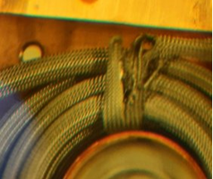
Source Reliability : FEBIAD targets
Recent FEBIAD success has come from re-routing the 500V carrying anode wire and improving its isolation in the vary cramped space of the target assembly
Also changing some operating processes
More time for stabilization built into schedule
Greater scrutiny on the stability of the proton beam, to reduce stress from thermal cycling
Sleeving on a wire inside the target destroyed by sparks in the old design.
See poster by #147 Fernando Maldonado for ongoing FEBIAD optimization work.

Slide 18
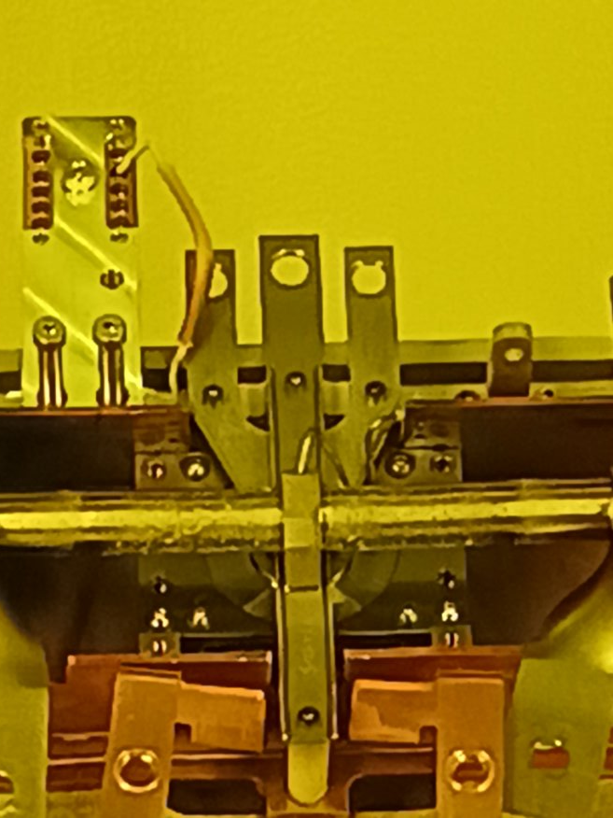
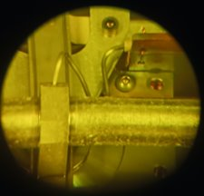
Source Reliability : New Targets
Some downtime related to finding the limits of new target materials or designs
When we started running graphite targets they only lasted 2 weeks. We have since changed the configuration so they last 3 weeks. Responsible for some of the 2022 DT.
ISAC ran TiC targets many years ago, but when we started running them again in the past few years, there was still uncertainty about the best material formulation and conditioning process. We needed a few tries to implement a reliable method.
TiC target container degradation seen in the hot cell

Slide 19
Source Reliability : Final Thoughts
FEBIAD target failures
FEBIAD target failures
As we solve the big problems, we start to run into the problems one level down - this is progress!
High power target failure due to human factors
Broken ion source, cause unclear
IGLIS target failure
COVID...

Slide 20
Reliability : a constantly moving target
Maintaining reliability in a research facility that wants to try new things requires constant adaptation.
Solving one problem usually reveals another, but this is working towards a systematic way to handle reliability.
Better reliability = more science & less stress

Slide 21




Thank you Merci
www.triumf.ca
Follow us @TRIUMFLab

