Slide 1

The study of the high-spin isomer beam production via the fragmentation reaction at 350 MeV/u
K.Kawata ¹⁾
S.Ota ¹⁾, K.Yako ²⁾, M.Dozono ^{2, 3)}, J.Zenihiro ^{3,4)}, C.Iwamoto ^{2, 5)}, N.Kitamura ²⁾, H.Sakai ⁴⁾, S.Masuoka ²⁾, S.Michimasa ²⁾, R.Yokoyama ²⁾, T.Harada ^{4, 6)}, H.Nishibata ^{3, 7)}, R.Tsunoda ²⁾, N.Imai ²⁾, N.Zhang ^{2, 8)}, J.Hwang ^{2, 9)}, and F.Endo ^{1, 10)}
RCNP 1), CNS 2), Kyoto University 3), RIKEN Nishina Center 4), RIKEN Center for Advanced Photonics 5), Toho University 6), Kyushu University 7), Institute of Modern Physics 8), Center for Exotic Nuclear Studies 9), Tohoku University 10)

Slide 2
Introduction
Isomers :longer life excited state(>1 ns), Spin-gap, Deformed and K
High-spin isomers: valuable probes
nuclear structure, nuclear astrophysics, and applied research.
The interaction at the higher level
Nuclear reaction
Hyper deformation
Torus
The unstable beam produced by fragmentation
The selective production and separation of
specific isomeric states remain challenging.
Phys. Rev. Lett. 57, 811(1986)

Slide 3
Fragmentation
Projectile E >100 MeV/u
spectator picture
Excited state(pre-fragment)
de-excited
isomer or g.s.
p_{F}
K
Target
The momentum width is spread by Fermi motion.(G.H. Formula )
$σ=σ_{0}\sqrt{\frac{A_{f}(A_{p}−A_{f})}{A_{p}−1}}$ , $σ_{0}=90 MeV/c$
A.S. Goldhaber Physics Letters B 53 306308 (1974)
・Isomer and g.s. are produced for the secondary beam via the pre-fragment

Slide 4
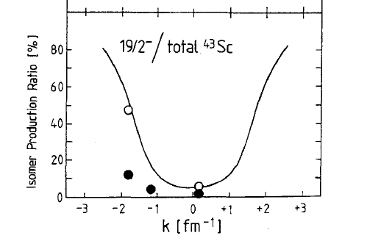
Previous study in isomer production
⁴⁶Ti to ⁴³Sc(19/2-)
⁷⁸Kr to ⁵³Fe(19/2-) ,⁵³Co(19/2-)
⁹²Mo to ⁸⁸Zr(8+)
● exp
○ calc
W.-D. Schmidt-Ott, et al
Zeitschrift für Physik A Hadrons and Nuclei 350 215--219 (1994)
X. L. Tu et al
PRC 95,014610(2017)
J. M. Daugas,et al
Phys. Rev. C 63 064609 (2001)
・Isomer ratio depends on the momentum transfer
・The theoretical calculation suitable for each experimental condition is under discussion. (De jong Nucler.Phys A 4, 435444 (1997))

Slide 5
Purpose
To explore an effective way to produce various unstable beams, including the high-spin isometric state.
To clarify the momentum transfer to the isomer in fragmentation

Slide 6
Pre-fragment production and decay
pre-fragment
・A high-spin isomer can restrict the angular momentum.
Ex
High-spin isomer
g.s.
Angular momentum
Classical relationship
・The momentum distribution with and without isomer may provide the relationship between transferred linear momentum and angular momentum.
Momentum
Angular momentum

Slide 7
Experiment @HIMAC
Fragment | L_{iso}
⁵²Fe | 10
⁵³Fe | 8
⁵⁴Co | 6
Projectile
⁵⁸Ni
⁵⁹Co
Primary(350 MeV/u) ~10⁷ pps
Fragment:(300 MeV/u) ~10³ pps
angle slit
F1Wedge
D1
Target ⁹Be 14 mm
F22
F1slit
±4 mm(±0.2%)
ToF
D2
・ΔE-ToF-Bρ Method for PID
・4 Ge detectors for γ-rays from isomer decay
F3
F22slit
F23Deg
F22PL
F23Ge
F23Xe
F23Stop
ΔE
ε_{γ}=1 % @1333 keV
F23PPAC
F23Veto

Slide 8
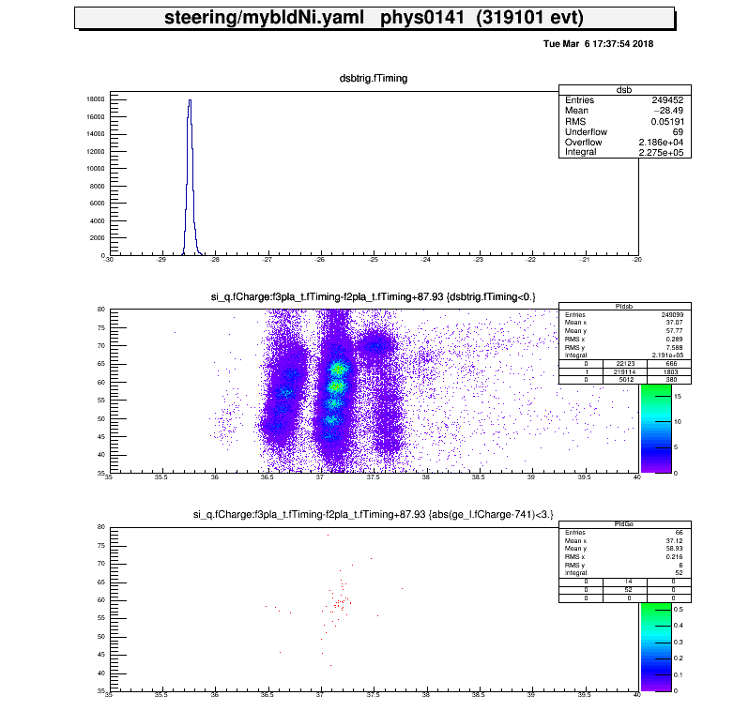
Analysis of yield of the isomer and g.s.
γ-ray Energy plot
⁵²Fe(12+) decay scheme
PID
1h and 1 Mpps primary beam
ΔE(MeV)
⁵²Fe
ToF(ns)
⁵²Fe(12+)
・Fragment :ΔE-ToF plot ・Isomer : γ-ray energy plot

Slide 9
Result & Discussion: momentum distribution
L_{iso}=10
L_{iso}=8
L_{iso}=6
Δp_{diff}
g.s.
From ⁵⁸Ni
isomer
P_{diff}=0 MeV/c
: the same velocity on the reaction
From ⁵⁹Co
The distribution of the isomer decelerated the distribution of g.s .
The larger the L_{iso}, the more g.s. and isomer seems to deviate.
P_{diff}(MeV/c)
P_{diff}(MeV/c)
P_{diff}(MeV/c)
Horizontal axis shows P_{diff}(MeV/c)
The representative value of the momentum distribution is fitted by Gaussian.
The center of gaussian defined as M_{diff}(unb),M_{diff}(iso)
Momentum peak of the isomer(M_{diff}(iso)) decelerated in comparison with M_{diff}(unb).
The larger the L_{iso}, the more M_{diff}(iso) and M_{diff}(unb) seem to deviate.

Slide 10

Results: Correlation (L_{iso} vs Δp_{diff})
Fitting function
1/a₀=R_{prj}=5.58±0.30+^{4.62}_{-0.58} fm
L₀=4.58±0.02+^{0.13}_{-1.08} ħ
Δp_{diff and} L_{iso} are correlated
Radius of ⁵⁸Ni:1.3*A^1/3~4.7 fm
L₀
L₀
・The fragmentation shows the peripheral reaction on the projectile surface.
・L₀ shows the limited angular momentum in the g.s. momentum distribution.

Slide 11

Result & Discussion: Isomer ratio
L_{iso}=10
g.s.$/Iso$
g.s
R
(1.70±0.08)×10⁻²
(6.01±0.74)×10⁻³
P_{diff}(MeV/c)
P_{diff}(MeV/c)
・R increases with large momentum transfer.
・R: isomer is about 3 times as many as g.s.

Slide 12
Result & Discussion: Isomer ratio
L_{iso}=10
L_{iso}=8
L_{iso}=6
Δm=4
From ⁵⁸Ni
Δm=6
Δm=5
From ⁵⁹Co
Δm=7
Δm=6
Δm=5
P_{diff}(MeV/c)
P_{diff}(MeV/c)
P_{diff}(MeV/c)
・R depends on the L_{iso}
・R depends on the mass loss(Δm)

Slide 13
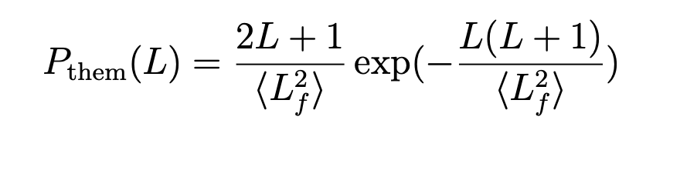
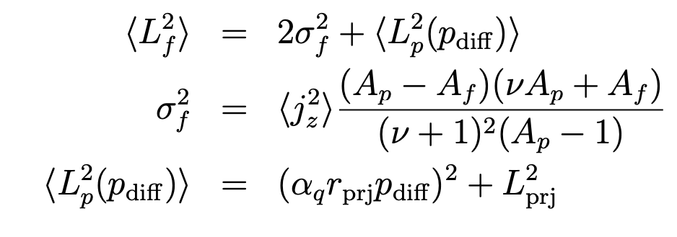

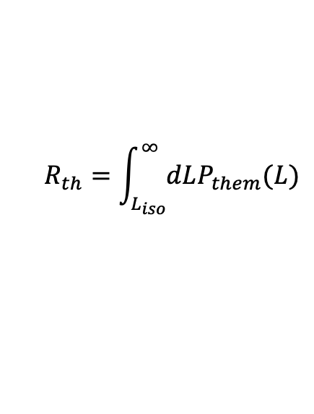
Result & Discussion: Isomer ratio
$$R_{th}=\int_{L_{iso}}^{∞}{dLP_{them}(L)}$$
De jong Nucler.Phys A 4, 435444 (1997)
・Spin cut off parameterization
original dejong
・The phenomenological calculation with dejong can be adapted to the R.
・The spin cut-off parameter can be quenched.
$α_{q}$~0.2
Red is a new parameter

Slide 14
Conclusion
・Systematic measurement of the momentum distribution by changing the kind of projectile, fragment, and isomer.
・The angular momentum of the high-spin isomer correlates with the linear momentum.
・The projectile fragmentation shows the reaction near the projectile surface.
・The angular momentum of the fragment can be restricted by a high-spin isomer.
・The isomer ratio depends on the P_{diff}.

Slide 15
Thank you for listening

Slide 16
backup

Slide 17
Introduction
Isomers are excited nuclear states with lifetimes longer than 1 ns, due to factors such as spin gaps, nuclear deformation, or K.
High-spin isomers in rare unstable beams are valuable probes for nuclear structure, nuclear astrophysics, and applied research.
Information about the interaction at the higher level
Nuclear reaction from the high-spin state and the excited state
Hyper deformation
Many of the unstable nuclei in various facilities are produced by fragmentation
The selective production and separation of specific isomeric states remain challenging.

Slide 18
Contents
Introduction
high-spin isomer
fragmentation
Purpose
Experiment

Slide 19
Fragmentation in previous study
[1] A.S. Goldhaber Physics Letters B 53 306308 (1974)
[2]K. Summerer Phys. Rev. C 61 034607 (2000)
[3] Notani Phys. Rev. C 76 044605 (2007)
[4] M. Tanaka PhysRevC.106.014617(2022)
[5] J.-J. Gaimard Nuclear Physics A 531 709745 (1991)
[6] De jong Nucler.Phys A 4, 435444 (1997)
・Systematic measurements in g.s.:
:Cross-section[2], Momentum distribution[3], Momentum peak shift [3]such as isomer production
・Theoretical calculation study:
：Glauber model[4],Eikonal approximation[4],Gaimard-Schmidt method[5],EPAX[2]

Slide 20
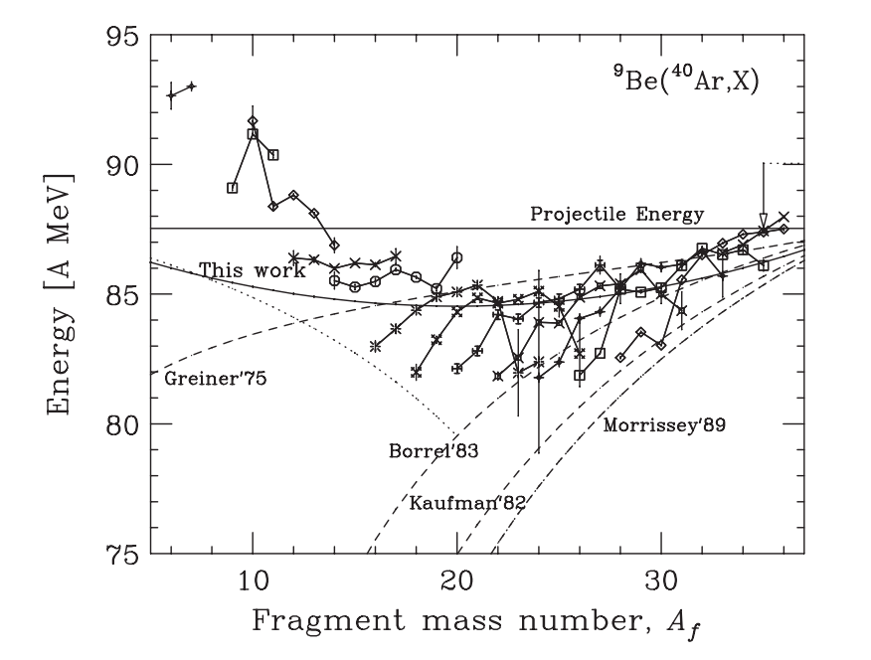
Model calculation
Widht
Notani
(Abrasion)
(Ablation過程)
Projectile
Fragment
Pre-fragment
A_{p}
v_{p}
v_{pf}
v_{pf}
v_{f}
A_{f}
Fermi motion
γ
v_{p}≠v_{f}
Target
・
Phys. Rev. C 76 044605 (2007)

Slide 21
Decay scheme of the isomer

Slide 22
Abstract
High-spin nuclear isomers in rare unstable beams are important for studies in nuclear structure, nuclear astrophysics, and applied research. While fragmentation reactions, widely used at in-flight rare-isotope beam facilities, can produce a diverse range of nuclides, the selective and high-intensity production and separation of specific isomer states remain challenging. This study aimed to experimentally investigate the correlation between parallel momentum transfer and angular momentum transfer in fragmentation reactions, contributing to the development of selective beam production techniques for isomer states.
We focused particularly on previous studies [1] that showed an increase in the isomer ratio by selecting the tail of the fragment momentum distribution, with the goal of clarifying its physical origin. In this research, we investigated the correlation between angular momentum and parallel momentum transfer by selecting events from high-spin isomer states and comparing their momentum distributions with those of events primarily in the ground state. The experiment was conducted at the SB2 beamline of the High-Energy Heavy-Ion Accelerator Facility (HIMAC). Primary beams of Ni and Co accelerated to 350 MeV/u irradiated a 14 mm thick Be target to produce nuclides around Fe through fragmentation reactions. The produced fragments were separated by a fragment separator (two dipole magnets) and identified using the time-of-flight (ToF), energy loss(E), and magnetic rigidity (B) method. Among the identified nuclides, de-excitation gamma rays from high-spin isomers Fe(12), Fe(19/2) and Co(7) were measured using four Ge detectors placed at the end of the flight path with the particle identification. As a result of the analysis, a clear tendency was observed for the relative production of high-spin isomers to increase in the region of large momentum transfer away from the center of the fragment momentum distribution (the tail of the distribution), consistent with previous studies [2][3]. Furthermore, by comparing the measured properties of multiple isomer states, a clear positive correlation was found between the magnitude of the imparted angular momentum and the parallel momentum transfer. In this presentation, we will report these experimental results in detail and discuss the current understanding of the angular momentum generation mechanism in fragmentation reactions and its potential application to the production of high-purity, high-intensity isomer beams.

Slide 23
核破砕反応のモデル
(A) G.Hモデル
摩耗過程 (Abrasion過程)
Projectile
Fragment
Fragmentはspectator
A_{p}
v_{p}
v_{p}
v_{p}
A_{f}
Fermi運動量程度
Target
□提案するモデル
摩耗過程 (Abrasion過程)
蒸発過程 (Ablation過程)
標的と反応
Projectile
古典的に角運動量を獲得
Fragment
Pre-fragment
基底状態
A_{p}
v_{p}
v_{pf}
v_{pf}
A_{f}
R
Δp
Δp
A_{f,}J^{π}
isomer状態
γ
中性子
Target
Fermi運動量程度

Slide 24
核破砕反応のモデル
(B) Notaniモデル
摩耗過程 (Abrasion過程)
蒸発過程 (Ablation過程)
Projectile
Fragment
Pre-fragment
A_{p}
v_{p}
v_{pf}
v_{pf}
v_{f}
A_{f}
Fermi運動量程度
γ
Target
中性子
□提案するモデル
摩耗過程 (Abrasion過程)
蒸発過程 (Ablation過程)
標的と反応
Projectile
古典的に角運動量を獲得
Fragment
Pre-fragment
基底状態
A_{p}
v_{p}
v_{pf}
v_{pf}
A_{f}
R
Δp
Δp
A_{f,}J^{π}
isomer状態
γ
中性子
Target
Fermi運動量程度

Slide 25
核破砕反応のモデル
(C) Schmitdt-Ottモデル
Projectile
Knockout like過程
Fragmentはspectator
基底状態
v_{p}
A_{f}
v_{p}
A_{p}
A_{f,}J^{π}
isomer状態
特定の核子が抜ける
□提案するモデル
摩耗過程 (Abrasion過程)
蒸発過程 (Ablation過程)
標的と反応
Projectile
古典的に角運動量を獲得
Fragment
Pre-fragment
基底状態
A_{p}
v_{p}
v_{pf}
v_{pf}
A_{f}
R
Δp
Δp
A_{f,}J^{π}
isomer状態
γ
中性子
Target
Fermi運動量程度

Slide 26
核破砕反応のモデル
(D) 統計的abrasion-ablationモデル(De jong)
摩耗過程
（Abrasion過程）
Projectile
Pre-fragment
Fragment
基底状態
A_{p}
A_{f}
_{f}
A_{f,}J^{π}
isomer状態
γ
Target
中性子
□提案するモデル
摩耗過程 (Abrasion過程)
蒸発過程 (Ablation過程)
標的と反応
Projectile
古典的に角運動量を獲得
Fragment
Pre-fragment
基底状態
A_{p}
v_{p}
v_{pf}
v_{pf}
A_{f}
R
Δp
Δp
A_{f,}J^{π}
isomer状態
γ
中性子
Target
Fermi運動量程度

Slide 27
核破砕反応のモデル
(E) Okunoモデル
摩耗過程 (Abrasion過程)
蒸発過程 (Ablation過程)
Projectile
Fragment
Fragmentはspectator
Pre-fragment
v_{pf}
基底状態
A_{p}
v_{p}
v_{pf}
A_{f}
R
Δp
Δp
γ
A_{f,}J^{π}
isomer状態
Target
Fermi運動量程度
中性子
□提案するモデル
摩耗過程 (Abrasion過程)
蒸発過程 (Ablation過程)
標的と反応
Projectile
古典的に角運動量を獲得
Fragment
Pre-fragment
基底状態
A_{p}
v_{p}
v_{pf}
v_{pf}
A_{f}
R
Δp
Δp
A_{f,}J^{π}
isomer状態
γ
中性子
Target
Fermi運動量程度

