Slide 1
Towards Lv (Z = 116) Chemistry with UniCell
Jochen Ballof
A. Yakushev, Y. Wei, M. Biljan, R. Cantemir, J. Krier, J. Kulawik, S. Löchner,
F. Zielke, Ch. E. Düllmann

Slide 2

Chemical Studies on SHE
 | 1 |  |  |  |  |  |  |  |  |  |  |  |  |  |  |  |  | 18
 | 1 |  |  |  |  |  |  |  |  |  |  |  |  |  |  |  |  | 2
 | H | 2 |  |  |  |  |  |  |  |  |  |  | 13 | 14 | 15 | 16 | 17 | He
 | 3 | 4 |  |  |  |  |  |  |  |  |  |  | 5 | 6 | 7 | 8 | 9 | 10
 | Li | Be |  |  |  |  |  |  |  |  |  |  | B | C | N | O | F | Ne
 | 11 | 12 |  |  |  |  |  |  |  |  |  |  | 13 | 14 | 15 | 16 | 17 | 18
 | Na | Mg | 3 | 4 | 5 | 6 | 7 | 8 | 9 | 10 | 11 | 12 | Al | Si | P | S | Cl | Ar
 | 19 | 20 | 21 | 22 | 23 | 24 | 25 | 26 | 27 | 28 | 29 | 30 | 31 | 32 | 33 | 34 | 35 | 36
 | K | Ca | Sc | Ti | V | Cr | Mn | Fe | Co | Ni | Cu | Zn | Ga | Ge | As | Se | Br | Kr
 | 37 | 38 | 39 | 40 | 41 | 42 | 43 | 44 | 45 | 46 | 47 | 48 | 49 | 50 | 51 | 52 | 53 | 54
 | Rb | Sr | Y | Zr | Nb | Mo | Tc | Ru | Rh | Pd | Ag | Cd | In | Sn | Sb | Te | I | Xe
 | 55 | 56 | 57-71 | 72 | 73 | 74 | 75 | 76 | 77 | 78 | 79 | 80 | 81 | 82 | 83 | 84 | 85 | 86
 | Cs | Ba | La-Lu | Hf | Ta | W | Re | Os | Ir | Pt | Au | Hg | Tl | Pb | Bi | Po | At | Rn
 | 87 | 88 | 89-103 | 104 | 105 | 106 | 107 | 108 | 109 | 110 | 111 | 112 | 113 | 114 | 115 | 116 | 117 | 118
 | Fr | Ra | Ac-Lr | Rf | Db | Sg | Bh | Hs | Mt | Ds | Rg | Cn | Nh | Fl | Mc | Lv | Ts | Og
 |  |  | 57 | 58 | 59 | 60 | 61 | 62 | 63 | 64 | 65 | 66 | 67 | 68 | 69 | 70 | 71
 |  |  | La | Ce | Pr | Nd | Pm | Sm | Eu | Gd | Tb | Dy | Ho | Er | Tm | Yb | Lu
 |  |  | 89 | 90 | 91 | 92 | 93 | 94 | 95 | 96 | 97 | 98 | 99 | 100 | 101 | 102 | 103
 |  |  | Ac | Th | Pa | U | Np | Pu | Am | Cm | Bk | Cf | Es | Fm | Md | No | Lr
warm fusion
projectile
Superheavy elements
transuranium target materials
chemical studies
up to ~TBq

Slide 3
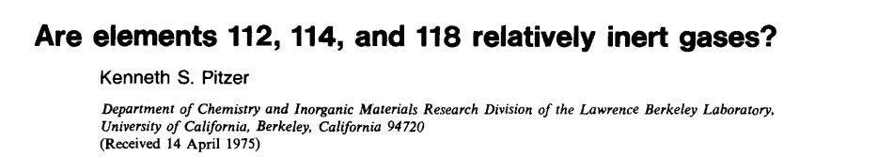
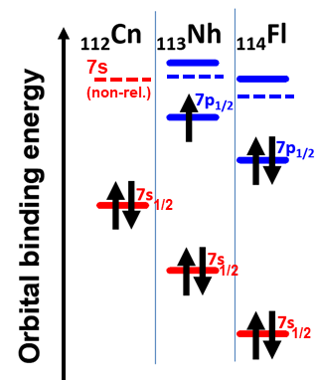
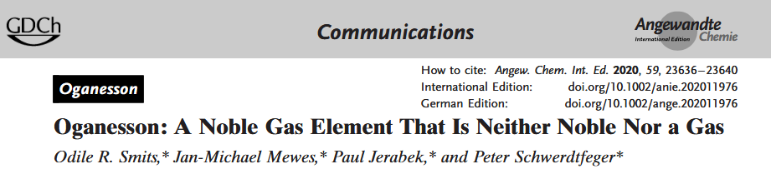
Chemical Studies on SHE
 | 1 |  |  |  |  |  |  |  |  |  |  |  |  |  |  |  |  | 18
 | 1 |  |  |  |  |  |  |  |  |  |  |  |  |  |  |  |  | 2
 | H | 2 |  |  |  |  |  |  |  |  |  |  | 13 | 14 | 15 | 16 | 17 | He
 | 3 | 4 |  |  |  |  |  |  |  |  |  |  | 5 | 6 | 7 | 8 | 9 | 10
 | Li | Be |  |  |  |  |  |  |  |  |  |  | B | C | N | O | F | Ne
 | 11 | 12 |  |  |  |  |  |  |  |  |  |  | 13 | 14 | 15 | 16 | 17 | 18
 | Na | Mg | 3 | 4 | 5 | 6 | 7 | 8 | 9 | 10 | 11 | 12 | Al | Si | P | S | Cl | Ar
 | 19 | 20 | 21 | 22 | 23 | 24 | 25 | 26 | 27 | 28 | 29 | 30 | 31 | 32 | 33 | 34 | 35 | 36
 | K | Ca | Sc | Ti | V | Cr | Mn | Fe | Co | Ni | Cu | Zn | Ga | Ge | As | Se | Br | Kr
 | 37 | 38 | 39 | 40 | 41 | 42 | 43 | 44 | 45 | 46 | 47 | 48 | 49 | 50 | 51 | 52 | 53 | 54
 | Rb | Sr | Y | Zr | Nb | Mo | Tc | Ru | Rh | Pd | Ag | Cd | In | Sn | Sb | Te | I | Xe
 | 55 | 56 | 57-71 | 72 | 73 | 74 | 75 | 76 | 77 | 78 | 79 | 80 | 81 | 82 | 83 | 84 | 85 | 86
 | Cs | Ba | La-Lu | Hf | Ta | W | Re | Os | Ir | Pt | Au | Hg | Tl | Pb | Bi | Po | At | Rn
 | 87 | 88 | 89-103 | 104 | 105 | 106 | 107 | 108 | 109 | 110 | 111 | 112 | 113 | 114 | 115 | 116 | 117 | 118
 | Fr | Ra | Ac-Lr | Rf | Db | Sg | Bh | Hs | Mt | Ds | Rg | Cn | Nh | Fl | Mc | Lv | Ts | Og
 |  |  | 57 | 58 | 59 | 60 | 61 | 62 | 63 | 64 | 65 | 66 | 67 | 68 | 69 | 70 | 71
 |  |  | La | Ce | Pr | Nd | Pm | Sm | Eu | Gd | Tb | Dy | Ho | Er | Tm | Yb | Lu
 |  |  | 89 | 90 | 91 | 92 | 93 | 94 | 95 | 96 | 97 | 98 | 99 | 100 | 101 | 102 | 103
 |  |  | Ac | Th | Pa | U | Np | Pu | Am | Cm | Bk | Cf | Es | Fm | Md | No | Lr
J. Desclaux,
ADNDT 12 (1973) 311
closed shells
7s²6d¹⁰
7s² 7p_{1/2}²
7s² 7p⁶
V. Pershina, M. Ilias,
Ch. E. Düllmann
transuranium target materials

Slide 4
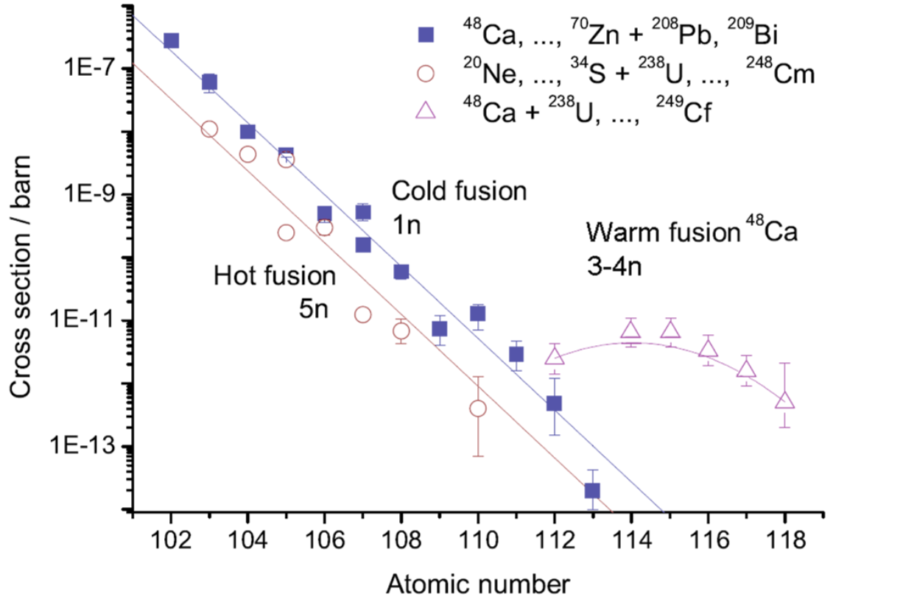
SHE Chemistry Challenges
Half-lifes (longest-lived known isotope)
Production rates
hours
milli-
seconds
atoms
per min
atoms
per day
~hours, mins
~sec
~ms
Typical limit for SHE gas-phase
chemistry
Türler and Pershina, CR 2013, 1237

Slide 5
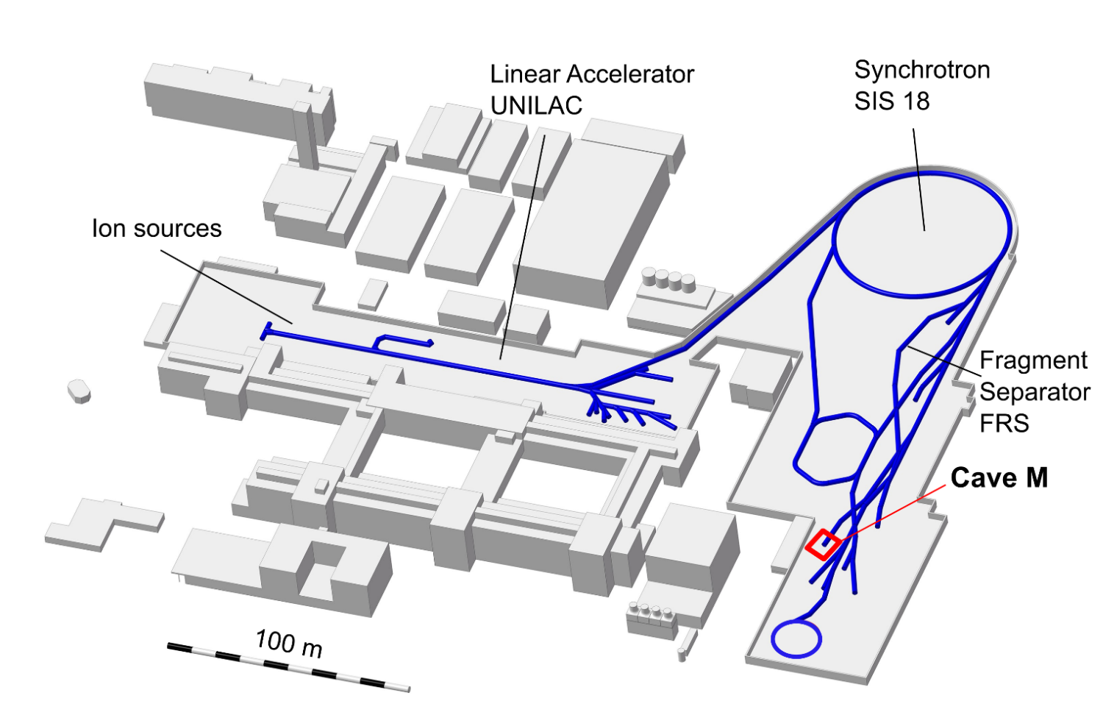
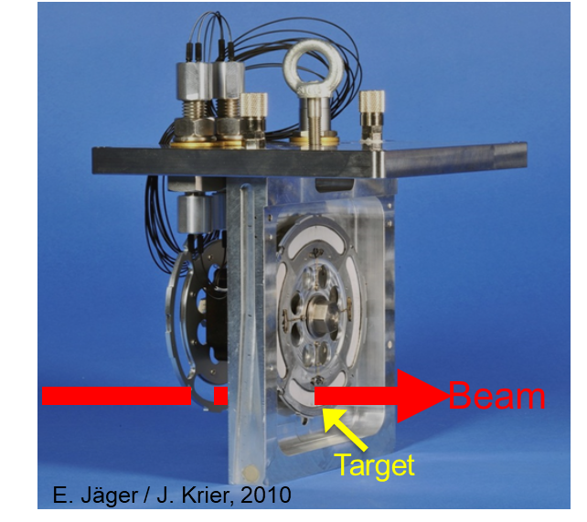
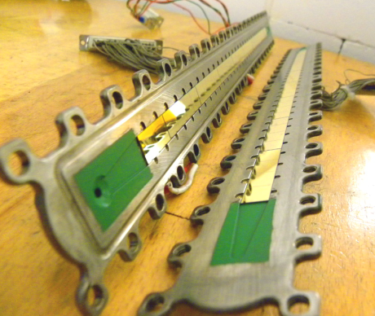
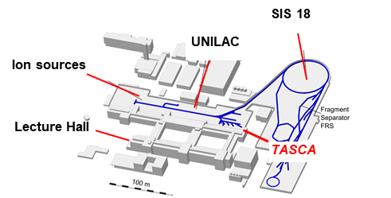
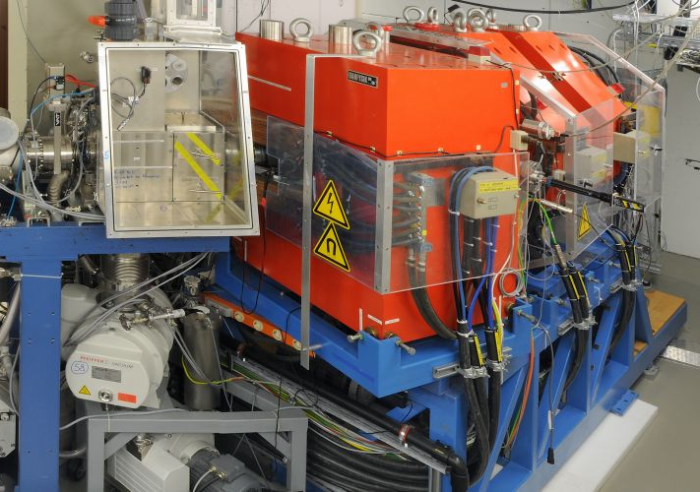
Tools for studying SHE chemistry
Detektor COMPACT
Target wheel
SIS 18
UNILAC
GSI Accelerator complex
Ion sources
Lecture Hall
TASCA
TransActinide Separator and Chemistry Apparatus – TASCA
Beam from UNILAC
2 qadrupole
magnets
Target wheel
Dipole
magnet

Slide 6
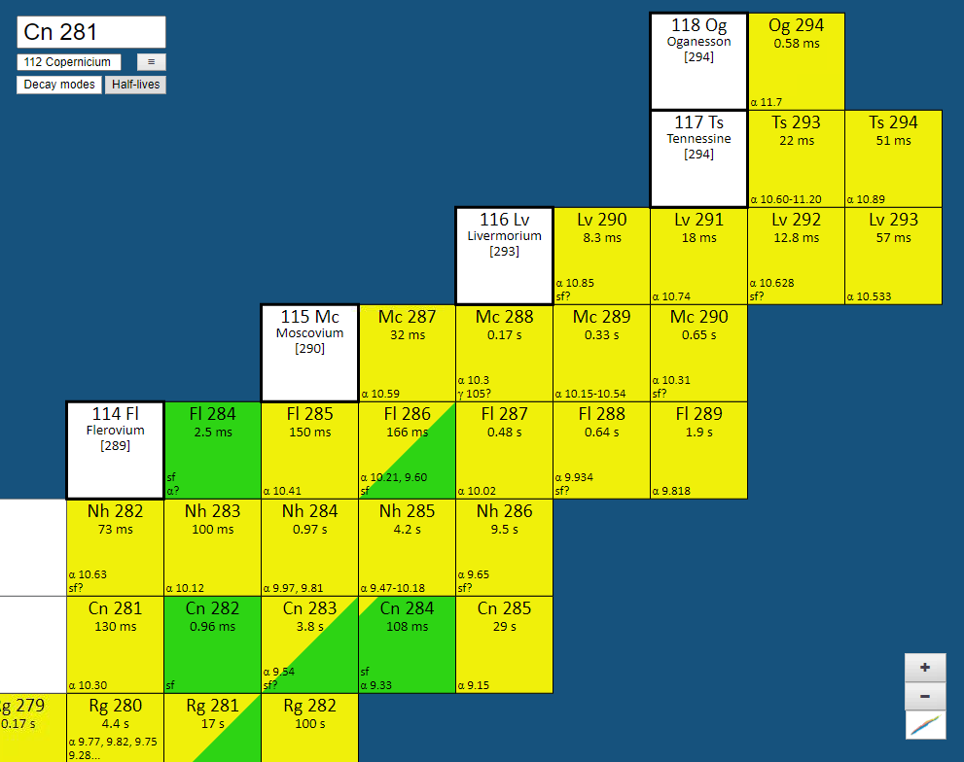
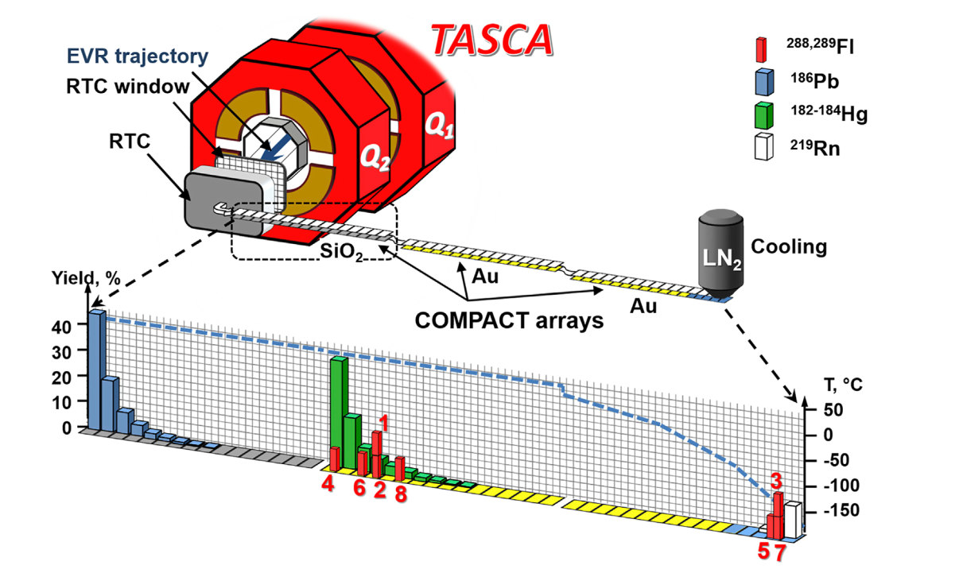
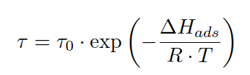

Recent experiments with 114Fl, 113Nh and 115Mc at GSI
Probing the interaction strength:
⁴⁸Ca beam
on ²⁴⁴PuO₂ target
₁₁₄Fl campaign at GSI
in total 8 decay chains of ₁₁₄Fl in three runs
in contrast to Pb: No adsorption on quartz
short PTFE
capillary
₁₁₃Nh and ₁₁₅Mc campaign at GSI
Both elements are reactive (open shell)
Detector-Setup adapted to fit directly on RTC outlet
Four chains of short-lived ²⁸⁸Mc (193 ms) detected on SiO₂-covered detector
15 Nh chains detected
A. Yakushev et al., Front. Chem. 12:1474820 (2024)
A. Yakushev et al., Front. Chem. 9: 753738 (2021)
A. Yakushev et al, 2022

Slide 7

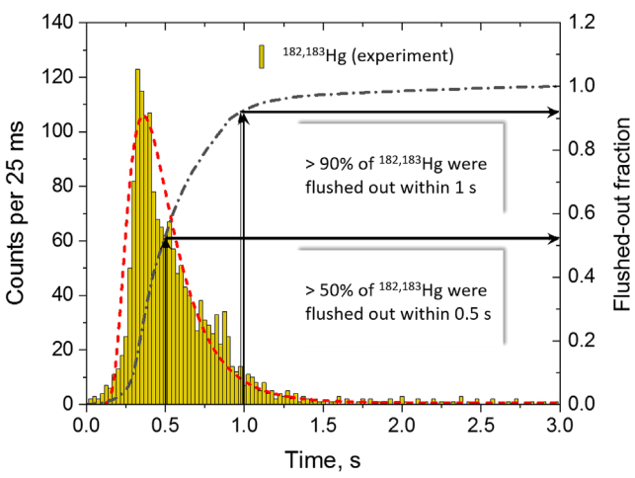

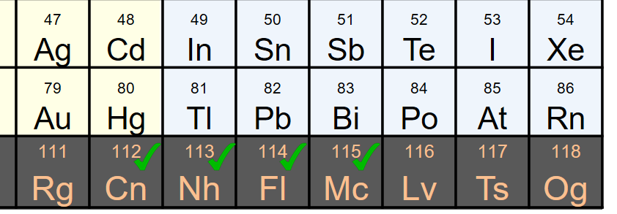
Towards chemistry studies of 116Lv and 117Ts
All known ₁₁₆Lv and ₁₁₇Ts isotopes have half-lives below 60 ms
Current MiniCOMPACT + RTC setup needs ca. 500 ms extraction time
Prerequisites for Lv or Ts studies
Development of a gas-stopping cell with shorter extraction time
Studies with homologues Po and At
T_{1/2}
< 60 ms
xCOMPACT
RTC
RTC governs
extraction time

Slide 8


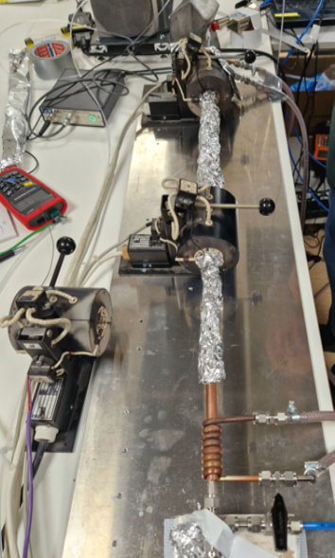
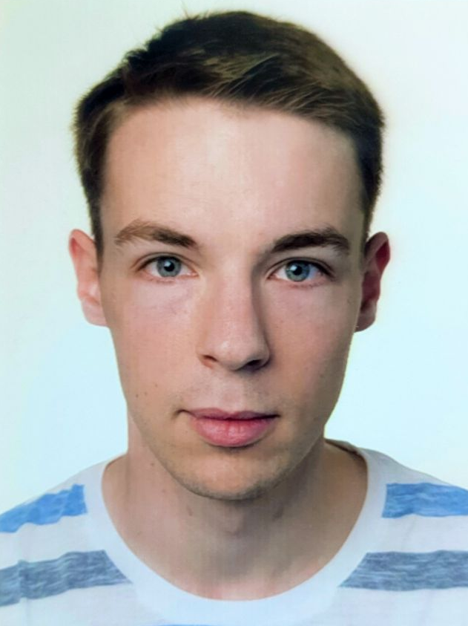

Homologues studies: Po and At at Rez (Cz) and GSI
Experimental campaign to study gas-phase chemistry of Po and At
  At GSI and the cyclotron of UJV Rez, Czech republic
  Chromatography with short-lived nuclides at elevated temperatures
  Detection of short-lived activity by Gamma or Alpha-spectroscopy
Compound formation leading to different volatilities
  Addition of reactive gases
  Quartz and gold surfaces
Experiments yield adsorption enthalpies of Po, At and their compounds
Importand data for future Lv and Ts experiments
Next run at Rez in March 2024
Example setup
Oven
Chromatography
column
He
BiO₂
Cooling
Reactive gases
(H₂, O₂)
³He²⁺
Cyclotron
Target
chamber
At in He
D. Dietzel (PhD thesis)
K. Hermainski (Master thesis)
PTFE tube ~10m

Slide 9


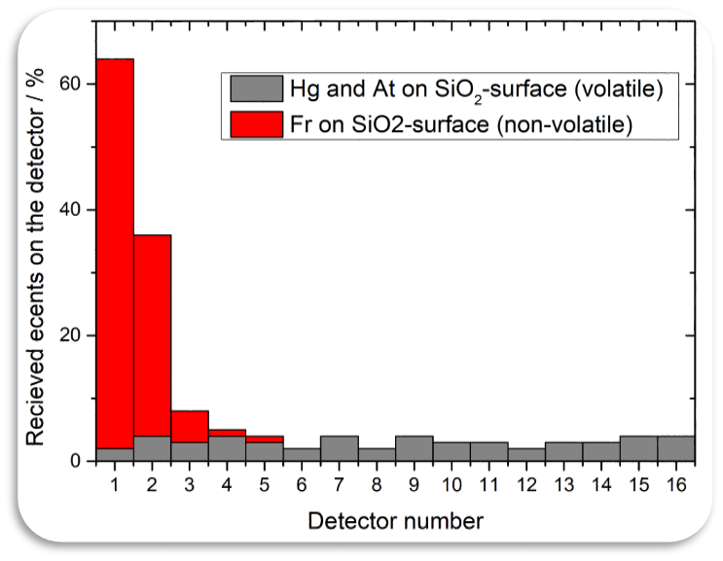
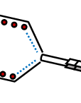
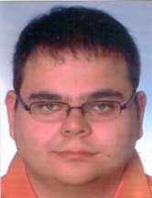
Towards faster extraction – Stopping Cell
Replacing RTC by existing buffer-gas cell with ion funnel
DC field accelerates ion -> faster extraction
RF field prevents wall encounters
Proof-of-concept experiment with old „SHIP“ Buffer gas cell
~ 30 mbar
ε_{extr} (Fr) = 24%
F_{DC}
≈ 50 ms extraction time
F_{RF}
S. Götz et al.,
NIM A 165090 (2021)
S. Götz et al.,
NIM B 27 (2021)
Notes:
Extraction time is online at TASCA, including losses in window and not stopped ions

Slide 10
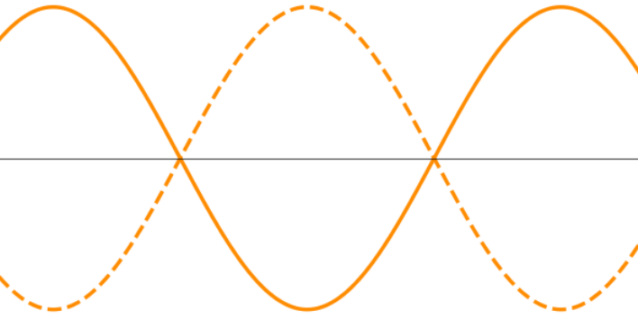











Towards faster and more efficient extraction – UniCell
DC Cage
Funnel
Fast extraction: Increase DC field $E_{DC}$
$$F_{RF }$$
reduced ion mobility
$$F_{gas }$$
$v_{d }\text{∝} \frac{K_{0}}{p} E_{DC}$
SHE
$$F_{DC }$$
pressure
~ 40 MeV
drift velocity
$$p$$
$$F_{RF }$$
High $F_{DC}$ requires high repelling RF field
Window
limited by discharges
Electrodes
$$V_{rf}$$
+
$F_{RF }\text{∝}\frac{1}{p^{2}}\frac{V_{rf}^{2}}{d^{3}}$
t
+
-
high pressure
desired for stopping
electrode spacing
-
+
$$d$$
M. Wada et al. NIMB 04 (2003) 570

Slide 11

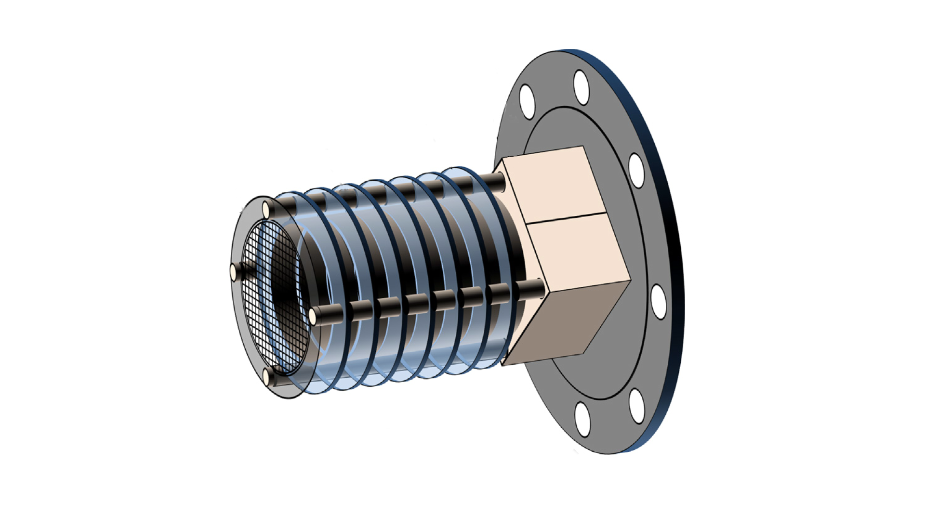
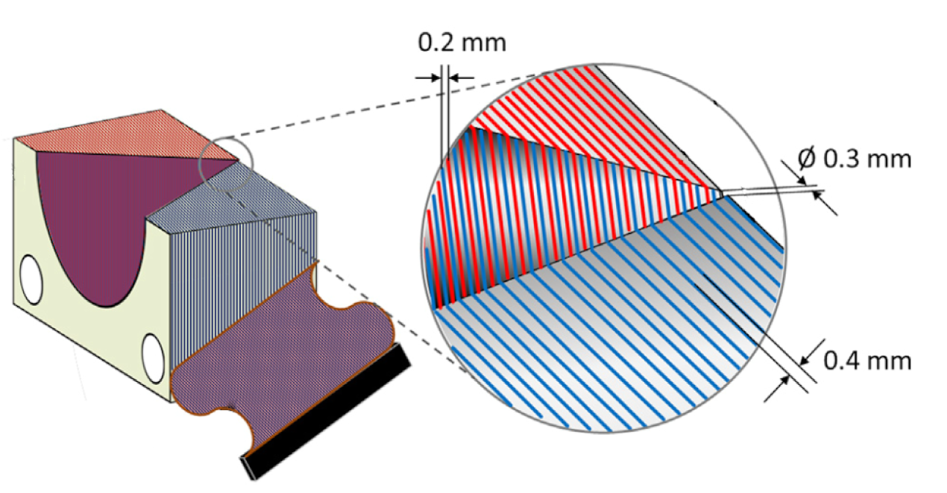
Towards faster extraction – UniCell
UniCell Concept: High-density and fast extraction
35 mm
Outlet orifice
70 mm
Simulations SIMION / VARJET
Extraction time | ~ 2 ms
Pressure | ~ 1 bar
Efficiency | ~ 100%
High stopping efficiency at 1 bar (He)
Faster extraction by high DC field > 100 V / cm
Requires stronger RF repelling force
Electrode pitch ~ 0.2 mm
V. Varentsov, A. Yakushev, NIM A 940 (2019) 206

Slide 12
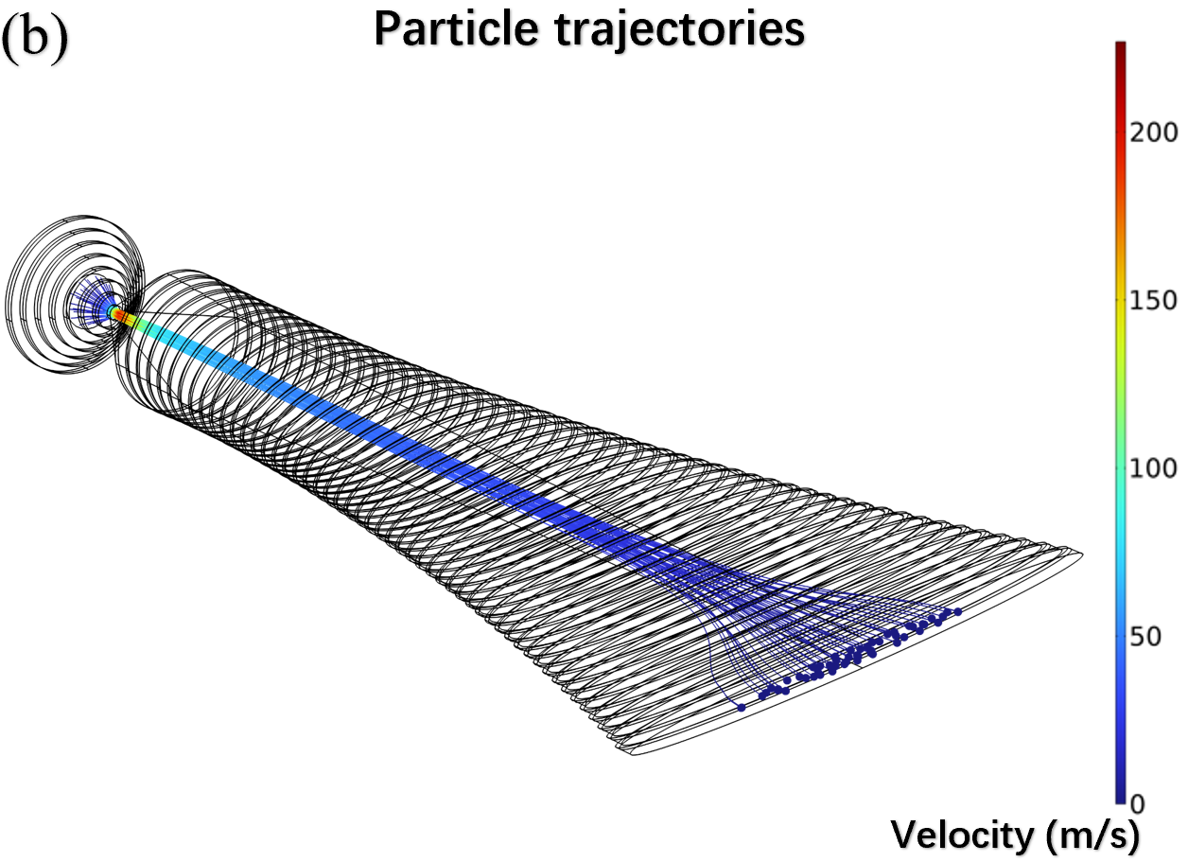
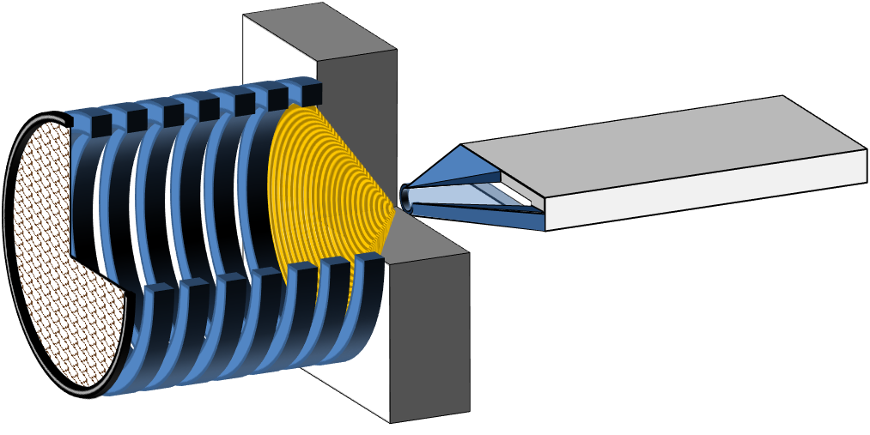


Connecting UniCell to detector: ITGF
  Simulation results:
  Ion Transfer by Gas Flow device
  Interface between UniCell and COMPACT detector
  Quantitative transport above
  ~ 20 mbar L / s without electrical fields
  Addition of sheath gas and electrical fields also allows operation at lower flow rates
  UniCell
  COMPACT
m/s
  Lv, Ts
  ITGF
  ITGF
  10 cm
  UniCell
  Nozzle
  Gas-flow needs to be taken into account
  COMSOL-simulation of gas-flow (CFD) and ion transport (particle tracing)
  2 cm
$$F=F_{el}+F_{drag}+F_{Brown}$$
Yeqiang Wei
NST (2025) 36:187
electric
viscous dampening
molecular diffusion

Slide 13
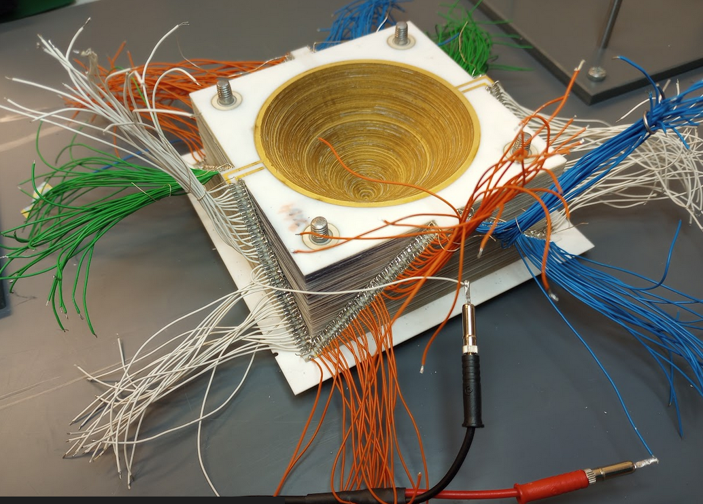
The fabricated ion funnel
Impedance Analysis
Self-resonance at 2.7 MHz
Typically, operation below self-resonant frequency
Difficult to drive above 2.7 MHz
capacitive
inductive
Manufactured by ITE Cracow
Funnel made of ca. 350 ZrO₂ sheets
thickness of each 0.1 mm
recessed insulators
Ions don‘t collide with insulators
Au plating
ZrO₂ sheets
0.1 mm
0.1 mm

Slide 14
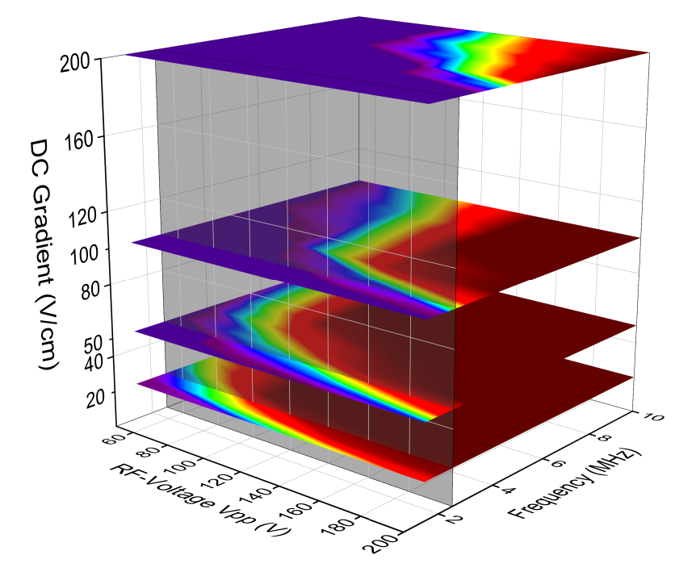
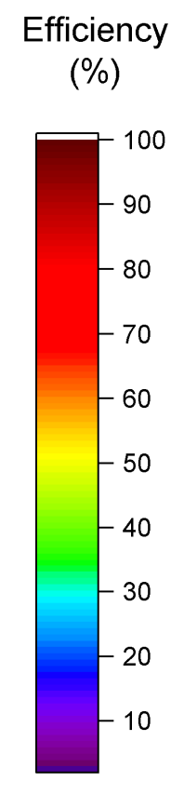
Funnel Transmission ²⁹⁸Lv in extended parameter space
SIMION simulation of transmission efficiency in wider parameter range
1 ms
Extraction at lower frequency is feasible
Quantitative extraction at 2.5 MHz in 10 ms for ²⁹⁸Lv²⁺ expected
3 ms
4 ms
10 ms
F_{RF}
F_{DC}
F_{RF}
²⁹⁸Lv²⁺
2.5 MHz
F. Zielke, M. Dudeja (2025)
128 simulations, data interpolated
Notes:
ToDo: Replace the plot!

Slide 15
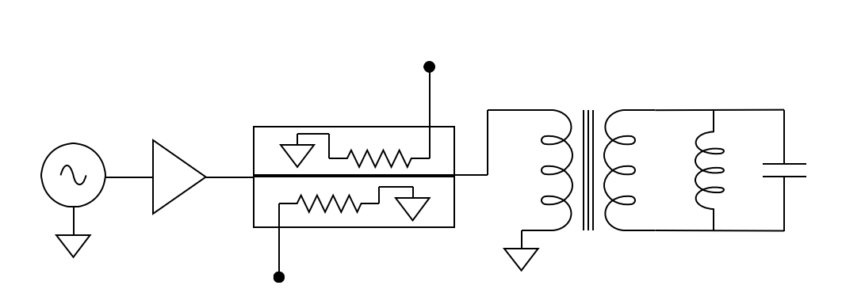
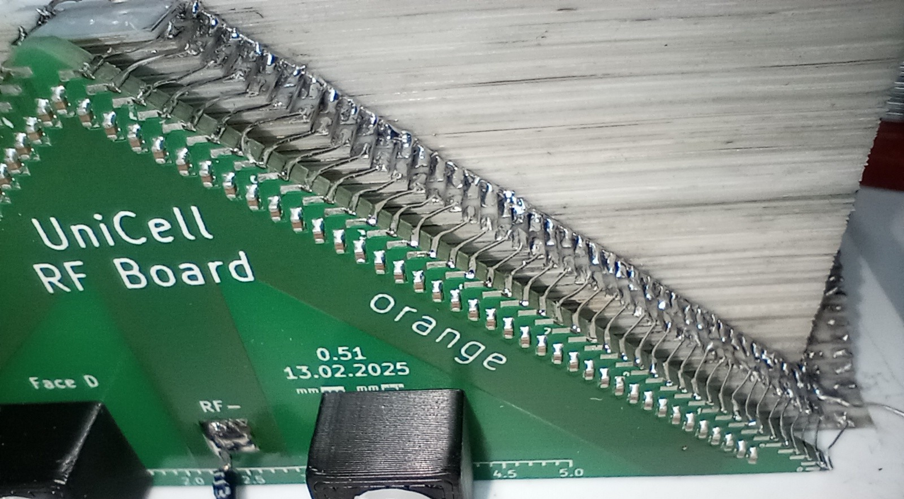
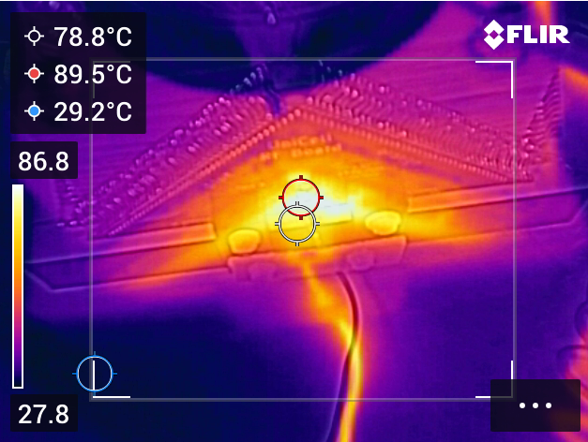
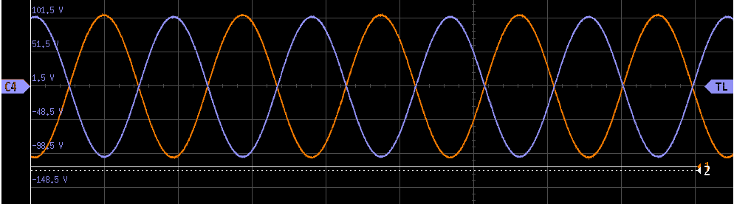
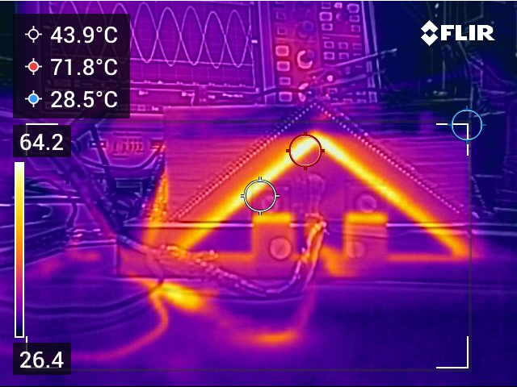

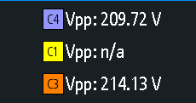

UniCell – RF Interface PCB
coupled
reverse
Resonantly coupled at 2.8 MHz
Reaching required
Required RF power ~ 60 W
Limited by PCB-temperature: ~ 90 °C
amplifier
$$V_{rf−pp}=200 V$$
60 W
coupled
forward
balun
funnel
New version of RF-PCB with „ultra-low ESR“ capacitors (C0G) built – awaits testing
0402
X7R capacitors

Slide 16
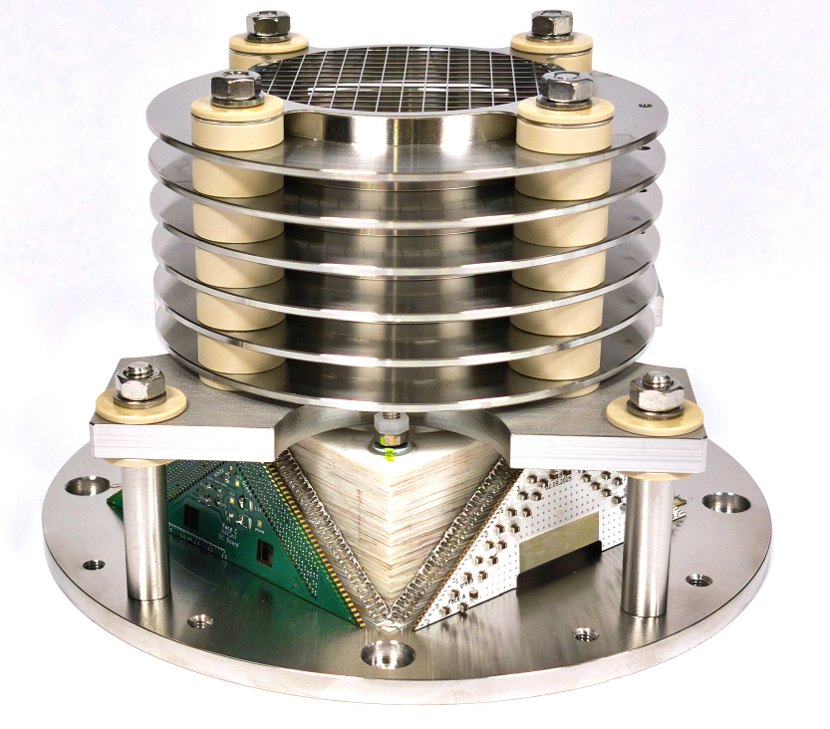
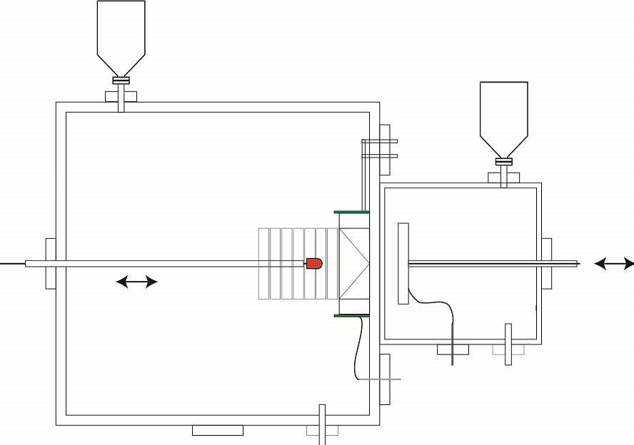
Summary
Stopping cell required for chemistry studies of elements₁₁₆Lv and heavier.
DC-cage and funnel fabricated
Electronics developed - awaiting final test
DC cage
First offline test with source scheduled December 2025
²²⁵Ac
DSSD detector
RF coupling
PCB (V2)
^{~1 bar}
DC bias
PCB
Ion Funnel
^{~1 bar}
^{He}
^{He}

Slide 17
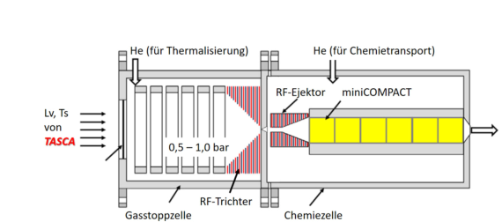
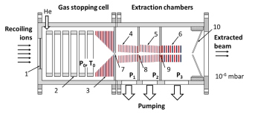
Outlook
Phase 2
ITFG – Chemistry interface
Chemistry-experiments at ~ 0.3 – 1 bar
In-design / under construction now
UniCell
Universal gas stopping cell
QMF
Phase 4
Mass filter
Phase 1
Pumping
Fast stopping and extraction
Phase 3
Vacuum interface
Experiments in vacuum
Mass-resolved (m/q) SHE beams

Slide 18

Thank you!
Special thanks to…
Electronics
Sven Löchner
Marco Biljan
Target Lab
Bettina Lommel
Anette Hübner
Funnel production
Jan Kulawik
Funding
Machine Shops at
GSI and JGU Mainz
RF
Gordon Anderson
Piotr Kowina
Dimitar Simonovski
Dennis Renisch
Meyhar Dudeja
GSI: SHC und SHP
05P21UMFN2
05P24UM3

