Slide 1



Online commissioning and
current status of CLaSsy at RAON
Oct. 21, 2025
Jaehyun Song
IBS-IRIS (Korea)
Notes:
Good morning. I am Jaehyun Song from IRIS, and I will be presenting on the 'Online commissioning and current status of CLaSsy at RAON'.

Slide 2
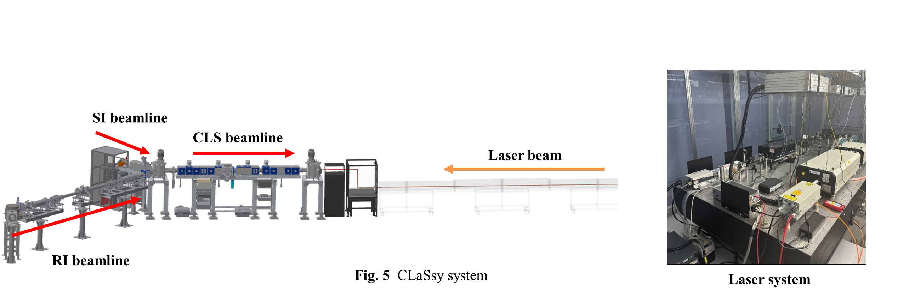
CLaSsy (Collinear Laser Spectroscopy) @ RAON
Contents
Introduction to CLaSsy
Online commissioning experiment (2024)
Preliminary results and discussions
Summary and outlook
Off-line Ion Source
Notes:
CLaSsy is an experimental apparatus designed for collinear laser spectroscopy of radioactive isotopes at RAON. This presentation will provide an overview, beginning with an introduction to CLaSsy, followed by details of the 2024 commissioning experiment, preliminary results and discussions, and will conclude with future prospects.

Slide 3
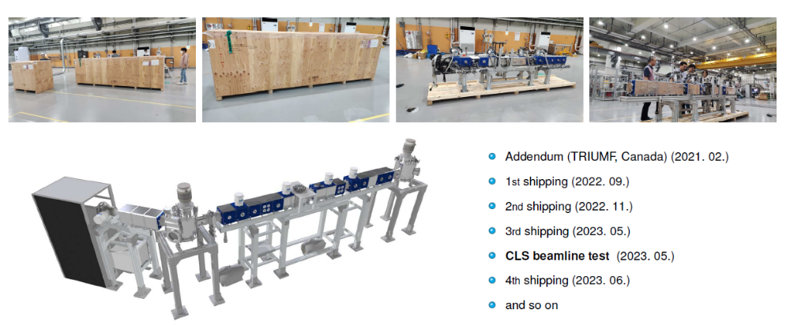
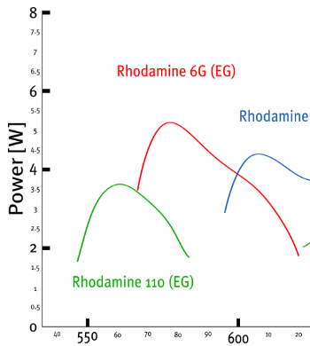
CLS beamline (from TRIUMF) & Laser system
Dye Laser
Ti:Sa Laser
(565-610 nm)
Notes:
The CLS beamline was sourced from TRIUMF in 2023. This includes all the major hardware components necessary for the CLS, except for the laser system and the RI Beamline. For the laser system we have a Ti:Sa laser and two dye lasers. For the commissioning experiment we used a dye laser that covers the wavelength around 600 nm

Slide 4
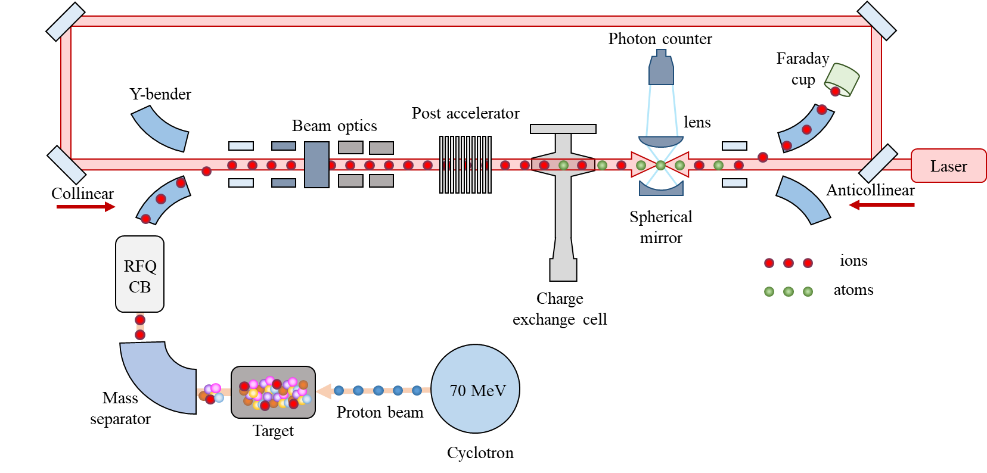
CLaSsy Layout
Max. V: ±10 kV
(min. step: 0.3 V)
Rb
Notes:
Here is the schematic for our CLS system. Ions generated from the target, after undergoing mass-selection and passing through the RFQ-CB, proceed to the CLS beam line. At the post accelerator, we scan the beam's energy for doppler tuning. Then the ions are partially neutralized after passing through the charge exchange cell and interact with the laser beam. If the doppler frequency matches the resonance frequency, the laser excites the atoms and we detect the fluorescence photons emitted by the excited atoms.

Slide 5
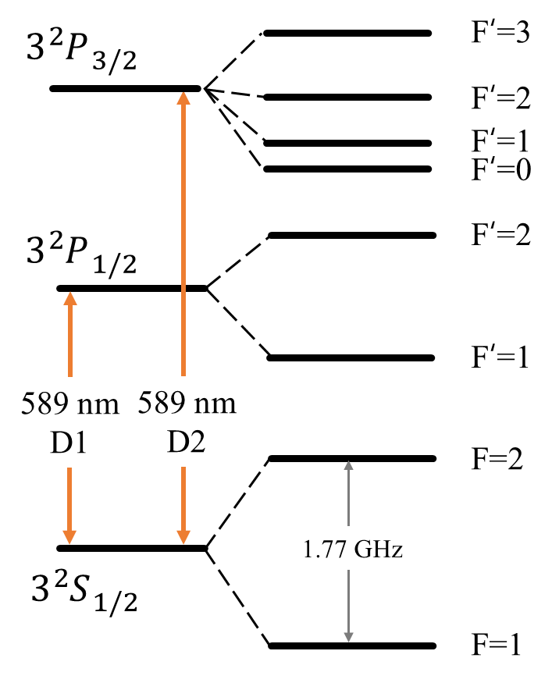
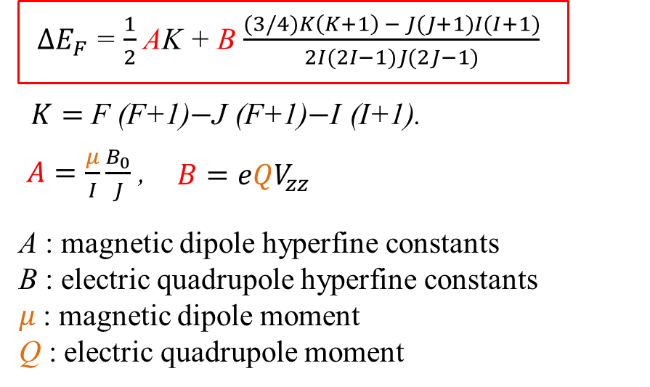
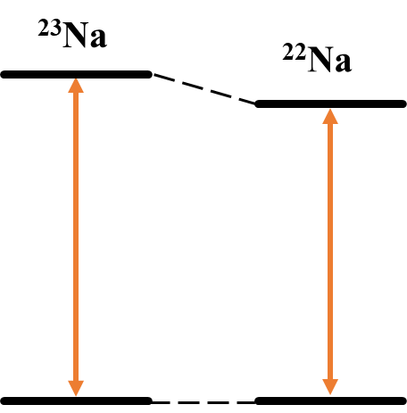
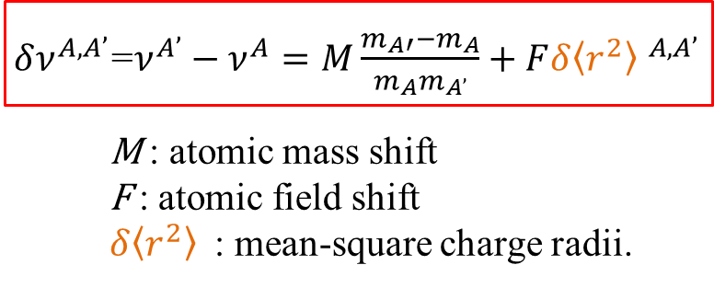
Goals of Collinear Laser Spectroscopy
Hyperfine structure of ²³ Na
Electric quadrupole moments
Hyperfine
Structure
Magnetic dipole moments
CLS
Nuclear spins
Isotope shift
Mean-square charge radii
Isotope shift ( ²³Na, ²²Na )
Notes:
The fundamental goal of cls is to extract nuclear properties in a model-independent manner. Specifically, the Isotope shift is measured to determine the mean-square charge radii of isotopes. By analyzing the Hyperfine structure, we can extract crucial information such as nuclear spins, electric quadrupole moments, and magnetic dipole moments.

Slide 6



Online commissioning experiments of CLaSsy (Oct.-Nov. 2024)
Collaborators
Ion beams species: ²³Na, ²²Na, ²¹Na
Energy: ~ 20 keV
Experimental goals:
- D1 (3²S_{1/2}→3²P_{1/2}) transition
- D2 (3²S_{1/2}→3²P_{3/2}) transition
Physics goals:
- Resolving hyperfine structures
- Determining isotope shifts
KAFA
Notes:
The online commissioning experiments for CLaSsy took place from October to November 2024 in collaboration with domestic users. The ion beam species used were sodium 23, 22, and 21. The beams were accelerated to an energy of approximately 20 keV. The primary experimental objectives were to observe the optical D1 and D2 transition, aiming to resolve the hyperfine structures and determine the isotope shifts

Slide 7
Initial challenges we faced during the campaign
Frequency drift (~ 8 MHz/min)
Background noise (Laser scattering)
Weak signal
Beam energy uncertainty
Notes:
However, we encountered several initial challenges that limited our CLS measurements. These challenges included frequency drift of the dye laser, considerable background noise caused by laser scattering, and a weak fluorescence signal due to significant limitation in beam transmission rate. And there was also an issue regarding the precision of the beam energy.

Slide 8
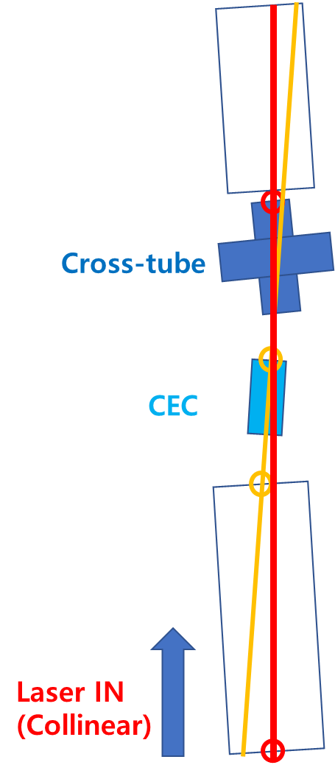
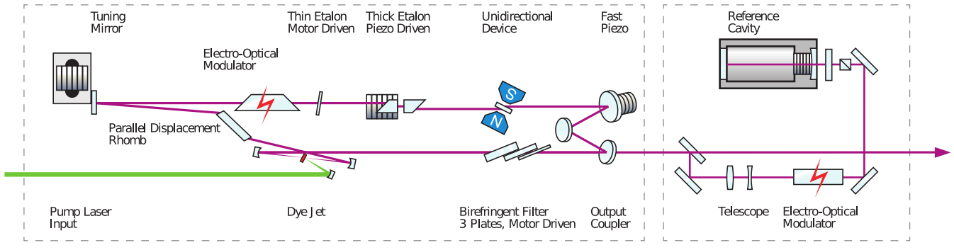
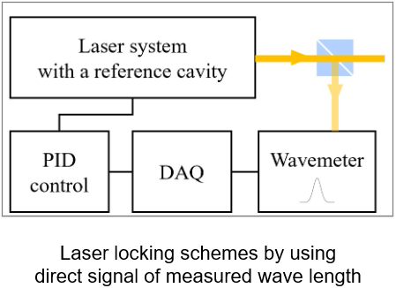
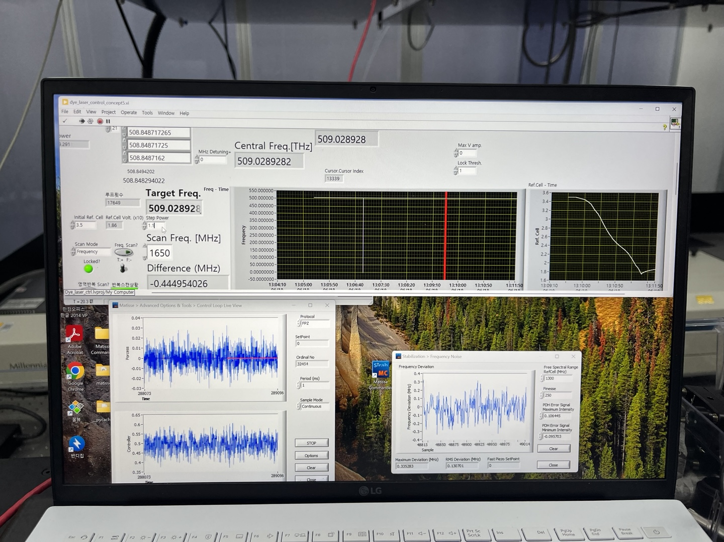
(1) We added a feedback loop to the locking system using the wavemeter.
(2) We focused the laser beam and optimized the alignment.
Dye Laser
Short term stability: ~ 300 kHz
Long term stability: < 1 MHz
<DAQ&Controller>
<Misaligned apertures>
Notes:
To solve the frequency drift problem of the dye laser, we fed back the wavemeter values to the reference cavity of the dye laser. And we could control the frequency to remain within 1 MHz of the target value.
Regarding the high background noise at the fluorescence detection, we found that the apertures inside the beamline were not in a straight line and were clipping the laser beam. Rearranging these apertures was problematic, as it would require to fully open the beamline chamber, leading to the oxidation of Rb in the CEC. Therefore, as a temporary measure, we focused the laser beam to minimize the scattered light near the detection area.

Slide 9
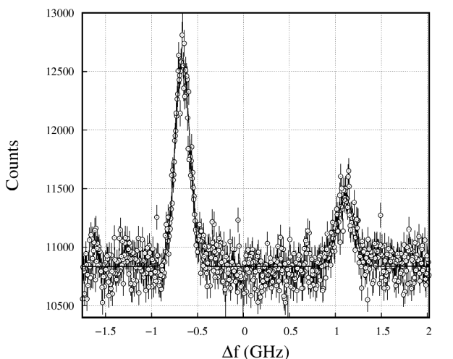
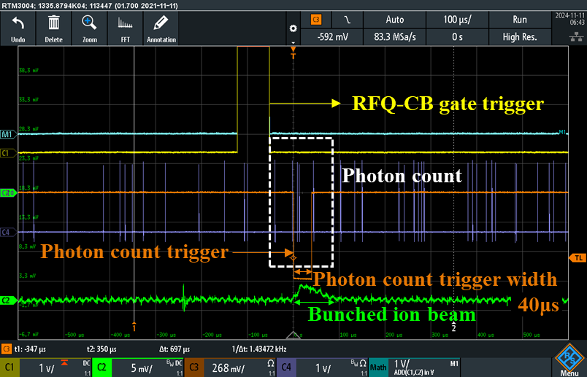
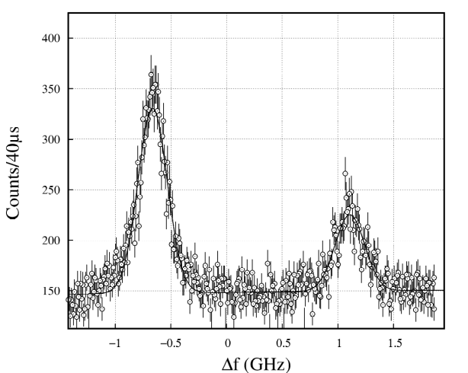
(3)We doubled SNR by using bunched beams and gated DAQ
²³Na, D2 line
Beam flux:
~2.8 x 10¹⁰ pps (at RFQ-CB)
S/N: ~1.2
CW
Bunched
beam (50 Hz)
S/N: ~2.4
Beam flux:
~2.8 x 10⁸ ppb (at RFQ-CB)
Notes:
Since the considerable amount of noise in the photon count was inevitable, we used bunched beam and coincidence gate to distinguish the signal in time domain. By doing so, we were able to suppress the noise level significantly and double the signal-to-noise ratio.

Slide 10
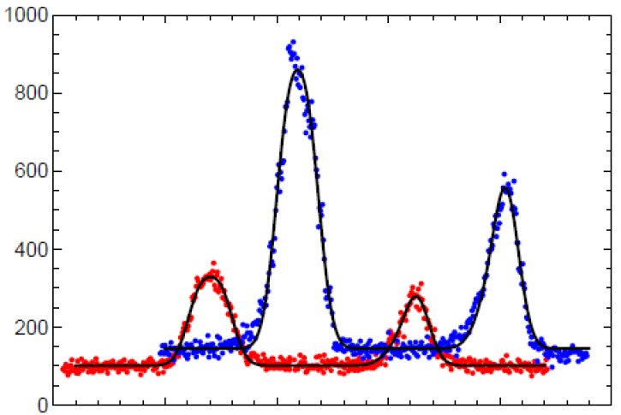
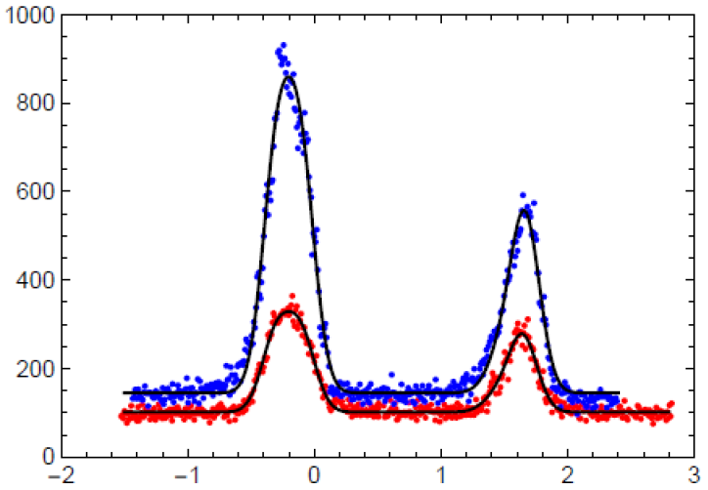
(4)We calibrated the ion beam energy using
collinear & anti-collinear geometries
Anti-collinear
CEC
Collinear
E = ~19.93 keV
E = ~19.92 keV
Photon counts (a.u.)
Photon counts (a.u.)
- 7 eV
Frequency detuning (GHz)
Frequency detuning (GHz)
Notes:
The collinear and anti-collinear geometries were alternately employed to measure the fluorescence spectra as a function of Doppler frequency. The overlap of these spectra, achieved by adjusting the energy value by 7 eV, enabled us to precisely determine the beam energy to be 19.92 keV.

Slide 11
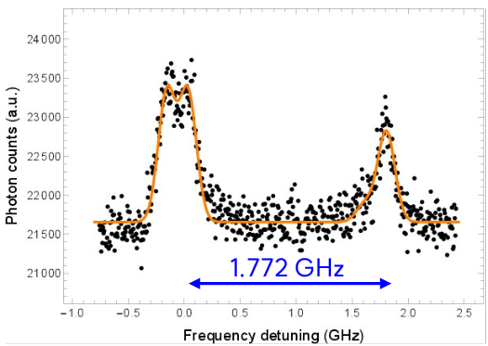
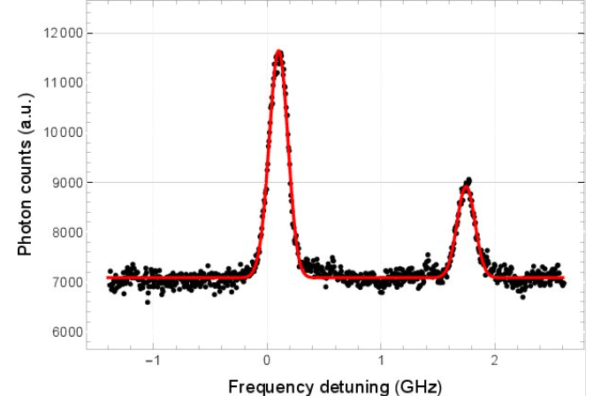
Preliminary results 1
D1
Optical spectra of ²³Na D1 and D2 transitions
(CW beams)
D2
Notes:
Moving on to our preliminary results, These are the optical spectra of sodium 23 D1 and D2 lines using CW ion beams.
As you can see, the hyperfine splitting of the S1/2 ground state for both transitions were clearly observed which is about 1.8 GHz.
However for the HFS of the excited states, we were able to partially resolve D1 but not D2.
This means that our spectral resolution is about 150 MHz in this case

Slide 12
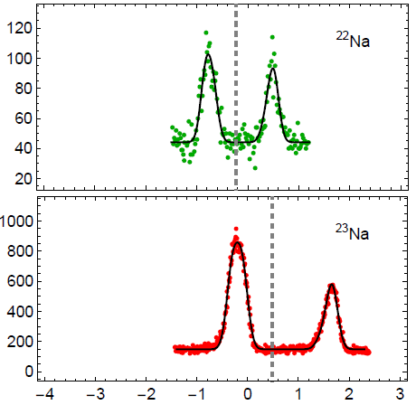
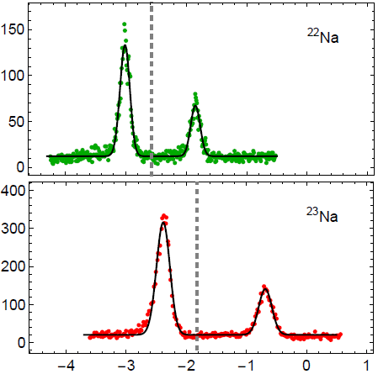
Preliminary results 2
Optical spectra of ^{22,23}Na D1 and D2 transitions (bunched beam )
Hyperfine constants A
Mass | A(3²S_{1/2}) | A(3²P_{1/2}) | Ref.
22 | 344(4) 349.3(8) 348.7(2) | 41(1) 37.2(8) 37.0(1) | This work [1] [2]
23 | 885(2) 885.70(25) | 95(2) 94.25(15) | This work [2]
²²Na D1
²²Na D2
Photon counts (a.u.)
Photon counts (a.u.)
Isotope shifts of ^{22, 23}Na from D1
²³Na D1
²³Na D2
Isotopes | Isotope shift (MHz) | Ref.
²²Na - ²³Na | -730 -754.0(23) -758.5(7) | This work [1] [2]
Isotope shifts of ^{22, 23}Na from D2
Frequency detuning (GHz)
Frequency detuning (GHz)
Isotopes | Isotope shift (MHz) | Ref.
²²Na - ²³Na | -754 -757.72(24) | This work [3]
[1] F. Touchard, J.M. Serre, S. B¨uttgenbach, P. Guimbal, R. Klapisch, M. de Saint Mimon, C. Thibault, H.T. Duong, P. Juncar, S. Liberman, J. Pinard, and J.L. Vialle, Phys. Rev. C 25 (1982) 2756.
[2] K. Pescht, H. Gerhardt, and E. Matthias, Z. Physik A 281 (1977) 199.
[3] Yu.P. Gangrsky, D.V. Karaivanov, K.P. Marinova, B.N. Markov, L.M.
Melnikova, G.V. Mishinsky, S.G. Zemlyanoi, and V.I. Zhemenik, Eur. Phys. J. A 3 (1998) 313.
Notes:
The graphs shows the optical spectra of D1 and D2 transitions, using sodium 22 and 23 bunched beams
From the acquired spectra, we extracted the hyperfine constants, A. The data showed consistency with the published reference values but with rather big uncertainties.
Also, the obtained Isotope shift of sodium 22 and 23 showed significant difference compared to the reference values with large uncertainties.
These initial results imply that our measurements require much narrower linewidth, well below 50 MHz

Slide 13
Points for improvement (Long term plans)
Kinematic compression (E > 60 keV)
Ion beam cooling (ΔE< 3 eV)
Detection sensitivity (Fluorescence collection)
+ Further approaches
Notes:
To achieve this, improved beam preparation and enhanced detection sensitivity will be necessary. Although this endeavor will be time-consuming, it is essential for the precision measurement with our system.

Slide 14
Points for improvement (Short term tasks)
Beam transmission rate (Beam alignment + tuning)
Noise suppression (Laser alignment )
Spectral resolution (Absorption spectroscopy)
7
Notes:
As beam time is scheduled for December this year, several short-term tasks have been prioritized.

Slide 15
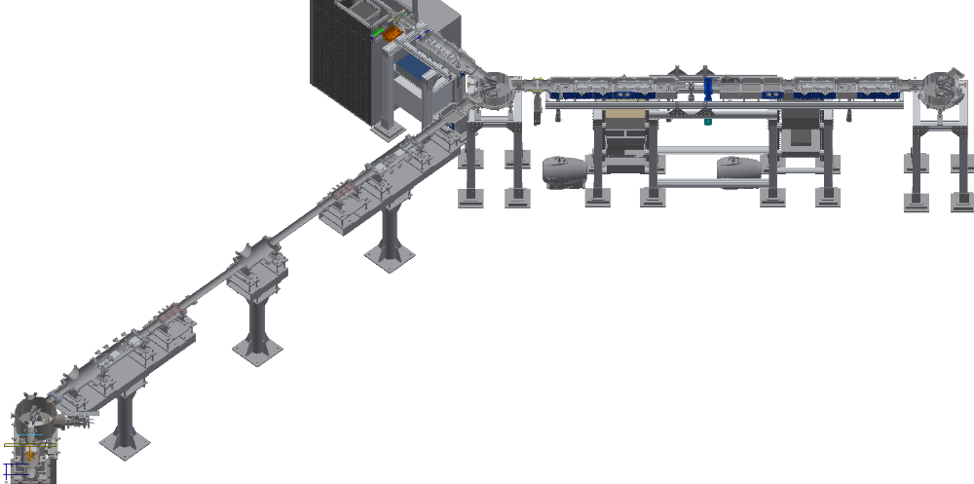
(1)We checked the beamline alignment and the transmission rate.
CLS Beamline
2
3
4
5
6
7
y
C
z
x
1
B
ISOL-CLS Beamline
RI beam
1
2
3
4
5
6
7
A
 | FC-RFQCB | FC-A | FC-B | FC-C
I | 4.5 nA | 3.83 nA | 0.76 nA | 0.61 nA
Rate | 100% | 85.1% | 16% | 12.8%
Enhancing Beam transmission rate (ongoing)
Notes:
First, we checked the alignment of our beamline and we are now in progress improving the Beam transmission rate accordingly.

Slide 16
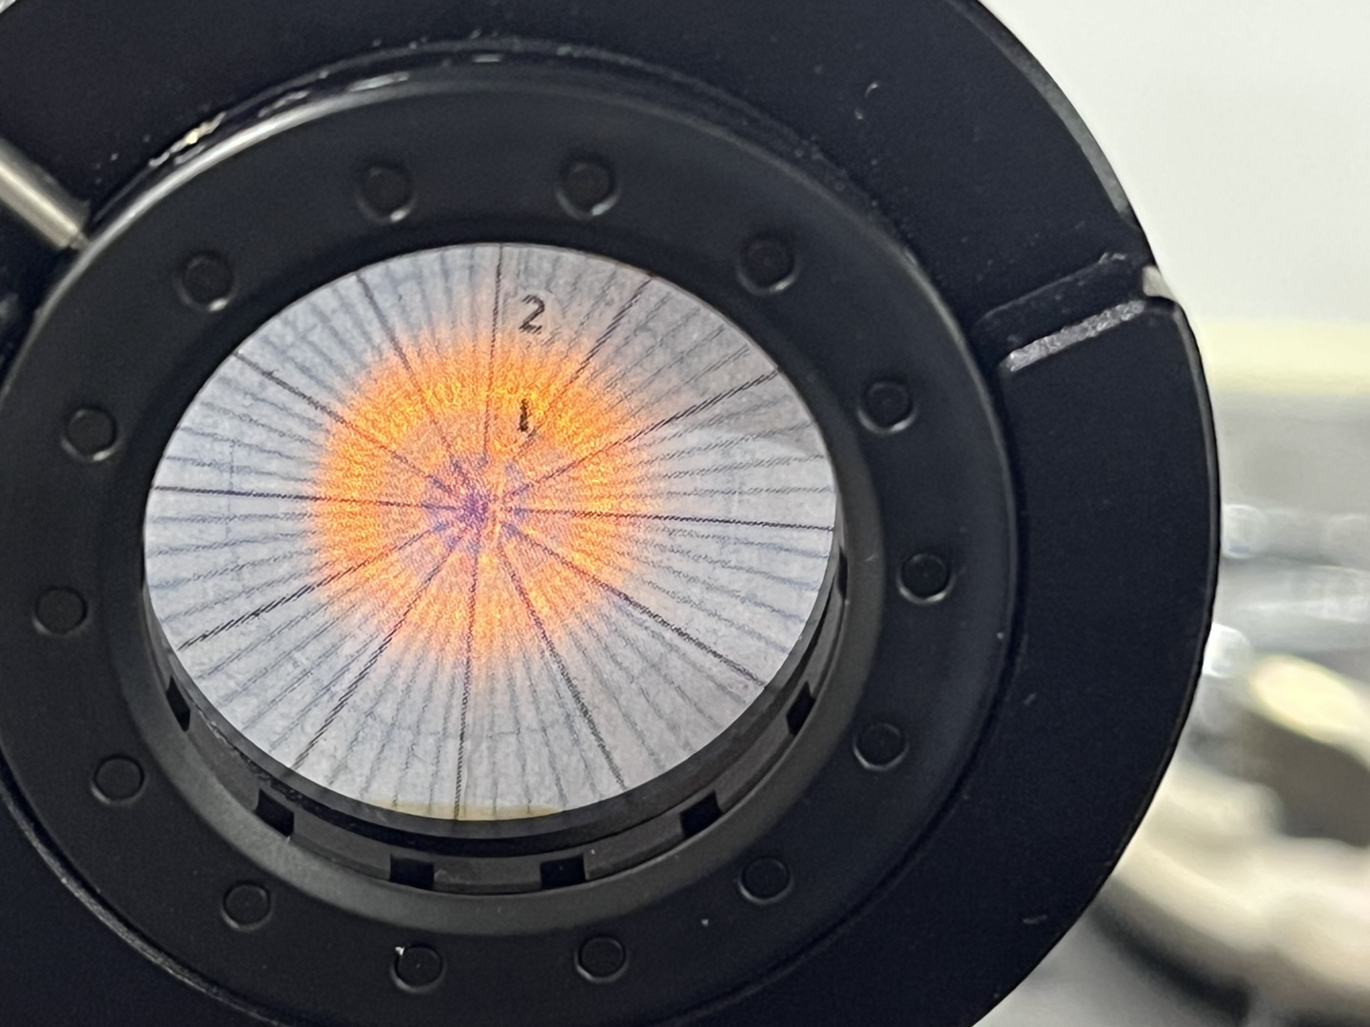
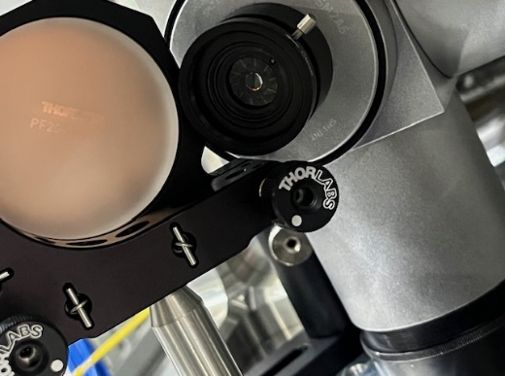
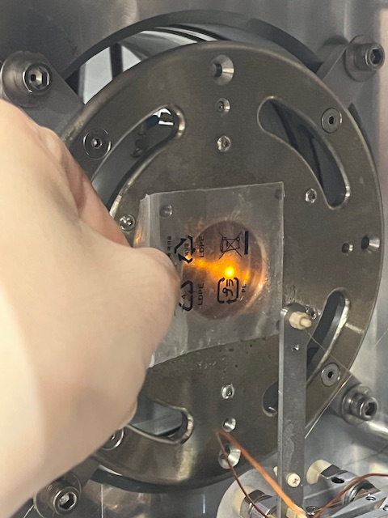

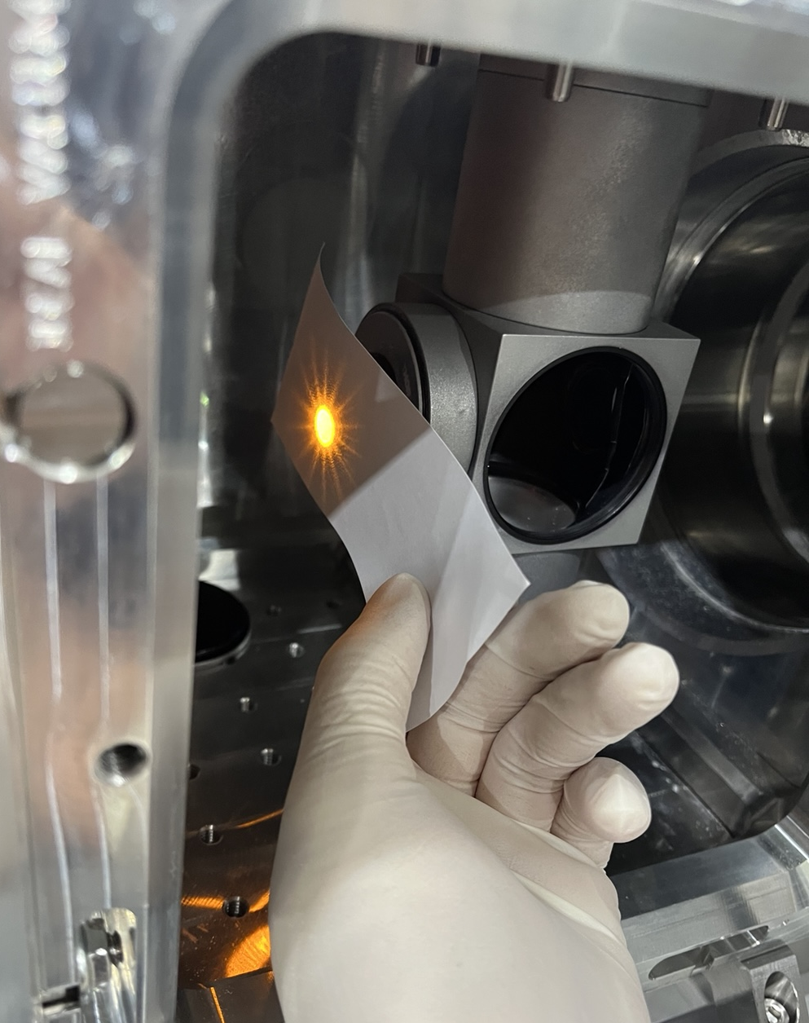

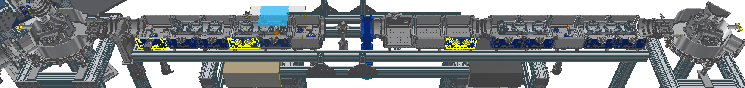
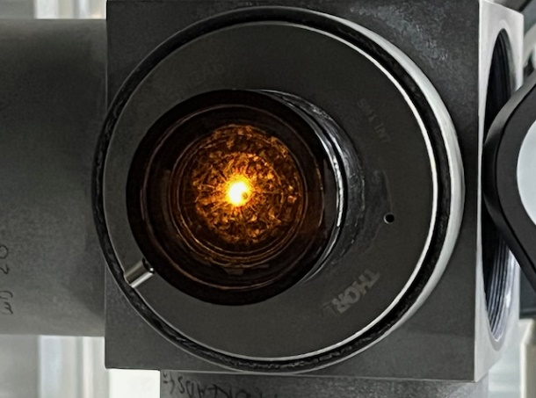
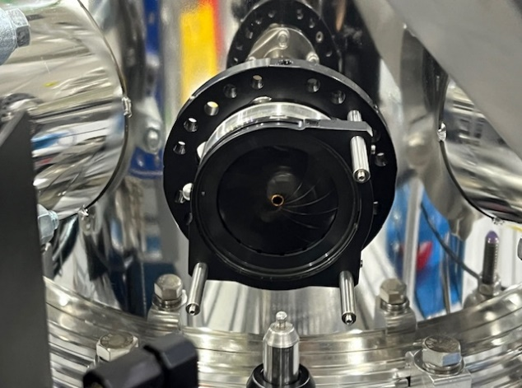
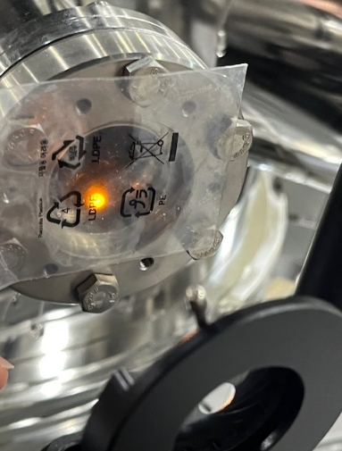
(2)We rearranged the misaligned apertures and
optimized the laser beam alignment (collimated, r = ~5 mm).
Laser IN
(Collinear)
Cross-tube OUT
(2nd Ref. point)
Post Acc. IN
Cross-tube IN
Collinear IN
(1st Ref. point)
Collinear OUT
Notes:
Second, in order to suppress the background noise coming from the laser, we rearranged the misaligned apertures inside the beamline and
optimized the laser alignment to a 5-mm-radius collimated beam.

Slide 17
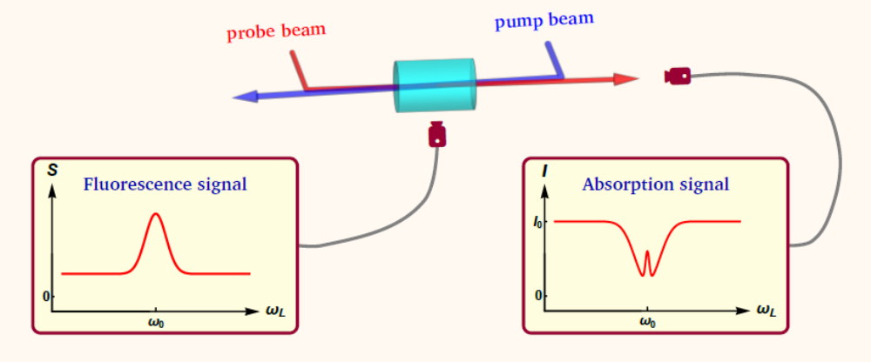
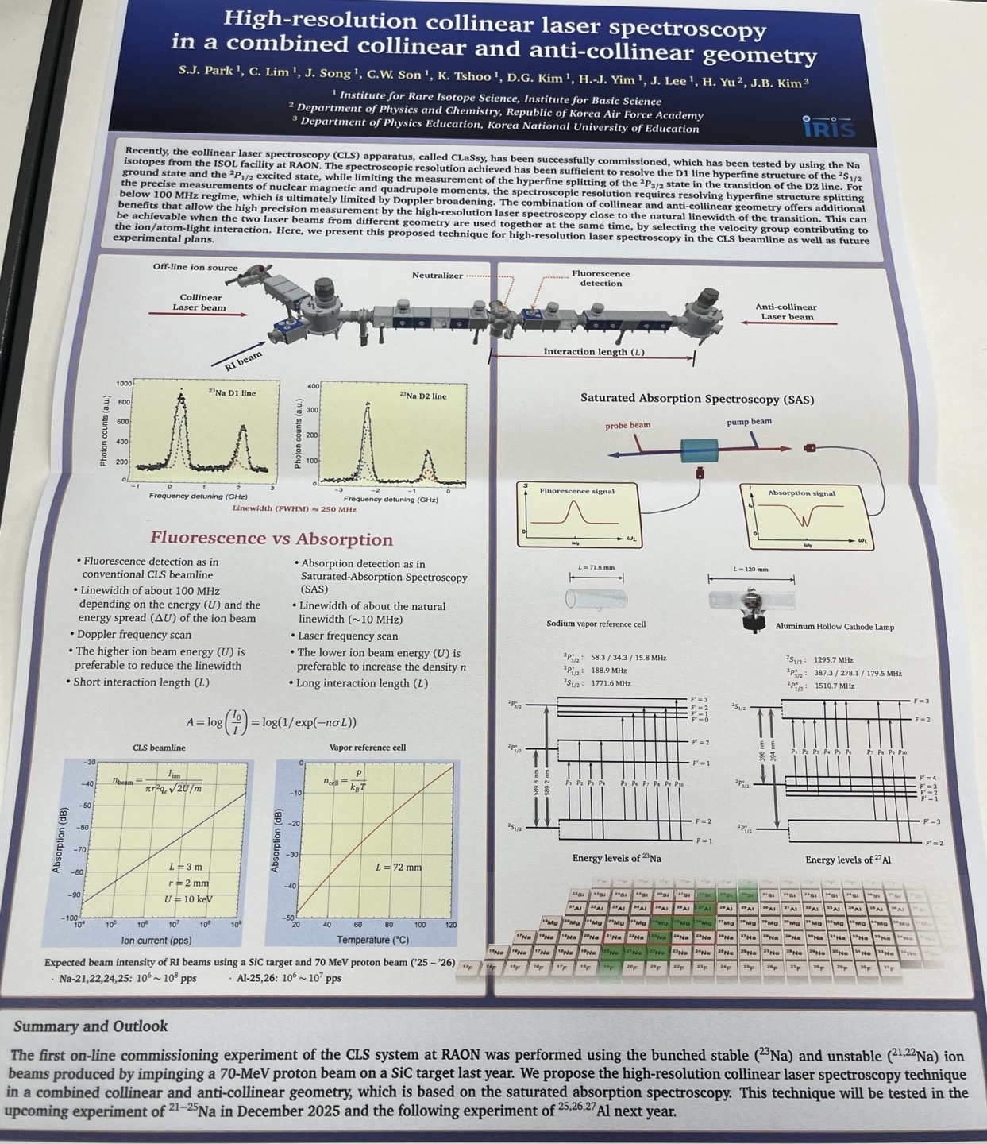
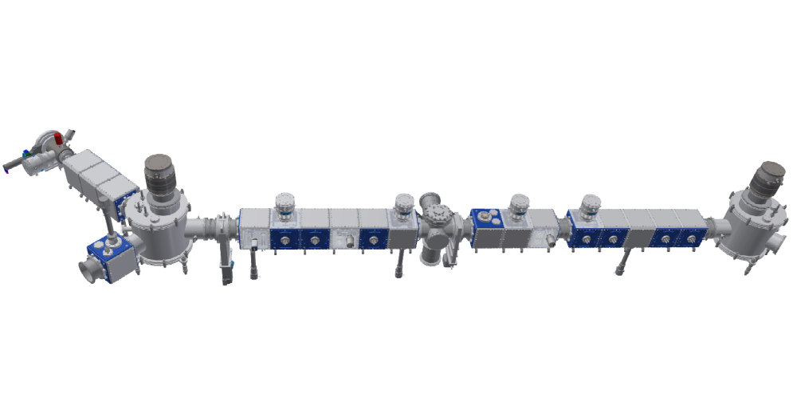
(3)Absorption measurements for CLaSsy beamline
Sung Jong Park et al.
Neutralizer
Collinear
Laser beam
Anti-collinear
Laser beam
RI beam
Interaction length
Notes:
Finally, we plan to implement absorption spectroscopy using a refined setup incorporating both collinear and anti-collinear laser beams. Detailed information about this scheme can be found in the poster session of Dr.Sung Jong Park,

Slide 18

Summary & Outlook
Summary
First CLS signals observed using CLaSsy beamline with ISOL RI beams (^{21,22,23}Na)
CLaSsy has been successfully commissioned; the basic setups were all functional.
Continued efforts are needed to achieve high-precision measurements.
Future experiments
Stable, RI beams:
- ²¹⁻²⁵Na (Dec. 2025)
- ^{25,26,27}Al (2026)
CLaSsy
Notes:
In summary, we have successfully commissioned CLaSsy , obtaining the first CLS signals using ISOL radioactive ion beams (21Na,22Na,23Na). The commissioning confirmed that the basic setups of CLaSsy are fully functional. However, continuous efforts remain essential to achieve the required precision for high-resolution measurements. Looking ahead, our outlook includes experiments with stable and RI beams for sodium this year, and measurements on aluminum isotopes (25,26,27Al) is planned for next year.

Slide 19
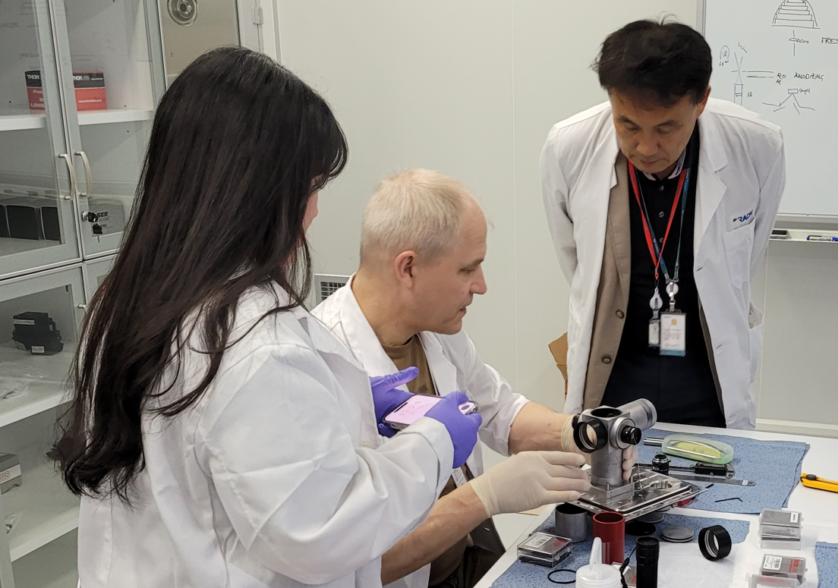
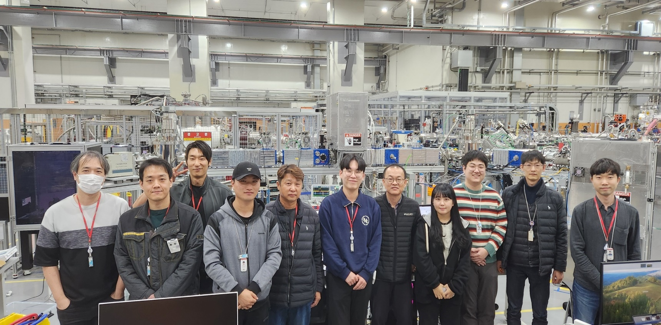
Thank you for your attention.
TRIUMF
– Jens Lassen
KNUE​
– J. B. KIM​
KAFA​
– H. YU
CENS
– J. WON, J. HA, Y.H. KIM
IRIS
ISOL team
– J.H LEE, H.J. YIM, S.J. Heo, Y.S. KIM
Experimental system team
–S.J. PARK, C. LIM, J. SONG, C. SON,
K. TSHOO, D.G. KIM, S.J. PYEON,
D. KWAK, C. HAM, M.S. KWAG

