Slide 1
Development of the Fast Plastic Scintillation Detector for High-Resolution Velocity β Measurements in a Short Flight Path
Dept. of Physics, The University of Osaka, Japan
Soshi Ishitani
Collaborators
Niigata University
M. Fukutome, T. Ohtsubo, T. Izumikawa
Osaka University
M. Fukuda, G. Takayama, R. Taguchi,
M. Mihara
Kyusyu University
M. Tanaka
Tokyo City University
D. Nishimura
Saitama University
T. Suzuki, T. Yamaguchi
University of Tsukuba
T. Moriguchi, A. Ozawa, A. Yano
Kochi University of Technology
S. Momota
QST
A. Kitagawa, S. Fukuda, S. Sato
Notes:
Thank you for introduction.
I’m Soshi Ishitani from the University of Osaka, in Japan. I will give this presentation on behalf of Dr. Miki Fukutome from Niigata University.
Today, I’d like to talk about “Development of the Fast Plastic Scintillation Detector for High-Resolution Velocity Measurements in a Short Flight Path”.
These are collaborators of this study.

Slide 2
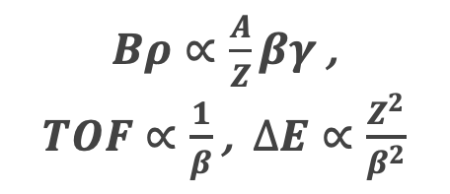
1. Introduction
Fig. 1. Schematic layout of the BigRIPS separator.
Research Background
Plastic scintillation detectors are widely used as time-of-flight (TOF) detectors in nuclear and particle physics experiments, being installed along accelerator beamlines to measure the flight time of particles between reference detectors.
Time-of-flight (TOF) measurements play a crucial role in particle identification (PID). Therefore, improving the TOF resolution, namely the time resolution of the detector, leads to enhanced PID performance.
Bρ—TOF—ΔE → A/Q vs Z
$Bρ∝\frac{A}{Z}βγ$ ,
$TOF∝\frac{1}{β}$ , $∆E∝\frac{Z^{2}}{β^{2}}$
In this work, we focus on developing and testing high-time-resolution plastic scintillation detectors for use at modern rare isotope beam facilities.
Fig. 2. Z versus A/Q particle identification plot for fission fragments produced in the 238U+Be reaction at 345 MeV/nucleon.
[N. Fukuda et al., NIM B 317 (2013) 323–332.]
Notes:
In this presentation, I will report on the development and performance evaluation of a fast plastic scintillation detector with excellent time resolution.
Plastic scintillation detectors are widely used for time-of-flight measurements in nuclear and particle physics experiments. They are sometimes installed along accelerator beamlines to measure the flight time of particles between reference detectors. (Fig.1.を指しながら)
TOF measurements provide important information for particle identification. Therefore, by improving the TOF resolution — for example, the time resolution of the detector — we can achieve better separation and improve the PID performance. In this work, we focus on developing and testing high-time-resolution plastic scintillation detectors for use at modern rare isotope beam facilities.

Slide 3
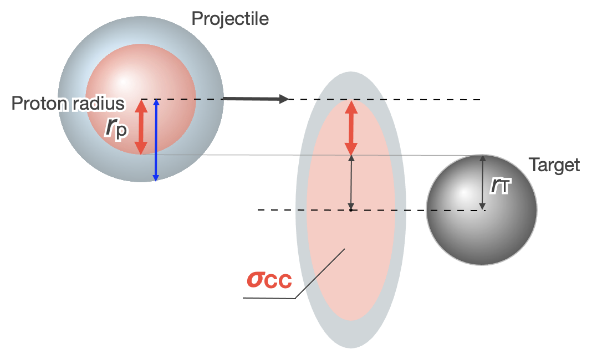
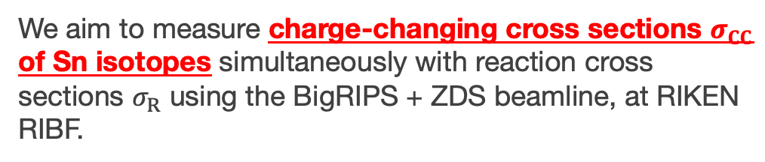



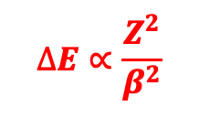


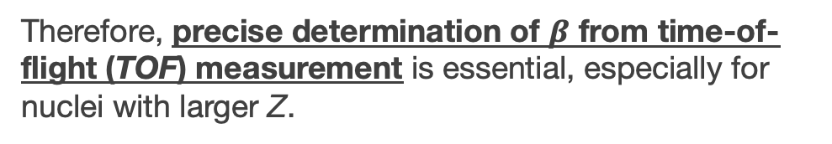
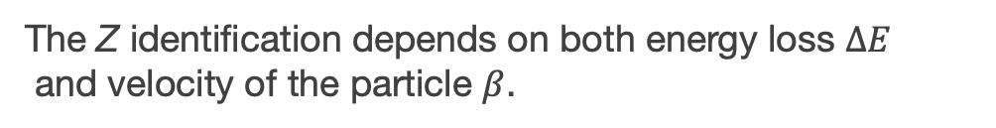

1. Introduction
We aim to measure charge-changing cross sections $σ_{CC}$ of Sn isotopes simultaneously with reaction cross sections $σ_{R}$ using the BigRIPS + ZDS beamline, at RIKEN RIBF.
Purpose : Atomic-Number Identification for $σ_{CC}$ of Sn isotopes
PL1
$$∆E∝\frac{Z^{2}}{β^{2}}$$
PL2
For $σ_{CC}$ measurement, identification of atomic number Z after the reaction target is required.
target
IC
$$∆E$$
The Z identification depends on both energy loss $∆E$
and velocity of the particle $β$.
Dipole Magnet
$TOF$, L ~2 m
Therefore, precise determination of $β$ from time-of-flight (TOF) measurement is essential, especially for nuclei with larger Z.
Charge-changing cross section σCC
Total charge (Z)-changing reaction
Since only selected non-reacted particles can be transported to downstream by dipole magnets, TOF must be measured within a short flight path (~2 m) between the reaction target and the next dipole magnet.
→ Development of a fast plastic scintillation detector with excellent time resolution is required.
The correlation between $∆E$ and $β$ around ¹²⁴Sn.
$$σ_{CC}∼π(r_{p}+r_{T})^{2}$$
Notes:
As a specific application, we are planning to apply such detectors to measure the charge-changing cross sections of tin isotopes, simultaneously with reaction cross sections, using the BigRIPS and Zero Degree Spectrometer beamlines, at RIKEN RIBF.
For 𝜎_𝐶𝐶 measurement, identification of atomic number Z after the reaction target is required.
The Z identification depends on both energy loss $∆E$ and velocity $β$ of the particle.
Therefore, precise determination of $β$ from TOF measurement is essential, especially for nuclei with larger Z.
However, in the reaction cross-section measurement, Since only selected non-reacted particles can be transported to downstream by dipole magnets, TOF must be measured within a short flight path about 2 meters between the reaction target and the next dipole magnet.
For this purpose, Development of a fast plastic scintillation detector with excellent time resolution is required.

Slide 4
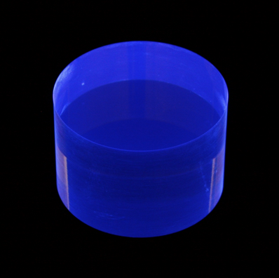
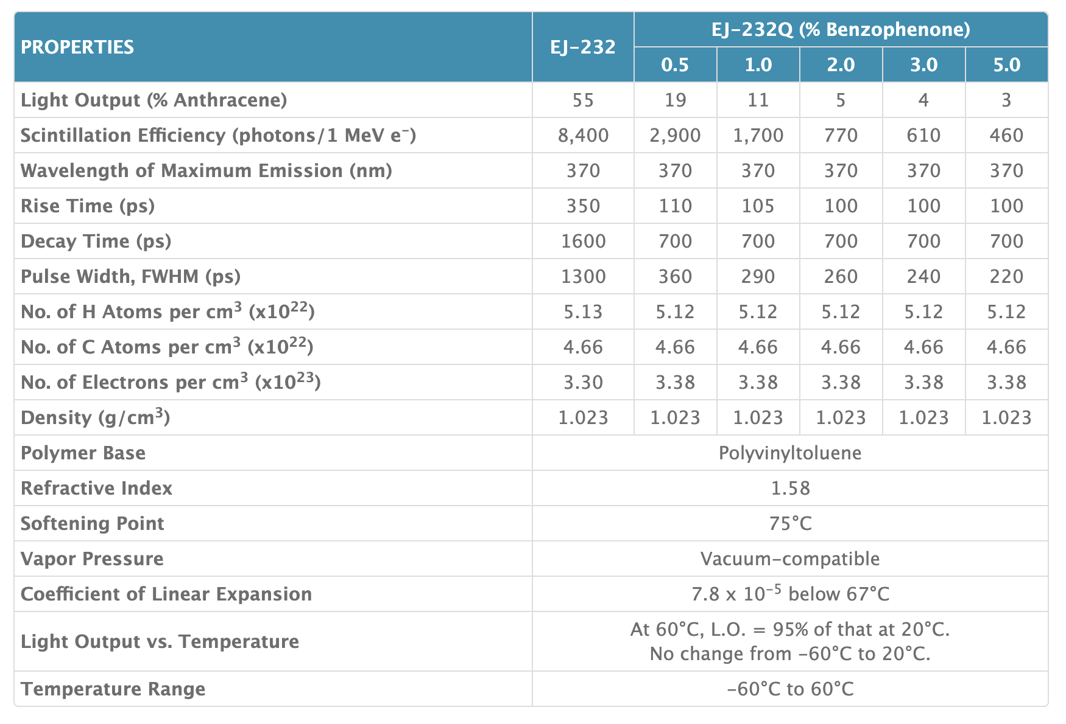
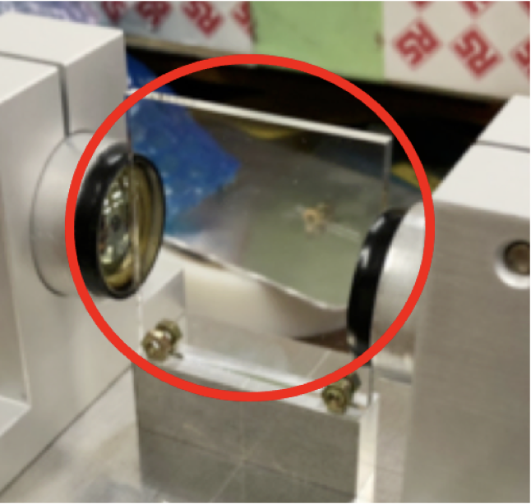
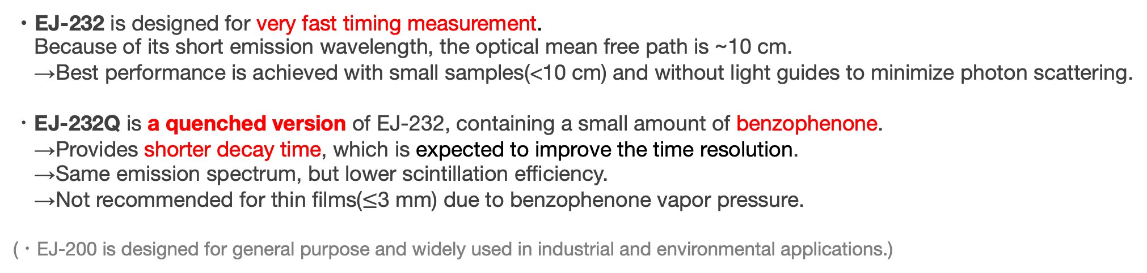
2. Experimental Equipment (Scintillator)
Fast Timing Plastic Scintillator, EJ-232, EJ-232Q(ELJEN TECHNOLOGY)
EJ-200
64
10,000
425
900
2100
Scintillator
2500
Source: https://eljentechnology.com/products/plastic-scintillators/ej-232-ej-232q
・EJ-232 is designed for very fast timing measurement.
Because of its short emission wavelength, the optical mean free path is ~10 cm.
→Best performance is achieved with small samples(<10 cm) and without light guides to minimize photon scattering.
・EJ-232Q is a quenched version of EJ-232, containing a small amount of benzophenone.
→Provides shorter decay time, which is expected to improve the time resolution.
→Same emission spectrum, but lower scintillation efficiency.
→Not recommended for thin films($≤$3 mm) due to benzophenone vapor pressure.
(・EJ-200 is designed for general purpose and widely used in industrial and environmental applications.)
Notes:
In this study, we constructed detectors by combining fast-response plastic scintillators with new-type fast photomultiplier tubes.
As the scintillators, we used EJ-232 and EJ-232Q, both manufactured by ELJEN Technology. These scintillators have much faster time responses — including rise time, decay time, and pulse width — compared to commonly used types such as EJ-200, which are designed for general-purpose applications.
EJ-232Q is a quenched version of EJ-232, containing a small amount of benzophenone to further improve the time response.
However, as a trade-off, the light output is significantly reduced.
Later, I will discuss how these differences in scintillator properties affect the time resolution of the detector.

Slide 5
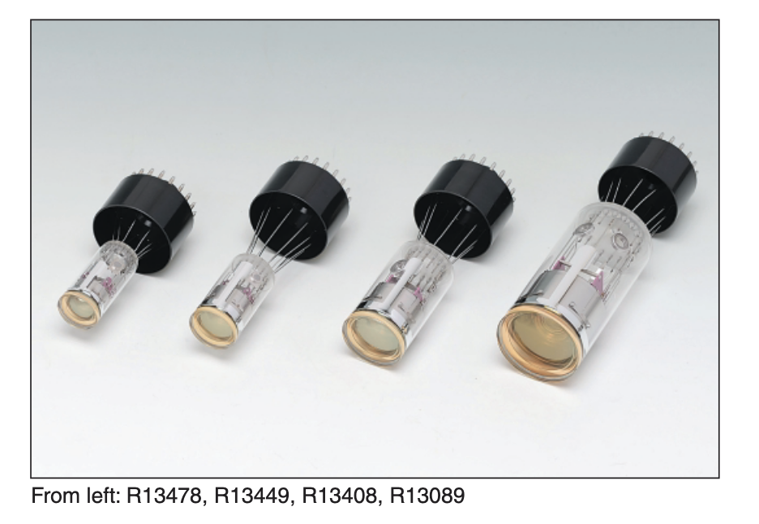
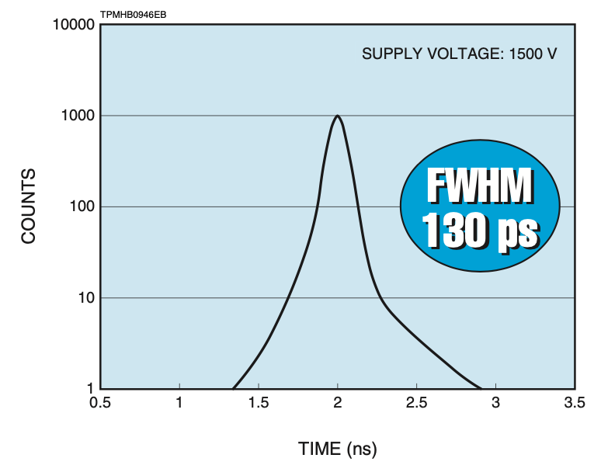
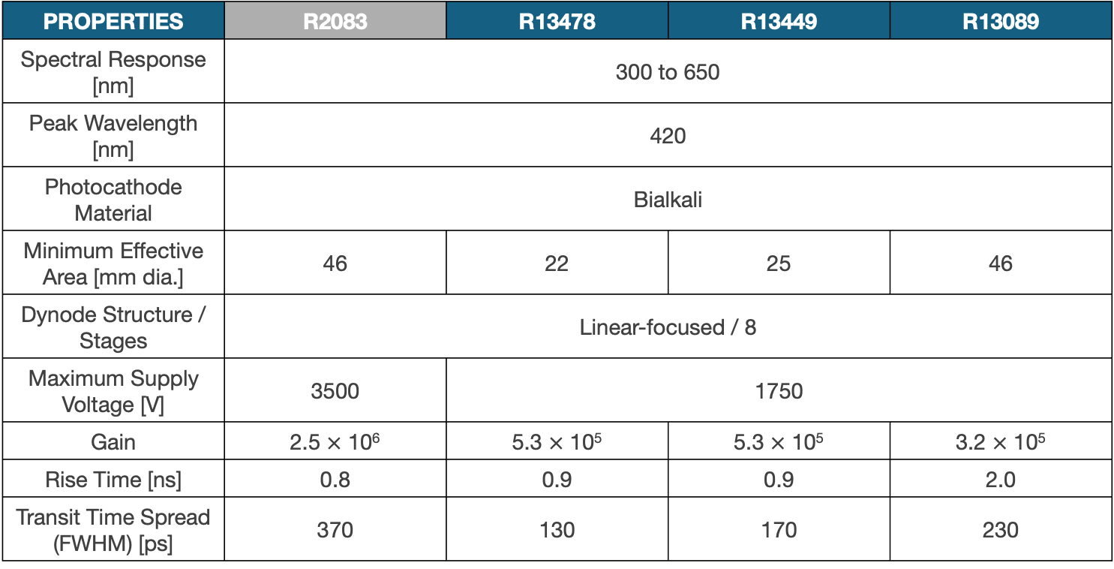
2. Experimental Equipment (Photomultiplier Tube)
Fast Time Response PMT, R13478, R13449, R13089 (HAMAMATSU)
PROPERTIES | R2083 | R13478 | R13449 | R13089
Spectral Response [nm] | 300 to 650
Peak Wavelength [nm] | 420
Photocathode Material | Bialkali
Minimum Effective Area [mm dia.] | 46 | 22 | 25 | 46
Dynode Structure / Stages | Linear-focused / 8
Maximum Supply Voltage [V] | 3500 | 1750
Gain | 2.5 $×$ 10⁶ | 5.3 $×$ 10⁵ | 5.3 $×$ 10⁵ | 3.2 $×$ 10⁵
Rise Time [ns] | 0.8 | 0.9 | 0.9 | 2.0
Transit Time Spread (FWHM) [ps] | 370 | 130 | 170 | 230
From left: R13478, R13449, R13408, R13089
Source:https://hamamatsu.su/files/uploads/pdf/.../r13478_r13449_r13408_r13089_tpmh1363e.pdf
T.T.S. (R13478)
・Transit time spread (T.T.S.) is smaller than that of the fastest conventional PMT (R2083).
・Investigate whether the time resolution depends on the photocathode size.
Notes:
Regarding the photomultiplier tubes, or PMTs. For this study, we used these Fast Time Response PMT developed by Hamamatsu Photonics. (point to the slide) These are shown in the pictures on this slide.
In the standard detector setup along the BigRIPS beamline at RIKEN, the fastest conventional PMT, R2083, is commonly used. However, the PMTs we tested have a much smaller transit time spread, or TTS, compared to the R2083, which means they are expected to provide better timing performance.

Slide 6
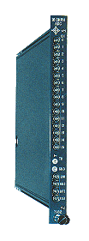
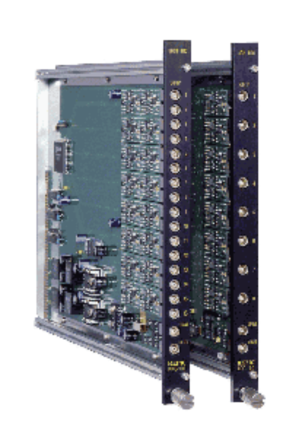
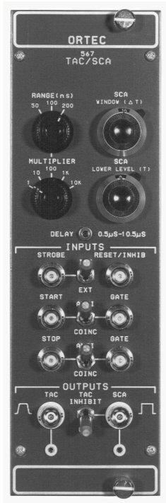
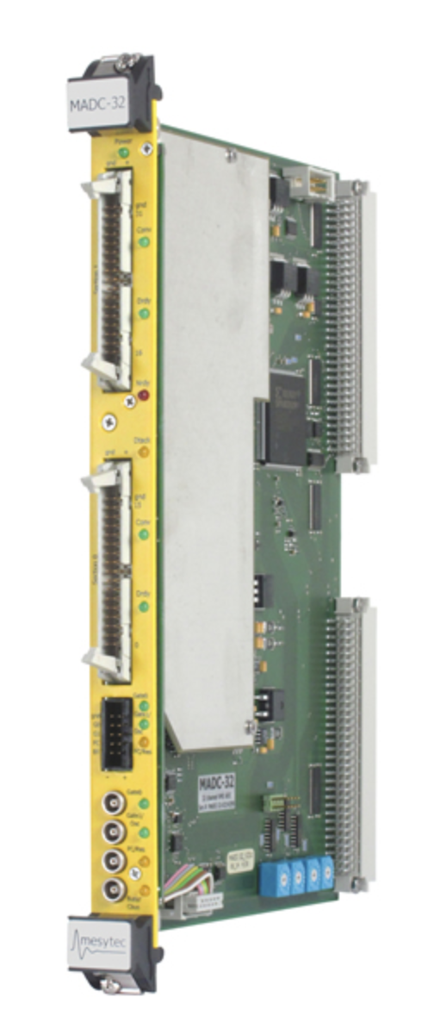

3. Experiment
We carried out a test experiment using the primary beam from the HIMAC(Heavy Ion Medical Accelerator in Chiba) Synchrotron Accelerator at National Institute for Quantum Science and Technology, Japan.
Experimental Period | Primary Beam | Energy [AMeV]
Nov 2017 | ⁵⁸Ni | 500
Dec 2020, Dec2021 | ¹³²Xe | 420
HIMAC Synchrotron Accelerator Facility
Improvement of the Data Acquisition System
Standard System
Improved System
ADC(CAMAC)
HOSHIN C008
Conversion gain : 14 bit
Full range : 5 V
→Time bin : 1.5 ps/ch
TDC
REPIC RPC-180
Full scale : 100 ns
Dynamic range : 12 bit
Time bin : 25 ps/ch
TAC(Time to Amplitude Converter)
ORTEC567
Time range : 50 ns
Amplitude : 0 to +10 V
+
or
ADC(VME)
Mesytec MADC32
Conversion gain : 13 bit
Full range : 4 V
→Time bin : 2.5 ps/ch
$σ_{syst.}<$ 4 ps
Notes:
Using these scintillators and PMTs, we assembled some plastic scintillation detectors with different sizes and model combinations. Then, we evaluated their performance by test experiments using these primary beams at HIMAC in Japan.
And, we also improved the data acquisition system.
In the previous setup, we used a TDC for time measurement. But in this work, we replaced it with a combination of a TAC and an ADC to obtain the timing information. As a result, the time bin was improved from 25 ps up to 1.5 ps.

Slide 7
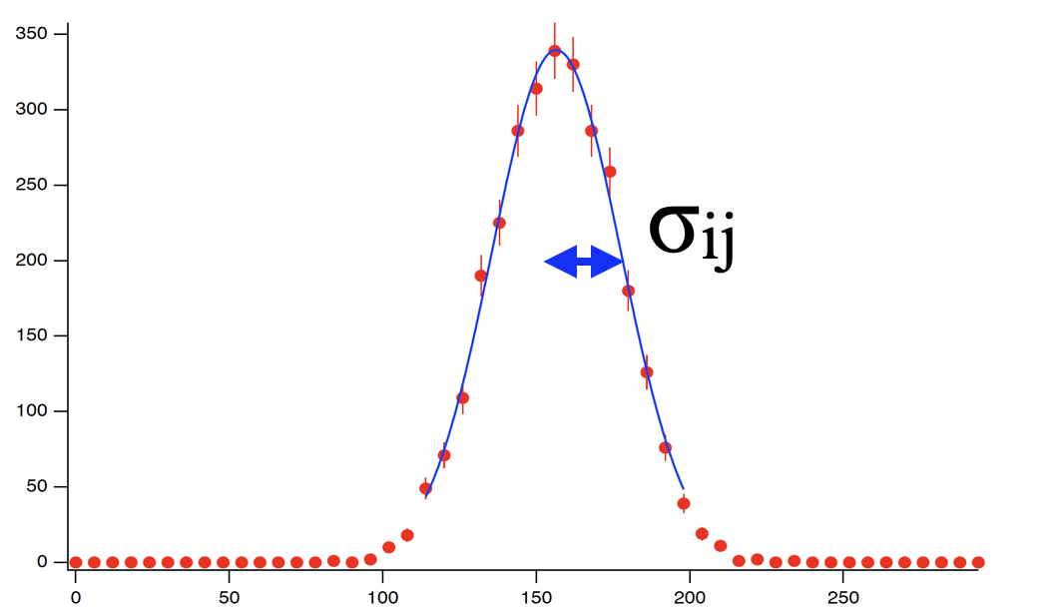
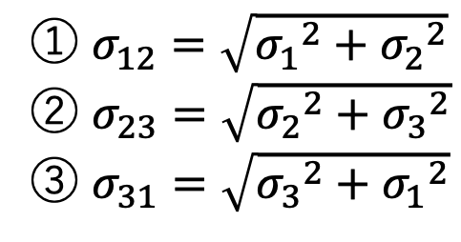
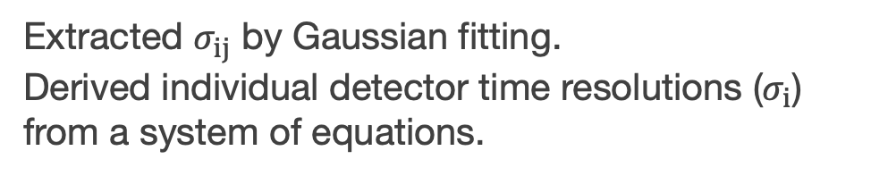

3. Experiment
Setup
F3PL1
F3PL2
F3PL3
Primary Beam
⁵⁸Ni, 500 AMeV
¹³²Xe, 420 AMeV
③
Obtained time-difference spectra
① $σ_{12}=\sqrt{{σ_{1}}^{2}+{σ_{2}}^{2}}$
② $σ_{23}=\sqrt{{σ_{2}}^{2}+{σ_{3}}^{2}}$
③ $σ_{31}=\sqrt{{σ_{3}}^{2}+{σ_{1}}^{2}}$
$∆E<{10}^{−4}$
②
①
Measured the time-difference spectra in three configurations.
Extracted $σ_{ij}$ by Gaussian fitting.
Derived individual detector time resolutions ($σ_{i}$) from a system of equations.
Notes:
Now, let me explain the experimental setup. We placed three plastic scintillation detectors at the F3 focal plane and measured the time-difference spectra in three configurations.
The obtained spectra were fitted with Gaussian functions to determine the TOF resolutions. Each TOF resolution is calculated from the time resolution of the involved detectors, using this formulas.
So, we can derive the individual time resolutions of each detector by solving these equations.

Slide 8
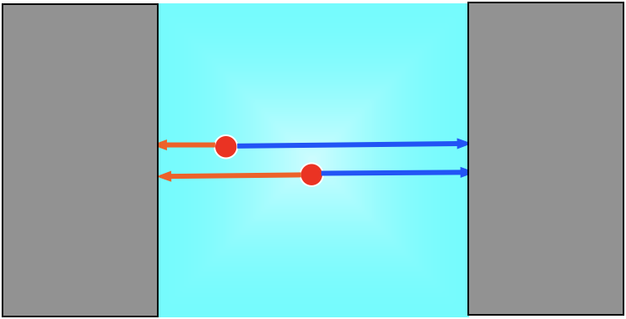
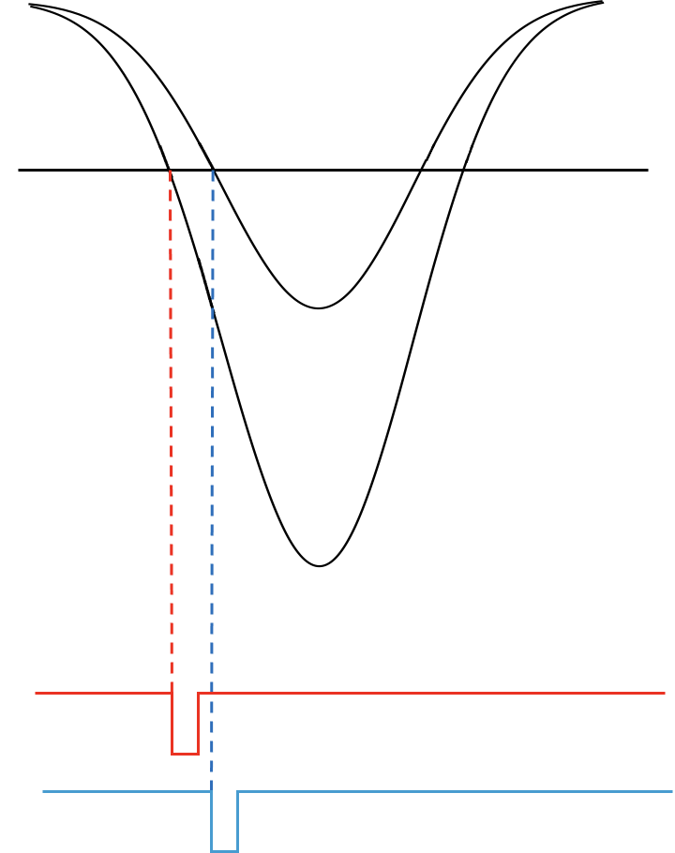
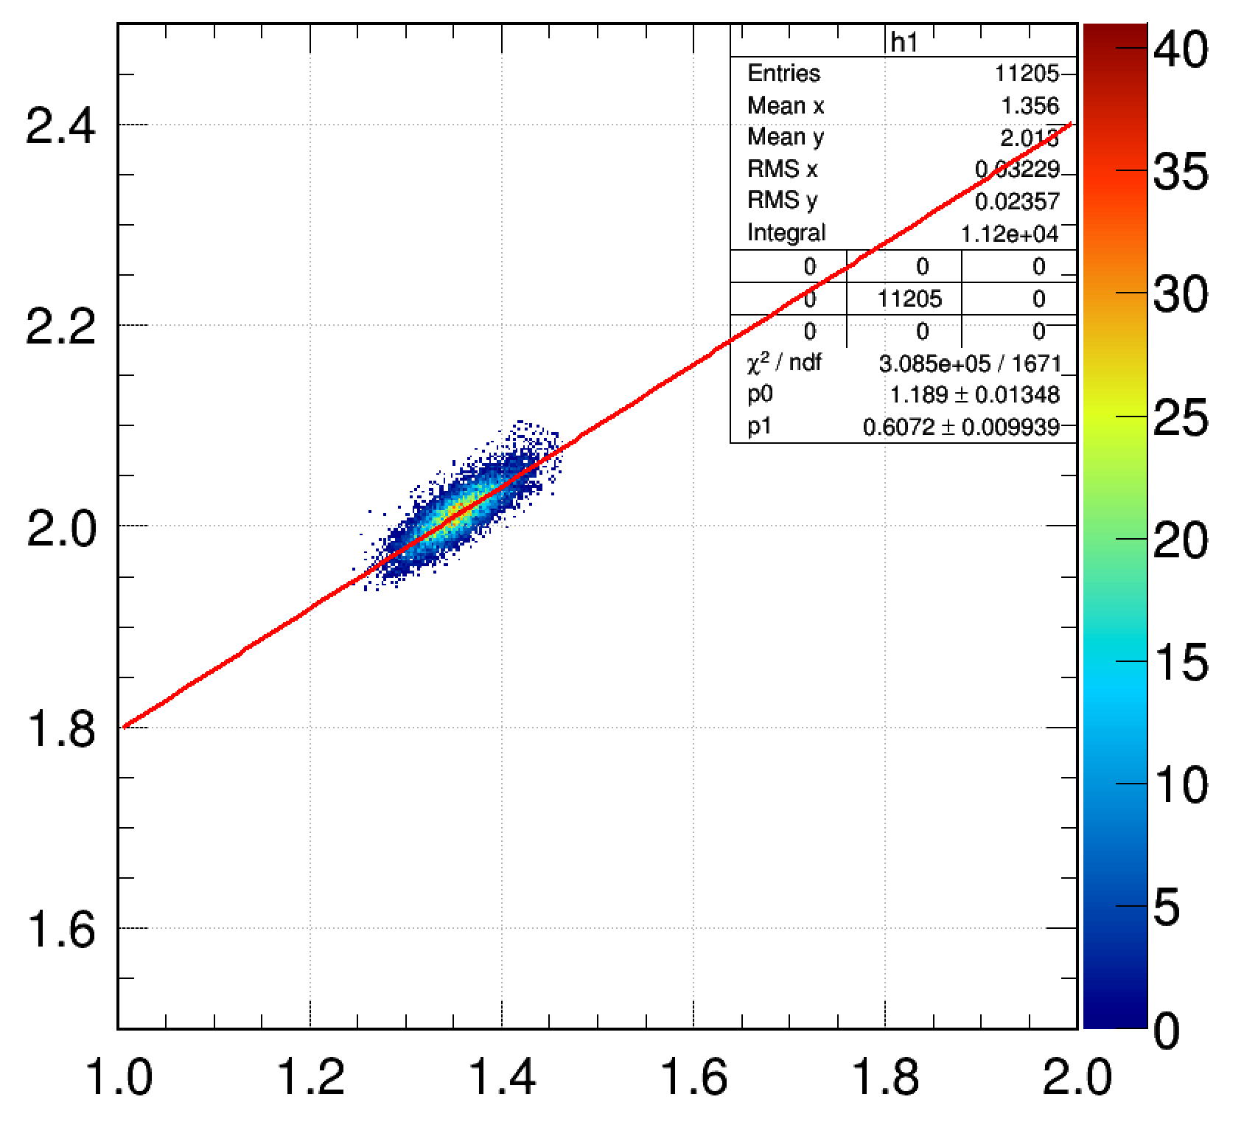
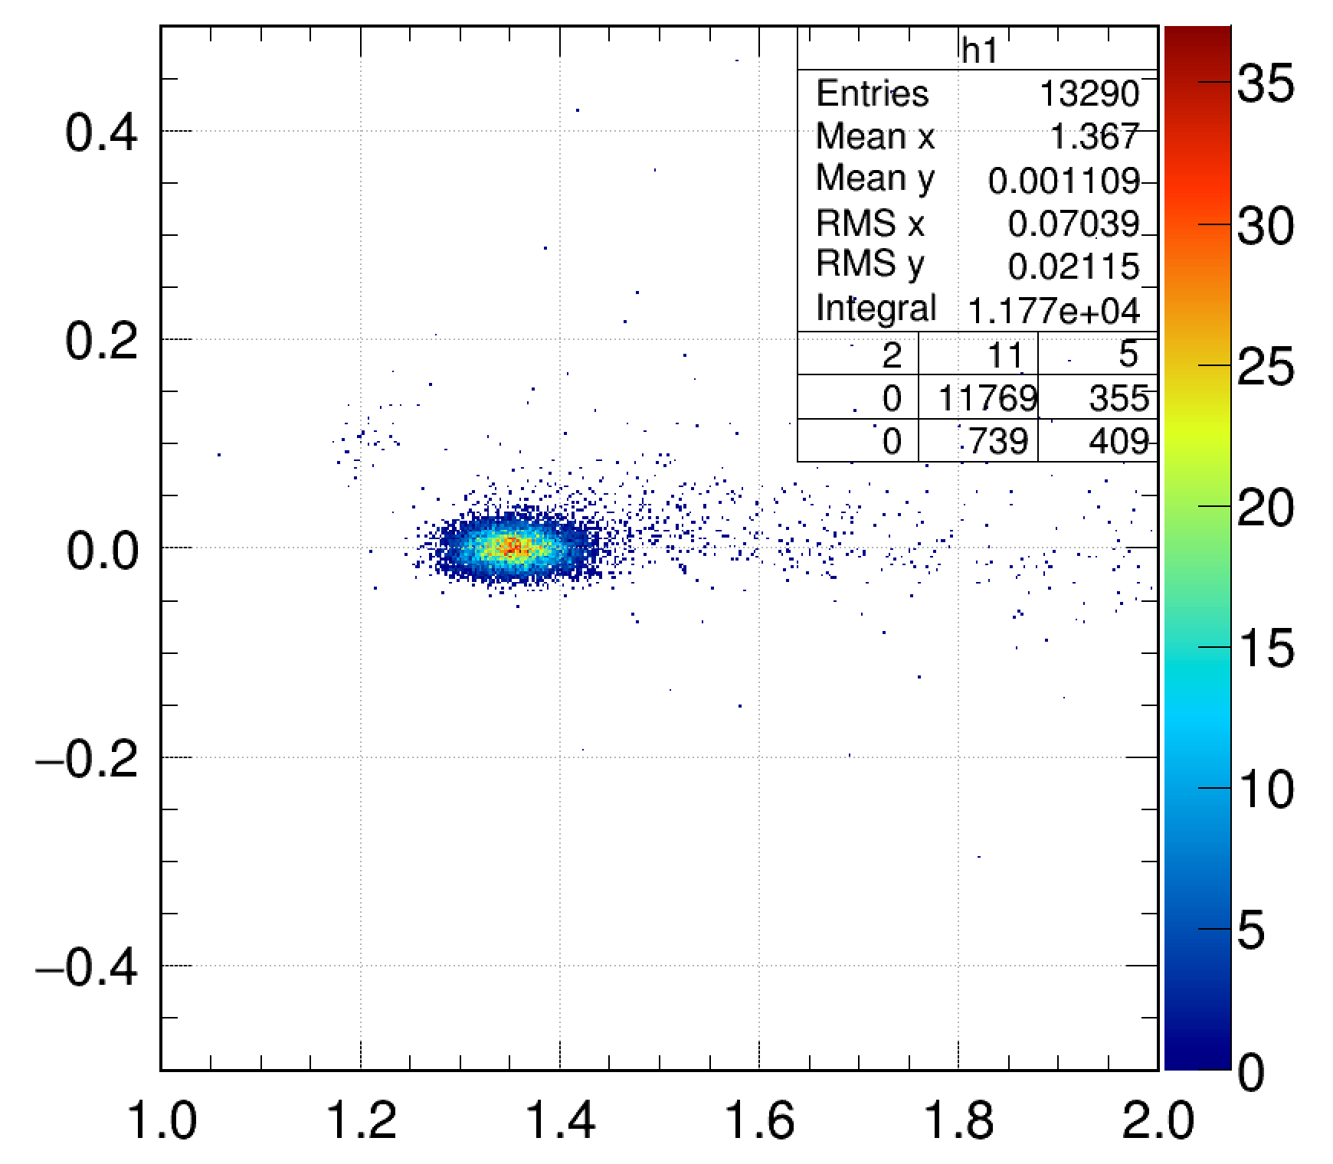
4. Analysis
(i) Pulse Height Dependence
(ii) Position Dependence
In plastic scintillation detectors, the signal timing depends on the pulse height (time walk effect).
This occurs because higher pulses cross the discriminator threshold earlier.
L
R
Detector Signal
PMT
PMT
Low Pulse Height
Discriminator Threshold
When the beam hits different positions, the distance to each PMT changes. This causes position dependence in the timing signals.
However, by taking the arithmetic mean of the left and right PMT timings, the first-order position dependence is effectively canceled out.
The beam incident position was determined by tracking with multiple position-sensitive detectors (PPACs).
High Pulse Height
Timing Signal (High Pulse Height)
Timing Signal (Low Pulse Height)
Time difference [ns]
Time difference [ns]
Time
corrected
The pulse height was defined as the geometric mean of the integrated charges from the left and right PMTs.
Pulse Height or Position
Pulse Height or Position
Notes:
Next, I will explain the analysis to determine the TOF resolutions. We mainly applied two types of corrections — the pulse-height dependence and the hit position dependence.
In plastic scintillation detectors, the signal timing depends on the pulse height (time walk effect).
This occurs because higher pulses cross the discriminator threshold earlier.
As shown in this figure, we fitted the correlation between the pulse height and the measured time difference with a linear function, and used the fit result to correct for this dependence.
When the beam hits different positions, the distance to each PMT changes, which causes position dependence in the timing signals.
By taking the mean of the left and right PMT timings, the first-order position dependence is effectively canceled out.
However, in order to remove any remaining higher-order position dependence, we applied a similar correction based on the correlation between the hit position and timing.

Slide 9
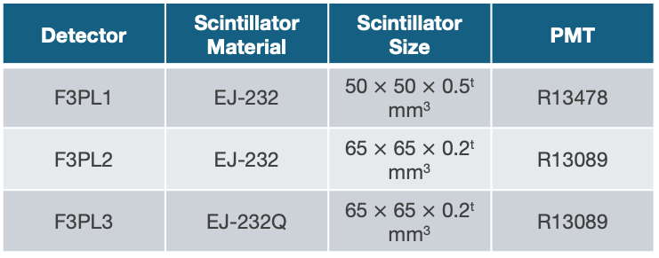
5. Experimental Results
(a)
(i) Optimization of PMT HV and Discriminator Threshold
Primary Beam : ¹³²Xe, 420 AMeV
F3PL1
F3PL2
F3PL3
Detector | Scintillator Material | Scintillator Size | PMT
F3PL1 | EJ-232 | 50 $×$ 50 $×$ 0.5^{t} mm³ | R13478
F3PL2 | EJ-232 | 65 $×$ 65 $×$ 0.2^{t} mm³ | R13089
F3PL3 | EJ-232Q | 65 $×$ 65 $×$ 0.2^{t} mm³ | R13089
(a) PMT HV Dependence
The time resolution was improved with increasing HV and reached its best performance above 1500 V. → This is because the spread of electron transit time inside the PMT decreases with higher HV.
(b)
(b) Discriminator Threshold Dependence
The best time resolution was obtained when the threshold level was
7–15% of the signal pulse height. → Too low or too high thresholds cause time jitter increasing.
Due to, for example, noise in the signal slope.
Notes:
Next, I will move on to the experimental results. We constructed three plastic scintillation detectors using various combinations of the scintillators and PMTs I mentioned earlier. This performance test was carried out using a 420-MeV per nucleon of 132Xe primary beam.
As a first step, we optimized the high voltage and discriminator threshold for the PMTs.
To determine the optimal condition for the high voltage, we fixed the discriminator threshold at –100 mV and changes the high voltage from 1000 to 1750 volts. The time resolution was improved with increasing HV and reached its best performance above 1500(fifteen hundred) volts. This is because the spread of electron transit time inside the PMT decreases with higher HV.
In the second test, we fixed the HV and changes the discriminator threshold. The best time resolution was obtained when the threshold level was between 7 and 15 percent of the signal pulse height. This is because, Too low or too high thresholds cause time jitter increasing. Due to, for example, noise in the signal slope.

Slide 10
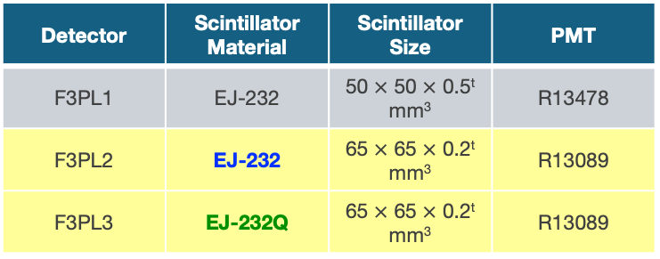
5. Experimental Results
(b)
Effect of Scintillator Material
(ii) Effect of Scintillator Material on Time Resolution
Primary Beam : ¹³²Xe, 420 AMeV
F3PL1
F3PL2
F3PL3
Detector | Scintillator Material | Scintillator Size | PMT
F3PL1 | EJ-232 | 50 $×$ 50 $×$ 0.5^{t} mm³ | R13478
F3PL2 | EJ-232 | 65 $×$ 65 $×$ 0.2^{t} mm³ | R13089
F3PL3 | EJ-232Q | 65 $×$ 65 $×$ 0.2^{t} mm³ | R13089
EJ-232
EJ-232Q
Two detectors, F3PL2 and F3PL3, have identical geometry and PMTs, but use different scintillator materials: EJ-232 and EJ-232Q, respectively.
EJ-232Q is EJ-232 doped with 0.5% benzophenone (a quenching agent). → It provides a much faster light response, but with significantly reduced light output.
The results show that EJ-232Q achieved slightly better time resolution. However, when the HV and discriminator thresholds are optimized, the difference between the two materials is small.
EJ-232Q
Notes:
Next, we checked the effect of Scintillator Material on time resolutions.
By comparing the results of the second and the third detector in (b), we can evaluate the difference in time resolution arising from the scintillator material. This is because both detectors have the same scintillator size and use the same type of PMT.
So, the only difference is the scintillator material — EJ-232 for the second one and EJ-232Q for the third one.
EJ-232Q is EJ-232 doped with 0.5% benzophenone as a quenching agent. It provides a much faster light response, but with significantly reduced light output.
The results show that EJ-232Q achieved slightly better time resolution than EJ-232. However, when the HV and discriminator thresholds are optimized, the difference between the two materials is small.

Slide 11
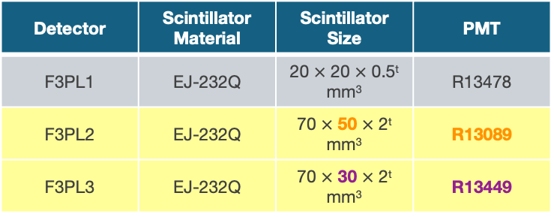
5. Experimental Results
Effect of Scintillator and PMT Size
(iii) Effect of Scintillator and PMT Size on Time Resolution
Primary Beam : ¹³²Xe, 420 AMeV
Secondary Beam : ¹³⁰Cs, 340 AMeV
F3PL1
F3PL2
F3PL3
Detector | Scintillator Material | Scintillator Size | PMT
F3PL1 | EJ-232Q | 20 $×$ 20 $×$ 0.5^{t} mm³ | R13478
F3PL2 | EJ-232Q | 70 $×$ 50 $×$ 2^{t} mm³ | R13089
F3PL3 | EJ-232Q | 70 $×$ 30 $×$ 2^{t} mm³ | R13449
F3PL2 and F3PL3 use PMTs R13089 and R13449, respectively, with photocathode diameters of 46 mm and 25 mm. The scintillator lengths were designed to match the PMT sizes (50 mm and 30 mm).
R13449 shows better timing performance, likely due to more uniform electron trajectories from the smaller photocathode. F3PL3 with R13449 achieved slightly better time resolution.
However, the difference was small, and R13089 still provided sufficient resolution. Larger scintillators with R13089 are useful for measurements with wider acceptance.
Type | R13089 (F3PL2) | R13449 (F3PL3)
Diameter | 51 mm (2 inch) | 28 mm (1.13 inch)
Effective Area | 46 mm | 25 mm
Tube Length | 112 mm | 55 mm
Gain | 3.20E+05 | 5.30E+05
Rise Time | 2.0 ns | 0.9 ns
T.T.S. | 230 ps | 170 ps
Notes:
Next, I will explain the following test experiment. We tested other combinations of scintillator materials, sizes, and PMT types using both the primary of 132Xe beam and the secondary beams produced from the Xe.
The third one shows better timing performance, likely due to more uniform electron trajectories from the smaller photocathode, and achieved slightly better time resolution.
When we compare their time resolutions, the third one, which uses the smaller PMT, shows a better timing performance as expected shown by violet symbols. However, since the difference between the two detectors is quite small, the second one which has a bit larger photocathode still provided sufficient resolution. Therefore, Larger scintillators are also useful for measurements with wider acceptance.

Slide 12
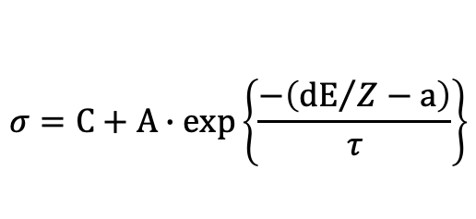
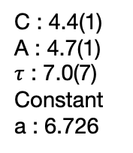
5. Experimental Results
(iv) Dependence of Time Resolution on Light Yield in the Scintillator
Higher atomic number Z ions deposit more energy in the scintillator.
However, due to quenching effects, the light yield does not increase linearly with energy deposit.
So, the light yield was defined as dE/Z.
Measurements were performed under the optimized HV and threshold conditions obtained previously.
The right figure shows the correlation between light yield and time resolution.
A clear dependence of time resolution on light yield was observed, which was more significant than differences caused by scintillator material or PMT type.
→ The light yield is one of the most critical factors in achieving excellent timing performance.
Fitting : Exponential Decay Function
C : 4.4(1)
A : 4.7(1)
$τ$ : 7.0(7)
Constant
a : 6.726
$$σ=C+A∙exp\left\{\frac{−\left({dE}/Z−a\right)}{τ}\right\}$$
Notes:
Finally, I will focus on the dependence of the time resolution on the light yield in the scintillator.
Higher atomic number Z ions deposit more energy in the scintillator.
However, due to quenching effects, the light yield does not increase linearly with energy deposit.
So, the light yield was defined as dE/Z here.
A clear dependence of time resolution on light yield was observed, which was more significant than differences caused by scintillator material or PMT type. This result indicates that the light yield is one of the most critical factors in achieving excellent timing performance.

Slide 13
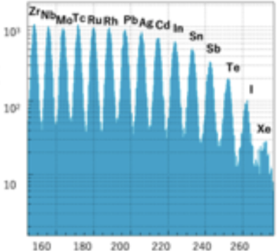
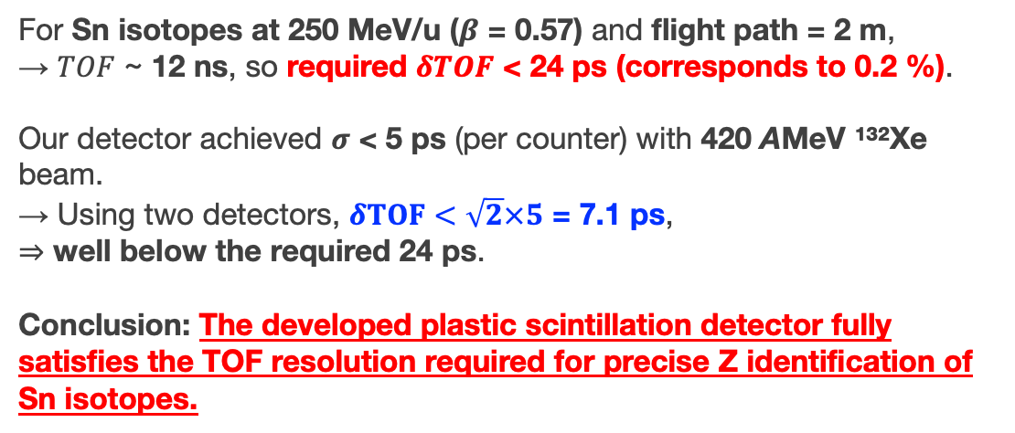
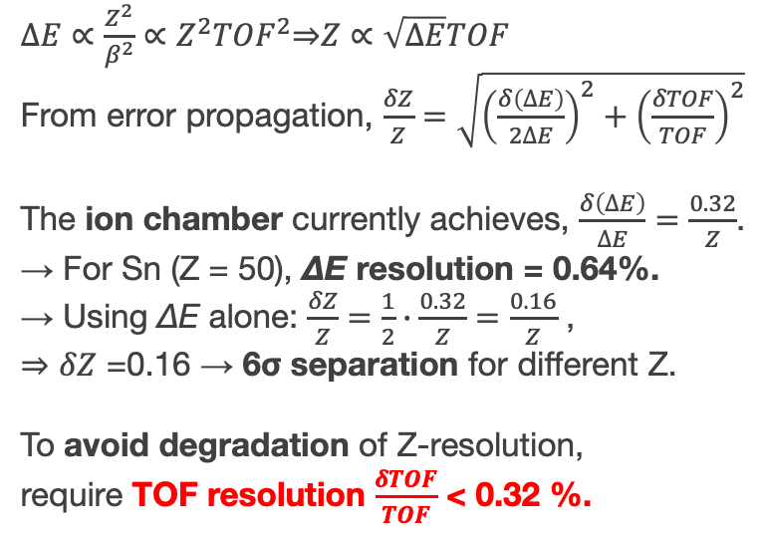


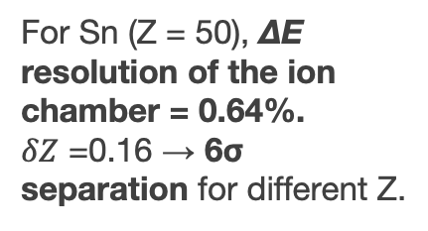
6. TOF Resolution Requirement
PL1
PL2
For Sn (Z = 50), ΔE resolution of the ion chamber = 0.64%.
$δZ$ =0.16 → 6σ separation for different Z.
target
IC
$$∆E$$
Dipole Magnet
ΔE in IC
$TOF$, L ~2 m
$∆E∝\frac{Z^{2}}{β^{2}}∝Z^{2}{TOF}^{2}$⇒$Z∝\sqrt{∆E}TOF$
From error propagation, $\frac{δZ}{Z}=\sqrt{{\left(\frac{δ\left(∆E\right)}{2∆E}\right)}^{2}+{\left(\frac{δTOF}{TOF}\right)}^{2}}$
The ion chamber currently achieves, $\frac{δ\left(∆E\right)}{∆E}=\frac{0.32}{Z}$.
→ For Sn (Z = 50), ΔE resolution = 0.64%.
→ Using ΔE alone: $\frac{δZ}{Z}=\frac{1}{2}∙\frac{0.32}{Z}=\frac{0.16}{Z}$ ,
⇒ $δZ$ =0.16 → 6σ separation for different Z.
To avoid degradation of Z-resolution, require TOF resolution $\frac{δTOF}{TOF}$ < 0.32 %.
For Sn isotopes at 250 MeV/u ($β$ = 0.57) and flight path = 2 m, → $TOF$ ~ 12 ns, so required $δTOF$ < 24 ps (corresponds to 0.2 %).
Our detector achieved $σ$ < 5 ps (per counter) with 420 AMeV ¹³²Xe beam.
→ Using two detectors, $δTOF<\sqrt{2}×5$ = 7.1 ps,
⇒ well below the required 24 ps.
Conclusion: The developed plastic scintillation detector fully satisfies the TOF resolution required for precise Z identification of Sn isotopes.
Notes:
In the final part of this presentation, we evaluated whether our detector can achieve the required TOF resolution for precise atomic-number identification.
The atomic number $Z$identification depends not only on the energy loss but also on the particle velocity. The ionization chamber currently used in our group provides a delta-E resolution of 0.64% for tin isotopes, which allows us to separate the atomic number with about six sigma precision without beta dependence.
Therefore, To avoid degradation of Z-resolution, require TOF resolution is better than 0.32 %.
For Sn isotopes at 250 MeV per nucleon traveling a flight path of 2 meters, the TOF is roughly 12 nanoseconds, which means the required TOF resolution is better than 24 picoseconds.
In our study, the plastic scintillation detectors we developed achieved a time resolution better than 5 picoseconds for a 132Xe beam at 420 MeV per nucleon. Thus, when using two detectors of this type for TOF, the overall TOF resolution is expected to be around 7 picoseconds.
In conclusion, our newly developed timing detector fully satisfies the TOF resolution required for atomic-number identification in the tin isotope region.

Slide 14
7. Summary
・Developed fast plastic scintillation detectors for high-resolution TOF (β) measurements in a short flight path (~2 m).
・Aim: Atomic-number identification (Z) for charge-changing cross-section (σ_{CC}) measurements of Sn isotopes at RIKEN RIBF.
・ Test experiments were performed at HIMAC using a 420 AMeV ¹³²Xe primary beam.
・Optimization studies for PMT high voltage and discriminator threshold showed the best timing performance above 1500 V and 7–15% threshold level.
・ EJ-232Q scintillator (benzophenone-quenched) showed slightly better time resolution than EJ-232, though the difference becomes small under optimal conditions.
・ PMT size dependence: R13449 (25 mm) provided slightly superior resolution than R13089 (46 mm) due to smaller transit-time spread, but both achieved excellent results.
・ Time resolution improves with higher light yield in the scintillator, showing stronger correlation than material or PMT-type differences.
・ Required TOF resolution for Z separation in the Sn region: δTOF < 24 ps (0.2%). Our detectors achieved σ < 5 ps per detector, giving δTOF ~ 7 ps for two-detector TOF measurement.
・ Conclusion: The developed plastic scintillation detector system, verified through HIMAC test experiments, fully satisfies the timing requirements for precise atomic-number identification and charge-changing cross-section measurements in high-energy rare-isotope beam experiments.
Notes:
Let me summarize my talk.

Slide 15
BACK UP

Slide 16
Projectile
Proton radius
Proton radius
rp
rp
Target
rT
rT
σCC

Slide 17
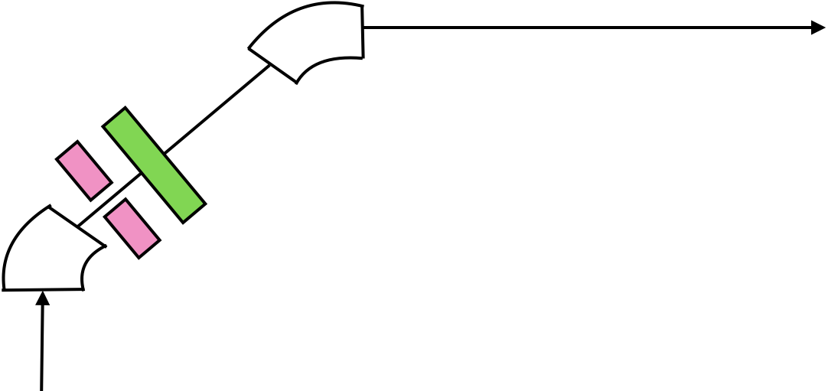


Dipole2
$$\sim$$
F1
$$\sim$$
F1PL
Slit
Dipole1
不必要な情報(Dipole, Slit, F1PL)を消す

Slide 18
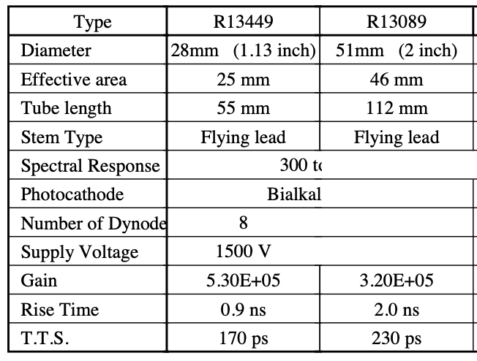
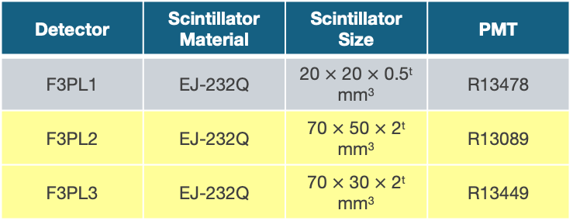
5. Experimental Results
(iii) Effect of Scintillator and PMT Size on Time Resolution
Primary Beam : ¹³²Xe, 420 AMeV
Secondary Beam : ¹³⁰Cs, AMeV
F3PL1
F3PL2
F3PL3
Detector | Scintillator Material | Scintillator Size | PMT
F3PL1 | EJ-232Q | 20 $×$ 20 $×$ 0.5^{t} mm³ | R13478
F3PL2 | EJ-232Q | 70 $×$ 50 $×$ 2^{t} mm³ | R13089
F3PL3 | EJ-232Q | 70 $×$ 30 $×$ 2^{t} mm³ | R13449

Slide 19
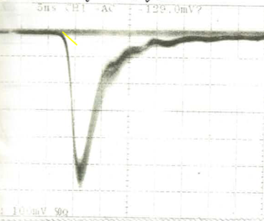
結果②
¹³²Xeのデータ
PMTにかけるHV
0.8, 1.0, 1.2, 1.4, 1.6 kV
の5パターン
(最大印加電圧：1750V)
オシロスコープで生信号を見る
5%
15%
計15パターンのHV、
Discriの設定で
時間分解能を測定
30%
各HVにつき、
Discr.のスレショルド
レベルを3パターンで測定
単位時間あたりの
電圧変化を
信号の波形から求める
5ns, 100mV

