Slide 1

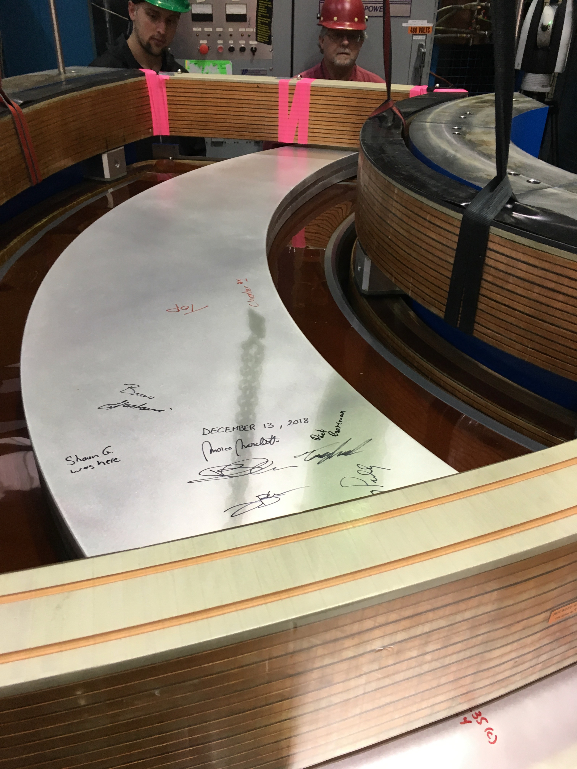
What’s special about the ARIEL HRS?
Rick Baartman
on behalf of Beam Physics Group
TRIUMF
October 21, 2025

Slide 2
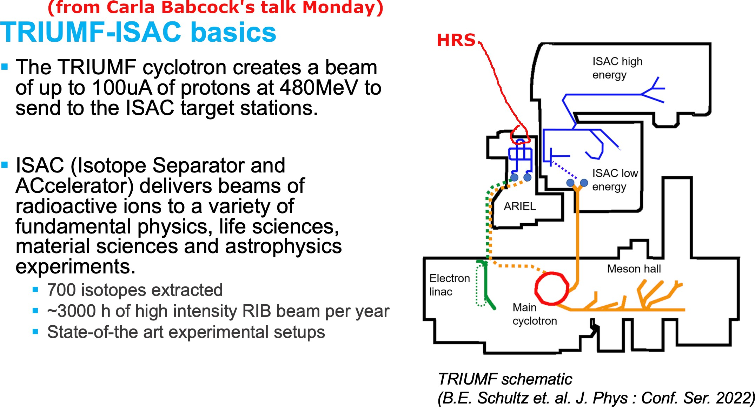

Slide 3
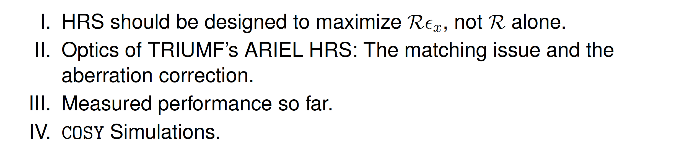
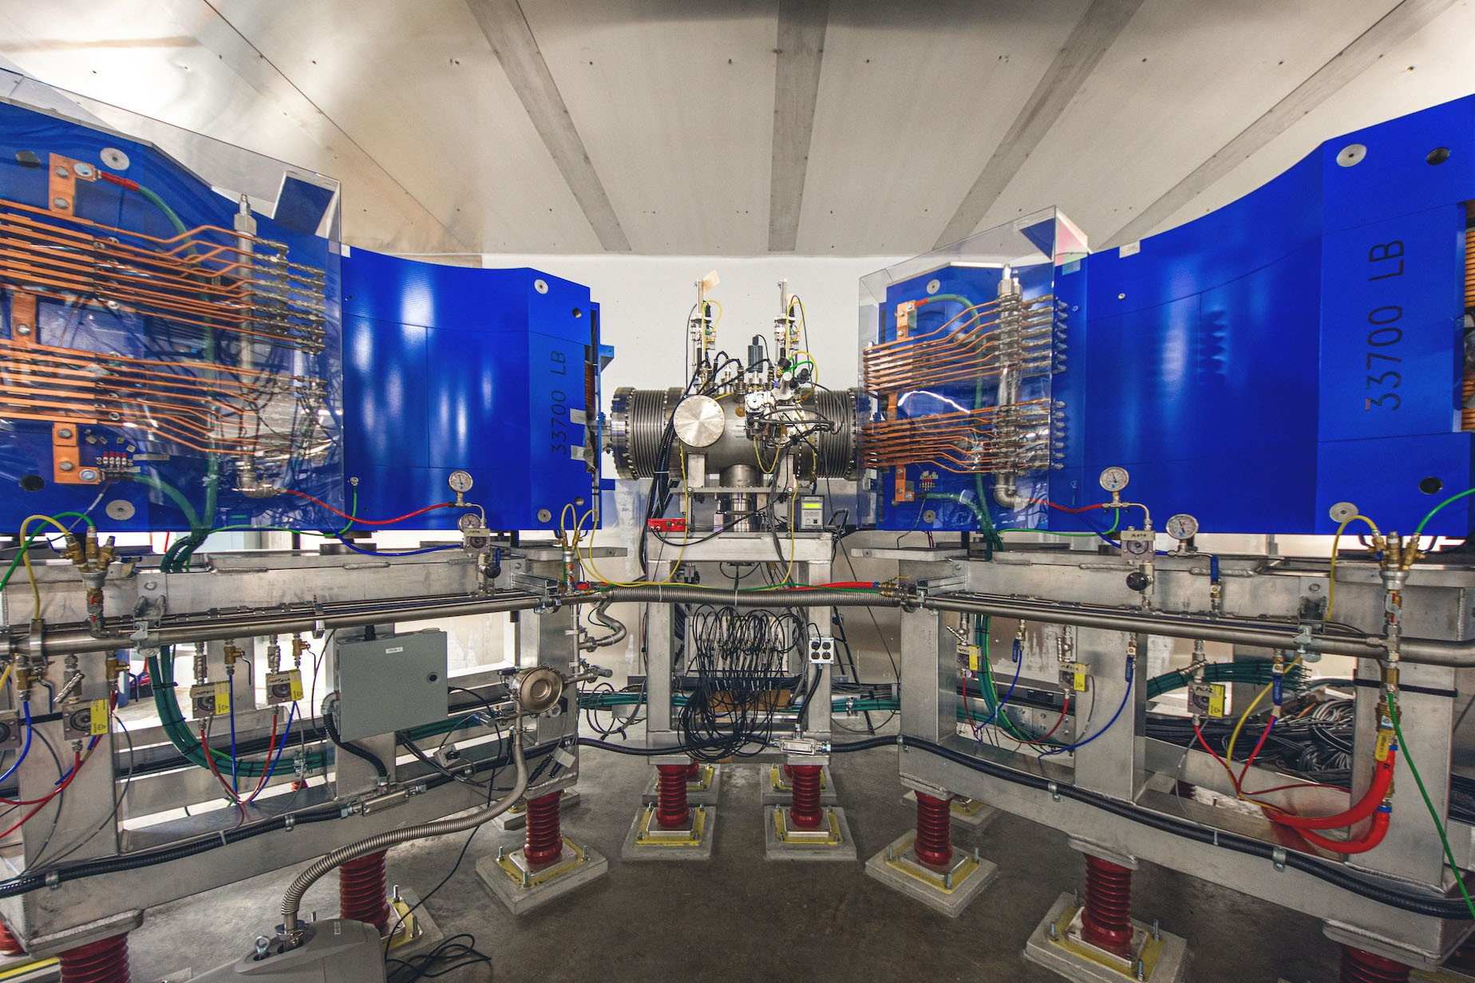
Outline
HRS should be designed to maximize RE_{x}, not R alone.
Optics of TRIUMF’s ARIEL HRS: The matching issue and the aberration correction.
Measured performance so far.
COSY Simulations.
Rick B. EMIS2025: ARIEL HRS
-15

Slide 4
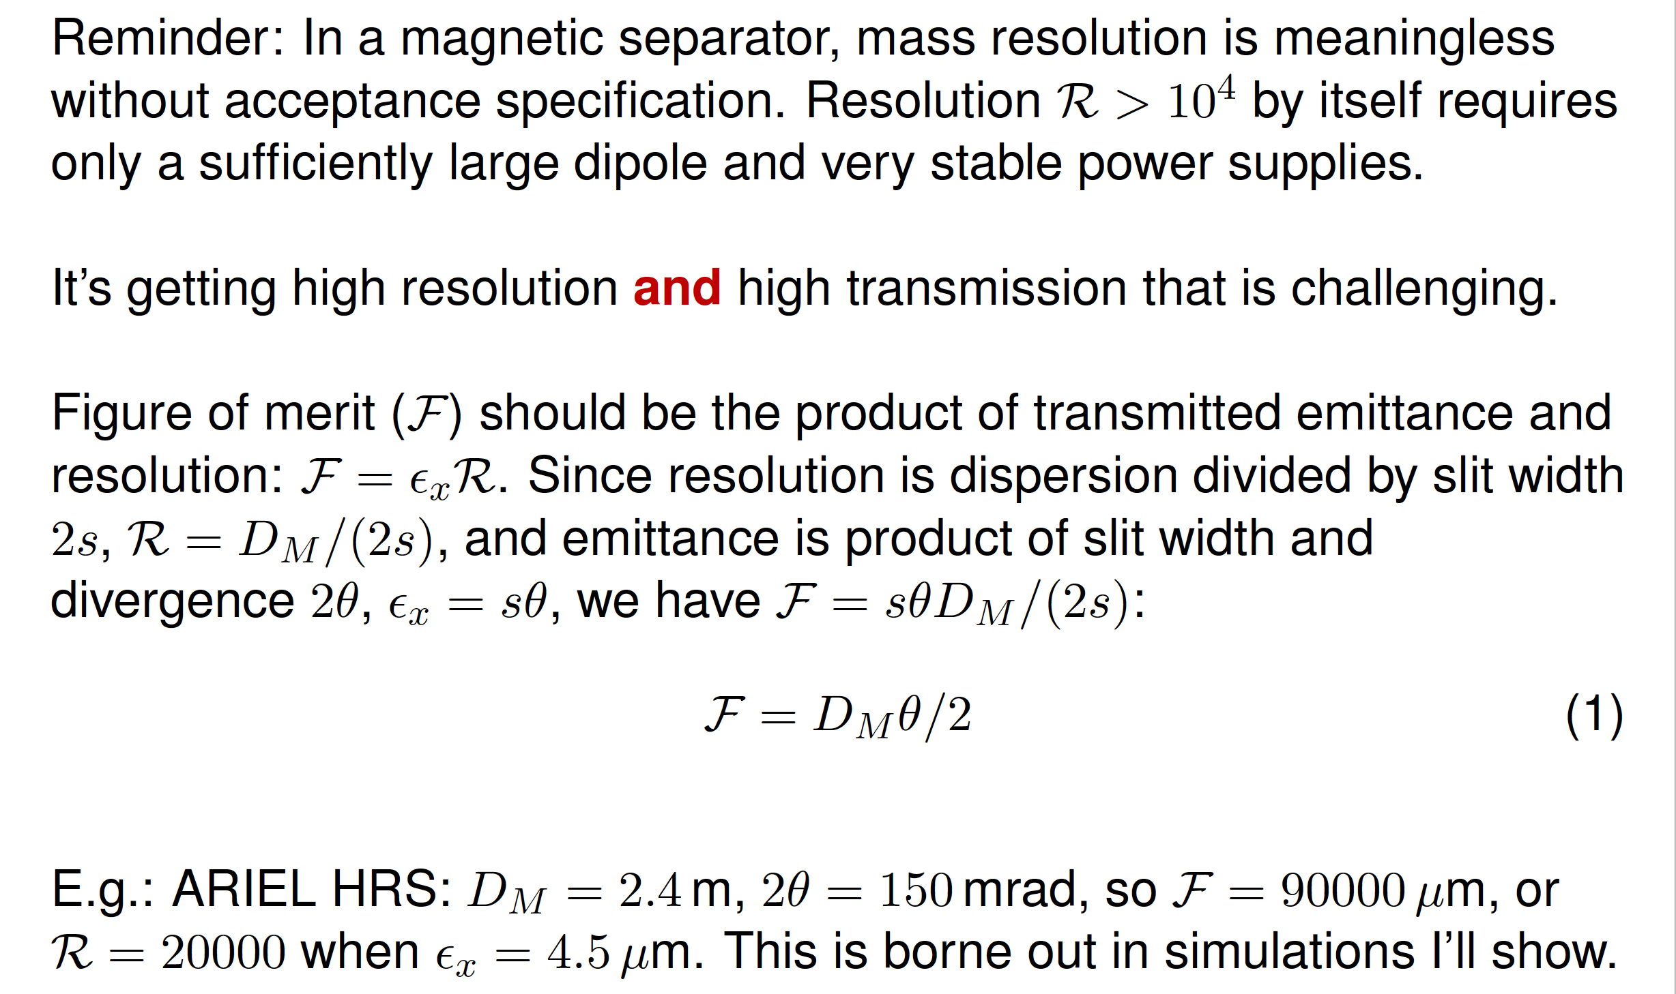
Resolution is not the figure of merit
Reminder: In a magnetic separator, mass resolution is meaningless without acceptance specification. Resolution R > 10⁴ by itself requires only a sufficiently large dipole and very stable power supplies.
It’s getting high resolution and high transmission that is challenging.
Figure of merit (F) should be the product of transmitted emittance and resolution: F = E_{x}R. Since resolution is dispersion divided by slit width 2s, R = D_{M} /(2s), and emittance is product of slit width and divergence 2θ, E_{x} = sθ, we have F = sθD_{M} /(2s):
F = D_{M} θ/2 (1)
E.g.: ARIEL HRS: D_{M} = 2.4 m, 2θ = 150 mrad, so F = 90000 µm, or
R = 20000 when E_{x} = 4.5 µm. This is borne out in simulations I’ll show.
Rick B. EMIS2025: ARIEL HRS
-14

Slide 5
TRIUMF ARIEL HRS Main features
Two dipoles, each 90◦, arranged to have a −I horizontal transport slit to slit.
Dipoles have radius ρ = 1.2 m, resulting in mass dispersion of
2.4 m.
Thus, a 0.100 mm slit results in a mass resolution of 24000.
Slit to midpoint is 90◦ phase advance, β_{x} = 1.6 m, so dipoles’ good field region of 320 mm results in acceptance of ±100 mrad at slit.
So phase space acceptance is 5 πmm-mrad for 24000 mass resolution, or 3 πmm-mrad and a 60 µm slit for 40000 mass resolution, but as will be shown, the optics cannot support this. We use at most 240 mm of the good field region.
Rick B. EMIS2025: ARIEL HRS
-13

Slide 6
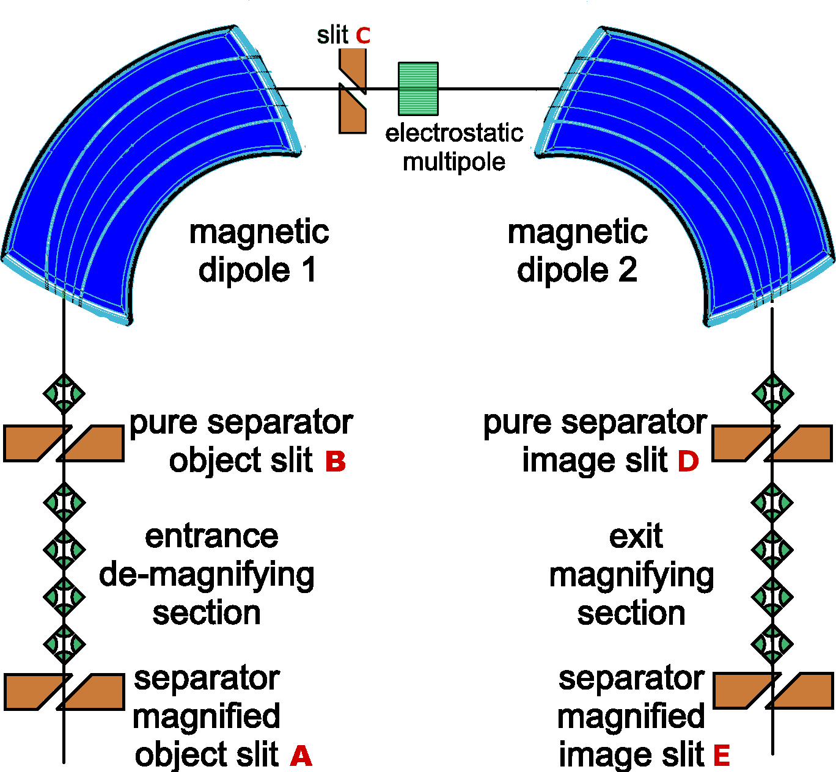
TRIUMF ARIEL HRS Hardware Layout
Two features:
1
The matching quadrupoles can demagnify up to factor of m = 10, allowing object and mass slits to be 1 mm rather than
0.1 mm. Effective dispersion is up to 24 metres.
The high order correction device is a rectangular box of electrodes.
2
Rick B. EMIS2025: ARIEL HRS
-12

Slide 7
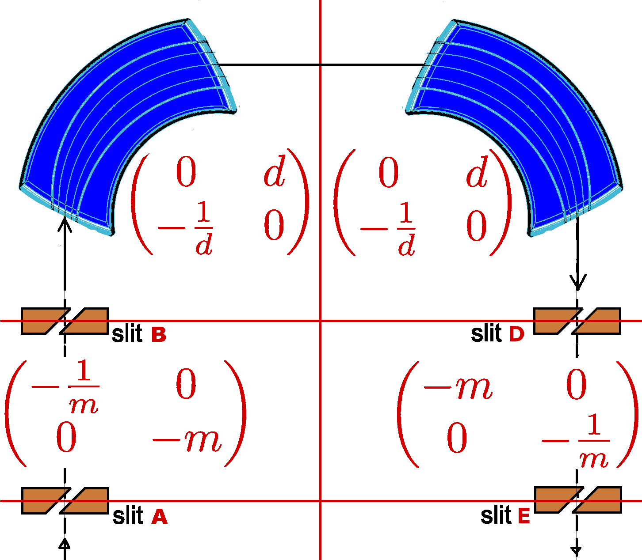
TRIUMF ARIEL HRS Optics Matrices
Two features:
1
The matching quadrupoles can demagnify up to factor of m = 10, allowing object and mass slits to be 1 mm rather than
0.1 mm. Effective dispersion is up to 24 metres.
The high order correction device is a rectangular box of electrodes.
2
m = 3 to 10, d = 1.6 m.
Rick B. EMIS2025: ARIEL HRS
-11

Slide 8
2 Modes of Operation
1
In ‘Pure Separator’ mode, the 4-quad sections are simply matching sections. Slit ‘B’ is used as object and Slit ‘D’ is image or mass selection. Mass dispersion is 2.4 m, so a slit width of
0.100 mm needed for a resolution of 24000.
In the second mode, slits ‘B’ and ‘D’ are ‘out’. The matching section can be tuned to a magnification of up to m = 10. Slit ‘A’ is the object and Slit ‘E’ the mass selection point. At m = 10, mass dispersion is also magnified and becomes 24 m, so slit sizes are
1.00 mm. In this mode, the mass selection is far less dependent upon the slit condition. The aberrations include those from the quadrupoles, but they also can be corrected by the multipole.
2
Rick B. EMIS2025: ARIEL HRS
-10

Slide 9
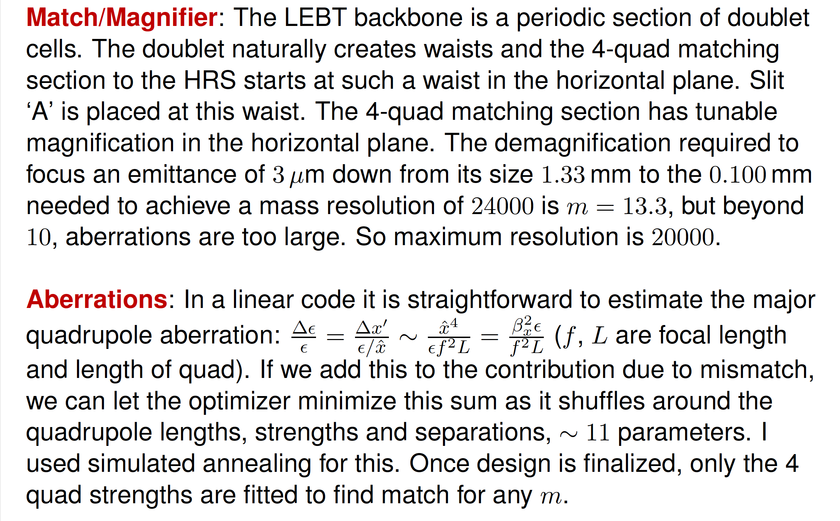
Match/Magnifier optimization
Match/Magnifier: The LEBT backbone is a periodic section of doublet cells. The doublet naturally creates waists and the 4-quad matching section to the HRS starts at such a waist in the horizontal plane. Slit ‘A’ is placed at this waist. The 4-quad matching section has tunable magnification in the horizontal plane. The demagnification required to focus an emittance of 3 µm down from its size 1.33 mm to the 0.100 mm needed to achieve a mass resolution of 24000 is m = 13.3, but beyond 10, aberrations are too large. So maximum resolution is 20000.
Aberrations: In a linear code it is straightforward to estimate the major
2
quadrupole aberration: ^{∆E} = ^{∆xt} ∼
xˆ⁴
β E
= (f , L are focal length
x
E E/xˆ Ef ²L f ²L
and length of quad). If we add this to the contribution due to mismatch, we can let the optimizer minimize this sum as it shuffles around the quadrupole lengths, strengths and separations, ∼ 11 parameters. I used simulated annealing for this. Once design is finalized, only the 4 quad strengths are fitted to find match for any m.
Rick B. EMIS2025: ARIEL HRS
-9

Slide 10
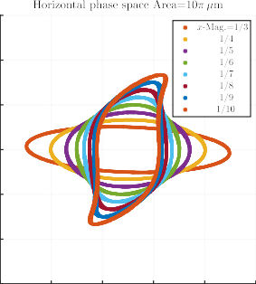
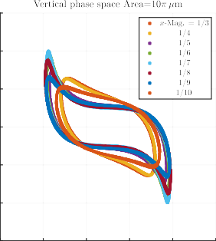
Match/Magnifier Aberrations
The matching section operates as a ‘zoom’ lens in the horizontal plane. Using requirements: (1) (De)Magnification (M₂₂ =) from 3 to 10,
(2) Entry (Slit ‘A’) should image to exit (Slit ‘B’), i.e. M₁₂ = M₂₁ = 0.
Below is shown the 8 different magnifications calculated to 5th order in
COSY at slit B. Only the emittance perimeter shown.
150
15
100
10
50
5
0
0
-50
-5
-100
-10
-150
-0.5
-0.3
-0.1
0.1
0.3
0.5
-15
-5
-3
-1
1
3
5
Rick B. EMIS2025: ARIEL HRS
-8

Slide 11
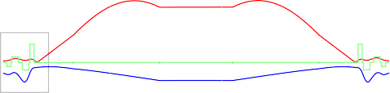
Beam envelopes vs. magnification (zoom)
12
magnification=1/3
1
0.5
x-envelope/cm
-y-envelope/cm focal power
10
slit.A
Q4
slit.B
0
-0.5
-1
Q1
Q2
Q3
Q5
8
6
4
0 20 40 60 80 100
2
0
entry-----
exit------
entry-----
exit------
dipole.1
dipole.2
slit.A
slit.B Q5
Centre
slit.D
slit.E
Q1
Q2
Q3
Q4
Q5
Q4
Q3
Q2
Q1
-400
-200
0
200
distance/cm
400
600
800
Rick B. EMIS2025: ARIEL HRS
-7

Slide 12
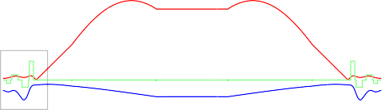
Beam envelopes vs. magnification (zoom)
12
magnification=1/4
1
0.5
x-envelope/cm
-y-envelope/cm focal power
10
slit.A
Q4
slit.B
0
-0.5
-1
Q1
Q2
Q3
Q5
8
6
4
0 20 40 60 80 100
2
0
entry-----
exit------
entry-----
exit------
dipole.1
dipole.2
slit.A
slit.B Q5
Centre
slit.D
slit.E
Q1
Q2
Q3
Q4
Q5
Q4
Q3
Q2
Q1
-400
-200
0
200
distance/cm
400
600
800
Rick B. EMIS2025: ARIEL HRS
-7

Slide 13
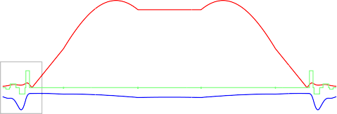
Beam envelopes vs. magnification (zoom)
12
magnification=1/5
1
0.5
x-envelope/cm
-y-envelope/cm focal power
10
slit.A
Q4
slit.B
0
-0.5
-1
Q1
Q2
Q3
Q5
8
6
4
0 20 40 60 80 100
2
0
entry-----
exit------
entry-----
exit------
dipole.1
dipole.2
slit.A
slit.B Q5
Centre
slit.D
slit.E
Q1
Q2
Q3
Q4
Q5
Q4
Q3
Q2
Q1
-400
-200
0
200
distance/cm
400
600
800
Rick B. EMIS2025: ARIEL HRS
-7

Slide 14
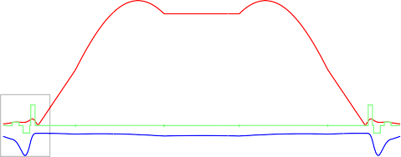
Beam envelopes vs. magnification (zoom)
12
magnification=1/6
1
0.5
x-envelope/cm
-y-envelope/cm focal power
10
slit.A
Q4
slit.B
0
-0.5
-1
Q1
Q2
Q3
Q5
8
6
4
0 20 40 60 80 100
2
0
entry-----
exit------
entry-----
exit------
dipole.1
dipole.2
slit.A
slit.B Q5
Centre
slit.D
slit.E
Q1
Q2
Q3
Q4
Q5
Q4
Q3
Q2
Q1
-400
-200
0
200
distance/cm
400
600
800
Rick B. EMIS2025: ARIEL HRS
-7

Slide 15
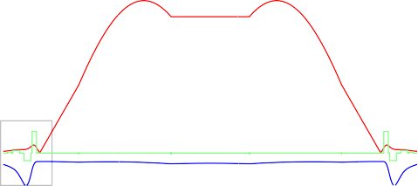
Beam envelopes vs. magnification (zoom)
12
magnification=1/7
1
0.5
x-envelope/cm
-y-envelope/cm focal power
10
slit.A
Q4
slit.B
0
-0.5
-1
Q1
Q2
Q3
Q5
8
6
4
0 20 40 60 80 100
2
0
entry-----
exit------
entry-----
exit------
dipole.1
dipole.2
slit.A
slit.B Q5
Centre
slit.D
slit.E
Q1
Q2
Q3
Q4
Q5
Q4
Q3
Q2
Q1
-400
-200
0
200
distance/cm
400
600
800
Rick B. EMIS2025: ARIEL HRS
-7

Slide 16
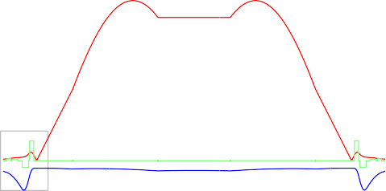
Beam envelopes vs. magnification (zoom)
12
magnification=1/8
1
0.5
x-envelope/cm
-y-envelope/cm focal power
10
slit.A
Q4
slit.B
0
-0.5
-1
Q1
Q2
Q3
Q5
8
6
4
0 20 40 60 80 100
2
0
entry-----
exit------
entry-----
exit------
dipole.1
dipole.2
slit.A
slit.B Q5
Centre
slit.D
slit.E
Q1
Q2
Q3
Q4
Q5
Q4
Q3
Q2
Q1
-400
-200
0
200
distance/cm
400
600
800
Rick B. EMIS2025: ARIEL HRS
-7

Slide 17
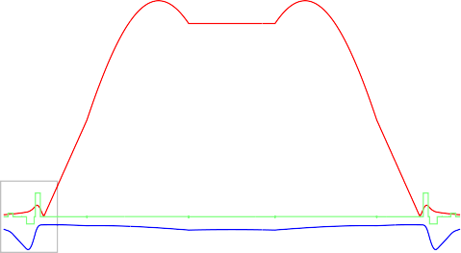
Beam envelopes vs. magnification (zoom)
12
magnification=1/9
1
0.5
x-envelope/cm
-y-envelope/cm focal power
10
slit.A
Q4
slit.B
0
-0.5
-1
Q1
Q2
Q3
Q5
8
6
4
0 20 40 60 80 100
2
0
entry-----
exit------
entry-----
exit------
dipole.1
dipole.2
slit.A
slit.B Q5
Centre
slit.D
slit.E
Q1
Q2
Q3
Q4
Q5
Q4
Q3
Q2
Q1
-400
-200
0
200
distance/cm
400
600
800
Rick B. EMIS2025: ARIEL HRS
-7

Slide 18
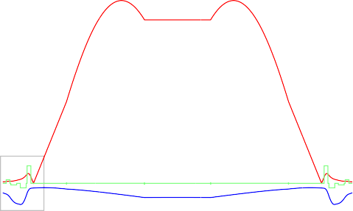
Beam envelopes vs. magnification (zoom)
12
magnification=1/10
1
0.5
x-envelope/cm
-y-envelope/cm focal power
10
slit.A
Q4
slit.B
0
-0.5
-1
Q1
Q2
Q3
Q5
8
6
4
0 20 40 60 80 100
2
0
entry-----
exit------
entry-----
exit------
dipole.1
dipole.2
slit.A
slit.B Q5
Centre
slit.D
slit.E
Q1
Q2
Q3
Q4
Q5
Q4
Q3
Q2
Q1
-400
-200
0
200
distance/cm
400
600
800
Rick B. EMIS2025: ARIEL HRS
-7

Slide 19
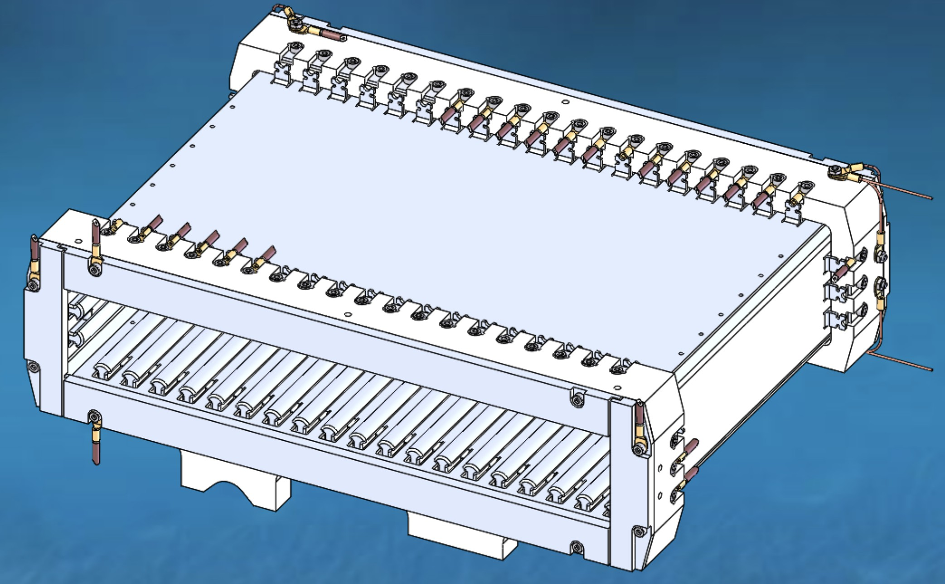
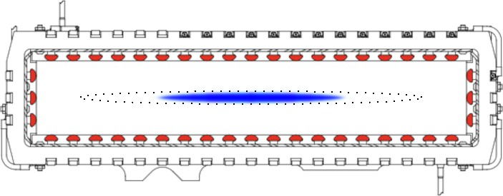
“Multipole”
HRS multipole corrector, viewed in the direction of the reference trajectory (left), and 3D (right). Inside size is 29 cm W by 5 cm H. Each electrode (Red) is 20 cm in length. Typical beam used so far is coloured Blue. Eventually it will be twice this width (dotted outline).
The electrodes are set according to an algorithm that uses the emittance scan at the mass slit (rotated 90◦ in phase space). No decomposition into multipole components is used or needed. This has been tested with success. [TRIUMF internal note TRI-BN-21-15]
Rick B. EMIS2025: ARIEL HRS
-6

Slide 20
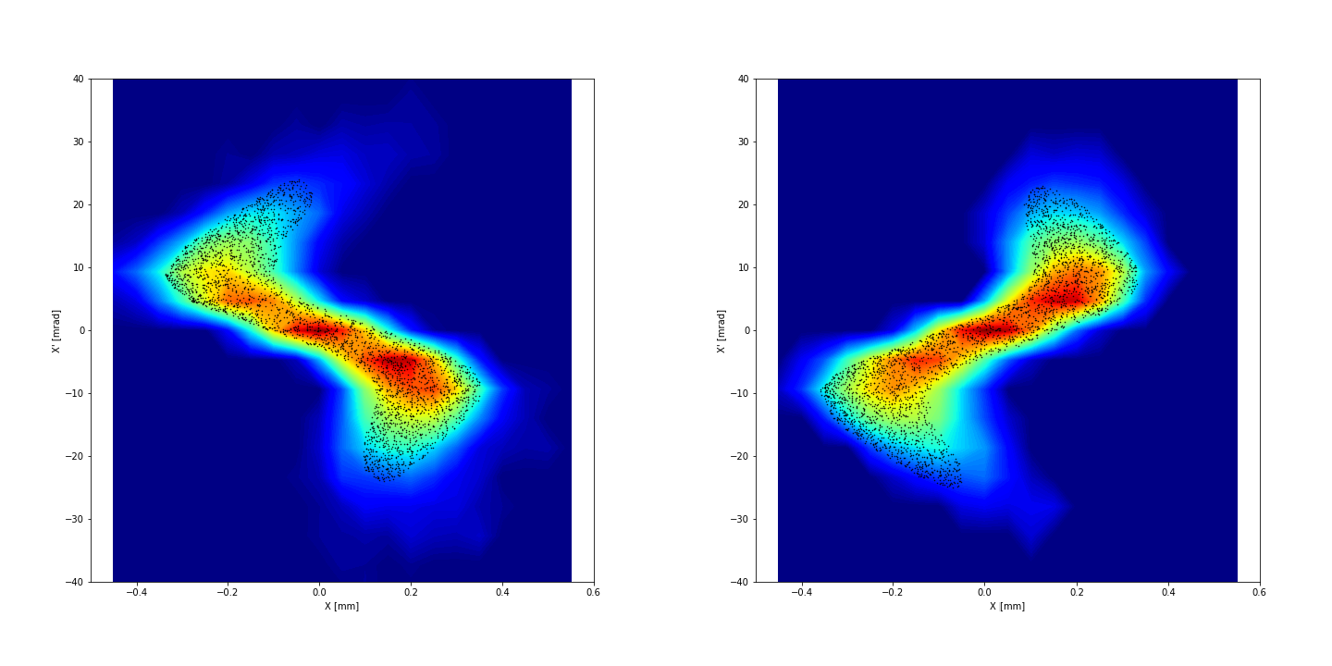
“Multipole” tests
Measured emittance scans at the mass slit using a ³⁹K source. In this test, the central multipole electrode was powered to 5 volts (left) and -5 volts (right). The coloured contours are from emittance scan, the Black dots are a ZGOUBI simulation using initial uniform beam.
[O. Lailey, M. Marchetto, S. Saminathan, TRIUMF internal note TRI-BN-21-15]
Rick B. EMIS2025: ARIEL HRS
-5

Slide 21
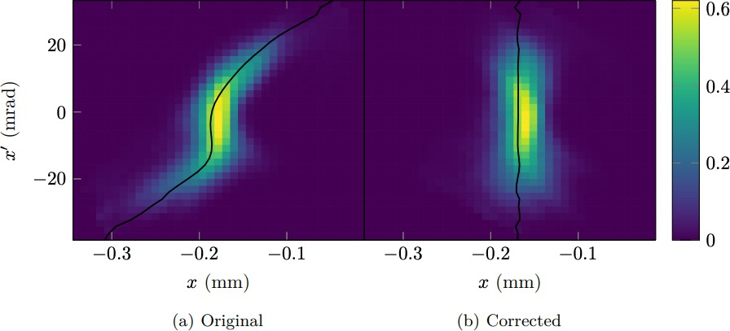
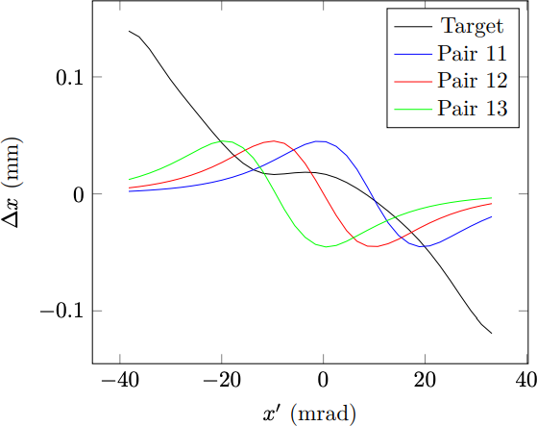
“Multipole” algorithm development
There are 19 electrode pairs; each forms a “basis function”. (Only 3 shown here.)
Emittance scan → Locus of centring error (black curve) → Set of electrode voltages
[J. Kraan, S. Saminathan, T. Planche, TRIUMF internal note TRI-BN-22-26]
Rick B. EMIS2025: ARIEL HRS
-4

Slide 22
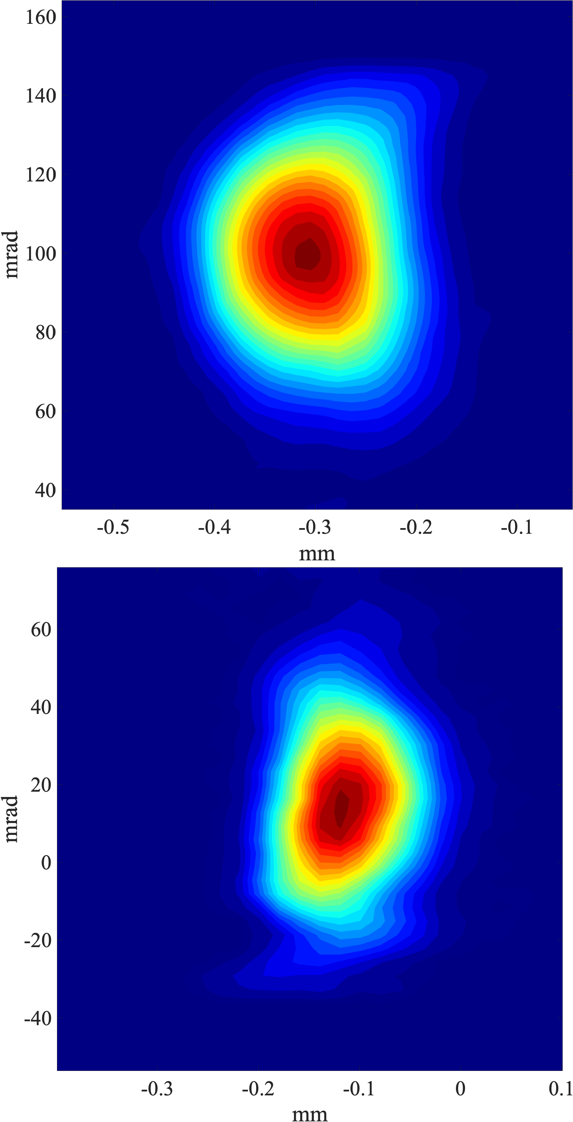
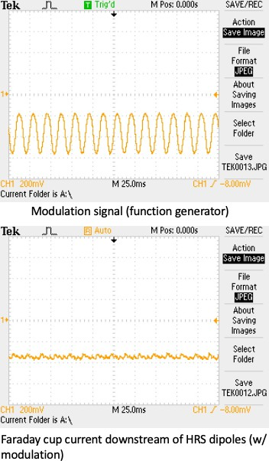
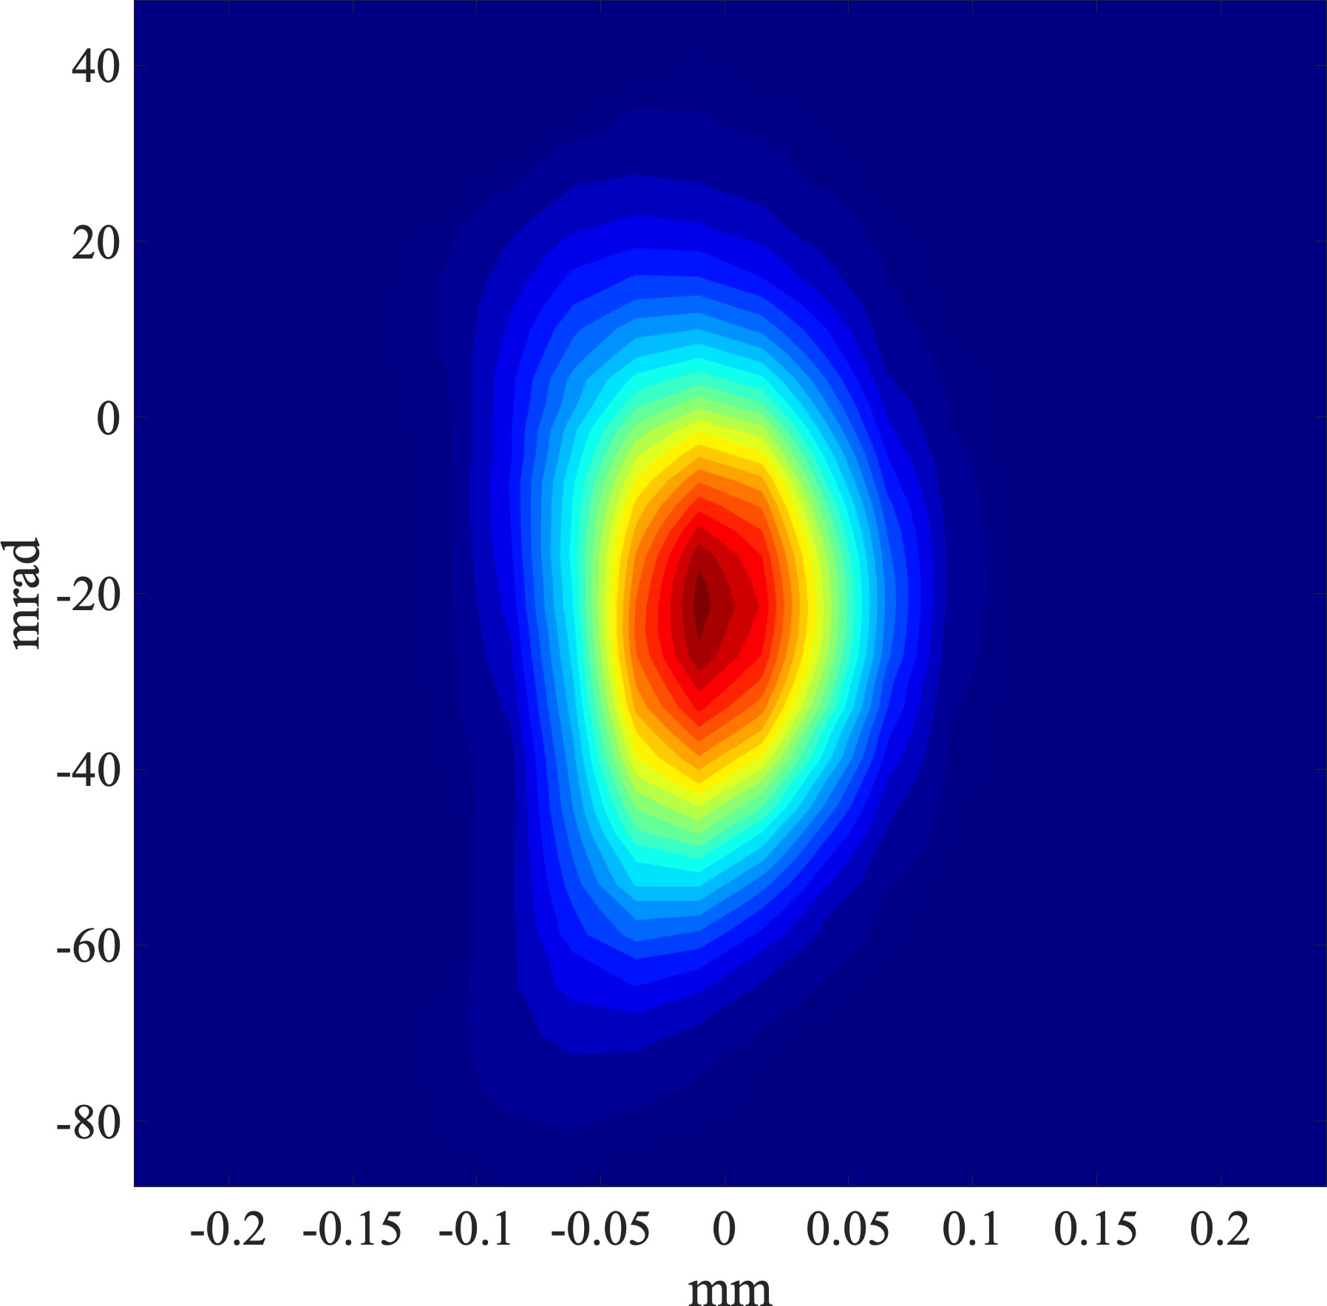
Anomalous emittance growth: found and cured
Above is emittance at object slit. On the right-top is resulting image at mass slit. FWHM=0.165mm.On the right-bottom is after correcting an offending 60Hz ripple in extraction power supply.
FWHM=0.120mm.
The beam energy, 30 keV, times extra beam width of 0.045 mm, divided by dispersion of 2.4 m implies a peak-to-peak ripple of 0.56 Volt.
N.B.: These show total divergence 2θ ∼ 80 mrad, so (eq. 1)
F = 2.4 m × 40 mrad/2 = 48000 µm; about half the HRS’s ulitmate capability.
Rick B. EMIS2025: ARIEL HRS
-3

Slide 23
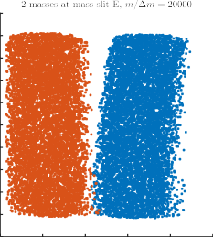
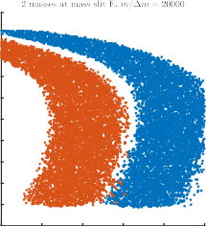
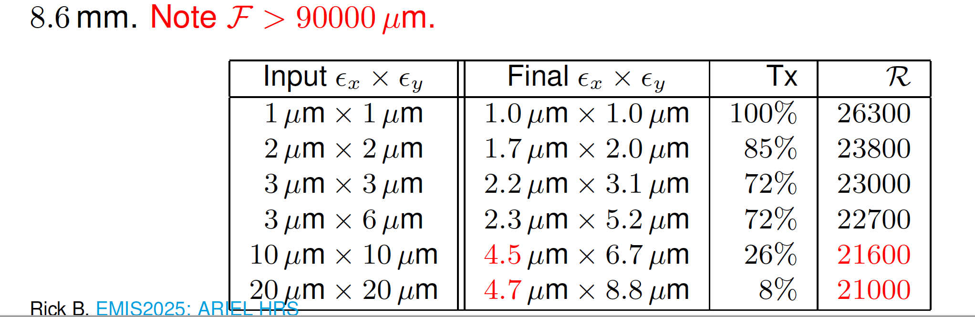
COSY-∞ Simulations: Resolution and Transmission
10
At left is the result at the mass slit: well separated beam at R = 20000. The transmission of the 10 πµm beam is 26%. For reference, the case on the right was calculated for multipole OFF.
10
8
8
6
6
4
4
2
2
0
0
-2
-2
-4
-4
-6
-6
-8
-8
-10
-1
-10
-1.5
-1 -0.5
0
0.5
1
-0.5
0
0.5
1
1.5
Table: Transmission and resolution at base (100% separation) versus input emittance (uniform ellipse). Slit ‘A’ is 0.8 mm by 12 mm; slit ‘C’ is 240 mm by
8.6 mm. Note F > 90000 µm.
Input Ex × Ey | Final Ex × Ey | Tx | R
1 µm × 1 µm 2 µm × 2 µm 3 µm × 3 µm 3 µm × 6 µm 10 µm × 10 µm 20 µm × 20 µm IEL HRS | 1.0 µm × 1.0 µm 1.7 µm × 2.0 µm 2.2 µm × 3.1 µm 2.3 µm × 5.2 µm 4.5 µm × 6.7 µm 4.7 µm × 8.8 µm | 100% 85% 72% 72% 26% 8% | 26300 23800 23000 22700 21600 21000
Rick B. EMIS2025: AR
-2

Slide 24
Conclusion
Caveat: The simulations show the design to be good, but they do not include misalignment or slit errors.
Status: Functioning of all optics has been successfully demonstrated. There are still diagnostic and controls issues to resolve; see Riley Schick-Martin poster. It has performed very well in part because the stable source has a too-small emittance of 3 µm; we have not yet explored the limits.
Rick B. EMIS2025: ARIEL HRS
-1

Slide 25
Acknowledgements
Marco Marchetto for magnet design, Jim Maloney for pure HRS parameters, Thomas Planche for clarifying physics of magnets and for ZGOUBI, Suresh Saminathan for commissioning, the co-op programs and the many students (Owen Lailey, Dan Sehayek, Joshua Kraan, ...) that were made available.
Rick B. EMIS2025: ARIEL HRS
0

Slide 26
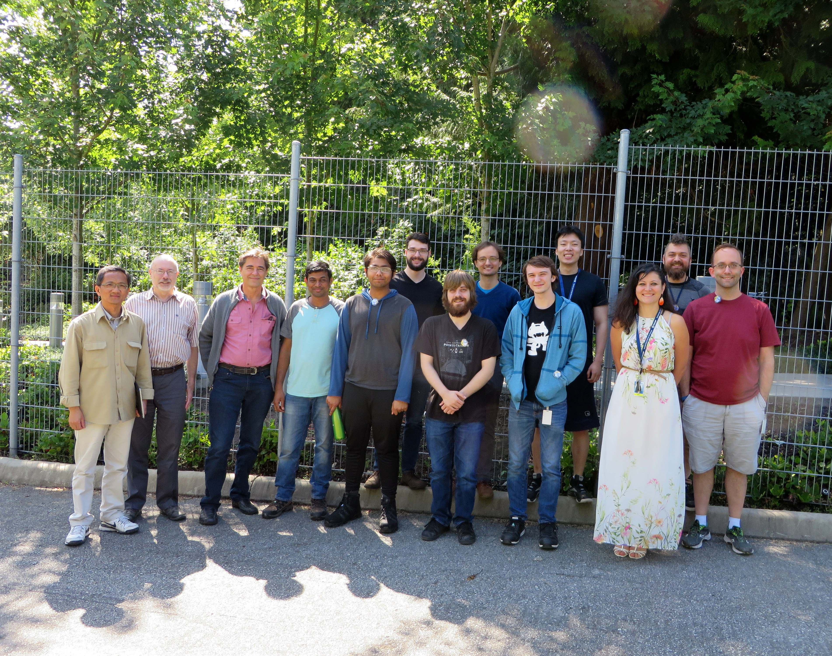
Thank you Merci

Slide 27
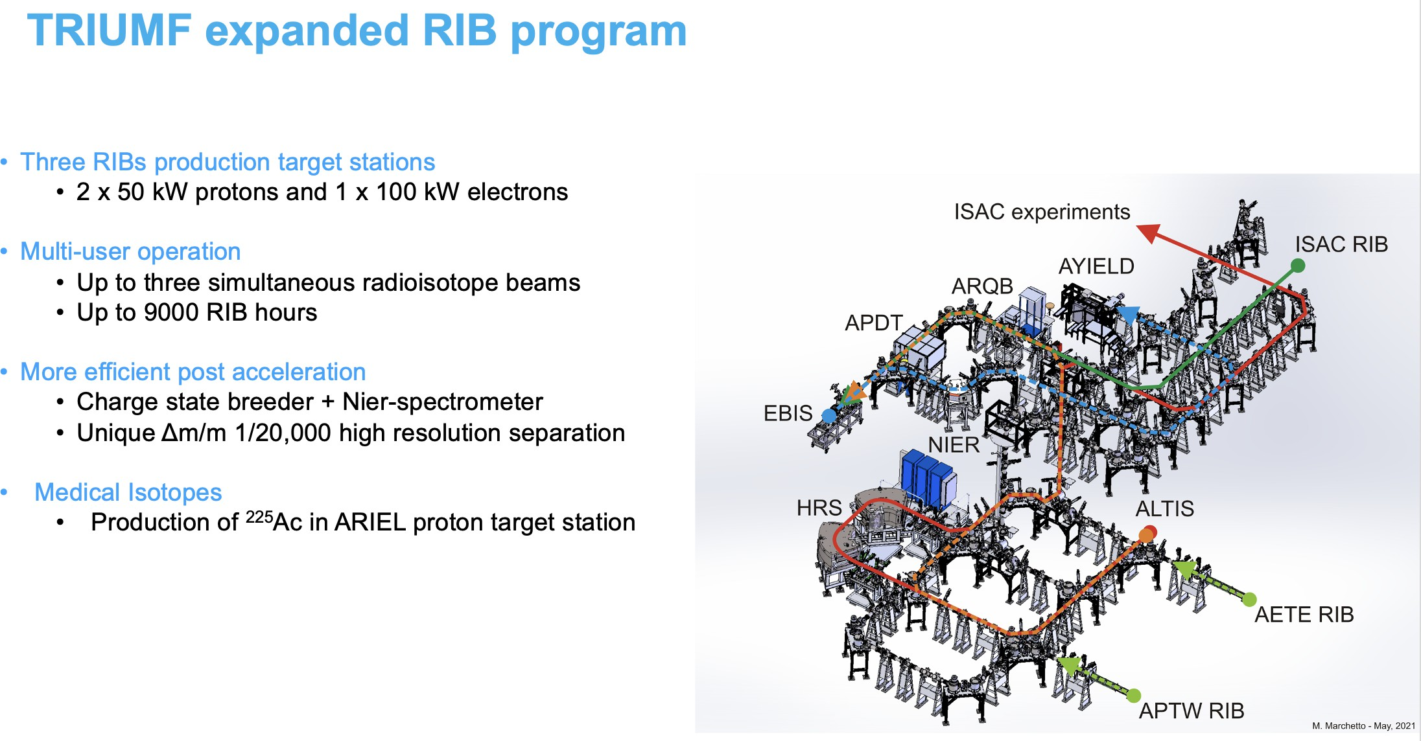
Rick B. EMIS2025: ARIEL HRS

Slide 28
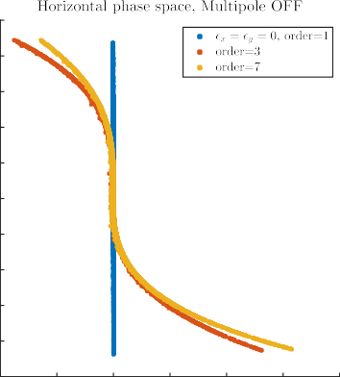
COSY-∞ Simulations
100
80
Simulating “pure” separator, i.e. from slit ‘B’ (with zero width to clearly see x-aberration) to slit D, and multipole OFF.
60
40
20
0
-20
Multipole can accept and correct up to ±75 mrad (2θ = 150 mrad as in slide -14.)
-40
-60
-80
-100
-0.4
-0.2
0
0.2
0.4
0.6
0.8
Rick B. EMIS2025: ARIEL HRS

Slide 29
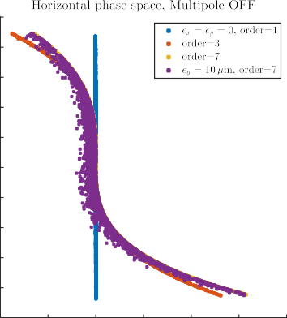
COSY-∞ Simulations
Simulating “pure” separator, i.e. from slit ‘B’ (with zero width to clearly see x-aberration) to slit D, and multipole OFF.
100
80
60
40
20
Multipole can accept and correct up to ±75 mrad (2θ = 150 mrad as in slide -14.)
0
-20
-40
-60
Purple: Smear caused by nonlinear coupling when y beam size in dipoles allowed to reach 16 mm full vertical size.
-80
-100
-0.4
-0.2
0
0.2
0.4
0.6
0.8
Rick B. EMIS2025: ARIEL HRS

Slide 30
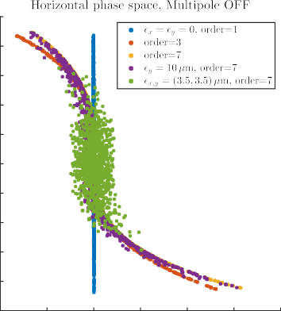
COSY-∞ Simulations
Simulating “pure” separator, i.e. from slit ‘B’ (with zero width to clearly see x-aberration) to slit D, and multipole OFF.
100
80
60
40
20
Multipole can accept and correct up to
±75 mrad (2θ = 150 mrad as in slide
-14.)
0
-20
-40
Green dots are a Gaussian to represent the stable source used up till now. Clearly this is consistent with hardly having to use the multipole up to this point.
-60
-80
-100
-0.4
-0.2
0
0.2
0.4
0.6
0.8
Rick B. EMIS2025: ARIEL HRS

Slide 31
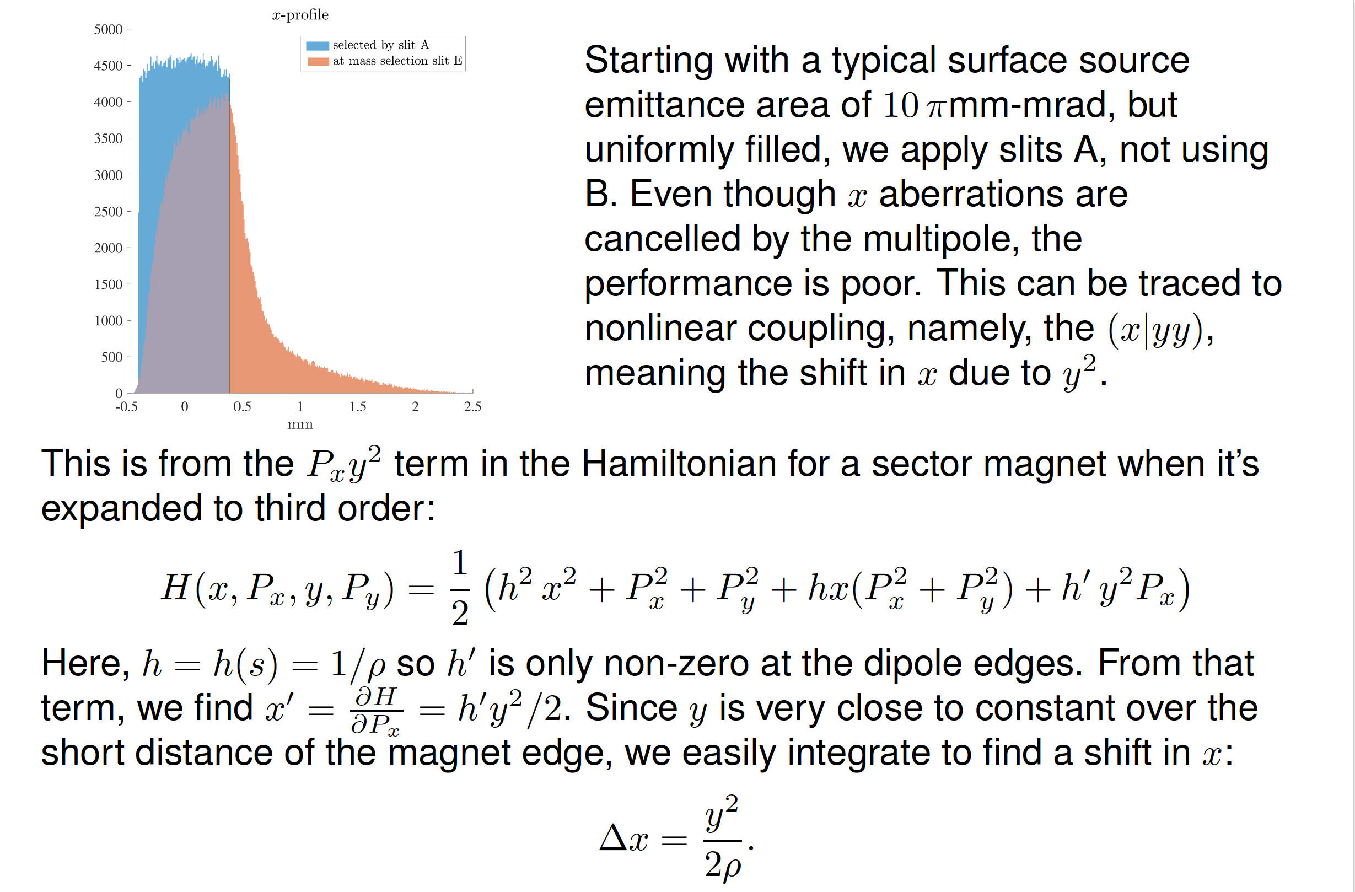
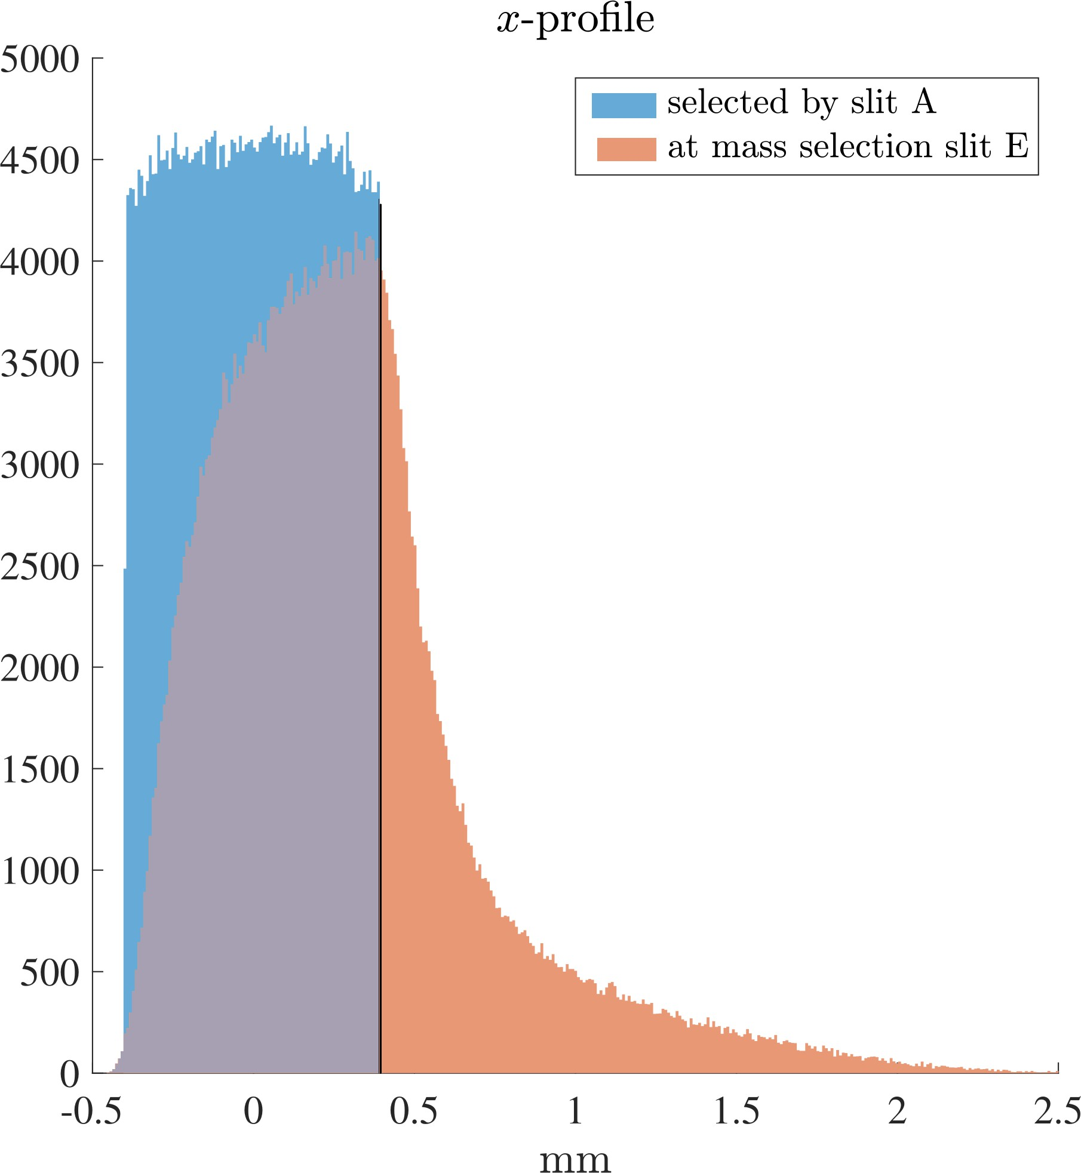
COSY-∞ Simulations of Ultimate Performance
Starting with a typical surface source emittance area of 10 πmm-mrad, but uniformly filled, we apply slits A, not using
B. Even though x aberrations are cancelled by the multipole, the performance is poor. This can be traced to nonlinear coupling, namely, the (x|yy), meaning the shift in x due to y².
This is from the P_{x}y² term in the Hamiltonian for a sector magnet when it’s expanded to third order:
1
( )
2 2 2 2 2 2 t 2
H(x, P , y, P ) = h x + P + P + hx(P + P ) + h y P
x y
2
x y x y x
Here, h = h(s) = 1/ρ so h^{t} is only non-zero at the dipole edges. From that
term, we find x^{t} = ^{∂H} = h^{t}y²/2. Since y is very close to constant over the
∂Px
short distance of the magnet edge, we easily integrate to find a shift in x:
_{y}2
∆x = .
2ρ
Rick B. EMIS2025: ARIEL HRS

Slide 32
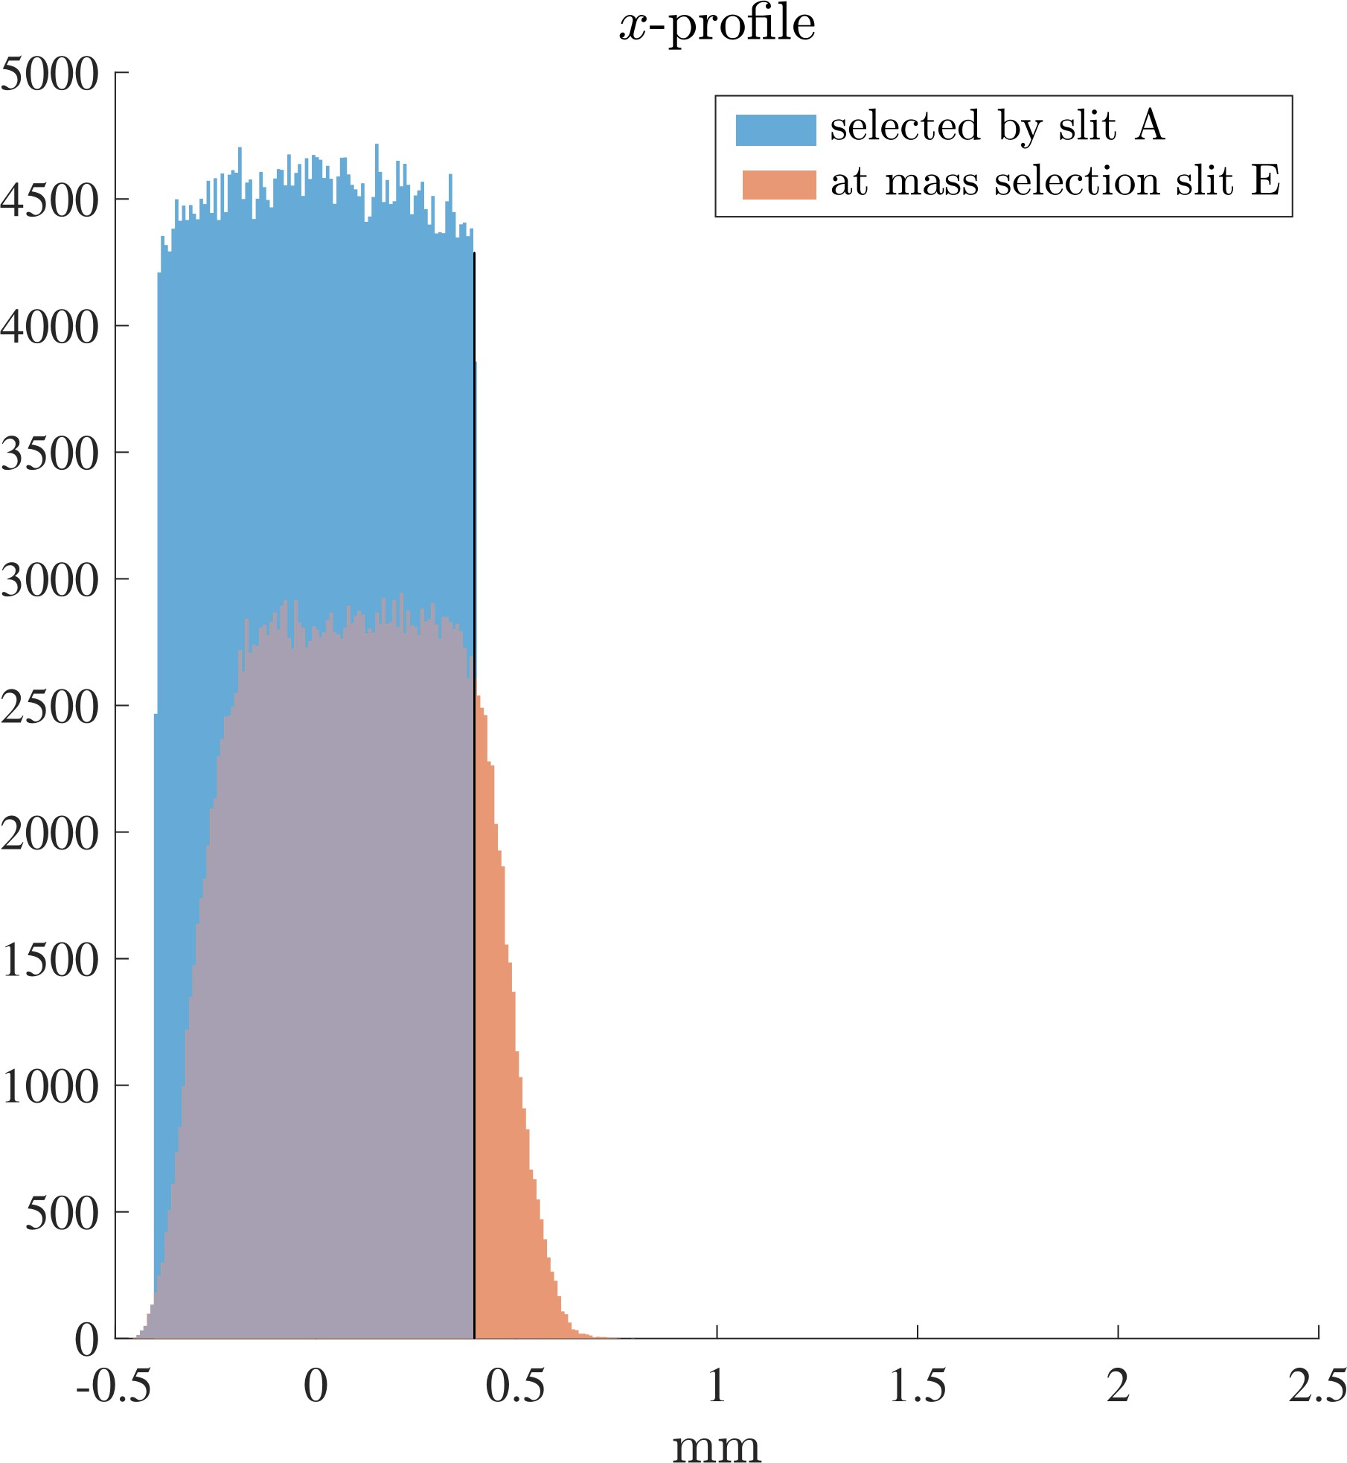
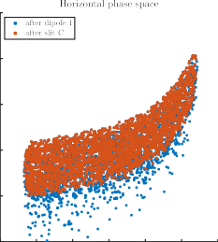
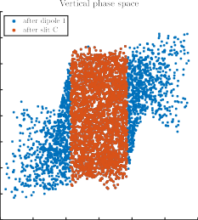
COSY-∞ Simulations with slit C
With slit ‘C’ set to 9 mm full height, the final focus is restored to 1.0 mm FW.
0.15
2
At right we can see the effect of the slit C; it collimates the vertical beam and eliminates the downward smear of the horizontal beam.
1.5
0.1
1
0.05
0.5
0
0
-0.5
-0.05
-1
-1.5
-0.1
-150
-100 -50 0 50 100 150
-2
-15
-10
-5
0
5 10
15
Rick B. EMIS2025: ARIEL HRS

Slide 33

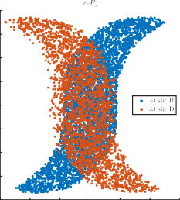
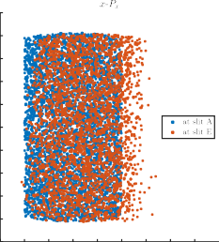
COSY-∞ Simulations: Aberrations in the 4-Quad magnifier
At left we can see large third order aberration of the 4-quad match/magnifier.
These are cancelled by the multipole and by the fact that the pure separator is an exact
−I.
80
10
8
6
4
2
0
-2
-4
-6
-8
-10
60
40
20
0
-20
-40
-60
In spite of the
“S”-shaped distortion, the beam arrives at the mass slit upright, as seen on the right.
-80
-0.15
-0.1 -0.05 0 0.05 0.1 0.15
-0.6 -0.4 -0.2 0 0.2 0.4 0.6 0.8 1
Rick B. EMIS2025: ARIEL HRS

