Slide 1


Towards in-trap laser spectroscopy of fast radioactive ions
Stefanos Pelonis, PhD student
Instituut voor Kern- en Stralingsfysica, KU Leuven, Belgium
20th International Conference on Electromagnetic Isotope Separators and Related Topics (EMISXX 2025)

Slide 2
Motivation
Lots of theoretical effort in understanding the Strong Nuclear Force exists within our community.
However:
These theories require experimental input for benchmarking
A particularly successful technique is laser spectroscopy, which gives access to 4 complementary quantities in a model-independent way:
Magnetic dipole moment (μ)
Nuclear spin (I)
Electric quadrupole moment (Q_{s})
Nuclear charge radius (δ<r²>)

Slide 3
Motivation
Experimental precision
GHz
What can we gain from increased precision?
RIS
Requirements:
EM moments (μ,Q_{s})
CLS
CRIS
To obtain nuclear observables with high precision, one needs:
Charge radii (δr²)
MHz
Narrow transitions (Hz) like dipole forbidden E2 transitions
ABMR
Narrow lasers
Higher order EM (Ω)
Elimination of Doppler broadening
kHz
TRAPS
Higher order radii (δr⁴)
Objectives:
Decelerate fast (radioactive) ions
Capture them in an ion trap
Cool them
Perform spectroscopy with narrow-band lasers and drive narrow transitions
Hz
Beyond Standard Model physics

Slide 4

Plan
Ion Source
Ions of interest
Contaminant
Bunching
Cooler-buncher
PMT
10s of keV
few eV ~ 1000s of K
Spectroscopy
laser
CAMERA
Deceleration
Few eV
Buffer gas cooling: 300K -> hot
Cryogenic buffer gas: few K -> hot
Trapping
Doppler laser cooling
Segmented ion trap

Slide 5
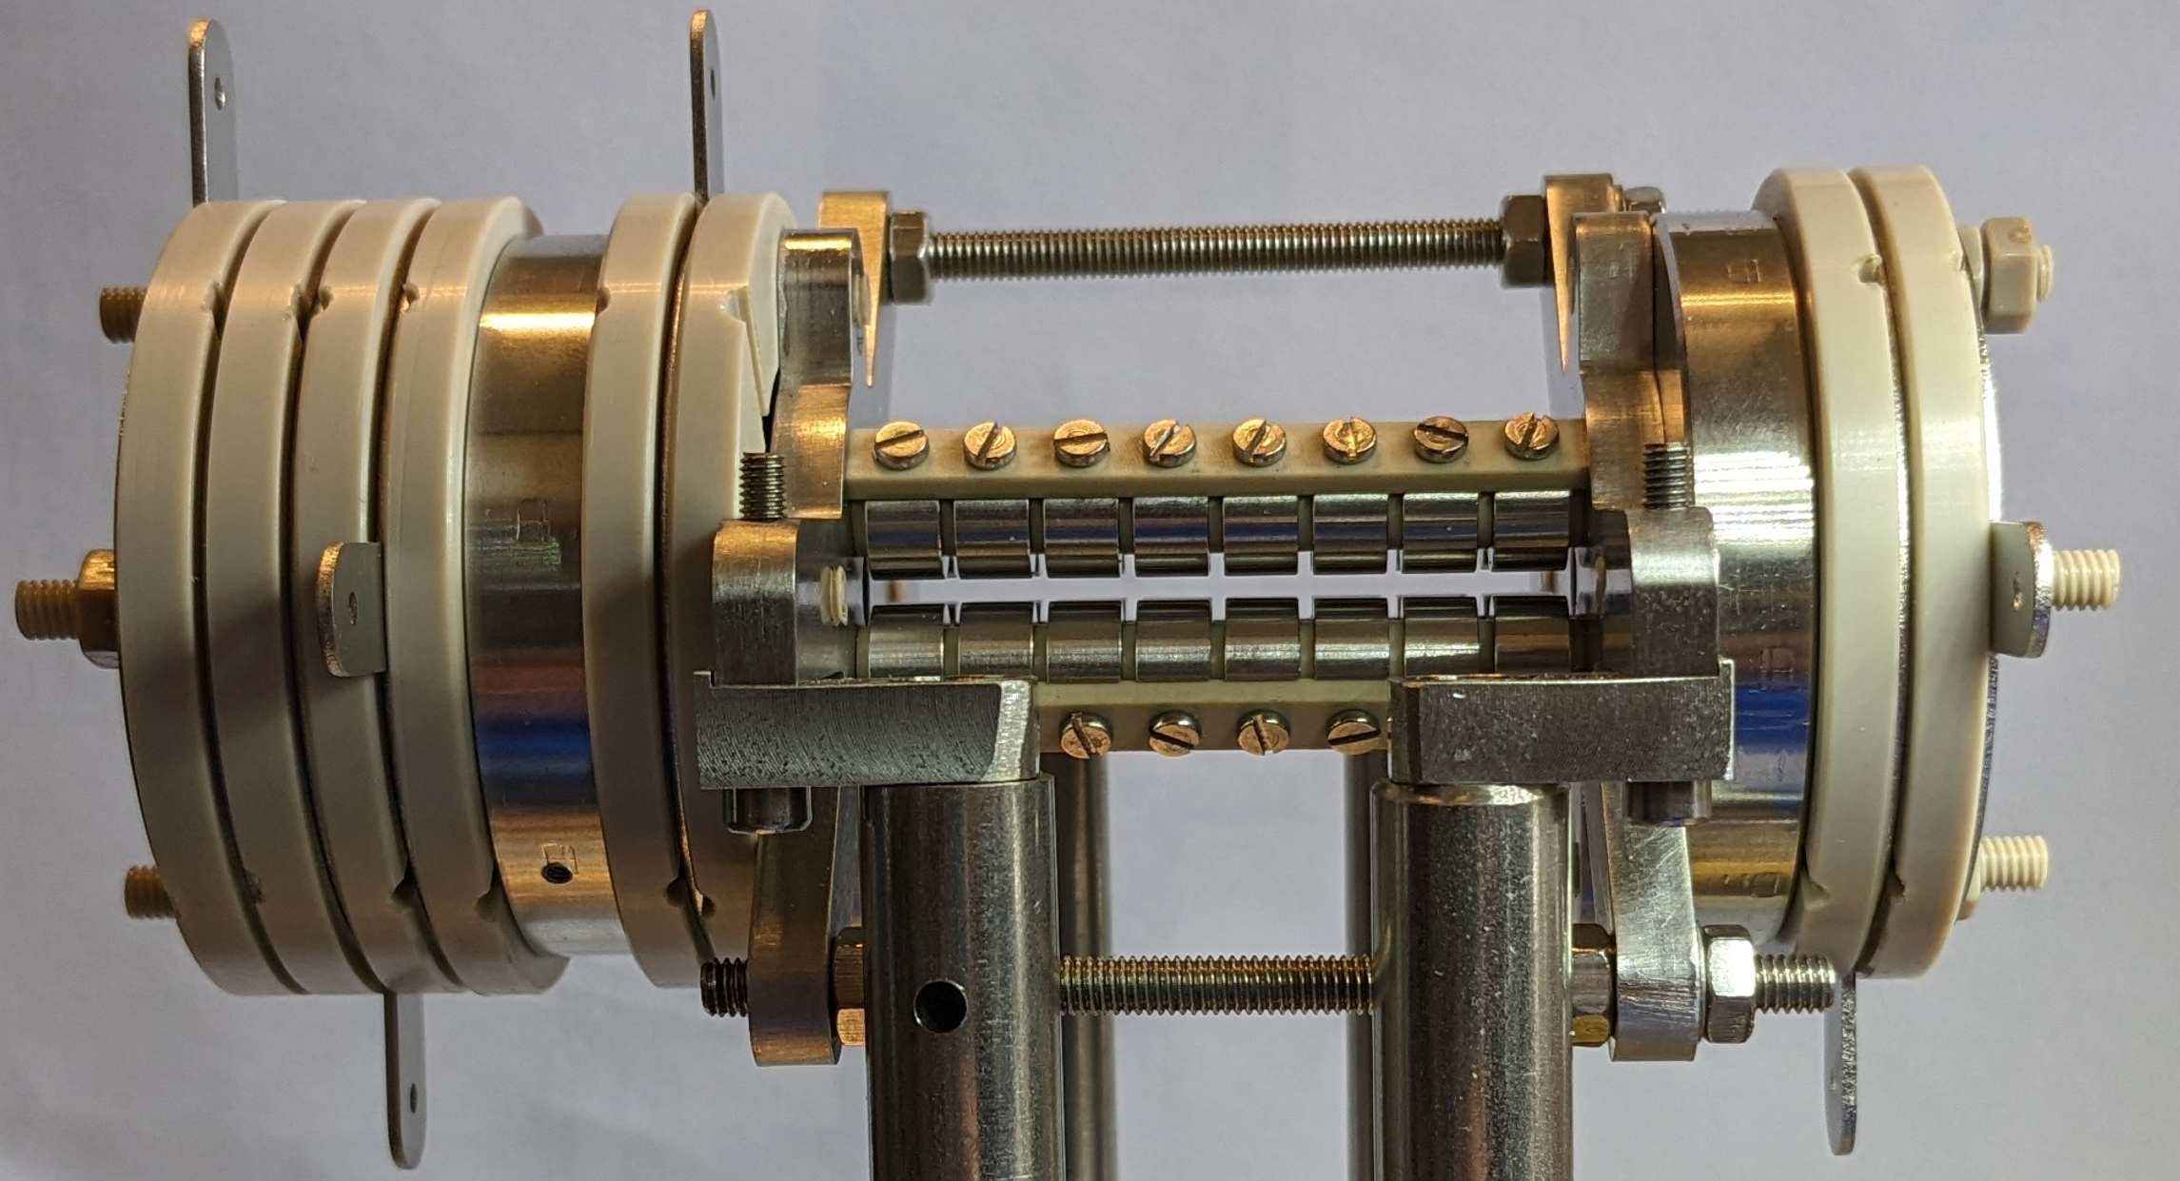
Plan
Ion Source
Ions of interest
Contaminant
Bunching
Cooler-buncher
5.5 cm
PMT
10s of keV
Spectroscopy
laser
CAMERA
Deceleration
Few eV
Trapping
Segmented ion trap

Slide 6
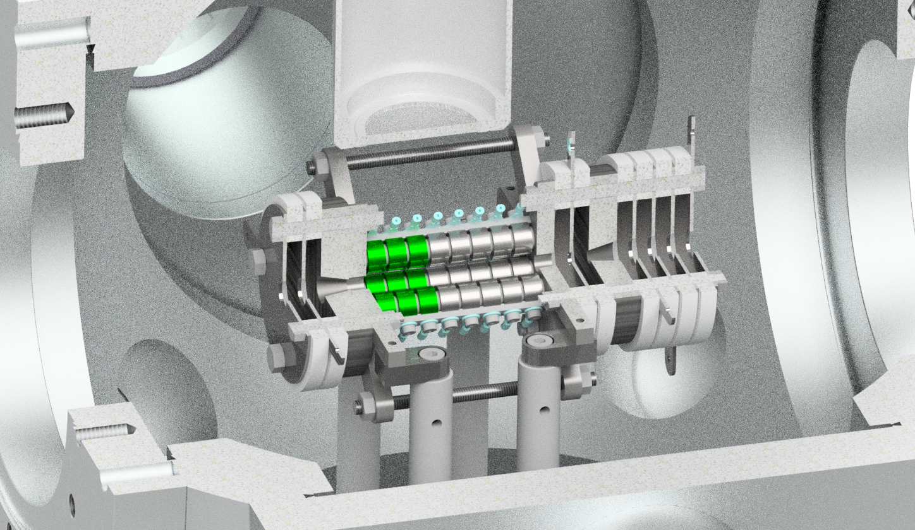
Plan
Ion trap setup:
V

Slide 7
Plan
Ion trap setup:
V

Slide 8
Plan
Ion trap setup:
V

Slide 9
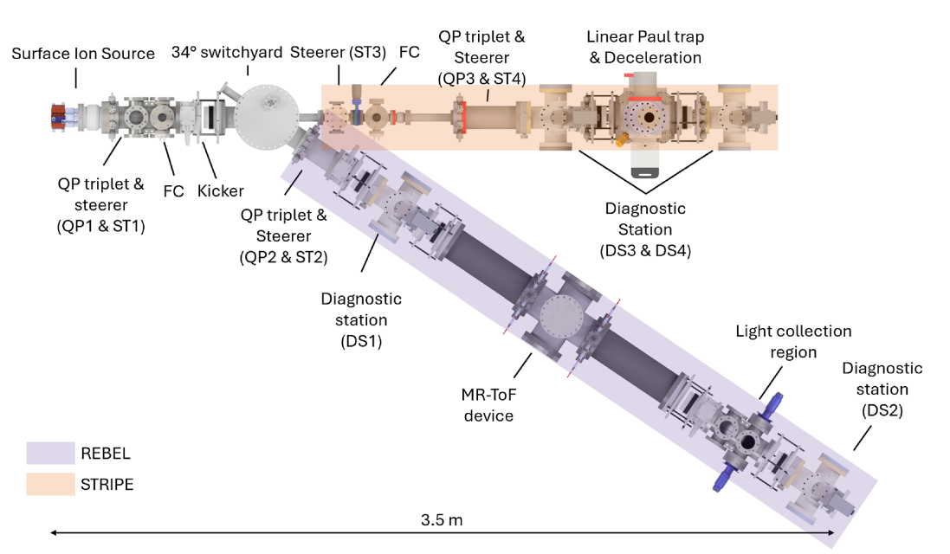
Plan
Stopping and Trapping Radioactive Ions for Precision Experiments (STRIPE)
REBEL & STRIPE:
Light Collection Region
MagneToF
Adapted from [1]
[1] P. Imgram et al. Review of Scientific Instruments 96 (2025) 093302

Slide 10
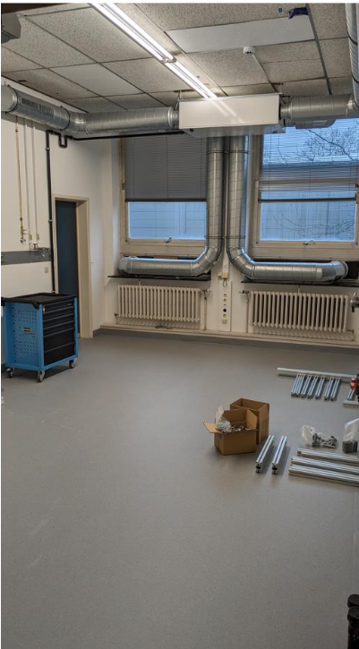
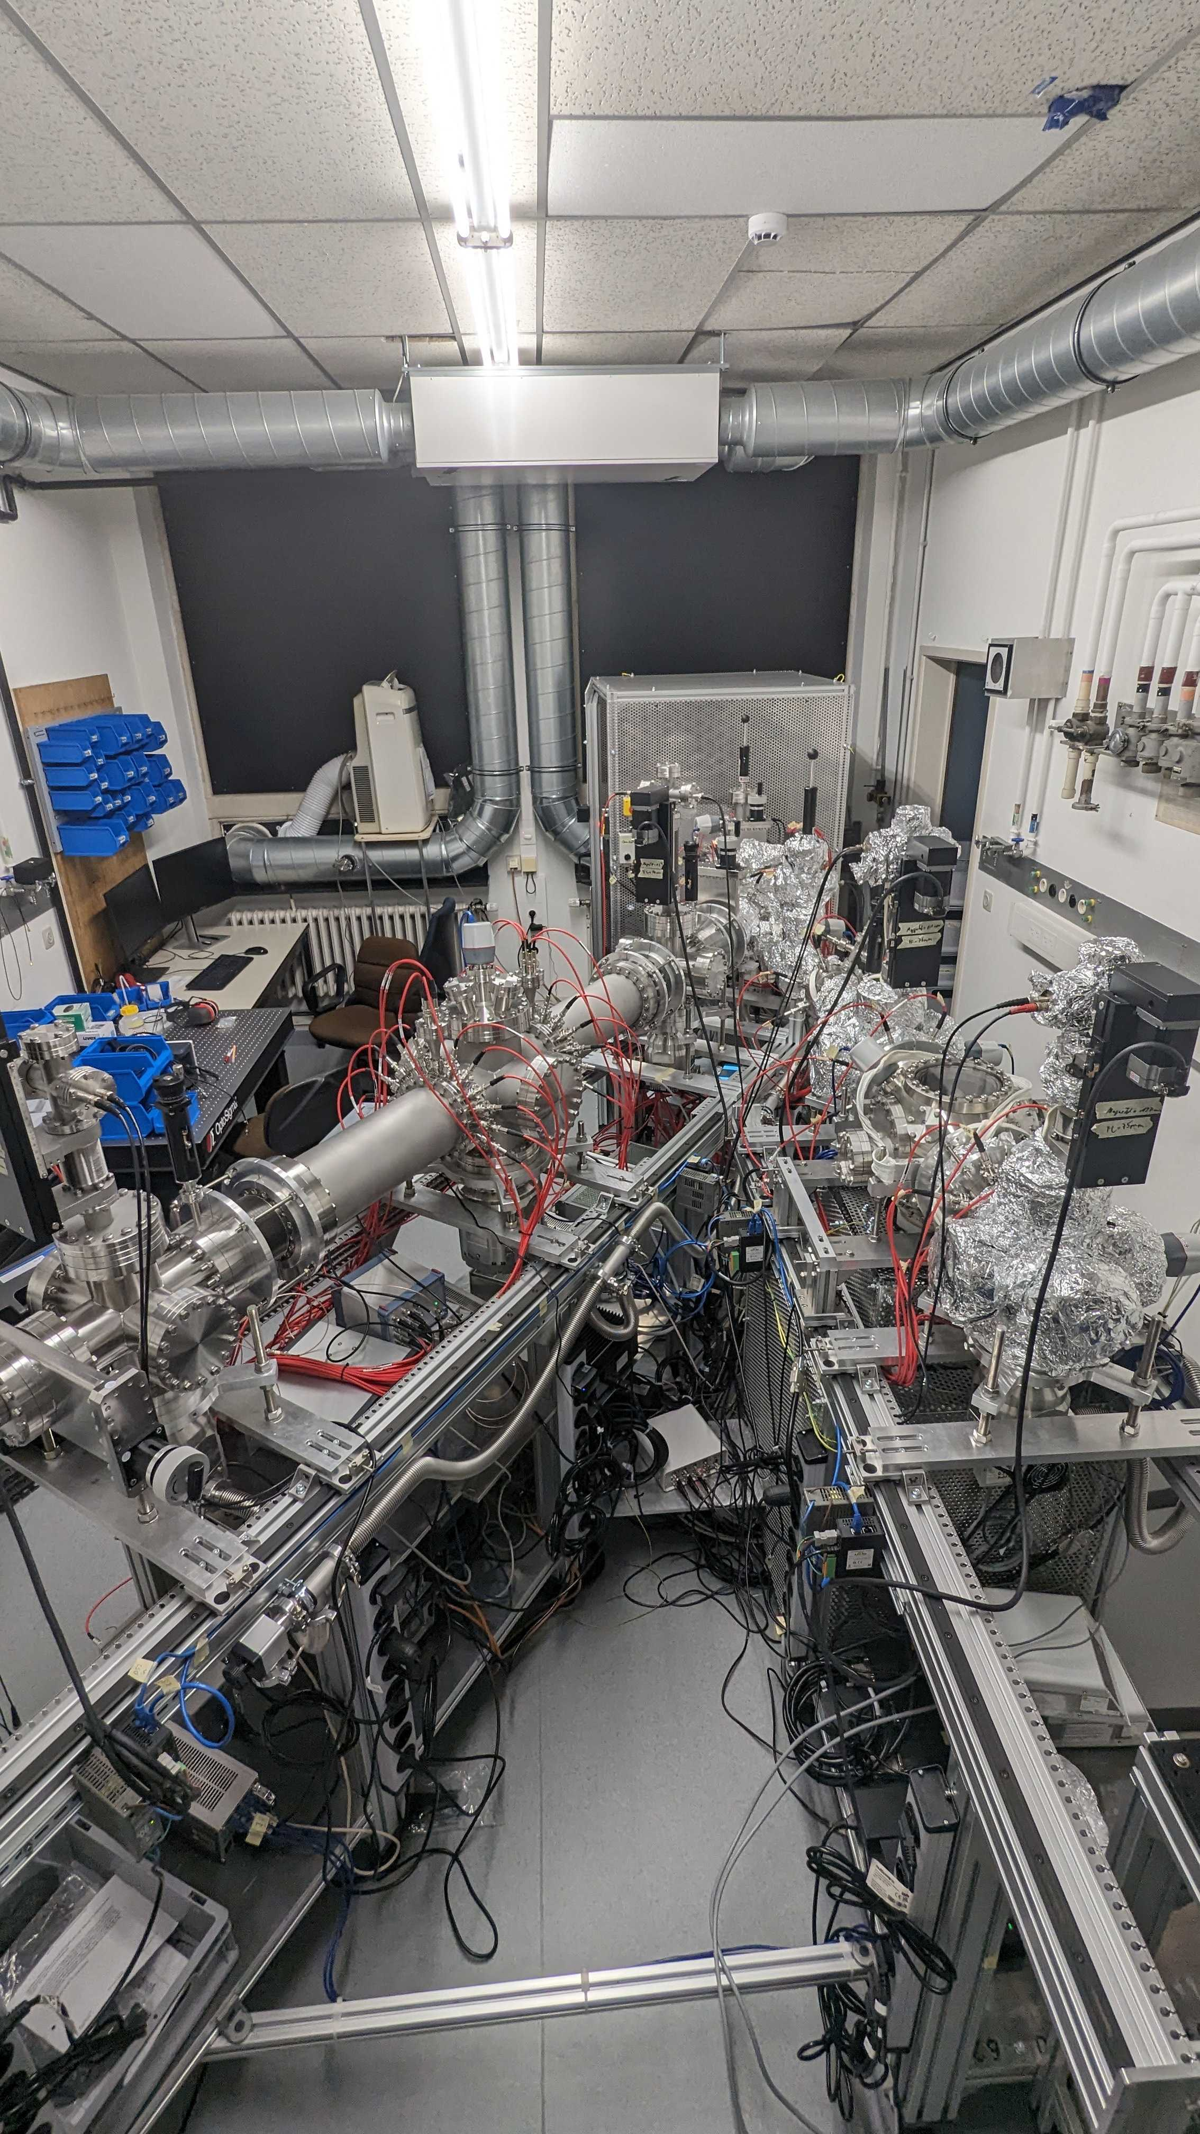
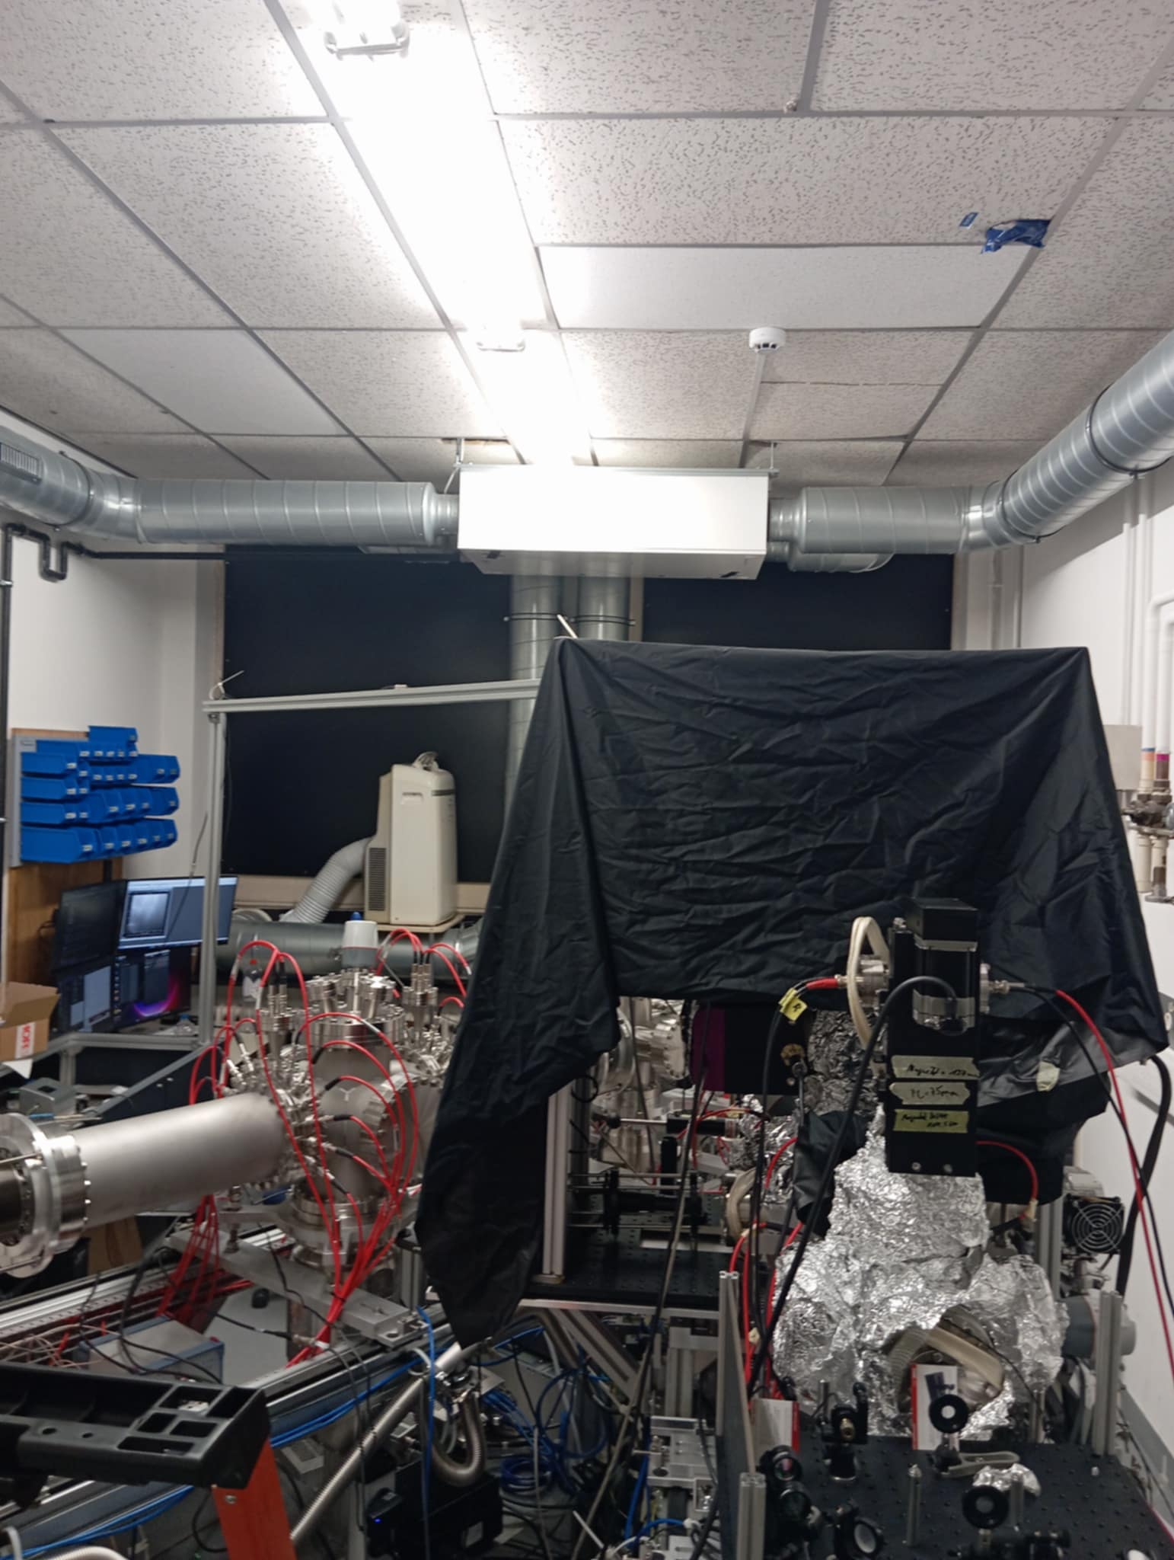
Plan
REBEL & STRIPE:
February 2024
December 2024
June 2025

Slide 11
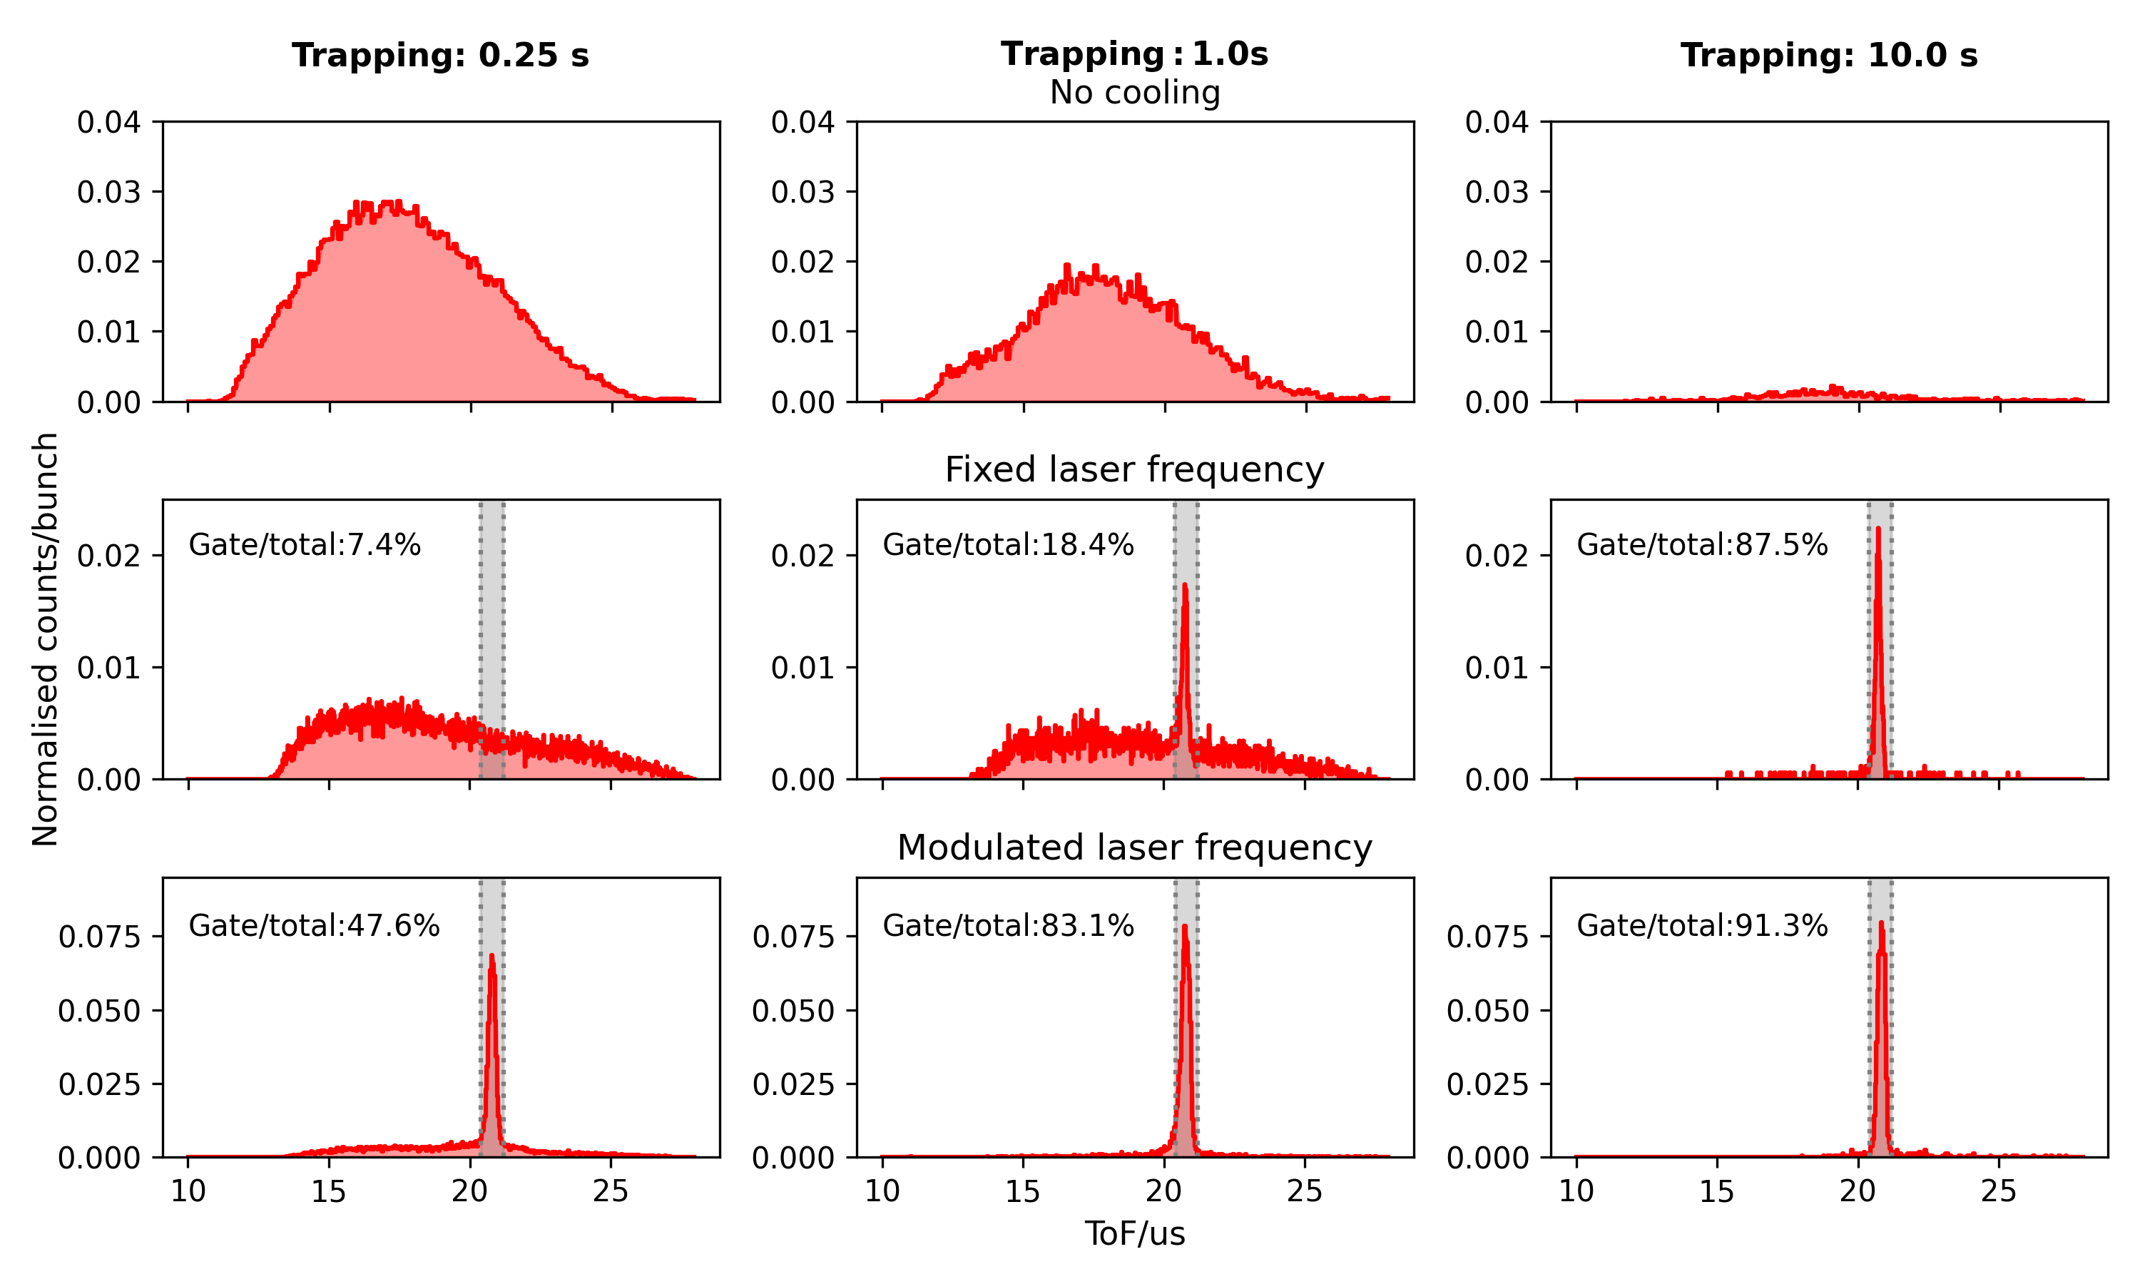

Measurements
How cold are these ions?
Trapping and laser cooling:
P_{1/2}
1092nm
422nm
D_{3/2}
S_{1/2}
422nm: cooling transition
1092nm: repump

Slide 12
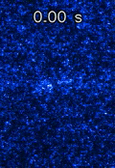
Measurements
Formation of Coulomb crystals:
⁸⁸Sr is being cooled
Settings:
12s cycle
Camera capture rate: 2 fps
Exposure time: 500 ms
The formation of Coulomb crystals proves that:
T = a few 10s of mK

Slide 13
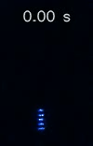
Measurements
Let’s move the ions around!
Formation of Coulomb crystals:
⁸⁸Sr is being cooled
Settings:
28s cycle
Camera capture rate: 2 fps
Exposure time: 500 ms
Typical trapping times:
Few hours at 1e-8 mbar

Slide 14
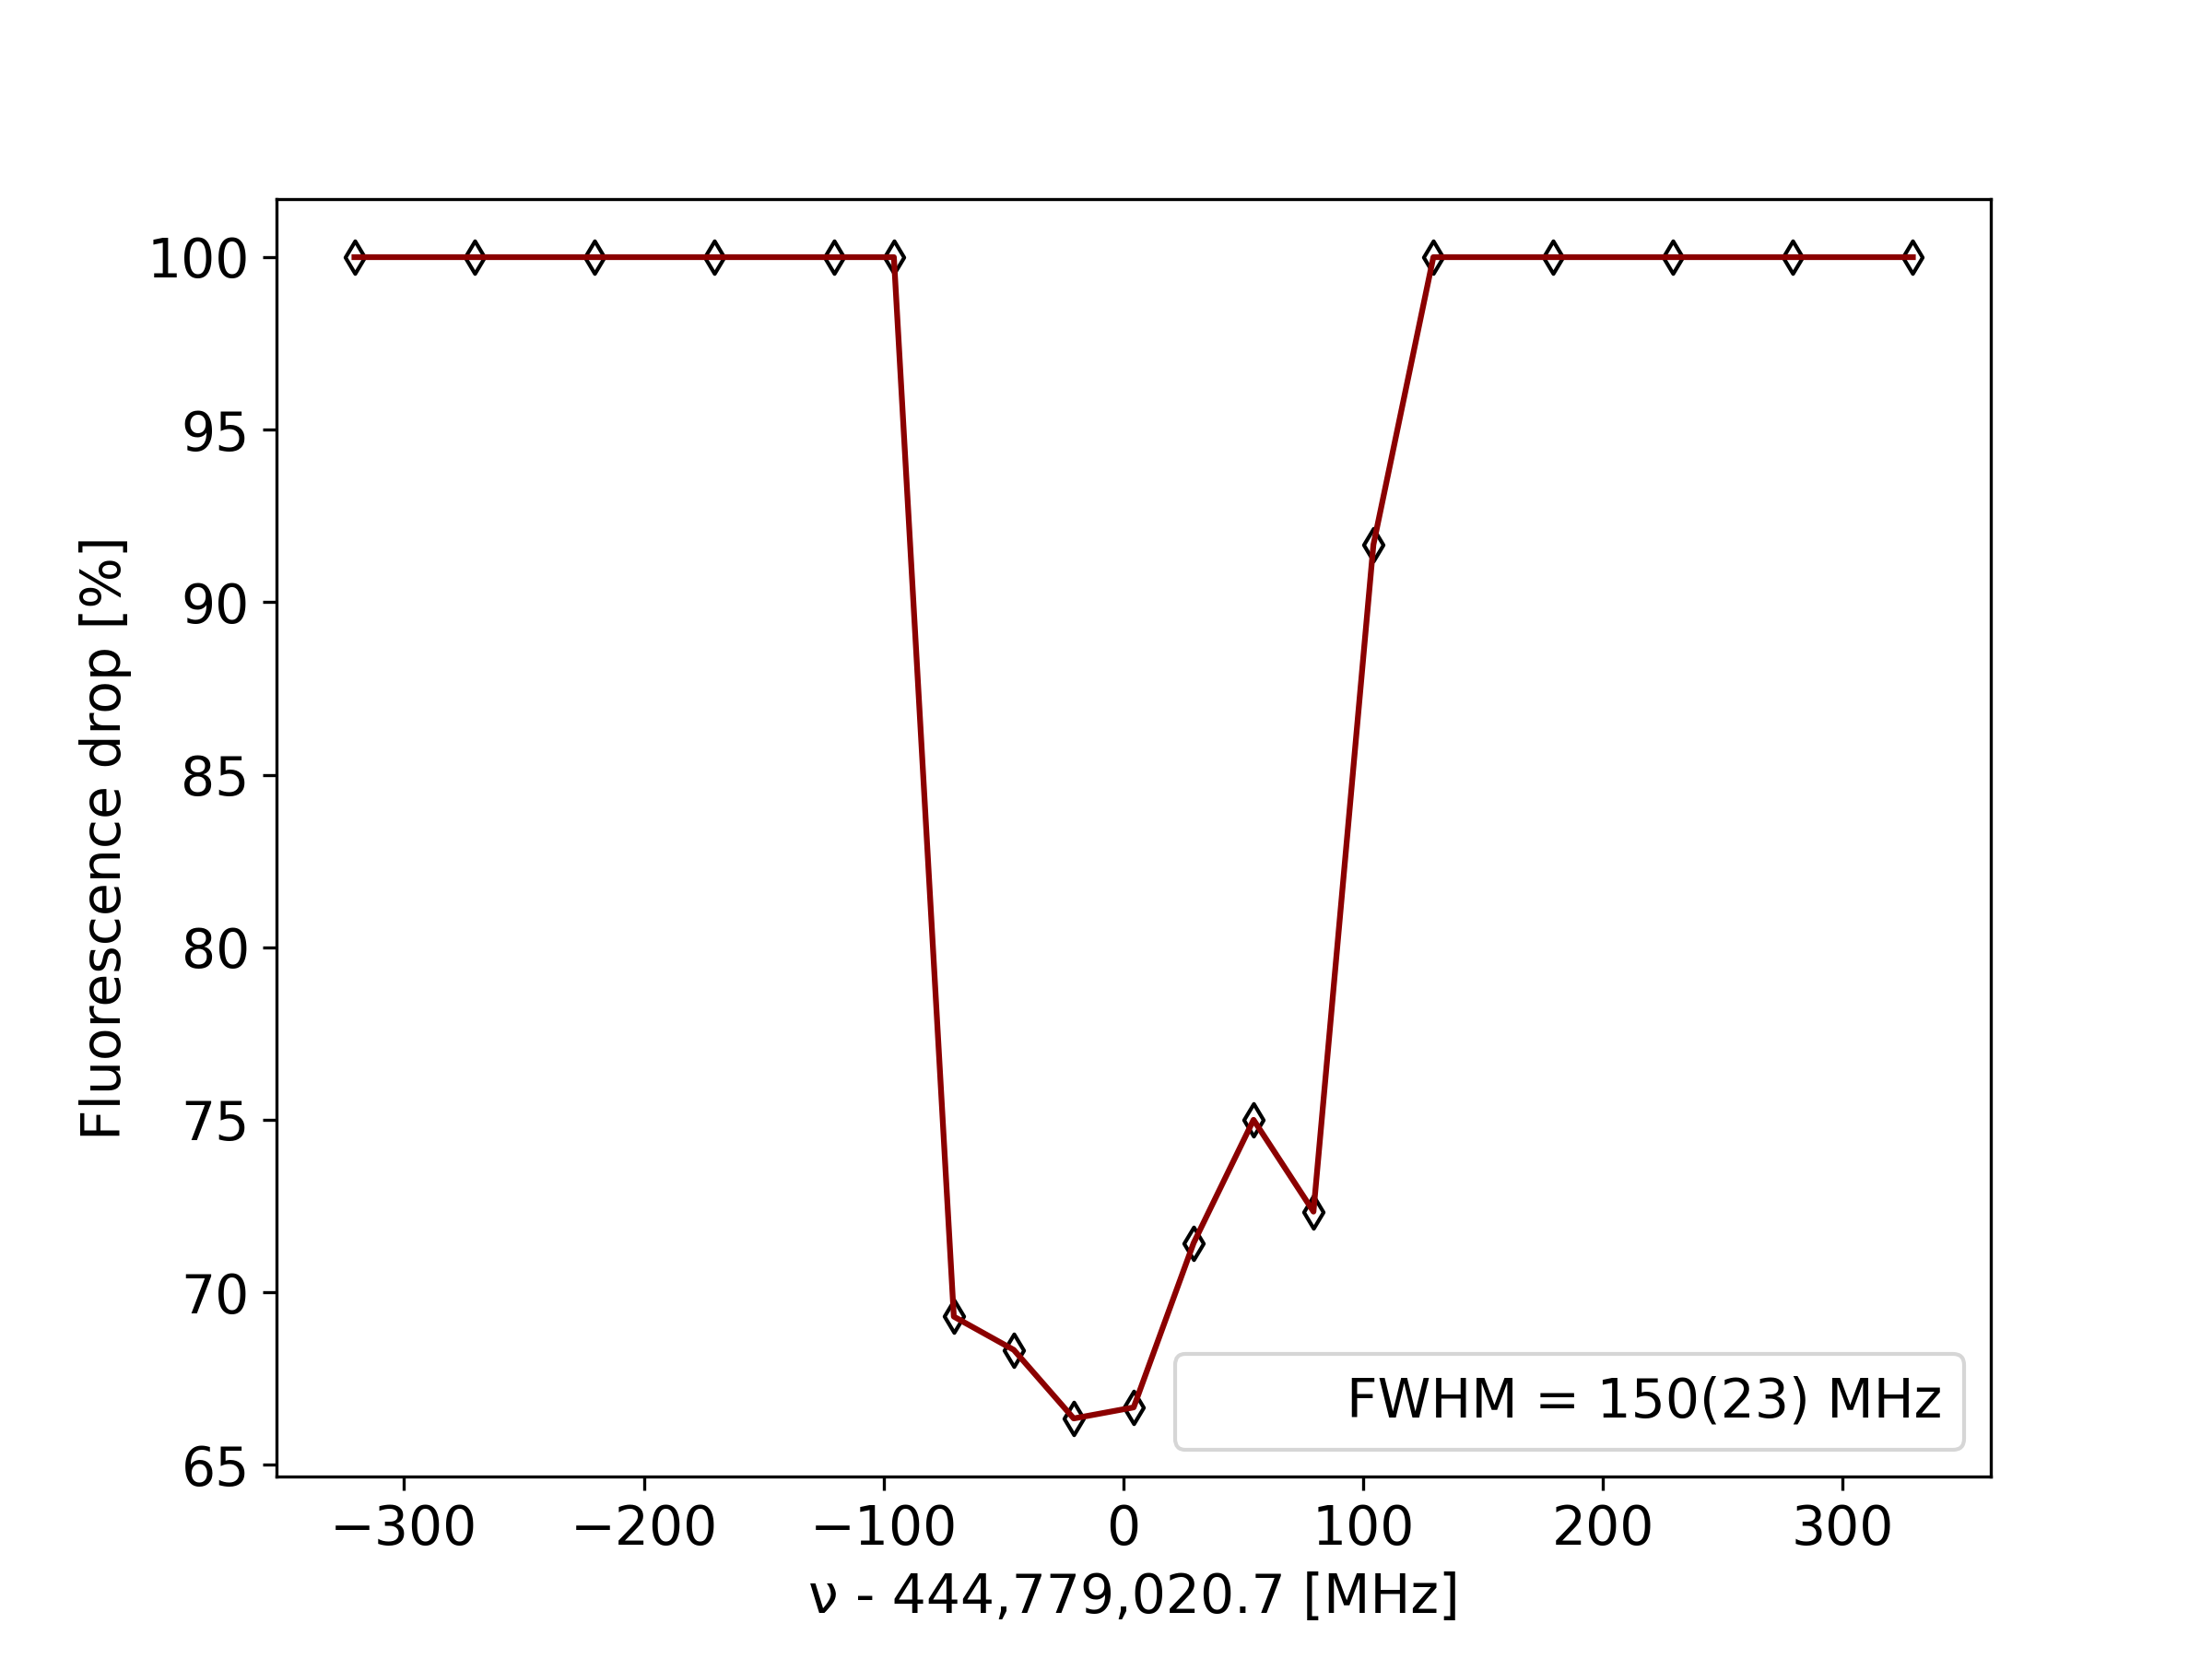
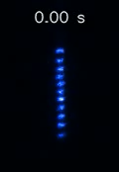
Measurements
Huge power broadening from the cooling transition
This work: 444,779,021.3(83) MHz
Lit: 444,779,044,095,485.5(9) Hz
In-trap laser spectroscopy:
Shelving of ⁸⁸Sr⁺ ions in the D_{5/2} state:
0-10s: ⁸⁸Sr⁺ is being cooled
10-20s: Ions shelved on the D_{5/2} state become dark
P_{1/2}
D_{5/2}
422nm
1092nm
D_{3/2}
674nm
S_{1/2}

Slide 15


Next steps
System stability:
Better routines of crystal stability and increased lifetime
Better micromotion control
Make sure they look like:
Instead of:

Slide 16
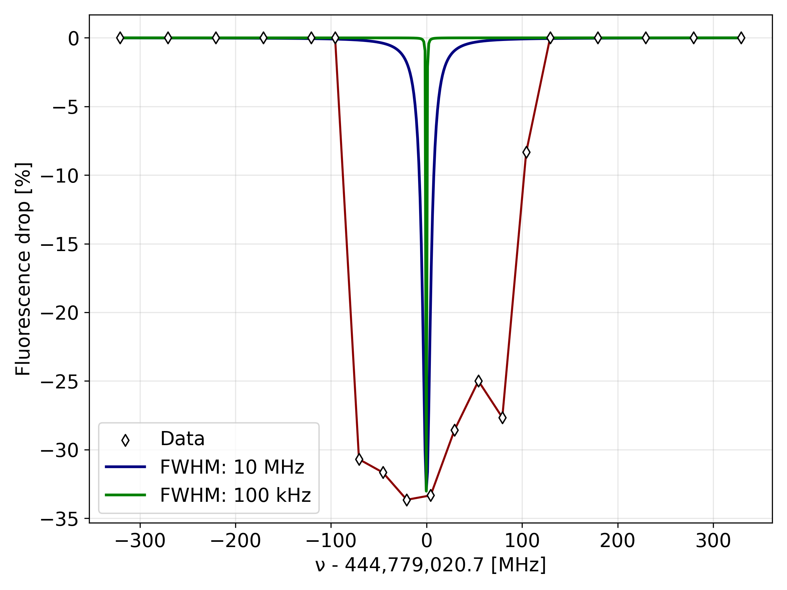
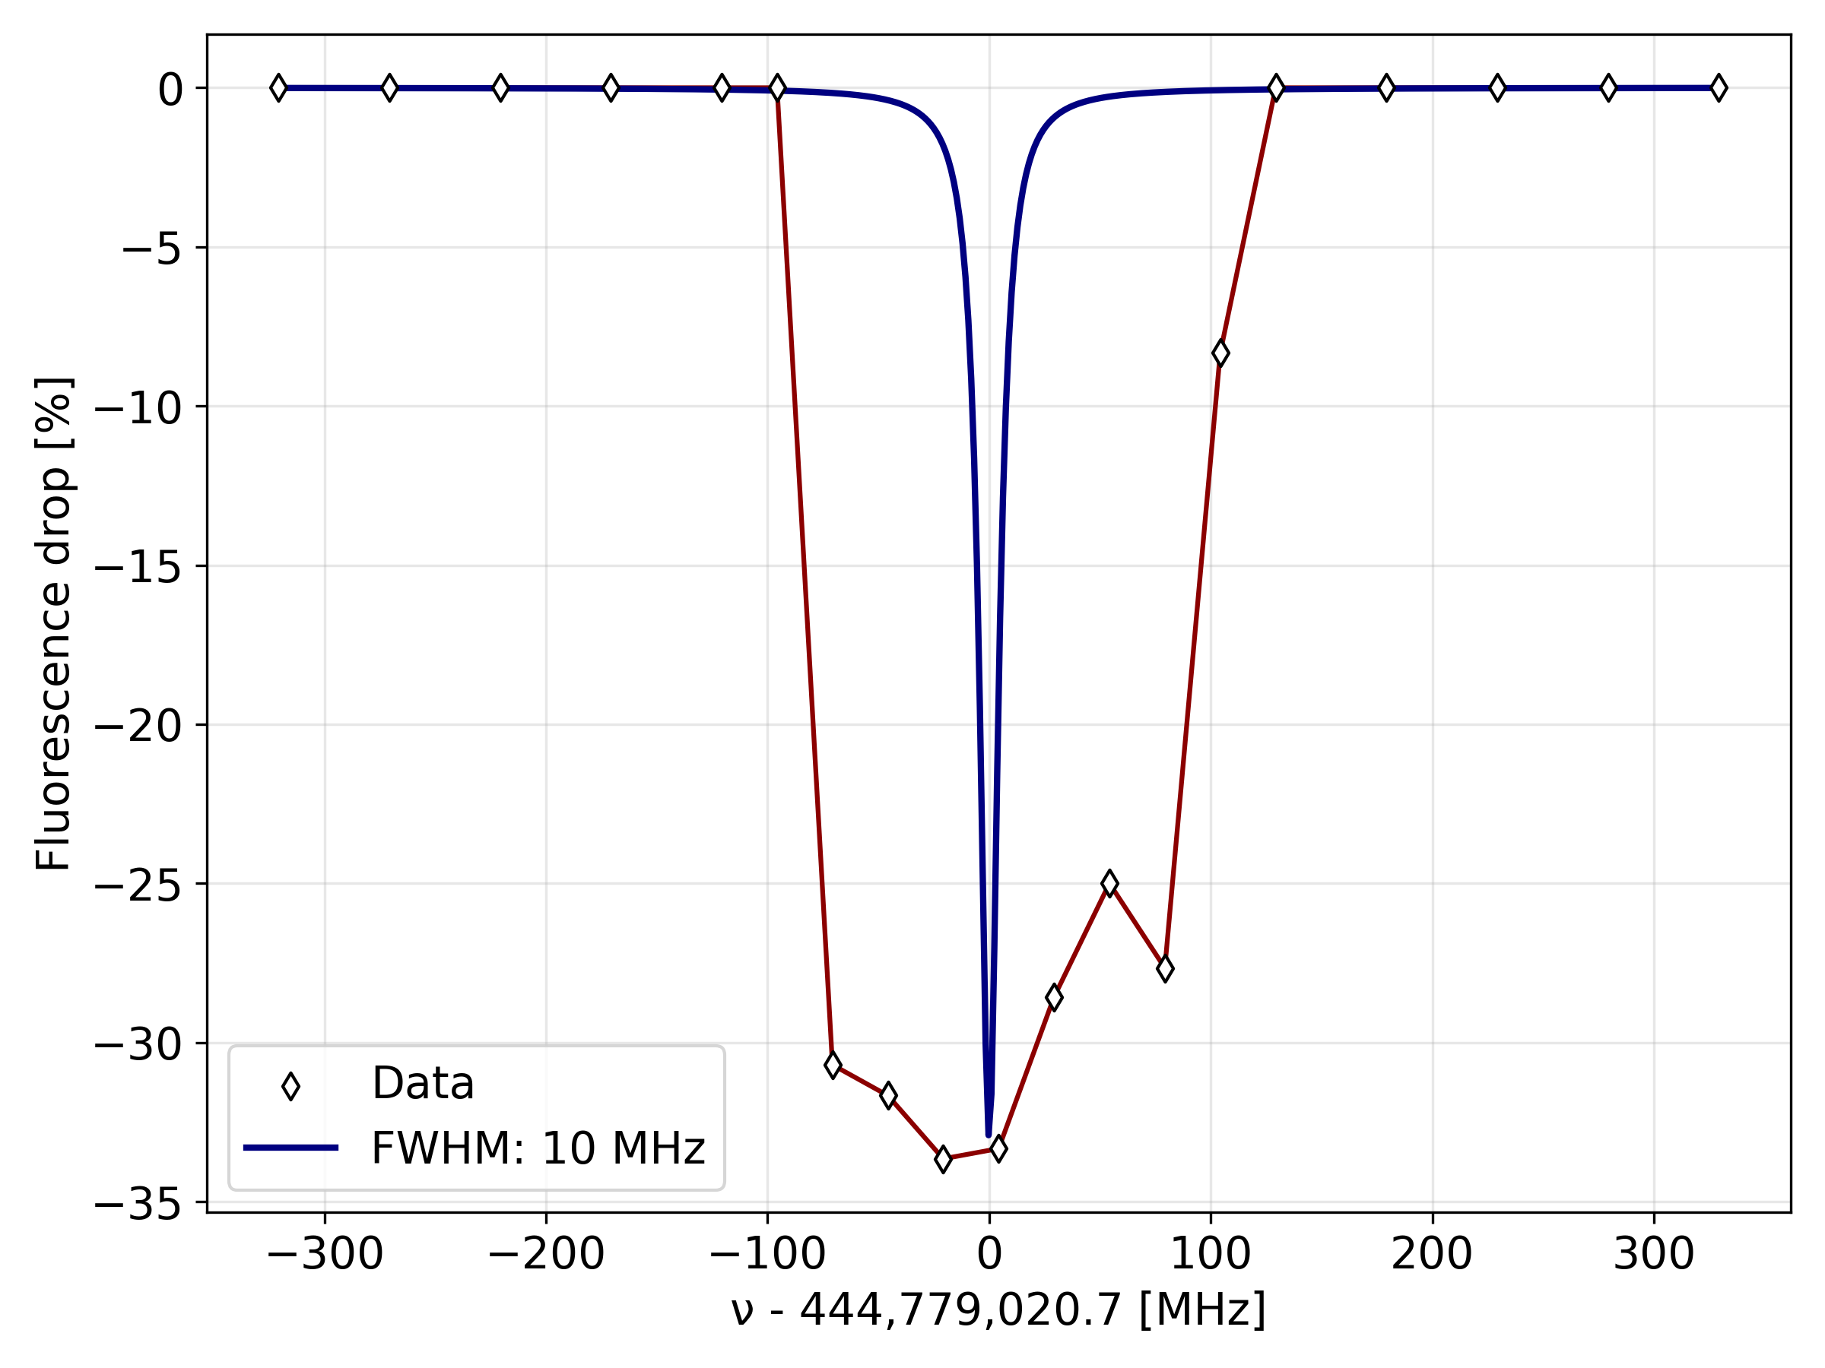
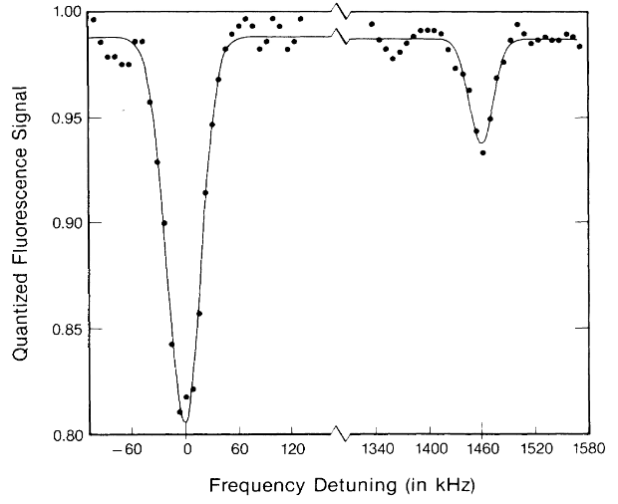
Next steps
Spectroscopy:
Reduce power broadening
-> FWHM from 150 to roughly 10-20 MHz
Obtained quantized fluorescence signal [1]
-> FWHM from 10-20 MHz down to 10-100 kHz
[1] J. C. Bergquist et al, Physical Review A 36 (1987) 428

Slide 17
Next steps
Going online:
October 2025
We are currently shipping an improved copy of the setup will be moved to the IGISOL radioactive facility in Finland.
EMISxx
Equipment move to IGISOL
February 2026
Offline commission
June 2026
Application on radioactive ions
Early 2027

Slide 18
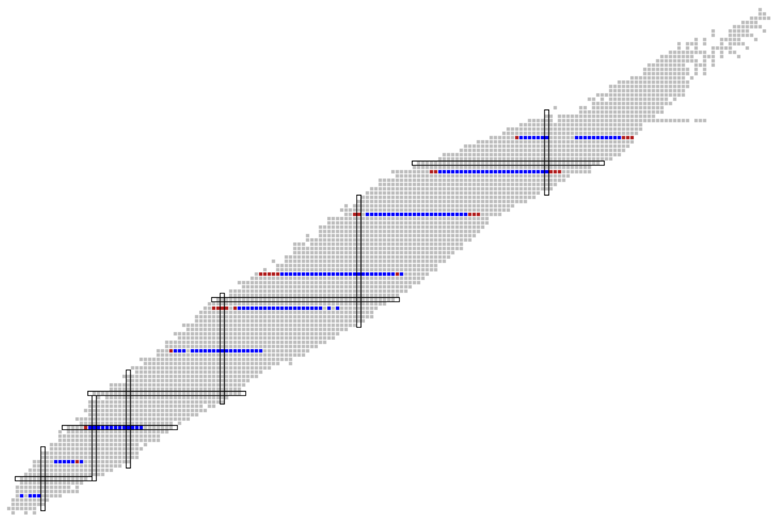
Applications
8 elements
189 isotopes
Requirements:
Laser coolable
T_{1/2} >= 500 ms
Ra
Hg
Possibly obtained observables:
Magnetic Dipole moments (μ)
Electric Quadrupole moments (Q_{s})
Magnetic Octupole moments (Ω)
Square charge radii (δ<r²>)
Quartic charge radii (δ<r⁴>)
Spins
Yb
Ba
Cd
Sr
More with sympathetic cooling ;-)
Ca
Measured
Mg
Be
Unmeasured

Slide 19
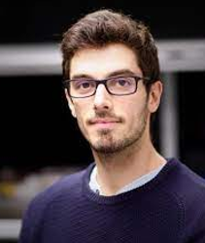


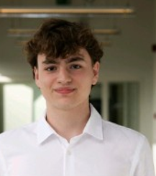
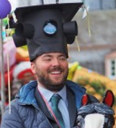

Thank you for your time!
Other main contributors:
Involved in the project:
Pierre Lassegues, PD
Sandro Kraemer,
PD
Ruben de Groote, PI
Robbe Van Duyse,
PhD
Phillip Imgram,
PD
Julien Grondin,
PhD

Slide 20
Any questions?
How long to form Coulomb crystals?
A few s (can do better)
What is the temperature?
A few 10s mK
How long do they stay trapped?
Hours (can do better)
In what pressure?
1e-8 mbar (for sure can do better)
With what ion efficiency?
Roughly 30% of ions that reach the decelerator

Slide 21
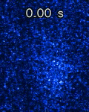
Measurements
Formation of Coulomb crystals:
⁸⁶Sr fluorescence:
Settings:
Camera capture rate: 2 fps
Exposure time: 300 ms
⁸⁶Sr < 10% of trapped ions
Yet, it still sympathetically cools ^{87,88}Sr!

Slide 22
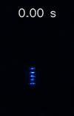
Measurements
Let’s block the cooling lasers!
Formation of Coulomb crystals:
⁸⁸Sr is being cooled
Settings:
28s cycle
Camera capture rate: 2 fps
Exposure time: 500 ms
Notes:
Back-up

Slide 23
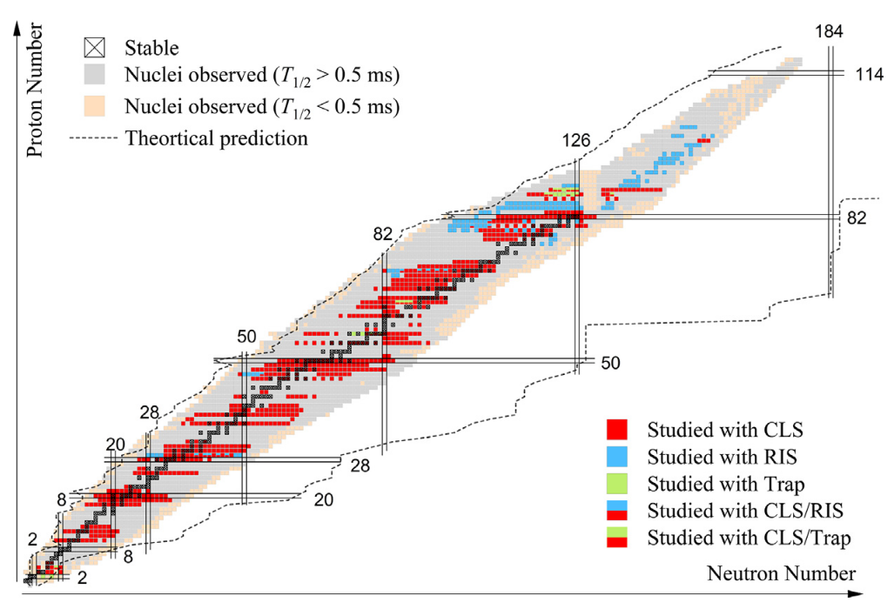
Motivation
Laser spectroscopy:
Successfully applied to around 1/3 of the 3000 nuclei produced at RIB facilities [1]
However:
The ion-laser interaction time is usually < 1 us which:
Limits sensitivity due to signal/bkg ratio
Requires dipole allowed transitions, which limits the precision at the MHz level
Adapted from [1]
[1] X. Yang et al. Progress in Particle and Nuclear Physics 129 (2023) 104005
Notes:
SKIP IT

Slide 24
Measurements
Overall:
How long to form Coulomb crystals?
A few s (can do better)
What is the temperature?
A few 10s mK
How long do they stay trapped?
Hours (can do better)
In what pressure?
1e-8 mbar (for sure can do better)
With what ion efficiency?
Roughly 30% of ions that reach the decelerator

