Slide 1







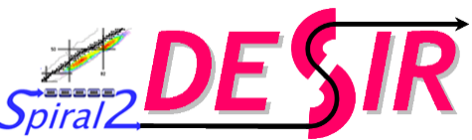



EMIS XX – 20/10/2025
GPIB & PIPERADE
commissioning for DESIR
Corentin Roumegou
on behalf of the GPIB-PIPERADE collaboration

Slide 2
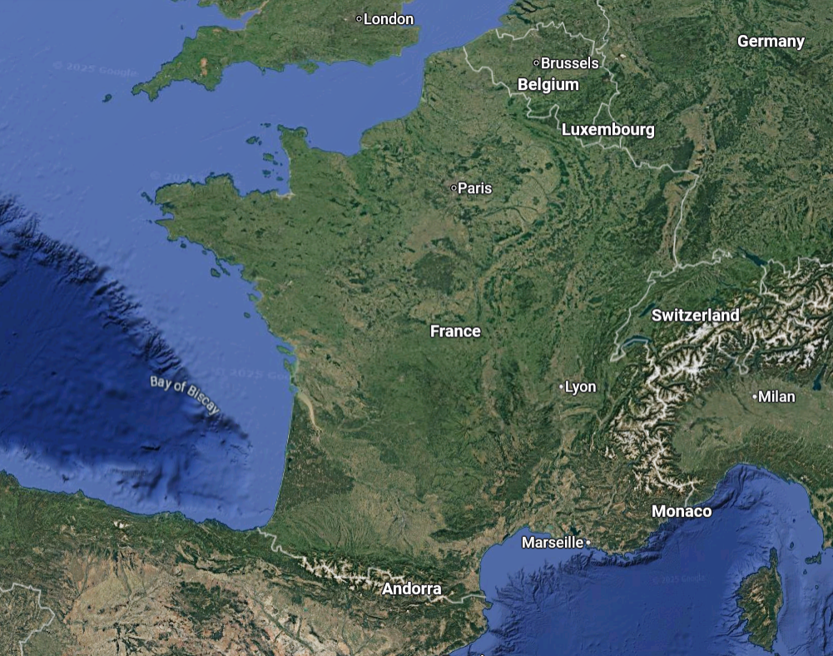

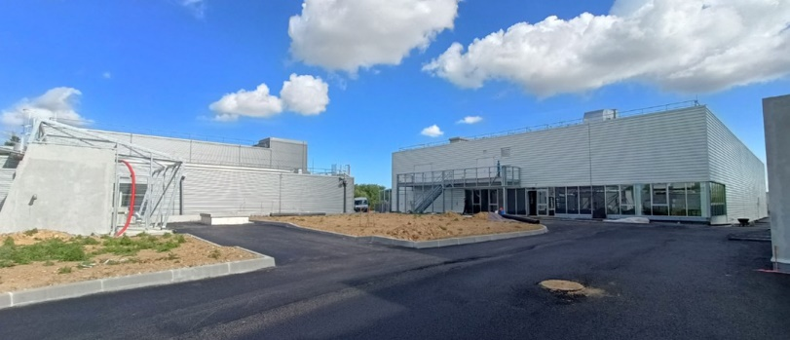
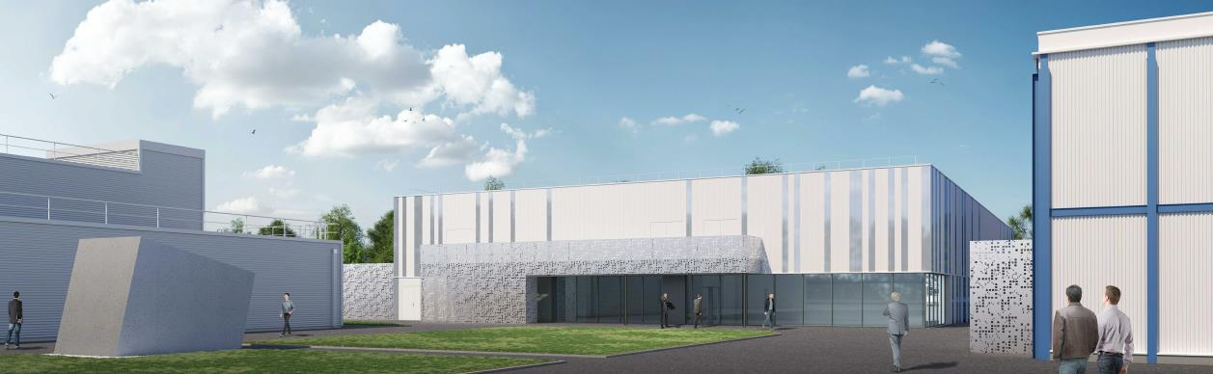
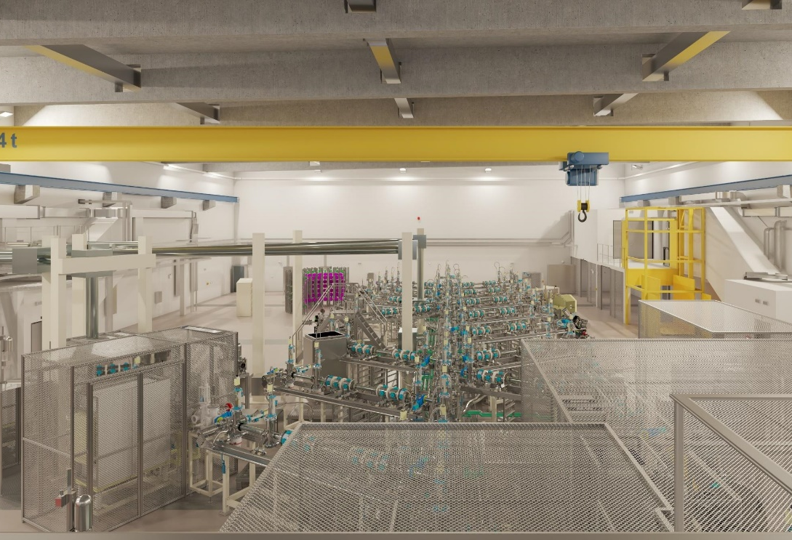
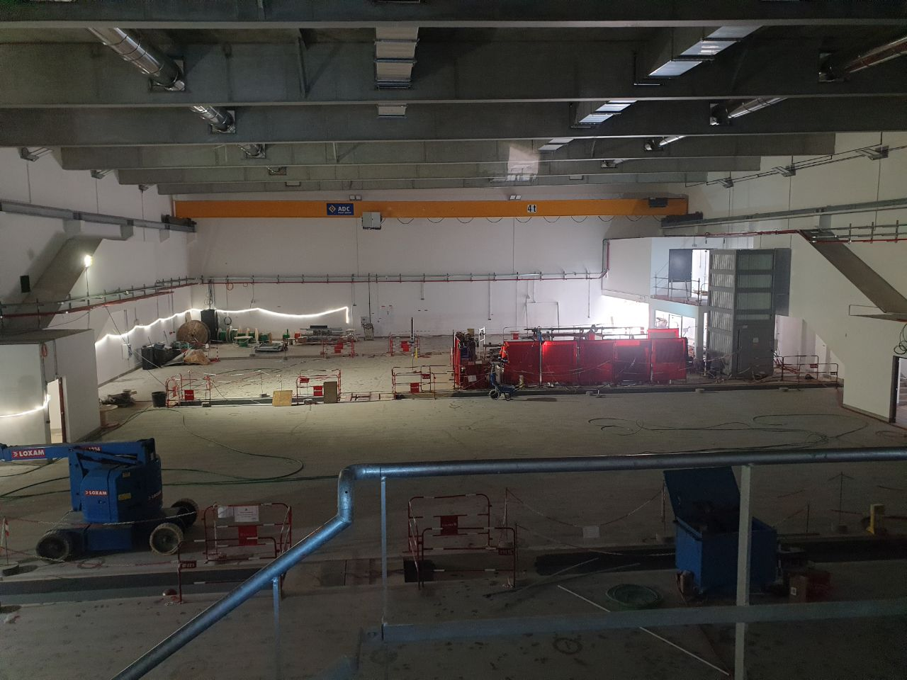
The DESIR facility
New experimental hall in GANIL
September 2025
Caen
Low-Energy RIB facility
FRANCE
Building just delivered !
In the future…
…Today

Slide 3

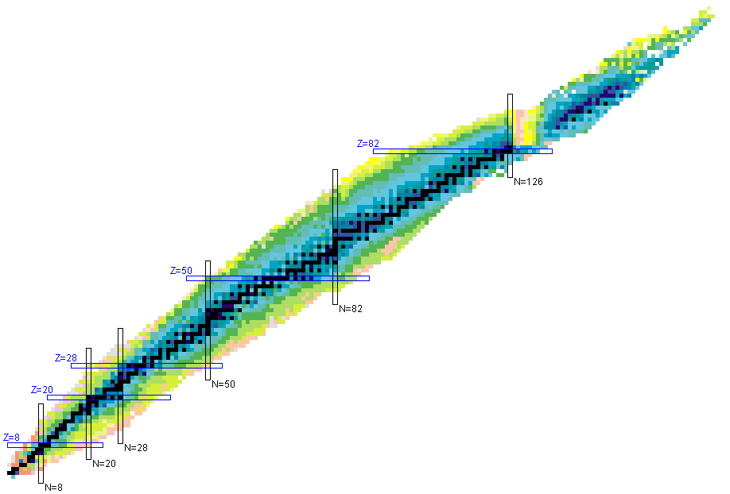
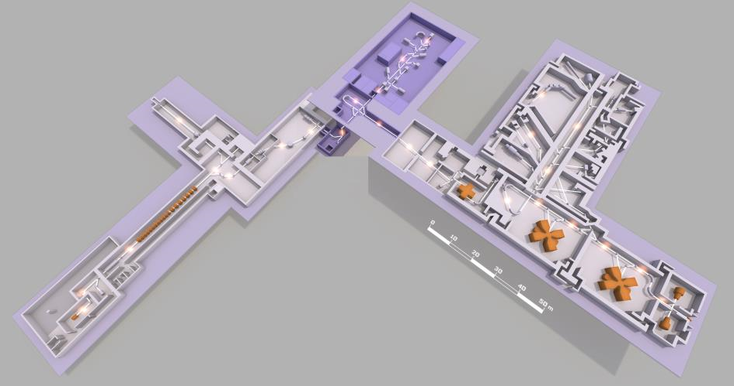
The DESIR facility
@
S3
Low-energy RIB
from SPIRAL1
and S3
fusion-evaporation
DESIR
S3
SPIRAL1
fragmentation
fusion-evaporation
SPIRAL2
SPIRAL1

Slide 4

Physics at DESIR
Décroissance, Excitation et Stockage d’Ions Radioactifs
Decay, Excitation and Storage of Radioactive Ions
Decay Spectroscopy
LASER Spectroscopy
Traps
Exotic decay modes
High-precision β-decay studies
TAS measurements
Charge radii
Nuclear moments
Spins
Mass measurement
Fundamental interactions
Trap-assisted spectroscopy
BESTIOL
LUMIERE
DETRAP

Slide 5
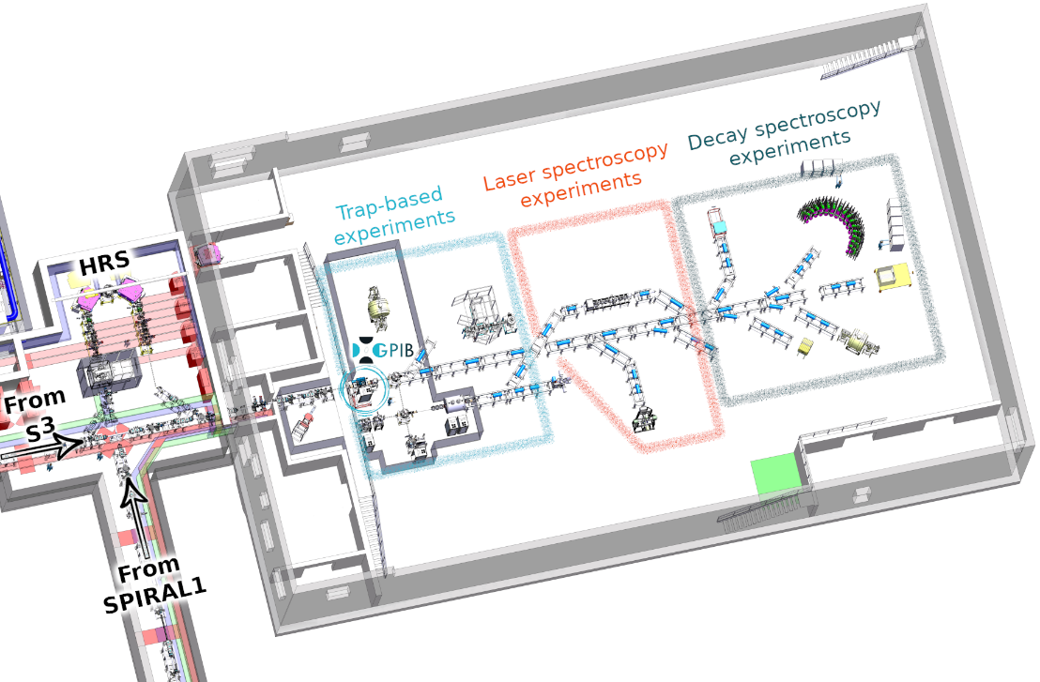
The DESIR facility
@
Low-energy RIB from SPIRAL1 and S3
Beam is possibly:
S3
Contaminated
Continuous
High-emittance
fusion-evaporation
SPIRAL1
fragmentation
fusion-evaporation
BESTIOL
LUMIERE
DETRAP

Slide 6
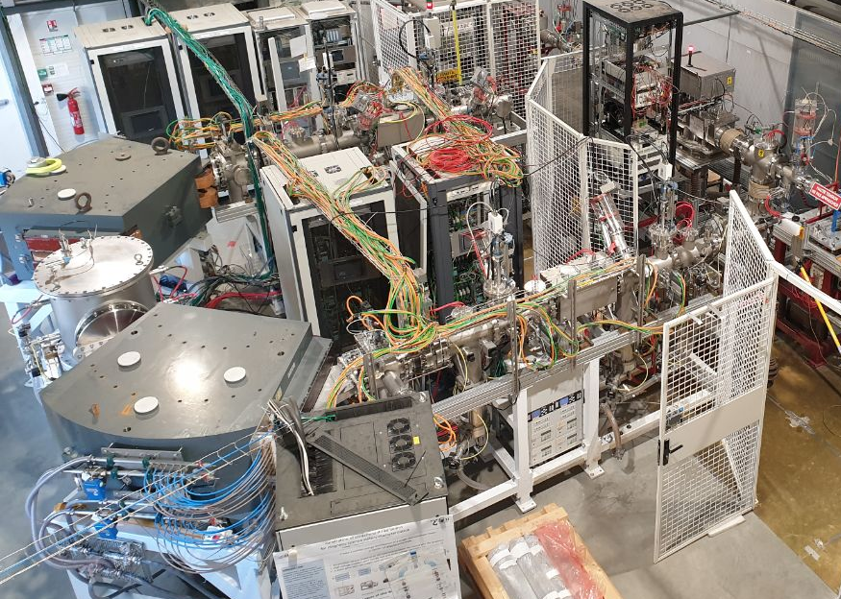

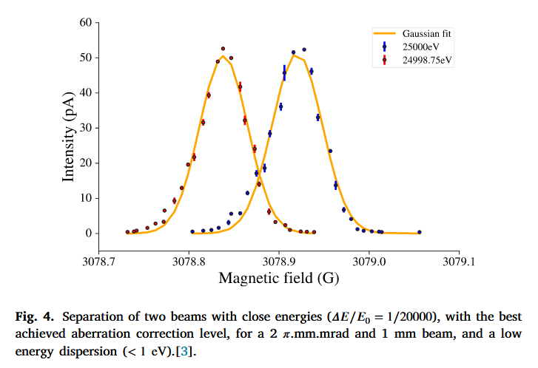
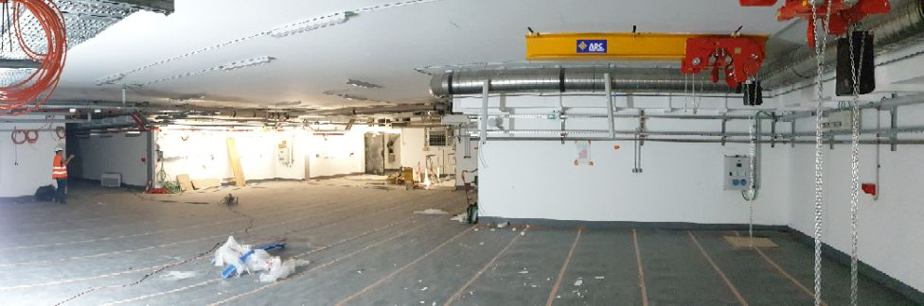

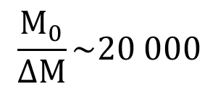
Beam preparation: mass separation
HRS : High Resolution Separator
U-shape mass separator
Currently commissioning in Bordeaux
$$\frac{M_{0}}{ΔM}\sim 20 000$$
J. Michaud et al., Nucl. Instrum. Methods Phys. Res. B (2023)

Slide 7
The DESIR facility
@
Low-energy RIB from SPIRAL1 and S3
Beam is possibly:
S3
Contaminated
Continuous
High-emittance
fusion-evaporation
SPIRAL1
fragmentation
fusion-evaporation
BESTIOL
LUMIERE
DETRAP

Slide 8
Beam preparation: cooling & bunching
General Purpose Ion Buncher
RadioFrequency Quadrupole Cooler - Buncher (RFQCB)
Reduce beam emittance
Bunch the beam

Slide 9





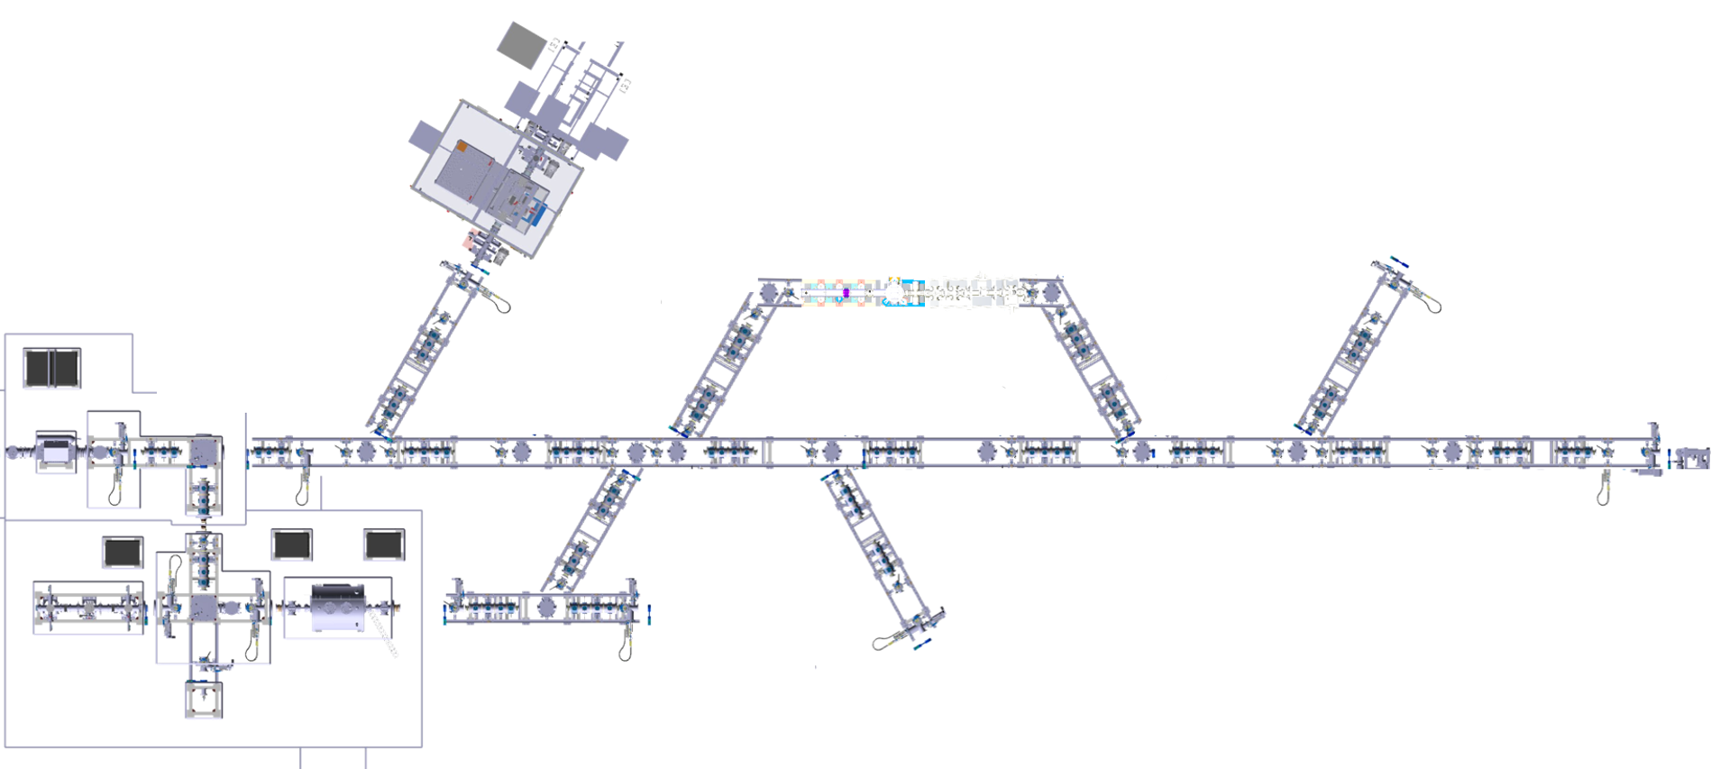

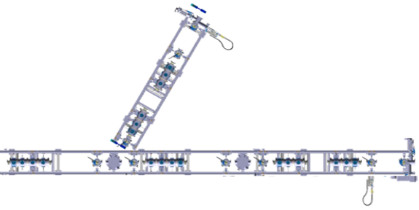


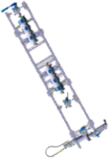
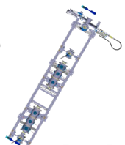
Bunching Radioactive Ions To…
(NA)²STARS
MR-ToF-MS
GPIB
* Non-exhaustive list. The exact location of each setup may change

Slide 10
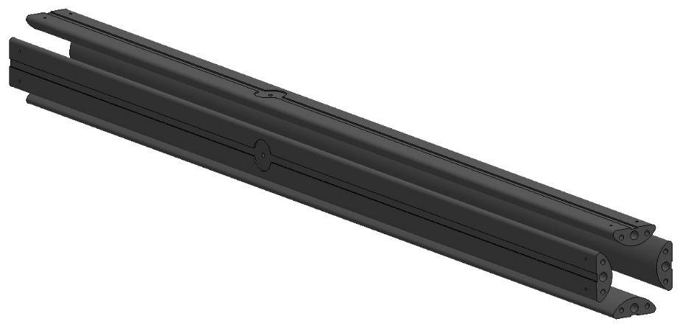
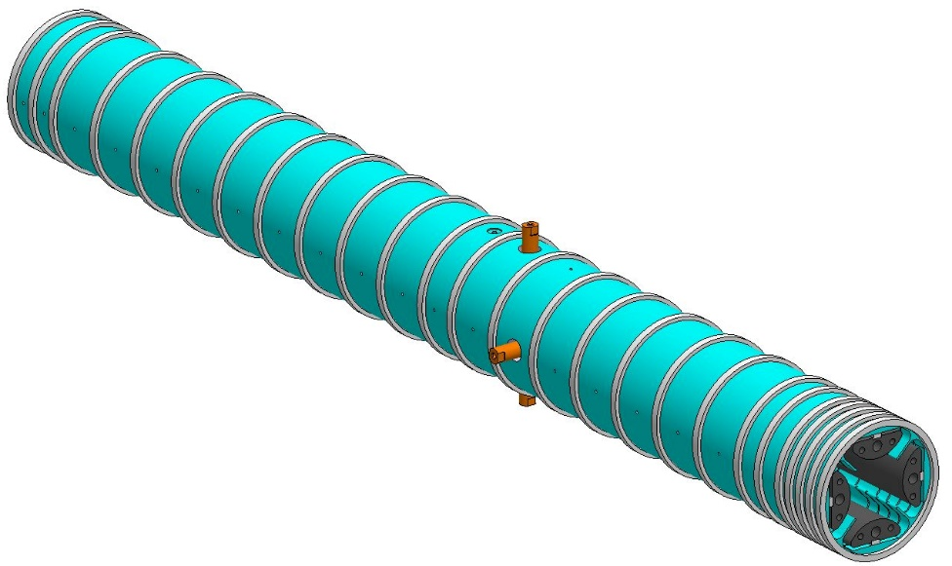
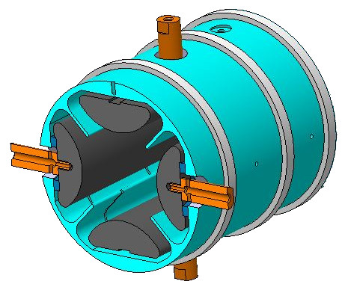
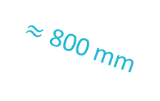
“GPIB”
ions
General Purpose Ion Buncher
$≈$ 800 mm
RFQ: Paul Trap
Mechanical design based on ISCOOL (ISOLDE RFQCB)
Transverse trapping with 4 unsegmented RF rods
Longitudinal trapping with 25 independent DC segments
DC
RF

Slide 11
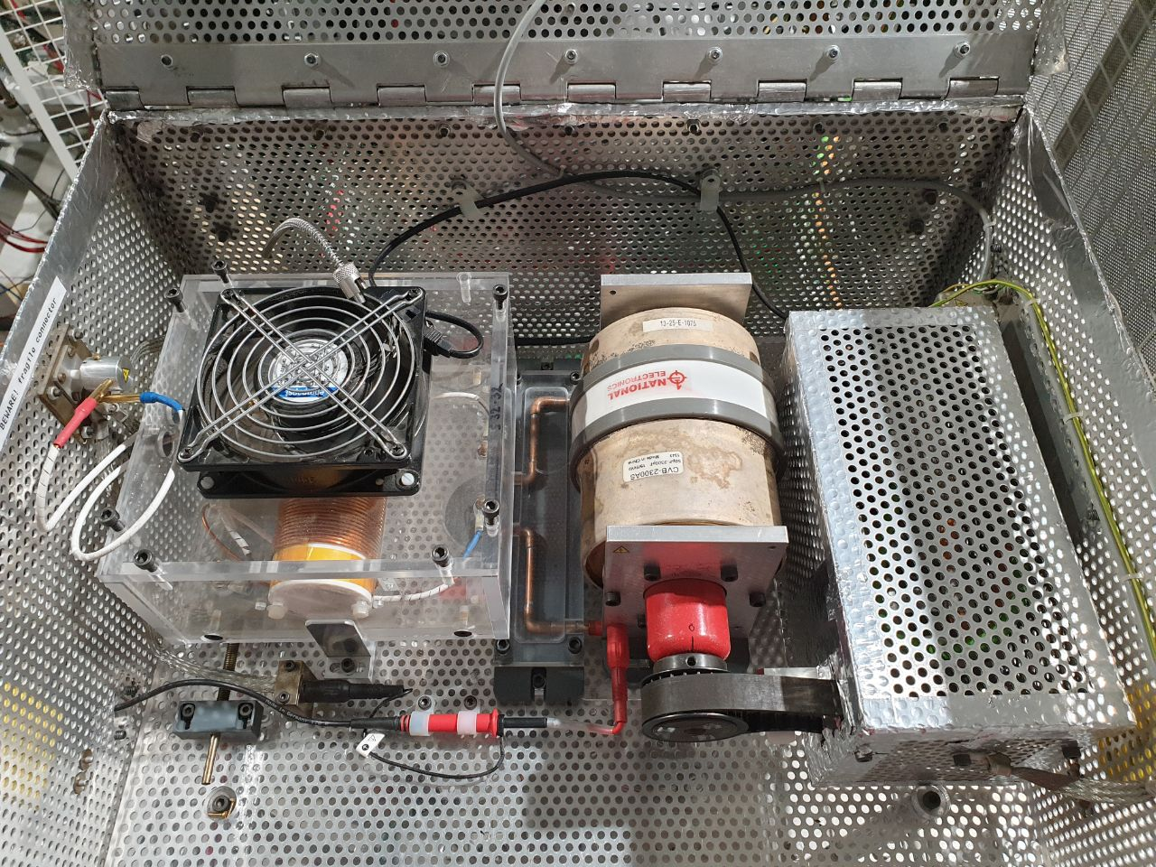
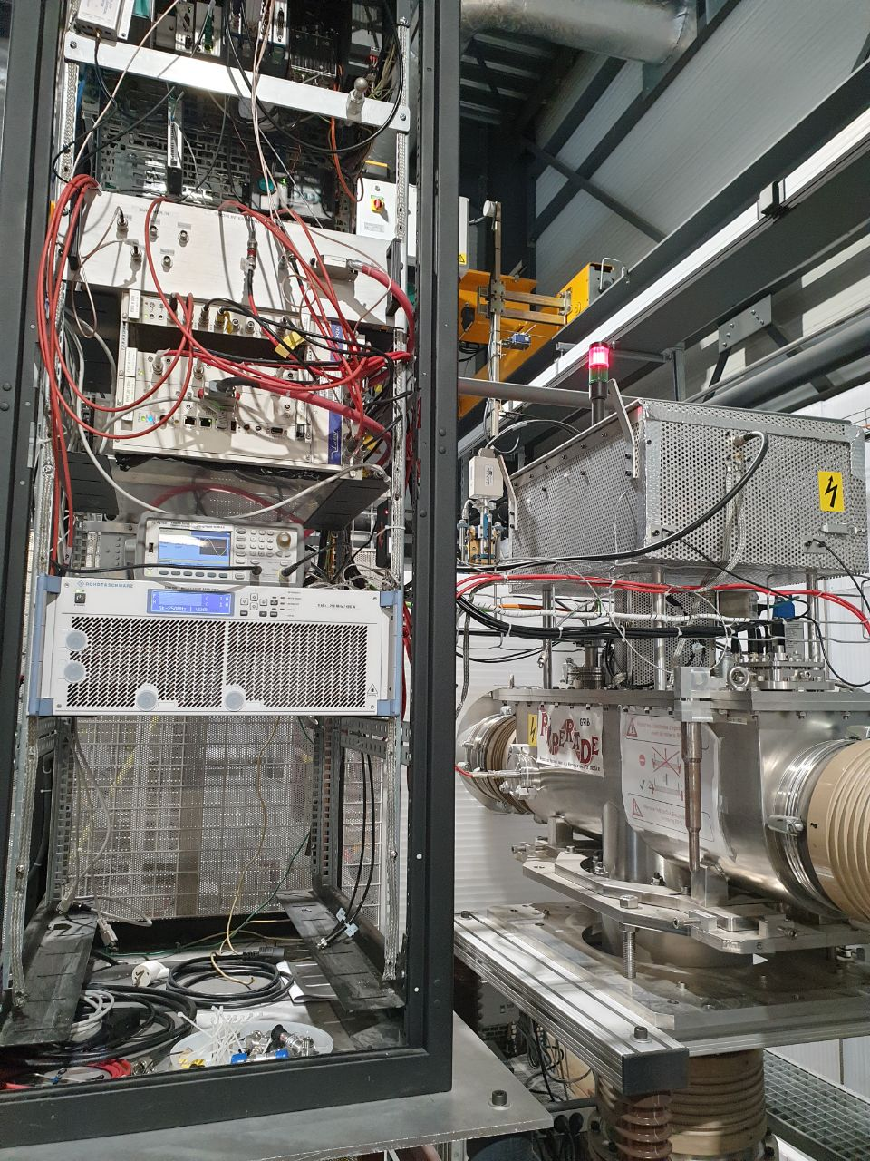
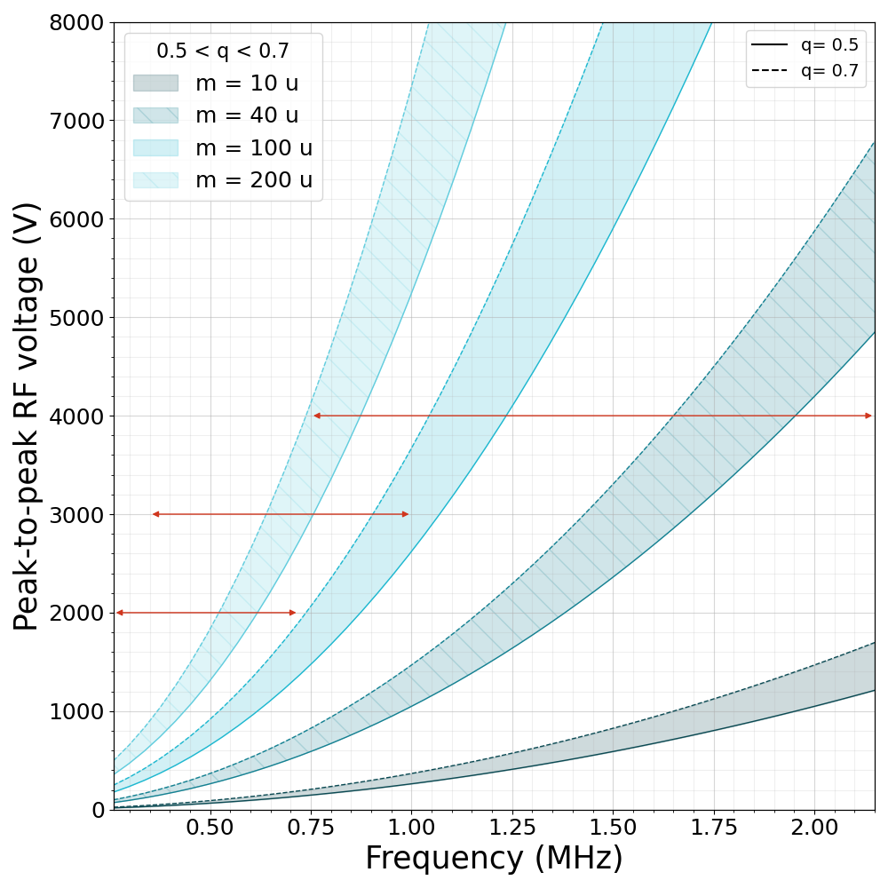
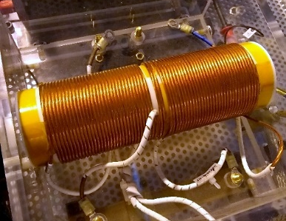
GPIB RF system
Balun-transformer circuit
Tunable capacitor
Waveform generator
S24-24
S32-32
400W RF amplifier
S38-38
S32-32 windings
(exchangeable)

Slide 12
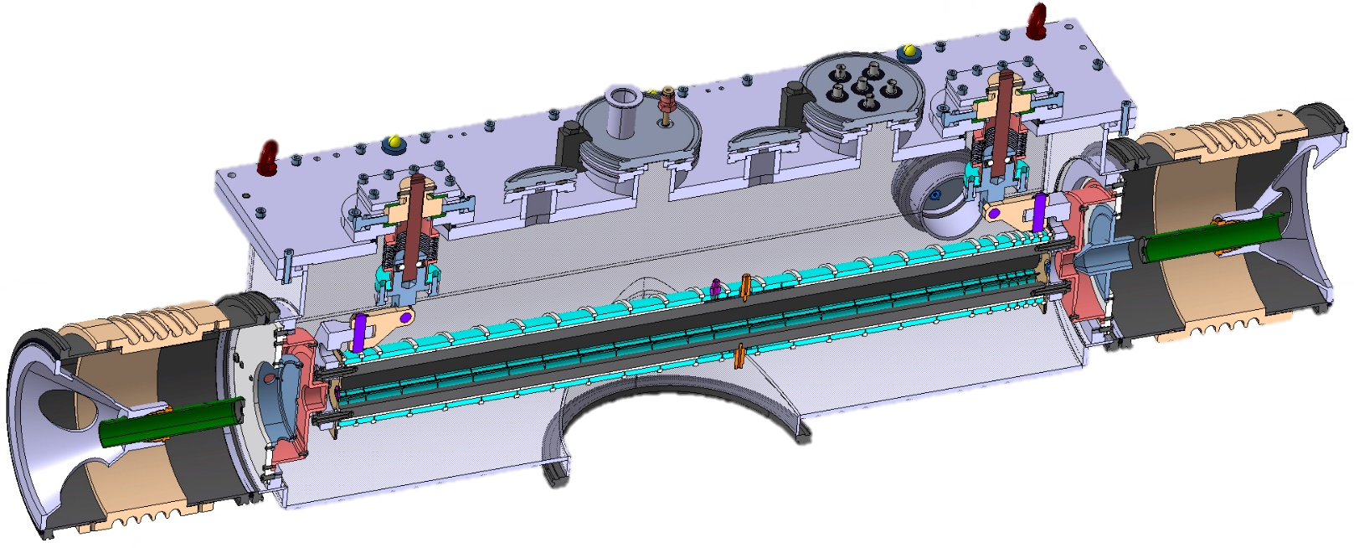
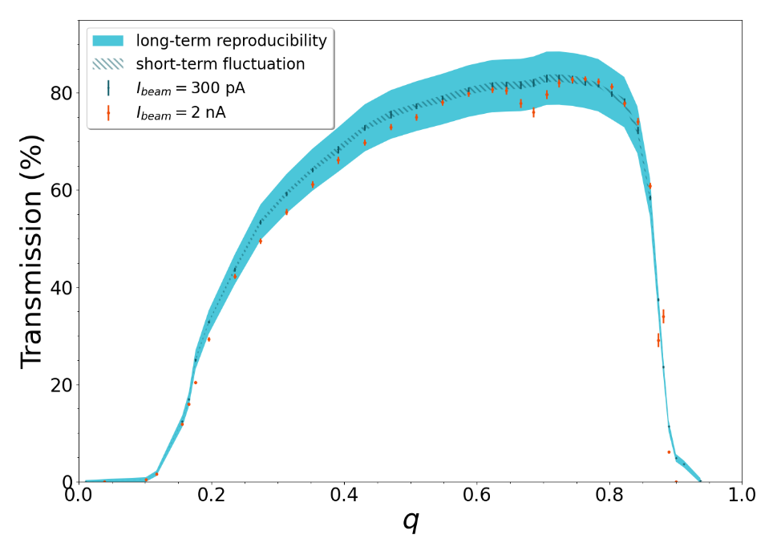


Cooling
He
Cooled beam
to DESIR
Radioactive ions
From SPIRAL1/S3
$$\sim {10}^{−2} mbar$$
$${}_{}^{nat}{K^{+}}$$
“Buffer-gas cooling” with He
Up to 90% transmission

Slide 13
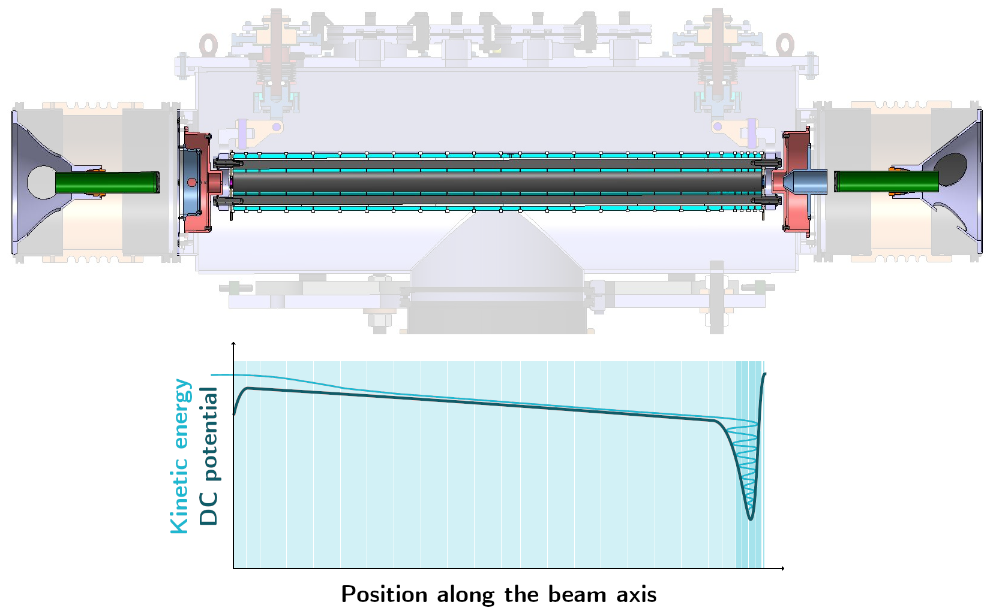
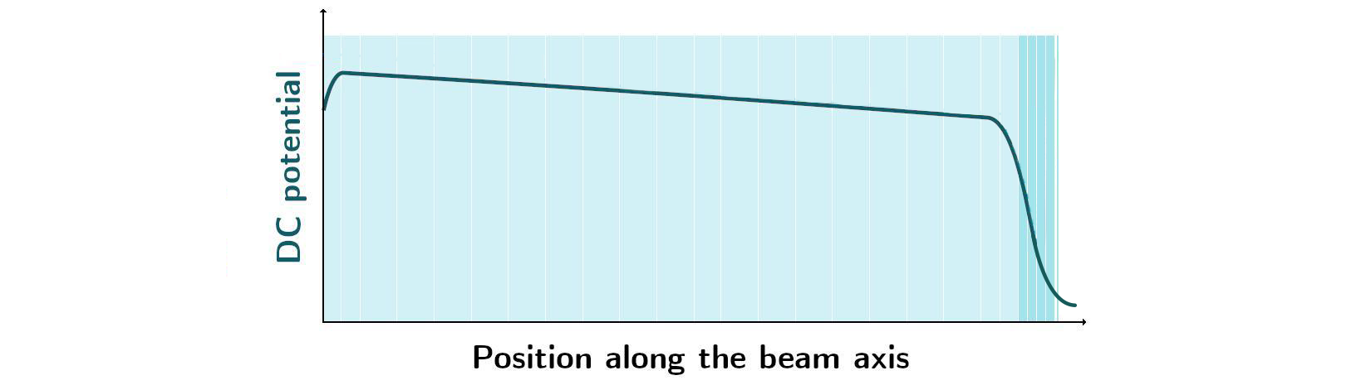
Bunching
5 last electrodes can be switched
switchable
Continuous beam
from HRS
Cooled & Bunched
ions to DESIR
ions

Slide 14


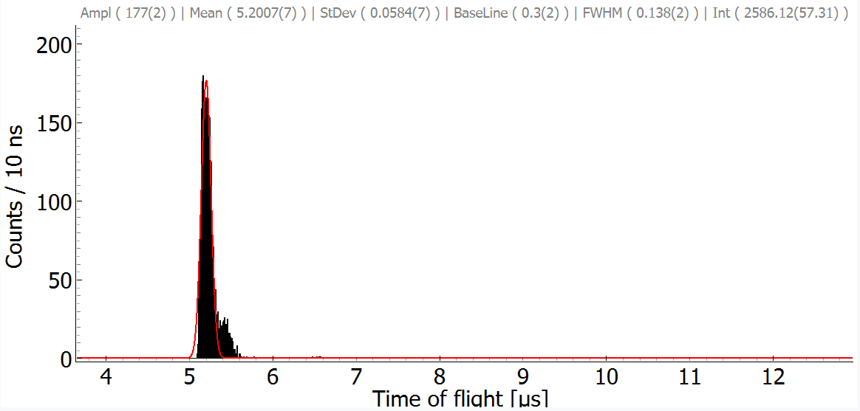
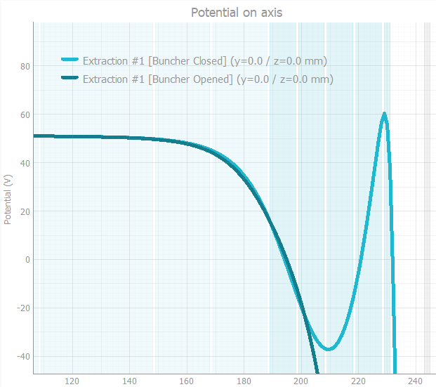
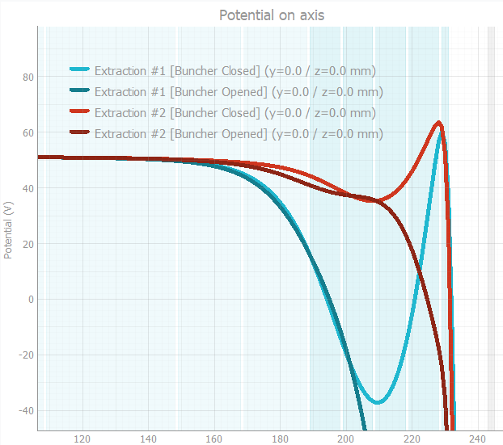
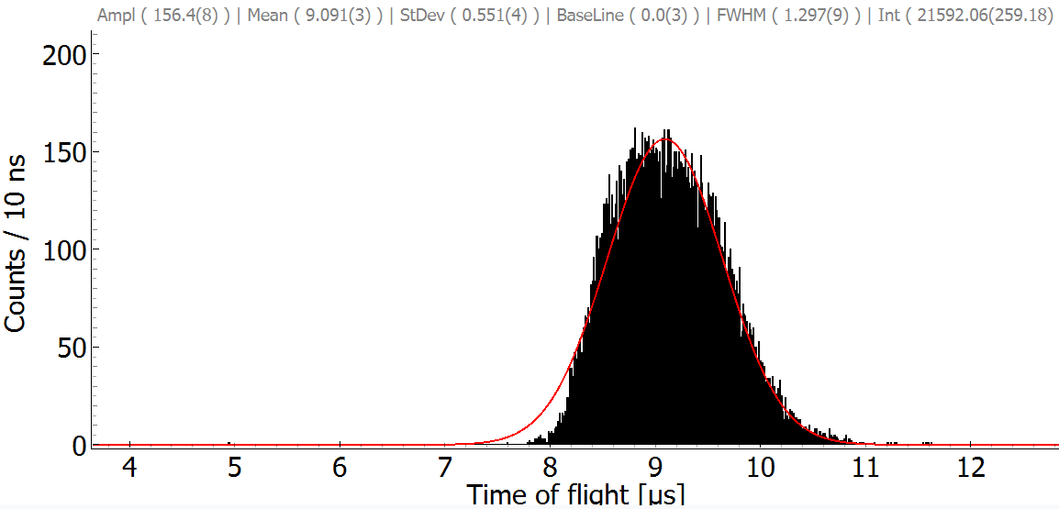
Bunching
made with
and
Ions on MCP detector
Modular trapping/extraction curves
Favor either time or energy dispersion
σ < 60ns
σ > 500ns

Slide 15

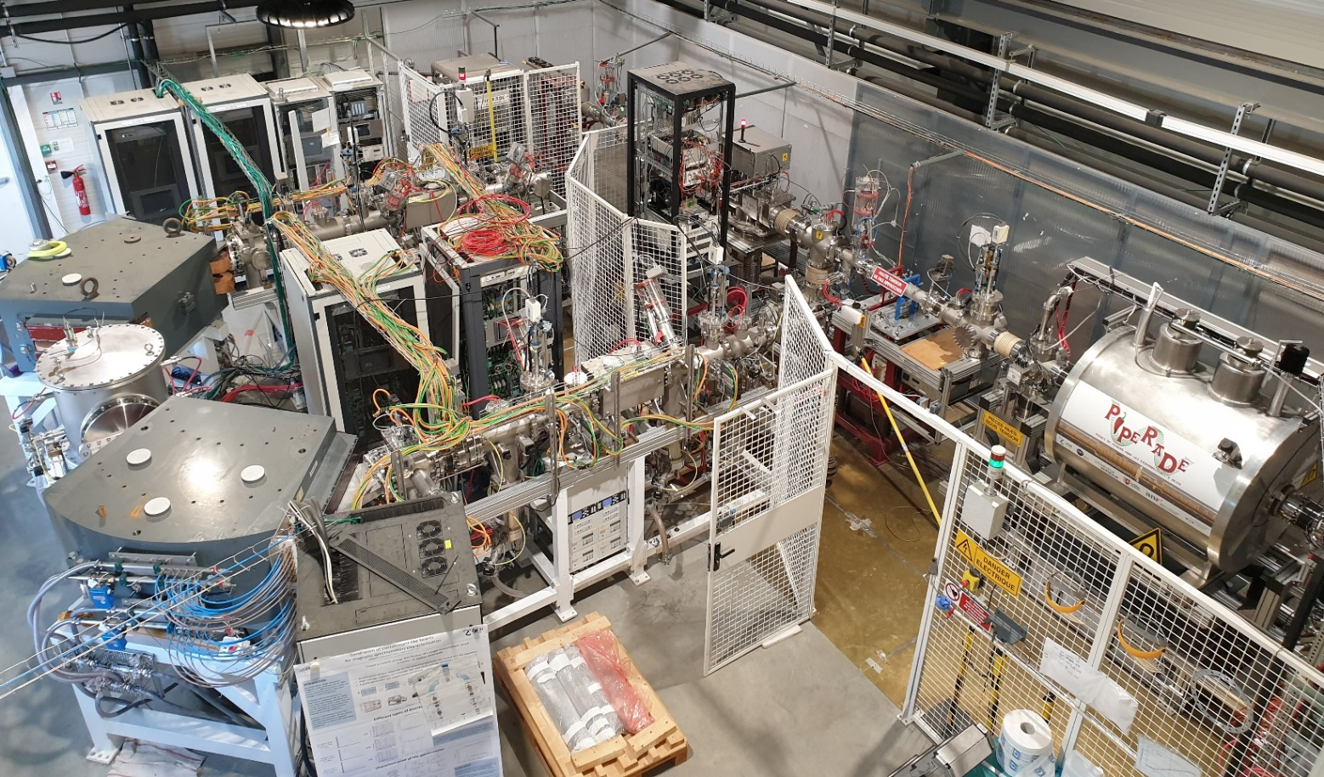



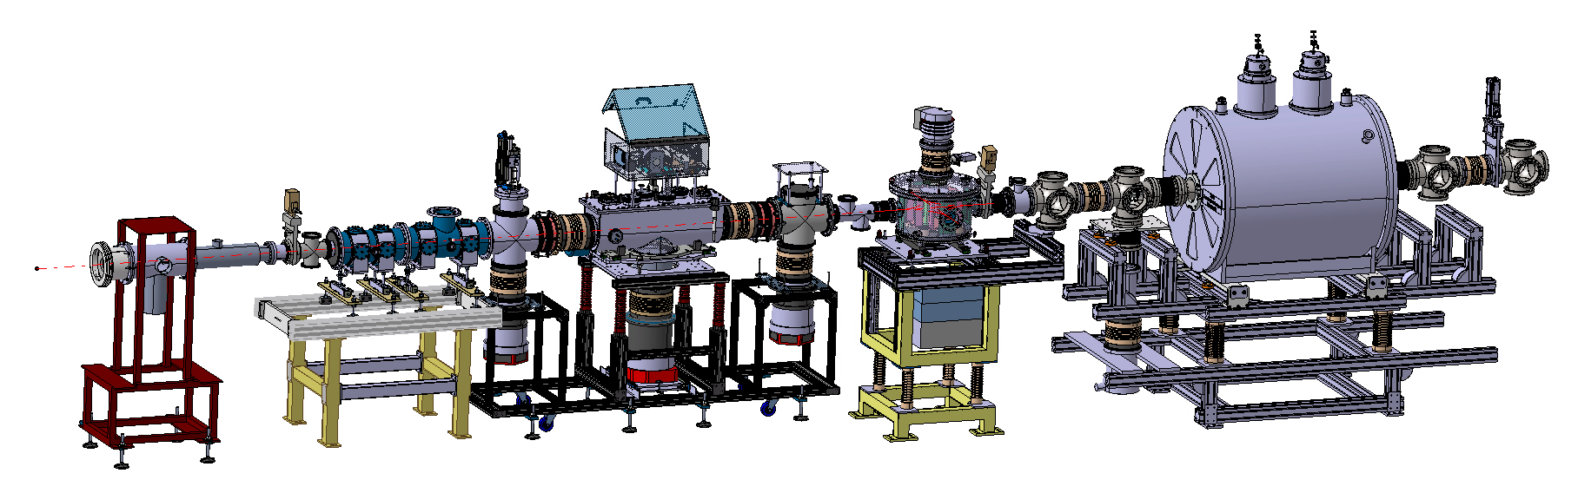

Commissioning
@
Stable-ion source
Commissioning in Bordeaux
with stable ions
Work still in progress:
Precise bunches energy dispersion and transverse emittance measurements
Correlations between output beam characteristics (#ions, ΔE, Δt, ε, …)
Caen
Bordeaux
GPIB
Stable-ion source
(Alkali)
2026
Moving to GANIL
New place, New life, New Name…

Slide 16

PIPERADE
Pièges de Penning pour les Radionucléides à DESIR
Penning Traps for Radionuclides at DESIR
Double Penning-Trap with 2 main objectives at DESIR:
Further beam purification
High-precision mass measurements

Slide 17
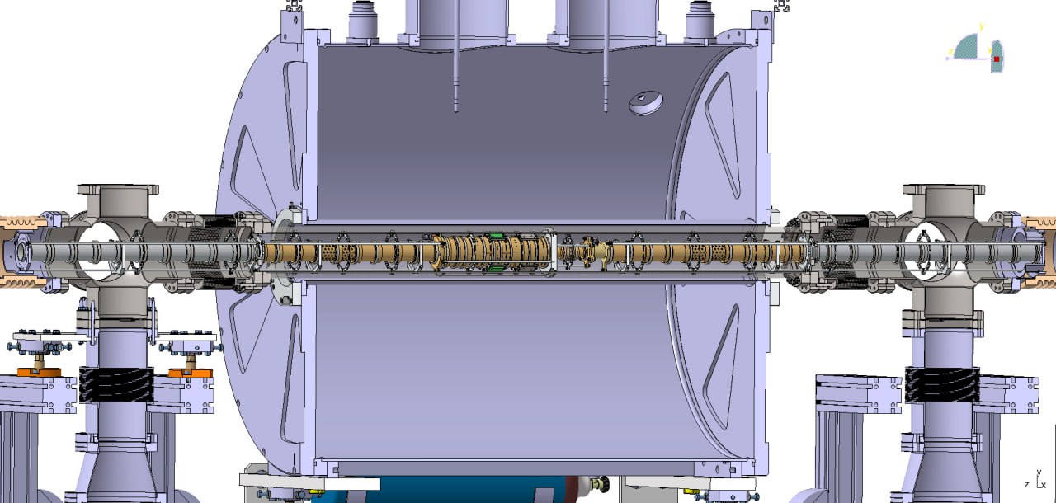
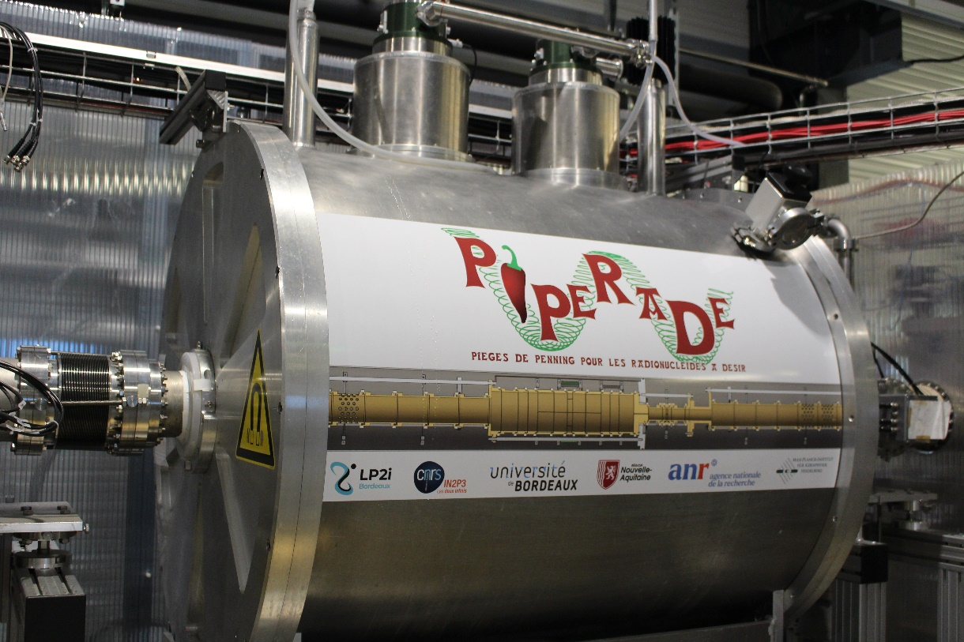
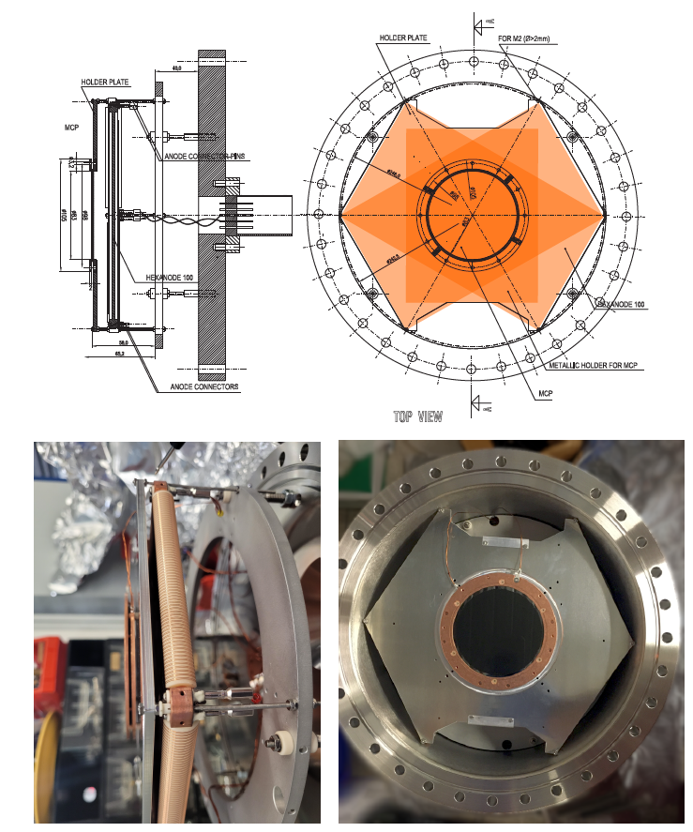



PIPERADE Design
Transverse trapping with 7T magnetic field
Ions guided on longitudinal axis thanks to electrostatic electrode tower
Caen
Heidelberg
From
GPIB
Bordeaux
Diaphragm (1mm Ø)
MCP
Counting
ToF
Position
Injection optics
Purification Trap (64mm Ø)
Measurement Trap (20mm Ø)
Extraction optics
Tower designed and machined at MPIK Heidelberg

Slide 18



PIPERADE
@
Located at the entrance of the DESIR hall

Slide 19

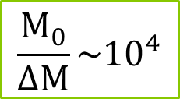
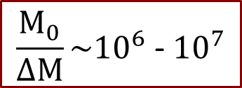
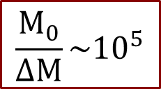

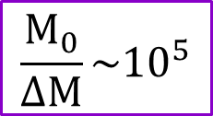


Resolving power
@
Selectivity
Rapidity
HRS
$$\frac{M_{0}}{ΔM}\sim {10}^{4}$$
$\sim {10}^{−5}$ s
Clean most of isobars
(demonstrated)
MR-ToF
$$\frac{M_{0}}{ΔM}\sim {10}^{5}$$
$\sim {10}^{−2}$ s
(expected)
Clean almost all isobars
PIPERADE
1st trap
$$\frac{M_{0}}{ΔM}\sim {10}^{5}$$
$\sim {10}^{−1}$ s
Buffer-gas cooling
(demonstrated)
PIPERADE
2nd trap
$$\frac{M_{0}}{ΔM}\sim {10}^{6} \text{−} {10}^{7}$$
Clean isomeric states separated by a few 10 keV
$\sim {10}^{0}$ s
Phase-cleaning
(expected)
Trap-assisted spectroscopy

Slide 20
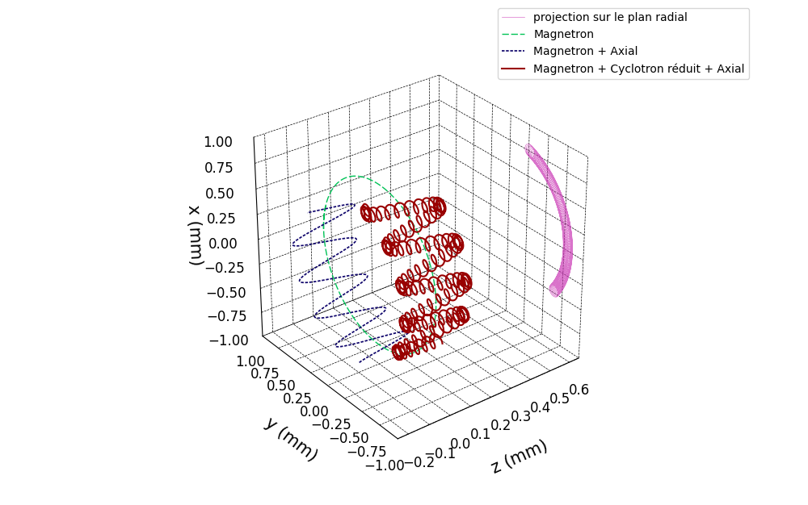
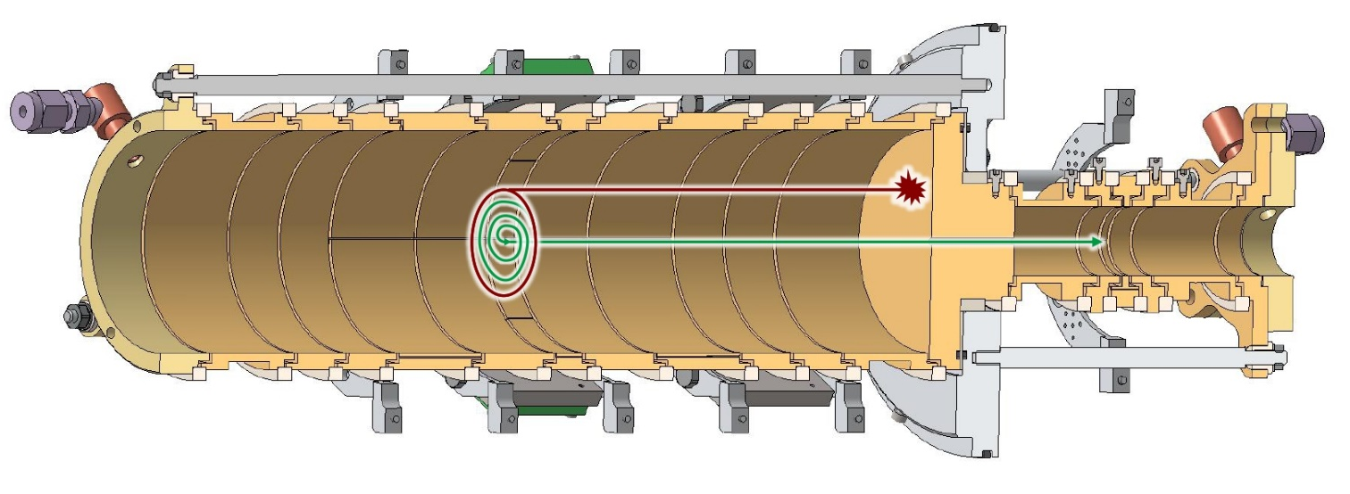
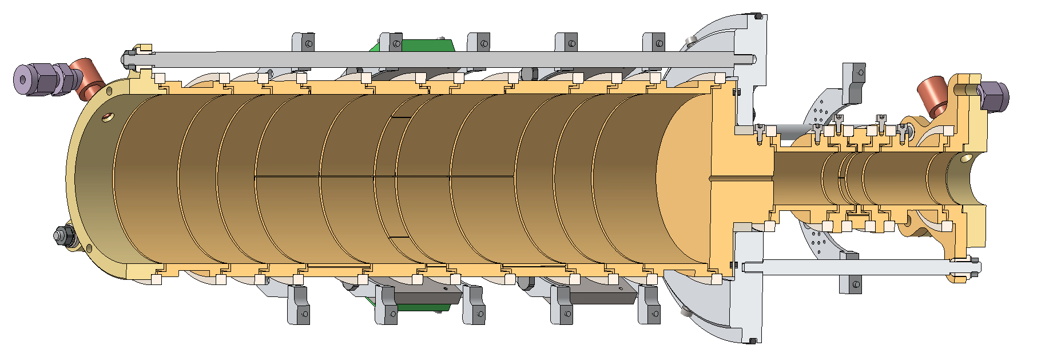
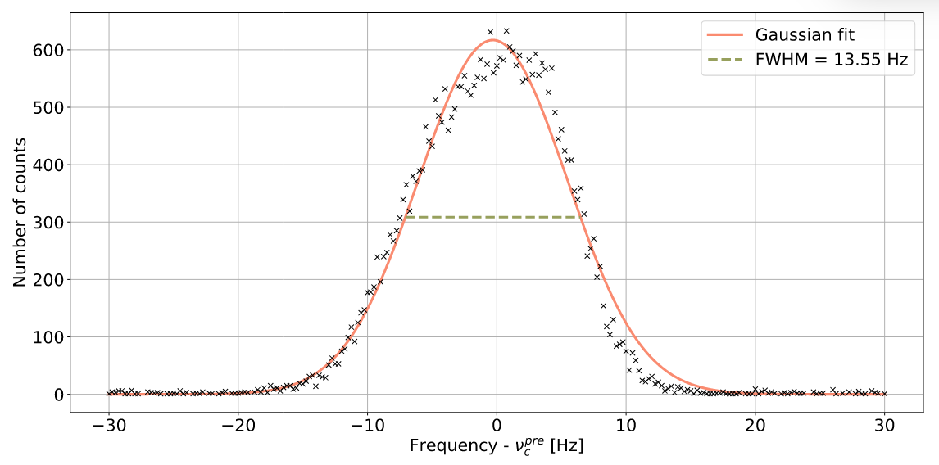
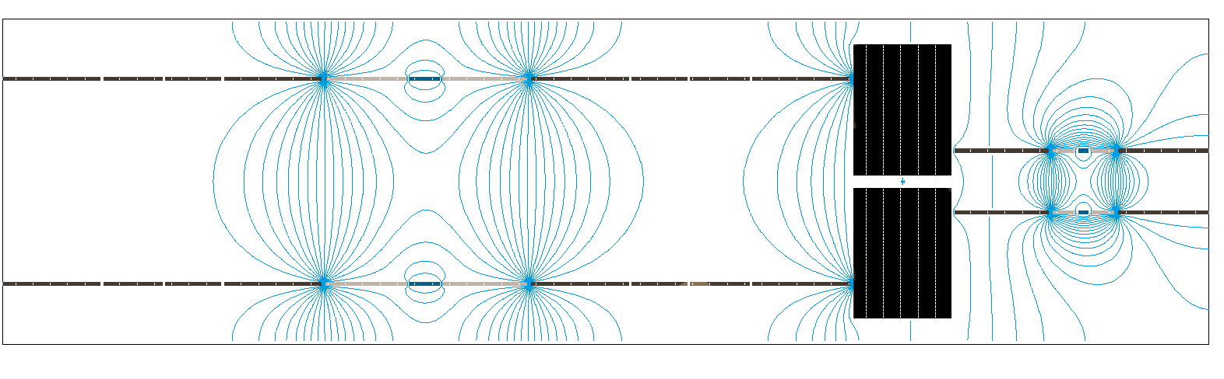







Taking advantage of ions motions
Radial projection
3 types of motions in a Penning Trap:
Magnetron
Magnetron + Axial
$ν_{−}$ Magnetron motion
$$\sim 1 kHz$$
Magnetron + Axial + Reduced Cyclotron
$ν_{z}$ Axial motion
$$\sim 100 kHz$$
Mass
dependent
$ν_{+}$ Reduced Cyclotron motion
$$\sim 1000 kHz$$
One can enhance / damp / convert these motions with RF excitations
Buffer-Gas Cooling in PIPERADE
$$\frac{m}{Δm}=2.{10}^{5}$$
Ion of interest
Purification Trap (64mm Ø)
contaminants
M. Flayol, PhD Thesis (2024)

Slide 21
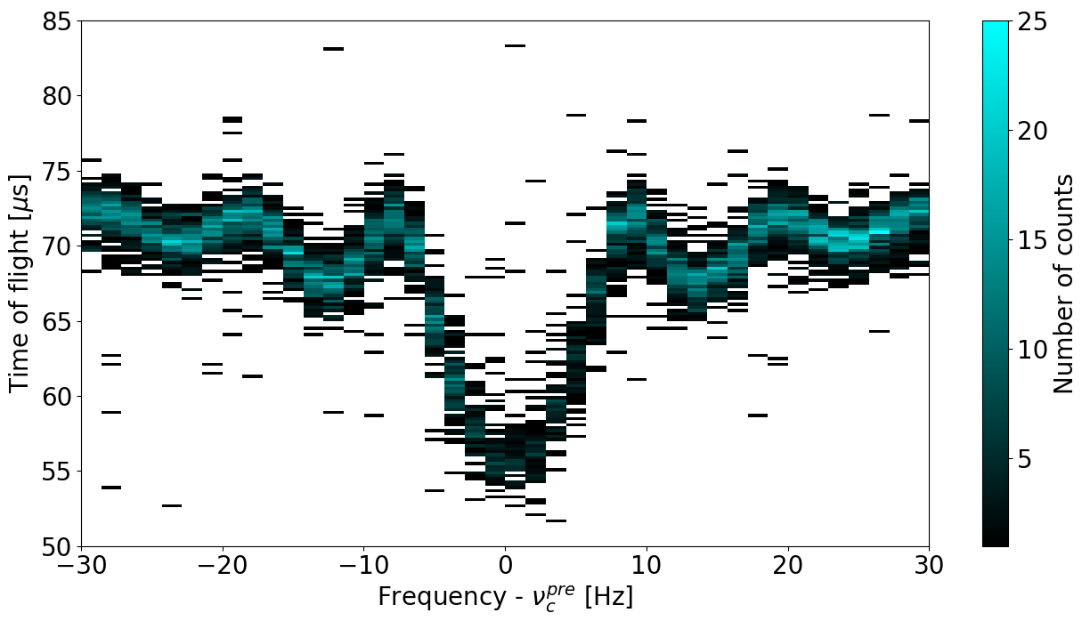
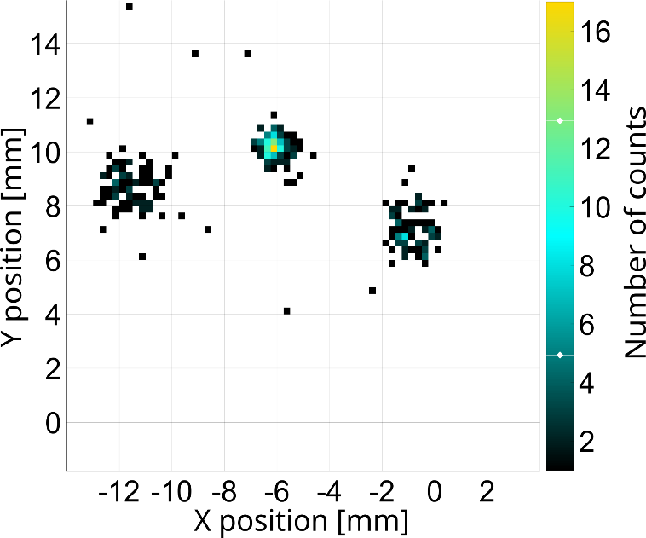
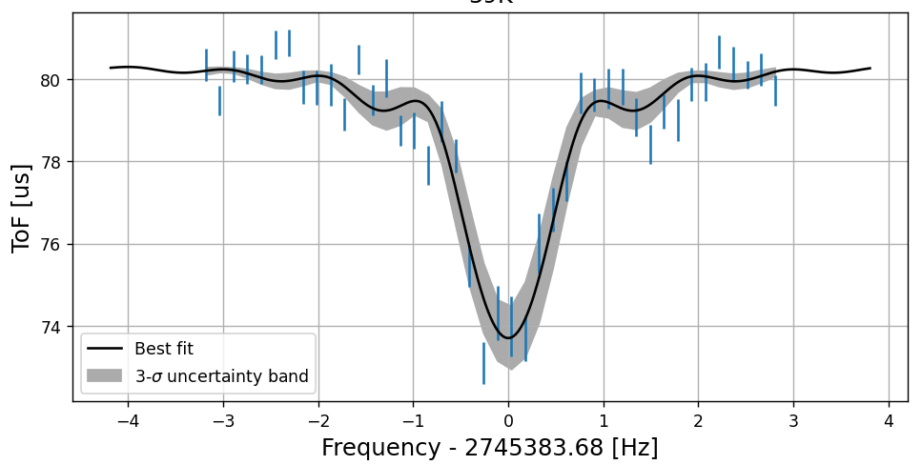

















Mass measurements with PIPERADE
made with
ToF-ICR
PI-ICR
$$υ_{c}$$
Center
$Φ_{c}={2ν}_{C}πt_{acc}$- $2π$n
$$Φ_{c}$$
Reduced
cyclotron
Magnetron
$$ν_{c}= \frac{qB}{2πm}$$
$$ν_{c}= \frac{qB}{2πm}$$
$$m_{{}_{}^{41}K}=\frac{ν_{c}({}_{}^{39}{K^{+}})}{ν_{c}({}_{}^{41}{K^{+}} )}\left(m_{{}_{}^{39}K}−m_{e}\right)+m_{e}$$
$${}_{}^{39}{K^{+}}$$
$${}_{}^{41}{K^{+}}$$
$${}_{}^{39}{K^{+}}$$
$${}_{}^{39}{K^{+}}$$
$${}_{}^{41}{K^{+}}$$
$${}_{}^{39}{K^{+}}$$
M. Flayol, PhD Thesis (2024)

Slide 22




ToF-ICR measurements
made with
Time-of-Flight Ion Cyclotron Resonance
29/08/2025
ToF-ICR measurements of ${}_{}^{41}K$ with ${}_{}^{39}K$ as reference with $100ms$ and $1s$ of conversion time
Good agreement with tabulated value
Relative precision $\sim {3×10}^{−9}$
Relative accuracy $\sim {2×10}^{−9}$

Slide 23



PI-ICR measurements
made with
Phase-Imaging Ion Cyclotron Resonance
07/08/2025
PI-ICR measurements of ${}_{}^{41}K$ with ${}_{}^{39}K$ as reference with $100ms$ of accumulation time
Good agreement with tabulated value
Relative precision $\sim {2×10}^{−9}$
Relative accuracy $\sim {5×10}^{−10}$
Issue currently under investigation when going for longer accumulation time…

Slide 24





Conclusion & Perspectives
Well-advanced commissioning of GPIB and PIPERADE at LP2i Bordeaux
Still some upgrades / characterization / problems solving to perform …
…
Continue software development
starting in
View of the DESIR hall from GPIB
2026
Moving to GANIL
Installation in DESIR hall & re-commissioning
First exotic beams and Physics !

Slide 25




Thank you !
P. Alfaurt, P. Ascher, D. Atanasov, A. Balana, B. Blank, L. Daudin, M. Flayol, M. Gerbaux, S. Grévy, G. Guignard, M. Hukkanen, A. Husson, G. Jevelot, B. Lachacinski, S. Lechner, E. Rey-herme, M. Roche, A. de Roubin, C. Roumegou

Slide 26
BACKUP SLIDES

Slide 27





Beam preparation: reduce emittance
RFQ-1p (formerly SHIRaC)
RFQ Cooler
Transmission $\sim 70 \%$for $1µA$ beam
Output Emittance $<2.5 π.mm.mrad$ /$∆E<4eV$
Currently commissioning at LPC Caen
SHIRaC
RFQ-1p
R. Boussaid et al., PRCST 18 (2015) 072802

Slide 28



The “GPIB”: an RFQ Paul Trap
Transverse trapping with 4 unsegmented RF rods
y
z
$≈$ 800 mm
Longitudinal trapping with 25 independent DC segments

Slide 29



GPIB RF system
Adjustable
ground
20 dB
Directional
coupler
6 dB
Primary
winding
Power
amplifier
Secondary
windings
attenuator
attenuator
Tunable
capacitor
Function generator
Osc. ch1
Osc. ch2
Osc. ch3
RFQ
Osc. ch4

Slide 30




Cooling: emittance reduction
$$\sim 20π.mm.mrad$$
$$\sim 3π.mm.mrad$$
Buffer-gas cooling
Before GPIB
After GPIB
Beam from
SPIRAL1 / S3
Ions to DESIR
Measured in Bordeaux with electrical sweep type emittance scanner, for a 30keV continuous beam

Slide 31


Energy dispersion measurement
MCP/MagneToF with retarding grid
MCP amplification is beam-shape dependent
Retarding grid
Grounded grid

Slide 32

GPIB mechanical design
Alignment system
Grounded
electrode
He
RF feeding
RF rods
Grounded
electrode
DC segments
Pumping

Slide 33




BGC sequence
Step 2 & Step 3
Step 4
Cyclotron motion is damped by interactions with the gas
Magnetron -> Cyclotron conversion with quadrupolar excitation at $ν_{c}$ (mass-dependent)
Magnetron motion enhanced by dipolar excitation at $ν_{−}$
Cyclotron cooled by gas
M. Flayol, PhD Thesis (2024)

Slide 34


PDC sequence
Enhance cyclotron motion
Phase separation (mass-dependent cyclotron motion)
Conversion Reduced cyclotron -> Magnetron motion
Damp IoI‘s Magnetron motion
D. A. Nesterenko et al. EPJ A 54, 154 (2018)
M. Flayol, PhD Thesis (2024)

Slide 35


ToF-ICR sequence
“Scanning $ν_{c}$”
M. Flayol, PhD Thesis (2024)

Slide 36





PI-ICR sequence
Eliseev, S et al. Appl. Phys. B 114 (2014) 107–128
Initial conditions
Magnetron damping
ν₊ excitation
Magnetron conversion
Wait…
Wait…
Step 3
Step 1
Step 1^{bis}
Step 2
Step 4
Step 5
M. Flayol, PhD Thesis (2024)

Slide 37


Position-sensitive MCP
MCP rings
Holder plate
DLD
Mounting ring
Base flange 250 mm

Slide 38

MCP Delay Lines
t1
t2
Multiple Hit Readout of a Microchannel Plate Detector With a Three-Layer Delay-Line Anode
Isometric view

Slide 39


PTSD
Python Trap Scanner for DESIR
Scan all EPICS variables
Control trapping sequence
Signal acquisition
Position reconstruction
Data gating and fitting
Adaptable to various DESIR detector type
Already compatible with 2 MCP types (simple ToF signal or position-sensitive with delay lines), Faraday Cups and MagneToF - For Continuous or Bunched beam.

Slide 40



IPA
Interface for PIPERADE Analysis
PIPERADE Analysis software
ToF-ICR & PI-ICR fitting and mass determination

Slide 41

SPICE
Simulation of PIPERADE Ions’ Clean Extraction
Optimize PIPERADE extraction
Use SIMION simulations
Good correlation with experimental observations
K. Ronxin, Internship (2025)

Slide 42


P3: PythonPlotPot
Interface with SIMION python PA library
Adjust electrodes voltages
Plot potential curve on a given axis of beamline
Check current beamline settings and create new ones

