Slide 1



Mass Measurements of the Heaviest Elements with the SHIPTrap Mass Spectrometer @GSI
Francesca Giacoppo
GSI Darmstadt
Helmholtz-Institut Mainz
20th International Conference on Electromagnetic Isotope Separators and Related Topics, EMISXX - Oct. 19 -24, 2025 Whistler, Canada

Slide 2
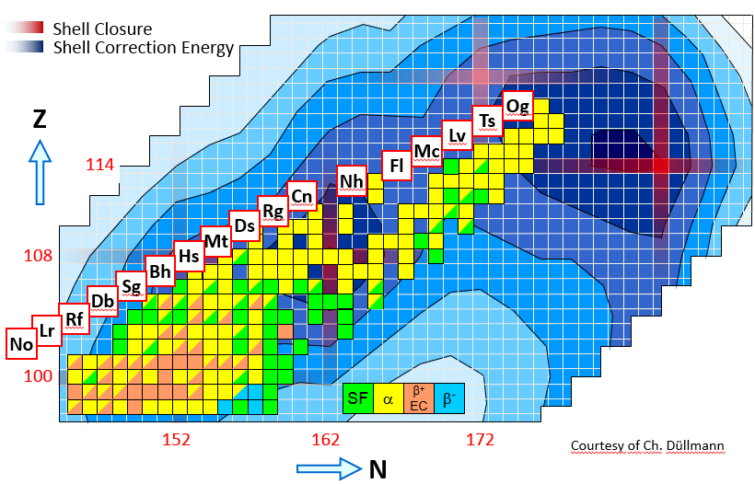
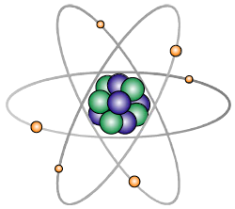

PTMS for SHE
≈ 1/s ≈ 1/day ≈ 1/week
What is the structure of SHEs?
...Stability due to shell effects
→ accurate binding energies!
EMISXX - 21.10.2025

Slide 3
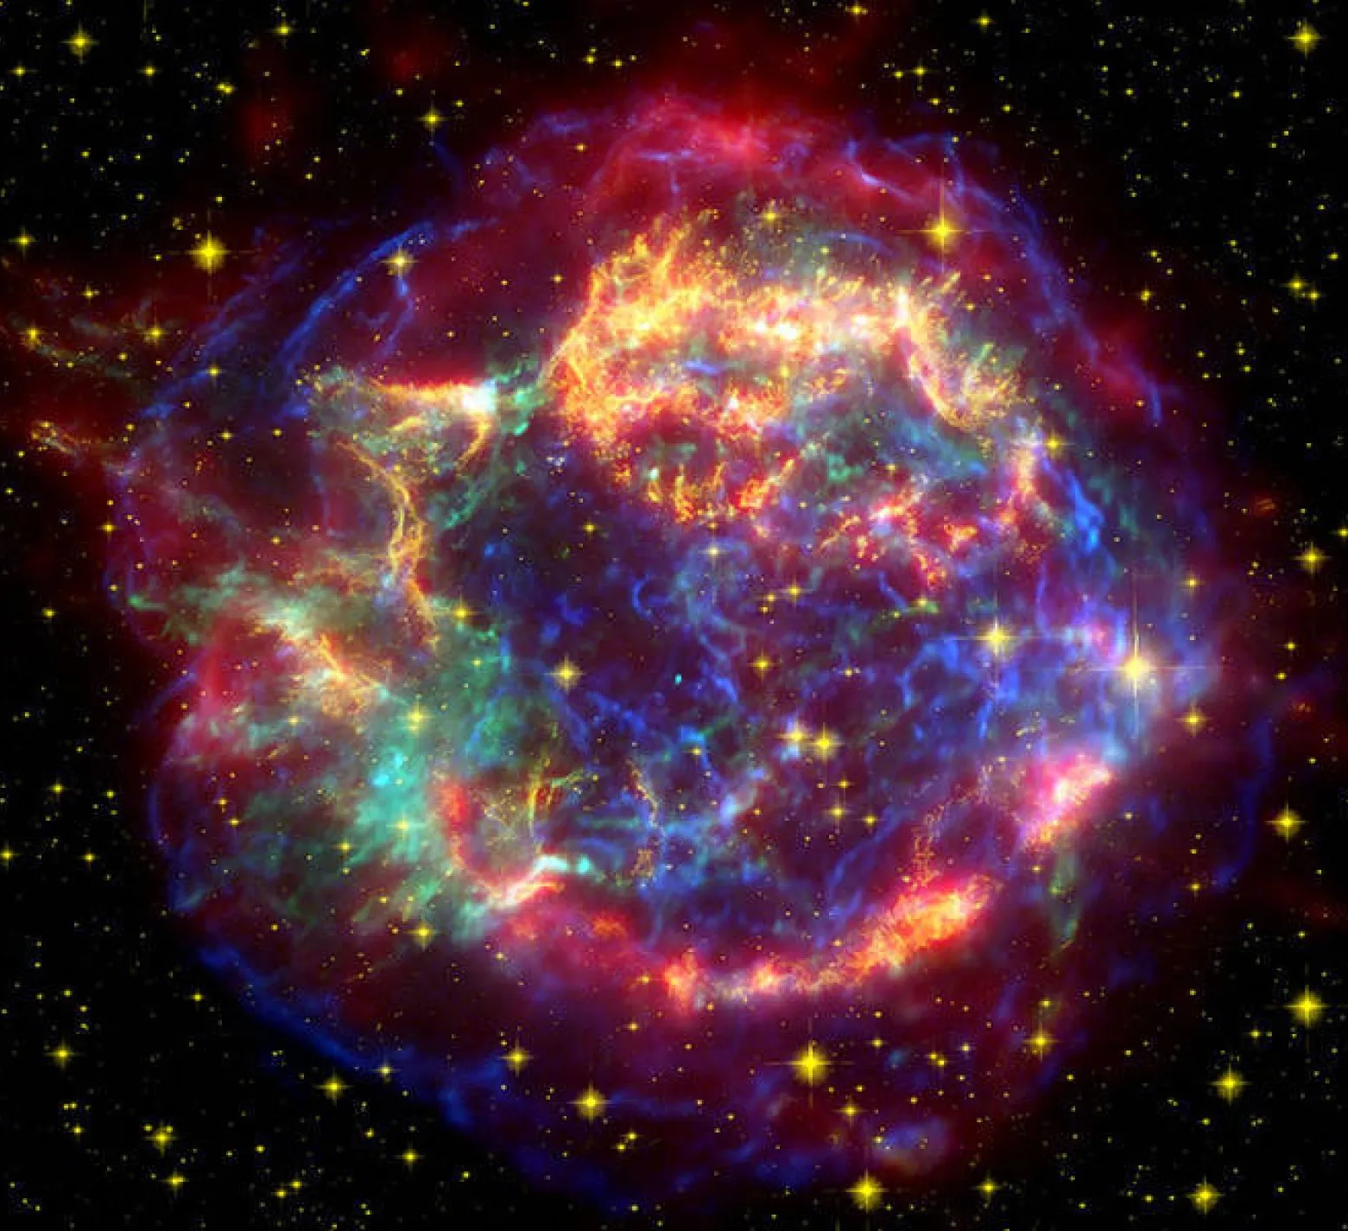
Are superheavies made in the r-process?
≈ 1/s ≈ 1/day ≈ 1/week
What is the heaviest element
that can be synthetized in a lab?
...and in the stars?
O. R. Smits et al, Nature Rewiew P. 6 86 (2024)
S. A. Giuliani et al, RMP 91, 011001 (2019)
EMISXX - 21.10.2025

Slide 4
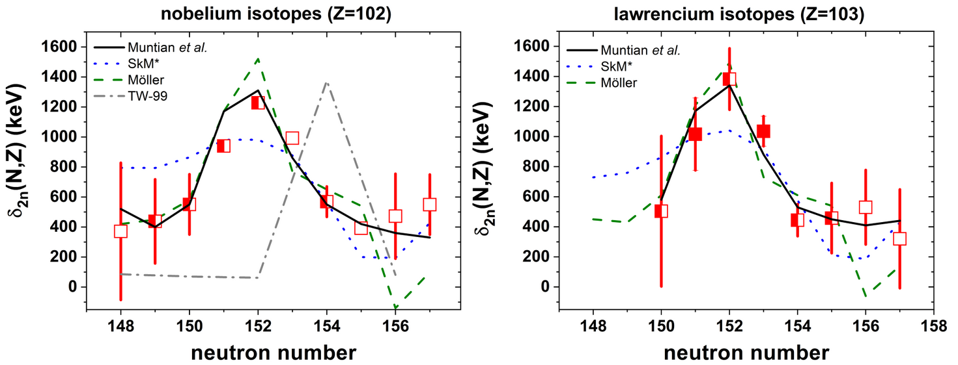
Mapping nuclear shell effects with direct mass measurements
High-precision mass spectrometry of the SHEs allow to...
... map and study nuclear shell effects
... provide anchor points to fix alpha decay chains
... benchmark theoretical models
… investigate isomeric states
E. Minaya Ramirez et al, Science 337 1207 (2012)
O. Kaleja et al, PRC 106, 054325 (2022)
EMISXX - 21.10.2025

Slide 5
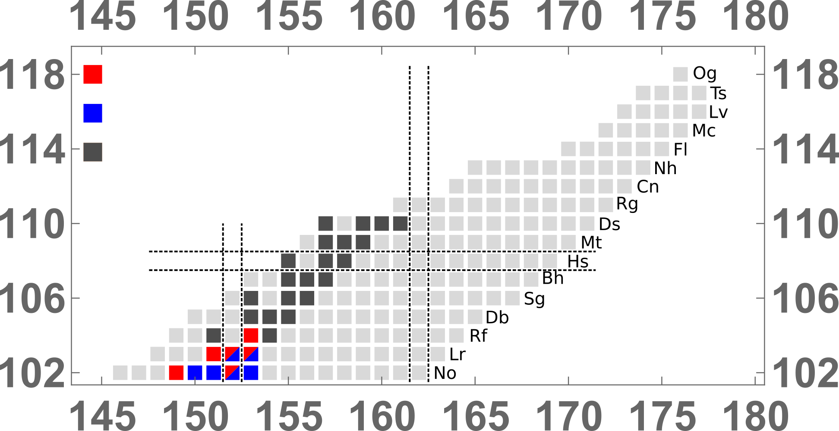
Mapping nuclear shell effects with direct mass measurements
High-precision mass spectrometry of the SHEs allow to...
... map and study nuclear shell effects
... provide anchor points to fix alpha decay chains
... benchmark theoretical models
… investigate isomeric states
Z = 110
α
²⁷⁰Ds
0.1ms
Z = 108
α
²⁶⁶Hs
2.3ms
Z = 106
α
²⁶²Sg
6.9ms
SHIPTRAP PI-ICR
SHIPTRAP TOF-ICR
Connected isotopes
Z = 104
α
²⁵⁸Rf
13ms
Z = 102
²⁵⁴No
55s
²⁷⁰Ds mass can now be fixed with about 40 keV uncertainty
M. Dworschak et al, PRC 81 (2010)
O. Kaleja et al, PRC 106, 054325 (2022)
EMISXX - 21.10.2025
TASCA 21 @GSI, 22 June 2021

Slide 6
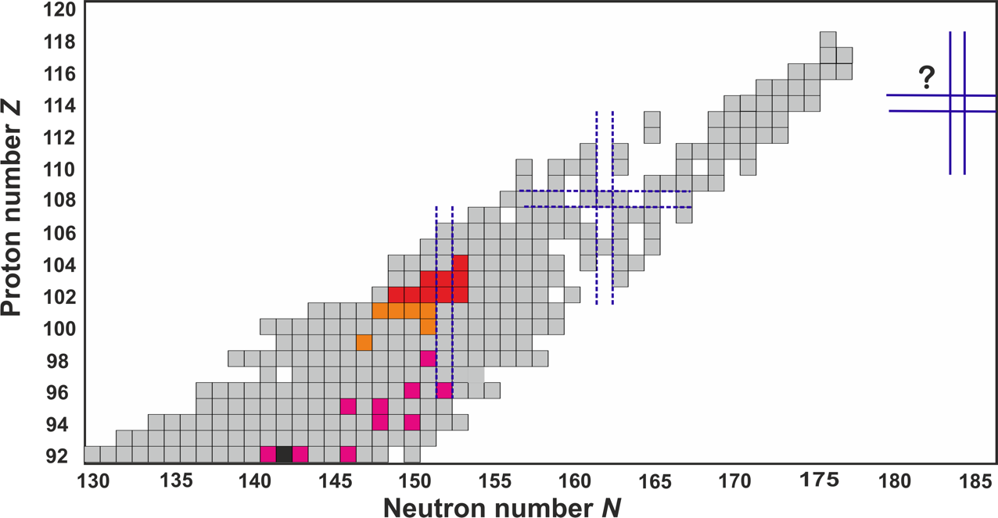

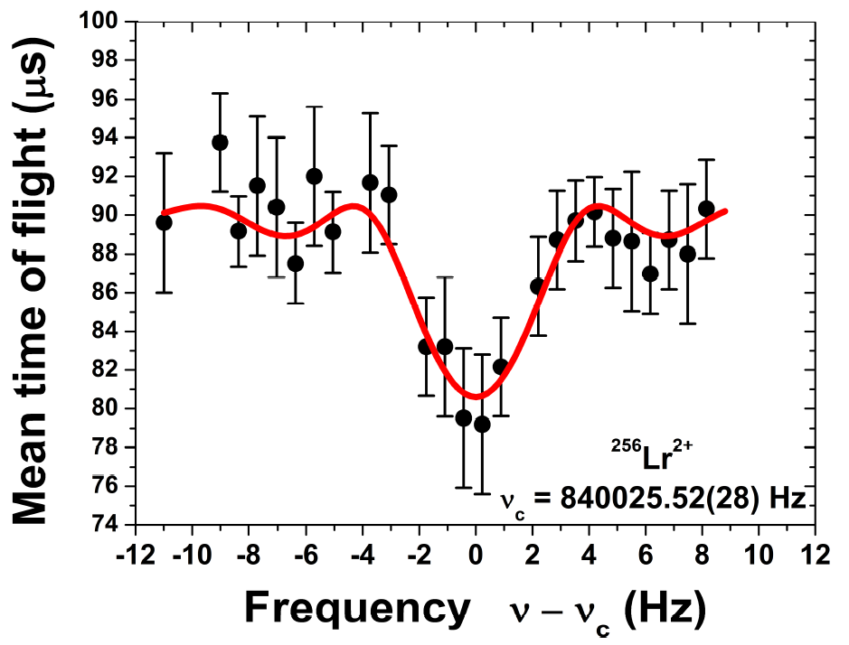
PTMS for SHE: Where we started and where we are
Until 2012 up to masses of
²⁵²⁻²⁵⁵No and ^{255,256}Lr
with δm/m ~ 10⁻⁷ to 10⁻⁸
SHIPTRAP
2021
2018
50 ions in 4 days
𝝳m/m = 3E-7
SHIPTRAP @GSI
TRIGATRAP @ Mainz
MR-TOF @Riken
²⁵⁶Lr²⁺
M. Block et al., Nature 463, 785 (2010)
M. Dworschak et al., PRC 81, 064312 (2010)
E. Minaya Ramirez et al., Science 337, 1183 (2012)
O. Kaleja et al., PRC106, 054325 (2022)
EMISXX - 21.10.2025

Slide 7
The SHIPTRAP setup
EMISXX - 21.10.2025

Slide 8
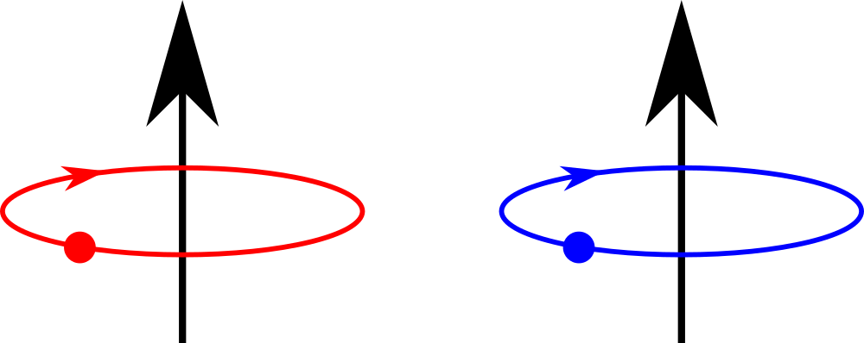



Ion storage in a Penning Trap
Ion of interest
Reference ion
Reference
Ion of interest
Time
Important: (systematics) → choice of reference!
¹³³Cs⁺
???
radioactive
Low ion rate = long measurements
Challenges:
Reduced drift of the magnetic field → Two/three steps temperature stabilization
of the magnet bore
(temperature fluctuations reduced to ~ 10mV)
Reduced drift of the trapping voltage → More stable power supplies for MT temperature-controlled cabinet (dV < 1 mV)
EMISXX - 21.10.2025
DPG SAMOP 2024 – 11.03.2024

Slide 9
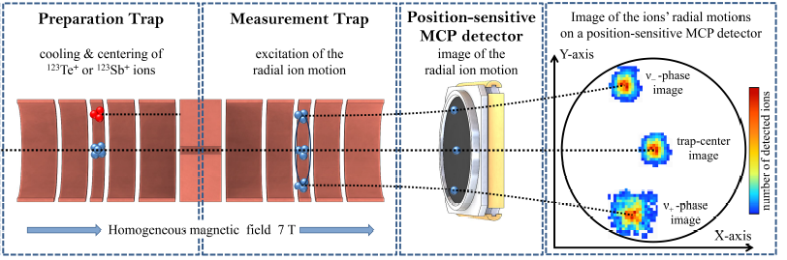
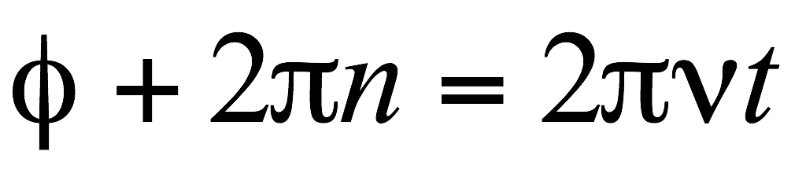
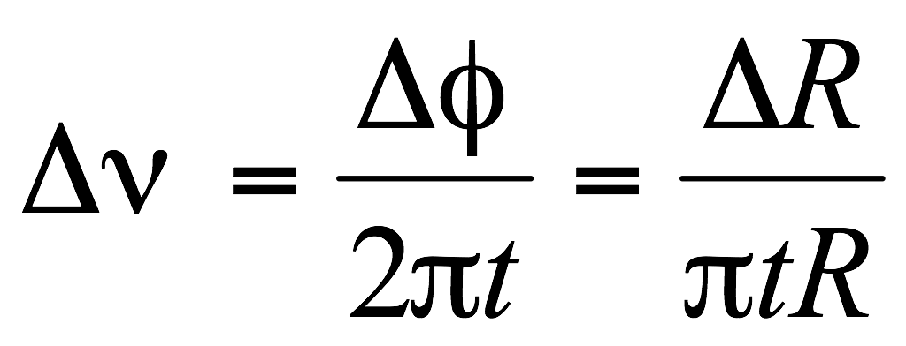
Phase Imaging Ion-Cyclotron Resonance method PI-ICR
P. Filianin et al, Phys. Lett. B 758 407-411 (2016)
Φ
Radial excitation
Gain in Precision ≈ 4.5
Gain in resolving power ≈ 40
Determination of the
spatial distribution
Radial excitation followed by
a phase accumulation time
S. Eliseev et al., Phys. Rev. Lett. 110, 082501 (2013)
S. Eliseev et al., Appl. Phys. B114, 107 (2014)
EMISXX - 21.10.2025

Slide 10
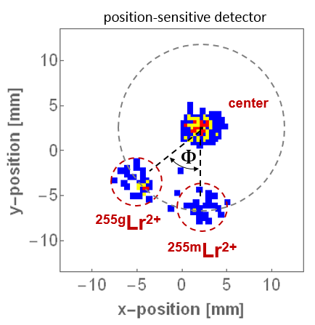
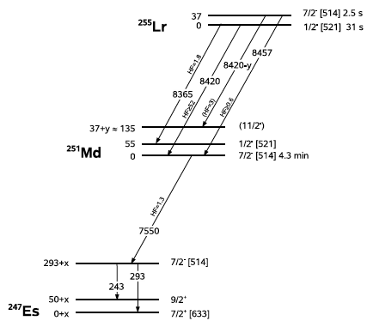
Beamtime June-July 2018: ^{255m}Lr
^{255m}Lr
E*≈30 keV
T_{1/2}≈2.5 s
Cyclotron Phase
PRELIMINARY
O. Kaleja et al., PRC 106, 054325 (2022)
Resolving power ≈
11 000 000 !!!
A. Chantillon et al., Eur. Phys. J. A 30 (2006) 397
F. Hessberger et al., Phys. At. Nucl. 70 (2007) 1445
S. Antalic et al., Eur. Phys. J. A 38 (2008) 219
EMISXX - 21.10.2025

Slide 11
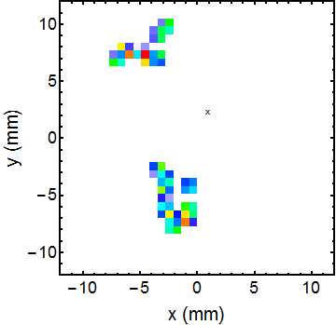
Beamtime April-June 2021
Mass measurements of heavy nuclides with SHIPTRAP @GSI in 2021/24: ²⁵⁷Rf (Z=104) & ²⁵⁸Db (Z=105)
²⁵⁷Rf : supreme mass resolving power of SHIPTRAP up to 11,000,000 allows resolving low-lying nuclear isomers (resolution at the keV-level for excitation energy!)
²⁵⁸Db : first measurements with only 5 detected ions in total and rates down to ≈ 0.00002/s
^{257g}Rf²⁺
center
PRELIMINARY
^{257m}Rf²⁺
15 events in 15 hours
~1200 ms Acc. time
F.-P. Heßberger et al, Z. Phys. A 359 415 (1997)
K. Hauschild et al, Eur. Phys. J. A 58 6 (2022)
EMISXX - 21.10.2025

Slide 12
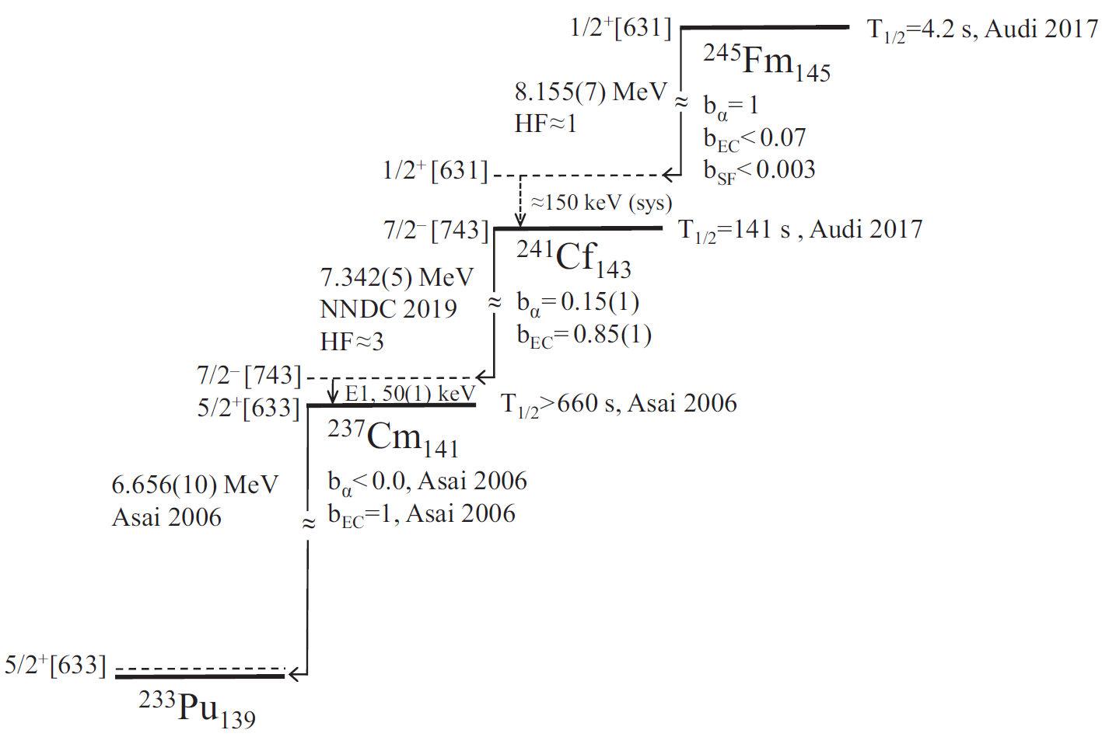
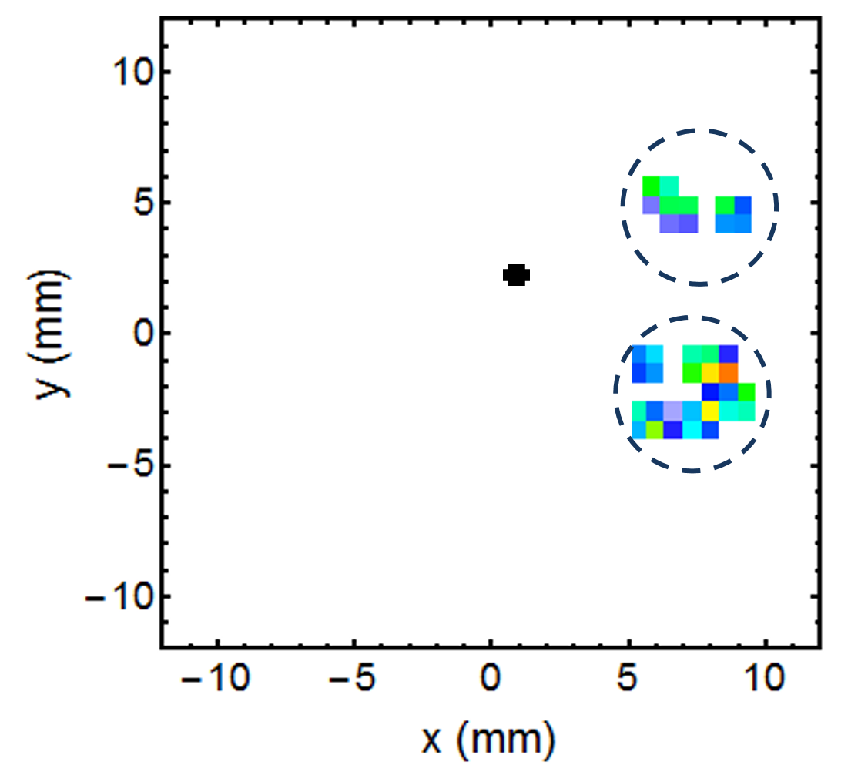
²⁴¹Cf has an isomer!
200 ms
Acc. time
^{241m}Cf²⁺
PRELIMINARY
²⁴¹Cf²⁺
19 events in 8 hours
~200 ms Acc. time
EMISXX - 21.10.2025

Slide 13
Summary
Thanks to the technical and methodical improvements achieved at SHIPTRAP in the last years we had extended our investigations towards more exotic nuclides with higher Z.
Implementation of the Cryogenic buffer-gas cell Boosted overall efficiency of about a factor of 10 compared to 2010
Development of a new measurement method, the PI-ICR technique Confirmed PI-ICR high mass resolving power for radioactive nuclides at the lowest production yields
Successful direct measurements of the first superheavy
²⁵⁷Rf (σ=15 nb) and its low-lying isomeric state!
EMISXX - 21.10.2025

Slide 14
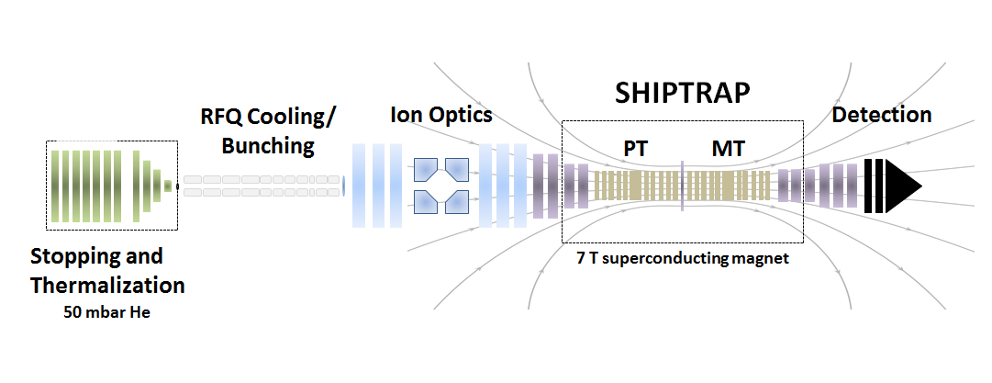
Low ²⁵⁸Db incoming rate: efficiency drop?
Outlook: Hunting ²⁵⁸Db
²⁵⁸Db(2)
²⁵⁸Db(1)
(5⁺, 10⁻)
51 keV
(0⁻)
0 keV
T_{1/2}=4.4 s
T_{1/2}=2.17 s
The cryocell entrance
window got thicker with time!
^{254m}Lr
^{254g}Lr
M. Vostinar et al., EPJA 55, 17 (2019)
P. Schury et al., RIKEN AP Rep. 55, 7 (2022)
Exp. February 2024 X
Exp. May 2025 X
SHIP
EMISXX - 21.10.2025
TASCA 21 @GSI, 22 June 2021

Slide 15
Outlook: What’s next?
New Off-line Branch for SHIPTrap: recoil source buffer-gas cell + compact buncher
53% Extraction efficiency
in first tests with ²²⁵Ac source
EMISXX - 21.10.2025
TASCA 21 @GSI, 22 June 2021

Slide 16
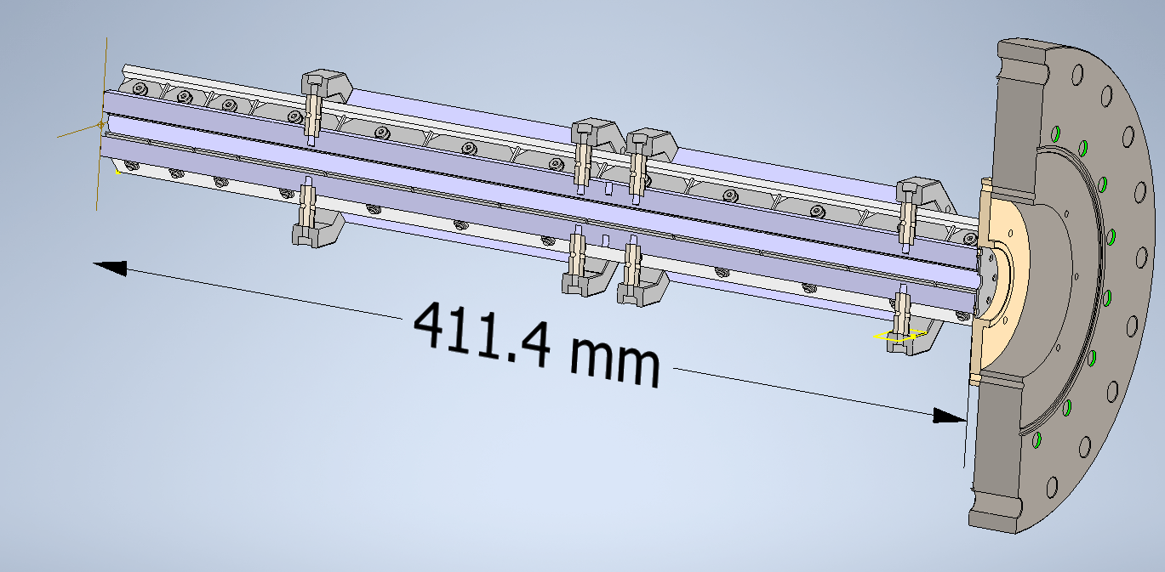
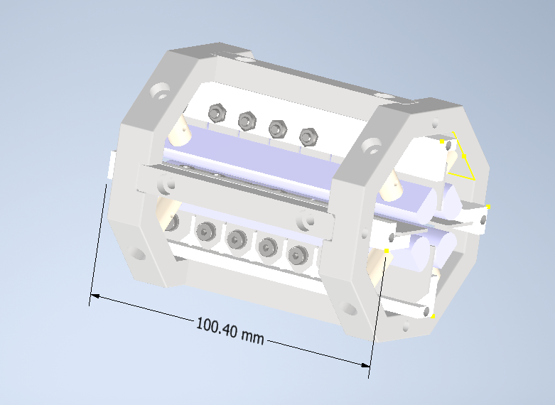
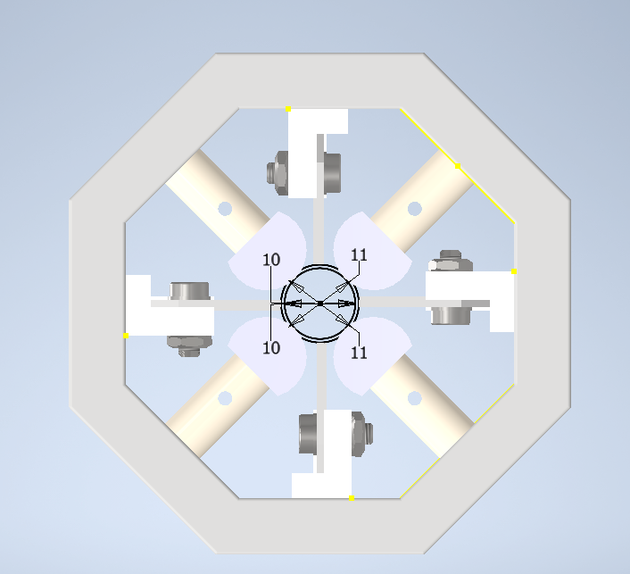
Outlook: What’s next?
New Off-line Branch for SHIPTrap: recoil source buffer-gas cell + compact buncher
53%
EMISXX - 21.10.2025
TASCA 21 @GSI, 22 June 2021

Slide 17
Outlook: What’s next?
New Buncher for SHIPTrap → Cryogenic! (Ongoing)
Design of a new Penning-trap system → more efficient purification and PI-ICR in cryogenic environment (Starting Soon)
(We are looking for a PhD student!)
SHIP
EMISXX - 21.10.2025
TASCA 21 @GSI, 22 June 2021

Slide 18











SHIPTRAP collaborators
B. Anđelić, L. Arcila Gonzalez, K. van Beek, J. Berrocal Sanchez, A. Brizard, L. Blaauw, K. Blaum,
M. Block, J. Cipagauta Mora, P. Chauveau, S. Chenmarev, P. Chhetri, C. E. Düllmann, M. Eibach, J. Even, P. Filianin, M. Gutierrez Torres, B. Hartigan, F. P. Hessberger,
N. Kalantar-Nayestanaki, O. Kaleja, T. Kieck, J. van de Laar, M. Laatiaoui, S. Lohse,
E. Minaya Ramirez, A. Mistry, S. Morard, E. Morin, Y. Nechiporenko, D. Neidheer,
S. Nothhelfer, Y. Novikov, J. Patel, S. Raeder, E. Rickert, D. Rodriguez,
L. Schweikhard, P. G. Thirolf, J. Warbinek, A. Yakushev
EMISXX - 21.10.2025

Slide 19
Thank you for your attention!
EMISXX - 21.10.2025
TASCA 21 @GSI, 22 June 2021

Slide 20
EMISXX - 21.10.2025
TASCA 21 @GSI, 22 June 2021

Slide 21
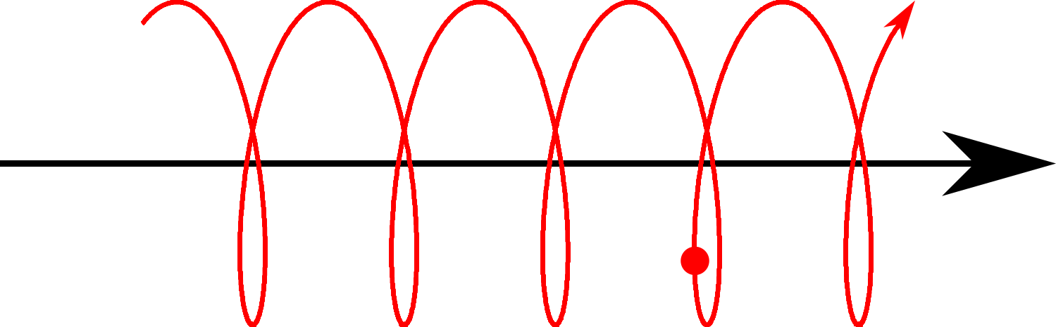
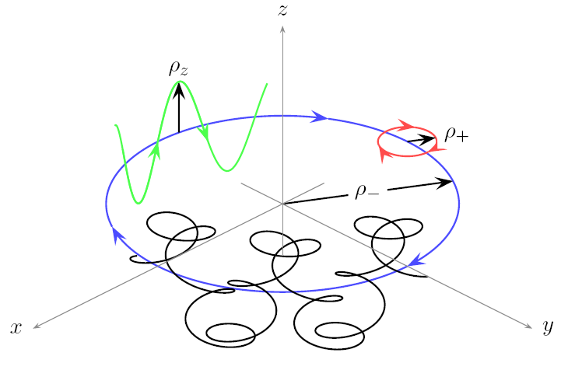
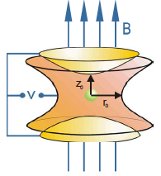
Ion storage in a Penning Trap
axial motion
axial motion
cyclotron motion
ν_{z}
ν₊
ν₋
trajectory
magnetron motion
EMISXX - 21.10.2025

