Slide 1
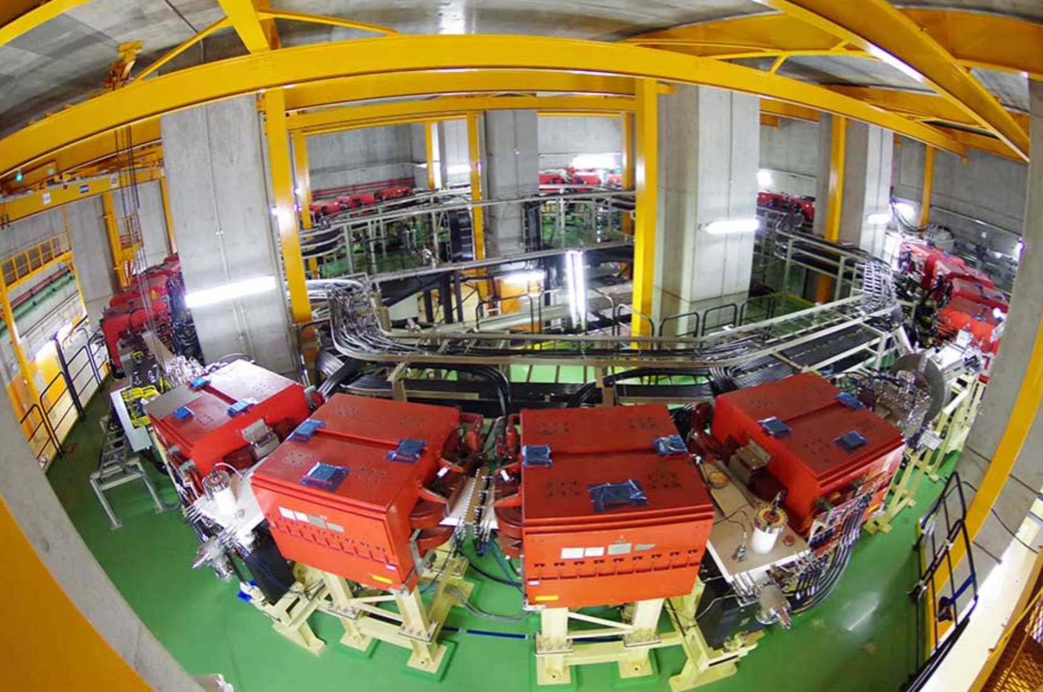



Present and future mass measurement methods
of the Rare-RI Ring
A. Yano (Univ. of Tsukuba / RIKEN)
for the Rare-RI Ring collaboration

Slide 2
Outline
Introduction
- Principle of isochronous mass spectrometry
- The Rare-RI Ring facility@RIBF
- Achieved isochronism & mass precision
Recent upgrades
- Injection to the Rare-RI Ring
- Extraction from the Rare-RI Ring
- Future mass measurements in the Rare-RI Ring
Summay & Outlook

Slide 3

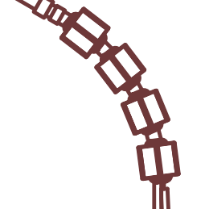
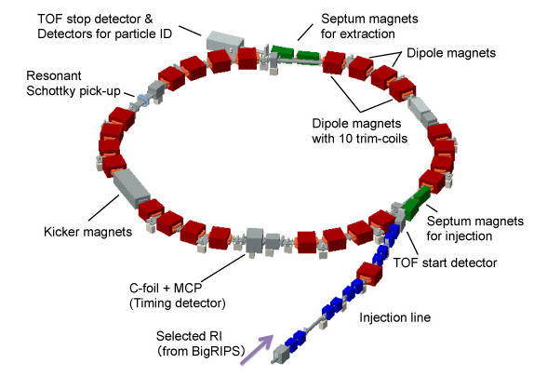




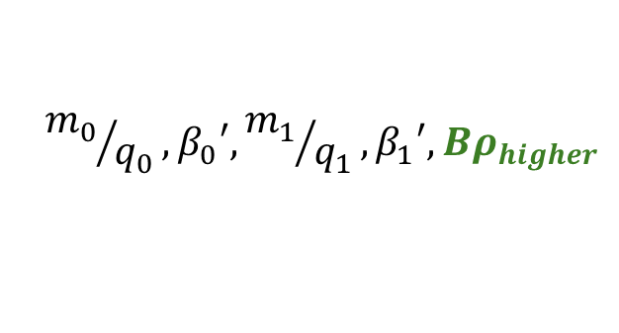
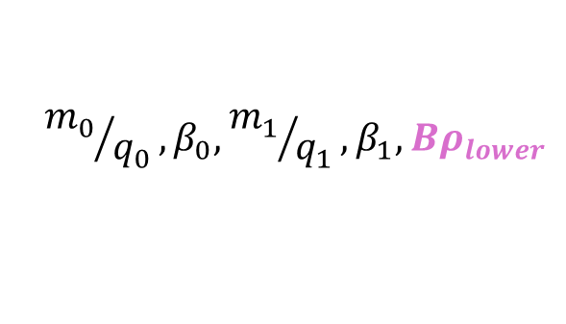




Principle of mass measurements
Isochronous mass spectrometry (IMS)
Isochronism: constant revolution time ($T$)
Orbit length ($L$) ⇔ Magnetic rigidity ($Bρ$)
$T_{0}=$ $T_{0}‘$ for the reference particles
$$L=β_{0}T_{0}=β_{1}T_{1}$$
$β_{0}$< $β_{0}′$
$$T_{0}′,β_{0}′$$
$${m_{0}}/{q_{0}},β_{0}, {m_{1}}/{q_{1}},β_{1}, {Bρ}_{lower}$$
Reference particles
Target particles
$$T_{0},β_{0}$$
$${m_{0}}/{q_{0}},β_{0}′, {m_{1}}/{q_{1}},β_{1}′, {Bρ}_{higher}$$

Slide 4

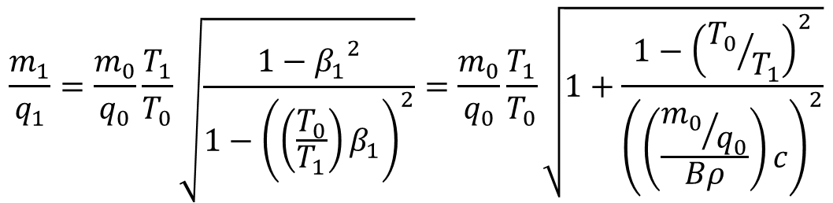


Principle of mass measurements
Isochronous mass spectrometry (IMS)
Isochronism: constant revolution time ($T$)
Orbit length ($L$) ⇔ Magnetic rigidity ($Bρ$)
$T_{0}=$ $T_{0}‘$ for the reference particles
$$L=β_{0}T_{0}=β_{1}T_{1}$$
$β_{0}$< $β_{0}′$
$$T_{0}′,β_{0}′$$
$${m_{0}}/{q_{0}},β_{0}, {m_{1}}/{q_{1}},β_{1}, {Bρ}_{lower}$$
Reference particles
Target particles
$$T_{0},β_{0}$$
$${m_{0}}/{q_{0}},β_{0}′, {m_{1}}/{q_{1}},β_{1}′, {Bρ}_{higher}$$
$$\frac{m_{1}}{q_{1}}=\frac{m_{0}}{q_{0}}\frac{T_{1}}{T_{0}}\sqrt{\frac{1−{β_{1}}^{2}}{1−{\left(\left(\frac{T_{0}}{T_{1}}\right)β_{1}\right)}^{2}}}=\frac{m_{0}}{q_{0}}\frac{T_{1}}{T_{0}}\sqrt{1+\frac{1−{\left({T_{0}}/{T_{1}}\right)}^{2}}{{\left(\left(\frac{{m_{0}}/{q_{0}}}{Bρ}\right)c\right)}^{2}}}$$
where $T=2π\frac{m}{qB}$
$β$ correction method
$Bρ$ correction method
Revolution times,
Velocity,
or
Magnetic rigidity

Slide 5
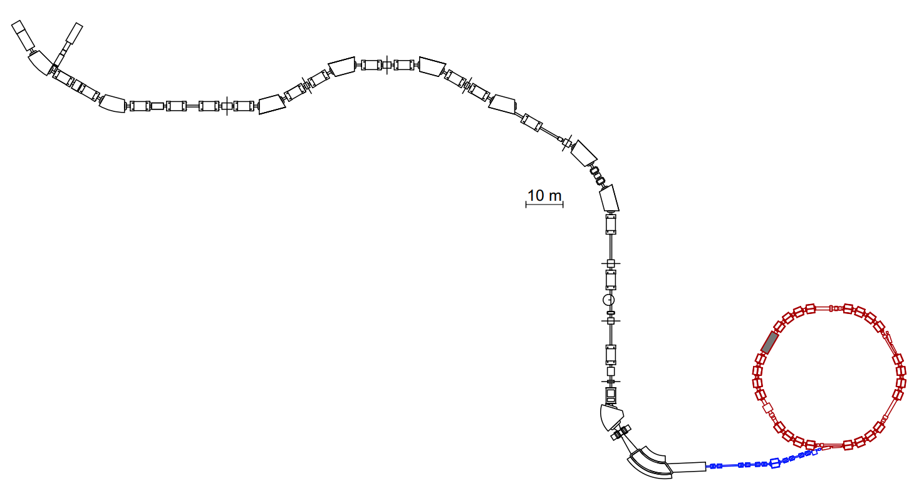
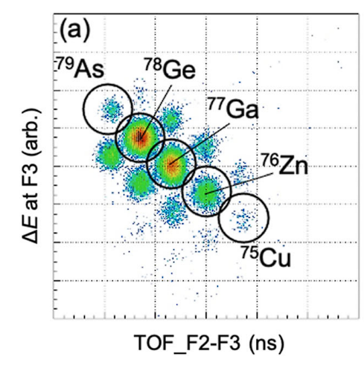
The Rare-RI Ring (R3) facility
A. Ozawa et al., PTEP2012 03C009 (2012)
Y. Yamaguchi et al., NIM-B317 629-635 (2013)
Combined with a powerful
in-flight separator, BigRIPS
BigRIPS
F5
F2
F3
Individual injection method
Circumference
60.35 m
Trigger signal
Max. Bρ
6.4 Tm
Momentum acceptance
dp/p=1%
Injection
acceptance of R3
Measurement
time
<1 ms
R3
OEDO-SHARAQ
S0
Kicker
magnet
PID plot@F2-F3
S. Naimi et al., EPJA 59-90 (2023)
Injection beamline

Slide 6
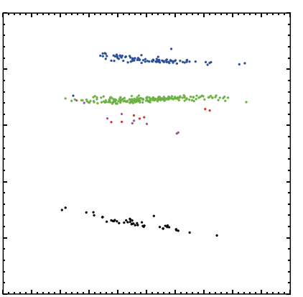
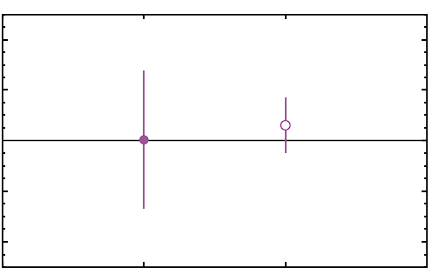








Achieved isochronism & mass precision
701600
⁷⁸Ge (isochronous reference)
Isochronism: ~5.4x10⁻⁶
⁷⁸Ga
701500
4.0$×$10⁻⁵
⁷⁵Cu
701400
2.0$×$10⁻⁵
Stored time [ns]
⁷⁹As
⁷⁵Cu
$(m/{q)}_{exp}$ - $(m/{q)}_{AME2020}$
701300
0.0$×$10⁰
⁷⁶Zn
-2.0$×$10⁻⁵
701200
-4.0$×$10⁻⁵
$β$ correction
$Bρ$ correction
701100
δ(m/q) 2.7x10⁻⁵ 1.1x10⁻⁵
-0.5
-0.4
-0.3
-0.2
-0.1
0.0
0.1
0.2
0.3
0.4
0.5
dp/p [%]
δm ~740 keV ~290 keV
D. Nagae et al., PRC110, 014310 (2024)

Slide 7
Recent upgrades
(i) Injection to R3
(ii) Extraction from R3
(iii) Future mass measurements

Slide 8
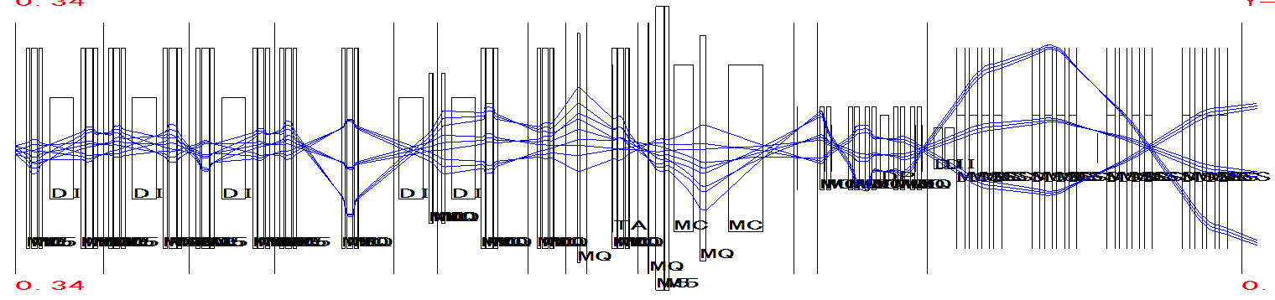
(i) Injection to R3
Vertical steering magnets
Low injection efficiency to R3
±18 mm
F3
Vertical shift
Y : -2.0 mm
Y’: -2.7 mrad
Injection
line
R3
00
Geometrical acceptance

Slide 9
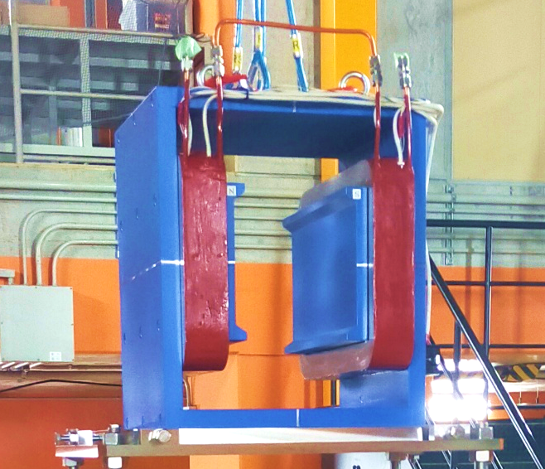
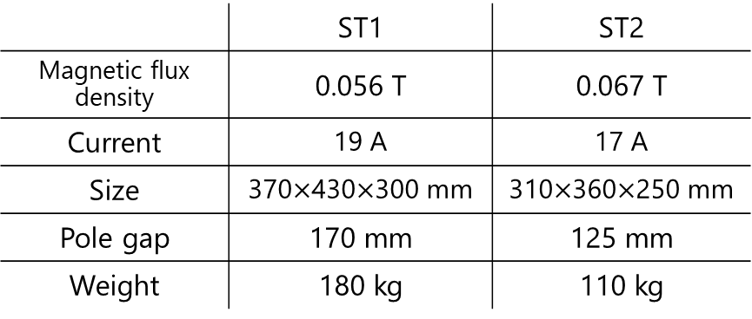
(i) Injection to R3
Vertical steering magnets
Low injection efficiency to R3
±18 mm
F3
Vertical shift
Y : -2.0 mm
Y’: -2.7 mrad
Injection
line
R3
00
Geometrical acceptance
 | ST1 | ST2
Magnetic flux density | 0.056 T | 0.067 T
Current | 19 A | 17 A
Size | 370$×$430$×$300 mm | 310$×$360$×$250 mm
Pole gap | 170 mm | 125 mm
Weight | 180 kg | 110 kg
ST1

Slide 10
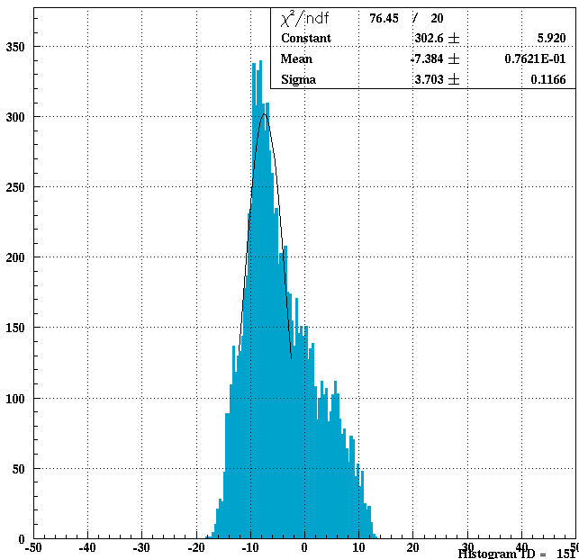
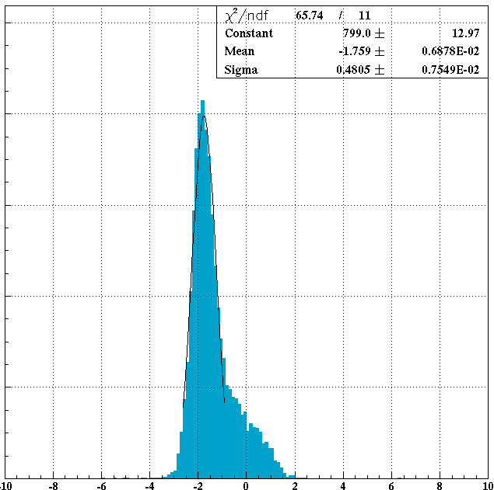
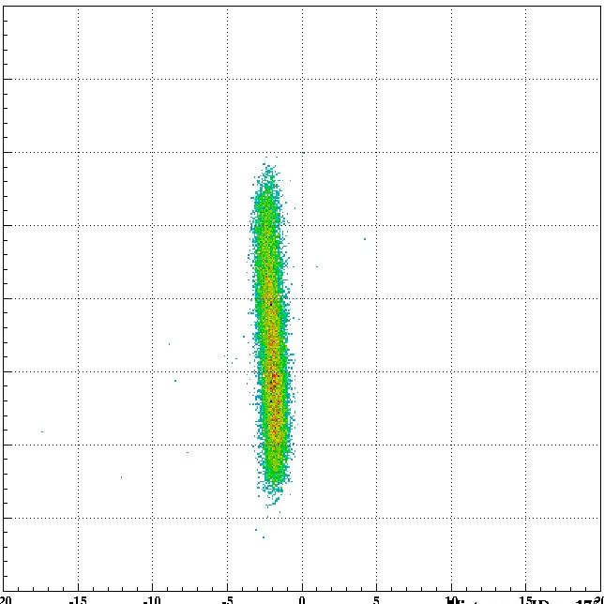
(i) Injection to R3
Commissioning results
Y and Y’ at the kicker magnet
¹²⁴Xe ~155 MeV/u@R3
Kicker magnet
20
w/o ST
w/o ST
-7.4 mm
-1.8 mrad
10
Y’ [mrad]
0
Deflection angle
ST1: -1.5 mrad
ST2: +1.7 mrad
-10
-50
0
50
-10
0
10
Y [mm]
Y’ [mrad]
-20
-10
0
10
20
Y [mm]
Vertical beam profile@F3
Y: -2.0 mm
Y’: -2.8 mrad

Slide 11
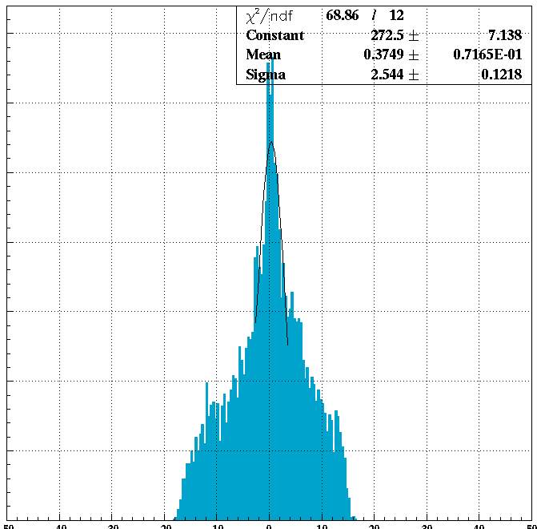
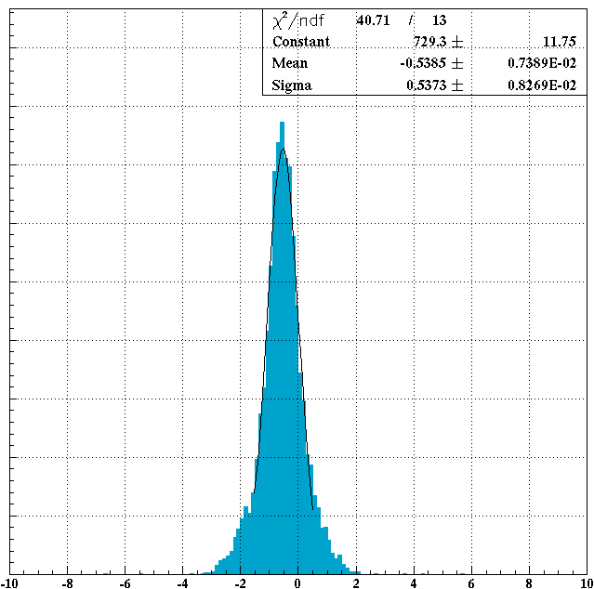
(i) Injection to R3
Commissioning results
Y and Y’ at the kicker magnet
¹²⁴Xe ~155 MeV/u@R3
Kicker magnet
20
w/o ST
w/o ST
-7.4 mm
-1.8 mrad
10
Y’ [mrad]
0
Deflection angle
ST1: -1.5 mrad
ST2: +1.7 mrad
-10
w/ ST
w/ ST
-20
-10
0
10
20
0.4 mm
-0.5 mrad
Y [mm]
Vertical mismatch
was corrected
Vertical beam profile@F3
Y: -2.0 mm
Y’: -2.8 mrad
Injection x2
Extraction x3.5
-50
0
50
-10
0
10
Y [mm]
Y’ [mrad]

Slide 12
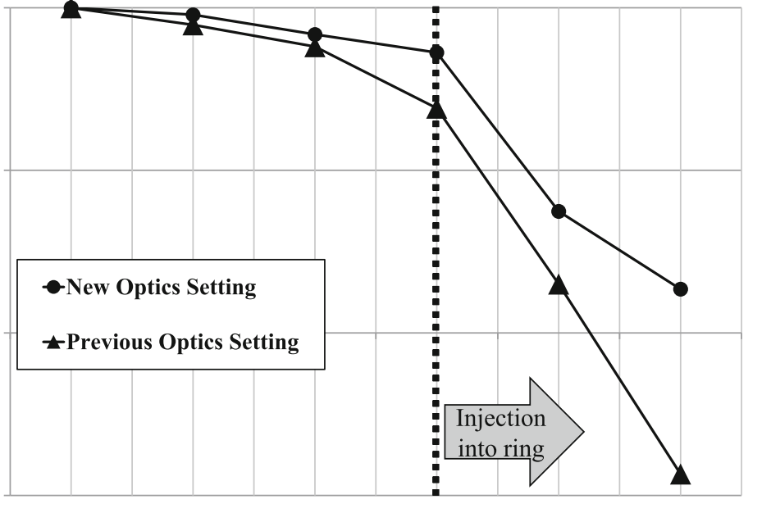
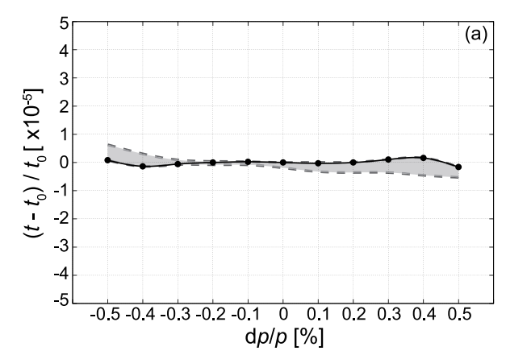
(ii) Extraction from R3
Beam motion inside R3
Beam tracking simulation with B_{y}
F3
S0
ILC1
ILC2
RMD-4
ELC
Runge-Kutta method
100
Isochronism evaluation
10
⁷⁸Ge, 4.8508 Tm (175 MeV/u)
Transmission relative to F3
1
x10
0.9 ppm standard deviation
0.1
S. Naimi et al., EPJA 59-90 (2023)
Stored
Y. Abe et al., NIM-A1072,170083 (2023)
Still large gap between RMD-4 and ELC
→ Beam motion inside R3
3D magnetic field

Slide 13
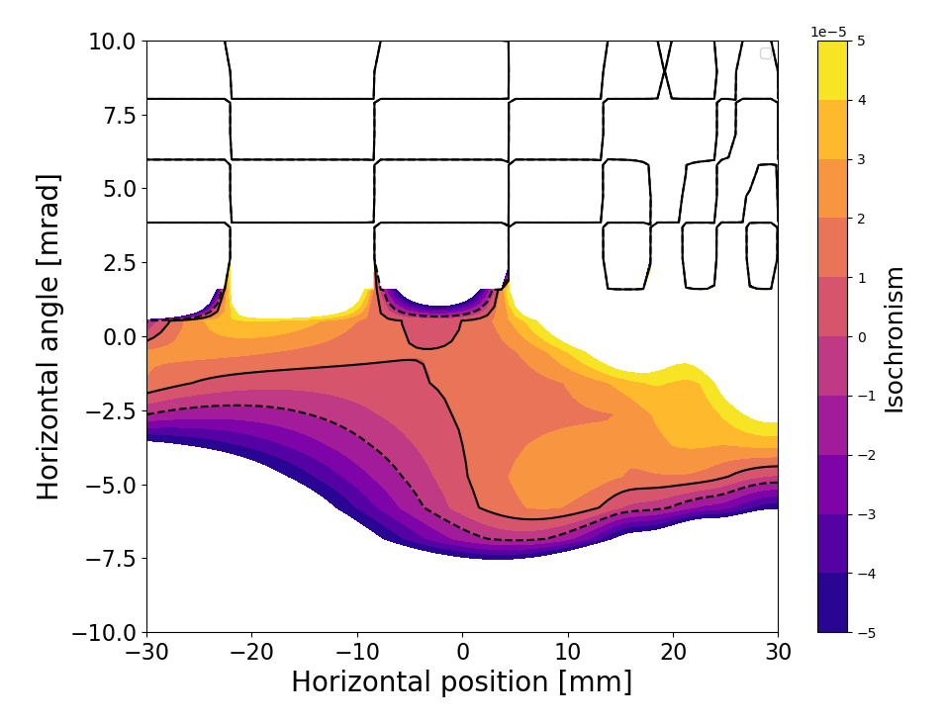
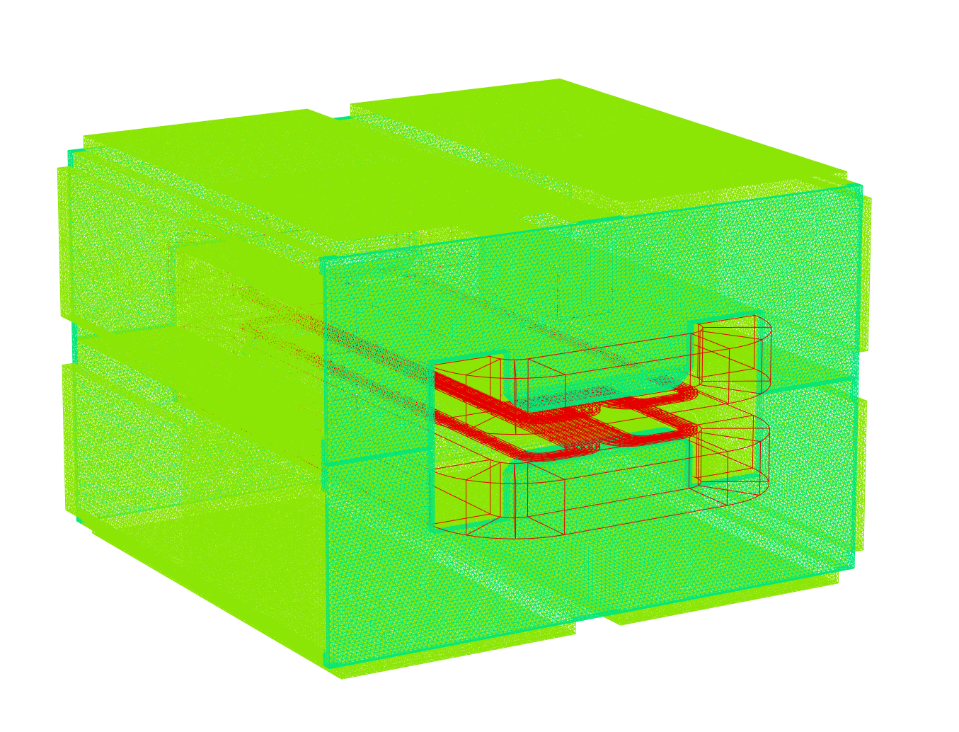
(ii) Extraction from R3
Vertical beam motion
Simulated isochronous conditions of dp/p=0 particles
Calculate 3D magnetic field using Opera 2023
⁷⁸Ge
4.8508 Tm (175 MeV/u)
After 6 revolutions
Parameterize the magnetic field as a function of the beam position
Main coils
Trim coils for isochronous magnetic field
ppm-order isochronism region

Slide 14
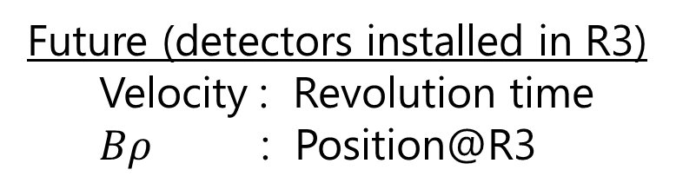
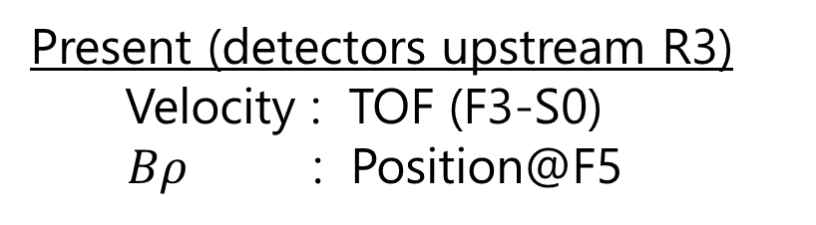
(iii) Future mass measurements
Schottky-based IMS
Present (detectors upstream R3)
Velocity : TOF (F3-S0)
$Bρ$ : Position@F5
Future (detectors installed in R3)
Velocity : Revolution time
$Bρ$ : Position@R3
Whole measurements will be completed inside R3
Better transmission of high-Z beams

Slide 15
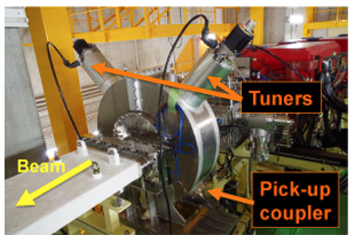
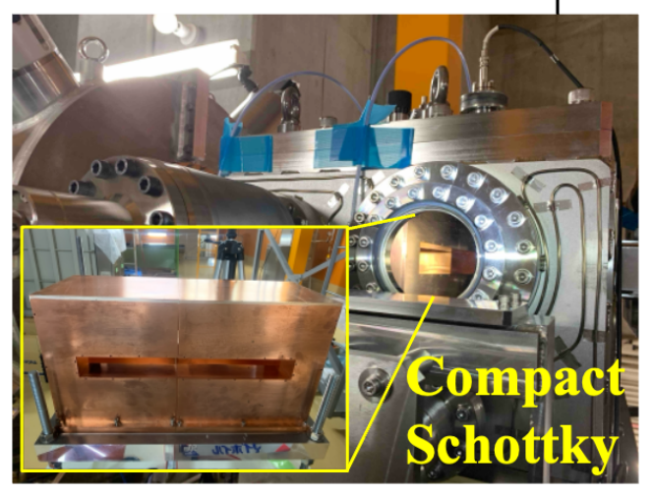
(iii) Future mass measurements
Schottky-based IMS
Present (detectors upstream R3)
Velocity : TOF (F3-S0)
$Bρ$ : Position@F5
Future (detectors installed in R3)
Velocity : Revolution time
$Bρ$ : Position@R3
Whole measurements will be completed inside R3
Better transmission of high-Z beams
Schottky detectors
Compact Schottky
for velocity measurements
Electric or magnetic field is induced
Non-destructive
Fast detection
¹²⁴Xe⁵⁴⁺ (155 MeV/u) was detected <10 ms!
F. Suzaki et al.,
RIKEN APR49,179 (2016)
T. Yamaguchi et al.,
RIKEN APR58

Slide 16
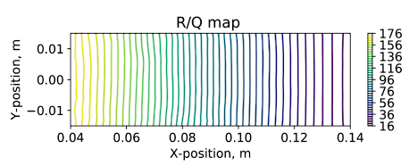
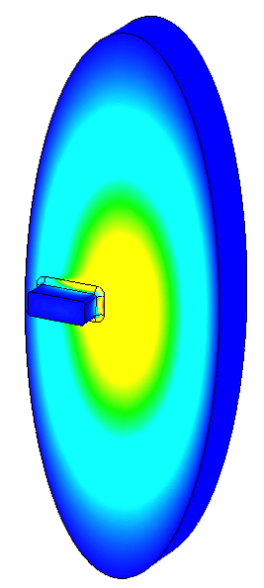
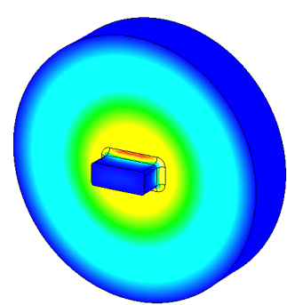
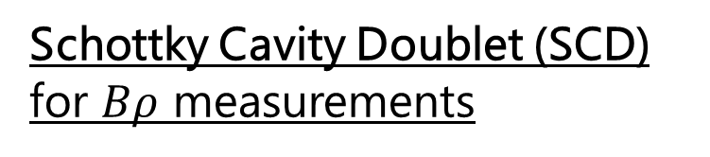
(iii) Future mass measurements
Schottky Cavity Doublet (SCD)
Schottky Cavity Doublet (SCD)
for $Bρ$ measurements
Signal sensitivity of the elliptical cavity
Position-sensitive
D. Dmytriiev et al., NIM-B463, 320-323 (2020)
Reference cavity
Elliptical cavity
Courtesy by G. Hudson-Chang

Slide 17
(iii) Future mass measurements
Schottky Cavity Doublet (SCD)
Schottky Cavity Doublet (SCD)
for $Bρ$ measurements
Signal sensitivity of the elliptical cavity
Positional dependence
Position-sensitive
D. Dmytriiev et al., NIM-B463, 320-323 (2020)
Signal height (elliptical cavity / reference cavity)
→The beam position inside R3
Reference cavity
Elliptical cavity
Courtesy by G. Hudson-Chang

Slide 18
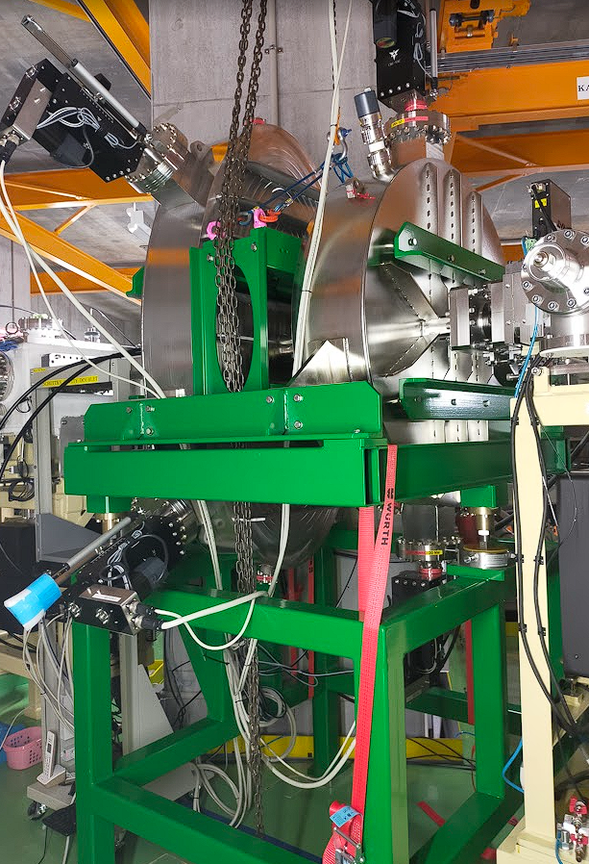


(iii) Future mass measurements
Schottky Cavity Doublet (SCD)
Schottky Cavity Doublet (SCD)
for $Bρ$ measurements
Sep. 2024
Shipped from Germany
Position-sensitive
Reference cavity
Elliptical cavity
Courtesy by G. Hudson-Chang

Slide 19
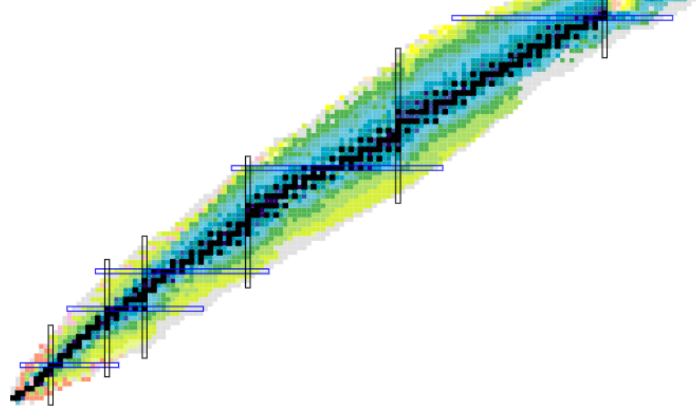
Summary & Outlook
The Rare-RI Ring facility: A unique storage ring optimized for IMS
Some recent upgrades:
Injection to the Rare-RI Ring
- The vertical beam trajectory correction → The vertical steering magnets
- The Injection (x2) and the extraction (x3.5) was improved
Extraction from the Rare-RI Ring
- Injected beam is not fully extracted → Beam motion
- The beam tracking simulation with 3D magnetic field
Future mass measurements
- Schottky-based IMS
- Compact Schottky & Schottky Cavity Doublet
High-Z
Outlook:
Test of Schottky Cavity Doublet
Mass measurements:
n-rich side / high-z region with ²³⁸U
p-rich side with ¹²⁴Xe
Isomer beam filter: Poster #128
T_{1/2} < ~20 ms

Slide 20
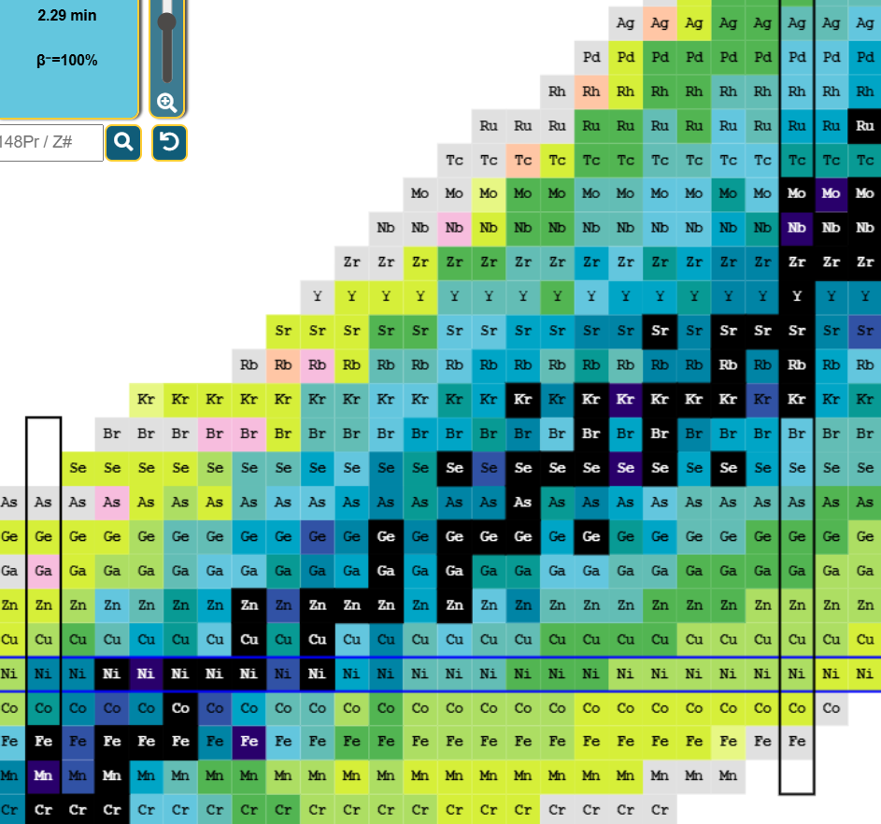
Summary & Outlook
The Rare-RI Ring facility: A unique storage ring optimized for IMS
Some recent upgrades:
Injection to the Rare-RI Ring
- The vertical beam trajectory correction → The vertical steering magnets
- The Injection (x2) and the extraction (x3.5) was improved
Extraction from the Rare-RI Ring
- Injected beam is not fully extracted → Beam motion
- The beam tracking simulation with 3D magnetic field
Future mass measurements
- Schottky-based IMS
- Compact Schottky & Schottky Cavity Doublet
50
28
Outlook:
Test of Schottky Cavity Doublet
Mass measurements:
n-rich side / high-z region with ²³⁸U
p-rich side with ¹²⁴Xe
Isomer beam filter: Poster #128
28

Slide 21








Thank you for your listening!
M. S. Sanjari¹, A. Ozawa², Y. Yamaguchi³, T. Ohnishi³, Y. Abe³, G. Hudson-Chang^{3,4},
D. Nagae⁵, T. Yamaguchi⁵, N. Chandratakumar^{3,4}, N. Imai⁶, Y. Kikuchi⁵, N. Kitamura⁶, R. Kojima⁶,
J. Li⁶, T. Moriguchi², S. Nishizawa⁵, F. Suzaki⁷, K. Takiura⁵, N. Tomioka⁵, R. Tuchiya⁶, M. Wakasugi⁸,
K. Watanabe⁵, R. Yokoyama⁶, and H. Zhang²
1 - GSI, 2 – University of Tsukuba, 3 – RIKEN, 4 – University of Surrey, 5 – Saitama University,
6 – The university of Tokyo, 7 – JAEA, 8 – Kyoto University

Slide 23
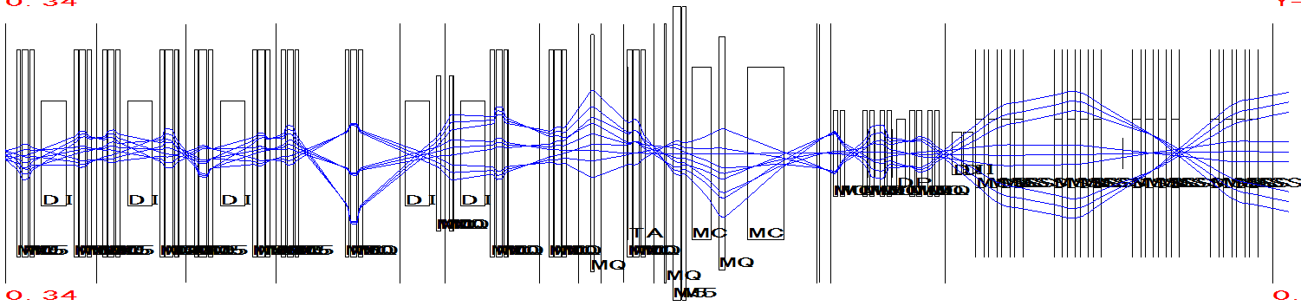
(i) Injection to R3
10@Injection
100@F3
1@ELC
Low injection efficiency to R3
Y: -2.0 mm, Y’: -2.7 mrad
R3
Vertical
steering
magnets
F3
Injection
line
R3
00
Correct
the vertical
beam trajectory
ST1: -0.7 mrad
ST2: +1.0 mrad

Slide 24
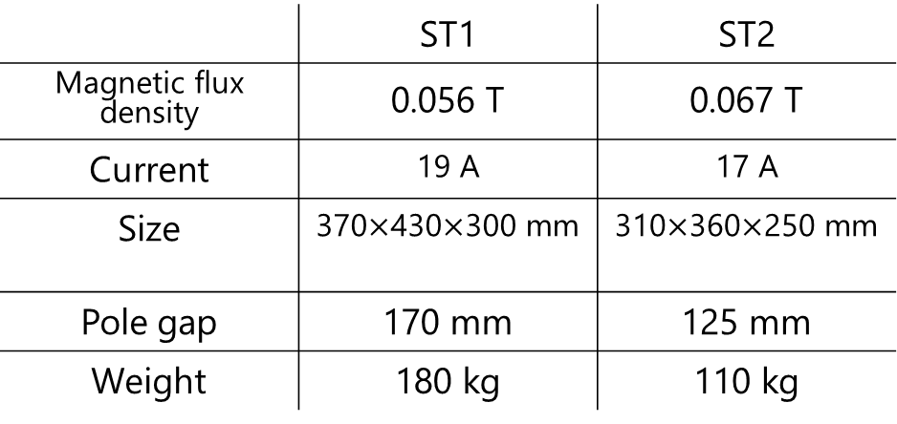
Design of the vertical steering magnets
Geometrical requirements
Aperture of the beam pipe
ST1 : 150 mm
ST2 : 110 mm
Max. pole length
ST1 : 300 mm
ST2 : 250 mm
ST1
ST1
ST2
Concidered beam conditions
Max. Bρ 6.4 Tm
Position deviation < |3| mm
Angle deviation < |6.5| mrad
 | ST1 | ST2
Magnetic flux density | 0.056 T | 0.067 T
Current | 19 A | 17 A
Size | 370$×$430$×$300 mm | 310$×$360$×$250 mm
Pole gap | 170 mm | 125 mm
Weight | 180 kg | 110 kg
→ Required BL product : ~0.0192 Tm

Slide 25
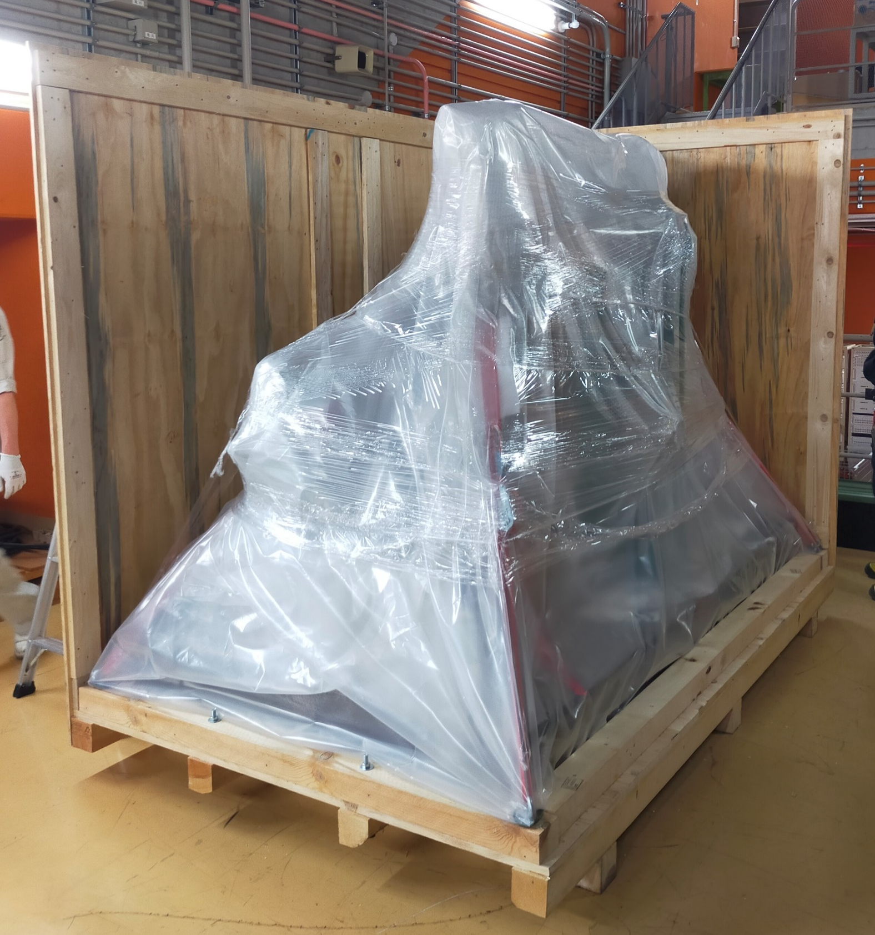
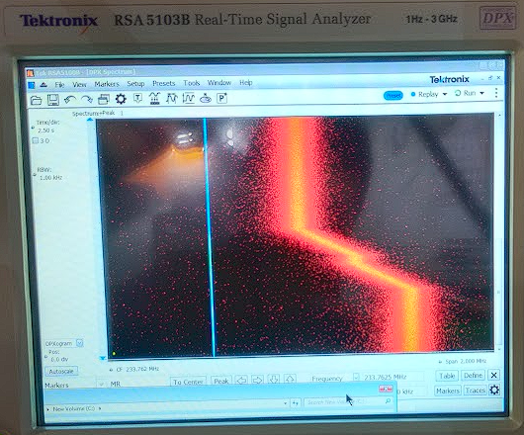
Schottky Cavity Doublet (SCD)
Elliptical cavity
Reference cavity
Installed at the 2nd
straight section
Beam
Signal
Sep. 2024
Shipped from GSI
F.G.

Slide 26
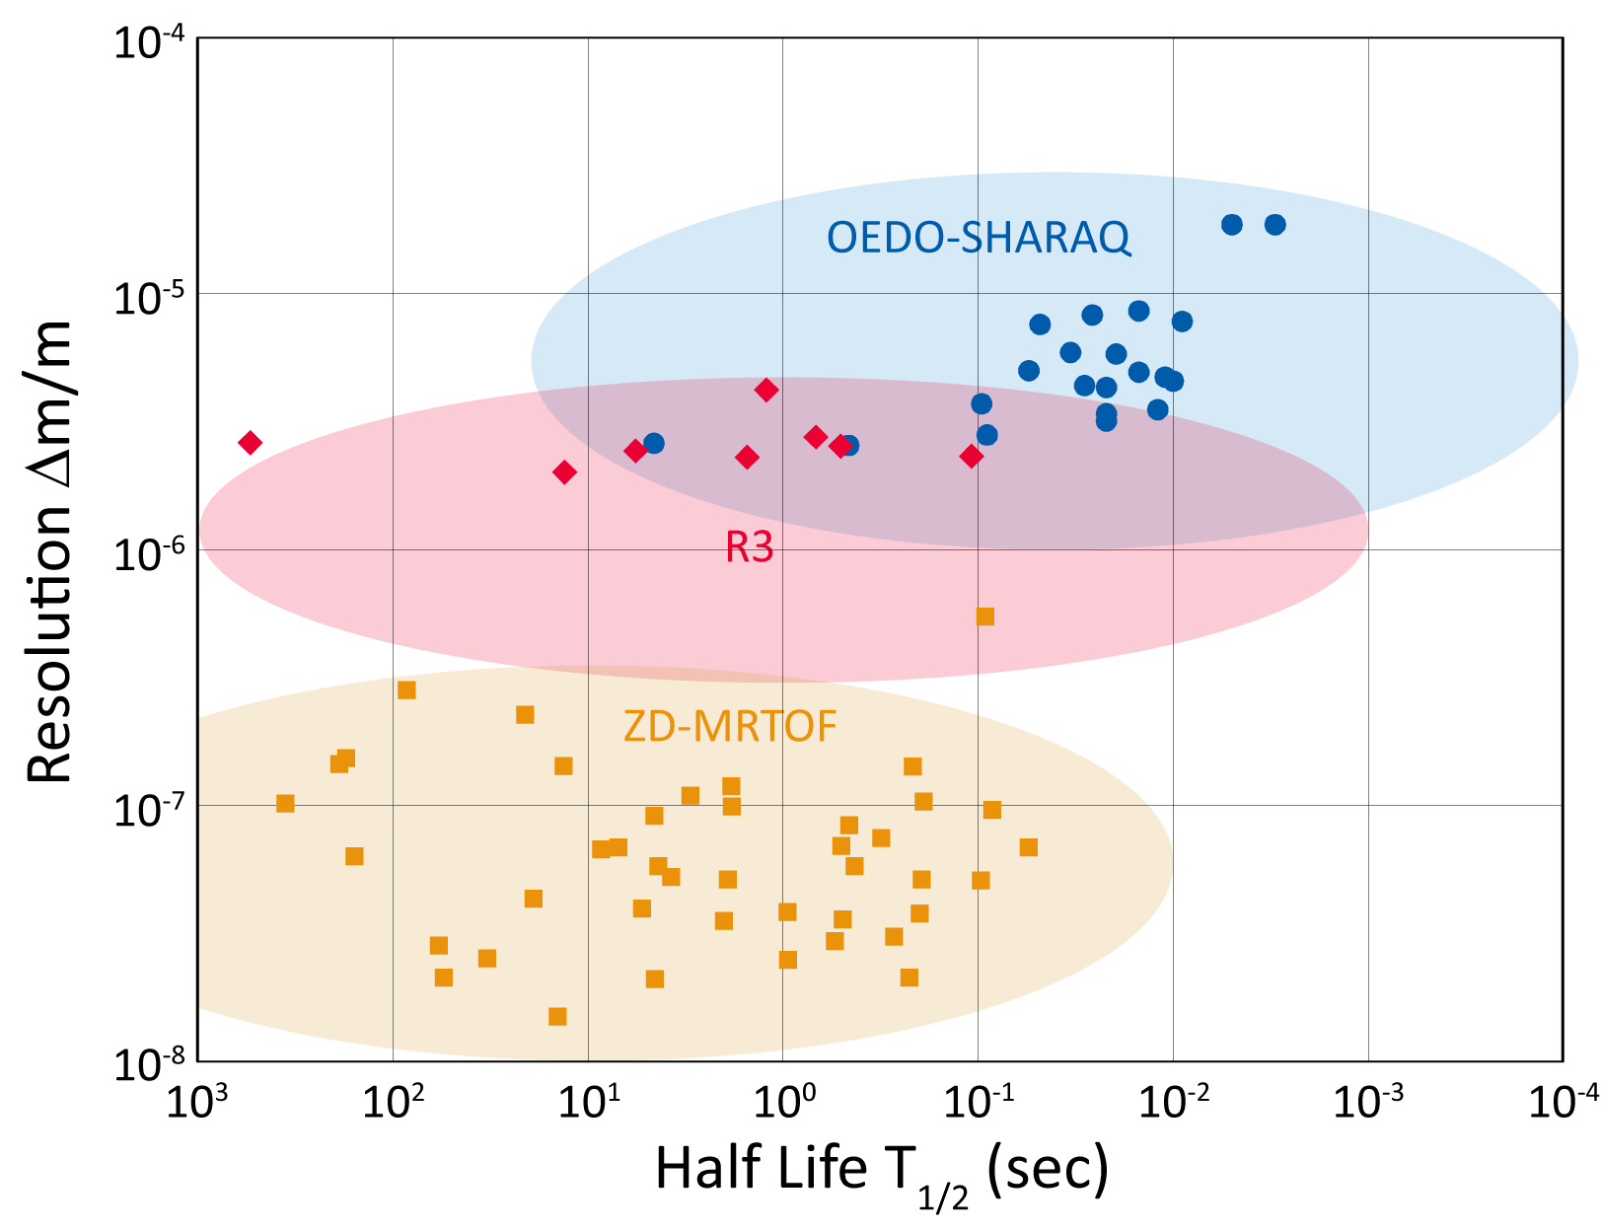
Mass measurements in R3 vs other techniques
Advantages of R3
Short measurement time
Δm ~few 100 keV
⁷⁵Cu
T_{1/2} < ~20 ms
RIKEN APR56, S1-S5 (2023)

Slide 27
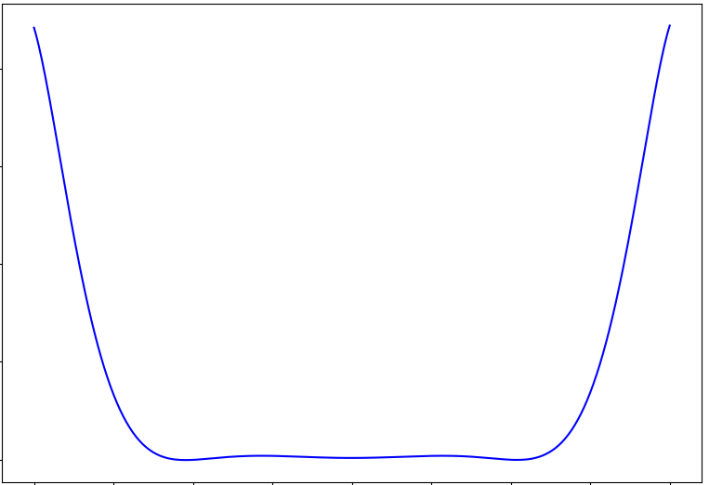
How to prepare 3D magnetic field in the simulation
Parameterized B_{y} distribution
of the main coils
w/ Trim coils
Y=Z=0 mm
-8000
Y=Z=0 mm
1915 A
1915 A
-9000
Y-magnetic field flux [G]
-10000
Y
Total B = B_{main} + B_{trims}
-11000
Main coils
-12000
X
-200
-150
-100
-50
0
50
100
150
200
Trim coils
X-position [mm]
Z
Z-direction: 5-order enge function

Slide 28
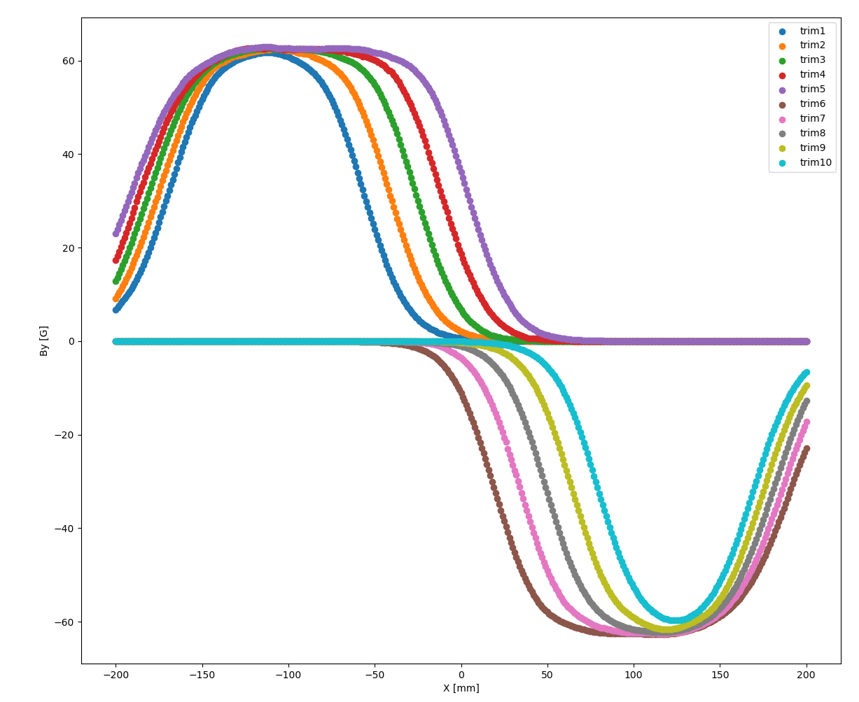
How to prepare 3D magnetic field in the simulation
Parameterized B_{y} distribution
of the trim coils
w/ Trim coils
60
40
20
Y-magnetic field flux [G]
0
Y
Total B = B_{main} + B_{trims}
-20
Main coils
Y=Z=0 mm
-40
X
-60
200 A
Trim coils
-200
-150
-100
-50
0
50
100
150
200
Z
X-position [mm]

Slide 29
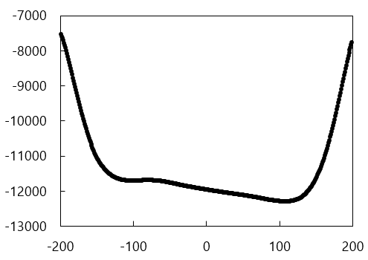
How to prepare 3D magnetic field in the simulation
Parameterized
B_{y_main} + B_{y_trims} distribution
w/ Trim coils
Y=Z=0 mm
Y-magnetic field flux [G]
Y
Total B = B_{main} + B_{trims}
Main coils
X
X-position [mm]
Trim coils
-20 mm≦Y≦20 mm in 1 mm steps
→ Spline interpolation
Z

Slide 30
Specifications of the Schottky detectors
Res. freq. | ~500 MHz
Q-factor | ~7000
R_{sh} | ~3 MΩ
Res. freq.
Q-factor | ~3000 | ~2300
R_{sh} | ~420 kΩ | -
~230 MHz

