Slide 1
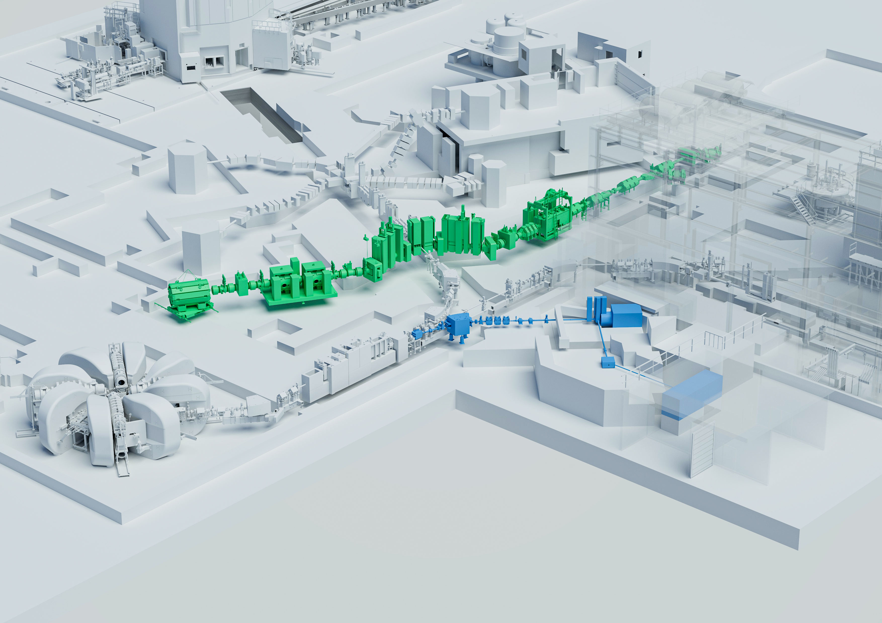
Ion source development for TATTOOS: the new large-scale radionuclide production infrastructure at PSI
IMPACT/TATTOOS
Maryam Mostamand
EMIS 2025, 22 Oct 2025

Slide 2
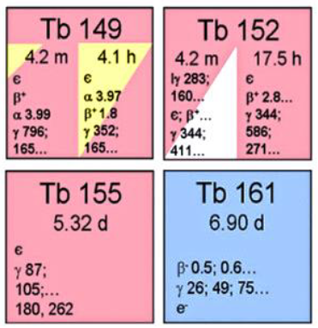
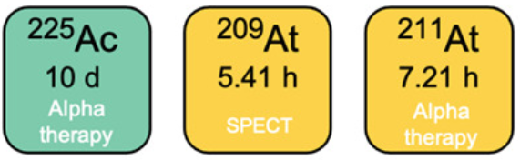
IMPACT-TATTOOS/PSI
P⁺
100 μA, 590 MeV
α- therapy
β- therapy
Auger therapy
SPECT
PET
TATTOOS

Slide 3

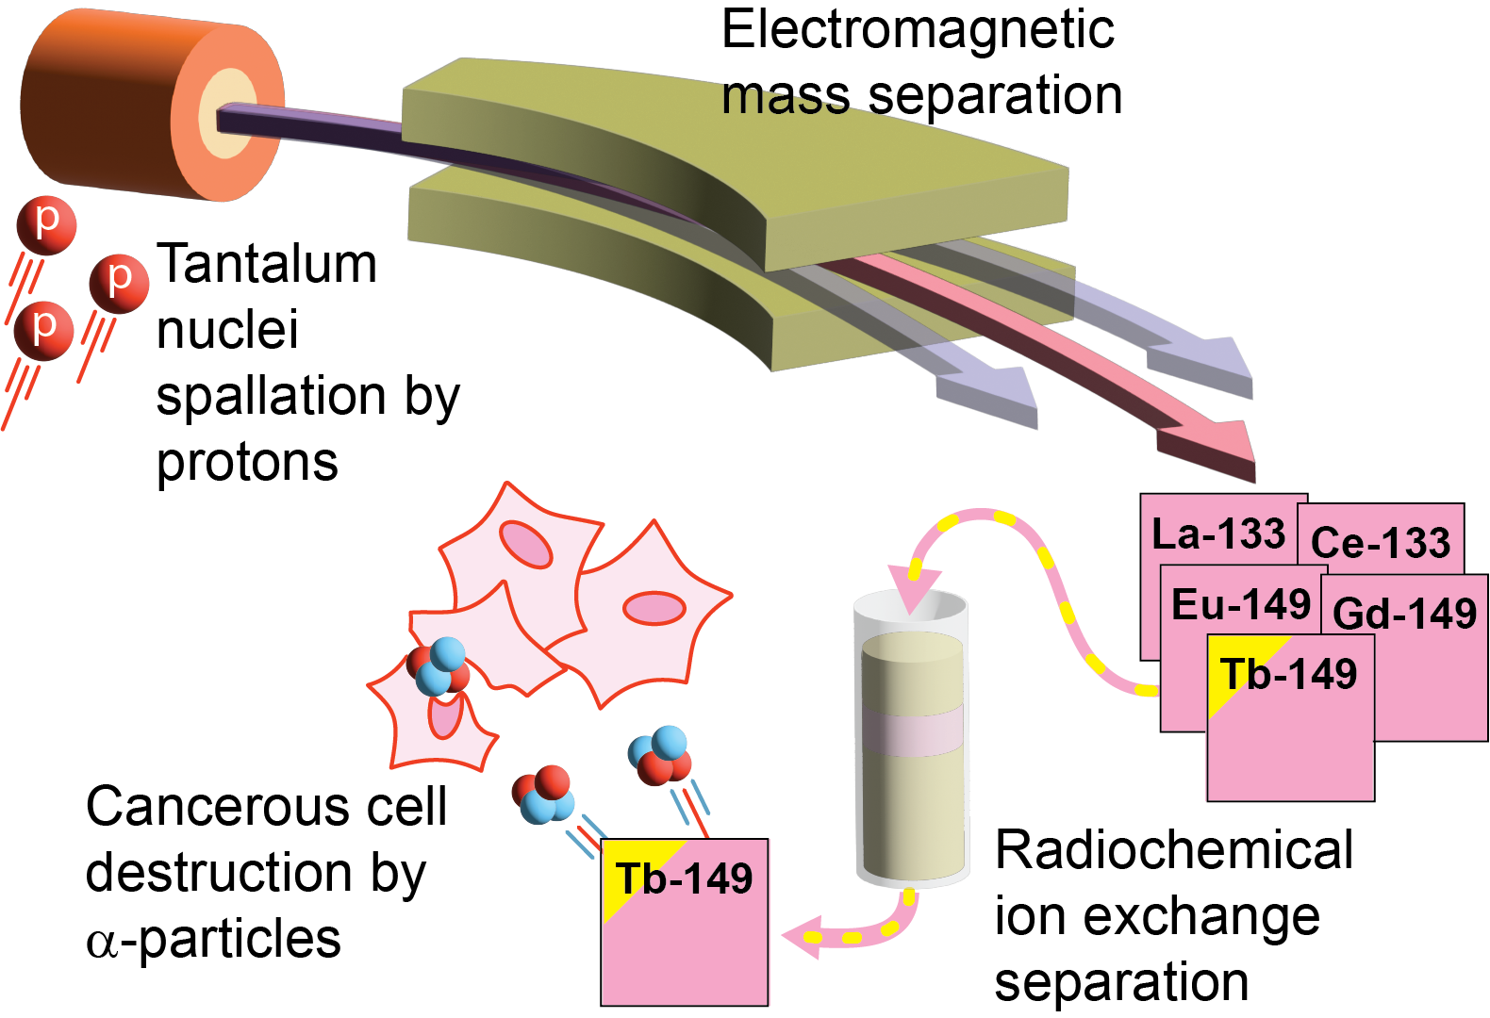
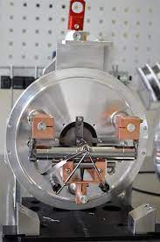
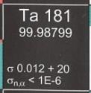


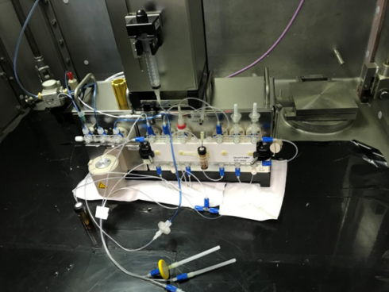
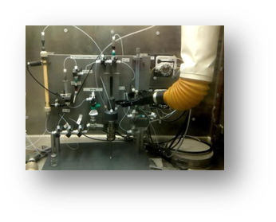





¹⁴⁹Tb: A flowchart based on ISOLDE/PSI collaboration
¹⁸¹Ta(p,10p + 23 n)¹⁴⁹Tb
Radiopharmaceutical
manufacture

Slide 4
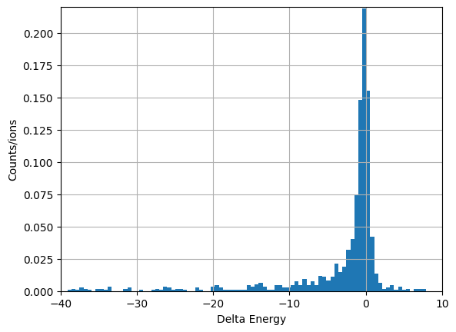
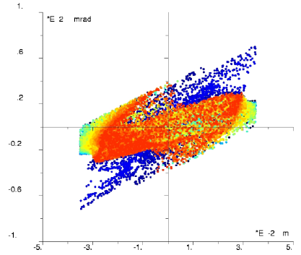
Introduction: Target & Front end
Reusable target
ISOLDE-like target (sealed target)
Very high throughput (10’s of μA beams)
Beam quality
Energy spread
Emittance
Focal point
Separations
emittance
Energy spread
Extraction system

Slide 5
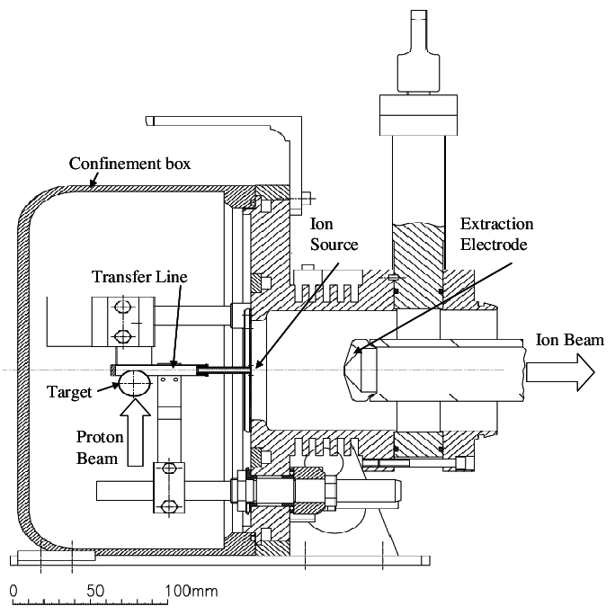
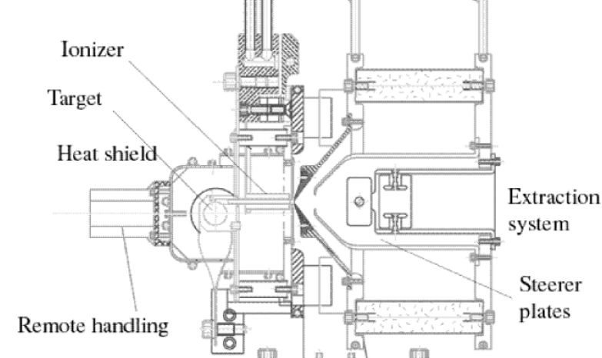
Extraction system
ISAC
ISOLDE
HV
HV
Plasma electrode
Lens
(extraction electrode)
Ground electrode
Movable ground electrode
Fixed electrodes
The production target at ISAC, P. Bricault, et. al. American Institute of Physics (2001).
Schematic layout of a standard ISOLDE target-ion source unit, E. Bouquerel, et al. Thesis (2009)

Slide 6
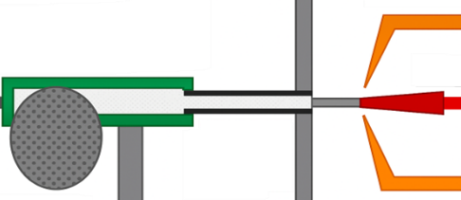
Simulation representation (COMSOL)
Extraction electrode
(grounded)
Laser beam
Two separate particle seeding methods have been generated for laser ionization and surface ionization.
Laser ionization seeding is within the ionizer volume and ions hitting the ionizer wall, will be removed from the remaining computations.
Surface ionization seeding only occurs on the surface of the ionizer walls. ions hitting on the wall, reset their energy and bounce back as thermal re-emissions.
Ionization processes are not considered, only transport considerations.
Plasma effect and space charge effect are not included in the simulations.
Axis-symmetry (r-z plane).
Ion source
Target
Laser beam

Slide 7
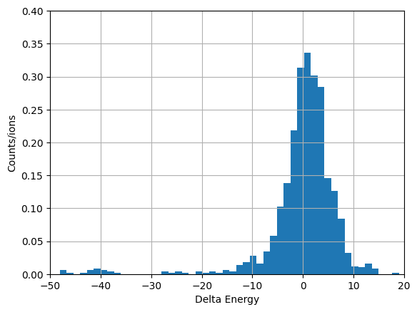
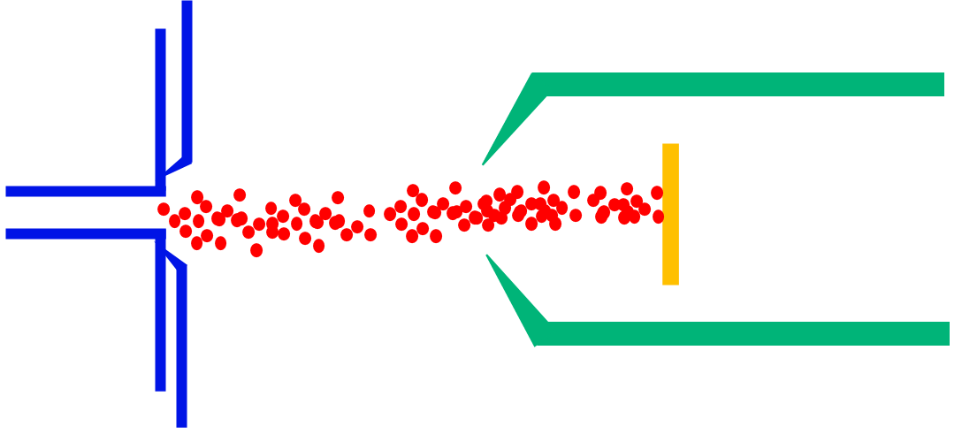
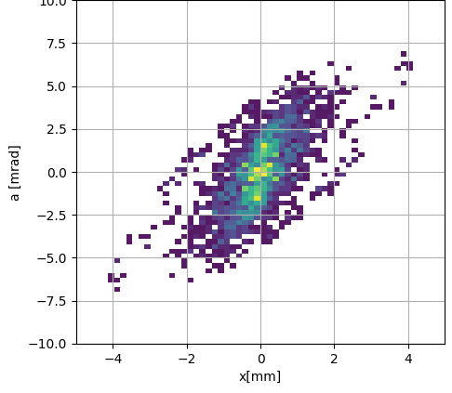
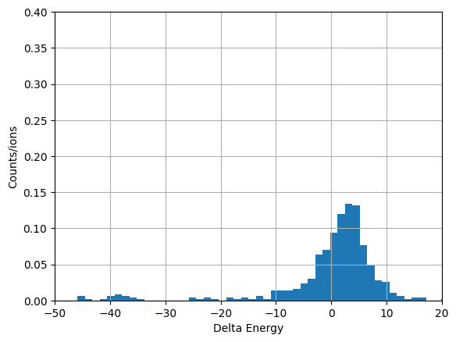
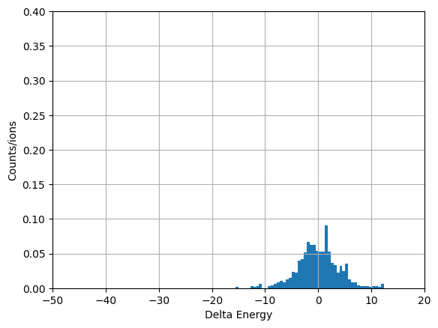
1. ISOLDE-like extraction
Surface & laser ions
d= 60 mm
4ϵ_{rms} = 5.8 ± 0.3 mm-mrad
laser only
Surface only

Slide 8
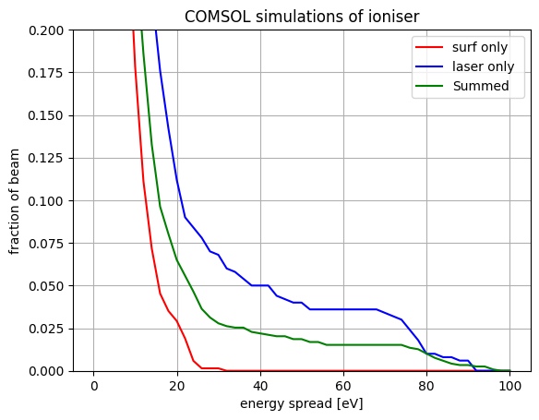
1. ISOLDE-like extraction
d= 60 mm
25 % outside 10 eV

Slide 9
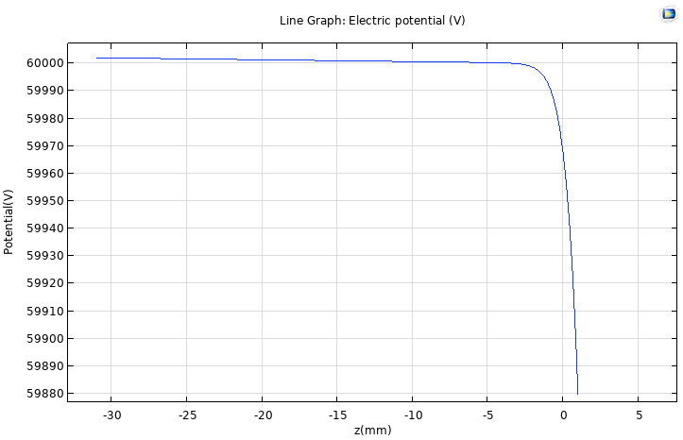
ISOLDE-like extraction- discussion
Acceleration region
Acceleration region inside the ionizer
Energy spread is large in this design
The opening angle of the screen is important:
The field inside the ionizer tube changes.
The angle helps with the focusing of the beam while varying ground electrode distance with respect to the ionizer (d) doesn’t have significant impact on the beam collimation.
Ɵ

Slide 10
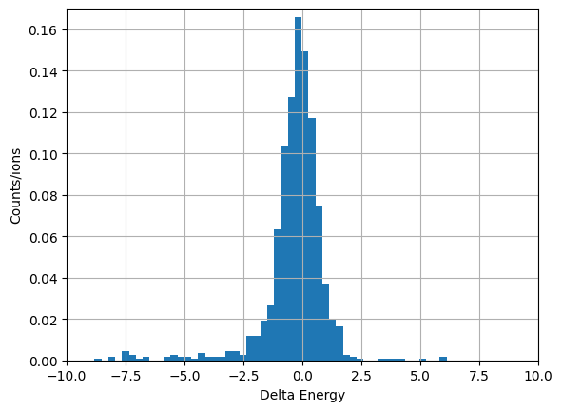
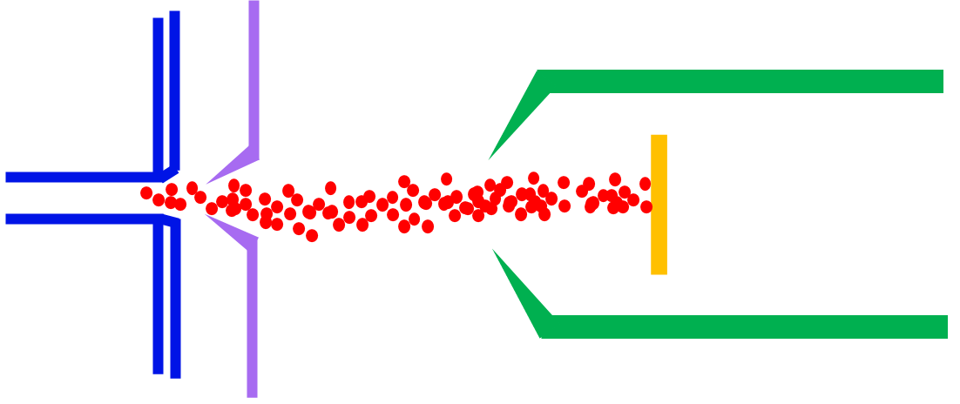
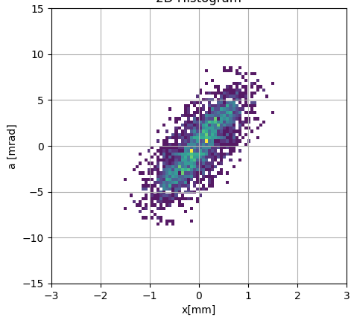
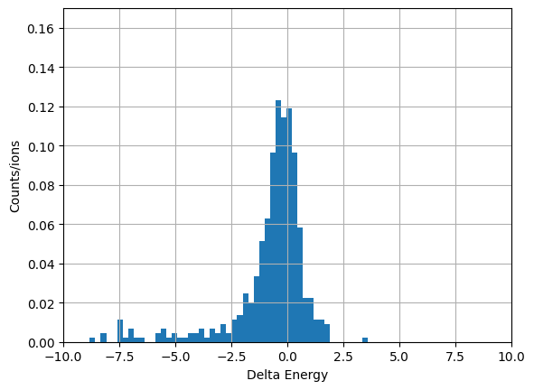
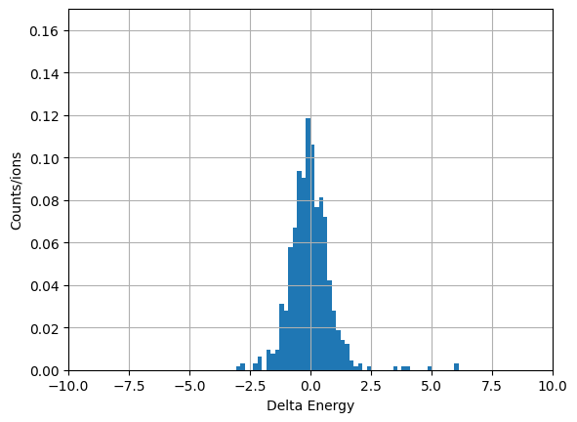
2. ISAC-like extraction
Surface & laser ions
lens
Ground electrode
Plasma electrode
4ϵ_{rms} = 4.1 ± 0.2 mm-mrad
Laser only
Surface only

Slide 11
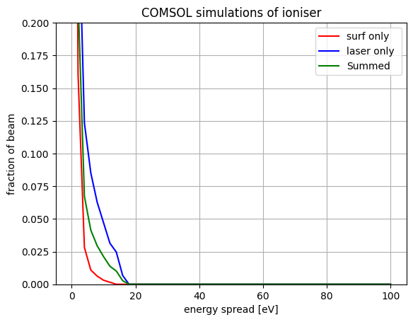
2. ISAC-like extraction
lens
Ground electrode
2 % outside 10 eV
Plasma electrode

Slide 12
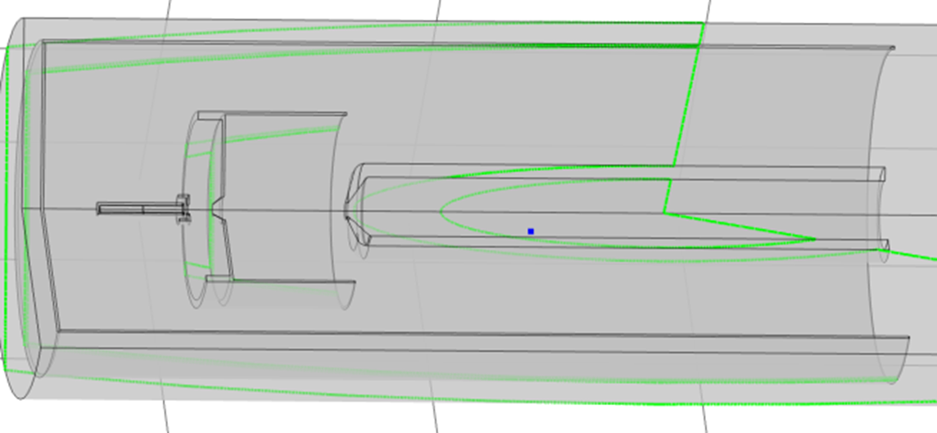
2. ISAC-like extraction- observations
d
Changing G electrode distance (d) with fixed lens voltage:
Slight change in energy spread and beam focusing, No change in emittance.
Fixed G electrode with lens voltage variation:
Higher bias voltages result in larger E_spread, Emittance; slight change in beam focusing, however beam will have tails for higher bias voltages. Optimal is between 1-2kV.
Plasma electrode angle variations:
Slight change in beam focusing, smaller angle result in larger emittance and E_spread due to larger field penetration. Optimal is around 60 – 75 degrees.

Slide 13
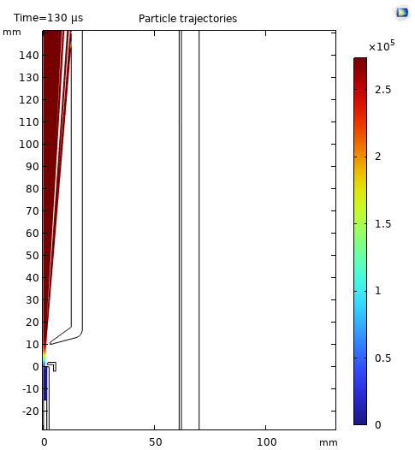
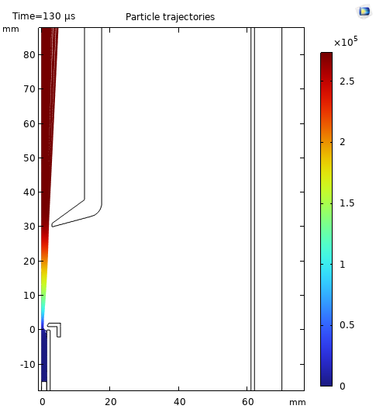
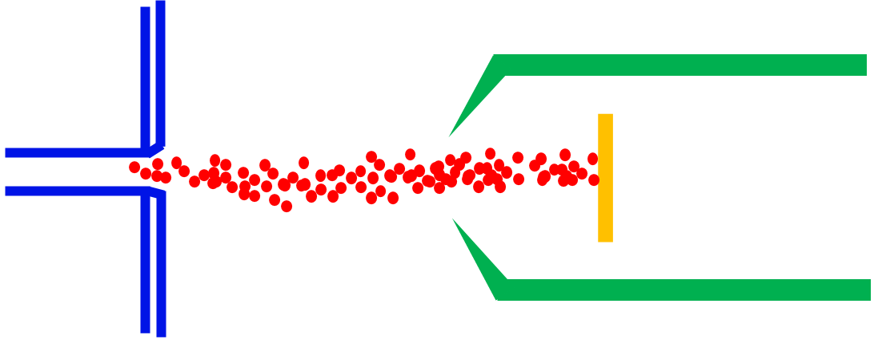
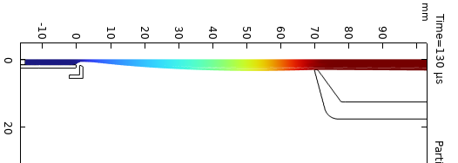
3. ISAC-like extraction without lens
By increasing distance of G electrode, emittance and energy spread becomes smaller (comparable to the ISAC design), while the ion beam is well collimated. Optimal is 90 mm.

Slide 14
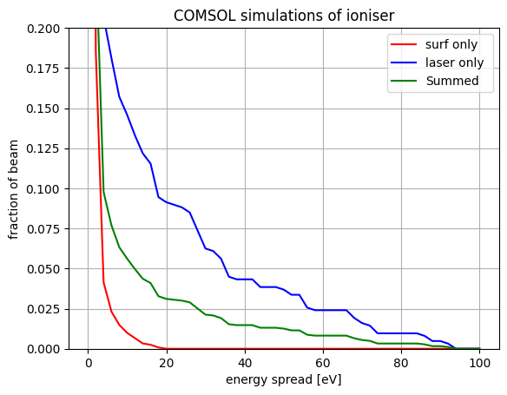

Energy spread
Extraction with 2 electrodes
Extraction with 1 electrode
2 % outside 10 eV
6 % outside 10 eV
25 % outside 10 eV
d = 70 mm
d = 100 mm
d = 60 mm

Slide 15
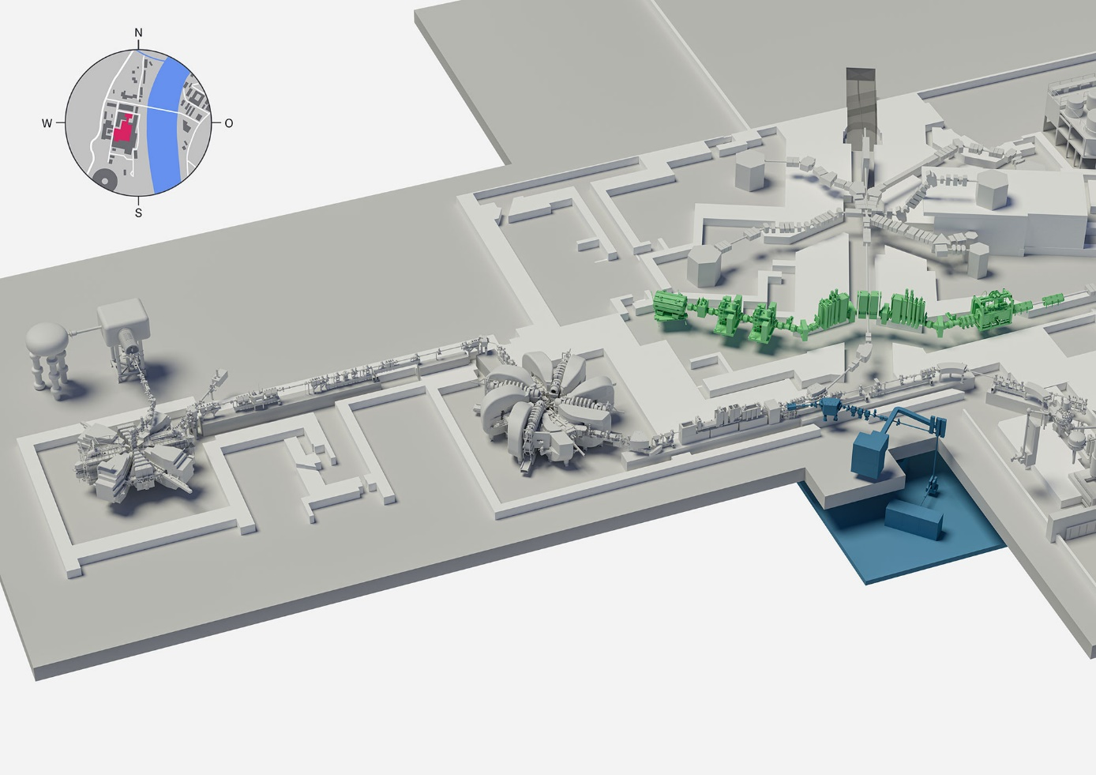
Conclusions
Laser ionization has larger energy spread and smaller emittance.
Surface ionization has larger emittance and smaller energy spread.
The shape and opening diameter of the closest electrode/plate to the ionizer tube is what defines the field shape inside the ionizer and consequently changing the beam quality.
Having a gradual extraction such as adding an extra electrode between the ionizer and ground electrode can smooth the field inside the ionizer and improve the energy spread significantly.
This additional electrode also keeps the energy spread and emittance consistently small while the beam collimation can be adjusted by the ground electrode.

Slide 16
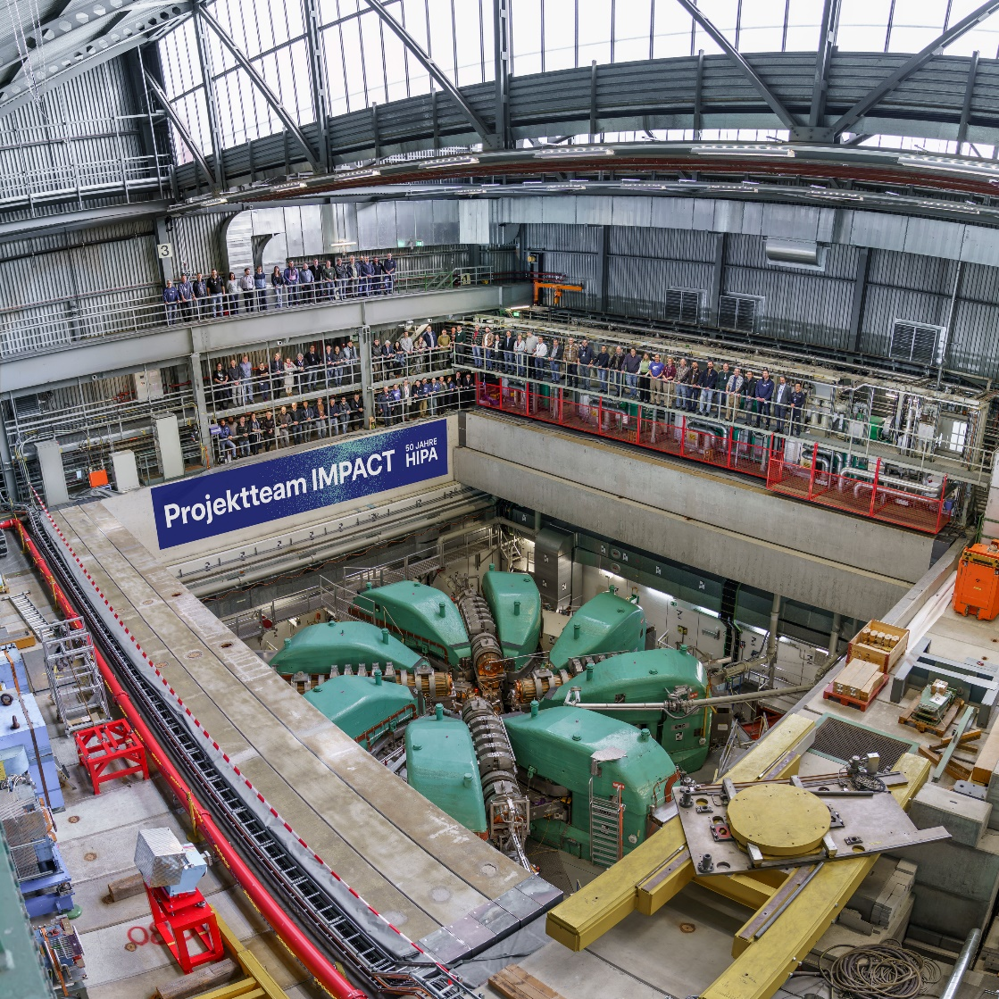
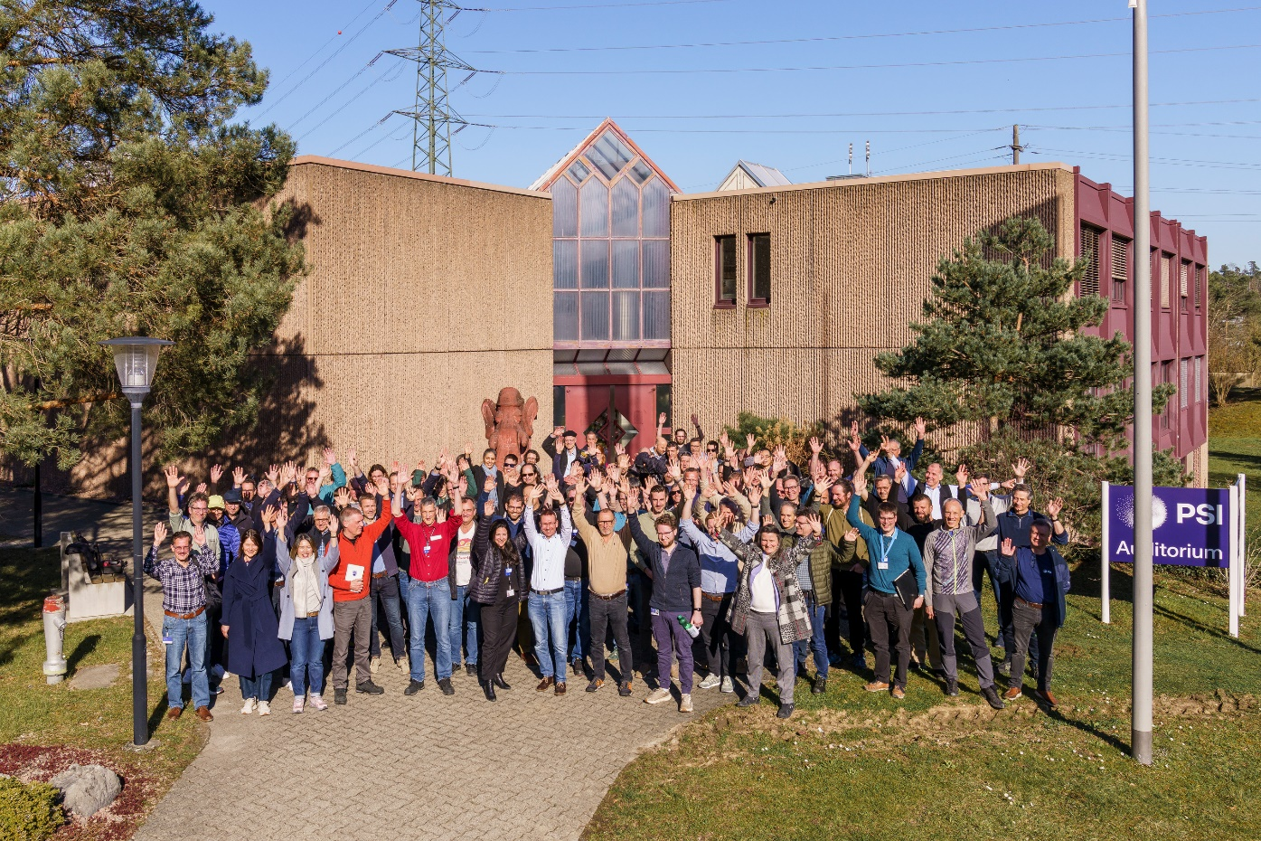
Thank you for your attention!
Thanks to all the TATTOOS team members and the external advisors!

Slide 17
Back up slides

Slide 18
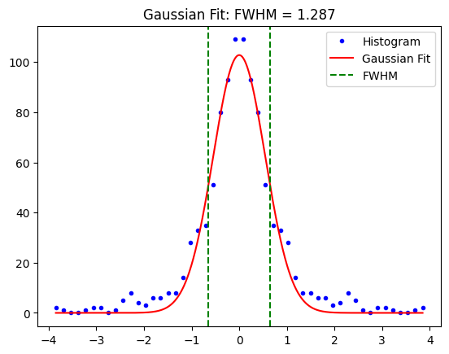
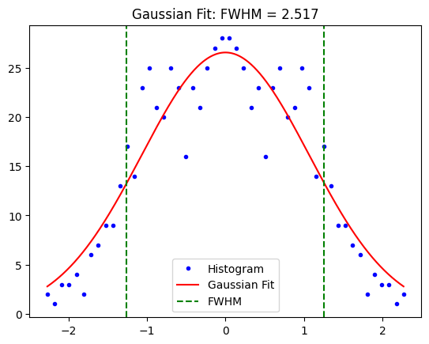
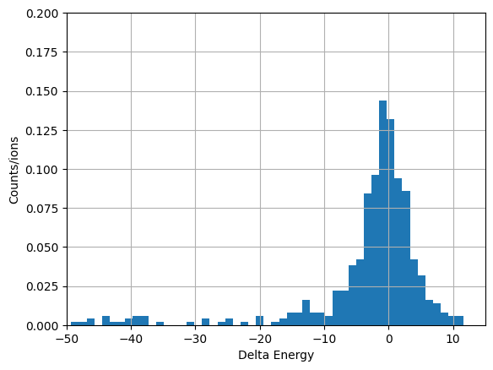
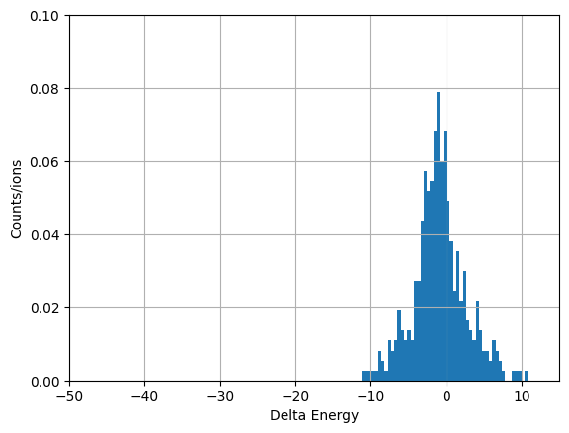
ISOLDE
Laser ionization
Gap: 60 mm
Gap: 100 mm

Slide 19
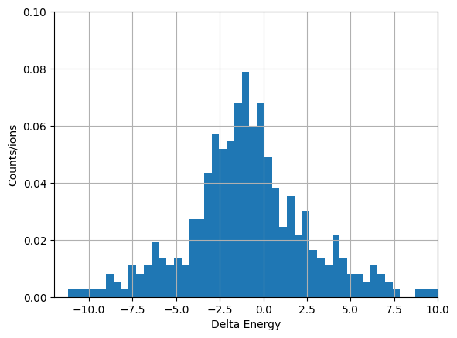
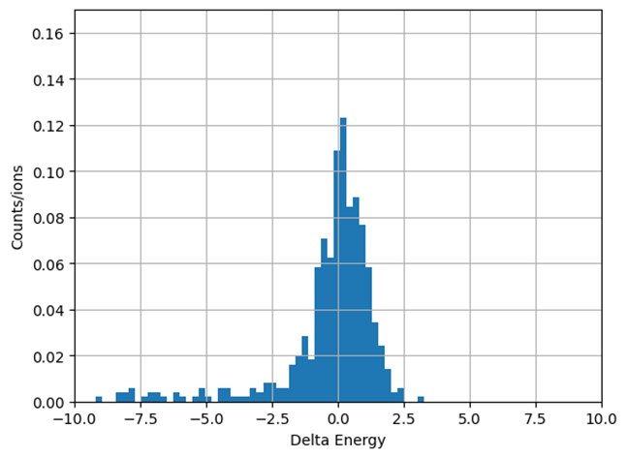
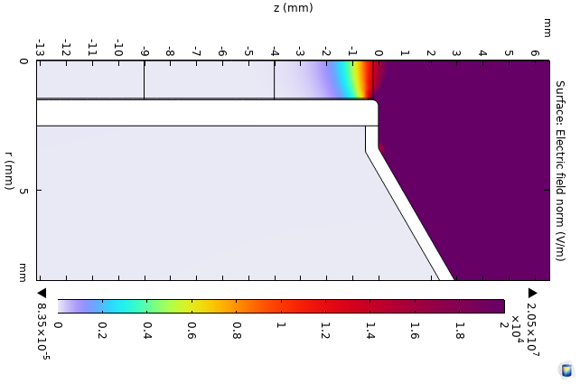
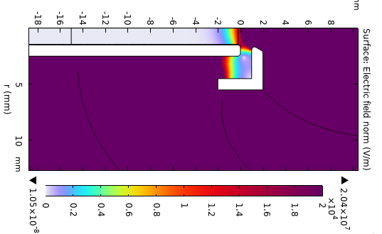
Laser ionization
ISOLDE-gap 100mm
ISAC_lens 2 kV

Slide 20
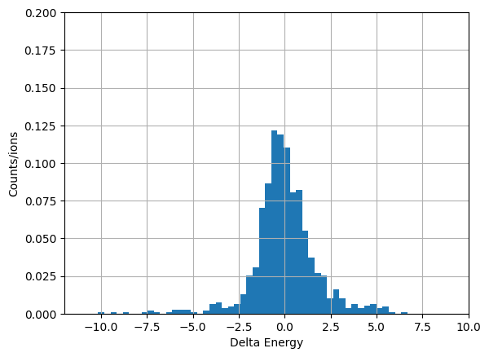
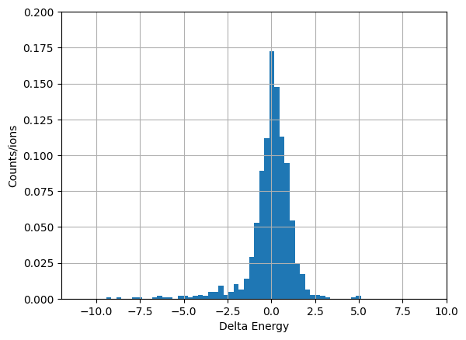
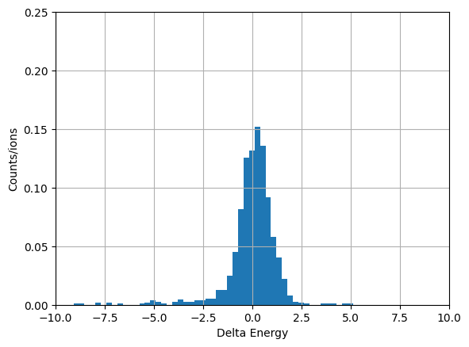
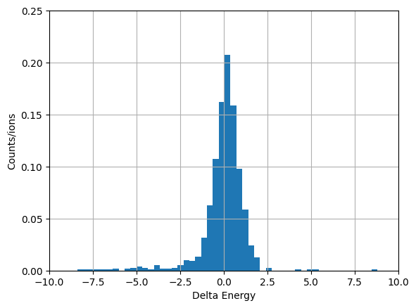
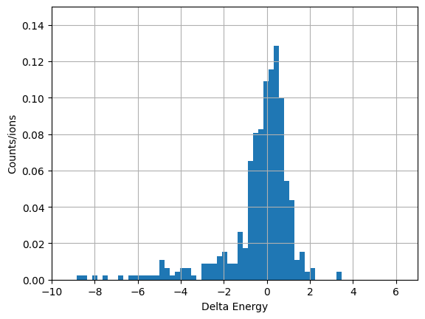
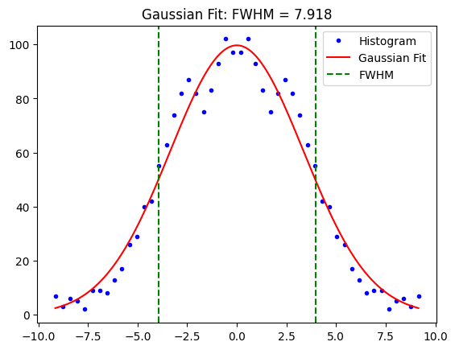
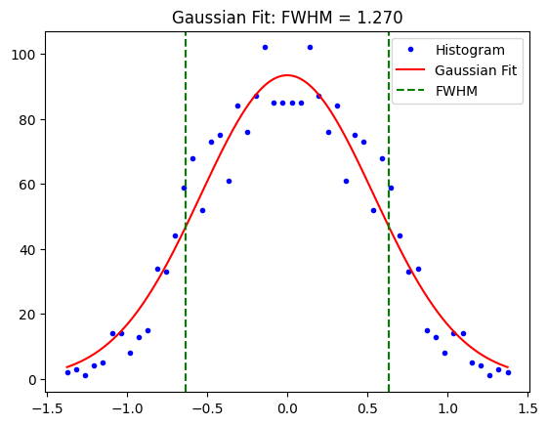



ISAC-lens: 2kV, Plasma angle: 60,
G electrode distance (d): variable
d
452+645=1097
d=30 mm
d=60 mm
d=70 mm
d=80 mm
d=90 mm
4.0 +/- 0.2
4.0 +/- 0.2
4.0 +/- 0.2
4.0 +/- 0.2
4.0 +/- 0.2

Slide 21






ISAC-lens: 2kV, Plasma angle: 90,
G electrode distance (d): variable
1077
d=30 mm
d=60 mm
d=90 mm
3.7 +/- 0.2

Slide 22











No lens- plasma angle: 60,
G electrode distance (d): variable
1107
1076
d=70 mm
d=90 mm
d=10 mm
d=30 mm
d=60 mm
4rms: 10.5 +/-0.6
4rms: 7.0 +/-0.4
4rms: 4.8 +/-0.3
4rms: 4.3+/-0.3
4rms: 4.0 +/-0.2
Adding extra extraction lens helps with keeping the emittance and energy spread small while moving the G electrode!

Slide 23






Ionizer radius: 2 mm, no lens, d=90mm, plasma angle: 75º, plasma r= 1.5 mm
4rms = 5.8 +/- 0.3
1516
Lens: 2kV, d=70mm
4rms = 5.7 +/- 0.3
1529

Slide 24






Ionizer radius: 2mm, lens: 2kV, d=80mm, plasma angle: 75º , plasma r= 1.8 mm
4rms = 6.0 +/- 0.3
1553
plasma r= 1.5 mm
4rms = 5.7 +/- 0.3
1543

Slide 25









gap: 30 mm
gap: 60 mm
gap: 100 mm
gap: 30 mm
gap: 60 mm
75°
15°
gap: 30 mm
gap: 60 mm
gap: 100 mm
gap: 100 mm
^{60°}

Slide 26

ISOLDE (measurements)

