Slide 1


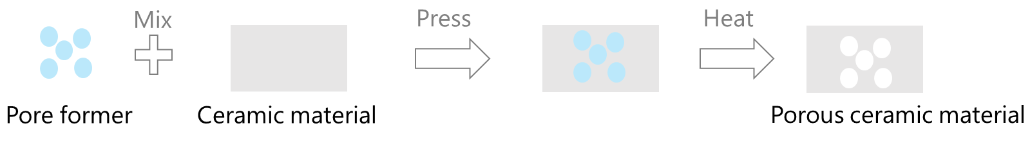
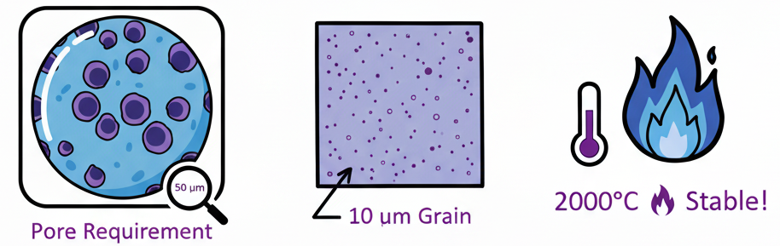
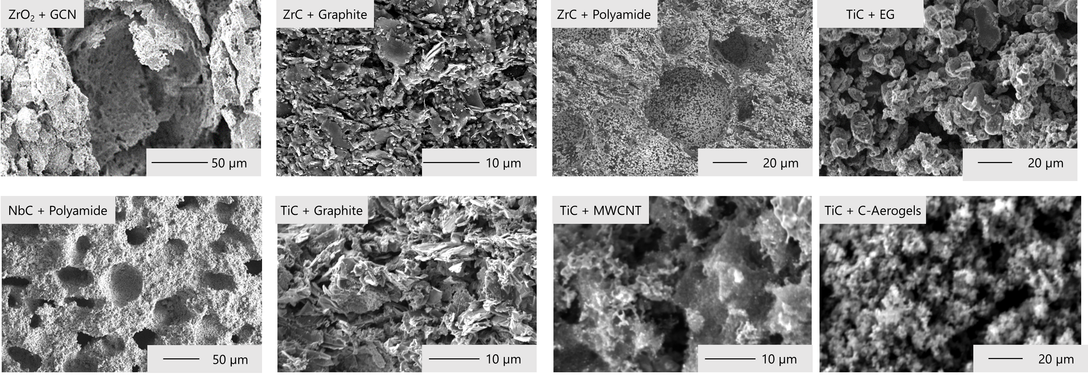
Development of porous non-actinide target materials for the facility ISOL@MYRRHA
L. Gubbels^{1,2}, B. Acevedo¹, J.P. Ramos¹, A.G. Cordero^{1,3}, C. Rodríguez^{1,3}, G. Longhi^{2,4}, N. Rey-Raap⁵, F. Jutier¹, S. Huang², A. Arenillas⁵, P. Creemers¹, D. Hermans¹, M. Verwerft¹, J. Vleugels², L. Popescu¹
¹Belgian Nuclear Research Centre (SCK CEN), Mol, Belgium
²KU Leuven, Department of Materials Engineering (MTM), Leuven, Belgium
³Universidad Politécnica de Madrid (UPM), Madrid, Spain
⁴ Università degli Studi di Trento (UNITN), Trento, Italy
⁵ Instituto de Ciencia y Tecnología del Carbono, INCAR-CSIC. Francisco Pintado Fe, 26. 33011, Oviedo, Spain
Introduction
Sintering hindering mechanisms
Efficient isotope release in ISOL targets operating at extreme temperatures (≥2000 °C) requires materials with high porosity (>50 %) and thermal stability to ensure sustained radioactive isotope beam production. This study focuses on non-actinide carbide and oxide target material, specifically TiC, ZrC, ZrO₂, and NbC, synthesized via carbothermal reduction and advanced powder processing techniques. This was done as surrogate material work for ThO₂ and ThC_{x}. By incorporating various carbon sources -Expanded graphite (EG), multi-walled carbon nanotubes (MWCNT), carbon aerogels (C-aerogels) and polyamide - and pore former graphitic carbon nitride (GCN), we aim to control microstructural properties such as grain size, porosity, and phase stability to hinder sintering and maintain high diffusion and effusion rates. Optimizing these parameters is critical for enhancing refractory isotope release and extending target lifetime in high-power proton beam environments like ISOL@MYRRHA.
Using pore formers on oxides
Using excess carbon on carbides
Heat
Mix
Press
Oxide
Carbide harder to sinter
Carbon source
Materials processing
Objectives
ZrO₂ mixed with pore formers (Cordero 2024)
Carbothermal reduction of TiO₂ (Rodriguez, 2025) and ZrO₂ (Longhi, 2025) with excess carbon
Oxide (s) + Carbon (s) → Carbide (s) + Volatile species (g) + Excess carbons
NbC_{x} mixed with carbon sources (Longhi 2025)
Small grain size < 10µm
Stable at > 2000 °C
Open porosity of 50 %
Pore size of 50 µm
ZrC_{x}/NbC_{x}/TiC_{x}
ZrO₂
Results
3
 | ZrO₂ | ZrC_{x} |  |  | NbC | TiC
Pore former/ Carbon sources | GCN | Graphite | Polyamide |  | Polyamide | Graphite | MWCNT |  | EG | C-aerogels
Ratio | 57* | 5** | 5** |  | 30* | 5** | 5** |  | 5** | 4**
Mixed conditions | dry, turbula | wet,turbula | wet,turbula |  | wet,turbula | wet,turbula | wet,sonicator |  | wet,turbula | wet,sonicator
Sintering | 1 h, 1750 °C | std |  | std | std | std |  | std | std | std
Bulk density (%) | 46 | 37 | 25 |  | 53 | 30 | 10 |  | 10 | 10
Open porosity (%) | 54 | 39 | 61 |  | 13 | 64 | 88 |  | 77 | 89
1
* Ratio in % volume,** Ratio in mol, std refers to standard conditions 2000 °C for 15 h in vacuum, ZrO₂ was heat treated in reductive conditions
The SEM picture heat-treatment are presented in the table.
All materials kept grain size <10 µm after heat treatment. Porosity stability up to 2000 °C was observed for carbides, which is crucial for ISOL targets.
ZrO₂ + GCN: 54% open porosity, large pores (~50 µm) → good diffusion.
TiCₓ + MWCNT + graphite: very high porosity (88% total, 64% open) → excellent release, lower strength.
ZrCₓ: 61% open porosity → promising balance.
NbC: Porosity too low for efficient isotope release in ISOL targets
Conclusion and Outlook
All six materials achieved grain sizes below 10 µm, meeting structural requirements. Porosity levels varied depending on composition and processing. TiCₓ, with added MWCNT and graphite, showed the highest open porosity, making it a strong candidate for ISOL targets. In contrast, NbC, despite the use of polyamide, had insufficient porosity for efficient isotope release. These results highlight the importance of pore formers and mixing methods in tailoring material performance for high-temperature isotope production.
Acknowledgments
This research was funded by the MYRRHA project and the SCK CEN Academy.
References
Longhi, G. (2025). Synthesis and characterisation of highly porous transition metal carbides, Master thesis, KULeuven.
Cordero, A. G. (2024). Tuning of ThO₂ target materials towards highly porous structure to produce medical radioisotopes, Master Thesis, Universidad Politécnica de Madrid.
Rodriguez, C. (2025). Carbon source assessment for ISOL ThC_{x} target materials, Master thesis, Universidad politcnedad Madrid.
www.sckcen.be

