Slide 1

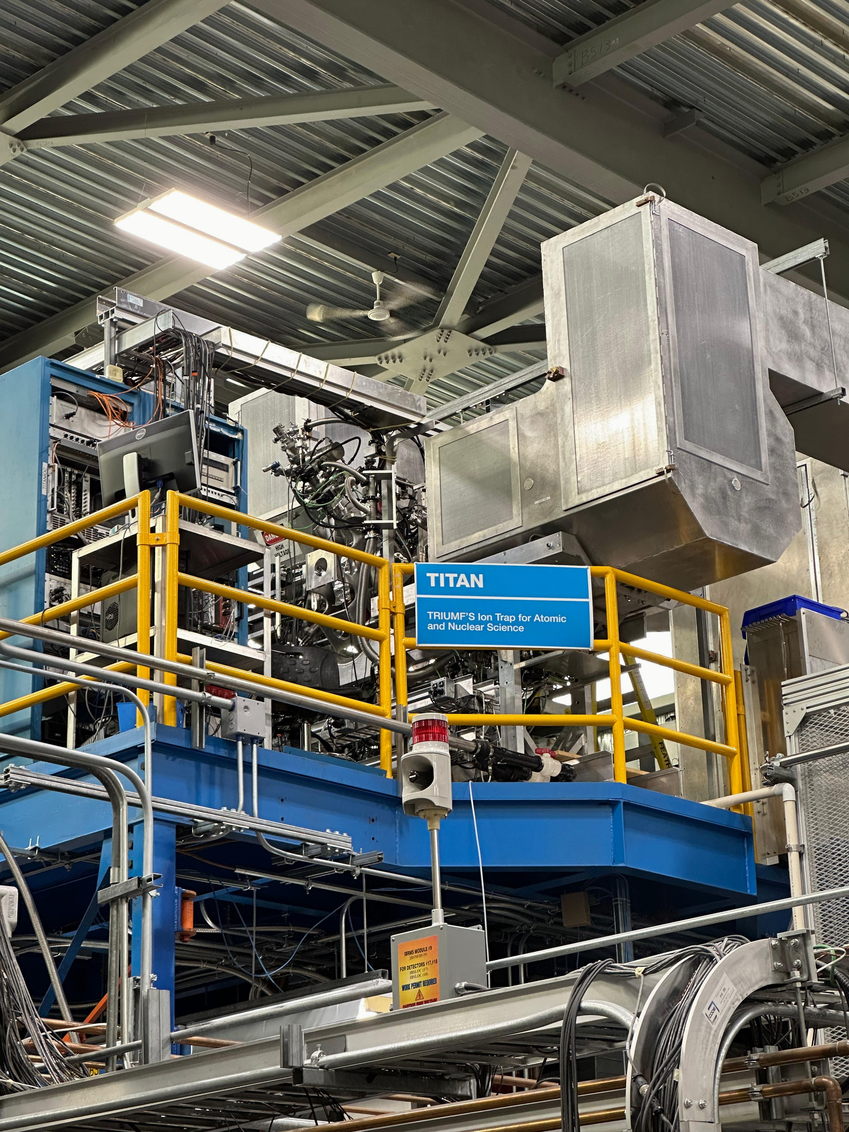
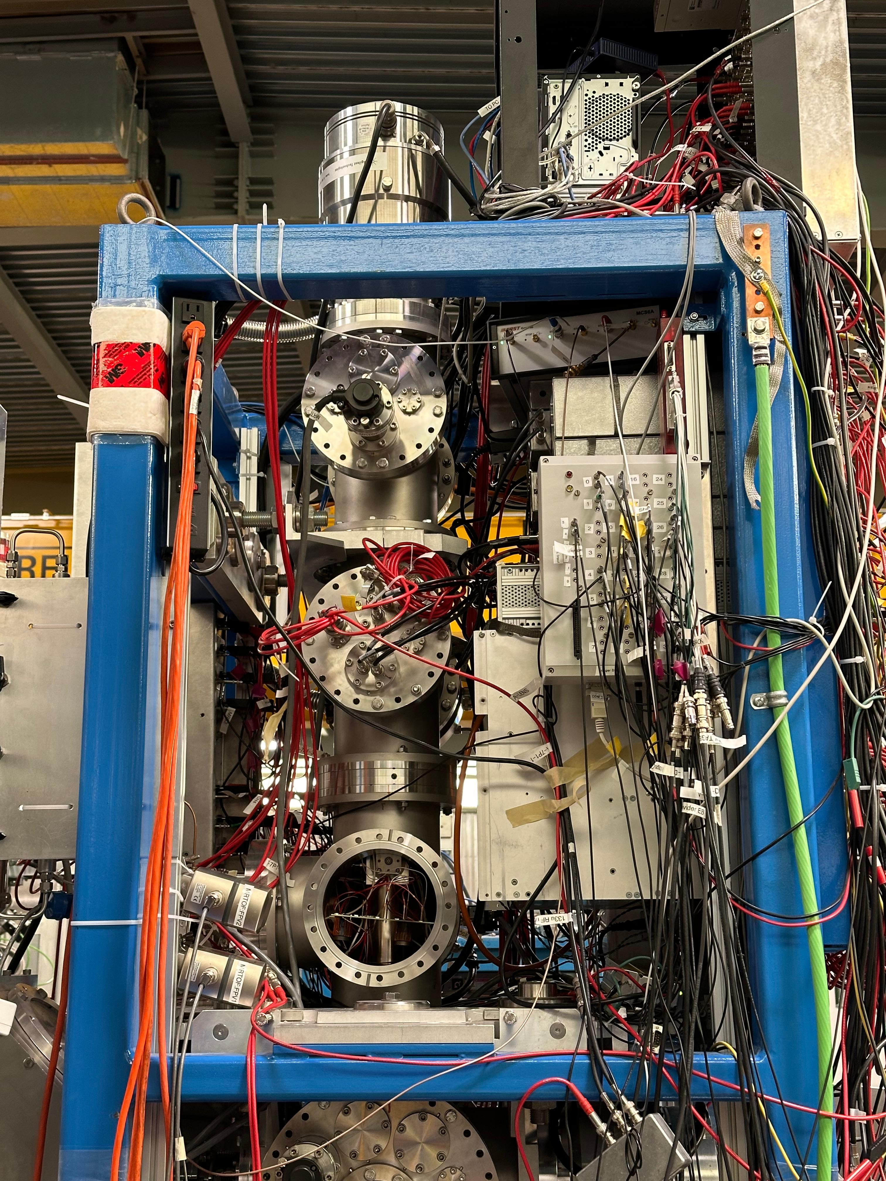
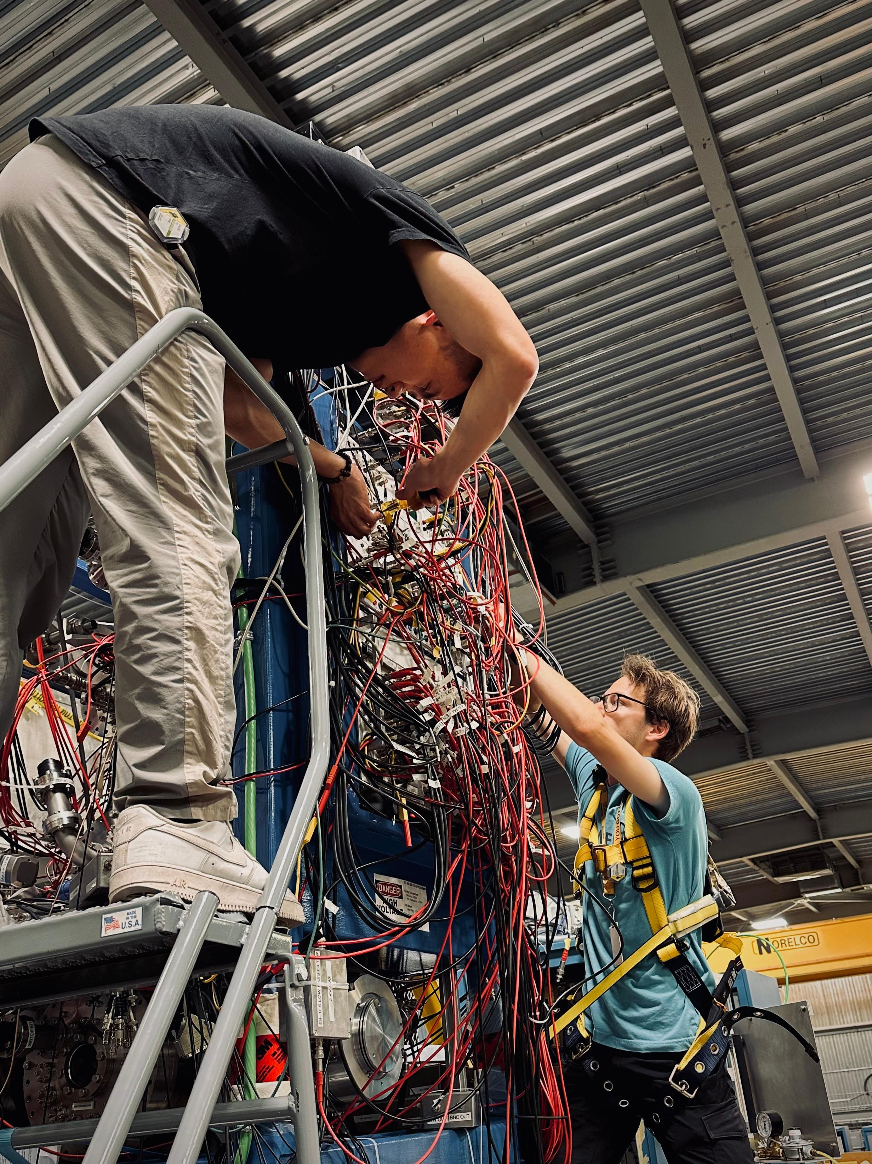
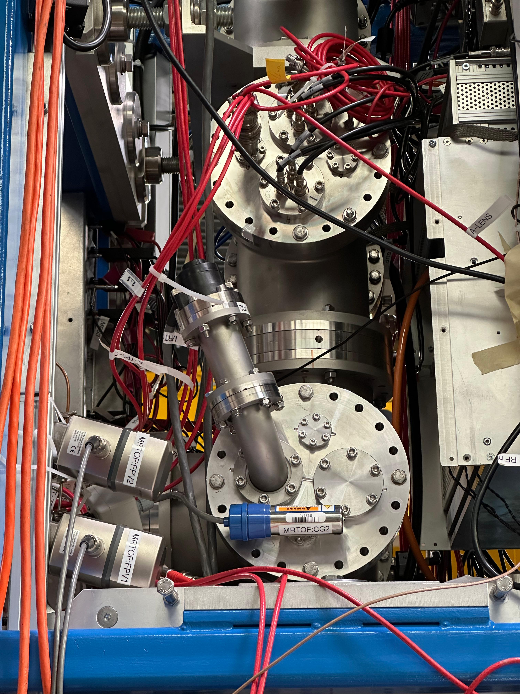
High-precision mass measurements with
TITAN Multi-Reflection Time-of-Flight (MR-TOF)
Mass Spectrometry
1
Pavithra Weligampola | EMIS 2025 | TRIUMF and University of Manitoba

Slide 2
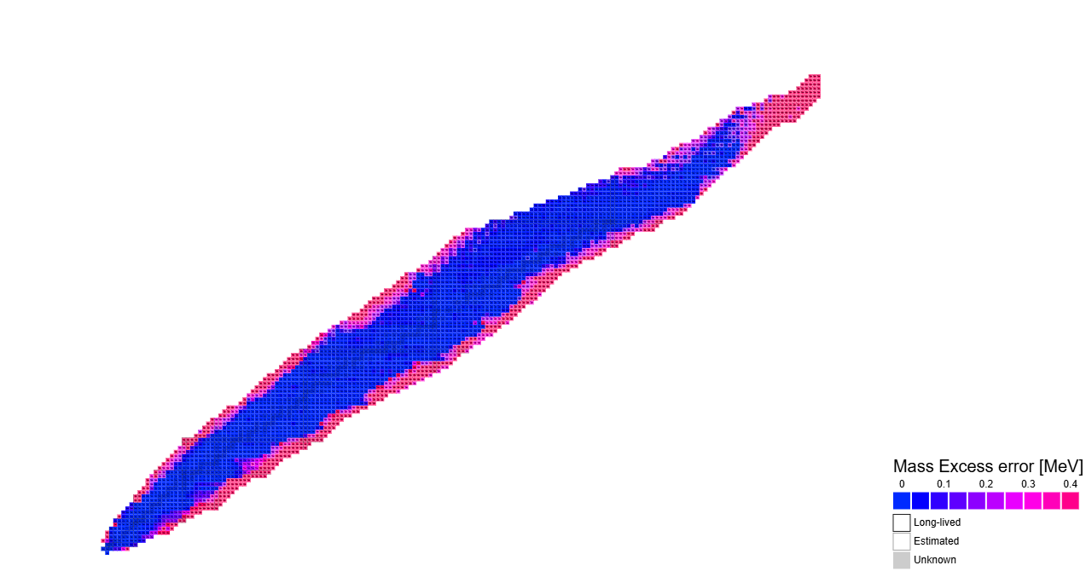
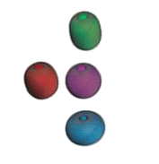
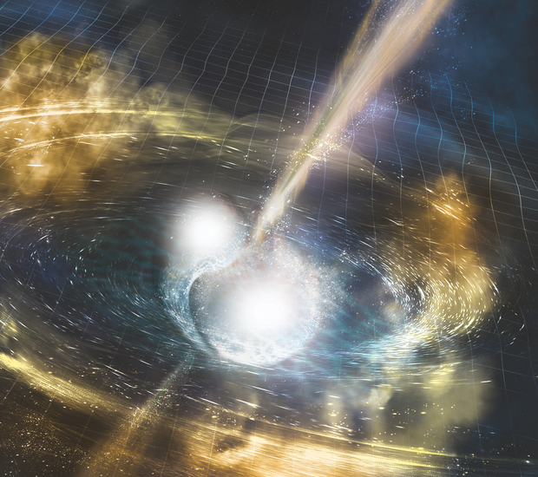
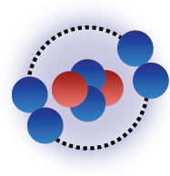
Precision in mass measurements away from stability is crucial for our understanding of nuclear structure and astrophysical studies
Nuclear shell structure
Nucleosynthesis
via the r-process
δm/m = 10⁻⁵ – 10⁻⁶
Halos and skins
δm/m = 10⁻⁷
δm/m < 10⁻⁶ – 10⁻⁷
And we need high-precision mass measurement tools !
https://people.physics.anu.edu.au/~ecs103/chart/

Slide 3
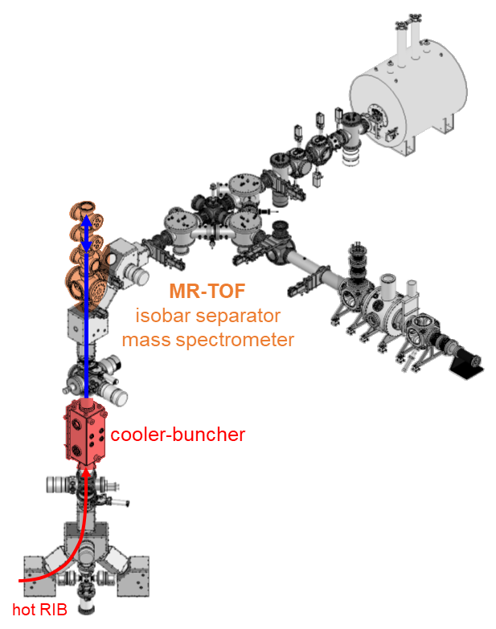
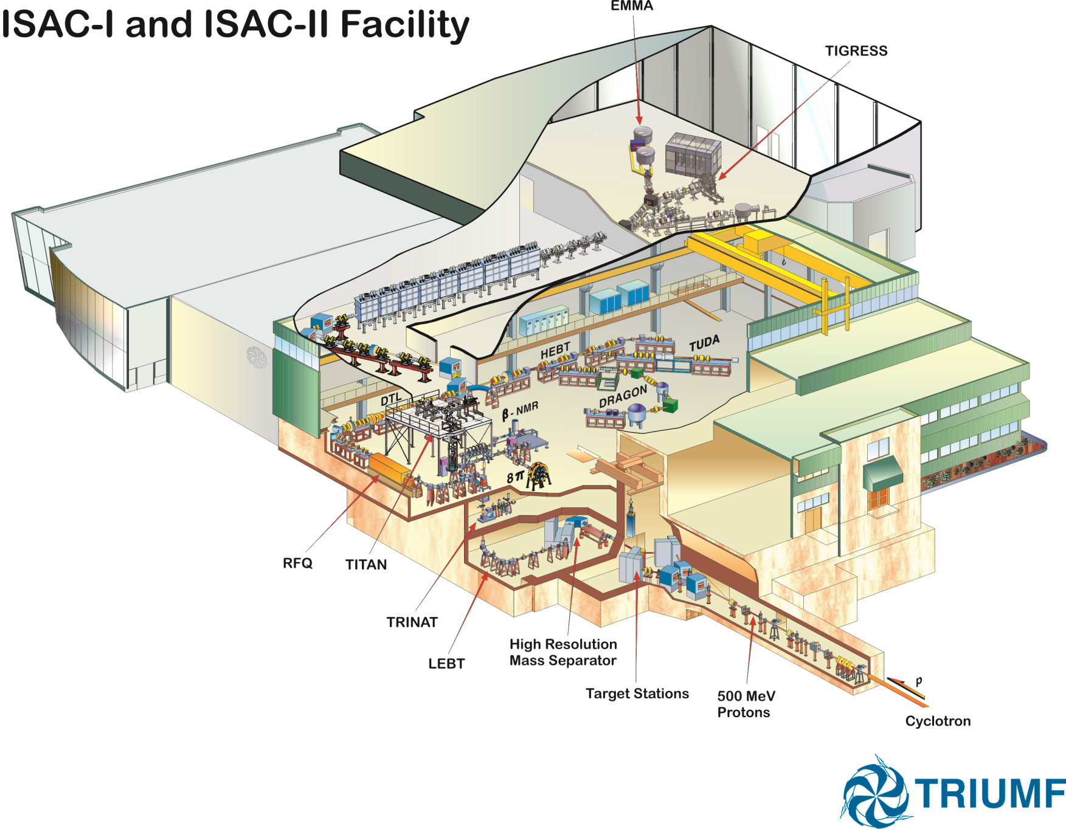
TITAN facility at TRIUMF can perform such measurements
Penning trap mass spec.
EBIT Charge breeder
MR-TOF
TITAN
RFQ
Cooler & buncher
Low-energy
beam transport
Isobar Mass
Separator
ISOL Target
≤100uA,
500 MeV
protons from cyclotron
TRIUMF’s Ion Trap for Atomic and Nuclear science (TITAN)

Slide 4
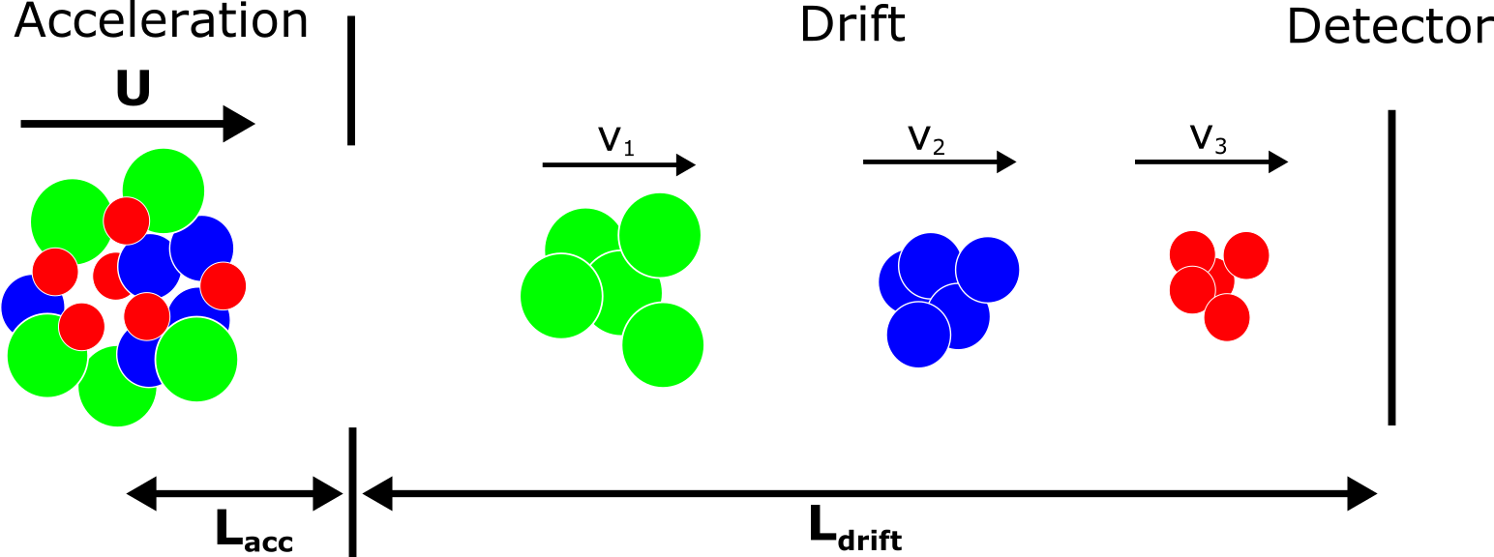
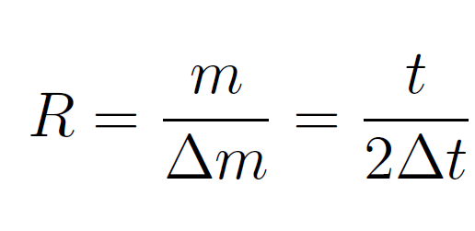
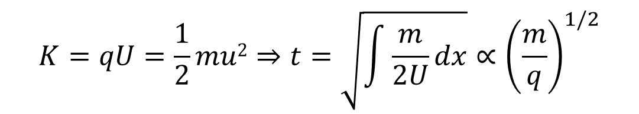
  The mass is determined by its time-of-flight (TOF).
  Mass resolving power (R)
$$K=qU=\frac{1}{2}mu2⇒t=\sqrt{\int{\frac{m}{2U}dx}}∝{\left(\frac{m}{q}\right)}^{1/2}$$

Slide 5
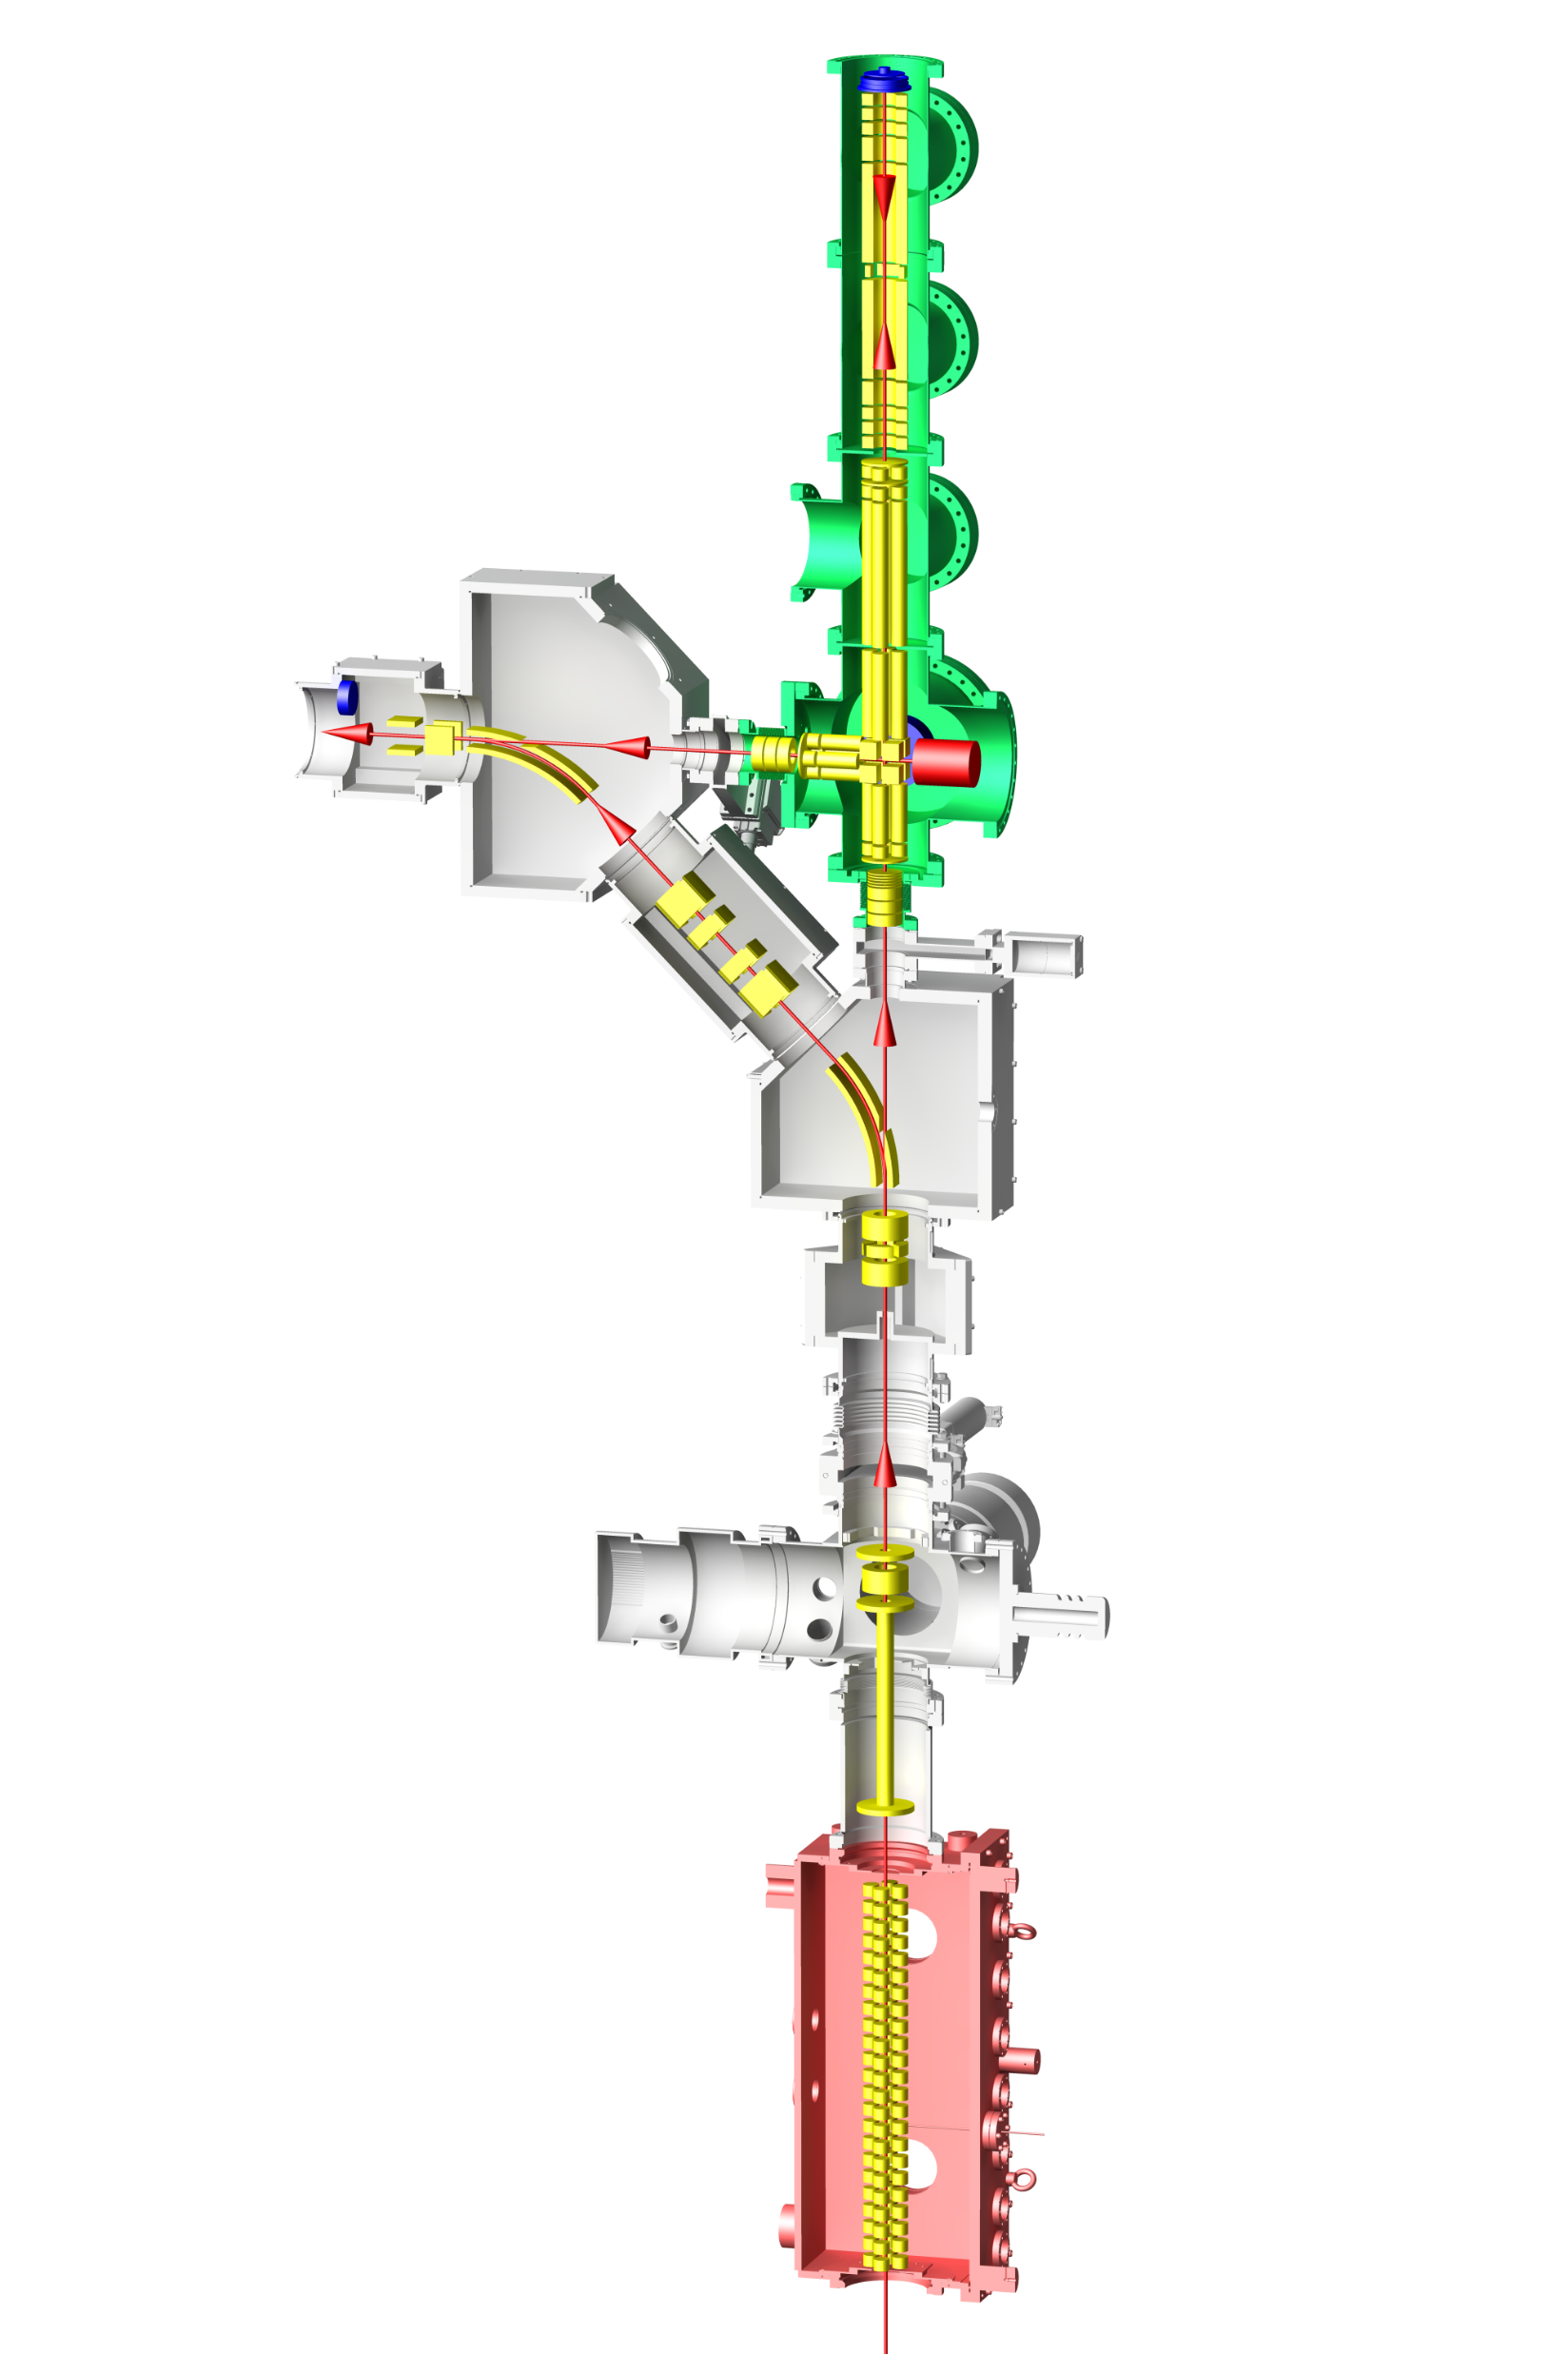

TITAN MR-TOF achieves high performance to meet its science objectives.
MagneTOF Detector
  High resolving power $\frac{ΔM}{M}≤$600,000
  High dynamic range 10⁴ -10⁸
  Mass accuracy $\frac{δM}{M}\sim$10⁻⁷
  Published sensitivity 0.006 pps*
TOF Analyzer
Trap section
Resolved low-lying isomers
Bonus: complementary to ISAC Yield Stn.
High performance largely due to re-trapping
Transfer RFQ
RF switchyard
Thermal ion source
Cooled and bunched RIB
C. Jesch et al., Hyperfine Interact. 235 (2015) 97, M. Yavor et al., Int. J. Mass Spec. 381 (2015) 1-9 ,T. Dickel et al., J. ASMS 28 (2017) 1079

Slide 6
Beam purification with mass-selective re-trapping
10⁴-10⁸ suppression of isobaric background ions
Purification for
  MR-TOF itself
  downstream traps
Analyzer mirror 1
How it’s done:
  Inject ions into TOF analyzer and separate in time
  Dynamical re-capture/trap ions of interest back into the injection trap
  Re-cool ions of interest
  Re-inject into the TOF analyzer and make mass measurement
Injection trap

Slide 7
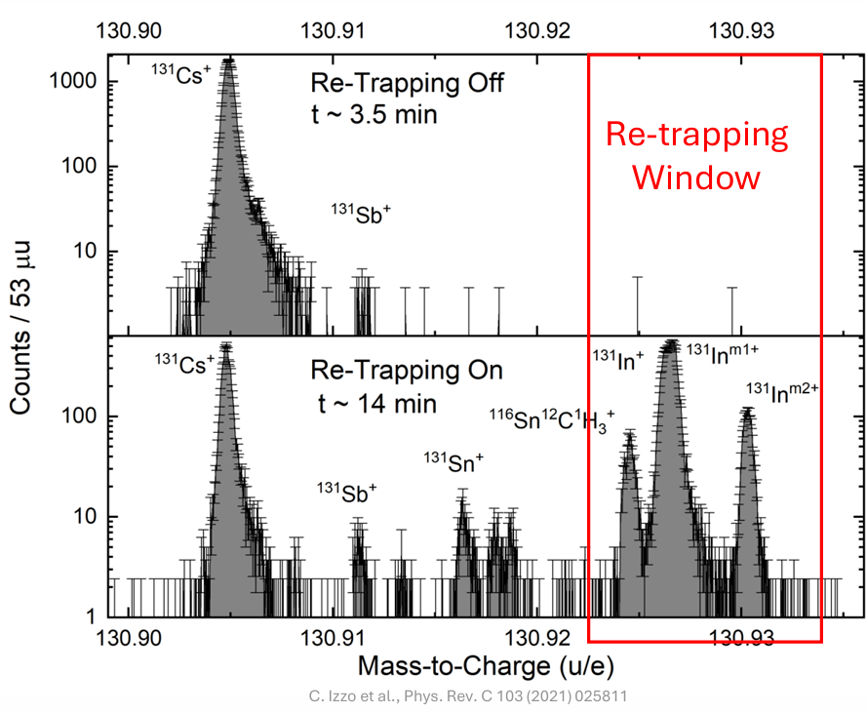
Contaminants dominate the spectra (Attenuated beam)
Increased isotope of interest while suppressing Contaminants
(Unattenuated beam)

Slide 8
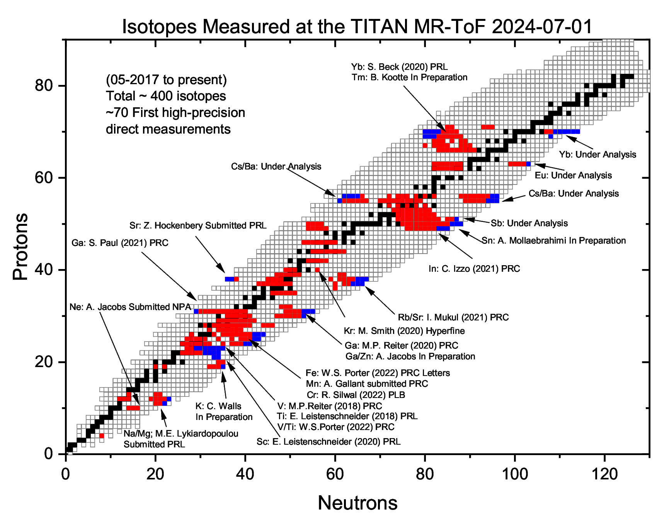
Mass measurements with
TITAN MRTOF up to fall 2024

Slide 9
TITAN has developed 3 methods to determine half-lives with the atomic mass in the MR-TOF.

Slide 10
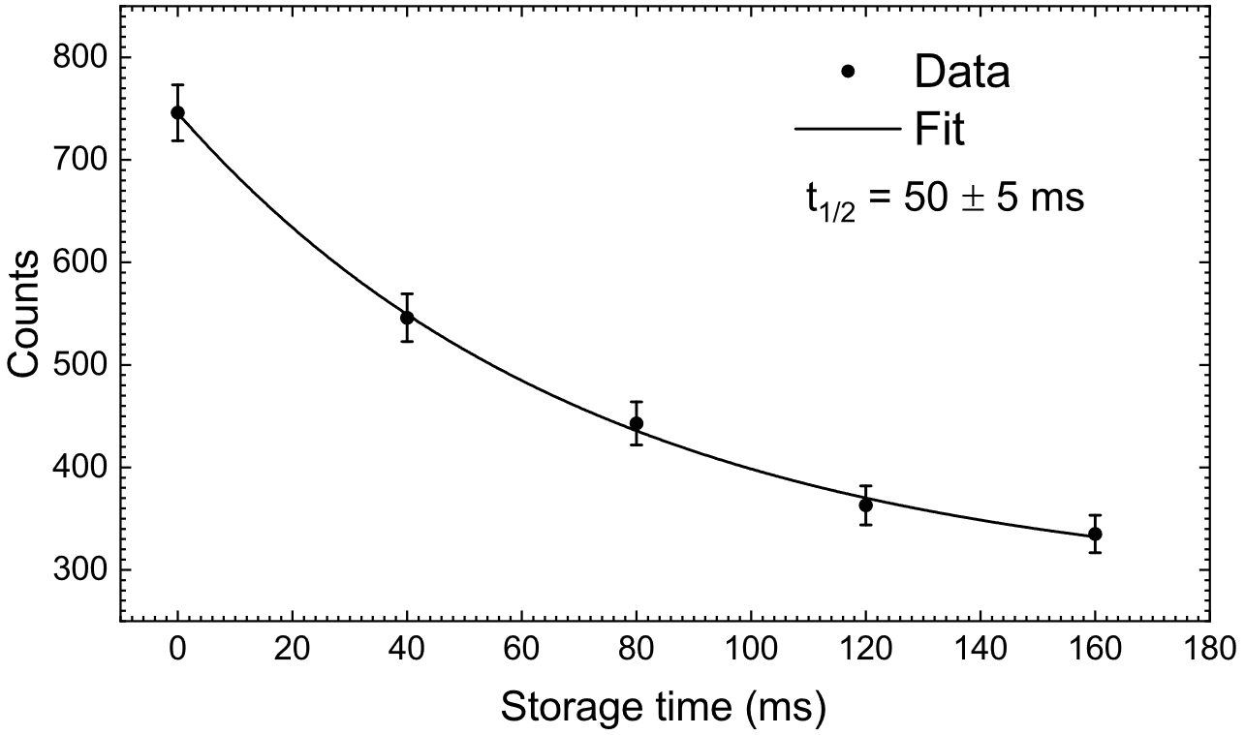
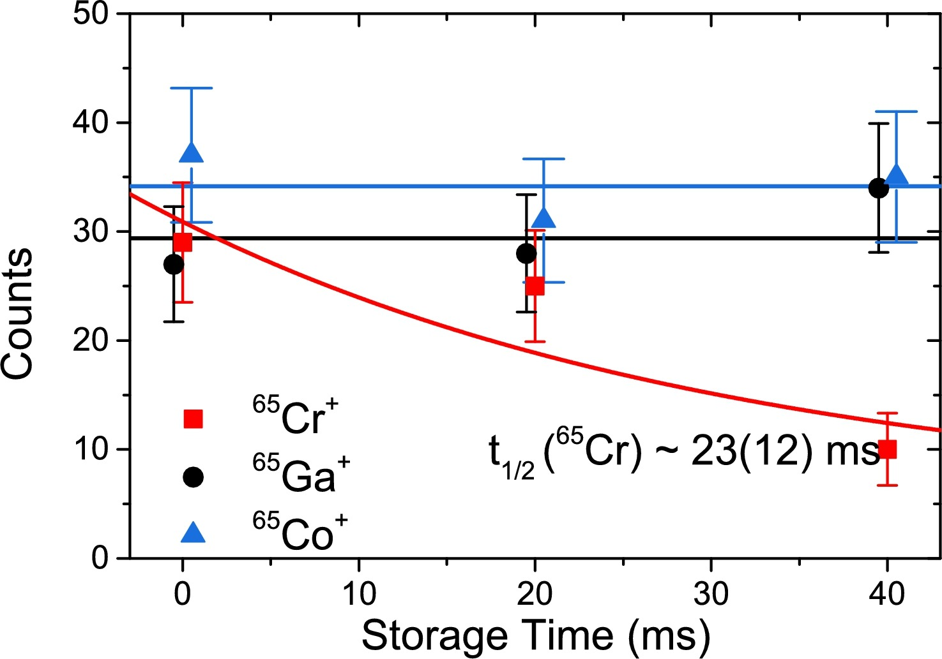
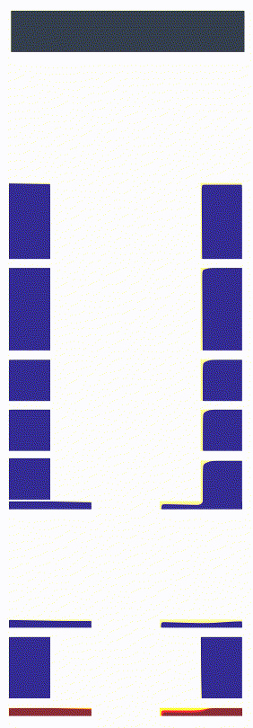
1. Half-lives via variation of storage time in injection trap
¹⁰⁰Rb
Counts
Counts
t_{1/2 exp} = 23 (12) ms, t_{1/2 lit} = 28 ms
¹⁰⁰Rb⁺
t_{1/2 exp} = 50 ±5 ms, t_{1/2 lit} = 52 ms
t_{1/2 lit} = 15.13 min
t_{1/2 lit} = 1.16 s
Storage time (ms)
Storage time (ms)
I. Mukul et al., J. Phys: Conf. Ser. 1643 (2020) 012057
R. Silwal et al., Phys. Lett. B. 833 (2022) 137288
https://www.nndc.bnl.gov/nudat3/
https://www.nndc.bnl.gov/nudat3/
Half-lives ~50ms
I. Mukul JPCS (2020); C. Walls, PhD thesis, U. Manitoba 2025

Slide 11
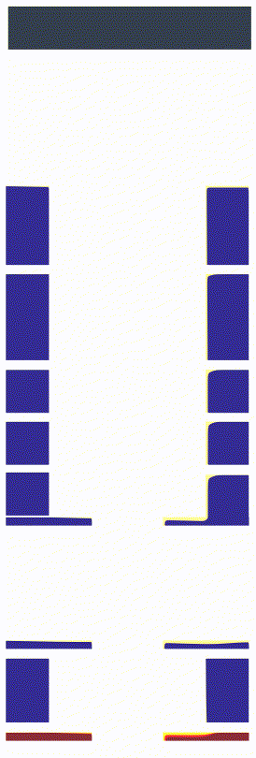
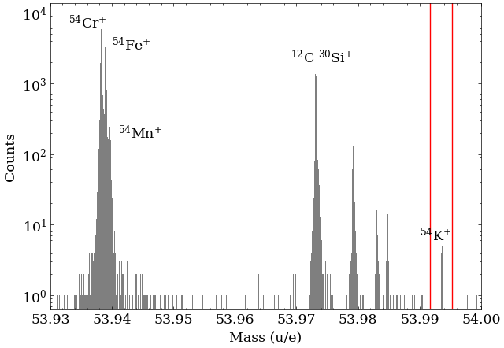
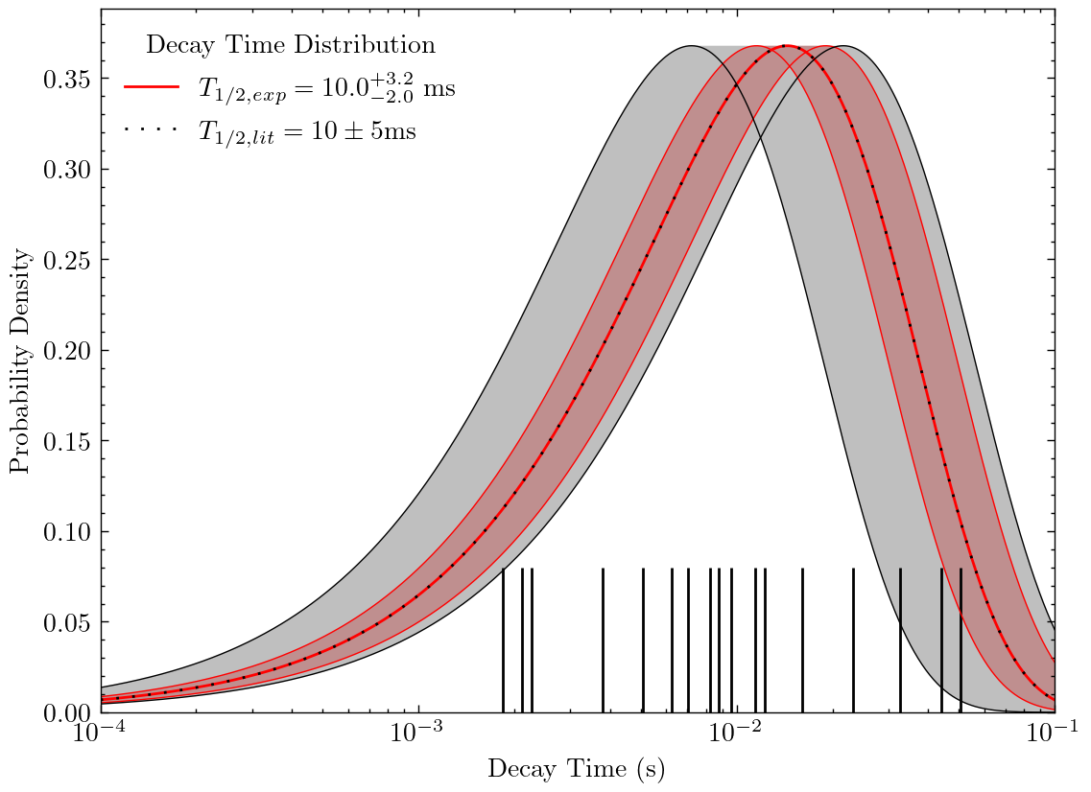
2. Half-Lives with Beta Tagging
Detector
Half-lives ~ 10ms - 50ms, decided by the MRTOF cycle time
Low ion rate/ Ion-by-ion decay tagging
~50% detection efficiency
C. Walls, PhD thesis, U. Manitoba 2025
Red : T _{½ Exp}
Dotted : : T _{½ lit}
Counts
Probability Density
⁵⁴K⁺
Decay time (s)
Mass (A/Q)
Injection trap

Slide 12
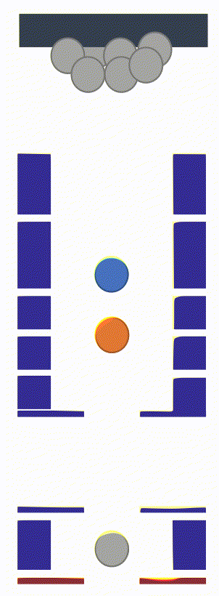
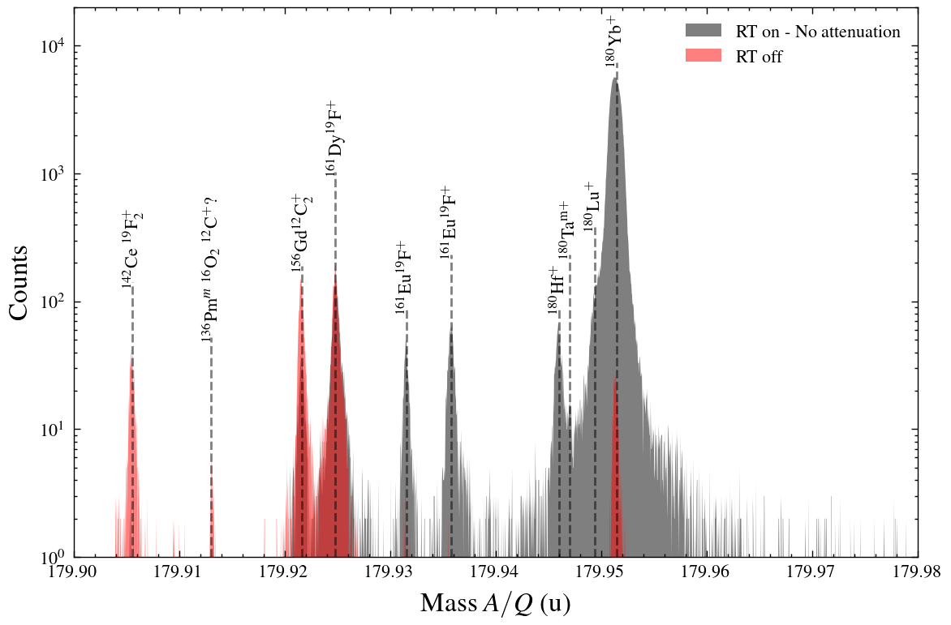
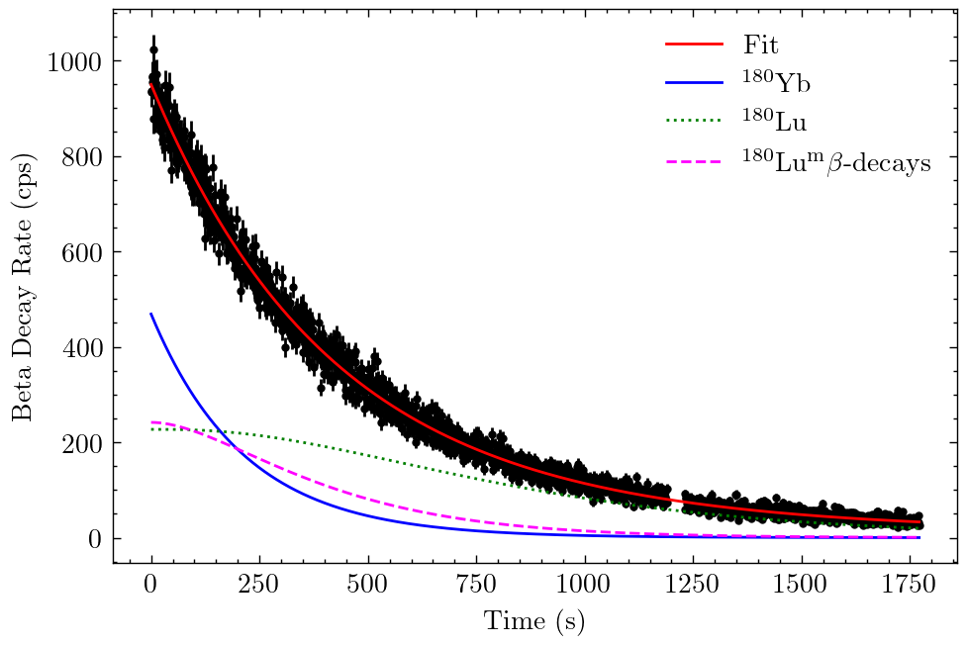
3. Half-lives with a high purity source
Half-lives 30s to several minutes
Re-trapping to reduce isobaric contaminants
Contamination checked with mass spectrometry
C. Walls, PhD thesis, U. Manitoba 2025
¹⁸⁰Yb⁺
¹⁸⁰Lu⁺
T_{1/2}
Counts
Beta decay rate (cps)
= 2.45 min
Mass (A/Q)
Time (s)

Slide 13
Switching gears to The Science

Slide 14
First mass measurements of n-rich ¹³⁶⁻¹³⁸Sn isotopic chain to examine nuclear shell evolution and r-process nucleosynthesis.
Lasers ON
¹³⁸Sn
Experiment setup
Protons: 480MeV, 50 μA
Target : p-to-n UC_{x}
Ion source: TRILIS
¹³⁸Sn yield: 0.08 pps
MR-TOF res. power: 450k
Re-trapping on
Precision ≤ 29 keV
t ~ 2.2 hours
Lasers Blocked
t ~ 0.5 hours
Publication: A. Mollaebrahimi et al., Physical Review Letters 134 (2025)
Sn: A. Mollaebrahimi et al., Physical Review Letters 134 (2025). p-to-n target: L. Egoriti, PhD thesis, UBC 2023

Slide 15
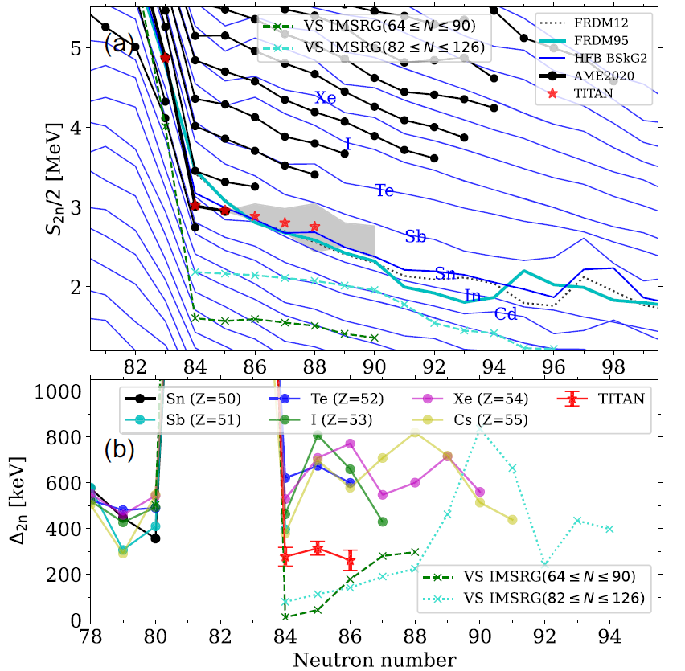
Flatter trend in S_{2n} beyond N = 82 has implications for nucleosynthesis.
S_{2n} and ab- initio theory flatter than extrapolated AME
Empirical shell gap Δ_{2n}
  Strong peak at N=82 as expected
  Flat trend in Sn lower than neighbors
$$Δ_{2n}=S_{2n}\left(Z,N\right)−S_{2n}\left(Z,N+2\right)$$
A. Mollaebrahimi et al., Physical Review Letters 134 (2025).

Slide 16
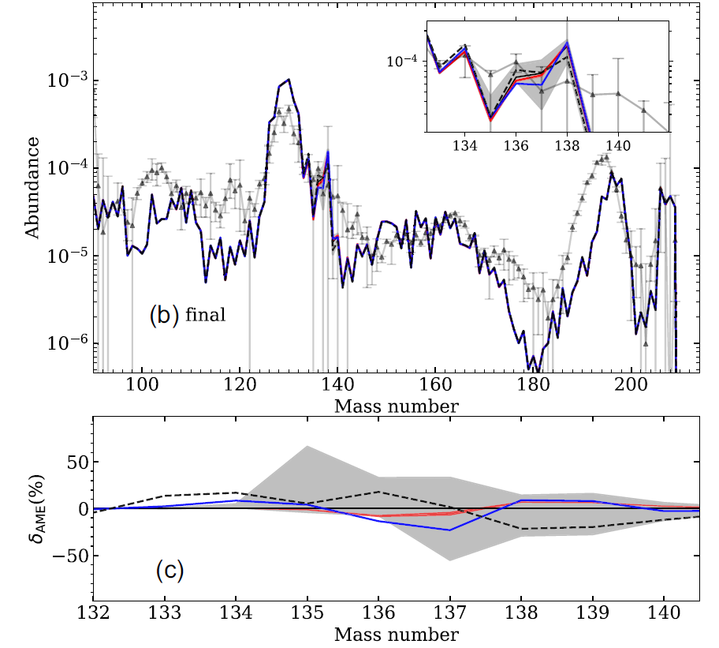
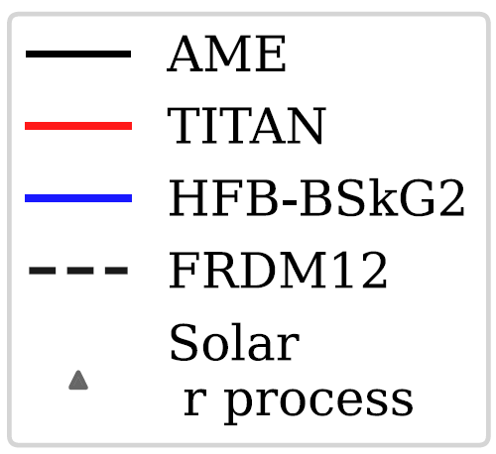
R-process Abundance Calculations
Our mass measurements
  TITAN mass uncertainty : too small to contribute to abundance uncertainty.
  Predict a lower abundance of A=135 compared to A=137 in the calculated scenario
A. Mollaebrahimi et al., Physical Review Letters 134 (2025).

Slide 17
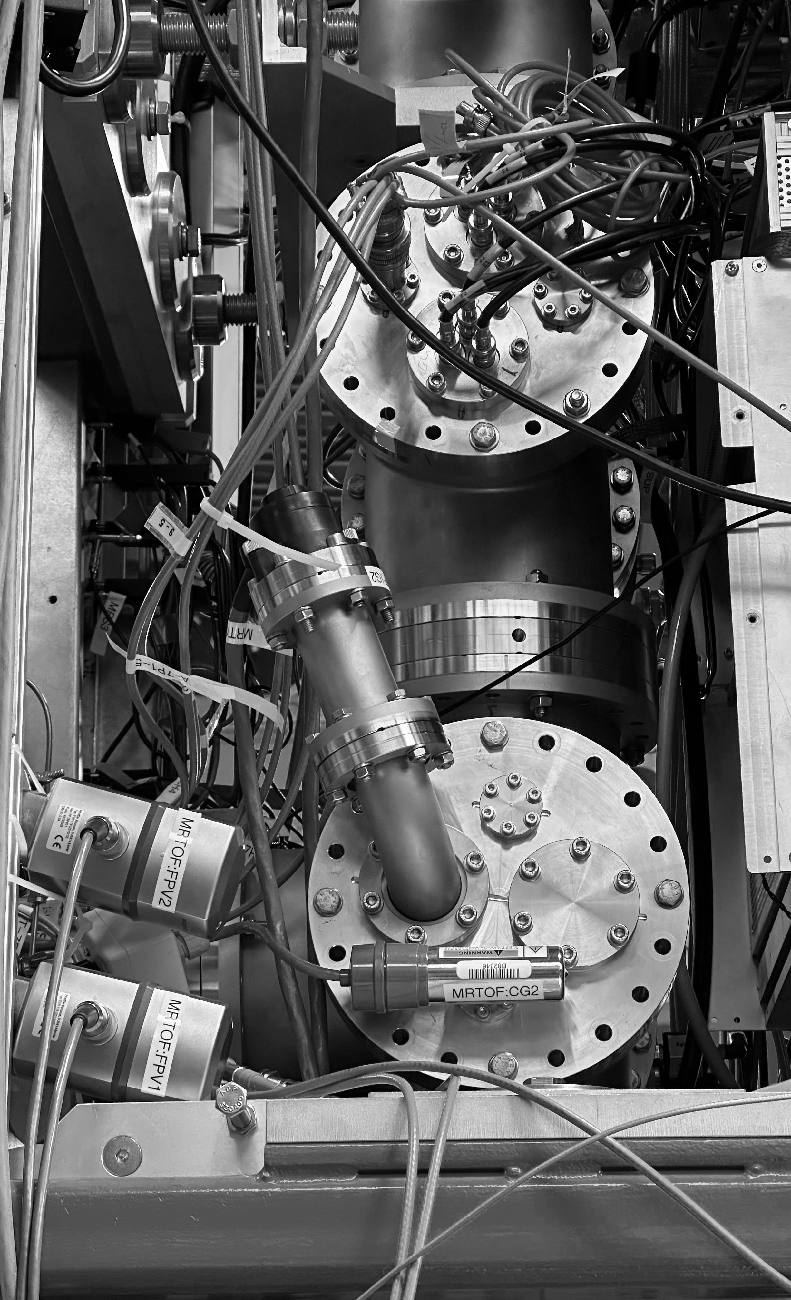
Summary:
  TITAN MR-TOF provides high-precision mass measurements of radioactive isotopes far from stability for nuclear structure & astrophysical studies.
  The addition of simultaneous half-life measurements has been used for isotope identification purposes and science
  Measurement of n-rich Sn up to ¹³⁸Sn
Outlook:
  TITAN prepares for the ARIEL era with triple the RIB capacity
  Upcoming upgrades to improve precision and performance of the MR-TOF
    Laser ablation ion source (LAS) to add more calibrants and enable off-line science
    Active thermal stabilization of mirror electrode power supplies for higher resolving power
  Outstanding experiments require coupling the MR-TOF with downstream ion traps from Penning-trap mass spec and in-trap spectroscopy
Notes:
Next slide TITAN group thank

Slide 18


