Slide 1
The low energy storage ring CRYRING@ESR operational experience and beams available for experiments
F. Herfurth, Z. Andelkovic, S. Fedotova, W. Geithner, N. Kehl, C. Krantz, M. Lestinsky, S. Trotsenko, G. Vorobyev
GSI Helmholtz Center for Heavy Ion Research GmbH, Darmstadt, Germany

Slide 2

Collaborators and Support Team
GSI/FAIR Expert Groups
Construction
External Partners TU Darmstadt
HIJ Jena Stockholm University Krakow University
KVI Groningen
IKF Frankfurt
Facility
Engineering
Mechanical Design/Integration
Ion Sources
System Design
HITRAP
UNILAC RF
Ring RF
Accelerator Physics
Magnets
ESR
Atomic Physics
SPARC
APPA
collaboration
Accelerator Operations
Vacuum
Decelerator Experiments
SPARC Det.
Decelerators
(DEC)
Power Suppl.
Beam Diagns.
Controls
BMBFTR (Ministry)
„Verbundforschung“
DEC @ GSI
Z. Andelkovic, S. Fedotova, W. Geithner, FH, N. Kehl, N. Kotovskiy, J. Ködel, D. Racano, S. Rausch, N. Stallkamp, S. Trotsenko, G. Vorobjev, D. Zisis
Transport&Installation
Beam Cooling
Notes:
Nice example of cowork between GSI – FAIR – Research – Accelerator – Collaborations and external Partners

Slide 3
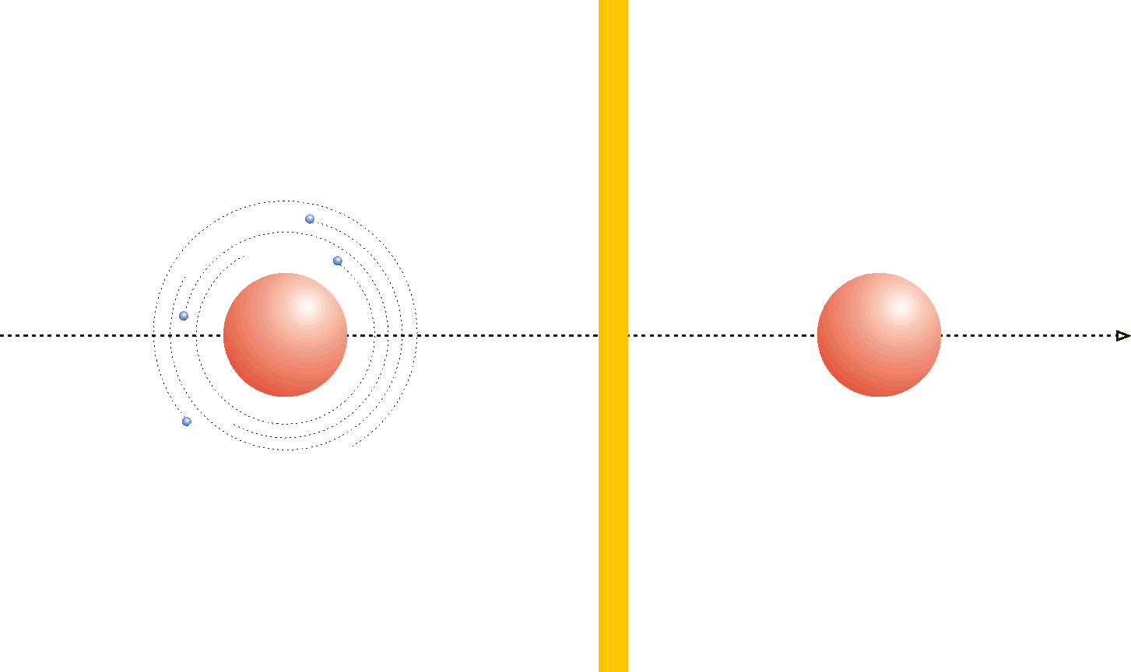
Exotic (rare) Ions
- radioactive
- (heavy) highly charged (HCI)
- antiprotons
Precision Experiments
- Ion traps ( <eV/u)
- Optical traps (<meV/u)
- Storage Rings (100s keV/u)
MeV/u
100 MeV/u
GeV/u
Heavy element’s
fragments / HCI
(and p̅)

Slide 4
Slow, Heavy, Highly-Charged Ions at GSI/FAIR
400 MeV/u
400 MeV/u
UNILAC
SIS
Stripper
FRS
ESR
HITRAP – in development / partially operational
Linear Decelerator and Ion Trap as a source for heavy, HCI at keV .. 0 eV energies
up to 10⁶ of ions alike U⁹¹⁺, Bi⁸²⁺ …
constructed 2003 .. 2007 with some refurbished parts
online operating time about two 10-day periods p.a.
4 K
HITRAP
4 MeV/u
S-EBIT
4 MeV/u … 100 keV/u
CRYRING@ESR – in regular operation
Low energy storage ring for heavy, HCI at 0.1 .. 10 MeV/u
includes a local injector for lighter, lower charged ions
built in Sweden in the 1990s, recommissioned at GSI 2016+
Operation within GSI beamtime periods
10 MeV/u
CRYRING
ECR

Slide 5
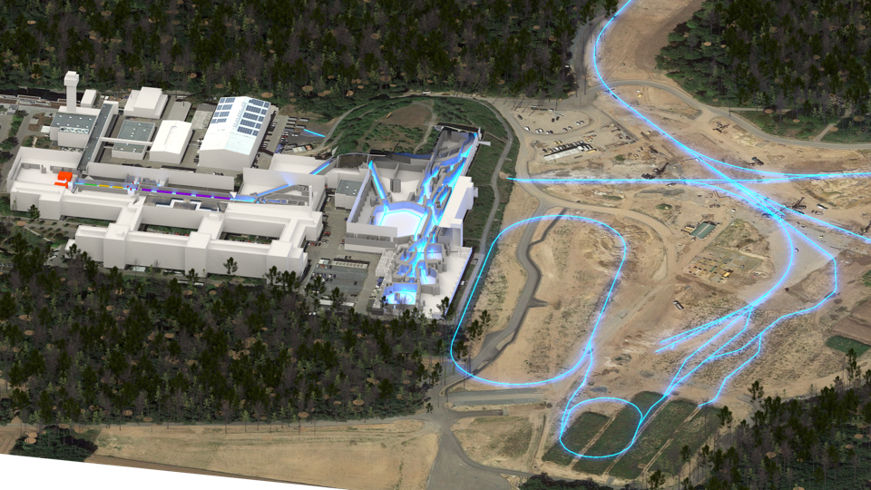

Slow, Heavy, Highly-Charged Ions @ GSI/FAIR
Ionsources
Fragment-
separator
HITRAP
SIS18
SIS100
image created by W. Geithner
CBM
HESR,
PANDA
UNILAC
Super-FRS,
Antiproton
target
ESR
CRYRING@ESR
Collector-Ring

Slide 6
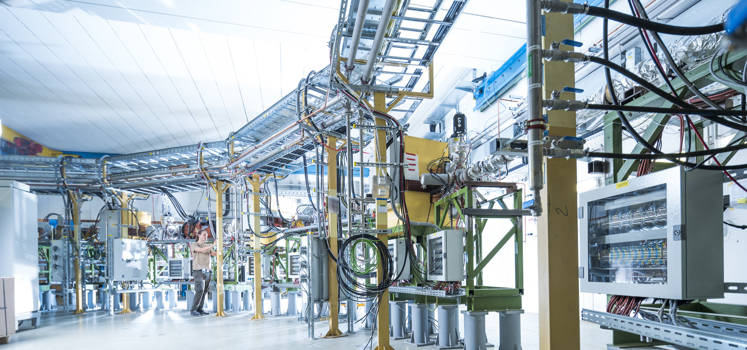
The low energy storage ring CRYRING@ESR
Introduction
CRYRING@ESR
Key layout and Electron Cooling
Opportunities for experiments using examples
In case you are interested how HITRAP is doing .. two slides
Summary

Slide 7
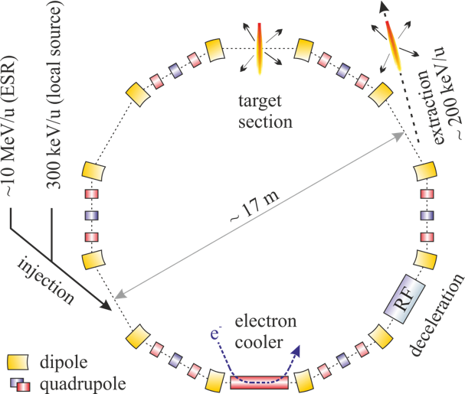
CRYRING@ESR
Max. rigidity 1.44 Tm
15 MeV/u U⁹²⁺
96 MeV/u protons
Min. rigidity ~ 0.054 Tm
Actual limit given by beam life time
UHV … 10⁻¹¹ mbar

Slide 8
Beams available in CRYRING@ESR
ESR
ions from GSI Accelerator Chain and ESR
transfer efficiency (stored to stored) ~ 50%!
I.e. 1e6 ions at 10 MeV/u in ESR = 5e5 ions in YR
example: up to 2·10⁶ U⁹¹⁺ or 8·10⁶ Au⁷⁵⁺ in YR
ions from local injector
intensity limited by ion source and physics
independence allows for high flexibility
constant development of ions from local source (mostly 10 GHz ECR)
in 2023/24 Li, S, W
in 2024/25 F
Up to 50%
CRYRING@ESR
local injector | GSI complex (from ESR)
H₂⁺, D⁺ | Ar¹⁸⁺
C⁺, ⁷Li⁺, O⁶⁺, Ne^{2,3,7+}, ^{24,25}Mg⁺ | Pb⁷⁸⁺, Au⁷⁸⁺, U⁹¹⁺
S³⁺, ⁶Li^{1+,2+,3+}, F⁶⁺, W^{?+}

Slide 9
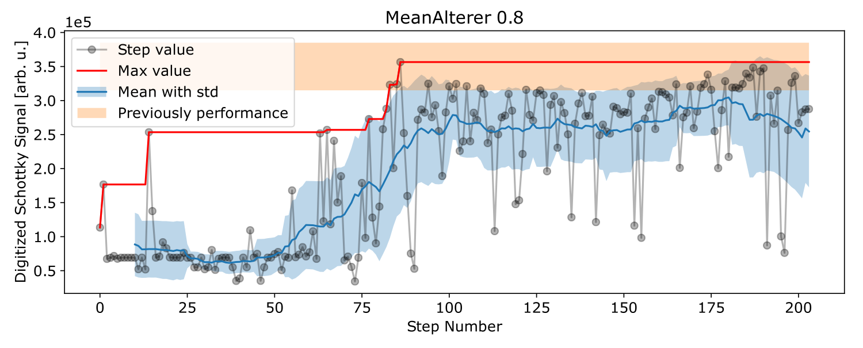
Beams available in CRYRING@ESR
Work on improvements : Genetic Opt.
ions from GSI Accelerator Chain and ESR
transfer efficiency (stored to stored) ~ 50%!
I.e. 1e6 ions at 10 MeV/u in ESR = 5e5 ions in YR
example: up to 2·10⁶ U⁹¹⁺ or 8·10⁶ Au⁷⁵⁺ in YR
ions from local injector
intensity limited by ion source and physics
independence allows for high flexibility
constant development of ions from local source (mostly 10 GHz ECR)
in 2023/24 Li, S, W
in 2024/25 F
[1] S. Appel, W. Geithner, et al.: “Optimization of heavy-ion synchrotrons using nature-inspired algorithms and machine learning”,
13th Int. Computational Accelerator Physics Conf., doi:10.18429/JACoW-ICAP2018-SAPAF02
local injector | GSI complex (from ESR)
H₂⁺, D⁺ | Ar¹⁸⁺
C⁺, ⁷Li⁺, O⁶⁺, Ne^{2,3,7+}, ^{24,25}Mg⁺ | Pb⁷⁸⁺, Au⁷⁸⁺, U⁹¹⁺
S³⁺, ⁶Li^{1+,2+,3+}, F⁶⁺, W^{?+}

Slide 10
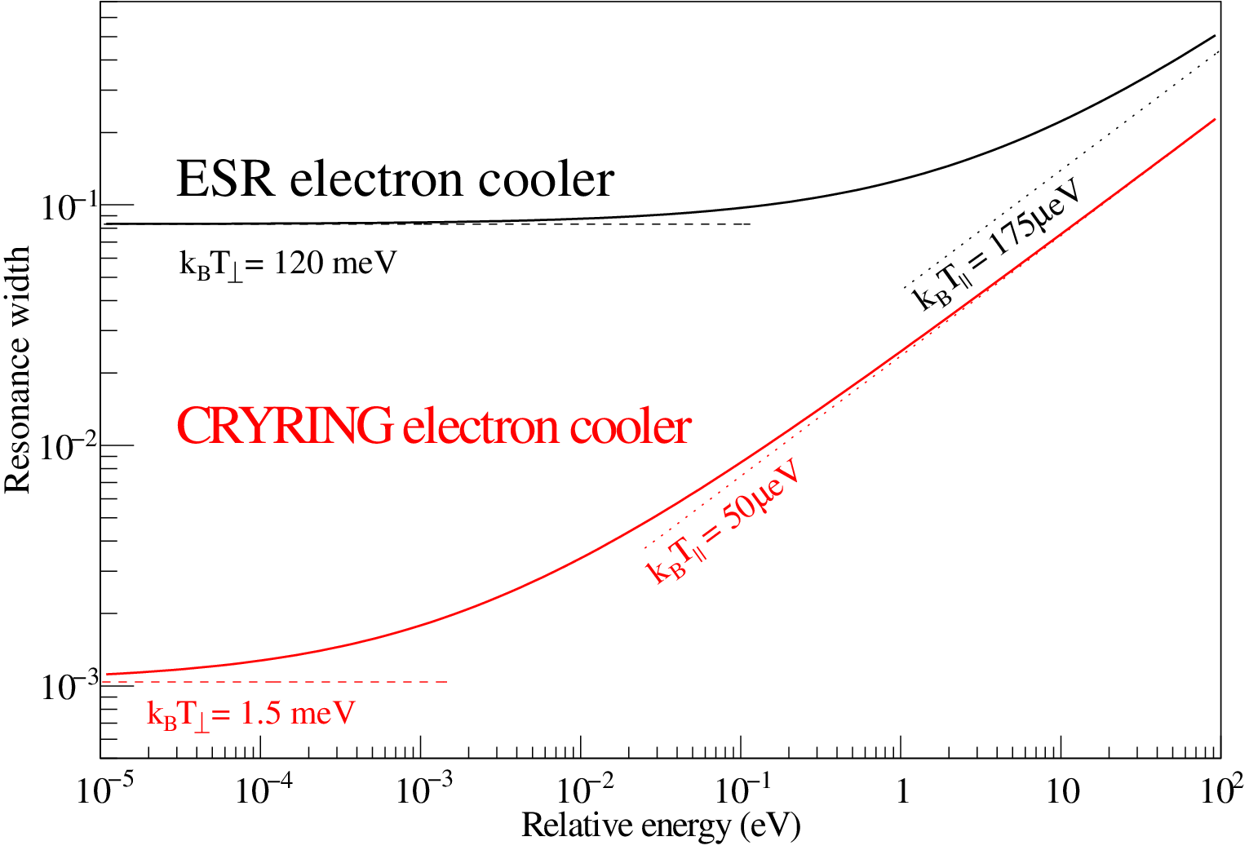
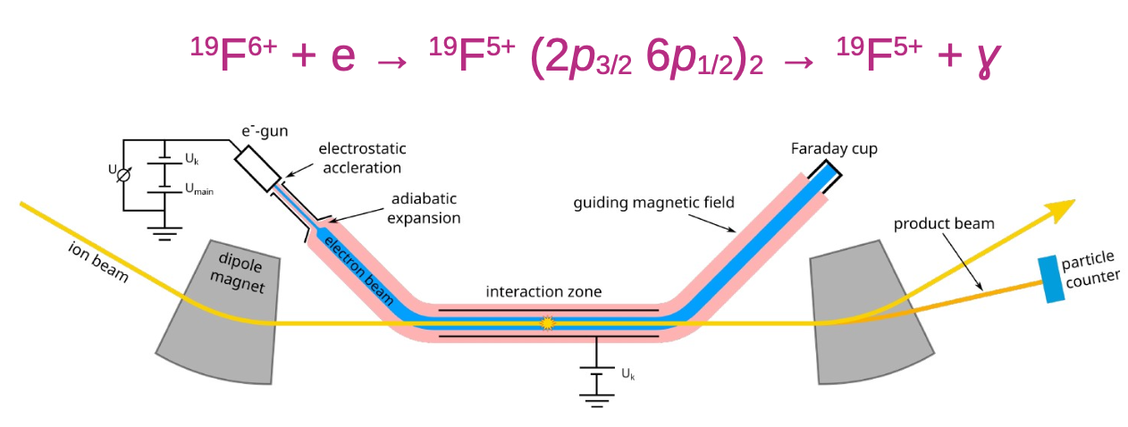
Electron Cooling ESR - CRYRING
Data and graphics courtesy of C. Krantz

Slide 11
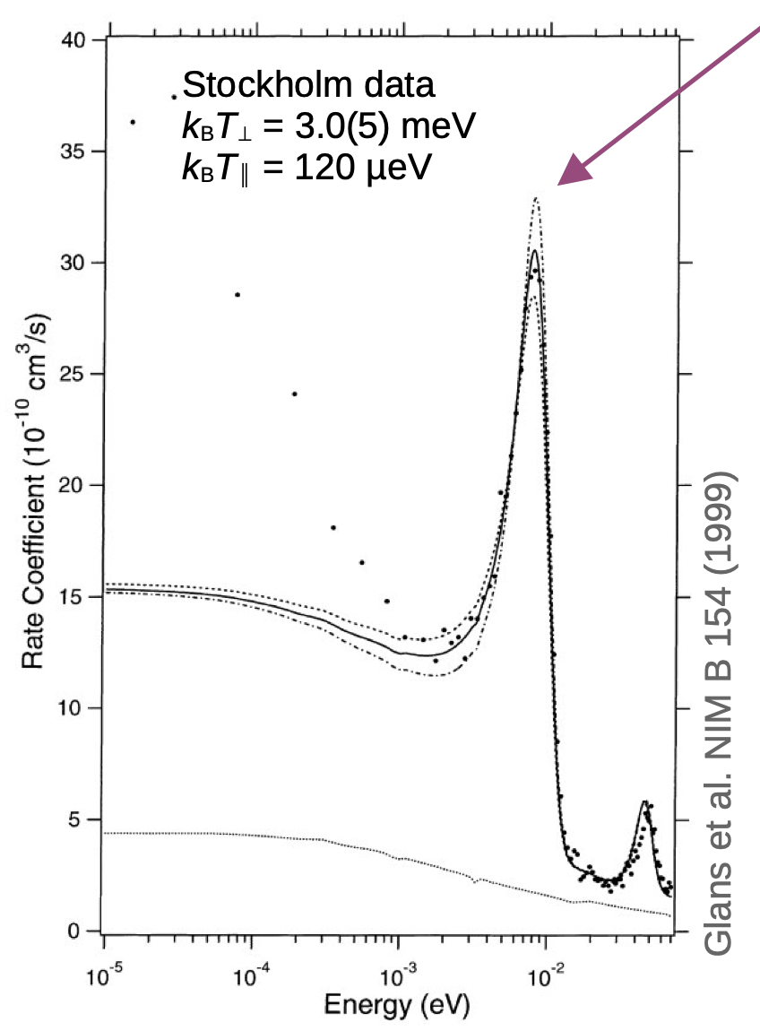
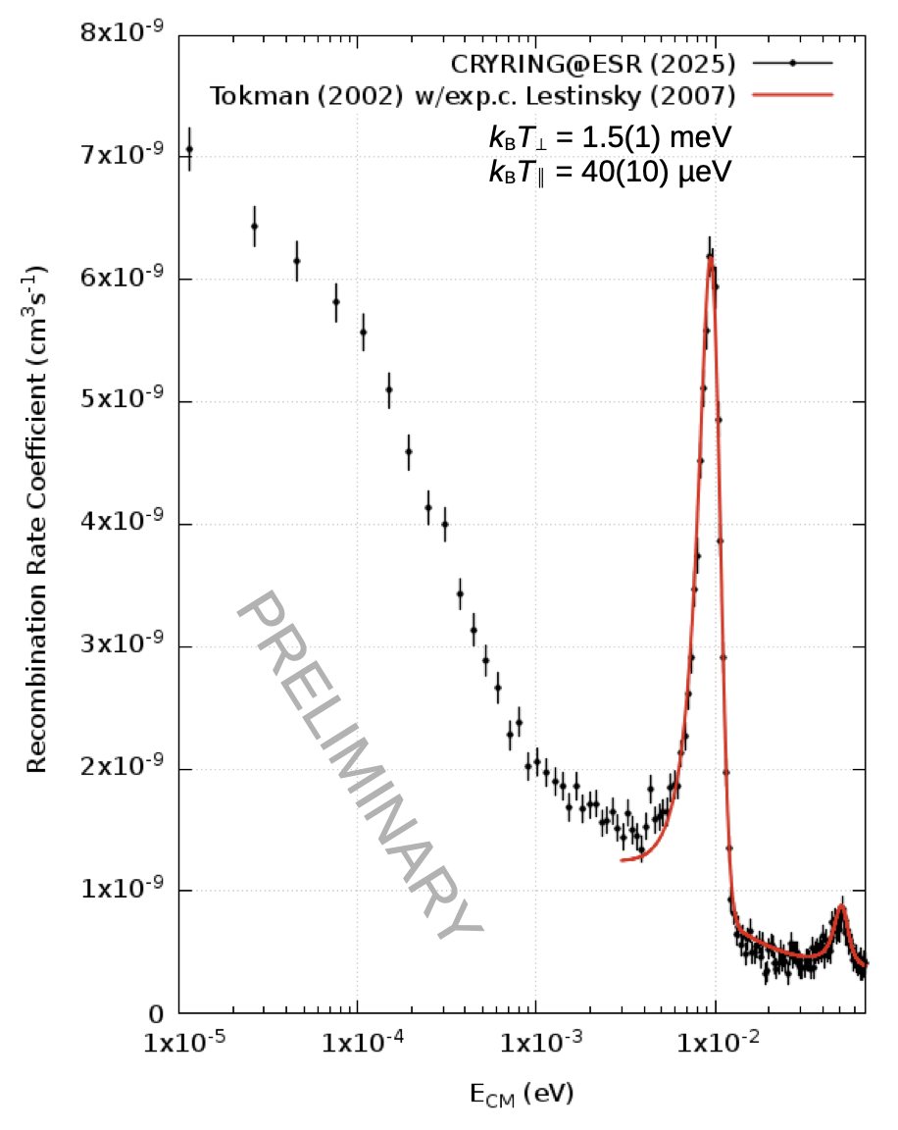
Electron Cooling ESR - CRYRING
Data and graphics courtesy of C. Krantz, M. Lestinsky

Slide 12
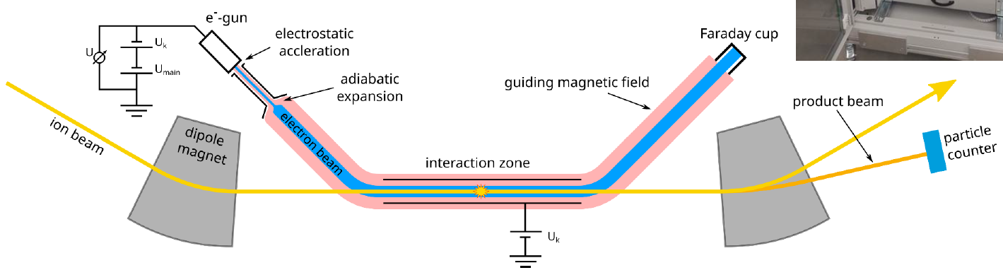
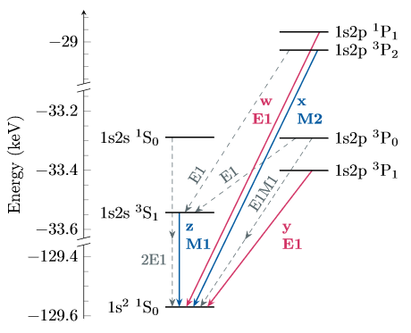
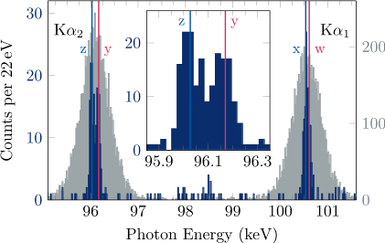

X-Ray Spectroscopy of U⁹⁰⁺
· U⁹¹⁺ beam
13 MeV/u
· Duty cycle
40 sec.
· 5∙10⁶ ions
e⁻ beam
30 mA
U⁹¹⁺ ions
U⁹⁰⁺ ions
stopped by particle detector
maXs
180°
maXs
0°
Radiative recombination followed by photon emission
Coincidence
condition
First (!) identification of Kα components in a high-Z system
Transition energies in agreement with bound-state QED
Uncertainty dominated by counting statistics
G. Weber, T. Stöhlker, et al.

Slide 13
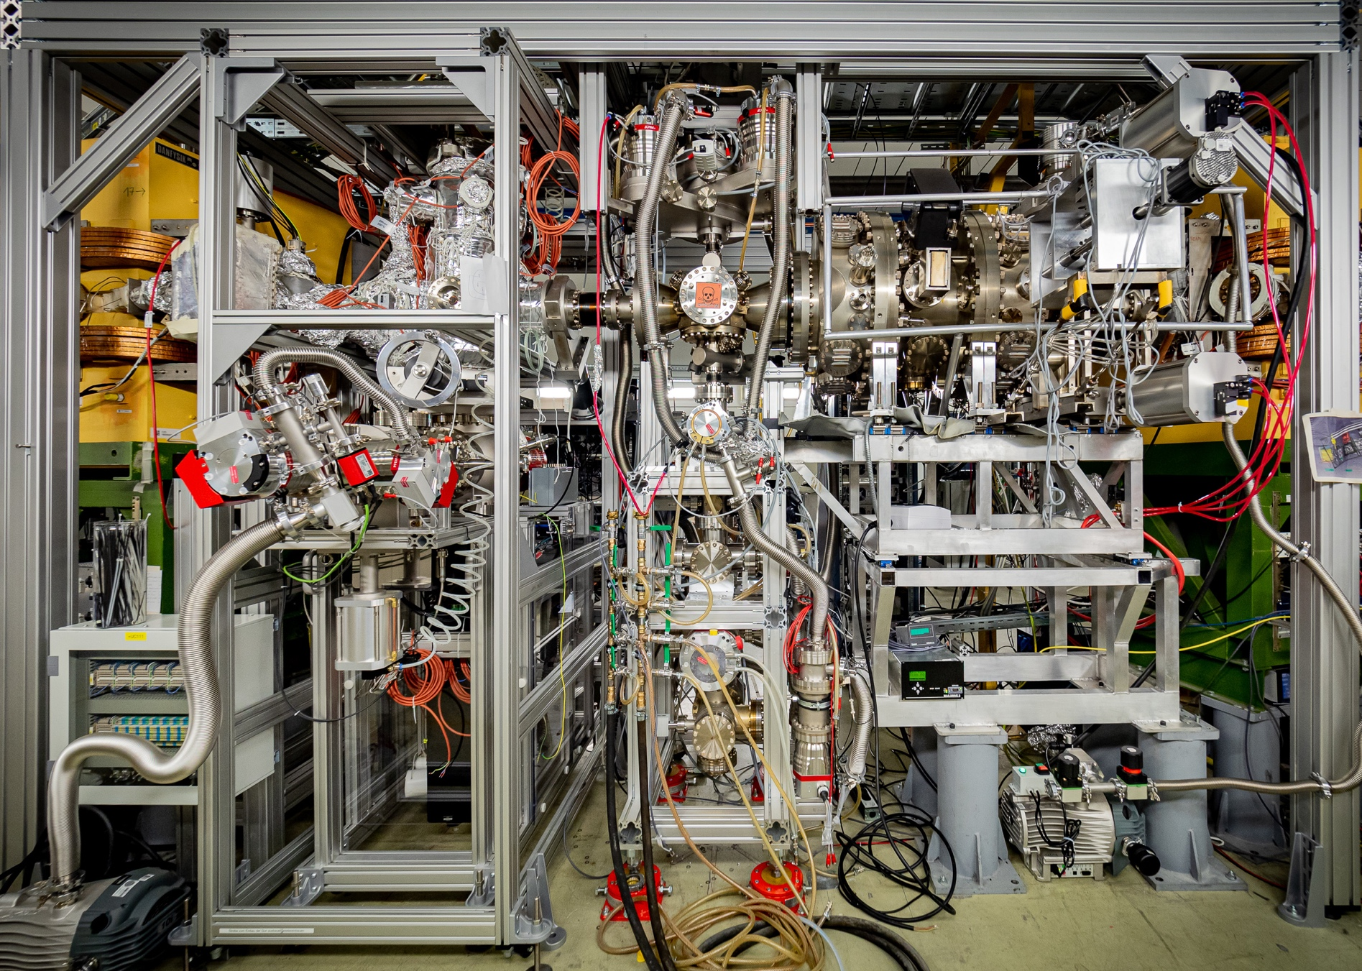
Section YR09: targets
First transversal electron target – commissioned C. Brandau et al.
Gas jet target – lots of improvements:
Pumping
Controls and DAQ
Shutter for jet
Hydrogen gas safety
N. Petridis, A. Biniskos et al.
Electron target
Gasjet target
CARME
coordination of user activites: M. Lestinsky
Photo: C. Brandau

Slide 14
Section YR09: targets
Gas | Density (cm⁻²)
H2 | 2x10¹⁴
He | 6x10¹¹
Kr | 2x10¹²
Xe | 6x10¹²
N2 | 6x10¹¹
First transversal electron target – commissioned C. Brandau et al.
Gas jet target – lots of improvements:
Pumping
Controls and DAQ
Shutter for jet
Hydrogen gas safety
N. Petridis, A. Biniskos et al.
Electron target
Gasjet target
CARME
coordination of user activites: M. Lestinsky
Photo: C. Brandau

Slide 15
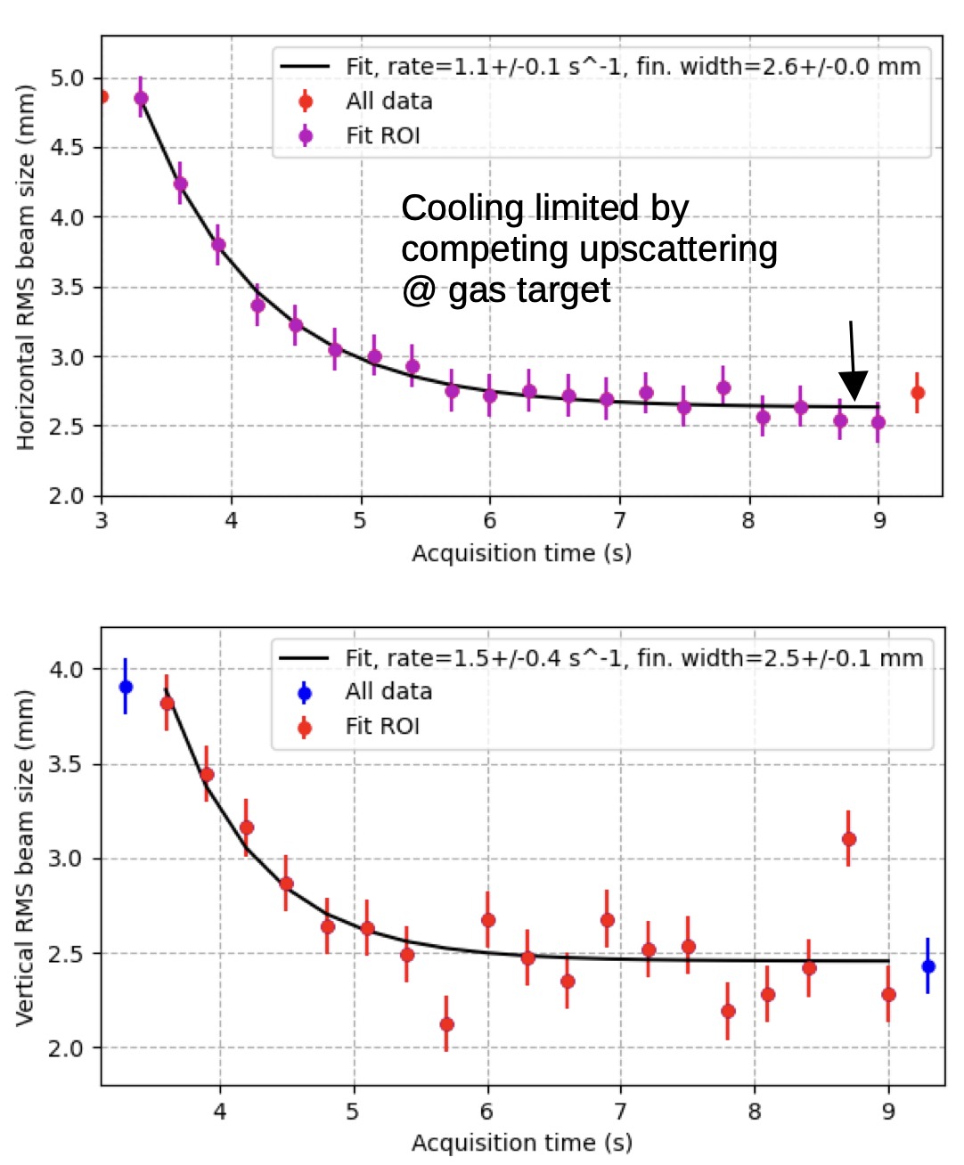
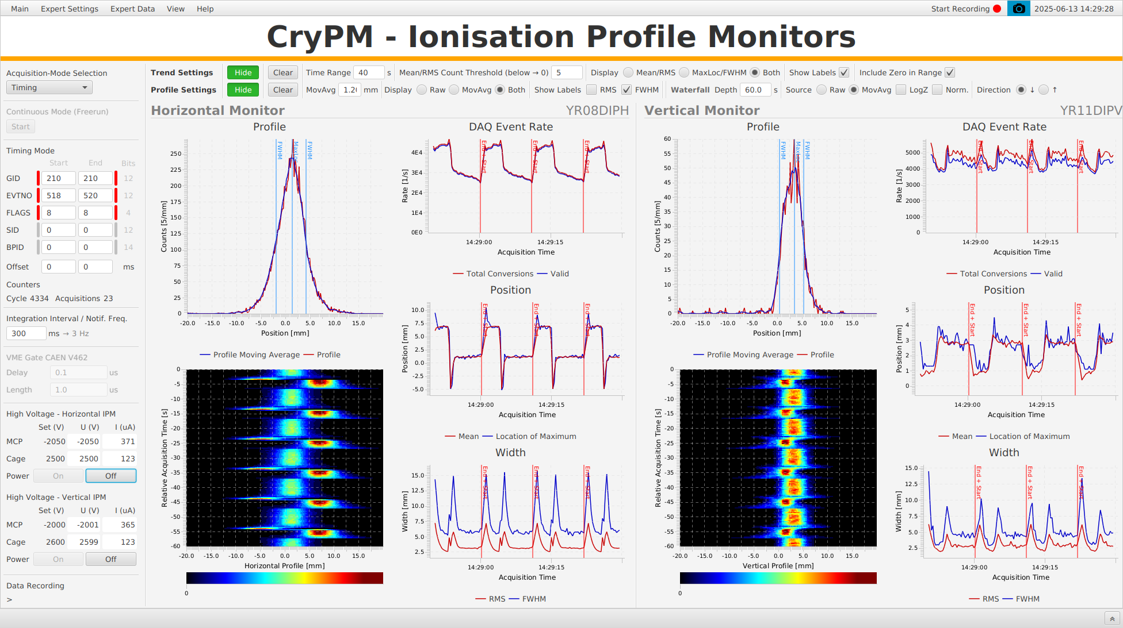
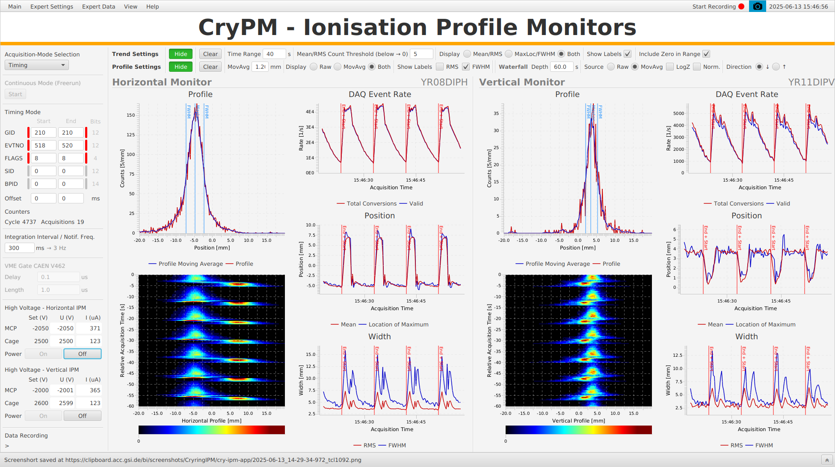
Section YR09: gas jet target and ion beam
Target effect on beam is well under control
Injection at 300 keV/u
Cooling
Deceleration to 92 keV/u
Cooling
Horizontal Beam Profile as time goes by
Electron Beam only 0.5 mA@50eV
w/o gasjet
w gasjet

Slide 16
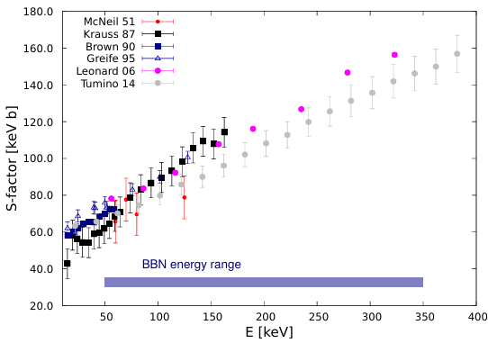
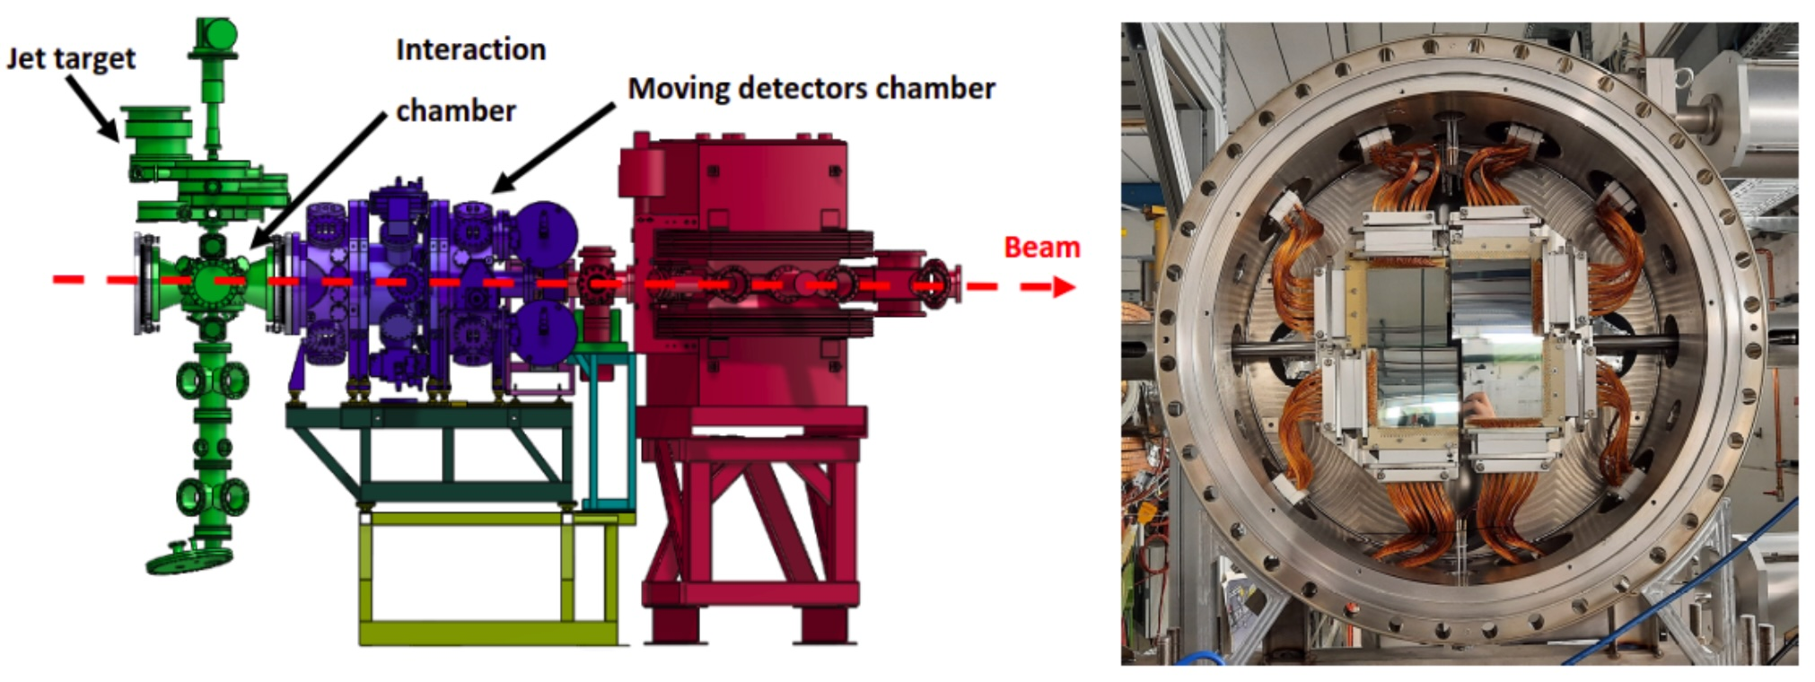
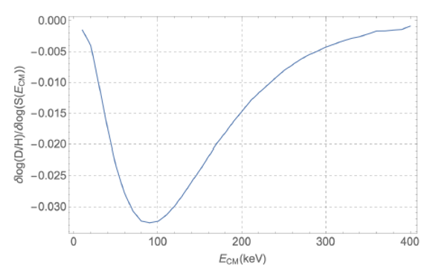
Nuclear Reactions at very low energy
Big Bang Nucleosynthesis: D(D,p)3H
5∙10⁸ locally produced D⁺ ions, E ≥ 90 keV/u, f = 300 kHz
detection with Double-sided Silicon Strip Detectors (CARME)
Jordan Marsh, Carlo Bruno et al. (CARME)

Slide 17
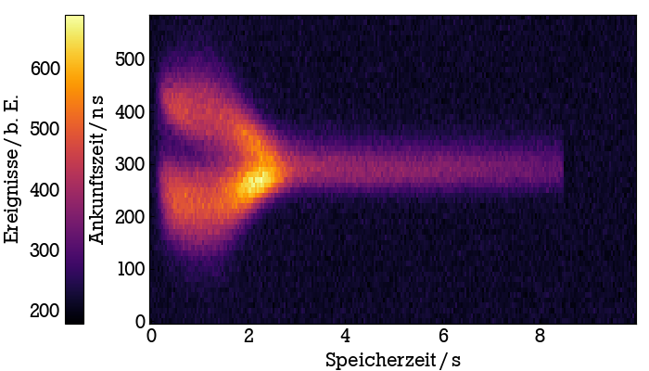
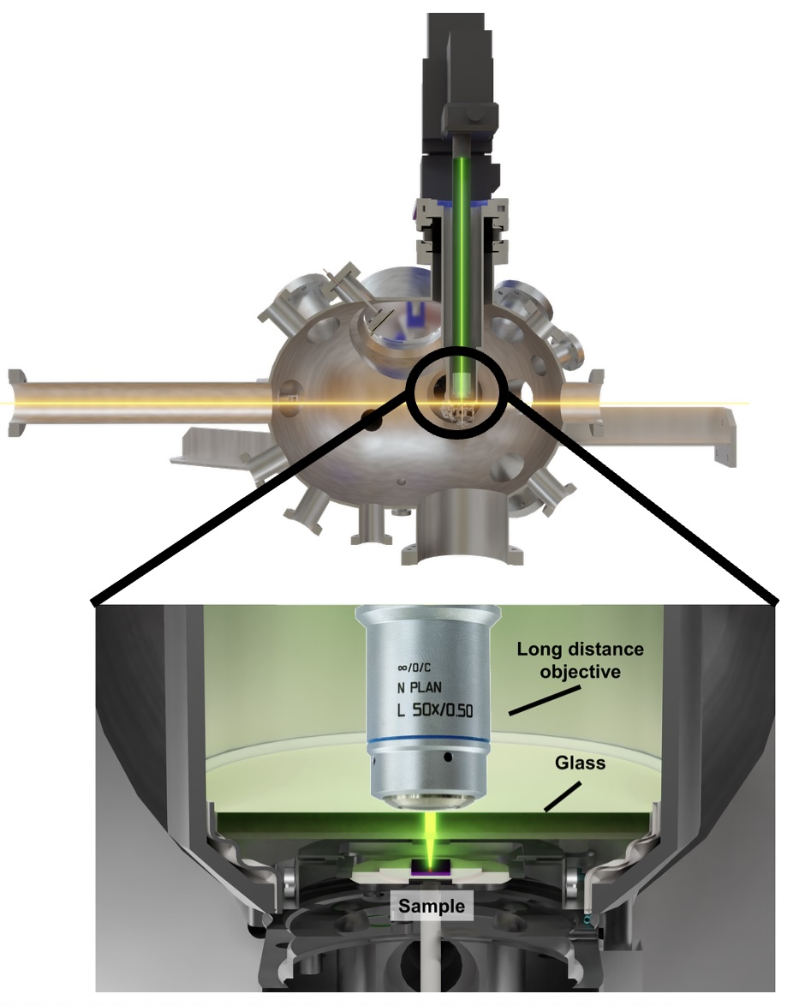
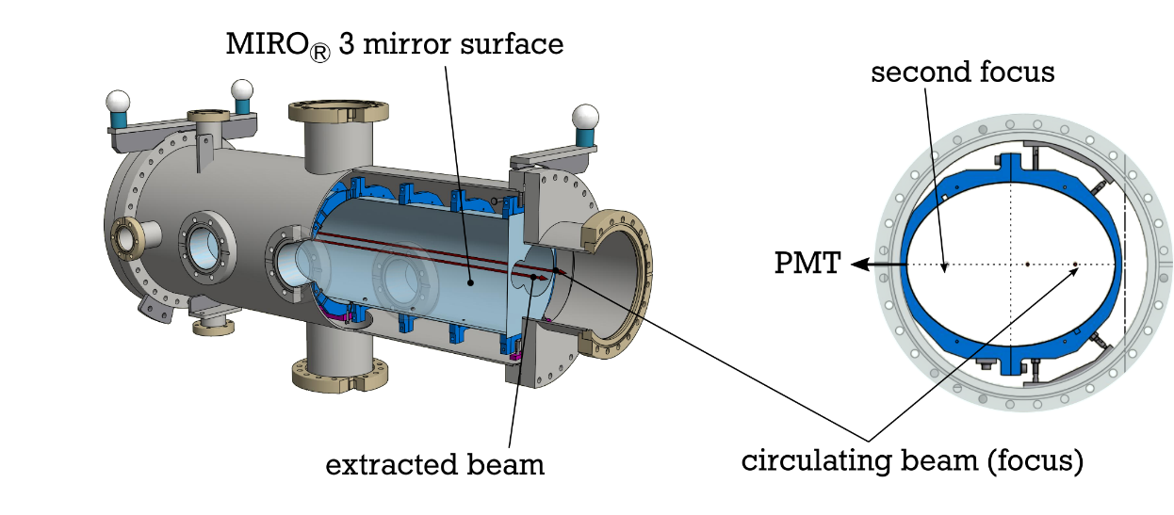
Section YR07: Laser Spectroscopy & Extraction
Laser Spectroscopy of Mg⁺ and Li⁺
Extraction and Raman spectroscopy of Au⁷⁵⁺, 4.8 MeV/u for swift HCI – surface interactions
Lowest possible energy: HCI 0.8 MeV/u, LCI 90 keV/u
K. Mohr, PhD Thesis, TU Darmstadt 2022

Slide 18
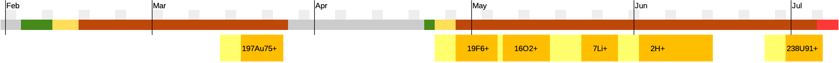
Beamtime Schedule 2025
HITRAP 197Au79+
Easter break
achieved intensity
1⋅10⁷
8⋅10⁶
5 ⋅ 10⁷
5 ⋅ 10⁷
4⋅10⁸
2 ⋅ 10⁶
requested in proposal
5 ⋅ 10⁶
3 ⋅ 10⁶
2⋅10⁷
8⋅10⁶
5 ⋅ 10⁷
1.4⋅10⁶
2021-25 ca. 5 months of beam for experiments, going towards 200 days per year from 2028 onwards
CRYRING@ESR beam is granted by G-PAC when ESR beam
intensity goals and beam quality well under control
New proposals welcome! Especially for local operation.

Slide 19
Low energy, exotic ion beams – Highly charged and heavy Low energy storage ring CRYRING@ESR and HITRAP
CRYRING@ESR
in operation = delivers cooled beam to Experiments
with heavy, exotic and highly charged ions produced at GSI (via ESR)
with local injector : light ions but more beam time available
Exceptionally well controlled beam (cooling, energy, position)
Opportunity for exciting experiments
e.g. at astrophysical energies (100s of keV/u down to several 10 keV/u)
HITRAP
electron cooling of highly-charged ions demonstrated (offline)
Capture of Heavy, Highly-Charged ions in a Penning trap!
First User Experiment Q1/2025: surface implantation of Au⁷⁹⁺ @6 keV/u!
On-Line e-cooling still to be done. Charge state population and energy spread investigation to come.

Slide 20

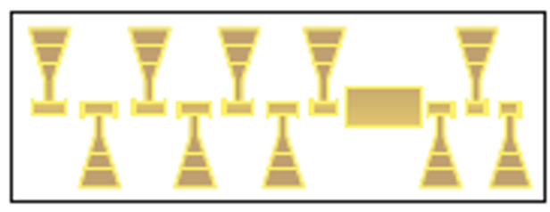


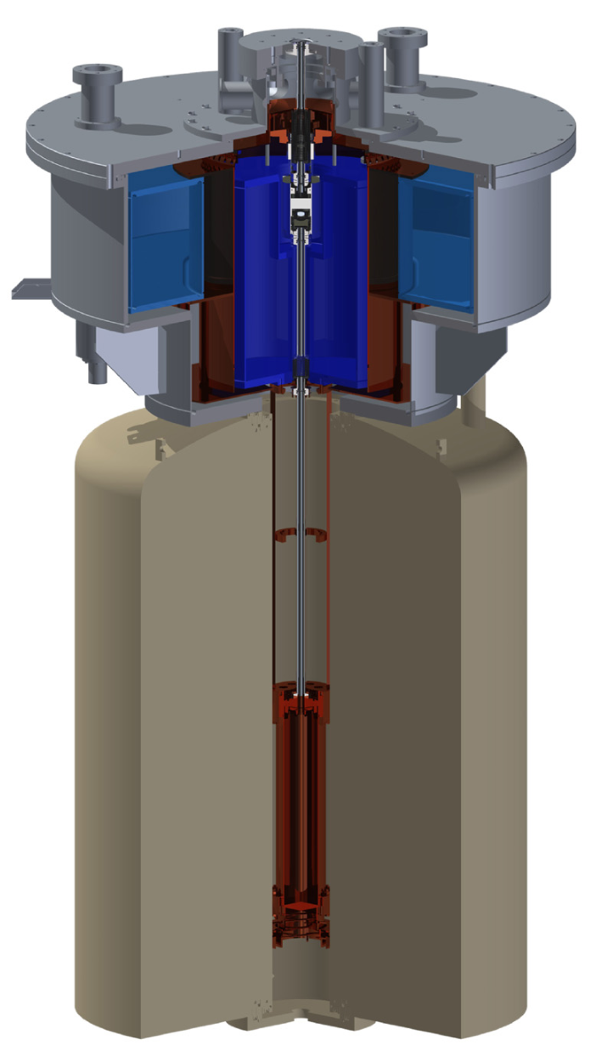
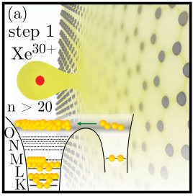
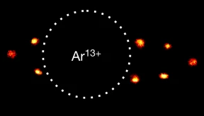
HITRAP facility - overview
EBIT
Experimental stations
Platform
Buncher
IH
RFQ
from ESR
Cooling trap
4MeV/u
500keV/u
6keV/u
~eV/q
~10m
Cave
Optical Clocks with HCI, e.g. Micke, Leopold, King et al., Nature 578 (2020)
g-Factor of Ar¹³⁺, e.g. I. Arapoglou, A. Egl, M. Höcker et al., PRL 122 (2019)
HCI interaction with surfaces, e.g. Wilhelm et al., PRL 119 (2017)

Slide 21
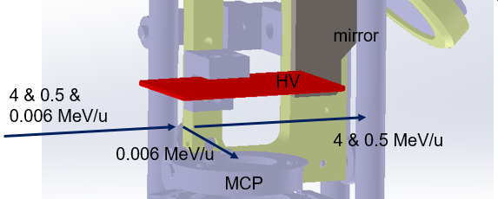
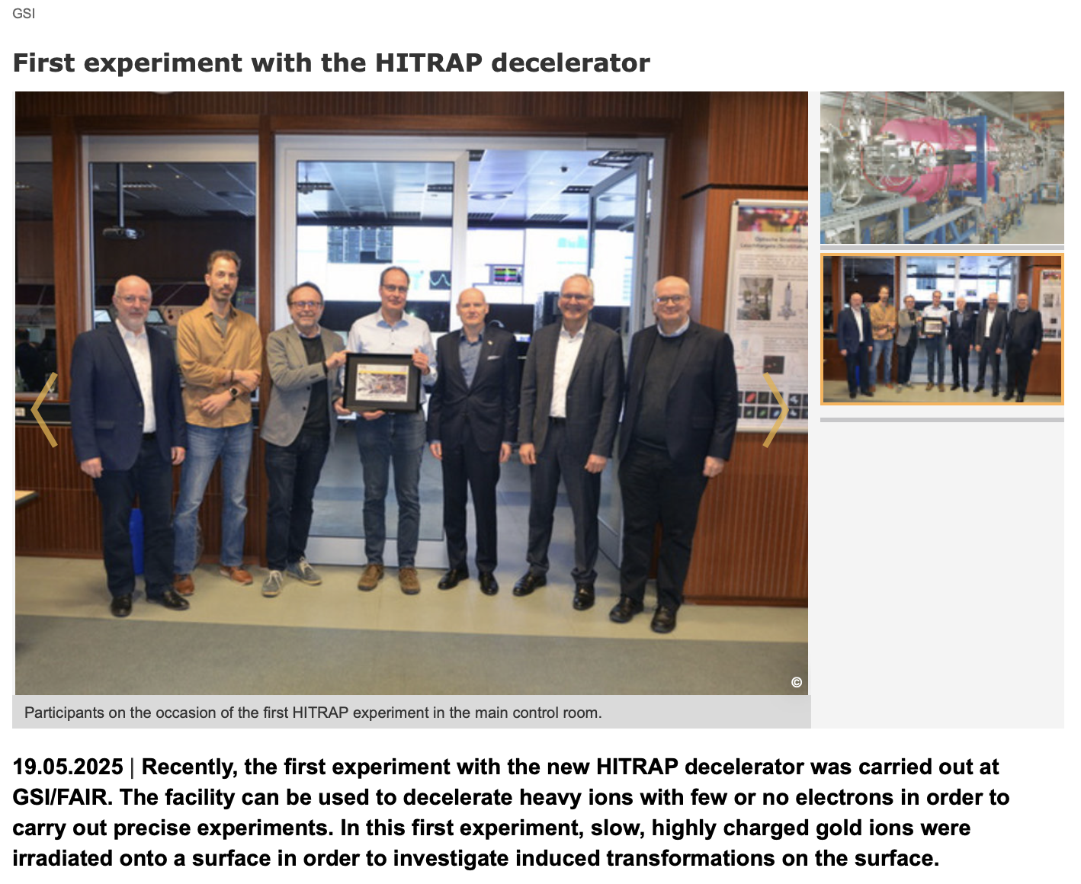
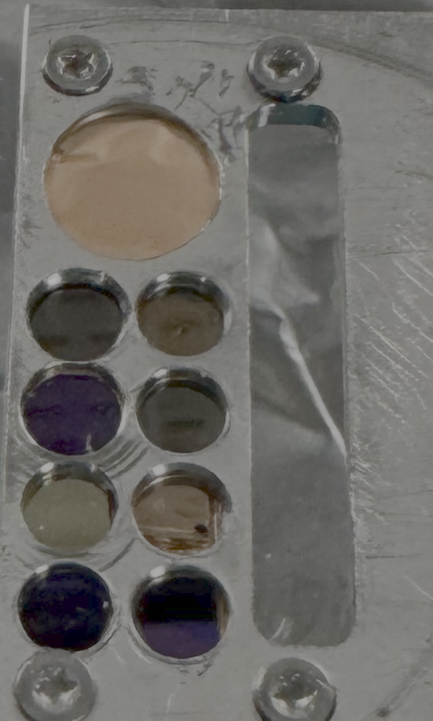
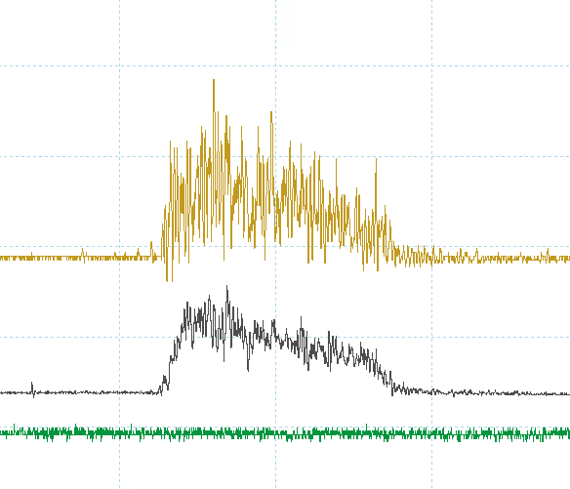
First Experiment with decelerated HCI
Irradiation of solid state surface with Au⁷⁹⁺ ions at only 6 keV/u
6 keV/u only!
Beam to Trap
A. Niggas et al., G-22-00057: Nanostructuring of monolayer graphene by highly charged ions
18 ± 3 keV/q
10⁻¹⁰ mbar

Slide 22
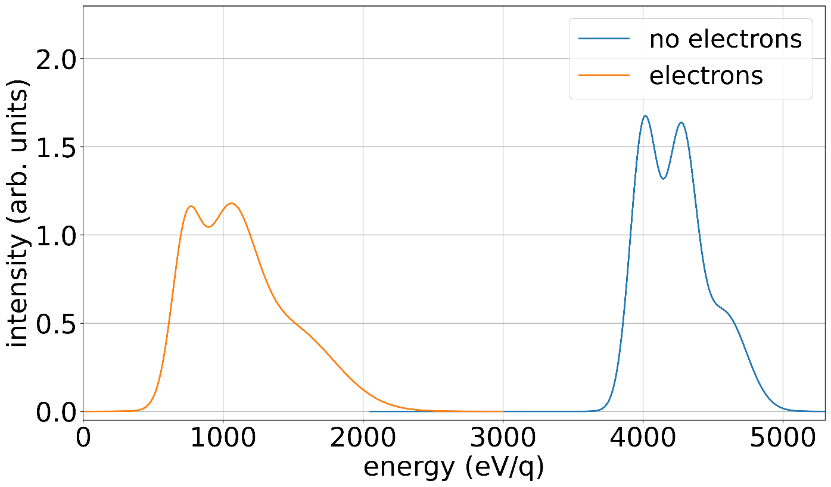
Electron cooling!
6 kV
Ar18+
6 kV
4 keV/q
: HCI
4 keV/q
: HCI
: electron
Coulomb
interaction
0 V
0 V
- 600 V
- 600 V
< eV
First electron cooling of highly charged ions!!
Simon Rausch, Max Horst, Nils Stallkamp, Zoran Andelkovic, Sergiy Trotsenko et al.

