Slide 1
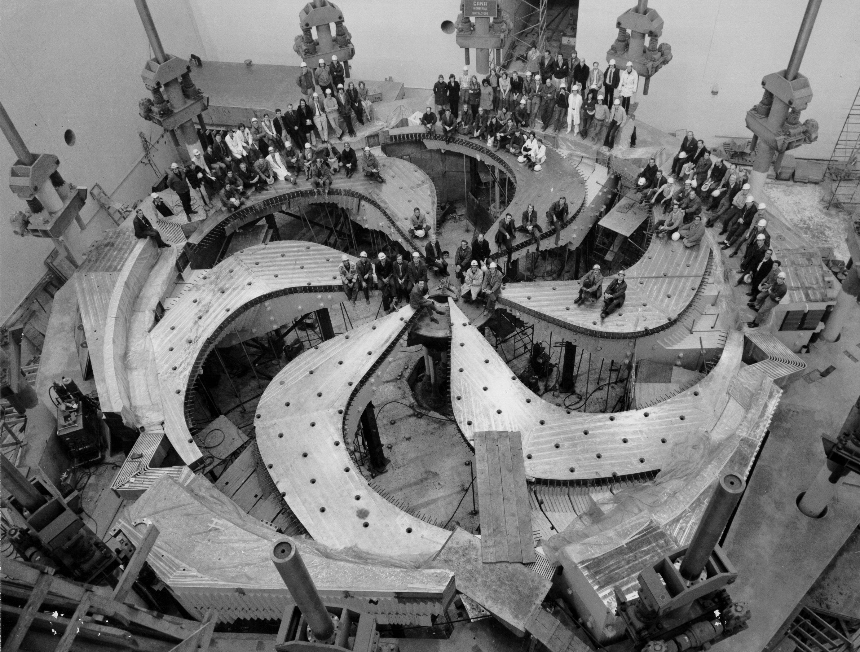
Tripling TRIUMF’s RIB capabilities with the ARIEL facility
Luca Egoriti
Target Physicists
ARIEL Target Stations Project Co-Lead
EMIS-XX, October 20th, 2025, Whistler, Canada

Slide 2
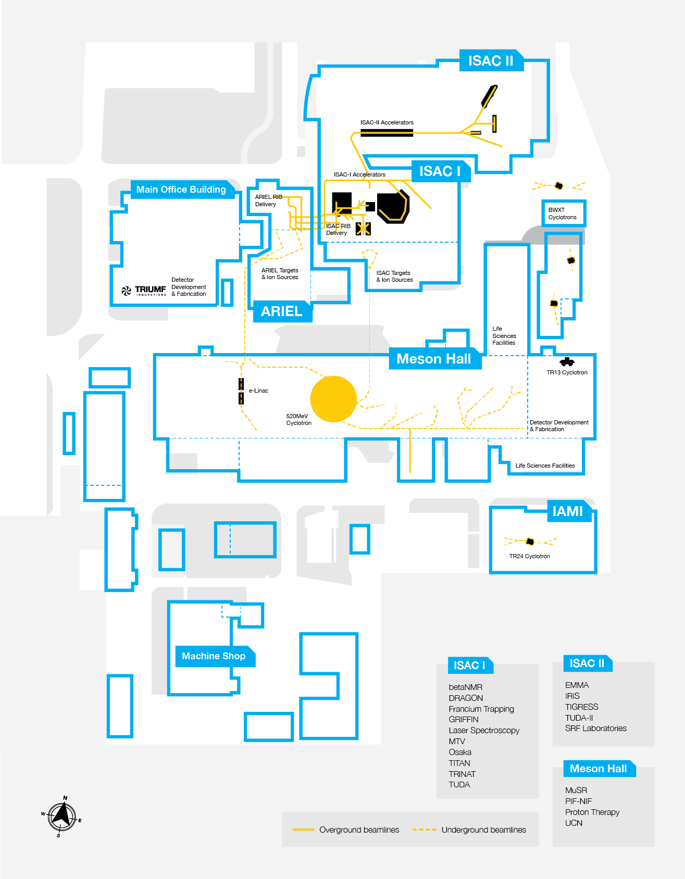


Slide 3
User facilities
Cyclotron & beamlines (since ~1975)
TRIUMF accelerators
ISAC ISOL targets (since 2000s)
RIB lines
ARIEL ISOL targets (from 2027)
E-linac and beamline (since ~2013)
Radioactive Ion Beams
~10 user facilities
Nuclear & atomic physics
Material science
Spectroscopy γ, β, n (GRIFFIN and DESCANT, LE)
Precision mass measurements (TITAN, LE)
β-NMR (LE)
Atomic laser trap (TRINAT, LE)
Recoil separator (DRAGON, ME)
Recoil detector (TUDA, ME)
Radiochemistry (ASPIRE, ME)
Gamma-ray spectrometer (TIGRESS, HE)
Recoil separator (EMMA, HE)
Recoil detector (IRIS, HE)
ISAC I and II halls
Medical isotopes
ISOL
(ARIEL)
TR: 13
APTW
AETE
TR: 30-1
TR: 30-2
ISOL
(ISAC)
TR: 24
120 MeV – 10 nA
Electronics irradiations
Proton FLASH
Ocular melanoma treatments (-2019)
ITW
ITE
PIF
Neutron Irradiations
BL2A
NIF
⁸²Sr medical production
STF
BL2C
Muons for
material science
²²⁵Ac et al. production
T1
T2
IPF
30 MeV – 10 mA
e- LINAC
500 MeV – 400 μA
P+ Cyclotron
BL1A

Slide 4
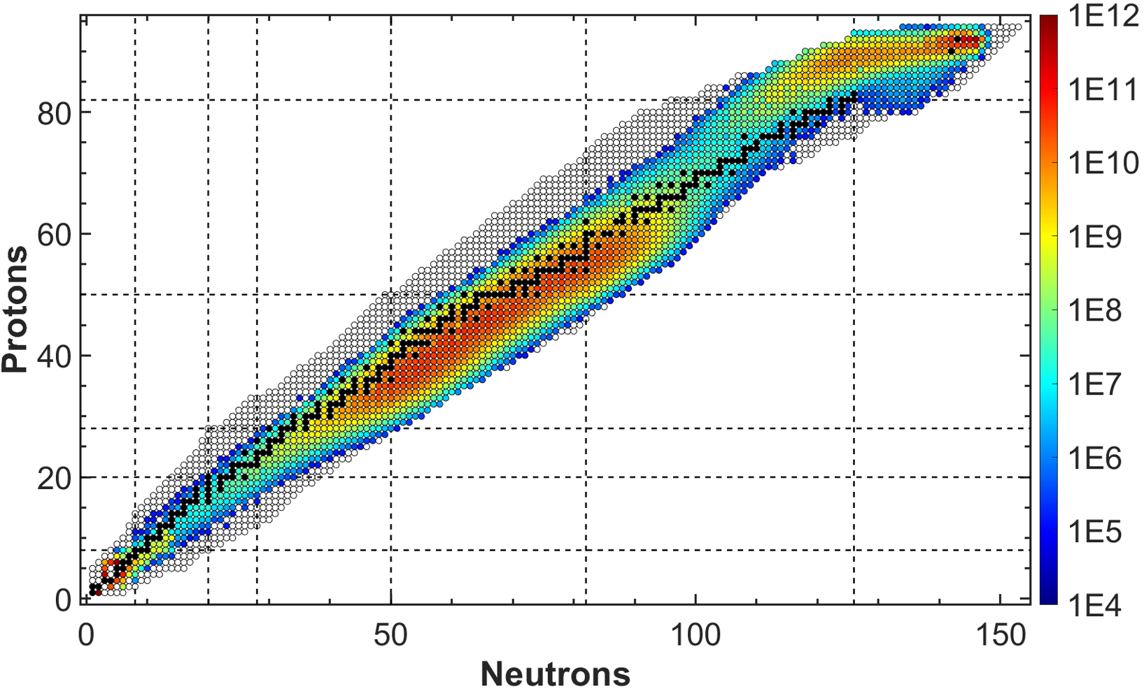
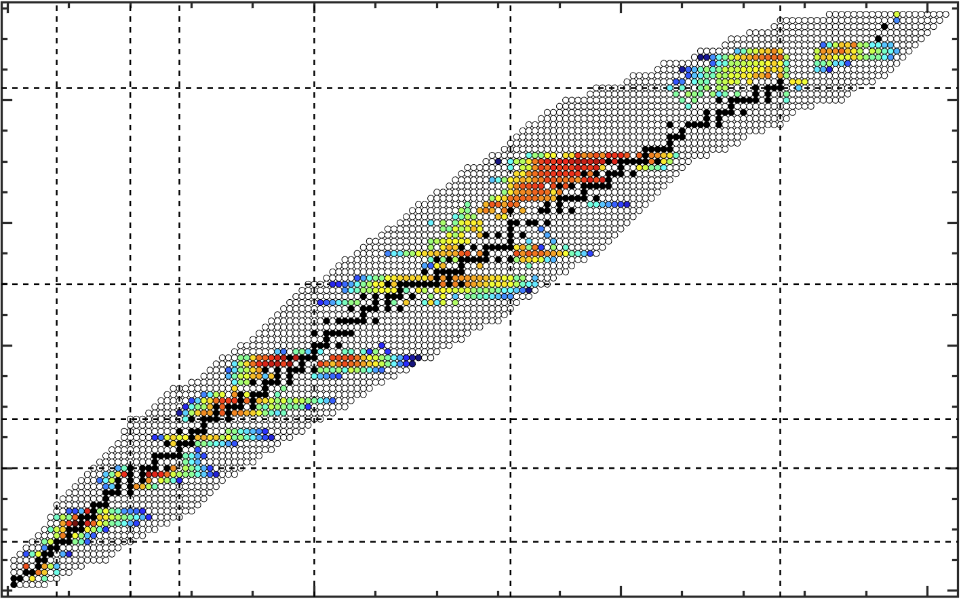
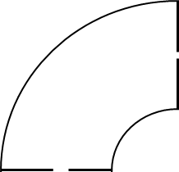
ISOL targets for RIB production
[pps]
Mass separator
Post-accelerator
Low energy experiments
High energy experiments
Radioactive
Ion
Beam
18 m
Extraction electrode
Medium E: RFQ + DTL
  0.117 MeV/u to 1.8 MeV/u
High E: SC linac
  6 MeV/u up to 16 MeV/u
HV ~60 kV
Ionizer
Target
T=2000 °C
Neutrals
Isobars only
500 MeV – 100 μA
P+ Cyclotron
Ions
Post-accelerated
20 cm

Slide 5
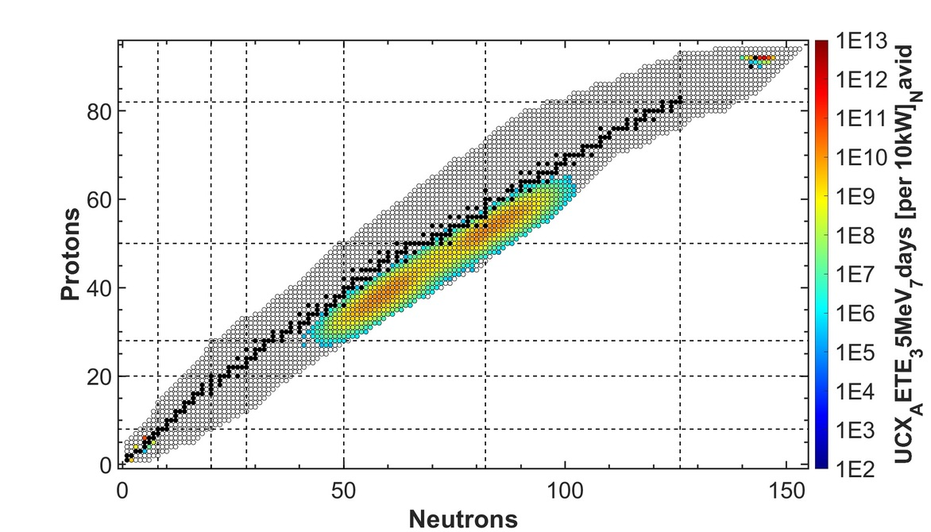
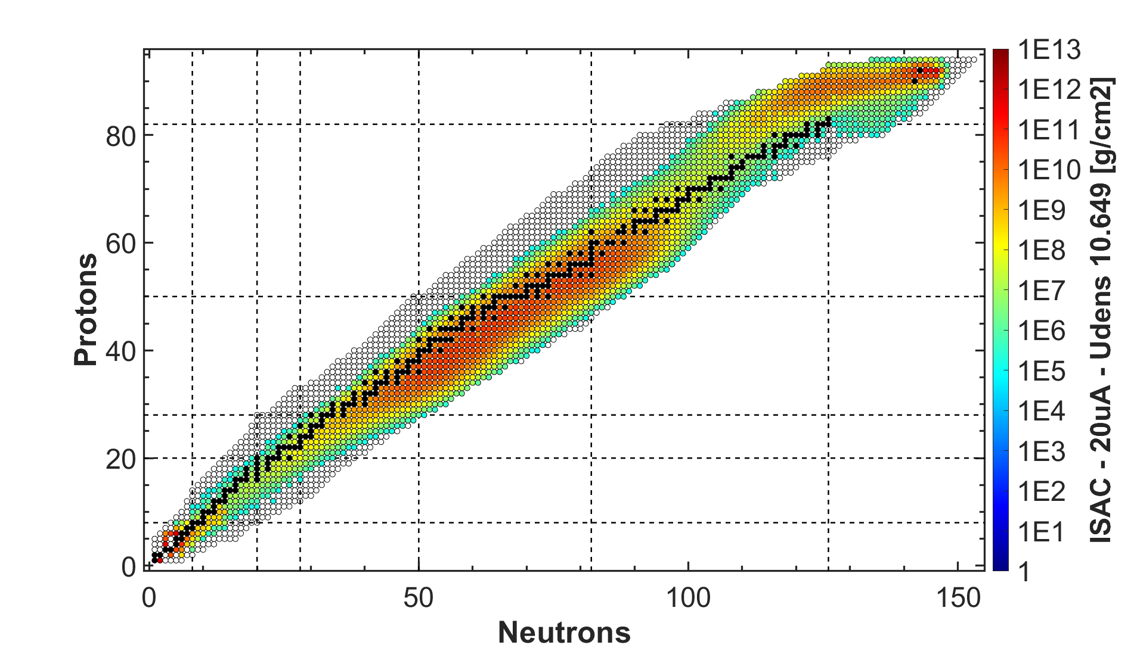
Three parallel RIBs once ARIEL is operational
ISAC I and ISAC-II halls
[1/s]
[1/s]
x 2
30 MeV – 10 mA
e- LINAC
ARIEL - AETE
ARIEL - APTW
ISAC
500 MeV – 100 μA
P+ Cyclotron

Slide 6

User facilities
Cyclotron & beamlines (since ~1975)
RIBs from electrons: How?
ISAC ISOL targets (since 2000s)
RIB lines
ARIEL ISOL targets (from 2027)
E-linac and beamline (since ~2013)
[1/s]
Radioactive Ion Beams
~10 user facilities
Nuclear & atomic physics
Material science
Medical isotopes
ISAC I and II halls
ISOL
(ARIEL)
TR: 13
APTW
TR: 30-1
AETE
TR: 30-2
Current ISAC Future APTW
ISOL
(ISAC)
CP: 42
120 MeV – 10 nA
Electronics irradiations
Proton FLASH
Ocular melanoma treatments (-2019)
ITW
ITE
PIF
TR: 24
[1/s]
Neutron Irradiations
BL2A
NIF
γ
γ
e-
e-
BL2C
Muons for
material science
²²⁵Ac et al. production
Ion Source
T1
T2
Ion Source
IPF
30 MeV – 10 mA
e- LINAC
Future AETE
500 MeV – 400 μA
P+ Cyclotron
BL1A
Converter
Target
Converter
Target

Slide 7
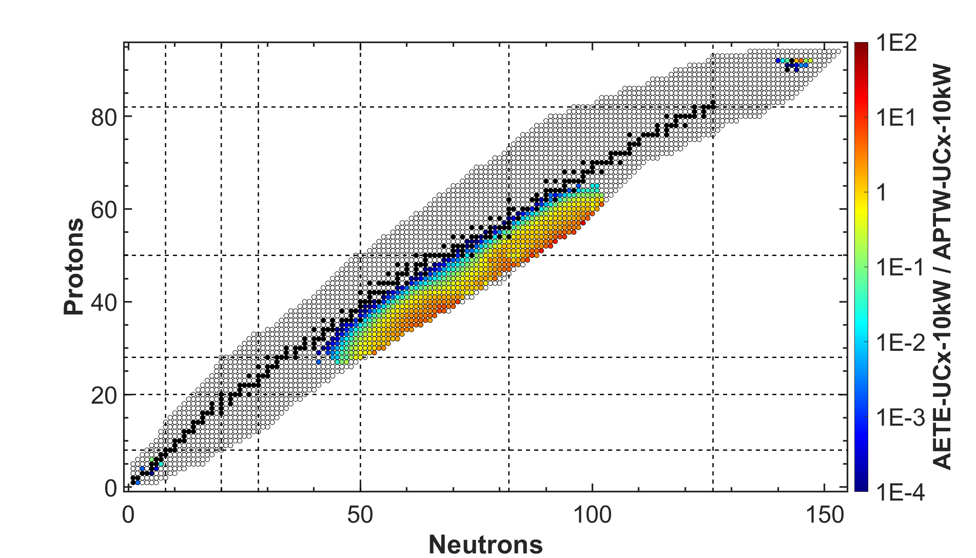
User facilities
Cyclotron & beamlines (since ~1975)
RIBs from electrons: How?
ISAC ISOL targets (since 2000s)
RIB lines
ARIEL ISOL targets (from 2027)
E-linac and beamline (since ~2013)
[1/s]
Radioactive Ion Beams
~10 user facilities
Nuclear & atomic physics
Material science
Medical isotopes
ISAC I and II halls
ISOL
(ARIEL)
TR: 13
APTW
TR: 30-1
AETE
TR: 30-2
Current ISAC Future APTW
ISOL
(ISAC)
CP: 42
120 MeV – 10 nA
Electronics irradiations
Proton FLASH
Ocular melanoma treatments (-2019)
ITW
ITE
PIF
TR: 24
[1/s]
Neutron Irradiations
BL2A
NIF
γ
e-
BL2C
Muons for
material science
²²⁵Ac et al. production
T1
T2
Ion Source
IPF
30 MeV – 10 mA
e- LINAC
Future AETE
500 MeV – 400 μA
P+ Cyclotron
Converter
Target

Slide 8
ARIEL target station concept
And comparison to the operational ISAC facility

Slide 9
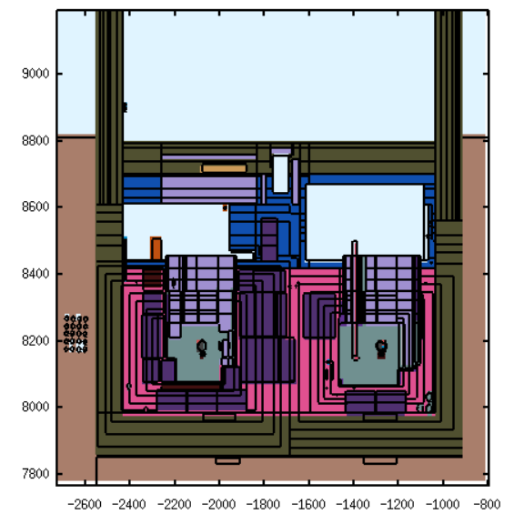
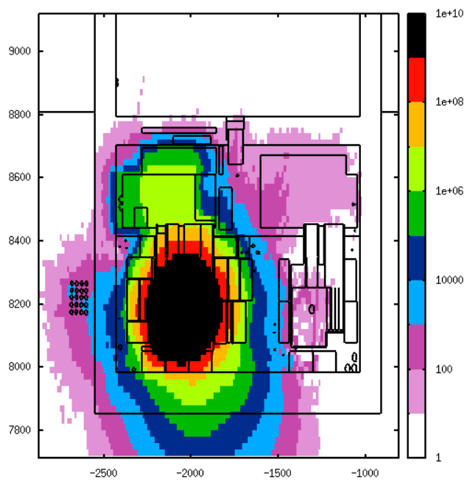

Compact, modular shielding approach – similar to ISAC
P⁺ beam on APTW at 100 µA
[µSv/h]
~2m tall
Steel + Concrete
~2.5m tall
Steel “plugs”
APTW target
AETE target

Slide 10

ISAC target lifetime and sequence
Three weeks irradiation
One week cooldown
Hands-on service disconnection
Move module to Hot Cell
Remote target exchange in Hot Cell
Move module to irradiation station
Hands-on service connection
Few days pump-down
Three weeks irradiation
ISAC
Irradiation station
ISAC
Hot Cell
Service connections
Shielding
Shielding
Approx. two-three weeks without beam on one station
RIB
ISAC
ITW
ITE
Front end
+
Target
Front end
+
Target
Vacuum volume

Slide 11
ARIEL target lifetime and sequence
Three weeks irradiation
Few hours of cooldown
Remote vacuum disconnection
Move target to spent target vault
Move new target to irradiation station
Remote vacuum connection
Few hours pump-down
Three weeks irradiation
ARIEL
Irradiation station
Target hall
Service connections
Shielding
Approx. two days without beam on one station
Spent target vault
Front end
+
Target
(New) Target
Target
Vacuum volume

Slide 12
ISAC vs ARIEL target exchange
ISAC
ARIEL
Three weeks irradiation
One week cooldown
Hands-on service disconnection
Move module to Hot Cell
Remote target exchange in Hot Cell
Move module to irradiation station
Hands-on service connection
Few days pump-down
Three weeks irradiation
Three weeks irradiation
Few hours of cooldown
Remote vacuum disconnection
Move target to spent target vault
Move new target to irradiation station
Remote vacuum connection
Few hours pump-down
Three weeks irradiation
Approx. two-three weeks without beam on one station
RIBs
Approx. two days without beam on one station
APTW
ISAC
ITW
ITE

Slide 13
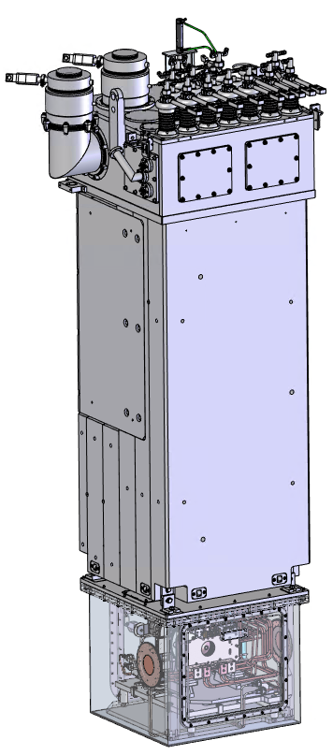
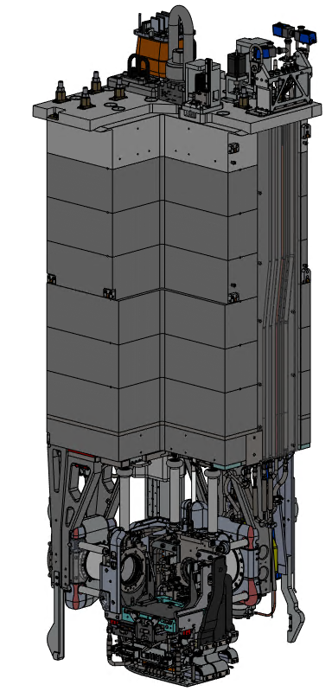
ISAC vs ARIEL target module – services
Service connections
Service connections
Shielding
Shielding
Front end
+
Target
Front end
+
Target
Vacuum volume
Vacuum volume
All services routed within tall vacuum volume
All services routed in GN₂

Slide 14
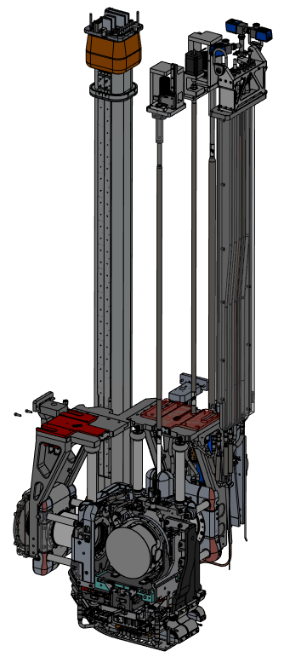
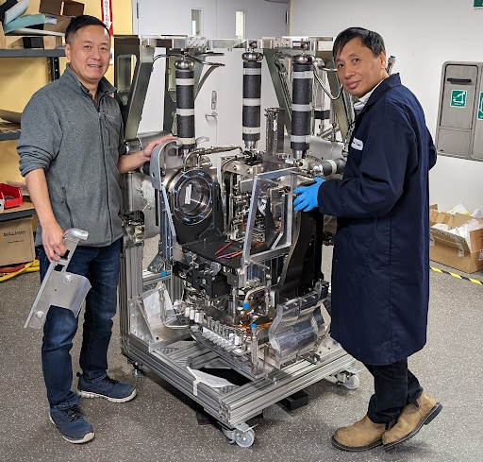
ARIEL target module – services
Ground services: roughing line, water cooling
Actuation: GND electrode movement, Gate Valves (x2)
High Voltage Feed Through (HVFT)
Front End:
  Beam lines connections
  Structural supports (HV breaks)
  “Last meter” service delivery
  Pneumatic target vessel engagement mechanism
Hermetic Target Vessel (HTV)

Slide 15
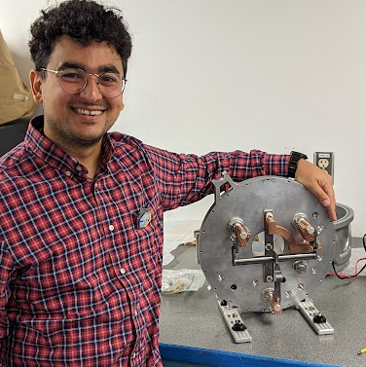
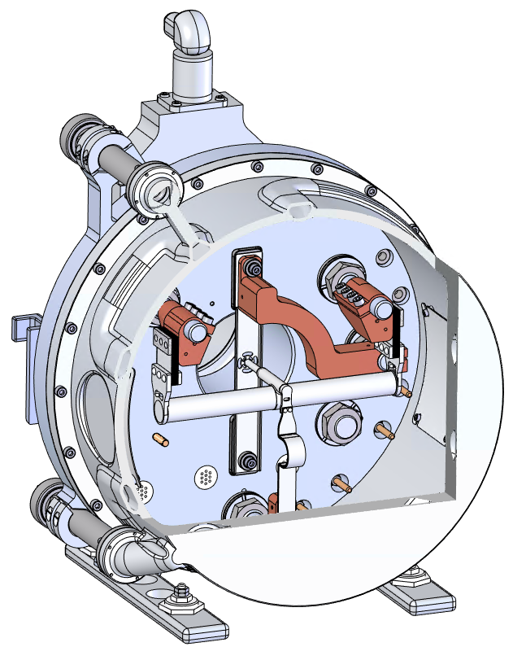
Hermetic Target Vessel (HTV) capabilities
APTW HTV
ISOLDE-style, high-power target vessel
Improved DC current delivery
  Increasing temperature
  Thicker target heaters to reduce likelihood of breaking
  Bigger diameters possible
  Compatible with beam rastering (rotating)
Mass markers for offline/pre-delivery tuning
Gas injection
  For plasma ion source (FEBIAD)
  To support radioactive molecule production
All-metal sealing solution is possible
50 kW protons @ 500 MeV
Gate valve
See Navid’s poster
HTV
back plate
HTV cup
Gas injection
P⁺ beam window
Mass markers conductors
Feet for landing
Ion source
Target

Slide 16
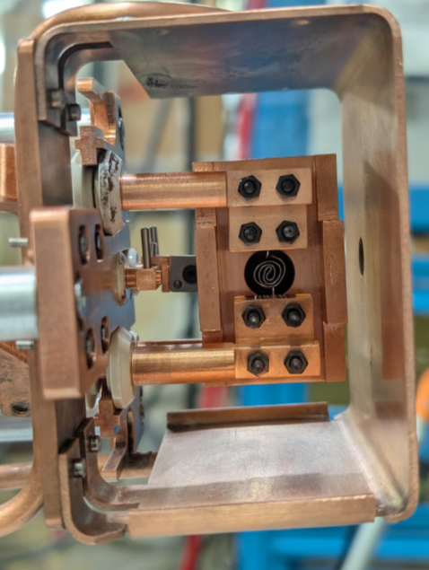
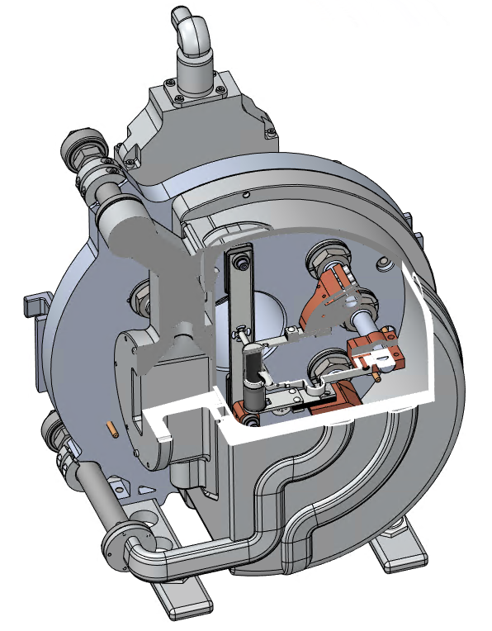
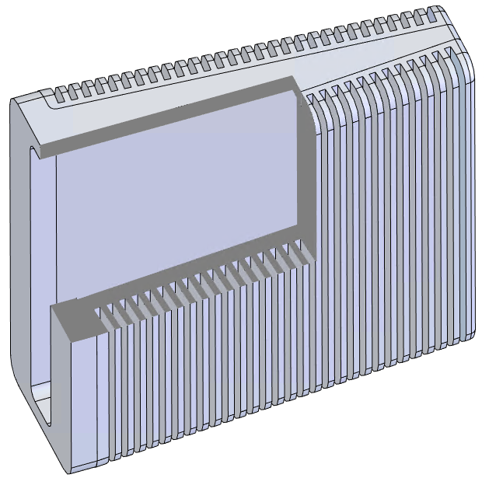
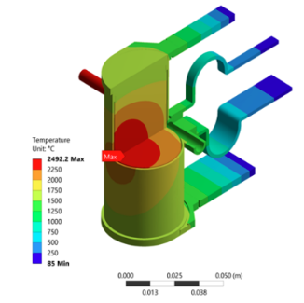
AETE HTV, target and converter
100 kW electrons @ 30 MeV
AETE HTV
AETE converter
See Navid Noori’s poster
e-
e-
See Sundeep Ghosh’s poster
γ
e-
Ion Source
Converter
Target
25 kW e⁻ beam power

Slide 17
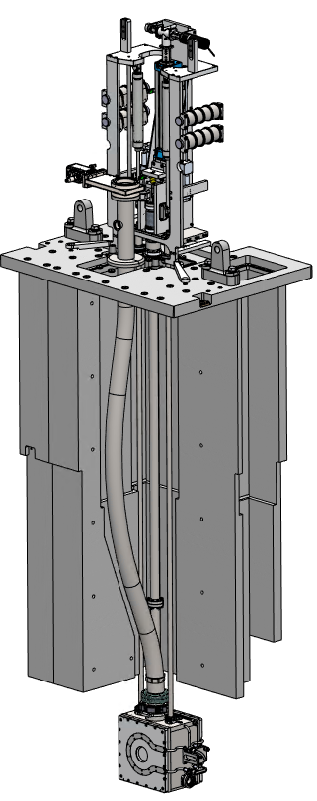
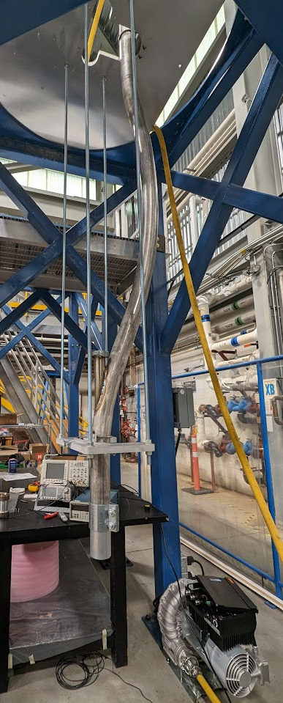
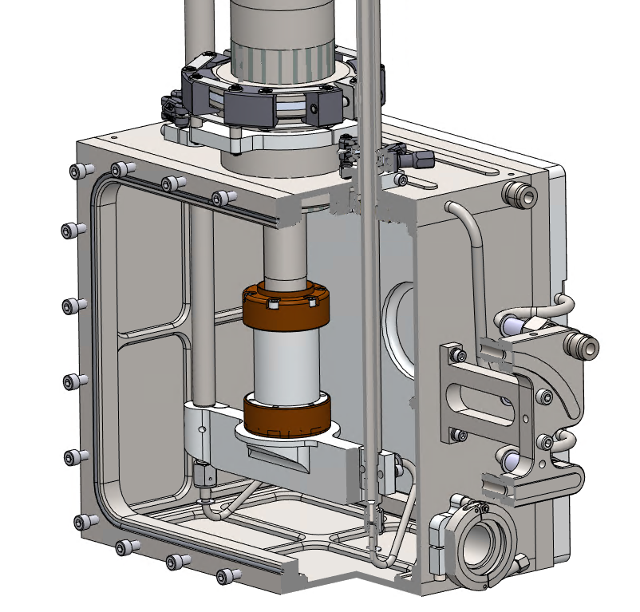
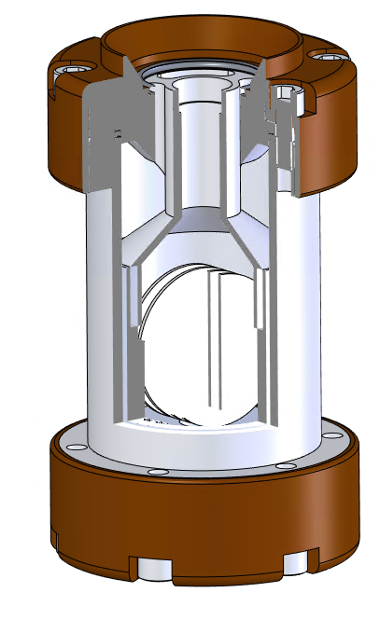
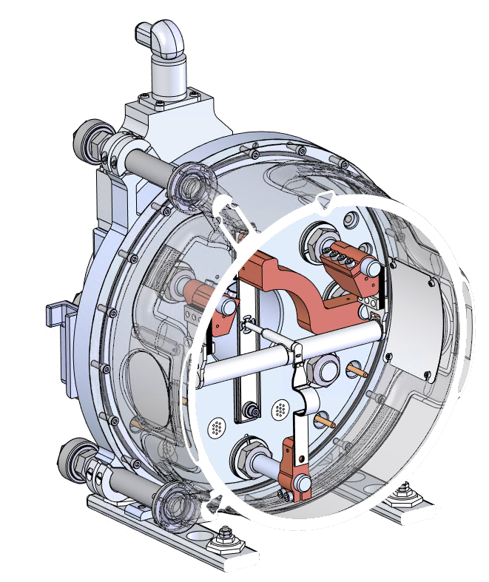
Medical facility for ²²⁵Ac production
Hundreds of co-produced isotopes including
²²⁵Ra, ²²⁵Ac, ²²⁴Ra, ²²³Ra, ²¹³Bi, ²¹²Pb, ²¹²Bi
Few tens of GBq of ²²⁵Ac produced per week, 10d after EoB
Pneumatically transferred into hot cell for extraction
APTW medical rabbit and enclosure
Medical module
ISOL vessel

Slide 18
Timeline
Today
2025
2026
2027
2028
Q1
Q2
Q3
Q4
Q1
Q2
Q3
Q4
Q1
Q2
Q3
Q4
Q1
Q2
Q3
Q4
Fixed Shielding
Fixed Shielding Construction Complete
Construction
Station
Infrastructure
Proton station ready to receive modules
Electron station ready to receive modules
ARIEL-II: Proton & Electron Stations
Proton Station Modules
Modules ready to install
Electron Station Modules
Modules ready to install
Driver Beam Lines
BL4N and electron line installed
Therapeutic Isotopes
Medical Module & Target
Medical module ready to install
ARIEL Operations
Ramp up
Ready for beam commissioning on both stations
Commiss. with beam and Ops
Shutdown of operations during 2026

Slide 19
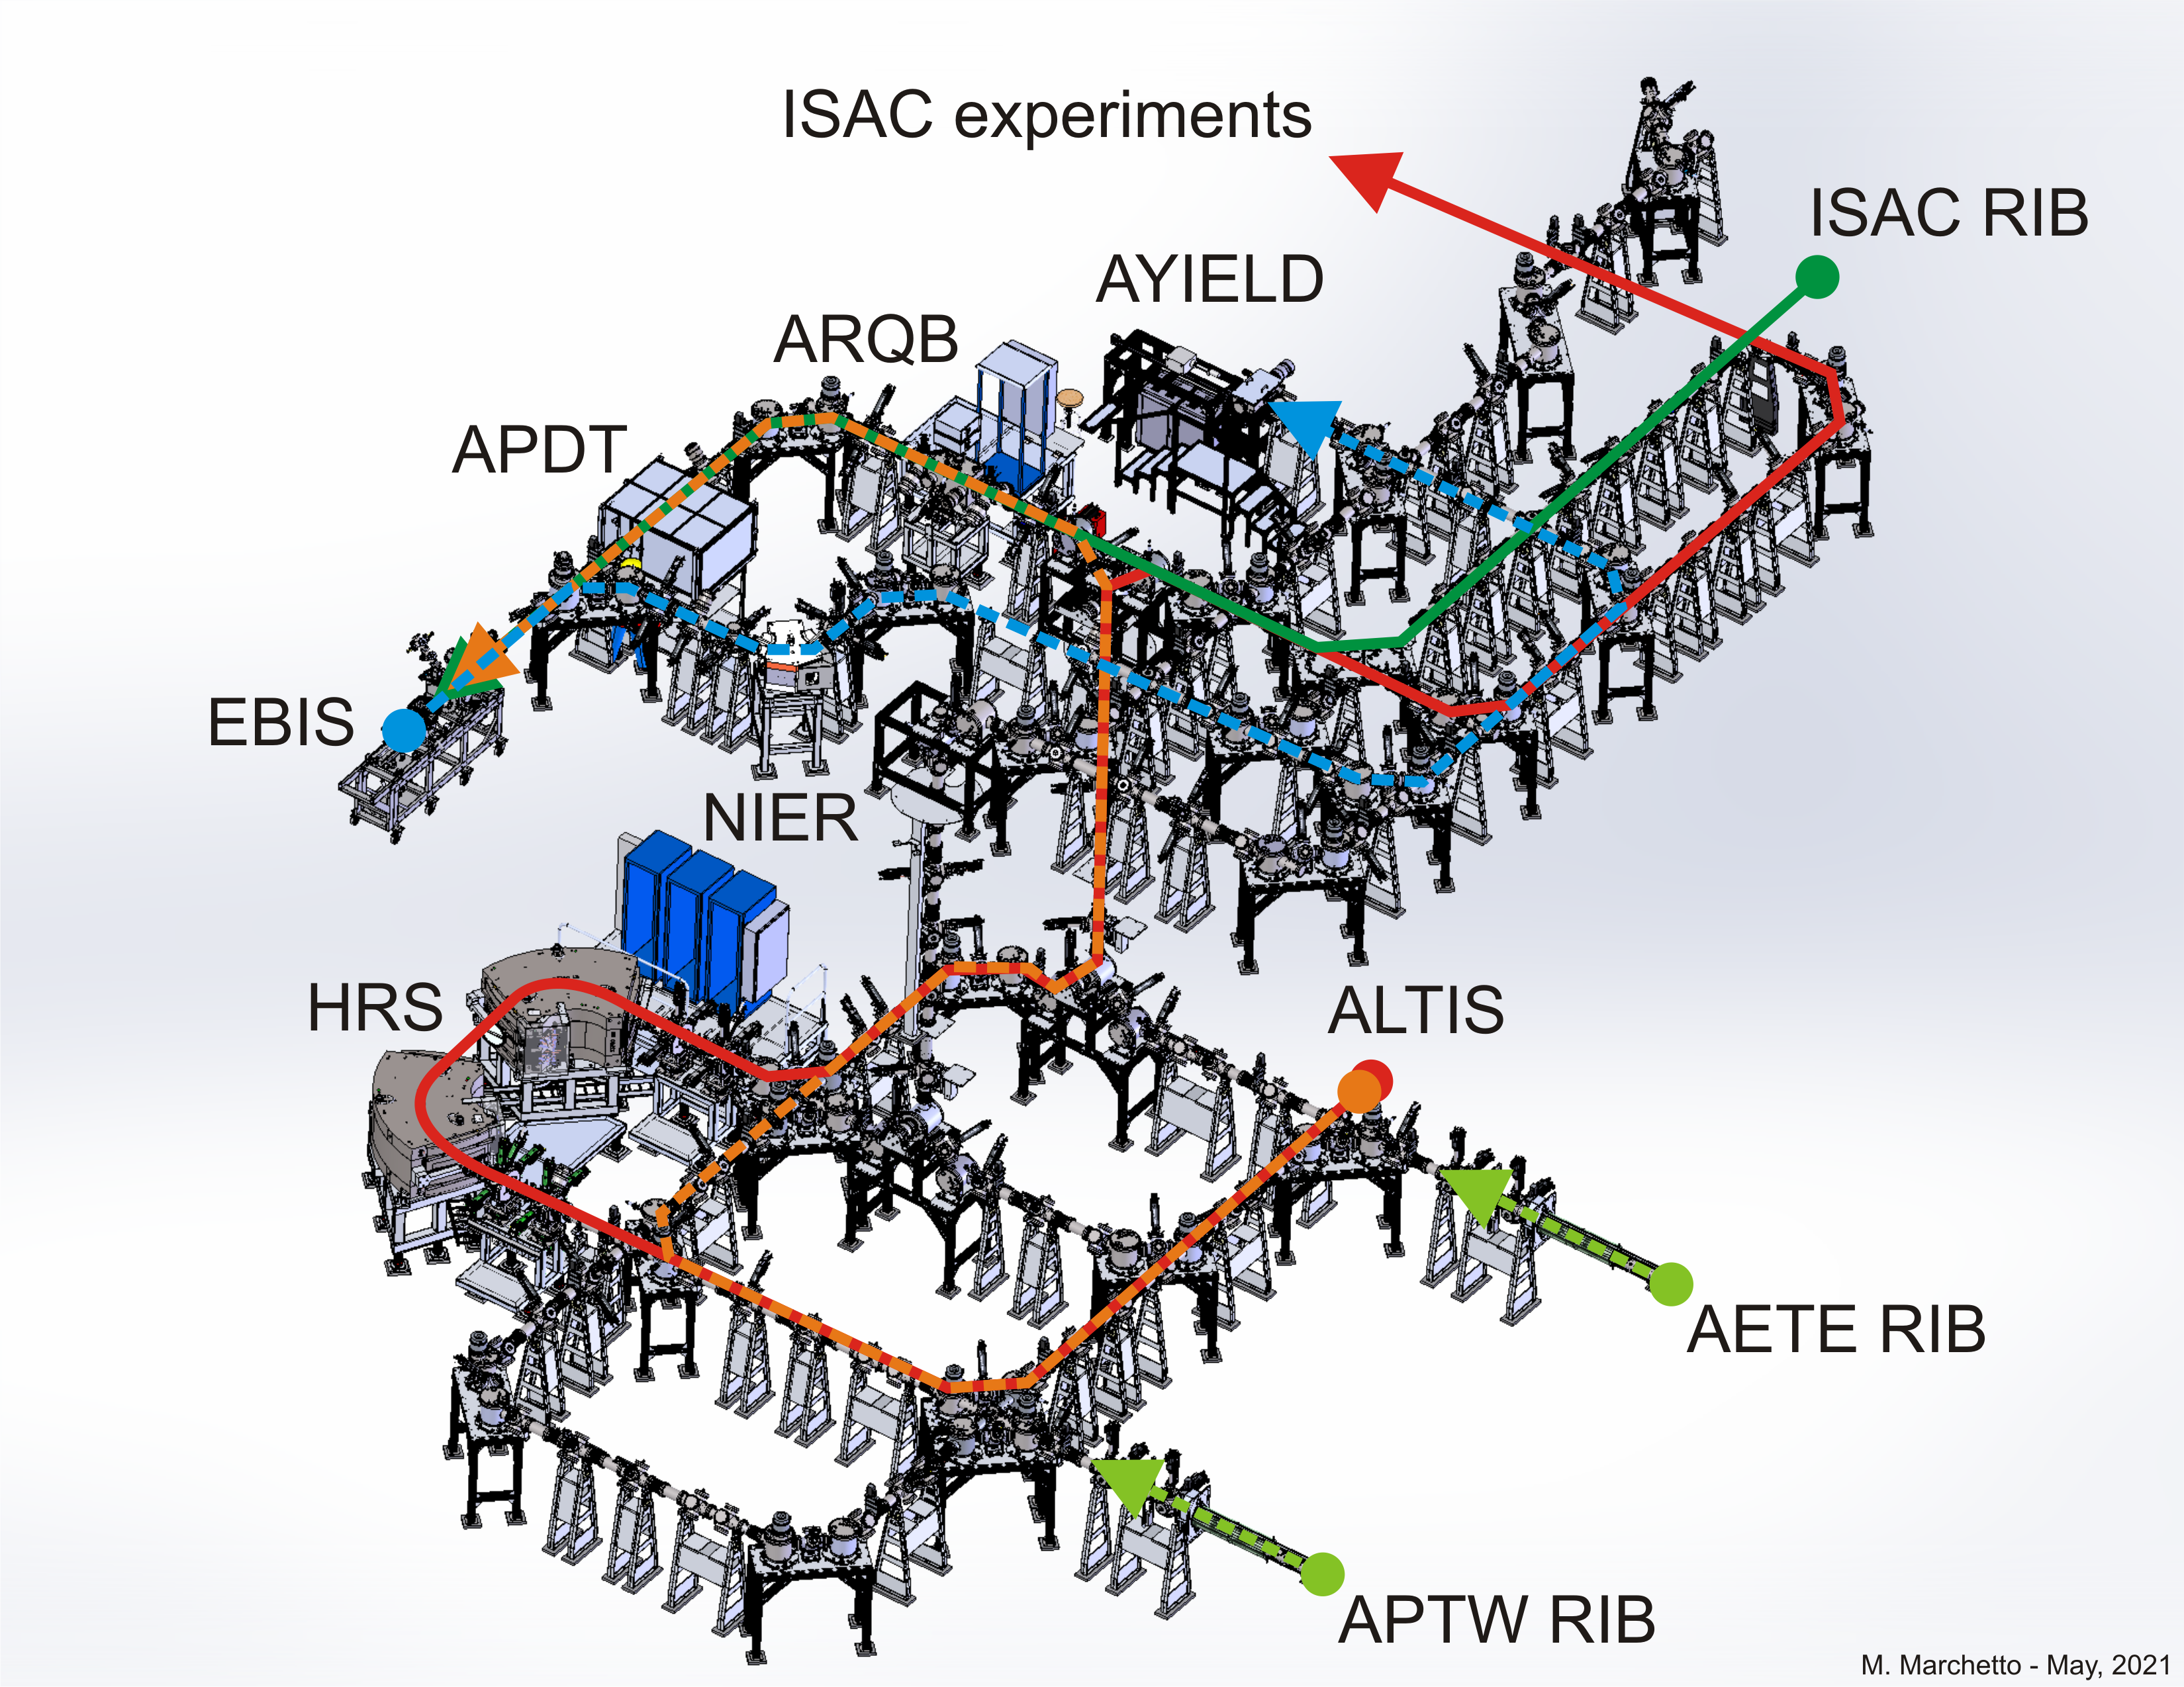
TRIUMF expanded RIB program
Three RIBs production target stations
  2 x 50 kW protons and 1 x 100 kW electrons
Multi-user operation
  Up to three simultaneous radioisotope beams
  Up to 9000 RIB hours
More efficient post acceleration
  Charge state breeder + Nier-spectrometer
  Unique Δm/m 1/20,000 high resolution separation
Medical Isotopes
  Production of ²²⁵Ac in ARIEL proton target station

Slide 20
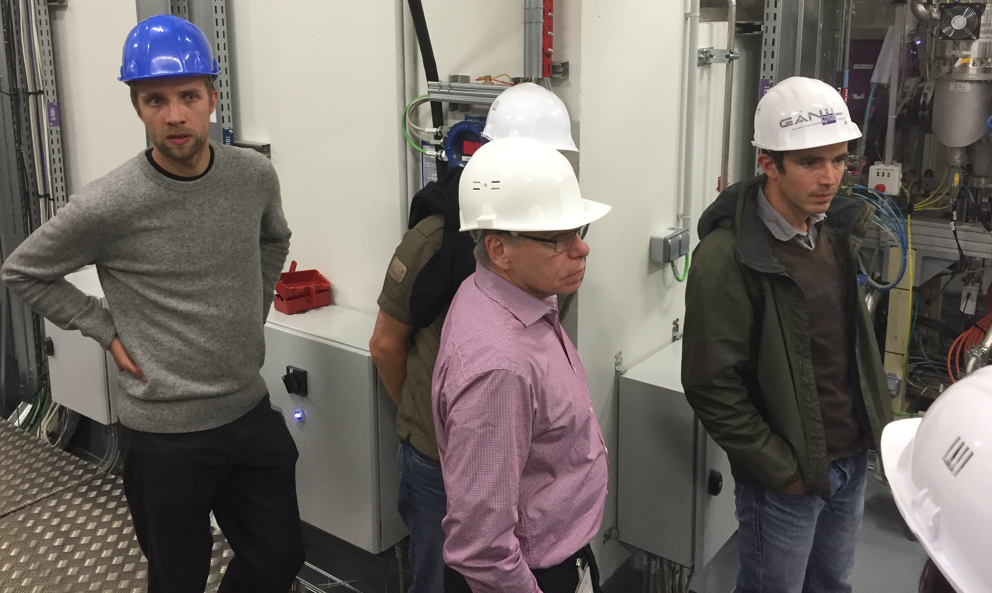
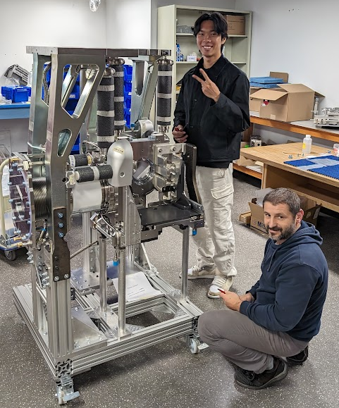
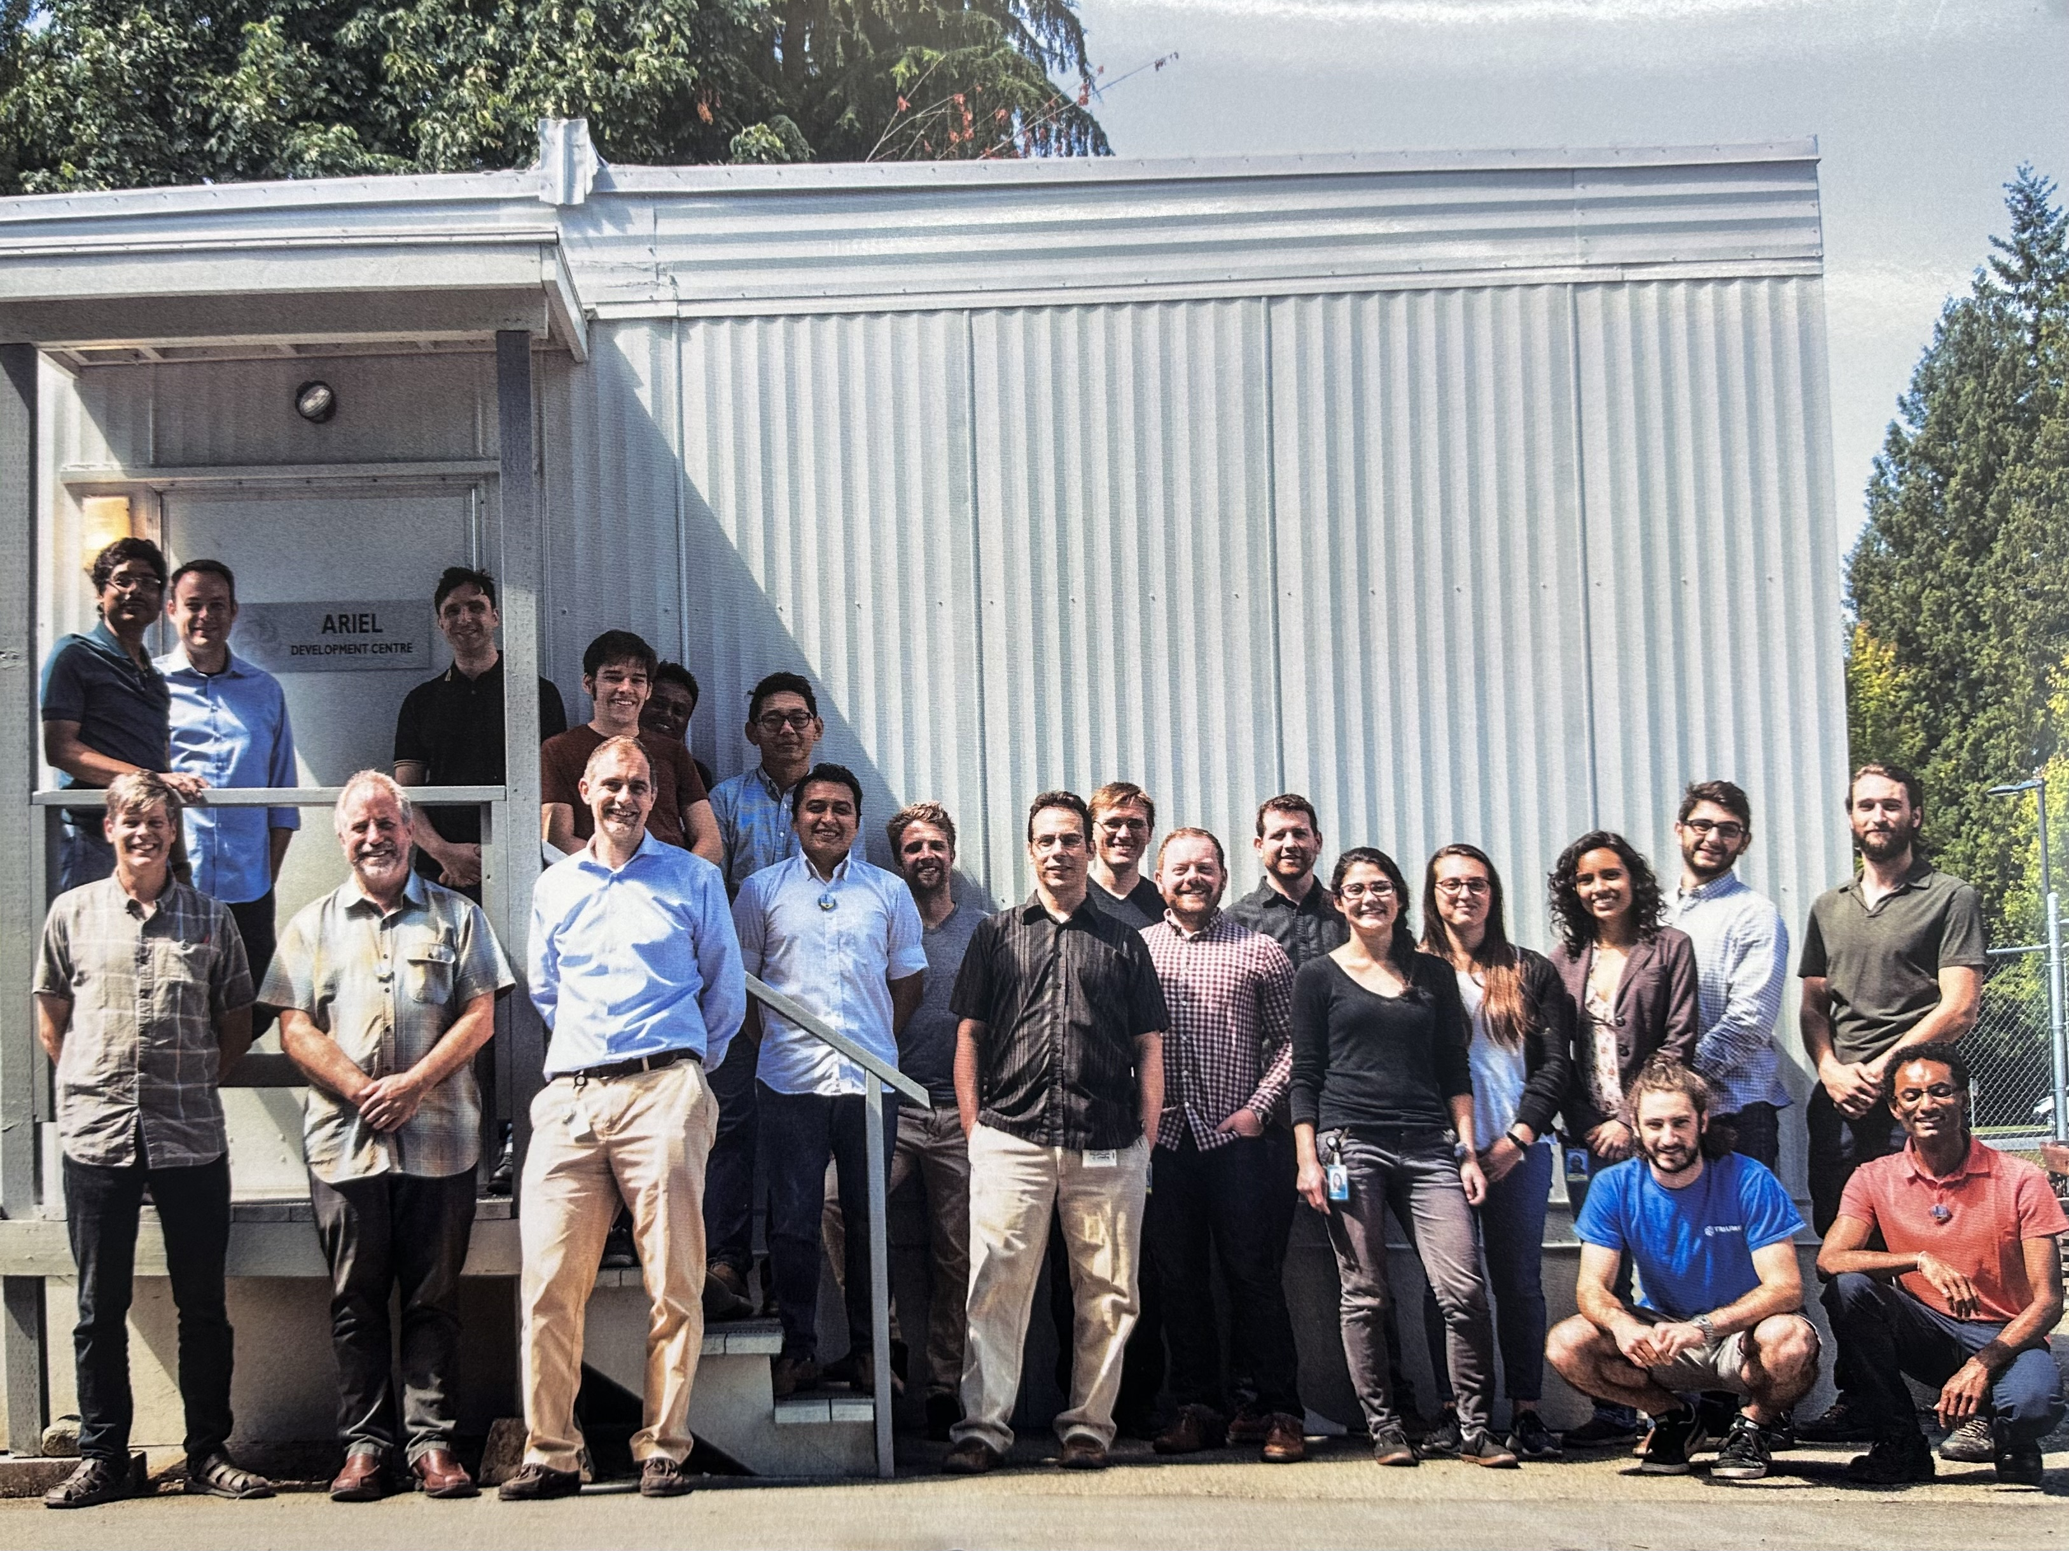
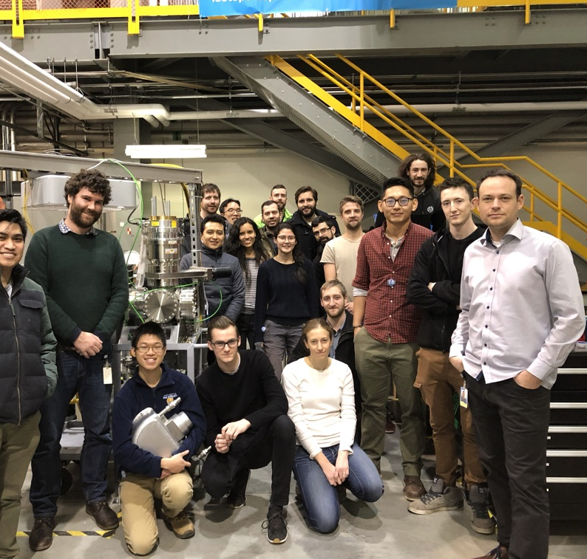
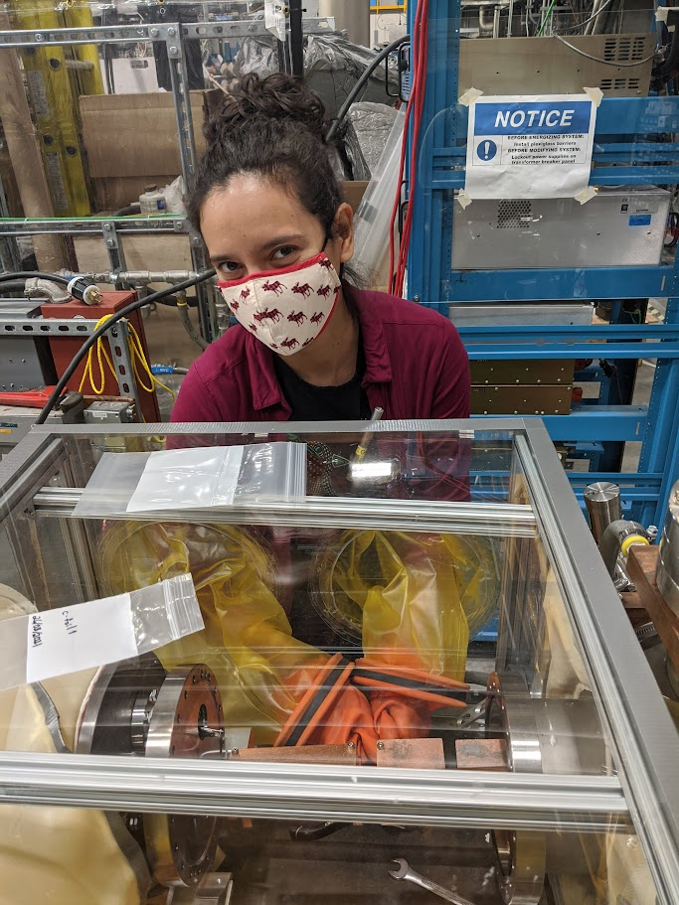
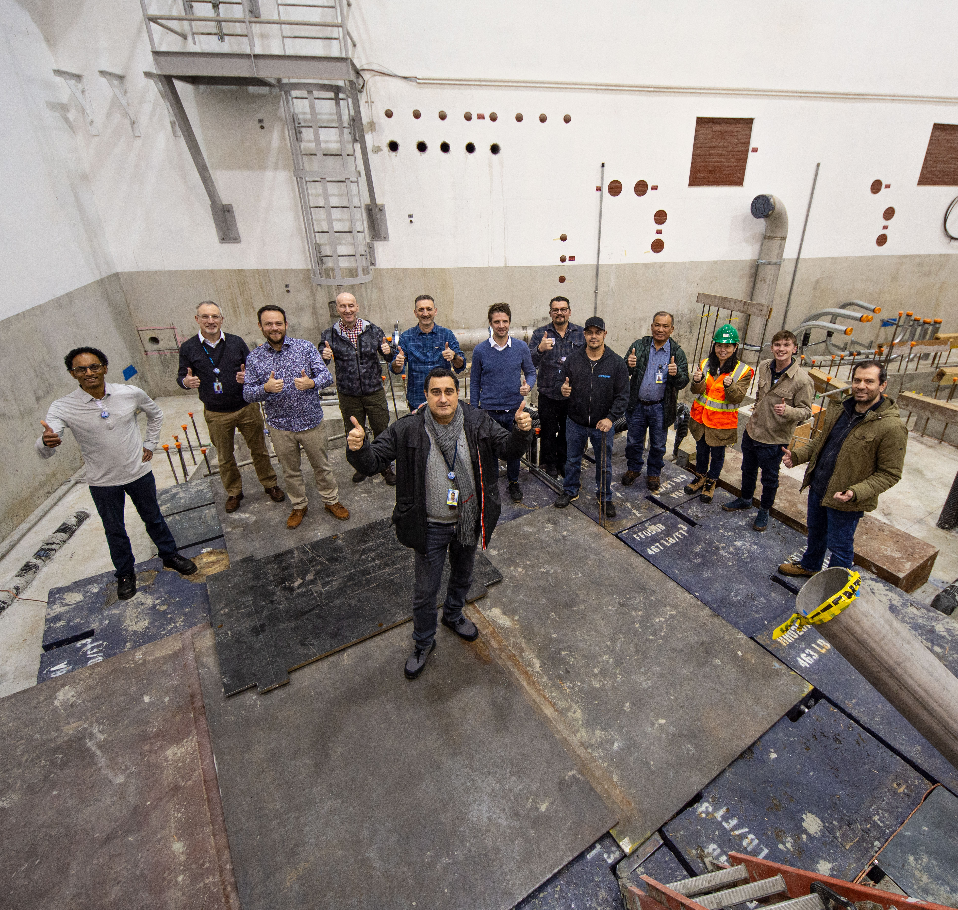
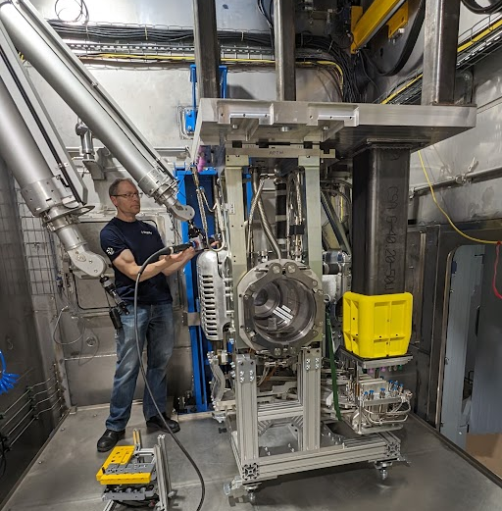
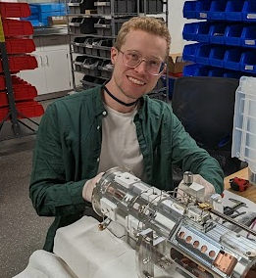
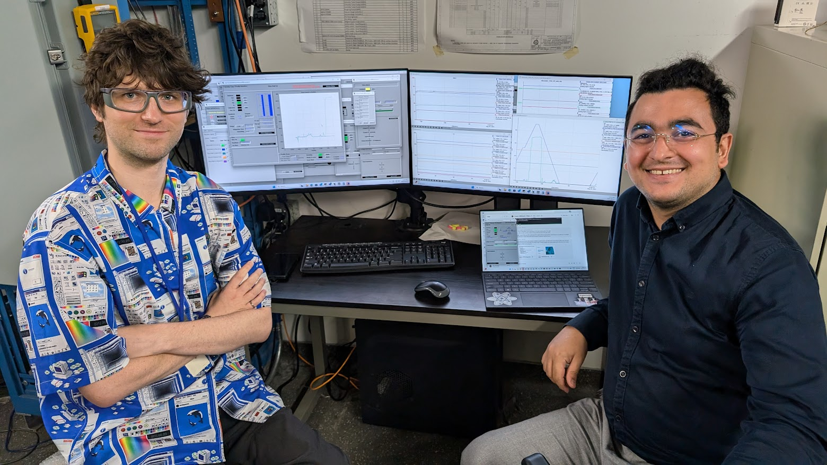
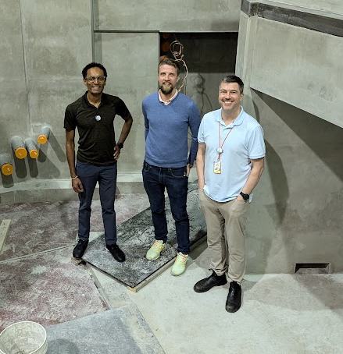
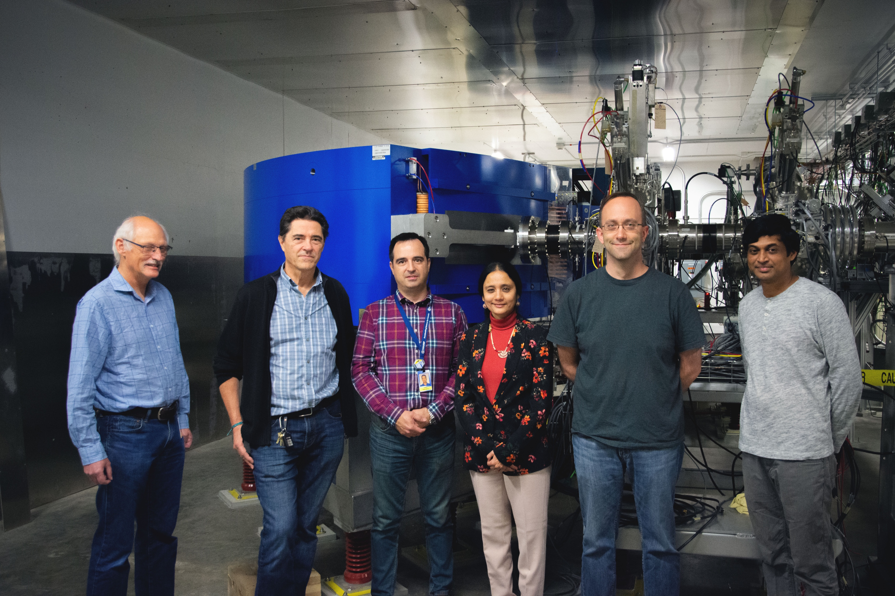
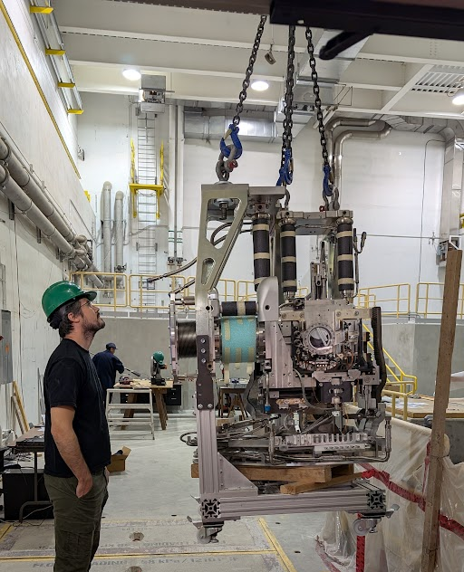
Several contributors through the years
Early conceptual development of ARIEL target stations by:
Pierre Bricault, Alex Gottberg, Grant Minor, Bill Paley
Early involvement: Anne Trudel, Mina Nozar, Allon Messenberg, Dan Brennan, Nemanja Jovicic
Many, many more involved from ~2017 onwards

