Slide 1
Producing short-lived isotopes by fusion-evaporation reactions in the TULIP TISS at GANIL
P. Jardin¹, B. Blank⁴, V. Bosquet², P. Chauveau¹, S. Damoy¹, P. Delahaye¹, M. Dubois¹, R. Frigot¹, H. Guérin¹, J. Guillot³, S. Hormigos¹,
S. Hurier¹, V. Kuchi¹, M. Lalande¹, E. Le Villain¹, M. MacCormick³, C. Michel¹, B. Rebeiro¹, A. Ribet¹, J-C. Thomas¹
¹Grand accélérateur National d’Ions Lourds (GANIL), 14076 CAEN cedex 5, France ² Laboratoire de Physique Corpusculaire, 6 Bvd du Maréchal Juin, 14000 CAEN, France ³ Laboratoire de Physique des 2 infinis Irène et Joliot-Curie (IJCLab), 15 rue Georges Clémenceau, 91400 Orsay, France
⁴ Laboratoire de Physique des 2 infinis-Bordeaux, 19 chemin du Solarium 33170 Gradignan

Slide 2
GANIL Installation
J.-C. Thomas and B. Blank, doi.org/10.1142/9789814417952_0045
SPIRAL2
DESIR
Energy ranges :
33 MeV for protons
40 MeV for deuterons
< 14.5 MeV/A for heavy ions
High intensities:
up to 5 mA for deuterons
< 1mA for heavier ions
NFS
S³ (in-flight)
Exp. hall
SPIRAL1
(ISOL)
Post-acceleration energy
Up to 25 MeV/A
https://hal.science/hal-04099110v1
Historic GANIL
From C to U
Beam energies < 95 MeV/A
EMIS XX 2025 19–24 oct. 2025 Chateau Fairmont Whistler Canada

Slide 3
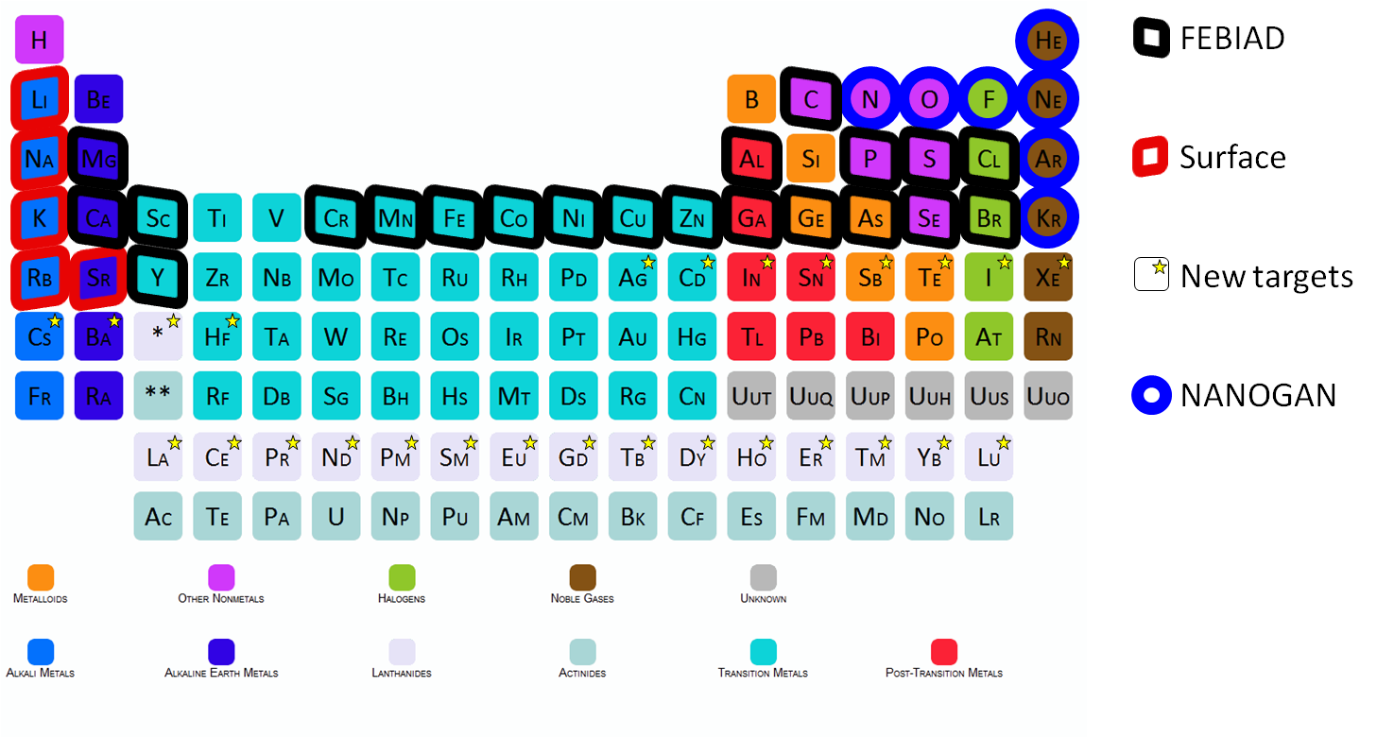
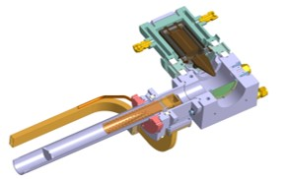
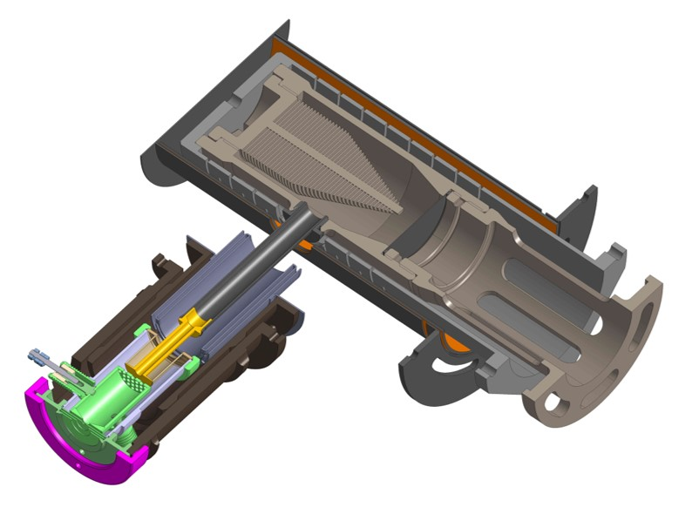
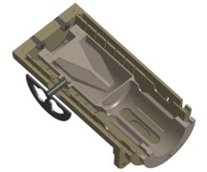
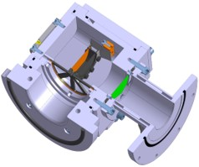
SPIRAL1 installation
58 primary beams from ¹²C to ²³⁸U
Graphite target (so far)
4 ion sources
The ISOL technique
Primary beam
Target/stopper
Ion source
Separator
TISS
To user/
acceleration
N+
1+
1+
1+
Nanogan
For gas
FEBIAD
For condensable
MonoNaKe
For alkaline
TULIP (SIS or FEBIAD)
For neutron deficient isotopes
For more details, see P. Chauveau, Proceedings of ICIS 2025 conference, Oxford
EMIS XX 2025 19–24 oct. 2025 Chateau Fairmont Whistler Canada

Slide 4
Origin of the TULIP project
Atom-to-ion transformation Eff x In-Target Production
= RIB intensity
Position and magnitude
depend on the half-live
Atom-to-ion transformation efficiency (AIT)
In-target production
Power deposited in the target
(or size of the target)
Towards short-lived isotopes

Slide 5
TULIP project questions
Is it possible to produce competitive RIB intensities by favoring the Atom-to-Ion Transformation efficiency rather than the in-target production?
Why address this issue?
How to go about it?

Slide 6
Ideal case
Use of a code able to predict the optimum design
=> Requires all the right input parameters
Without code
Minimize the time of each process
Diffusion
Effusion
Ionization
Chose the primary beam-target couple allowing this minimization

Slide 7
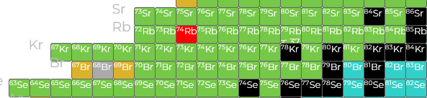
Case study: production of ⁷⁴Rb⁺. Why?
Regarding the TISS design
Possible to produce by fusion-evaporation reaction
Low energy (~Coulomb barrier)
Low recoil energy of the residues
Short range in material (few µm)
>> fast diffusion
Low power
small target volume
>> fast effusion
Ionize by hot surface
High efficiency
Selective
And Selective in-target production
Regarding the physical interest
Region of the nuclide chart little explored with ISOL systems
Very exotic (11 neutrons from the ⁸⁵Rb)
Short lived isotope (64,8 ms)
N=Z nucleus, 0+ -> 0+ superallowed emitter
Regarding the operation : low cost solution
Reduced activation of the TISS and of its surrounding
Limited production of artificial radioactivity
Short delay before recycling

Slide 8

Technical principle for ⁷⁴⁻⁷⁸Rb⁺ production
20Ne @ 117 MeV
Production of radioactive isotopes by fusion-evaporation reactions
Ions pushed towards the exit aperture
Production target
(Mo/^{nat}Ni/Mo)
(0,3 µm/4 µm/0,3 µm)
Collection of the residues in the cavity independent of
The recoil energy spread
The angular spread
The charge state of residues
Target thickness can be maximized (up to ~6 µm)
Window
Graphite, 2 µm thick
⁷⁴Rb Residu
Accelerated ion beam
Electric field
Graphite catcher
~1500°C
100 µm
Implantation
Thickness (~10µm)
HV
I
TISS Exit aperture
Diffusion
Surface ionization
High current for ohmic heating and E field creation

Slide 9
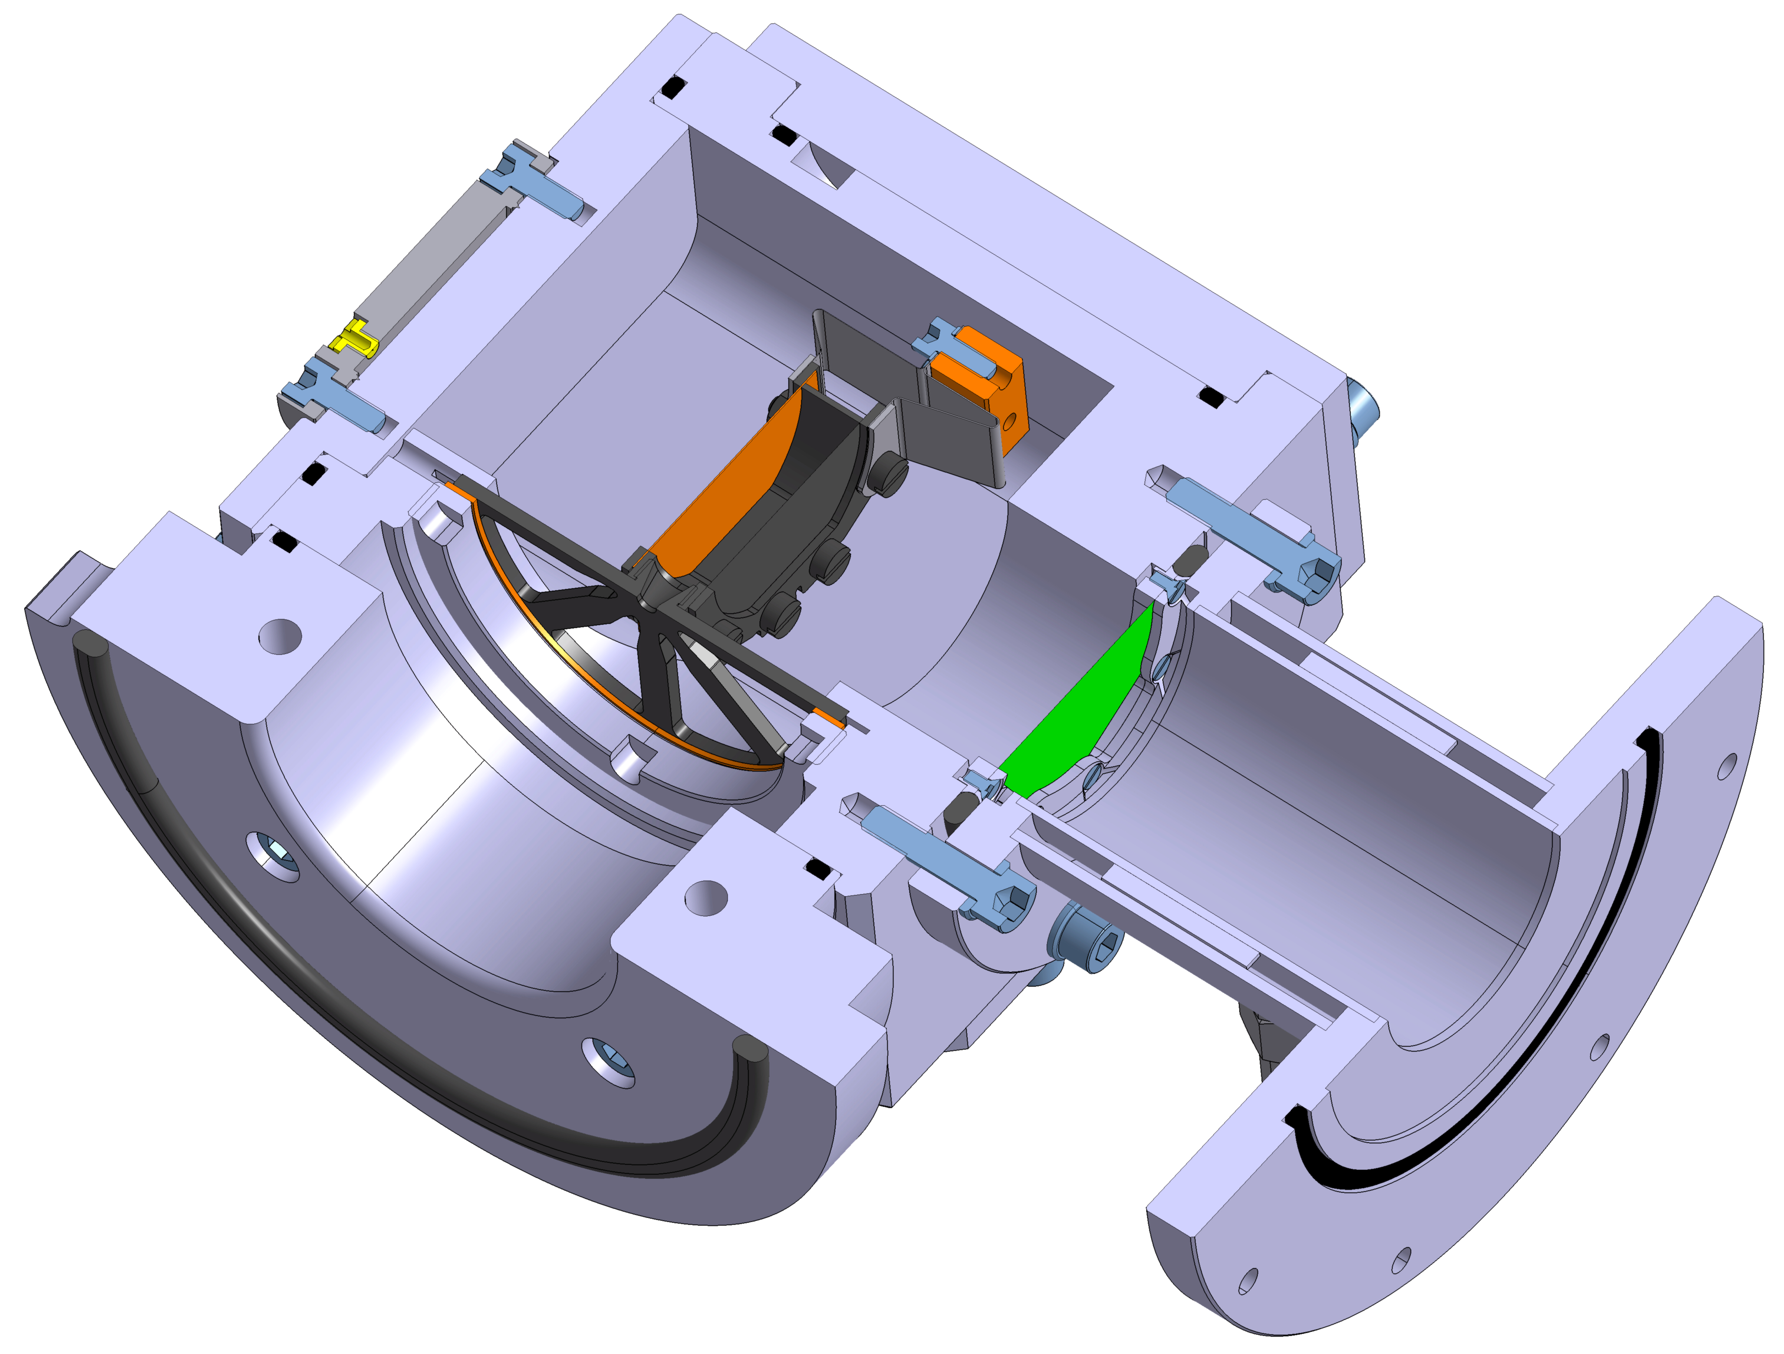
Present design
Catcher
Entrance window
Cavity: 12 mm long, 40 mm in diam.
Material: graphite
Heating power: up to ~3 kW + 70 W on catcher
Temperature: 1500-1600°C
Target
0,3 µm Mo/4 µm ^{nat}Ni/0,3 µm Mo*
Beam power deposited: 30 W/100W of ²⁰Ne
Life time observed at 3 kW > 3 days
Ni target
Primary
beam
RIB
* Thin layer deposition, https://kerdry.com

Slide 10
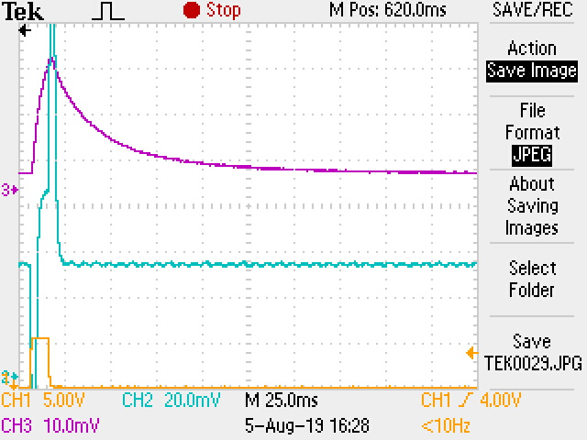
Effusion time expected (Flight + sticking)
Ion gun
Magnetic
separator
*
lens
Rb⁺
Faraday cup
Cavity power: 2242 W
Temperature: 1347°C
T_{1/2}=18,2 ms
Pulseur
*A. Pichard et al., Rev. Scient. Instrum. 81, 02A908 (2010)

Slide 11
Diffusion time expected
Production reaction: ²⁰Ne@ 117 MeV on Mo/Ni/Mo
Maximum range of ⁷⁴Rb residues in the carbon catcher: 5 µm
⇒ Release time out of the carbon catcher* at 1500°C : ~2 ms
Total atom-to-ion transformation time is expected to be of few millisecondes
* Extrapolated from dedicated measurements, J. Guillot et al., NIM B 526 (2022) 9-18

Slide 12
⁷⁴⁻⁷⁸Rb⁺ ion rates obtained in 2023
Reaction: 20Ne @ 90 MeV on Mo/^{nat}Ni/Mo
Temperature ~1200°C + T_{beam power} (~100 °C)
19 s
64,8 ms
system
Consistent with the predictions
Implies an atom-to-ion transformation time shorter than the half-live of ⁷⁴Rb

Slide 13
2025: ⁷⁴Rb⁺ production
Optimized reaction: ²⁰Ne @ 117 MeV on Mo/^{nat}Ni/Mo
Maximum heating (T=1500°C) + beam power (~100W)
Preliminary results
20Ne 1,1 µAp +^{nat}Ni 4 µm
x ~25 ?
x 500
x ~20
⁷⁴Rb⁺ rate is not consistent with the prediction
Calculation: LISE++, PACE4

Slide 14
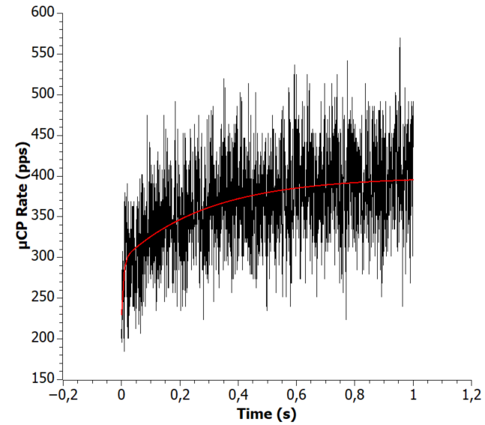
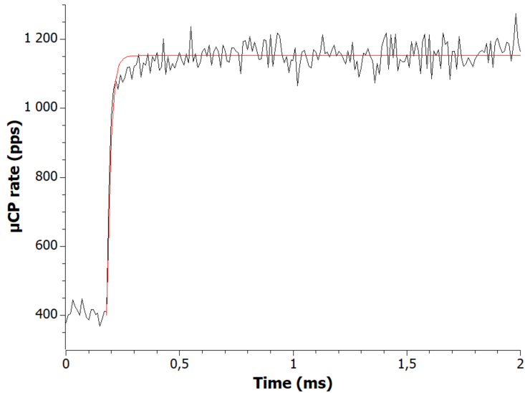
2025: ⁷⁴Rb⁺ atom-to-ion transformation time
20Ne @ 117 MeV on Mo/^{nat}Ni/Mo
I²⁰Ne = 0,2 p.µA, T_{cavity} ~ 1300°C
⁷⁶Rb⁺ (T1/2=36,8 s)
208 ms
Preliminary
4,3 ms
Beam ON
11,2 µs
⁷⁴Rb⁺ (T1/2=64,5 ms)
Preliminary
Beam OFF
I²⁰Ne = 0,9 p.µA, T_{cavity} ~ 1500°C
Background
Beam chopper 6 s ON/6 s OFF
Beam chopper 50 ms ON/10 ms OFF

Slide 15
2025: ⁷⁴Rb⁺ atom-to-ion transformation time
20Ne @ 117 MeV on Mo/^{nat}Ni/Mo
I²⁰Ne = 0,2 p.µA, T_{cavity} ~ 1300°C
I²⁰Ne = 0,9 p.µA, T_{cavity} ~ 1500°C
⁷⁶Rb⁺ (T1/2=36,8 s)
208 ms
Preliminary
4,3 ms
²⁰Ne Beam
Target
11,2 µs
Preliminary
Window
E
RIB
Beam OFF
Background
Beam chopper 6 s ON/6 s OFF
5 october 6:30
7 october 2:00

Slide 16
Conclusion on ⁷⁴⁻⁷⁸Rb⁺ production
The TISS works as expected (appart the window, which must be rendered more robust)
Long lived isotope (⁷⁵⁻⁷⁸Rb) rates are convenient with the predictions
Few hundreds of ⁷⁴Rb+ produced within 11 µs
AIT time probably longer (~5 ms) with a no-broken window
⁷⁴Rb+ probably higher

Slide 17
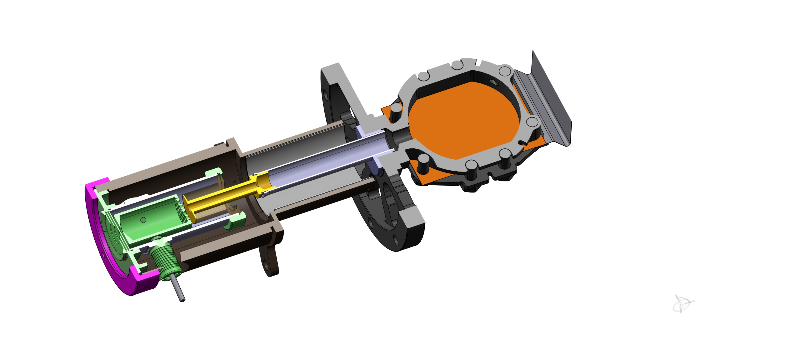
Towards the production of metallic elements around ¹⁰⁰Sn
Metallic elements => first ionisation potentiel energy > 6 eV
➔Association of the TULIP cavity (designed for alkali production) with a FEBIAD*
Graphite container
Ta screens
Transfer tube
TULIP cavity
Ta connection
Thermo-mechanical tests at nominal currents
(I_{cathode} = 330 A, I_{cavity} = 500 A, T=1500°C)
No hint of aging after 4 days
Usual ⁴⁰Ar ionization efficiency: 20%
Expected for stable Sn, In, Cd, Ag: 10% to 40%
Ready for online test
FEBIAD
ion source
Catcheur
Intermediate connection
*V. Bosquet et al 2022 J. Phys.: Conf. Ser. 2244 012071

Slide 18
Expected production of ¹⁰⁰Sn
⁴⁶Ti at 203 MeV, 2.5×10¹² pps on 4 µm thick ^{nat}Ni target
Production cross section of ¹⁰⁰Sn: 0.1 mbarn
Reduction factor of 10: 10 µbarn
In target production: ~600 pps
Max. range of ¹⁰⁰Sn in carbon catcher: 9 µm
Release efficiency of ¹²⁰Sn out of the catcher at 1500°C: ~10%
Sn ionization efficiency assumed: few tens of %
➔¹⁰⁰Sn⁺ rate at the exit of the TISS: few tens per second
Physics will decide
First test expected by Spring 2026
PACE4
B. Blank et al., NIM B 416 (2018) 41-49
LISE++
A. Ribet et al. – Defect and Diffusion Forum – 439, 139-146
Graphite container
Ta screens
Transfer tube
TULIP cavity
Ta connection
FEBIAD
ion source
Catcheur
Intermediate connection

Slide 19
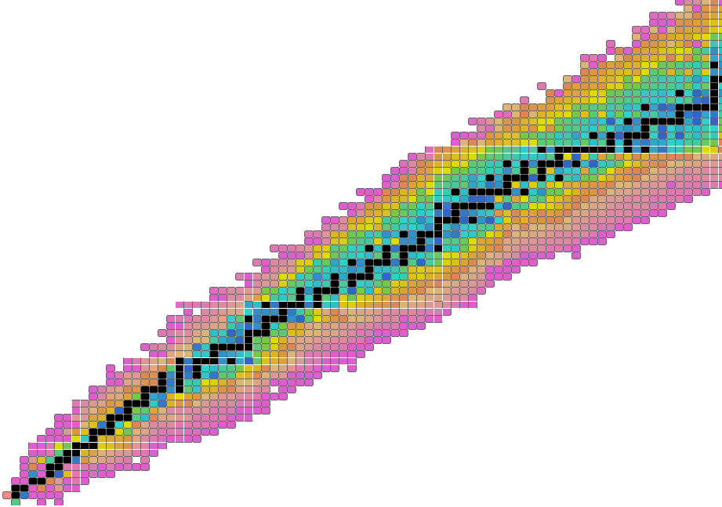
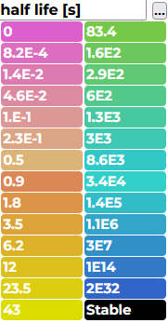
Next step
On the left side of this line, nuclei have half lives shorter than one milliseconde
M=130
Compounds considered
Ce
Combining GANIL beams with « easy » targets (few µm thick)
Xe
Ba
Te
Sn
50
Cd
Pd
Ru
Mo
Zr
Sr
Considered elements, T_{boiling} < 3000°C)
Kr
Ge
Se
Ga
Refractory elements
Zn
Ni
28
Fe
Cr
50
Ti
Ca
20
Ar
S
P
Mg
Al
Ne
28
O
N
C
20
8
Extracted from https://www-nds.iaea.org/relnsd/vcharthtml/VChartHTML.html

Slide 20

Thank you for your attention
For any question regarding the future beams, and for preparing the letters of intent, please contact the persons responsible for the development of the new beams via the following generic email address: chartbeams-spiral1@ganil.fr
Amsterdam Airport

