Slide 1




Beam Commissioning and First User Experiments
at the RAON Low-Energy Experimental Systems
2025. 10. 24.
Do Gyun Kim
Institute for Rare Isotope Science (IRIS),
Institute for Basic Science (IBS)
20TH INTERNATIONAL CONFERENCE ON ELECTROMAGNETIC ISOTOPE SEPARATORS AND RELATED TOPICS (EMISXX)
CHATEAU FAIRMONT WHISTLER, CANADA OCTOBER 19 - 24, 2025
Notes:
Good morning, everyone.
My name is Do Gyun Kim from the Institute for Rare Isotope Science, at the IBS in Korea.
First, I would like to thank the organizing committee for giving me the chance to present the recent achievements of the RAON accelerator here at the 20th EMIS conference.
The title of my talk is “Beam Commissioning and First User Experiments at the RAON Low-Energy Experimental Systems.”

Slide 2
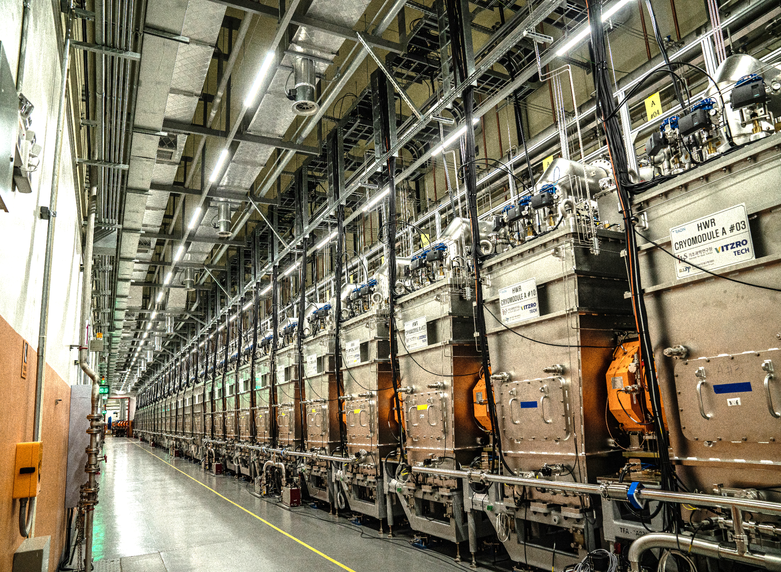
2
Presentation Outline
1. Status of RAON
2. Beam Commissioning and User Experiment Results
- KoBRA
- NDPS
- CLaSsy
3. User Experiments in 2025 and Future Plan
4. Summary
Notes:
My presentation consists of four parts.
First, I’ll briefly introduce the status of RAON.
Second, I’ll present the beam commissioning results and user experiments, focusing on three experimental systems — KoBRA, NDPS, and CLaSsy.
Third, I’ll discuss the user experiments planned for 2025 and our future plan.
Finally, I’ll give a short summary.

Slide 3
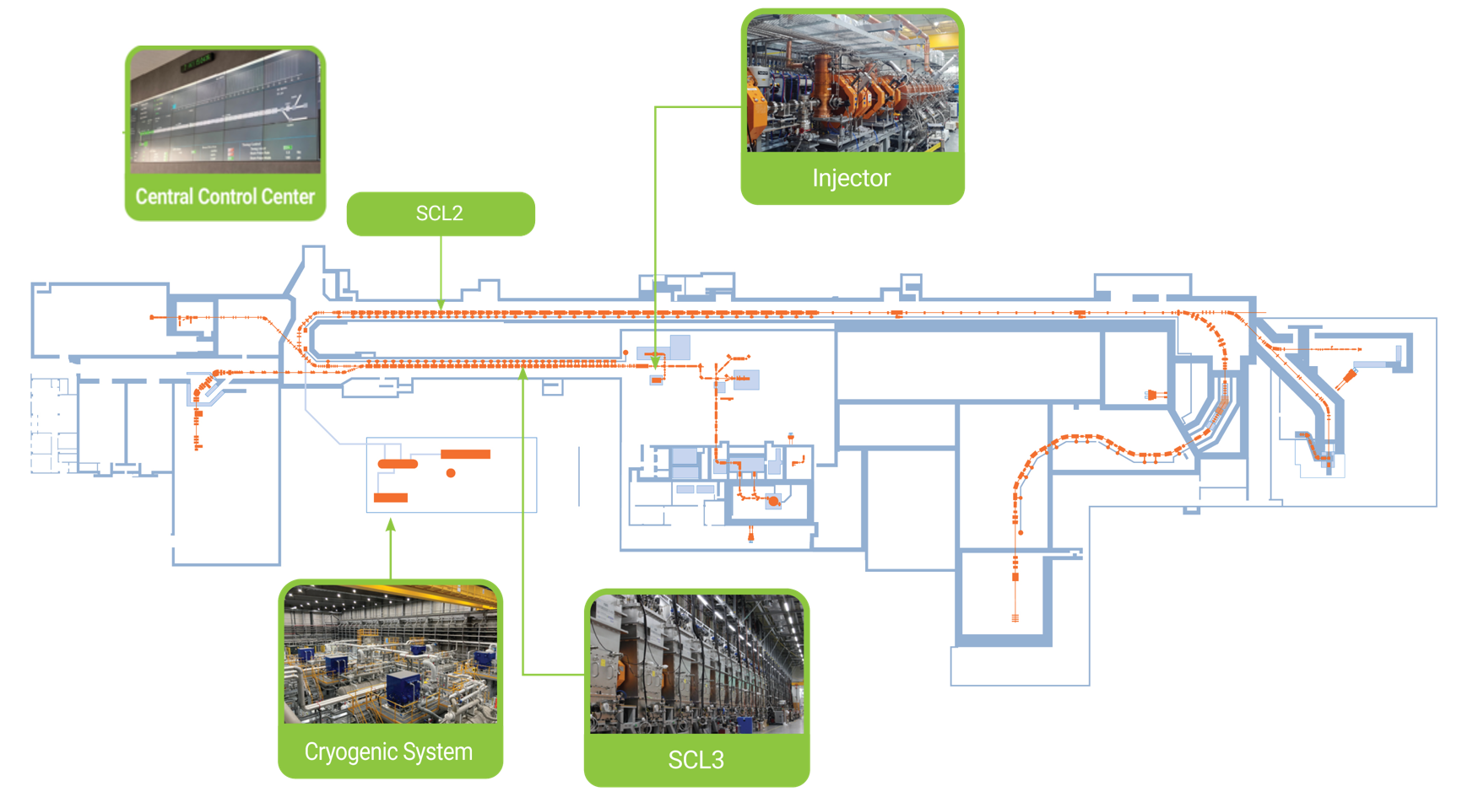
3
Overview of the RAON Facility
“Rare Isotope Science Project” (RISP) → “Institute for Rare Isotope Science” (IRIS)
1st Phase: Dec. 2011 ~ Dec. 2022
Construction of key accelerator component:
Injector, Cryogenic system, and Low-energy linac (SCL3)
ISOL system with Cyclotron and IF Separator
Experimental systems: KoBRA, NDPS, and others
NDPS
MMS
CLsSsy
BIS
ISOL
IF Separator
uSR
KoBRA
Cyclotron
Current Activities
Facility operations ongoing using SCL3 and ISOL beams for user experiments
R&D for the development of the high-energy linac (SCL2) (Dec. 2022 ~ Dec. 2027)
LAMPS
Mon 20/10, Taeksu Shin, "RIB production & Overview of RAON"
Notes:
First, let me briefly introduce the RAON facility.
The Rare Isotope Science Project, or RISP, started in December 2011 and completed its first phase in December 2022.
During the first phase, we constructed the major accelerator components — including the injector, cryogenic system, and low-energy linac (SCL3), as well as the ISOL system with the cyclotron and IF separator, and several experimental systems, such as KoBRA and NDPS.
Currently, the facility is operated using the SCL3 and ISOL beams for user experiments, while R&D for the development of the high-energy linac (SCL2) is ongoing from December 2022 to December 2027.

Slide 4
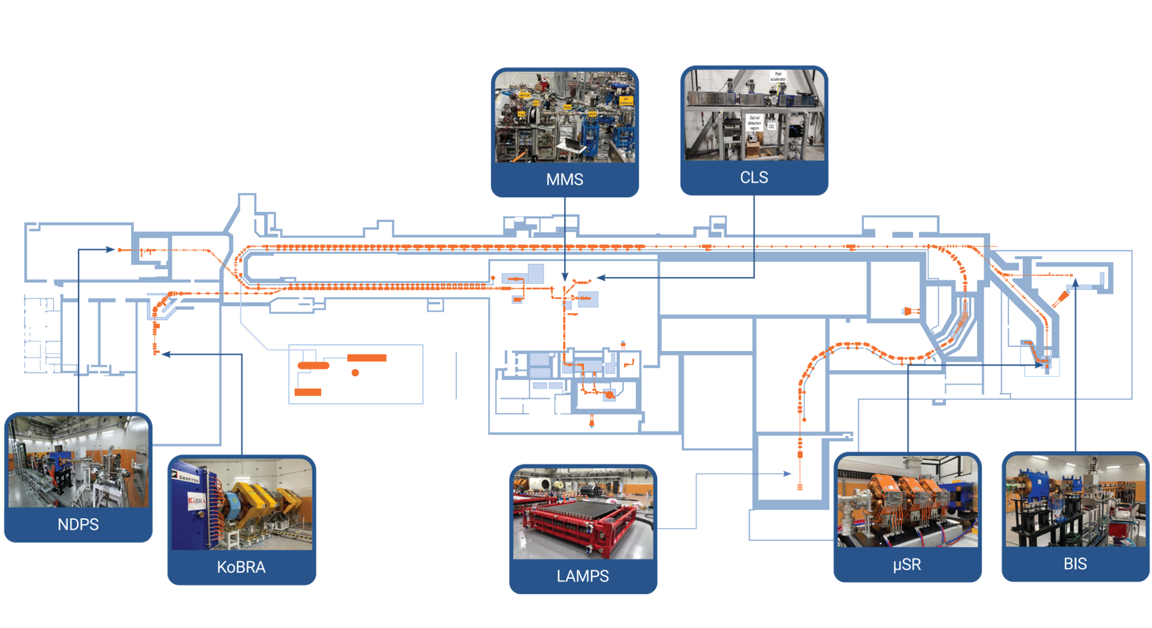
4
Experimental Systems of RAON
Tue 21/10, Jaehyun Song, "Online commissioning and current status of CLaSsy at RAON"
Sung Jong Park, "High-resolution collinear laser spectroscopy in a combined collinear and anti-collinear geometry"
Ha-Na Kim, "Current Status of Laser Ion Source Development at RAON"
Seongjin Heo, "Status of RFQ Cooler Buncher for rare isotope experiments with Isotope Separation On-Line system"
Jinho Lee, "Status of Rare Isotope Beam Operation at RAON"
Very Low Energy < a few keV/u
Mass
Measurement System
Collinear Laser Spectroscopy
Low Energy < a few tens of MeV/u
High Energy < hundreds of MeV/u
Nuclear Data
Production System
Muon Spin Rotation/
Relaxation/Resonance
Beam Irradiation System
Korea Broad Acceptance Recoil Spectrometer and Apparatus
Large-Acceptance
Multi-Purpose Spectrometer
Notes:
The RAON facility consists of several experimental systems —
very-low-energy systems such as CLaSsy and MMS,
Low-energy systems such as KoBRA and NDPS,
and high-energy systems including LAMPS, uSR, and BIS.
As I mentioned earlier, the high-energy linac (SCL2) has not yet been completed.
Therefore, at this stage, user beams are available only for the very-low-energy and low-energy experimental systems.
Several talks related to these systems were already presented on Tuesday,
covering topics such as laser spectroscopy at CLaSsy and the ISOL system, including the laser ion source and RFQ cooler buncher.

Slide 5
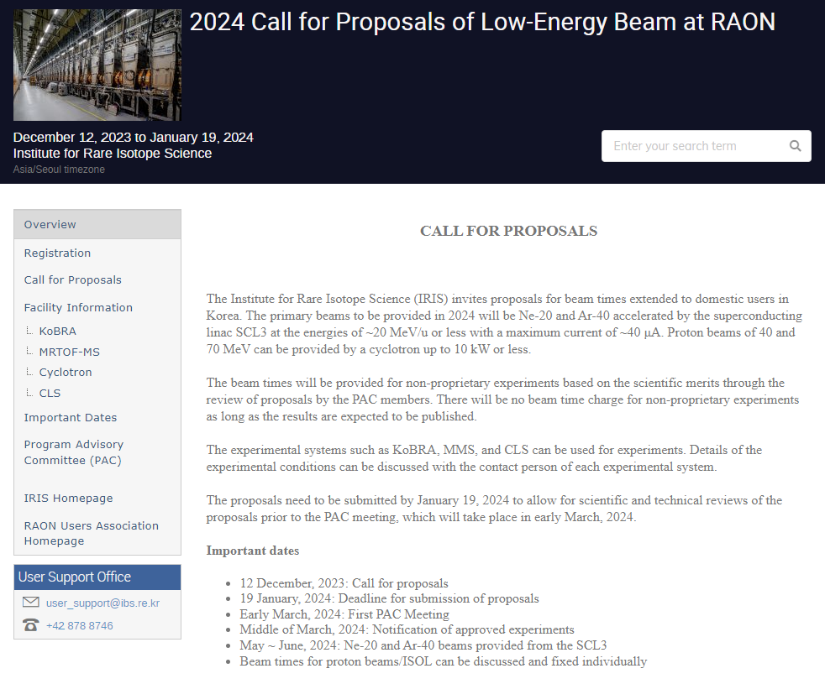
5
First Call for Proposals
First Call for Proposals
(for 2024 Low-Energy Beam Experiments at RAON)
First Commissioning User Services in 2024
Name (affiliation) | Experiments | Dates | Beams | Exp. facility
D. S. Ahn (CENS/IBS) | Measurement for production cross section and momentum distribution of projectile fragmentation | Jul 9 ~ Aug 23 | ⁴⁰Ar (16.4 Mev/u, 5 pnA) | KoBRA
J. B. Kim (KNUE) | High-resolution laser spectroscopy for the study of sodium | Nov 25 ~ 28 | ^{22,23}Na (20 keV, 3.3E7 ppb) | CLaSsy
D. H. Kim (CENS/IBS) | 40Ar + p elastic scattering experiment for a study of optical model potential | Aug 5 ~ 8 | ⁴⁰Ar (8.1 Mev/u, 5 pnA) | KoBRA
W. J. Lee (KARI) | Single event effects test for space semiconductor at KoBRA | Jul 24 | ⁴⁰Ar (16.4 Mev/u, 5 pnA) | KoBRA
J. H. Won (CENS/IBS) | Collinear laser spectroscopy of neutron-deficient Na isotopes | Nov 29 ~ Dec 3 | ^{21,23}Na (20 keV, 1.3E6 ppb) | CLaSsy
Period: Dec. 12, 2023 - Jan. 19, 2024 (6 weeks)
For domestic users
30 proposals submitted
313 participants from 15 institutions
Notes:
In December 2023, we opened the first call for proposals for low-energy beam experiments at RAON.
The call period was six weeks, from December 12, 2023, to January 19, 2024.
This call was limited to domestic users only.
In total, 30 proposals were submitted, with participation from 15 institutions.
After PAC review, five experiments were selected and conducted in 2024 - three with KoBRA and two with CLaSsy.
This marked the official start of the RAON user program, using beams from both the SCL3 and ISOL systems.

Slide 6
6
Presentation Outline
1. Status of RAON
2. Beam Commissioning and User Experiment Results
- KoBRA
- NDPS
- CLaSsy
3. User Experiments in 2025 and Future Plan
4. Summary
Notes:
Next, I will talk about KoBRA, one of the main experimental systems at RAON.
KoBRA is a key setup for low-energy nuclear reaction studies using both stable and RI beams.
I will first show the results from its beam commissioning and user experiments.

Slide 7
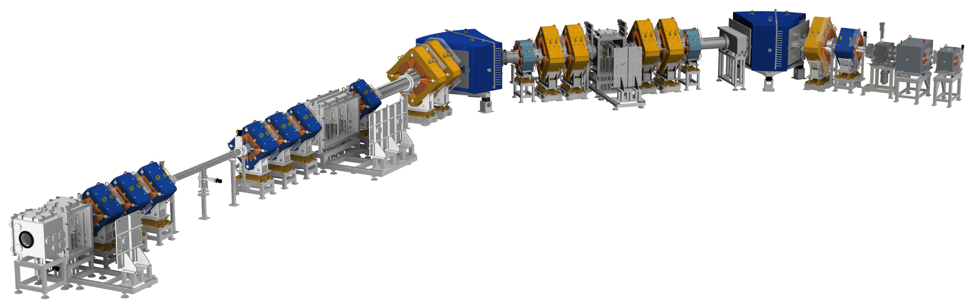
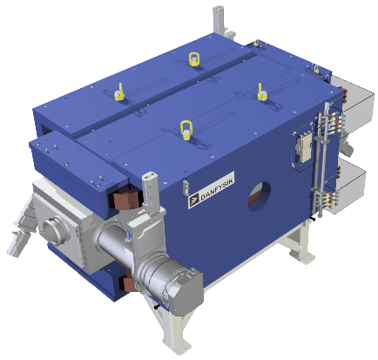
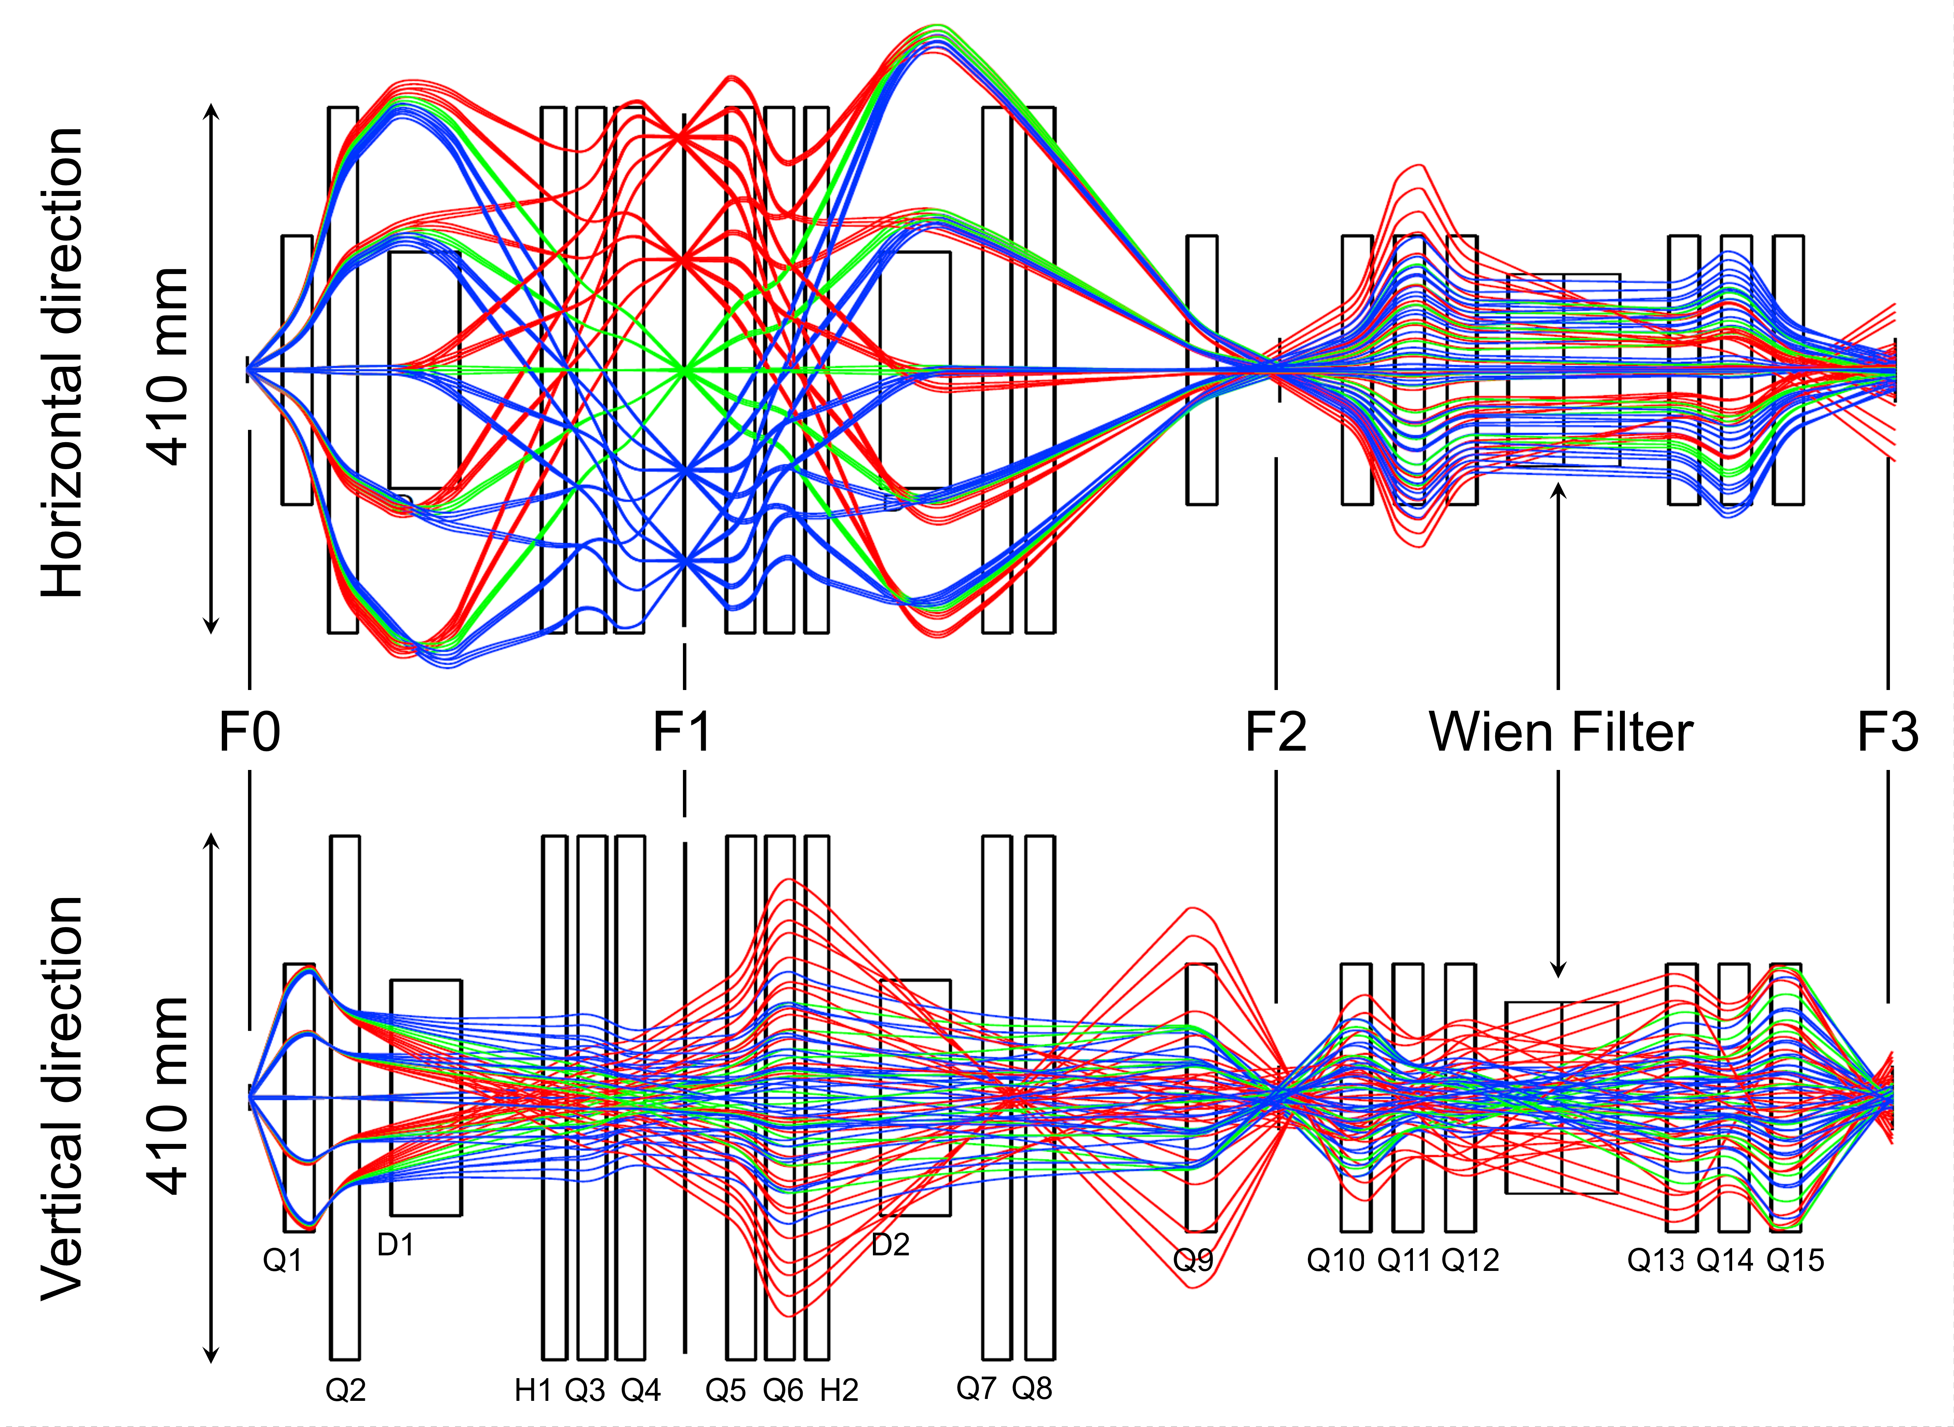
7
KoBRA (Korea Broad Recoil Spectrometer & Apparatus)
KoBRA Configuration
F1
F0
LQ4
LQ3
LQ2
D1
LQ1
Stable or
rare isotope
beam from SCL3
D2
LQ5
H1
SQ1
SW2
LQ6
H2
SW1
F2
LQ7
SQ2
SQ3
SQ4
SQ5
Wien Filter
Scattering
Chamber
F3
SQ6
SQ7
SQ8
F1: Dispersive Focal Plane
F2, F3: Double Achromatic Focal Plane
K. Tshoo
Beam swinger | up to 12 degree for 3 Tm
Degrader at F1 | Homogeneous or Curved
Magnetic rigidity | 0.25 – 3.0 Tm
Angular acceptance | 80 mrad (H) 200 mrad (V)
Momentum acceptance | 8%
High order correction | up to 4th order
Momentum resolving power at F1 | 2100 at 2 mm beam size
Mass resolving power (with Wien filter) | 750 at 2 mm beam size
D.G. Kim
K. Tshoo et al., Nucl. Instrum. Methods Phys. Res., Sect. B 541, 56 (2023)
Notes:
This figure shows the layout of KoBRA.
KoBRA is designed to accommodate a wide angular and momentum acceptance.
The angular acceptance is 80 mrad in the horizontal and 200 mrad in the vertical direction.
The momentum acceptance is 8%, and the magnetic rigidity range covers 0.25 to 3.0 Tm.
This figure shows the beam envelope calculated using a 5th-order optical matrix.

Slide 8
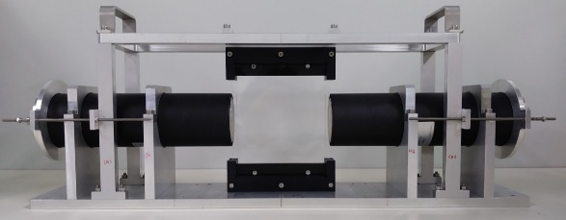
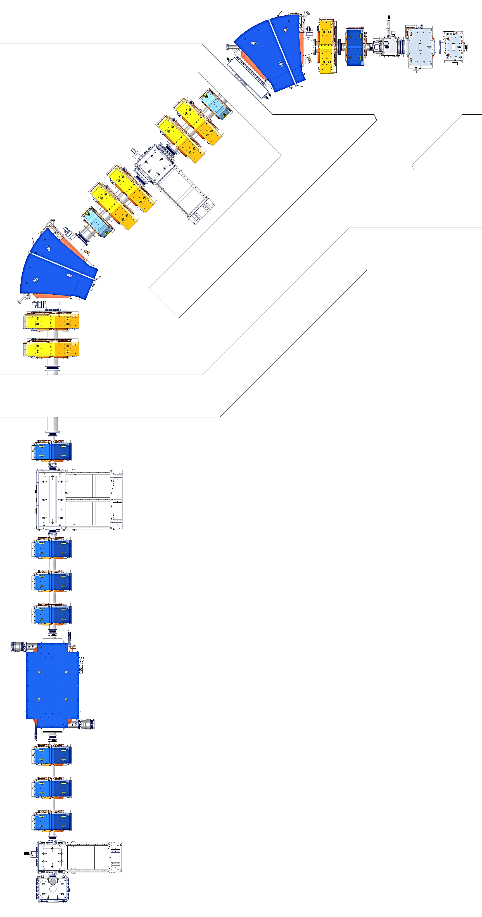
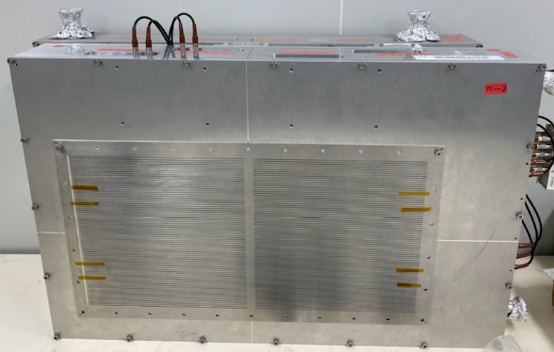
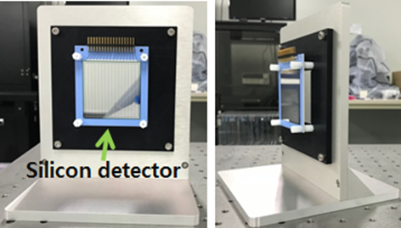
8
Detector Configuration of KoBRA
Primary beam
Plastic scintillator
Active area: 10 × 10 cm²
Thickness: 100 μm(F1, F3), 50 μm(F2)
Time resolution: < 100 ps (FWHM)
F0 Chamber
Phosphor screen
Target (graphite)
F1 Chamber
Plastic (100 × 100 mm²)
Slit (X: ± 200 mm, Y: ± 100 mm)
PPAC (400 × 200 mm²)
Energy degrader (Aluminum)
Phosphor screen
PPAC (400 × 200 mm²)
PPAC (Parallel Plate Avalanche Counter)
Active area
: 40 × 20 cm² for F1
: 10 × 10 cm² for F2, F3
Position resolution: < 1.0 mm (FWHM)
Time resolution
: ~ 1000 ps (FWHM, F1)
: ~ 300 ps (FWHM, F2 & F3)
F2 Chamber
Plastic (100 × 100 mm²)
Slit (X: ± 50 mm, Y: ± 50 mm)
PPAC (100 × 100 mm²)
Slit (X: ± 50 mm, Y: ± 50 mm)
Si SSD (horizontal 16 ch.)
PPAC (100 × 100 mm²)
Si SSD (Solid-State Detector)
F3 Chamber
Slit (X: ± 50 mm, Y: ± 50 mm)
PPAC (100 × 100 mm²)
Si SSD (horizontal 16 ch.)
Plastic (100 × 100 mm²)
Slit (X: ± 50 mm, Y: ± 50 mm)
PPAC (100 × 100 mm²)
Active area: 5 × 5 cm²
Thickness: 50 μm
16-channel strip detector
Energy resolution: ~3% (FWHM)
Notes:
This slide shows the KoBRA detector system, from F0 to F3.
The system uses a combination of plastic scintillators, PPACs, and silicon detectors to perform timing, position tracking, and energy-loss measurements.
Each plastic scintillator has an active area of 10 by 10 square centimeters.
Two thickness options are used — 100 and 50 micrometers.
The time resolution is better than 100 picoseconds (FWHM).
For the PPACs, the active area is 40 by 20 square centimeters for the F1, and 10 by 10 square centimeters. for F2 and F3. And the position resolution is better than 1 mm FWHM.
The silicon strip detectors have an active area of 5 by 5 square centimeters squared and a thickness of 50 micrometers. Their energy resolution is approximately 3 percent FWHM.

Slide 9
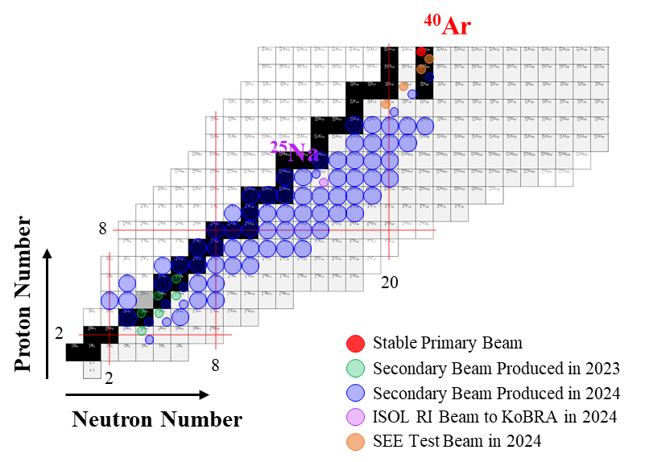
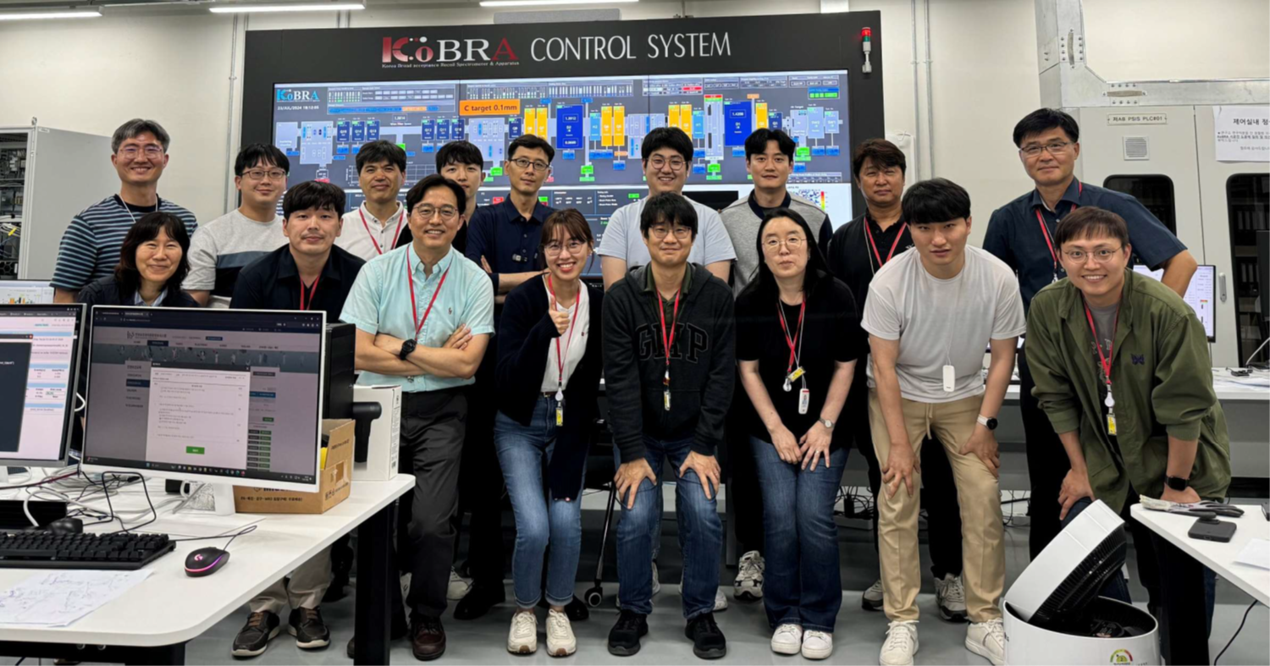
9
Commissioning Results of KoBRA
Beam commissioning and user experiments at KoBRA
May 2023 - First acceleration of ⁴⁰Ar⁹⁺ beam to 16.1 MeV/u using SCL3 and delivery to KoBRA
June 2023 - First production of low-Z (Z ≤ 5) secondary RI beams using ⁴⁰Ar⁸⁺ beam
June 2024 - Secondary RI beam production extended up to Z = 17
July 2024 - User experiments conducted using SCL3 Ar beam and KoBRA
  (1) Deuk Soon Ahn et al. (CENS, IBS), “Measurement for production cross section and momentum distribution of projectile fragmentation”
  (2) Dahee Kim et al. (CENS, IBS), “⁴⁰Ar + p elastic scattering experiment for a study of optical model potential”
  (3) Woojun Lee et al. (KARI), “Single event effects (SEE) test for space semiconductor at KoBRA”
August 2024 - First acceleration of the ISOL RI beam (²⁵Na⁵⁺) using SCL3 and its delivery to KoBRA
D.G. Kim
IBS IRIS & CENS
Notes:
Here’s a brief beam commissioning timeline of KoBRA.
Between May 2023 and August 2024, we achieved several key milestones.
We first accelerated the 40Ar beams, then produced low-Z and higher-Z RI beams, and finally delivered the first ISOL RI beam to KoBRA.
Three user experiments were also conducted during this period.

Slide 10
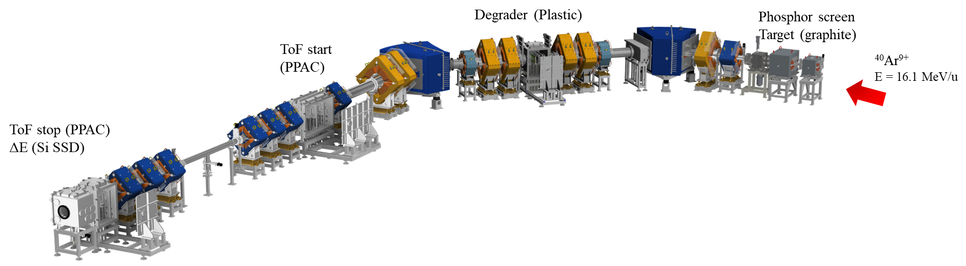
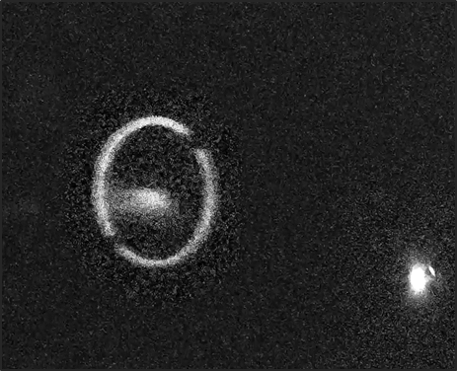
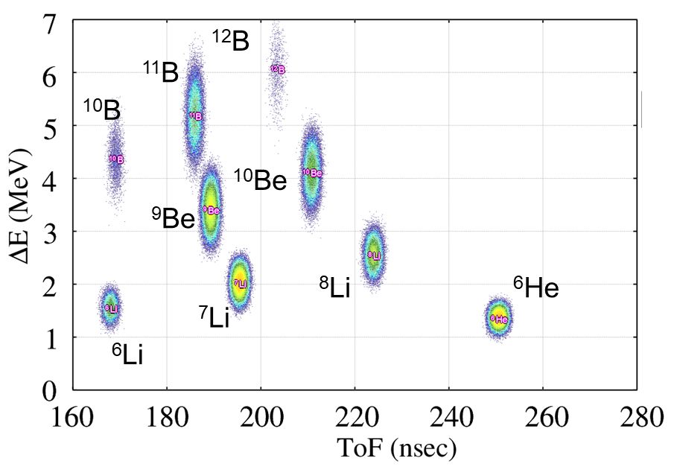
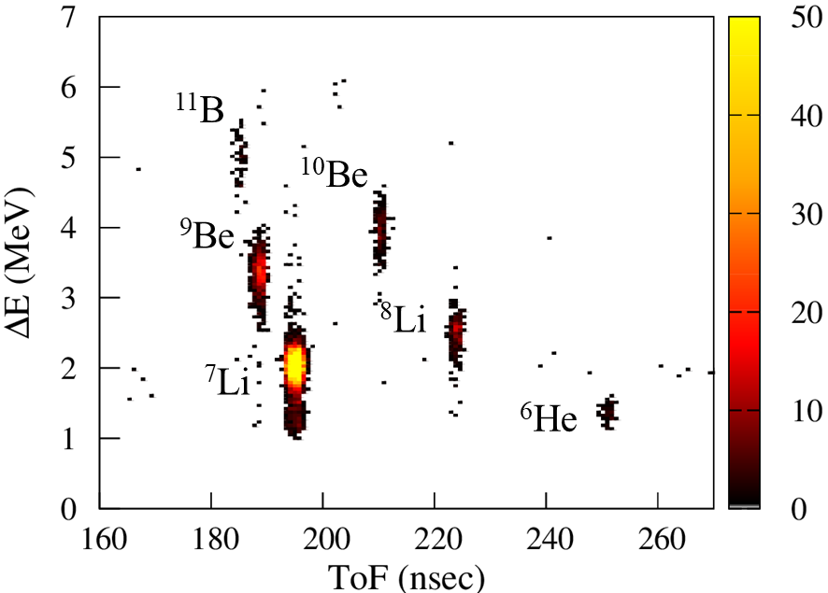
10
KoBRA Commissioning
First acceleration of ⁴⁰Ar⁹⁺ beam and delivery to KoBRA (2023)
⁴⁰Ar⁹⁺ Primary Beam
2 PPACs (F2, F3): ToF measurement
Si SSD: ΔE measurement
at F0 Position
First production of low-Z RI beams
(⁶He, ⁷Li, ⁸Li, ⁹Be, ¹⁰Be, ¹¹B)
Simulation
Experiment
By K. Tshoo, D.G. Kim, M.S. Kwag, K.B. Lee et al.
Notes:
In 2023, we successfully delivered the Ar beam to the KoBRA beamline for the first time.
Using this primary beam, we produced several low-Z RI beams, such as helium (He), lithium (Li), beryllium (Be), and boron (B) isotopes.
To identify these RI beams, we used two PPACs at F2 and F3 for TOF measurement, and a silicon detector for ΔE measurement.

Slide 11

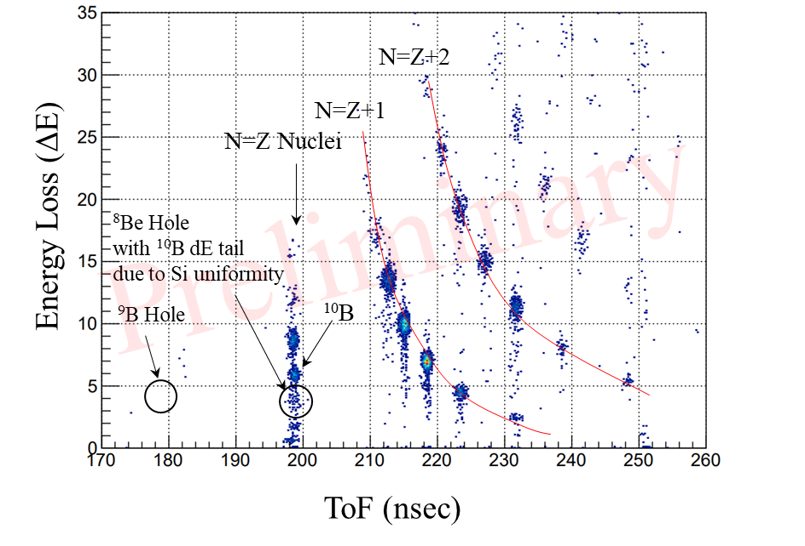
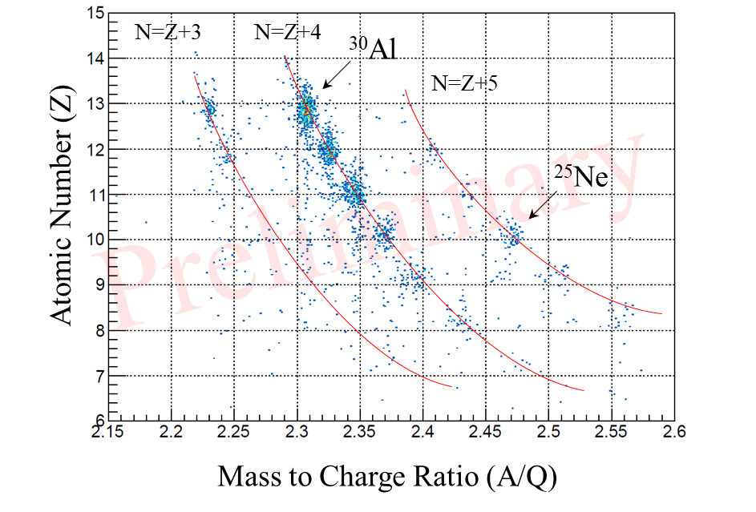
11
KoBRA Commissioning
RI beam production extended to higher-Z isotopes with ⁴⁰Ar⁸⁺ beam (2024)
PPAC (F1): Bρ measurement
2 PPACs (F2, F3): ToF measurement
Si SSD: ΔE measurement
Secondary RI beams up to Z = 14 were successfully produced and identified using the Bρ–ΔE–ToF method with KoBRA beamline detectors.
The momentum distribution and production cross sections are currently under analysis.
Magnetic Rigidity Setting for ¹⁰B
Without F1 Al degrader & PPACs
Δp/p = 0.2%
Magnetic Rigidity Setting for ²⁵Ne
With F1 PPACs (functions as a energy degrader)
Δp/p = 8% (full momentum acceptance)
By K. Tshoo, D.G. Kim, M.S. Kwag, K.B. Lee et al.
Notes:
In 2024, we extended RI beam production up to Z=17.
The PPAC at F1 was used to measure Bρ (magnetic rigidity), two PPACs were used for ToF measurements, and the silicon detector was used to measure ΔE.
RI beams were successfully produced and identified using the Bρ–ΔE–ToF method.

Slide 12
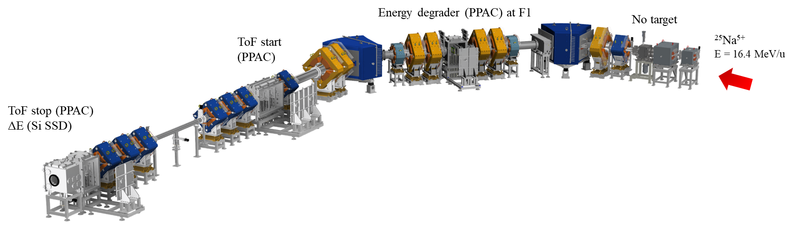
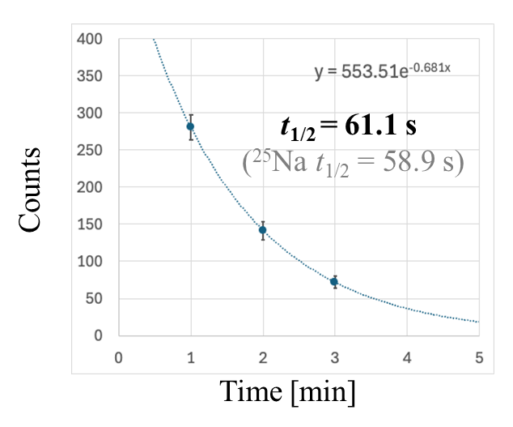
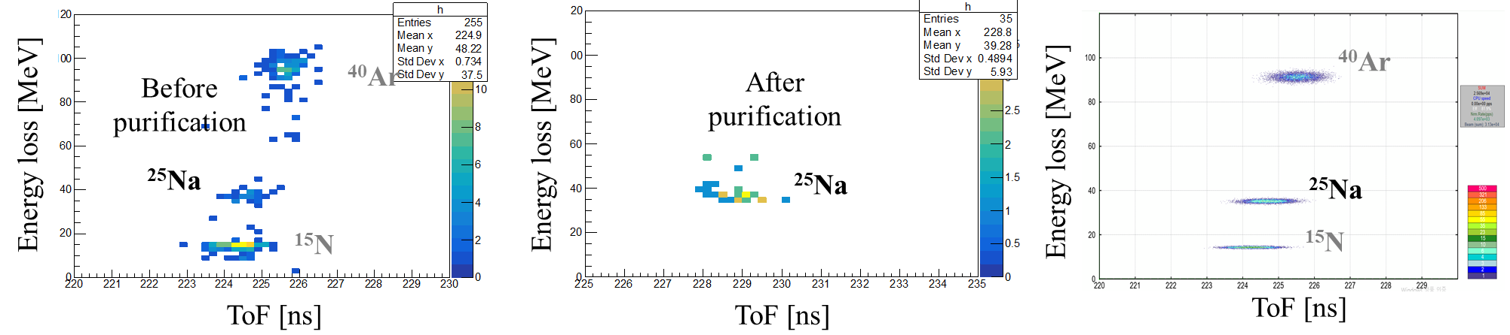
12
KoBRA Commissioning
First acceleration and delivery of the ISOL RI beam (²⁵Na⁵⁺) to KoBRA (2024)
PPAC (F1): Energy degrader
2 PPACs (F2, F3): ToF measurement
Si SSD: ΔE measurement
²⁵Na⁵⁺ RI beam was successfully identified and purified using KoBRA, and its identity was confirmed through β-decay measurement.
β-decay measurement (@F3)
Experiment
Experiment
Simulation
By K. Tshoo, D.G. Kim, M.S. Kwag, K.B. Lee et al.
Notes:
This slide shows the successful transport and identification of the ISOL RI beam, 25Na.
It was purified with the help of the PPAC at F1 acting as an energy degrader.
And it was confirmed via β-decay measurements.
The Na beam was stopped at the F3 slit for a certain time, and the number of electrons from the β-decay was counted using the plastic scintillator.

Slide 13

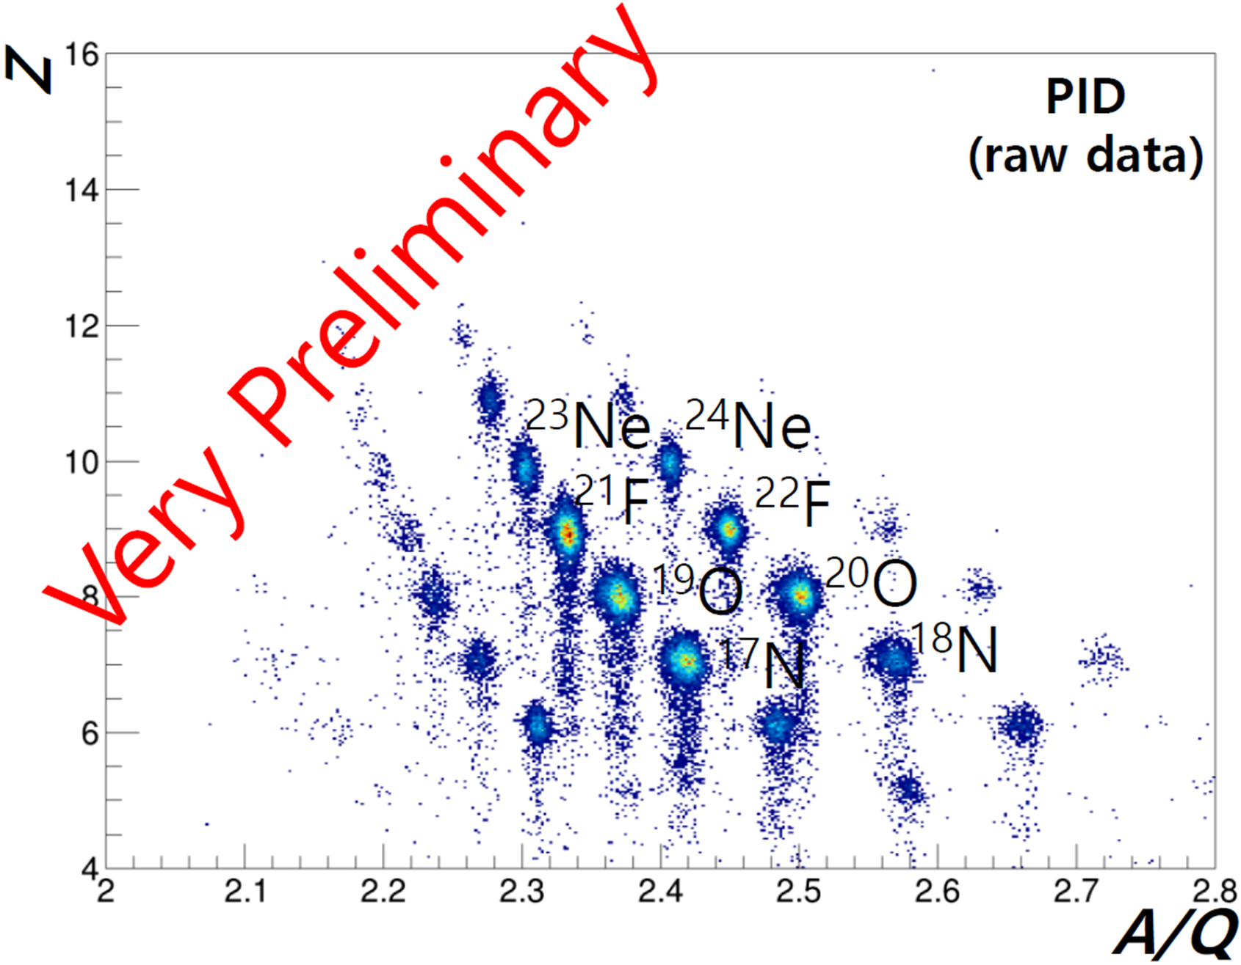
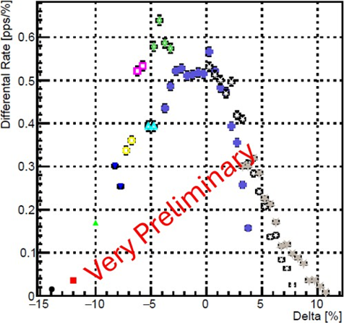
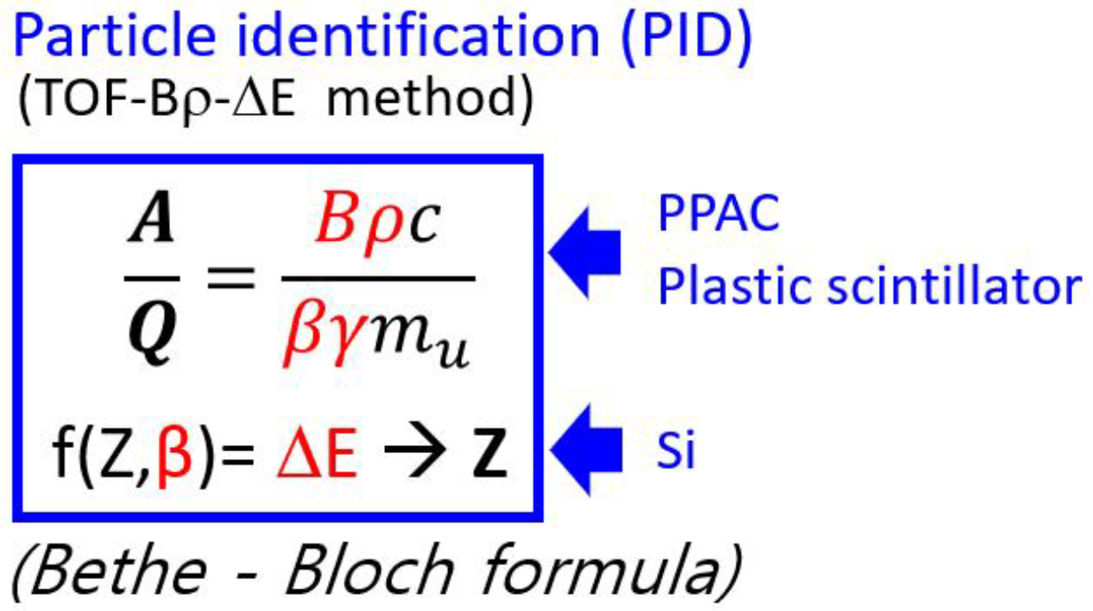
13
User Experiments at KoBRA
1st Exp. [KO-24-30] Deuk Soon Ahn et al. (CENS, IBS)
Measurement for production cross section and momentum distribution of projectile fragmentation
Goal: To measure the production rates, cross sections, and momentum distributions of fragments around ³⁴Si using a 20 MeV/u ⁴⁰Ar primary beam and a carbon target, and to compare the results with various RI beam production models.
⁴⁰Ar⁸⁺
E = 16.4 MeV/u
F2
- PPAC (ToF start)
- Plastic
F3
- PPAC (ToF stop)
- Plastic
- Si SSD (ΔE)
F1
- PPAC (Bρ)
F0
- Phosphor screen
- Target (graphite)
Primary beam: ⁴⁰Ar (16.4 MeV/u, 5 pnA)
Target: Graphite, 0.13 mm
PPAC (F1): Bρ measurement
2 PPACs (F2, F3): ToF measurement
Si SSD: ΔE measurement
Plastic scintillator: ΔE measurement
Production cross section and momentum distribution of O - Ne isotopes were measured
Notes:
Next, I will present the results from three experiments conducted at KoBRA.
The first experiment was led by Dr. Deuk Soon Ahn from CENS, titled ‘Measurement of production cross sections and momentum distributions of projectile fragmentation’.
In this experiment, production cross sections and momentum distributions of oxygen and neon isotopes were measured from the fragmentation of a 40Ar beam.
A 16.4 MeV/u Ar beam was used with a 0.13 mm thick graphite target.
F1 PPAC was used for Bρ, F2 and F3 PPACs for TOF measurement. And the silicon detector and plastic scintillator were used for ΔE measurement.

Slide 14
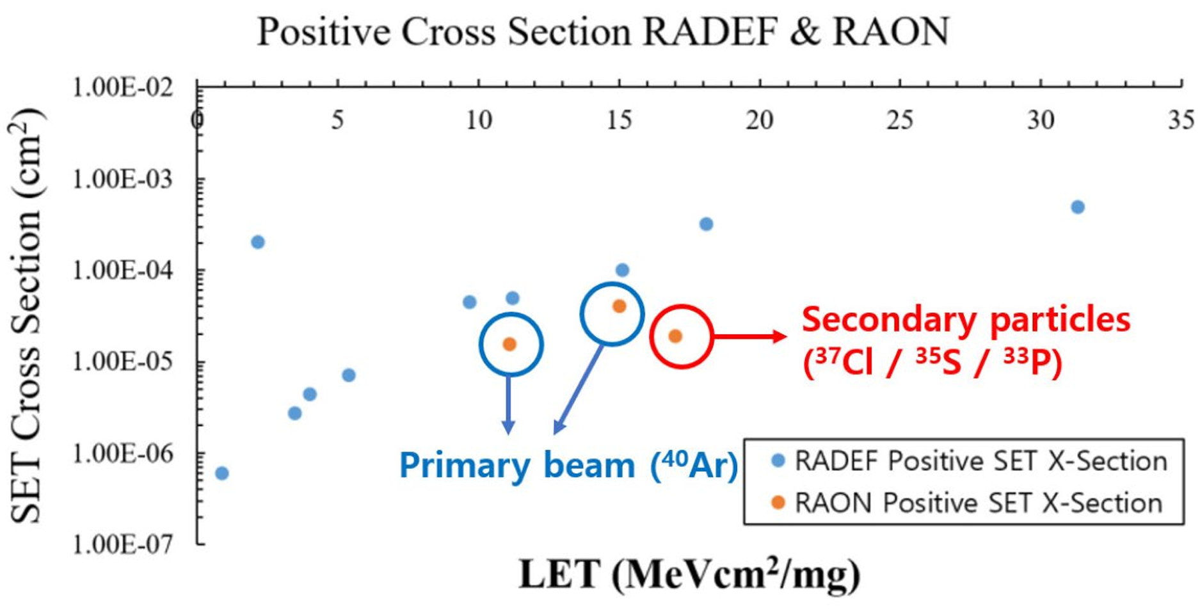
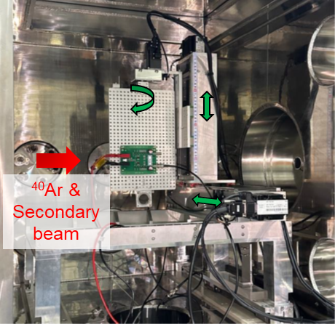
14
User Experiments at KoBRA
2nd Exp. [KO-24-22] Woojun Lee et al. (KARI)
Single event effects test for space semiconductor at KoBRA
Goal: To demonstrate domestic capability for Single Event Effect (SEE) testing of space semiconductors using 40Ar primary and secondary beams produced at KoBRA.
⁴⁰Ar⁸⁺
E = 16.4 MeV/u
F2
- PPAC (ToF start)
F1
- Al degrader
F0
- Phosphor screen
- Target (graphite)
F3
- PPAC (ToF stop)
- Si SSD (ΔE)
Primary beam: ⁴⁰Ar
Secondary beam: ³⁷Cl, ³⁵S, ³³P
Single Event Transient (SET) cross section was measured
Measured SET (Single Event Transient) cross section as part of SEE testing
Single Event Transient (SET)
: A temporary voltage excursion (voltage spike) at a node in a logic, or linear, integrated circuit. Caused by a single energetic particle strike.
Notes:
The second experiment was conducted by Dr. Woojun Lee from KARI and focused on Single Event Effects test for space semiconductors at KoBRA.
The goal of this experiment was to demonstrate domestic capability for SEE testing using both primary and secondary beams produced at KoBRA.
This slide shows the beamline configuration and beam conditions for the SEE test.
For the experiment, the test board containing the semiconductor chip was installed in the F3 SNACK chamber.
The primary beam was 40Ar, and secondary beams such as 37Cl (chlorine 37), 35S (sulfur 35), and 33P (phosphorus 33) were used.
In this experiment, the cross section of Single Event Transient (SET), one type of SEE, was measured.
As shown in the figure below, the voltage spike caused by an SET was detected using an oscilloscope.
The measured SET cross section with the 40Ar beam was close to the reference results from RADEF, as shown in the plot.
However, the results from the secondary beams showed lower cross sections.

Slide 15
15
User Experiments at KoBRA
3rd Exp. [KO-24-21] Dahee Kim et al. (CENS, IBS)
⁴⁰Ar + p elastic scattering experiment for a study of optical model potential
Goal: Compare the phenomenological and microscopic optical models for the ⁴⁰Ar + p elastic scattering in low energy region.
⁴⁰Ar⁸⁺
E = 8.3 MeV/u
F2
F1
Slit
F0
- Phosphor screen
- Al degrader (30.2 um & 46.3 um)
F3
Primary beam: ⁴⁰Ar (8.3 MeV/u, 5 pnA)
Energy: 4.4, 5.9, 8.3 MeV/u (using Al degrader @ F0)
Target: CH2, 200 μg/cm²
Angular distributions were measured using the forward part of the STARK system.
The target is positioned 5~6 m far from the F3 focal plane.
Notes:
The third experiment, led by Dr. Dahee Kim from CENS, studied 40Ar + p elastic scattering in low energy region.
In this experiment, a primary beam of 40Ar at 8.3 MeV/u was used.
Beam energies of 4.4 and 5.9 MeV/u were achieved by inserting an aluminum degrader at the F0 position.
The target was CH₂ with a thickness of 200 micrograms per square centimeter.
The angular distributions of the scattered protons were measured using the forward part of the STARK detection system, which was located about 5 to 6 meters downstream from the F3 focal plane.
A total of 12 silicon telescopes and 16 single silicon detectors were installed for the angular distribution measurements.

Slide 16
16
Presentation Outline
1. Status of RAON
2. Beam Commissioning and User Experiment Results
- KoBRA
- NDPS
- CLaSsy
3. User Experiments in 2025 and Future Plan
4. Summary
Notes:
Next, let me move on to NDPS.
I will briefly show its layout and the results from the first beam test.

Slide 17
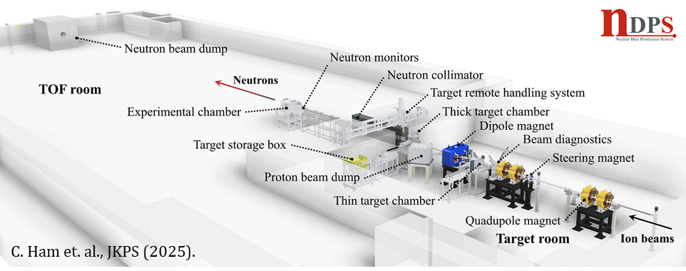
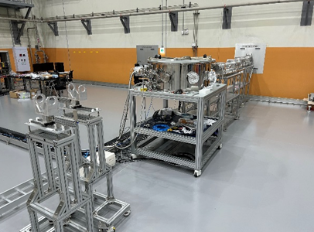
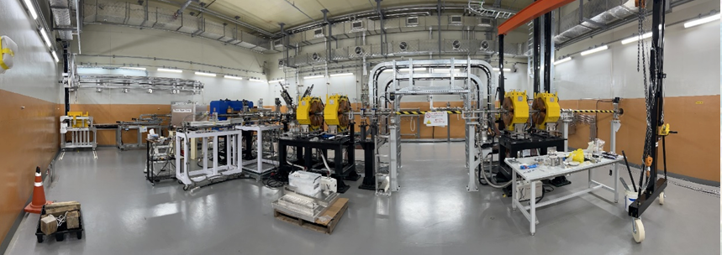
17
NDPS (Nuclear Data Production System)
Specification of NDPS
Beam Ion | Proton, deuteron, ⁴⁰Ar, etc
Ion Beam Energy | 20~80 MeV for proton ~50 MeV/u for deuteron Up to 18 MeV/u for heavy ion
Target | ^{nat}C for white neutron Li for monoenergetic neutron
Flight length of neutron | 5 – 50 m
Calculated neutron flux | ~ 10¹⁰ n/sec/sr/pμA (@ 0°)
Neutron beam size | Minimum 4 cm in diameter
TOF Room
Target Room
C. Ham et al., Nucl. Instrum. Methods Phys. Res., Sect. B 541, 363 (2023)
Notes:
This slide shows the overall configuration of the NDPS system
The layout consists of two main areas: the Target Room and the TOF Room.
A natural carbon target is used for white neutrons, while a lithium target is used for monoenergetic neutrons.
The neutron flight length is adjustable from 5 to 50 meters.
The neutron beam size is at least 4 cm in diameter after neutron collimator.

Slide 18
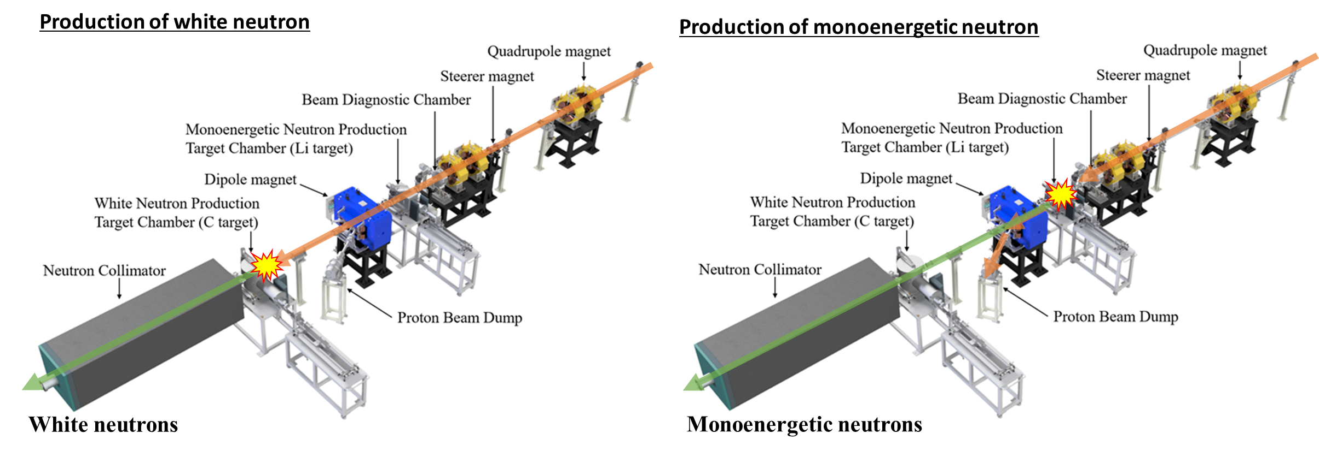
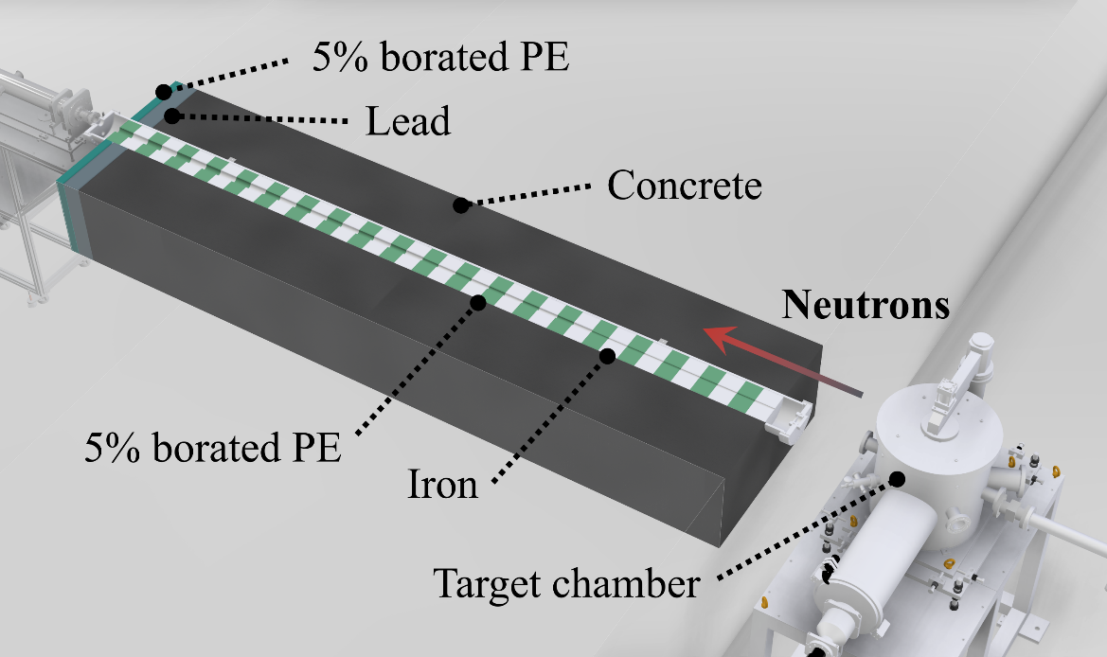
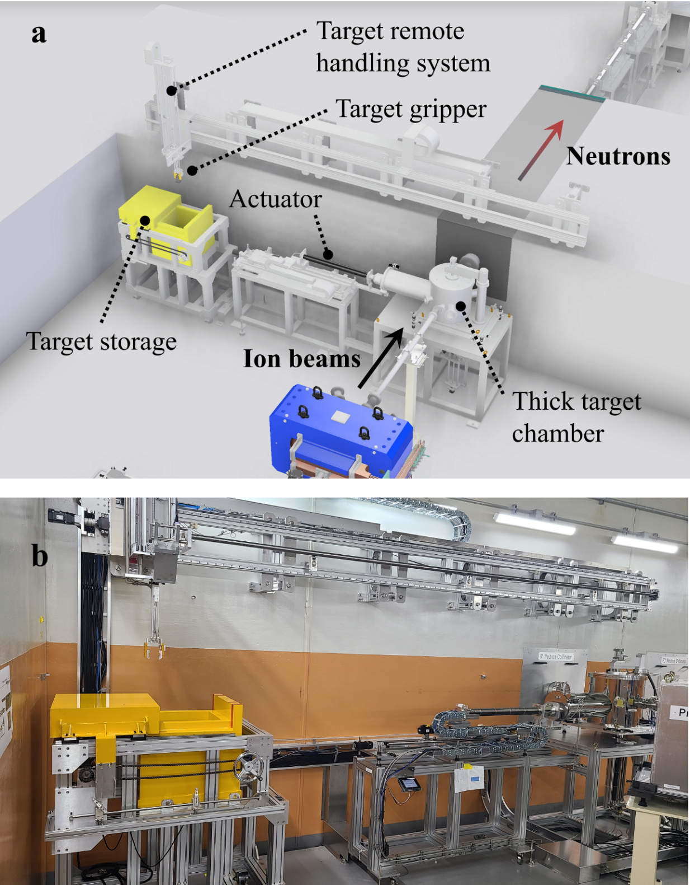
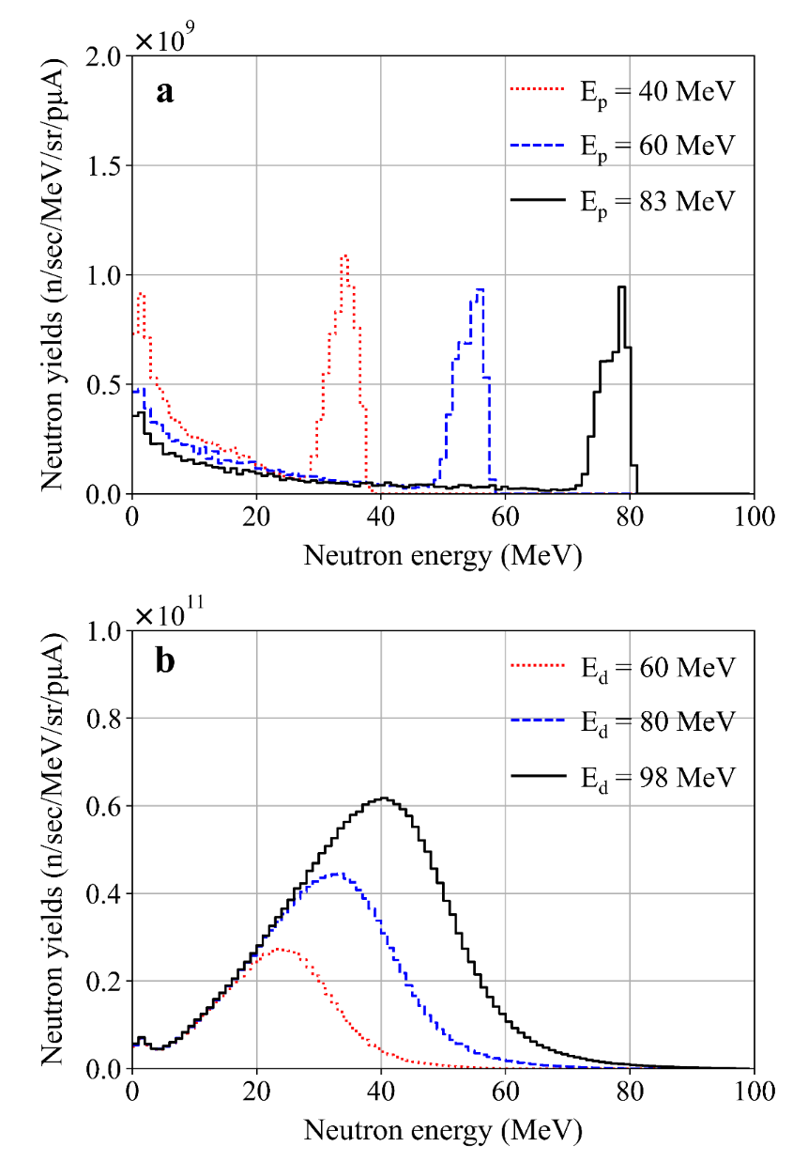
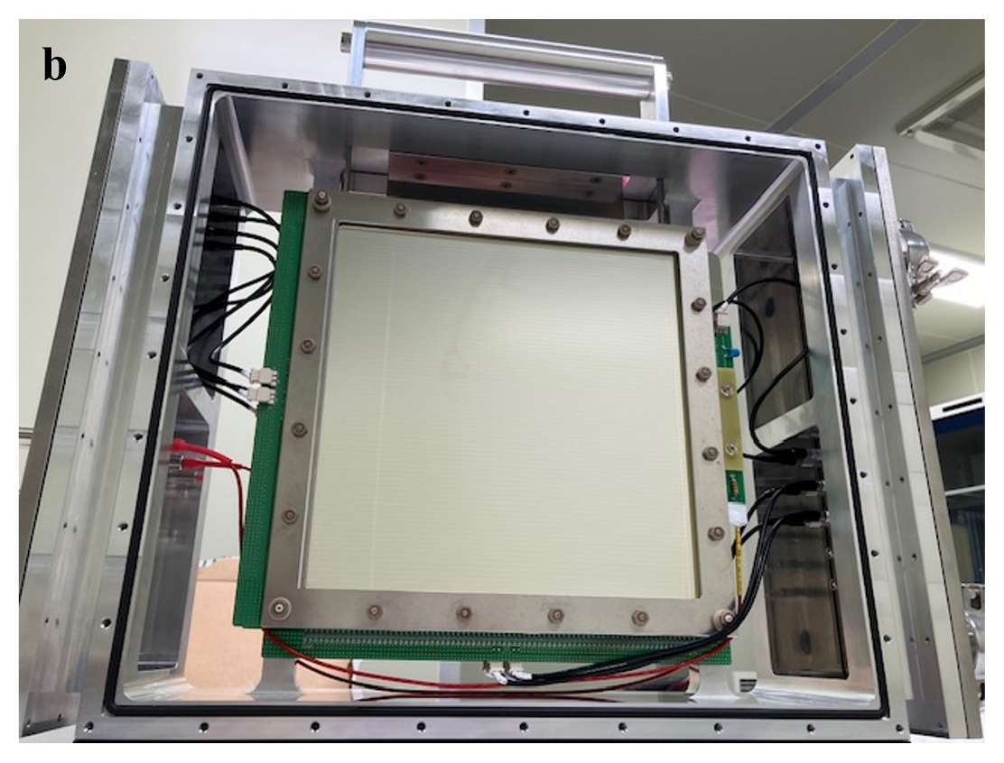
18
NDPS Configuration
NDPS Configuration
Neutron collimator is composed of iron and 5% borated polyethylene. It consists of 4 sections, ID increases 1 cm/m
Neutron yield at 0° (±2.5°)
by proton beams with
a 5mm thick lithium target
a Schematic view and b photograph of the thick target chamber, the target remote handling system, and the target storage box
Neutron yield at 0° (±2.5°)
by deuteron beams with
a thick graphite target
PPAC detector: active area of 20 × 20 cm².
For neutron detection, a thorium converter is placed between two active volumes.
C. Ham et al., J. Korean Phys. Soc. 87, 662 (2025)
Notes:
This slide provides additional details on the NDPS configuration.
On the left side, you can see examples of neutron yield spectra for different beam and target combinations.
At the top, monoenergetic neutrons are produced using a proton beam and lithium target.
At the bottom, white neutrons are produced using deuteron beam and a thick graphite target.
In the center, we show the neutron collimator structure. It is made of iron and 5% borated polyethylene. It consists of four sections and the inner diameter increases by 1 cm per meter. Therefore, the last section has an inner diameter of 4cm.
The middle-bottom image shows the PPAC detector with an active area of 20 by 20square centimeters. For neutron detection, a thorium converter is placed between the two active volumes.
The image on the right shows the thick target chamber and the remote handling system.

Slide 19
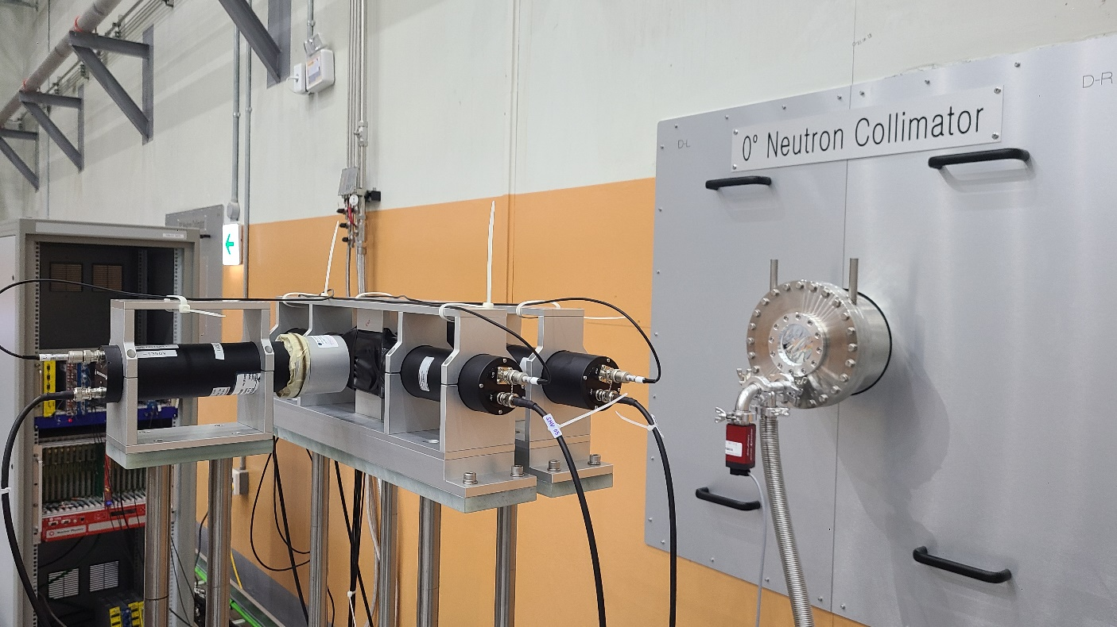
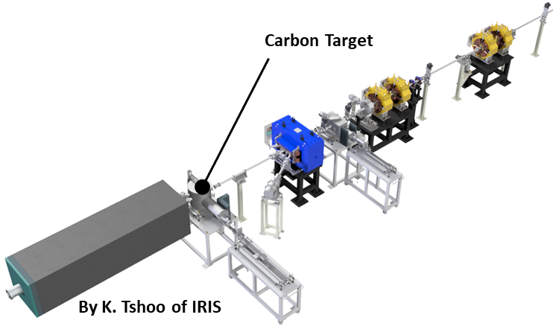
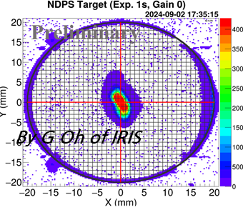
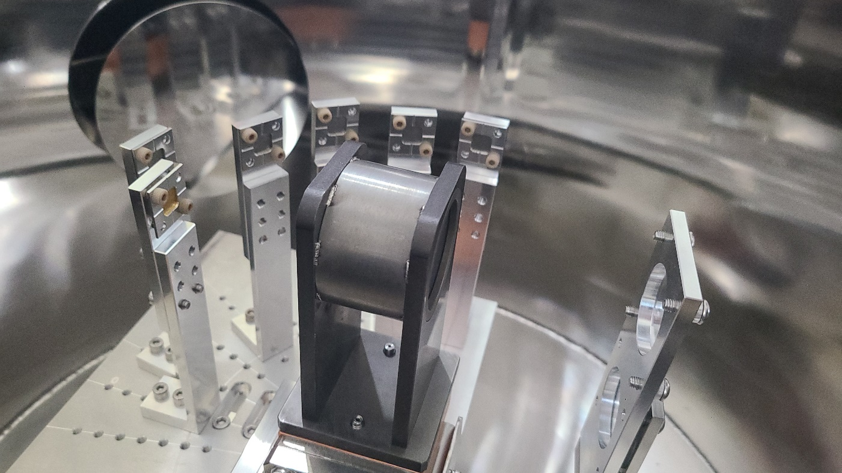
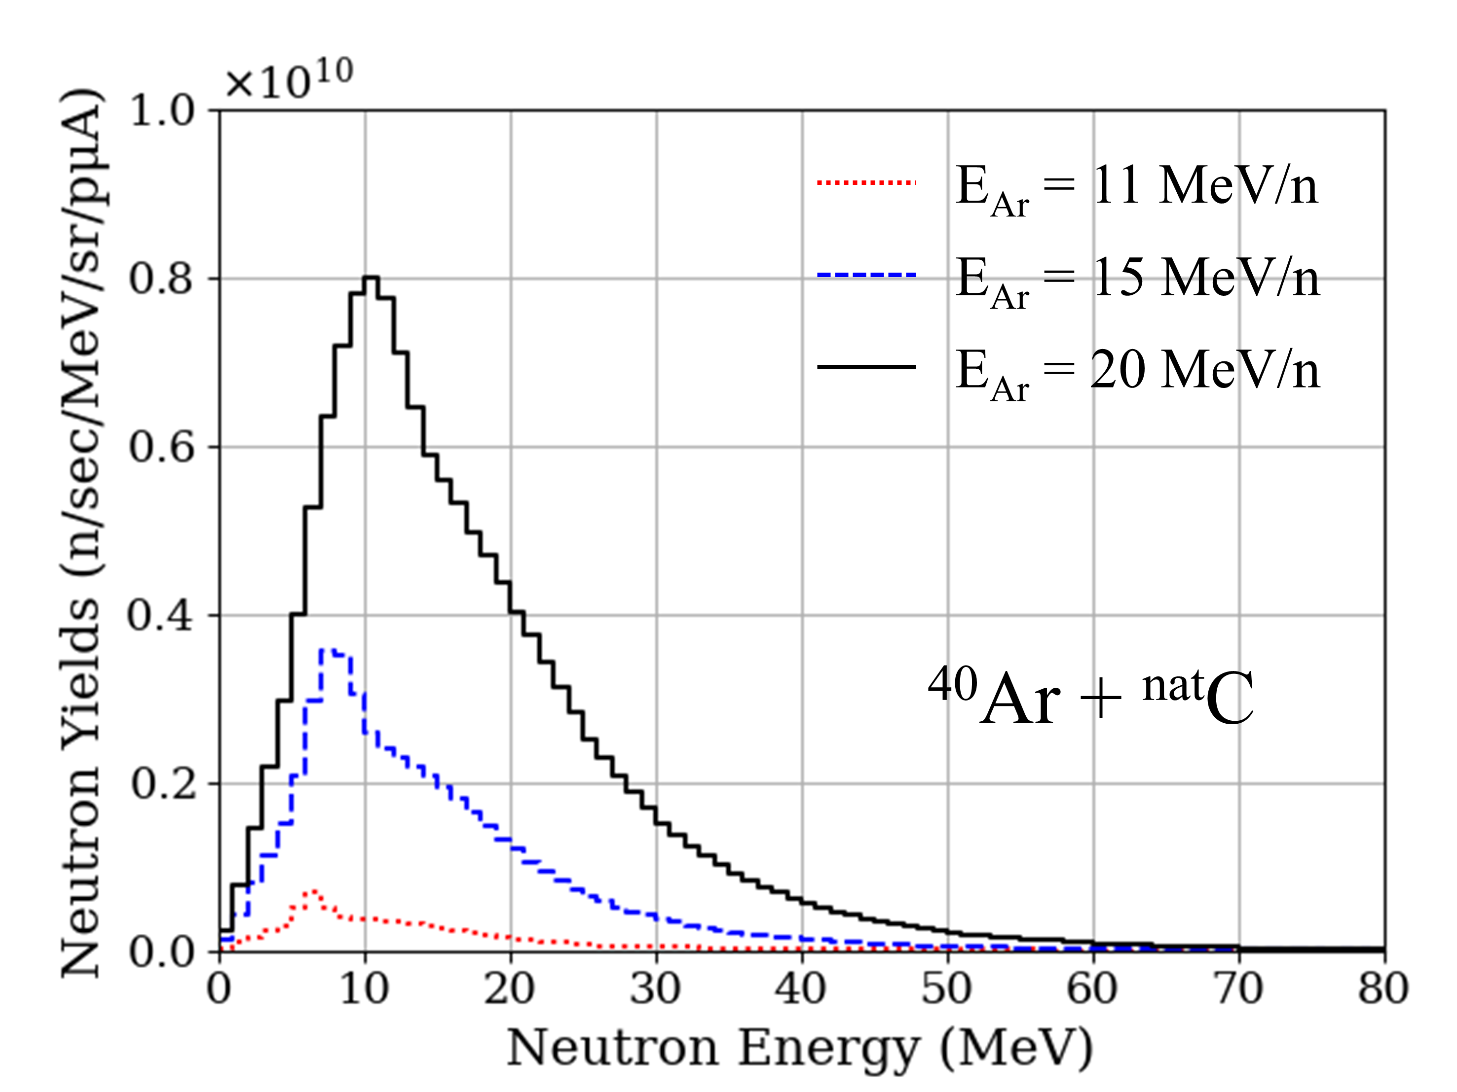
19
NDPS Commissioning
NDPS first beam test in 2024
Beam: 16.3 MeV/u ⁴⁰Ar (~ 3 W, ~10³ neutrons/sec are expected)
EJ-301 scintillator and activation foils were used to measure neutron flux
Neutron detector
(EJ-301)
Veto detectors
(Plastic scintillator)
⁴⁰Ar¹⁸⁺
Beam
Activation foils
(target chamber)
Neutrons
Neutron detection using EJ-301
Neutron
Activation foils
Graphite target
Quartz and Phosphor
Neutron detector
(EJ-301)
⁴⁰Ar beam profile measured at the phosphor screen located just in front of the NDPS target
Neutrons
⁴⁰Ar¹⁸⁺
Neutron yields at 0° (± 2.5°) produced by ⁴⁰Ar beam with the thick graphite target
Activation foils
(Fe, Al, Ti, Ni, Zr, Nb, Au, Bi)
Notes:
This slide shows the first beam test of the NDPS system.
A 40Ar beam with an energy of 16.3 MeV/u was used.
Neutron flux was measured using EJ-301 liquid scintillator detectors and activation foils.
The diagram on the left illustrates the neutron production setup using a thick graphite target, and the graph shows the neutron yield at 0 degrees.
The upper-right image shows the EJ-301 detector setup with veto plastic scintillators for background rejection.
The lower right image shows activation foils placed around the graphite target for neutron detection

Slide 20
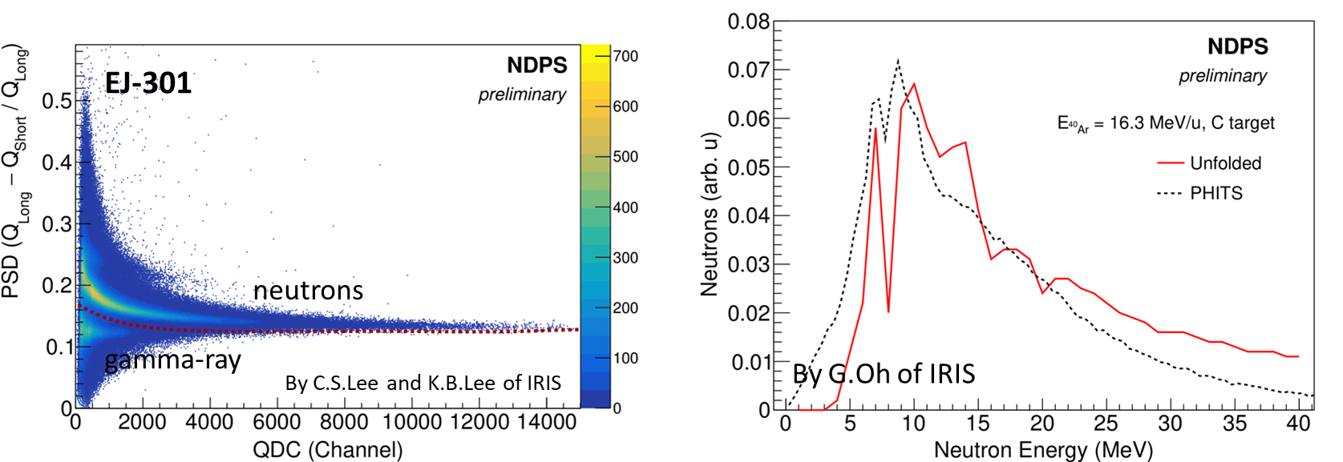
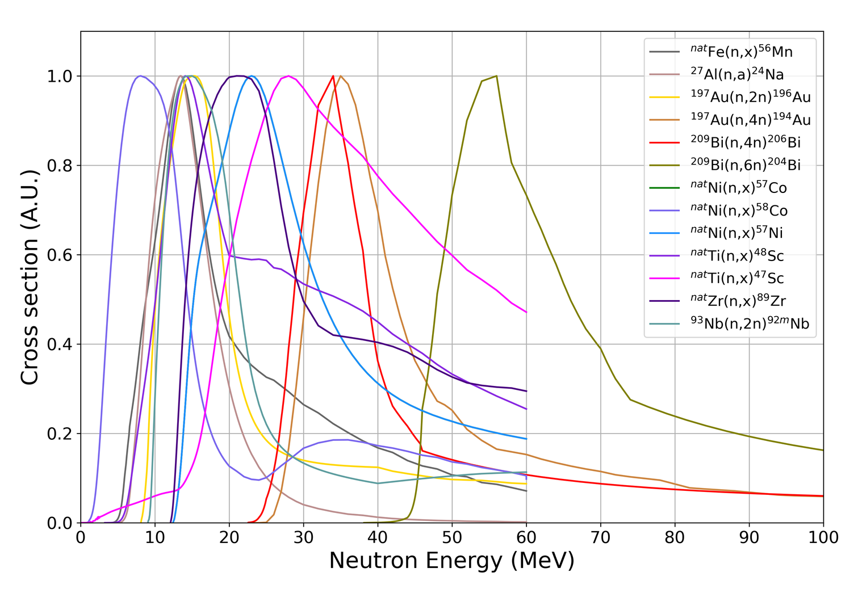
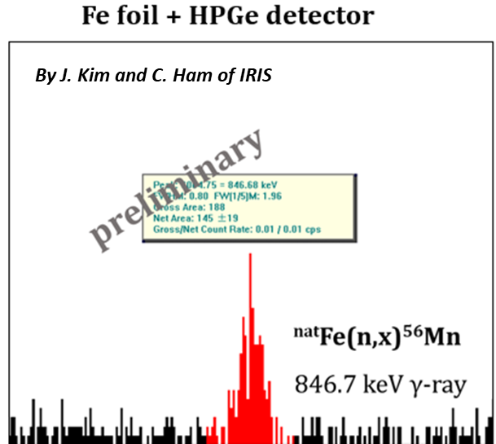
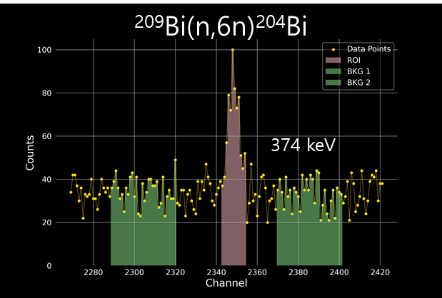
20
NDPS Commissioning
NDPS first beam test in 2024
Neutron detection performed with the EJ-301 detector
EJ-301: Liquid scintillator for neutron and gamma pulse shape discrimination (PSD)
Gamma rays and neutrons were distinguished using the EJ-301 scintillator and pulse shape discrimination (PSD).
An unfolding algorithm is being development to extract the neutron energy spectrum.
Activation foils: After neutron irradiation, gamma rays emitted from each foil were measured using an HPGe detector.
Normalized cross sections
Activation foils: Fe, Al, Ti, Ni, Zr, Nb, Au, Bi (The foils were overlapped in the 0-degree direction, while only the Fe foils were placed on the side)
High-energy neutrons above 40 MeV were confirmed based on the 209Bi(n,6n)204Bi reaction cross-section and the detection of 374 keV gamma rays emitted from 204Bi (374.7 keV).
209Bi(n,6n)204Bi
* IRDFF2 data used, MENDL for Au (n,4n)
Fe foil (847 keV γ-ray from 56Mn)
Bi foil (374 keV γ-ray from 204 Bi)
Notes:
This slide shows neutron detection results using the EJ-301 detector.
The 2D plot on the left shows the separation between gamma rays and neutrons using pulse shape discrimination.
The graph on the right shows the QDC spectrum after gamma-ray rejection, from which the neutron energy spectrum can be unfolded.
An unfolding algorithm is currently under development to extract the neutron energy spectrum.
The bottom half of the slide summarizes the results using activation foils.
After neutron irradiation, the gamma rays emitted from the foils were measured using a high-purity germanium (HPGe) detector.
For example, the right image shows the detection of a 374 keV gamma ray from 204Bi, indicating high-energy neutrons above 40 MeV.

Slide 21
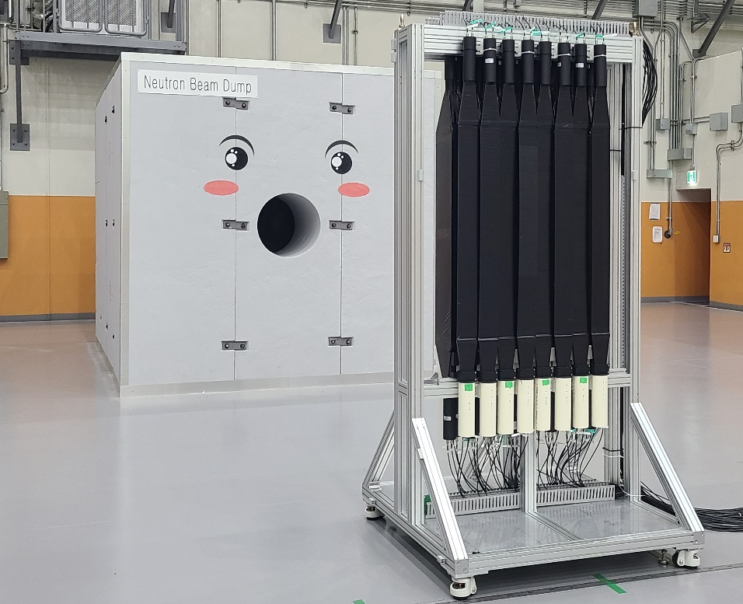
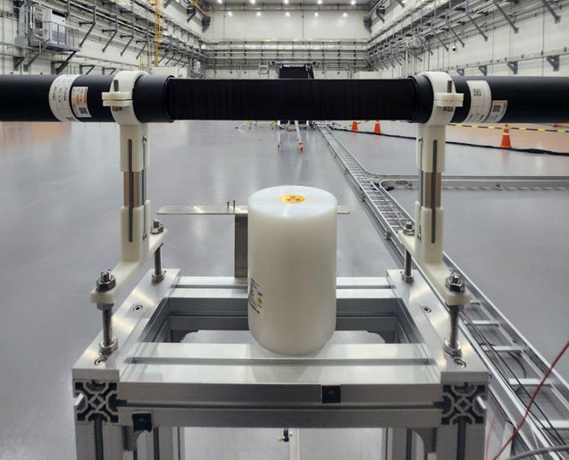
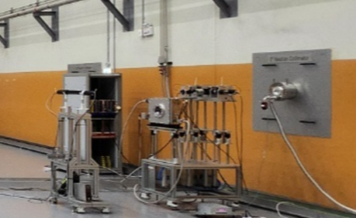
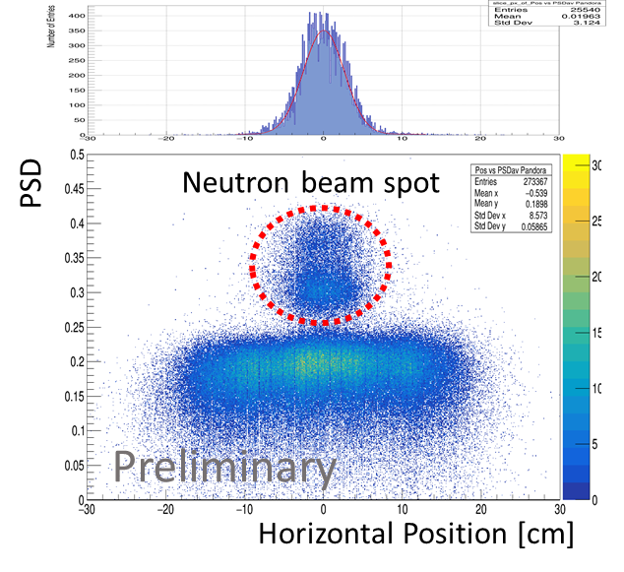
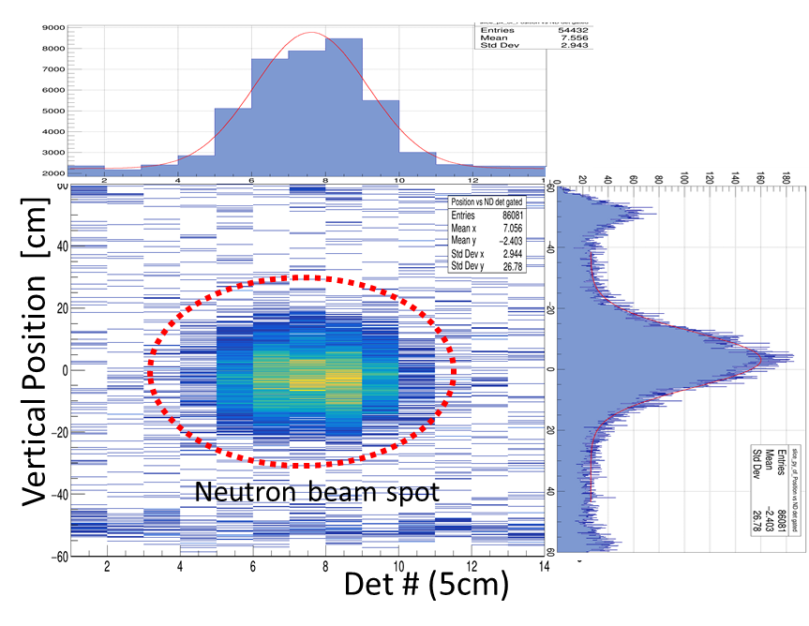
21
NDPS Commissioning
Neutron position distribution measurement by IRIS and CENS (Courtesy of Y.H. Kim and CENS)
PSD available plastic Scintillator (PANDORA)
Plastic detector arrays (LaPANE)
PANDORA detector
Plastic scintillators
Neutrons
Beam position
: 5 mm off-center
Beam size
: 18 x 20 cm (FWHM),
resolution not taken into account
Plastic scintillator with two PMTs
Horizontal beam size:
2.6 cm (in 1σ)
EJ-276: pulse-shape discriminating (PSD) plastic scintillator enables the separation of gamma and fast neutron signals on the basis of their timing characteristics
Notes:
This slide shows the results of neutron position distribution measurements conducted jointly by IRIS and CENS.
On the left side, you can see the PANDORA setup, which uses a PSD available plastic scintillator to detect neutron positions.
The scintillator is read out by two PMTs, and the system can distinguish neutrons from gamma rays.
As shown in the 2D plot, the horizontal beam profile was measured with a width of 2.6 cm in 1 sigma.
On the right, the LaPANE system consists of an array of plastic scintillator bars for 2D beam profile measurements.
The beam size was approximately 18 by 20 square cm in full width at half maximum (FWHM).

Slide 22
22
Presentation Outline
1. Status of RAON
2. Beam Commissioning and User Experiment Results
- KoBRA
- NDPS
- CLaSsy
3. User Experiments in 2025 and Future Plan
4. Summary
Notes:
Next, I’ll talk about CLaSsy, the Collinear Laser Spectroscopy system, and show some results from its commissioning and user experiments.

Slide 23
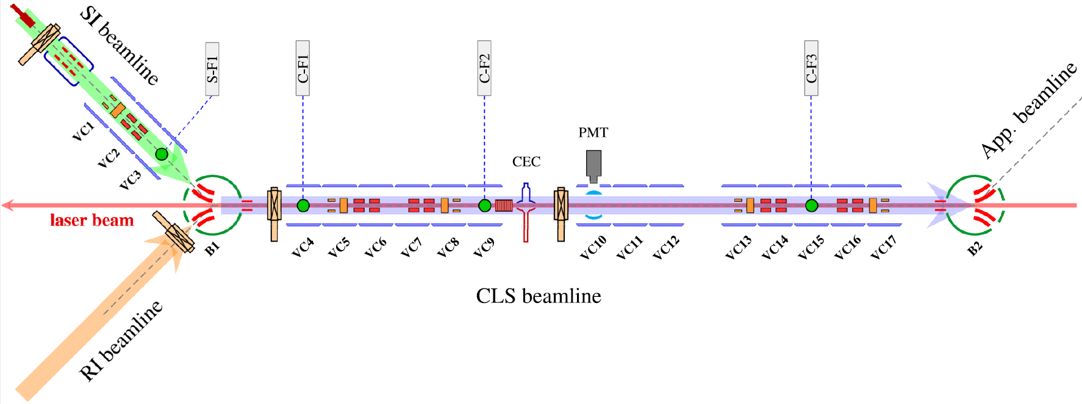



23
CLaSsy (Collinear Laser Spectroscopy)
CLaSsy Beamline and Laser System
CLaSsy beamline (originally developed at TRIUMF, Canada)
- Vertical charge-exchange cell for neutralization
- Post accelerator for Doppler tuning of the ion beam (±10 kV)
- Resonance photons collected by the light-collection system (PMT)
SI beamline: commercial hot-cathode plasma ion source
- Delivers various ion beams depending on the injected sample
RI beams are transmitted from the ISOL facility.
Laser system: Ti:Sapphire and dye lasers
S. J. Park et al., J. Korean Phys. Soc. 87, 649 (2025)
Notes:
This slide shows the configuration of the CLaSsy system.
The central CLS beamline was developed at TRIUMF, in 2021.
It allows Doppler frequency tuning of the ion beam by up to ±10 kV.
The beamline is also equipped with a vertical charge-exchange cell to neutralize the ions.
Resonance photons are collected using a PMT.
The SI beamline, on the left, uses a commercial hollow cathode ion source to extract various ion beams depending on the input materials.
The RI beamline, shown below, transports RI beams from the ISOL into the CLS line.
The laser system used for CLaSsy includes both Ti:Sapphire lasers and dye lasers.

Slide 24




24
CLaSsy Commissioning and User Experiments
4th Exp. [CL-24-12] Jung Bog Kim et al. (KNUE)
High-resolution laser spectroscopy for the study of sodium
D1 transition spectrum
Goal: Establish a high-resolution laser spectroscopy system and apply it to precisely measure the hyperfine constants of sodium isotopes using vapor cells, off-line beams, and on-line beams.
This work served as the full commissioning of the CLaSsy system and was performed in collaboration with CLaSsy members and Prof. Hoon Yu (ROKAFA).
Na-23 D1 & D2 line spectrum
D2 transition spectrum
Notes:
The fourth experiment, led by Prof. Jung Bog Kim from KNUE, focused on high-resolution laser spectroscopy for the study of sodium isotopes.
The goal of this experiment was to establish a high-resolution laser spectroscopy system and use it to precisely measure the hyperfine constants of sodium isotopes using vapor cells, off-line beams, and on-line beams."
This experiment also served as the full commissioning of the CLaSsy system and was carried out in collaboration with our team, Prof. Kim, and Prof. Hoon Yu from the ROKAFA.
This slide presents the results of laser spectroscopy performed using on-line sodium beams.
On the left side, you can see the energy level diagrams for the D1 and D2 transitions of ²³Na.
On the right, we show the measured fluorescence spectra for the D1 and D2 transition lines, where each peak corresponds to a specific hyperfine transition.
In the D1, D2 spectrum, the hyperfine splitting of 1.772 GHz is clearly resolved

Slide 25



25
CLaSsy Commissioning and User Experiments
5th Exp. [CL-24-16] Junho Won et al. (CENS, IBS)
Collinear laser spectroscopy of neutron-deficient Na isotopes
Goal: Perform high-precision charge radius measurement of ²¹Na using CLS, contributing to nuclear structure studies and serving as a commissioning run for the system.
Notes:
This slide presents the results of the fifth experiment, conducted by Dr. Junho Won from CENS, focusing on collinear laser spectroscopy of neutron-deficient sodium isotopes.
This experiment is a continuation of the previous one, and both the experimental work and data analysis are being carried out collaboratively by two groups.
The primary goal of this experiment was to perform a high-precision charge radius measurement of ²¹Na using the CLaSsy system.
On the slide, you can see the D1 transition spectra of ²¹Na, ²²Na, and ²³Na, measured in both collinear and anti-collinear geometries.

Slide 26
26
Presentation Outline
1. Status of RAON
2. Beam Commissioning and User Experiment Results
- KoBRA
- NDPS
- CLaSsy
3. User Experiments in 2025 and Future Plan
4. Summary
Notes:
Finally, I’ll introduce the user experiments scheduled for 2025 and our future plan.

Slide 27
27
User Program and Experiment Plan for 2025-2026
Second Call for Proposals (2025-2026)
Period: Jan 9 - Feb 20, 2025 (6 weeks)
Received: 22 Proposals & 8 Letters of Intent (LoIs) (28 in nuclear physics, 2 in applications)
392 Participants from 7 institutions
Call for Technical Beam Time Requests (2025)
Purpose: For technical beam tests and feasibility studies (not PAC-reviewed)
Scope: Detector / instrumentation tests and pilot feasibility experiments
Period: Jul 14 - Aug 3, 2025 (3 weeks)
Received: 6 Proposals
Third Call for Proposals (2026)
Period: Sep 10 - Oct. 28, 2025 (7 weeks)
Available systems: KoBRA, NDPS, CLaSsy, MRTOF-MS (MMS), and Cyclotron setups
3rd PAC meeting: Planned for Jan 2026
International User Program
Plan to provide RAON beams to international users in 2028
Notes:
The second call for proposals was held earlier this year, receiving 22 proposals and 8 letters of intent from seven institutions.
In July, we also conducted a technical beam time request call, which received 6 proposals for detector and feasibility tests.
The third call is now open and will close next Tuesday, with the third PAC meeting planned for January 2026.
So far, our proposal calls have been open only to domestic users. but we are planning to open RAON beam access to international users in 2028.

Slide 28
28
User Experiment and Services in 2025
Name (affiliation) | Experiments | Dates | Beams | Beam time | Exp. facility
Taehyo Kim (KARI) | Single Event Effect Test for Space Semiconductor at KoBRA | Sep 9 - 15 | ⁴⁰Ar (16.5 Mev/u, 5 pnA) | 5 days | KoBRA
Arunita Mukherjee (CENS/IBS) | Explore Triaxiality and re-measure the lifetime of the excited states in A ~ 80 using fusion evaporation reaction | Oct 20 - 28 | ²⁰Ne (4.5 Mev/u, 1.5 pnA) | 7 days | KoBRA
Xesus Pereira-Lopez (CENS/IBS) | Probing isospin symmetry and the systematics of single-nucleon removal with mirror reactions | Nov 6 - 7 | ²⁰Ne (10 Mev/u, 1.5 pnA) | 2 days | KoBRA
Hiroshi Watanabe (CENS/IBS) | High-spin spectroscopy of N~20 nuclei towards the island of inversion by RIB-induced fusion-evaporation reactions | Nov 12 - 18 | ²⁵Na (10 Mev/u, 1E6 pps) | 5 days | KoBRA
Joochun Park (CENS/IBS) | Coulomb excitation of 181Ta and 197Au with 40Ar | Nov 24 - 28 | ⁴⁰Ar (4.5 Mev/u, 1.5 pnA) | 5 days | KoBRA
Anastasiia Chekhovska (CENS/IBS) | Production of medical isotopes 97Ru, 103Ru, and 105Rh with 35-70 MeV protons | Nov 25 - 27 | proton (35~65 MeV, 1 nA) | 3 days | Cyclotron
Young Soo Yoon (KRISS) | Neutron energy spectrum measurements using Bonner sphere spectrometer | Dec 3 ~ 12 | ⁴⁰Ar (16.5 Mev/u, 1E10 pps) | 8 days | NDPS
Hoon Yu (RoKAFA) | Doppler free collinear laser spectroscopy with Na isotopes | Dec 1 ~ 5 | ^{21~25}Na (20 keV, 1E7~8 pps) | 5 days | CLaSsy
Junho Won (CENS/IBS) | Collinear Laser Spectroscopy of 21-25Na | Dec 8 ~ 12 | ^{21~25}Na (20 keV, 1E7~8 pps) | 5 days | CLaSsy
A total of nine user experiments are scheduled across the KoBRA(5), NDPS (1), CLaSsy (2), and Cyclotron (1) systems.
In addition, four technical experiments are planned for system and detector tests at KoBRA (1), NDPS (2), and the Cyclotron (1).
Notes:
In 2025, a total of nine user experiments are scheduled at four systems — five at KoBRA, one at NDPS, two at CLaSsy, and one at the Cyclotron.
Most of them are nuclear physics experiments proposed by domestic users.
Stable 40Ar and 20Ne beams, and the 25Na RI beam will be delivered to KoBRA and NDPS, while 21-25Na beams will be used in the ClaSsy experiments.
In addition, four technical experiments are planned for system and detector commissioning at KoBRA, NDPS, and the Cyclotron.

Slide 29
29
Summary and Outlook
KoBRA: Beam commissioning completed
- Secondary RI beams up to Z=17 were produced using a ⁴⁰Ar beam.
- Beam optics were verified using the Bρ–ΔE–ToF method with the full detector system (PPAC, Si-SSD, plastic scintillators).
- In 2024, the first successful delivery of low-energy beams from SCL3 and ISOL to domestic users was achieved.
NDPS: First beam test completed with ⁴⁰Ar beam
- Neutron production was confirmed using activation foils and PSD techniques.
- Development of neutron unfolding algorithms is in progress.
CLaSsy: System commissioning completed
- High-resolution spectroscopy successfully performed for ²¹⁻²³Na isotopes
First call for proposals among domestic users: Dec 2023 (30 proposals submitted)
In 2024, low-energy beams from SCL3 and ISOL were first delivered to users for five experiments
(three with KoBRA - RI production, SEE test, and elastic scattering; two with CLaSsy - laser spectroscopy of Na isotopes).
Second call for proposals/LOIs: Jan 2025 (22 Proposals and 8 LoIs submitted).
In 2025, a total of nine user experiments, and four technical experiments will be conducted across KoBRA, NDPS, CLaSsy, and Cyclotron.
Call for Proposals 2026: Sep 10 ~ Oct 28, 2025. (KoBRA, NDPS, CLaSsy, MRTOF-MS (MMS), and Cyclotron setups will be available)
We are planning to open RAON beam access to international users in 2028
Notes:
Both KoBRA and CLaSsy systems have completed commissioning.
They successfully delivered low-energy beams from SCL3 and ISOL to users and produced meaningful results.
NDPS also achieved its first beam test with a 40Ar beam, confirming neutron production.
In 2024, five user experiments were conducted, and nine more are scheduled in 2025 along with four technical runs.
The next call for proposals, covering all major systems including MRTOF-MS and the Cyclotron, will close at the end of October

Slide 30




30
Acknowledgements
This work was supported by the Institute for Basic Science (IBS-I001-D1) and the National Research Foundation of Korea (NRF) funded by the Ministry of Science and ICT (2013M7A1A1075764), Republic of Korea.
Special thanks to:
Minsik Kwag, Dong Geon Kim, Mijung Kim, Eunhee Kim, Jae Cheon Kim, Sung Jong Park, Geonhee Oh, Sangjin Lee, CheongSoo Lee,
Seong Jae Pyeun, Cheolmin Ham, Kwang‑Bok Lee, Changwook Son, Donghyun Kwak, Jaehyun Song, Jaesung Kim, Chaeyoung Lim,
Kyoungho Tshoo, Taeksu Shin, Jinho Lee, Young-Ouk Lee, Young Suk Kim, Hee‑Joong Yim, Seongjin Heo
Collaborating institutes:
CENS (Center for Exotic Nuclear Studies)
Jung-Bok Kim (KNUE), Hoon Yu (KAFA)
Notes:
I would like to thank all my colleagues from IRIS and our collaborators from CENS, KNUE, and the KAFA, for their great support and contributions to these experiments.

Slide 31
Thank you for your attention.

