Slide 1
Nuclear structure studies by collinear laser spectroscopy
Ági Koszorús
MYRRHA chair at KU Leuven
SCK CEN

Slide 2
Goal of this talk
Overview of collinear laser spectroscopy
New results as a results of developments (mostly experimental)
New setups (slides from collaborators)
Not covered: laser polarization beamline (talk yesterday)
RAON: talk yesterday and today
*Due to limited time not every development could be discussed ☹

Slide 3
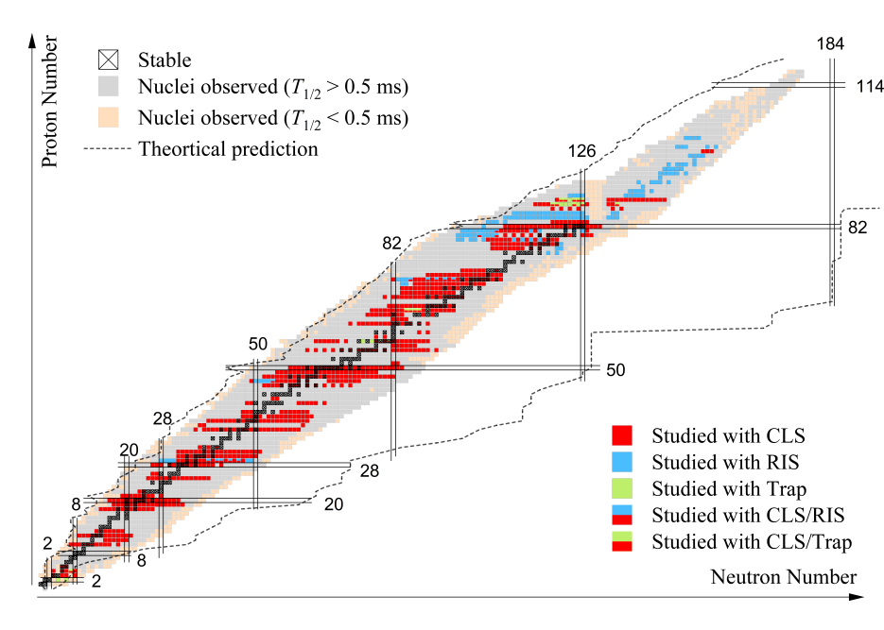
X.F. Yang et al Progress in Particle and Nuclear Physics, Volume 129, March 2023, 104005

Slide 4
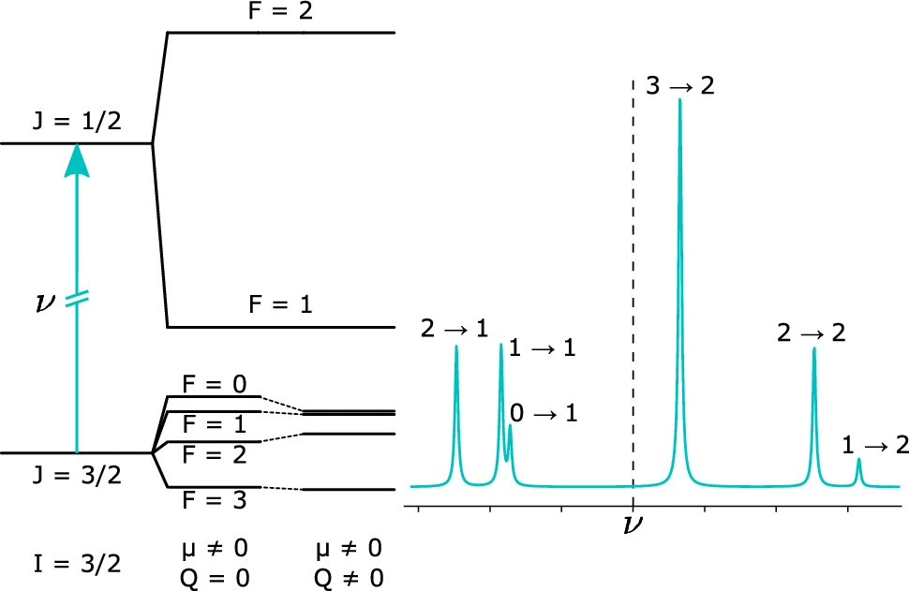
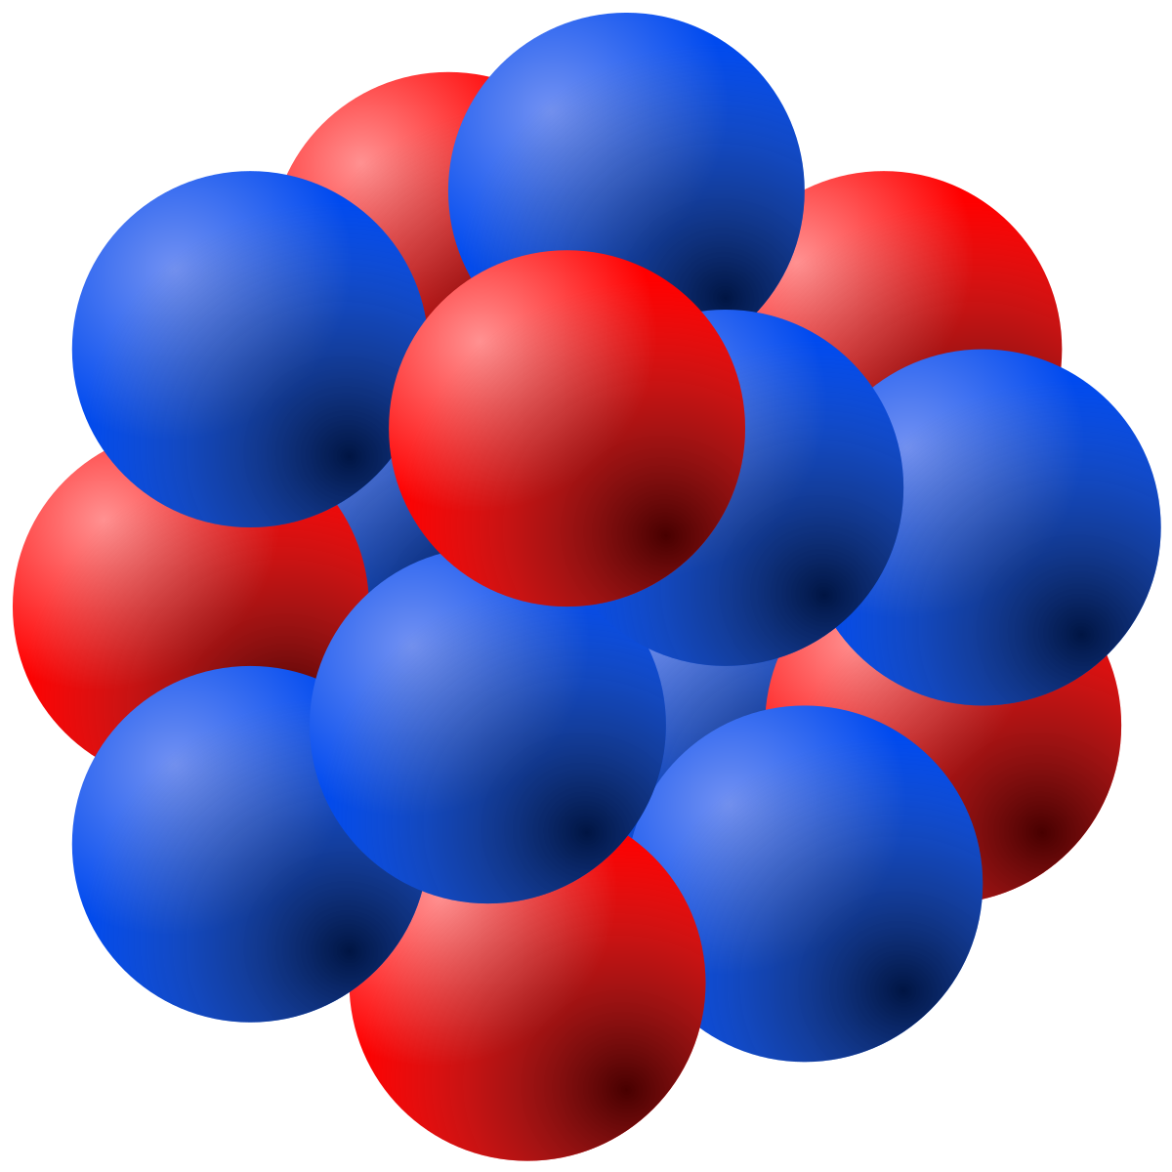
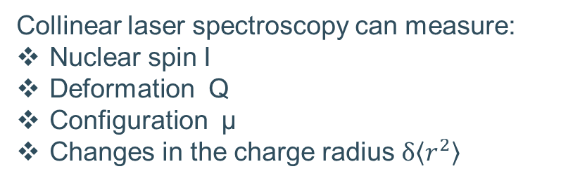
Collinear laser spectroscopy: basics
Hyperfine splitting of the electronic levels
Electron
Angular momentum J
F
J
I
J=1/2
I
Nucleus with spin I
J
F
J=1/2
Collinear laser spectroscopy can measure:
Nuclear spin I
Deformation Q
Configuration µ
Changes in the charge radius $δ\left\langle r^{2}\right\rangle$

Slide 5
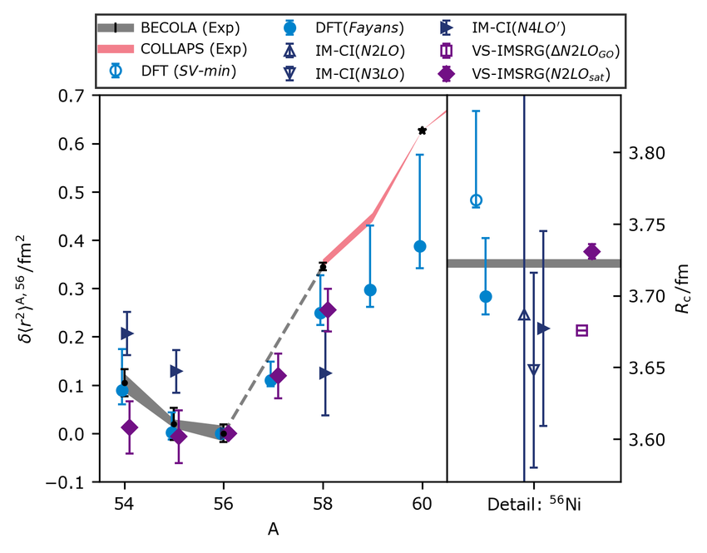
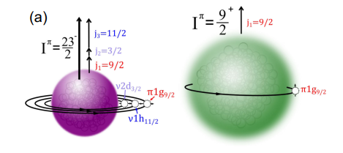
Hot topics in nuclear structure research:
Kink in the radii at (new) shell closures and islands of inversion
Single-particle nature and deformation at exotic shell closures
Charge radius and configuration of proton emitters and proton halos
…
R.F. Garcia Ruiz et al., PRL 134, 252501 2025
F. Sommer et al., PRL 129, 132501 2022

Slide 6
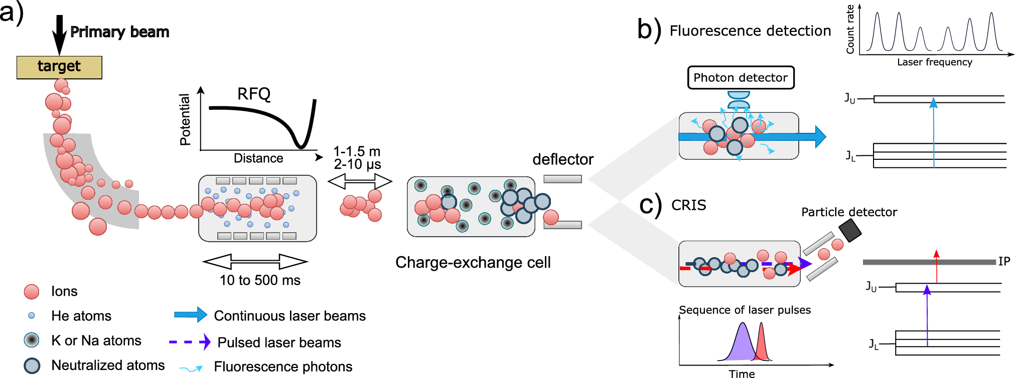
Collinear laser spectroscopy: types

Slide 7
The bottleneck and some solutions
Facility:
Production yields
High energy and energy spread
Isobaric contamination
→ Target ion source developments
Stopping cell, cooler
→ Selective and sensitive way of detection:
→ Particle detection, decay detection, selective ionization …
Atomic structure:
Difficult laser wavelengths
Low sensitivity to nuclear properties
High density of metastable states
→ Charge exchange, optical pumping in the cooler-buncher, resonance ionization, dedicated (tailored) spectroscopy schemes
→ Strong atomic theory collaborations
→ New laser light production (frequency mixing, Raman laser, …)

Slide 8
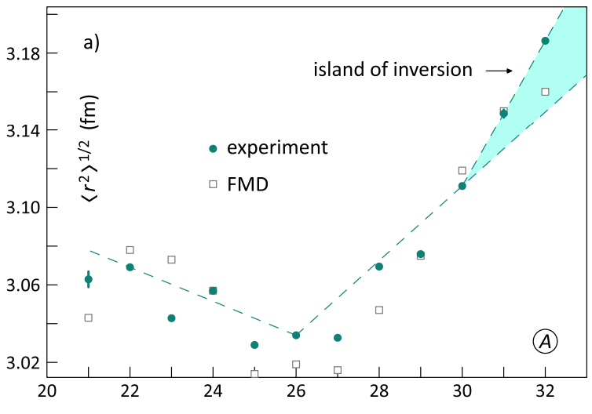
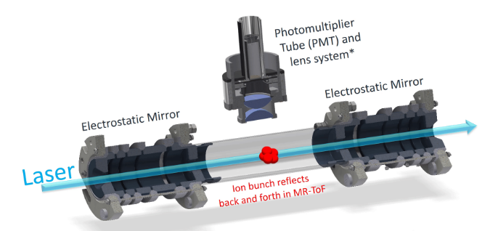
New collinear technique: MIRACLS @ ISOLDE
Perfect for closed ionic systems: Cd, Mg, …
Neutron rich Mg measured into the island of inversion
Nuclear structure of short-lived Cd
Previous results obtained using laser-induced nuclear orientation for isotope shift measurement https://doi.org/10.1103/PhysRevLett.108.042504
ISOLDE website, ISOLDE Newsletter 2025

Slide 9
New collinear technique: MIRACLS @ ISOLDE
Perfect for closed ionic systems: Cd, Mg, …
Neutron rich Mg measured into the island of inversion
Nuclear structure of short-lived Cd
Previous results obtained using laser-induced nuclear orientation for isotope shift measurement https://doi.org/10.1103/PhysRevLett.108.042504
Talk by Franziska Maier
ISOLDE website, ISOLDE Newsletter 2025

Slide 10
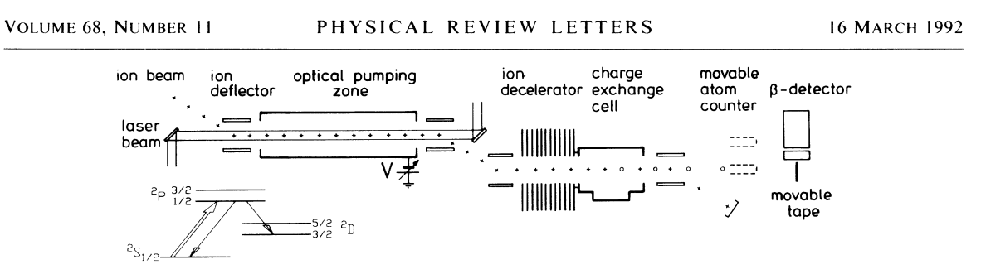
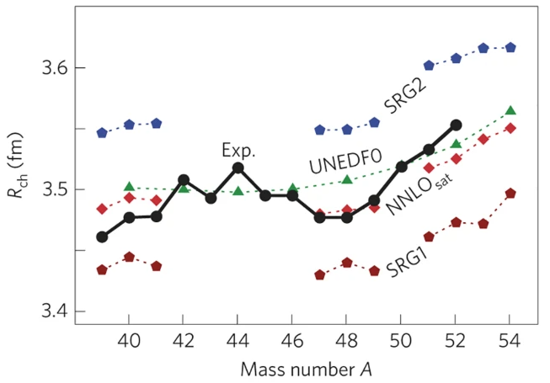
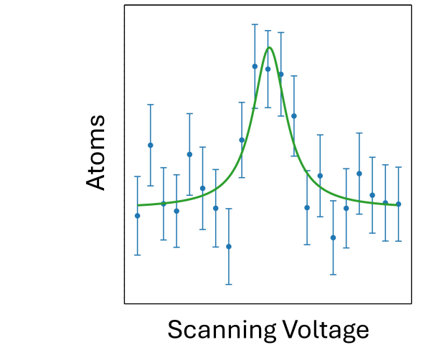
What goes around comes around: ROC at COLLAPS
Revived by the COLLAPS collaboration
Addressing the magic nature of N=32 and N=34 in Ca
Works for atomic systems with similar S→ P→ D schemes
There is a whole class of techniques relying on selective charge exchange
But follow the talk of Jessica Warbinek
⁵⁴Ca
ISOLDE newsletter 2025
R.F. Garcia Ruiz Nature Physics 12, 594–598 (2016)

Slide 11
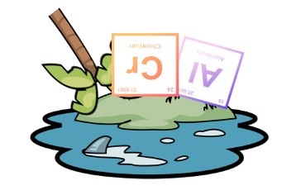
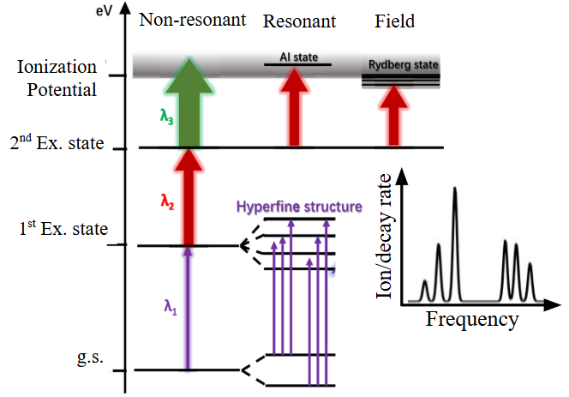
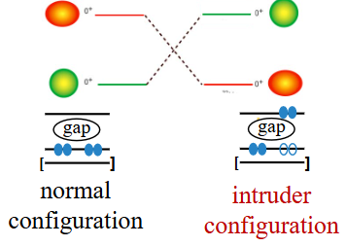
Neutron-rich Cr @ CRIS (collaboration with RILIS)
CRIS measurement of ⁵⁰⁻⁶²Cr
Nuclear structure at the N=40 island of inversion
RILIS developed a RIS with and AI state – boost in efficiency
⁶¹Cr produced at 2000 cps
⁶²Cr produced at 300 cps
Molecular isobaric contamination in this region at ISOLDE

Slide 12
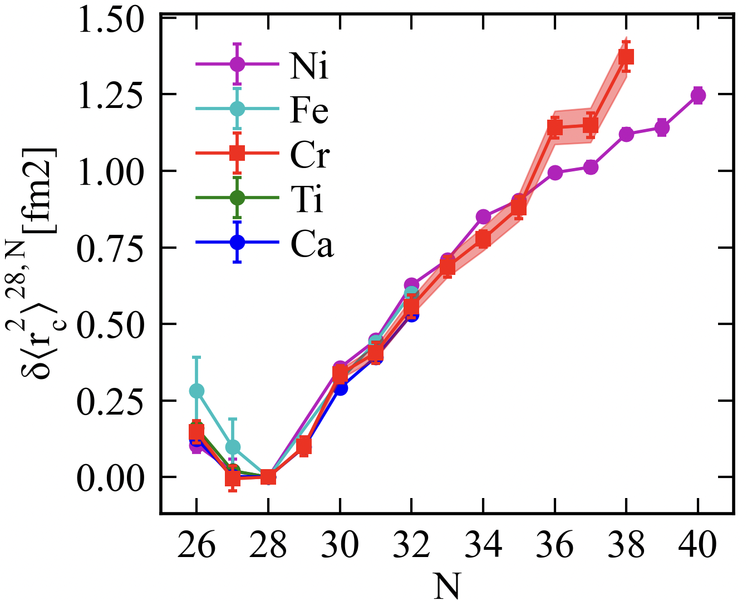
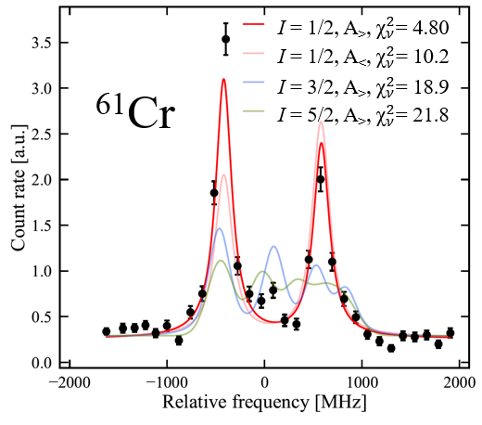
Neutron-rich Cr @ CRIS (collaboration with RILIS)
50
⁵⁰Cr
⁵⁷Cr
250
0
0
50
⁵¹Cr
0
⁵⁸Cr
100
100
⁵²Cr
0
0
5
1000
⁵⁹Cr
Count Rate [s⁻¹]
⁵³Cr
0
0
2.5
1000
⁵⁴Cr
⁶⁰Cr
0
0
100
⁵⁵Cr
⁶¹Cr
2.5
0
0
Spin of the ⁶¹Cr revised I=1/2
Triaxiality of ⁶¹Cr ground state
Clear sigh of the deformation = island of inversion
50
⁵⁵Cr
⁶²Cr
1
0
0
Relative Frequency [MHz]
L. Lalanne et al., PRC 112, L031301 (2025)

Slide 13
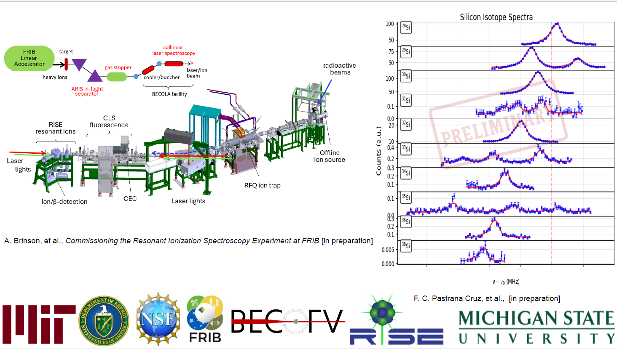
Slide from Fabian Pastrana (MIT)

Slide 14
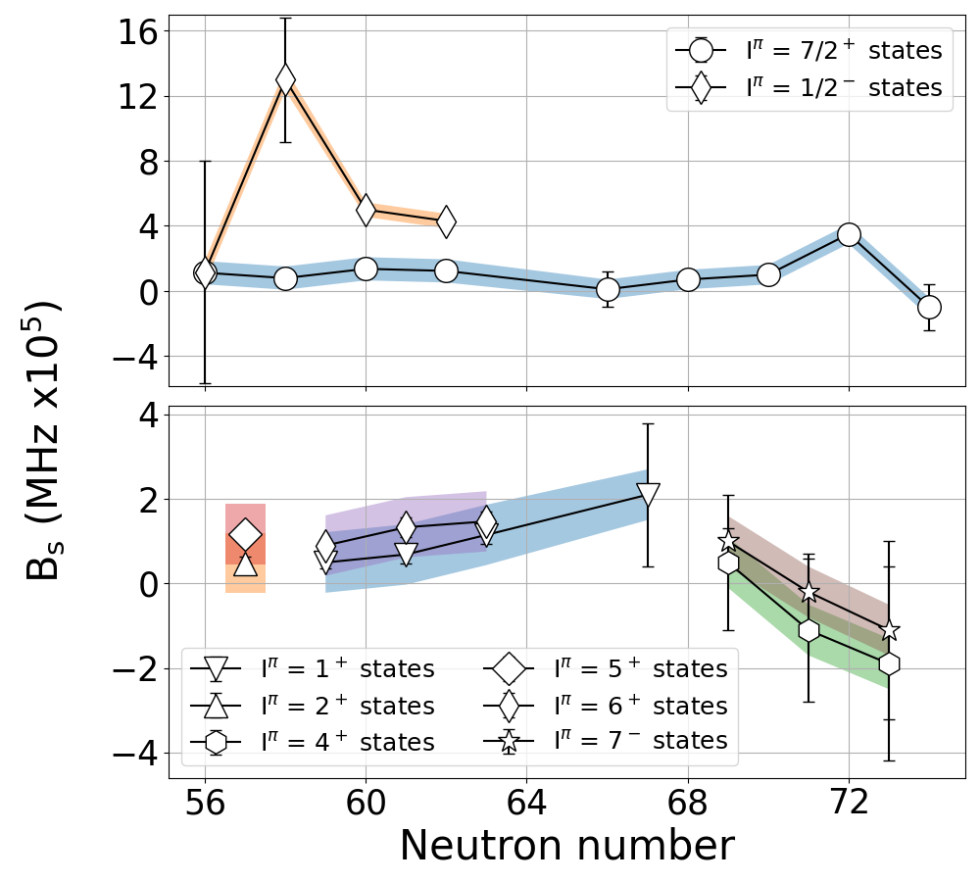
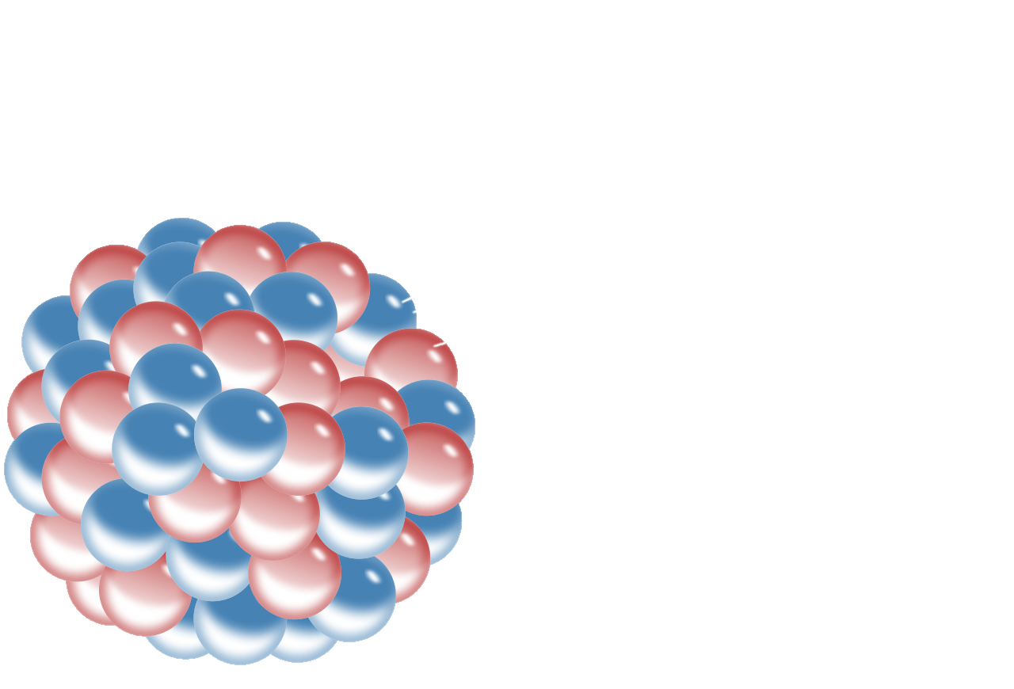

IGISOL: BW contribution in Ag
Slide from Bram van den Borne
Combine BW sensitive state, BW insensitive state & atomic calculations
BW effect contribution
Absolute BW parameter B_{S}
$B_{s}= \frac{{\tilde{A}}_{0}+{\tilde{A}}_{QED}−\frac{IJ}{μ_{P3/2}}A_{S1/2}}{{\overset{̿}{A}}_{BW,el}}∝ \int{gf\left(1−F\left(r\right)\right)dr}$^{[1]}
F(r) is unknown function of nuclear
magnetisation distribution^{[2]}
µ
[5]
So far only performed on stable/long-lived nuclei!^{[2,3]}
Combination of atomic calculations and laser spectroscopy can provide a benchmark for the nuclear magnetisation distribution of short-lived nuclei^{[4]}
[1] Skripnikov, L. V, et al., The Journal of Chemical Physics 153.11 (2020).
[2] Sanamyan, G., B. M. Roberts, and J. S. M. Ginges. Physical Review Letters 130.5, 053001 (2023).
[3] Horst, M, et al., Nat. Phys. 21, 1057–1063 (2025)
[4] Skripnikov, L. V., et al., Physical Review C (to be submitted). [5] Credit to Mualla Aytekin for data

Slide 15
Watch out for new beamlines at new facilities:
PLASEN @BRIF
LASAGN @DESIR (GANIL)
REBEL @KULeuven + ISOL@MYRRHA
RAON (already presented)
….

Slide 16


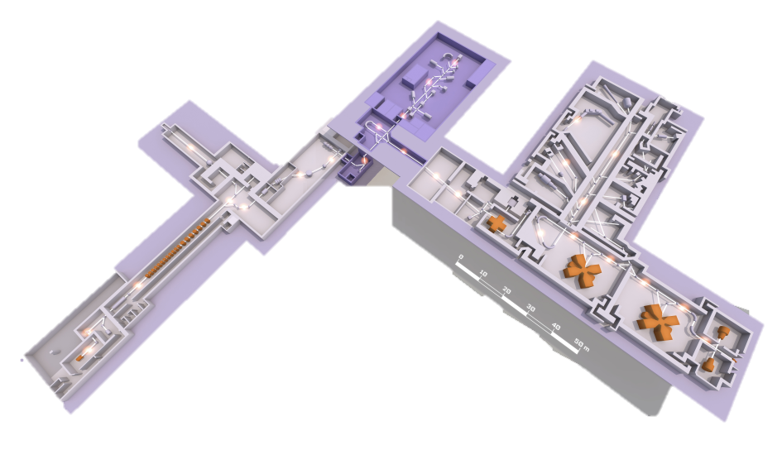


The GANIL / SPIRAL2 facility
Slide from L. Lalanne
16
Desintegration, Excitation and Storage of Radioactive Ions
Hall for low-E and precision (nuclear) physics experiments
experimental areas
DESIR (2027)
LASAGN
NFS
Neutron For Science
High intensity neutron beam
1-30MeV
LISE spectrometer
NEW Ganil INjector
Super Separator Spectrometer
SPIRAL1
ISOL fragmentation RIB
SPIRAL2 SC Linac
HI up to 15 MeV/A
few 10 pµA
cyclotrons
SPIRAL2 ion source
¹²C to ²³⁸U, up to 95 MeV/A
< 1 pµA
ion sources

Slide 17
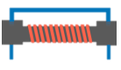

LASAGN : LAser Spectroscopy At GaNil
17
Ionization unit
Differential pumping
RF electrode
LASAGN phase 3
diagnostics
Quad. triplet
DP
Voltage scanning device
Ion detector / Si / MR-TOF
Charge exchange cell
Optical detection
Interaction region 10⁻¹⁰ mbar
Kicker
Ion source
Quadrupole doublet + steerers
→
CLS with fluorescence detection
CRIS with ion detection
High res : > 50MHz
Background free
Combo with trap and decay setups
High sensitivity : > 1 pps
Kicker/bender
RIB →
RIB →
RIB →
DESIR central beam line
Timeline :
Fluorescence / day 1 RIB : 2028
CRIS : 2029
LASAGN : Versatile high-resolution, high-precision and high-sensibilty laser spec. setup
Benefits from the many beam preparation and purification devices of DESIR
Unique opportunities in the light region with SPIRAL1 RIB (O, F, Cl, P, Zn…)
Allow to re-inject RIS beams to the central beam line → synergy with trap and decay setups
Slide from L. Lalanne

Slide 18
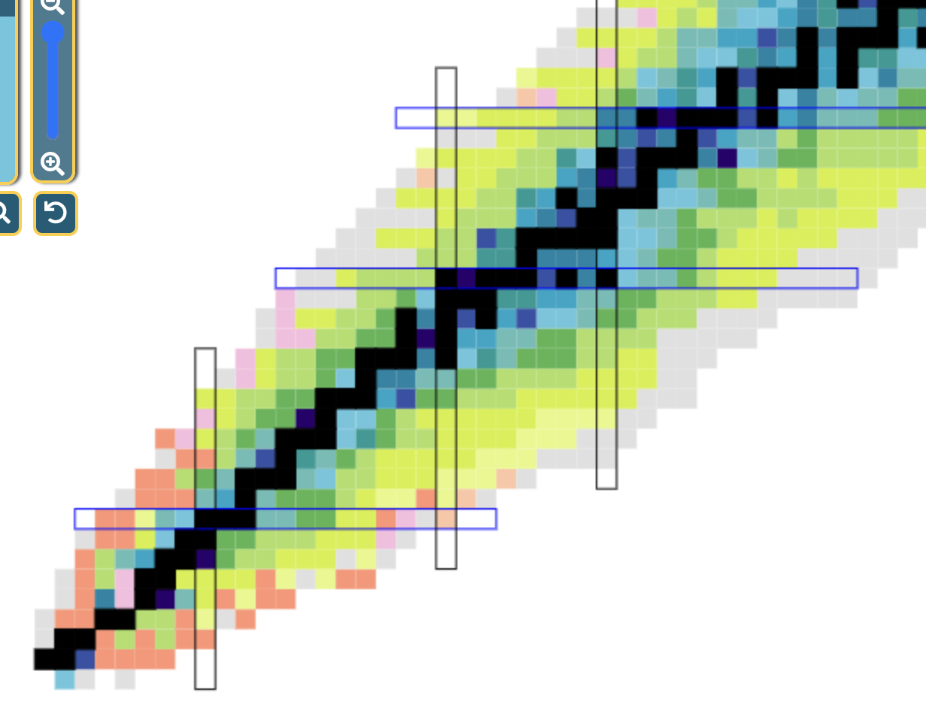
Slide from L. Lalanne
LASAGN First Physics
Physics questions investigated at LASAGN :
Physics Cases :
Investigate the origin of charge radii kink
Characterize N=6, 8, 14, 16, 20, 28 and 40
through radii and moments measurements
Provide stringent tests to shell-model
and ab-initio theories and investigate
the microscopic origin of radii trends
Study NN correlations in
N=Z and deformed isotopes
Evidence proton halo
structures with
charge radii
Many others…
Zn:
evolution towards N=28
In-trap decay of Mn to Fe :
Collectivity bellow ⁶⁸Ni
N=40
Ar: proton halo and deformation
Cl: shell evolution and N=28 shell closure
P: proton halo, N=20, toward N=28
N=28
F: Proton halo and N=14,16 magicity
N=20
N=14 16
O: radii kinks at N=6, 8 and N=14,16 magicity
N=Z
N=6
N=8

Slide 19
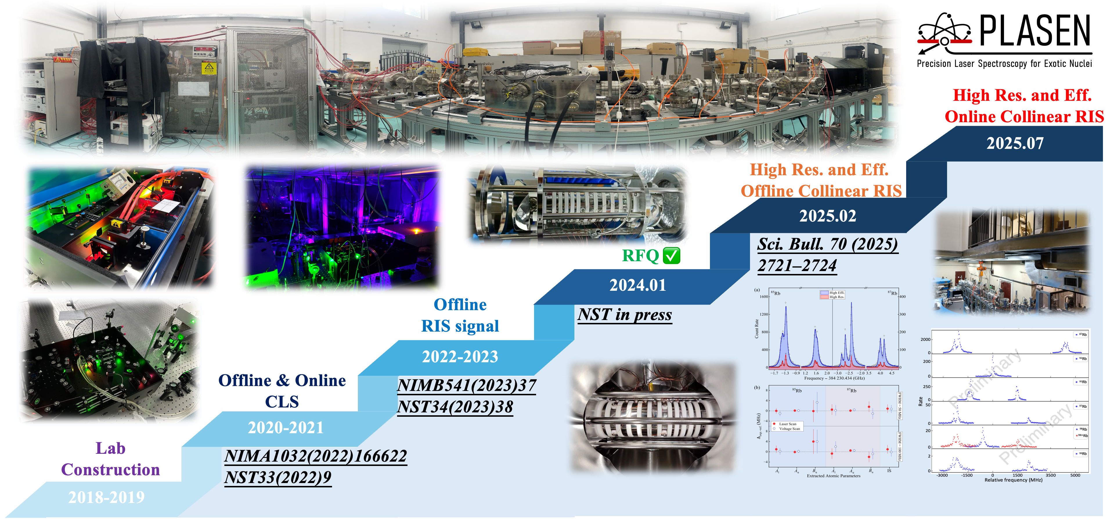
Slide from X.F. Yang

Slide 20
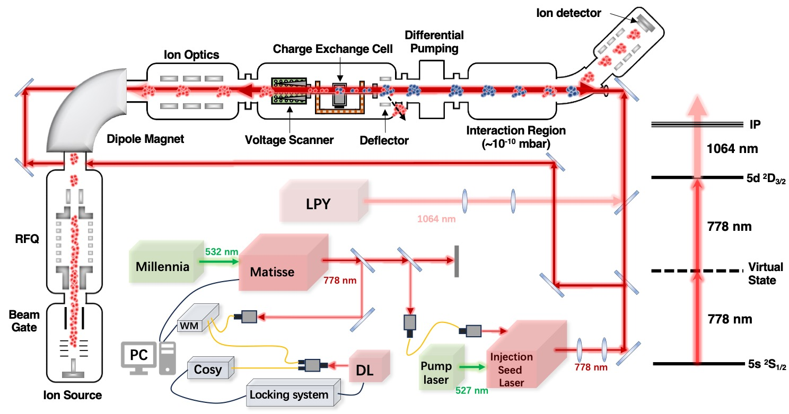
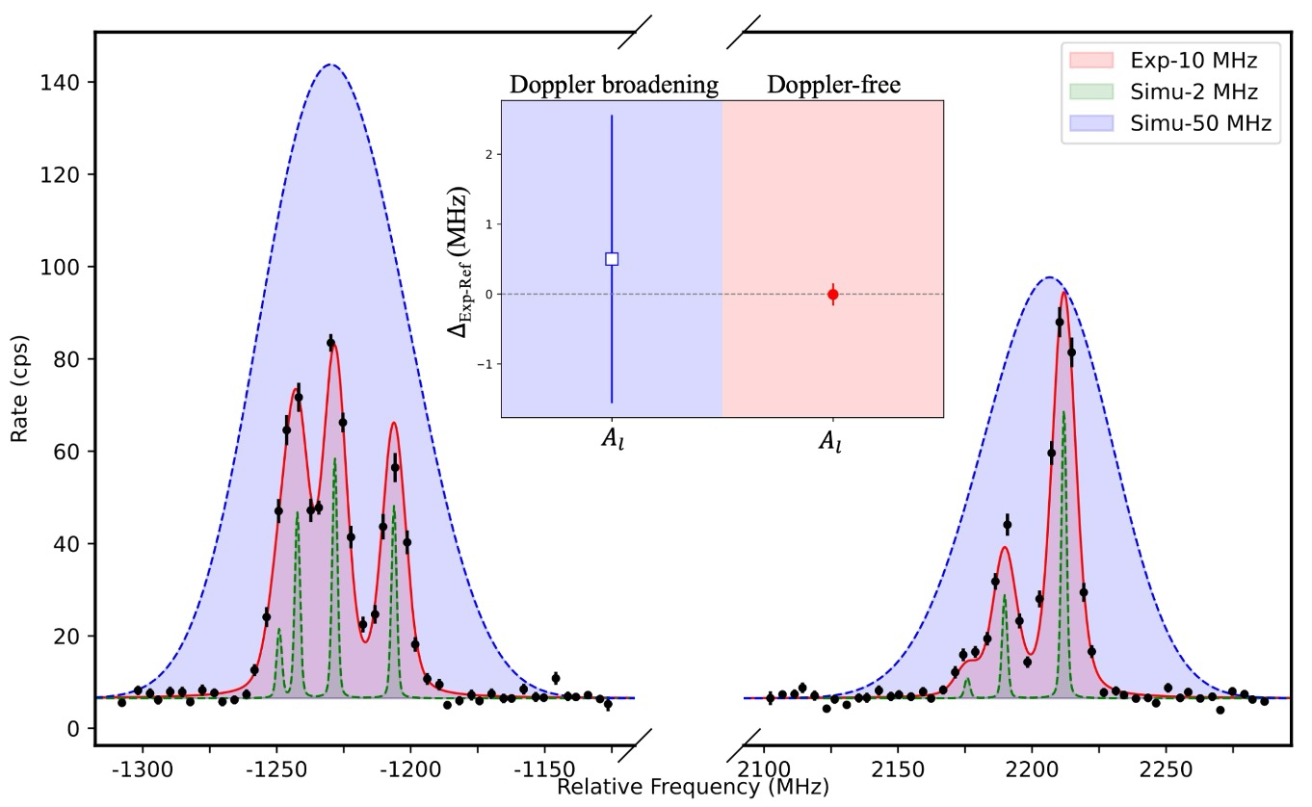
Offline PLASEN: Doppler-free two photon RIS
An idea originating from the CRIS collaboration
-Hyperfine anomaly
-Q_{s} moment of light nuclei
-Higher order moment?
-First realization using CRIS technique
-Doppler Broadening is suppressed
-10 times improvement in precision for As_{1/2}
Slide from X.F. Yang
Y.F. Guo et al., In preparation (2025)
20

Slide 21
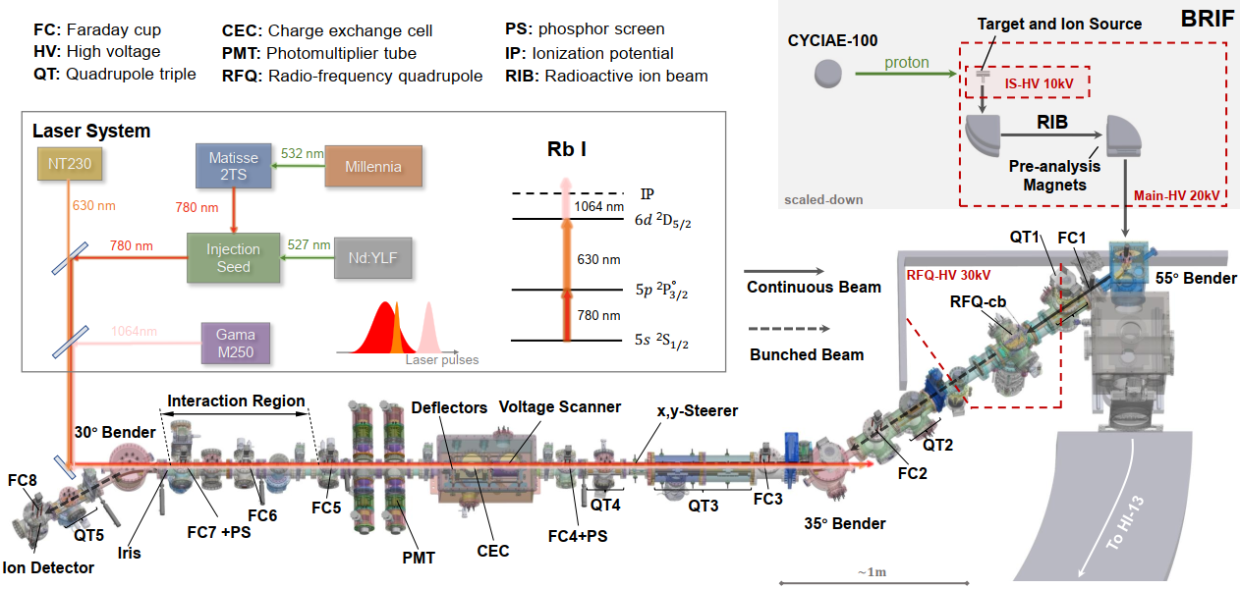
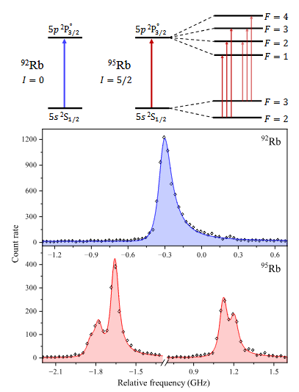
Online PLASEN @BRIF
Beijing Radioactive Ion-beam Facility
The large energy spread of RIB from BRIF was successfully handled by RFQ-cb;
PLASEN reached a high resolution of 100 MHz and High efficiency of 1:200 measurement of RIB！
Slide from X.F. Yang
W.C. Mei et al., In preparation (2025)

Slide 22

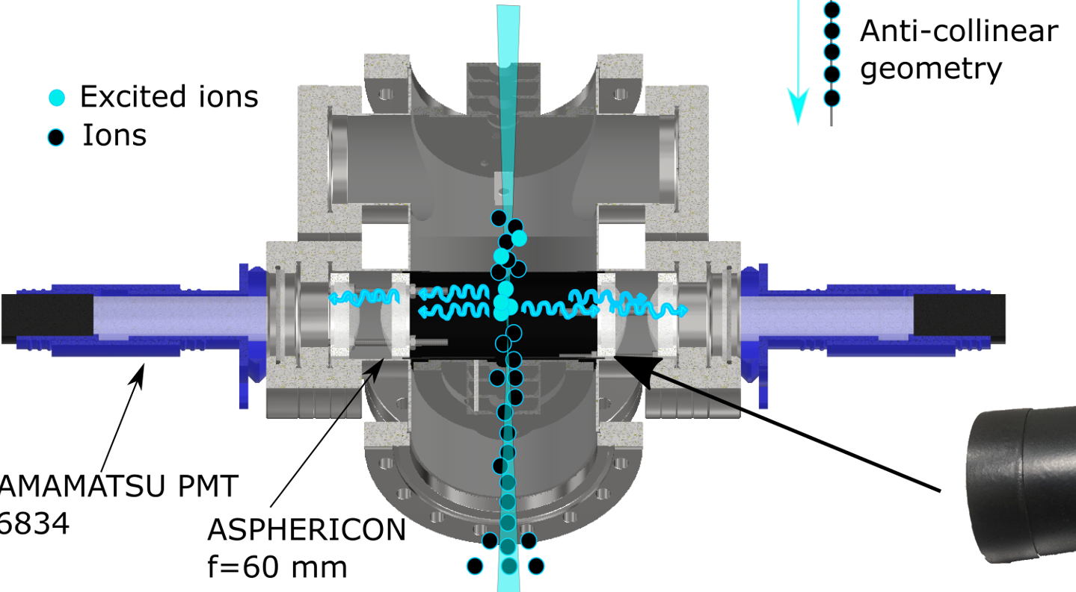
REBEL setup for Precision Laser spectroscopy at ISOL@MYRRHA
Analysis of the ion beam composition during the start-up of the facility
Pure beams
Ion beam energy adjustable
Tailor made experiments
Classic CLS
Double resonance spectroscopy
Potential to grow (CRIS experiment)
Very expensive – already started building it
Ion trap
QT
RFQ
MR-ToF
Ion source
QT
CEC
Bunched beam CLS
Needed for the MR-ToF as well
Neutralization
Laser-RF
Modular interaction region with light collection chambers

Slide 23
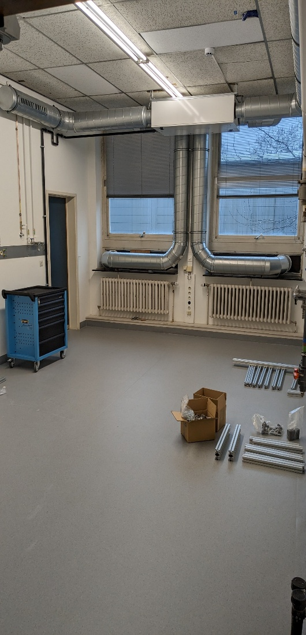
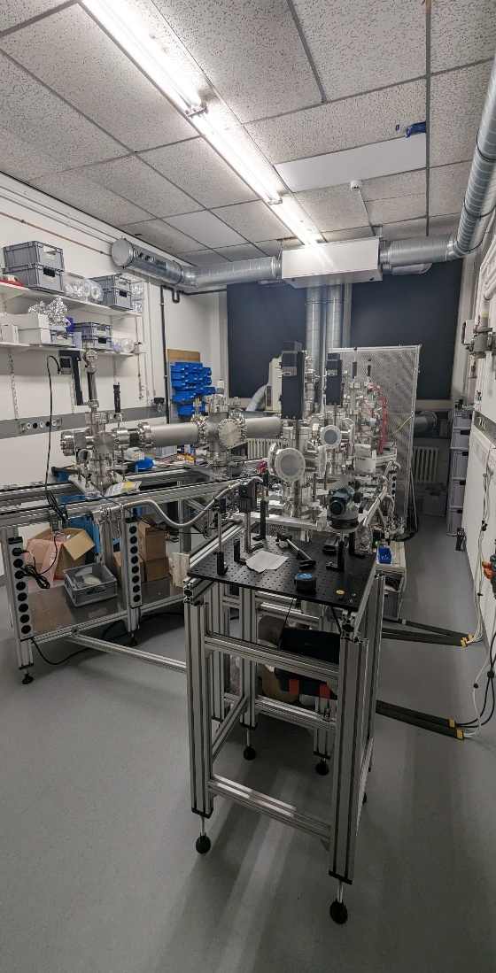
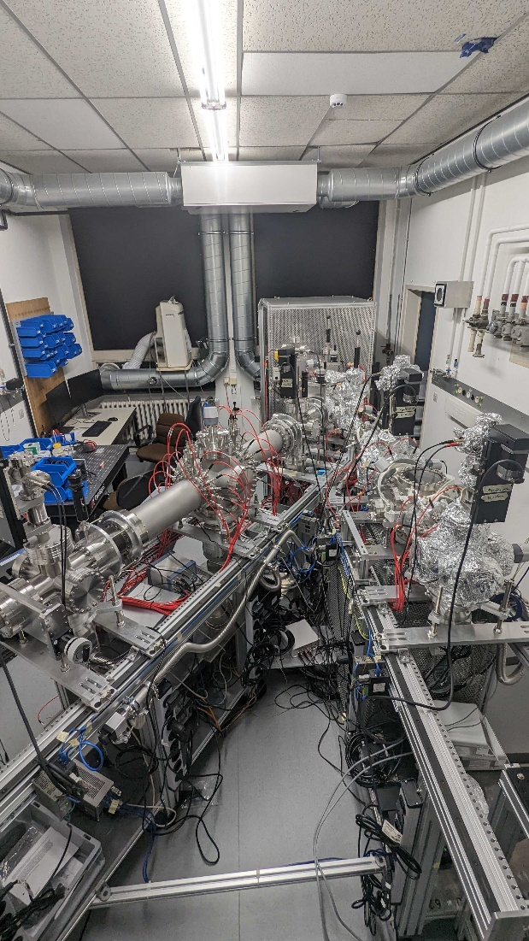
Construction progress during 2024
Slide from Phillip Imgram | Instituut voor Kern- en Stralingsfysica
Results will be shown by Stefanos Pelonis and Tobias Christen
February ‘24
June ‘24
October ‘24

Slide 24
Conclusions
Busy field: I could not cover all beamlines and all developments (tune in for other talks)
Collinear laser spectroscopy is still under continuous development
Nuclear structure research mostly focuses on the short-lived isotopes
More and more labs combine different techniques
New setups are being built and commissioned in emerging RIB facilities

Slide 25
Thank you for your attention

Slide 26
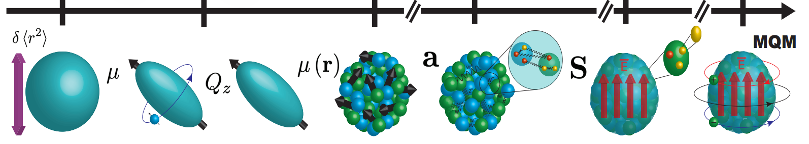
Unique opportunities at ISOL@MYRRHA
Phase 1
Exploiting long beamtimes for precision studies
--------------------------------------------
Beams which are easily produced
Tailor-made techniques (which we will master in our offline lab)
Double resonance technique (combine laser and RF)
Moments, Nuclear magnetization radius
³⁷⁻⁴⁵K, Sc, Ca, …
Phase 2
Exploiting long beamtimes for very exotic cases
--------------------------------------------
Fission fragments provide an exceptional opportunity to extend the measurements on the neutron-rich side
CRIS experiment combined with MR-ToF
Measurements of nuclear spins, moments, radii and binding energies beyond N=50,82
Yields and targets from João Pedro Ramos

Slide 27
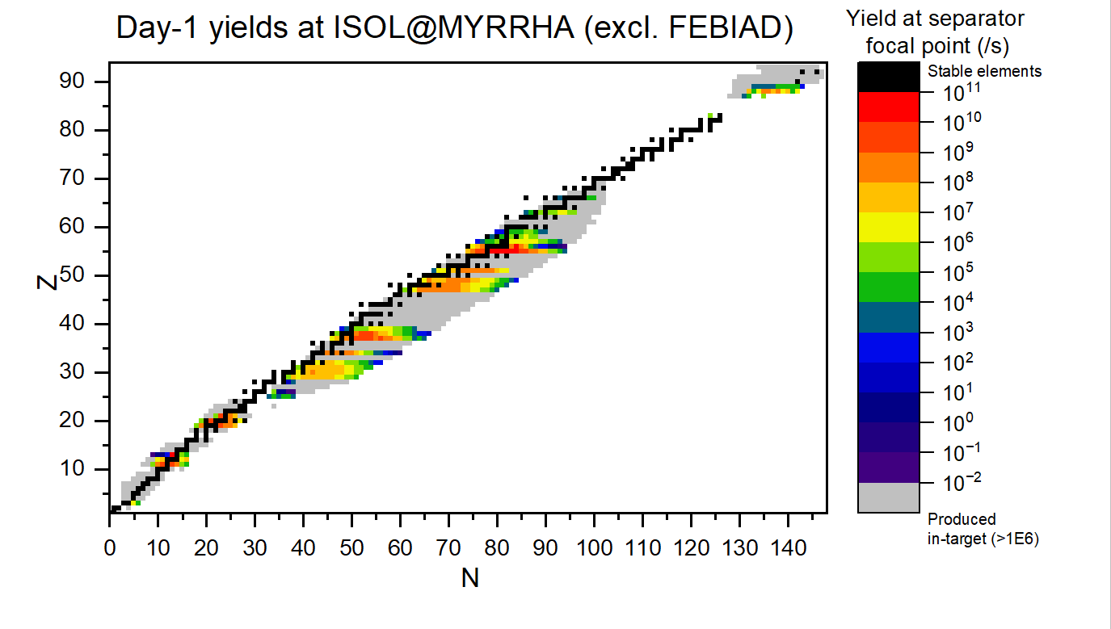
Day1 yields for ThO₂ - examples
laser
surface
Most interesting cases occur in regions with Y_{ioi}:Y_{c} = 1:10⁶
Big advantage of ISOL@MYRRHA is the absence of n-def contaminants
laser
surface
Y_{ioi}
Y_{c}
Total efficiencies considerations:
- For observed beam at other ISOL facilities using directly experimental values
- For unknown beams scaled by exponential law from observed
*courtesy of D. Houngbo, K. Rijpstra, J.P. Ramos

Slide 28
Unique opportunities at ISOL@MYRRHA
Analysis of the ion beam composition during the start-up of the facility
Pure beams
Ion beam energy adjustable
Tailor made experiments
Classic CLS
Double resonance spectroscopy
Potential to grow (CRIS experiment)
Very expensive – already started building it
Ion trap
QT
RFQ
MR-ToF
Ion source
QT
CEC
Bunched beam CLS
Needed for the MR-ToF as well
Neutralization
Laser-RF
Modular interaction region with light collection chambers

Slide 29
Experiments with offline long-lived beams:
^{59,60}Fe
⁶⁰Co
Tc
⁵¹Cr
Hyperfine anomaly: Cs, Fr, …
Nuclear structure around ¹³²Sn
Surface ionized radioactive K
Setup installed
Laser ion source
Possibility of having radioactive beam
UO_{x} target available
Facility running with nominal capacity
Commissioning with Na beam from offline source
Q moment of K and hyperfine anomaly
Q moment of Cr

