Slide 1
Overview of ISOL Facilities EMIS XX 2025 Whistler, Canada
(RIB Production techniques given yesterday at the lecture)
João Pedro Ramos
Monday, 20 Oct 2025

Slide 2
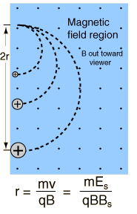


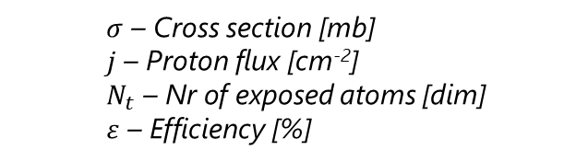
ISOL Isotope Separation
OnLine
From the lecture yesterday…
Extraction electrode
Extraction optics
Particle
0 V
Mass separator
<60 kV
Ion Source
Target unit
Transfer line
+/- 15V
Energetic particles
1000 A
(on target)
20 cm
up to 2300 °C
Target heating by current and/or beam
+/- 15 V
2400 A
(on converter)
1. Production
4. Ionization
$$Beam Int.=σ.j.Νt.ε$$
2. Diffusion
5. Mass Separation
$$ε={ε_{diff}ε}_{eff}{ε_{is}ε_{sep}ε}_{trans}$$
$σ$ – Cross section [mb]
$j$ – Proton flux [cm⁻²]
$N_{t}$ – Nr of exposed atoms [dim]
$ε$ – Efficiency [%]
3. Effusion
6. Transport

Slide 3
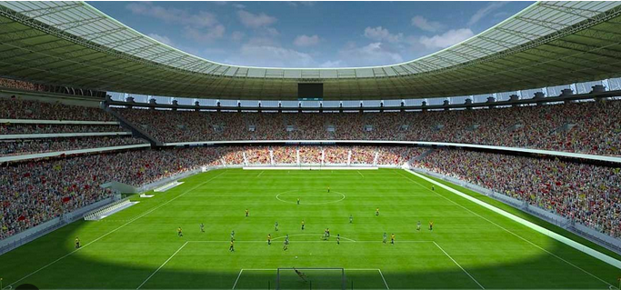
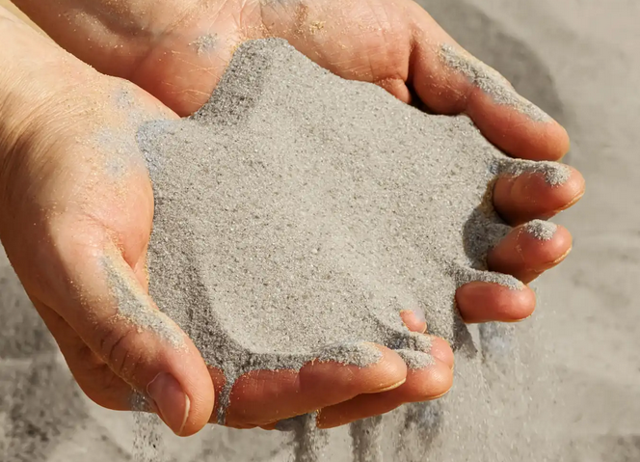
Efficiency is key!
1 proton on target
~1 isotope created
(order of magnitude)
pico – 10⁻¹²
femto – 10⁻¹⁵
atto – 10⁻¹⁸
Target (U/Th)
RIB of interest
All production
~0.5 mol
~10²³ atoms
1 µA p+
~6 pmol/s
~10¹² atom/s
~0.2 fmol/s
~10⁸ atom/s
~0.2 amol/s
~10⁵ atom/s
(6x10¹²)
(to extract!!)
Sand:
8 – 15 billion grains per m³
Let’s fill it with sand!
Full stadium has now:
10¹⁶ – 10 quadrillion grains of sand
Now we need hope that 1 specific grain of sand gets out of the stadium by heating it up to 2000°C!
Typical football stadium. Inner volume ~ 1 million m³
(corresponds to an isotope with an in-target production of ~10⁷ /s=16 amol/s)

Slide 4
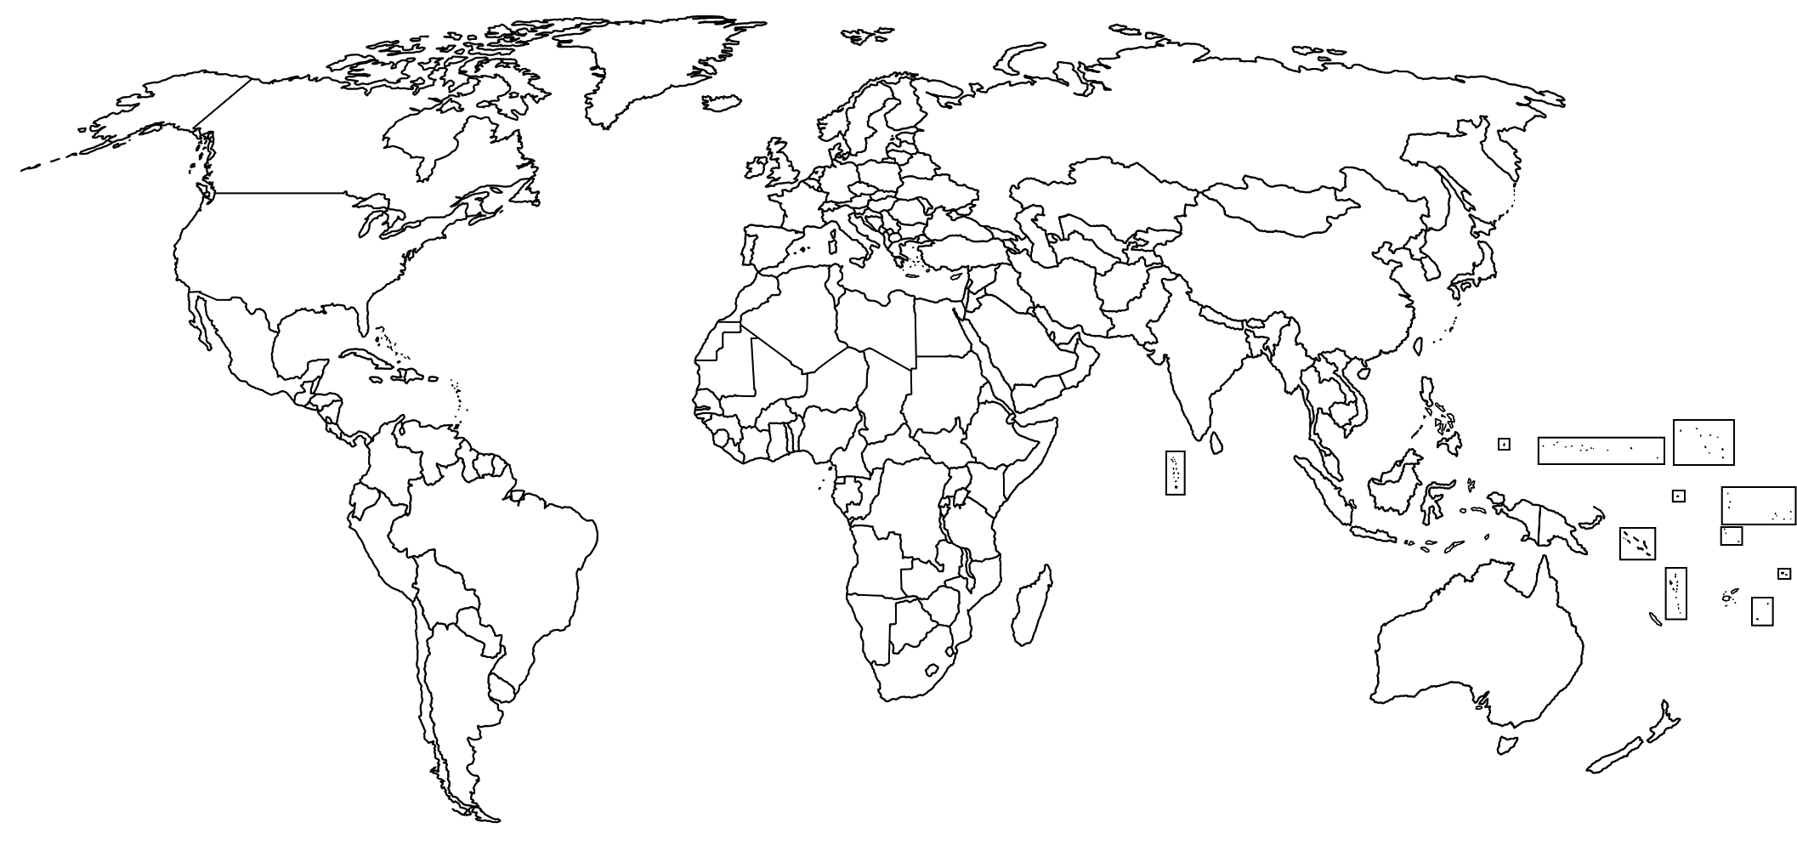

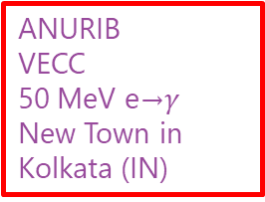
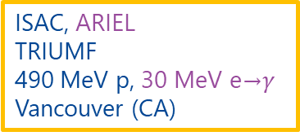
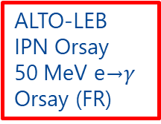
ISOL Facilities Worldwide
Operational
Future
Gas catcher
Heavy ion
Reactor
e→$γ$
Legend:
p⁺ High energy
p⁺ Low energy
Offline RIB (operational)
RISIKO
UNI Mainz
External sources
Mainz (DE)
IGISOL
UNI-JYFL
30 MeV p, 14 MeV d,
HI < 130 MeV/u Jyväskylä (FI)
IRIN-PIK reactor
PNPI
n (3×10¹³ n/(cm² s)
St. Petersburg (RU)
IRIS
PNPI
1 GeV p
St. Petersburg (RU)
SPES
INFN-LNL
40 MeV p
Legnaro (IT)
BISOL-CARIF reactor
CIAE
n (8 × 10¹⁴ n/(cm² s)
Beijing (CN)
TRIGA Reactor
UNI Mainz
n (1.1×10¹¹ n/(cm² s)
Mainz (DE)
BRIF
CIAE
100 MeV p Beijing (CN)
ISAC, ARIEL
TRIUMF
490 MeV p, 30 MeV e→$γ$ Vancouver (CA)
ISOL RAON
IBS
70 MeV p
Daejeon (KR)
CARIBU
Argonne National Lab
²⁵²Cf sf Lemont (US)
ANURIB
VECC
50 MeV e→$γ$ New Town in Kolkata (IN)
Spiral, SPIRAL-II
GANIL
HI <95 MeV/u ,40 MeV d, 33 MeV p, 14.5 MeV/u HI
Caen (FR)
ISOL@MYRRHA
SCK CEN
100 MeV p
Mol (BE)
ALTO-LEB
IPN Orsay
50 MeV e→$γ$ Orsay (FR)
LERIB
iThemba LABS
70 MeV p Cape Town (ZA)
ISOLDE
CERN
1.4 – 1.7 GeV p Geneva (CH)
MEDICIS
CERN
1.4 GeV p and
external sources
Geneva (CH)
TATTOOS
PSI
590 MeV p Villigen (CH)

Slide 5
High Energy Proton Facilities
Operational
Future
Gas catcher
Heavy ion
Reactor
e→$γ$
Legend:
p⁺ High energy
p⁺ Low energy
Offline RIB (operational)
IRIS
PNPI
1 GeV p
St. Petersburg (RU)
ISAC, ARIEL
TRIUMF
490 MeV p, 30 MeV e→$γ$ Vancouver (CA)
ISOLDE
CERN
1.4 – 1.7 GeV p Geneva (CH)
TATTOOS
PSI
590 MeV p Villigen (CH)

Slide 6


ISOLDE at CERN
Operational
Future
Gas catcher
Heavy ion
Reactor
e→$γ$
Legend:
p⁺ High energy
p⁺ Low energy
Offline RIB (operational)
Contributions
Invited (Wed 8h30): M. Au – Molecular beams
Talk (Thu 4:30 PM): W. Wojtaczka – TbF beams for medical applications
ISOLDE
CERN
1.4 – 1.7 GeV p Geneva (CH)

Slide 7

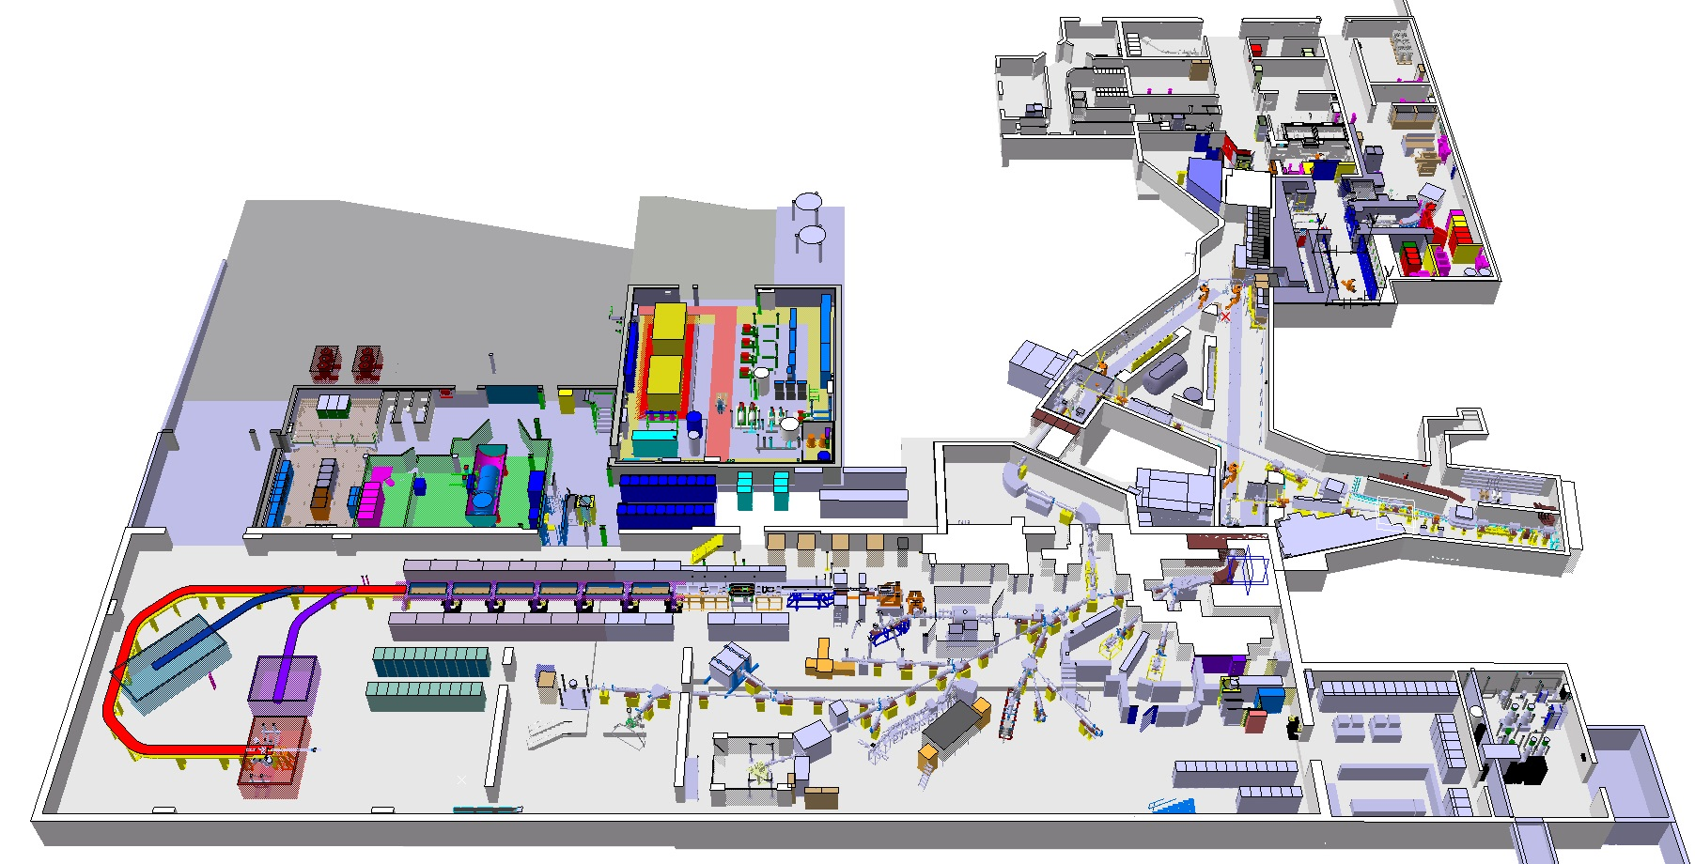

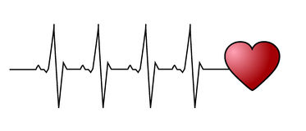


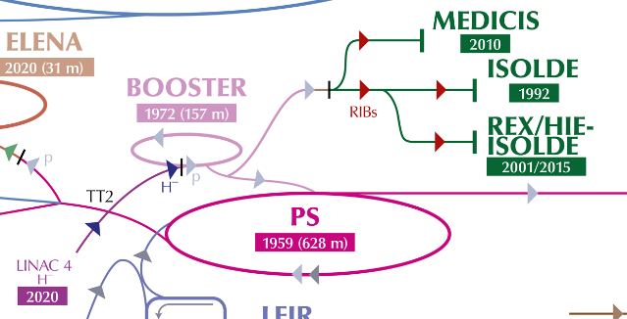

Facility
Will enter long shutdown (CERN wide upgrades) for 3 years
Extension: nano actinide lab
Protons (1.4 – 1.7 GeV)
Low energy RIBs (up to 60 keV)
Radioactive laboratory Class A
MEDICIS
(later)
High energy RIBs (up to 10 MeV/u – A/q=4.5)
Pulsed protons (1.2 s)
1.4 – 1.7 GeV
3.3x10¹³ protons per pulse
HRS
High Resolution Separator
High Energy RIB
Target area
Low energy RIB
GPS
General Purpose Separator
75 chemical elements
>1000 beams
>30 targets, 5 transfer lines, >5 ion sources

Slide 8
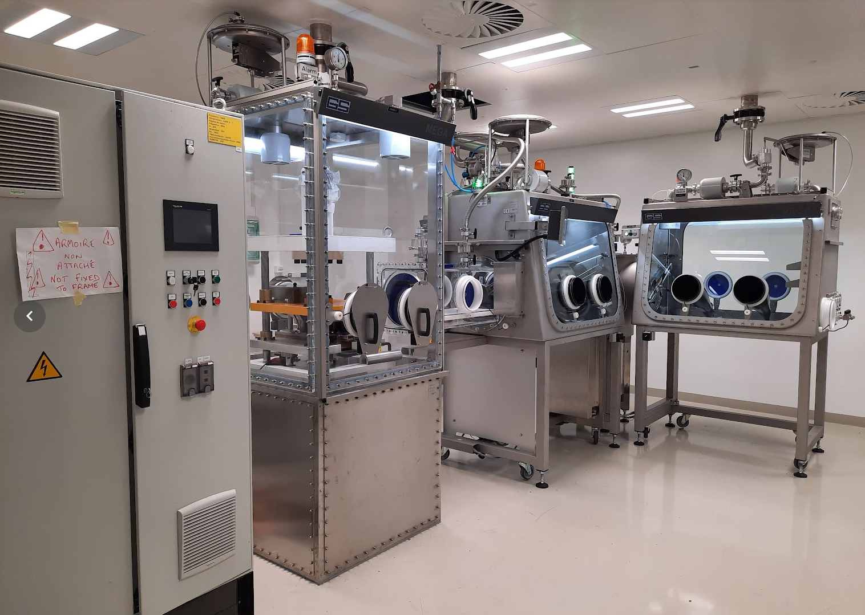

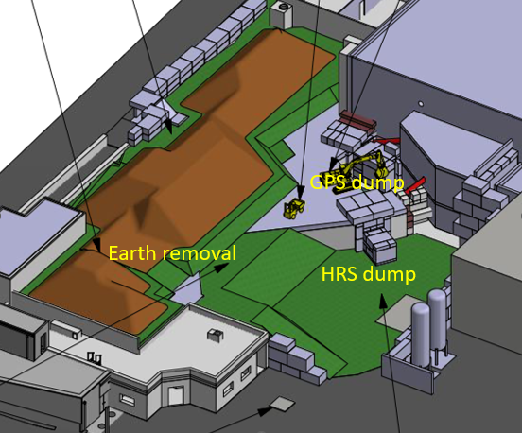
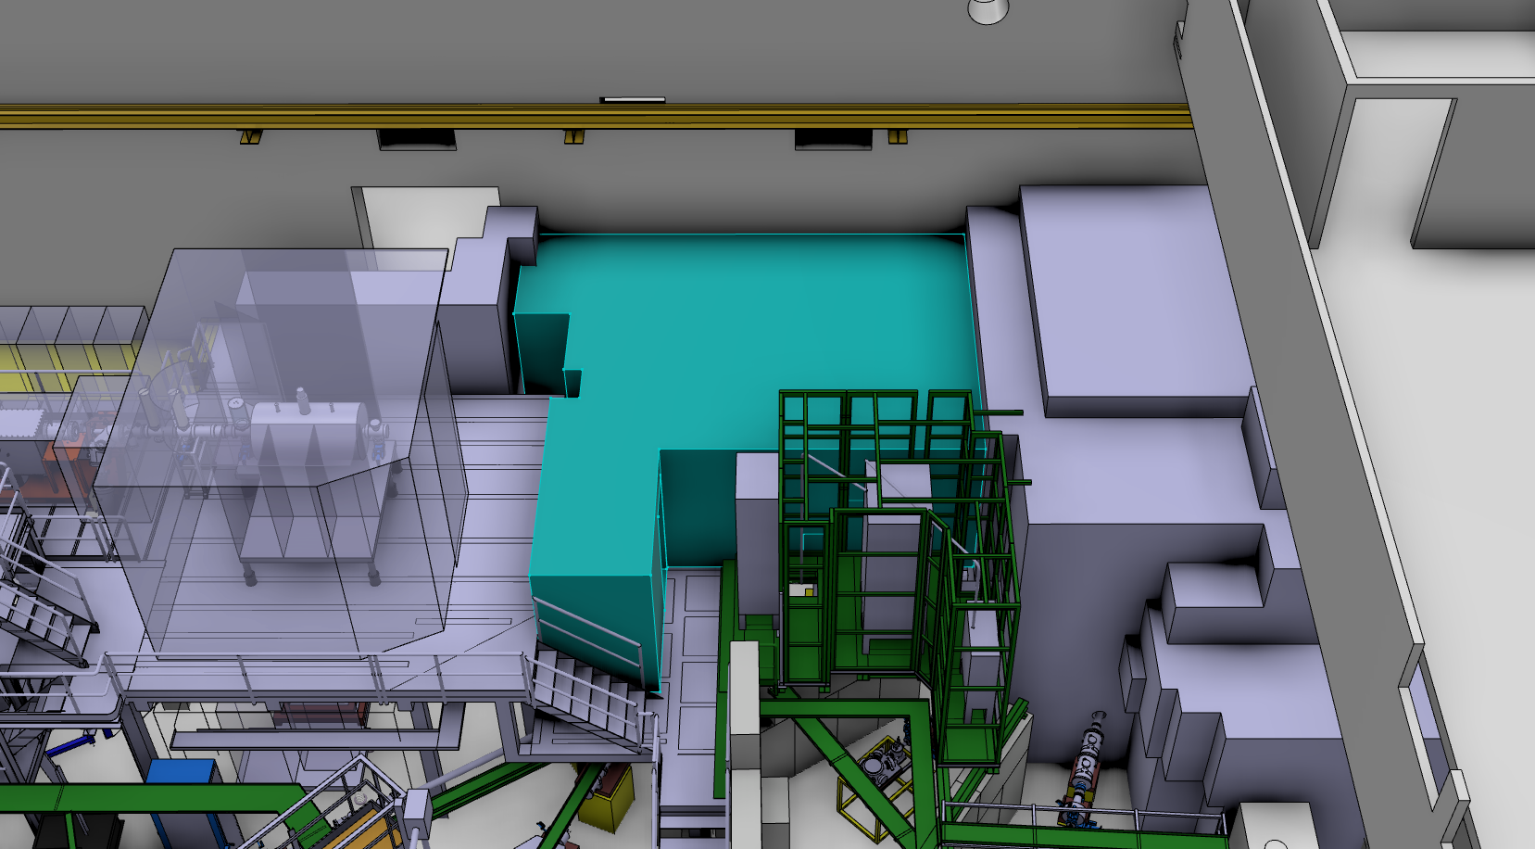
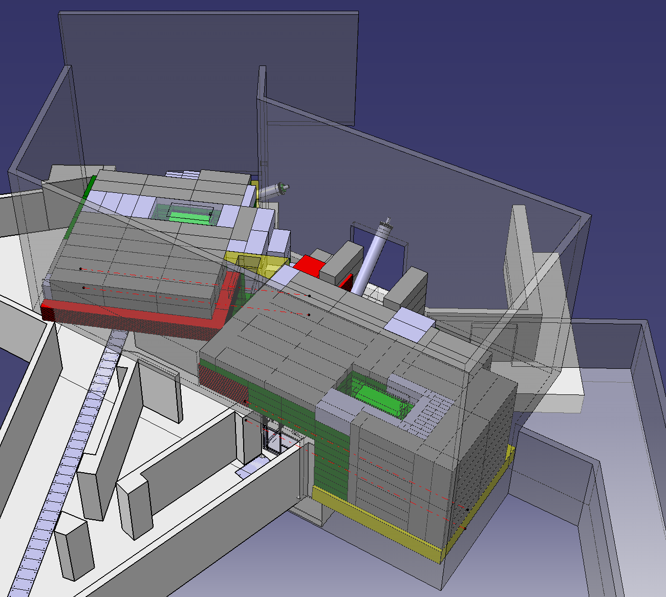
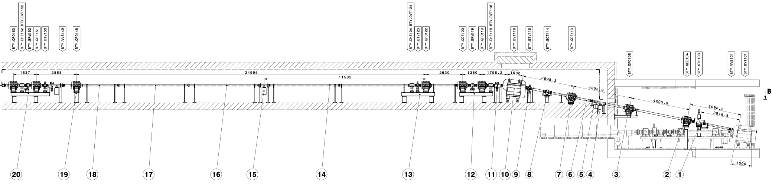
Facility
RILIS Laboratory situated in a very crowded area
Required to be close to GPS and HRS separator zones
Extension: nano actinide lab
Beam dump replacement
Radioactive laboratory Class A
MEDICIS
4 interconnected gloveboxes (air) to contain nanopowders
Lab being commissioned to start nanoUCx production
During shutdown, focus to upscale nanoUCx
HRS
High Resolution Separator
High Energy RIB
Study started in 2020
Will last 2 years from 2026
Target area
Low energy RIB
RILIS laser cabin to be extended
GPS
General Purpose Separator
Upgrade proton beam lines to allow 1.4 to 2.0 GeV p+
New magnets to be designed and produced
Beam dumps already account for 2.0 GeV upgrade
Slide Material Courtesy of J. Vollaire, E. Siesling and S. Stegemann

Slide 9

ISAC at TRIUMF
Operational
Future
Gas catcher
Heavy ion
Reactor
e→$γ$
Legend:
p⁺ High energy
p⁺ Low energy
Offline RIB (operational)
ISAC, ARIEL
TRIUMF
490 MeV p, 30 MeV e→$γ$ Vancouver (CA)
Contributions
Invited (Thu 1:30 PM): O. Hassan – Beam line tunning with Bayesian Optimization
Talk (Mon 11:20 PM): C. Babcock – ISAC reliability increase
Poster (Tue 6:00 PM): C. Babkock – upgrades to TIS HV operation
Poster (Tue 6:00 PM): D. Neilson– ISAC Test stand
Poster (Tue 6:00 PM): S. Ghosh– Thermal investigations target materials
Poster (Tue 6:00 PM): M. Cervantes – TaC coated Ta

Slide 10
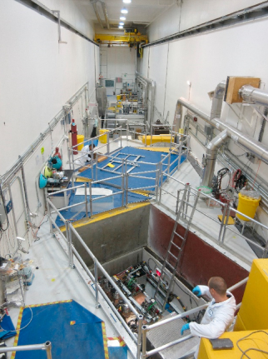
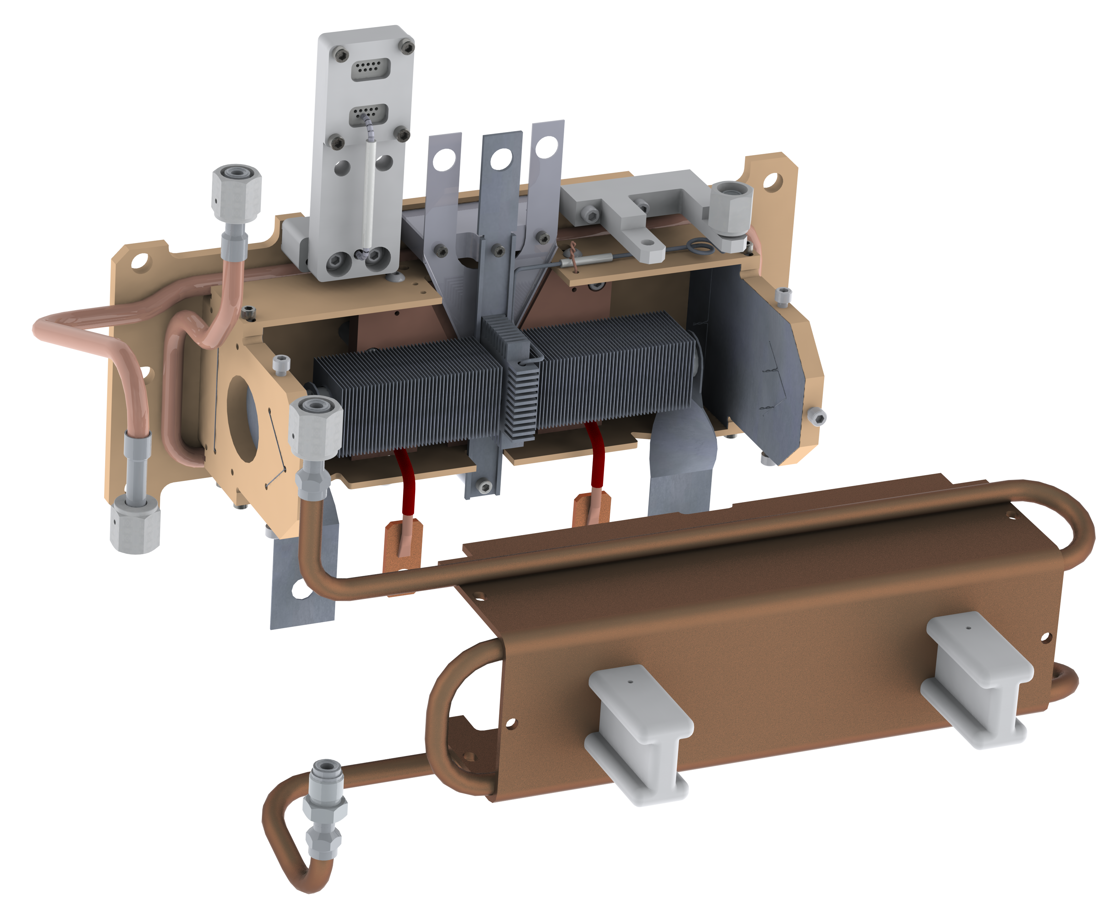
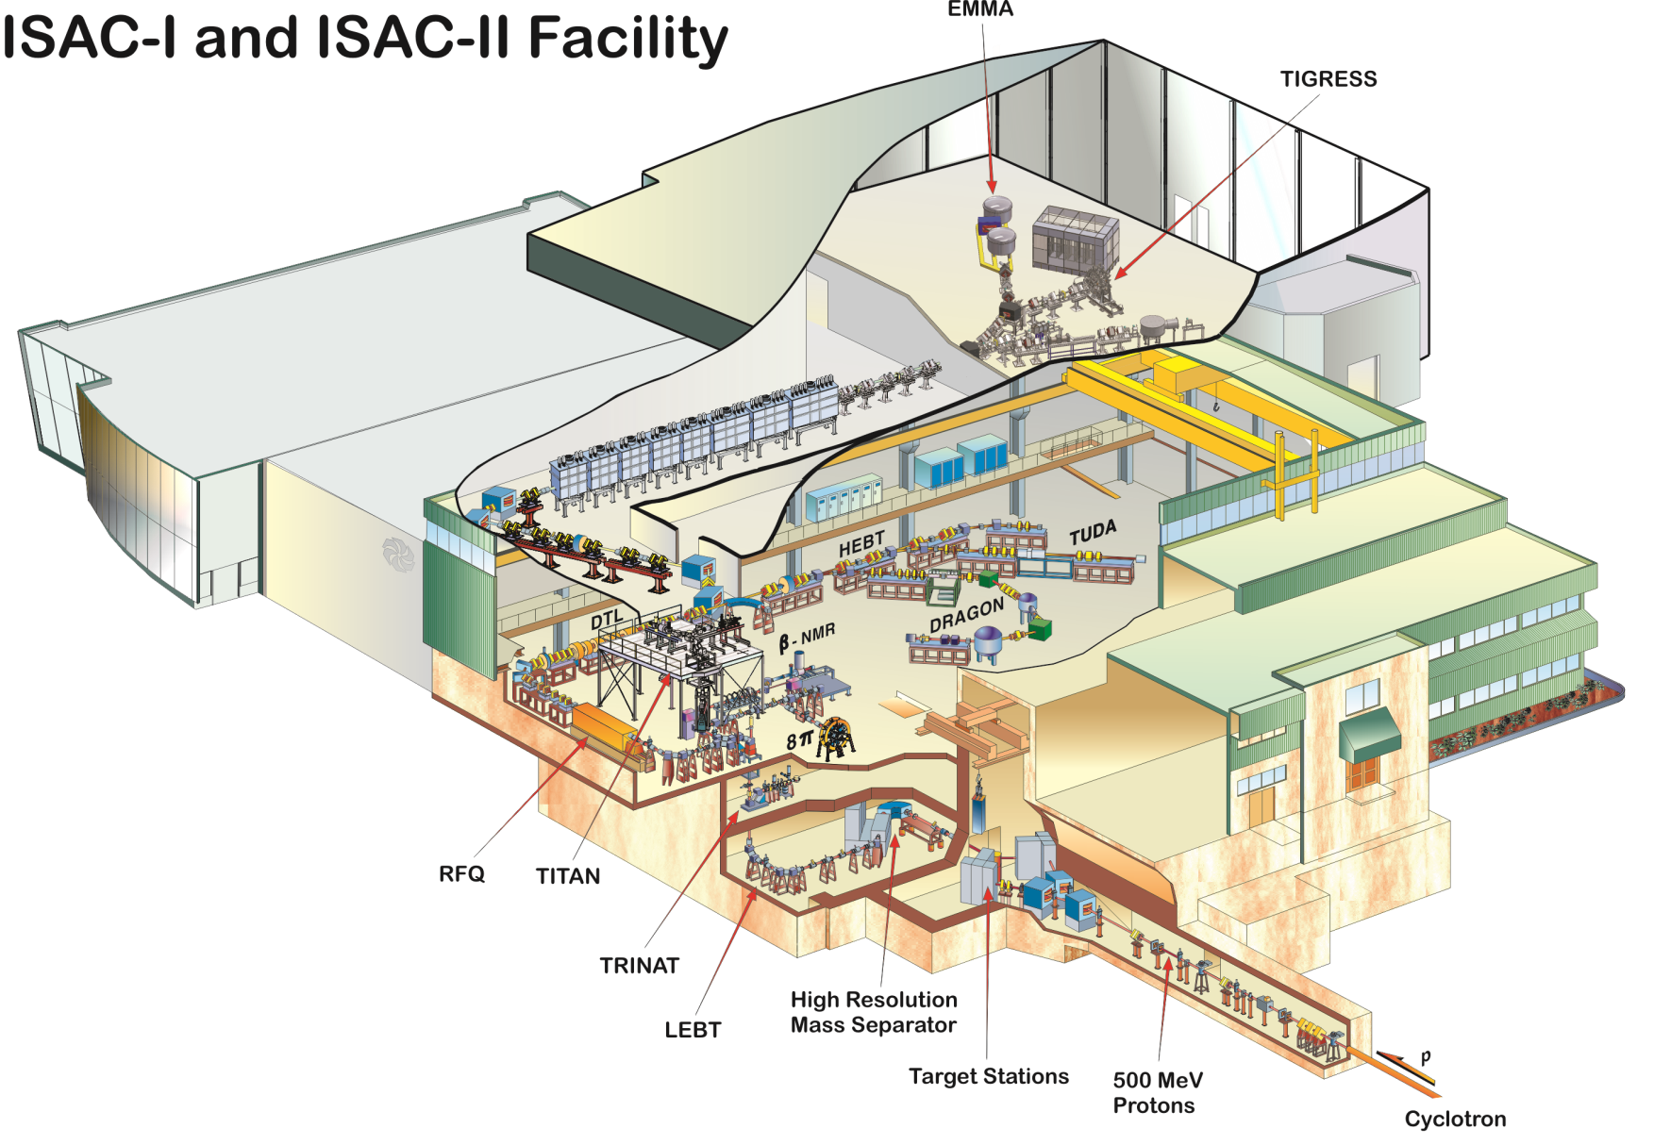
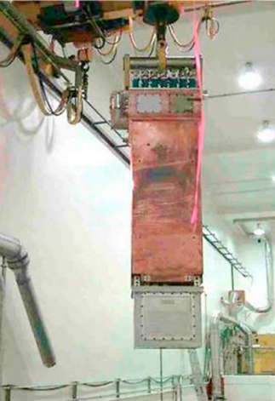
ISAC at TRIUMF
Target ion source service connections
target container ~2000 °C
(Ø 20 mm, 60 cm³)
Water-cooled heat
shields
500 MeV protons
up to 100µA
ion sources:
surface
resonant lasers
FEBIAD
IG-LIS
target materials:
UC_{x}
UO₂
ThO
Nb
Ta
TaC
NiO
ZrC
TiC
SiC
>700 isotopes extracted
Modular system!
Remote handling: G. Minor et al. DOI: 10.1016/j.net.2020.09.024
Slide Material Courtesy of A. Gottberg, C. Babcock

Slide 11

TATTOOS at PSI
Operational
Future
Gas catcher
Heavy ion
Reactor
e→$γ$
Legend:
p⁺ High energy
p⁺ Low energy
Offline RIB (operational)
Contributions
Talk (Mon 11:20 PM): S. Warren – TATTOOS facility talk
Talk (Wed 9:00 AM): M. Mostamand – Ion source development at TATTOOS
Poster (Tue 6:00 PM): D. Regianni – TATTOOS beam line and target design
TATTOOS
PSI
590 MeV p Villigen (CH)

Slide 12
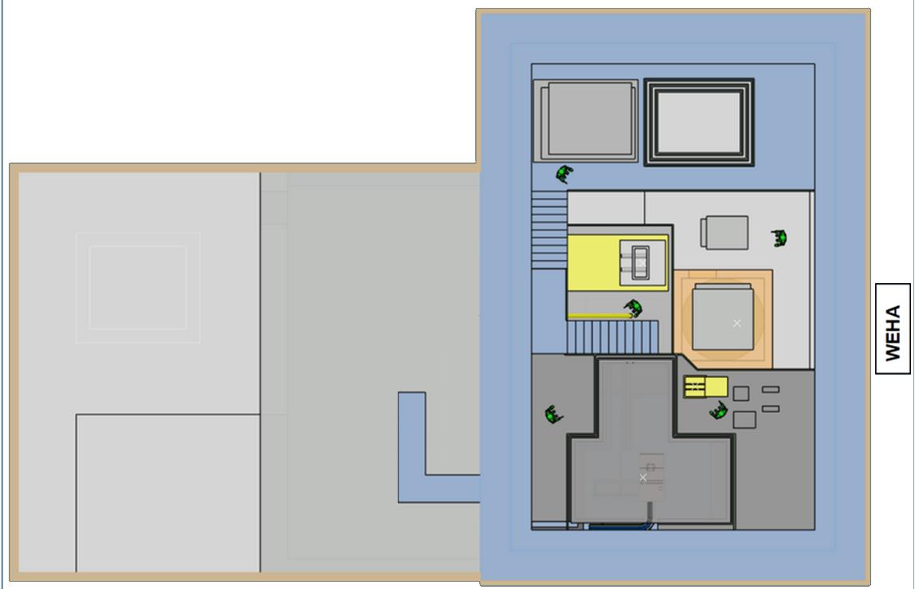
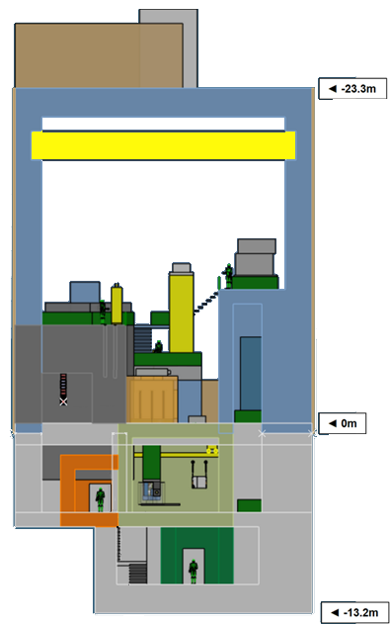
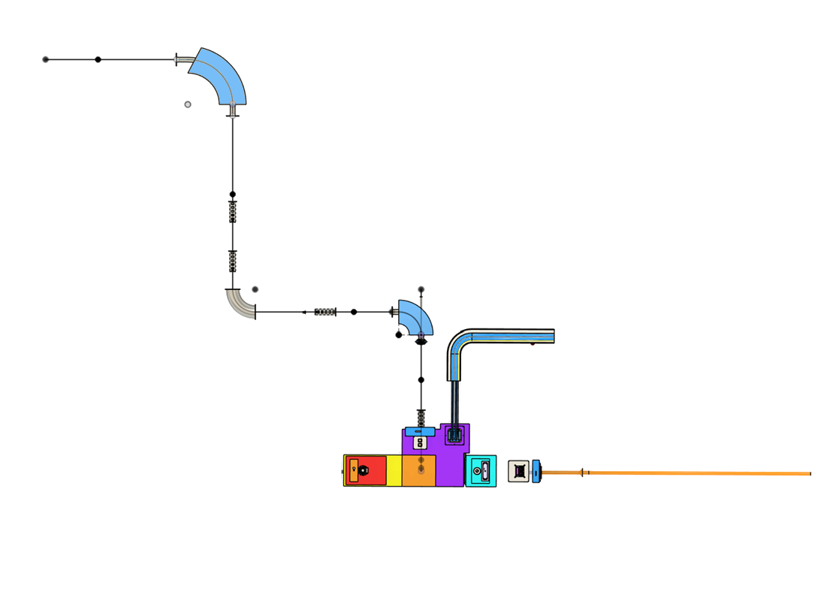
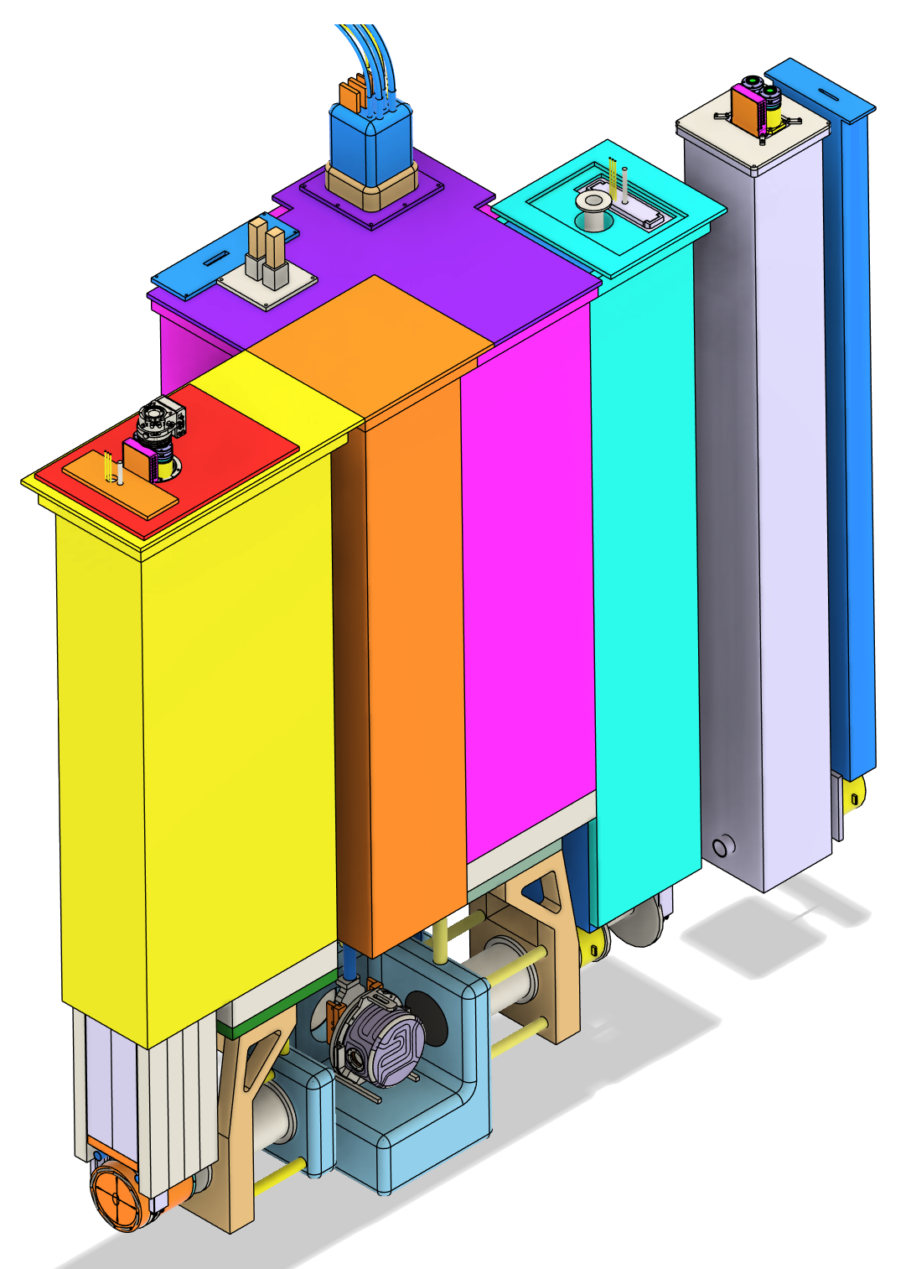
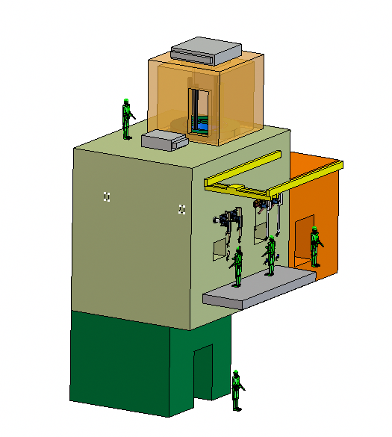
TATTOOS at PSI
Collections
Class – A LAB
Service Cells
60T crane
Access control port
Systems & services
Proton beam
Secondary ion beam line
Target station and front end
Modular systems inspired in TRIUMF
Chemical quantities of isotopes
100 uA [p⁺] 590 MeV driver beam
m/dm ~ 3000
RIB into Hot Cell
Slide Material Courtesy of S. Warren

Slide 13

Heavy ion facilities GANIL
Operational
Future
Gas catcher
Heavy ion
Reactor
e→$γ$
Legend:
p⁺ High energy
p⁺ Low energy
Offline RIB (operational)
Contributions
Invited (Fri 10:30 PM): P. Jardin – Fusion evaporation target TULIP
Talk (Mon 2:00 PM): S. Hurier – Novel fragmentation targets for SPIRAL1
Poster (Tue 6:00 PM): E. Le Villain – New RIBs of Fe, Ni, Co at SPIRAL1
Spiral, SPIRAL-II
GANIL
HI <95 MeV/u ,40 MeV d, 33 MeV p, 14.5 MeV/u HI
Caen (FR)
13

Slide 14
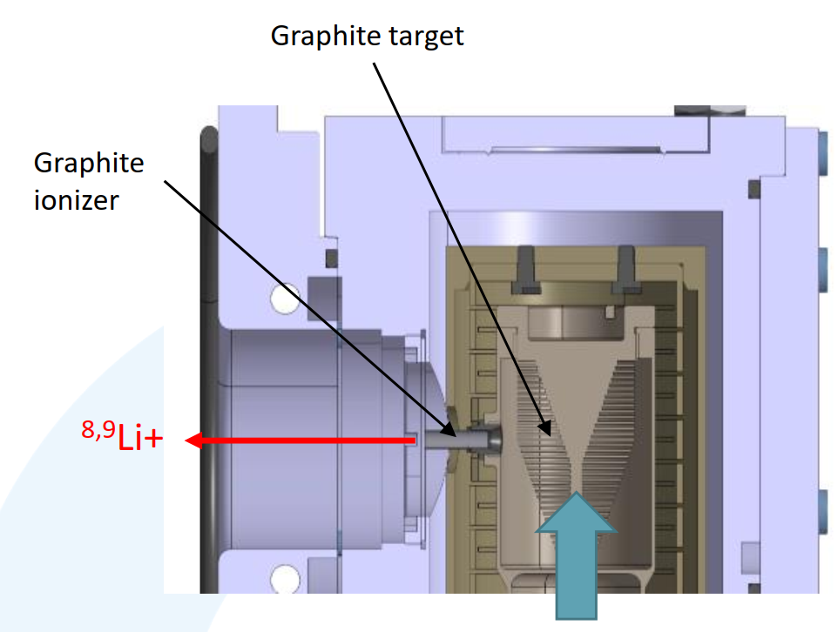
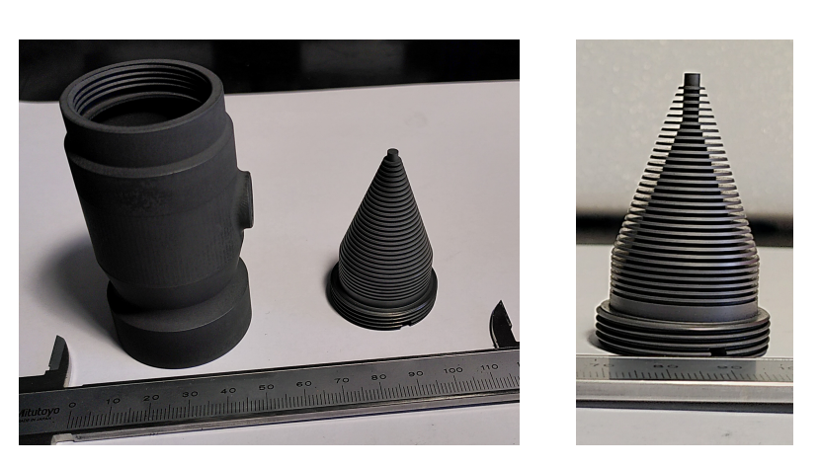
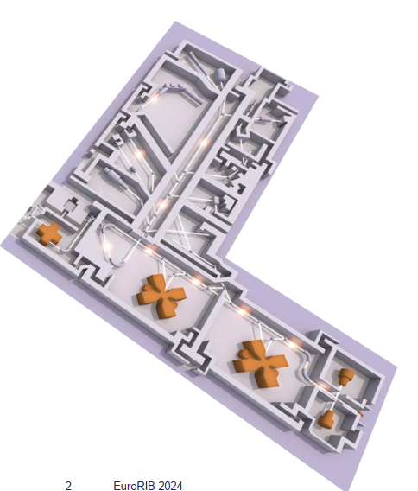
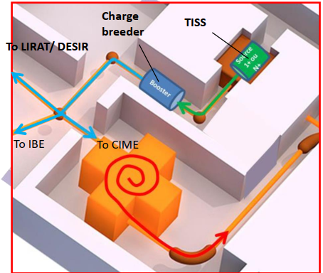
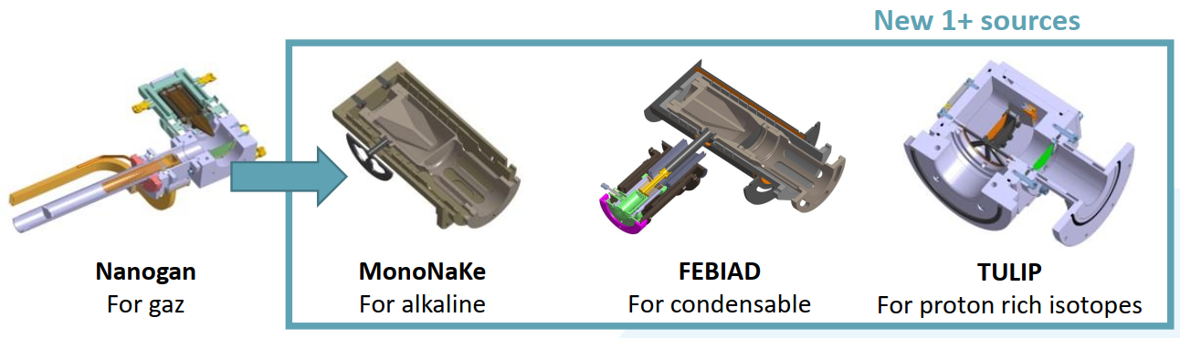
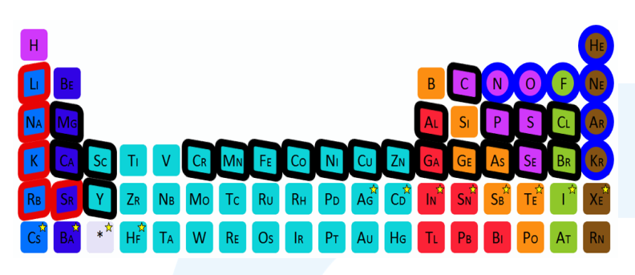
GANIL – SPIRAL 1
Operating since 2001
58 primary beams from ¹²C (2e13pps, 95MeV/u, 3kW) to ²³⁸U (5e9pps, 24MeV/u, 5W)
Targets:
Fragmentation target: Graphite target (so far), studies on expand this
Fusion-evaporation targets: new TULIP concept with a thin target
3 ion sources: MonoNaKe (surface ion source with a graphite ionizer), NANOGAN (ECR), FEBIAD + TULIP’s surface source
34 elements from He to Cs over 100 isotopes identified, including over 60 at more than 1e5pps.
Mass separation in the SPIRAL1 LEB : 2 dipoles magnets with a resolving power of a few 100. Low energy beams will typically be sent to the DESIR hall, which is equipped with a HRS with a measured resolving power of 20000-25000.
Post-acceleration possible with the CIME cyclotron from 2MeV/u, up to 25MeV/u for Q/A=1/2.
Slide Material Courtesy of P. Chauveau

Slide 15

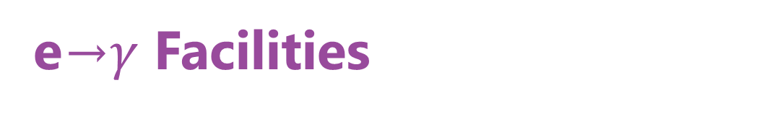
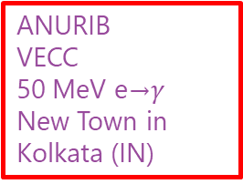
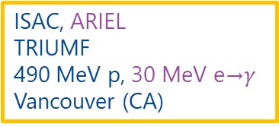
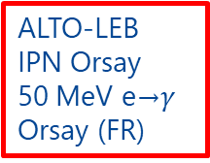
e→$γ$ Facilities
Operational
Future
Offline RIB (operational)
Gas catcher
Legend:
Heavy ion
p⁺ High energy
p⁺ Low energy
e→$γ$
ISAC, ARIEL
TRIUMF
490 MeV p, 30 MeV e→$γ$ Vancouver (CA)
ANURIB
VECC
50 MeV e→$γ$ New Town in Kolkata (IN)
ALTO-LEB
IPN Orsay
50 MeV e→$γ$ Orsay (FR)

Slide 16


ALTO-LEB at IJCLab
Operational
Future
Offline RIB (operational)
Gas catcher
Legend:
Heavy ion
p⁺ High energy
p⁺ Low energy
e→$γ$
ALTO-LEB
IPN Orsay
50 MeV e→$γ$ Orsay (FR)

Slide 17
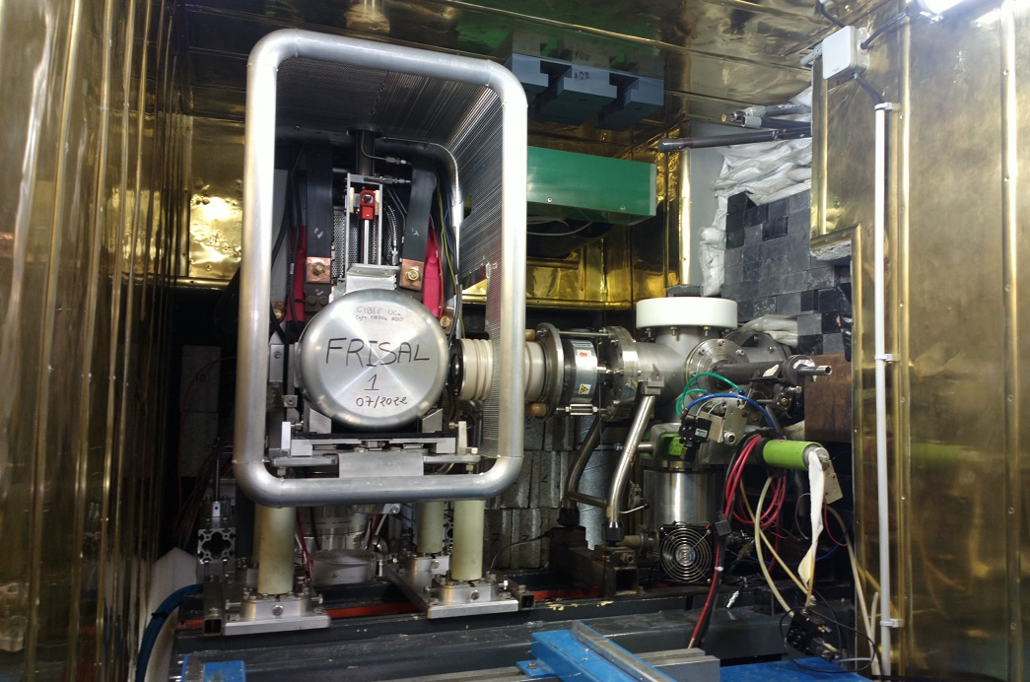
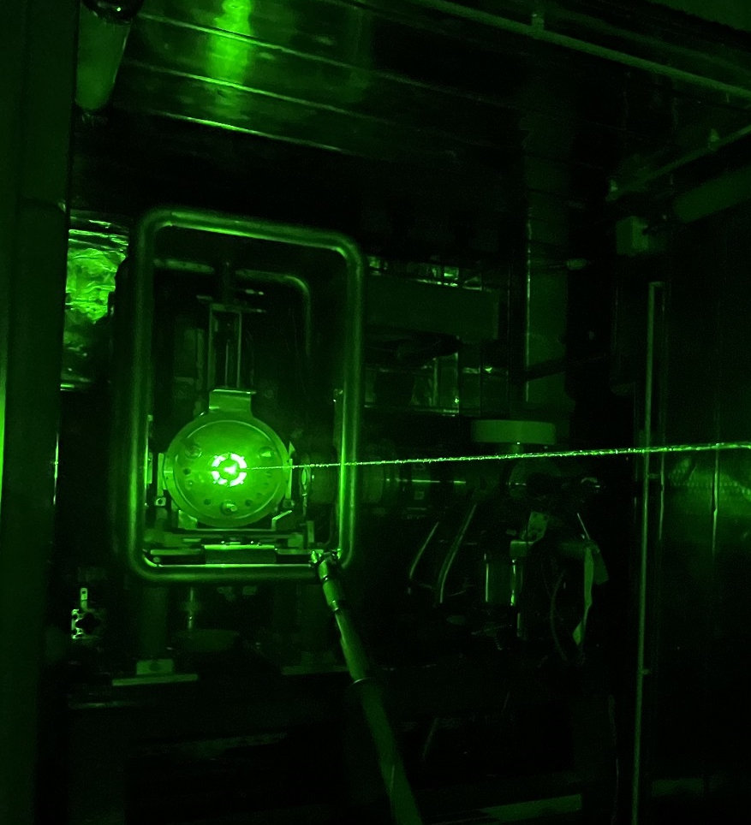
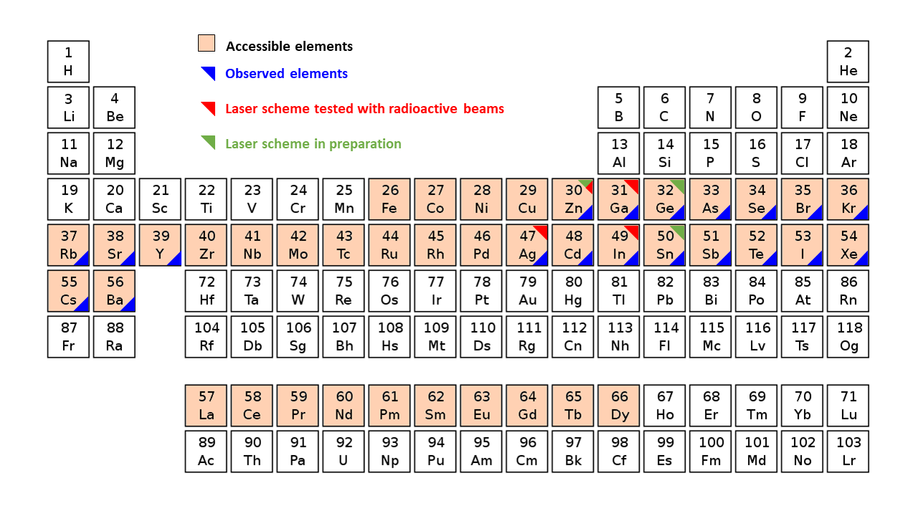
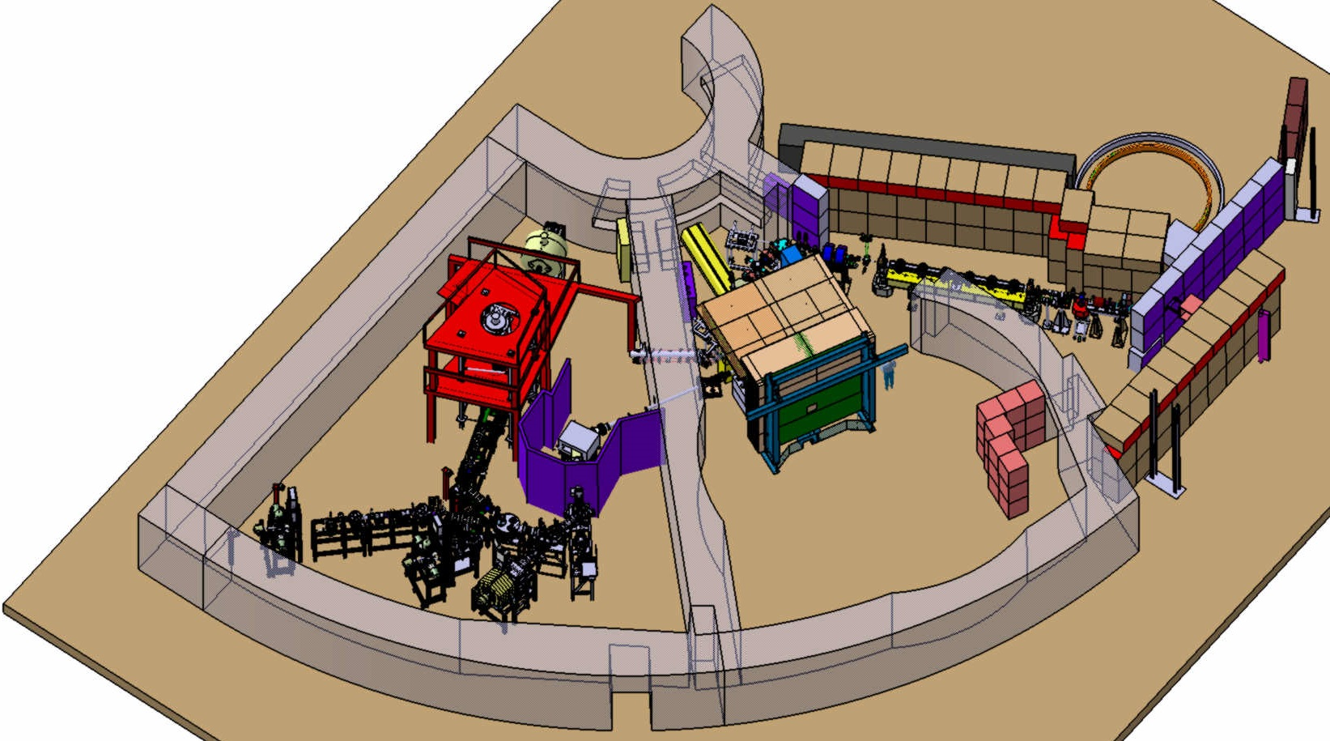

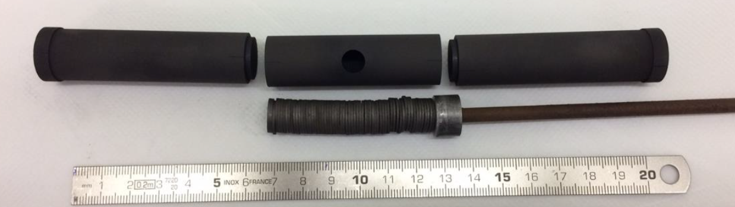
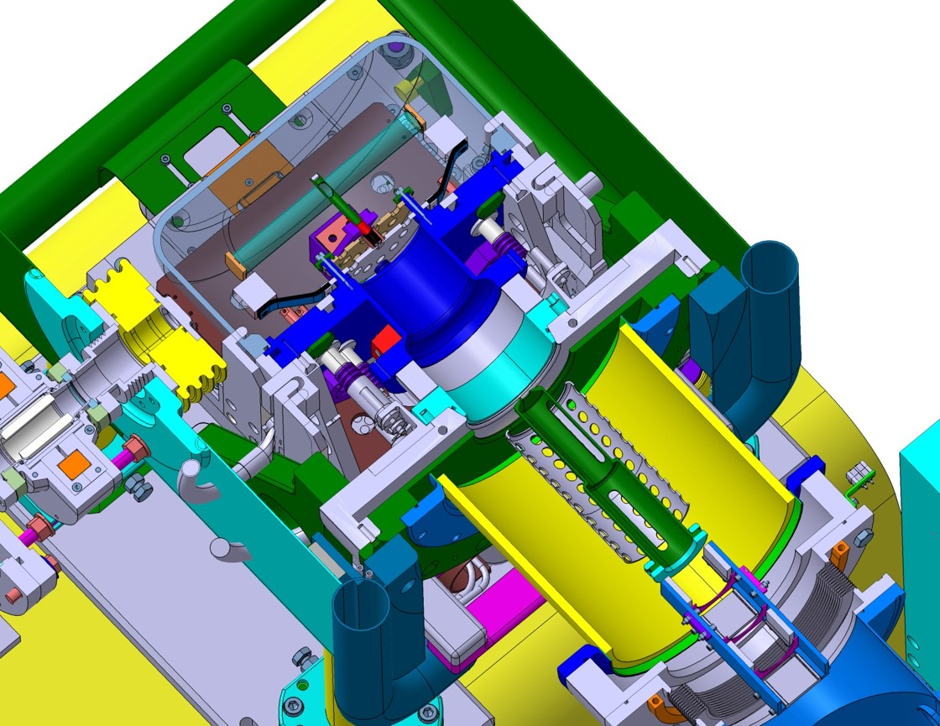
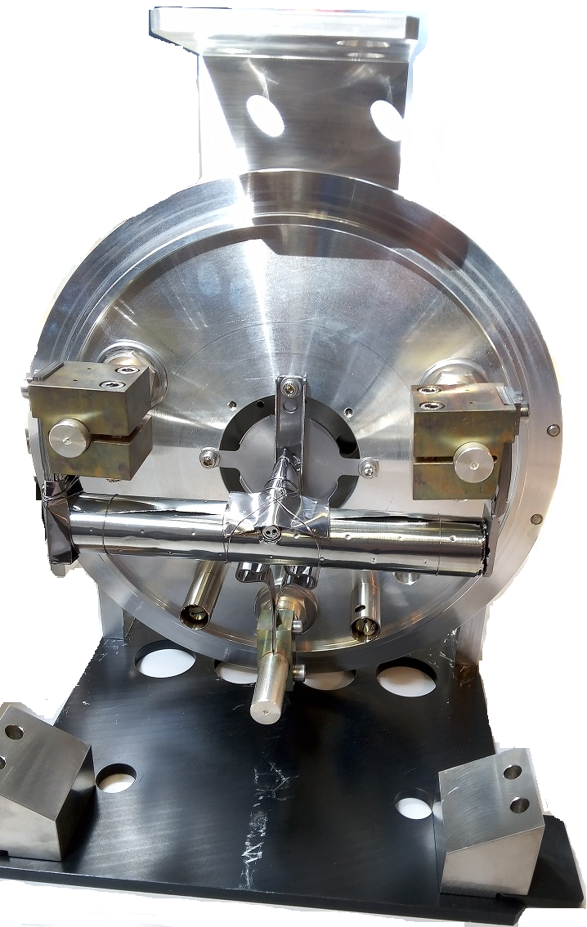
ALTO-LEB in IJCLab
e-
New frontend commissioned in October 2022
e-
https://alto.ijclab.in2p3.fr/en/facility/alto-leb/production/
RIB
UC_{x} targets (~25g, ~60 pellets)
Robot for TISS tested in Summer 2024
Ionizer tube
Mass separator
(magnet dipole) Δm/m = 1500
Target-ion source vault
50 MeV electrons, >10 µA, internal conversion in the UC_{x} target
March 2012 : Operating licence from nuclear safety regulator, based on ISOLDE concept
First operational RIB facility based on photo-fission
→ populating the GDR of ²³⁸U(~10¹¹ f/s)
Extraction electrode
Slide courtesy of E. Minaya

Slide 18
ARIEL at TRIUMF
Operational
Future
Offline RIB (operational)
Gas catcher
Legend:
Heavy ion
p⁺ High energy
p⁺ Low energy
e→$γ$
Contributions
Invited (Mon 1:30 PM): L. Egoriti – ARIEL overview
Talk (Fri 9:00 AM): J. Lassen – TRILIS upgrade for ARIEL
Talk (Tue 4:50 PM): R. Baartman – ARIEL high resolution separator
Talk (Fri 9:00 AM): F. Maldonado – R&D opportunities at ARIEL
Poster (Tue 6:00 PM): N. Noori – ARIEL Hermetic target vessel
Poster (Tue 6:00 PM): R. Schick-Martin – ARIEL HRS diagnostics
Poster (Tue 6:00 PM): M. Cervantes – ARIEL Target material labs
Poster (Tue 6:00 PM): M. Hartmann – post acceleration beamline CANREB
ISAC, ARIEL
TRIUMF
490 MeV p, 30 MeV e→$γ$ Vancouver (CA)

Slide 19
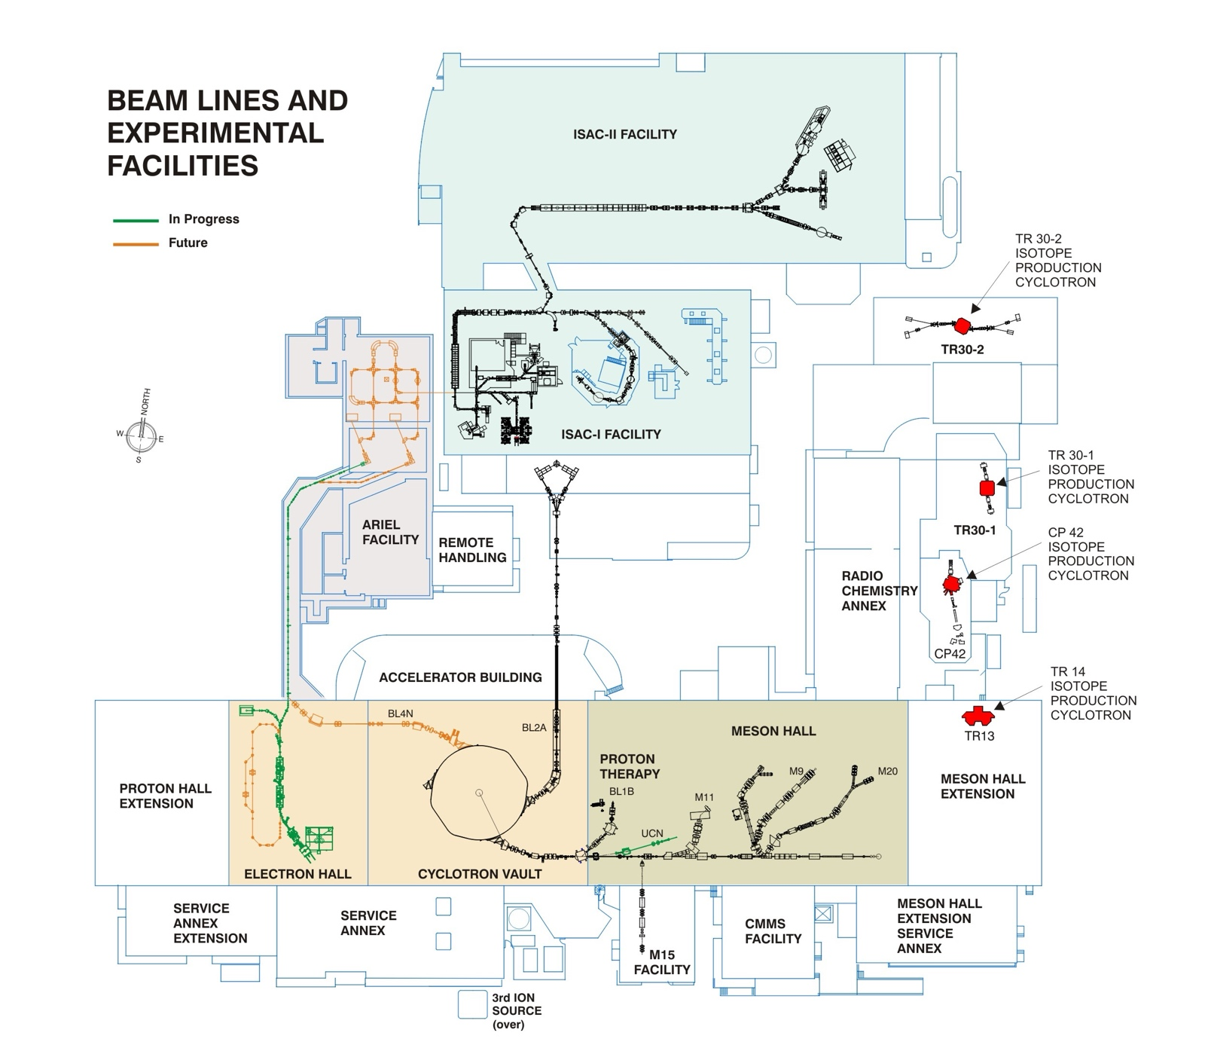
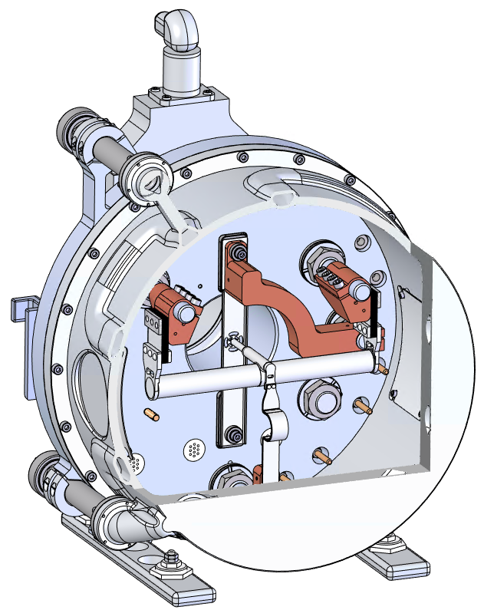
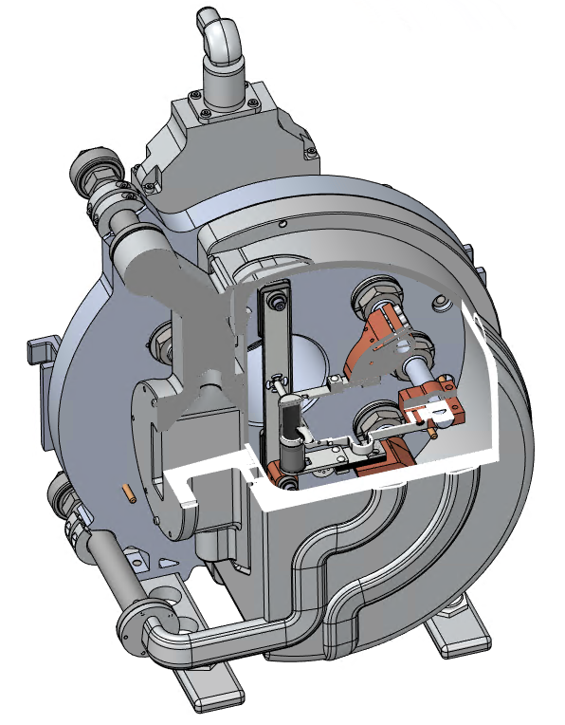

ARIEL at TRIUMF
Addition of two ISOL target stations to TRIUMF
e -> $γ$ station, 30 MeV electron, 10 mA
p+ station, 490 MeV up to 100 µA
Beam switchyard capable of delivering up to three simultaneous RIB to users
Flexible Target and Ion Source Assembly based on ISOLDE one
APTW HTV
100 kW electrons @ 30 MeV
AETE HTV
50 kW protons @ 500 MeV
Slide material courtesy of E. Egoriti and A. Gottberg

Slide 20
Low Proton Energy Facilities
Operational
Future
Gas catcher
Heavy ion
Reactor
e→$γ$
Legend:
p⁺ High energy
p⁺ Low energy
Offline RIB (operational)
SPES
INFN-LNL
40 MeV p
Legnaro (IT)
BRIF
CIAE
100 MeV p Beijing (CN)
ISOL RAON
IBS
70 MeV p
Daejeon (KR)
ISOL@MYRRHA
SCK CEN
100 MeV p
Mol (BE)
LERIB
iThemba LABS
70 MeV p Cape Town (ZA)
20

Slide 21


SPES at INFN-LNL
Operational
Future
Gas catcher
Heavy ion
Reactor
e→$γ$
Legend:
p⁺ High energy
p⁺ Low energy
Offline RIB (operational)
SPES
INFN-LNL
40 MeV p
Legnaro (IT)
Contributions
Invited (Mon 3:30 PM): T. Marchi – SPES facilty talk and commissioning
21

Slide 22
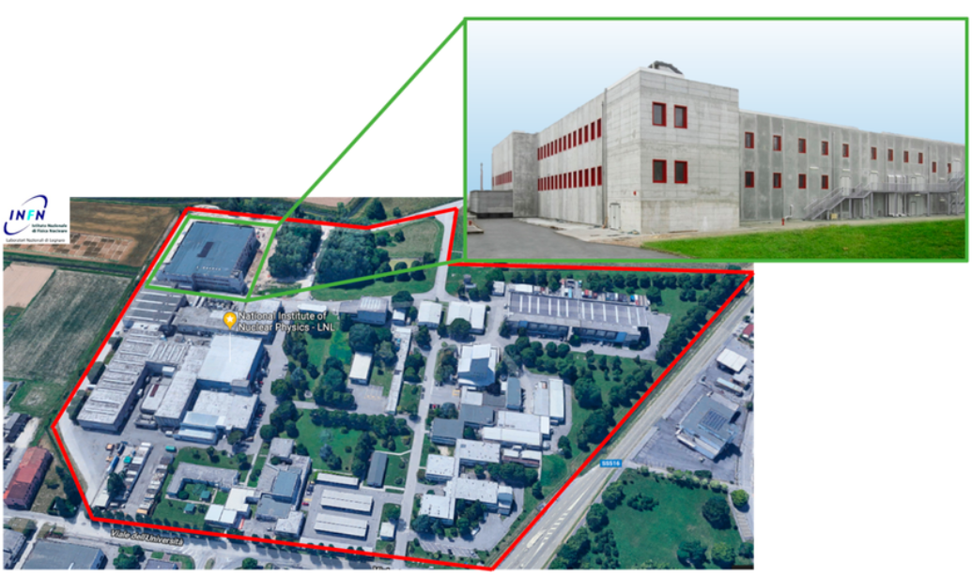
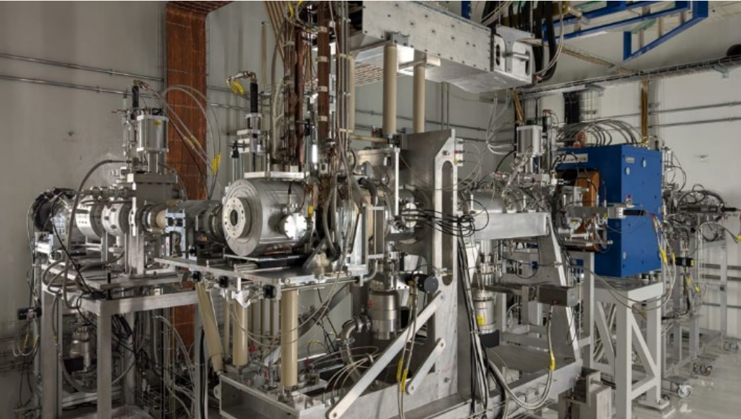
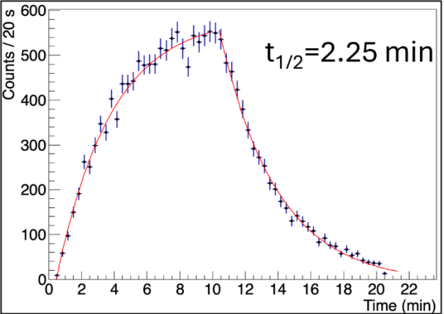
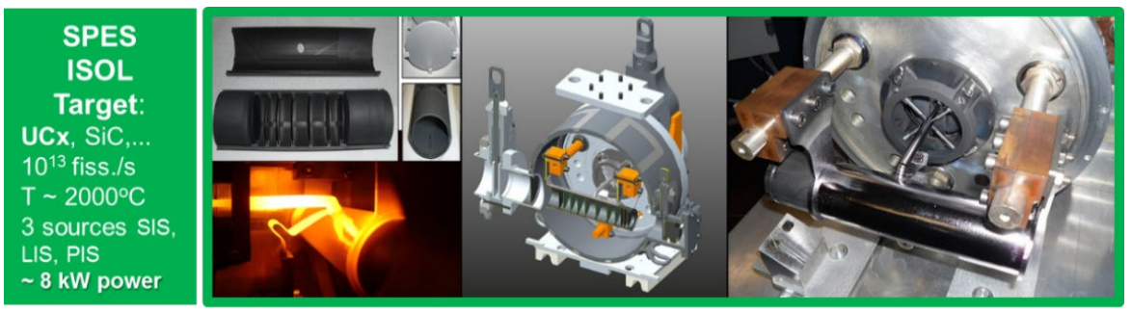
SPES at INFN-LNL
70 MeV cyclotron IBA up to 750 µA available
ISOL facility takes 40 MeV 200 µA
Targets used: SiC, TiC
Ion sources: FEBIAD and Surface+laser ion source
Commissioned at end of 2024
²⁸Al measured during commissioning
J. Esposito et al. DOI: 10.3390/molecules24010020
E. Fagotti et al. DOI: 10.18429/JACoW-HIAT2025-MOB01
T. Marchi et al. DOI: 10.1088/1742-6596/1643/1/012036

Slide 23


ISOL RAON at IRIS/IBS
Operational
Future
Gas catcher
Heavy ion
Reactor
e→$γ$
Legend:
p⁺ High energy
p⁺ Low energy
Offline RIB (operational)
Contributions
Invited (Mon 1:00 PM): T. Shin – RAON overview talk
Talk (Fri 9:00 AM): H.-N. Kim – Laser source for ISOL RAON
Poster (Tue 6:00 PM): H.-N. Kim – Laser source for ISOL RAON
Poster (Tue 6:00 PM): T. Shin – RIB operation at ISOL RAON
ISOL RAON
IBS
70 MeV p
Daejeon (KR)
23

Slide 24




ISOL RAON at IRIS/IBS
70 MeV cyclotron IBA up to 750 µA available
Based on the ARIEL/ISAC modular concept
For now 14 µA (1 kW are being used) – to be increased
Targets used: SiC, LaC_{x},
Ion sources: surface ion source (alkali), laser ion source (Mg)
new: TiC (this year) with FEBIAD, next year ThCx
Mass resolving power from 400 to 600 depending on ion source
Operational since March 2023
Institute for Rare Isotope Science | About IBS
J. Hee et al. DOI: 10.1016/j.nimb.2023.05.045
W. Hwang et al. DOI: 10.1016/j.nimb.2023.05.059

Slide 25

BRIF at CIAE
Operational
Future
Gas catcher
Heavy ion
Reactor
e→$γ$
Legend:
p⁺ High energy
p⁺ Low energy
Offline RIB (operational)
BRIF
CIAE
100 MeV p Beijing (CN)
25

Slide 26




BRIF at CIEA
100 MeV p+
ISAC like concept (target modules and target)
Modular design in L shape (with p beam diagnostics, target and beam dump modules all in one)
FEBIAD and surface ion source operation
K, Na, Al RIBs produced from CaO, SiC, MgO targets using up to 15 microA
Mass separation up to 20000
Commissioned in 2014
W. Nan et al. DOI: 10.1016/j.ppnp.2025.104188

Slide 27

ISOL@MYRRHA at SCK CEN
Operational
Future
Gas catcher
Heavy ion
Reactor
e→$γ$
Legend:
p⁺ High energy
p⁺ Low energy
Offline RIB (operational)
Contributions
Talk (Mon 2:20 PM): D. Houngbo– ISOL@MYRRHA facility update
Talk (Wed 9:40 AM): L. Gubbels – Th-based target materials for ISOL@MYRRHA
Talk (Thu 2:00 PM): S. Ramos Garces– Bayesian Optimization Algorithms for ion source tunning
Poster (Tue 6:00 PM): L. Gubbels – Non-actinide materials development at ISOL@MYRRHA
Poster (Tue 6:00 PM): F. Giudubaldi – Day-1 targets for development of Mg and Al beams at ISOL@MYRRHA
ISOL@
ISOL@MYRRHA
SCK CEN
100 MeV p
Mol (BE)
27

Slide 28







ISOL@MYRRHA at SCK CEN
Facility within the MYRRHA programme
Modular design the same as ARIEL
100 MeV, < 500 µA
Day-1 targets: SiC, Ti, ThO₂, UO₂
Start at low intensity (<20 µA)
Facility designed and licensed aimed at operation of ThC_{x} up to 200 µA (10 kW deposited power)
Ion sources: surface, laser, (FEBIAD)
ISOL@MYRRHA systems
under advanced prototyping
Building completed to basic design level
ISOL system design completed at conceptual level and most systems already completed basic design stage
Prototyping activities ongoing
See talk from D. Houngbo!
28

Slide 29
Gas Catcher and Reactor Facilities
Operational
Future
Gas catcher
Heavy ion
Reactor
e→$γ$
Legend:
p⁺ High energy
p⁺ Low energy
Offline RIB (operational)
IGISOL
UNI-JYFL
30 MeV p, 14 MeV d,
HI < 130 MeV/u Jyväskylä (FI)
IRIN-PIK reactor
PNPI
n (3×10¹³ n/(cm² s)
St. Petersburg (RU)
BISOL-CARIF reactor
CIAE
n (8 × 10¹⁴ n/(cm² s)
Beijing (CN)
TRIGA Reactor
UNI Mainz
n (1.1×10¹¹ n/(cm² s)
Mainz (DE)
CARIBU
Argonne National Lab
²⁵²Cf sf Lemont (US)

Slide 30


CARIBU and IGISOL
Operational
Future
Gas catcher
Heavy ion
Reactor
e→$γ$
Legend:
p⁺ High energy
p⁺ Low energy
Offline RIB (operational)
IGISOL
UNI-JYFL
30 MeV p, 14 MeV d,
HI < 130 MeV/u Jyväskylä (FI)
CARIBU
Argonne National Lab
²⁵²Cf sf Lemont (US)
Contributions
Talk (Wed 11:00 AM): G. Savard – Neutron-rich RIB from gas catchers

Slide 31


IGISOL in UNI-JYFL
CARIBU in Argonne
30 MeV protons up to 100 µA, 14 MeV d up to 50 µA
Thin targets ²³⁸U (or ²³²Th) to produce fission products
200 – 500 mbar of He as catcher
Transport times of ~100 ms
Allows refractory elements with ISOL
No ion source as the fragments are still ionized
~1 Ci, ²⁵²Cf spontaneous fission with a thin degrader
1.2 m x 0.5 m ø chamber filled with gas to stop the fragments
80 mbar of He as catcher
15 to 25 ms of transport times
30 to 50% efficiency at +1 or +2 charge state
D. Gorelov, et al. DOI: 10.1016/j.nimb.2016.02.049
Y. Blumenfeld, et al. DOI: 10.1088/0031-8949/2013/T152/014023
G. Savard et al. DOI: 10.7566/JPSCP.6.010008

Slide 32

Gas Catcher and Reactor Facilities
Operational
Future
Gas catcher
Heavy ion
Reactor
e→$γ$
Legend:
p⁺ High energy
p⁺ Low energy
Offline RIB (operational)
IRIN-PIK reactor
PNPI
n (3×10¹³ n/(cm² s)
St. Petersburg (RU)
BISOL-CARIF reactor
CIAE
n (8 × 10¹⁴ n/(cm² s)
Beijing (CN)
TRIGA Reactor
UNI Mainz
n (1.1×10¹¹ n/(cm² s)
Mainz (DE)

Slide 33




TRIGA at UNI Mainz
1440 μg ²³⁵U target
Neutron flux: 1.05 ⋅ 10¹¹ cm⁻²s⁻¹
Aerosol-based gas-jet system, e.g. N₂ as carrier gas + CdI₂ (BP 742 °C)
Fission fragments are sorbed by the aerosol and carried by the gas
1 s transport time, 60 to 70% transport eff.
Surface ion source breaks the up the aerosols to release the fission fragments
J. Grund et al. DOI: 10.1016/j.nima.2020.164013
J. Ketelaer et al. DOI: 10.1016/j.nima.2008.06.023

Slide 34





Offline RIB (operational)
Operational
Future
Gas catcher
Heavy ion
Reactor
e→$γ$
Legend:
p⁺ High energy
p⁺ Low energy
Offline RIB (operational)
RISIKO
Mainz UNI
External sources
Mainz (DE)
Worth to mention (future offline RIB facilities):
SMILES from ARRONAX (FR)
RIS² Lab - University of Manchester (GB)
LIS, Leuven – being restarted (BE)
Contributions
Talk (Fri 9:40 AM): K. Went – PI-LIST developed at RISIKO
Poster (Tue 6:00 PM): K. Went – PI-LIST developed at RISIKO
Poster (Tue 6:00 PM): T.E. Cocolios – Self sputtering of MEDICIS collections
Poster (Tue 6:00 PM): W. Wojtaczka– Revival of the LIS separator in Leuven
MEDICIS
CERN
1.4 GeV p and
external sources
Geneva (CH)

Slide 35




MEDICIS at CERN
RISIKO in Mainz UNI
unique facility approved for clinical applications (CERN Council decision March 2025), which started in 2017
Work with both locally irradiated sources (ISOLDE) or external ones (reactor/cyclotron activated samples)
(1-several) clinical doses demonstrated for Ac-225, Ra-223, Pb-212, High Molar activity Sm-153, Ba/Cs-128 and also extraction of others
Single collections of up to 1 GBq demonstrated
Has separated sources e.g. of ¹⁶³Ho for ECHo (≈ 10¹² atoms/MMC) and ⁵³Mn for PSI (≈ 5 × 10¹⁷ atoms total)
Laser ion source and surface ion source, thorughput up to 100 nA
Active development of ion source technologies (e.g. (PI-)LIST ion source for ISOLDE)
Normal mode
Simulation - FLUKA
C. Bernerd, T. Stora et al. DOI: 10.18429/JACoW-IPAC25-TUPB047
Dominik Studer, SANDA General Meeting 2021

Slide 36



Worth mentioning in this talk to pool resources for R&D and technology sharing
“Offline” Non-RIB facilities
ISOL@MYRRHA offline
ISOLDE offline 1
ISOLDE offline 2
ISAC offline
ARIEL TISA
ALTO Offline
… many others!

Slide 37
Thank you!
Discussions, content and advice for this talk: Lucia Popescu, Alexander Gottberg, Sebastian Rothe, Simon Stegeman
For sharing material, also: Luca Egoriti, Mia Au, Thierry Stora, Joachim Vollaire, Erwin Siesling, Julien Guillot, Enrique Minaya, Hee-joong Yim, Wonjoo Hwang, Michele Ballan, Pierre Chauveau, Stuart Warren, Donald Houngbo, Tom Day Goodacre
The EMIS XX International Adv. Committee for trust for the 2 invited contributions
For funding my participation in the conference!

Slide 38
Copyright © SCK CEN
All property rights and copyright are reserved.
This presentation contains data, information and formats for dedicated use only and may not be communicated, copied, reproduced, distributed or cited without the explicit written permission of SCK CEN.
If this explicit written permission has been obtained, please reference the author, followed by ‘by courtesy of SCK CEN’.
Any infringement to this rule is illegal and entitles to claim damages from the infringer, without prejudice to any other right in case of granting a patent or registration in the field of intellectual property.
SCK CEN
Belgian Nuclear Research Centre
Studiecentrum voor Kernenergie
Centre d'Etude de l'Energie Nucléaire
Foundation of Public Utility
Stichting van Openbaar Nut
Fondation d'Utilité Publique
Registered Office:
Avenue Herrmann-Debrouxlaan 40 - 1160 BRUSSELS - Belgium
Research Centres:
Boeretang 200 - 2400 MOL - Belgium

