Slide 1
High-Power Rare-Isotope-Beam Production and Separation at FRIB
Bradley Sherrill Associate Director for Fragment Separation sherrill@frib.msu.edu
20 October 2025

Slide 2
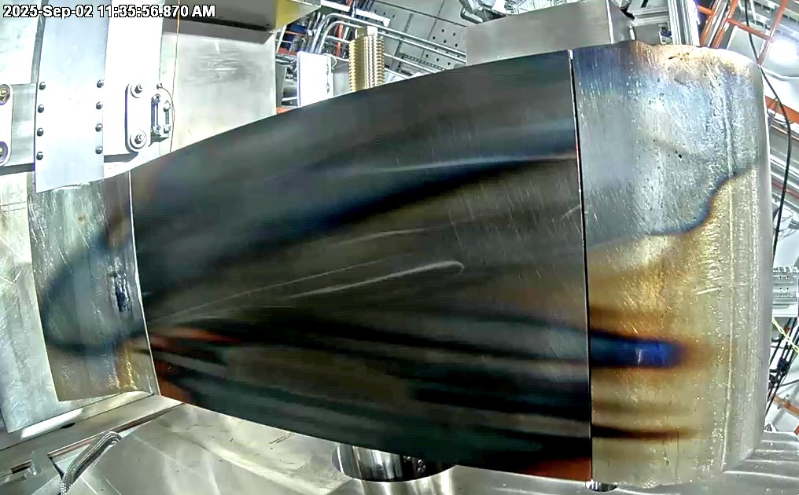
Outline
Introduction
The Facility for Rare Isotope Beams, FRIB, in context
Overview of FRIB
The Advanced Rare Isotope Separator, ARIS
High Power Details
Results from First Two Years of Operation
Summary
FRIB Beam Dump after 1 year of operation FY2025

Slide 3
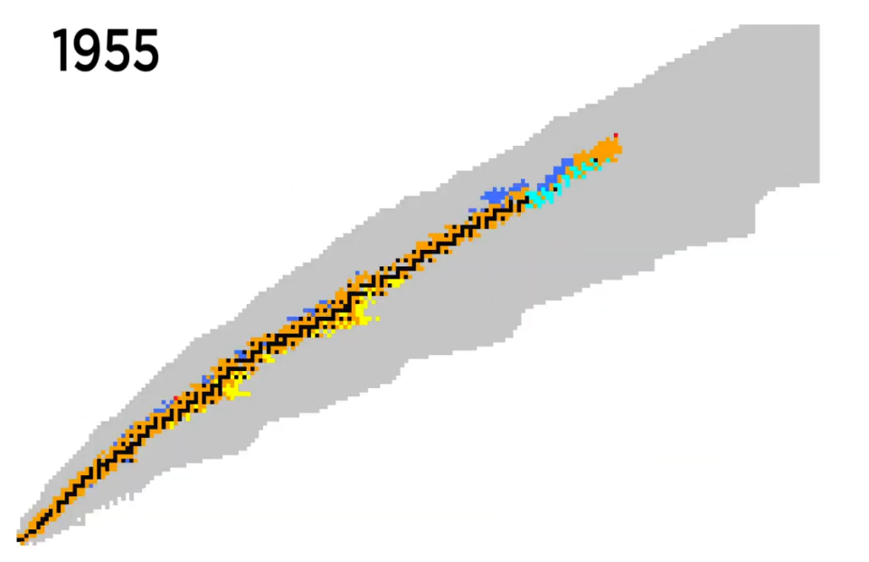
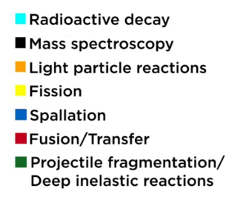

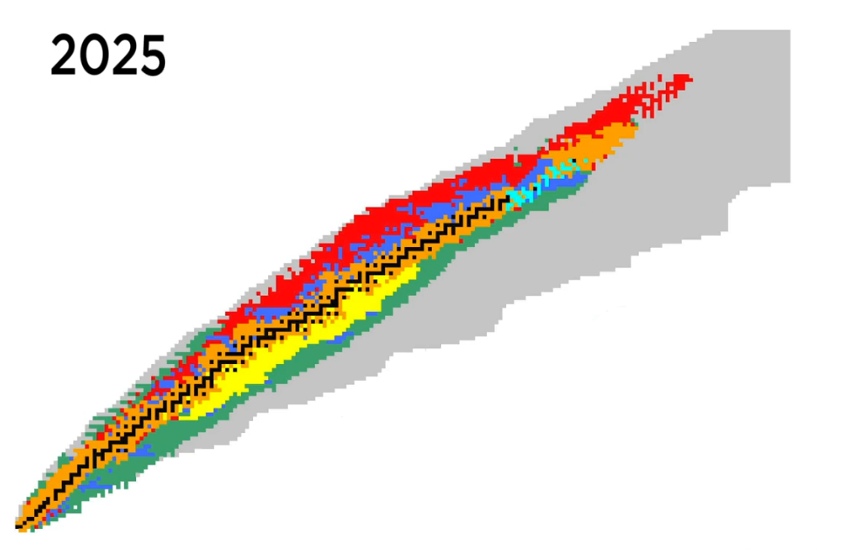
Congratulations EMIS on a 70th Birthday
The first EMIS conference was held in Harwell Laboratory in England in 1955 – Harwell separated stable isotopes
EMIS-14 was held in Victoria BC in 2002 and chaired by John D’Auria
EMISXX
The program has evolved to focus on rare isotope beam separation, instrumentation, and uses
In 1955 less than 1,000 isotopes were known
Discovery of Isotopes Project
M. Thoennessen frib.msu.edu

Slide 4
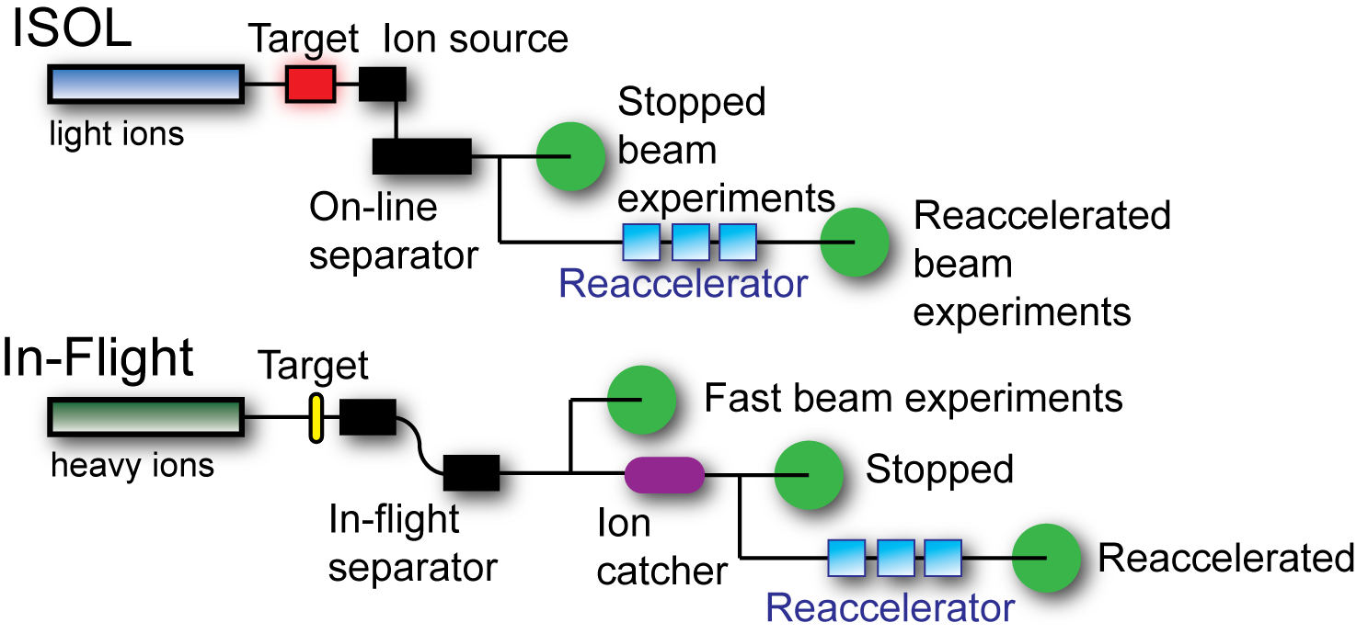
Rare Isotope Beam Production Methods
More primary beam → more rare isotope intensity, more isotopes accessible

Slide 5
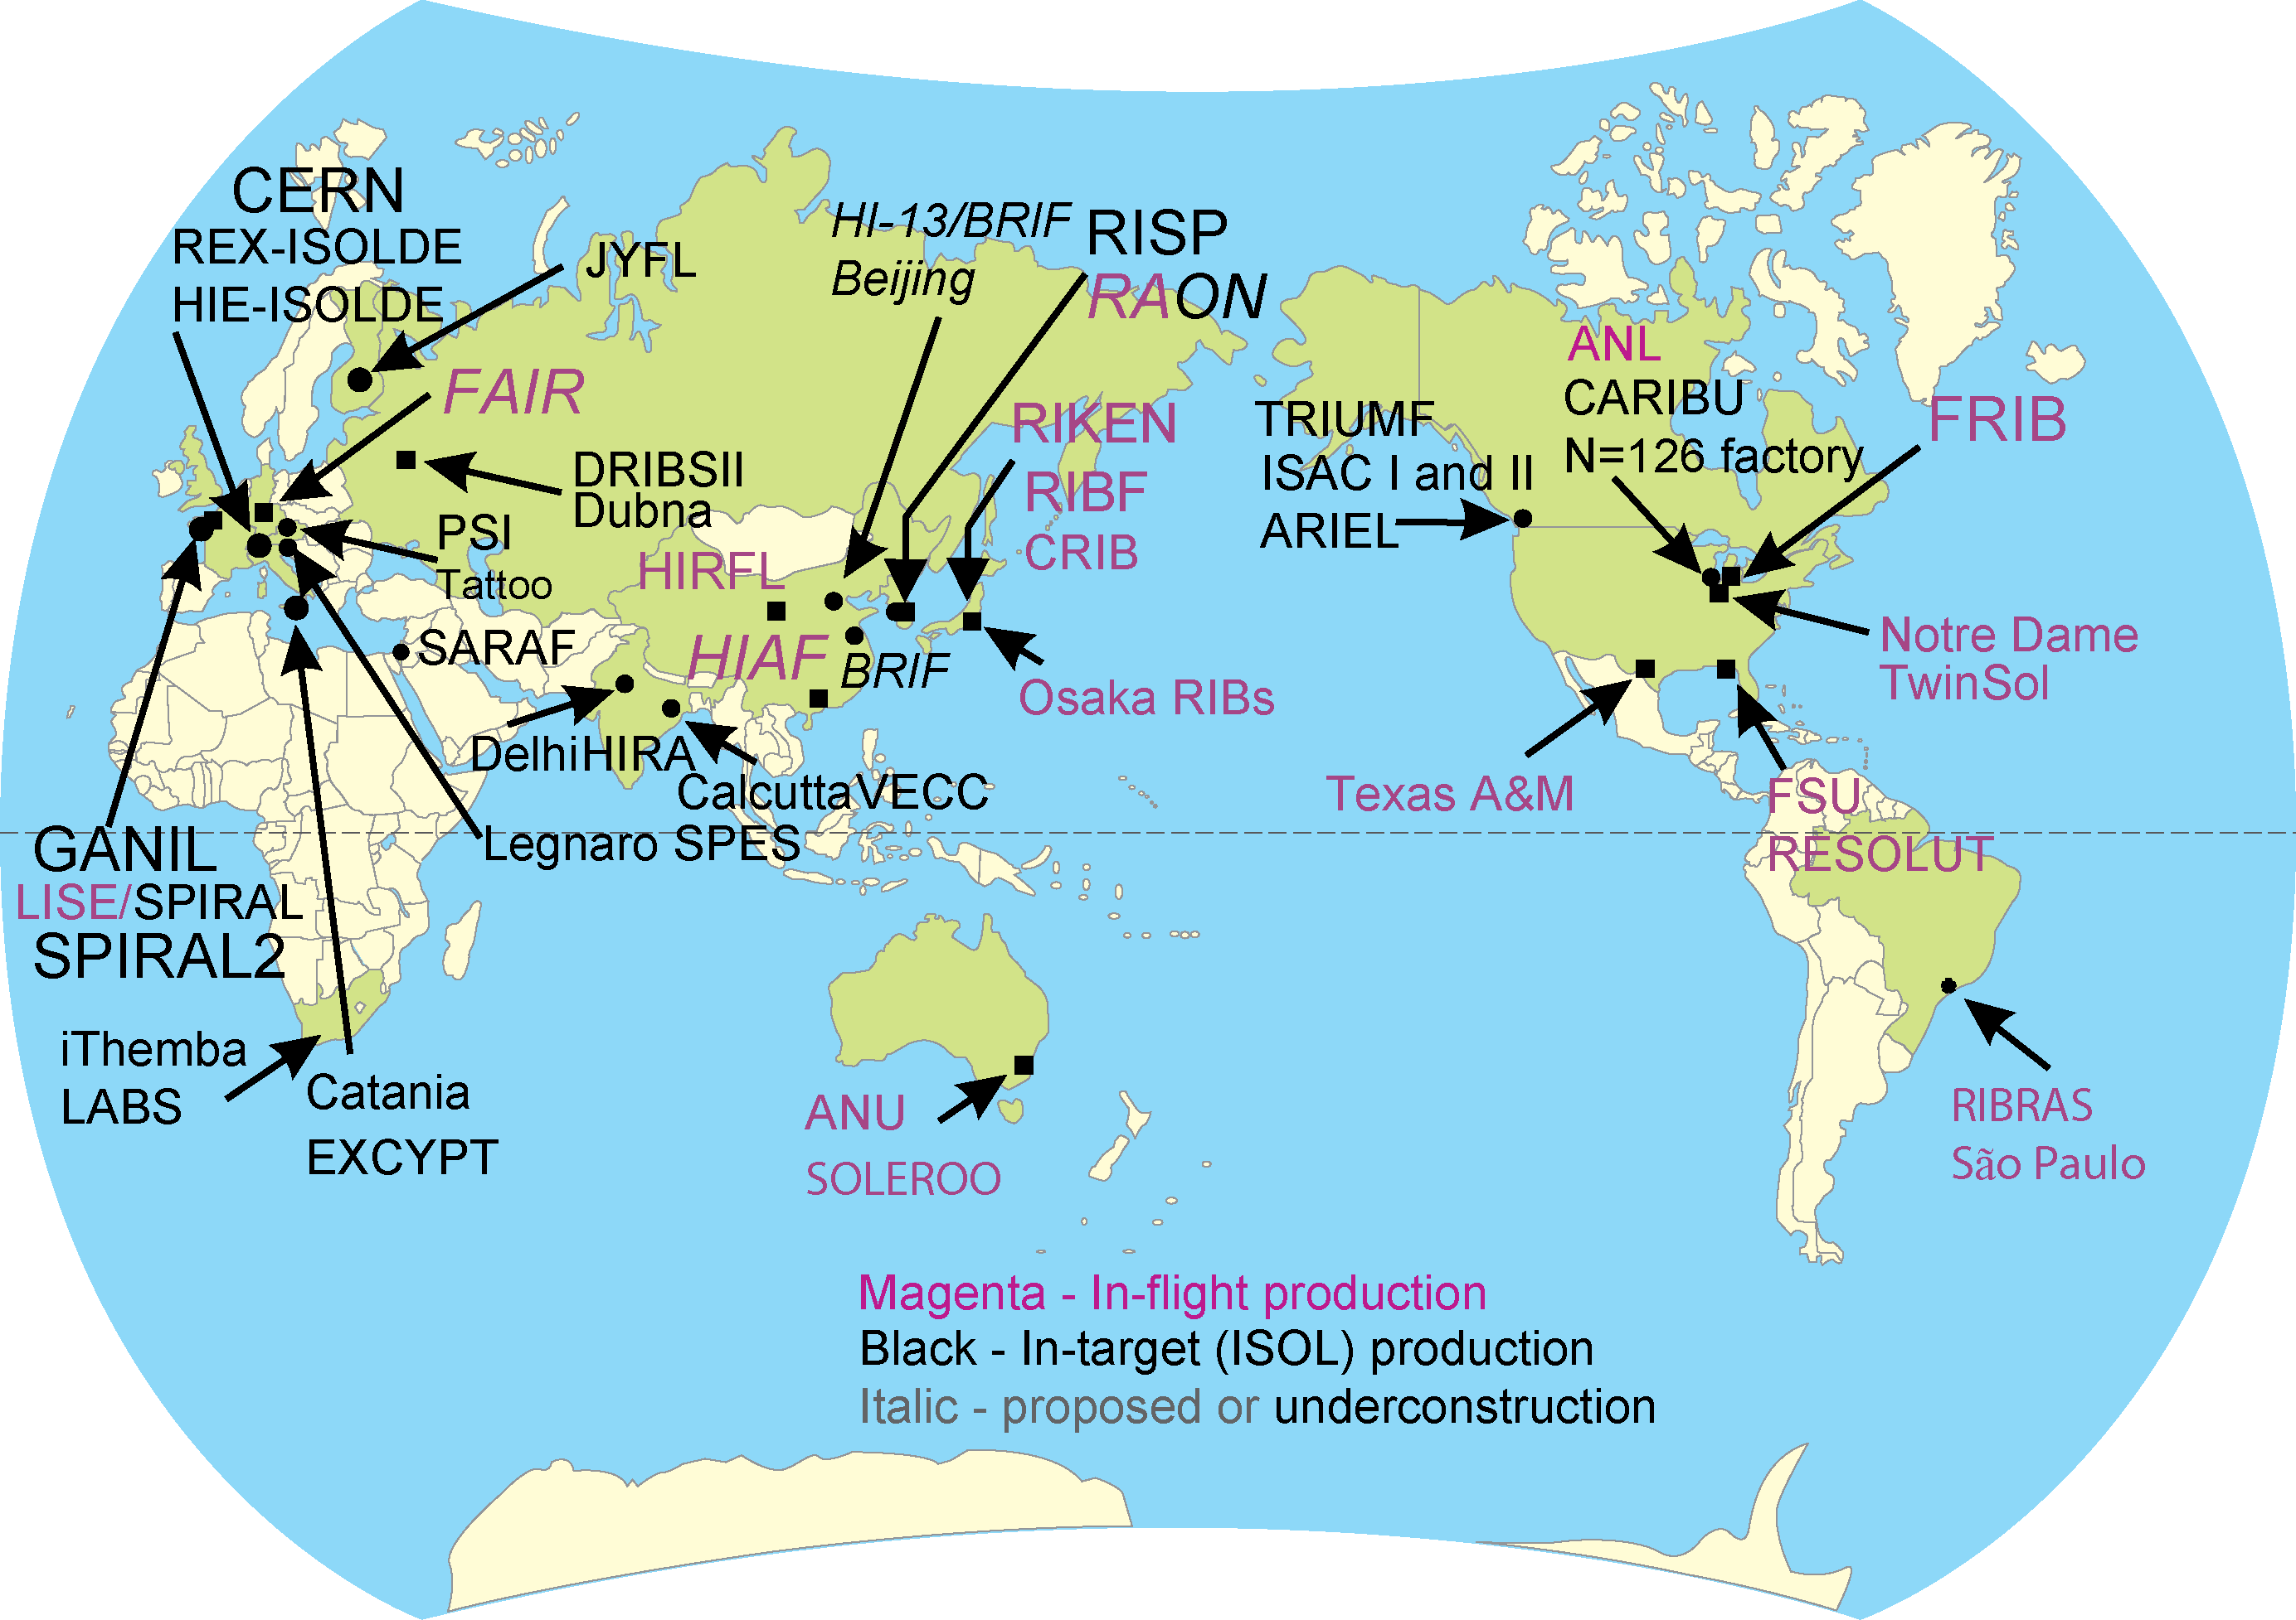
World Landscape of Rare Isotope Beam Facilities
Many of these facilities are represented by talks at EMISXX
The various facilities address similar science, but are complementary by providing unique capabilities
Different production mechanisms can use large cross sections or efficient separation, in addition to high power

Slide 6
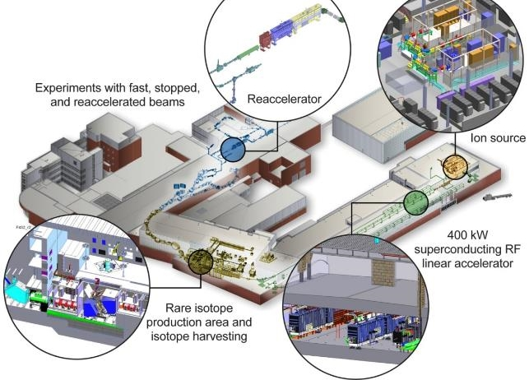
The Facility For Rare Isotope Beams
FRIB is designed for 400 kW beam power
8 p𝜇A or 5 x 10¹³ ²³⁸U /s
42 p𝜇A or 2.6 x 10¹⁴ ⁴⁸Ca /s
Operation at 20 kW now, power ramp-up underway
Range of beam energies provided for experiments
Fast – 20 to 200 MeV/u
Stopped – 10 kV
Reaccelerated – 1.5-10 MeV/u
Started operation in May 2022
58 experiments completed
Isotope harvesting capability ( collection of otherwise unused isotopes for applications)
3 experiment completed
Thomas Glasmacher, FRIB Laboratory Director

Slide 7
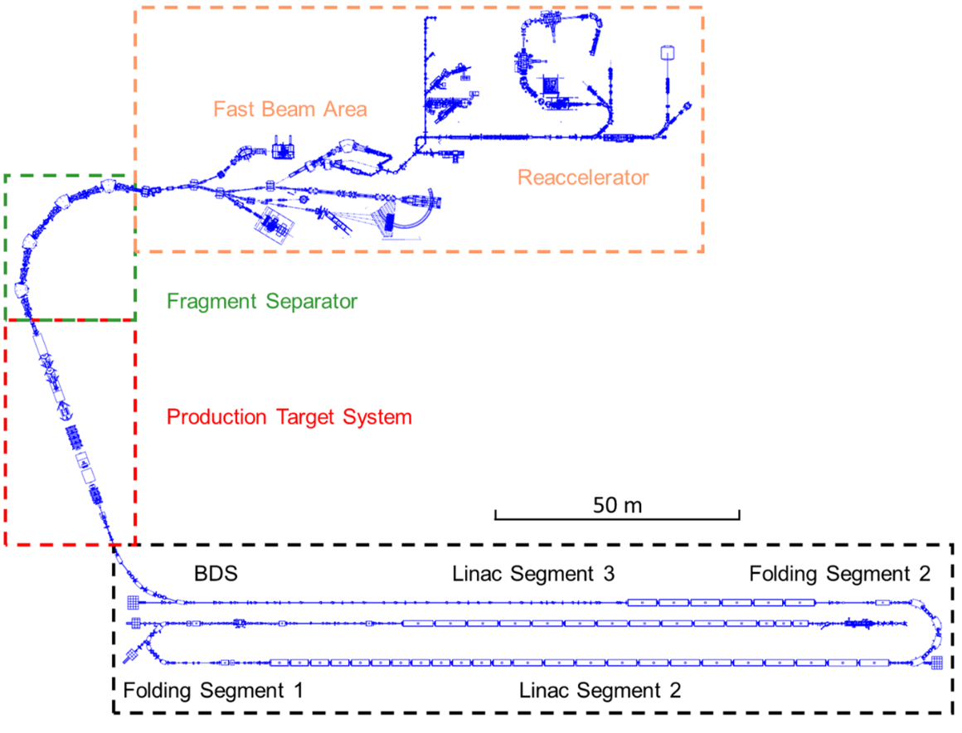
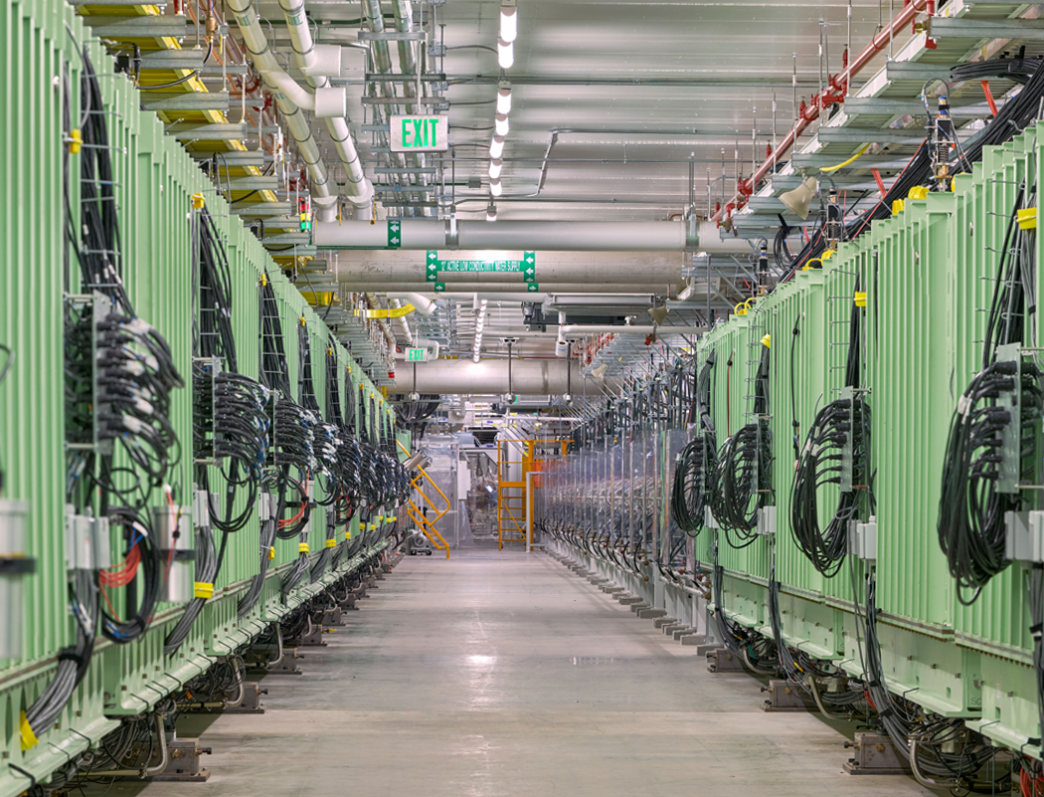
Schematic Overview of the FRIB Facility
Superconducting linear accelerator with 3 segments – 46 total cryomodules
Production area and fragment separator with remote access
Stopped beam area with two gas cells and cyclotron stopper
ReA3,6 (up to 10 MeV/u re-accelerator)
Stopped Beam Area
ReA3,6 up to 6-10 MeV/u
Concepts to add ReA12
Ground level
Pre-separator
15 m underground

Slide 8
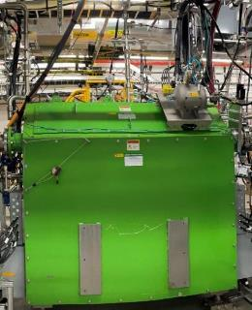
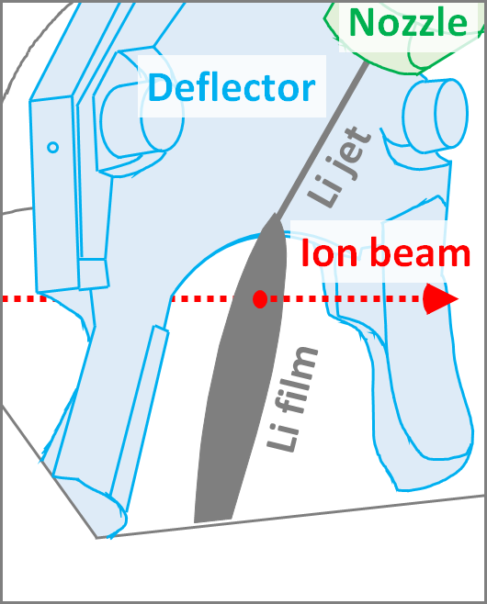
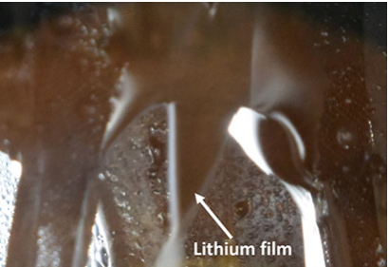
Liquid Lithium Charge Stripper
T. Kanemura et al., Phys. Rev. Lett. 128 (2022) 212301
Now used for all beams
Needed to achieve design-goal beam energies beyond 200 MeV/u and beam power up to 400 kW
Conventional charge stripping foil can only last seconds under FRIB beam power
Liquid lithium charge stripper installed in FRIB tunnel
Xe²⁶⁺ charge state after stripping

Slide 9
FRIB Power Ramp-up since Start of User Operations Liquid Lithium Charge Stripper Used to Push Heavy Ion Beam Power > 10 kW
30 kW
Test
Lithium routine operation started
Oct. 2023
20 kW test
20 kW
Lithium routine
10 kW
Lithium occasional use
3 kW
5 kW
1 kW
10/16/2025
T. Kanamura et al., J. Wei

Slide 10
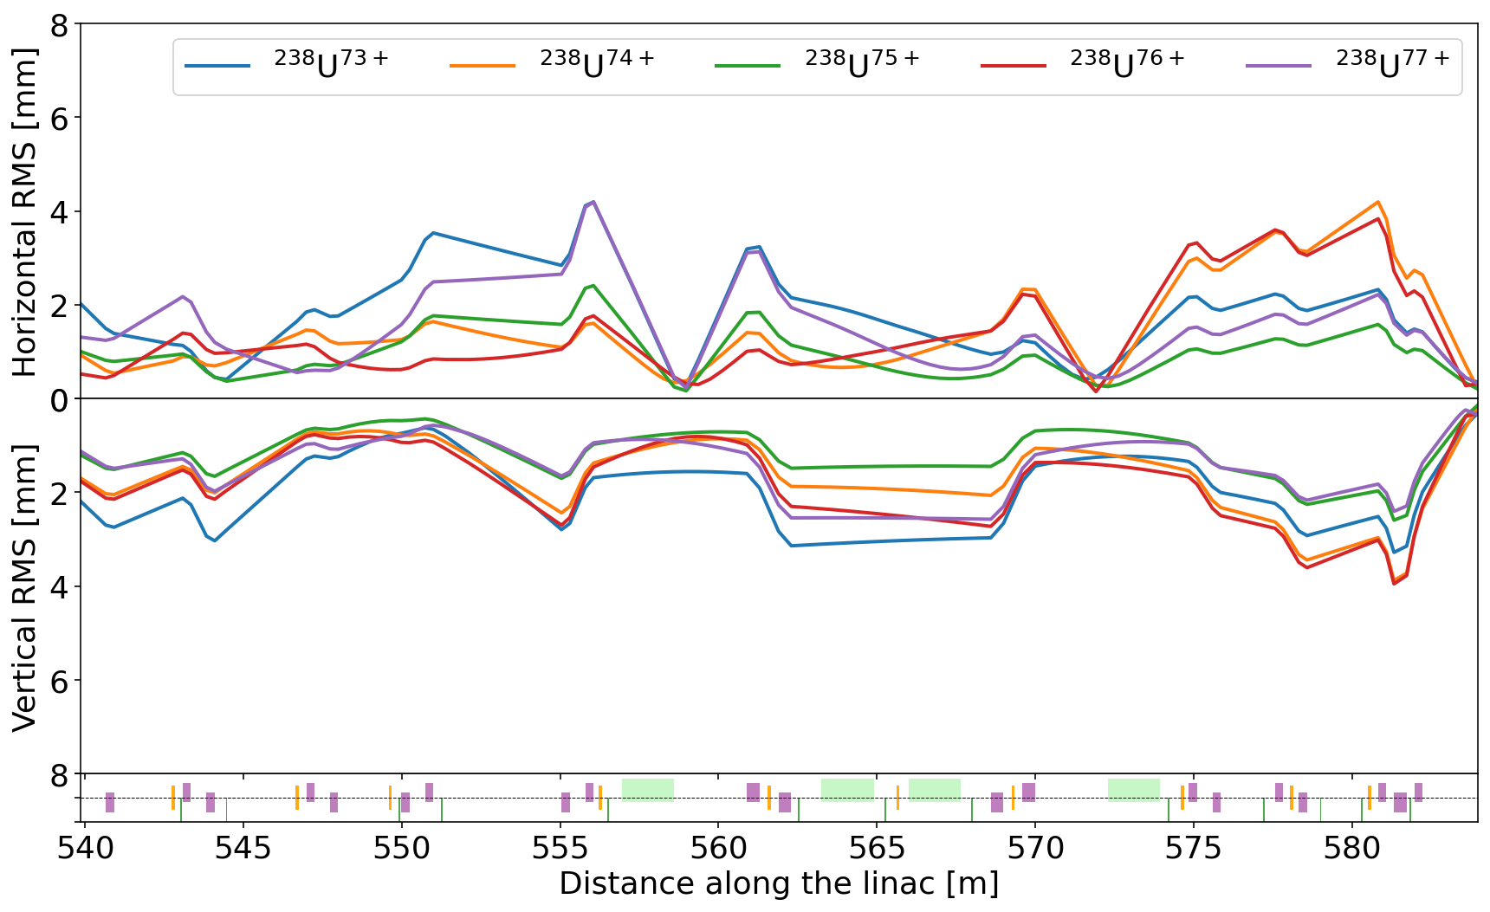
High (83% for ²³⁸U) Stripping Efficiency with Multiple Charge-state Simultaneous Acceleration
Routinely accelerating up to 5 charge states (for ²³⁸U) simultaneously
Multi-charge-state beams tuned to overlap at specified locations
Target (present)
Charge stripper (future)
Plan to accelerate multi-charge state beams in Linac Segment 1 (upstream of charge stripper)
In principle LINAC and stripper could operate at 100 kW
Simultaneous acceleration of five charge states of ²³⁸U beam in FRIB linac
P. N. Ostroumov, et al., Phys. Rev. Lett. 126, 114801 (2021)
20 kW Uranium – P. N. Ostroumov, et al., Phys. Rev. Acc. and Beams 27, 060101 (2024)

Slide 11
Rare Isotope Production and Separation
Rare isotopes are separated using the Advance Rare Isotope Separator, ARIS
M. Hausmann et al., NIM B317 (2013), presented at EMIS 2012 (16th EMIS)
Production target is 15 m underground
Experimental facilities are at ground level
Stopped Beam Area
Pre-separator
Bandura et al., NIM A645, Hausmann et al., NIM B317, Portillo et al., NIM B540

Slide 12
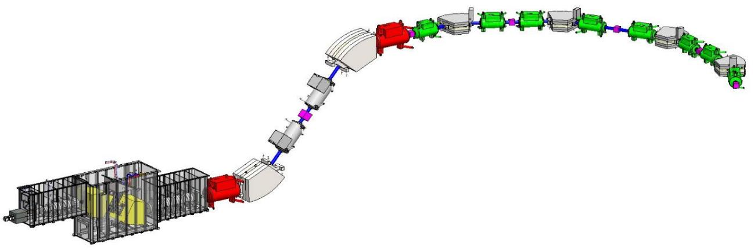
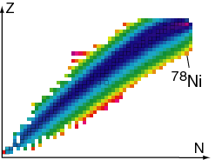
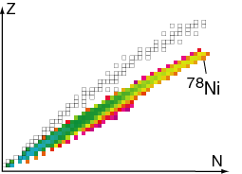
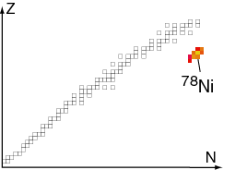
The Advance Rare Isotope Separator, ARIS
Three-stage separation by the use of “wedges”
Special features
Momentum compression
Particle identification, PID, of individual atoms
Designed for operation with 400 kW of primary beam
Remote handling of items in target/wedge area
Atom-by-atom identification of A, Z, q
Modeling with - LISE_{cute}⁺⁺
Bandura et al., NIM A645, Hausmann et al., NIM B317, Portillo et al., NIM B540
Two additional stages of separation for cleanup
Target – carbon disk
15m
“Wedge”
Example: ⁷⁸Ni from ⁸⁶Kr at 200 MeV/u
Fragments after target
Fragments after wedge
Fragments at focal plane

Slide 13
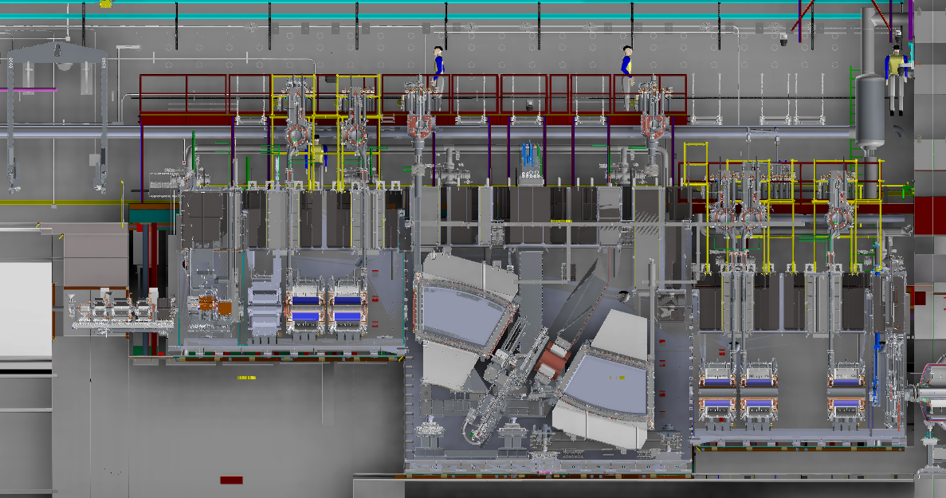
Target Hall Overview
ARIS “hot cell” target area
Remote handling team lead by M. Larmann
Remotely manipulated components
Target
Beam dump
Wedge module
Magnets
Shields
Power Supplies and Controls Cables Conduits
Cryo Servicing Platforms
Cryogenic Transfer Line
NCU Connections
Vacuum Vessels
Wedge System
Shielding
Beam from LINAC
BDS
WIQ1,2,3
Target System
SCD1
WIQ4,5,7
Beam Dump System
SCD2
Vertical Preseparator

Slide 14
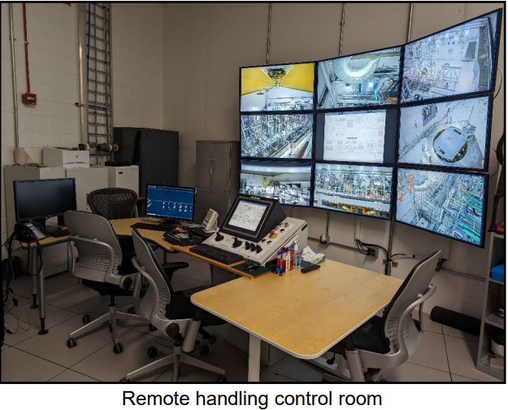
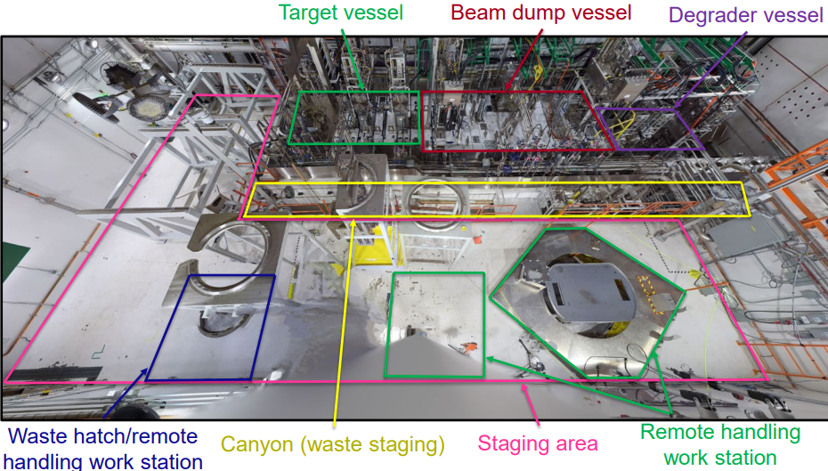
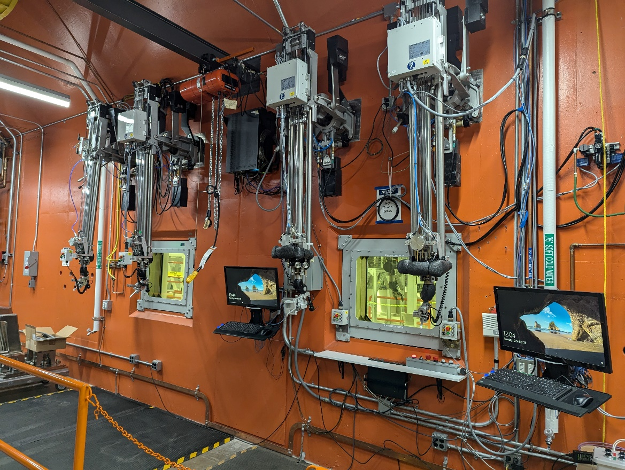
Remote Handling At FRIB
Target and wedge changes are done remotely
Capability to remove all components and inspect them with cameras (see examples from the ARIS beam dump)

Slide 15
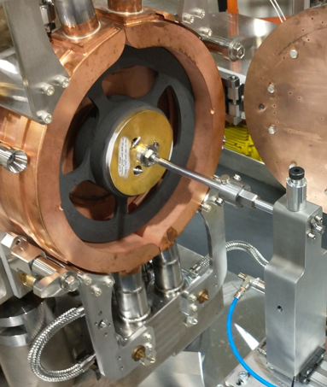
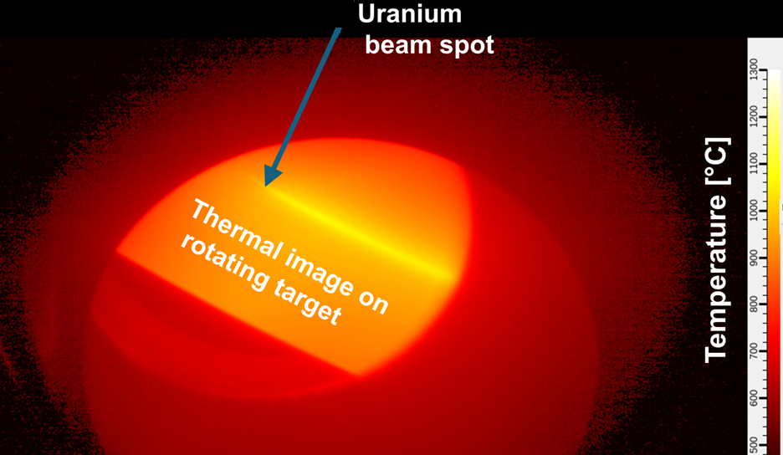
High-power Targetry Devices in Operations
Rotating, single-slice graphite target for rare isotope production
Absorbs ~ 25% beam power; accommodate small (~ 1 mm diameter) beam size
Static beam dump with shallow beam incident angle
Absorbs ~ 75% beam power; consideration of radio-activation in water and surroundings
Single-slice graphite production target
20 kW, 177 MeV/u ²³⁸U beam on 2.1 mm thick graphite target rotating at 500 r.p.m.
J. Song, et al., HIAT’25, East Lansing, (2025)

Slide 16
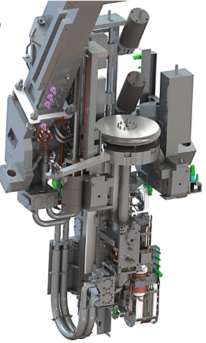
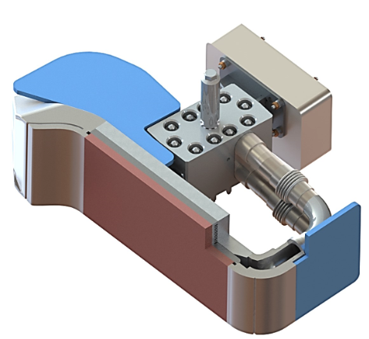
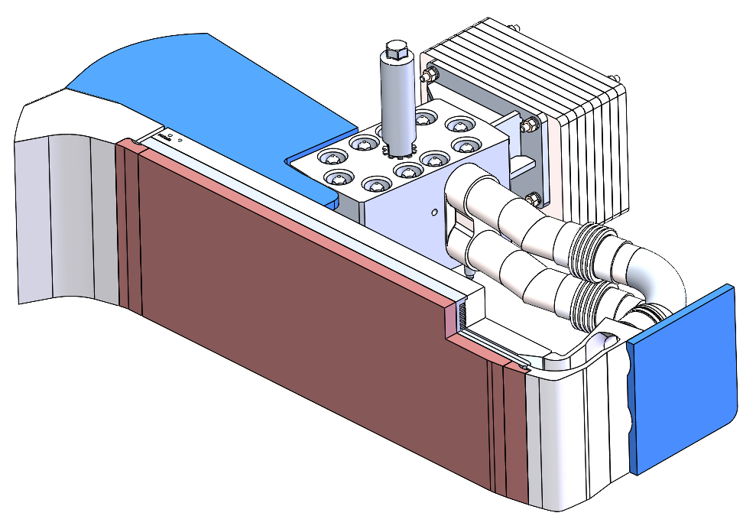
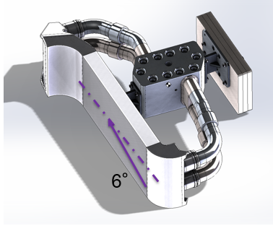
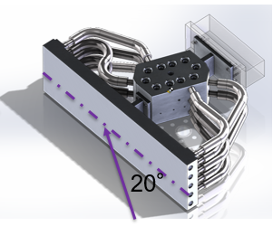

Beam Dump Power Ramp-up Plan
50 kW
S. Miller, et al., HIAT’25, East Lansing, (2025)
T. Kanemura
J. Song
J. Wei
1 kW
30 kW
Rotatable
400 kW
10 kW
Mini-channel static
Rotating drum
Mini-channel
Water cooling
Primary beam
Water cooling
20 deg static
6 deg static
$$6^{o}$$
Primary beam
copper-chromium-zirconium (C18150) material

Slide 17
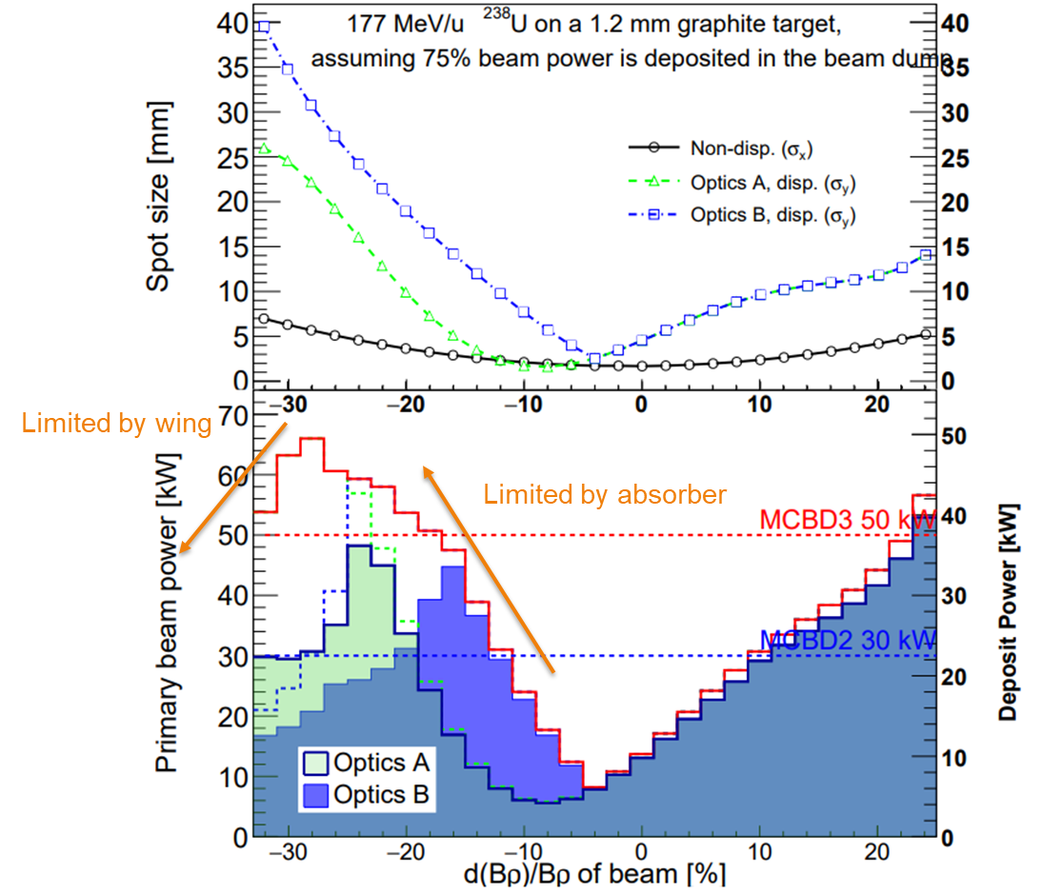
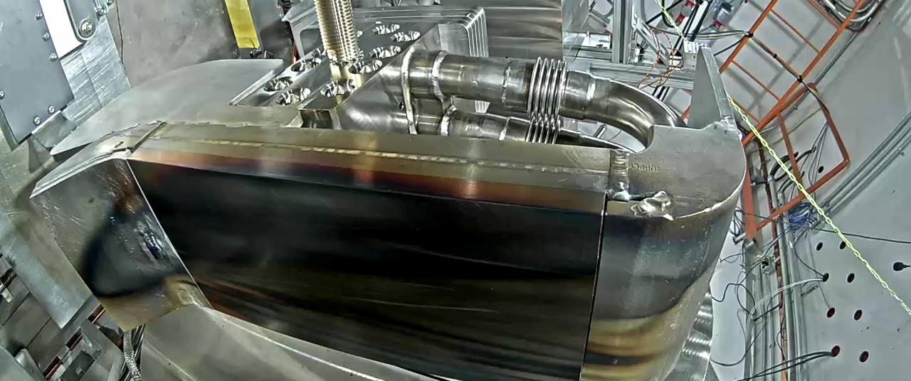
Static Beam Dump for 10 - 50 kW
Encouraging results from 20 kW operations in FY2025
e-beam test results show operation at 350 C possible
Power is limited based on calculated beam spot size
Observed features on FY2025 dump are understood
Power limited by beam spot size
6°version-2 beam dump removed from FRIB Sep. 2025
T. Kanemura J. Song

Slide 18
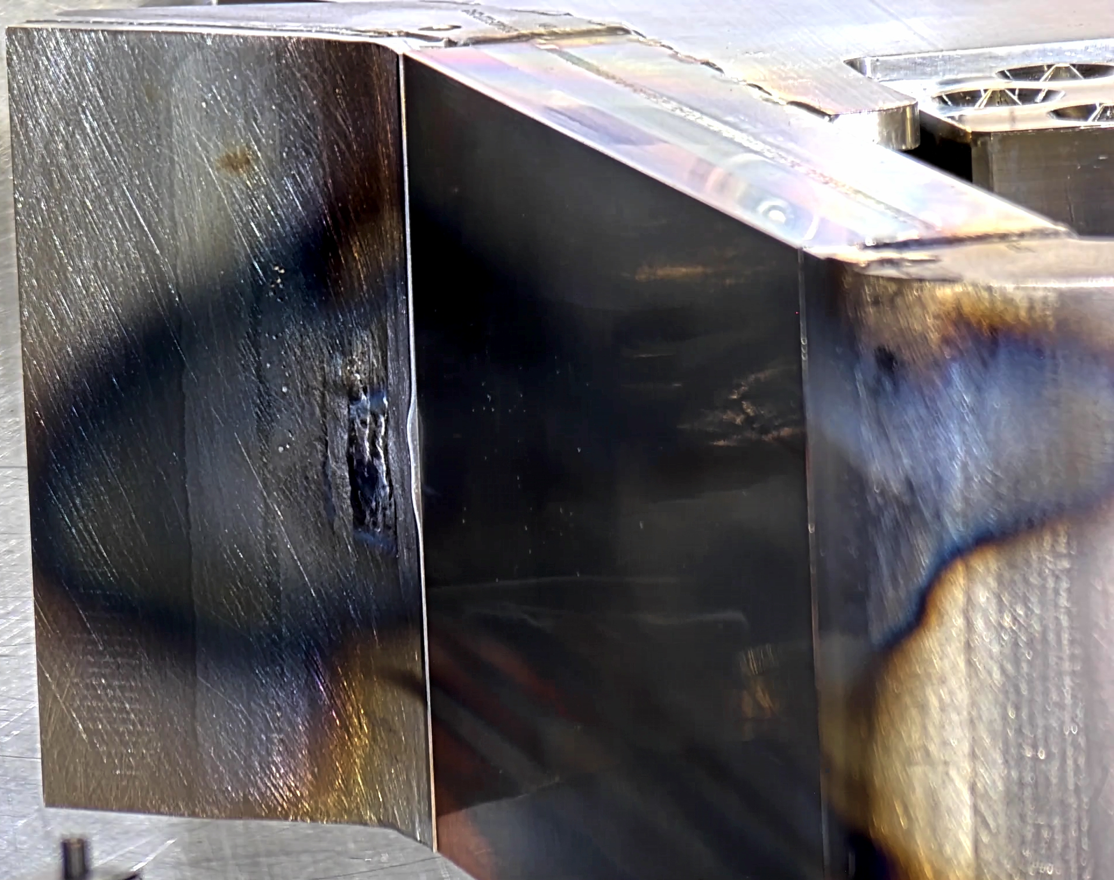
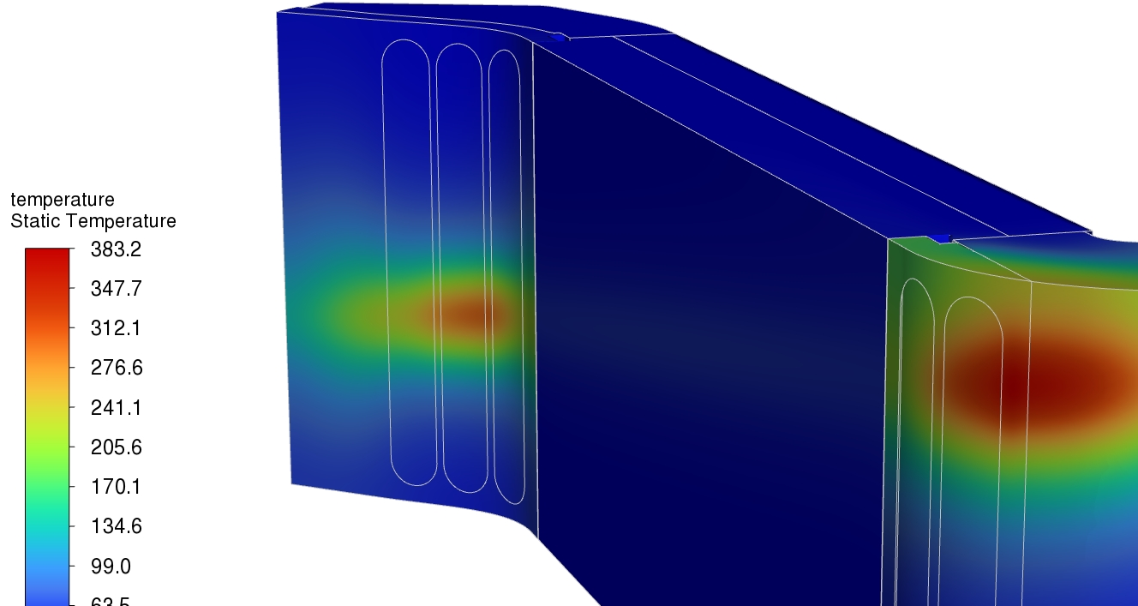
Thermal Simulation of Maximum Beam Power on the Wings
Deformation was observed in the 3D-printed wing of the beam dump
The beam power on the wing was around 1 kW
Based on FY24-25 operation, the max temperature on the 3D-printed Al 6061 wing was around 400 ˚C (Exp 23033)
383C
T. Kanemura J. Song; Simulated by M. Patil

Slide 19
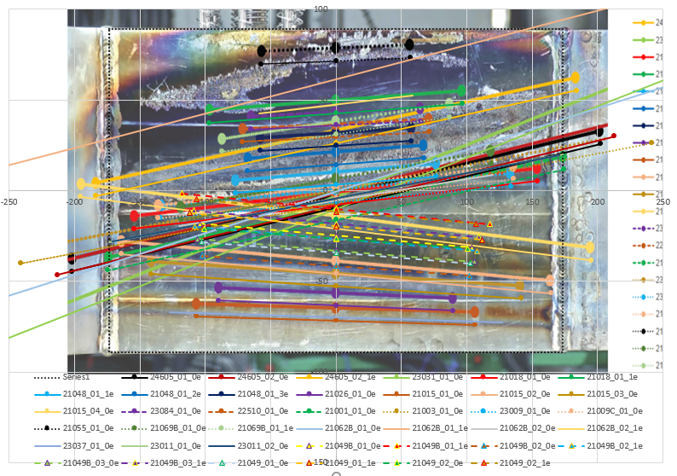
Beam Dump Image For FY2024 6-degree Dump
Primary beam locations and sizes on the dump for FY2024
Length of the lines are 2σ beam dimension
Agreement with marks on the dump is good → ability to predict beam dump conditions
Analysis by M. Hausmann
A goal is to implement a thermal imaging camera for the dump

Slide 20
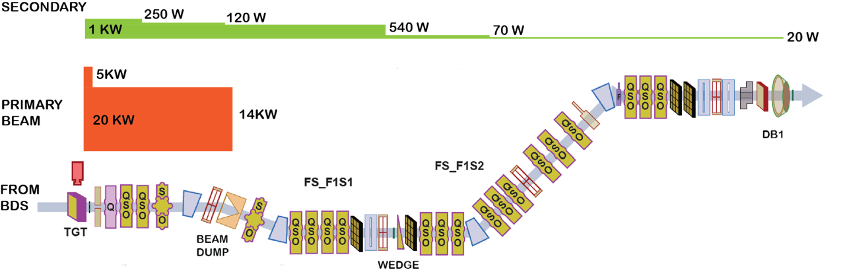
Power Distribution Along ARIS
Approximately 1-5% of the primary beam power is converted to fragments
A typical power distribution for a near-stability fragment (²⁹Mg from ⁴⁸Ca) is shown

Slide 21
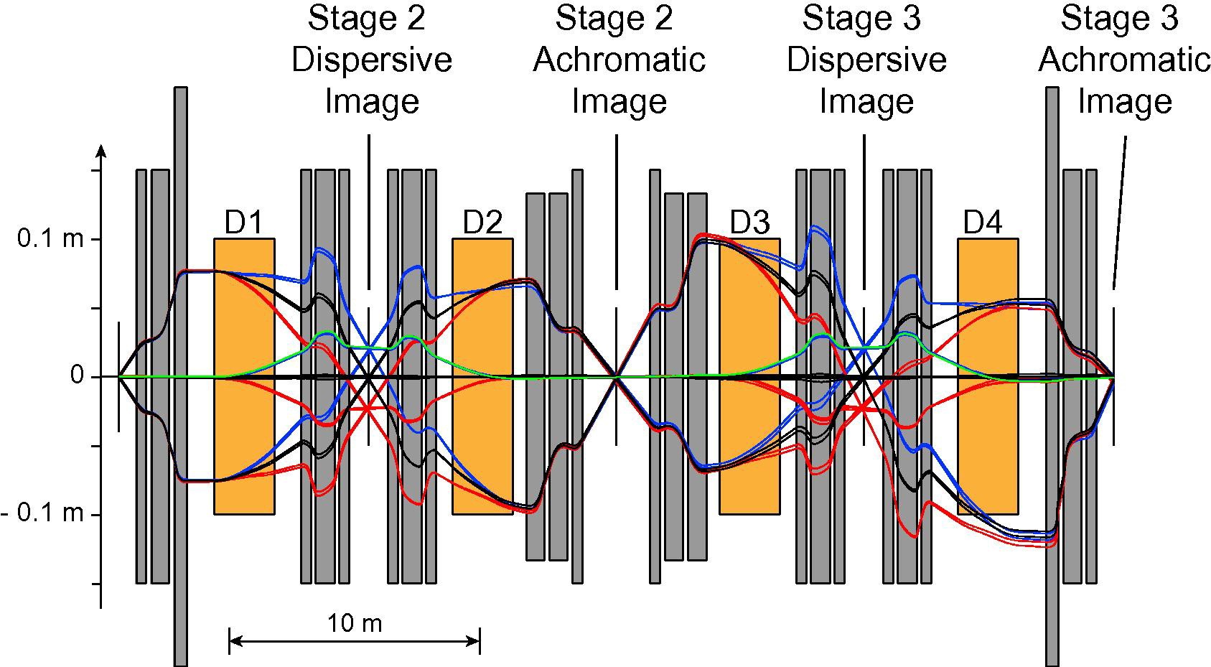
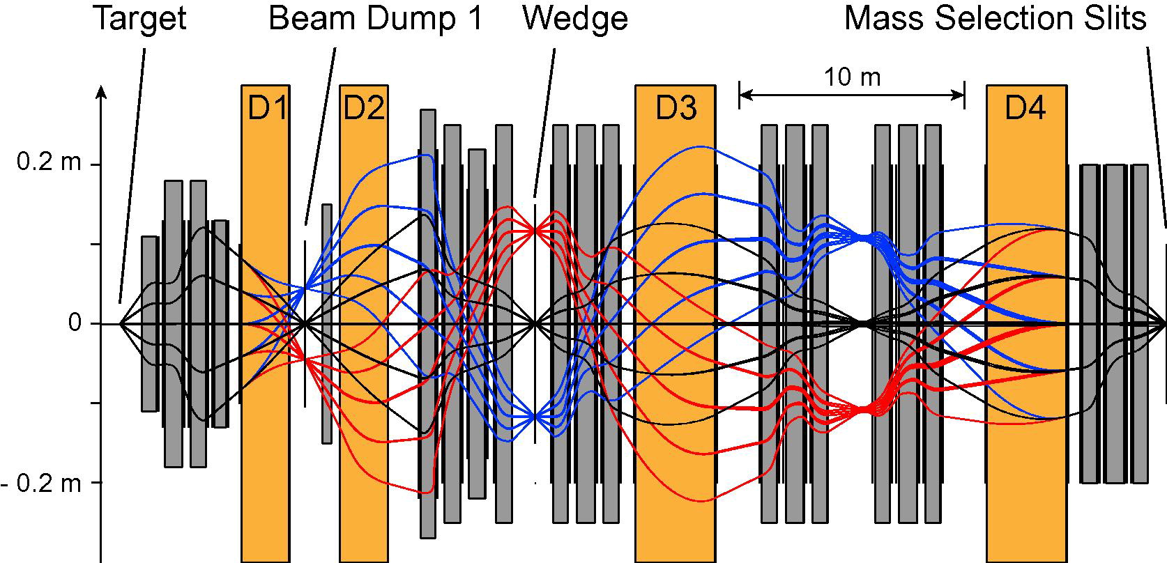
Ion Optics – ARIS
M. Hausmann, et al., NIM B317 (2013) 349
Optics in dispersive dimension:
Dump
Wedge
DB1
DB1
DB5
Preseparator
C-Bend

Slide 22
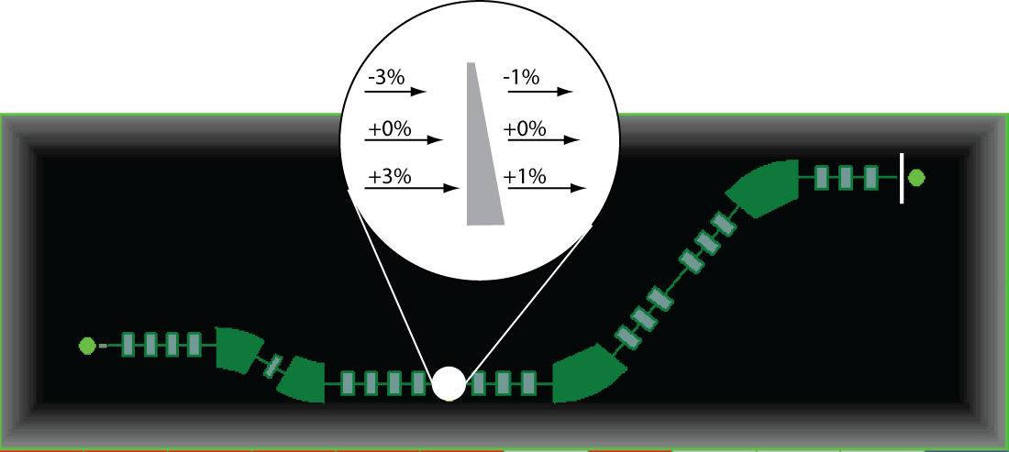
ARIS Feature: Momentum Compression
Preseparator wedge (energy degrader) slows down beam
Wedge shape compresses momentum distribution
Wedge at dispersive image
Higher energy particles slowed down more by thicker part of wedge
Larger resolving power in downstream section maintains achromaticity after 2nd magnetic rigidity separation
Momentum compression improved transmission through downstream beamlines
Target
Achromatic image position
Bandura et al., NIM A645

Slide 23

ARIS Diagnostics and Particle Identification
DB1
(Pre-Separator Focal Plane)
DB2
DB3
DB4
DB5
(Final
Focal Plane)
M. Smith, D. Kahl, A. Dombos
M. Cortesi, S. DiCarlo
Diamond
Event-by-Event Identification
PPACS
Sci / Diamond
Pins
TKE
PPAC
PPAC pair
Thin Sci
Tracking
ToF
dE
E
PPAC pair
PIN
Thick Sci
Thin Sci
Target
PPAC pair
PINs
Thick Sci
Thin
Sci
Pre-Separator Wedge
PPAC pair*
Not standard
HPGe
Notes:
Ok, now back to ARIS, detectors. Salvatore just shared a lot about the ARIS detectors, so I will tell you how we use them.

Slide 24
ARIS Detectors Allow for Ion-by-Ion Particle Identification
Example of “typical” Particle IDentification, PID, for ²³⁸U fragmentation at 177 MeV/u
1.2 mm ¹²C target; 1 Al mm wedge
TKE measured with a stack of Si-PIN detectors
Purity of high Z beam is acceptable
helium-like
Gate on
ΔQ = 0
hydrogen-like
Atomic Number (Z)
²¹²Rn
A/q

Slide 25
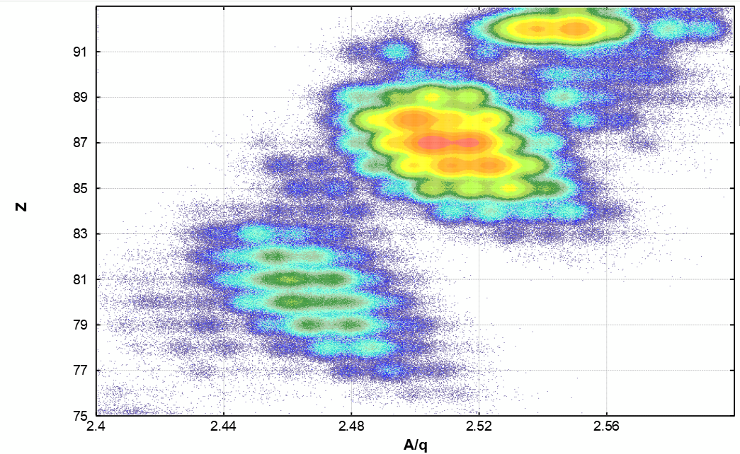
LISE⁺⁺ Simulation Code Allows Predictable Operations
LISE⁺⁺ code maintained at FRIB: covers all aspects of fragment production and separation O. Tarasov, D. Bazin, et al., Nuclear Instruments & Methods B376 and O. Tarasov, et al., NIM B541
Used in beam planning and RIB development at FRIB and elsewhere
Good agreement with experiment, reproduced complicated particle ID and separation for uranium fragmentation
LISE⁺⁺
Data 177 MeV/u ²³⁸U
helium-like
Gate on
ΔQ = 0
Experiment
hydrogen-like
Atomic Number (Z)
²¹²Rn
²¹²Rn
A/q
Notes:
We need our tools for fragment separation operation. We rely on LISE simulations (thanks Oleg) which allows us to check on all the needs for a beam delivery, from target to PID and more. You can see here we can get very good agreement, it’s a powerful tool.
Oleg will discuss much more on this in the next talk.

Slide 26
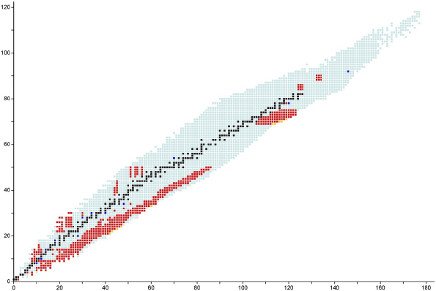
ARIS Department Supports Secondary Beam Development for Experiments
More than 450 Beams Delivered for Experiments as of 10/2025
Beams from ³H to ²²⁴Th
58 experiments completed so far
Figure from A. Stolz, M. Smith
Eventually we expect 4,500 isotopes to be made at FRIB
Primary Beams
¹⁸O
²²Ne
²⁸Si
³⁶Ar
⁴⁸Ca
⁶⁴Zn
⁷⁰Zn
⁸²Se
¹²⁴Xe
¹⁹⁸Pt
²³⁸U
Stable isotopes
Primary Beams
Observed isotopes
Experiments at FRIB
Discovered at FRIB

Slide 27
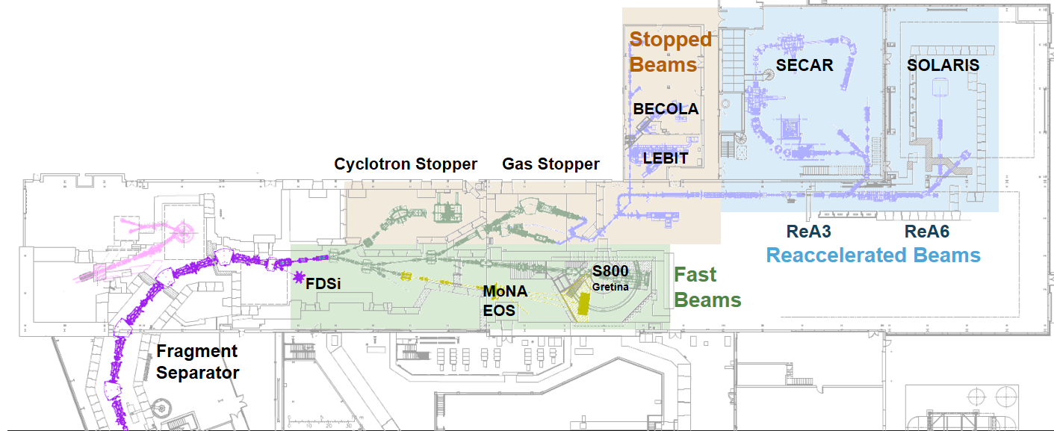
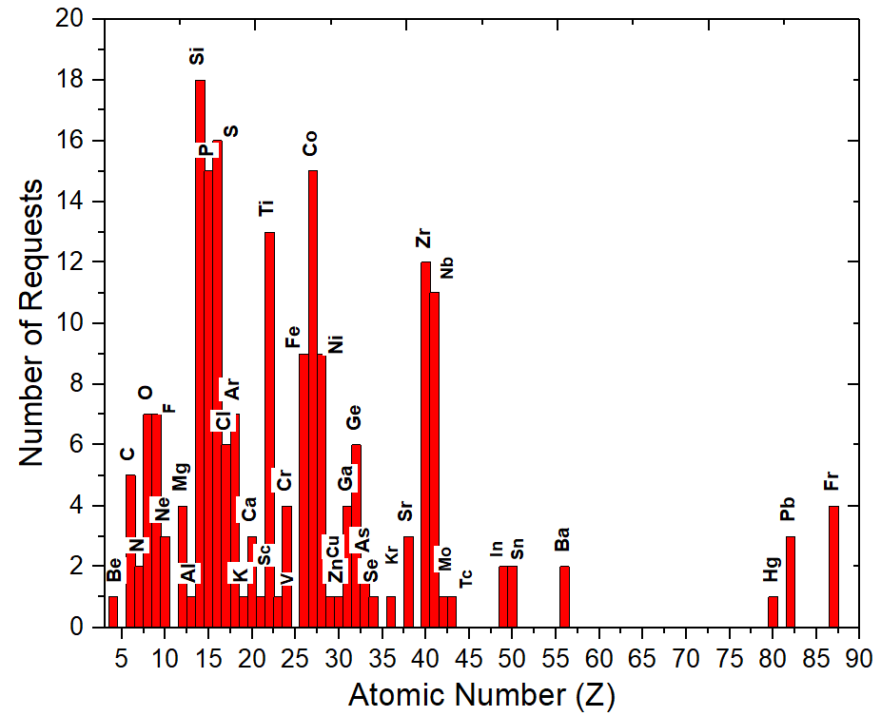
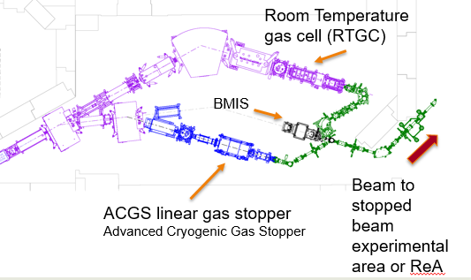
Gas Stopping – Beams for Laser Spectroscopy, Mass Measurements and Reacceleration
Provide beams to stopped beam areas and reaccelerated beam areas
User Demands
Stopped Beam Group
Chandana Sumithrarachchi (group leader), Xiangcheng Chen, Chris Izzo, Nadeesha Gamage, Sierra Rogers
Requests for beams during FRIB PAC3

Slide 28

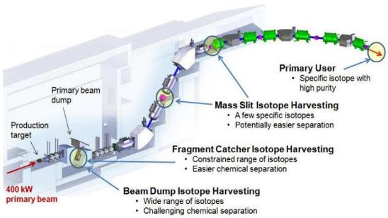
Collection of Unused Isotopes - Harvesting
Greg Severin, et al. – White Paper on Harvesting (J. Phys. G 46 (2019) 100501)
Describes opportunities for isotopes collected in parallel to normal operation
Matched pairs to diagnose and treat disease ⁶⁴Cu/⁶⁷Cu and ⁴⁴Sc/⁴⁷Sc
A readily available ⁵²Fe/^{52m}Mn generator for oncology, neurophysiology, and diabetes
Alpha and Auger emitters for therapy
PET imaging of plants, e.g., ⁵²Fe
Radioisotope Micro Power Source
Homeland security
Special isotopes for tests of Nature’s laws
Contributors: MSU, LLNL, LANL, ANL, Missouri, Alabama, ND, ORNL, BNL, Iowa
Cover: Erin O'Donnell
Available at frib.msu.edu

Slide 29
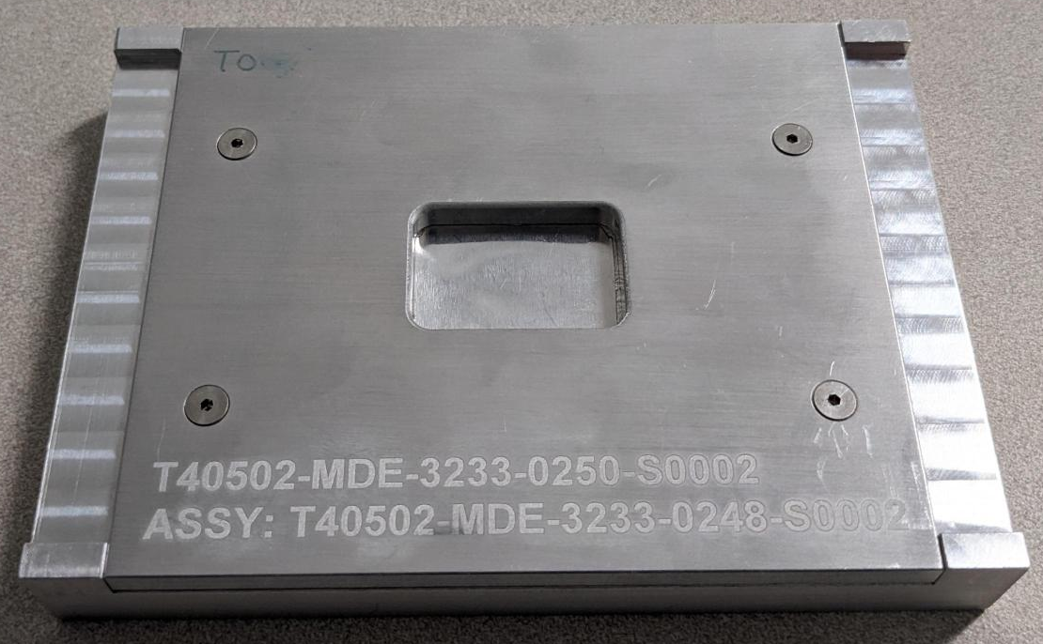
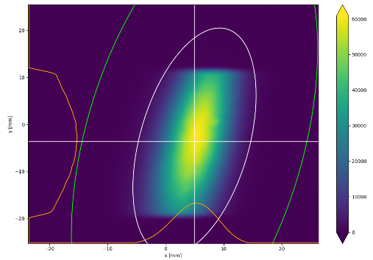
Example of Harvesting: ⁴⁷Ca Collection to Make a ⁴⁷Sc Generator
Work of K. Domnanich, et al.
⁴⁷Ca 1 hour collection in Al foils (performed two times) at ARIS DB2 location (at a dispersive image)
Successful ⁴⁷Sc test labeling with chelators L3 and L3-aga at Univ of Wisconsin
Preclinical SPECT/CT imaging planned
89mm
30mm
20mm
1st Step: Separate ⁴⁷Ca from bulk Al
2nd Step: ⁴⁷Ca/⁴⁷Sc Generator
⁴⁷Ca beam
127mm
⁴⁷Ca/bulk Al
⁴⁷Ca/⁴⁷Sc
Al foil stack
Cat⁺X
DGA
bulk Al
⁴⁷Ca
⁴⁷Ca
⁴⁷Sc
⁴⁷Ca yield ~90%
L3-aga

Slide 30
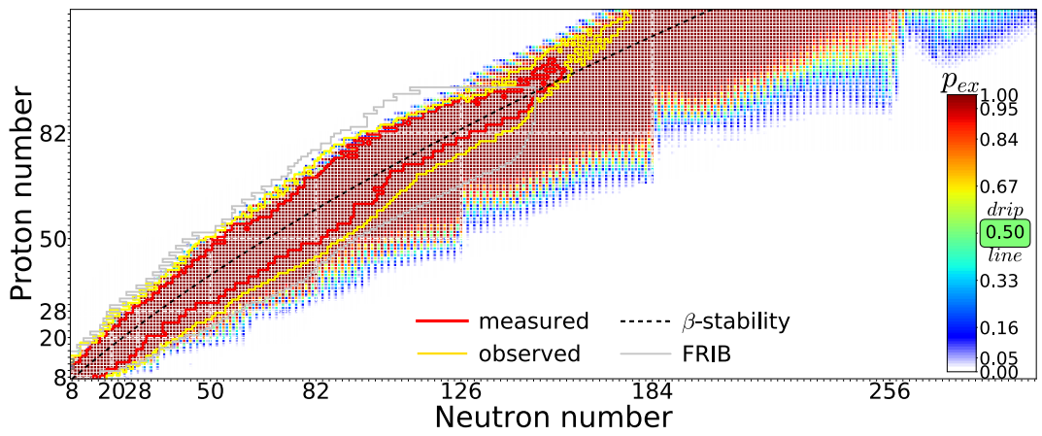
Possible Extent of the Nuclear Landscape
Approximately 258 “stable” isotopes are found on Earth
The full nuclear landscape can be estimated using existing nuclear models
Example: Bayesian Analysis of Nuclear Models - Neufcourt et al. Phys. Rev. C101 (2020) 044307
Estimate for Z,N > 8 and Z ≤ 119 is 7708±534 (10% chance of > 10,000)

Slide 31
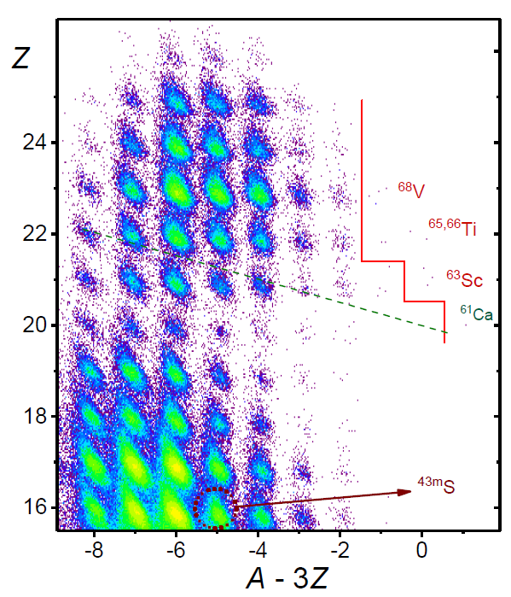
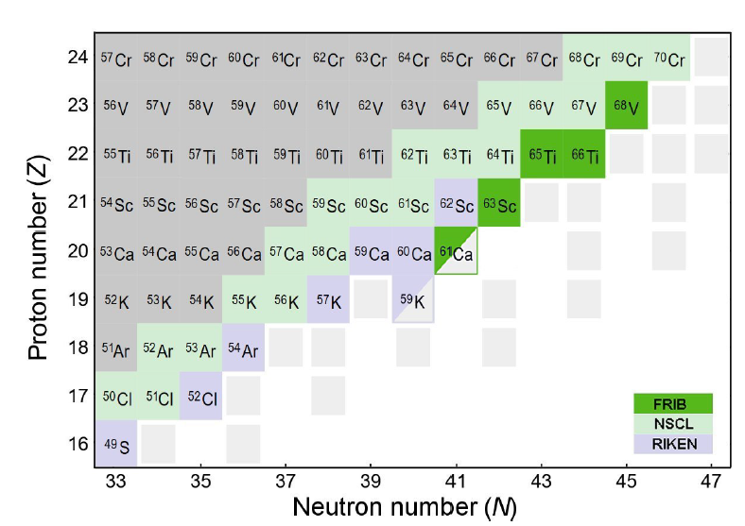
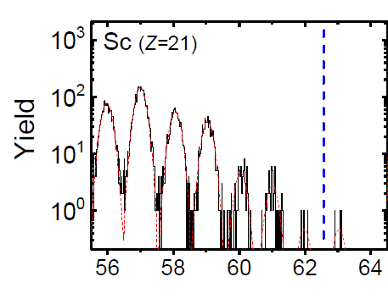
Study of Neutron-Rich Calcium Isotopes
Recently 5 (+1) new isotopes have been observed at FRIB using 225 MeV/u ⁸²Se at 20 kW (1 pμA)
⁶³Sc, ^{65,66}Ti, ⁶⁸V, ⁷¹Cr (next slide)
One event for ⁶¹Ca was observed (needs confirmation)
Production cross sections were measured
O. Tarasov et al, PRC 112 (2025) 034604
⁷¹Cr
Mass Number
RIKEN: Tarasov, Ahn, et al., Phys. Rev. Lett. 121 (2018)

Slide 32
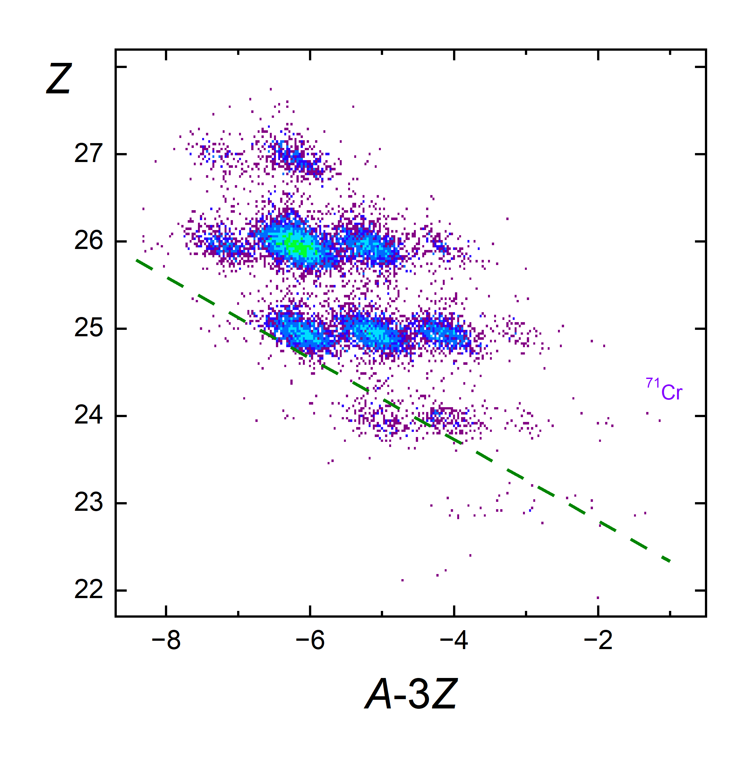

Observation of ⁷¹Cr
S Watters, O Tarasov
With ⁸²Se at 225 MeV/u on an 8 mm C target 2 events of ⁷¹Cr, were observed in approximately 40 hours at 550 pnA
3.3 yoctomoles
2 events meet all PID criteria and probability of misidentification is <10⁻⁸
⁷¹Cr, is interesting because many models have it weakly bound or even unbound – stability is related to N=50 shell closure
Preliminary

Slide 33


FRIB400 – Upgrade to 400 MeV/u Primary Beam Energy for Uranium
FRIB was designed to allow the opportunity to operate at higher primary beam energy
FRIB500 would provide 400 MeV/u for all beams at 400 kW
The upgrade would consist of 55 SC elliptical cavities (β_{OPT}=0.65, 644 MHz) in 11 cryomodules at 17.5 MV/m
Proposed but not funded
Space in the FRIB tunnel for the needed 11 cryomodules – lends itself to staged implementation

Slide 34

FRIB400 Reach Toward the Limits
Increase in the FRIB energy will significantly increase the yield of the most exotic isotopes
Greater than 10x gain
Better collection efficiency
Thicker production targets
Secondary reactions
Red – Current FRIB
Blue – FRIB400
FRIB400 offers the possibility of reaching the drip line up to Z=60 (Z=30 for FRIB)
UNEF0

Slide 35
Summary
Happy birthday EMIS
Overview of FRIB including ARIS
Isotope separation at FRIB is underway at 20 kW and science results are published (58 experiments conducted so far)
Details shown on the equipment needed for high-power operation
Prospects for further exploration of the nuclear landscape with ARIS and FRIB
11 new isotopes found so far
Many more isotopes for all of us to be separated before EMISXL

Slide 36
Acknowledgements
U.S. Department of Energy Office of Science Office of Nuclear Physics, Facility for Rare Isotope Beams; operations under Award Number DE-SC0023633.
US National Science Foundation under Open Quantum Systems grant No. PHY-23-10078
ARIS Department Members – DS. Ahn, M. Hausmann, M. Portillo, O. Tarasov, E. Kwan, M. Smith, A. Dombos, D. Kahl, M. Steiner, K. Fukushima
NSF Grant members - Oleg Tarasov, PhD students Isaiah Richardson, Shane Watters, Holly Matthews, Daniel Kaloyanov, Kenny Haak (graduated)

Slide 37





Magnets in ARIS High Power Areas
Warm-iron quad cross section
Cryostat wall
Multipole coils test-assembled around bore tube
Yoke (warm)
Quadrupole coil
Multipole coils
Model of triplet cryostat
Quadrupole yokes and coils (40 cm dia. aperture)
40 cm bore tubes with multipoles
T. Xu et al.

Slide 38


Sophisticated Preseparator Wedge Shape Improves Operation
⁴⁸Ca + C (8 mm) → ⁴⁴S @ ΔP/P=6%
⁴⁴S
Linear wedge
Chromatic distortions
F1S1.x width wider at edges/larger ΔP/P
Higher order wedge “parabolic-like”
Smaller chromatic distortions
Neighboring fragment
achromatic image
$${\text{LISE}}_{ cute}^{ ++}$$
dispersive image
$${\text{LISE}}_{ cute}^{ ++}$$
⁴⁴S
achromatic image
E23608

Slide 39

The ⁷¹Cr Production Cross Section
S. Watters
⁷¹Cr
FRIB200 Limit

Slide 40


Ion Optical Simulations Match Expectations
Preseparator simulated using LISE++
Currents read from control system and envelopes simulated by Monte Carlo tracing of rays
4 quads adjusted by 1 – 10%
Target Dump Wedge DB1
Target Dump Wedge DB1

