Slide 1
Photoassociation Studies on Francium Isotopes
EMISXX 2025
Louis Croquette
McGill University

Slide 2
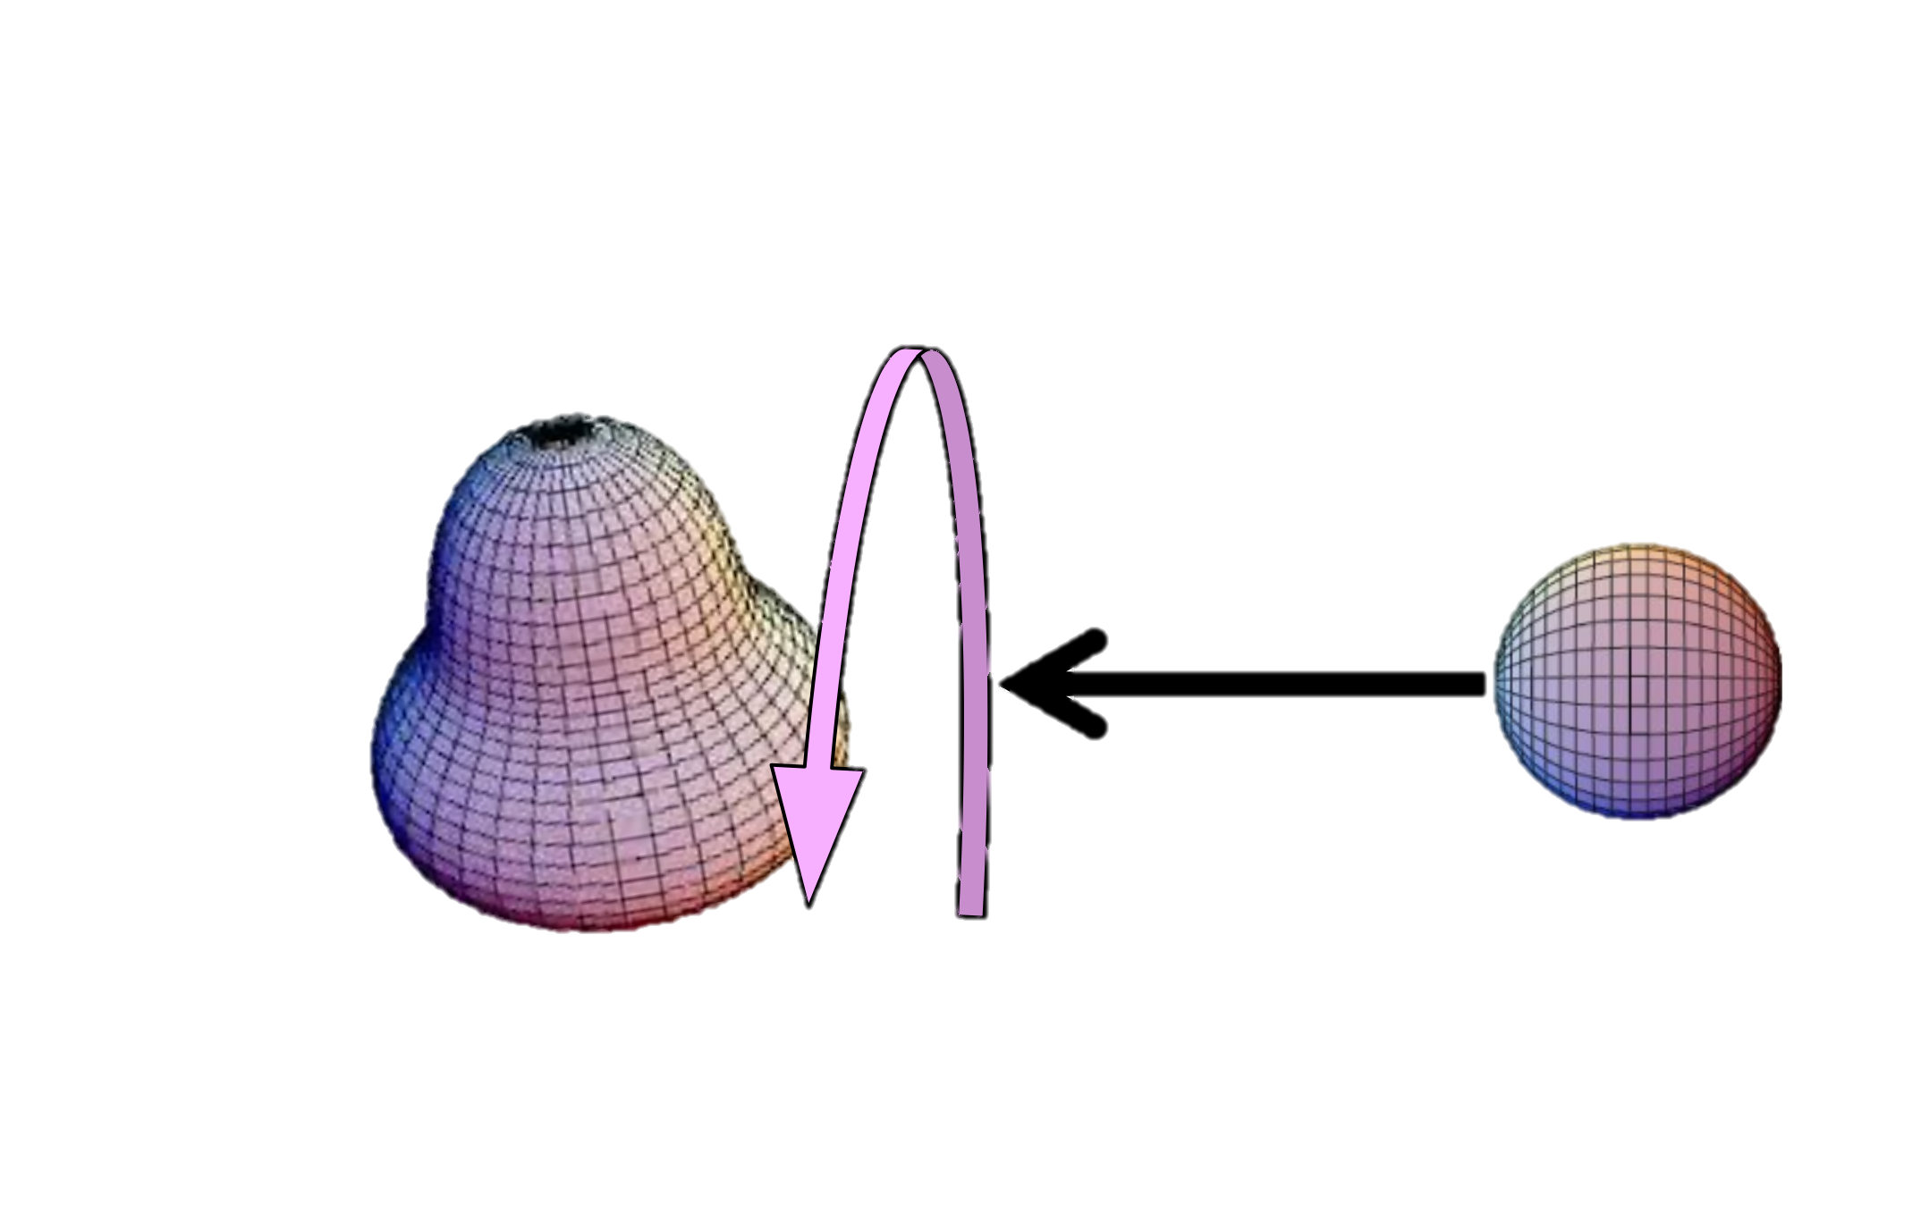
Matter-antimatter asymmetry
Matter-antimatter asymmetry not well-explained ⇒ new physics!
Charge-parity violation (CPV)
Nuclear Schiff moment (NSM)
“Gold standard” is Hg-199 measurement
Radioactive molecules more sensitive to new physics –
Polar molecules – x1,000-10,000
Nuclear octupole-deformation – x100-1,000
matter-antimatter
asymmetry
Graner et al. Phys. Rev. Lett. 116 (2016)
See R. Garcia Ruiz’s talk this afternoon
Garcia Ruiz et al. Nature 581 (2020)
Arrowsmith-Kron et al. Rep. Prog. Phys. 87(2024)
Klos et al. New J. of Phys. 24 (2022)

Slide 3
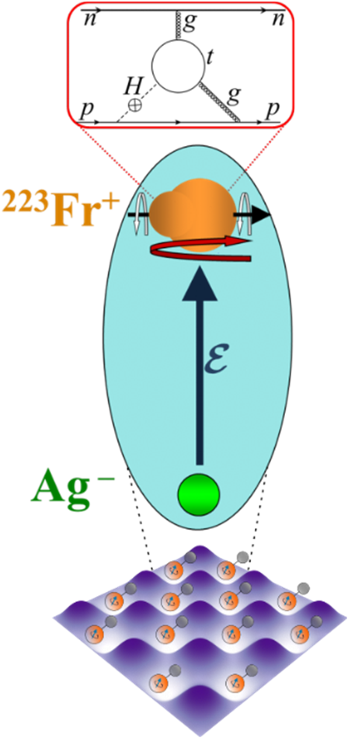

Molecule of choice - FrAg
Francium (²²³Fr) + Silver (¹⁰⁷Ag)
Octupole deformed ²²³Fr
Ionic bond ⇒ strong internal field
$\sim {10}^{7}$ larger intrinsic sensitivity
Assemble molecule from laser-cooled Fr and Ag
Nearly degenerate ultracold neutral samples
Ultracold collisional properties described by scattering length
nuclide | yield [1/s] | T1/2
²¹¹Fr | 9.3E+08 | 3.1 min
²²³Fr | 6.6E+6 | 22 min
TRIUMF ideally placed to host a FrAg experiment
TRIUMF Yield database
REDRUM Collaboration led by Dave DeMille
Notes:
Researching Electric Dipoles with Radioactive Ultracold Molecules

Slide 4
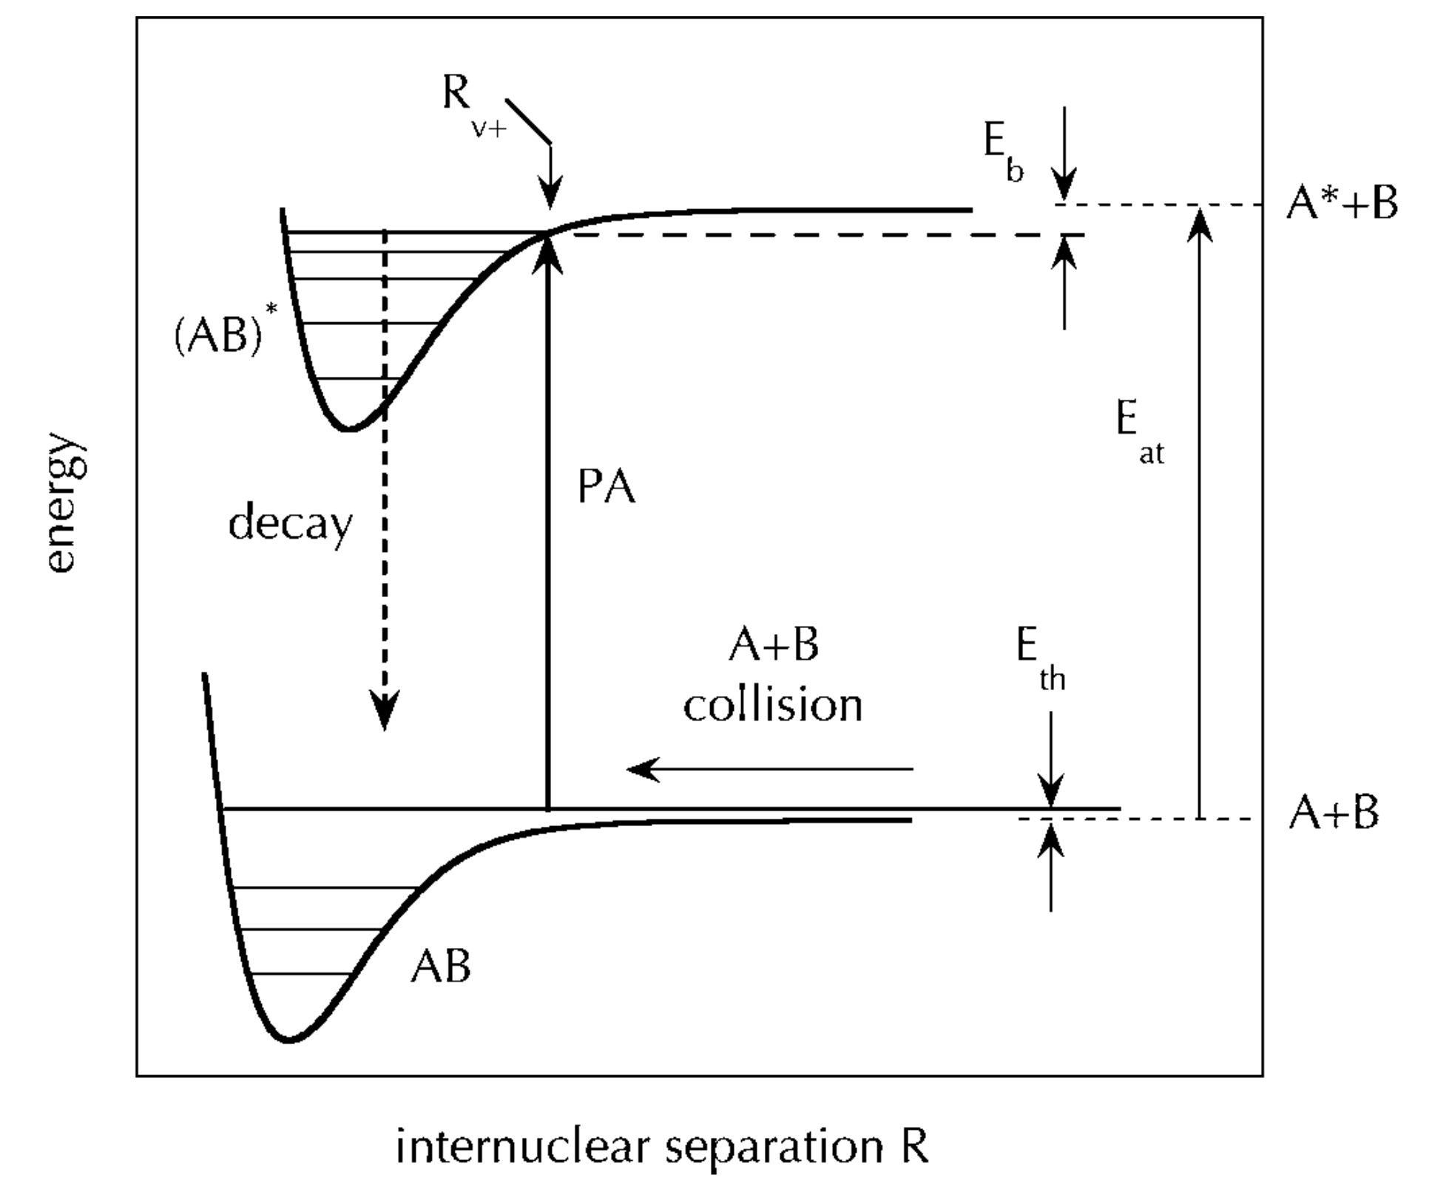



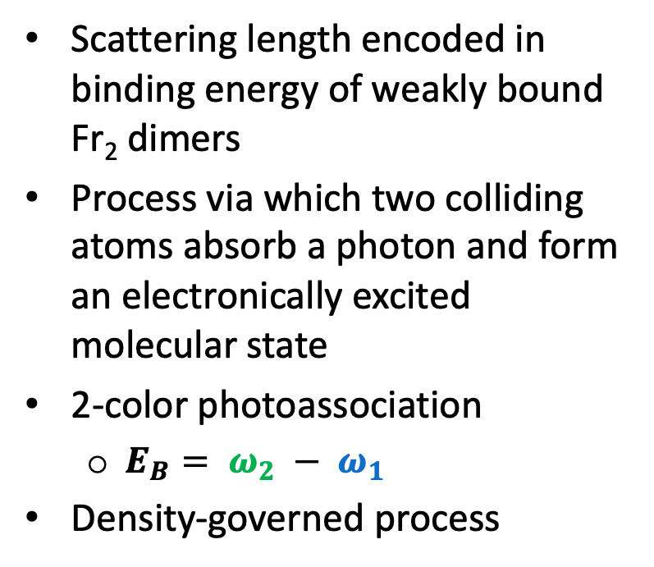
Photoassociation (PA)
Scattering length encoded in binding energy of weakly bound Fr₂ dimers
Process via which two colliding atoms absorb a photon and form an electronically excited molecular state
2-color photoassociation
$E_{B}= ω_{2} − ω_{1}$
Density-governed process
$$ω_{1}$$
$$ω_{2}$$
$$E_{B}$$
A
B
Weakly bound states of Fr₂
Adapted from Jones et al. Rev. Mod. Phys. 78, (2006)

Slide 5
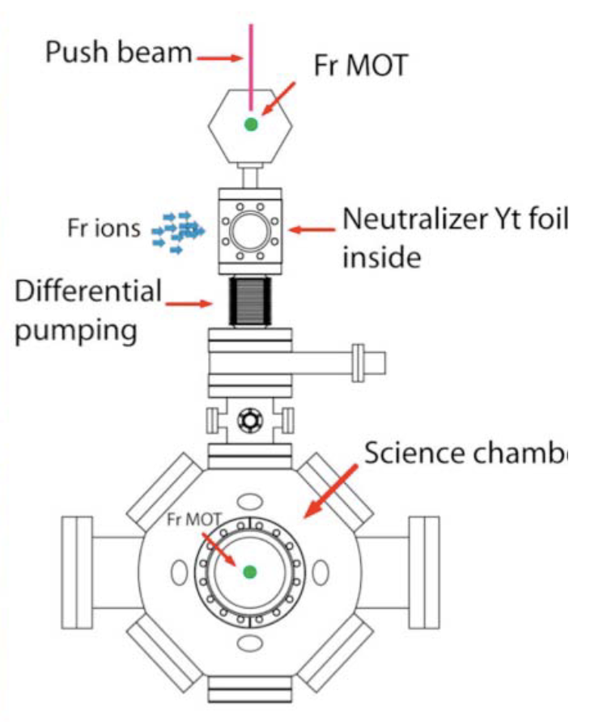
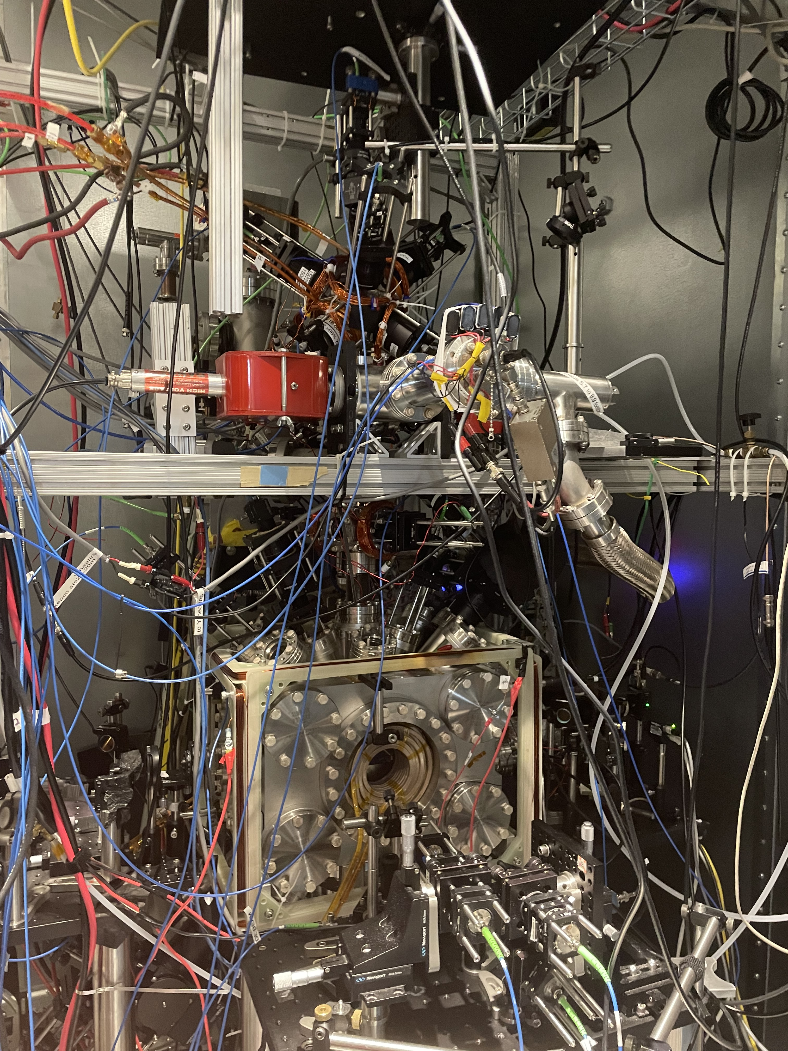
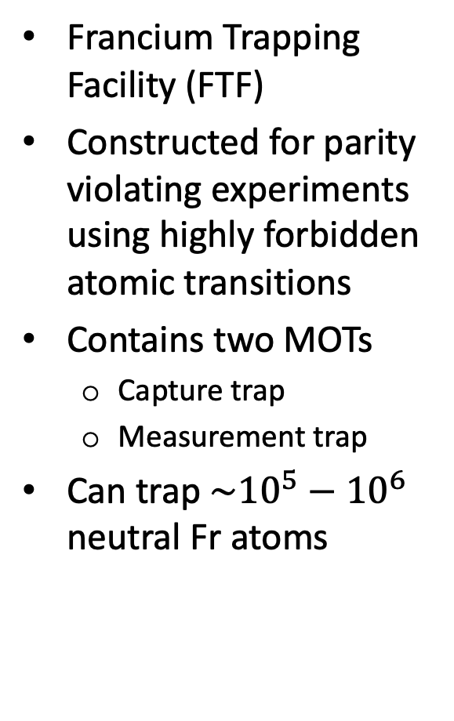
Experimental apparatus
Capture MOT
Francium Trapping Facility (FTF)
Constructed for parity violating experiments using highly forbidden atomic transitions
Contains two MOTs
Capture trap
Measurement trap
Can trap $\sim {10}^{5}−{10}^{6}$ neutral Fr atoms
Zr
Science chamber
Gwinner et al. Quantum Sci. Technol. 7 (2022)
Collister et al. Phys. Rev. A 92 (2014)
Aubin et al. AIP Conf. Proc. 1441 (2012)
Zhang et al. Phys. Rev. Lett. 115 (2015)
Measurement MOT

Slide 6
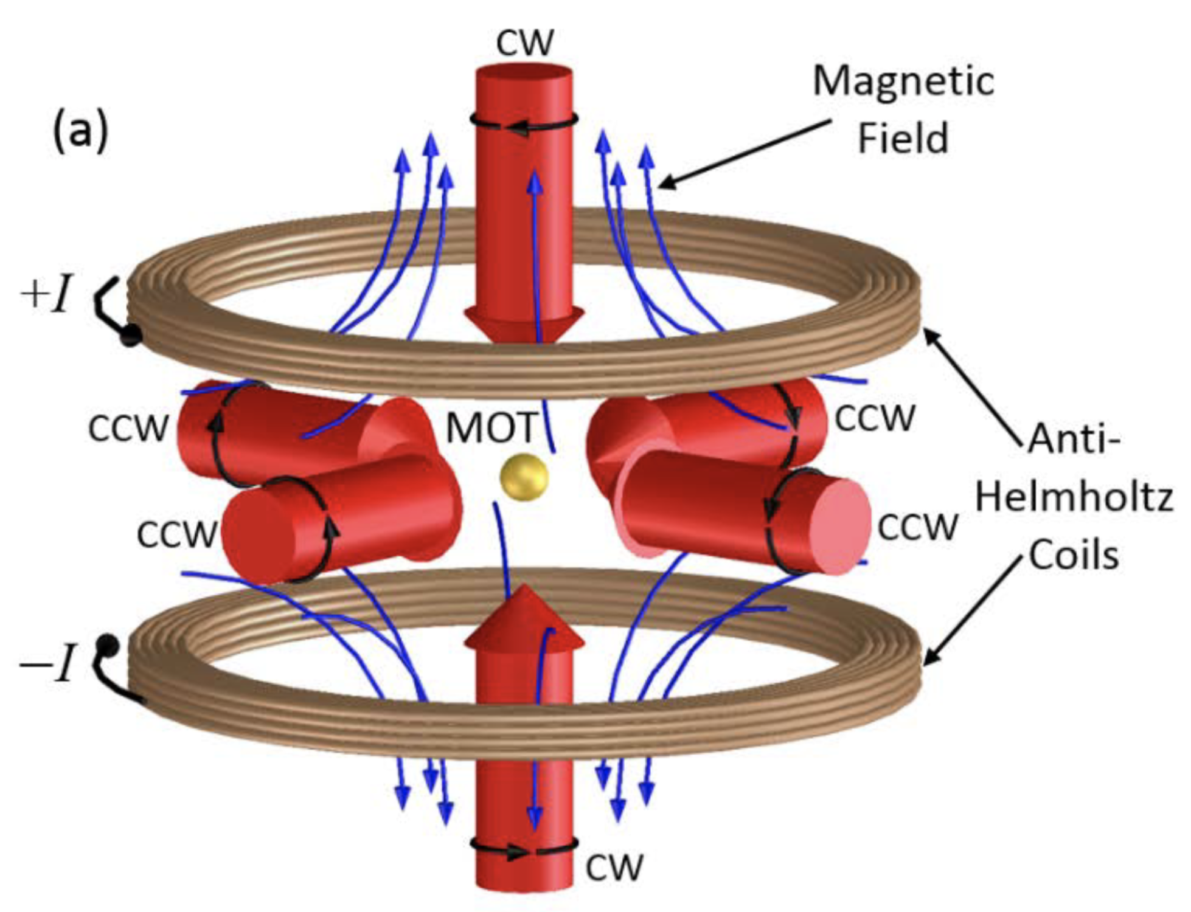
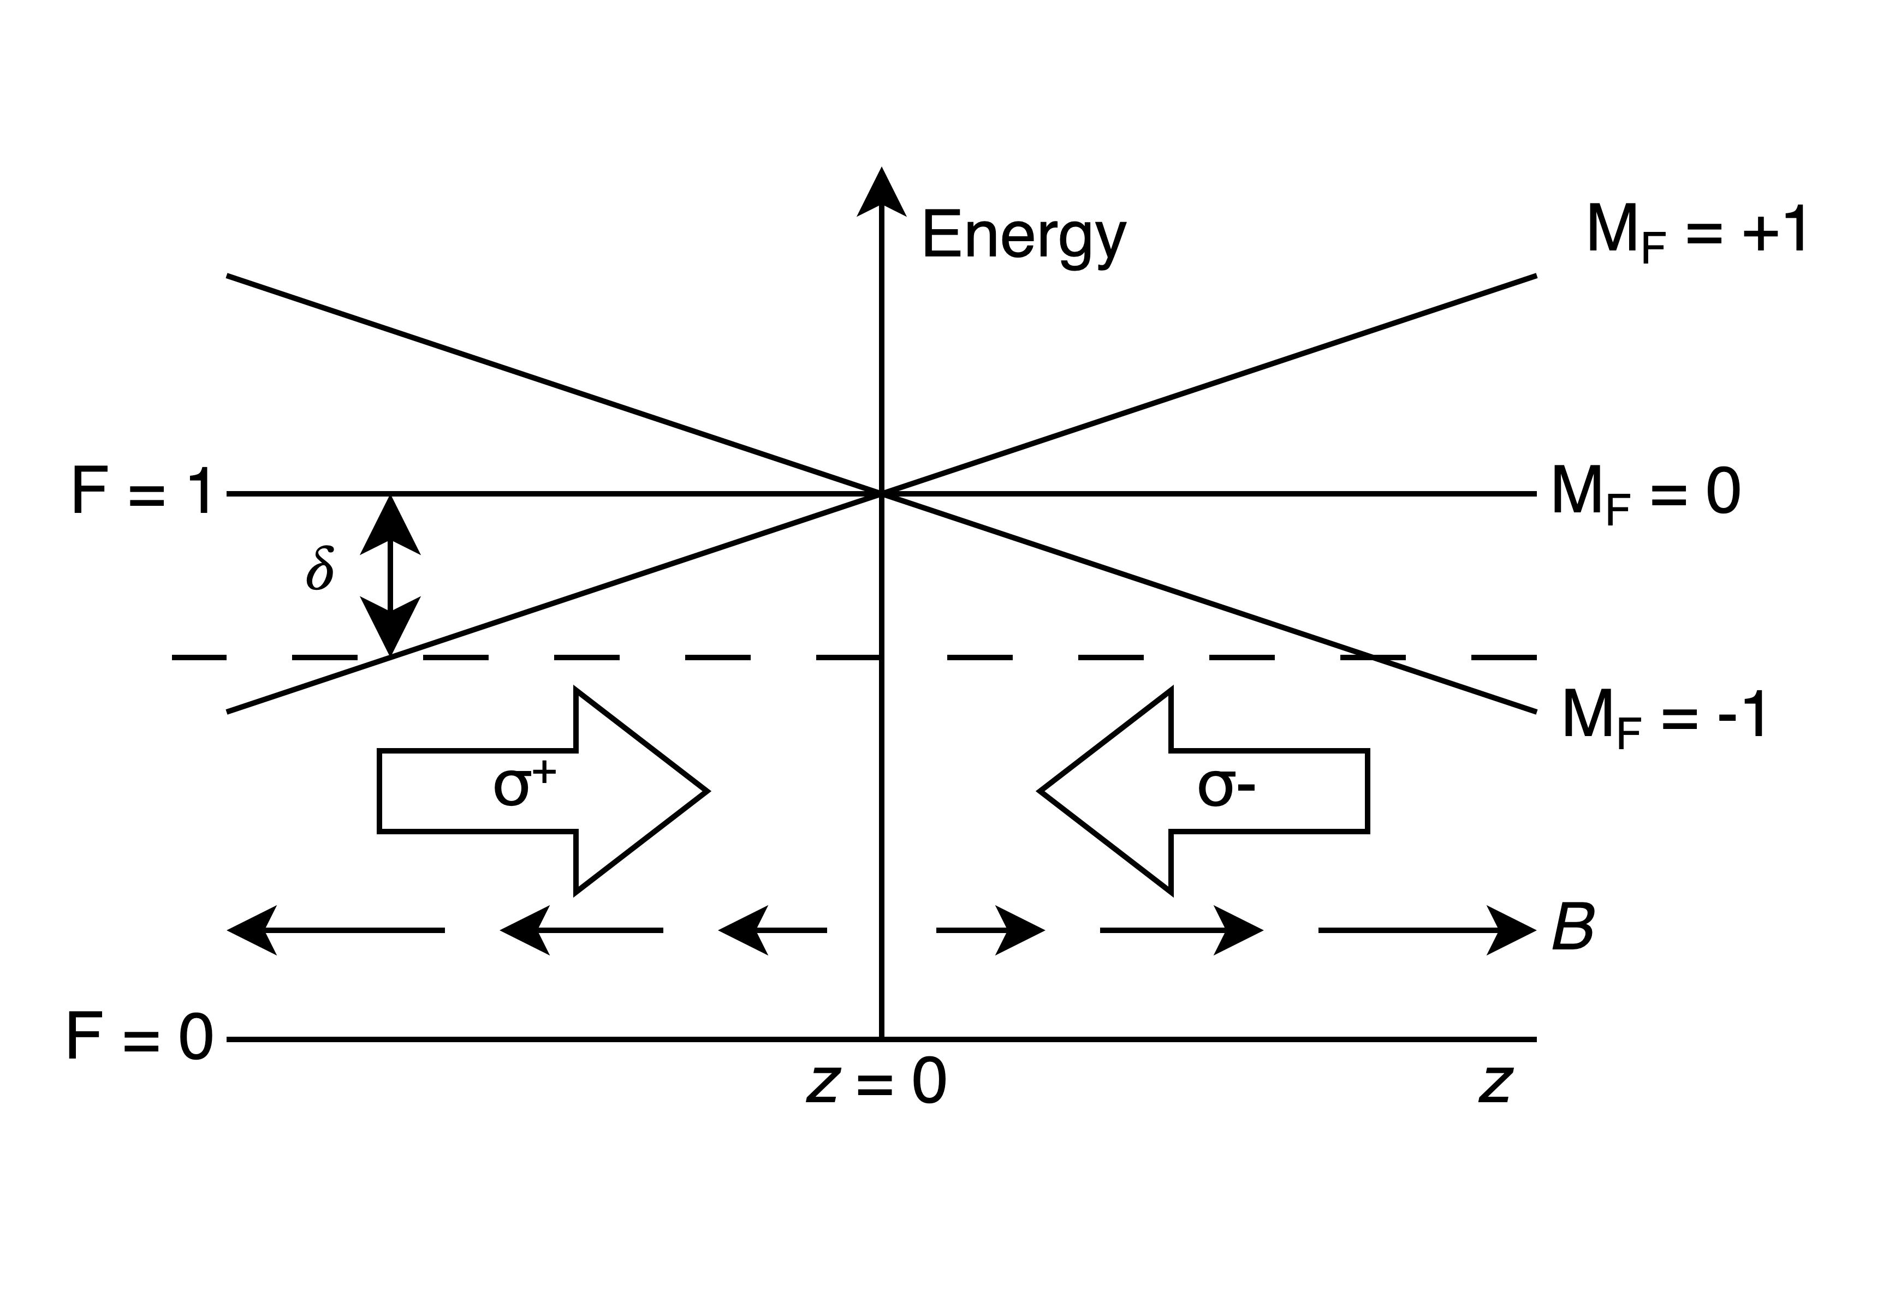
Magneto-optical traps (MOTs)
Need a cold neutral atom trap to perform this measurement
Lasers for Doppler cooling
B-field for position dependent restoring force
McClelland et al. Appl. Phys. Rev. 3, (2016)

Slide 7
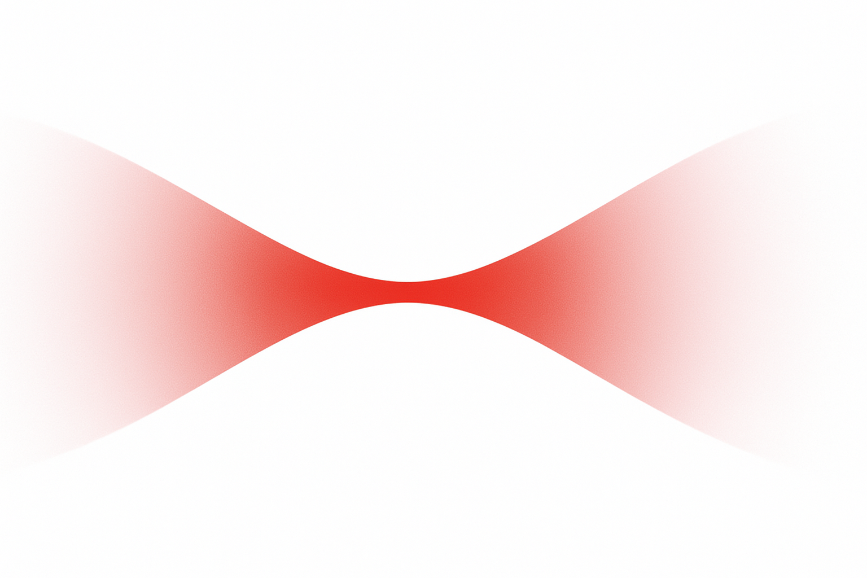
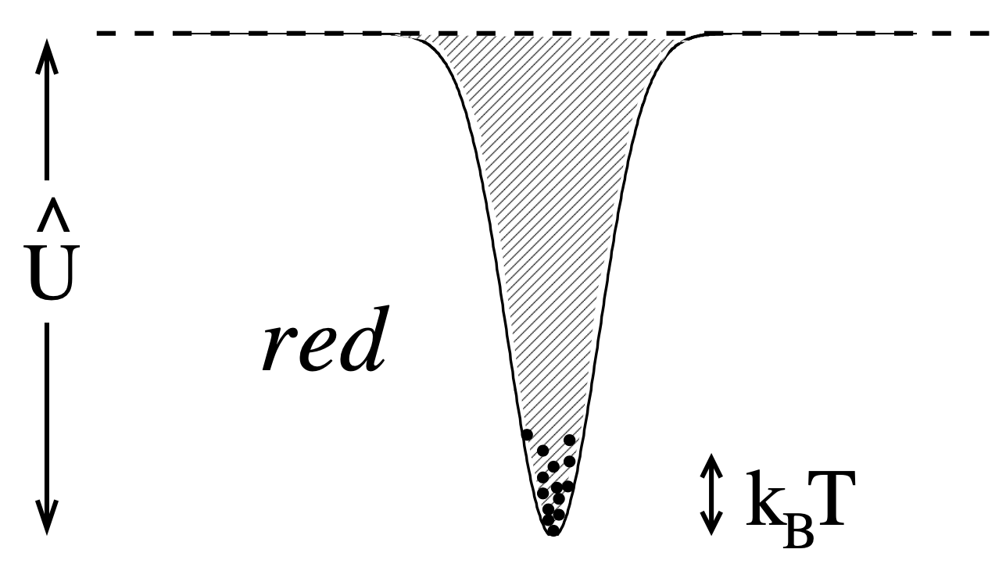
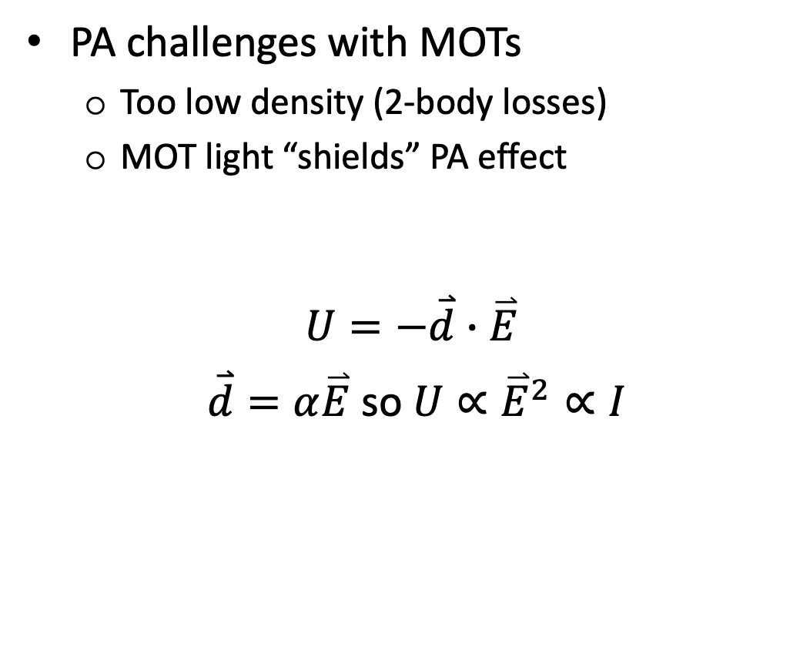
Optical dipole traps (ODTs)
PA challenges with MOTs
Too low density (2-body losses)
MOT light “shields” PA effect
$$U=−\overset{⃑}{d}∙\overset{⃑}{E}$$
$\overset{⃑}{d}=α\overset{⃑}{E}$ so $U∝{\overset{⃑}{E}}^{2}∝I$
MOT | ODT
10¹⁰ atoms/cm³ | 10¹² atoms/cm³
Focused laser beam
Grimm,et al. Adv. in AMO Phys. 42 (2000)

Slide 8
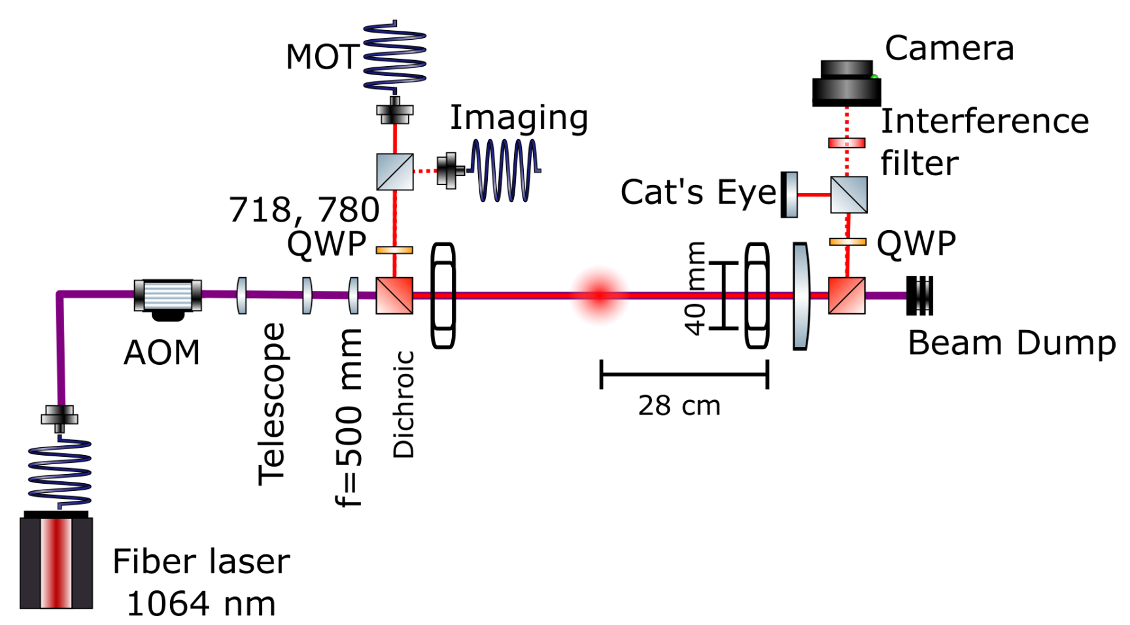
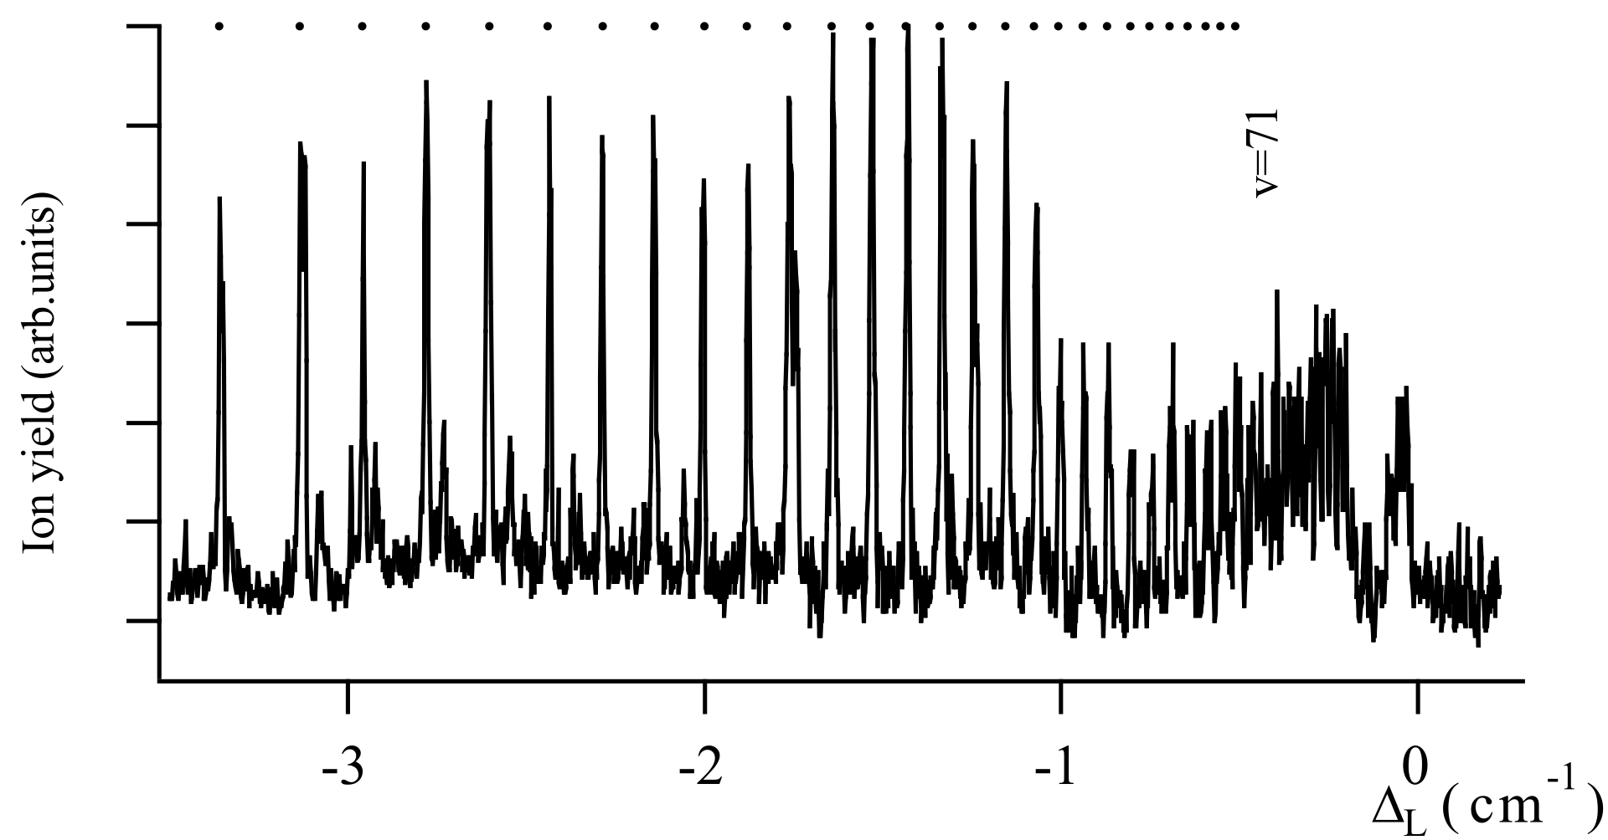
Measurement principle of 1PA
1. Load MOT
2. Subdoppler cool atoms
3. Load ODT
4. Perform PA
5. Absorption Imaging ⟶ estimate atom number
PA beam
Loss fraction (arb. units)
Fioretti et al. Eur. Phys. J. D 15 (2001)

Slide 9
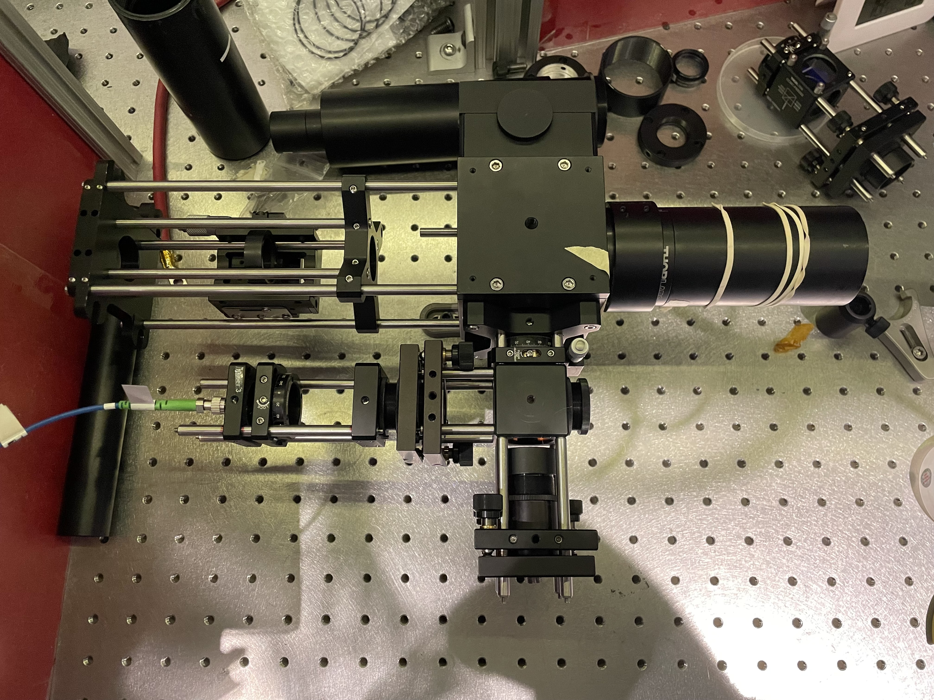
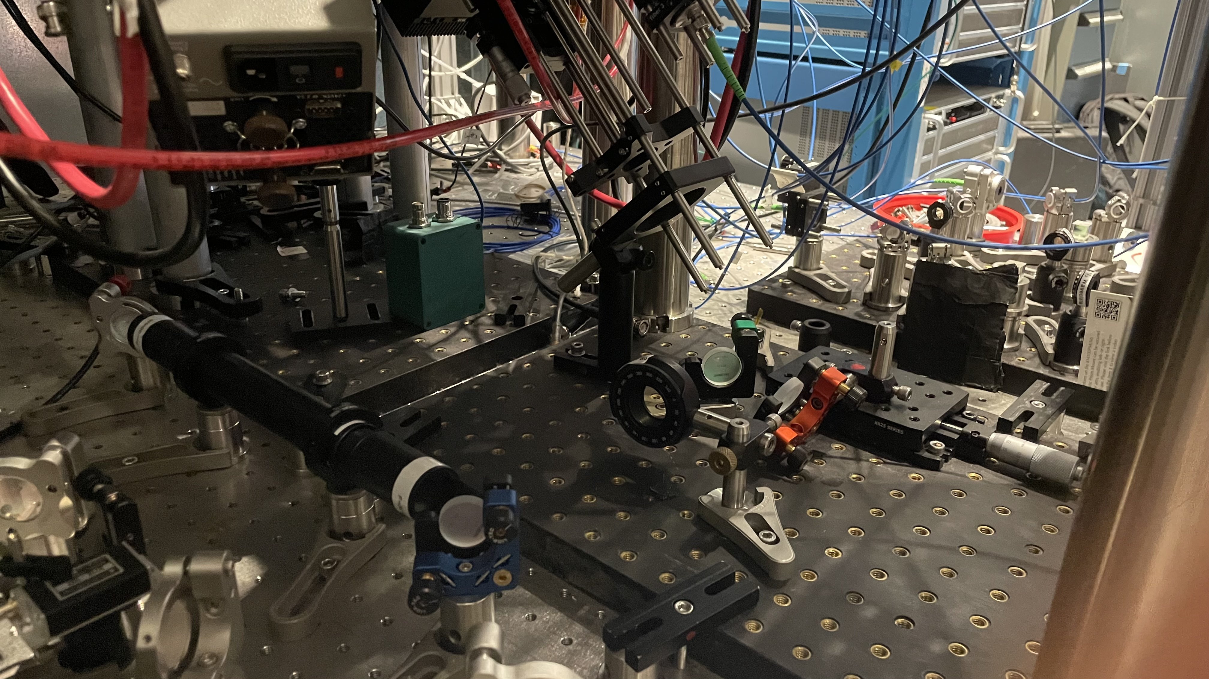
Pictures!
ODT beam
MOT
Imaging
Acoustic-optical modulator

Slide 10
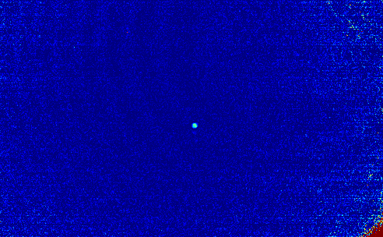
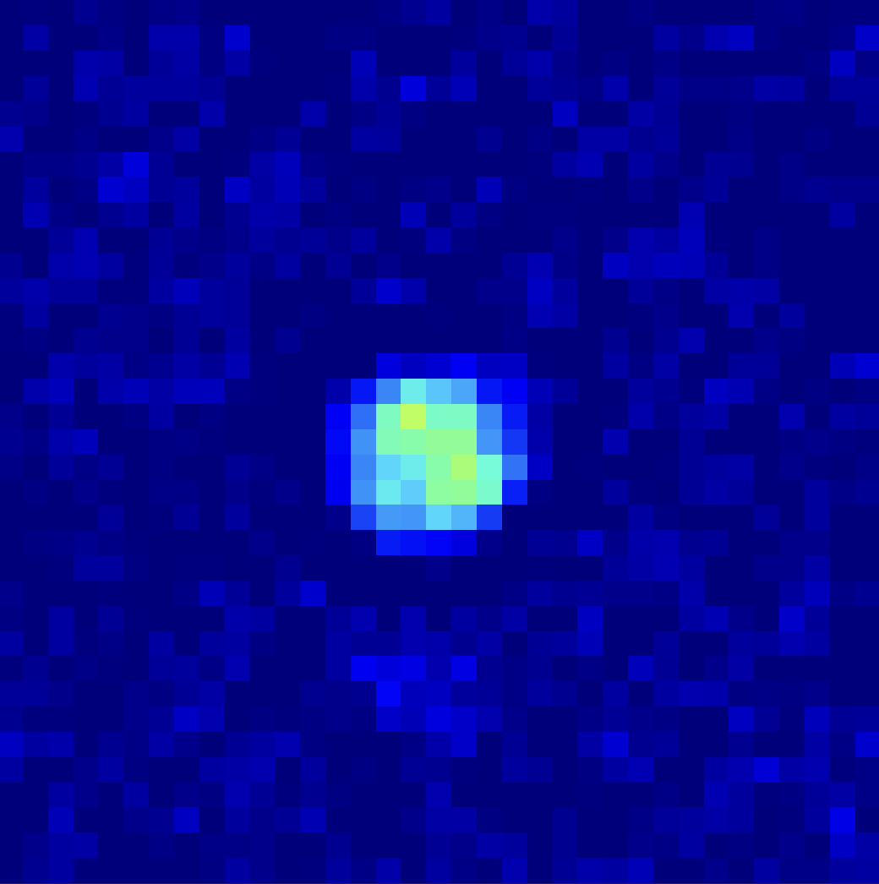
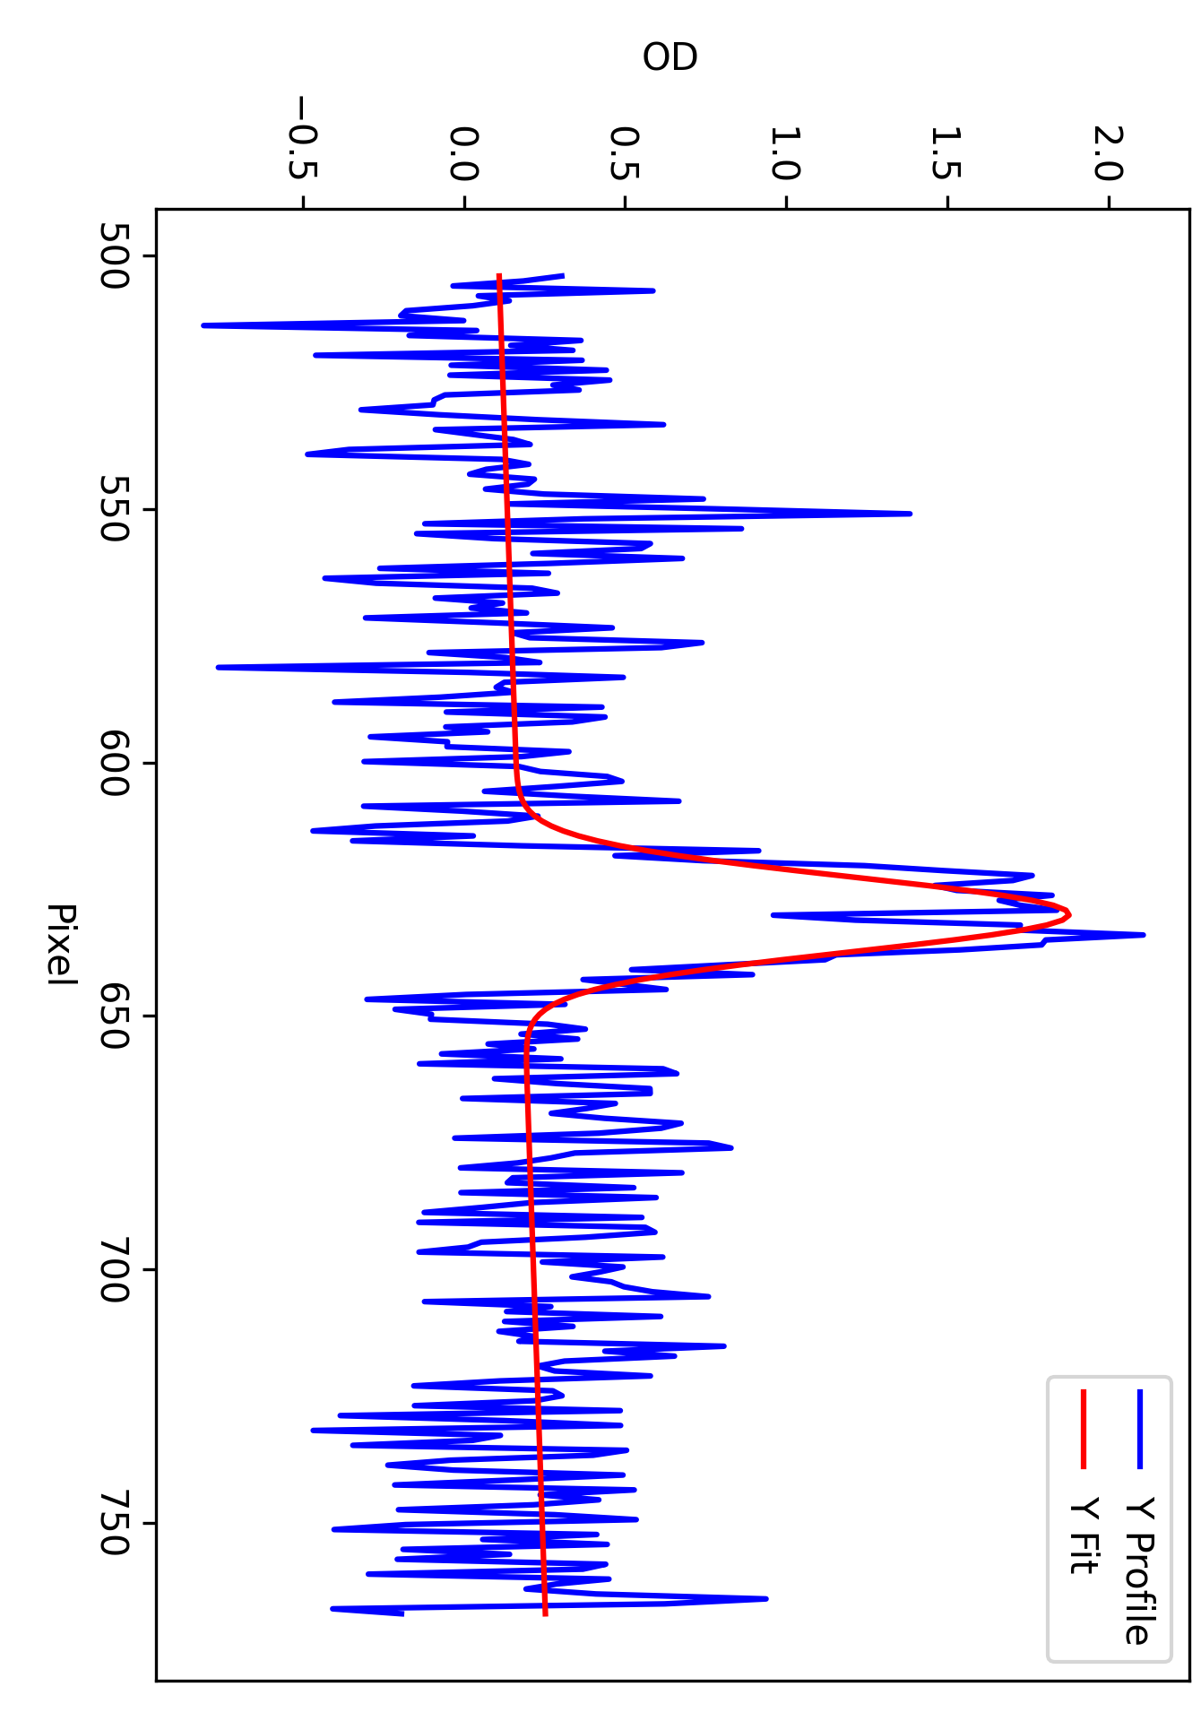
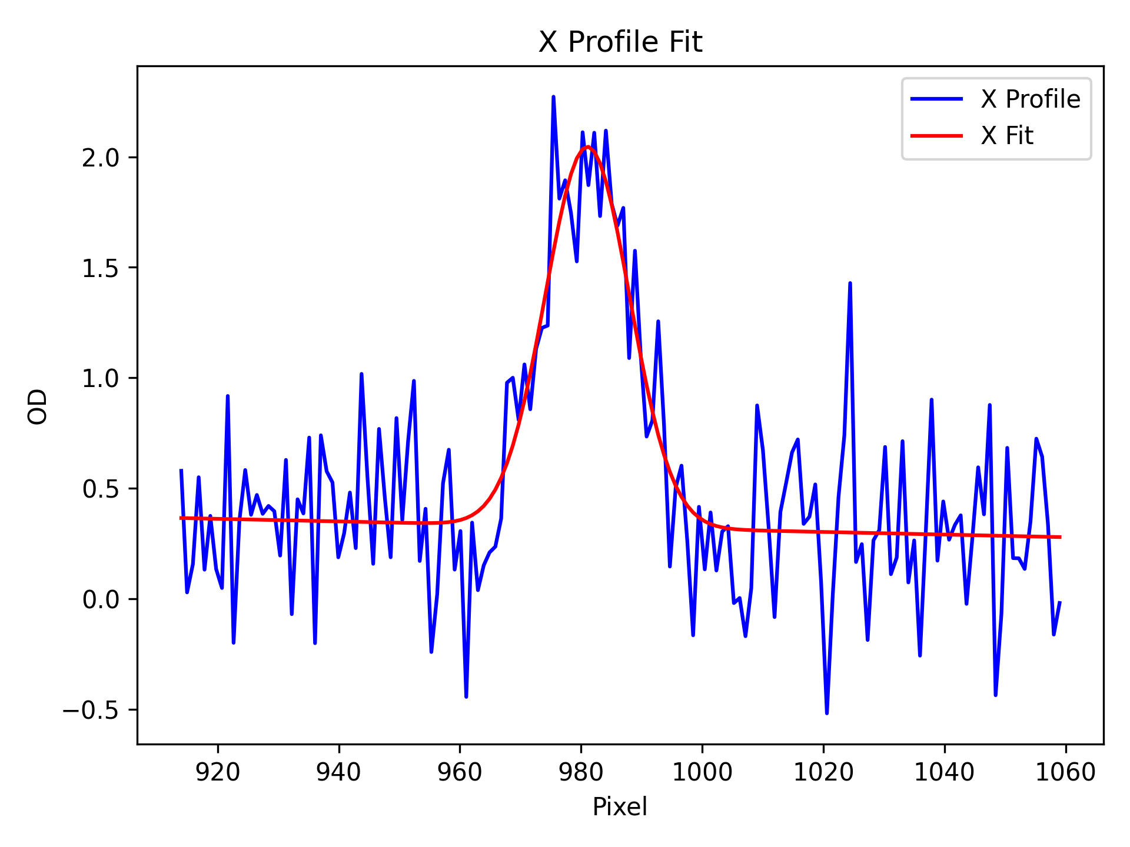
Fr Optical Dipole Trap Image
35 μm
(Preliminary)

Slide 11
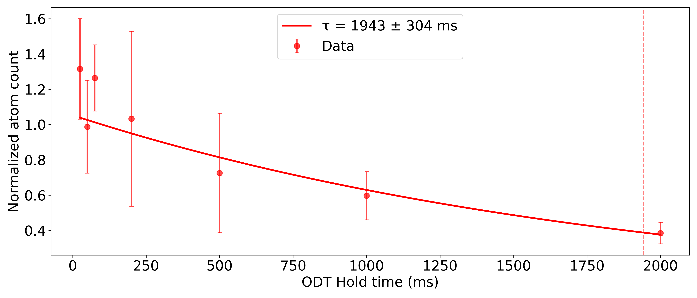
ODT Lifetime
Preliminary
Trapped ∼10,000 Fr atoms

Slide 12
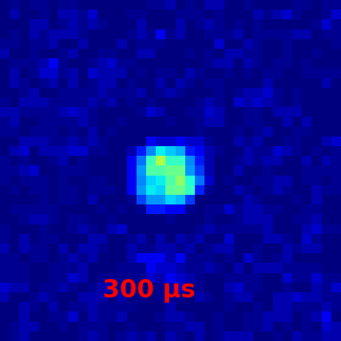
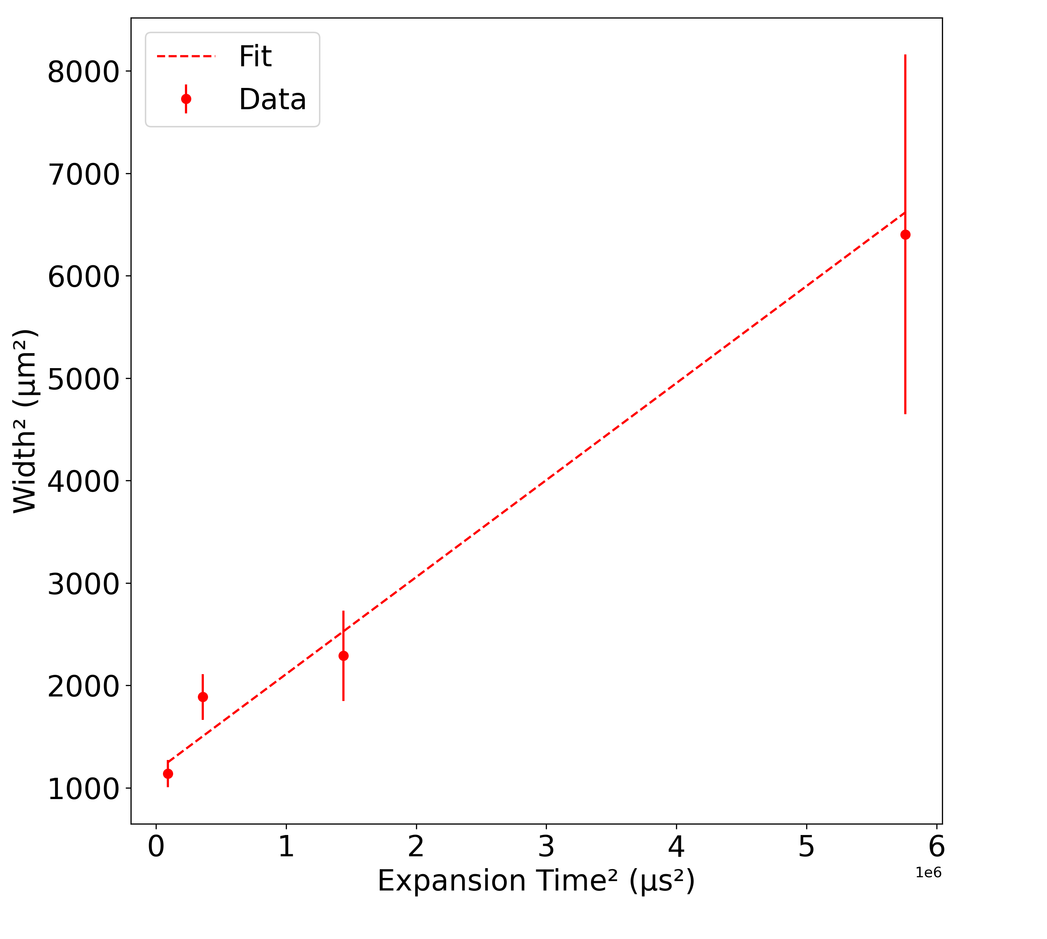
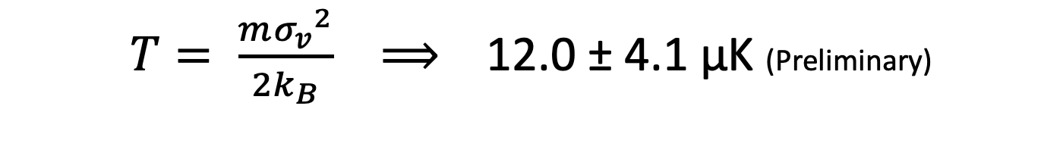
ODT Temperature
Preliminary
$T= \frac{m{σ_{v}}^{2}}{2k_{B}} ⟹$ 12.0 ± 4.1 μK (Preliminary)

Slide 13
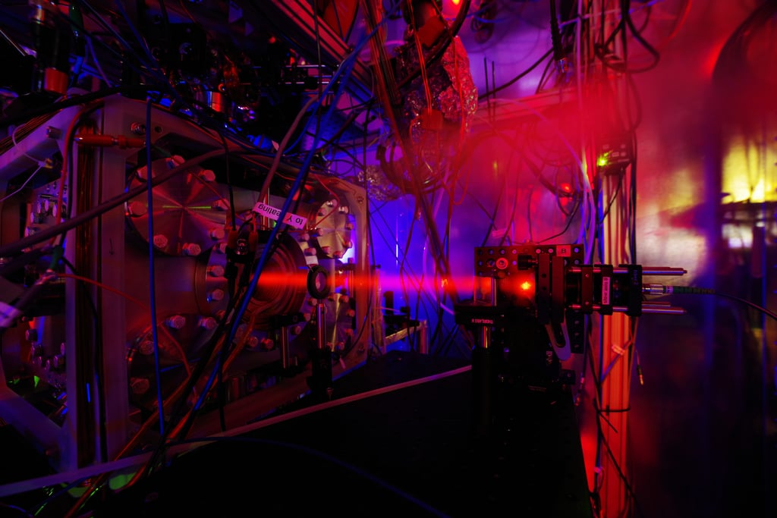
Summary
FrAg – promising probe for new physics
Photoassociation of francium
Probe weakly bound molecular state ⟶ scattering length
Measurement procedure ⟶ look for loss of atoms for PA resonance
Results
First Fr ODT
Excellent ODT lifetime
Coldest sample of Fr

Slide 14








Thank you and Questions?
G. Arrowsmith-Kron, J. Behr, F. Buchinger, O.-K. Budu, D. DeMille, E. Frieling, G. Gwinner, I. Halilovic, A. Jamison, A. Lagno, K. Madison, S. Malbrunot-Ettenauer, A. Okell, A. Sharma

