Slide 1
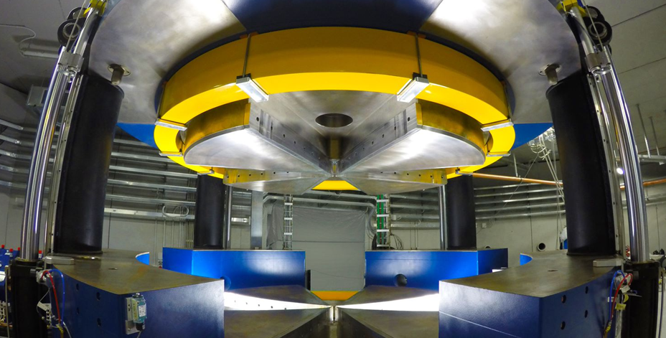

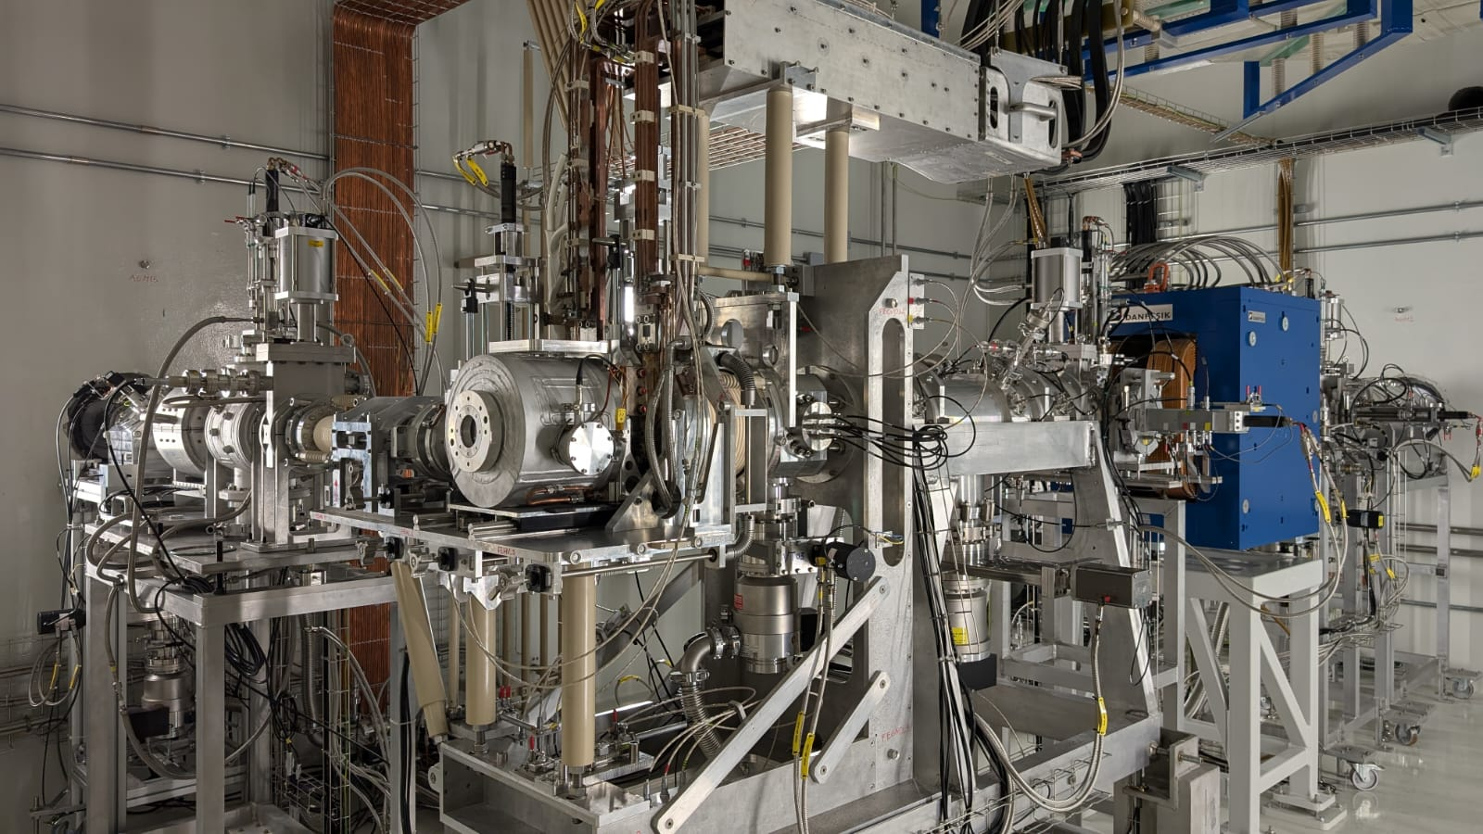
The SPES Facility
first ISOL RIB production
T. Marchi
XX EMIS conference
Whistler, October 20th 2025

Slide 2
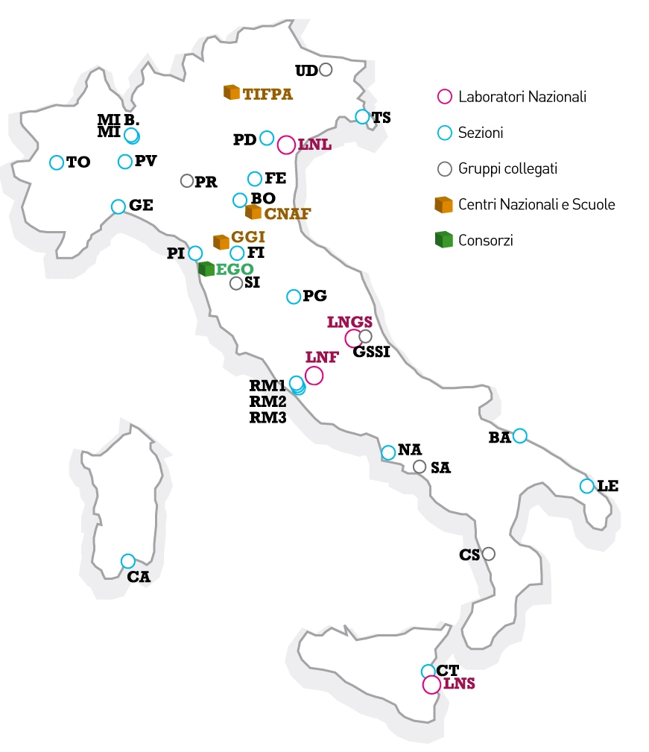
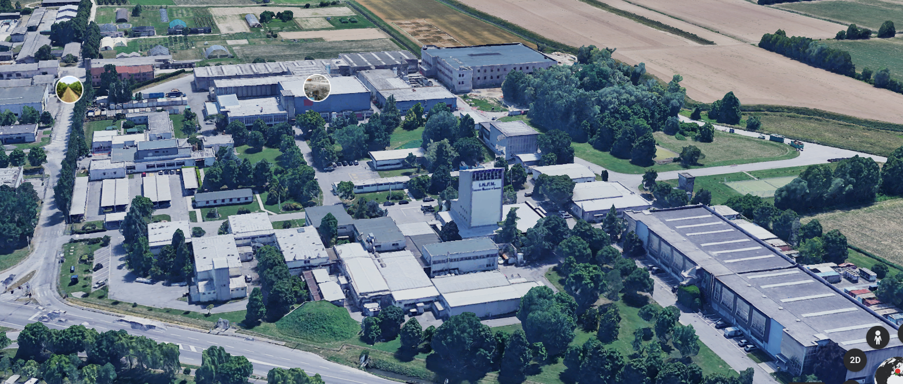

LNL accelerator complex and beamtime
Heavy-ion accelerator complex T.A.P.
SPES
AN2000
CN

Slide 3
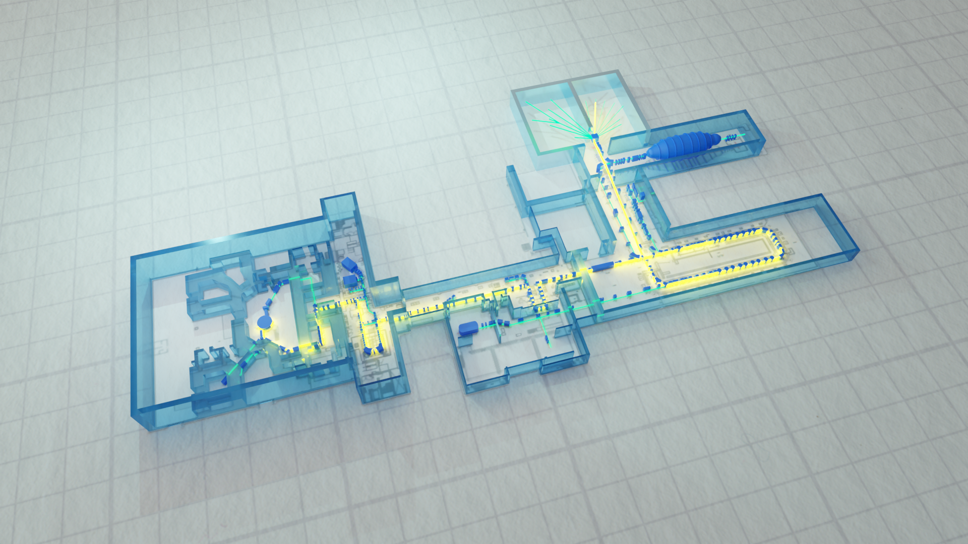
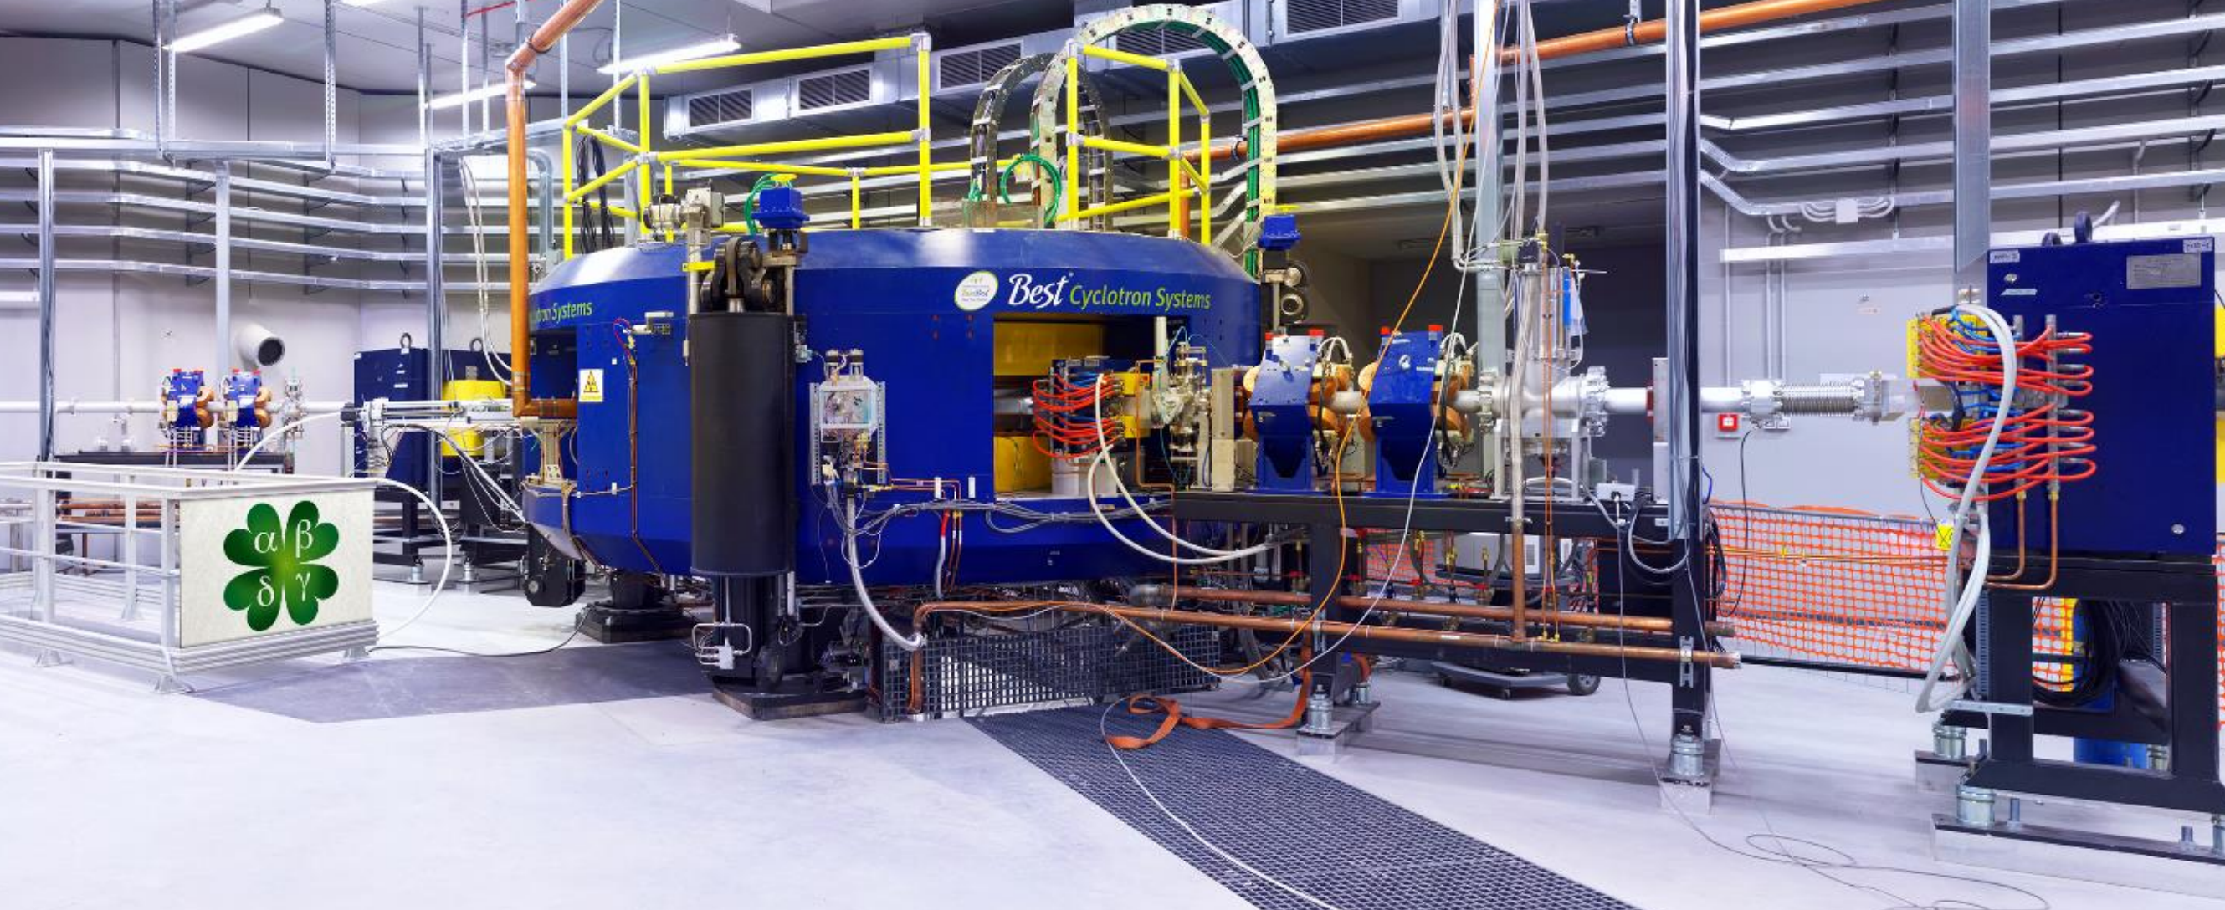
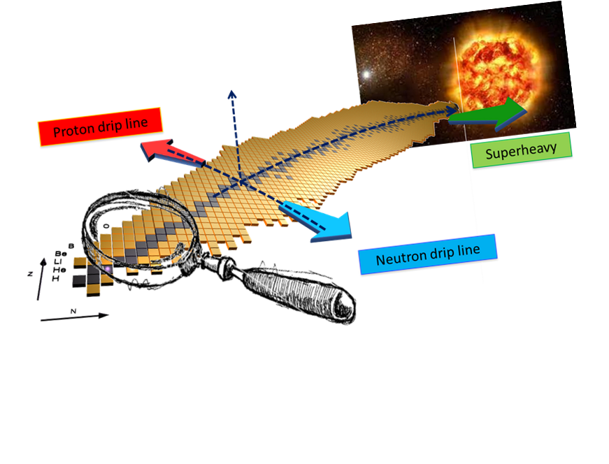
LNL TAP complex and the SPES project – RIB production and post-acceleration
EXP HALLS I & II
ALPI
LRMS
1+ exp hall
RFQ
ISOL front-end
CB + MRMS
BC + HRMS

Slide 4
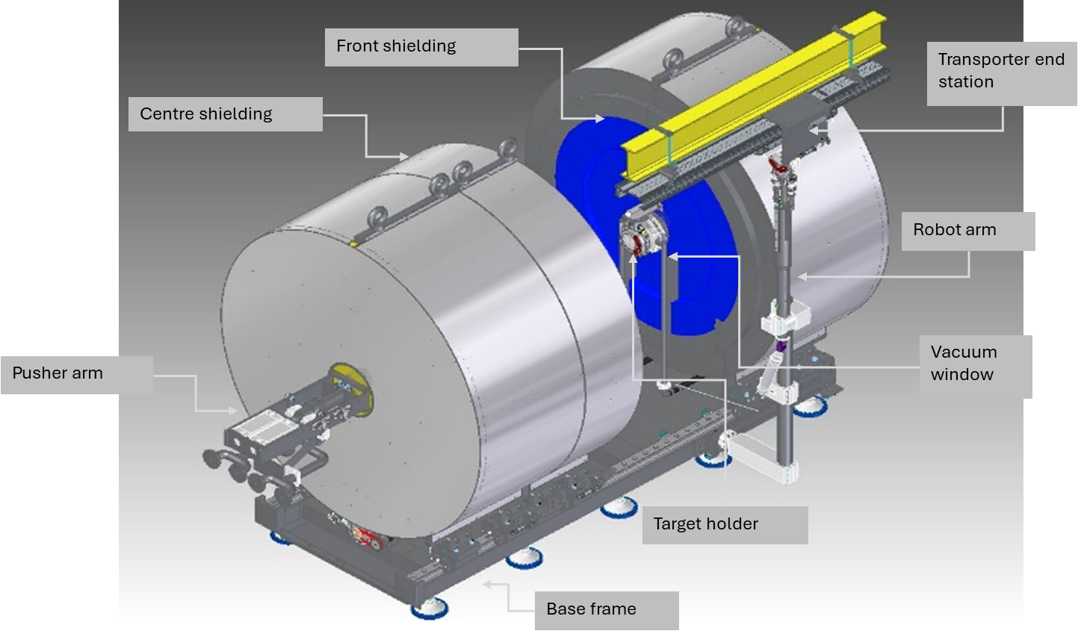
The SPES project
Once you have a powerful driver…
Radioisotopes production

Slide 5
Implementation
Experiments
Phase 1
Cyclotron
Phase 2
ISOL &
low energy EXPS
Phase 4
R.I. production
Phase 3
Post-acceleration
Phase 5
HRMS

Slide 6
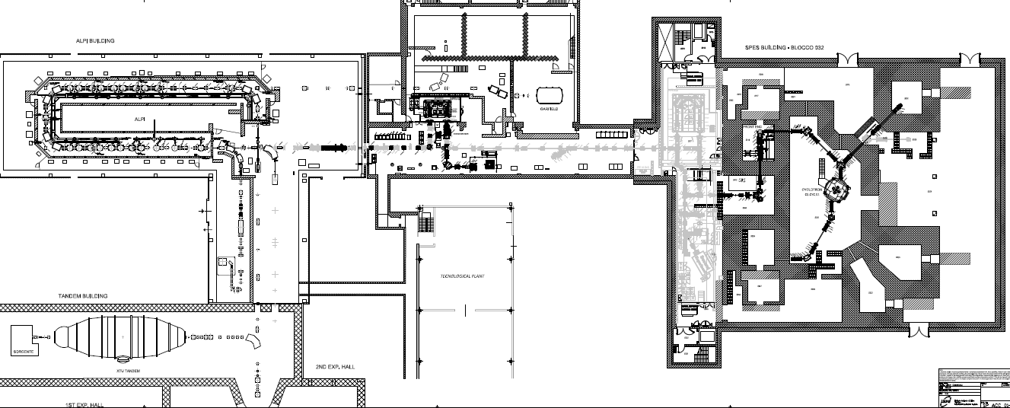
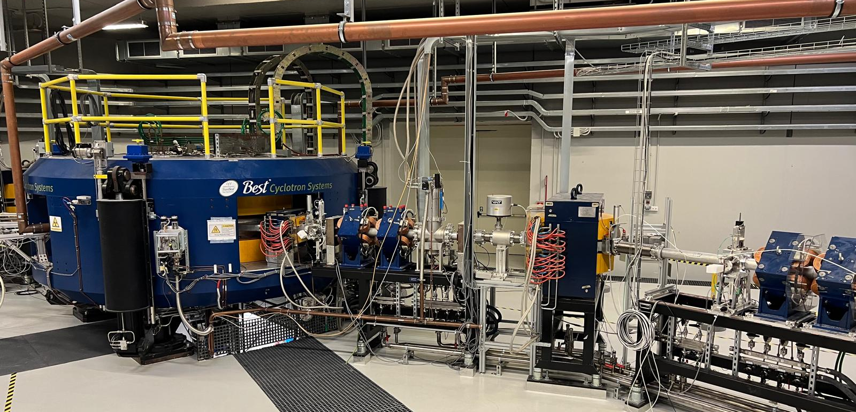
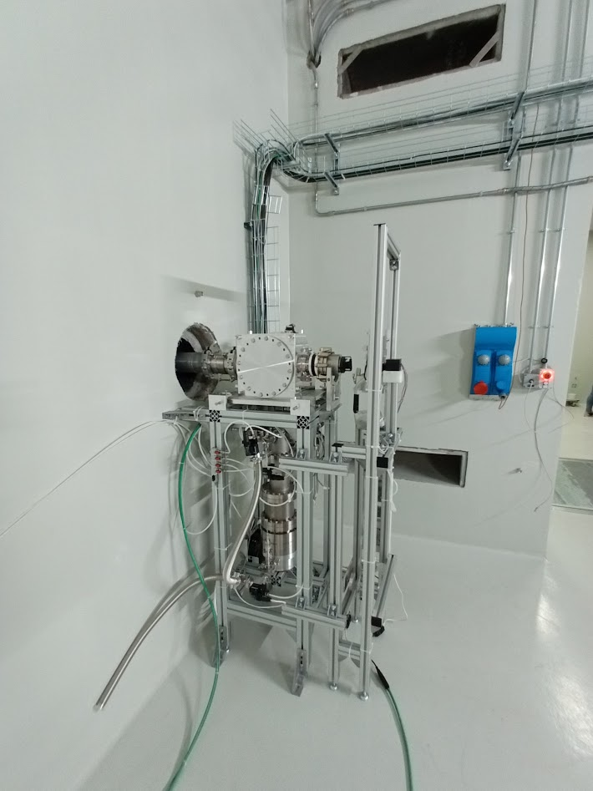
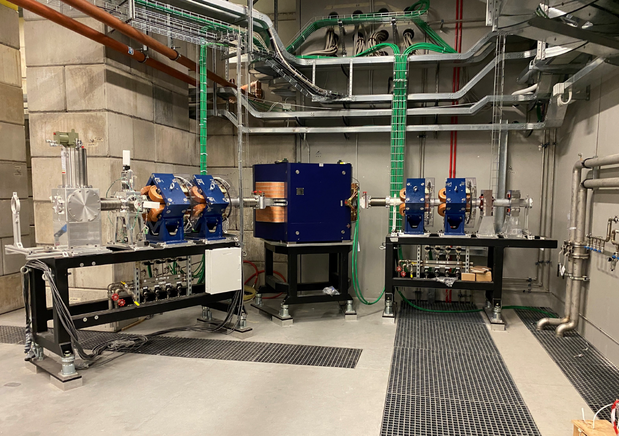
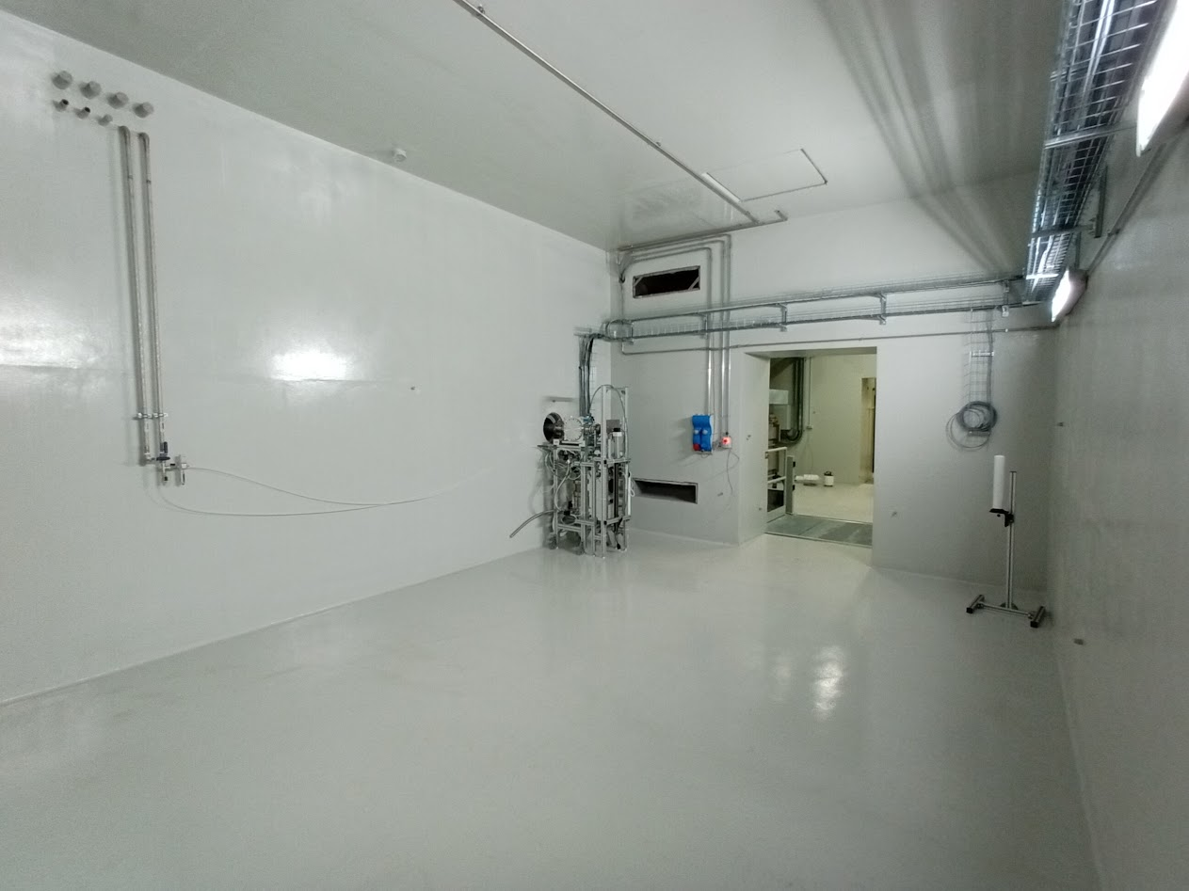
Phase 1 at completion: beam delivered May 2024
SPES-driver
Phase 1
SPES ISOL2
Phase 1 completed.
Cyclotron operational & target station tested.

Slide 7
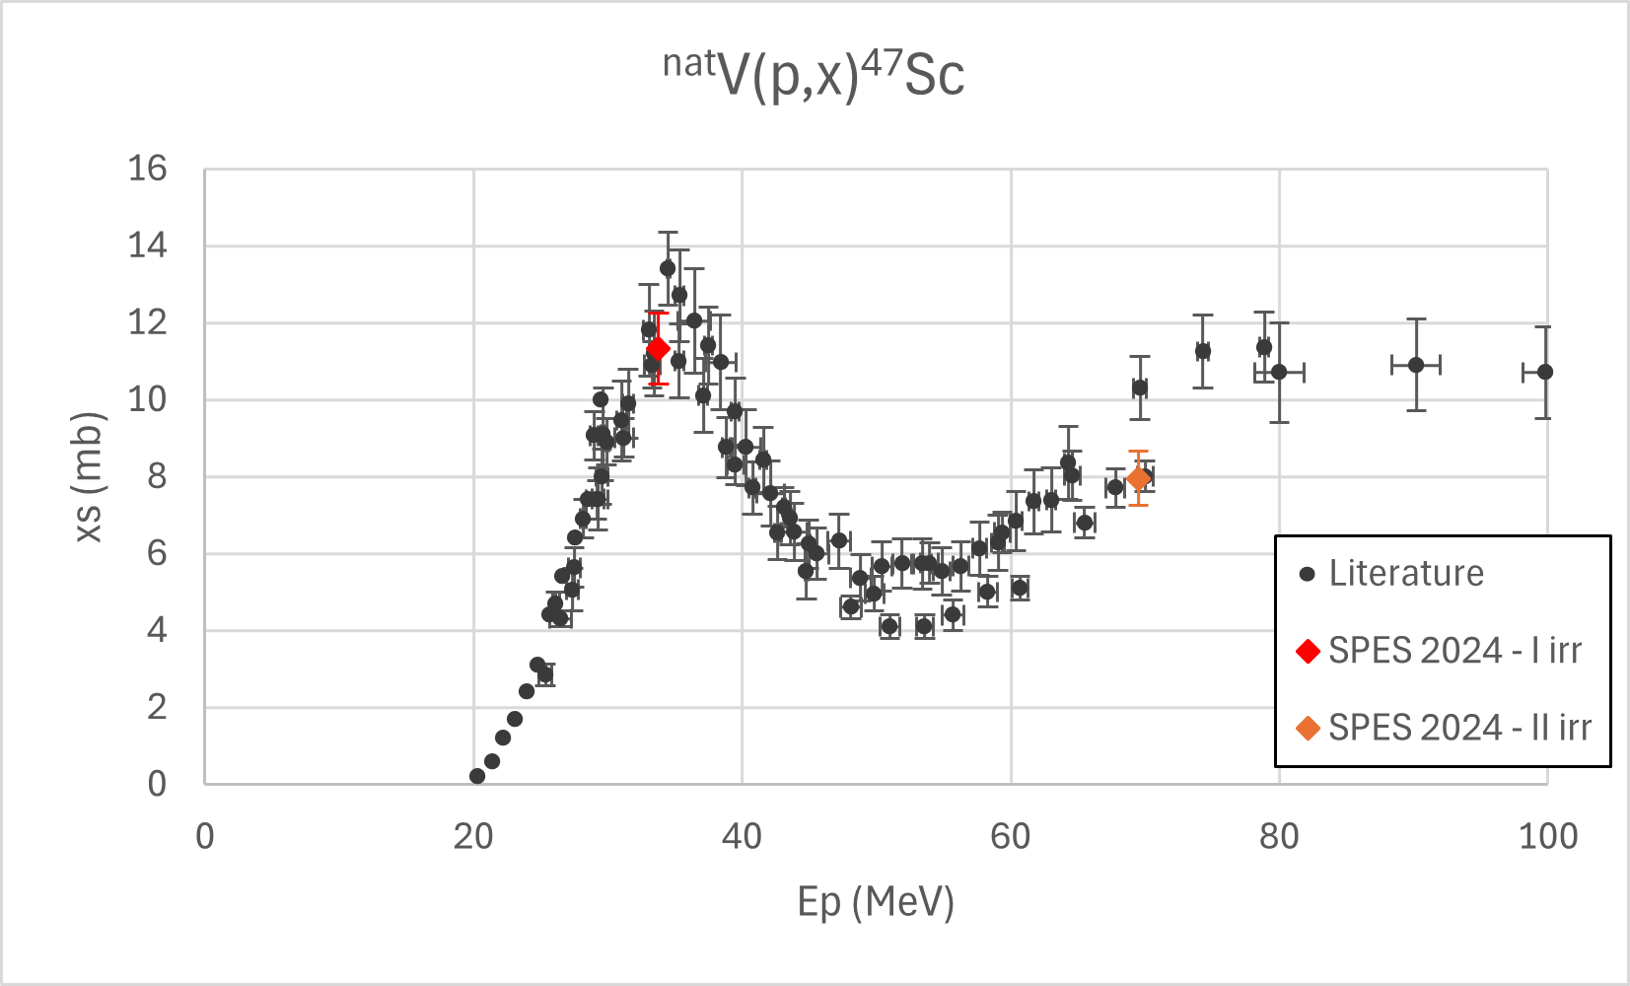
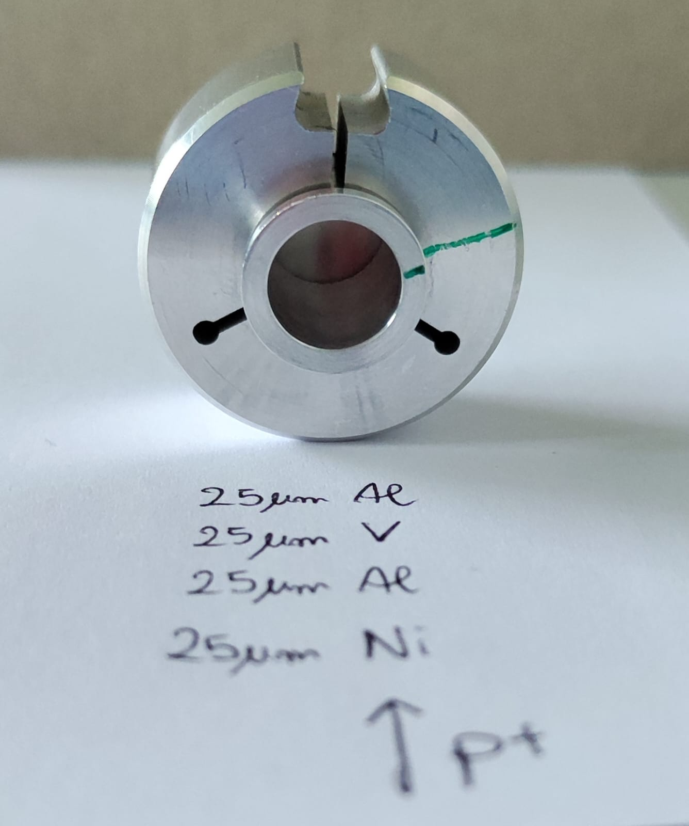
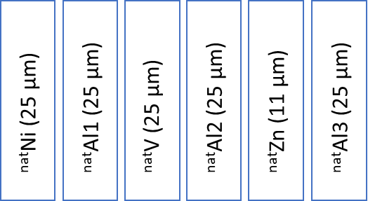
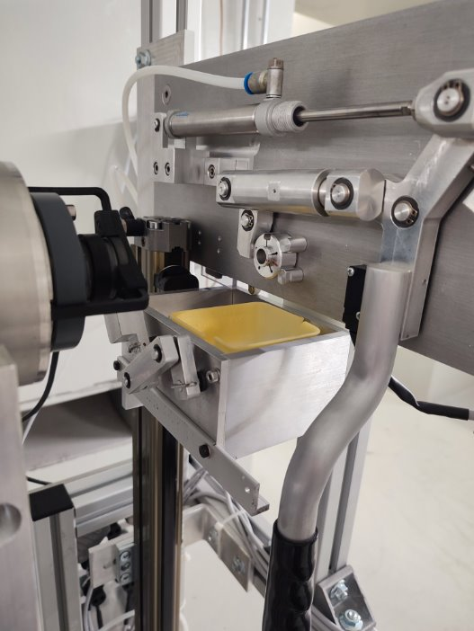
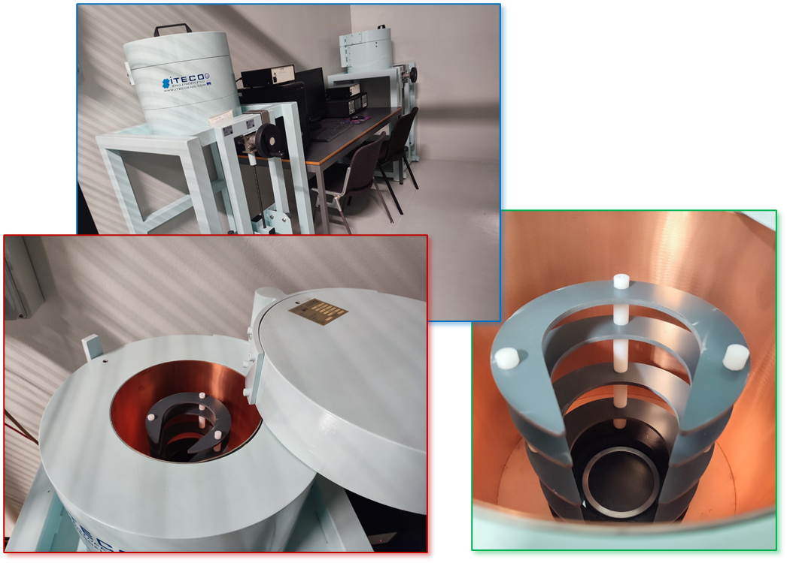
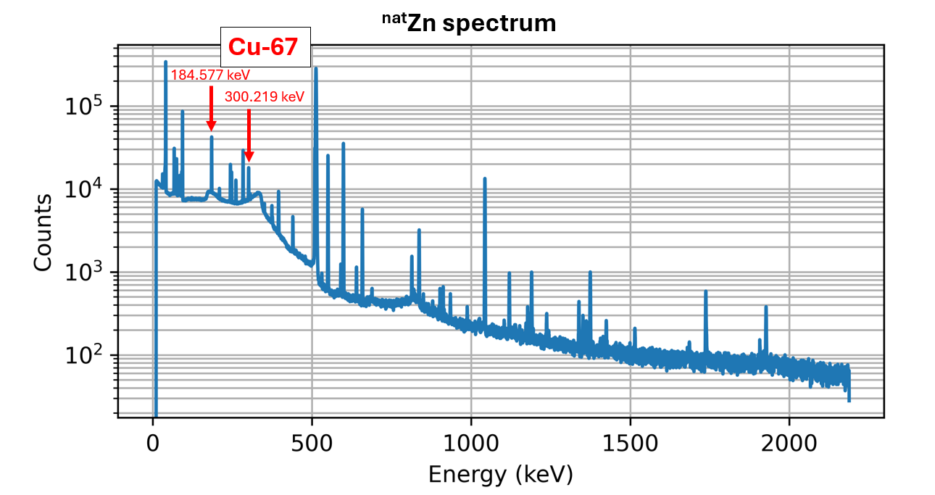
Three irradiation runs with 35, 50 and 70 MeV proton beams
Beamline characterization process using IAEA monitor reactions https://www-nds.iaea.org/medical/monitor_reactions.html
^{nat}Al(p,x)^{22/24}Na; ^{nat}Ni(p,x)⁵⁷Ni
Remeasuring xs for ⁶⁷Cu production route
⁶⁸Zn(p,x)^{67/64}Cu && ⁷⁰Zn(p,x)^{67/64}Cu
Beam

Slide 8
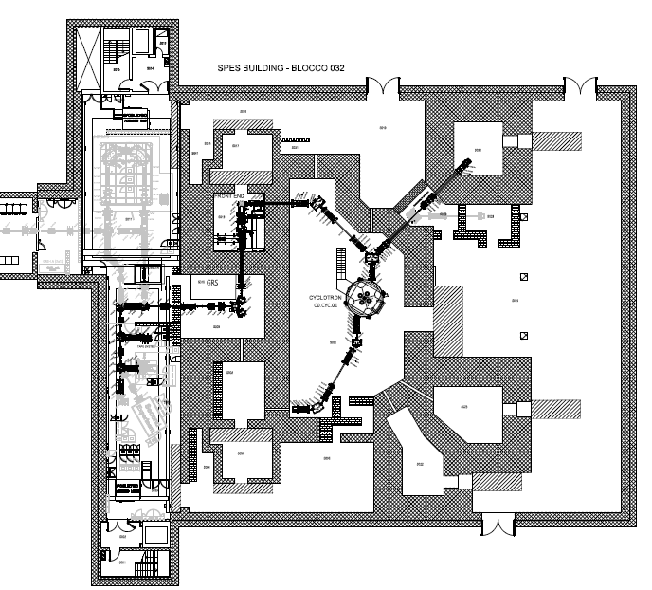
SPES – Phase 2: the ISOL facility and the low-energy exp hall
Phase 2 priorities and work plan:
ISOL Machine
Cooling plants
Pneumatic plants
HV plants
Vacuum plants & Gas Recovery System
Control systems & MPS
Laser laboratory
3 dye lasers
Cooling plants
Low-energy transport and selection beamline
Beamline elements
Vacuum plants
Control system & MPS
Cooling plants for LRMS
Handling & Temporary Storage Station
AGV
Horizontal Handling Machine
TSS
TASKS
ISOL machine completion & stable beam commissioning
In-beam commissioning of the ISOL machine
LERIB beamlines completion& stable beam commissioning
RIB commissioning on the tape station
AGV & TSS full commissioning
LASER lab. completion & commissioning
Phase2
SPES
LERIB

Slide 9
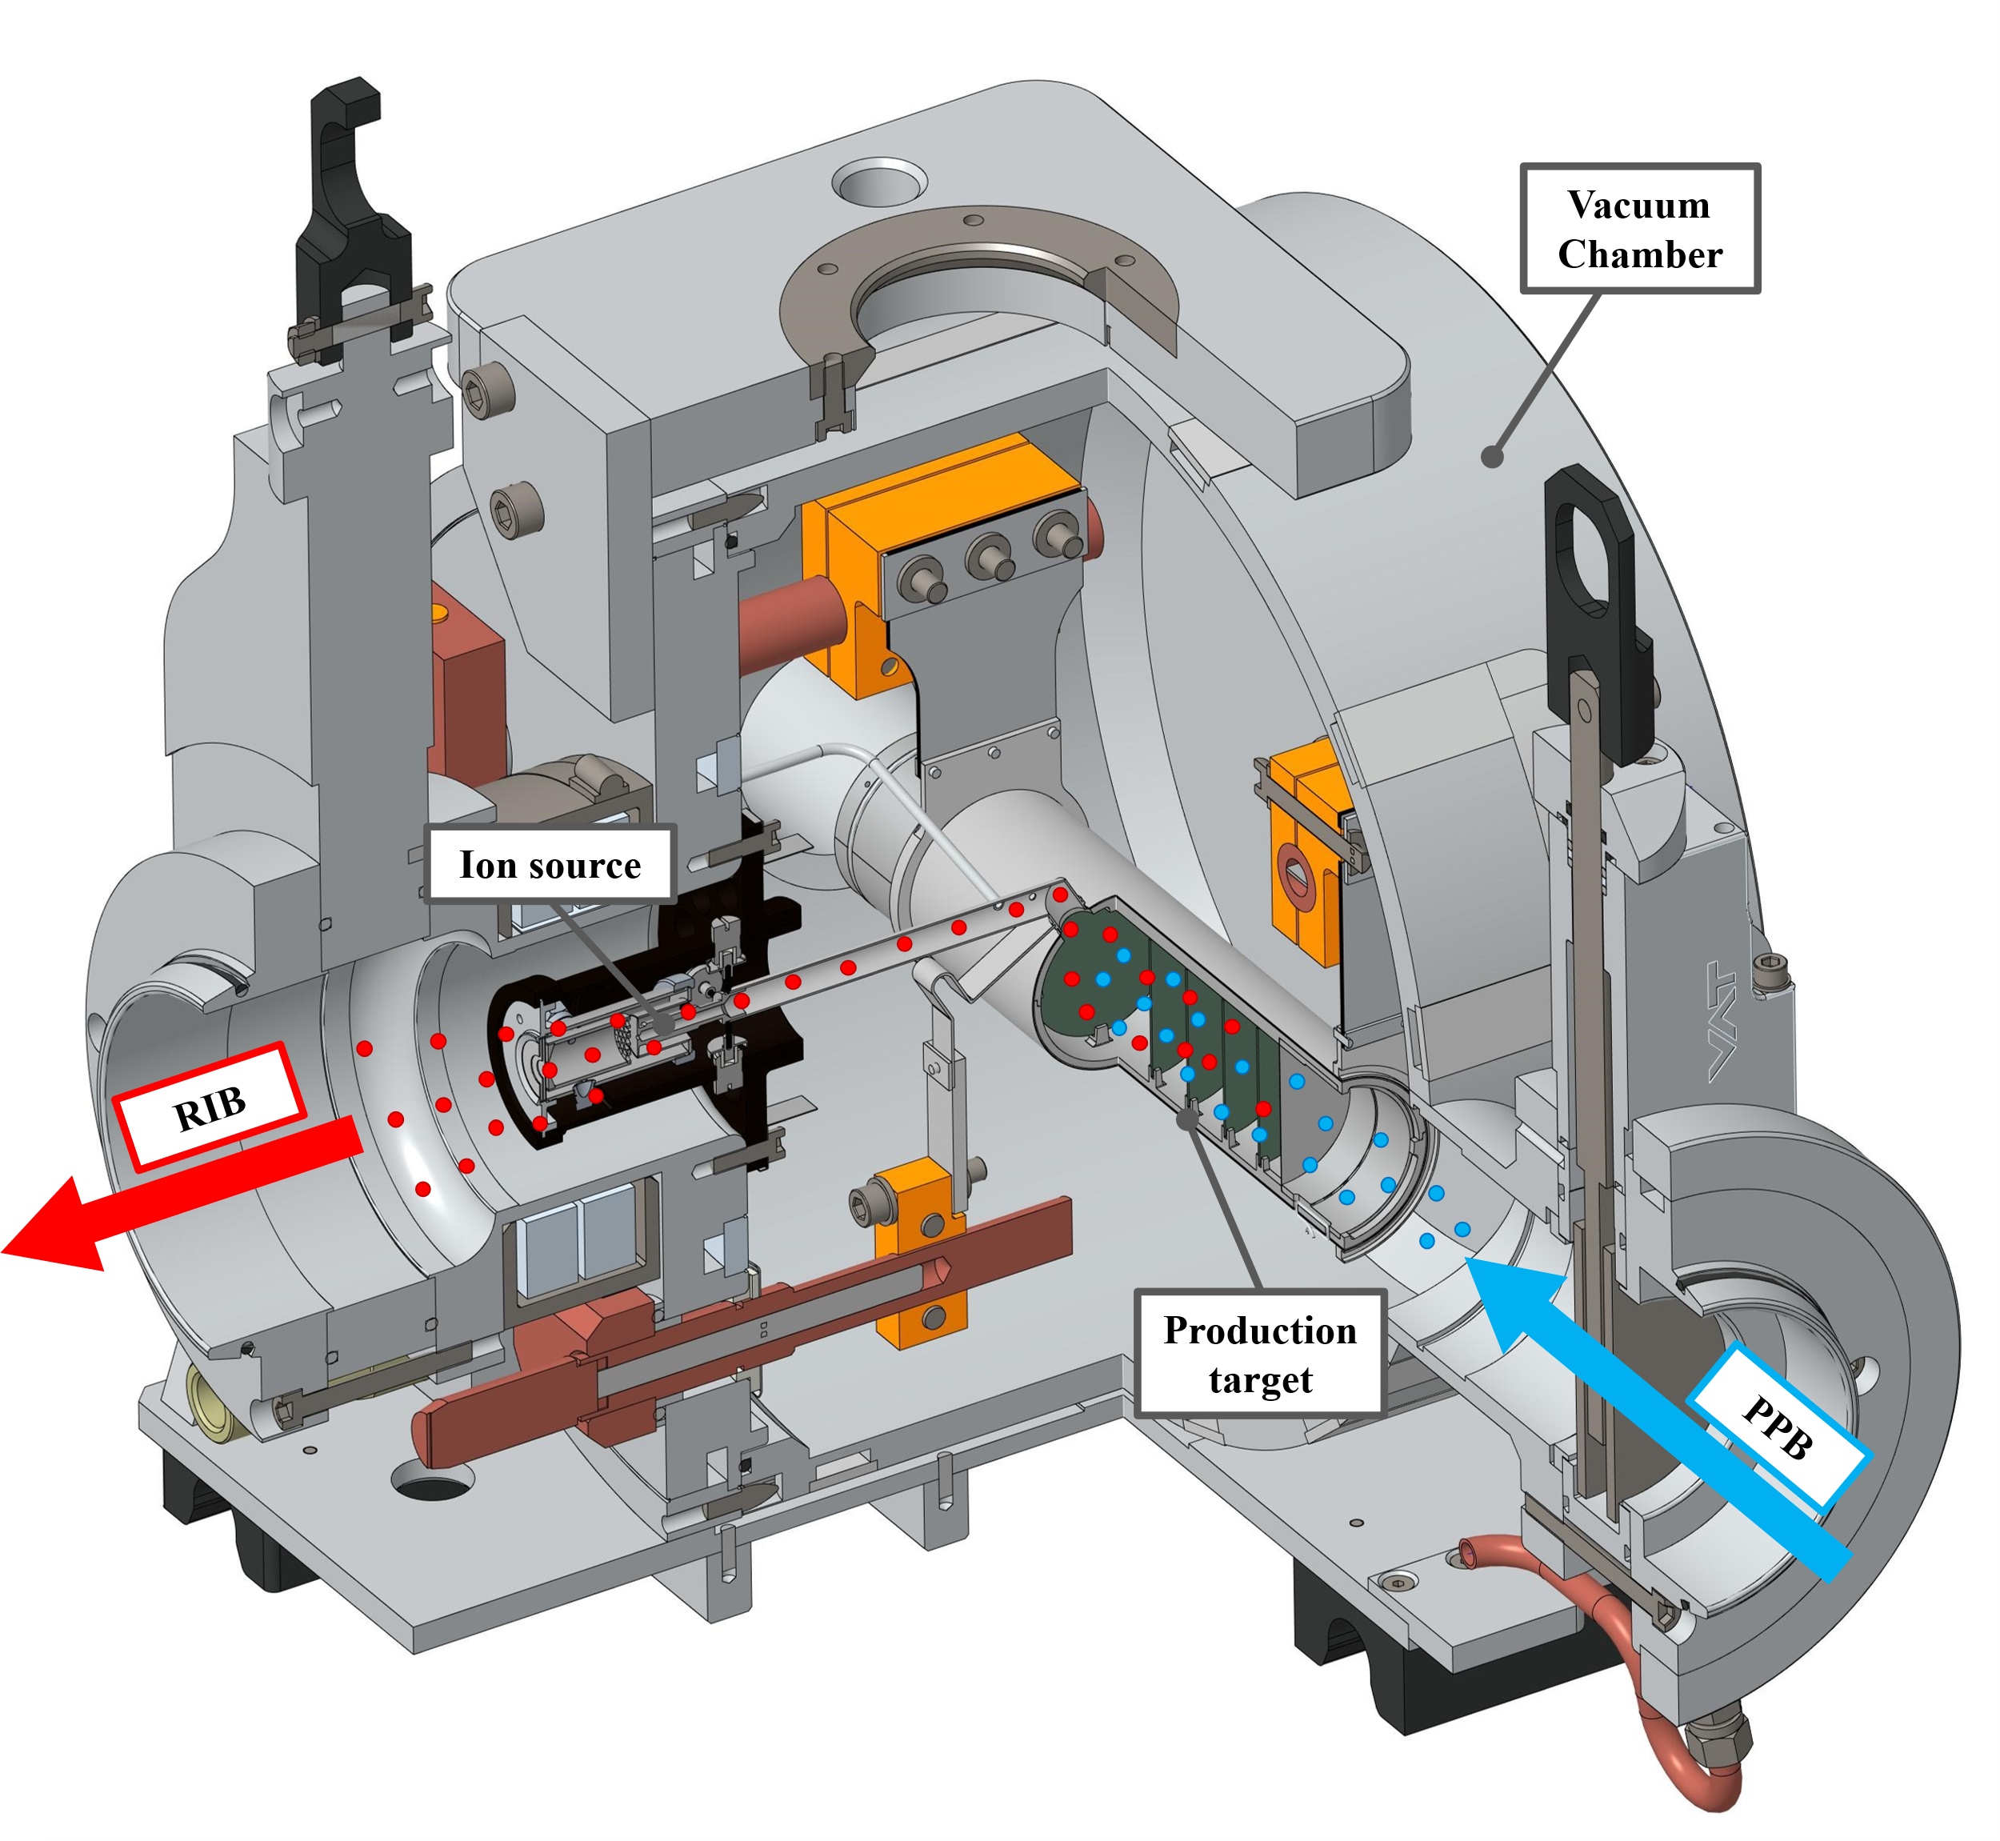
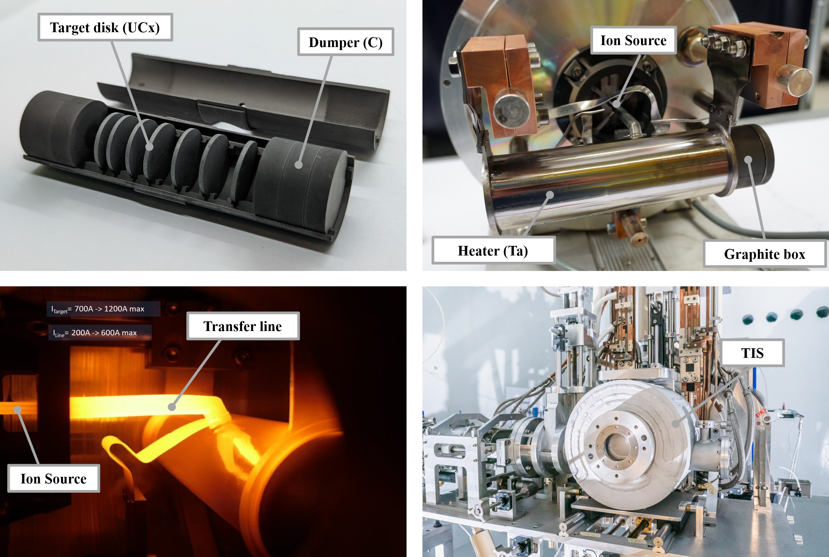
The SPES Target Ion Source
SPES ISOL
Target:
UCx, SiC,...
10¹³ fiss./s
T ~ 2000ºC
3 sources SIS, LIS, PIS
~ 8 kW power
Beam test at iThemba lab. (2014): 66MeV protons, 60 μA on full scale SiC prototype at 1600 ºC (FEM sim. Validation)
Former beam tests: ORNL (2007, 2010-2011) SiC, Ucx; ISOLDE(2009) UCx, IPNO (2013) UCx.

Slide 10
The ISOL machine is completely installed in the ISOL1 bunker

Slide 11
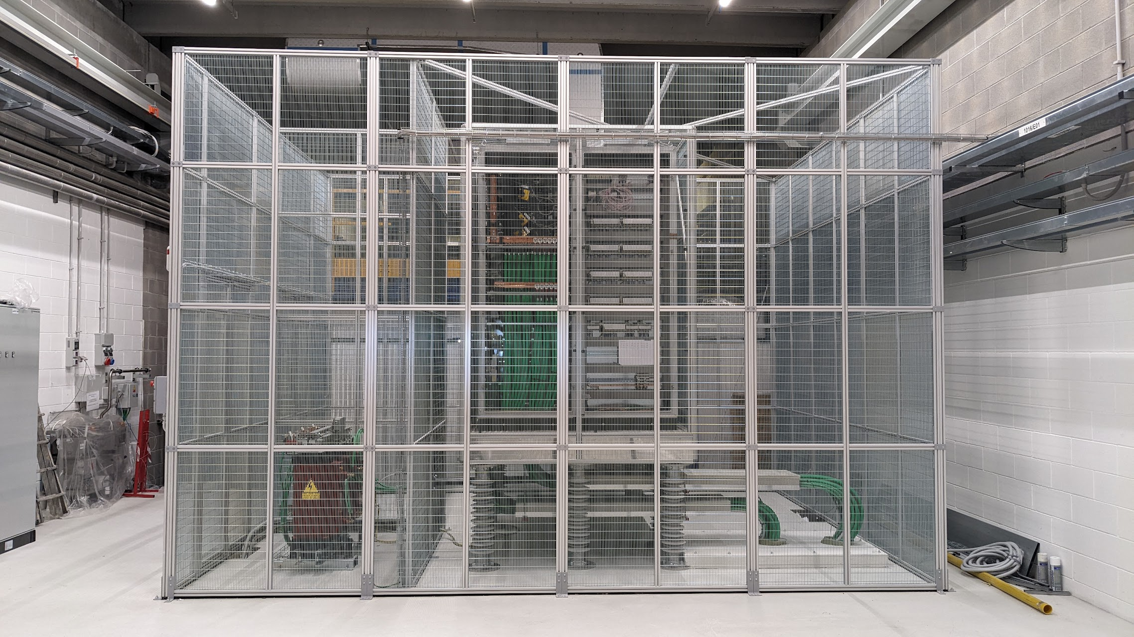
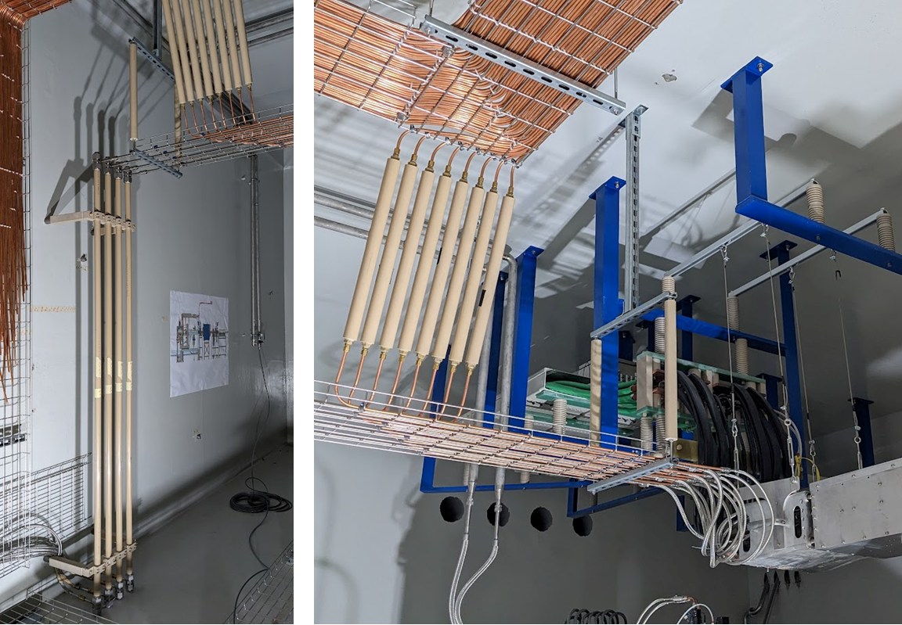
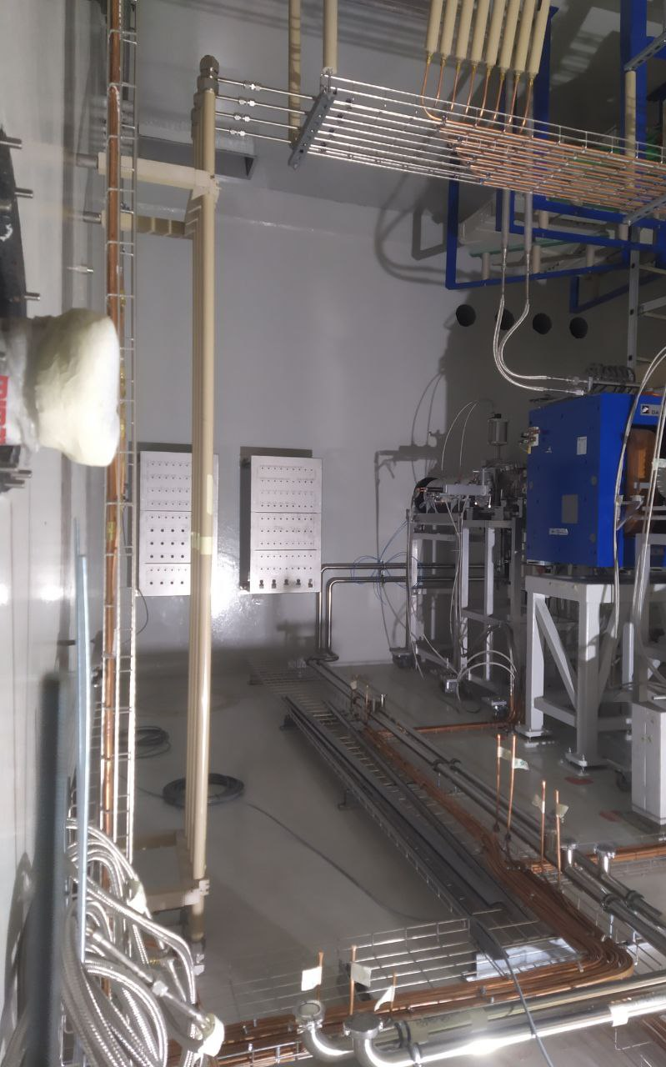
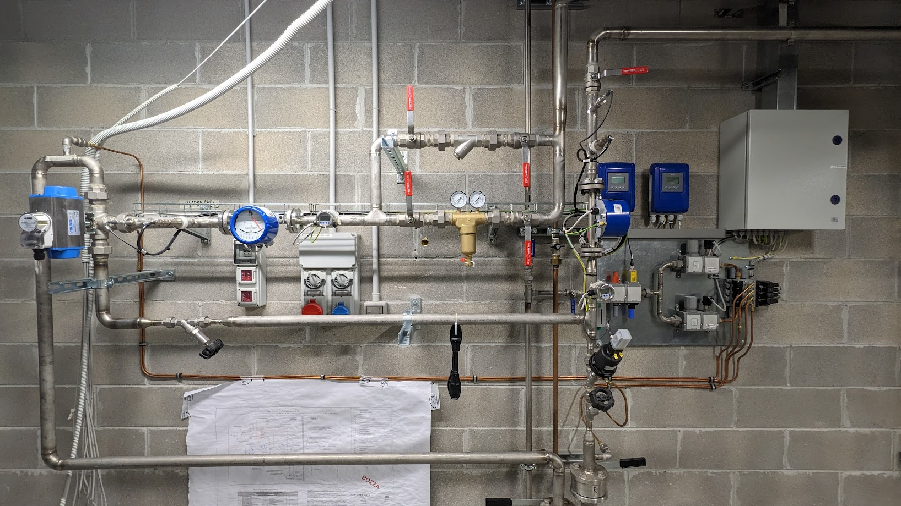
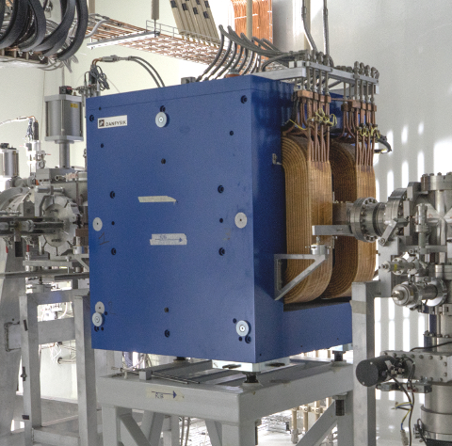
All service plants are completed and commissioned
50 kV HV platform
Cooling water & pneumatics distribution
Wien Filter cooling

Slide 12
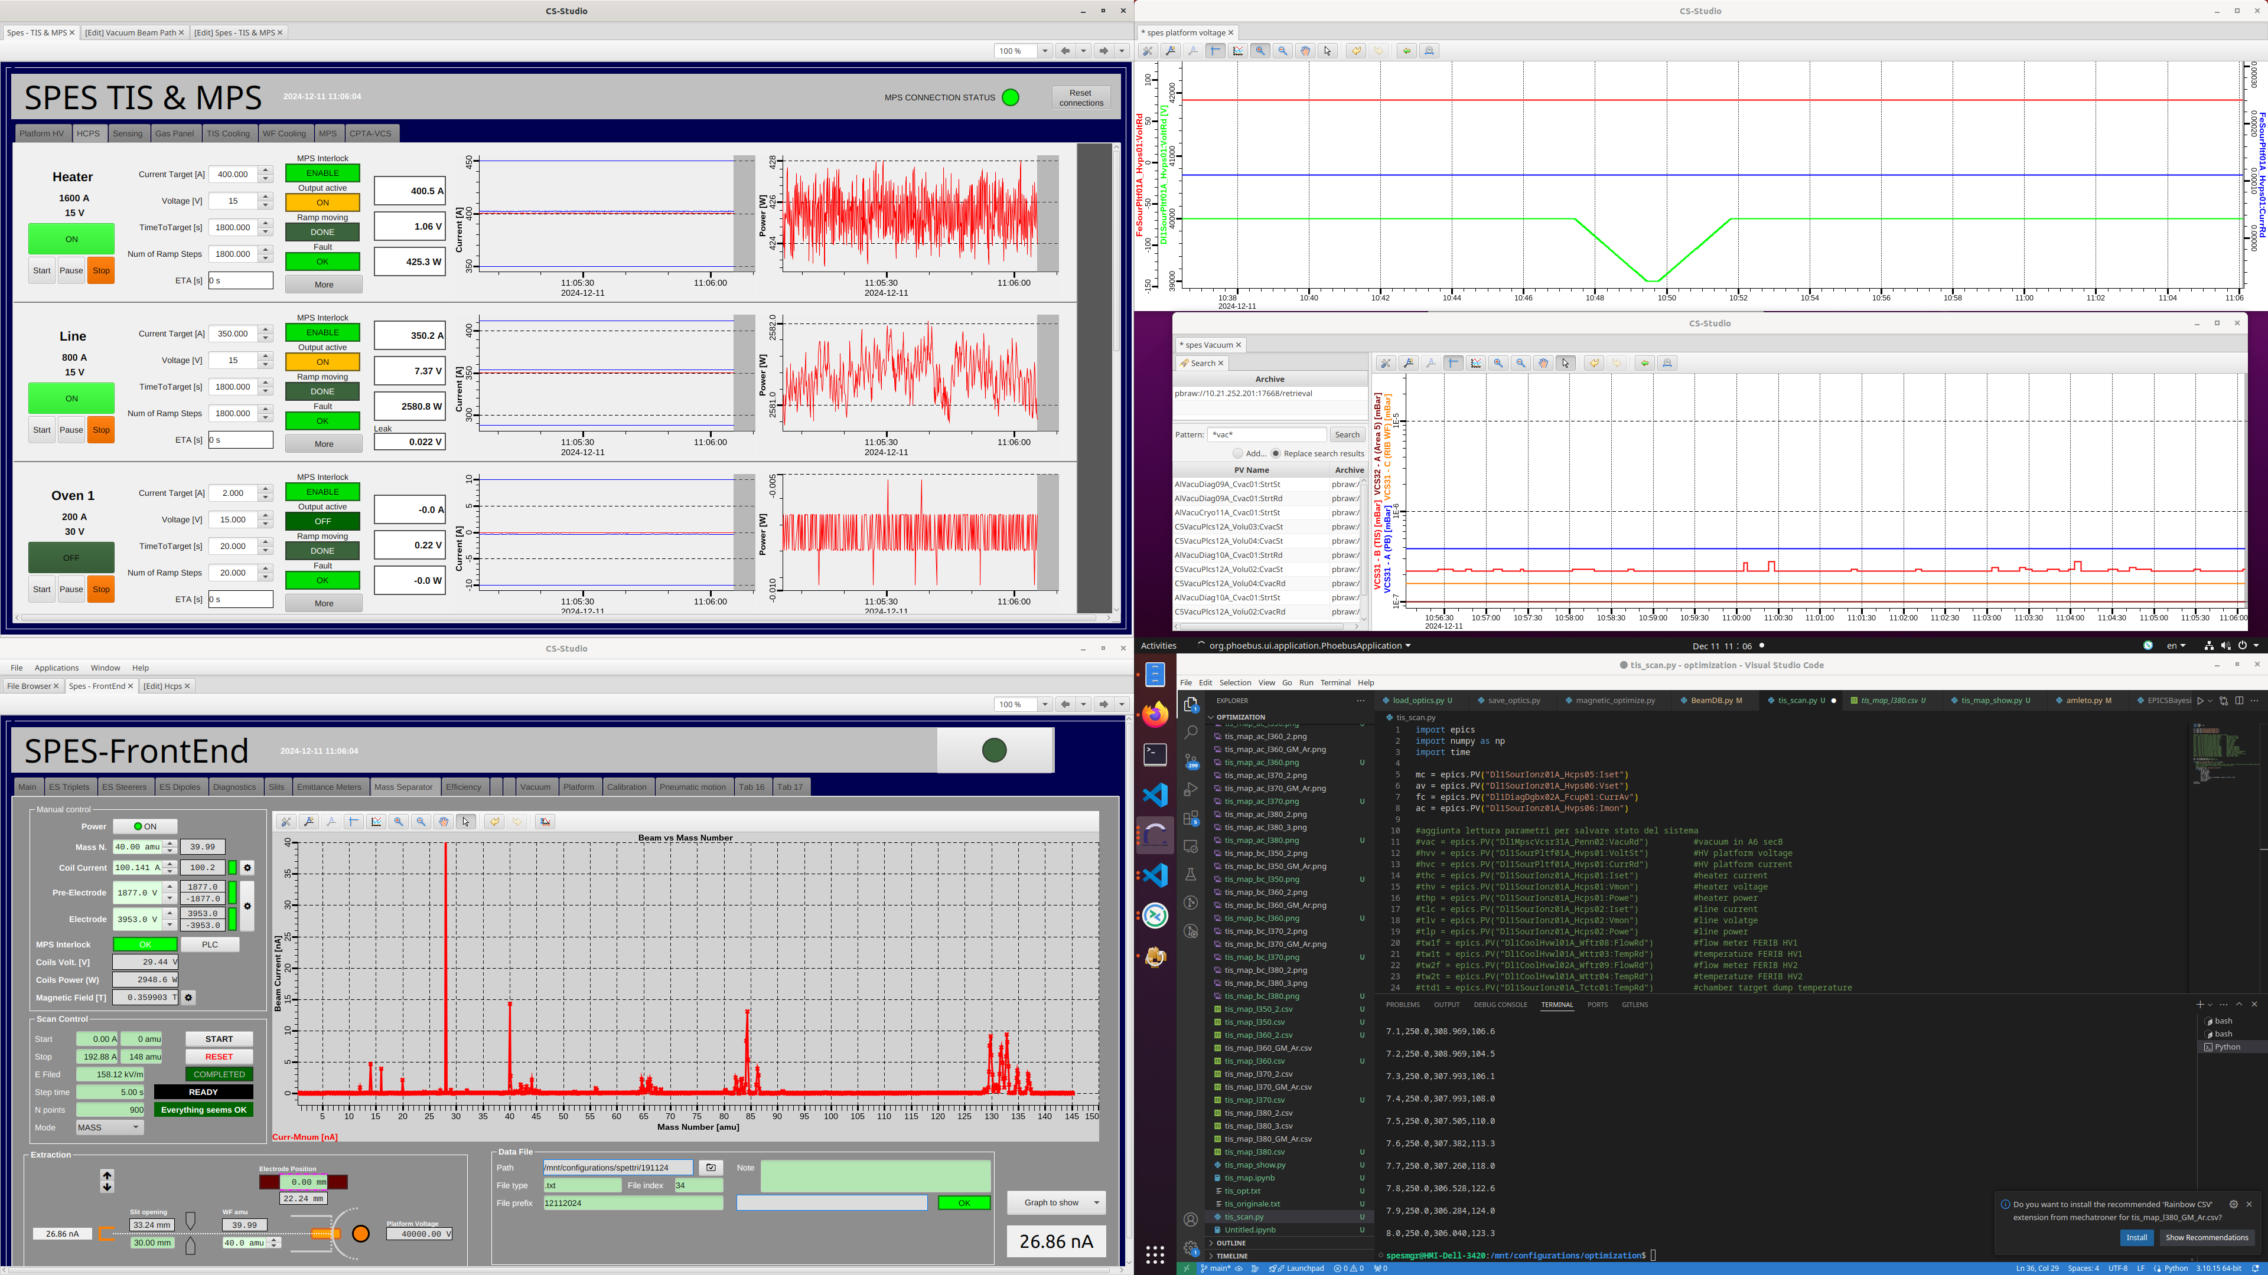
Controls & MPS are completed and operational
In-house developed control system (100%)
Based on EPICS framework and off-the-shelf Hardware
Compatible with all the LNL accelerators control system
Allows to exploit LNL-developed AI methods for beam transport
Integrated with the Machine Protection System and the Global Safety System
High Current Power Suppliers Control System
Wien Filter Control System: includesautomatic mass scan prcedures

Slide 13
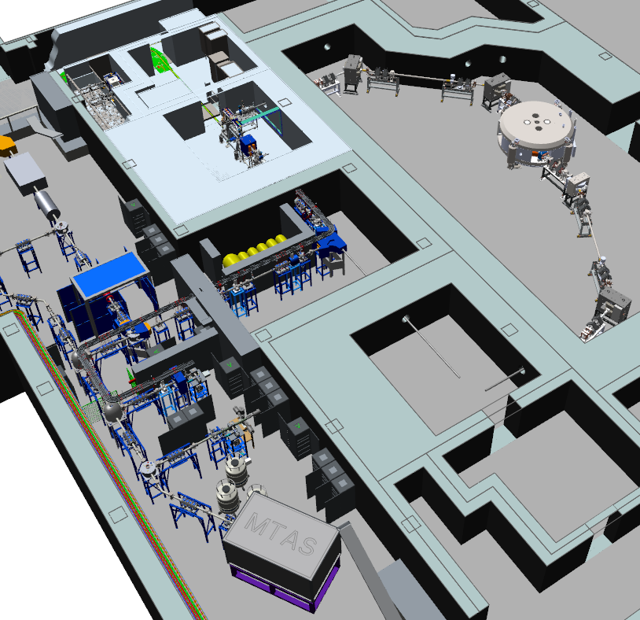
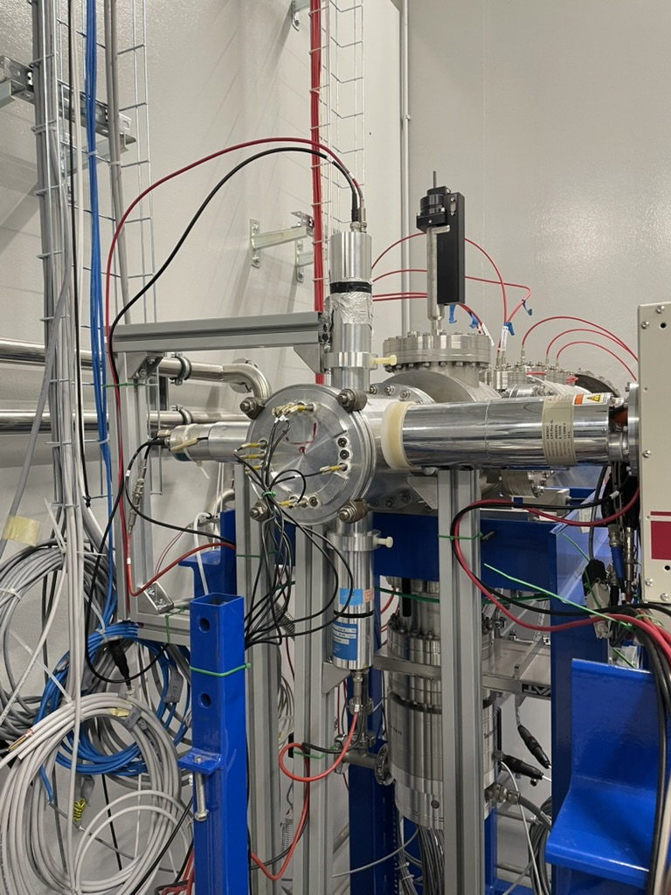
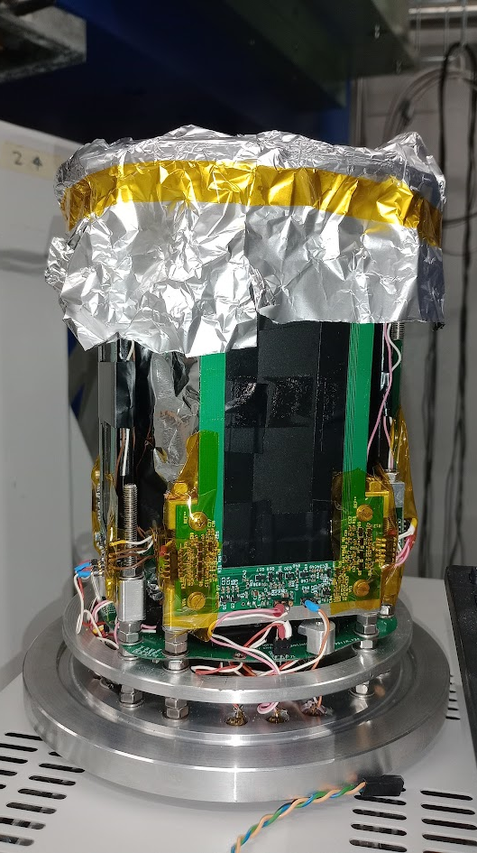
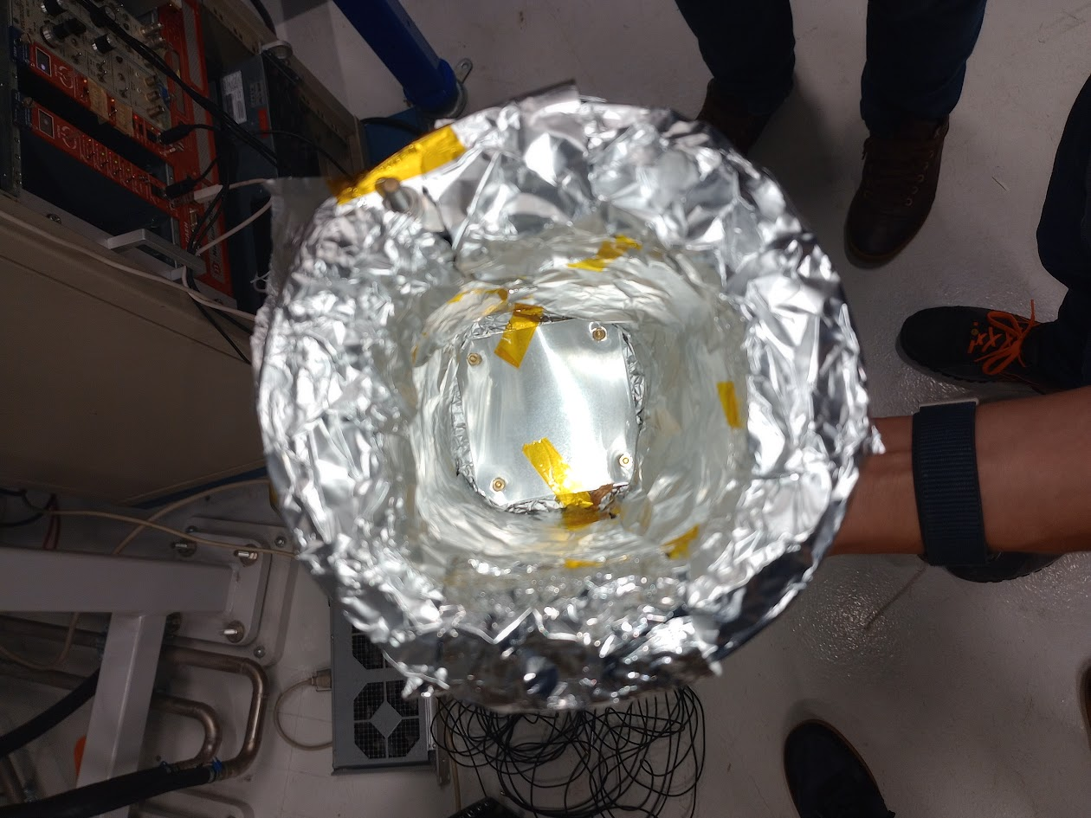
Phase 2a: RIB commissioning of the ISOL machine

Slide 14
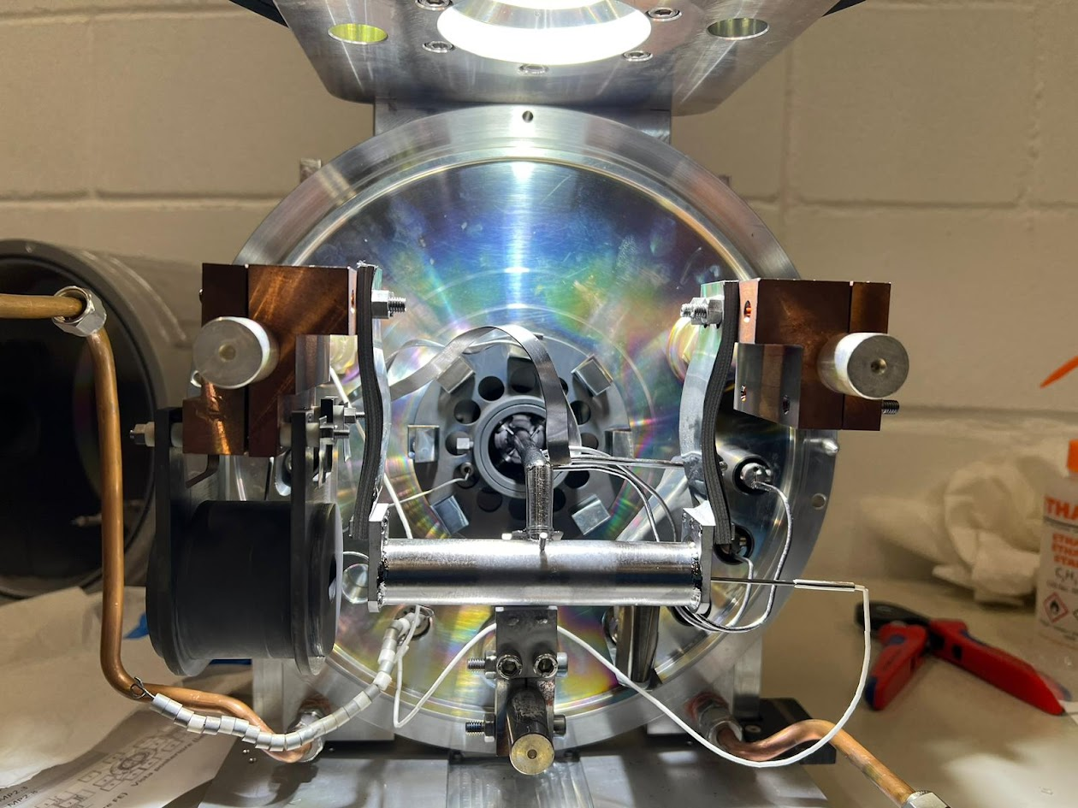
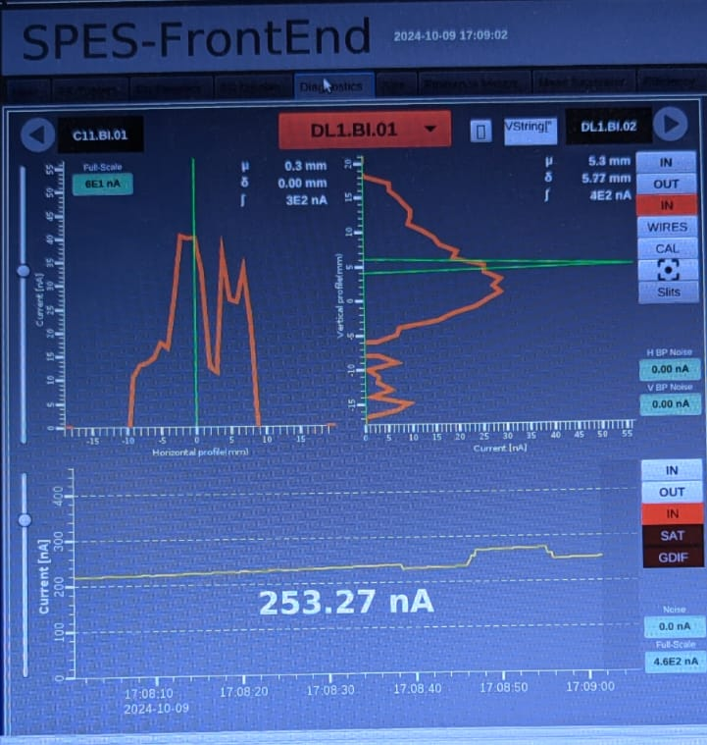
Phase 2a: RIB commissioning of the ISOL machine
7 target chambers available and tested for coupling/decoupling on the TIS
2 target chambers fully equipped, ready for beam
Mass markers:
residual pollution (CO+, N2+)
gas mix Ne:Ar:Kr:Xe
^{nat}Mg; ^{nat}S/^{nat}Sn
Preliminary test with stable beam completed

Slide 15
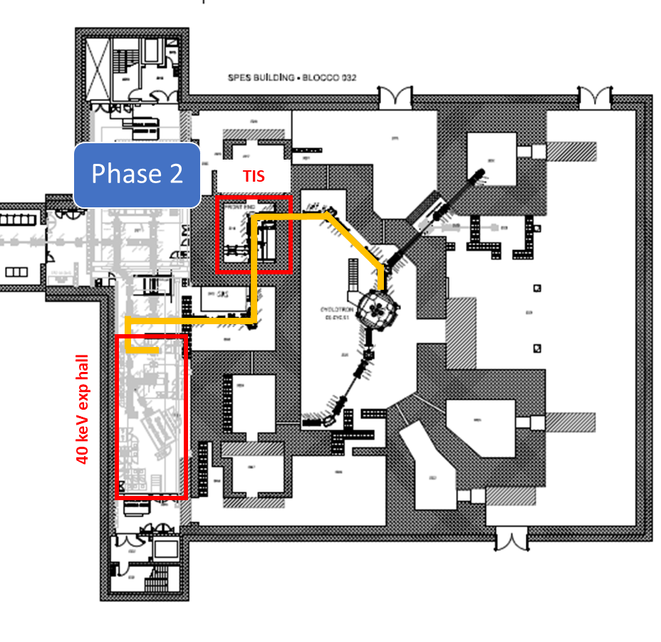
Phase 2a: RIB commissioning of the ISOL machine
Date: 14 Nov 2024
Primary beam energy: 40 MeV
Primary beam current: 100 nA
Target: SiC (standard)
Target temperature: 1600 °C
Ion Source: FEBIAD (plasma)
Extraction Voltage: 30 kV
Vacuum level in the target:
Oven off: 1.0 10⁻⁷ mbar
Oven on: 4.0 10⁻⁷ mbar
W.F. selection: 28 a.m.u.
Stable beam current F.C.2 (A=28) : ̴̴200 nA
Phase 2a
TIS

Slide 16
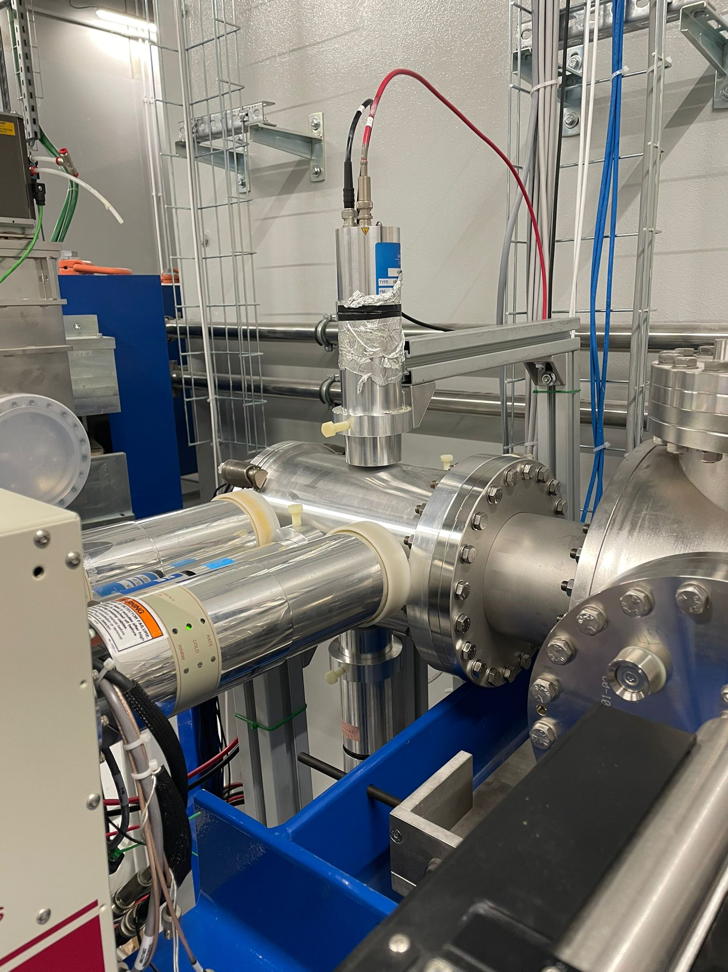
Phase 2a: RIB commissioning of the ISOL machine
Phase 2a
TIS
RIB

Slide 17
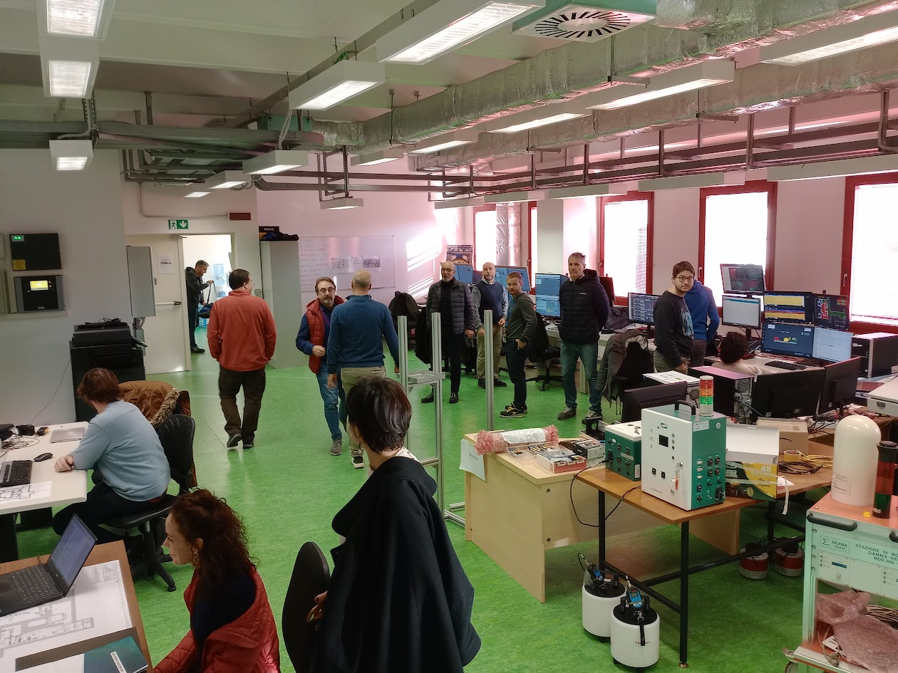
Phase 2a: RIB commissioning of the ISOL machine
Phase 2a
TIS
The beam is about to come…

Slide 18
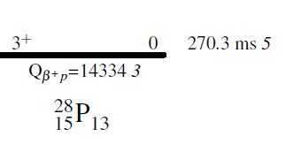
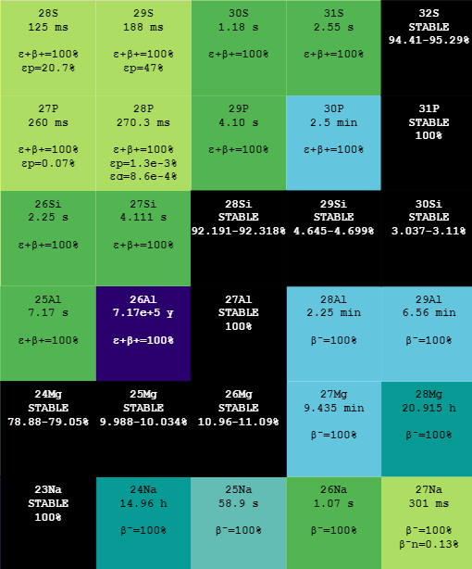
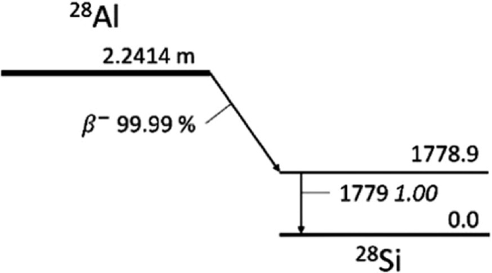
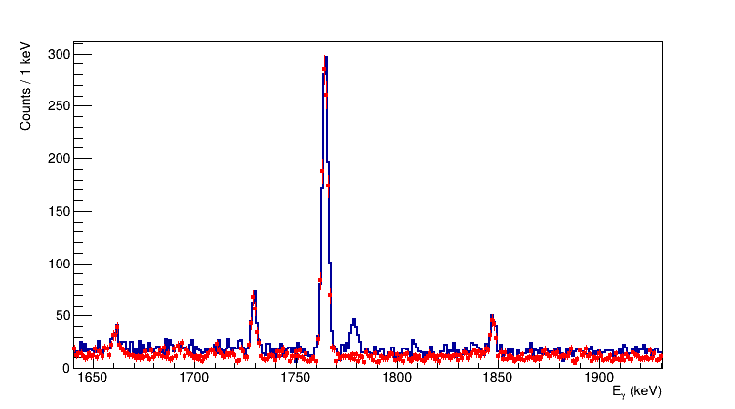
Phase 2a: RIB commissioning of the ISOL machine
HPGe spectrum in coincidence with beta signal
²⁸Si: 2⁺→0⁺
Beam ON

Slide 19
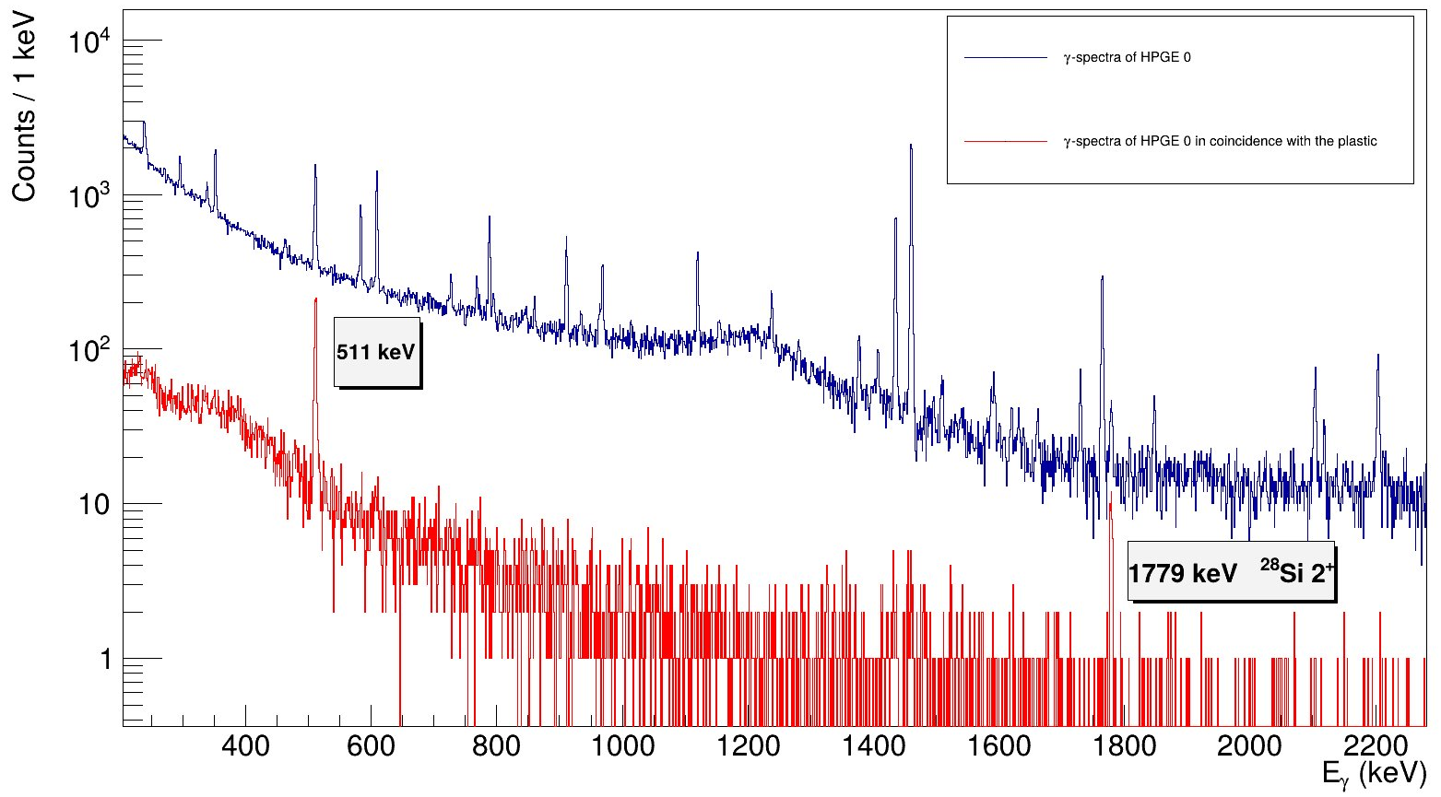
First ISOL RIB @ SPES: November 2024

Slide 20
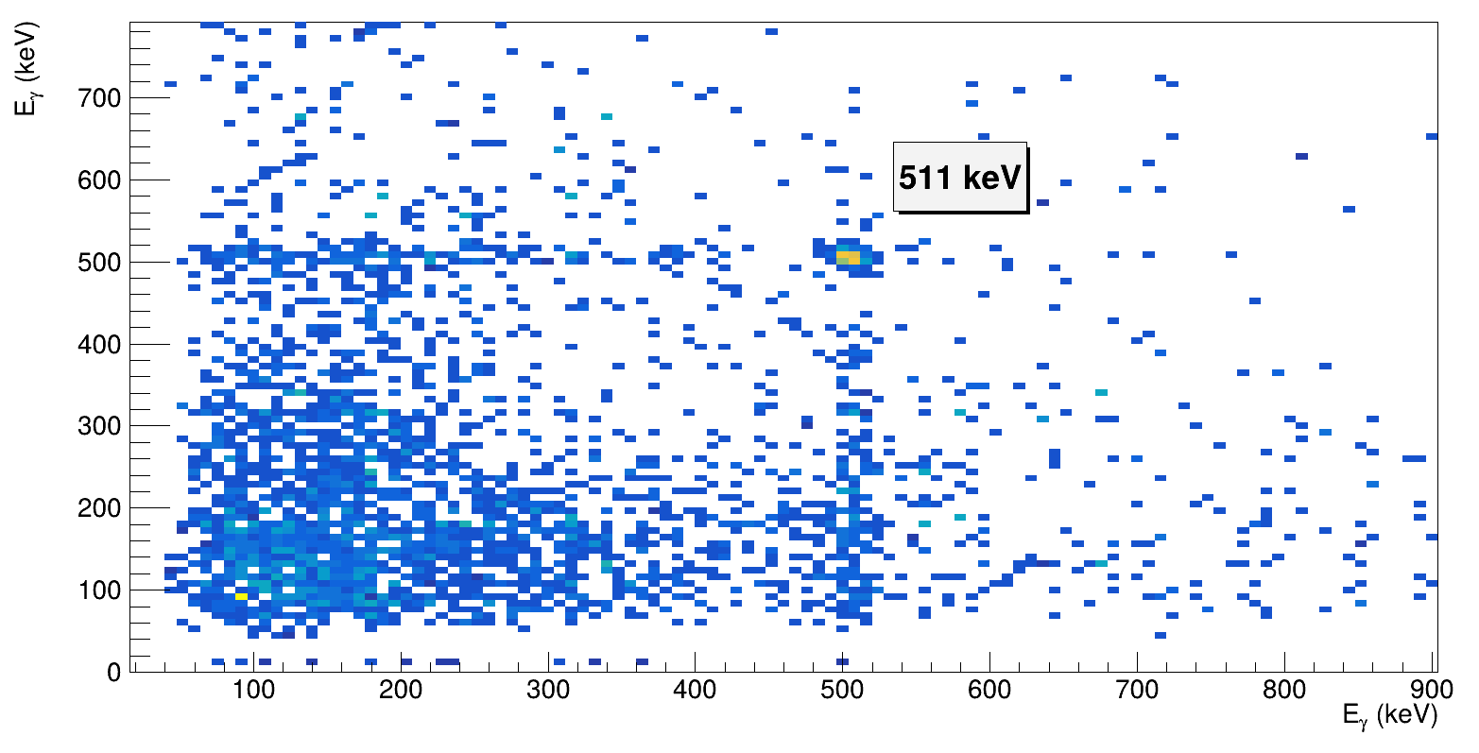
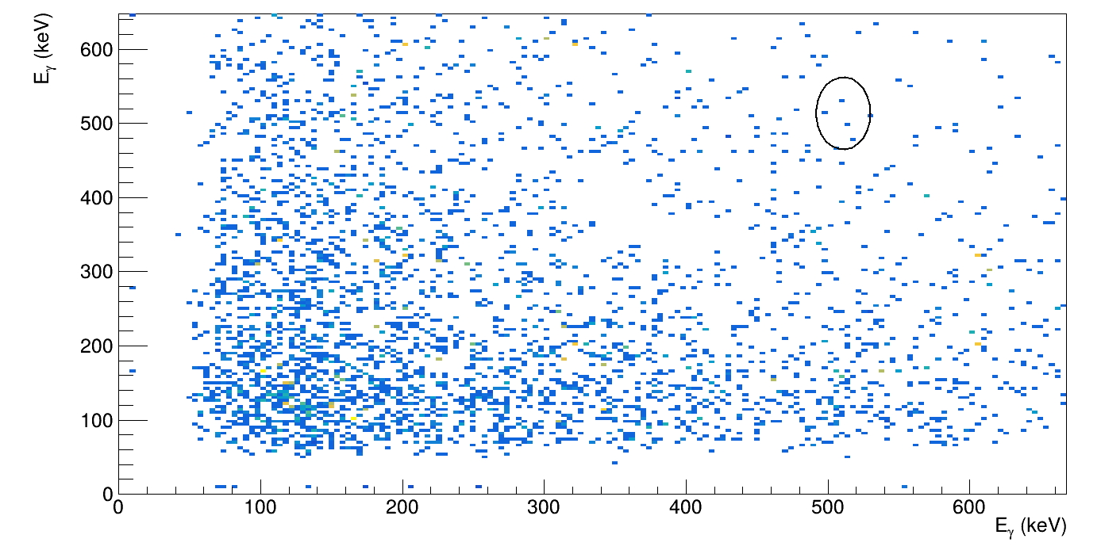
𝛾𝛾 coincidence in LaBr₃ with 𝛃 coincidence
BEAM ON
BACKGROUND
𝛽⁺ emitters with beam, no 𝛽⁺ activity without beam

Slide 21
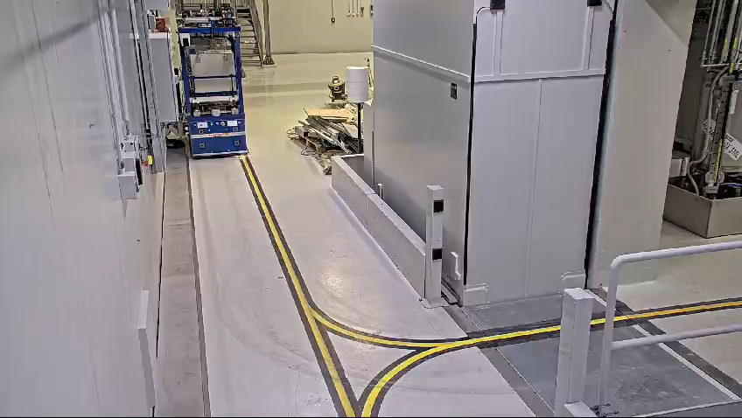
Remote Handling of Target-Ion-Sources ready and tested

Slide 22
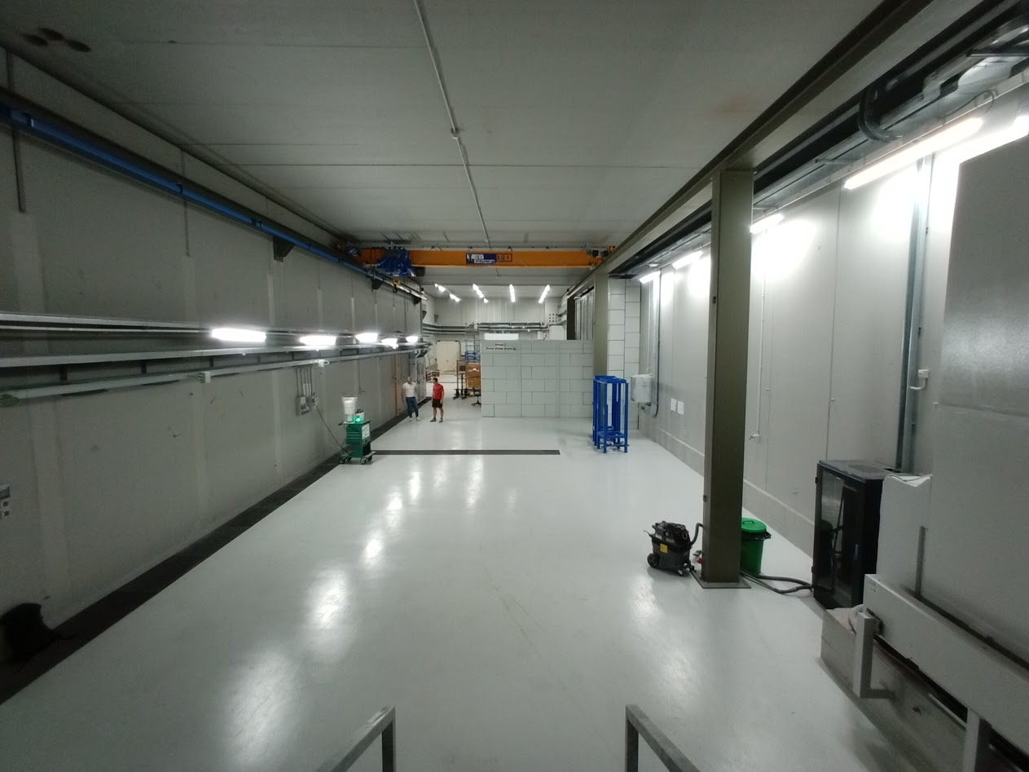
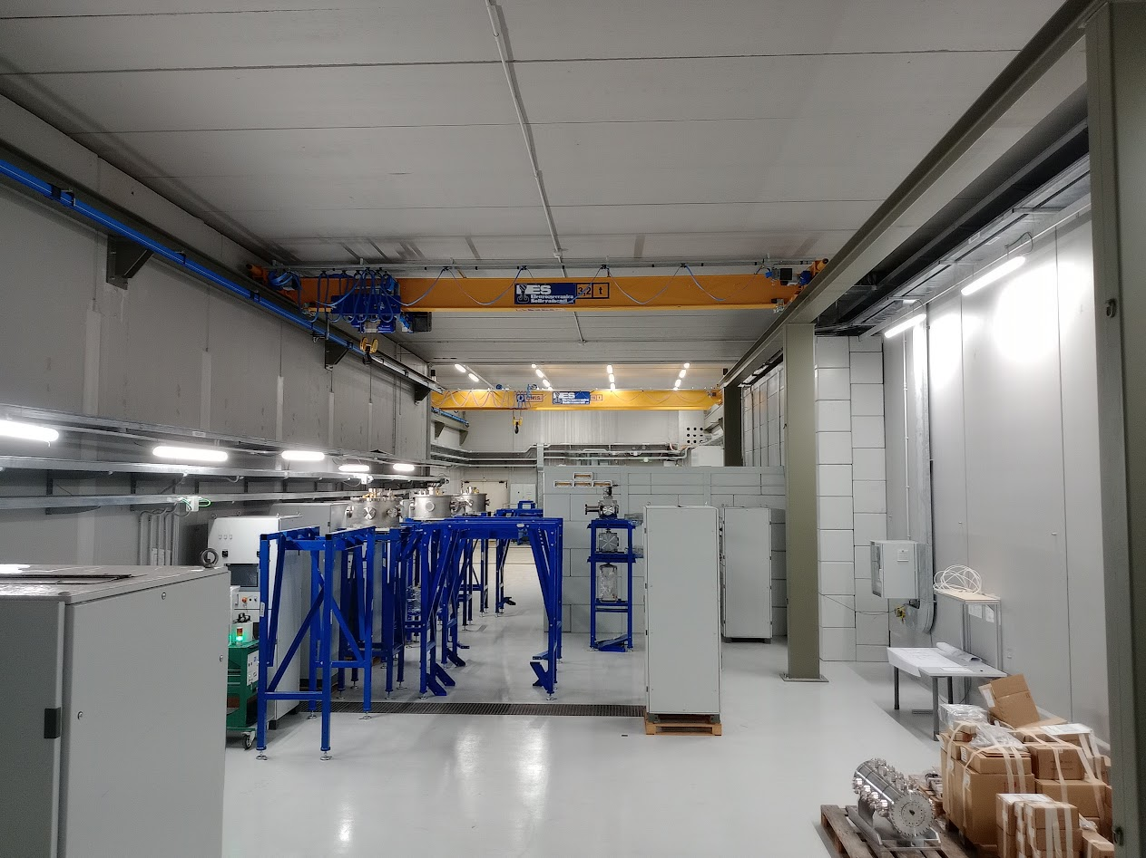
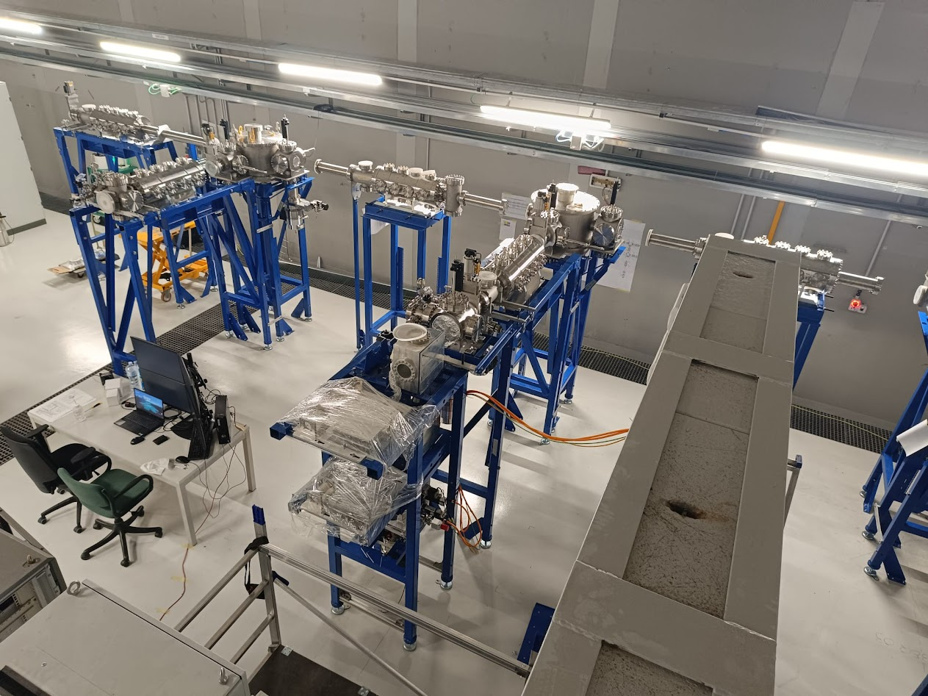
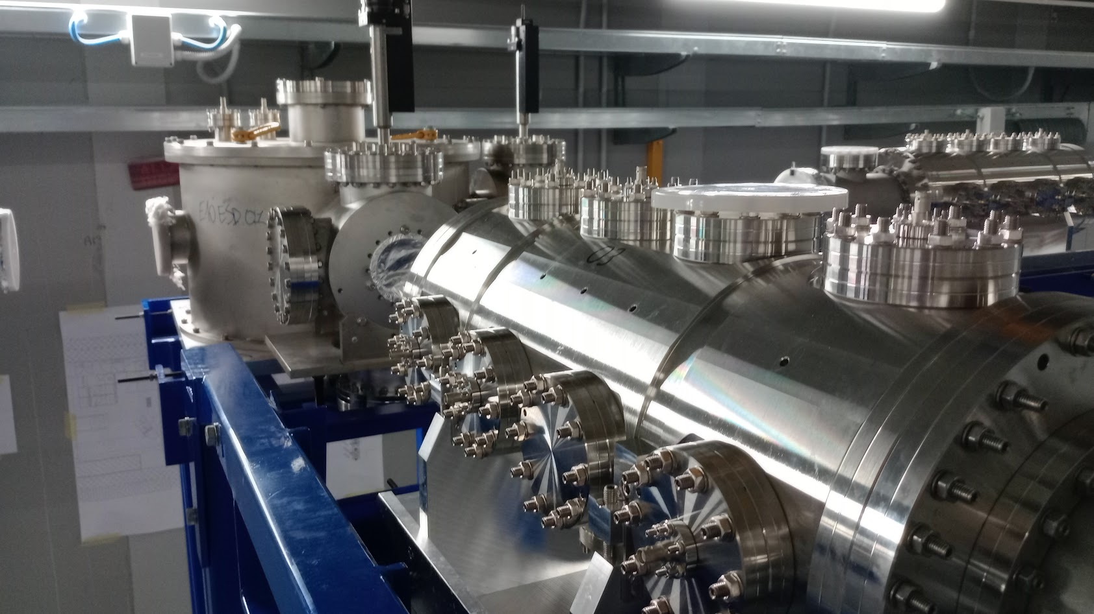
Completion of phase2: full LERIB facility
May 2024
June 2024
July 2024
22

Slide 23
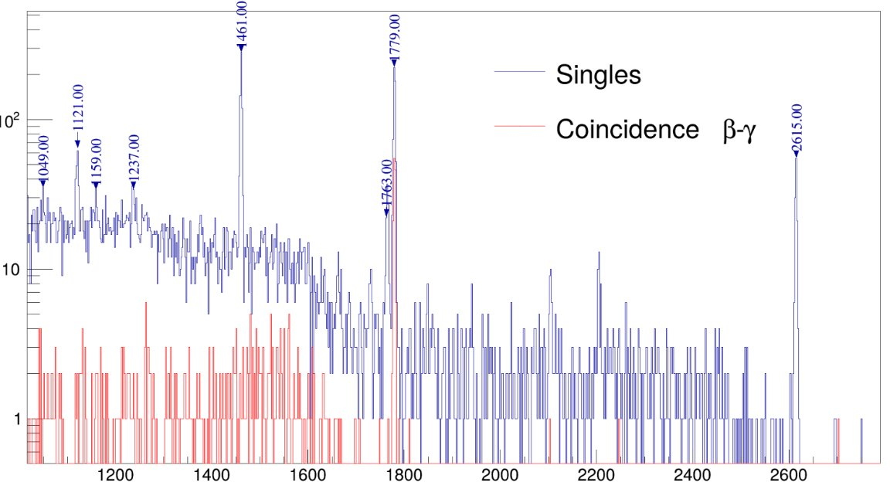


Phase 2 completion: RIB on the tape station
Again on mass 28:
beam
t_{1/2}=2.25 min

Slide 24


Completion of phase2: full LERIB facility
A/q = 29
24

Slide 25





Next steps: Phase 3 - ADIGE charge breeder

Slide 26

4. Phase 3: RFQ
RFQ assembly completed
Vacuum test passed
Bead pull measurements completed
Tuning completed
RF amplifier tested at 200 kW CW.
Couplers under construction
Main plants completed
Local plants to be installed

Slide 27


Phase 4

Slide 28










Phase 5
+$\frac{1}{20000}$
-$\frac{1}{20000}$
+$\frac{1}{20000}$
-$\frac{1}{20000}$
+$\frac{1}{20000}$
1 eV
-$\frac{1}{20000}$
Beam cooler

Slide 29


