Slide 1
ISOL RIB Production
EMIS XX Student Lecture Programme
Whistler, Canada
(Facilities overview will be given tomorrow at 10h30)
João Pedro Ramos
Sunday, 19 Oct 2025

Slide 2
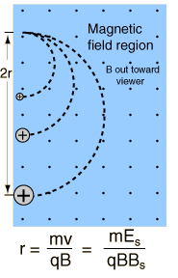


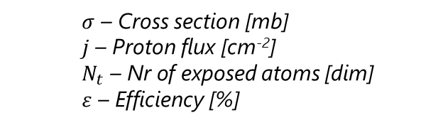
ISOL Isotope Separation
OnLine
Extraction electrode
Extraction optics
Particle
0 V
Mass separator
<60 kV
Ion Source
Target unit
Transfer line
+/- 15V
Energetic particles
1000 A
(on target)
20 cm
up to 2300 °C
Target heating by current and/or beam
+/- 15 V
2400 A
(on converter)
1. Production
4. Ionization
$$Beam Int.=σ.j.Νt.ε$$
2. Diffusion
5. Mass Separation
$$ε={ε_{diff}ε}_{eff}{ε_{is}ε_{sep}ε}_{trans}$$
$σ$ – Cross section [mb]
$j$ – Proton flux [cm⁻²]
$N_{t}$ – Nr of exposed atoms [dim]
$ε$ – Efficiency [%]
3. Effusion
6. Transport

Slide 3
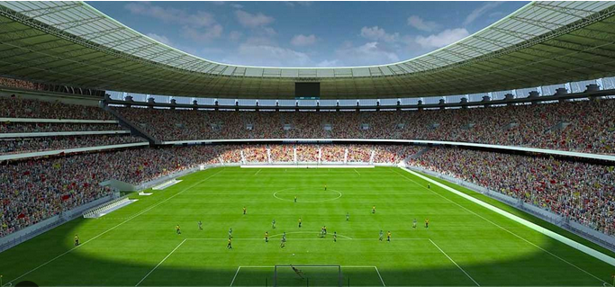
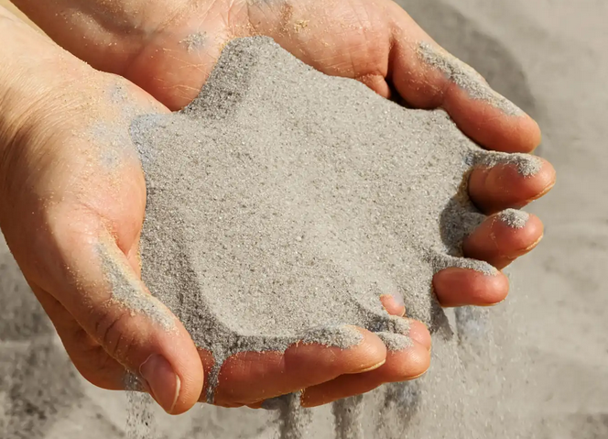
Efficiency is key!
1 proton on target
~1 isotope created
(order of magnitude)
pico – 10⁻¹²
femto – 10⁻¹⁵
atto – 10⁻¹⁸
Target (U/Th)
RIB of interest
All production
~0.5 mol
~10²³ atoms
1 µA p+
~6 pmol/s
~10¹² atom/s
~0.2 fmol/s
~10⁸ atom/s
~0.2 amol/s
~10⁵ atom/s
(6x10¹²)
(to extract!!)
Sand:
8 – 15 billion grains per m³
Let’s fill it with sand!
Full stadium has now:
10¹⁶ – 10 quadrillion grains of sand
Now we need hope that 1 specific grain of sand gets out of the stadium by heating it up to 2000°C!
Typical football stadium. Inner volume ~ 1 million m³
(corresponds to an isotope with an in-target production of ~10⁷ /s=16 amol/s)

Slide 4
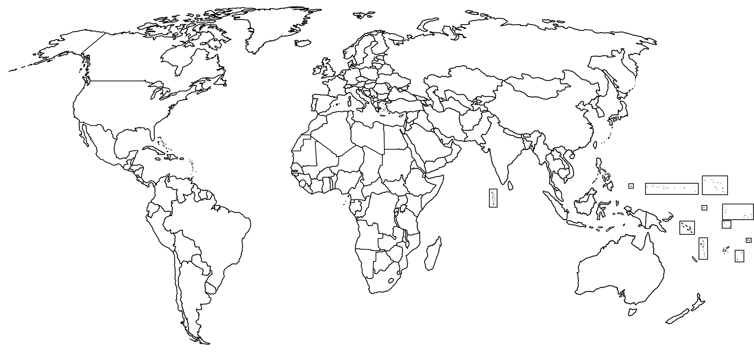

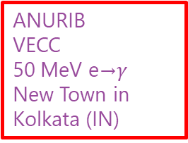
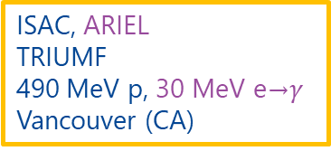
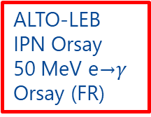
ISOL Facilities Worldwide
Operational
Future
Gas catcher
Heavy ion
Reactor
e→$γ$
Legend:
p⁺ High energy
p⁺ Low energy
Offline RIB (operational)
RISIKO
UNI Mainz
External sources
Mainz (DE)
IGISOL
UNI-JYFL
30 MeV p, 14 MeV d,
HI < 130 MeV/u
Jyväskylä (FI)
IRIN-PIK reactor
PNPI
n (3×10¹³ n/(cm² s)
St. Petersburg (RU)
IRIS
PNPI
1 GeV p
St. Petersburg (RU)
SPES
INFN-LNL
40 MeV p
Legnaro (IT)
BISOL-CARIF reactor
CIAE
n (8 × 10¹⁴ n/(cm² s)
Beijing (CN)
TRIGA Reactor
UNI Mainz
n (1.1×10¹¹ n/(cm² s)
Mainz (DE)
BRIF
CIAE
100 MeV p
Beijing (CN)
ISAC, ARIEL
TRIUMF
490 MeV p, 30 MeV e→$γ$
Vancouver (CA)
ISOL RAON
IBS
70 MeV p
Daejeon (KR)
CARIBU
Argonne National Lab
²⁵²Cf sf
Lemont (US)
ANURIB
VECC
50 MeV e→$γ$
New Town in Kolkata (IN)
Spiral, SPIRAL-II
GANIL
HI <95 MeV/u ,40 MeV d, 33 MeV p, 14.5 MeV/u HI
Caen (FR)
ISOL@MYRRHA
SCK CEN
100 MeV p
Mol (BE)
ALTO-LEB
IPN Orsay
50 MeV e→$γ$
Orsay (FR)
LERIB
iThemba LABS
70 MeV p
Cape Town (ZA)
ISOLDE
CERN
1.4 – 1.7 GeV p
Geneva (CH)
MEDICIS
CERN
1.4 GeV p and
external sources
Geneva (CH)
TATTOOS
PSI
590 MeV p
Villigen (CH)

Slide 5
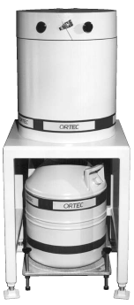

Why radioactive ion beams?
Detection:
low radiation background
Production:
high radiation environment
primary
beam
target
Speed (approx.)
Transport methods:
carry (“SRAFAP”)
drive (G.T. Seaborg and W.D. Loveland, The Elements beyond Uranium, John Wiley & Sons, 1990)
transport shuttle with pressurized air
transport in gas-jet
pump through vacuum system
send as ion beam
10 m/s
50 m/s
100 m/s
1’000 m/s
1’000’000 m/s
[SR22,UK06]
Slide courtesy of S. Rothe and S. Stegemann

Slide 6
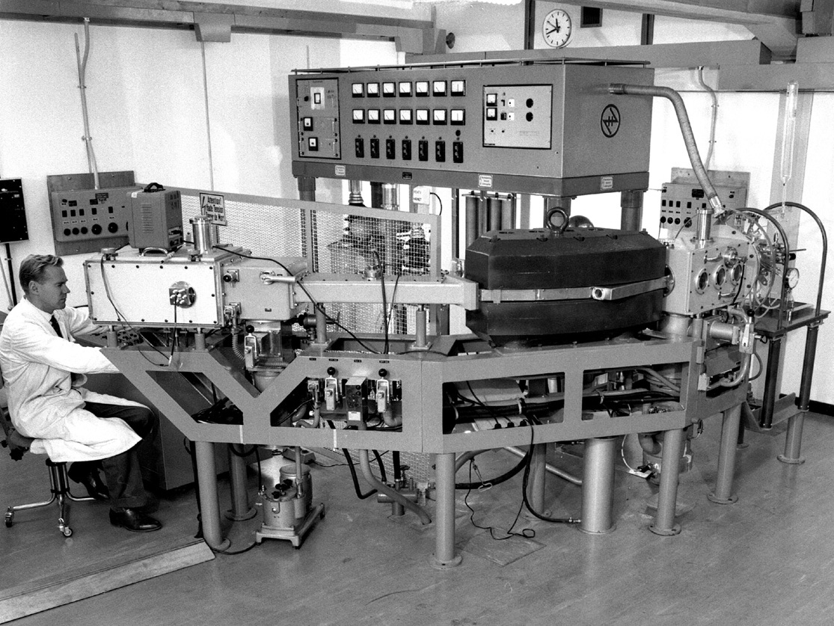
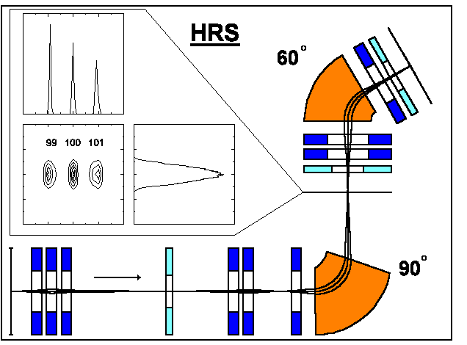
ISOL-history: off-line mass separation
Ionization to typ. q = 1+
Acceleration to e.g. 60 keV
Mass selection by magnetic deflection (Lorentz force)
( Bρ = p/q ∝ √A )
Position y
Position x
[SR22,UK06]
Slide courtesy of S. Rothe and S. Stegemann

Slide 7
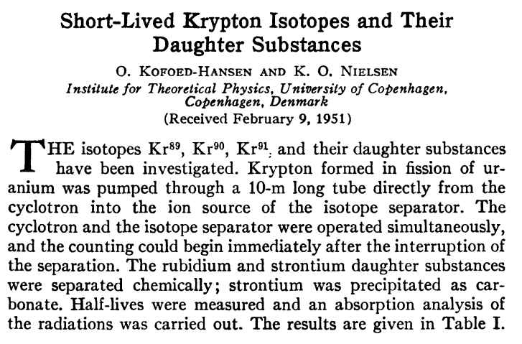
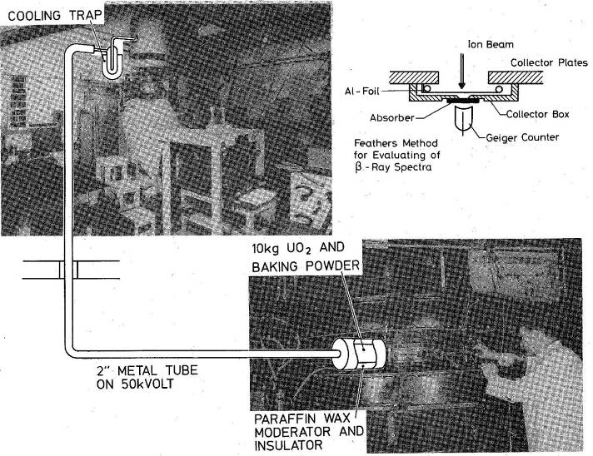
ISOL-history: first ISOL experiment at Niels Bohr Institute
ISOL beams of ⁸⁹⁻⁹³Kr
Slide courtesy of S. Rothe and S. Stegemann
[UK06, TDG17, SR22]
O. Kofoed-Hansen and K. O. Nielsen, Phys. Rev. 82 (1951)

Slide 8





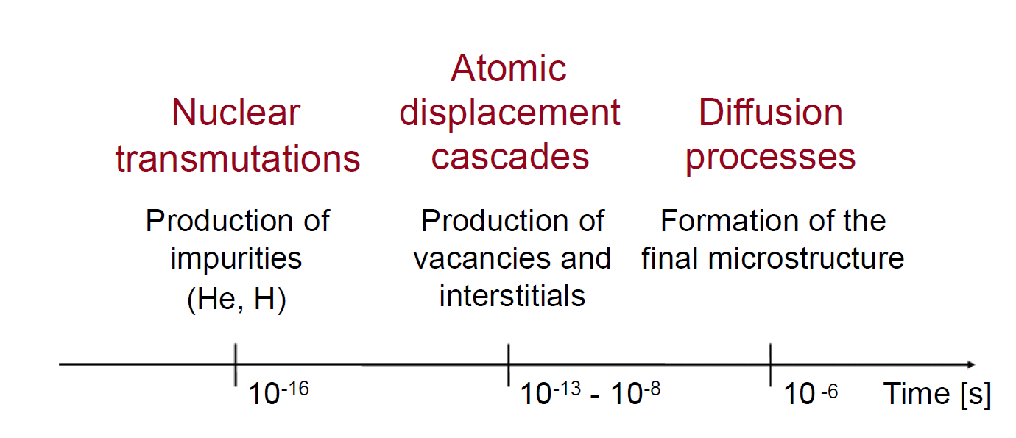
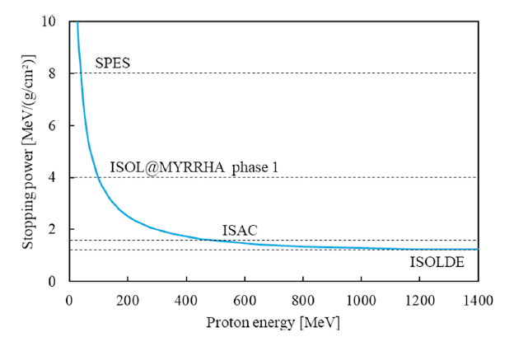
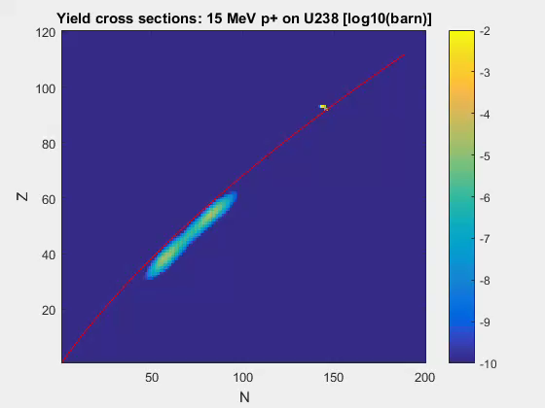
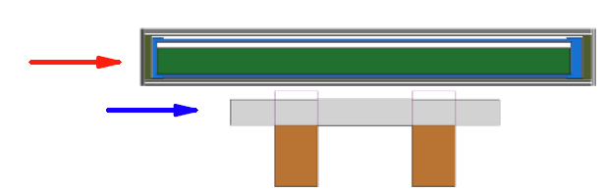
Production: Primary beam
Computational codes are typical tools used to estimate in-target productions (e.g. FLUKA)
ISOL@
Protons, electrons and (heavy) ions are typical primary beams
1.4GeV p⁺ – 2 μA
35 MeV e⁻ – 2.8 mA
95 MeV/u or 40 MeV d⁺ – mA
40 MeV p⁺ – 200 μA
2.8 kW (1.2 GW)
100 kW
(6 kW)
200 kW
8 kW
W
High Z material (Ta)
Fast neutrons
Bremsstrahlung photons
Ratio of cross sections at 100 MeV vs 1GeV
Induce fission in U
(p,nx): 15x
Isobarically pure n-rich fission products
(p,f): 3x
L. Popescu, et al., DOI: 10.1016/j.nimb.2019.05.023

Slide 9
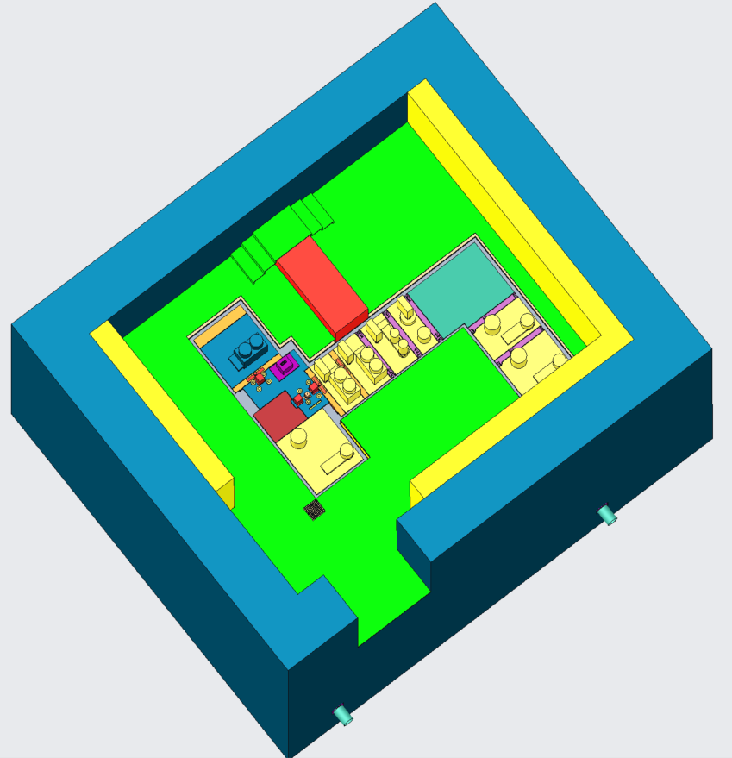
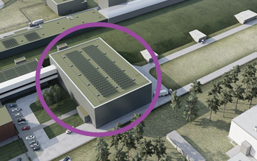
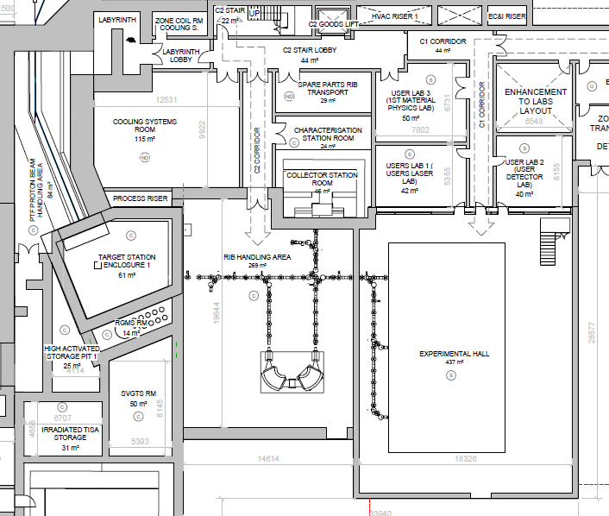
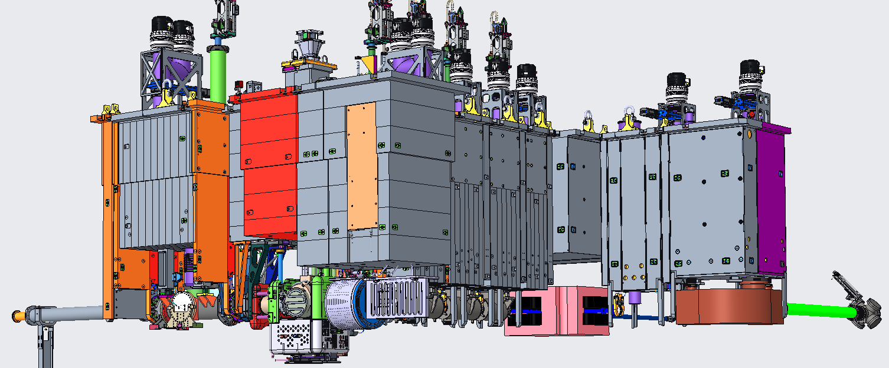
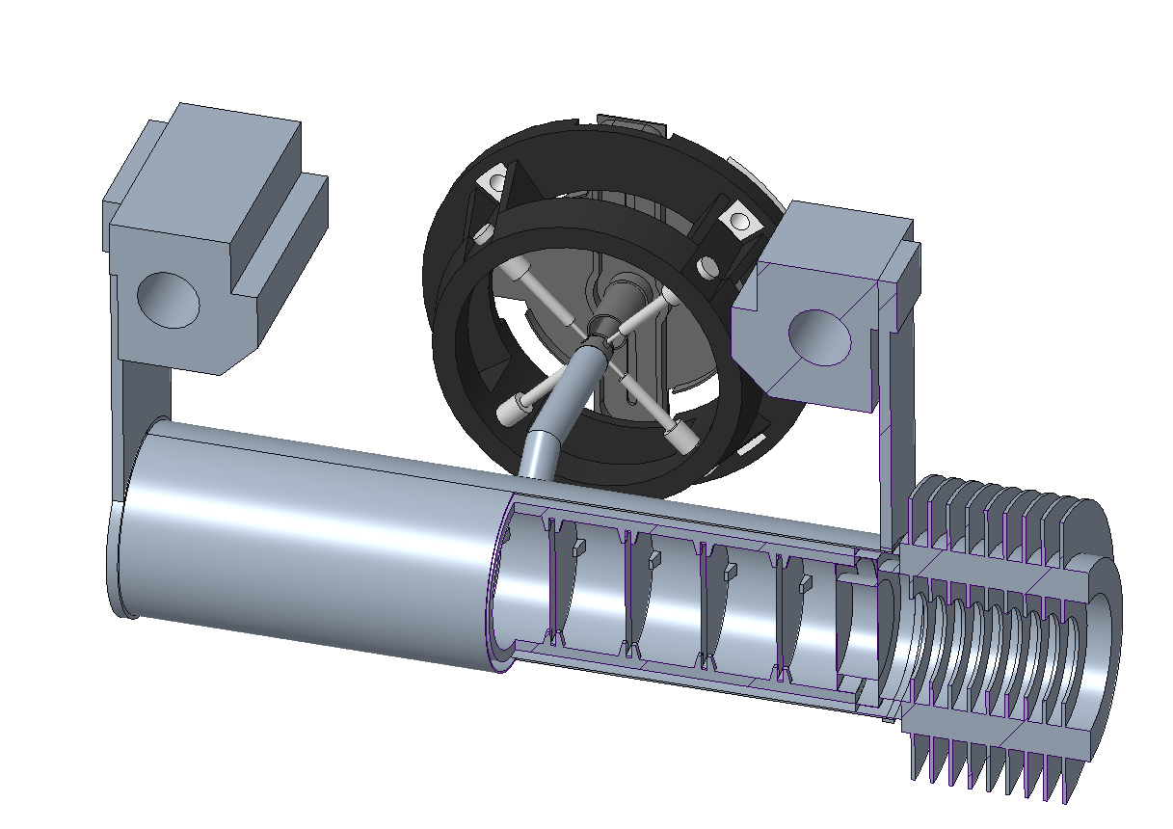
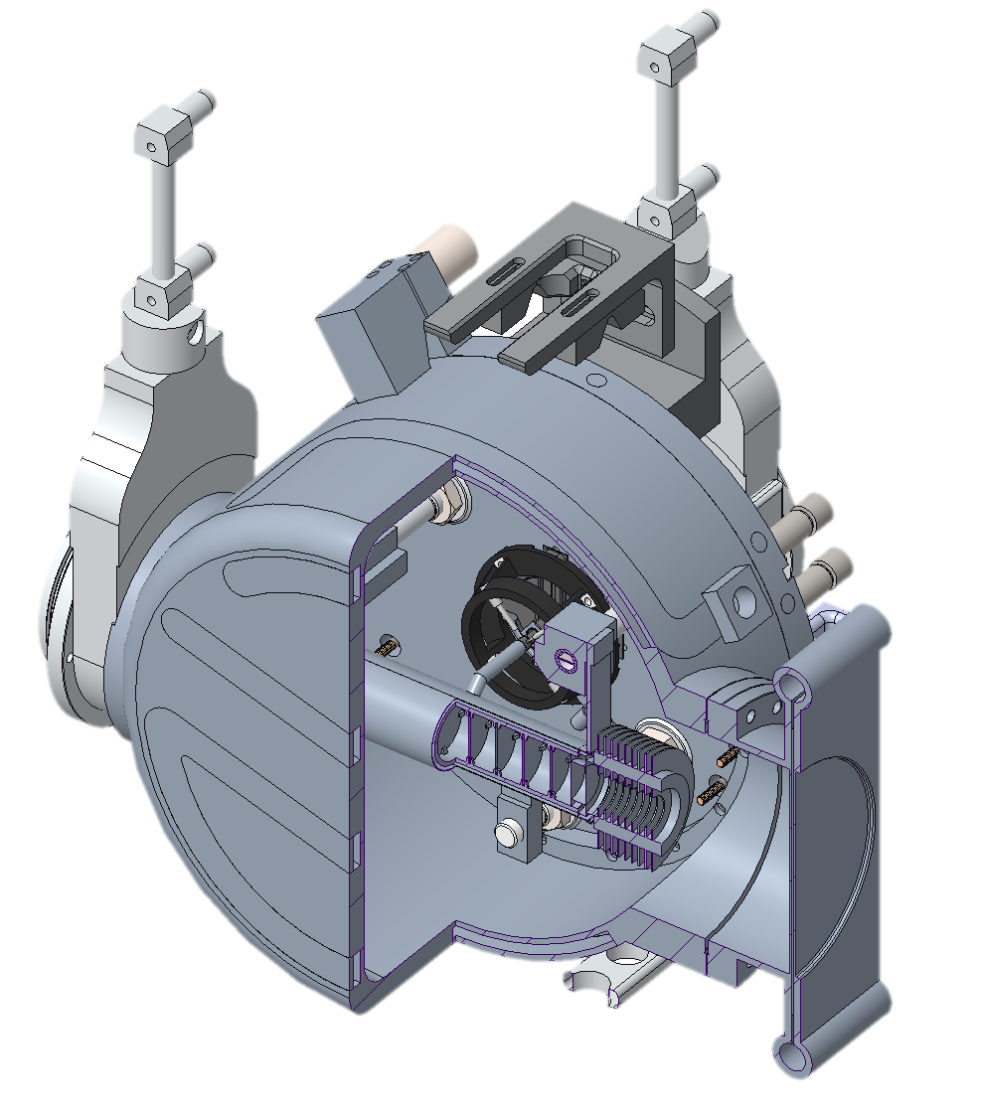
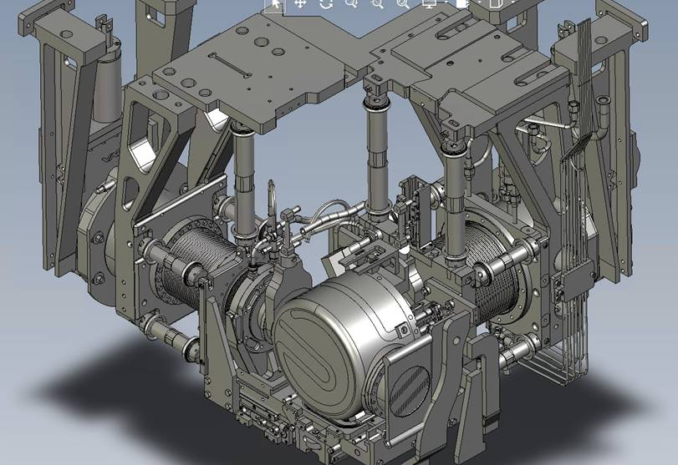
Proton beam
Let’s zoom into
ISOL@
Radioactive Ion Beam
*courtesy of A. Atherton and D. Atanasov
*courtesy of S. Hurier, D. Houngbo, K. Rijpstra
*courtesy of P. Creemers

Slide 10
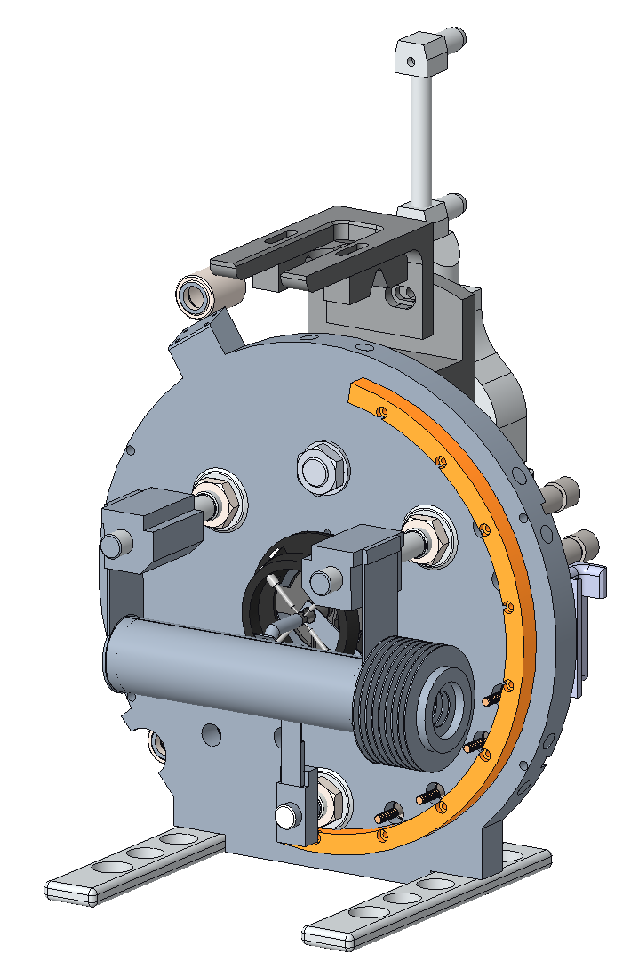
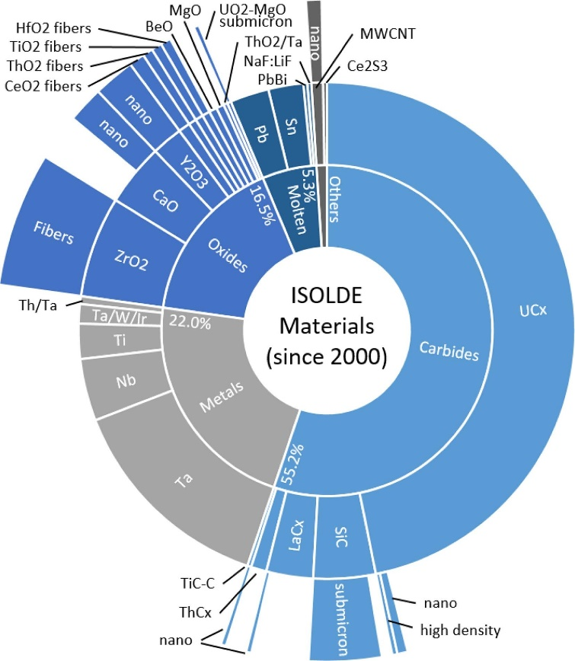
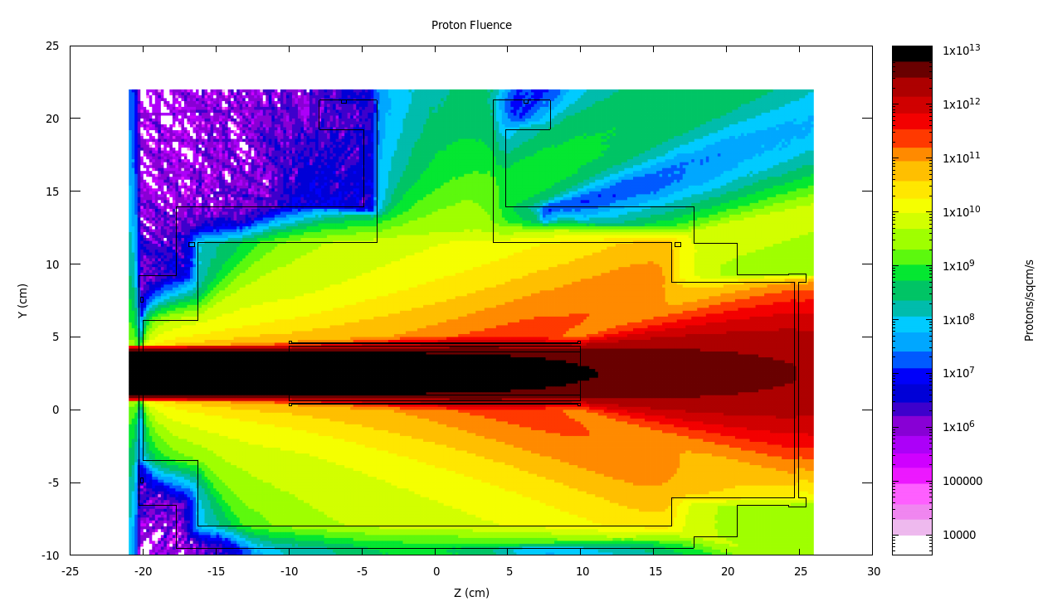
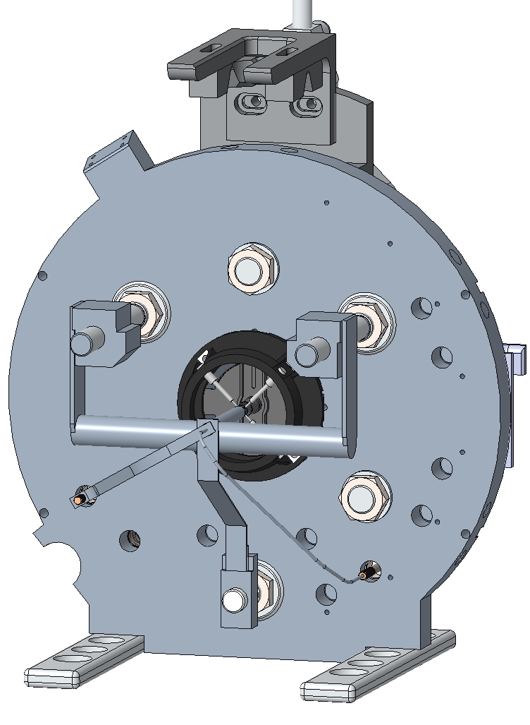
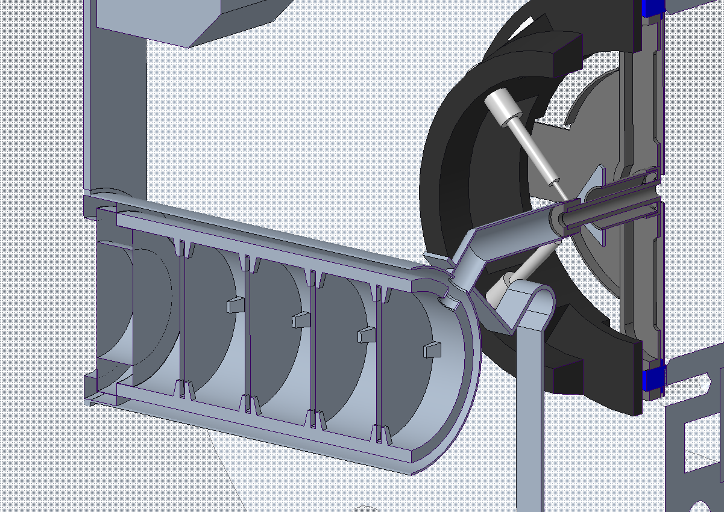
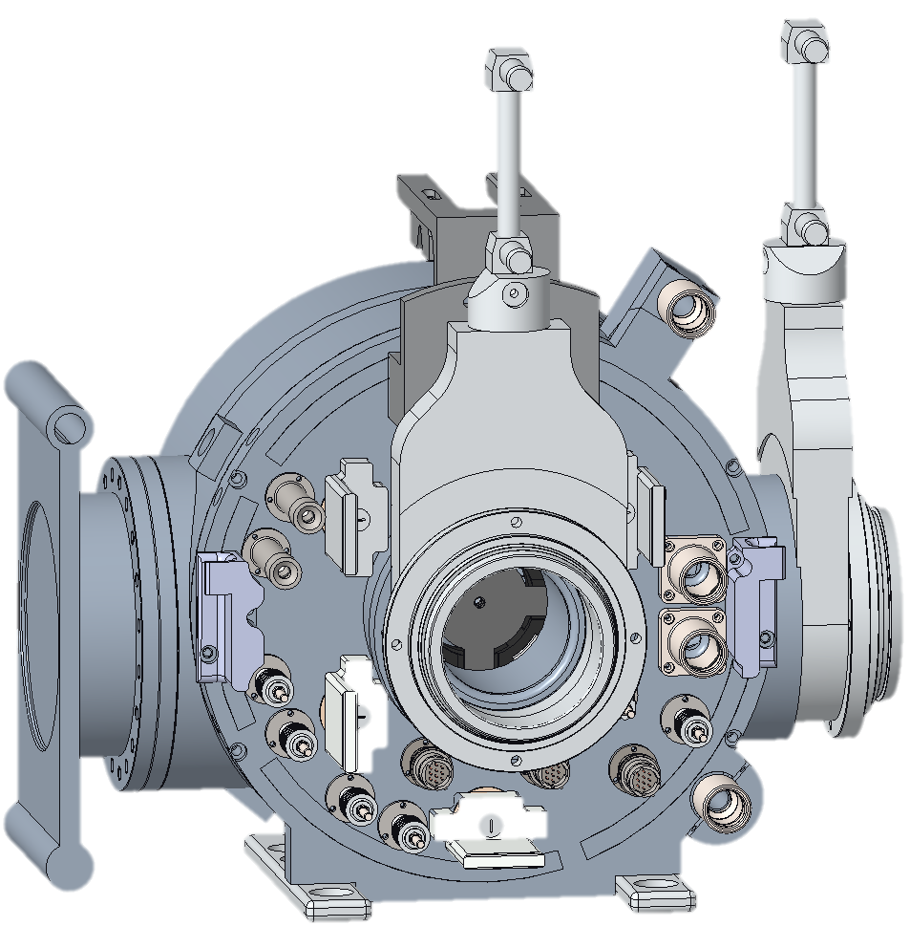
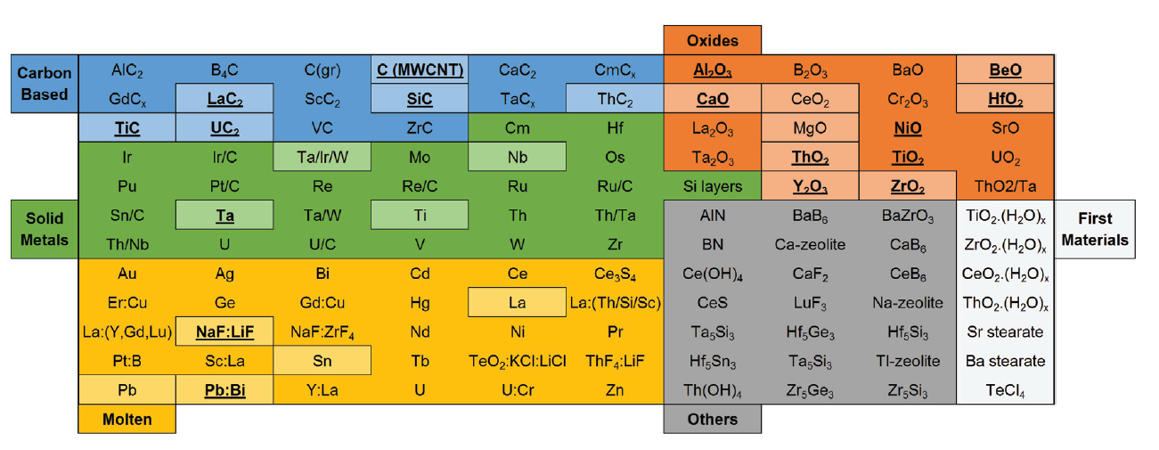
The Target Ion Source – variety of target materials
Top view – proton fluences
J.P. Ramos, NIM B 463 (2020)
Target and Ion Source Assembly
ISOL Target Materials tested so far
In a box: currently used
Underlined/bold: materials development
A. Gottberg, DOI: 10.1016/j.nimb.2016.01.020
J.P. Ramos, PhD thesis

Slide 11


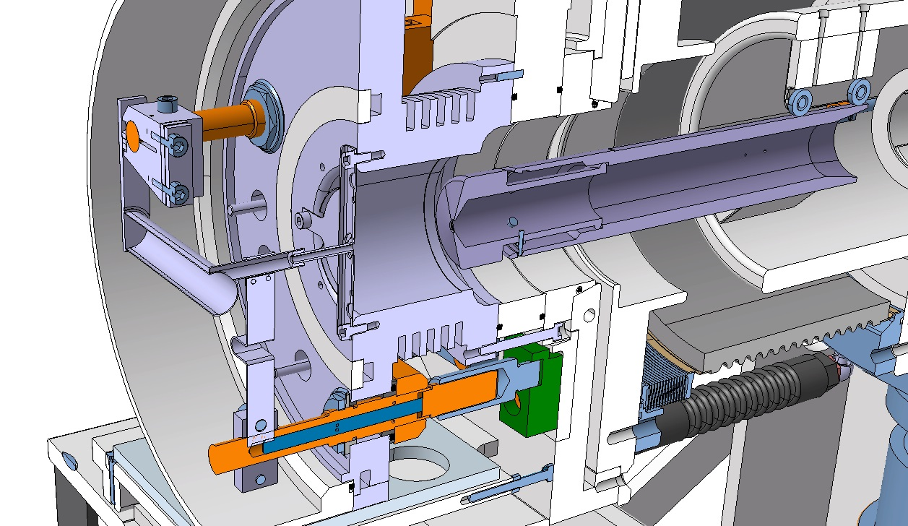
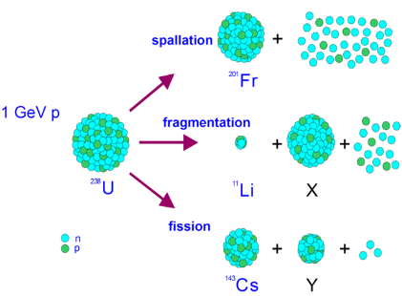
Target Unit – Heart of
Primary beam
Radioisotopes
Beam power
2.8 kW in average
1.2 GW (pulse length 2.3 μs)
  ~10% deposited
Ions
What is the sound of proton impact on target?
Vacuum
spallation
Air
1.4 GeV
proton
²⁰¹Fr
fragmentation
¹¹Li
²³⁸U
fission
X
*picture and animation courtesy of M. Delonca
¹⁴²Cs
Y

Slide 12
Targets

Slide 13
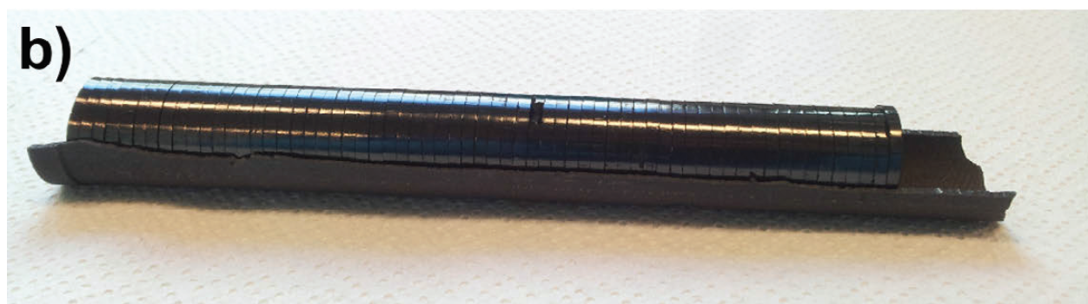
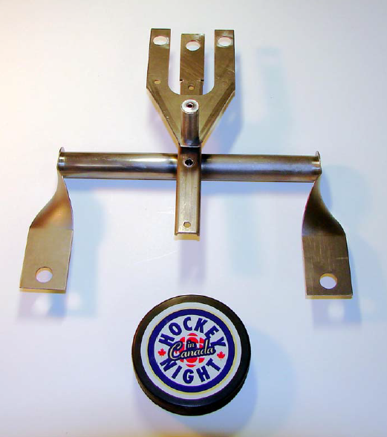
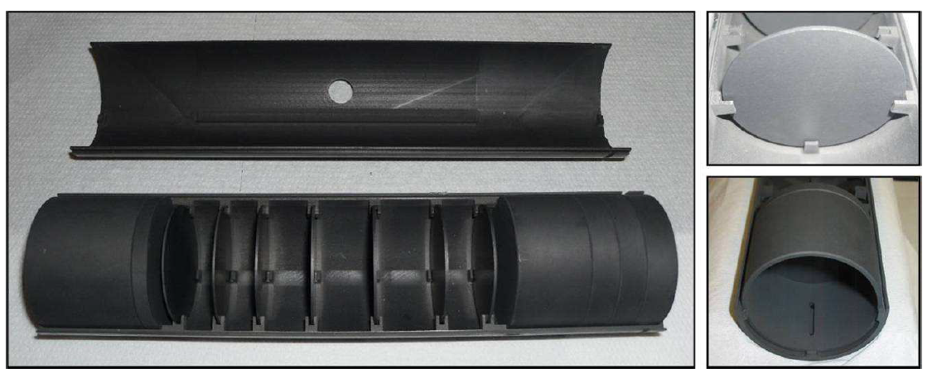
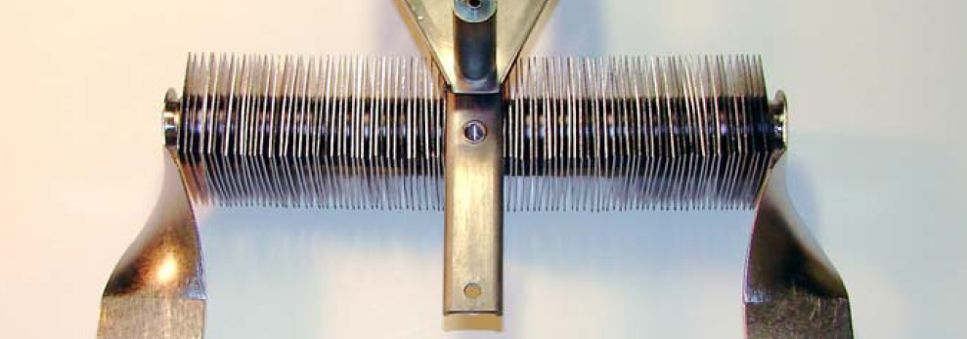
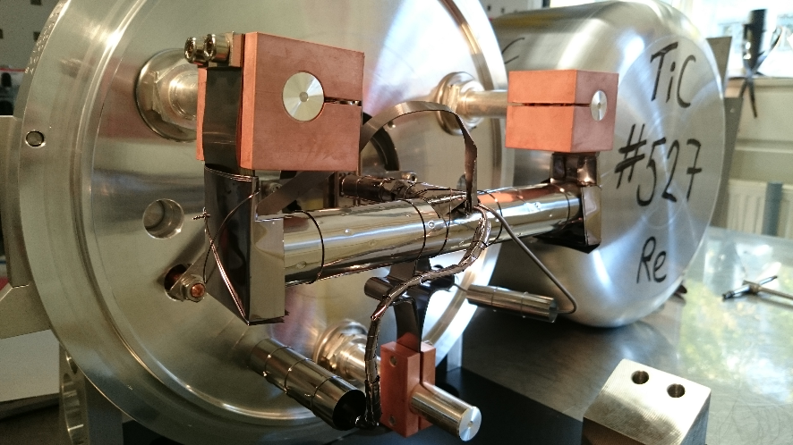
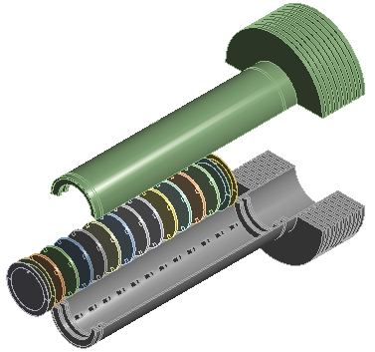
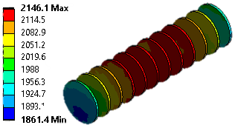
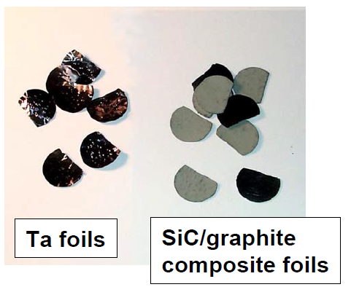
ISOL Targets
High Power Targets
ISOLDE - Low Power <300 W
ISAC Targets
ISOL@MYRRHA / SPES
TiC nano, J.P. Ramos, PhD Thesis
SPES target, M. Manzolaro, PhD Thesis
High Power
Target PTF, D. Houngbo
  Compact assembly of disks
  High energy beams (1.4 GeV) – very low energy loss/deposited
  Target needs to be heated with an oven
Stacked Ø 2 cm coated graphite foils to conduct heat away.
Need to be cooled
Complex and “dirty” fabrication procedure (pollute targets with many contaminants, long conditioning)
  Very high deposited power densities
  Needs to be cooled – radiative cooling
  In development – yet to be proven technology

Slide 14
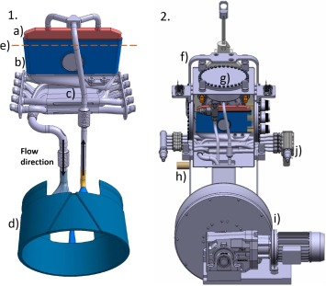
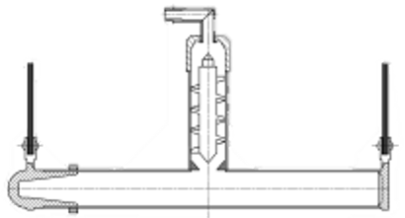
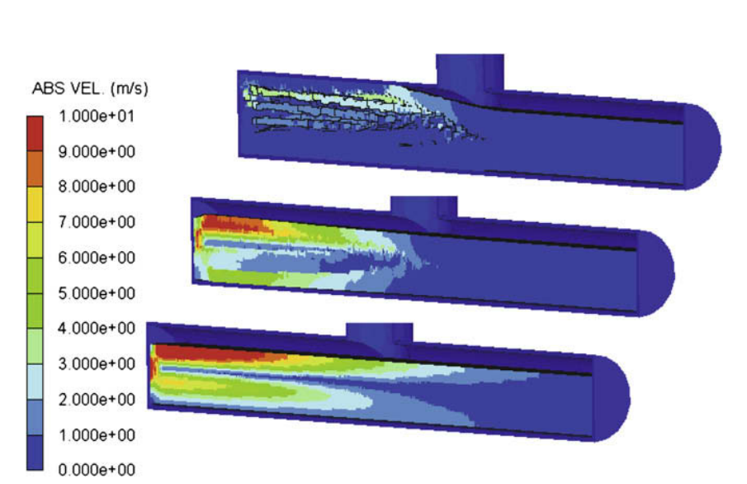
Liquid targets
Targets can also be liquid metals or salts (ISOLDE)
High density but slow diffusion times (cm instead of µm)
High vapor pressure needs usage of chimneys to condense targe material
Pulsed beams creates shockwaves
LIEBE target tested offline to create a LBE (Lead Bismuth Eutectic) loop and a shower of droplets
E. Noah et. al DOI: 10.1016/j.nimb.2008.05.051
F. Boix Pamies et. al DOI: 10.1016/j.nimb.2019.06.043

Slide 15
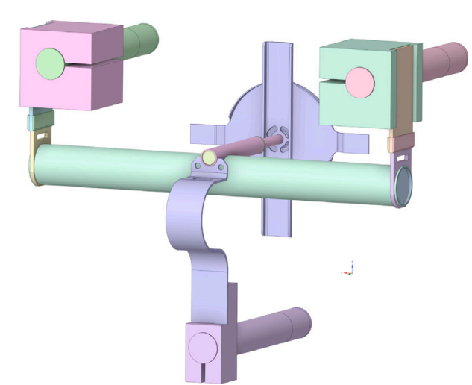
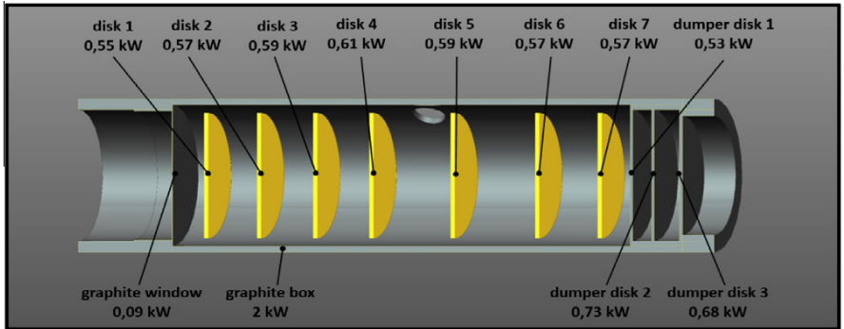
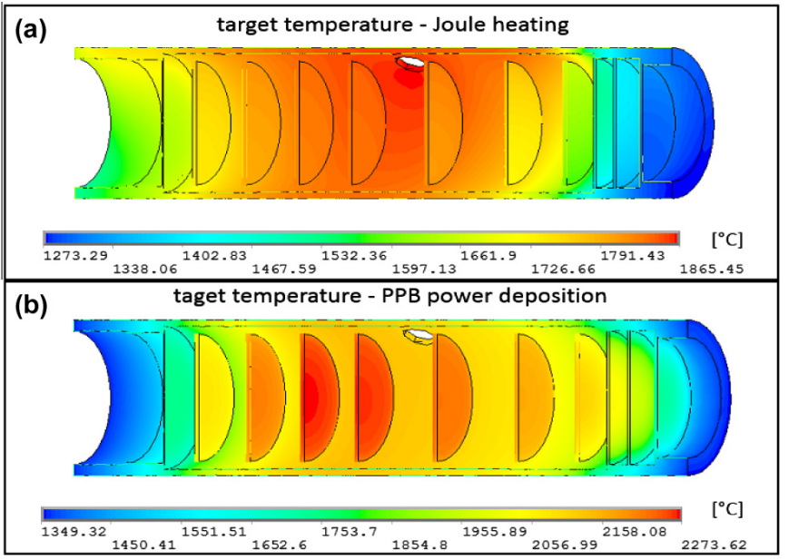
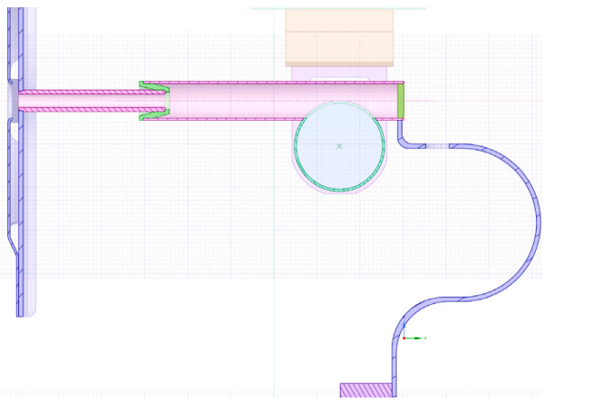
Temperature homogeneity importance
High Power – Ohmic + beam heating optimization!
Dy yield increased from around 1% to ~24%!
Low Power – Ohmic heating optimization!
S. Rothe et. al doi: 10.1016/j.nimb.2016.01.038
M. Ballan et. al doi: 10.1016/j.nimb.2016.01.038

Slide 16
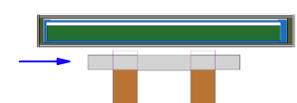
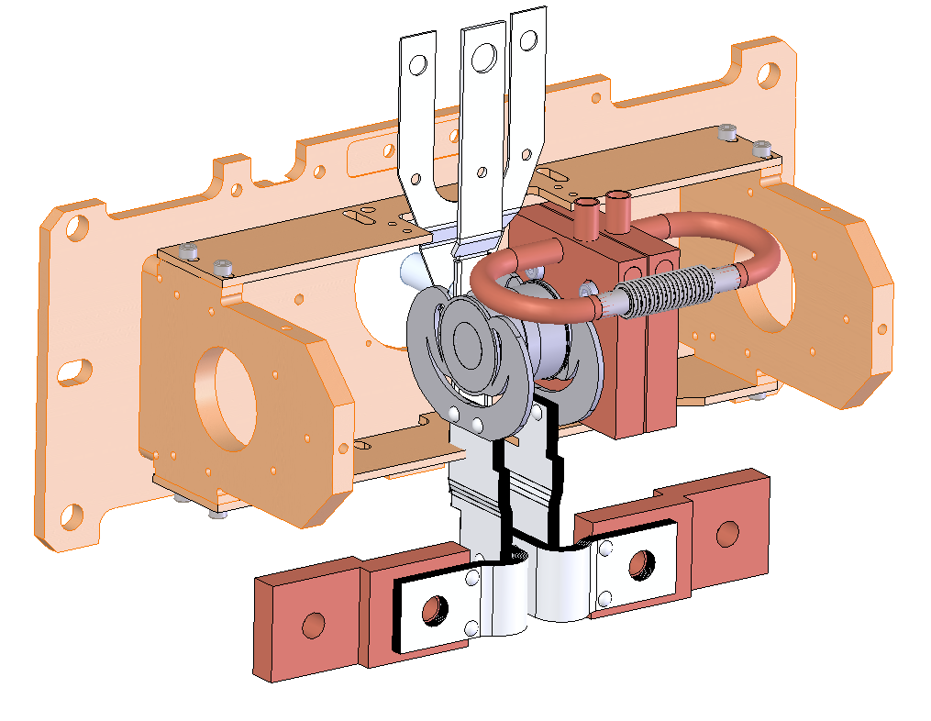





Converter targets
_{Graphite sleeve}
Tantalum container and legs
Converter Assembly
Target assembly at 2000 ºC
100 µA protons
Annular UC_{x} target material
100 µA protons
Axial screws & spring washers
J.P. Ramos, doi: 10.1016/j.nimb.2019.04.060
Tungsten converter
100 µA protons
Water cooled fins
Heating current OUT
Water cooled copper
Heating current IN
100 kW,
35 MeV electrons
(range ~ 5 mm)
L. Egoriti, A. Gottberg, HPTW 2018
A. Gottberg, HPTW 2018

Slide 17




Gas catcher and fragmentation
IGISOL U238 or Th232 target – 30 MeV p+ beam
Fragments are stopped in 200-500 mbar of He, but remain charged. They are transported by the He to the extraction optics for acceleration.
Y. Blumenfeld, et al. DOI: 10.1088/0031-8949/2013/T152/014023
P. Chauveau, S. Hurier, et al.

Slide 18


Target material influence on RIB intensity?
Very often
However during operation
Arrhenius dependence of effusion and diffusion with temperature
or even low from the beginning
Expected beam intensity
35Ar (1.78 s)
Targets are traditionally operated at very high temperatures (close to the materials melting point)
32Ar (98 ms)
31Ar (15.1 ms)
Target material degradation
Melting/Sublimation
Sintering
Grain size increase
Reduction of porosity

Slide 19


What is sintering?
Temperature - time
The smaller the particle size (larger surface area) the higher the sintering driving force
!
Main reason why nanomaterials were discarded in the past for ISOL target application
Micrometric materials
0.5 to 0.8T_{m}
Sintering temperature (densify):
Defined in function of the material melting point (T_{m})
Nanomaterials
0.2 to 0.4T_{m}
!
Sintering can be affected by irradiation (defect creation)

Slide 20
Target material influence on beam intensity?
In most cases ${ε_{diff}ε}_{eff}$limit by far the yields.
Time
Can we stabilize porous nanostructures at high temperatures?
Unique in the literature
Needs R&D
1
4
3
2
Nano materials sinter faster
Reduce operation temperature to stabilize
Diffusion/Effusion
Diffusion limited release:
$$λ ≤2μ$$
$$ε_{diff}=\frac{3}{π}\sqrt{\frac{μ}{λ}} ,μ=\frac{π^{2}D}{r^{2}}$$
r /10
$ε_{diff}$x10
Same T!
1 μm
Operation T
Grain size/Porosity
10x smaller!
Porous nanomaterials campaign started ~15 years ago (ISOLDE is 55 years old)
  Shorter diffusion lengths
  Higher porosity
100 nm
Diffusivity
(rate of diffusion)
t_{1/2} = 1 s
1s – 50%
2s – 25%
3s – 12.5%
4s – 6.25%
Diffusion lengths
Assess microstructure stability

Slide 21








How to develop a new target material?
ABRABLA
FLUKA
Refractory materials!
Identifying suitable target nucleus
and target chemical compound
Engineering desired
microstructure
Stabilizing microstructure at high temperature and high-power irradiation
2-5 years per material
Post-irradiation material analysis
Online tests
Studying diffusion and release properties
Protons
Slide adapted from A. Gottberg
Post irradiation pictures: S. Fernandes, J. Nucl. Mat. 416 (1-2), 99-110 (2011)

Slide 22
Material characterization techniques
Thermal techniques
Thermal treatments
Dilatometry
Residual gas analysis
Differential thermal analysis
Thermogravimetric analysis
Pore size distribution (micro, meso, macro)
Particle size (distribution)
Mass losses (temperature)
Elemental analysis
Linear shrinkage
Morphology
Grain size
Phase composition and changes
Crystallite size
Lattice parameters
Specific surface area
Isotope release properties
Microstructure
Scanning Electron Microscopy
Nitrogen adsorption
Mercury intrusion porosimetry
Laser diffraction particle size distribution
Phase and elemental composition
Energy Dispersive X-ray Spectroscopy
X-ray powder diffraction
X-ray photoelectron spectroscopy
Carrier gas hot extraction analysis
Combustion analysis with IR spectrometry
Radioactivity/online
Tapestation (ISOLDE facility)
Gamma spectroscopy
Dedicated physics experiments

Slide 23


Let’s keep zooming in! Into the microstructure…
“There is plenty of room at the bottom”! R. Feynman
…At ISOL@MYRRHA we span almost 10 orders of magnitude!
200 nm
660 nm
0.67 mm
100 μm
2.0 μm
200 x
20 μm
31 x
100 000 x
10 000 x
30 000 x
1 000 x

Slide 24


TRIUMF (non-)irradiated UCx analysis
About small 6 samples of uranium carbide sent to SCK CEN
  Both irradiated and non-irradiated
  Very radioactive samples (reduced size), also UC_{x} is pyrophoric
At TRIUMF… Sample preparation and extraction in hot cell (not in picture)
At SCK CEN… preparation of lamella
M. Cervantes et al. – To be published
MNA, NMS (Microstructural and Non-destructive analysis)
FMA, NMS (Fuel Material)

Slide 25


TRIUMF (non-)irradiated UCx analysis
Drastic changes are seen after irradiation.
Non-irradiated
Irradiated
Preliminary
Preliminary
MNA, NMS (Microstructural and Non-destructive analysis)
FMA, NMS (Fuel Material)
M. Cervantes et al. – To be published

Slide 26








Example of the B beams
870 ¹²BF₂⁺ / µC measured in IDS later
Measurement
Prediction
6.4 E+04
5.1 E+02
2 E+00
/ μC
Melting point 2070 °C
Boiling point ~4000 °C
Not extractable due to fixed efficiencies*
Reacts with other elements to form refractory compounds
0.15%
Half-life losses during release
Extracted yield
per μC of proton beam
1.7%
Injection of CF₄ or SF₆
0.0026%
Formation of BF_{x}
*not depending on half-life: ionization eff., molecular formation eff., etc.
Yield =
N₀
ε_{release} (T_{1/2})
ε_{form}
ε_{ion} ε_{other}
4352.1 m²
> 60% Football field
Specific Surface Area
293.1 m²/g
14.85 g of MWCNT
Area 7140 m² (68 x 105 m) – FIFA recommendation
J. Ballof, EMIS2018, PhD thesis & http://doi.org/10.1140/epja/i2019-12719-1

Slide 27




Example of the B beams
Online release curve fitted with release model
measured on ⁸B and corrected for decay
Release Efficiency: Fraction of isotopes not decayed before release
Yield =
N₀
ε_{release} (T_{1/2})
ε_{form}
ε_{ion} ε_{other}
1. Diffusion in the solid
Slow process
Was investigated in offline experiments
Long heat treatment times necessary ~ 30 min
Simple model: Fick‘s 2nd law
Characteristic diffusion time τ_{D} = 862 s
2. Effusion through open space
Fast process
Best investigated online
Model for release of a stable isotope:
Effusion time constant t_{eff} = 339 ms
Offline mobility studies: Christoph Seiffert
with , , m^{th} positive root of Bessel function of order 0, normalization constant
J. Ballof, EMIS2018 & http://doi.org/10.1140/epja/i2019-12719-1

Slide 28
Transfer Lines

Slide 29


Transfer lines - standard
Hot/standard transfer line
2000°C
(same temperature as ion source)
Cold transfer line
~25°C
Only very volatile species allowed:
Noble gases, CO, NO, O₂
All elements allowed

Slide 30






Transfer lines - special
“Warm”/temperature regulated transfer line
200-400°C
Quartz, temperature regulated transfer line
“Cold” type 380-790°C “Warm” type 680-1150°C
Delays/traps higher adsorption enthalpy elements (i.e. alkali):
Reduces beam of interest slightly
But Rb reduced by 10⁻⁵, Cs by 10⁻³ and Li, K by 10⁻².
Relatively low volatility elements allowed (Zn, Cd, Hg)
Mainly used in liquid metal targets: condense target material evaporating) but also filters less volatile elements

Slide 31
Ion Sources

Slide 32

Ionization methods
Also ECR ion sources, negative ion sources (but for another time…)
U. Koster, DOI: 10.1016/S0375-9474(01)01625-6
[UK06-mod]

Slide 33


Surface ionization
Ionizer material
* Ta, W, Re, Ir, Pt
* temperatures up to 2800 K
* e.g. tungsten with φ~4.5 eV at 2400 °C
* Work function depends on crystal orientation,
temperature and cleanliness
Ionization efficiency vs (eff.) ionization potential
R. Kirchner. NIM 198 (1981) 10.1016/0029-554X(81)90916-2
R. Kirchner. NIM A 292 (1990). 10.1016/0168-9002(90)90377-I
R. Kirchner. NIM B 204 (2003). 10.1016/S0168-583X(02)01900-6
Adapted from S. Stegemann, ISOL-France workshop V, Bordeaux Lecture, 2023 and S. Rothe, CERN Academic Training 2023
[UK06-mod, TDG17-mod]

Slide 34
Surface ionizable elements
S. Stegemann, ISOL-France workshop V, Bordeaux Lecture, 2023
[UK06]

Slide 35




Laser ionization
Auto-ionizing
state
Ion
$≤$10 eV
Ionization
potential
Energy
Excited states
Probed transition
Atom
Ground state
B. Marsh, DOI: 10.5170/CERN-2013-007.203
Ion
Mass separation
Resonance ionization
Ionization
lasers
Target /
sample
HV platform
Collection / Experiment
[UK06-mod, TDG17-mod, RH22-mod]
Adapted from S. Stegemann, ISOL-France workshop V, Bordeaux Lecture, 2023

Slide 36

Laser ionized elements (RILIS – CERN)
RILIS Elements, DOI: https://rilis-web.web.cern.ch/node/103
[RE23]

Slide 37


Electron impact ionization
Example: Forced Electron Beam Arc Discharge ion source
Properties
+ universal ionization (“dirty” ion source )
+ good efficiency for noble gasses and volatile species
+ moderate emittance (<20 π mm mrad at 15 kV, 95%)
Limited lifetime
- Has to be used with transfer lines to filter out contaminants
Adapted from S. Stegemann, ISOL-France workshop V, Bordeaux Lecture, 2023
[UK06-mod, TDG17, FW03, SR22]

Slide 38

Electron impact ionization
S. Stegemann, ISOL-France workshop V, Bordeaux Lecture, 2023
[TDG17]

Slide 39

Ionization methods: overview
ISOLDE
Hot cavity
Surface ionization
Laser ionization
FEBIAD – Plasma ion source
Efficiency
Universality
Selectivity
Simplicity
Reliability
Slide courtesy of S. Stegemann, S. Rothe, Y. Martinez
[YM17-mod, SR22]

Slide 40

Overview of element ionization techniques (ISOLDE)

Slide 41
Extraction optics
Mass separator
Target unit
Extraction, transport and mass separation

Slide 42



Extraction and beam transport
>+60 kV
0 V - Ground
Particle trajectories and potential in kV
Picture courtesy of S. Ramos
Potential field in kV
F. Maldonado, MSc thesis (TRIUMF)

Slide 43


Mass separation
+ molecules with lighter isotopes (e.g. 136Ce+16O is A=152)
+stable contaminants from targe/ion source (molecules or atomic)
Magnetic field
bends ions
Radioactive
isotopes
Too light
Too heavy
Selected mass
Adapted from M. Mougeot

Slide 44

Mass separation
А = 151
А = 152
А = 153
Typical resolution
Higher resolution
(MR-ToF)
Adapted from D. Atanasov

Slide 45
Key takeaways - efficiency is key!
1 proton on target
~1 isotope created
(order of magnitude)
pico – 10⁻¹²
femto – 10⁻¹⁵
atto – 10⁻¹⁸
Target (U/Th)
RIB of interest
All production
~0.5 mol
~10²³ atoms
1 µA p+
~6 pmol/s
~10¹² atom/s
~0.2 fmol/s
~10⁸ atom/s
~0.2 amol/s
~10⁵ atom/s
(6x10¹²)
(to extract!!)
Sand:
8 – 15 billion grains per m³
Let’s fill it with sand!
Full stadium has now:
10¹⁶ – 10 quadrillion grains of sand
Now we need hope that 1 specific grain of sand gets out of the stadium by heating it up to 2000°C!
Typical football stadium. Inner volume ~ 1 million m³
(corresponds to an isotope with an in-target production of ~10⁷ /s=16 amol/s)

Slide 46
Key takeaways
RIB production through ISOL is very diverse technique
Isotope production can happen through different driver beams which can include conversion steps (electron to gamma, proton to neutron)
Target materials microstructural behavior under high temperature and high irradiation and stabilization methods are essential for reliable cumulated yields to users.
In-situ chemical selection can be done, already in the target-ion source assembly, through special transfer lines, before reaching the mass separation
Ion sources in ISOL are highly efficient and a few methods exist
Molecular beams are becoming more popular for extraction of refractory beams, but also for contamination cleanup (shifting in A/q)
ISOL technique, with enough services available for the Target and Ion source Assembly, allows thousand of combinations with different targets, transfer lines and ion sources.
Working on efficient and innovative target and ion source systems (target materials, ion sources, etc.) is a much more cost-effective path than just increasing power on target, for high in-target production

Slide 47
Copyright © SCK CEN
All property rights and copyright are reserved.
This presentation contains data, information and formats for dedicated use only and may not be communicated, copied, reproduced, distributed or cited without the explicit written permission of SCK CEN.
If this explicit written permission has been obtained, please reference the author, followed by ‘by courtesy of SCK CEN’.
Any infringement to this rule is illegal and entitles to claim damages from the infringer, without prejudice to any other right in case of granting a patent or registration in the field of intellectual property.
SCK CEN
Belgian Nuclear Research Centre
Studiecentrum voor Kernenergie
Centre d'Etude de l'Energie Nucléaire
Foundation of Public Utility
Stichting van Openbaar Nut
Fondation d'Utilité Publique
Registered Office:
Avenue Herrmann-Debrouxlaan 40 - 1160 BRUSSELS - Belgium
Research Centres:
Boeretang 200 - 2400 MOL - Belgium

