Slide 1
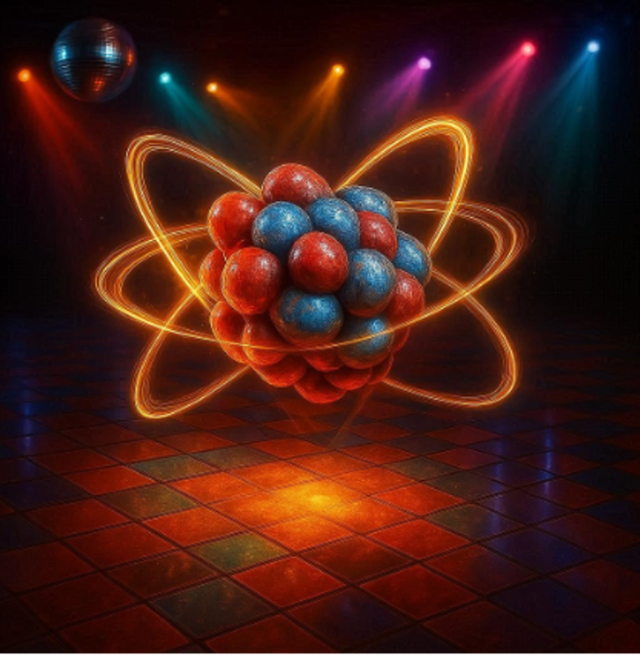

Lecture 4 Laser-based techniques for RIB
by Prof Thomas Elias Cocolios

Slide 2
Spectroscopy
Manipulation
Production

Slide 3
Basics of atomic structure
Finite size and hyperfine structure
Laser ion sources
Laser spectroscopy
Laser manipulations

Slide 4
Basics of atomic structure
Finite size and hyperfine structure
Laser ion sources
Laser spectroscopy
Laser manipulations

Slide 5
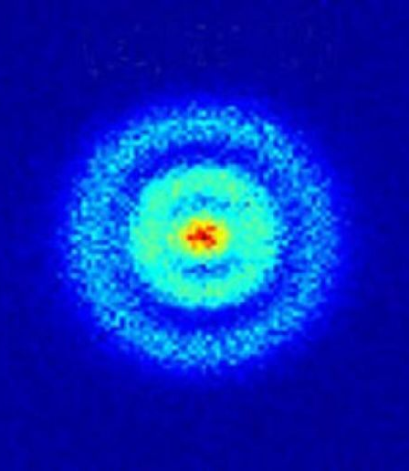
Solving the hydrogen atom…

Slide 6
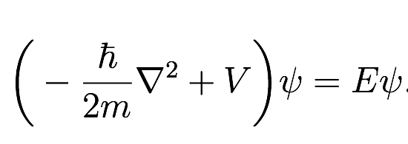
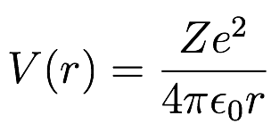
A quantum system under EM forces
Let’s look at the math…

Slide 7

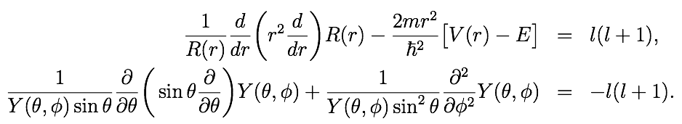

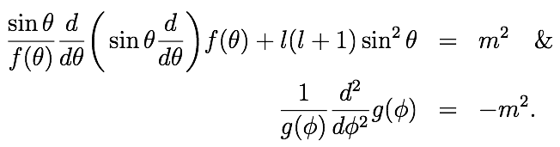
Solving the (hydrogen) atom
Double separation of variables in spherical coordinates
Separation constants make angular momentum quantum numbers appear naturally

Slide 8

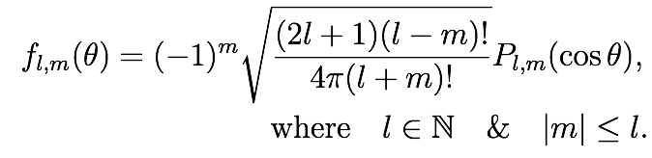
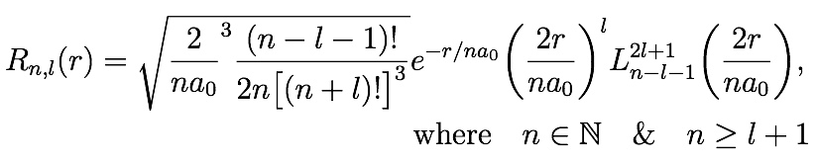

Solving the (hydrogen) atom
Solving backwards reveals some conditions on l & m
And let us not forget the electron spin too!
Quantisation is a natural outcome of solving the Schrödinger equation

Slide 9
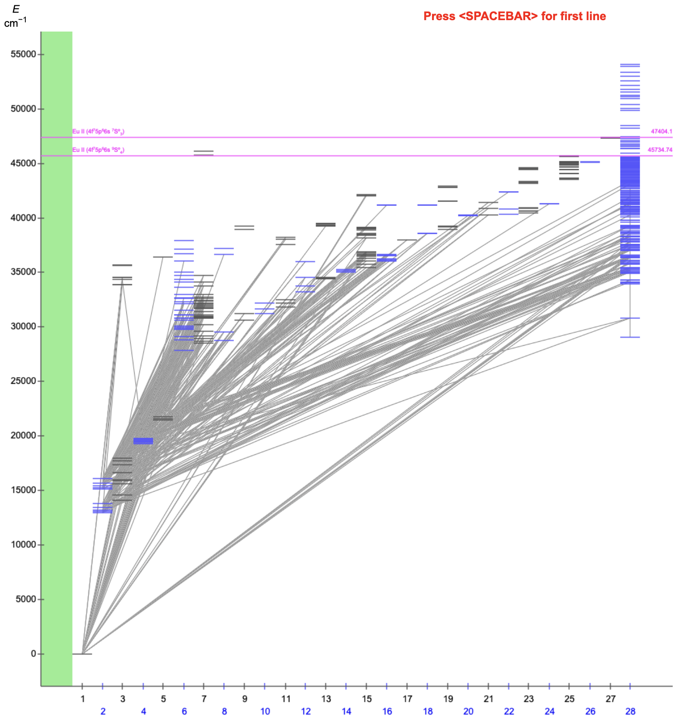
A typical atomic spectrum
A real atom is much more complex than the hydrogen atom. One must consider the interaction between the electrons and how this will affect the levels.
Some levels also arise from the combined excitation of multiple electrons, which can even give rise to levels BEYOND the ionization threshold – for which both electrons would be bound, but combined have more energy. Those levels are called autoionizing states, as one electron may give energy to the other, kicking one away from the atom while the other drops back down, hereby creating an ion.
Eu I

Slide 10
A matter of scale
The typical energy scale in an atomic system are of ~eV. Ionization potentials vary from ~3.5 eV in alkali to ~20 eV in noble gases.
Atomic transitions may be found from the UV to IR, spanning across the entire visible spectrum. Those are accessible with lasers!
The lifetime of atomic levels is of the order of ns. This translates in practice to natural linewidths of the order of few tens of MHz. Of course, long-lived states may be found that have narrower natural linewidth. They are populated, however, via weaker transitions that might be difficult to drive…

Slide 11
Basics of atomic structure
Finite size and hyperfine structure
Laser ion sources
Laser spectroscopy
Laser manipulations

Slide 12
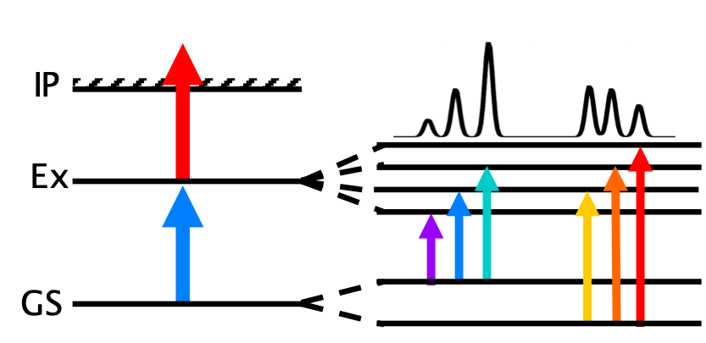
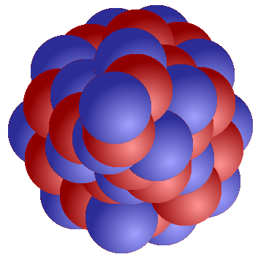
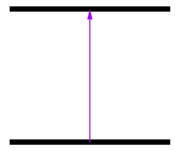
Probing the nucleus with atomic electrons
’
A
A’
1Å = 10⁻¹⁰m
1fm = 10⁻¹⁵m

Slide 13
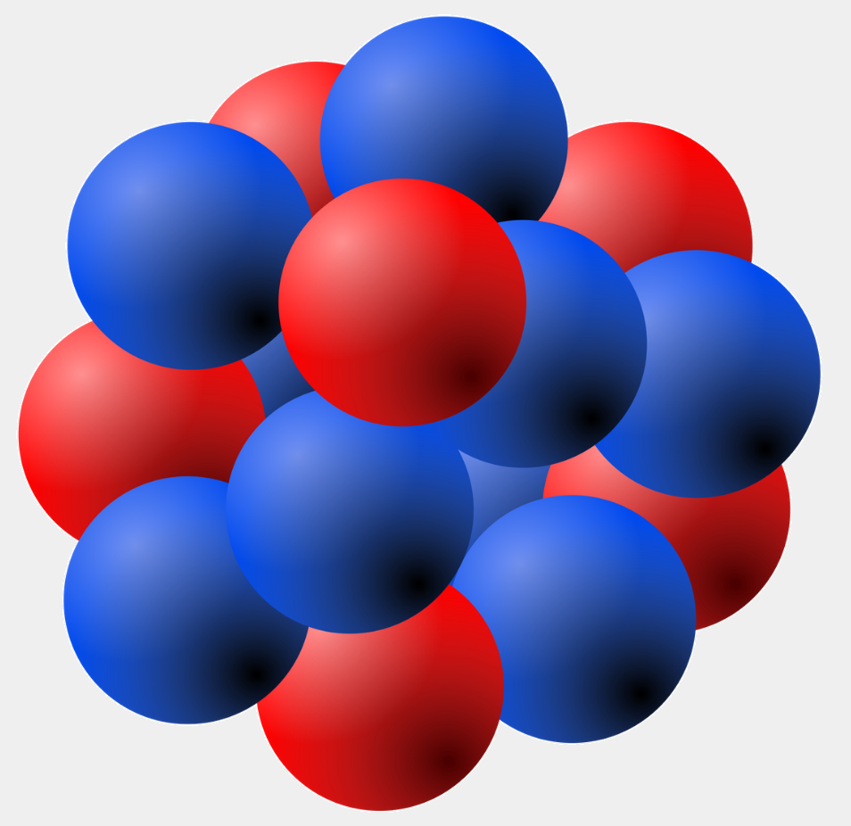
Finite size correction
r
Nuclear radius: few × 10⁻¹⁵ m
Atomic radius: few × 10⁻¹⁰ m
Potential is slightly deeper for the
smaller isotope: s-electrons more
tightly bound
V(r)
Isotope shift of atomic level
Point nuclear charge:
Coulomb potential (-1/r)
Illustration courtesy of R.P. de Groote.

Slide 14
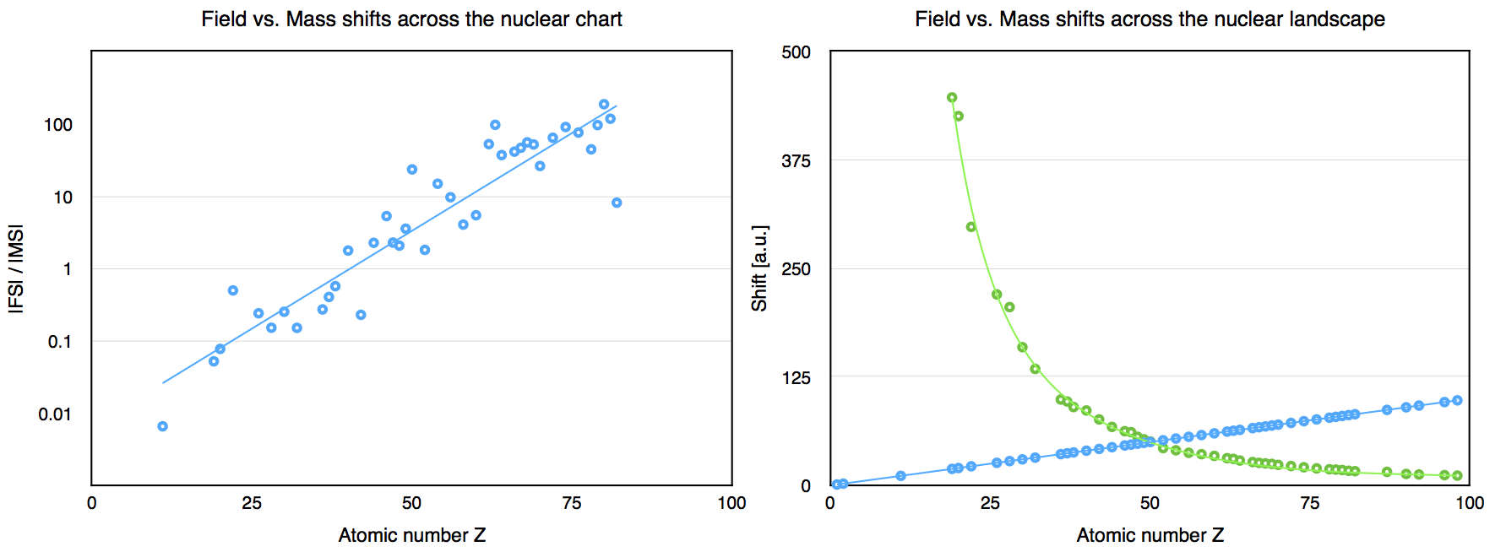
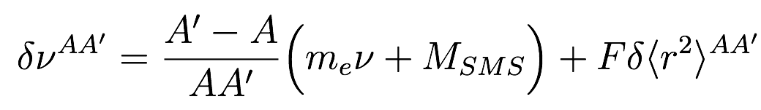
Finite size correction for transitions
Rather than extracting the absolute finite size effect on a single level, we probe the changes across isotopes of a transition between levels: isotope shifts
∂<r²>
Accessible over long chains of isotopes
’
A
A’
Completely independent of nuclear models!
MSMS and F are affected by the entire electron cloud
⇒ nearly impossible to compute from first principle beyond 3 electrons

Slide 15
Hyperfine structure
Besides the finite size effect, the structure of the nucleus results in the presence of electric currents and electric field gradients, with which the electrons may interact.
This is best represented in a Taylor expansion of the Coulomb interaction in terms of multipoles:

Slide 16
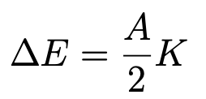
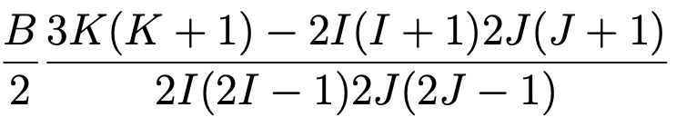
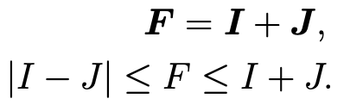


Hyperfine structure
The spin of the nucleus couples with the angular momentum of the electronic level and results in a perturbation of that level that lifts the degeneracy of the m-substates.
The hyperfine structure depends upon
The nuclear spin
The nuclear magnetic dipole moment
The nuclear electric quadrupole moment

Slide 17
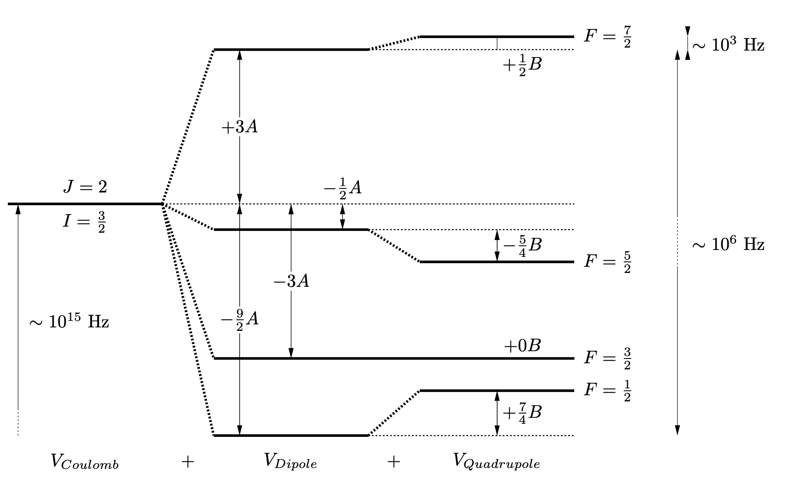
Hyperfine structure

Slide 18
Hyperfine structure
Transitions are then between F states with ΔF=-1,0,+1.
To first order, the ratio of A parameters can be used to either constrain the information or learn about different isotopes
The ratio of A parameters from two levels is constant for all isotopes of that element, as µ & I are independent of the state and thus cancel out.
The ratio of A from a given level across two isotopes is equal to the ratio of µ & I from those elements and allows to determine the magnetic dipole moment, given a reference is known, even if the B₀ parameter cannot be determined accurately.

Slide 19
Higher orders
Not featured at EMIS2026
The expansion does not stop with the electric quadrupole moment. However, the amplitude of the perturbation drops down substantially beyond the electric quadrupole.
It is possible to probe the magnetic octupole moment, but it requires already kHz precision, instead of the MHz required for the earlier perturbations. It also requires that both the nuclear spin and atomic angular momentum are at least 3/2.
So far, only ~20 isotopes have been investigated, none of them radioactive. Efforts are ongoing to explore this new avenue.
R.P. de Groote et al., Precision measurement of the magnetic octupole moment of 45Sc …, Phys Lett B 827 (2022)

Slide 20
Hyperfine anomaly
Not featured at EMIS2026
The claim that the hyperfine parameter ratio is constant or how it may be used to extract the magnetic dipole moment is actually an approximation.
Due to the changes in the finite size of the nucleus, the way the electron orbital overlaps with the nucleus varies ever so slightly, which may incur additional shifts beside the isotope shift and the hyperfine structure already mentioned.
This effect is called the hyperfine anomaly and can be up to a few % of the hyperfine parameter.
It can be used to explore the magnetization of the nucleus.

Slide 21
Basics of atomic structure
Finite size and hyperfine structure
Laser ion sources
Laser spectroscopy
Laser manipulations

Slide 22
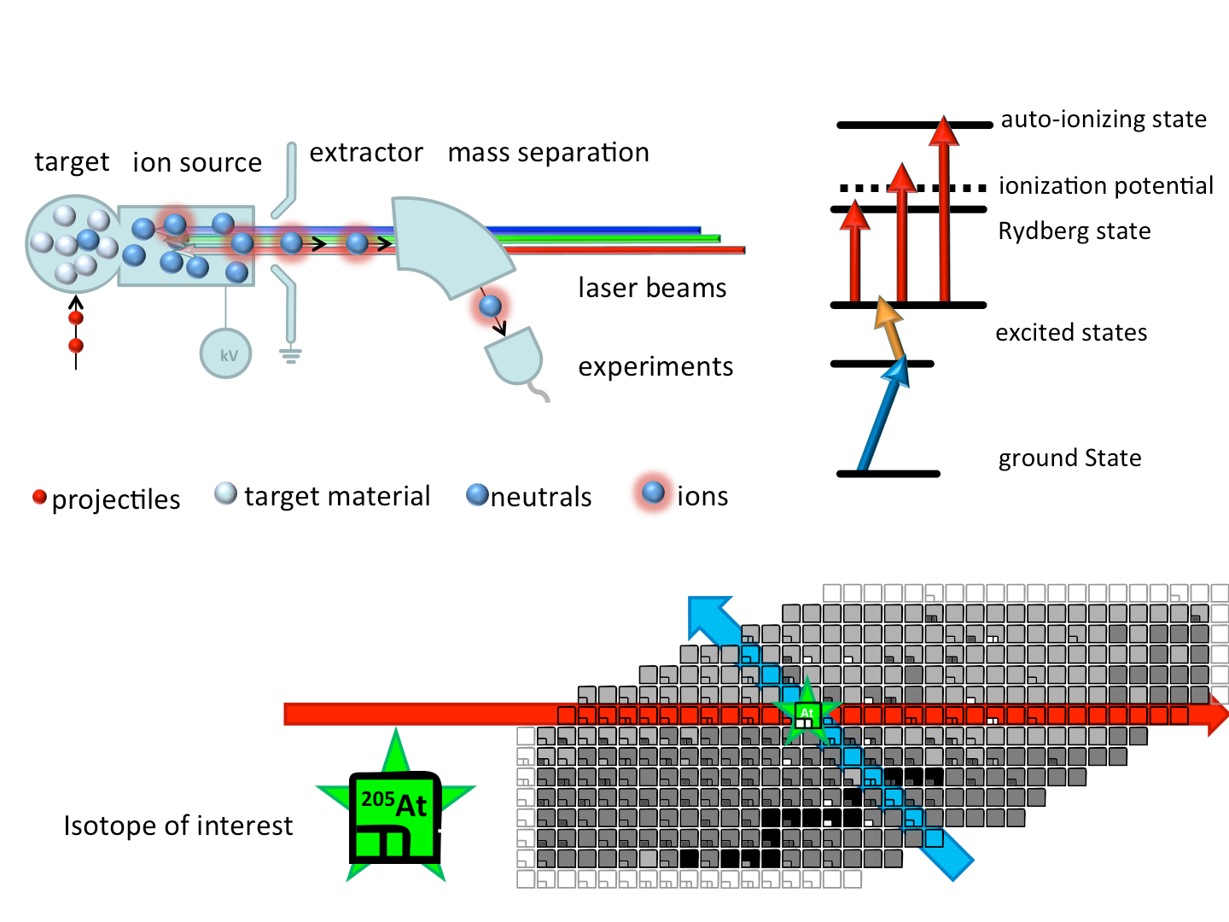
Resonance ionization
The atomic transitions are specific to each element across the periodic table of the elements. As such, resonances in the atom of an element are unlikely to be found in another element.
By applying a sequence of lasers, it is possible to resonantly bring an electron beyond the ionization threshold, and thus produce an ion.
By using multiple lasers, no single laser is sufficiently energetic to ionize any element, while it also decreases the likelihood of hitting multiple elements.

Slide 23
Resonance ionization in hot cavities

Slide 24
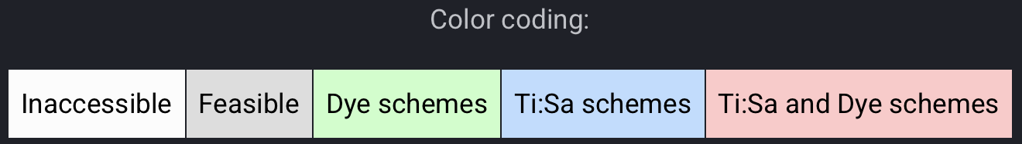
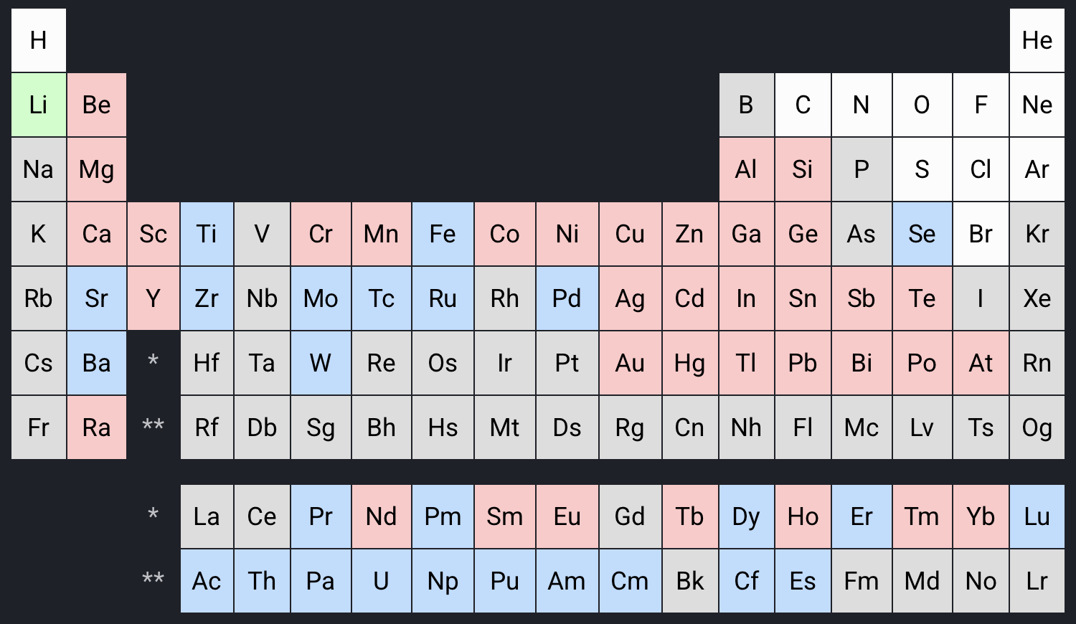
Contribute your own scheme!
https://cern.ch/rilis-db

Slide 25
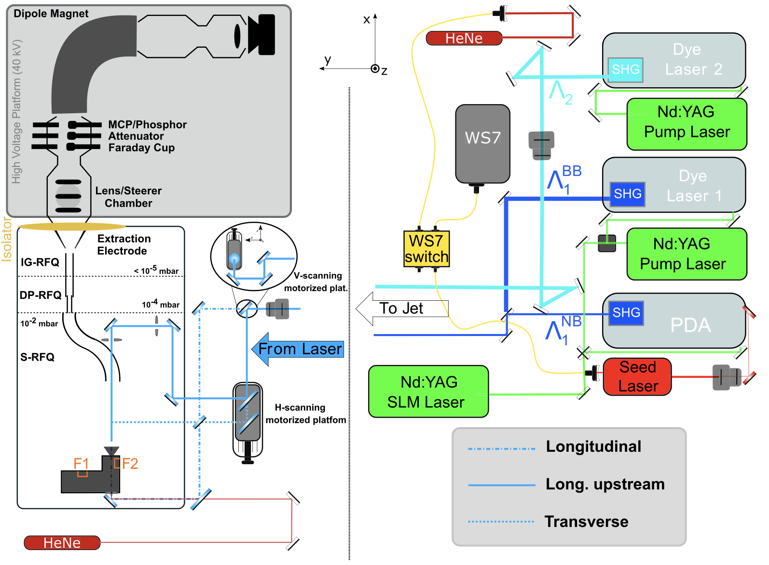
Gas cell twist
Compared to a hot cavity, a gas offers interesting advantages: lesser chemical sensitivity (= access to all elements), and operation at lower temperature (T_{room} down to cryogenic).
The supersonic gas jet offers even better conditions, reaching down to ~15K.
R. Ferrer et al., Physical Review Research 3 (2021) 043041.

Slide 26
Talks & posters on ion sources
Monday 20 Oct
11:20 – Carla Babcock, Expanding User Capabilities and Increasing Reliability at TRIUMF-ISAC
Tuesday 21 Oct
16:00 – Yoshikazu Hirayama, KISS1.5 to reveal the origin of heavy-element synthesis
17:10 – Sarina Geldhof, Recent advances of the S3-Low Energy Branch
Thursday 23 Oct
16:50 – Raphael Hasse, Purification of radioisotope beams at the RISIKO off-line RIB facility at Mainz
Friday 24 Oct
09:00 – Jens Lassen, Laser resonance ionization laser ion source(s) for radioactive ion beam delivery at TRIUMF
Posters
157 – Ha-Na Kim, Current Status of Laser Ion Source Development at RAON

Slide 27
Basics of atomic structure
Finite size and hyperfine structure
Laser ion sources
Laser spectroscopy
Laser manipulations

Slide 28
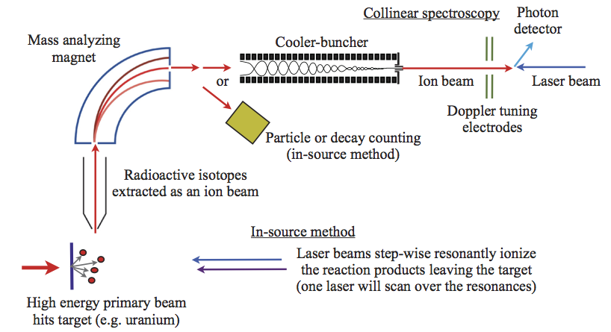
Laser spectroscopy: overview
B.Cheal, T.E. Cocolios & S. Fritzsche, PRA 86 (2012) 042501.

Slide 29
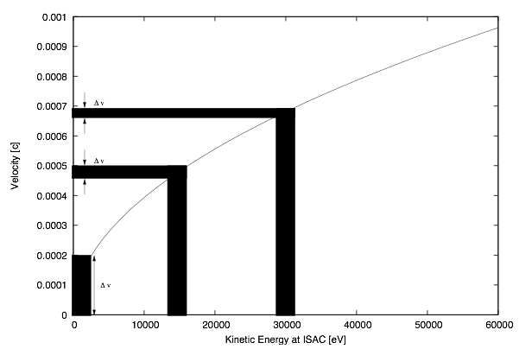
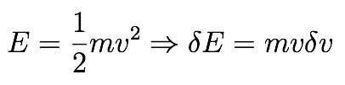
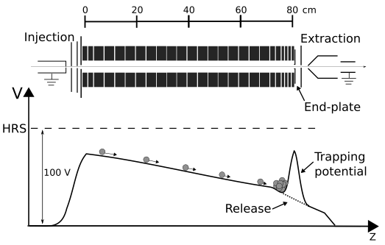
High resolution
Generally limited in efficiency
Step 1: excite, step 2: decay. Photon detection can have its challenges but the method is simple.
Doppler compression ensures that high resolution is maintained by minimizing the broadening to comparable levels to the natural linewidth <50 MHz.
Bunching the beam allows to control the photon yield, keeping the signal strength while suppressing the scattered light background by a factor 10⁴.

Slide 30
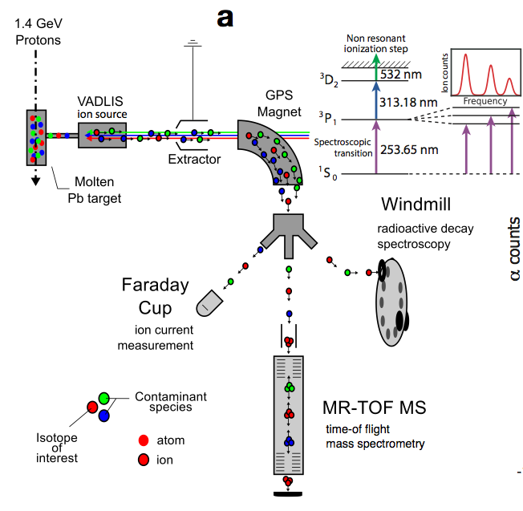
In-source
The resonance ionization technique can be used to probe the hyperfine structure and isotope shift in atomic transitions.
Combined with ion counting, high-resolution mass spectrometry in an MR-ToF or decay detection, it is possible to achieve high sensitivity – down to a few ions per minutes.
It suffers however from poor resolution due to the high temperature of the ion source, at ~5 GHz.
B.A. Marsh et al. Nature Physics 14 (2018) 1163.

Slide 31
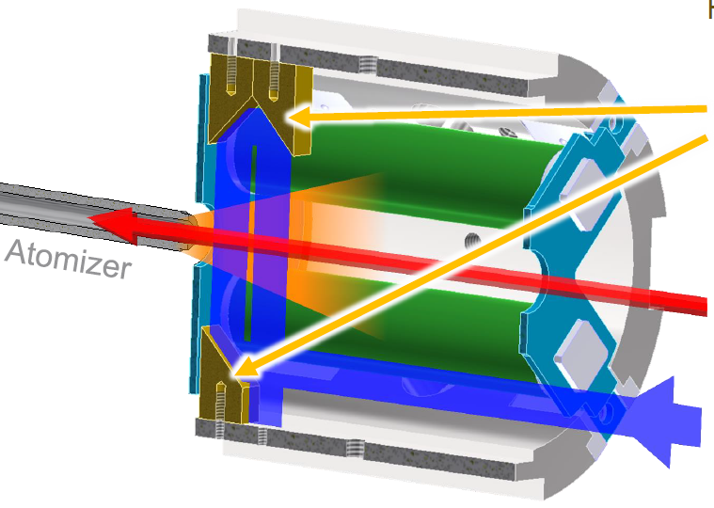
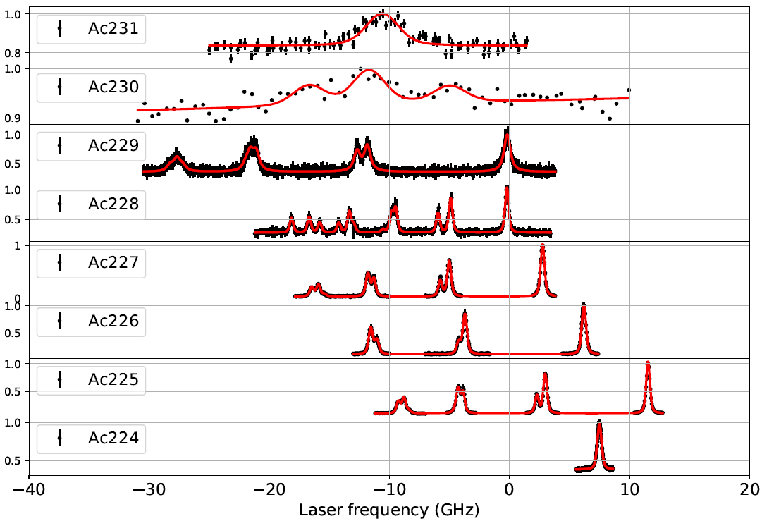
PI-LIST
It is possible to improve from the poor resolution of the in-source technique by probing the atomic population orthogonally.
This is achieved with the Perpendicularly-Illuminated Laser Ion Source and Trap, at the cost of efficiency.
Resolution down to 250 MHz has been achieved online, but required beams of hundreds per second.
R. Heinke et al., NIMB 541 (2023) 8-12. (EMIS 2022)

Slide 32
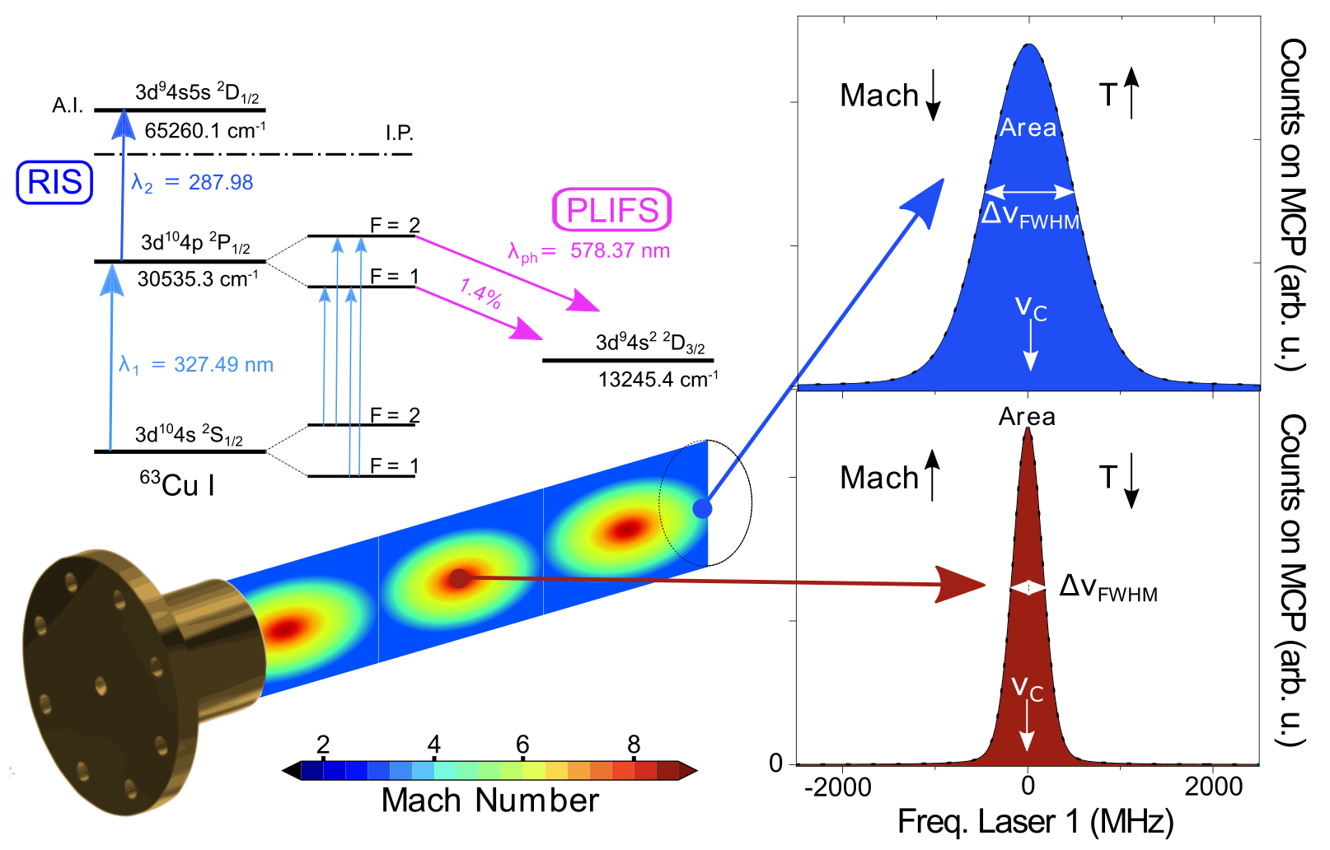
JetRIS
One may also make use of the low temperature of the supersonic jet (15K) to perform laser spectroscopy.
This technique was developed in Louvain-La-Neuve and is now applied in GSI, and soon at the GANIL S3-LEB
R. Ferrer et al., Physical Review Research 3 (2021) 043041.

Slide 33
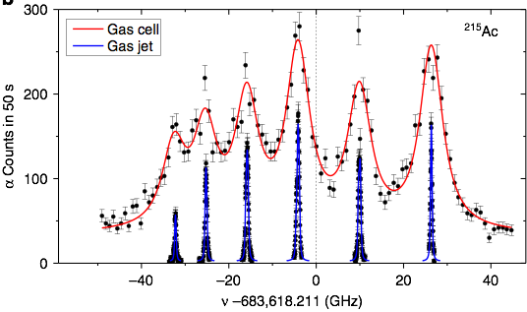
JetRIS
One may also make use of the low temperature of the supersonic jet (15K) to perform laser spectroscopy.
This technique was developed in Louvain-La-Neuve and is now applied in GSI, and soon at the GANIL S3-LEB
R. Ferrer et al, Nature Communications 8 (2017) 14520.

Slide 34
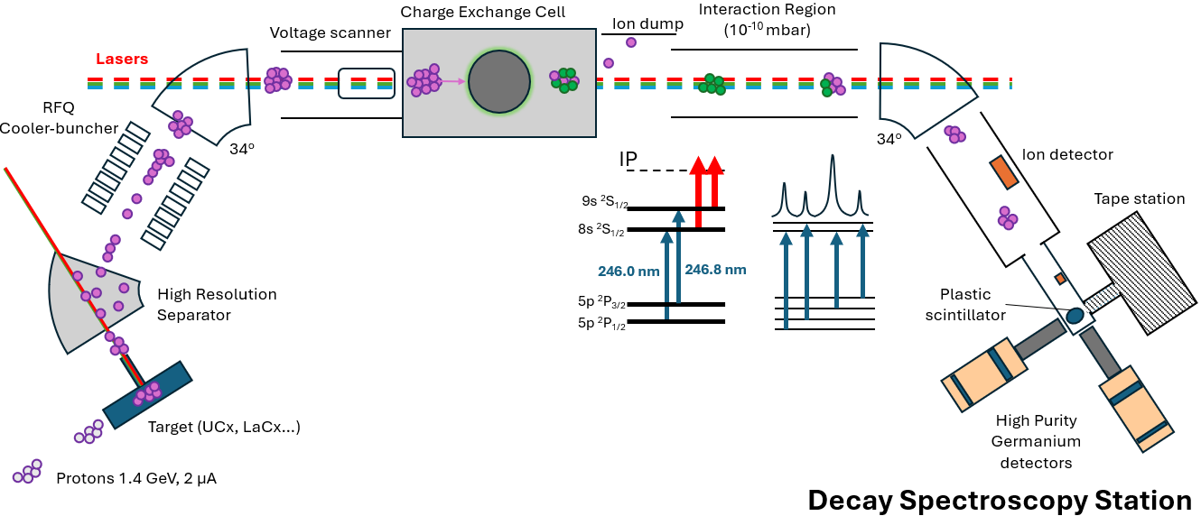
CRIS: combining resolution & efficiency
M. Athanasakis-Kaklamanakis et al., NIMB 541 (2023) 86-89 (EMIS 2022).
Illustration courtesy Simone Casci (KU Leuven).

Slide 35
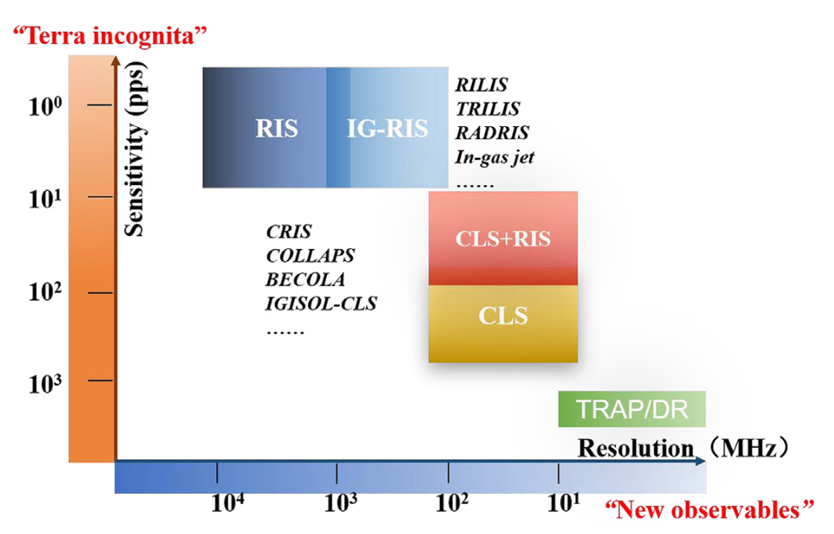
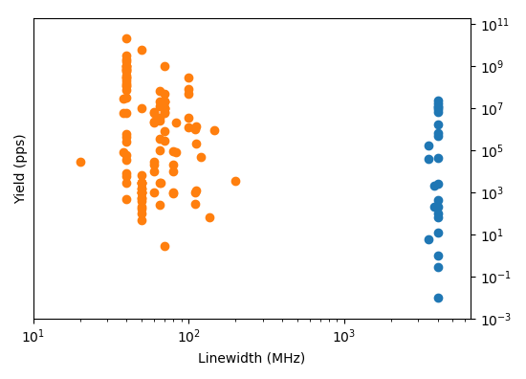
Laser spectroscopy
Predominantly collinear fast-beam experiments
Status ~2010
Sensitivity push
Precision push
In-source experiments
X.F. Yang et al., PPNP 129 (2023) 104005.
Illustration courtesy from R.P. de Groote

Slide 36
Talks & posters on spectroscopy
Monday 20 Oct
16:40 – Ruohong Li, Nuclear spin polarization and collinear laser spectroscopy program at TRIUMF
Tuesday 21 Oct
09:40 – Jaehyun Song, Online commissioning and current status of CLaSsy at RAON
10:30 – Agi Koszorus, Nuclear structure studies by collinear laser spectroscopy
Thursday 23 Oct
11:20 – Jessica Warbinek, The CRIS technique and its latest advances: towards more exotic isotopes and beyond nuclear structure studies
11:40 – Dave Lunny, Simultaneous mass spectrometry and in-source laser spectroscopy of exotic nuclides from ISOLDE
Friday 24 Oct
09:40 – Klaus Wendt, High resolution laser spectroscopy in the actinide region using the PI-LIST laser ion source
Posters
49 – Klaus Wendt, High resolution laser spectroscopy in the actinide region using the PI-LIST laser ion source
51 – Fedor Ivandikov, Hyperfine spectroscopy of the K=8⁻ isomer in No-254 with JetRIS and other applications of in-gas-jet laser spectroscopy
79 – Iain Moore, Probing the silver isotopic chain with mass- and laser spectroscopy
90 – Sung Jong Park, High-resolution collinear laser spectroscopy in a combined collinear and anti-collinear geometry
101 – Kenneth van Beek, Towards laser spectroscopy of longer-lived heavy nuclei with RADRIS

Slide 37
Basics of atomic structure
Finite size and hyperfine structure
Laser ion sources
Laser spectroscopy
Laser manipulations

Slide 38
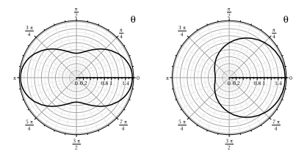
Laser polarization
Gamma and beta emissions from nuclei have a preferred orientation with respect to the nuclear spin. However, that spin does not have any preferred orientation and nuclei are often found in disorganized samples, meaning isotropic emissions.
It is however possible to correlate the nuclear spin to the atomic angular momentum, and to manipulate that later one to create a nuclear-spin-oriented sample.
This can be used to study emission anisotropy for weak interaction or to investigate how external factors may perturb that anisotropy (e.g., for solid state physics or biochemical investigations).

Slide 39
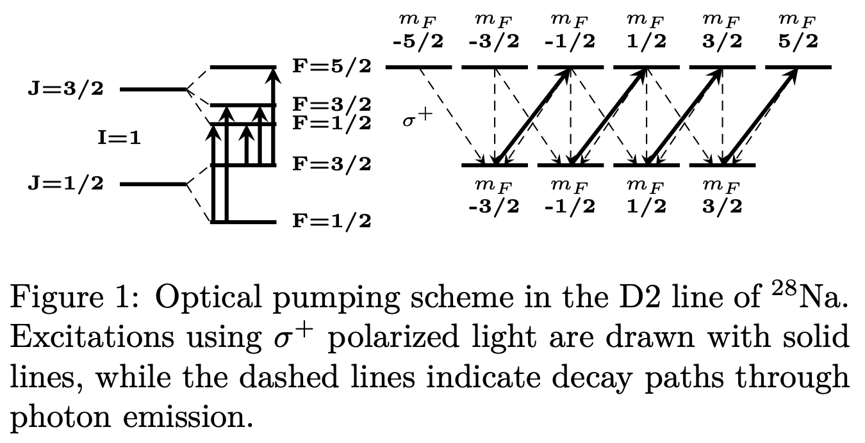
Laser polarization
A weak magnetic field is applied to spread the atomic substates in energy.
A circularly polarised light will impose a definite change in magnetic substate while the decay will be isotropic, inducing a global shift in the population.
Circulating multiple times through the transition increases the degree of polarization.
Finally, a different magnetic field is applied to lock the atomic population in a selected orientation.
W. Gins et al., NIMA 925 (2019) 24-32.

Slide 40
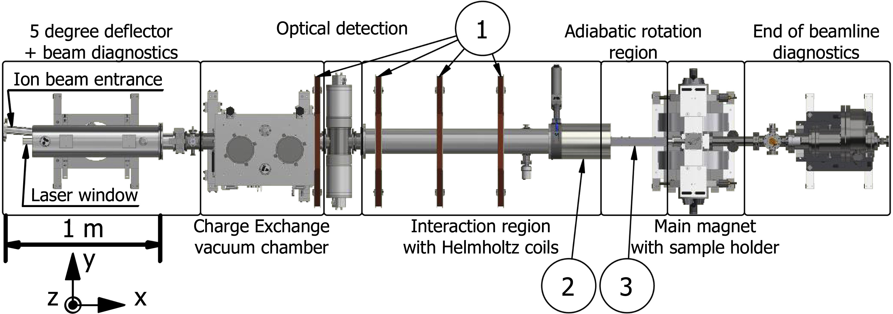
Laser polarization
W. Gins et al., NIMA 925 (2019) 24-32.

Slide 41
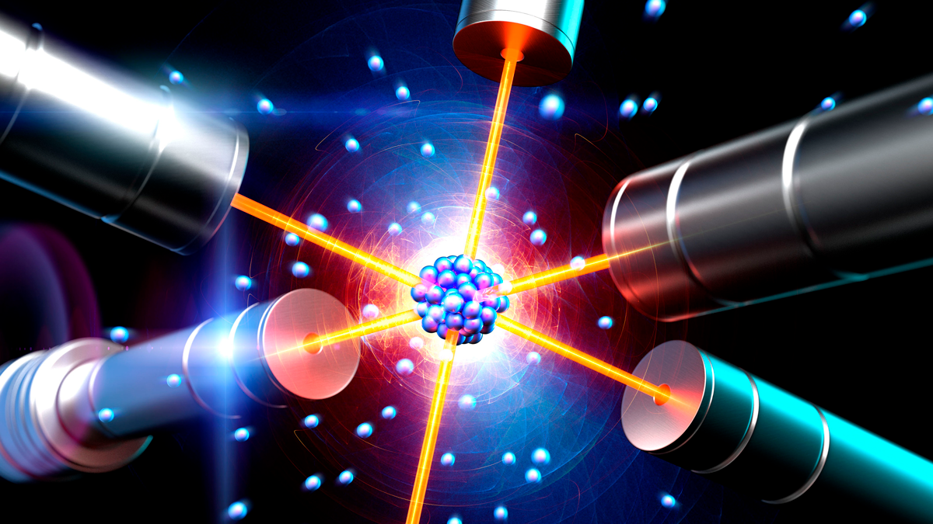

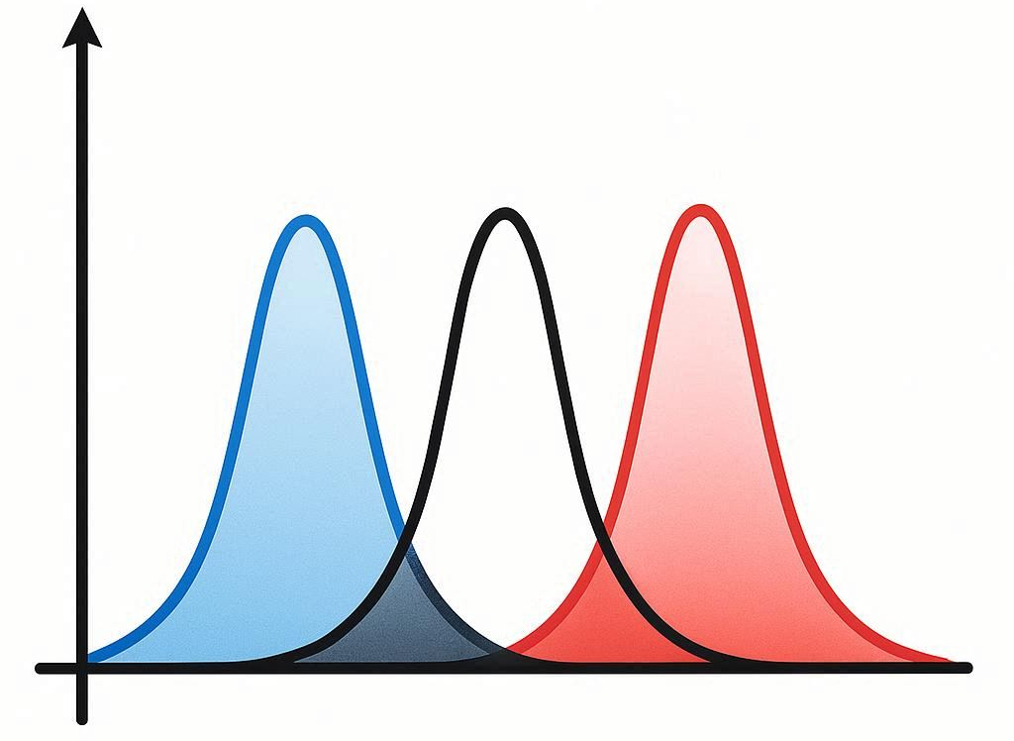
Laser cooling
Just like laser polarization, laser cooling plays on an isotropic vs anisotropic imbalance to act on an atomic sample.
A laser beam is directional and will thus exert a force onto an atom, however tiny, by transferring the photon momentum p=h/λ=E/c.
Radiation from an excited atom is isotropic, resulting in a net 0 force from the decay.
The resulting action is a net force in the direction of the laser beam.
A measurable action is obtained by repeating the excitation-decay cycles multiple times.
By tuning the laser beam slightly off resonance, it will scatter more photons from atoms that are Doppler shifted accordingly, namely that have a velocity component in the direction of the laser beam. This will contribute to bring that velocity closer to the central one, resulting in a net decrease of the velocity distribution ➔ cooling.

Slide 42
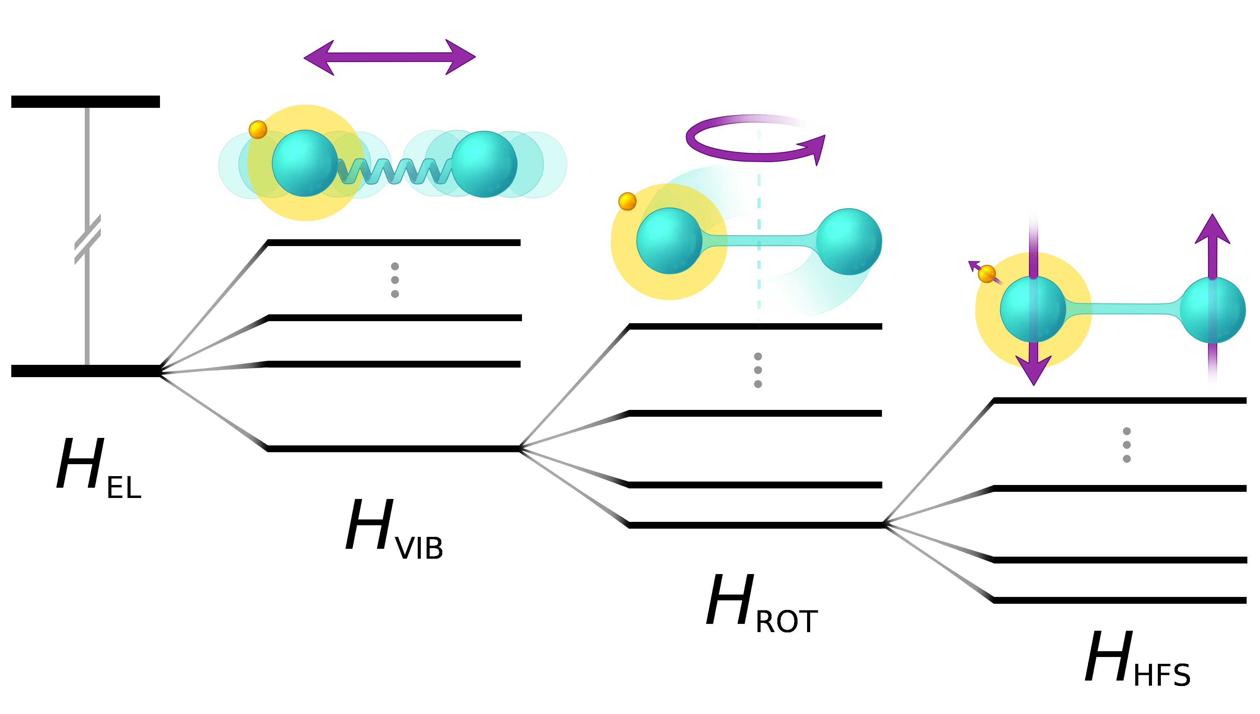
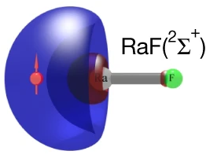
Molecules
Besides electronic levels, molecules have additional degrees of freedom: vibrations and rotations. Those give rise to additional transitions and selection rules on top of the ones applied in the atom, complexifying the spectrum. The HFS remains as well.
Some radioactive molecules may prove to be excellent ground for searches of physics beyond the standard model, as such effects might be enhanced in the presence of strong octupole deformation: FrAg, RaF, RaOH, AcF, …

Slide 43
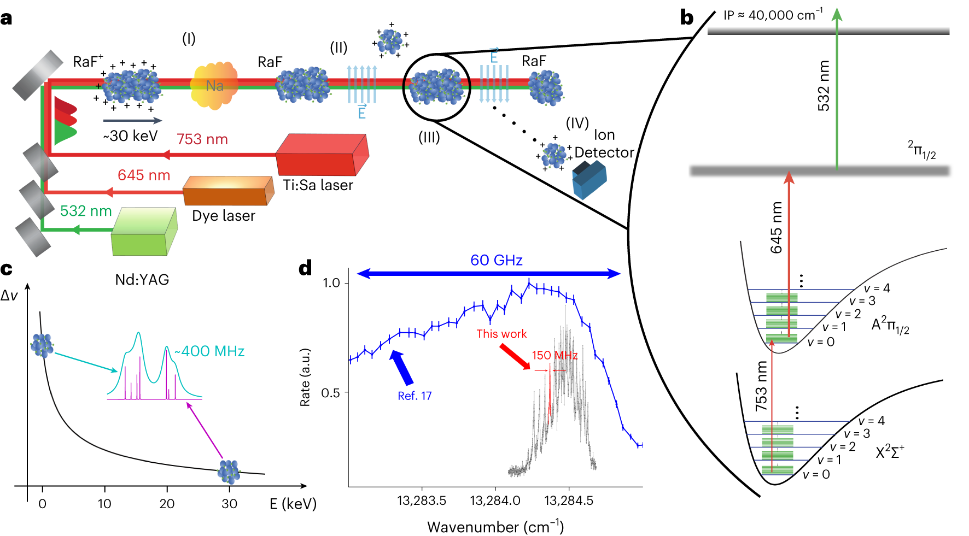
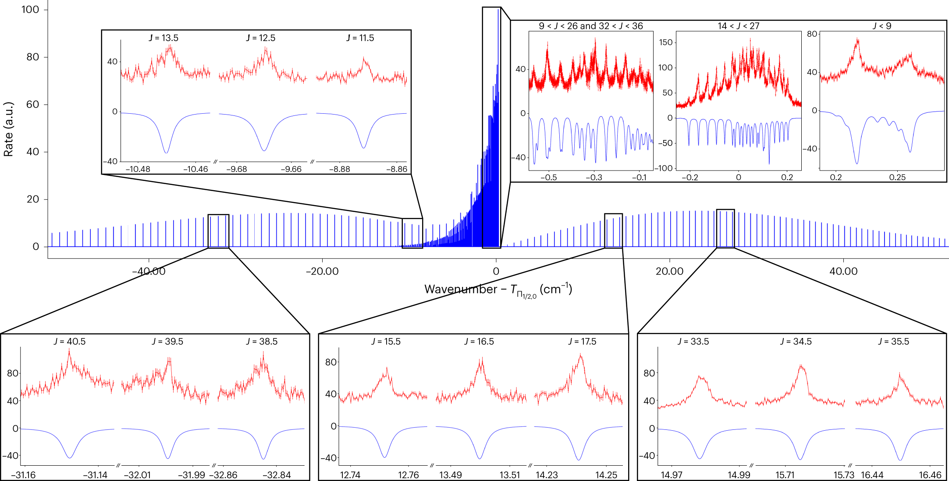
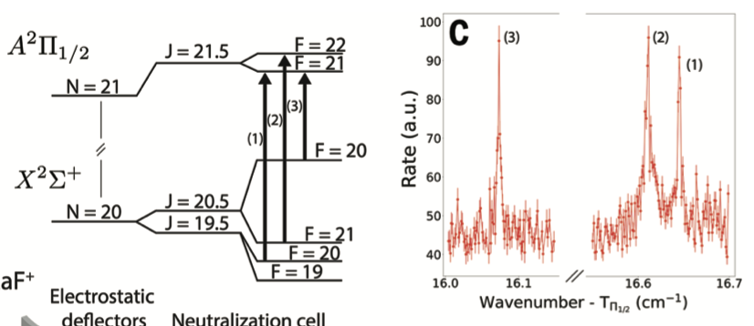
Molecules
R.F. Garcia Ruiz et al., Nature 581 (2020) 396-400.
S. Udrescu et al., Nature Physics 20 (2024) 202-207.

Slide 44
Talks & posters on spectroscopy
Monday 20 Oct
09:30 – Tommi Eronen, Proof-of-principle of in-trap laser polarization of Mg-23 ions with MORA at IGISOL
16:40 – Ruohong Li, Nuclear spin polarization and collinear laser spectroscopy program at TRIUMF
Tuesday 21 Oct
09:00 – Stephan Malbrunot-Ettenauer, Doppler and sympathetic cooling for the investigation of short-lived radionuclides
Wednesday 22 Oct
11:20 – Moritz Pascal Reiter, The RAdium-Fluride Ion Catcher Instrument - A path towards offline eEDM experiments with RaF
Thursday 23 Oct
11:00 – Louis Croquette, Photoassociation spectroscopy of francium molecules
15:30 – Ronald Fernando Garcia Ruiz, Developments for Standard Model tests with radioactive molecules

Slide 45
Lasers have multiple use with radioactive ion beams. All are based on probing the electronic levels in the atom and either using or probing their interaction with the nucleus.
For the production & purification of radionuclides (ion source, CRIS)
For the spectroscopy of radioactive ions and molecules (collinear, in source, in jet)
For the manipulation of radioactive atoms (polarization, colling)

Slide 46


