Slide 1
Ion Traps for Low-Energy Nuclear Science and Applications Using Rare Isotopes
R. Ringle
ringle@frib.msu.edu
EMIS Student Symposium

Slide 2
Ion Traps at Rare Isotope Beam Facilities Enable Broad Science Programs
GANIL
PIPERADE,
MORA,
PILGRIM,
MLLTRAP
Jyväskylä
JYFLTRAP
ANL
CPT,
BPT,
N=126 Factory
IMP
SHANS
GSI/FAIR
SHIPTRAP,
HITRAP,
Gießen MR-TOF,
MATS
TRIUMF
TITAN
FRIB
LEBIT, BECOLA, ReA
LBNL
AETHER
Texas A&M
TAMUTRAP
RIKEN
SLOWRI,
KISS
U. Notre Dame
St. Benedict
RAON
HPMMS
ISOLDE
ISOLTRAP, REX,
COLLAPS,MIRACLS
Mass/Q-value Beam Prep. Decay/Laser Spec. Charge Breeding

Slide 3
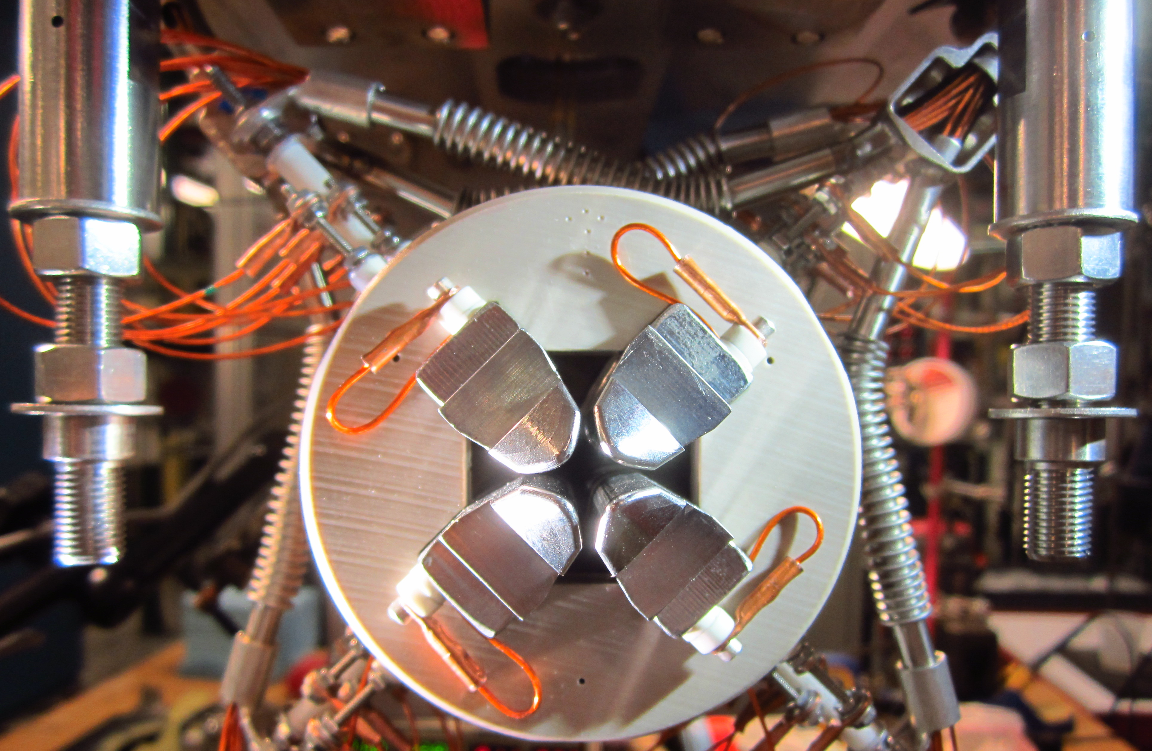
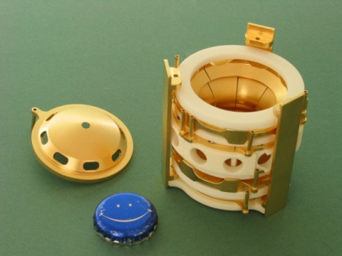
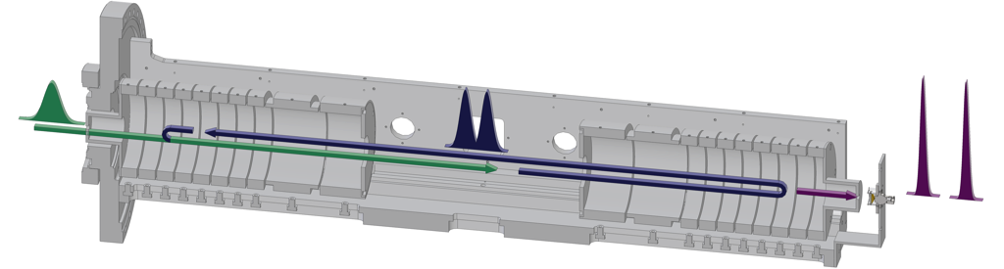
Three Main Types of Ion Traps Used in Research with RIBs
Radiofrequency multipole traps (RF+DC)
  Storage devices for charged particles
  Mass filters and spectrometers
  Ion (beam) manipulation
  Decay studies
  Analytical chemistry
Penning traps (DC + magnetic field)
  Highest-precision mass measurements
  Ion manipulation
  Decay studies
  g-factor measurements, quantum information
Multi-reflection time-of-flight devices (MR-TOFs, DC)
  High-precision mass measurements
  Ion manipulation
  Decay/laser studies
  Collective ion dynamics

Slide 4
Ion Traps Require Low-Energy Beams
Fast-beam fragmentation and in-flight separation (FRIB, FAIR, RIKEN)
Heavy ions, <2GeV/u
Mass
Sep.
~200 MeV/u
Target
Production: no chemistry involved, fast,
High beam energy ideal for many reaction experiments
Low intensity, poor beam quality – deceleration difficult
Gas Stopping
ISOL technique (ISOLDE, ISAC, SPIRAL2)
Protons, 1 GeV
Mass
Sep.
Ion source
~60 keV
High intensity, good beam quality
Ideal for stopped beam and low-energy beam experiments (traps, lasers)
A number of elements not possible, decay losses
Post-acceleration required for reaction experiments

Slide 5
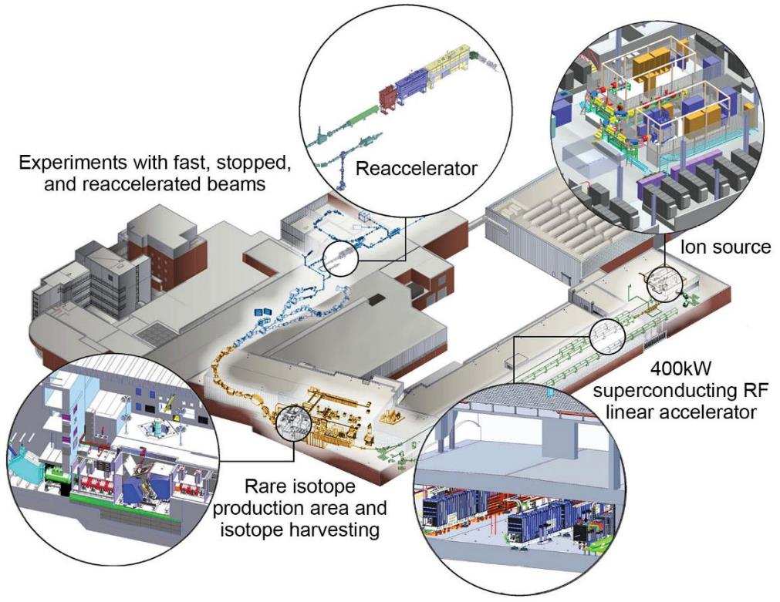
FRIB Optimized for Science with Fast, Stopped and Reaccelerated Rare Isotope Beams
Key feature is 400 kW beam power for all ions (5 x 10¹³ ²³⁸U/s) mission goal
Separation of isotopes in-flight provides
  Fast development time for any isotope
  Beams of all elements and short half-lives
  Fast, stopped, and reaccelerated beams
Power ramp-up to 400 kW
over several years
  Currently ~ 20 kW
Improvements projects, R&D,
and new equipment increase
FRIB’s capabilities for science
  Stopped and reaccelerated
  beams is one important area
Isotope harvesting capability from beam dump water
  Can provide additional beams for science
Future FRIB400 Energy Upgrade Will Increase Yields

Slide 6
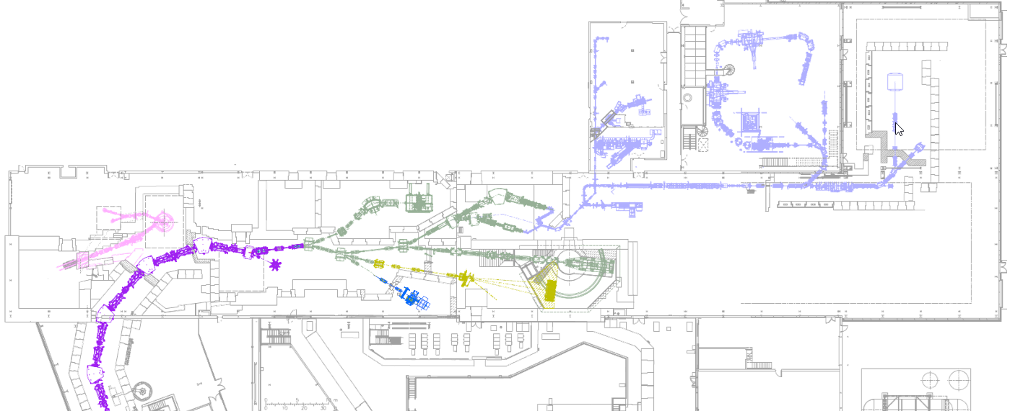
Experimental Areas for Fast, Stopped, and Reaccelerated Beam Experiments
LEBIT requires stopped beams (~ eV)
Gas stopping facility converts fast beams (~ 200 MeV/u) to stopped beams (~ 30 keV/q)
ReA reaccelerates stopped beams (~ 6 MeV/u)
Stopped
Beams
SECAR
SOLARIS
BECOLA
Cyclotron Stopper
Gas Stopper
LEBIT
ReA3
ReA6
ReA9
Reaccelerated Beams
S800
Gretina
Fast
Beams
FDSi
MoNA
EOS
FDSi
Fragment Separator

Slide 7
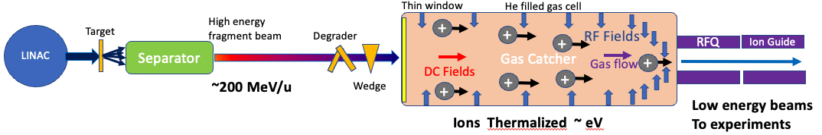
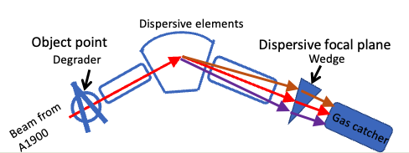
Beam Stopping of Fast Projectile Fragments
Production of fragments from high energy beam
  Large momentum spread due to reaction mechanism and production target.
Bρ and ΔE separation
  ARIS separator (High acceptance: 5% Δp/p), achromatic wedge
Momentum compression and thermalization
  Narrow momentum spread beams lead to high stopping efficiency¹
Gaseous ions collection
Low energy beam transport
30-60 kV platform
Method for producing an ideal incident beam:
Degrade beam at the object point
Bunch momentum spread with wedge at the dispersive focal plane^{2,3}
¹L. Weissman et al. NIM A 522 (2004) 212
²H. Weick et al., NIM B 164-5 (2000) 168
³H. Geissel et al., NIM A 282 (1989) 247

Slide 8
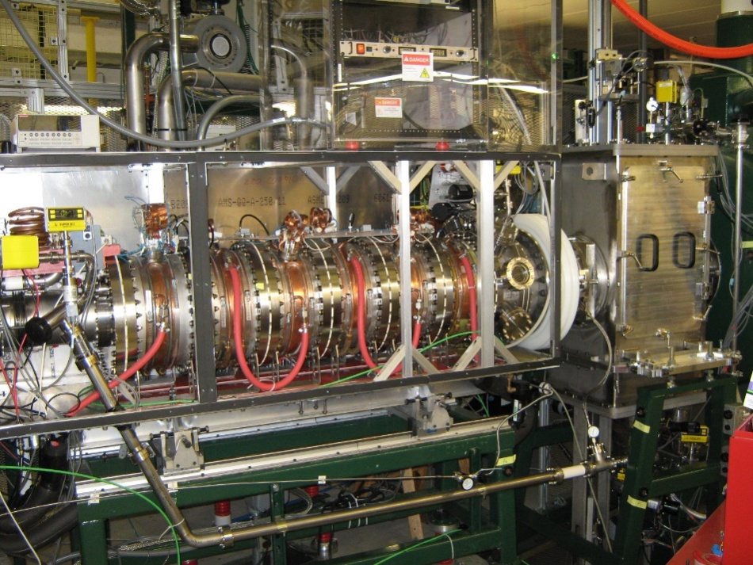
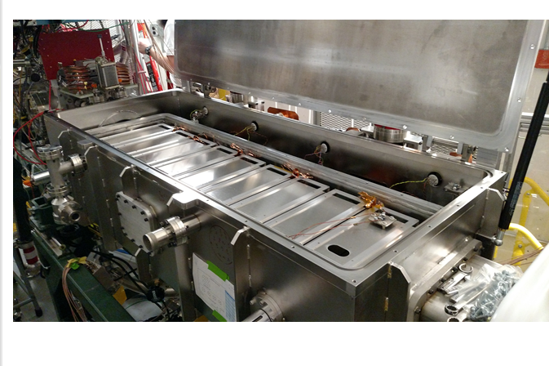
Beam Stopping Devices
Two Gas Cells Provide Beams to Experiments
Room Temperature Gas Cell (RTGC) - reliable
workhorse since 2011
  Large linear gas catcher developed and built by Argonne National Lab
  120 cm long gas catcher operates at pressure of 70 Torr and temperature of -10 ⁰C
  Operates with Radio-frequency (RF) + DC voltage gradient
Advanced Cryogenic Gas Stopper (ACGS) provides improved performance since 2017
  Novel geometry reduces space charge effects (>10x higher beam rate capability)
  Ion surfing technique for fast extraction (2x faster)
  Cryogenic operation for cleaner beams (in-situ gas purification)
  Features
    1.2 m (9 segments) wire carpet operated with
    4 phase-RF creating a traveling wave
    Each segment has 276 CuBe wires 50 μm diameter
Two gas stoppers provide redundancy

Slide 9
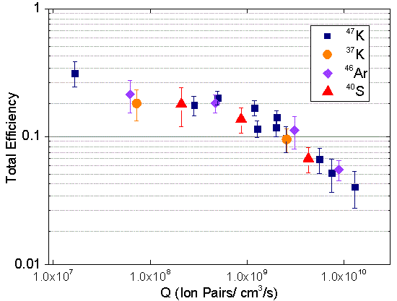
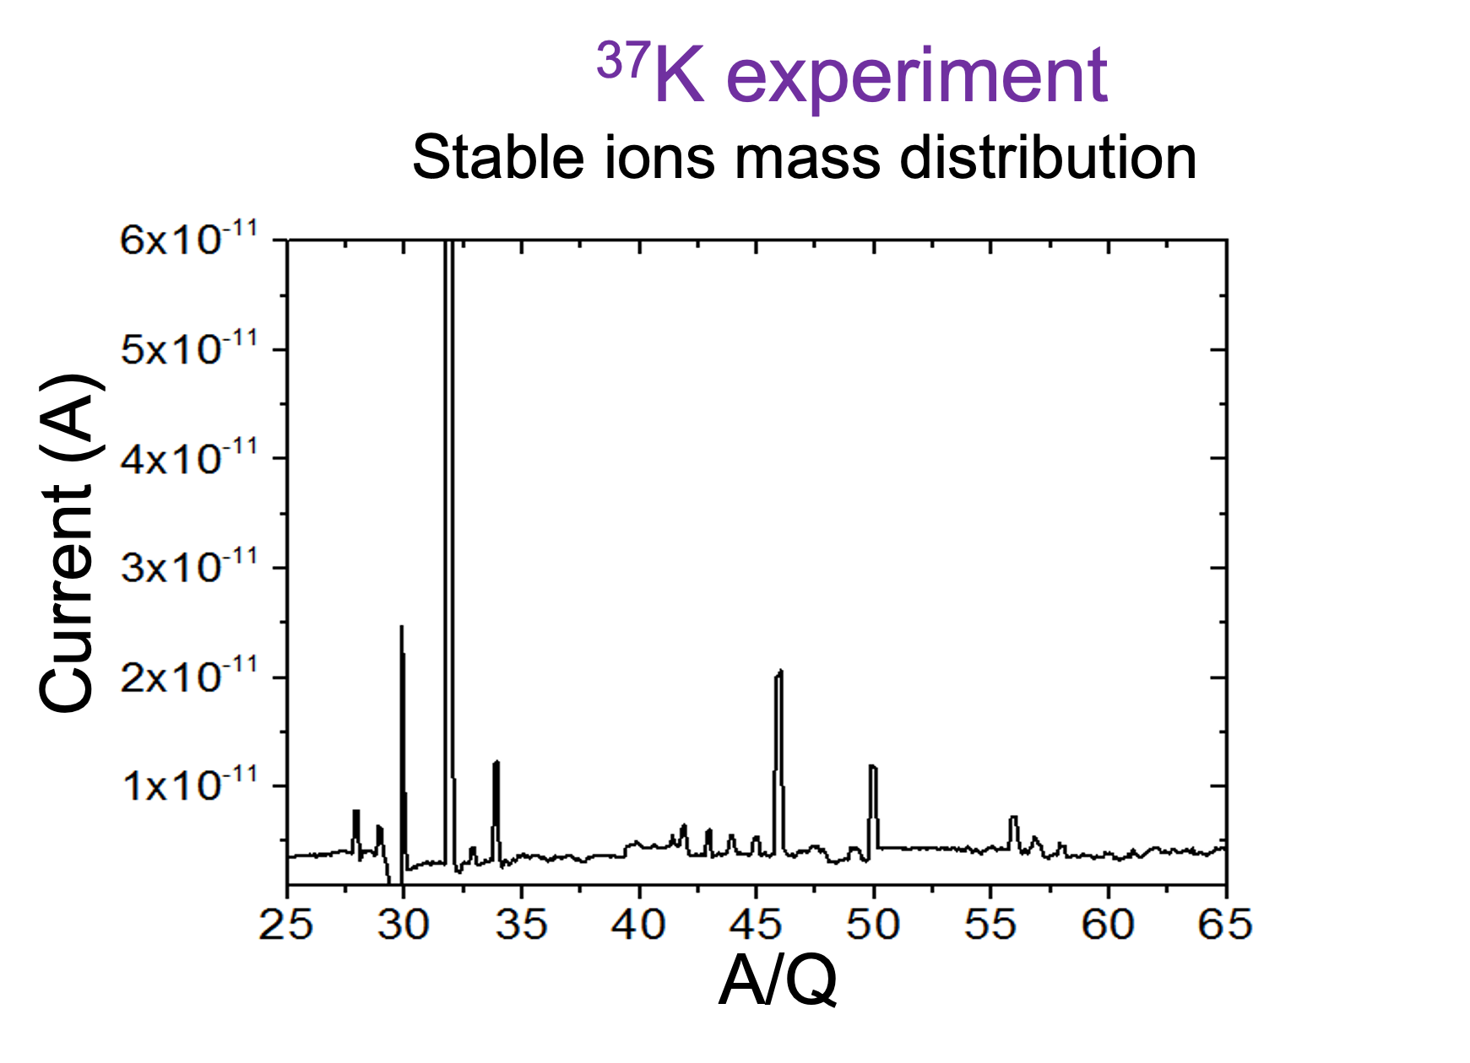
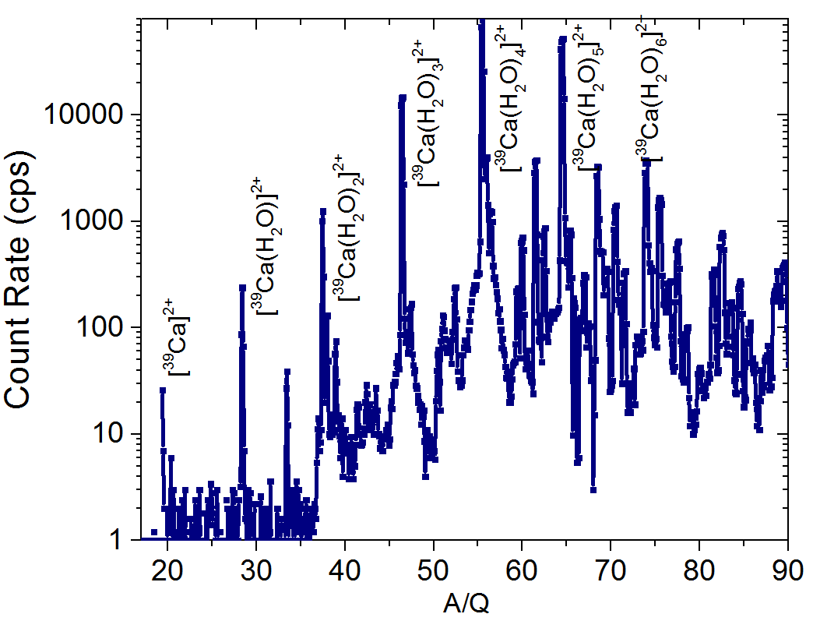
Challenges to Beam Purity, Rate, and Molecular Formation in Gas Stopping of Relativistic Heavy Ions
Generation of large space-charge fields
  ~ 10⁶ He⁺/e⁻ pairs per stopped ion created during stopping process
  Can hinder transport efficiency by generating large electric fields
Molecular ion formation with stopped rare isotopes
  Spreads rare isotope across several mass peaks
  Reduces efficiency through mass separator
Large stable molecular ion beams
  Trace contaminants in buffer gas or on surfaces are ionized during stopping process
  Can cause efficiency losses in extraction when squeezing large amounts of charge through small orifices
~10⁶ pps
RTGC
Can anything be done to mitigate these effects?
  Can we increase beam purity and intensity?
  Challenging for ion trap experiments
  Ion traps can play a big role in purifying beams
¹⁶O₂⁺
Stable ion
contaminants
³⁹Ca molecular
sidebands

Slide 10
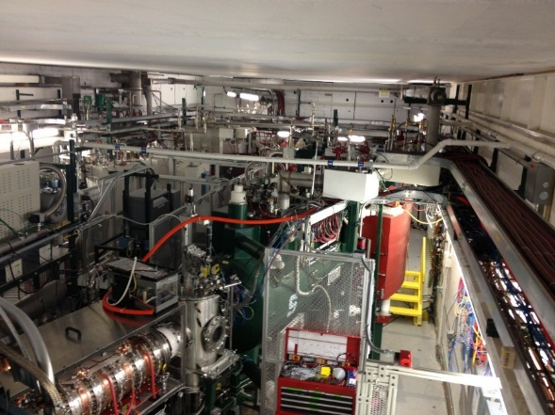
Experiments Using Stopped and Reaccelerated Beams Have Different Rate and Purity Requirements
Stopped beam experiment area
Decay experimental stations¹
High purity beams
Moderate rates
Isomeric beams
LEBIT³ (Mass measurements)
Very low rates
High purity
BECOLA² (Laser Spectroscopy)
High rates
High purity (for CRIS)
Stopped beam facility
(N4 vault)
ReA3/6⁴
High beam rates
Moderate purity
¹A. Simon, et al. NIM A 703, 16–21 (2013)
²K. Minamisono, et al. NIM A 709, 85–94 (2013)
³R. Ringle, et al. Int J Mass Spectrom 349, 87–93 (2013)
⁴A. C. C. Villari, et al. Proceedings of LINAC2016 390 (2018)

Slide 11
Homework: Gas Stopping Related Talks
Stopping of fast rare isotopes
  Addressing open riddles in heavy N=Z nuclei with the FRS Ion Catcher and plans for the first experiments at the Super-FRS Ion Catcher at FAIR (10/22 @ 10:30 a.m.)
Production of beams from reactions
  MNT reactions with slowed-down relativistic beams – on a pathway to heavy-ion Coulomb barrier reactions with secondary beams (10/20 @ 11:00 a.m.)
  Neutron-rich beams from gas catchers: the nuCARIBU and N=126 factory facilities (10/22 @ 11:00 a.m.)
  NEXT - A new setup to study Neutron-rich Exotic, heavy, nuclei produced in multinucleon Transfer reactions (10/23 @ 9:20 a.m.)
  KISS1.5 for multi-nucleon transfer experiment, ion optics of a mass range separator (10/21 @ 4:00 p.m.)
Superheavy elements
  Progress on the new Universal High-Density Gas Stopping Cell (UniCell) for Supherheavy Element Chemistry Studies (10/22 @ 11:40 a.m.)
Extra credit (posters)
  Commissioning the N=126 Factory, a new multi-nucleon transfer reaction facility at Argonne National Laboratory
  Beam Stopping Operation at FRIB with the Advanced Cryogenic Gas Stopper
  The First Radioactive Ion Beams at the St. Benedict Trapping Facility

Slide 12
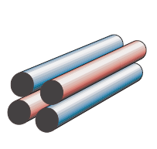
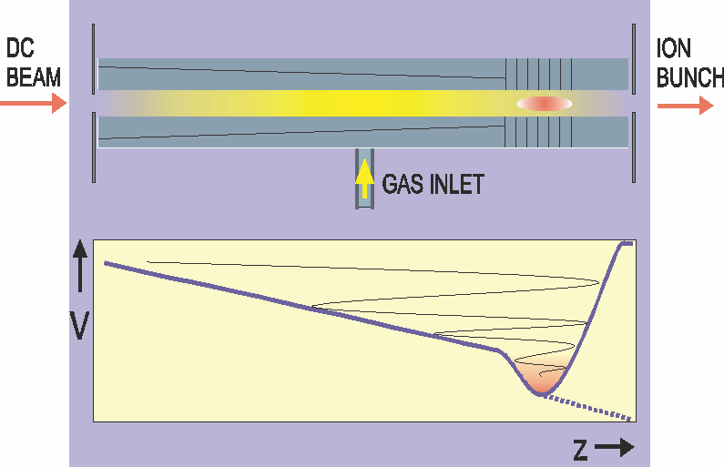
Manipulating Phase Space and Time Structure of Stopped Beams
Oscillating quadrupole electric fields provide transverse confinement – Radio Frequency Quadrupole (RFQ)
  Confinement depends on RF voltage, frequency
  Analogous to focusing/defocusing system
Cooling
  Buffer gas (usually He) damps ion motion
Moving and trapping ions
  Axial electric field created by segmentation of RFQ rods and application of additional DC potentials along rod in addition to RF
  Apply longitudinal push/drag field or form axial trap
Must be able to handle large number of ions to make full use of high-intensity stopped beams available at FRIB
  Particularly true for reaccelerated beams
RF 0°
RF 180°
Beam Path

Slide 13
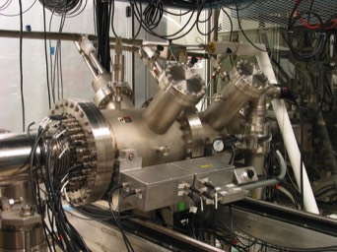
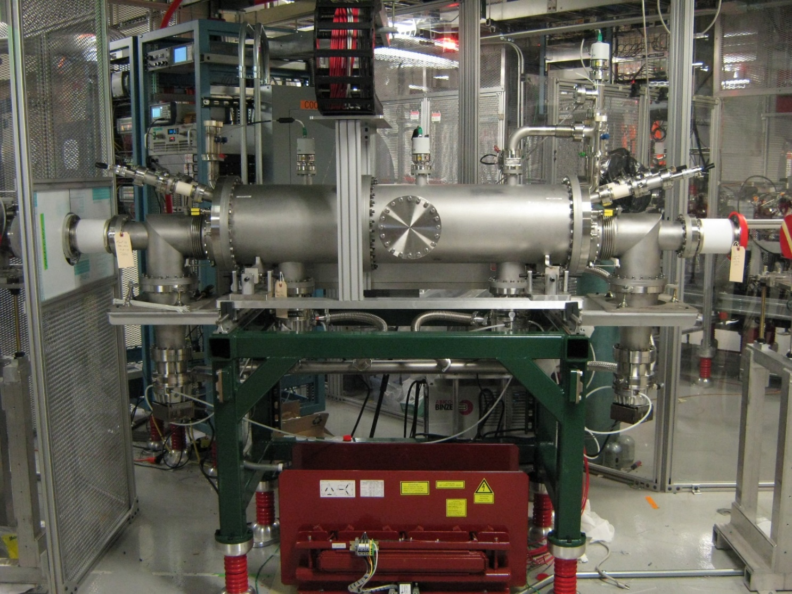
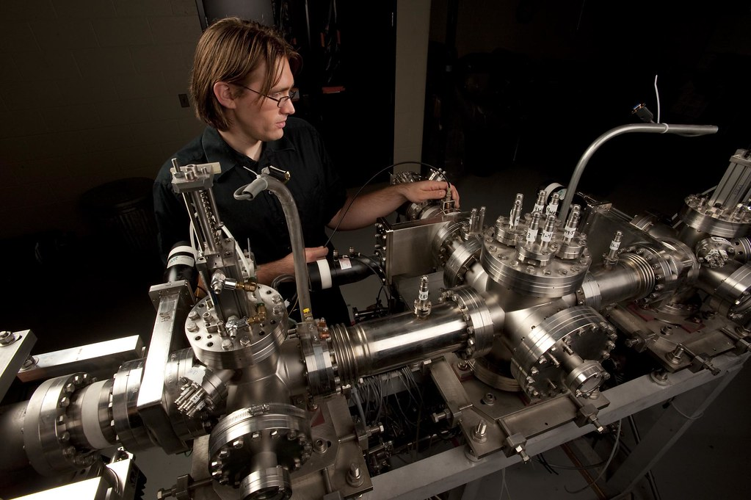
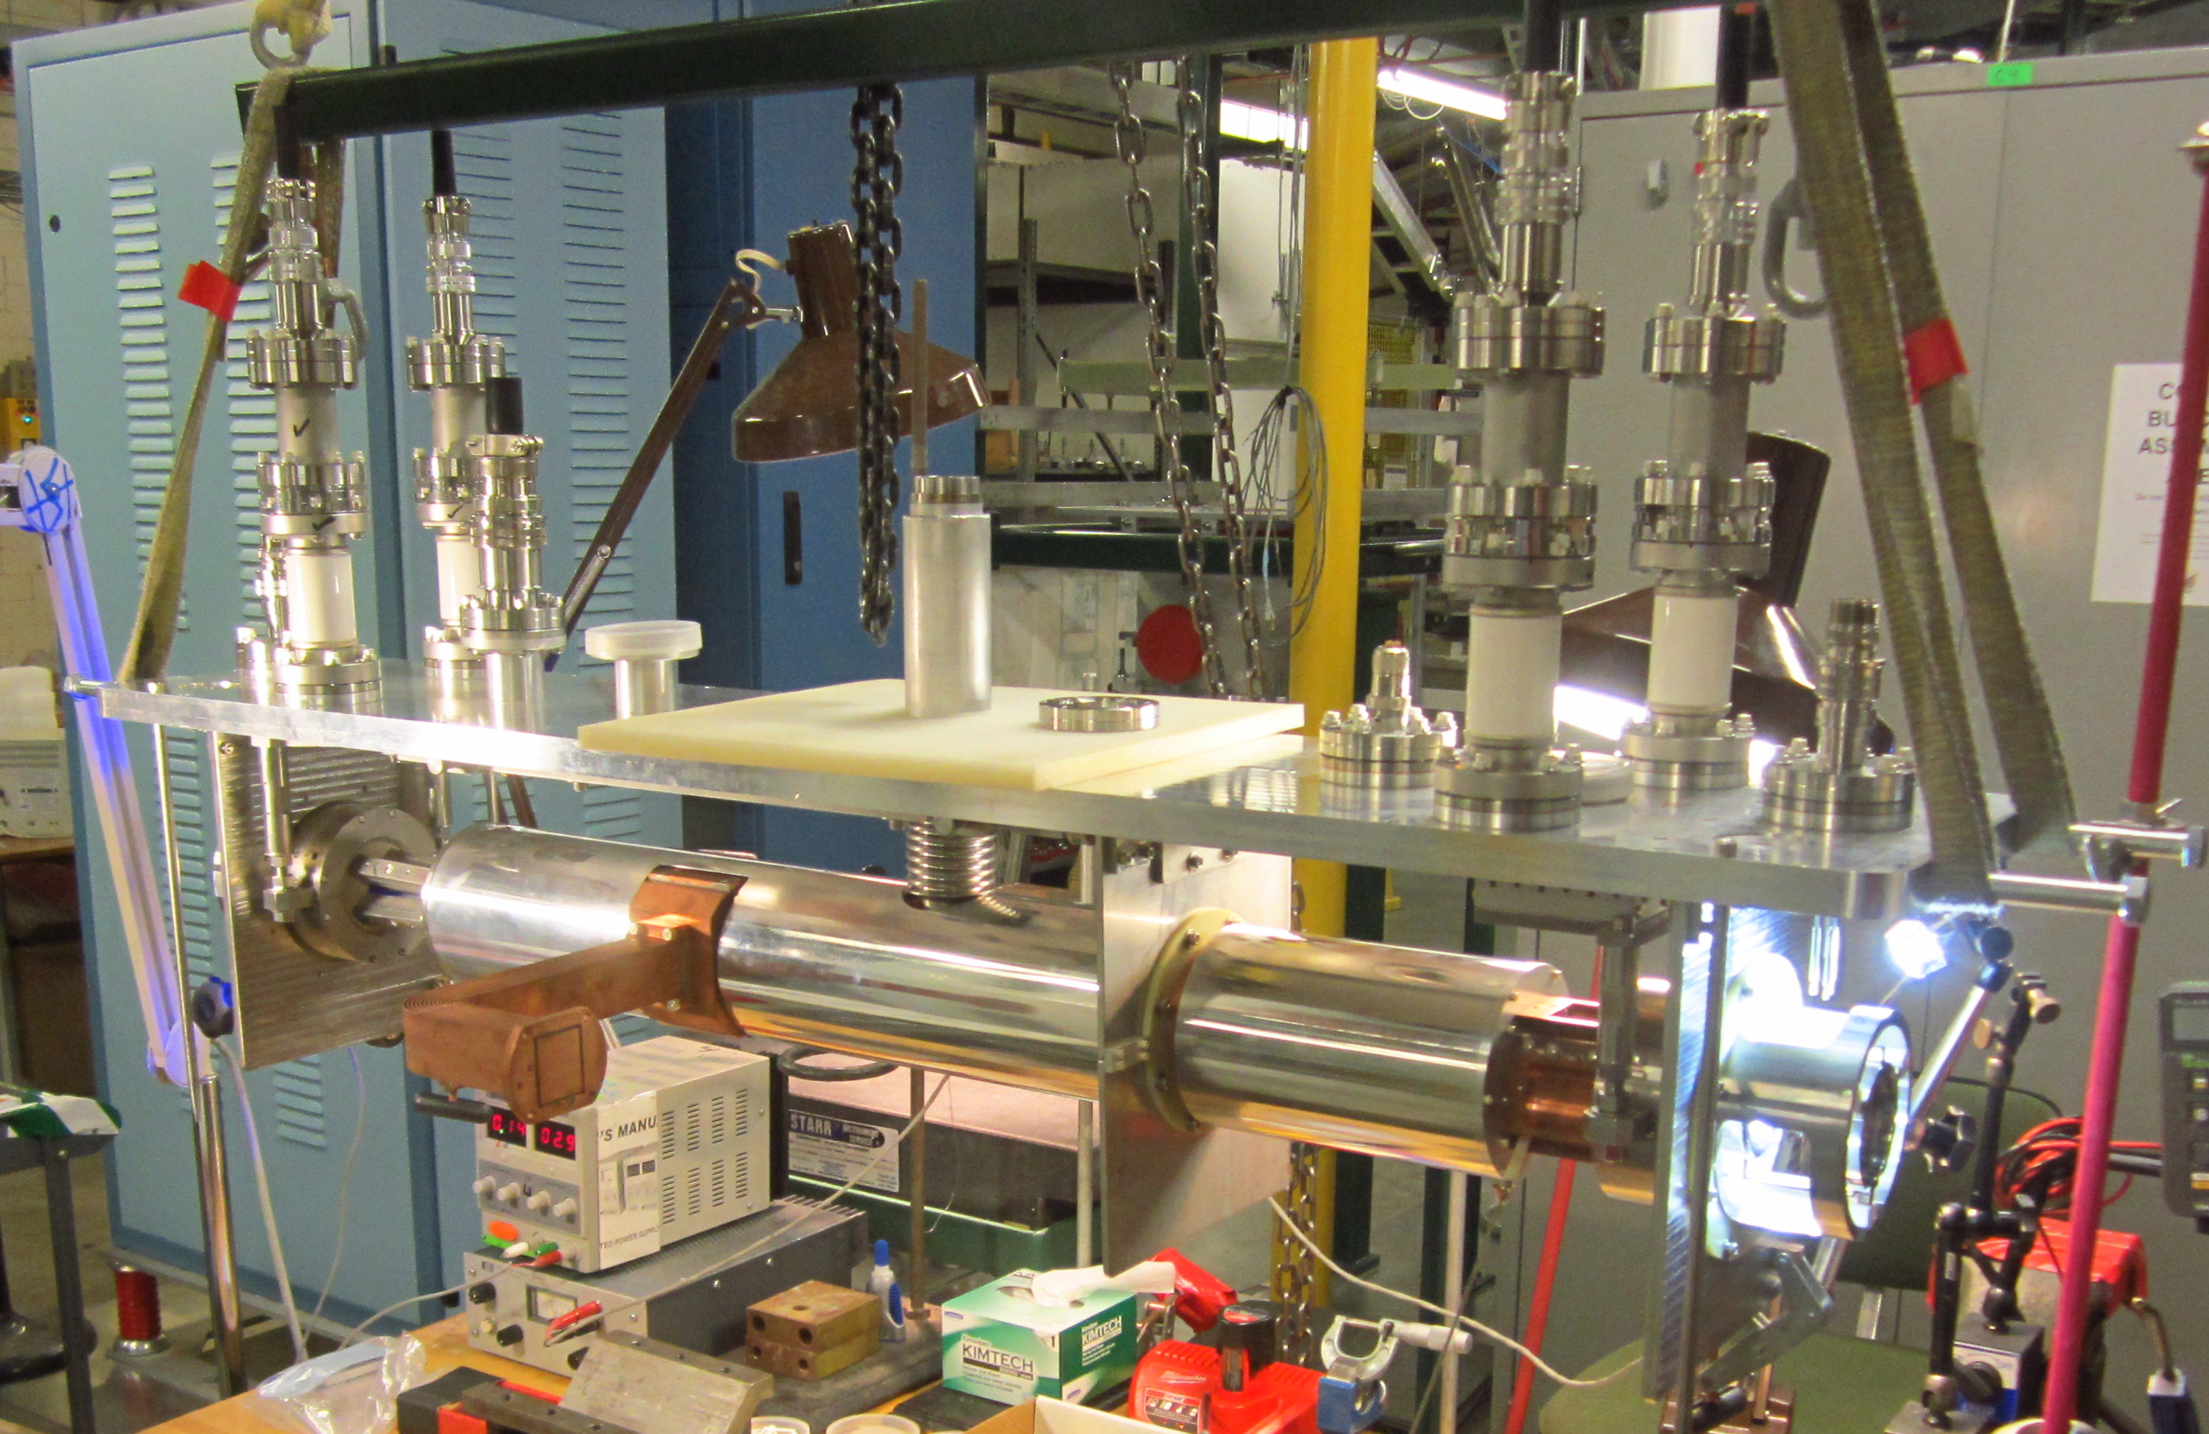
Three Generations of RFQ Cooler/Bunchers Developed at FRIB
First Generation – the LEBIT cooler/buncher¹
  First three-stage device separating cooling and bunching stages
  Cryogenic capable with circulating LN2
Second generation – the BECOLA cooler/buncher²
  Optimized for low energy spreads
  Cryogenic capable with flowing LN2
  Same design used for RTGC and ACGS extraction RFQs
Third generation – the EBIT cooler/buncher
  Optimized for large ion capacity and acceptance
  Cryogenic capable using cryocooler
  Design copied for many other experiments
    ATLANTIS and N=126 Factory at ANL
    St. Benedict at U. Notre Dame
BECOLA CB
(Brad Barquest)
LEBIT CB
EBIT CB
¹S. Schwarz, et al., NIMA 816, 131–141 (2016)
²B.R. Barquest, NIMA 866, 18–28 (2017)
³A. Lapierre, et al., J. Phys.: Conf. Ser. 2743, 012063 (2024)
R. Ringle, 10/19/2025, EMIS

Slide 14
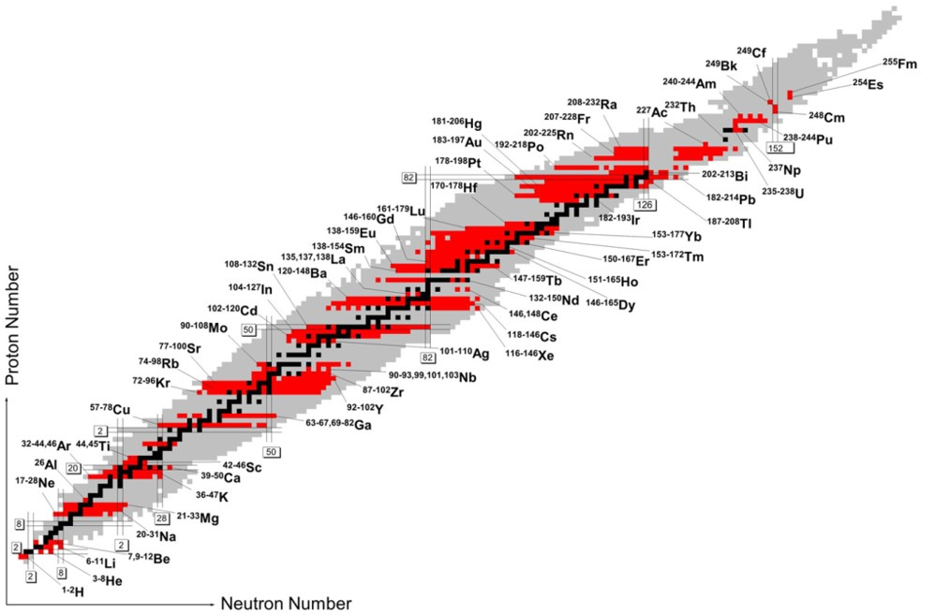
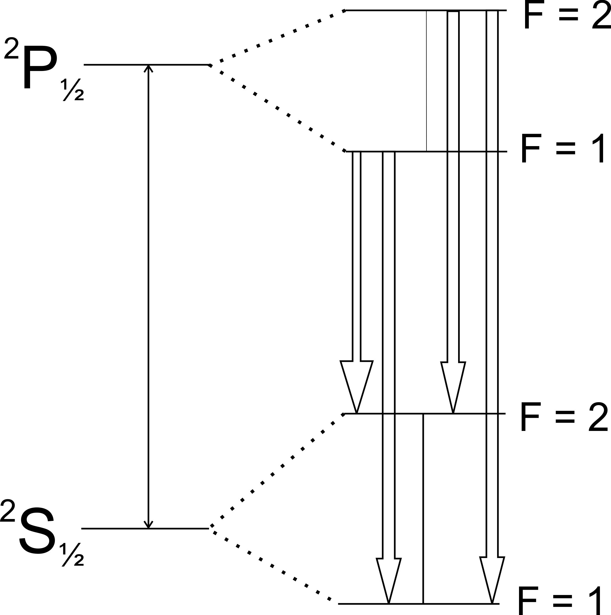
Collinear Las Spectroscopy (CLS) of Rare Isotope Beams
K. Blaum et al. Phys. Scr. 2013 014017
Infer µ, Q, <r_{ch}²> of rare isotopes from hyperfine spectra
Pioneered at ISOL facilities
Projectile fragmentation offers complementary capabilities (beams not available at ISOL)
R. Ringle, 10/19/2025, EMIS
, Slide 14

Slide 15
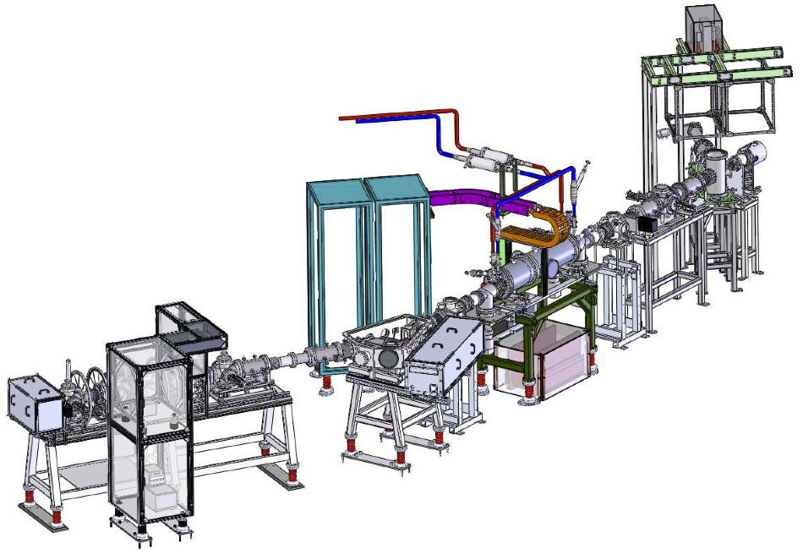
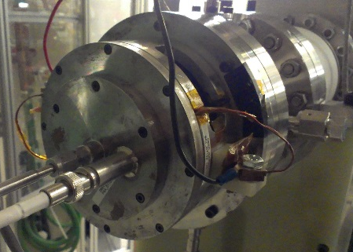
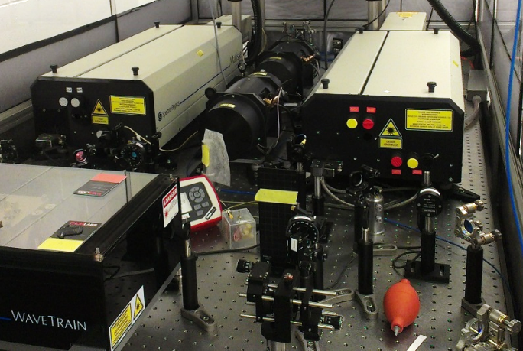
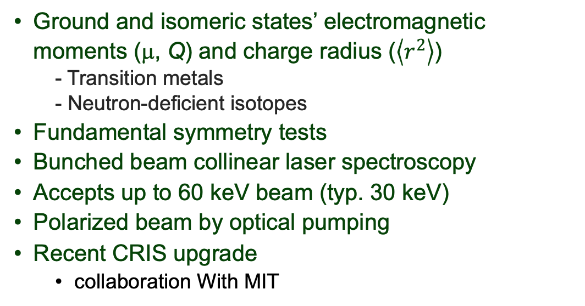
BECOLA Facility
(Beam Cooling and Laser Spectroscopy)
Ground and isomeric states’ electromagnetic moments (μ, Q) and charge radius ($\left\langle r^{2}\right\rangle$)
  - Transition metals
  - Neutron-deficient isotopes
Fundamental symmetry tests
Bunched beam collinear laser spectroscopy
Accepts up to 60 keV beam (typ. 30 keV)
Polarized beam by optical pumping
Recent CRIS upgrade
  collaboration With MIT
rare isotope
beams
PIG offline
ion source
collinear laser spectroscopy
laser system
laser/ion
beams
cooler/buncher
laser injection
K. Minamisono et al, NIMA 709, 85 (2013);
D. M. Rossi, K. M. et al., RSI85, 093503 (2014);
C. A. Ryder, K. M. et al., Spectrochim. Acta Part B 113, 16 (2015).
R. Ringle, 10/19/2025, EMIS
, Slide 15

Slide 16
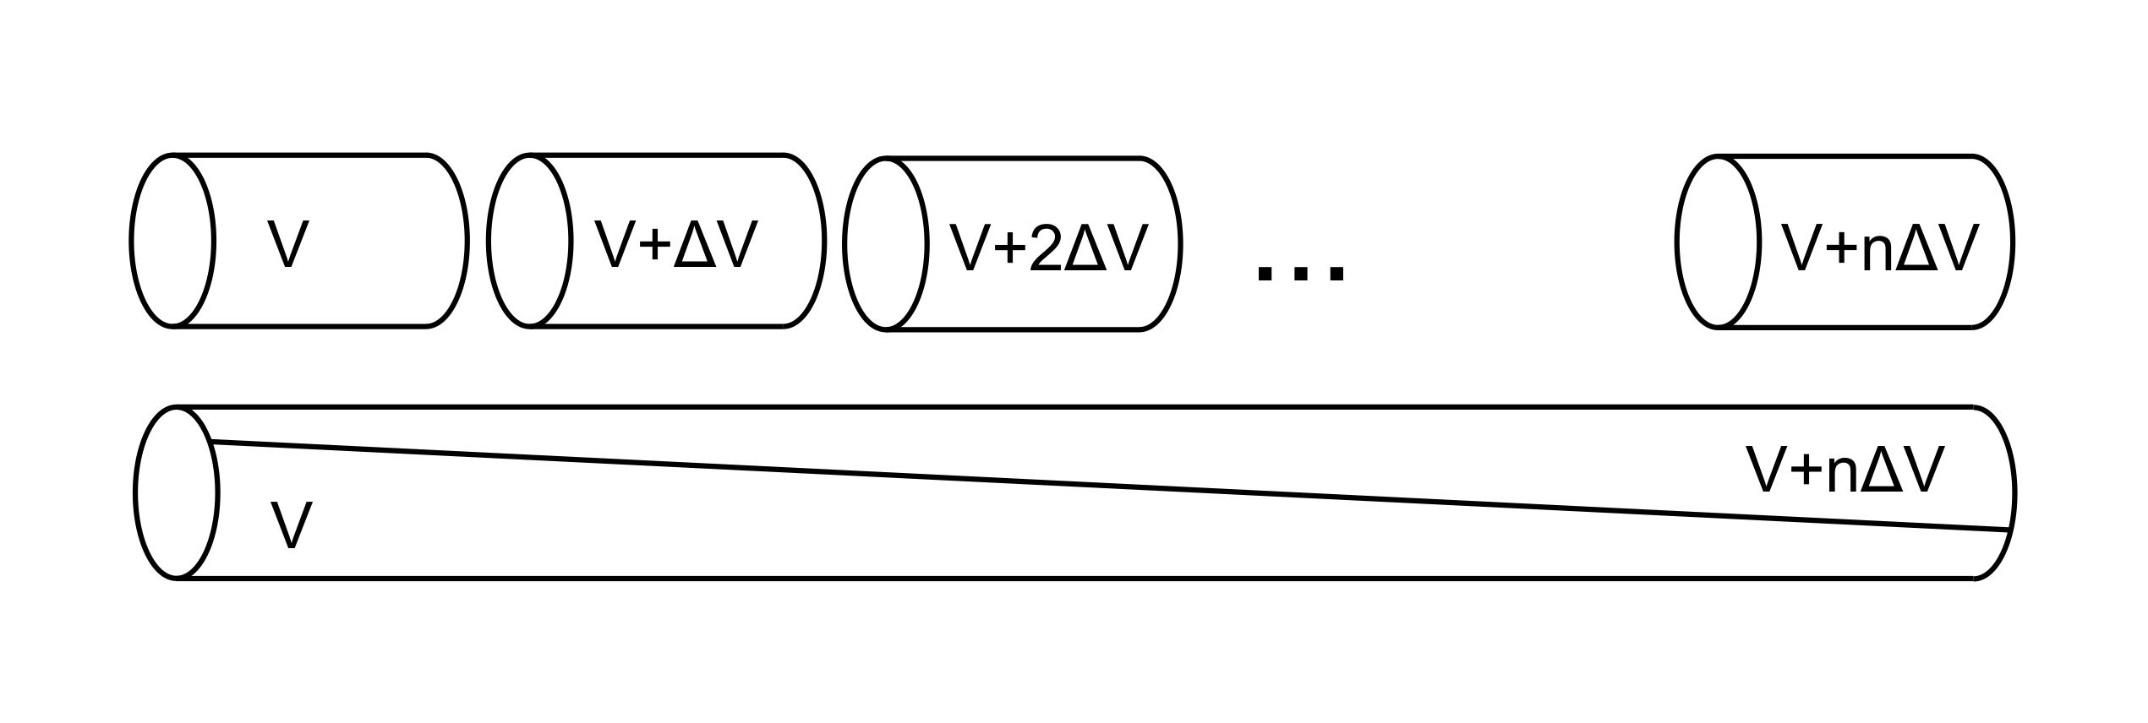
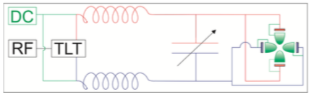
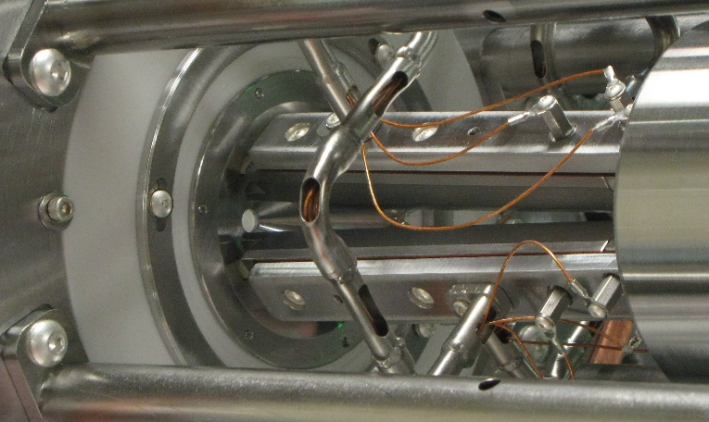
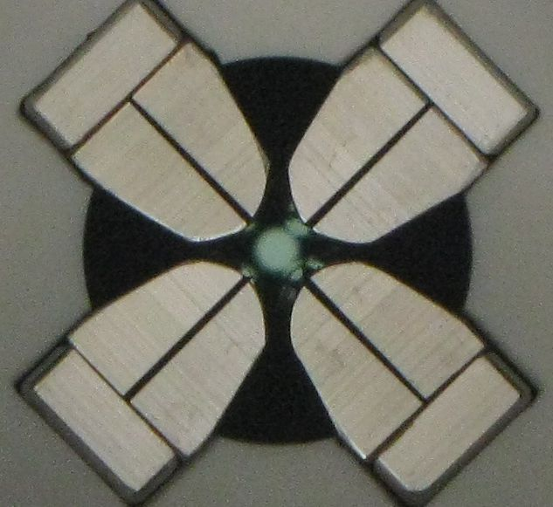
BECOLA RFQ¹ Provides Cooled and Bunched Ion Beams for Laser Spectroscopy
Crosscut geometry
  Fewer electrodes
  Simplified wiring
  Smoother gradient
RF
  Produced via tunable LC circuit
  Impedance matched with transmission line transformer
  Capacitively coupled to split electrodes
DC
  Leads fed through inductor
  Minimizes RF at power supply
¹B. R. Barquest et al., NIMA 866, 18 (2017)

Slide 17
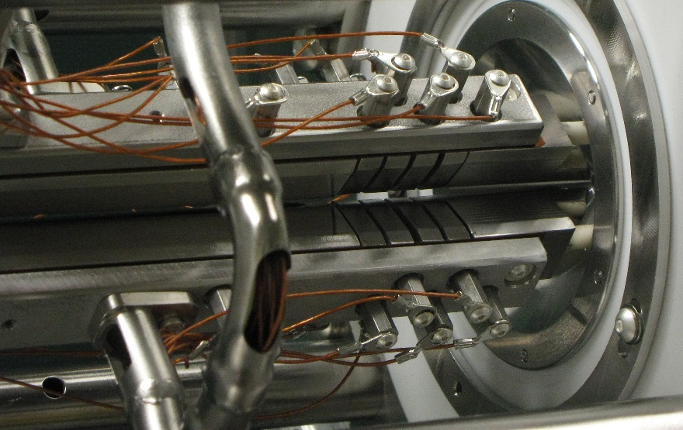
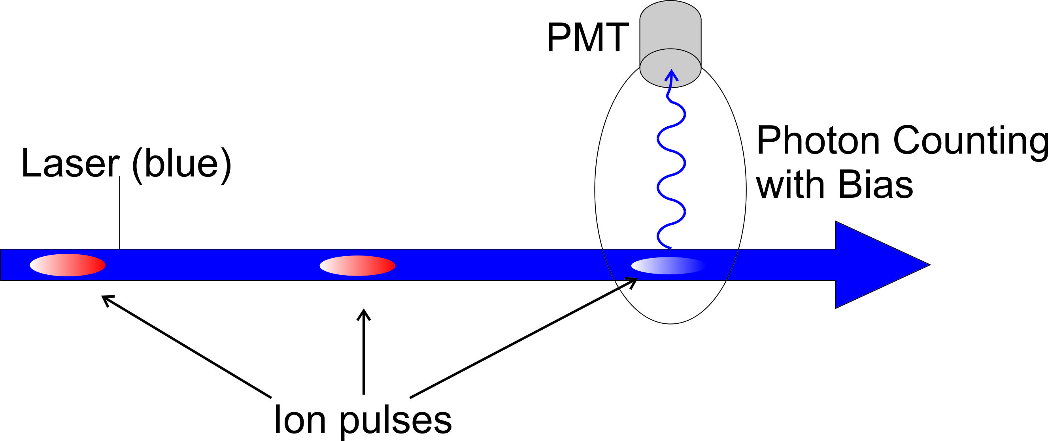
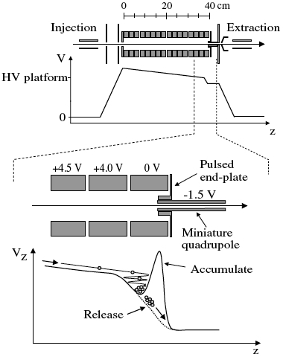
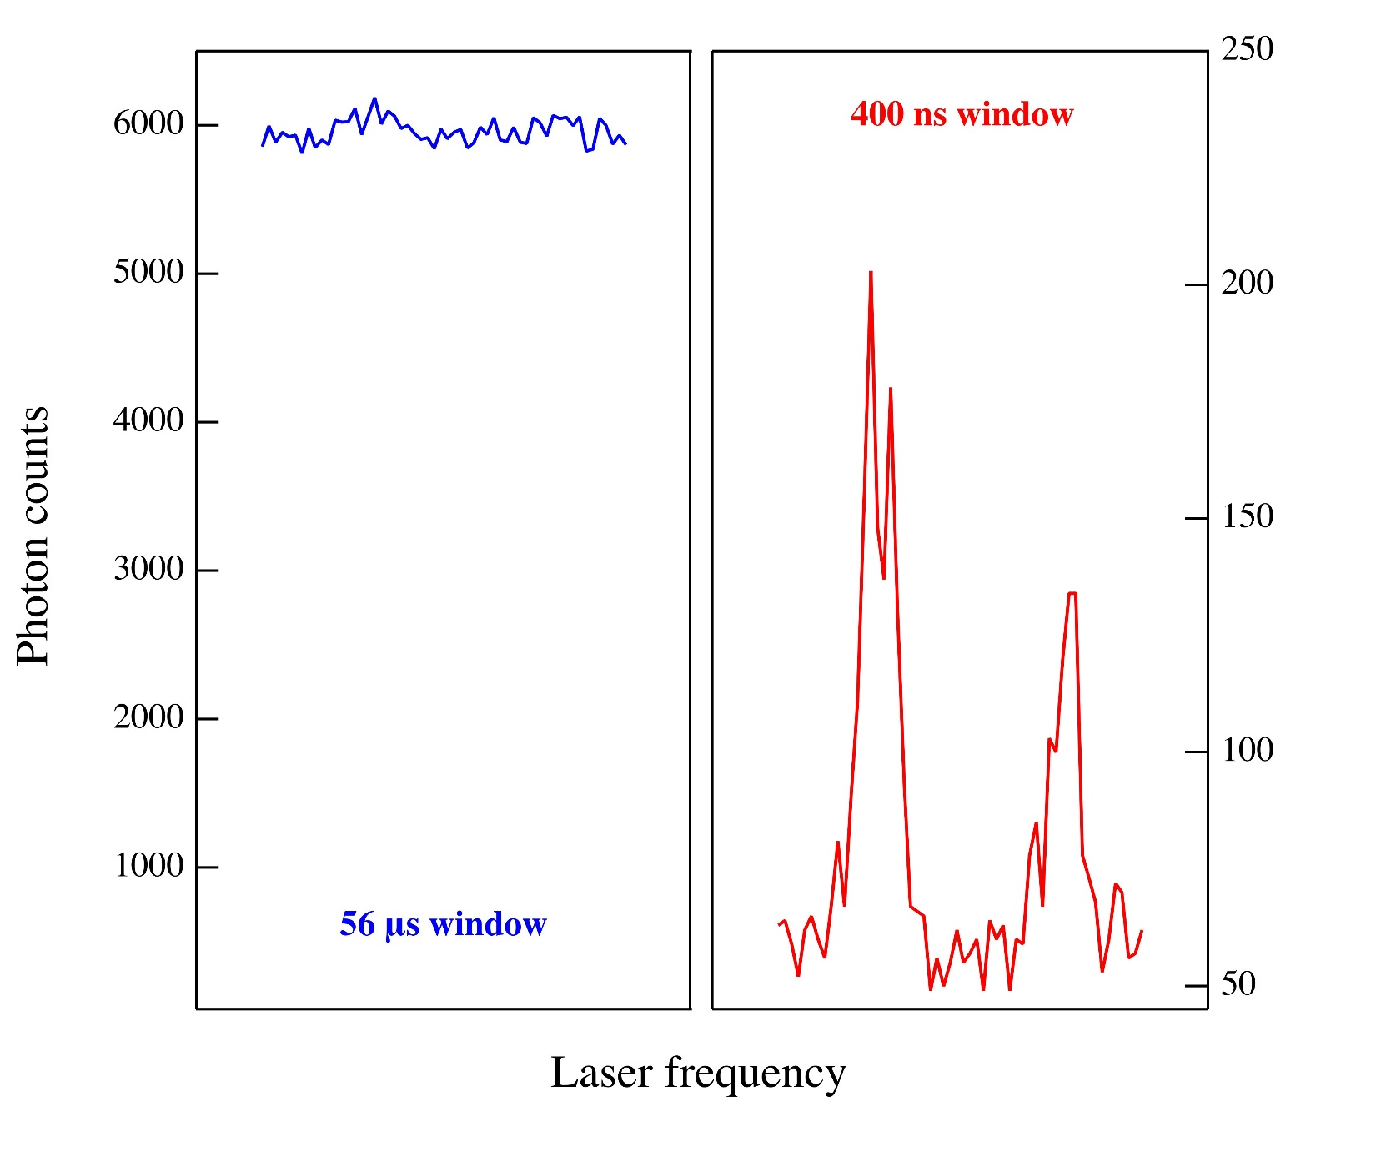
Bunched Ion Beams Reduce Background in CLS Measurements
³⁹K I: 4p ²P_{1/2} → 4s ²S_{1/2}
bunched
Ion beam bunching significantly enhances SNR of fluorescence spectrum.
First demonstrated at IGISOL¹
Significantly increases sensitivity of CLS
unbunched
¹A. Nieminen et al., PRL 88, 094801 (2002)

Slide 18
Homework : Laser Related Talks
Laser facilities & techniques
  Nuclear spin polarization and collinear laser spectroscopy program at TRIUMF (10/20 @ 4:40 p.m.)
  Online commissioning and current status of CLaSsy at RAON (10/21 @ 9:40 a.m.)
  The CRIS technique and its latest advances: towards more exotic isotopes and beyond nuclear structure studies (10/23 @ 11:20 a.m.)
Laser ion sources
  Simultaneous mass spectrometry and in-source laser spectroscopy of exotic nuclides from ISOLDE (10/23 @ 11:40 a.m.)
  Laser resonance ionization laser ion source(s) for radioactive ion beam delivery at TRIUMF (10/24 @ 9:00 a.m.)
Nuclear science results
  Nuclear structure studies by collinear laser spectroscopy (10/21 @ 10:30 a.m.)
  High resolution laser spectroscopy in the actinide region using the PI-LIST laser ion source (10/24 @ 9:40 a.m.)
Radioactive molecules
  Developments for Standard Model tests with radioactive molecules (10/23 @ 3:30 p.m.)

Slide 19
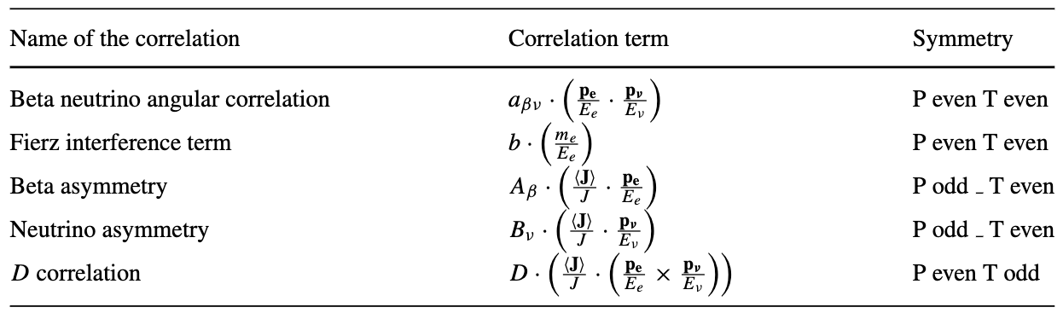
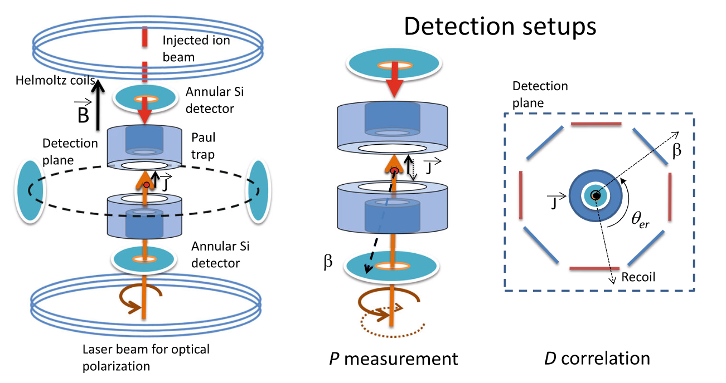
Correlation Measurements in β decay Using Trapped Ions
The MORA¹ project aims to search for explanations for the strong matter-antimatter asymmetry in the universe.
Large CP violation beyond that predicted in the SM via quark mixing.
MORA aims to measure the D correlation to search for CP-violating interactions in a region less accessible to EDM searchers.
LHC cannot offer competitive bounds for the specific CP-violating interactions affecting the D correlation.
¹P. Delahaye et al., Hyperfine Interact. 240, 63 (2019)

Slide 20
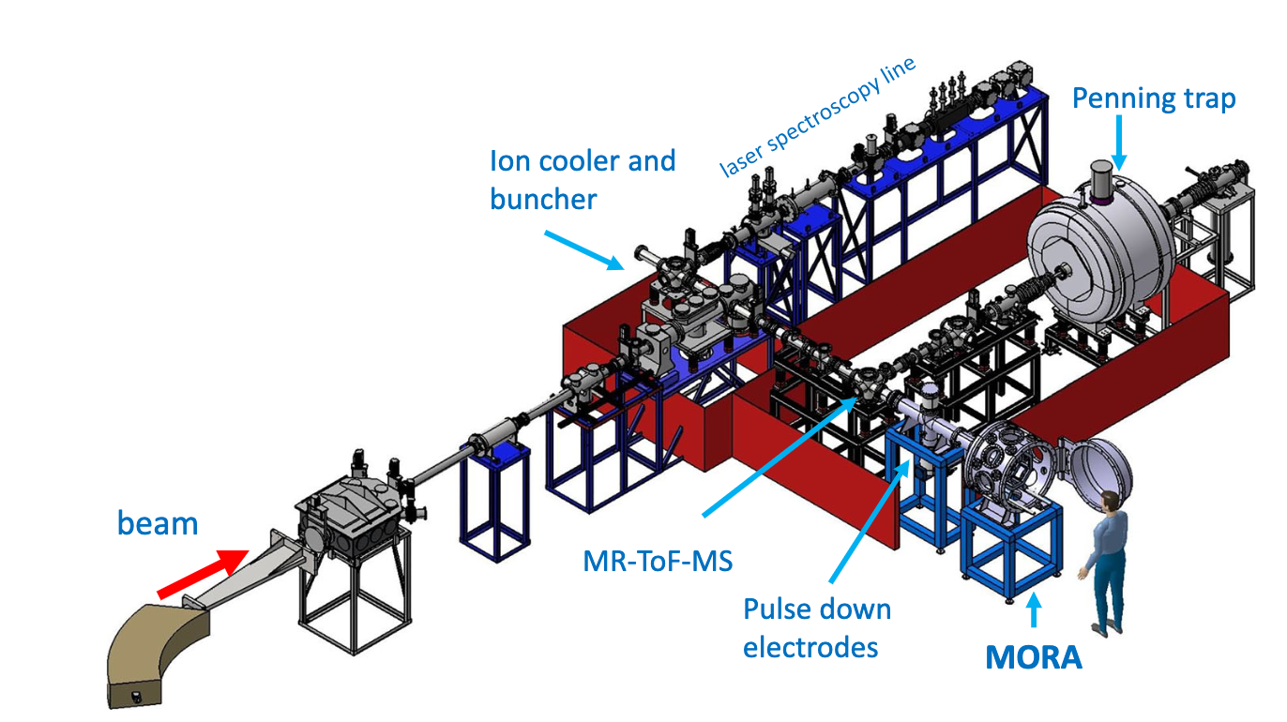
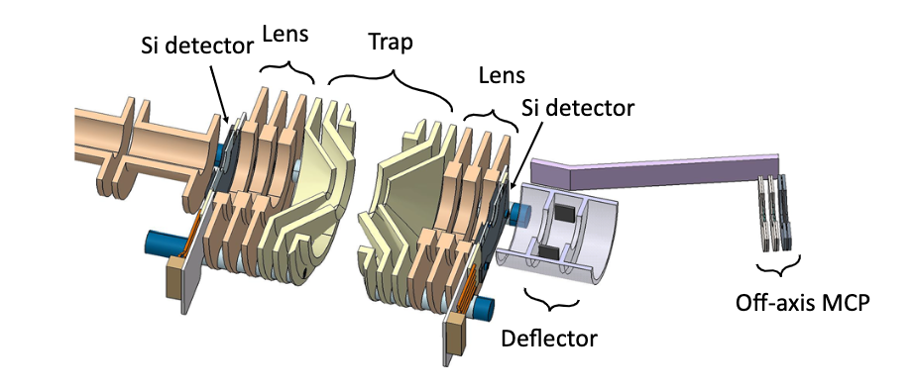
MORA Installation at IGISOL
IGISOL
(Jyväskylä)
Use of trapped ions offers several advantages:
  Increased sensitivity (plane selection)
  Reduced systematics related to source size, geometry and polarization
First measurements of D correlation in ²³Mg⁺ will be performed at IGISOL and later moved to GANIL.
Use of MR-TOF may be required to purify contaminant ²³Na⁺ ions
Talk by T. Eronen on Monday 9:30 a.m.

Slide 21
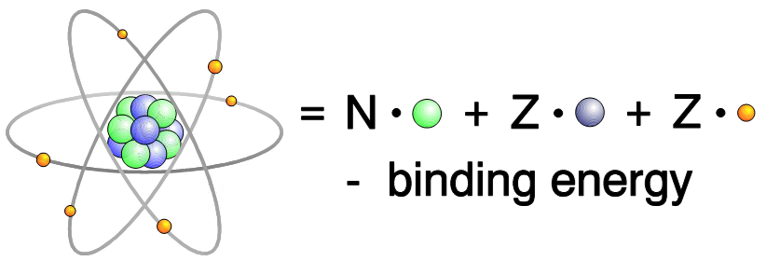
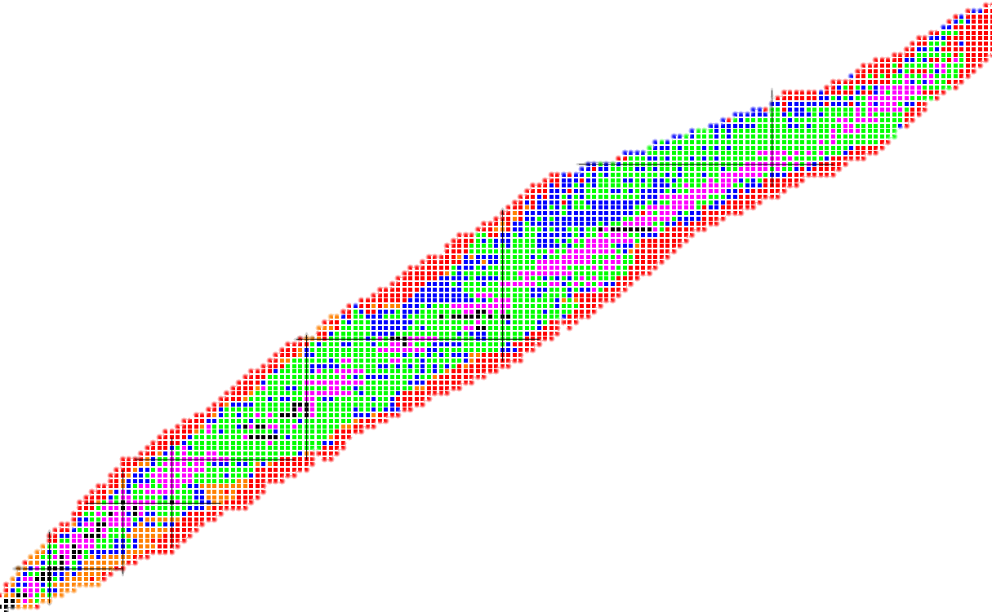
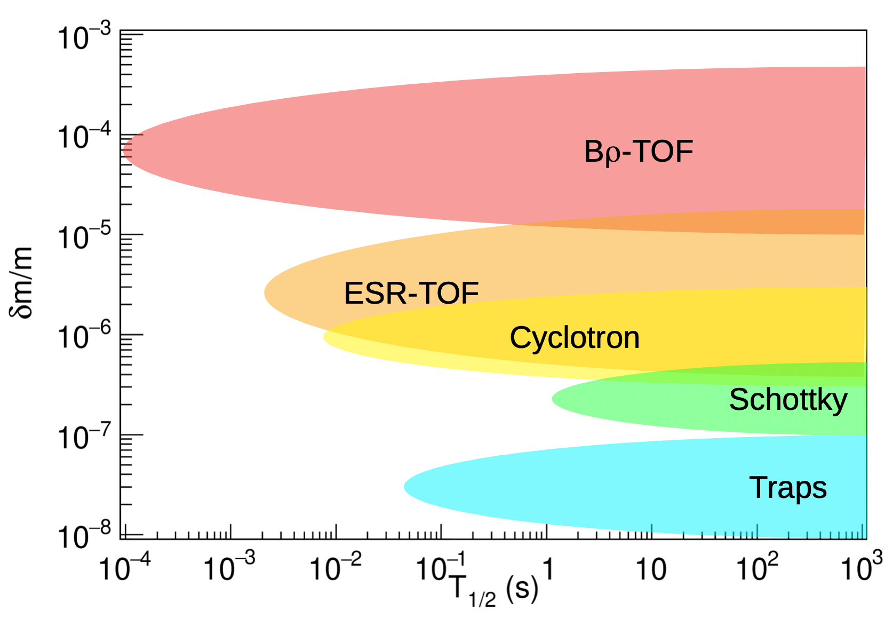
Mass Measurements of Rare Isotopes Needed to Address Many Physics Topics
AME20: Huang et al., Chin. Phys. C 45, 030002 (2021)
SHE studies
Δm/m < 10⁻⁶
Tests of Fundamental Interactions
Δm/m < 10⁻⁸
Element Synthesis
Via rp-Process
Δm/m ~ 10⁻⁷
Element Synthesis
Via r-Process
rp-process path
r-process path
Δm/m ~ 10⁻⁷
Relative mass uncertainty
Proton number Z
Δm/m ≤ 10⁻⁹
10⁻⁹ < Δm/m ≤ 10⁻⁸
Evolution of Nuclear Shell Structure
10⁻⁸ < Δm/m ≤ 10⁻⁷
10⁻⁷ < Δm/m ≤ 10⁻⁶
Δm/m > 10⁻⁶
Δm/m ≤ 10⁻⁶
unmeasured
Neutron number N
M. Famiano, Int. Journal Mod. Phys. E 28, 1930005 (2019)

Slide 22
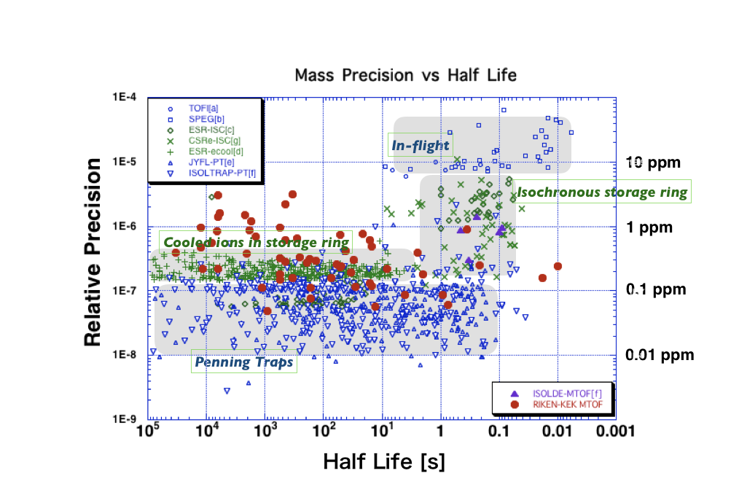
Ion Traps Required For Highest Precision Mass Measurements of Rare Isotopes

Slide 23
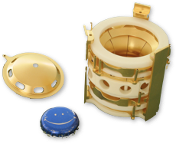
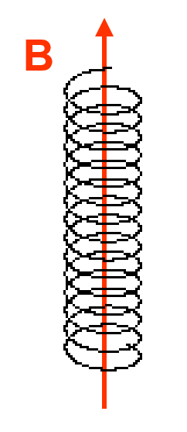
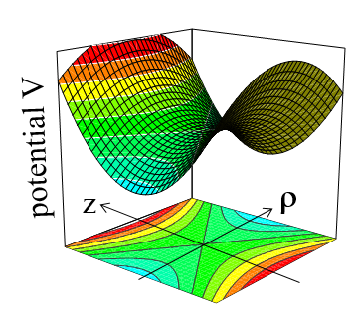
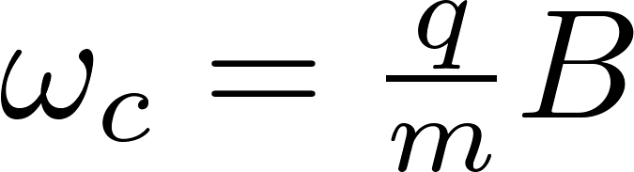
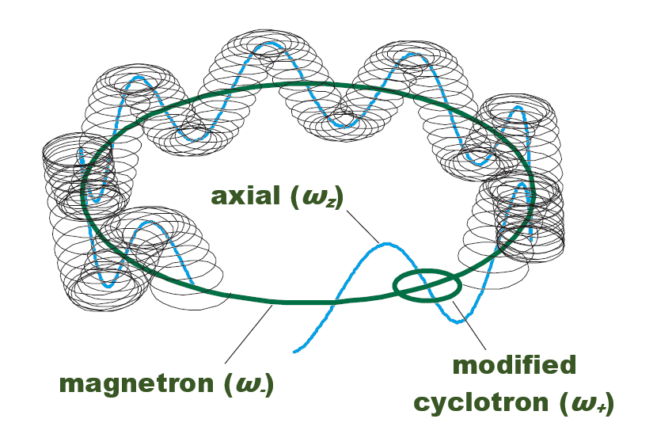

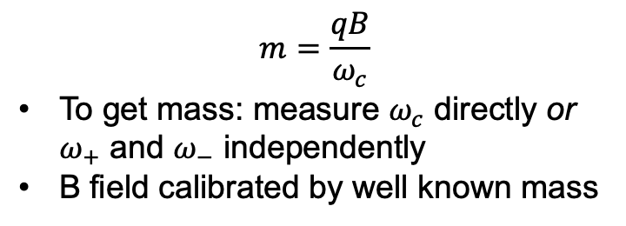


Penning Traps Enable High Precision Mass Measurements
Uniform Magnetic Field
+ Quadrupolar Electrostatic Field
= Penning Trap
(radial confinement & access to $ω_{c}$)
(axial confinement)
(3D confinement to probe $ω_{c}$)
“cyclotron
frequency”
$$m=\frac{qB}{ω_{c}}$$
To get mass: measure $ω_{c}$ directly or $ω_{+}$ and $ω_{−}$ independently
B field calibrated by well known mass

Slide 24
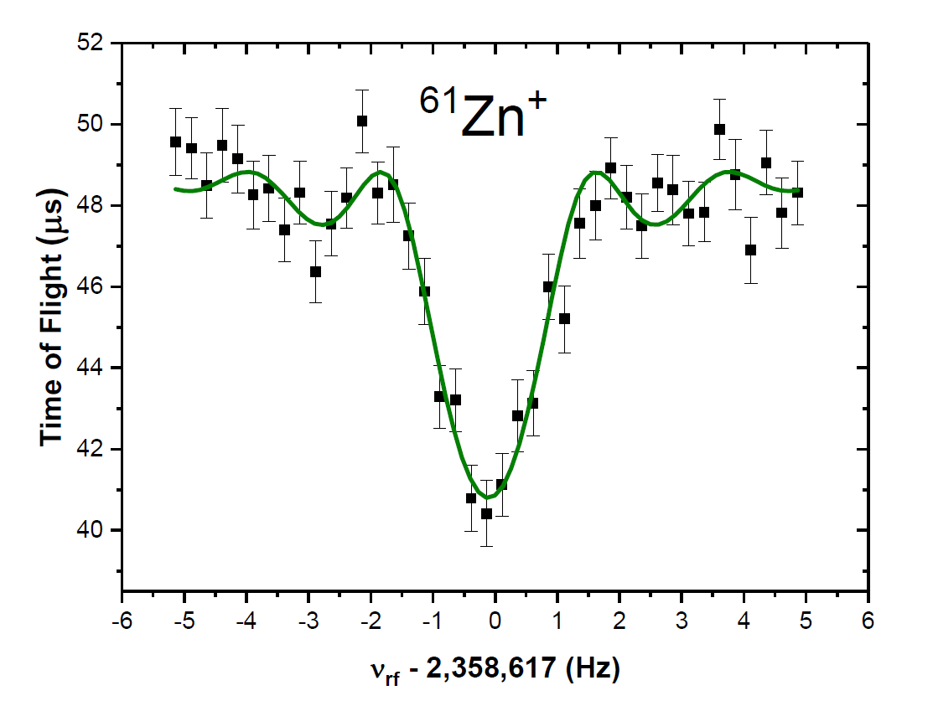
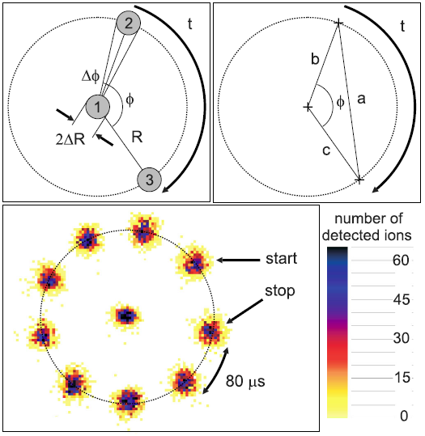
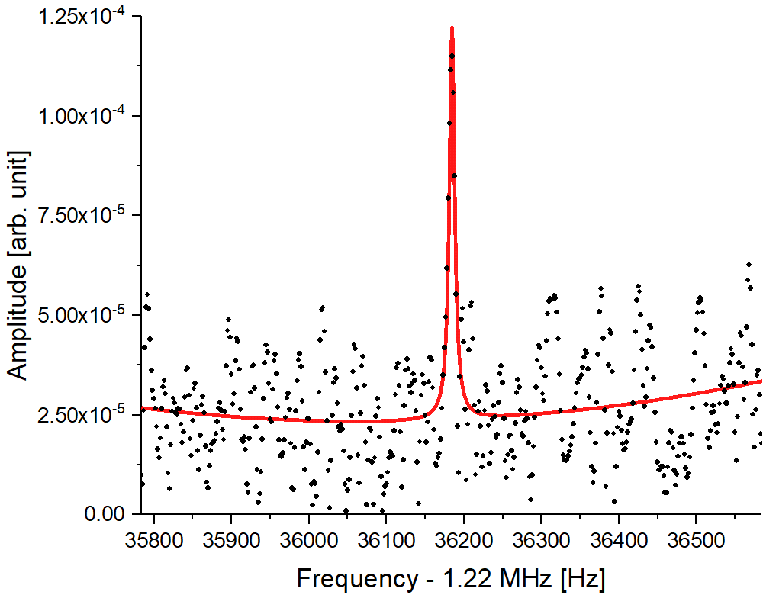


Cyclotron Frequency Measurement with Penning Traps
Time-of-flight ion cyclotron resonance (TOF-ICR)¹
  Original method developed for measurements of rare isotopes
  Scanning, very adaptable and easy to use
Phase-imaging ion cyclotron resonance (PI-ICR)²
  Measure phase accumulation of ions in the trap
  Offers higher precision than TOF-ICR
  Slightly more complicated, requires position-sensitive MCP
Fourier-transform ion cyclotron resonance (FT-ICR)³
  Originally developed for analytical chemistry
  Narrowband can reach single-ion sensitivity
  Mass measurements with a single ion.
TOF-ICR
4K
PI-ICR
FFT
FT-ICR
¹König et al. IJMSIP 142, 95 (1995). ²S. Eliseev et al. PRL, 110, 082501 (2013) ³Marshall et al. Mass Spectrom. Rev. 88, 1 (1998)

Slide 25



The LEBIT Penning Trap Mass Spectrometry Facility
30 kV offset
Off-line
Ion sources
Laser Ablation
RFQ cooler
buncher
Switchyard
9.4 T magnet
TOF-ICR
PI-ICR
Plasma Source
7 T SIPT
magnet
FT-ICR
Rare
isotope beam
Cryocooler
Laser Ablation: C. Izzo et al., NIM B 376, 60 (2016)
Cooler/Buncher: Schwarz et al., NIM A 816, 131-141 (2016)
9.4 T Spec.: R. Ringle et al., Int. J. Mass Spec 349-350 (2013)
SIPT: A. Hamaker et al., Hyperfine Interact. 240, 34 (2019)

Slide 26




Post-Trap Decay Spectroscopy with Isomeric Beams
Some ion traps can serve as an ultra-high-resolution mass separator
Isomeric beams can be purified and delivered
  Serves important topics in nuclear structure¹, astrophysics², and applications³
Example: three states in ⁷⁰Cu purified and delivered to SuN++ using LEBIT Penning trap
Total ion throughput in a Penning trap is limited
LEBIT detector
chamber
SuN++
9.4 T solenoid
NEC column
(HV break)
¹P. Walker & G. Dracoulis, Nature 399, 35–40 (1999)
²G.W. Misch & M.R. Mumpower, Eur. Phys. J. Spéc. Top. 233, 1075–1099 (2024)
³L. Hemmingsen, et al., Chem. Rev. 104, 4027–4062 (2004)

Slide 27













Beyond Standard Model Search with TAMUTRAP
Proton inherits information from leptons
  $β$-$ν$ correlation, Fierz interference
  sensitive to new physics
  (scalar/tensor currents)
Extremely clean measurement
Many cases to test systematics
$$J^{+}, T, T_{Z}$$
$$β^{+}$$
$$J^{+}, T,{T′}_{Z}$$
$$p$$
@ Texas A&M
scalar vs vector

Slide 28





TAMUTRAP Boasts the World’s Largest Penning Trap
Most cylindrical Penning traps have a length-to-radius ratio of $l/r=11.75$
To confine the protons from $T=2$ decays, need $r=90 mm$
  Needed a new design to make it fit in the 7T magnet
$$l=335 mm$$
$$l/r=3.72$$
M.Mehlman et al., NIMA 712, 9 (2013)
P.Shidling et al., Hyperfine Interact 240, 40 (2019)

Slide 29
Homework: Penning and Paul Trap Related Talks
Beam purification and preparation
  BuRI‑To & PIPERADE commissioning for DESIR (10/20 @ 4:00 p.m.)
Mass measurements
  Mass measurements of the heaviest elements with the SHIPTRAP mass spectrometer at GSI (10/21 @ 9:00 a.m.)
Decay spectroscopy
  Proof-of-principle of in-trap laser polarization of Mg-23 ions with MORA at IGISOL
Extra credit (posters)
  Next-generation Penning-trap mass spectrometry at TITAN
  Probing the silver isotopic chain with mass- and laser spectroscopy
  Status of RFQ Cooler Buncher for rare isotope experiments with Isotope Separation On-Line system

Slide 30



Multi-Reflection Time-of-Flight (MR-ToF) Devices are Versatile Devices
Downstream experiments
Ion mixture
time-of-flight separation in multiple revolutions
separated ion species
ion trajectory
 | Penning Traps | MR-ToF devices | Magnetic mass separators
 | >1,000,000 | > 100,000 | ~ 10,000
Processing time | (hundreds of ms) | (tens of) ms | continuous
Ion flux | 10’s of ions/s | < 10²-10⁷ ions/s depending on m/Δm | 10¹³ pps
$$R=\frac{m}{∆m}=\frac{m_{1}}{m_{2}−m_{1}}$$
MR-ToFs excel at high-precision mass measurements and beam purification
  Ion flux exceeds what is possible with a Penning trap

Slide 31


Path to High-Rate, High-Resolution MR-ToF Understood
Design Studies Complete
Current MR-ToFs typically operate with a few keV beam energy, resolving powers of ~100k for ~1000 pps
Simulations reveal that beam energy of
30 keV results in resolving power of ~100k for 10⁵ pps
Challenges of 30 keV operation met through design^{1,2}:
  Use of high-stability power supplies needed to maintain high resolving power
  Potential differences between neighboring electrodes kept below values recently demonstrated at MIRACLS/ISOLDE^{3,4}.
¹F. M. Maier et al., arXiv, 2509.16428 (2025)
²C. M. Ireland et al., arXiv, 2510.11741 (2025)
³F. M. Maier, M. Vilen et al., NIMA, 1048, 167927 (2023)
⁴S. Sels et al., NIMB 463, 310 (2020)

Slide 32



MIRACLS Can Happen When Combining Ion Traps and Lasers
Introducing the “Multi Ion Reflection Apparatus for Collinear Laser Spectroscopy” - MIRACLS
Similar concept as ion bunching to enhance CLS.
Reuse ions with a cyclic electronic transition.
Fast period enhances sensitivity!
@ CERN-ISOLDE
Modified an existing MR-TOF from Uni. Greifswald.
Performed offline measurements of isotope shift of stable ^{24,26}Mg⁺.
Demonstrated that the same MR-TOFs used for mass measurements can also be used for laser spectroscopy
S. Sels et al., NIM B 463, 310 (2020)
F. Maier et al., Hyperfine Interact. 240, 54 (2019)
V. Lagaki et al., NIM A 1014, 165663 (2021)

Slide 33

Photodetachment Measurements Enabled by MIRACLS
Graphic provided by E. Leistenschneider

Slide 34

Combining Ion Traps and Lasers Significantly Improves Sensitivity of Photodetachment Measurements
Graphic provided by E. Leistenschneider

Slide 35
Homework: MR-ToF Related Talks
Beam purification and applications
  MR-ToF Devices: New Applications and Developments (10/23 @ 10:30 a.m.)
  Development of high-flux MRTOF isobar separator at SCRIT facility (10/24 @ 11:00 a.m.)
Mass measurements
  Presence and Future of the MRTOF systems at RIBF, and new projects in East Asia (10/21 @ 8:30 a.m.)
  High-Precision Mass Spectrometry Near the Driplines with TITAN MR-TOF-MS (10/23 @ 9:40 a.m.)
Extra credit (posters)
  A Small Size High Resolution Multi-turn TOF Mass Analyzer
  An FPGA-based timing system for MRTOF
  Probing the Unknown: Mass Measurements near N=126 with the FRS Ion Catcher

Slide 36
Charge Breeding in an Electron Beam Ion Trap (EBIT)
  What is an Electron-Beam Ion Source/Trap and how does it work?
  Produces & traps highly charged ions with a high-current density electron beam
  3 Parts: e-gun, trap + magnet , e-collector
  Strong magnetic field: Electron-beam compression & Ionization by electron impact
  Trap electrodes (drift tubes) → Axial ion confinement
  Electron beam → Radial ion confinement
Magnetic field,
up to several Tesla
Quasi-continuous injection & accumulation (~100 ms)
A⁺
Electron
collector
Electron
beam
Trap electrodes
Electron
gun cathode
F~6 mm
Pulsed extraction
A^{Q+}
Highly charged ions
Hair-like electron beam
F~100 mm
Radial space-charge potential from the electron beam
Axial potential well from the trap electrodes

Slide 37


Atomic Spectroscopy of Highly Charged Na-Like Ions Enable Charge Radius and Isotope Shift Measurements
  Na-like ions have a single valence electron.
  The 3s valence electron orbital strongly overlaps the nucleus (high radial probability).
  3s-3p electronic transitions are highly sensitive to the size of the nucleus.
  Ab-initio atomic-structure calculations (with QED effects) can reach a high accuracy level and are highly sensitive to the nucleus’ size.
  Na-like 3s-3p transition energies can be a new tool for nuclear charge radius measurements and isotope shifts.
  Na-like 3s-3p transitions of heavy highly charged ions are in the EUV spectral range (~6 to 12 nm)…
  Simple atomic structure reduces dependence on atomic structure calculations.
Simplified Na-like atomic structure
3s
3s electron probability
Radial distance from the nucleus [atomic units]

Slide 38



Soft X-Ray Spectroscopy for Measuring Charge Radii of Rare Isotopes in an EBIT
EBIT EUV spectroscopy is in good agreement with other methods.
ReA EBIT at FRIB primarily used to produce highly charged ions for reacceleration.
Goal : Pursue charge radii measurements of heavy, rare-isotopes at FRIB with ReA EBIT
Access viewports specifically for spectroscopy

Slide 39

Precision Decay Spectroscopy with Highly Charged Rare Isotope Ions to Provide Insight into Solar Energy Production
In the sun’s core ~80% of ⁷Be is fully stripped and decays solely
through electron capture (EC) – understanding the EC rate as a
function of charge state is required¹.
Orbital electrons can significantly impact specific modes of
radioactive decay: electron capture, internal conversion
Examining the variance of the properties of these transitions under
different atomic conditions provides crucial insights into the
fundamental tests of electroweak interactions^{2,3,4}.
Suppression of EC allows for cleaner study of rarer decay branches
  γγ emission⁵ and bound-state β−decay⁶
Most nuclear physics experiments using highly charged ions are carried out in storage rings.
  No controlled environment that allows inspection of ions in a localized space and limit sensitivity
  If you don’t have a storage ring, they’re big and expensive
¹E.G. Adelberger et al., Rev. Mod. Phys. 83, 195 (2011) ⁴K. Siegień-Iwaniuk & Z. Patyk, Phys. Rev. C 84, 064309 (2011)
²Yu.A. Litvinov et al., Phys. Rev. Lett. 99, 262501 (2007) ⁵K. Leach et al., Atoms 5, 14 (2017)
³A.N. Ivanov et al., Phys. Rev. C 78, 025503 (2008) ⁶Y.A. Litvinov & F. Bosch, Rep. Prog. Phys. 74, 016301 (2011)
R. Ringle, 10/19/2025, EMIS

Slide 40


A Dedicated Cryogenic Paul Trap for Decay Spectroscopy of Highly Charged Rare Isotope Ions
Highly charged rare isotope ions produce by existing EBIT and delivered to Paul trap
  Reduced background
  Single charge states
  Room for detectors
Paul trap cryogenically cooled to maintain charge state
  Previous experience building cryogenic Paul traps
Large ion capacity required, particularly for long half lives
  Previous experience building high-intensity Paul traps
  Simulation codes already developed
In collaboration with LBNL
  E. Leistenschneider will be an FRIB Visiting Scholar
Alternative concept using a Penning trap¹
HCIs from EBIT
Cryogenic Paul Trap
¹S. Moroch et al., Phys. Rev. Res. 7, 033226 (2025)

Slide 41



Summary
Ion traps are everywhere in RIB research
  Nuclear structure
  Nuclear astrophysics
  Fundamental symmetries
Ion traps are also great auxiliary devices
  Improve transverse emittance
  Bunched beams
  High-resolution separators
  Generate highly-charged ions
  Isomeric beams?
Ion traps are even more extensively used outside of RIB research
  Quantum information
  Plasma physics
  Cluster physics
  Analytical Chemistry
  …

Slide 42

Thanks for Your Attention!
Shameless plug – postdoc position available at LEBIT
  Go to careers.msu.edu
  Search for posting 935807
  Part of a pool posting, express interest in LEBIT and your application will make its way to me

