Slide 1
Isobaric ion separation at CRIS
Tobias Christen, PhD student
Instituut voor Kern- en Stralingsfysica, KU Leuven, Belgium
20th International Conference on Electromagnetic Isotope Separators and Related Topics (EMISXX 2025)

Slide 2
Collinear laser spectroscopy
Successfully applied to over 1000 nuclei
Gives access to 4 quantities in a nuclear theory independent way
Nuclear spin (I)
Magnetic dipole moment
(μ)
Nuclear mean-square charge radius (δ<r2>)
Electric quadrupole moment
(Q)

Slide 3

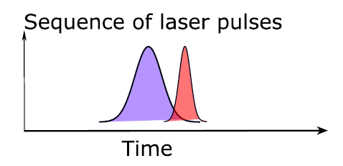
CRIS
RFQ
Talk of Jessica Warbinek
DC potential
Target
Particle detector
Distance
Deflector
Cooler-buncher
Charge exchange cell
Sequence of laser pulses
Ions
K or Na atoms
Time
He atoms
Neutralized atoms
Laser beam

Slide 4
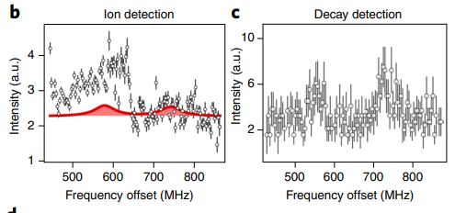
Handling of contamination at CRIS
Field ionization unit:
Applies a strong electric field (tens of kV/cm) between electrodes
This field ionizes atoms that are in highly excited (Rydberg) states
Cannot remove all the collisional background
Decay detection station:
Implantation of ion bunch on a tape
Plastic scintillator enables beta-tagging
Limitation on half lifetime of the nuclei
Figure from Á. Koszorús
Both methods are applicable to specific cases

Slide 5
Cases at CRIS
These cases provide an excellent test for the evolution of shell structure far from stability
Element | Proposed | Outstanding cases
Silver | ⁹⁴⁻¹²⁹Ag [1] | ¹²⁴⁻¹²⁹Ag
Indium | ¹⁰⁰⁻¹³⁴In [2] | ¹³¹⁻¹³⁴In
Tin | ¹⁰¹⁻¹³⁶Sn [3], [4] | ¹⁰¹⁻¹⁰³Sn, ¹³⁵⁻¹³⁶Sn
Antimony | ¹⁰⁷⁻¹¹¹Sb [5] | ¹⁰⁷⁻¹¹⁰Sb
Copper | ⁷⁵⁻⁷⁹Cu [6] | ⁷⁹Cu

Slide 6
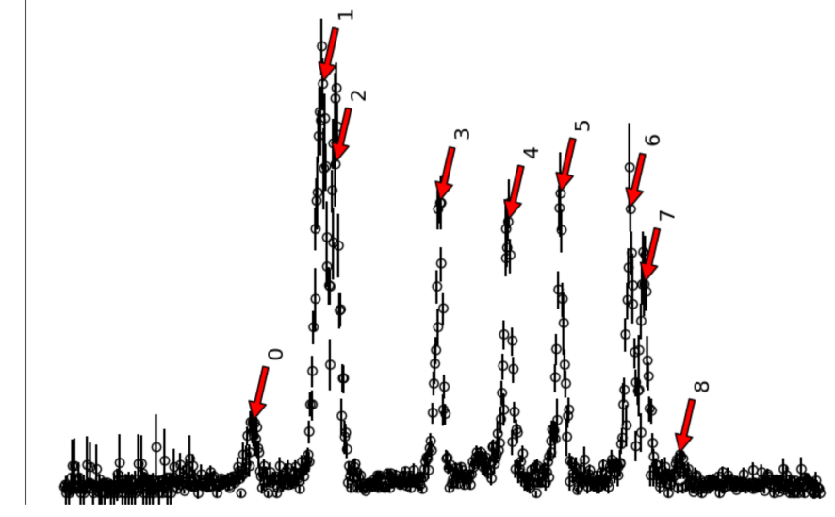
Specific case: Indium
Spectra shows ¹⁰¹In from CRIS
Expect 6 peaks from a P_{3/2} to S_{1/2} transition
Proton-beam gate analysis used distinguish ¹⁰¹In signals from contaminants
Peaks 0,1 and 8 are not from ¹⁰¹In
Contamination from SrF molecules
1
8
2
3
5
6
4
6
7
Rate [Hz]
4
0
2
8
0
Three resonance peaks due to ionized contaminants
0
1000
2000
3000
4000
5000
6000
7000
Frequency [MHz]
Figure adapted from [7]

Slide 7
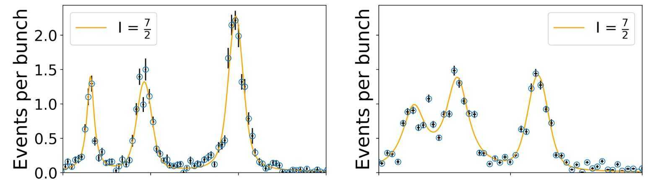
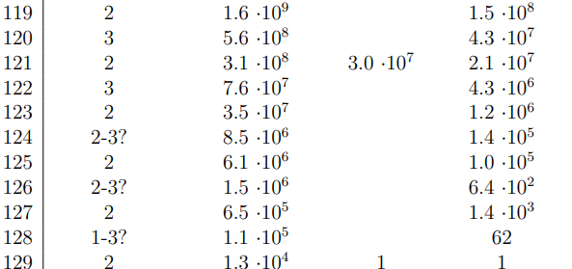
Specific case: Silver
Spectra of ¹¹⁹Ag
Low background
Figure from B. van den Borne

Slide 8
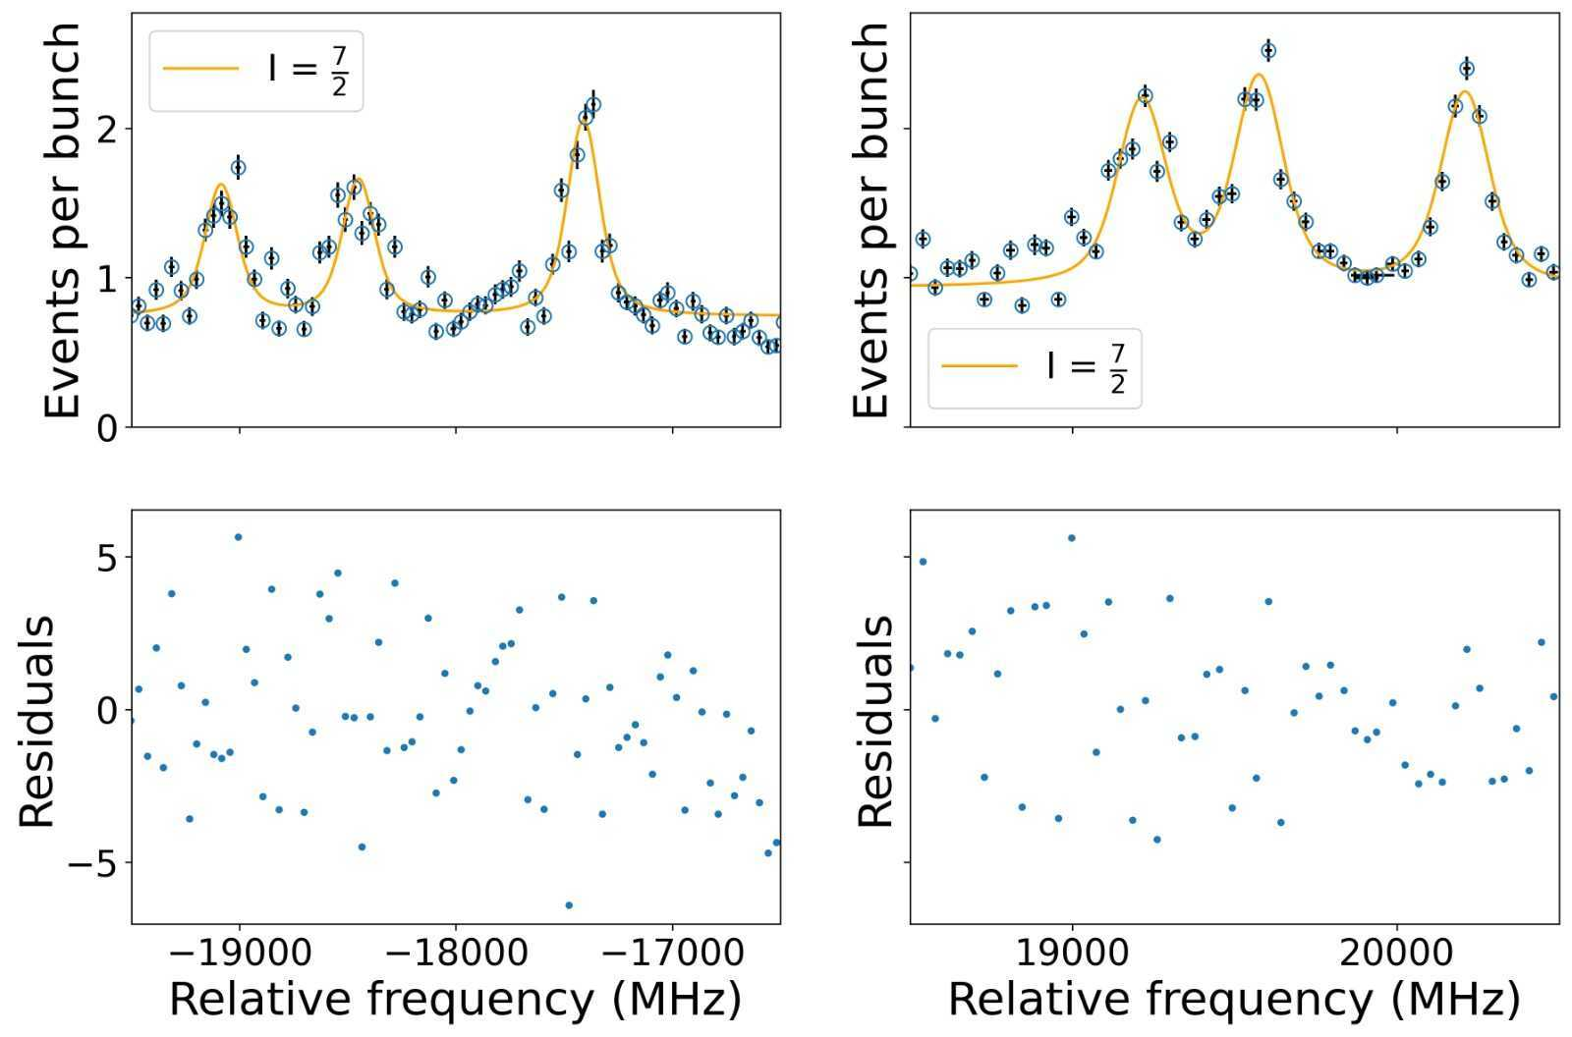
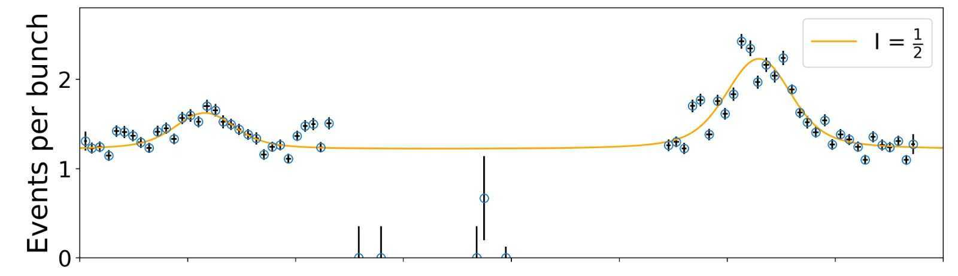
Specific case: Silver
Spectra ¹²³Ag and ^{123m}Ag
Background almost 1 event per bunch
Contaminants mostly Cs and Ba
For ¹²⁴Ag no resonance peak is visible
Decreasing signal to noise ratio
Figure from B. van den Borne

Slide 9
CRIS upgrade
Future upgrade
RFQ
DC potential
MR-ToF
Target
Distance
Deflector
Buncher
Cooler-buncher
Charge exchange cell
Sequence of laser pulses
Ions
K or Na atoms
Time
He atoms
Neutralized atoms
Time
Laser beam

Slide 10
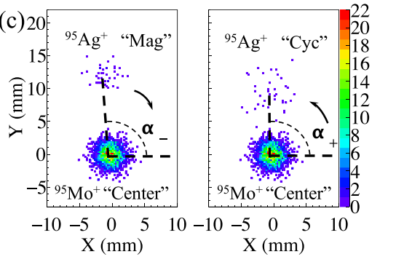
Combination of spectroscopy with mass measurement devices
In source laser spectroscopy combination with Penning trap for ⁹⁵Ag
Rates as low as 0.001 ions/bunch
Most contaminants are removed before the MR-ToF
Figure from Zhuang Ge, PHYSICAL REVIEW LETTERS 133, 132503 (2024)

Slide 11


Challenges of the buncher
Current cooler-buncher provides 3-4 μs bunches
Need bunches of around 100 ns for MR-ToF
Ions are accelerated to 30-40kV
Needs to be reduced to about 3kV
New buncher needs to be designed

Slide 12
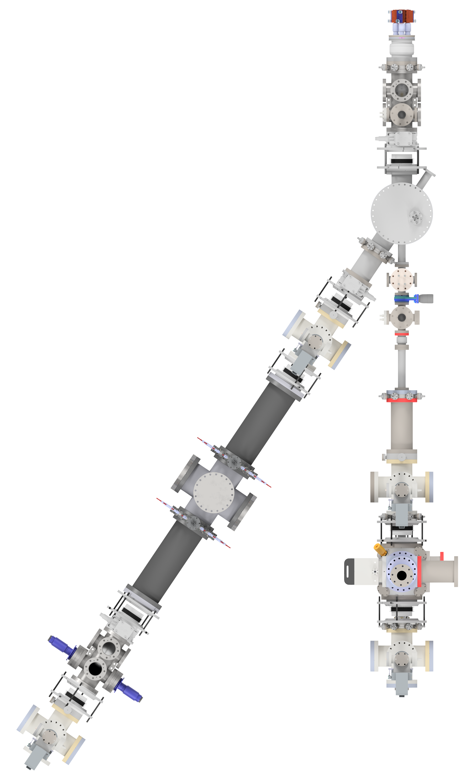
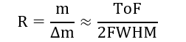
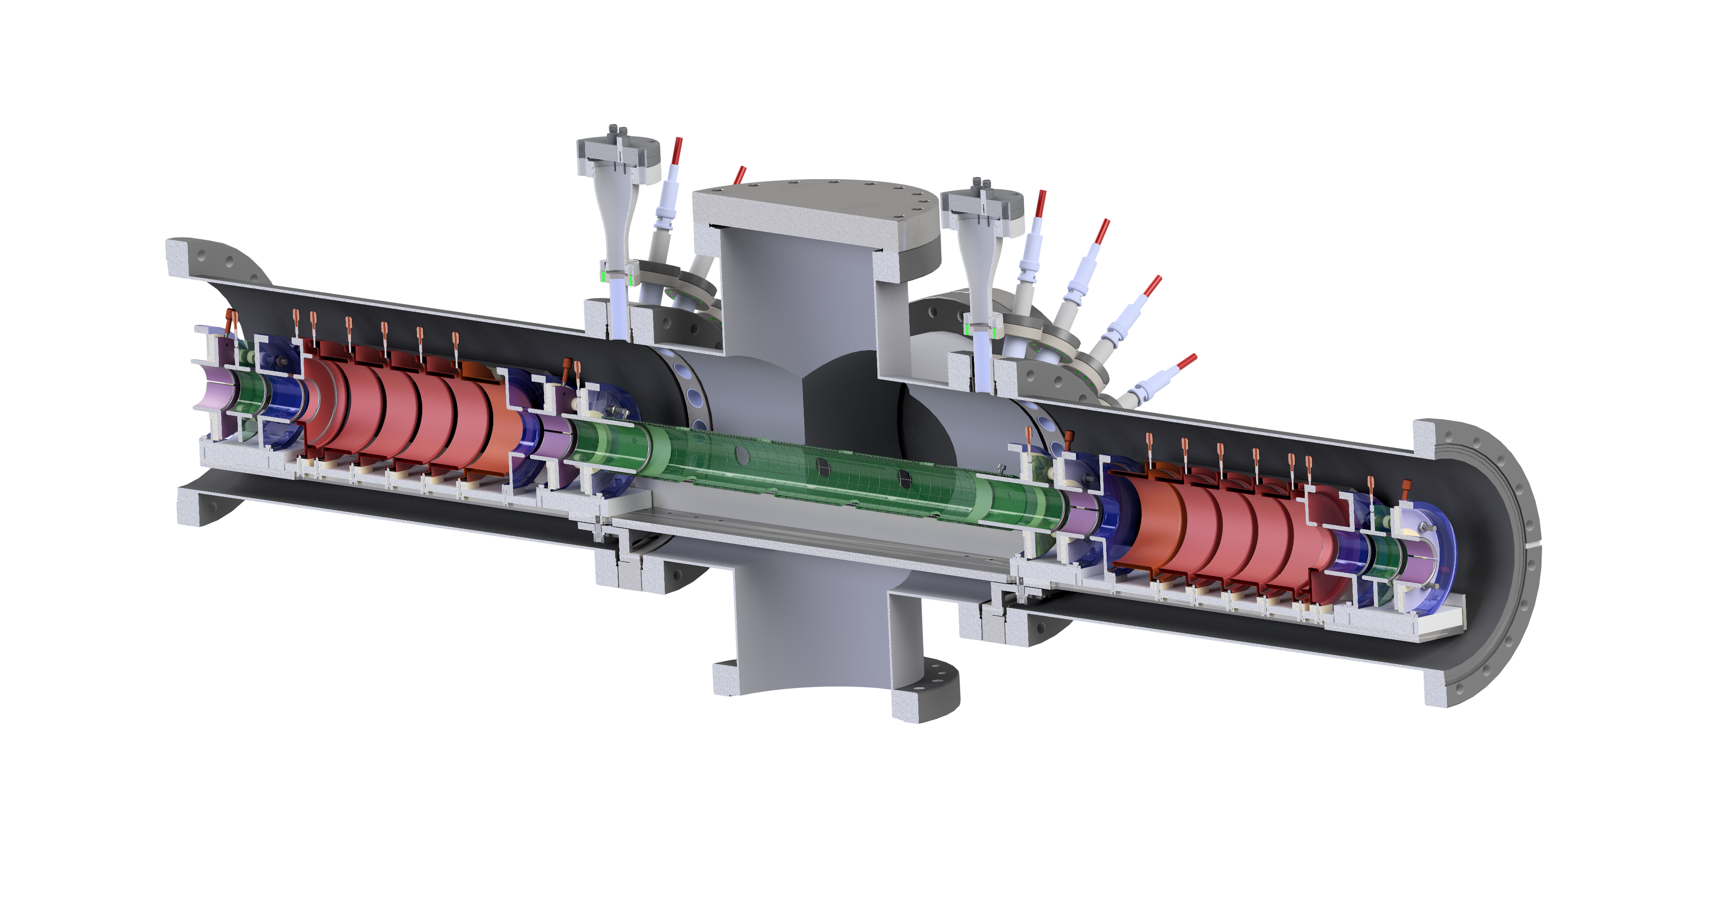
Offline lab
Surface ion source
BNG
Built an offline beamline including an MR-ToF, Bradburry-Nielsen gate and light collection region
Mass resolving power:
QP triplets & steerer
Diagnostic station
Light collection region
MR-ToF

Slide 13
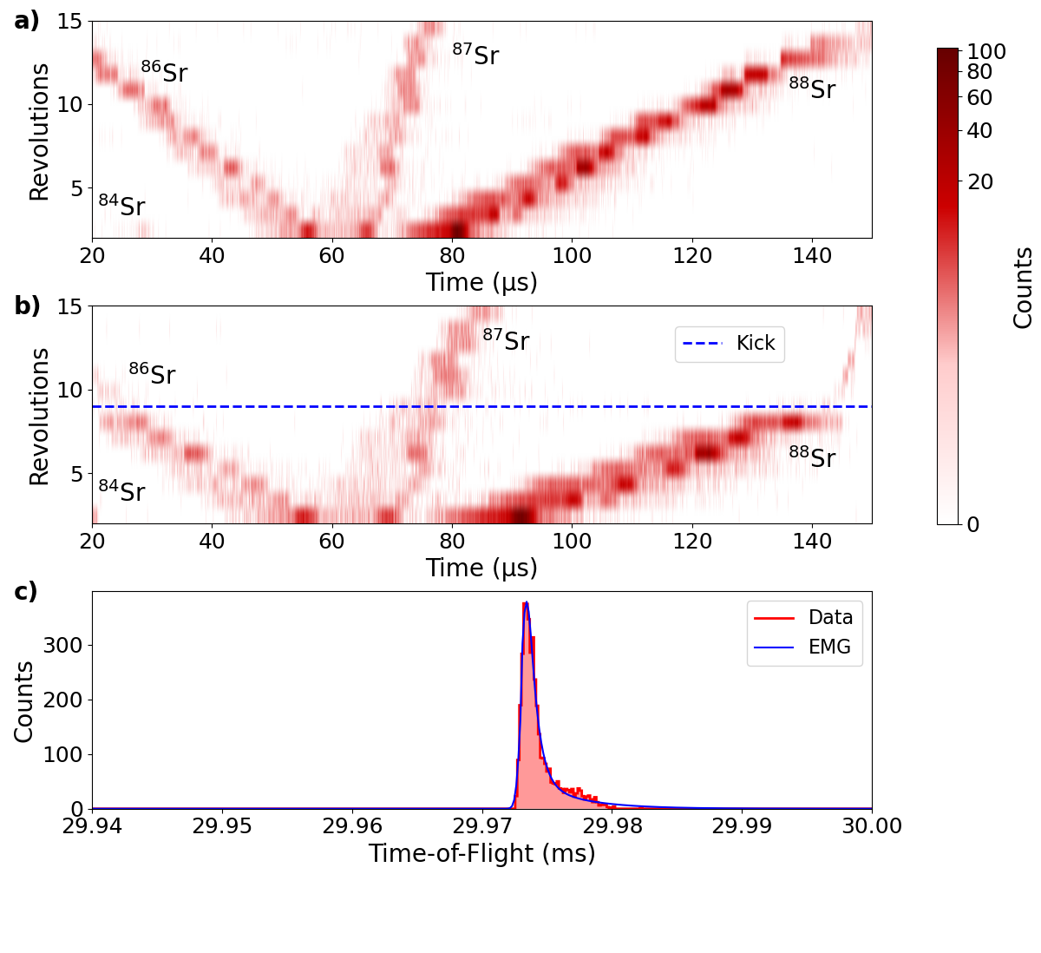
MR-ToF commissioning
MR-ToF commissioned with natural Sr
Deflection efficiency > 90%
Installation of the BNG allowed production of ≈ 170 ns bunches
Mass resolving power after 400 revolutions:
43,097 ± 546
Limited by FWHM of the ion bunch

Slide 14
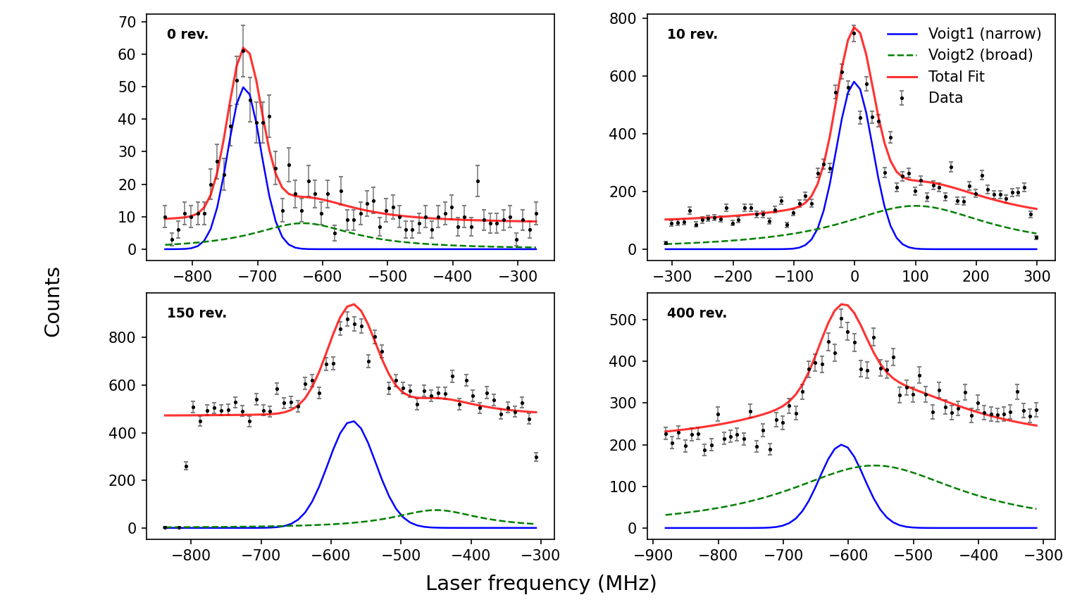
CLS after MR-ToF
Isobaric separation techniques to fluorescence laser spectroscopy
MR-ToF introduces shift of resonance frequency
Energy shift of the ions is 22 V
Possible explanation is the switching of the in-trap lift
Further study to understand the shifts

Slide 15

Outlook
Enhance mass resolving power and efficiency of MR-ToF
Characterize and minimize any systematic effects the MR-ToF may introduce on the spectroscopy
Develop new buncher for CRIS
At the end install MR-ToF to the CRIS beamline

Slide 16

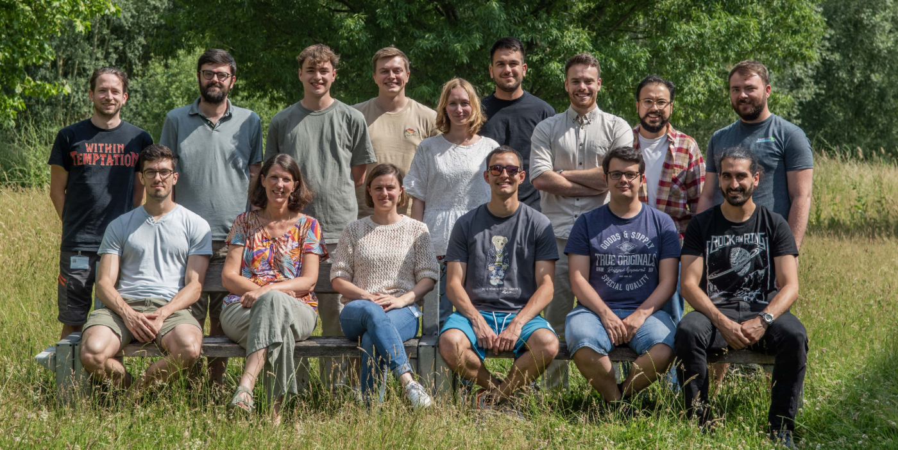

Acknowledgment

Slide 17
Thank you for your attention

Slide 18
References
R. de Groote et al., Technical report, CERN, Geneva, 2020
R. Garcia et al. Technical report, CERN, Geneva, 2017
R. Garcia et al. Technical report, CERN, Geneva, 2016
D. T. Yordanov et al. Technical report CERN, Geneva, 2016
K. M. Lynch et al. Technical report CERN, Geneva, 2023
G. Neyens et al. Technical report CERN, Geneva, 2011
C. Ricketts, PhD Thesis, 2021

Slide 19
Backup slides

Slide 20
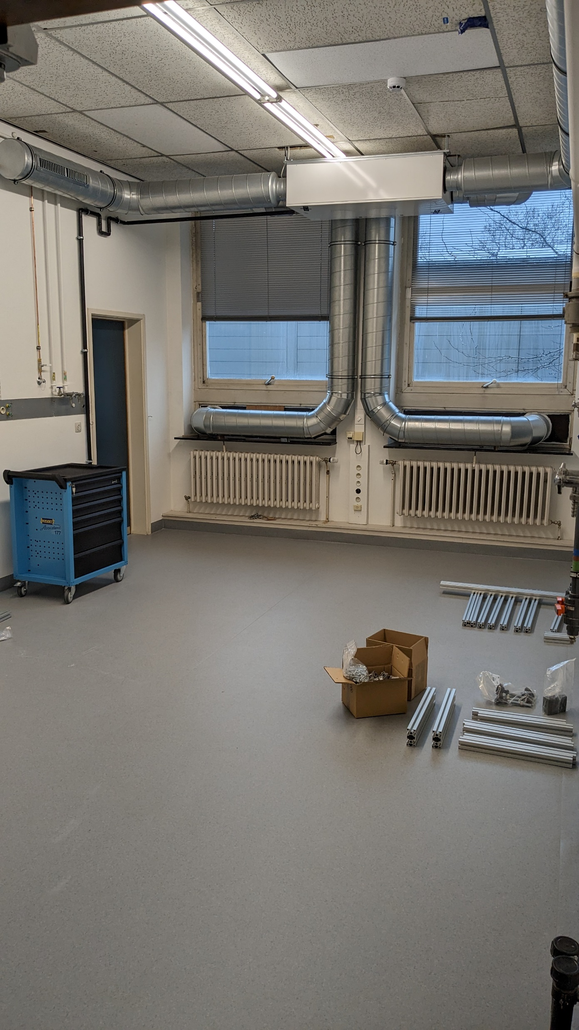
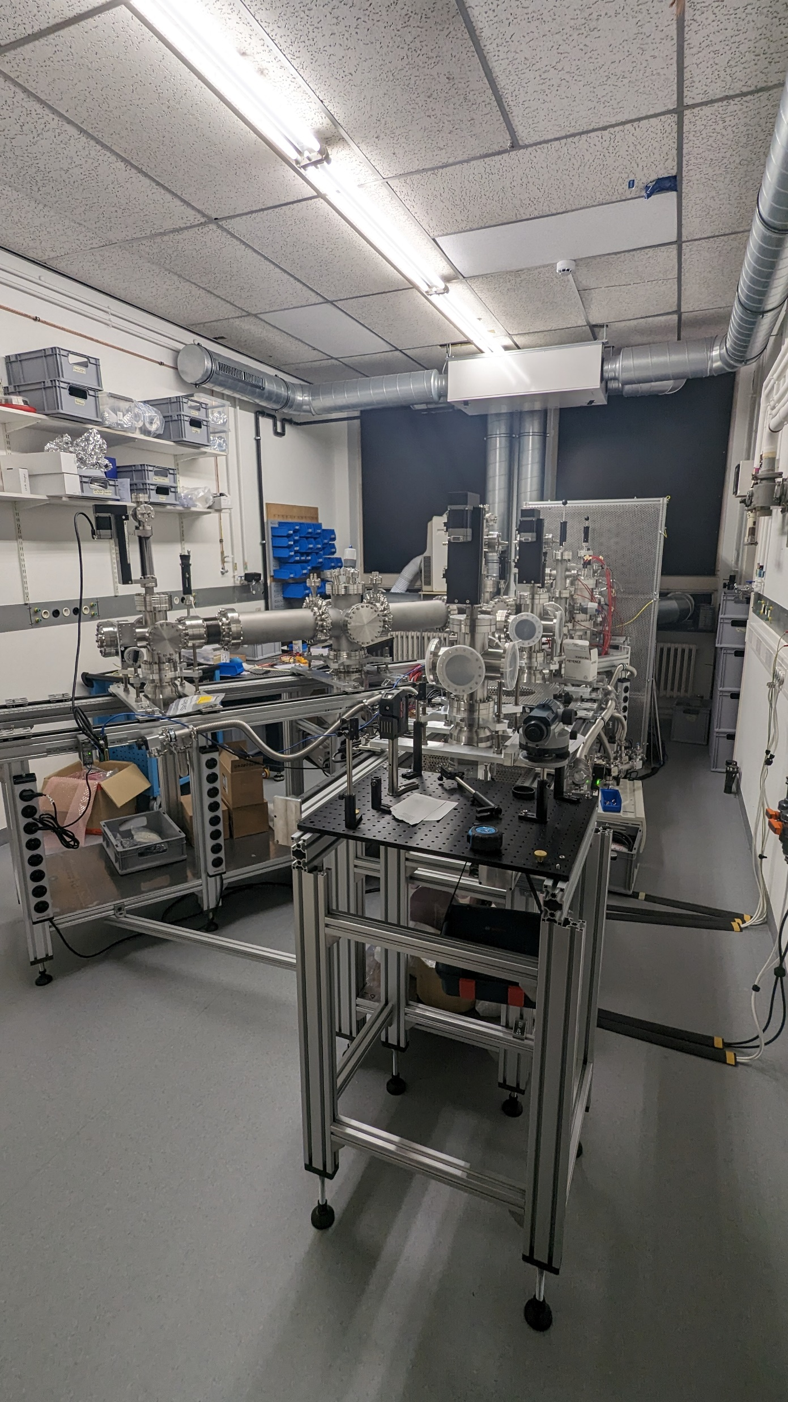
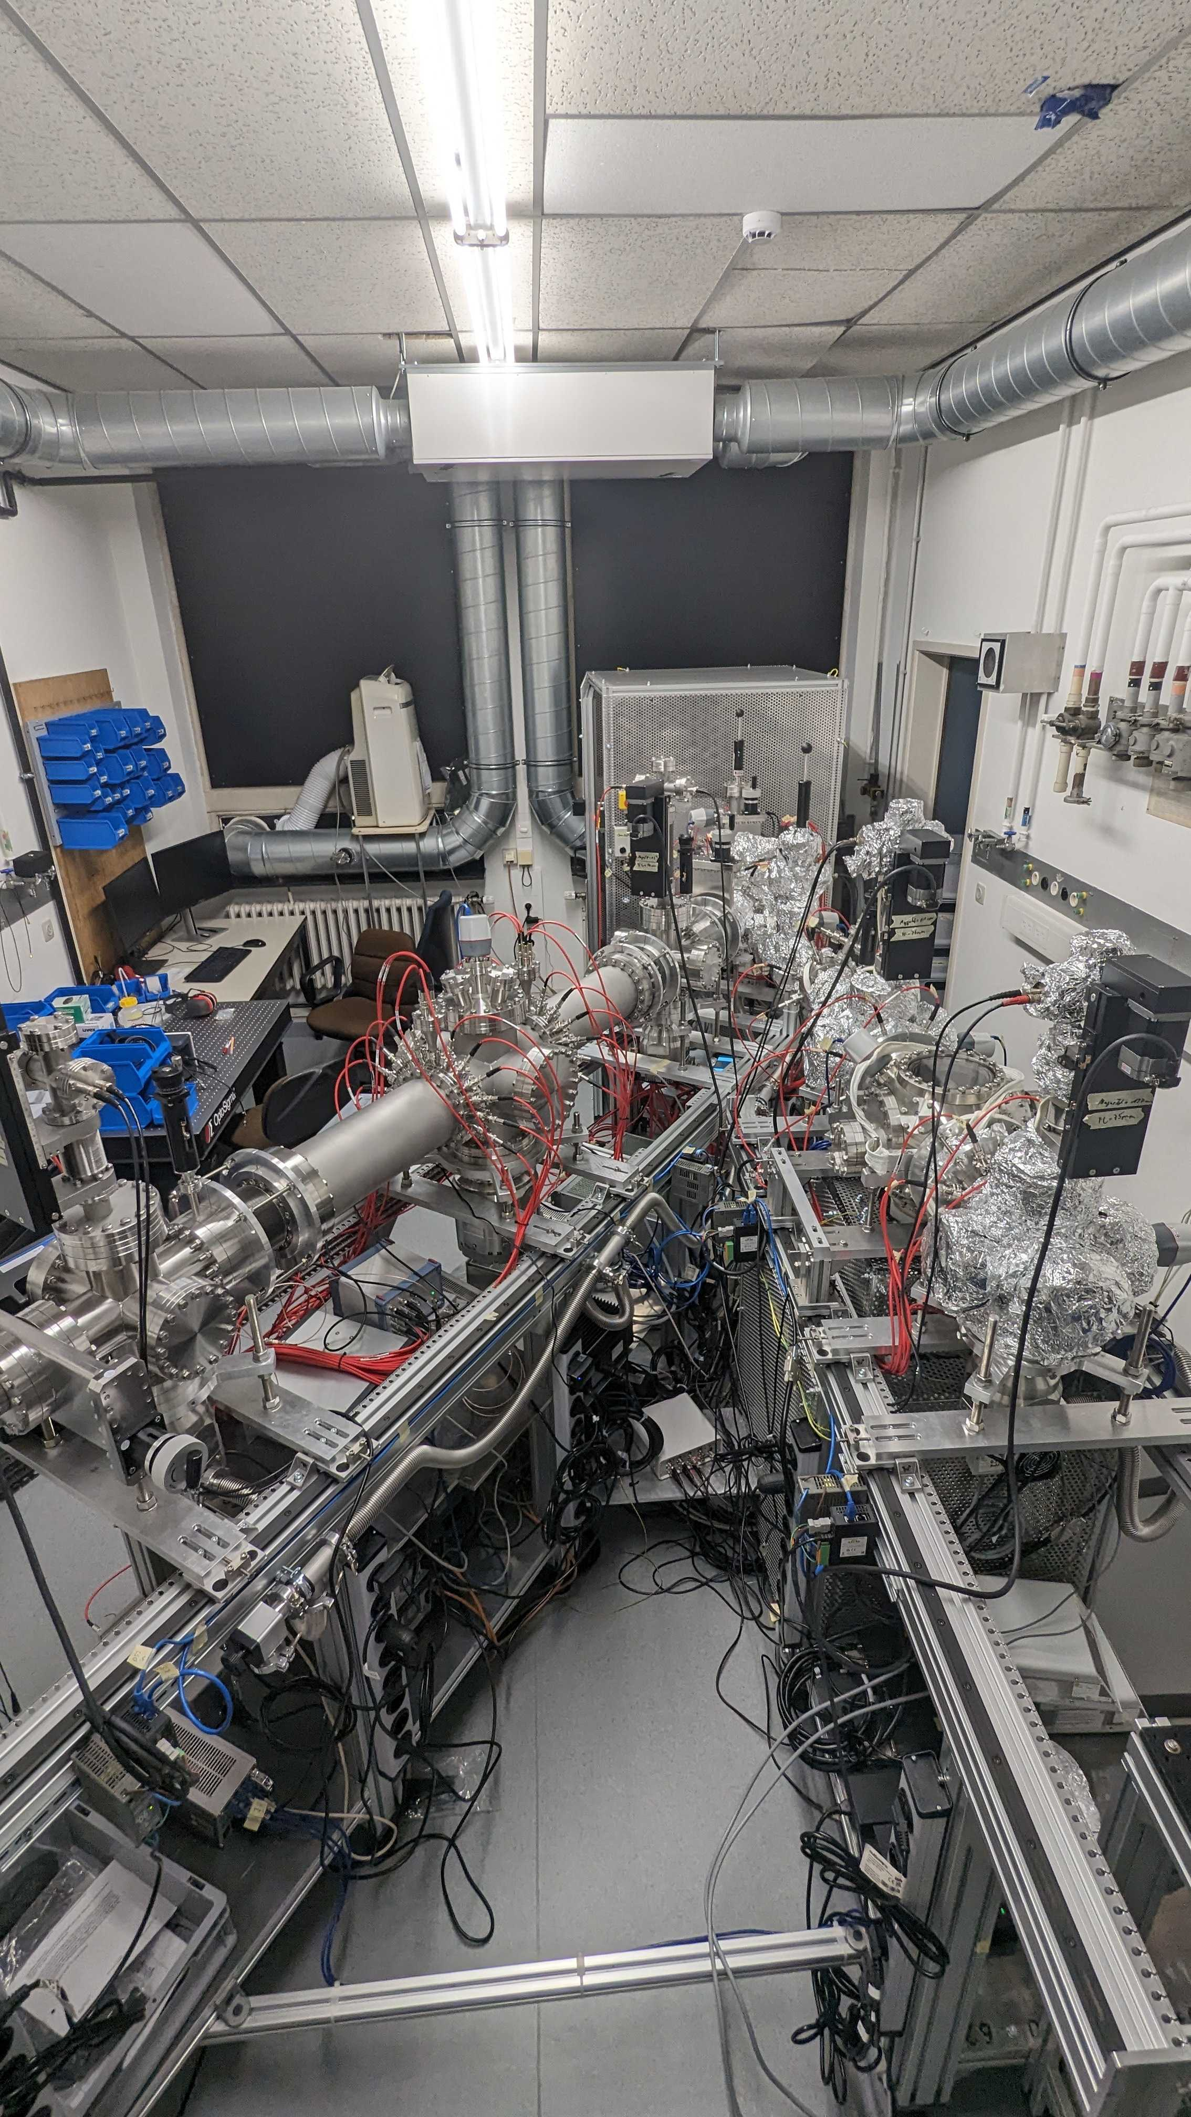
Development
February ‘24
June ‘24
October ‘24

