Slide 1
Exploring Conditioning Methods
April 8th

Slide 2
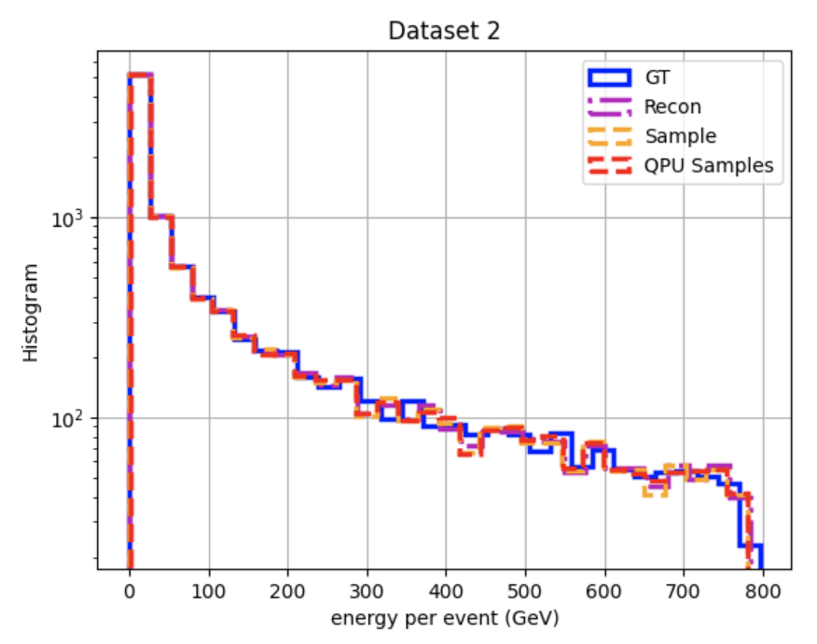
Remake of Unconditioned Encoder histograms
Old bug in beta estimation: dwave energies and rbm energies computed with different sets of hamitonian weights. Function was giving wrong temperature.

Slide 3
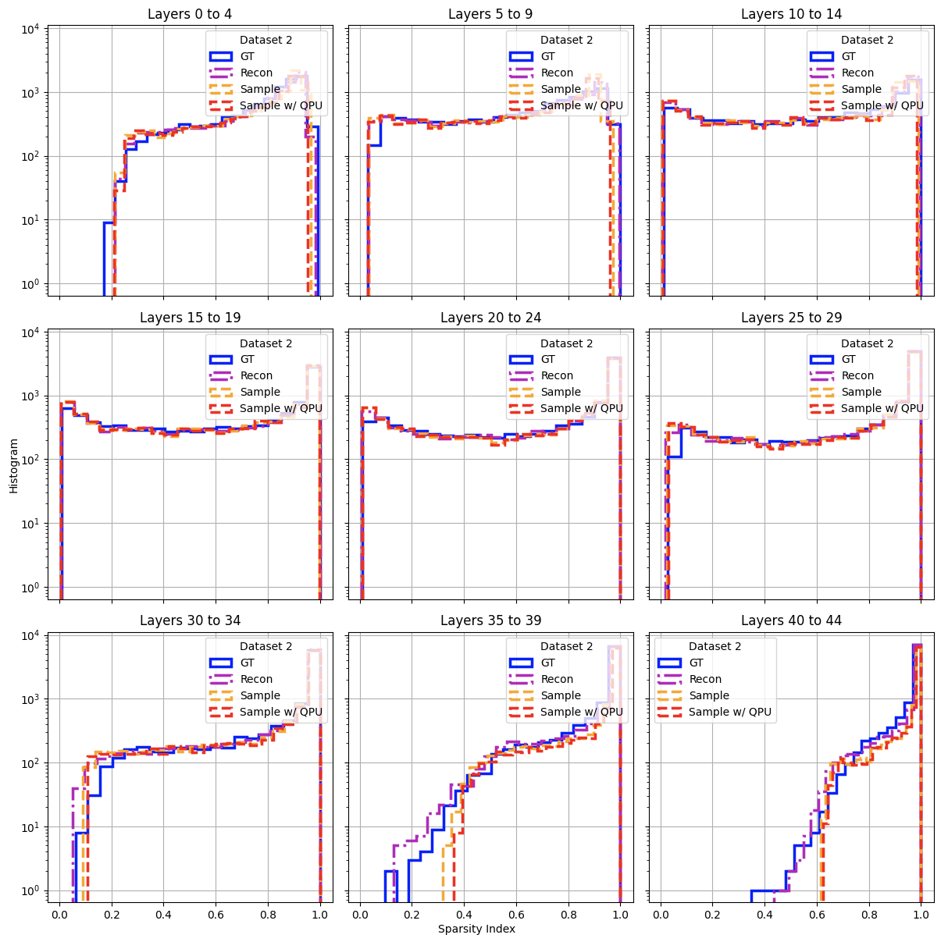

Slide 4
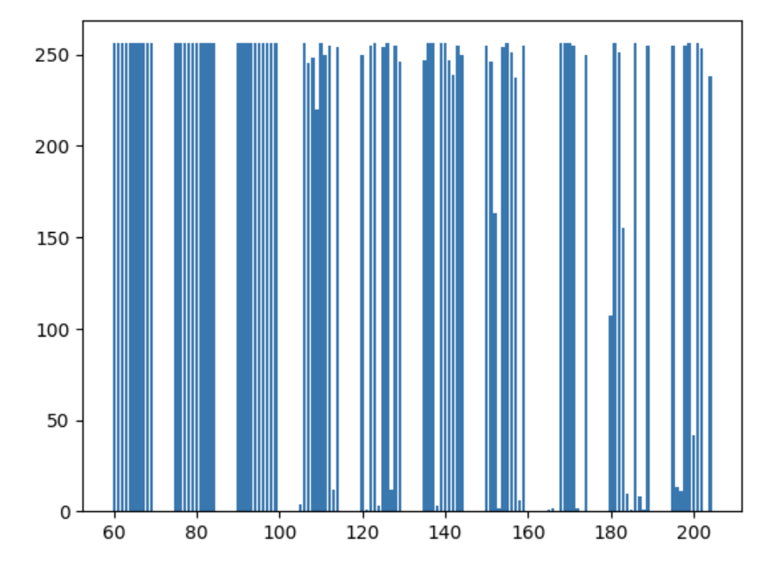
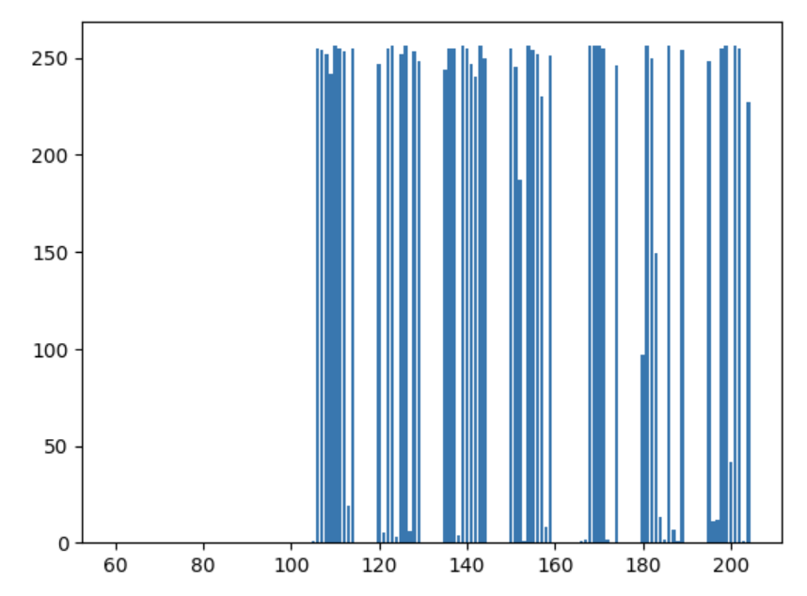
h range
$$h_{i}=−4.0 →P(X_{i}=1)≈1$$
$$h_{i}=+4.0 →P(X_{i}=0)≈1$$
$$h_{i}=−4.0 ∀i⊂[60, 100]$$
$$h_{i}=+4.0 ∀i⊂[60, 100]$$
Counts (256 total samples)
Counts (256 total samples)
Qubits from 60 to 100
Note: 60-100 qubits have on average 6-7 couplings
Qubits from 60 to 100

Slide 5
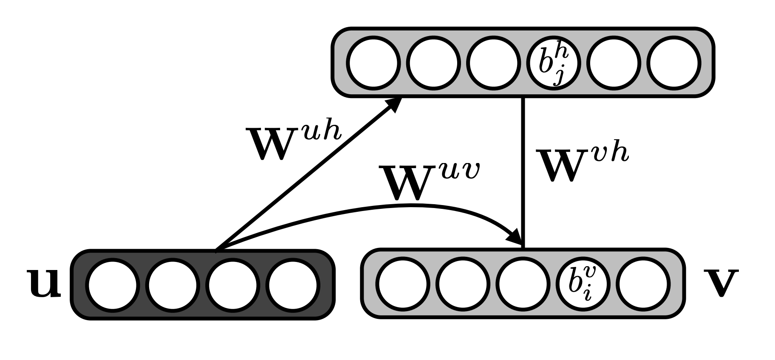
Conditional RBMs
Hamiltonian with new parameter u
$$\left|b^{u}\right|=4.0→u≈const.$$
$$−u^{T}b^{u}$$
$$≈const$$
$$W^{uh}≪h^{u}$$
$$W^{uv}≪h^{u}$$
https://arxiv.org/pdf/1202.3748.pdf - Mnih, V., Larochelle, H., Hinton, G. E. (2012) Conditional Restricted Boltzmann Machines for Structured Output Prediction

Slide 6
Conditional likelihood parameterized by CRBM
Note: Quadpartite-QRBM has no hidden units so
Sampling from CRBM:
$$E\left(p_{1}, p_{2}, p_{3}, u\right)=F\left(p_{1}, p_{2}, p_{3}, u\right)$$
$$P\left(p_{1,i}=1\right)=σ(b_{i}^{p_{1}}+W_{ij}^{p_{1},p_{2}}p_{2,j}+W_{ik}^{p_{1},p_{3}}p_{3,k}+W_{il}^{p_{1},u }u_{l})$$
$$P\left(p_{1},p_{2},p_{3} | u\right)=\frac{exp⁡(−E\left(p_{1}p_{1},p_{1},u\right))}{\sum_{{p′}_{1}{p′}_{2},{p′}_{3}}{exp⁡(−E\left({p′}_{1}{p′}_{2},{p′}_{3},u\right))}}$$
$$P\left(u_{l}=1\right)=σ(b_{l}^{u}+W_{lj}^{u,p_{2}}p_{2,j}+W_{lk}^{u,p_{3}}p_{3,k}+W_{li}^{u,p_{1} }p_{i})≈σ(b_{l}^{u})≈σ(4)≈1$$

Slide 7
CRBM Training Methods
1. Contrastive Divergence for 1000 < steps
Running CD for few steps does not discourage model from making bad predictions as V and Vk might have similar distributions
2. Minimizing Generilized Perceptron Loss - (LeCun et al., 2006)
Sample k negative examples and choose example with lowest energy
3. PCD – Potentially unfeasible as you must keep a persistent MC for each u label

