Slide 1
Conditioned RBM

Slide 2
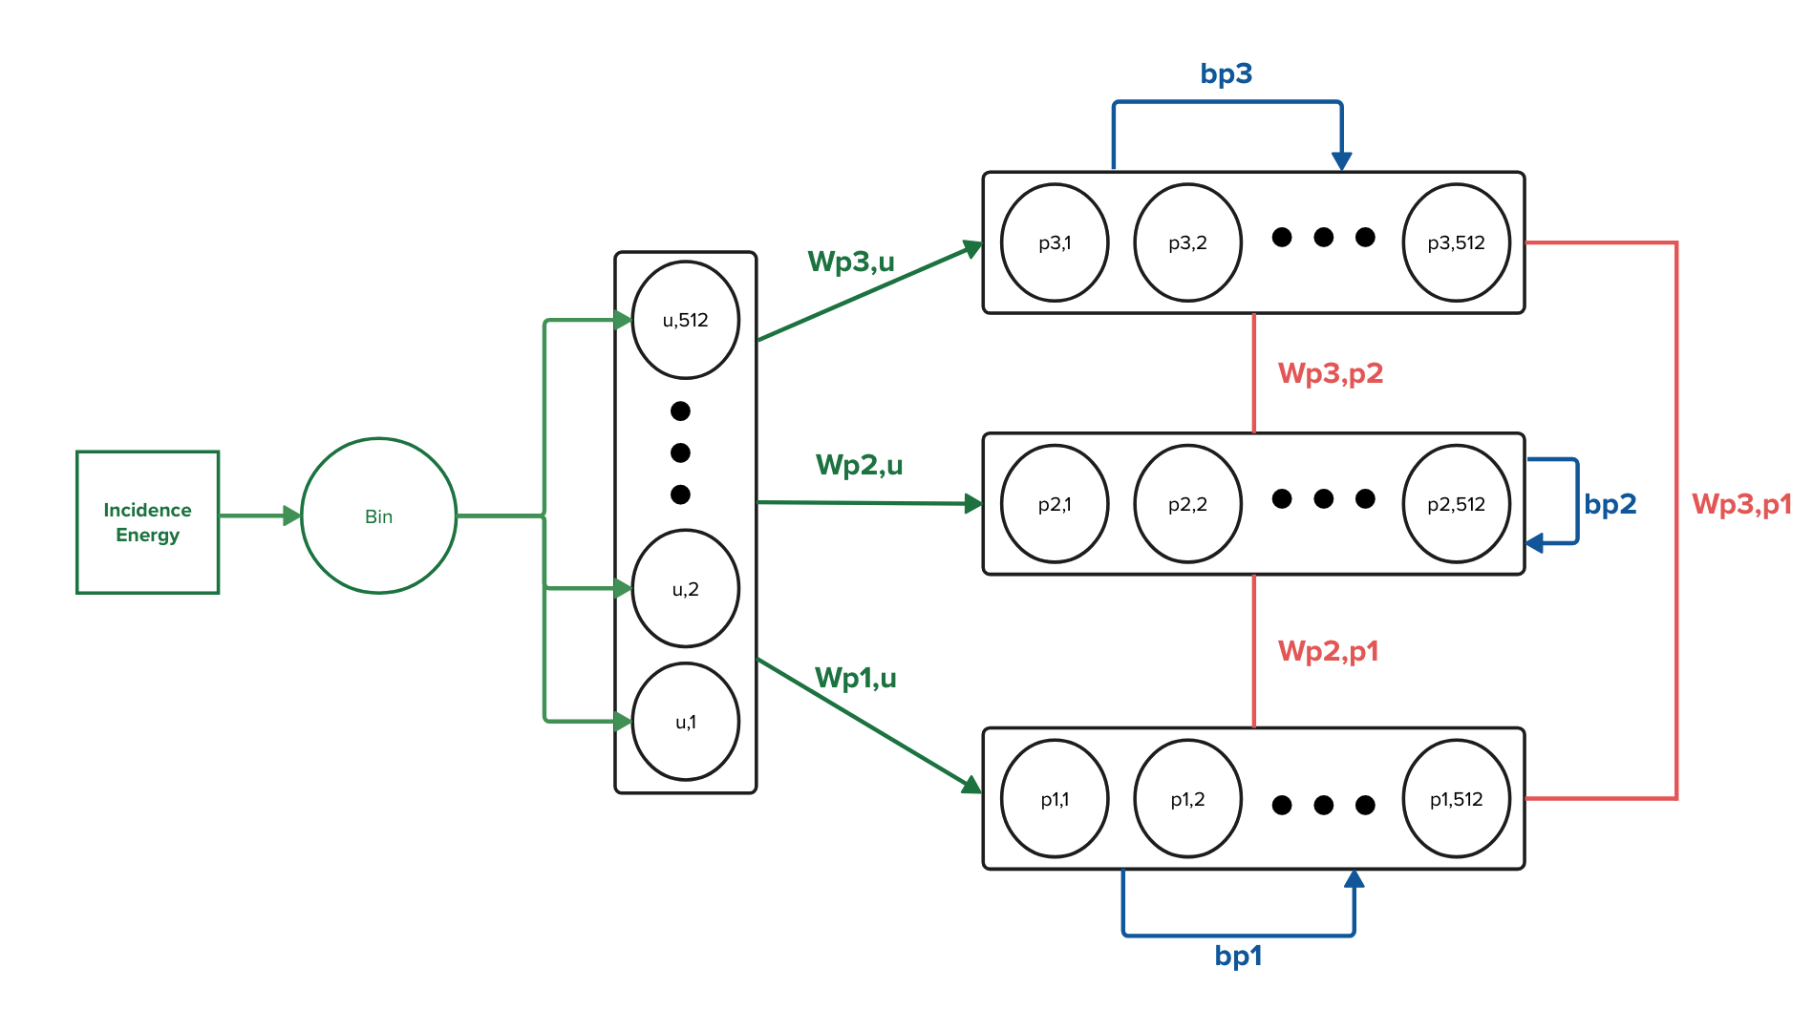


CRBM
$$2^{512}$$
$$2^{0}$$
$E(u,p_{1},p_{2}$, $p_{3})=−p_{2}^{T}W^{p_{2},p_{1} }p_{1}−p_{3}^{T}W^{p_{3},p_{1} }p_{1}−p_{3}^{T}W^{p_{3},p_{2} }p_{2}−p_{1}^{T}b^{p_{1}}−p_{2}^{T}b^{p_{2}}$ $−p_{3}^{T}b^{p_{3}}$
$$−p_{1}^{T}W^{p_{1},u }u−p_{2}^{T}W^{p_{2},u }u−p_{3}^{T}W^{p_{3},u }u$$

Slide 3
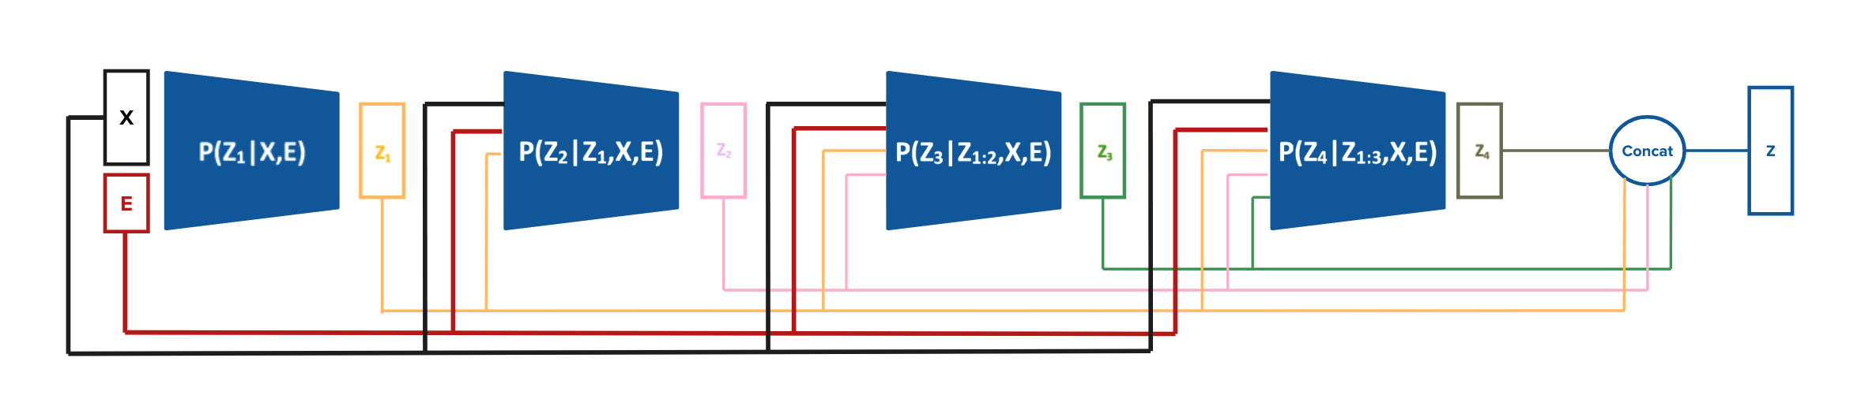
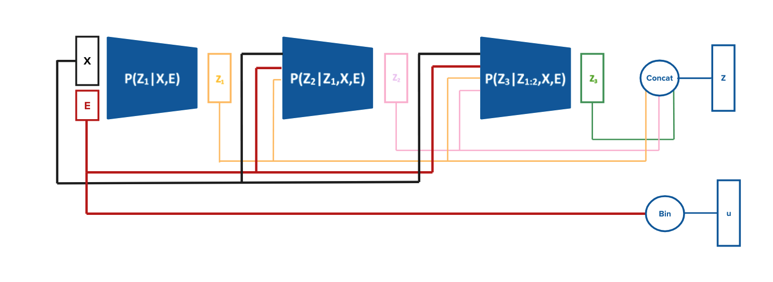
Changes to the Encoder
Old:
New:
Note: Decoder only takes $z_{1},z_{2}$& $z_{3}$ and ignores u, but adds E into layers as before

Slide 4


Changes to the loss
$Encoder logits: l_{1},l_{2}$, $l_{3}$
$Encoder samples: {z_{1},z_{2},z_{3}=GumbelMod(l}_{1},l_{2}$, $l_{3})$
$$Energy Binary Vector: {u=Bin(E}_{inc})$$
$CRBM samples:p_{1},p_{2},p_{3}=Gibss\left(u,z_{1},z_{2},z_{3}\right)$
* CD for now
$KL=Entropy(l_{1},l_{2}\text{,} l_{3}$, $z_{1},z_{2},z_{3})+PosEnergy\left(u,z_{1},z_{2},z_{3}\right)−NegEnergy(u,p_{1},p_{2},p_{3})$
Using new Hamiltonian: $E(u,p_{1},p_{2}$, $p_{3})$
Sampling from CRBM:
$$P\left(p_{1,i}=1\right)=σ(b_{i}^{p_{1}}+W_{ij}^{p_{1},p_{2}}p_{2,j}+W_{ik}^{p_{1},p_{3}}p_{3,k}+W_{il}^{p_{1},u }u_{l})$$
$$P\left(u_{l}=1\right)=σ(b_{l}^{u}+W_{lj}^{u,p_{2}}p_{2,j}+W_{lk}^{u,p_{3}}p_{3,k}+W_{li}^{u,p_{1} }p_{i})≈σ(b_{l}^{u})≈σ(4)≈1$$
Guaranteed by flux-biases = 20 and max connectivity of 16

Slide 5
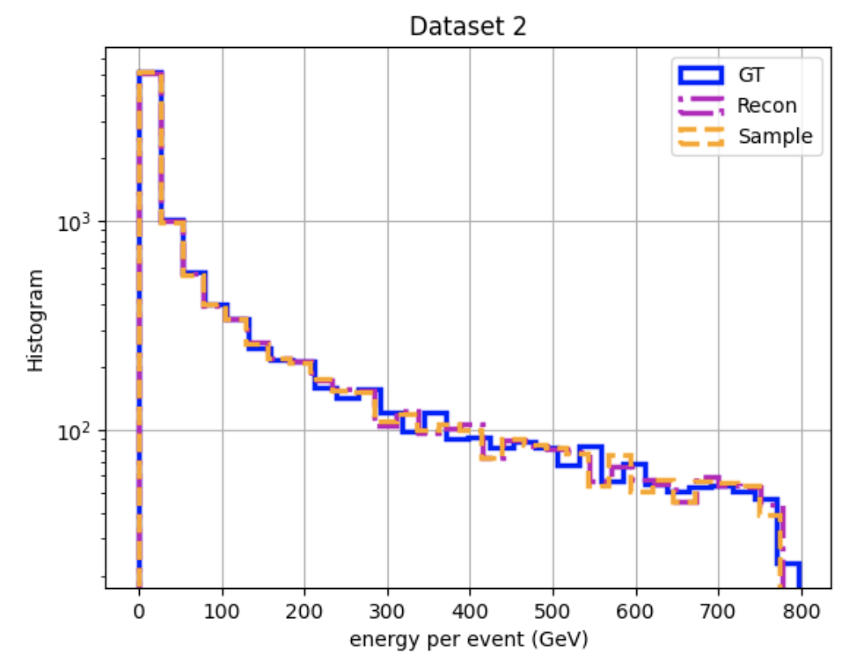
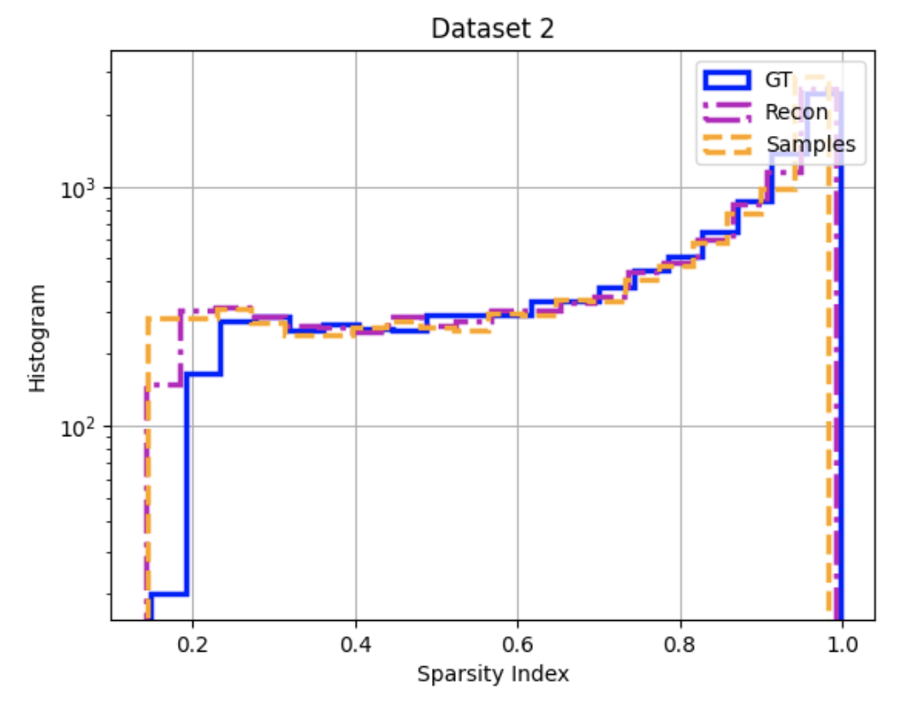

Slide 6
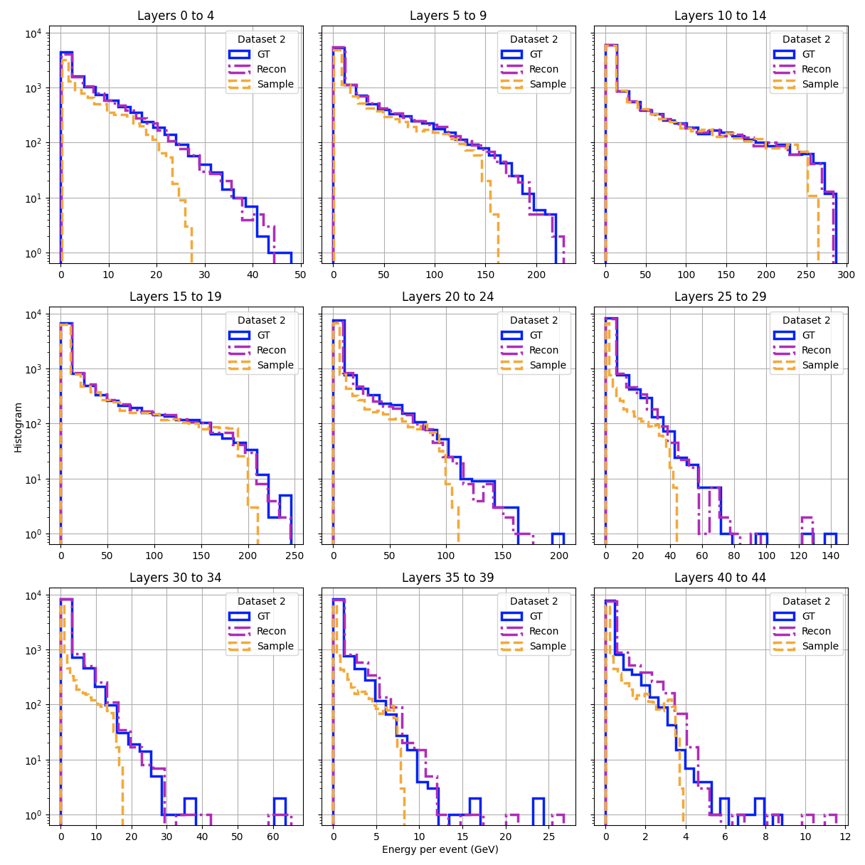
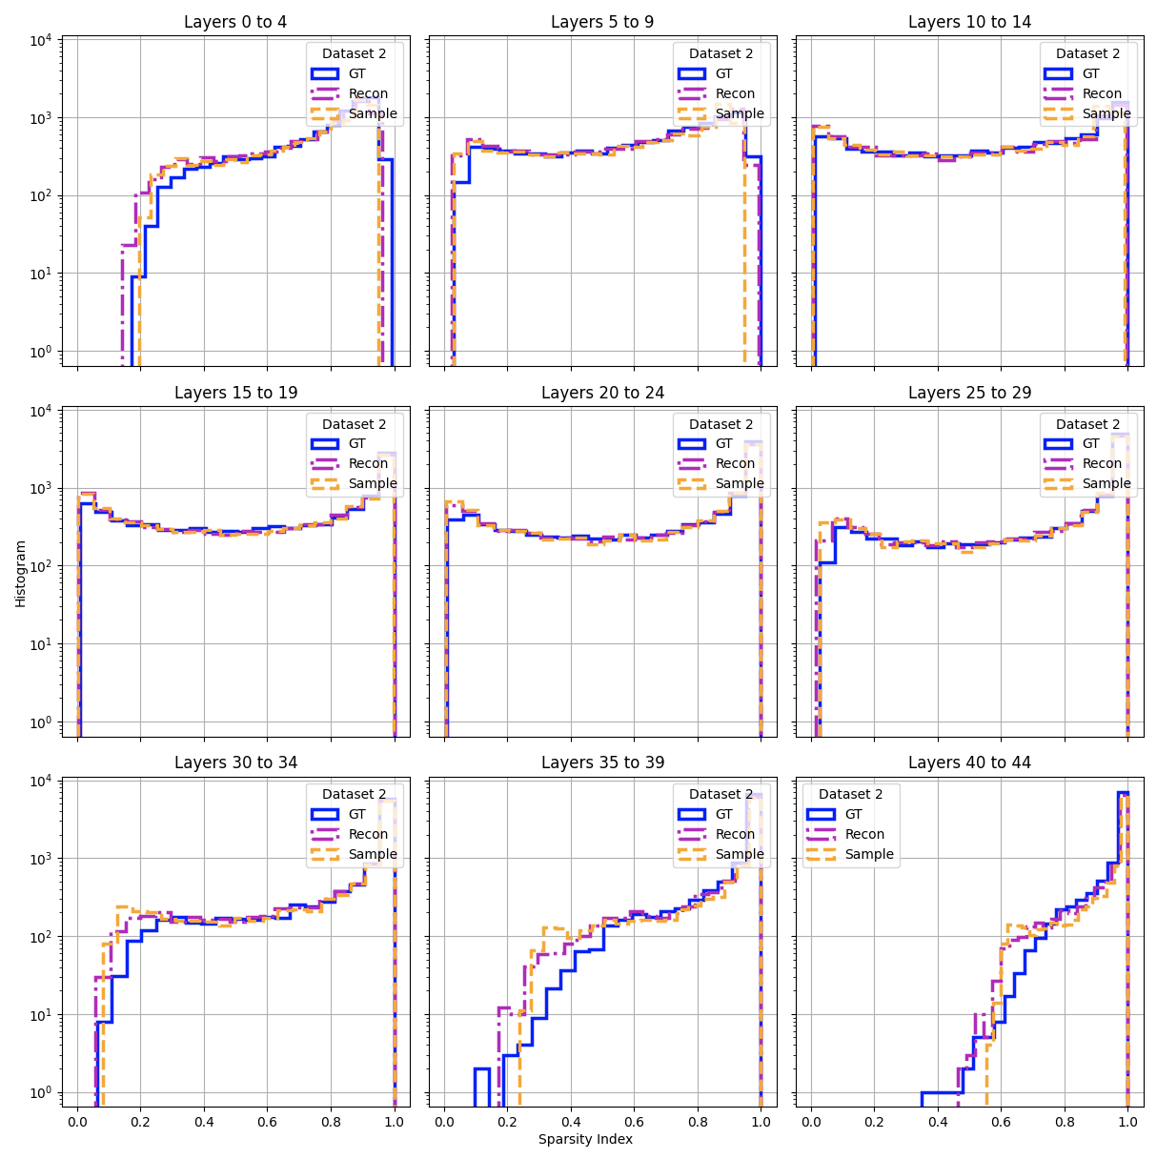

Slide 7
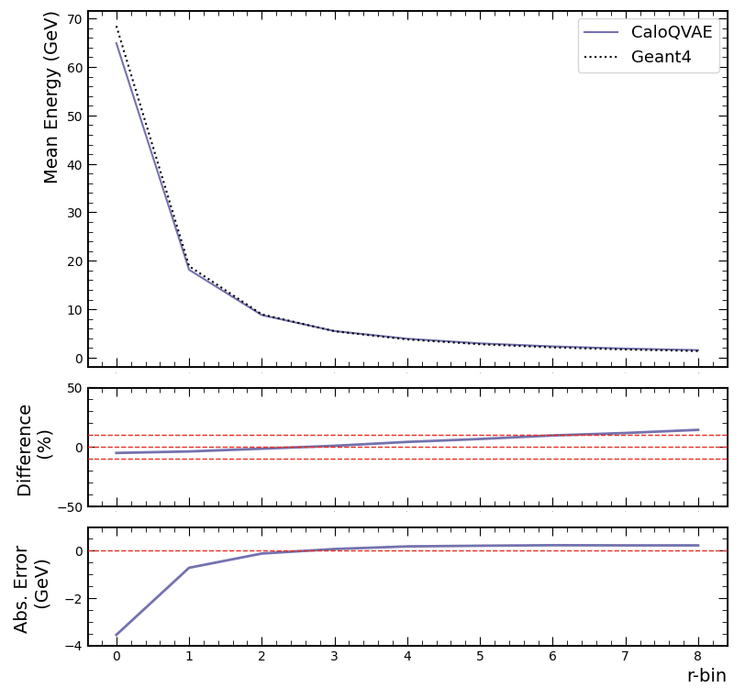
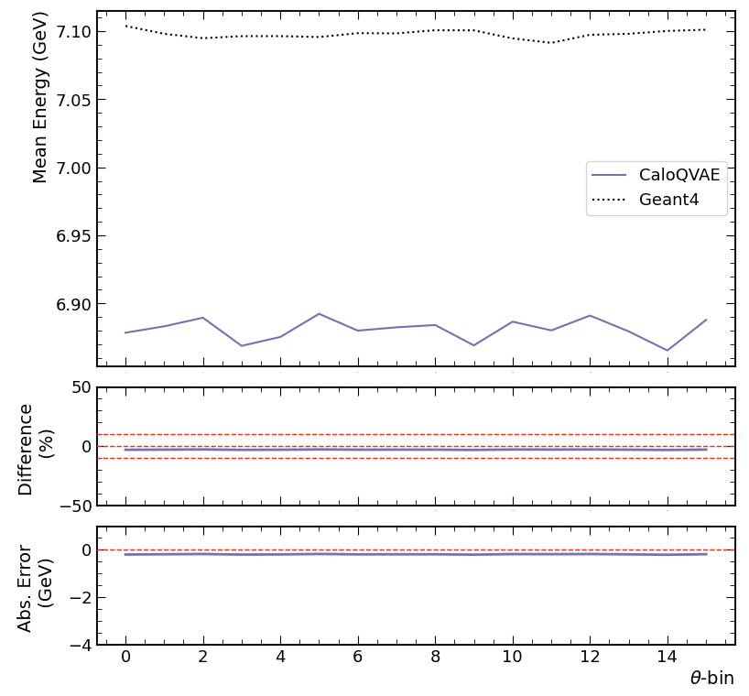
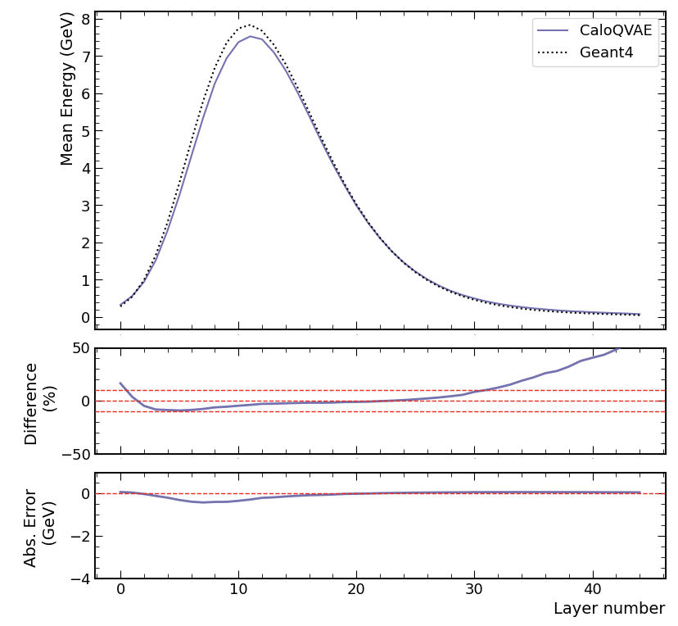

Slide 8
