Slide 1
Particle Physics Faculty Meeting
Agenda
  News
  Goals and Objectives for 2019 within PSD
  Space/Trailer FF move to MOB
  Update from Committees
  Update from Groups
  AOB

Slide 2
SMM – Important Dates
Dates: 2019 | Event
January 19 | Mid-Winter Celebration 2019
January 21 – 22 | MMS EEC (Molecular & Material Sciences Experiments Evaluation Committee)
January 24 | Supervisor Safety Training
January 28 – 29 | SAP EEC (Subatomic Physics Experiments Evaluation Committee)
February 6 | TRIUMF Innovations Board Meeting
April 3 | TRIUMF Innovations Board Meeting
April 8 – 10 | ACOT Spring 2019 (Advisory Committee on TRIUMF)
April 25 – 26 | TRIUMF BOM Spring 2019 (Board of Management)
June 10 – 21 | GRIDS (Graduate Instrumentation Detector School), TRIUMF
June 13 – 14 | LSPEC (Life Sciences Projects Evaluation Committee)
July 10 | TRIUMF Innovations Board Meeting
July 22 – August 2 | 2019 TRISEP (TRI-institute Summer School on Elementary Particles), TRIUMF
October 2 | TRIUMF Innovations Board Meeting
November 14 – 16 | ACOT Fall 2019 (Advisory Committee on TRIUMF)
December 5 – 6 | TRIUMF BOM Fall 2019 (Board of Management)
TBC | TRIUMF50 Science Soiree

Slide 3
NEW Opportunities
  UBC workshop for faculty on graduate supervision: Tuesday, March 12, 2019 - 12:30 to 14:30
    The workshop covers the fundamentals of effective graduate supervision, including:
Getting Started
  elements of excellent graduate supervision
  effective recruiting and selecting of graduate students
Building a Strong Student – Supervisor Relationship
  establishing communication, discussing expectations
  preventing and solving problems
  negotiating concerns, issues and conflicts that may arise
Maintaining Momentum
  the work plan, identifying and achieving milestones, assessing academic progress
  dealing with crises and program interruptions, maintaining motivation
Preparing for the Future
  career mentoring, professional skills development, the future relationship

Slide 4
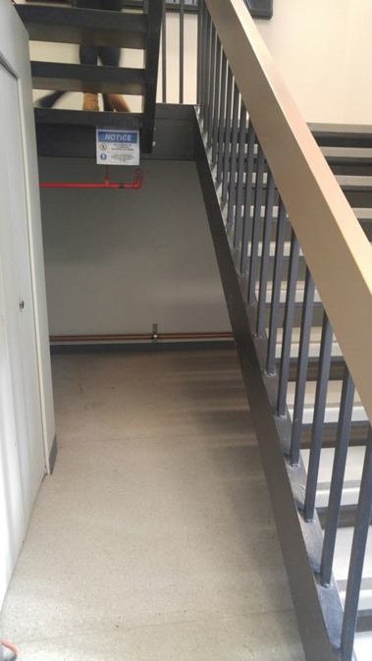
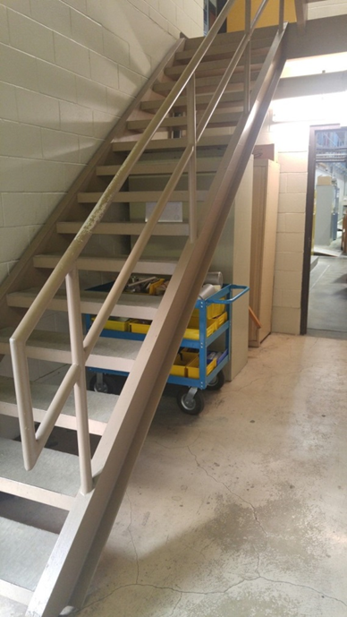
EHS Update
Fire Safety Requirements for Stairwells
Exit enclosures shall not be designed/used for any purpose other than exiting or for access to a floor area (NFPA 1010 / BC Building Code)
  NO STORAGE OF ANY KIND IN AN ENCLOSED STAIRWELL
  EXCEPTION: Storage of non-combustible items like metal cabinets is permitted in non-enclosed stairwells (e.g. MH, ISAC Experimental Halls)
All facility, hall and building coordinators contacted
Audit early Feb.
Requirements in
Document-163015

Slide 5
Goals 2019
  Operate safely and effectively
    Necessary space to carry out our research safely and productively
  Produce world class science
    deliver high-impact results in Particle Physics with a focus on ATLAS, T2K, UCN, ALPHA, SuperCDMS
    Continue the design and fabrication of instruments enabling scientific discoveries, beam delivery and commercial applications
    Drive the development of new technologies with high potential for enabling future scientific discoveries
    Maintain Science Technology department infrastructure and expertise that is critical for supporting existing and future projects
  Connect TRIUMF to the world
    Enhance user and university support and activities
    Enhance HQP education and academic activities
    Promote TRIUMF and its activities & connect TRIUMF nationally and internationally with new and existing partners to support established research goals

Slide 6
Objectives 2019
  ATLAS
ATLAS: Operate the ATLAS Tier-1 at the highest reliability and availability
ATLAS: Maintain ATLAS detector derive muon trigger scale factors, produce data derivatives
ATLAS: Analyze ATLAS data in searches for new physics, Higgs boson characterization and Standard Model measurements
ATLAS sTGC: Maintain production of ATLAS sTGC detectors at production level rate
ATLAS sTGC: Support ATLAS sTGC wedge assembly at CERN into production
ATLAS ITk: Complete ITk module zero proto-type end-cap strip module
ATLAS ITk: Complete Monte Carlo investigations of layouts with additional Barrel Completion Layer
ATLAS LAr upgrade: Prepare and go through the PRR review
ATLAS: Complete production of ATLAS-LAr upgrade 1 electronics. Complete fabrication of ITK module-0 prototype.
ATLAS: Complete initial R&D for ATLAS-LAr electronics upgrade 2.

Slide 7
Objectives 2018
  T2K/HyperK
T2K: Develop a future long baseline neutrino program for Canada and the world
T2K: Development of the multi-PMT and preparation for the next CFI grant request
T2K: Stable data taking and detector (OTR, TPC, FGD) operation
T2K: Publish the results of the hadron production experiment at Fermilab for neutrino fluxsystematics
T2K: Publish the detailed study of the SK PMT response and apply for the SK analysis
T2K: Participate in the design of the multi-PMT and construction of a prototype module for NuPRISM and HK
  ALPHA
ALPHA: Fulfill Canadian TRIUMF responsibilities for ALPHA-2 operation, including detectors, DAQ, and analysis software
ALPHA: Improve laser and microwave spectroscopy to new world leading levels
ALPHA-g: complete TPC construction and cosmic Veto R&D
ALPHA-g: Complete construction of TPC and final design of barrel scintillator

Slide 8
Objectives 2018
  UCN
UCN: complete UCN beam-line and source commissioning drive forward experimental program
UCN: participate in cold neutron cross-section measurements at J-Parc
UCN: prepare the installation of EDM prototype apparatus from RCNP and prepare tests
nEXO photo-detector: Identify solution for VUV light detection and establish technology selection process.
3DdSiPMs: Define program for 3DdSiPMs development for subatomic physics.

Slide 9
Objectives 2018
  Connecting to the World
Host international workshops, lecture series, summer schools and conferences
Develop metric and support for TRAC (Triumf’s academic committee): Determine TRIUMF’s academic activities and coordinate lectures; Contribute to undergraduate, graduate and post-graduate training
Develop and roll out University Program to facilitate stronger engagement and support of universities at TRIUMF, both experiment (and science technologies) and theory

Slide 10
Risks and Budget
  All three components (Goals, Objectives, and Risk) will be used for the Budget Submission
  Examples for Risks:
    Risks inside the division (-- and proposed mitigations):
    TIER 1 center power failure --- emergency power back up
    Sci Tech machine catastrophically fail --- TRIUMF emergency funds for repair or replacement
    Operate M11, power supply failure
    Risks external to the division
    Uninsured shipping damage
    …

Slide 11
MOB 201
  From Jens
    current time-line is that the project will be completed by mid to end of April
    The renovations include: remodeling of MOB201 into a grad-student and post-doc office, plus 2 (or 3) discussion rooms plus one single scientist office (currently for Makoto)
    Remodeling of the printer room, and conversion into a kitchen (printer will move to MOB201)
    Remodeling of MOB 299 into a 6-desk undergrad room
    In order to facilitate the move of all people from the trailer(s) FF (and HH) into the MOB, we will also make use of all double and triple office for senior members (TRIUMF scientist, affiliate and emeriti), that means, students and post-docs currently in these would move into MOB201
    Concept for MOB201 (currently 24 desk, each desk with a surface of 1.8m2, which is bigger than the recommended 1.5m2) with very open concept
    Under consideration is a reduced density with only 20 desks (these desk would be 2.1m2)
    For students and post docs we will have 4 dedicated rooms on the 2md floor: the ATLAS-office MOB290, MOB201, MOB299, and the theory student room MOB215
    Furniture order by the end of the month

Slide 12
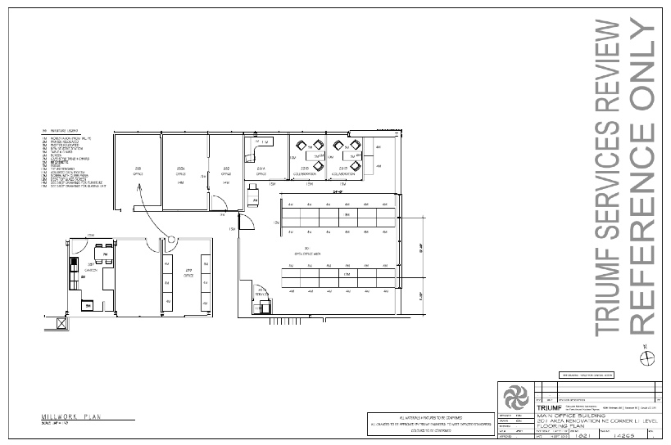
MOB 201

Slide 13
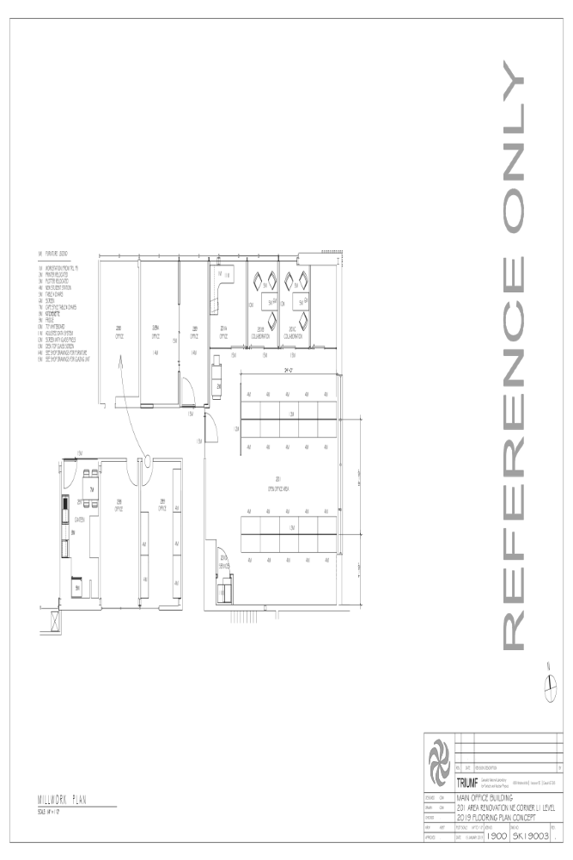
MOB 201

Slide 14
Trailer FF Move / MOB 201
  Consultation process from Akira
  Space committee recommendations from Nigel
  This Friday’s mixer will have Anne Aboud present for questions
  Next step:
  Suggest to write outlining the urgent need for more space, i.e. new building
  Space is amongst the top risks for TRIUMF’s future growth

Slide 15
Committee Updates
  Seminar/Colloquia
  Safety
  Space
  5S
  Academic
  Health & Wellness
  Data science
  Summer schools
  Diversity committee
  Physical Sciences Division
  IPP
  CAP PPD

Slide 16
Project News
  ATLAS
  T2K/HyperK
  UCN
  ALPHA
  SuperCDMS
  Pienu
  NA62
  DEAP
  SNO+
  EXO
  HALO
  g-2
  Belle 2
  Theory

Slide 17
AOB
Next meeting Thursday February 21st 2019 12:30?

