Slide 1


Extension of Dynamical Kubo-Toyabe Relaxation Function for the Refinement of Ion Dynamics Analysis
Takashi U. Ito¹⁾ and Ryosuke Kadono²⁾
¹⁾ Advanced Science Research Center, Japan Atomic Energy Agency, Tokai, Ibaraki 319-1195, Japan
²⁾ Institute of Materials Structure Science, High Energy Accelerator Research Organization (KEK), Tsukuba, Ibaraki 305-0801, Japan

Slide 2
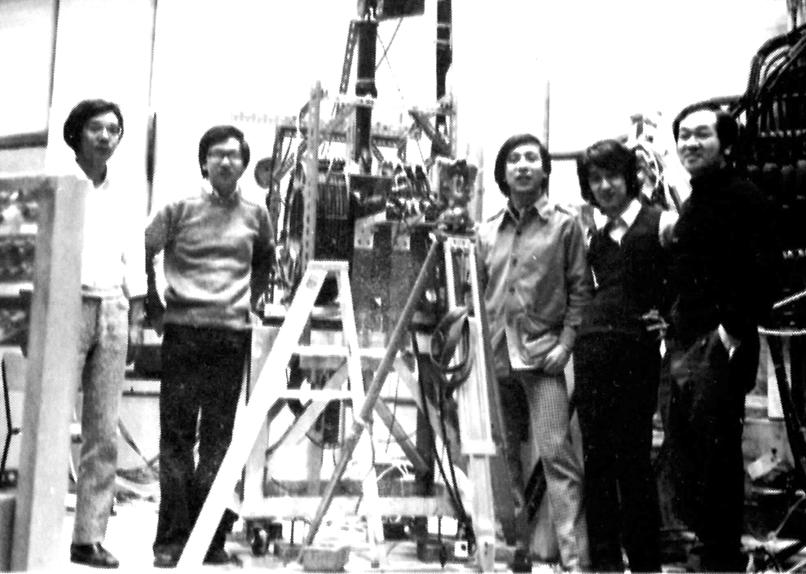
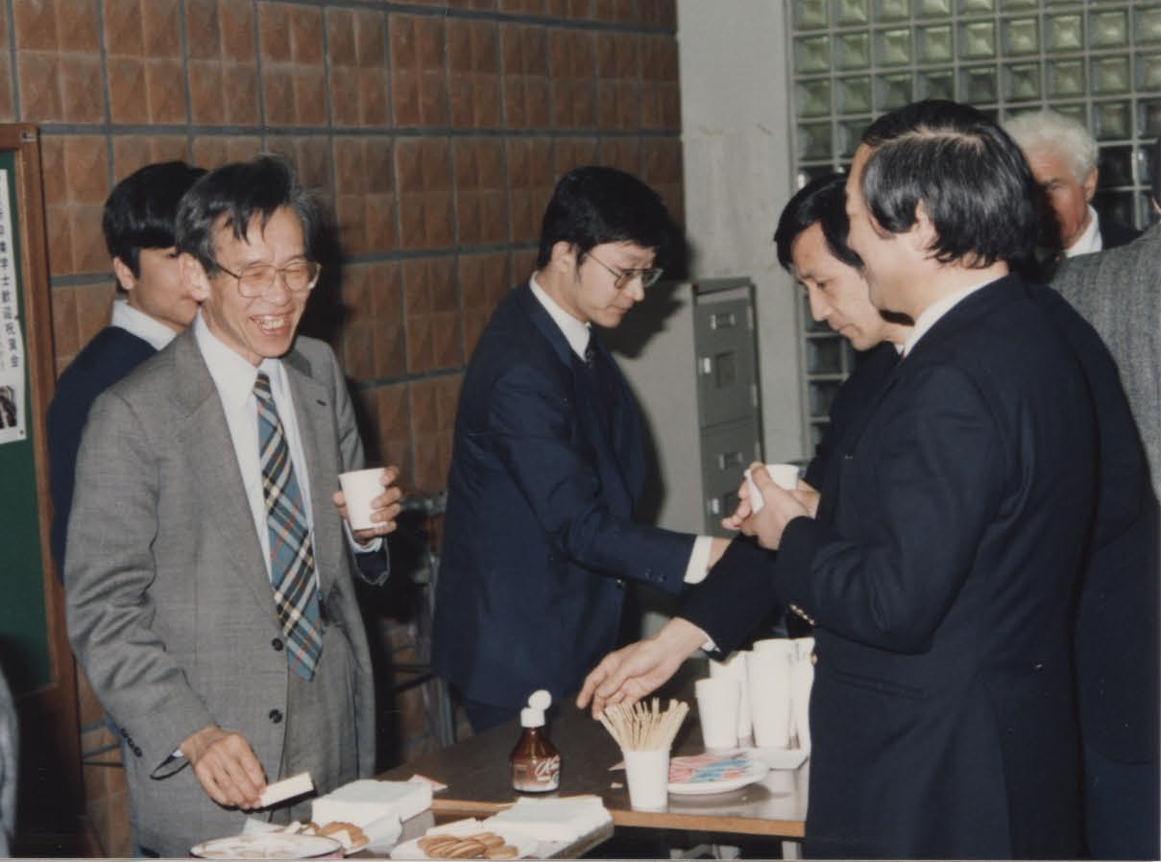
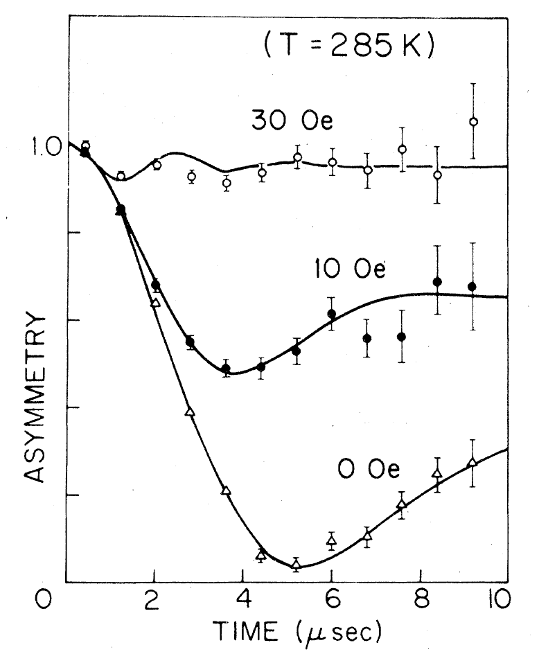
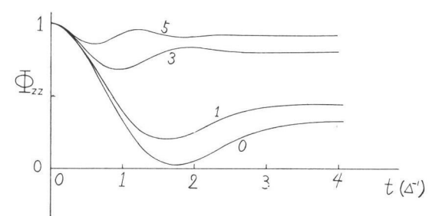
Dynamical Kubo-Toyabe (DKT) relaxation function
Stories behind the discovery of DKT function
At TRIUMF, Toshi Yamazaki and his coworkers were having great fun taking μ⁺SR data on a variety of samples, after long-time struggle with μ⁻ experiment.
TRIUMF, 1978
In the mean time, Toshi had to return to Tokyo earlier, leaving in the middle of the experiment. When he was back to his office, he happened to run into Prof. R. Kubo in the hallway, and was asked how the TRIUMF experiment was going.
Toshi showed Kubo the MnSi data faxed to him by Ryu Hayano, and Kubo noticed that the Gaussian decay resembled the behavior predicted by low-field NMR theory, which he and Toru Toyabe (then his master's student) had worked out many years before. Kubo suggested to take data with a wider time window, envisaging that they might find asymmetry recovering at a later timing.
J. Imazato
N. Nishida
R. Hayano
T. Uemura
T. Yamazaki
U. Tokyo,1988
Toshi devoured the paper Kubo had given him, informed his suggestion to Hayano, and they began enthusiastically performing additional measurements. (Faxes flew back and forth between Tokyo and Vancouver.)
R. Kubo
(1920-1995)
T. Yamazaki
(1934-2025)
Serendipity
R. Kubo and T. Toyabe,
14th Colloque Ampère Ljubljana, Slovenia) 1966 (Proceedings published in 1967).
R.S. Hayano et al.,
Phys. Rev. B20 850 (1979).

Slide 3
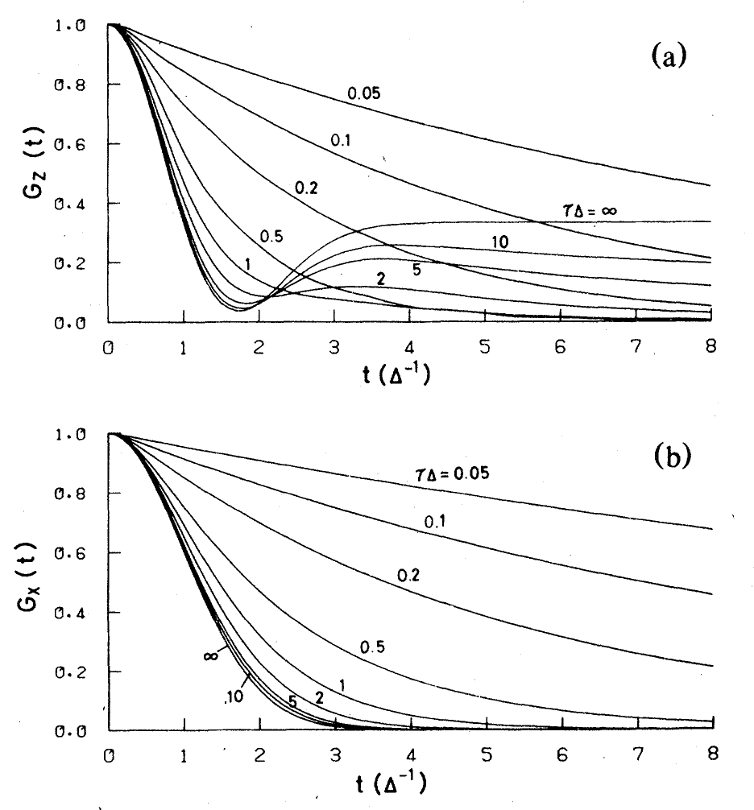
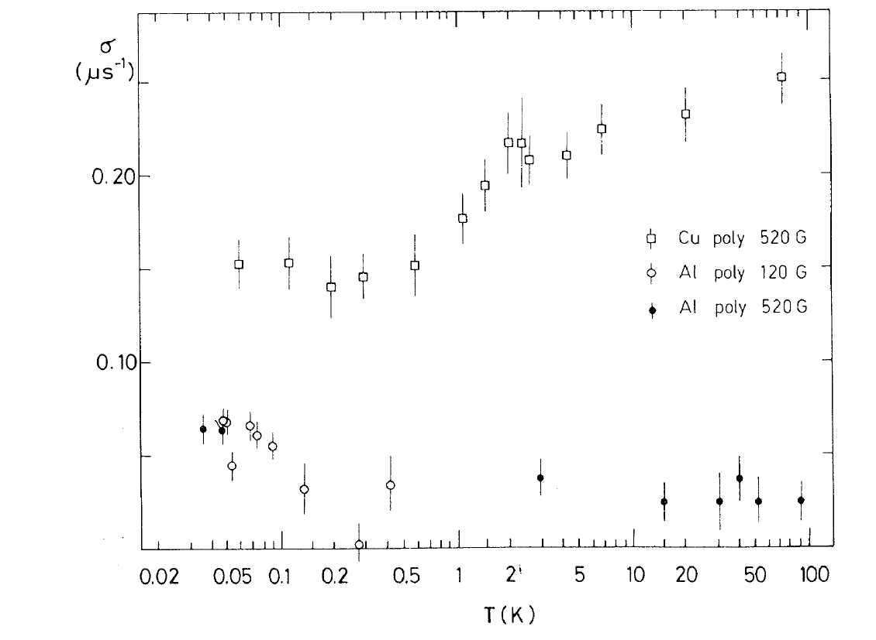

Dynamical Kubo-Toyabe (DKT) relaxation function
TF-µ⁺SR
$$σ^{−1}$$
µ⁺ in Cu/Al
Cu
• Partial delocalization?
• Partial delocalization?
• Trapping/detrapping with impurities?
• Quantum diffusion?
• Partial delocalization?
• Trapping/detrapping with impurities?
Al
O. Hartmann et al., Phys. Rev. Lett. 44, 337 (1980).

Slide 4
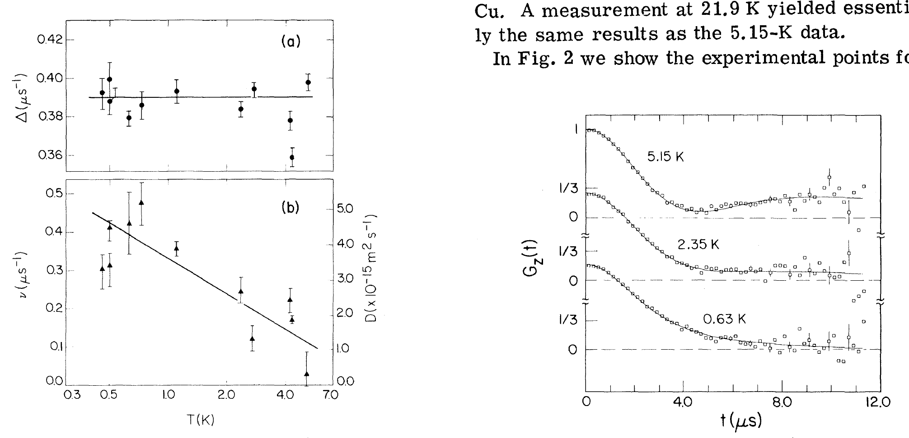

Dynamical Kubo-Toyabe (DKT) relaxation function
TF-µ⁺SR
ZF-µ⁺SR
$$≈\frac{1}{3}e^{−νt}$$
µ⁺ in Cu/Al
Cu
Cu
Al
O. Hartmann et al., Phys. Rev. Lett. 44, 337 (1980).
C.W. Clawson et al., Phys. Rev. Lett. 51, 114 (1983).

Slide 5
Dynamical Kubo-Toyabe (DKT) relaxation function
TF-µ⁺SR
ZF-µ⁺SR
µ⁺ in Cu/Al
Cu
👈
Cu
Quantum diffusion!
Al
O. Hartmann et al., Phys. Rev. Lett. 44, 337 (1980).
C. W. Clawson et al., Phys. Rev. Lett. 51, 114 (1983).

Slide 6
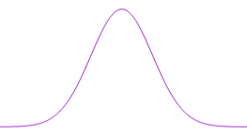
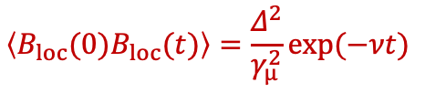
Dynamical Kubo-Toyabe (DKT) relaxation function G^{DKT}(t;Δ,ν)
Basic features
It describes spin relaxation under a Gaussian random local field.
The “strong collision” approximation is incorporated for the effect of local field fluctuations.
Preconditions for application to real systems:
Probability n(B_{loc})
High density spin systems where n(B_{loc}) obeys a Gaussian distribution
B_{loc}
B_{z}
a
d
g
b
e
h
Δ/γ_{μ}
0
B_{y}
c
f
i
0
B_{x}
Δ/γ_{μ}
a
g
c
d
f
e
b
h
i
B_{loc} is reset at every step of fluctuation (after mean time ν⁻¹)
n(B_{loc})
$$\left\langle B_{loc}(0)B_{loc}(t)\right\rangle =\frac{Δ^{2}}{γ_{µ}^{2}}exp(−νt)$$
mean time ν⁻¹
Δ/γ_{μ}
B_{loc}
0
t₃
t₂
ν
0
0
0
B_{loc}
t₁
t = t₁
t₂
t₃ …

Slide 7
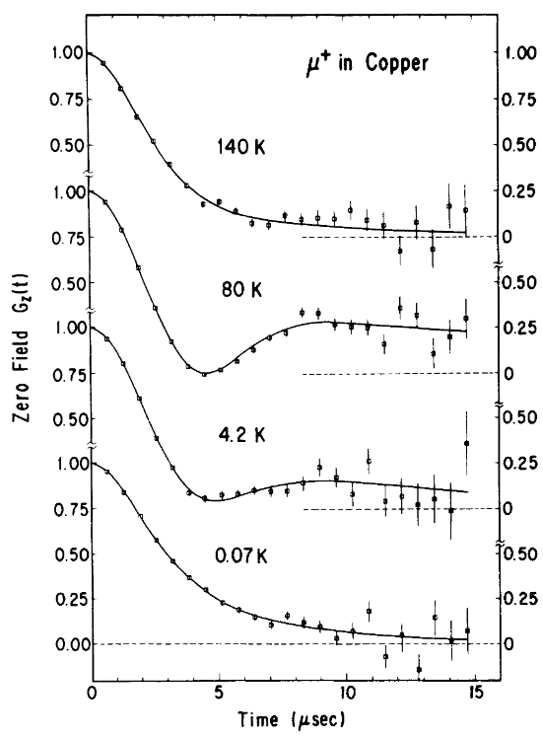
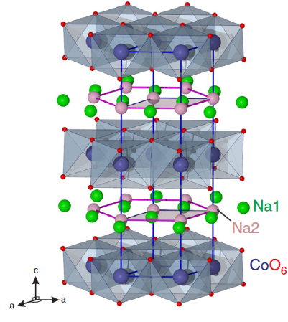

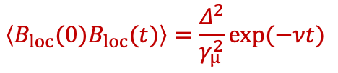
Dynamical Kubo-Toyabe (DKT) relaxation function G^{DKT}(t;Δ,ν)
Examples in which fluctuating B_{loc} is presumed:
• μ⁺ diffusion in metals
• Ion diffusion in Li/Na_{x}CoO₂
µ⁺ as an observer moves at random.
Only part of the ions moves at each step.
e.g., Na_{x}CoO₂
μ⁺SR
μ⁻SR
Na
μ⁺
μ⁺
Co
μ⁻
B_{loc}
0
t₃
t₂
J. Sugiyama et al.,
Phys. Rev. B 102, 144431 (2020).
t₁
Δ, ν
RyK et al.,
Phys. Rev. B 39, 23 (1989).
Månsson and Sugiyama
Phys. Scr. 88, 068509 (2013).
Δ = (Δ_{Co}² + Δ_{Na}²)^{1/2}
Δ_{Co} > Δ_{Na}
The long-time average of B_{loc} is zero.
$$\left\langle B_{loc}(0)B_{loc}(t)\right\rangle =\frac{Δ^{2}}{γ_{µ}^{2}}exp(−νt)$$

Slide 8

Dynamical Kubo-Toyabe (DKT) relaxation function G^{DKT}(t;Δ,ν)
Examples in which fluctuating B_{loc} is presumed:
• μ⁺ diffusion in metals
• Ion diffusion in Li/Na_{x}CoO₂
µ⁺ as an observer moves at random.
Only part of the ions moves around.
B_{dyn} (Li,Na)
t₁
t₃
Na
μ⁺
t₂
μ⁺
Co
μ⁻
B_{sta}(Co)
B_{loc}
0
t₃
B_{loc} = B_{sta} + B_{dyn}
t₂
t₁
Δ, ν
RyK et al.,
Phys. Rev. B 39, 23 (1989).
Månsson and Sugiyama
Phys. Scr. 88, 068509 (2013).
O
Δ_{Co} > Δ_{Na}
The long-time average of B_{loc} is zero.
The long-time average of B_{loc} is finite.
$$\left\langle B_{loc}(0)B_{loc}(t)\right\rangle =\frac{Δ^{2}}{γ_{µ}^{2}}exp(−νt)$$
$$\left\langle B_{loc}(0)B_{loc}(t)\right\rangle =\frac{Δ^{2}}{γ_{µ}^{2}}exp(−νt)$$

Slide 9
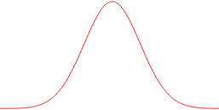
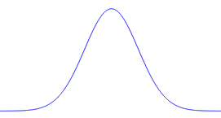
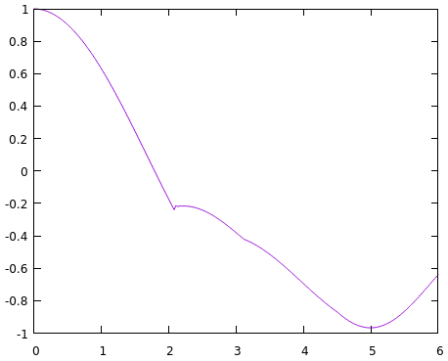
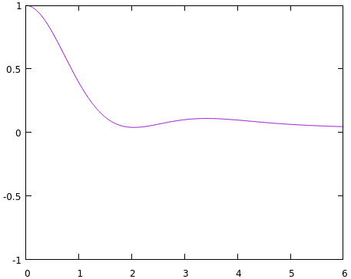
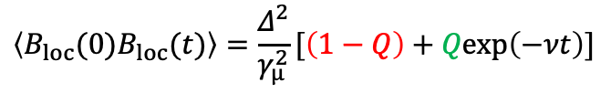
Extended DKT function G^{EA}(t;Δ,Q,ν) obtained by Monte Carlo method
Static comp.
ν
Dynamic comp.
O
B_{z}
t₃
n(B_{loc})
n(B_{loc})
t₂
0
B_{y}
Δ_{sta}/γ_{μ}
B_{x}
Δ/γ_{μ}
Δ_{dyn}/γ_{μ}
t₁
O
O
…
μ(1)
μ(2)
μ(3)
0
B_{x,y,z}
0
B_{x,y,z}
N=1
N=100,000,000
t₁
averaged
G_{z}(t)
G_{z}(t)
G^{EA}(t;Δ,Q,ν)
t₂
Δ/ν=1
t₃
Δ/ν=1
Δ_{sta}= Δ_{dyn} (Q=0.5)
Δ_{sta}= Δ_{dyn} (Q=0.5)
Δt
Δt
Δ²= Δ_{sta}²+ Δ_{dyn}²,
Δ_{dyn} = Q^{1/2}Δ,
Δ_{sta} =(1−Q)^{1/2}Δ
Edwards–Anderson-type autocorrelation
[Δ_{sta}, Δ_{dyn}] → [Δ, Q]
$$\left\langle B_{loc}(0)B_{loc}(t)\right\rangle =\frac{Δ^{2}}{γ_{µ}^{2}}[\left(1−Q\right)+Qexp\left(−νt\right)]$$

Slide 10
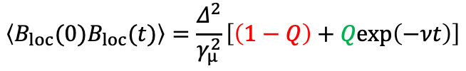
Extended DKT function G^{EA}(t;Δ,Q,ν) obtained by Monte Carlo method
$$\left\langle B_{loc}(0)B_{loc}(t)\right\rangle =\frac{Δ^{2}}{γ_{µ}^{2}}\left[\left(1−Q\right)+Qexp\left(−νt\right)\right]$$
B_{dyn}
ZF
Q
B_{sta}
1−Q
G^{EA}(t)
O
The gross lineshape resembles quasistatic DKT for Q < 1.

Slide 11



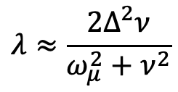





Extended DKT function G^{EA}(t;Δ,Q,ν) obtained by Monte Carlo method
The gross lineshape resembles quasistatic DKT for Q < 1: Why?
$$λ≈\frac{2Δ^{2}ν}{ω_{μ}^{2}+ν^{2}}$$
$$→\frac{2Δ^{2}ν}{Δ^{2}+ν^{2}}≈2ν$$
$$ω_{μ}→0,$$
Bloembergen-Purcell-Pound:
for
$$ν≪Δ$$
λ
$$\sqrt{1−Q}Δ$$
$$ω_{μ}= 0$$
$$≈\frac{1}{3}e^{−νt}$$
Relaxation Rate
$$\frac{QΔ^{2}}{ν_{loc}}$$
$$ω_{μ}=ν_{loc}$$
0
ν
G^{EA}(t;Δ,Q,ν) at ZF is dominated by zero fluctuation for Q < 1.

Slide 12
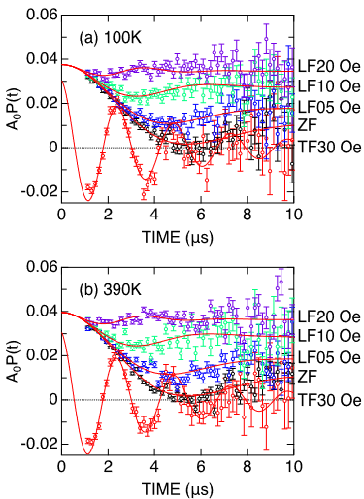
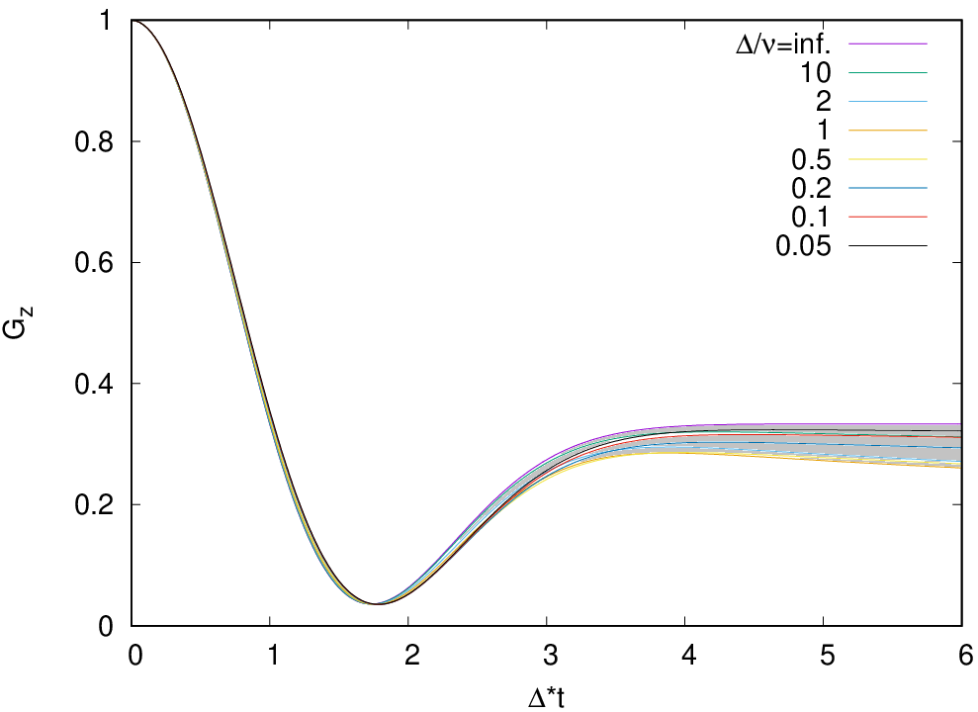
A test case: μ±SR studies of Na_{x}CoO₂
μ⁻SR
Application of the EA function based on the numbers reported in Phys. Rev. B 102, 144431 (2020).
“Immobile µ⁻O” picture
“Δ± was predicted by dipole field calculations with DIPELEC for the known structures.”
Δ = (Δ_{sta}² + Δ_{dyn}²)^{1/2} = 0.4861 μs⁻¹,
Δ_{sta} = (1-Q)^{1/2}Δ = 0.4718 μs⁻¹
∴ Q = 0.06
G^{EA}(t;Δ,Q=0.06,ν) corresponding to the above interpretation:
B_{dyn} (Na)
ZF
Q = 0.06
1−Q
= 0.94
B_{sta}(Co)
More importantly, Co ions are confirmed to be static in the time window of µSR.
μ⁻SR has little sensitivity to Na diffusion (consistent with the conclusion of PRB2020).
This is because G^{EA}(t) with small Q exhibits little variation with large change in ν, not just because Na ions are distant from µ⁻O.

Slide 13
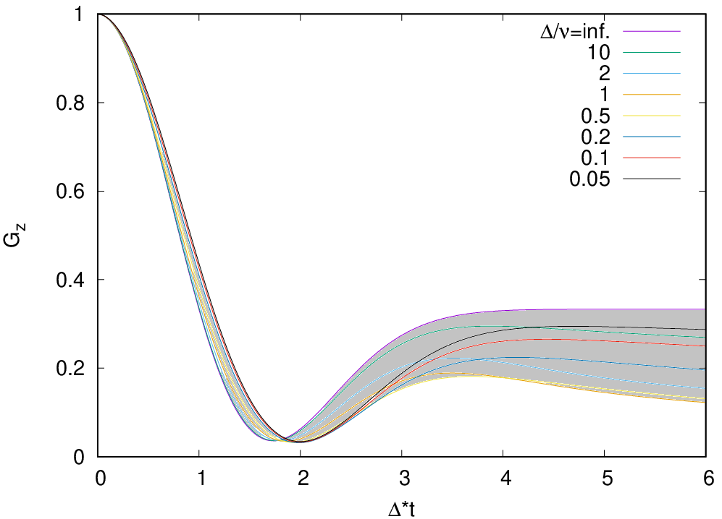
A test case: μ±SR studies of Na_{x}CoO₂
μ⁺SR
Application of the EA function based on the numbers reported in Phys. Rev. B 102, 144431 (2020).
“Immobile µ⁺” picture
“Δ± was predicted by dipole field calculations with DIPELEC for the known structures.”
Δ = (Δ_{sta}² + Δ_{dyn}²)^{1/2} = 0.494 μs⁻¹,
Δ_{sta} = (1-Q)^{1/2}Δ = 0.428 μs⁻¹
∴ Q = 0.25
G^{EA}(t;Δ,Q=0.25,ν) corresponding to the above estimations for Δ⁺:
B_{dyn} (Li,Na)
Q = 0.25
B_{sta}(Co)
1−Q
= 0.75
B_{loc} = B_{sta} + B_{dyn}
O

Slide 14
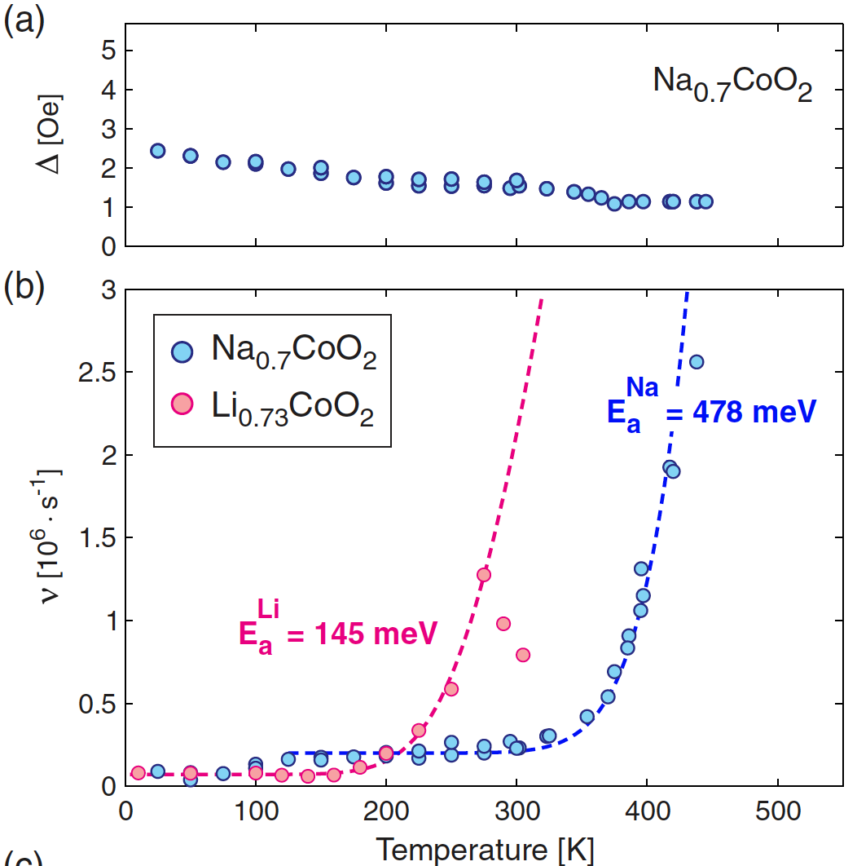
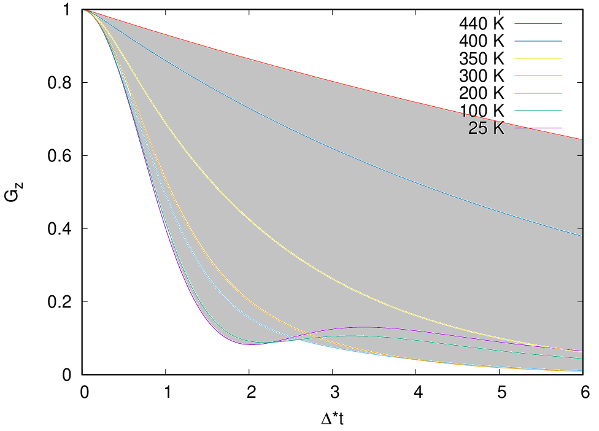
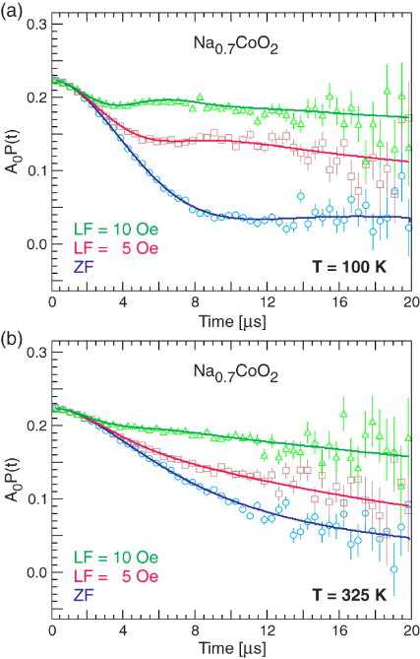
A test case: μ±SR studies of Na_{x}CoO₂
μ⁺SR
Result of analysis by the DKT function
Reproduced behavior of ZF-µSR spec-tra (25-430 K) using the DKT function
Q = 1
B_{loc}
0
ν
Månsson and Sugiyama, Phys. Scr. 88, 068509 (2013): Fig. 11 (a,b)

Slide 15
A test case: μ±SR studies of Na_{x}CoO₂
μ⁺SR
Result of analysis by the DKT function
G^{EA}(t;Δ,Q=0.25,ν) corresponding to the above estimations for Δ⁺:
Reproduced behavior of ZF-µSR spec-tra (25-430 K) using the DKT function
B_{dyn} (Li,Na)
Q = 0.25
B_{loc}
0
B_{sta}(Co)
ν
1−Q = 0.75
O
Q = 1
G^{EA}(t;Δ,Q=0.25,ν) fails to explain the observed behavior, suggesting that Q=1.
Since Co ions’ dynamics is inferred to be negligible from µ⁻SR, the remaining possibility for the origin of “Q=1” inferred by µ⁺SR is µ⁺ diffusion.

Slide 16
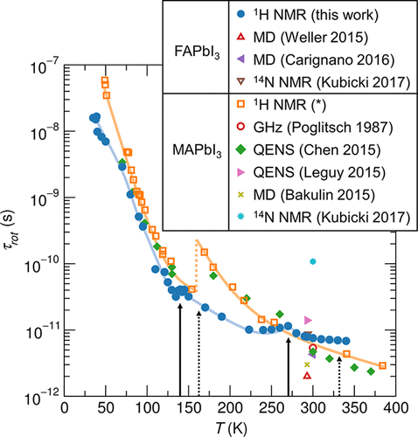
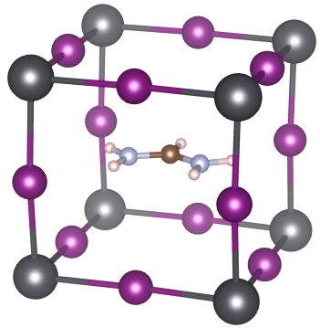
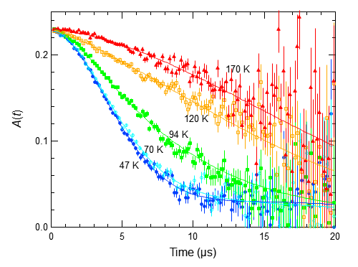
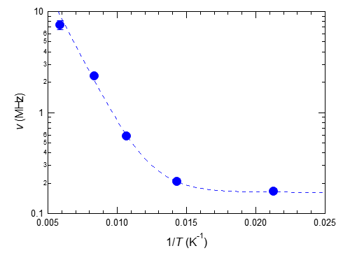
Example where G^{EA}(t;D,Q,ν) successfully reproduces µSR spectra
FAPbI₃ (hybrid perovskite)
Analysis by G^{DKT}(t;Δ,ν)
Static FA
Pb
Rotating FA
FA
I
μ⁺
Δ² = Δ_{PbI}² + Δ_{FA}²
The fluctuation rate ν does not reflect cation FA motion at all!
Rotational dynamics of the FA cation in the static PbI₃ frame
Hiraishi et al., J. Appl. Phys. 134, 055106 (2023)
Analysis by G^{EA}(t;Δ,Q,ν)
Q = 0.947(3)
√Q
√1-Q
FAPbI₃
H_{ext} = 0
T.U. Ito and RyK, JPSJ 93, 044602 (2024)

Slide 17
Conclusion
The muon spin relaxation in the microscopic coexistence of Gaussian distributed static and dynamic local magnetic fields is simulated by a Monte Carlo method and the extended DKT relaxation function G^{EA}(t;Δ,Q,ν) is obtained.
The behavior of G^{EA}(t;Δ,Q,ν) in terms of ν deviates significantly from G^{DKT}(t;Δ,ν) for 0 < Q < 1.
The new relaxation function will pave the way to the more refined ion dynamics analysis in solids by µSR.
References:
• T. U. Ito and R. Kadono, J. Phys. Soc. Jpn. 93, 044602 (2024).
• T. U. Ito and R. Kadono, arXiv:2505.09147 (2025).
Simulations have been extended to incorporate longitudinal fields B_{LF}.
User function G^{EA}(t;Δ,Q,ν,B_{LF}) for musrfit is available at the following URL:
https://github.com/tuito0/musrfit-dynGssEALF
• R. Kadono and T. U. Ito, J. Phys. Soc. Jpn. 94, 064601 (2025).
Further extension to paramagnetic Mu to distinguish the dynamics
of unpaired electron, Mu⁰ hoping motion, and molecular motion of hosts.

Slide 18
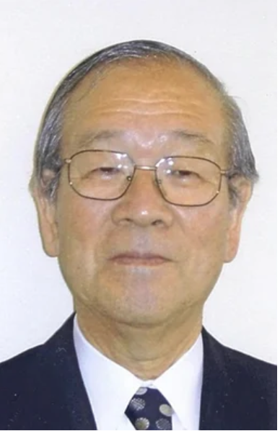
In closing my talk…
It is with great regret that I lost the opportunity to talk to Toshi about this new development on the Kubo-Toyabe function forever with his passing, but I would like to reiterate here my deepest gratitude for the favor and mentorship I received from him, and I respectfully pray for his soul rest in peace.
--RyK

Slide 19

Thank you for your attention.

